Slide 1
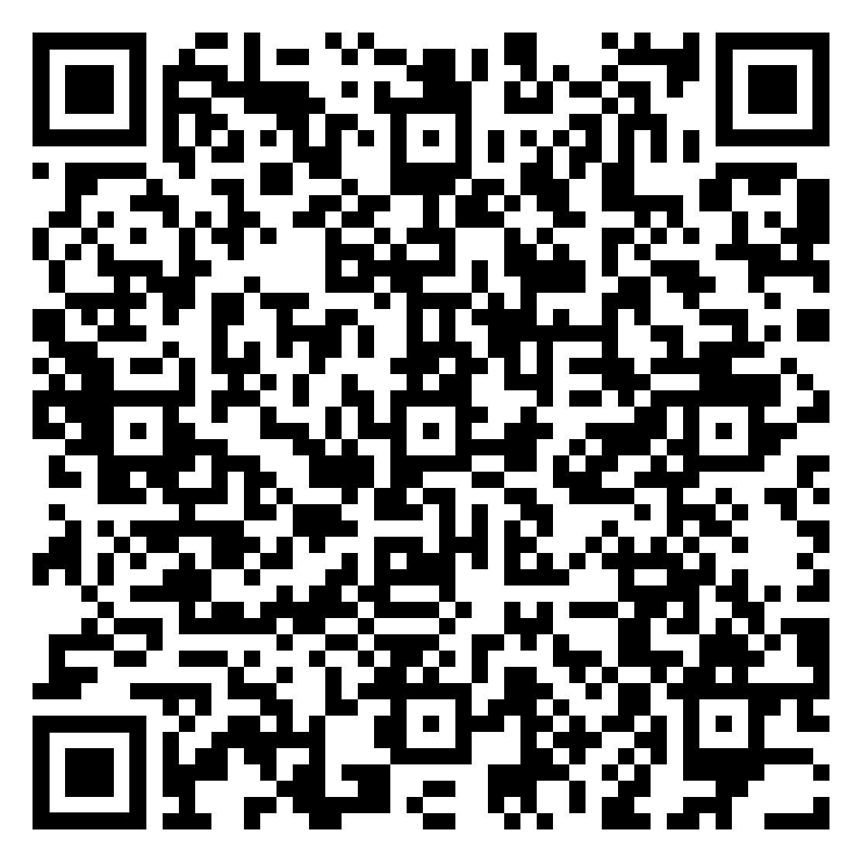
We would be grateful for your feedback on this session.
Please scan this QR code to respond to a brief survey:

