Slide 1


Merit-based Incentive Payment System (MIPS)
2022 MIPS Promoting Interoperability Performance Category Hardship Exception Application Guide

Slide 2

Contents
Already know what MIPS is?
Skip ahead by clicking the links in the Table of Contents.
How to Use This Guide 3
MIPS Promoting Interoperability Performance Category Hardship Exception Application Overview 5
MIPS Promoting Interoperability Performance Category Hardship Exception Information for Individuals, Groups, and Virtual Groups 7
MIPS Promoting Interoperability Performance Category Hardship Exception: Frequently Asked Questions 12 MIPS Promoting Interoperability Performance Category Hardship Exception: Application Steps 14
Help, Resources, Glossary, and Version History 30
Appendix 34

Slide 3
How to Use This Guide

Slide 4

How to Use This Guide
Table of Contents
The table of contents is interactive. Click on a chapter in the table of contents to read that section.
You can also click on the icon on the bottom left to go back to the table
of contents.
Please note: This guide was prepared for informational purposes only and isn’t intended to grant rights or impose obligations. The information provided is only intended to be a general summary. It isn’t intended to take the place of the written law, including the regulations. We encourage readers to review the specific statutes, regulations, and other interpretive materials for a full and accurate statement of their contents.
Hyperlinks
Hyperlinks to the Quality Payment Program website are included throughout the guide to direct the reader to more information and resources.
Purpose: This guide will provide general information about the MIPS Promoting Interoperability Performance Category Hardship Exception application and provide step-by-step instructions on how to complete the application.

Slide 5
MIPS Promoting Interoperability Performance Category Hardship Exception Application Overview

Slide 6
MIPS Promoting Interoperability Performance Category Hardship Exception Application Overview
Overview
What | MIPS Promoting Interoperability Hardship Exception applications allow you to request that your MIPS Promoting Interoperability performance category be reweighted to 0%.
Who | Individual clinicians, groups, and virtual groups reporting via traditional MIPS or the APM Performance Pathway (APP) Third Party Intermediaries can submit an application with permission from the clinician or practice. Some clinicians, groups and virtual groups automatically qualify for reweighting of the Promoting Interoperability performance category. If you qualify for automatic reweighting, you don’t need to apply for a MIPS Promoting Interoperability Hardship Exception. See Appendix A for information about the clinicians, groups and virtual groups that automatically qualify for reweighting of this performance category.
Why | You can submit an application to have your MIPS Promoting Interoperability performance category reweighted to 0% if: You have insufficient Internet connectivity You have decertified EHR technology You lack control over the availability of CEHRT Lacking 2015 Edition CEHRT doesn’t qualify as a reason to submit an exception application You face extreme and uncontrollable circumstances such as a disaster, practice closure, severe financial distress or vendor issues If you experience an extreme and uncontrollable circumstance that impacts multiple performance categories, the Extreme and Uncontrollable Circumstances exception application may be more suitable for your given circumstance.
When | Now through January 3, 2023, at 8 p.m. ET.
Where | Sign in to qpp.cms.gov with your HCQIS Access and Roles Profile (HARP) account. For more information on HARP accounts, please refer to the Register for a HARP Account document in the QPP Access User Guide (ZIP).
How | Register for a HARP account Sign in to qpp.cms.gov Select ‘Exceptions Application’ on the left-hand navigation Select ‘Add New Exception’ Select ‘Promoting Interoperability Hardship Exception’ Complete the application for individual, group or virtual group participation
Note: We automatically reweigh Promoting Interoperability for small practices. See page 8 for more information.
See Appendix B (traditional MIPS) and Appendix C (APP) for more information on performance category reweighting.

Slide 7
MIPS Promoting Interoperability Performance Category Hardship Exception Information for Individuals, Groups, and Virtual Groups

Slide 8
MIPS Promoting Interoperability Performance Category Hardship Exception Information for Individuals, Groups, and Virtual Groups
Overview
You may automatically qualify for reweighting in this performance category.
    See Appendix A.
    If you automatically quality for reweighting, you don’t need to submit an exception application.
You will complete the hardship exception application at the level for which you will report data to MIPS.
    If you are reporting data at the individual level, complete the hardship exception application at the individual level.
    If you are reporting data at the group level, complete the hardship exception application at the group level.
    Note, a group hardship exception application will only apply at the group level.
      If your practice is participating in MIPS at the individual level, don’t complete the hardship exception application at the group level. You will complete the hardship exception application at the individual level for each clinician (who doesn’t automatically qualify for reweighting) to be considered for reweighting.
You can still submit data for the MIPS Promoting Interoperability performance category.
    If your circumstances change and you’re able to collect and submit your Promoting Interoperability data, we will disregard your hardship exception application and you will be scored in this performance category.
    You will also be scored in this performance category if you attest to any data, such as selecting performance period dates or responding to attestation statements, during the submission period.
      Starting with performance year 2022, small practices qualify for automatic reweighting of the Promoting Interoperability performance category.
You aren’t required to submit documentation with your application.
    However, clinicians, groups and virtual groups should retain documentation of their circumstances supporting their application for their own records in the event they are selected by CMS for data validation or audit. See our 2022 MIPS Data Validation Criteria Guide (ZIP) for details on the data validation process.
New: Small practices now qualify for automatic reweighting.

Slide 9
MIPS Promoting Interoperability Performance Category Hardship Exception Information for Individuals, Groups, and Virtual Groups
Overview (continued)
You can apply for a MIPS Promoting Interoperability performance category hardship exception if you switch CEHRT vendors during the performance period.
    You would indicate an extreme and uncontrollable circumstances hardship exception and select vendor issues within the application.
The following circumstances qualify as extreme and uncontrollable circumstances for a MIPS Promoting Interoperability performance category hardship exception:
    A natural disaster resulting in damage to or destruction of your CEHRT
    Practice closure
    Severe financial distress resulting in bankruptcy or debt restructuring
    Vendor issues (such as a change in vendors during the performance period or errors with your CEHRT that your vendor is unable to address)
You may still be able to report if your electronic health record (EHR) product is decertified during the 2022 performance year.
    You can still submit your Promoting Interoperability performance category measures collected in your now-decertified EHR product if your performance period ended before the decertification occurred.
    If your performance period ended after the EHR decertification occurred, you can apply for a MIPS Promoting Interoperability performance category hardship exception and select decertified EHR technology.

Slide 10
MIPS Promoting Interoperability Performance Category Hardship Exception Information for Individuals, Groups, and Virtual Groups
Groups and Virtual Groups
To submit an application on behalf of a group, every office location/practice site within the Taxpayer Identification Number (TIN) must experience the hardship for the group to qualify for the Promoting Interoperability performance category hardship exception.
    For example, if one office location is within a broadband availability area but the other office(s) for the practice is not, the office with broadband availability would not qualify for the MIPS Promoting Interoperability performance category hardship and must report for those clinicians for whom they have data.
To submit an application on behalf of a virtual group, every office location/practice site for each TIN within the virtual group must experience the hardship for the virtual group to qualify for the Promoting Interoperability performance category hardship exception.
    For example, if one TIN is within a broadband availability area but the other TIN(s) in the virtual group is not, the TIN with broadband availability would not qualify for the MIPS Promoting Interoperability performance category hardship and must report for those clinicians for whom they have data.

Slide 11
MIPS Promoting Interoperability Performance Category Hardship Exception Information for Individuals, Groups, and Virtual Groups
MIPS APM Participants
MIPS eligible clinicians and groups with MIPS eligible clinicians participating in a MIPS APM can apply for hardship exceptions and qualify for automatic reweighting just like other MIPS eligible clinicians.
If you’re participating in MIPS at the APM Entity level (either reporting traditional MIPS or the APP), you would complete the application as an individual or group.
    If approved, the clinician will receive the APM Entity’s score, but will be excluded from the calculation when we create an average Promoting Interoperability score for the APM Entity.
APM Entities reporting the APP or traditional MIPS can’t submit a Promoting Interoperability hardship exception application on behalf of the entire Entity.
    When participating in MIPS as an APM Entity, the Promoting Interoperability performance category is still reported at the individual or group level.
A MIPS Promoting Interoperability performance category hardship exception doesn’t exempt you from reporting on any certified EHR technology (CEHRT) activities required for participation in your APM.

Slide 12
MIPS Promoting Interoperability Performance Category Hardship Exception: Frequently Asked Questions

Slide 13
MIPS Promoting Interoperability Performance Category Hardship Exception: Frequently Asked Questions
Question | Answer
Where Can I Look for a Status Update on Our MIPS Promoting Interoperability Performance Category Hardship Exception Application? | You can monitor your application status in your QPP Account on qpp.cms.gov.
Can Additional Staff Members Access/Receive Notifications About the Status of the MIPS Promoting Interoperability Performance Category Hardship Exception Application? | Yes, you can add additional staff or representatives who should receive notifications about the status of the application. In the Additional Access section of the application, provide the email address(es) of additional staff or representatives who would like to receive email notifications. Please note: the additional staff or representatives must have HARP credentials in order to see the application on qpp.cms.gov.
How Can I Correct a Mistake Made on Our MIPS Promoting Interoperability Performance Category Hardship Exception Application? | If you identified an error with your exception application, please contact the Quality Payment Program at 1-866-288-8292, Monday through Friday, 8 a.m.-8 p.m. ET or by e-mail at: QPP@cms.hhs.gov.

Slide 14
MIPS Promoting Interoperability Performance Category Hardship Exception: Application Steps

Slide 15
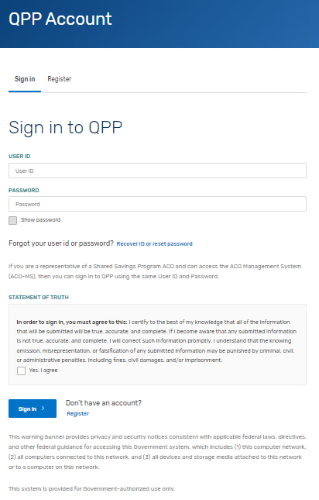
MIPS Promoting Interoperability Performance Category Hardship Exception: Application Steps
Step 1: Sign in to Your QPP Account
Sign in to your QPP Account at qpp.cms.gov with your HARP credentials.
Note: If you haven’t signed into qpp.cms.gov before, you must register for an account to obtain your HARP credentials. See our QPP Account Access Guide (ZIP) for information on creating an account.
*The screenshots included in this user guide were based on the QPP test environment. Because we are always working to incorporate feedback and improve experience, there may be differences between these screenshots and what you see on qpp.cms.gov.

Slide 16
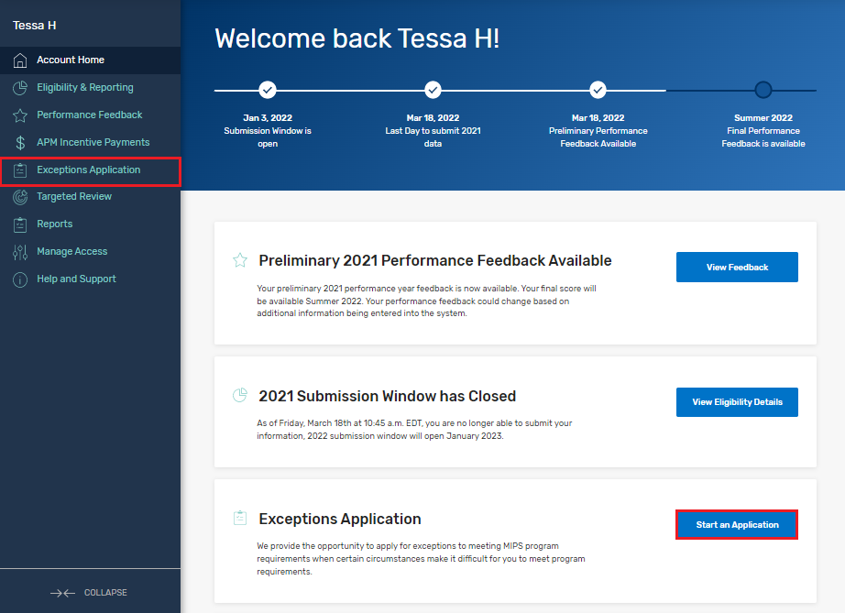
MIPS Promoting Interoperability Performance Category Hardship Exception: Application Steps
Step 2: Navigate to Your Exception Applications
Once you are signed into your account select:
The Exception Application tab in the left-hand navigation menu, then click + Add New QPP Exception
OR
The Start an Application quick link on the home page.
You can create and submit a new exception request until 8 p.m. ET on January 3, 2023.
*The screenshots included in this user guide were based on the QPP test environment. Because we are always working to incorporate feedback and improve experience, there may be differences between these screenshots and what you see on qpp.cms.gov.

Slide 17
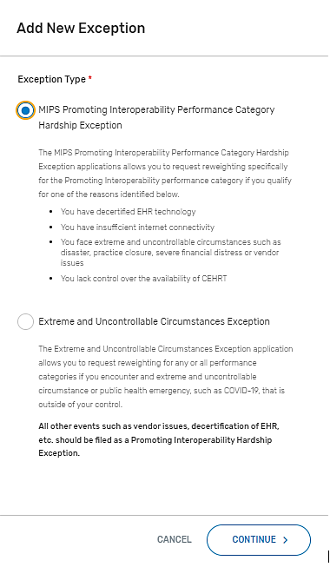
MIPS Promoting Interoperability Performance Category Hardship Exception: Application Steps
Step 3: Select the Exception Application
Select the MIPS Promoting Interoperability Performance
Category Hardship Exception, then Continue.
*The screenshots included in this user guide were based on the QPP test environment. Because we are always working to incorporate feedback and improve experience, there may be differences between these screenshots and what you see on qpp.cms.gov.

Slide 18
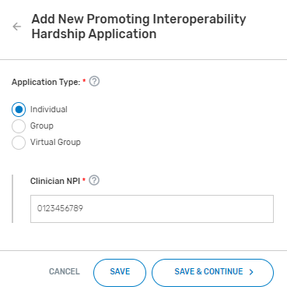
MIPS Promoting Interoperability Performance Category Hardship Exception: Application Steps
Step 4: Select Application Type
Select the participation level at which you intend to participate in MIPS, then select Save & Continue.
(Image features application at the individual level)
*The screenshots included in this user guide were based on the QPP test environment. Because we are always working to incorporate feedback and improve experience, there may be differences between these screenshots and what you see on qpp.cms.gov.

Slide 19
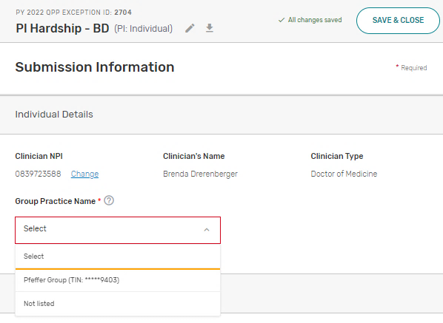
MIPS Promoting Interoperability Performance Category Hardship Exception: Application Steps
Step 5: Enter Participation Level Information
Enter the required participation level information.
The required information for each participation level is as follows:
Participation Level | Required Information
Individual Clinician | National Provider Identifier (NPI) Practice Affiliation
Group | Taxpayer Identification Number (TIN)
Virtual Group | Virtual Group Identifier
(Image features application at the individual level)
*The screenshots included in this user guide were based on the QPP test environment. Because we are always working to incorporate feedback and improve experience, there may be differences between these screenshots and what you see on qpp.cms.gov.

Slide 20
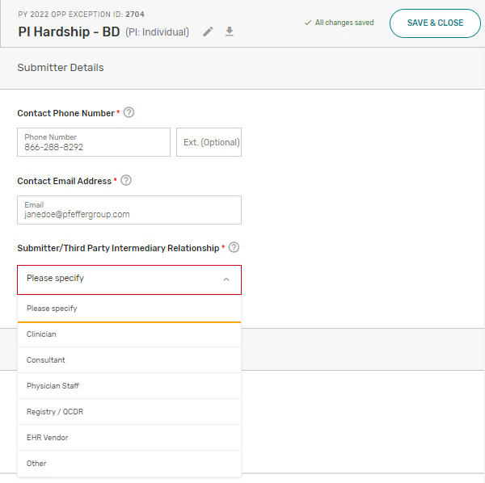
MIPS Promoting Interoperability Performance Category Hardship Exception: Application Steps
Step 6: Enter Submitter Details
Enter your contact information (as the submitter) and identify your relationship to the party identified in the application.
*The screenshots included in this user guide were based on the QPP test environment. Because we are always working to incorporate feedback and improve experience, there may be differences between these screenshots and what you see on qpp.cms.gov.

Slide 21
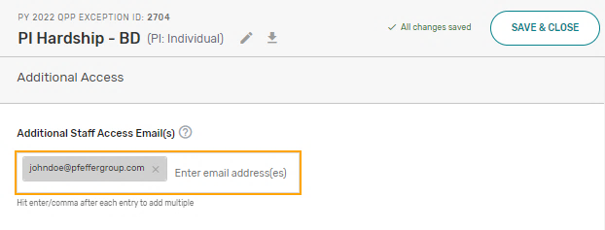
MIPS Promoting Interoperability Performance Category Hardship Exception: Application Steps
Step 7: Enter Additional Staff in Additional Access Section
You can identify additional users to receive notifications about the application in the Additional Access section.
If there’s a HARP account associated with the email address(es) you provide, the person will be able to sign in to their own account on qpp.cms.gov and access the application.
*The screenshots included in this user guide were based on the QPP test environment. Because we are always working to incorporate feedback and improve experience, there may be differences between these screenshots and what you see on qpp.cms.gov.

Slide 22
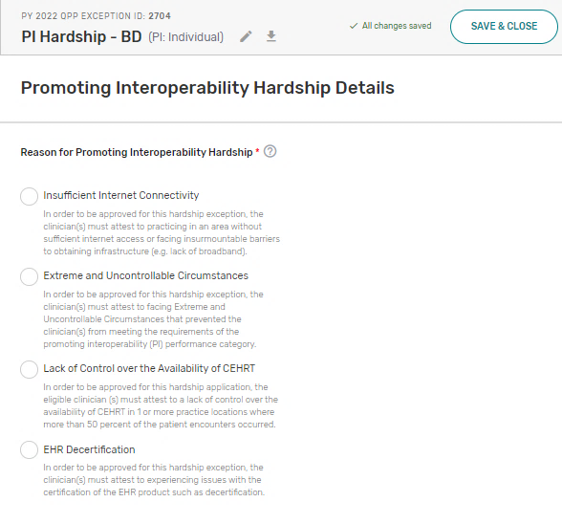
MIPS Promoting Interoperability Performance Category Hardship Exception: Application Steps
Step 8: Select the Reason for MIPS Promoting Interoperability Hardship
Select the option that aligns with your reason for submitting an MIPS Promoting Interoperability Hardship exception application.
Note: You don’t need to submit supporting documentation with your application. However, you should retain documentation of the circumstances supporting your application for your own records in case you are selected by CMS for data validation or an audit. See our 2022 MIPS Data Validation Criteria Guide (ZIP) for details on the data validation process,
*The screenshots included in this user guide were based on the QPP test environment. Because we are always working to incorporate feedback and improve experience, there may be differences between these screenshots and what you see on qpp.cms.gov.

Slide 23
MIPS Promoting Interoperability Performance Category Hardship Exception: Application Steps
Step 9: Complete Attestation and Provide Event Description
Before submitting your application, you must complete the attestation (differs for each reason option).
    Insufficient Internet Connectivity
    Extreme and Uncontrollable Circumstances
    Lack of Control Over the Availability of CEHRT
    EHR Decertification
You also can provide an optional brief description on the hardship you experienced and how performance data is impacted.

Slide 24
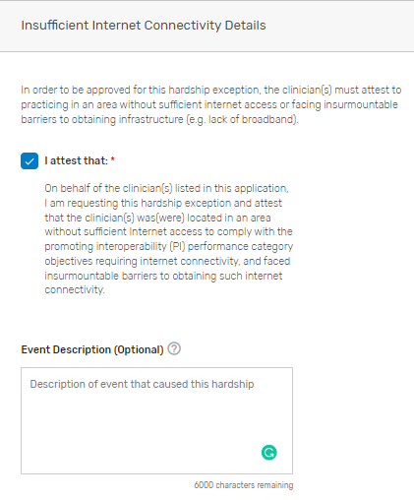
MIPS Promoting Interoperability Performance Category Hardship Exception: Application Steps
Step 9: Complete Attestation and Provide Event Description (continued)
Reason Option 1: Insufficient Internet Connectivity
Review the attestation statement and select “I attest.” You can provide an optional description of the hardship event.
*The screenshots included in this user guide were based on the QPP test environment. Because we are always working to incorporate feedback and improve experience, there may be differences between these screenshots and what you see on qpp.cms.gov.

Slide 25
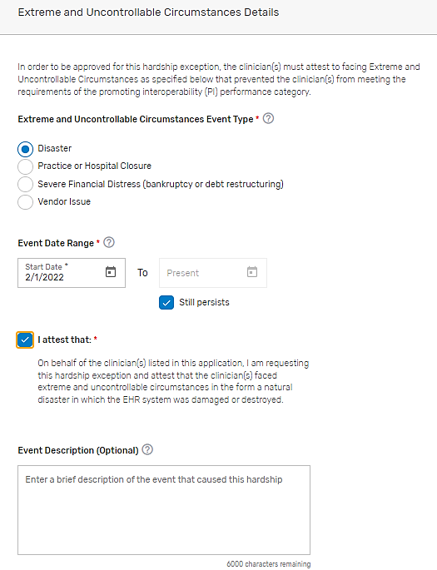
MIPS Promoting Interoperability Performance Category Hardship Exception: Application Steps
Step 9: Complete Attestation and Provide Event Description (continued)
Reason Option 2: Extreme and Uncontrollable Circumstances
Select the extreme and uncontrollable event type that applies to you, enter event dates, then review the attestation statement and select “I attest.”
You can provide an optional description of the hardship event.
*The screenshots included in this user guide were based on the QPP test environment. Because we are always working to incorporate feedback and improve experience, there may be differences between these screenshots and what you see on qpp.cms.gov.

Slide 26
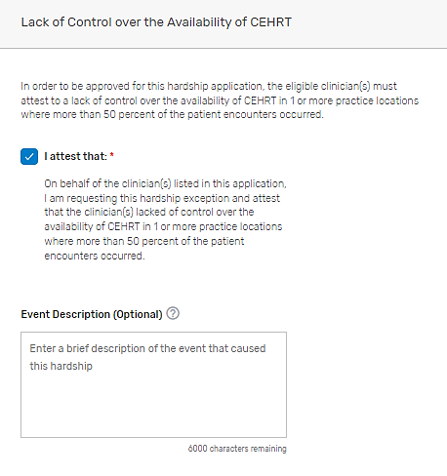
MIPS Promoting Interoperability Performance Category Hardship Exception: Application Steps
Step 9: Complete Attestation and Provide Event Description (continued)
Reason Option 3: Lack of Control Over the Availability of CEHRT
Review the attestation statement and select “I attest.” You can provide an optional description of the hardship event.
*The screenshots included in this user guide were based on the QPP test environment. Because we are always working to incorporate feedback and improve experience, there may be differences between these screenshots and what you see on qpp.cms.gov.

Slide 27
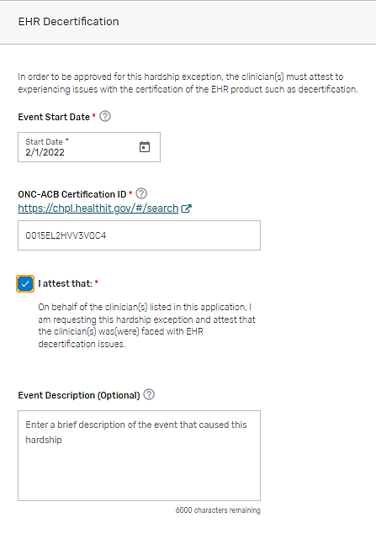
MIPS Promoting Interoperability Performance Category Hardship Exception: Application Steps
Step 9: Complete Attestation and Provide Event Description (continued)
Reason Option 4: EHR Decertification
Enter the date that your EHR was decertified and your ONC-ACB Certification ID. Then, review the attestation statement and select “I attest.”
You can provide an optional description of the hardship event.
*The screenshots included in this user guide were based on the QPP test environment. Because we are always working to incorporate feedback and improve experience, there may be differences between these screenshots and what you see on qpp.cms.gov.

Slide 28
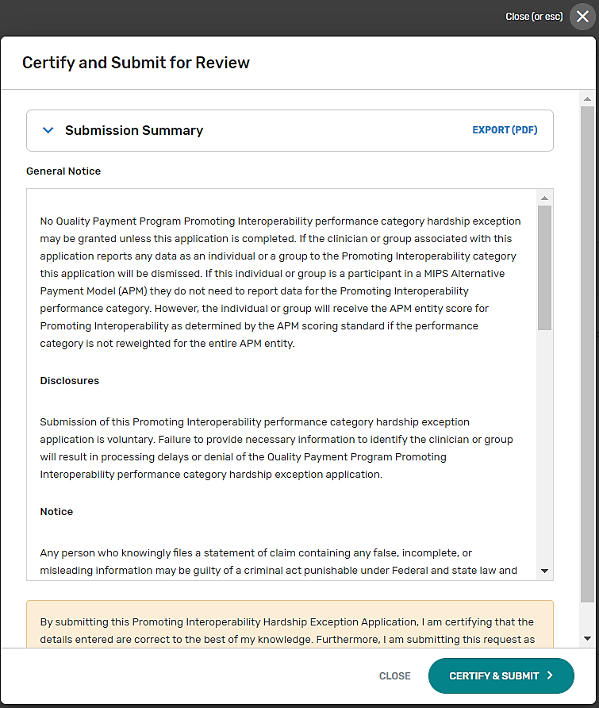
MIPS Promoting Interoperability Performance Category Hardship Exception: Application Steps
Step 10: Submit MIPS Promoting Interoperability Hardship Application
Once you are done with your application, review the disclosures, then select Certify & Submit.
*The screenshots included in this user guide were based on the QPP test environment. Because we are always working to incorporate feedback and improve experience, there may be differences between these screenshots and what you see on qpp.cms.gov.

Slide 29
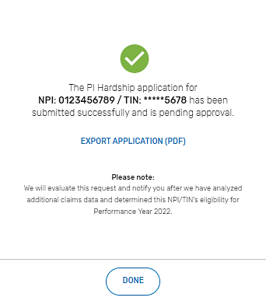
MIPS Promoting Interoperability Performance Category Hardship Exception: Application Steps
MIPS Promoting Interoperability Hardship Application Submission Confirmation
After you submit your MIPS Promoting Interoperability Hardship application, you will receive a message stating that your hardship application has been successfully submitted and is pending review.
You will also receive an email notification.
See Appendix D for information on the various application statuses.
*The screenshots included in this user guide were based on the QPP test environment. Because we are always working to incorporate feedback and improve experience, there may be differences between these screenshots and what you see on qpp.cms.gov.

Slide 30
Help, Resources, Glossary, and Version History

Slide 31
Help, Resources, and Version History
Where Can You Go for Help?
Contact the Quality Payment Program at 1-866-288-8292, Monday through Friday, 8 a.m.-8 p.m. ET or by e-mail at: QPP@cms.hhs.gov.
Customers who are hearing impaired can dial 711 to be connected to a TRS Communications Assistant.
Visit the Quality Payment Program website for other help and support information, to learn more about MIPS, and to check out the resources available in the Quality Payment Program Resource Library.

Slide 32
Help, Resources, Glossary, and Version History
Additional Resources
The QPP Resource Library houses fact sheets, measure specifications, specialty guides, technical guides, user guides, helpful videos, and more. We will update this table as more resources become available.
    2022 MIPS Promoting Interoperability Quick Start Guide (PDF)
    2022 MIPS Promoting Interoperability User Guide (PDF)
    2022 Extreme and Uncontrollable Circumstances Exception Application Guide (PDF)

Slide 33
Help, Resources, and Version History
Version History
If we need to update this document, changes will be identified here.
Date | Description
10/06/2022 | Updated deadline to request an exception to January 3, 2023, at 8 p.m. ET (slides 6 and 16)
05/02/2022 | Original Posting.

Slide 34
Appendix

Slide 35
Appendix
Appendix A. Automatic Reweighting in the MIPS Promoting Interoperability Performance Category
Reason for Reweighting (Individual Clinicians) | Action Needed by the Individual
You have one of these Special Statuses: (New) Small Practice; Ambulatory Surgical Center (ASC)-based; Hospital-based; or Non-patient facing | None – You are automatically excepted from having to submit data for this performance category as an individual, though you may still choose to do so. You will be scored in this performance category if your practice is participating as a group or virtual group and doesn’t qualify for reweighting.
You are one of these clinician types: | None – You are automatically excepted from having to submit data for this performance category as an individual, though you may still choose to do so. You will be scored in this performance category if your practice is participating as a group or virtual group and doesn’t qualify for reweighting.
Reason for Reweighting (Groups and Virtual Groups) | Action Needed by the Group or Virtual Group
You have one of these Special Statuses: Ambulatory Surgical Center (ASC)-based. Hospital-based: Group or virtual group must have more than 75% of clinicians designated as hospital-based. Non-patient facing: Group or virtual group must have more than 75% of clinicians designated as non-patient facing. | You will be scored in this performance category if your practice is participating as a group or virtual group and doesn’t qualify for reweighting.
All of the MIPS eligible clinicians in your group or virtual group qualify for reweighting as individuals (through any combination of special statuses, clinician type, and approved hardship exceptions). | You will be scored in this performance category if your practice is participating as a group or virtual group and doesn’t qualify for reweighting.
(New) Clinical social worker
Physician assistant
Nurse practitioner
Clinical nurse specialist
Certified registered nurse anesthetist
Physical therapist
Occupational therapist
Qualified speech-language pathologist
Qualified audiologist
Clinical psychologist
Registered dietitian or nutrition professional

Slide 36
Appendix
Appendix B. MIPS Performance Category Weight Redistribution Policies Under Traditional MIPS Finalized for the 2022 Performance Year: Individual Clinicians, Groups and Virtual Groups
Important Reminders:
    Individual Clinicians, Groups, Virtual Groups: If fewer than 2 performance categories can be scored (meaning 1 performance category is weighted at 100%, or all performance categories are weighted at 0%), the clinician, group, or virtual group will receive a final score equal to the performance threshold and the MIPS eligible clinicians will receive a neutral payment adjustment in the 2024 payment year.
The table below illustrates the 2022 performance category weights and reweighting policies that CMS will apply to clinicians, groups, and virtual groups reporting via traditional MIPS.
Refer to Appendix C for reweighting policies that apply to APM Entities.
MIPS Performance Category Reweighting Scenario | Quality Category Weight | Cost Category Weight | Improvement Activities Category Weight | Promoting Interoperability Category Weight
No Reweighting
Standard Weighting under traditional MIPS | 30% | 30% | 15% | 25%
Reweight 1 Performance Category
No Cost (Cost → Quality and Promoting Interoperability) | 55% | 0% | 15% | 30%
No Improvement Activities (Improvement Activities → Quality) | 45% | 30% | 0% | 25%
No Promoting Interoperability (Promoting Interoperability → Quality) | 55% | 30% | 15% | 0%
No Quality (Quality → Promoting Interoperability) | 0% | 30% | 15% | 55%
Note: Small practices have a different distribution policy than individual clinicians, larger groups, and virtual groups.
*Table continues on next slide.

Slide 37
Appendix
Appendix B. MIPS Performance Category Weight Redistribution Policies Under Traditional MIPS Finalized for the 2022 Performance Year: Individual Clinicians, Groups and Virtual Groups (continued)
MIPS Performance Category Reweighting Scenario | Quality Category Weight | Cost Category Weight | Improvement Activities Category Weight | Promoting Interoperability Category Weight
Reweight 2 Performance Categories
No Cost + No Promoting Interoperability (Cost + Promoting Interoperability → Quality) | 85% | 0% | 15% | 0%
No Cost + No Quality (Cost + Quality → Promoting Interoperability) | 0% | 0% | 15% | 85%
No Cost + No Improvement Activities (Cost + Improvement Activities → Promoting Interoperability + Quality) | 70% | 0% | 0% | 30%
No Promoting Interoperability + No Quality (Promoting Interoperability + Quality → Cost + Improvement Activities) | 0% | 50% | 50% | 0%
No Promoting Interoperability + No Improvement Activities (Promoting Interoperability + Improvement Activities → Quality) | 70% | 30% | 0% | 0%
No Quality + No Improvement Activities (Quality + Improvement Activities → Promoting Interoperability) | 0% | 30% | 0% | 70%
Note: If you have multiple performance categories reweighted to 0% so that a single performance category is weighted at 100% of your final score, you will receive a score equal to the performance threshold regardless of any data submitted or not submitted. See next slide for additional information.
*Table continues on next slide.

Slide 38
Appendix
Appendix B. MIPS Performance Category Weight Redistribution Policies Under Traditional MIPS Finalized for the 2022 Performance Year: Individual Clinicians, Groups and Virtual Groups (continued)
MIPS Performance Category Reweighting Scenario | Quality Category Weight | Cost Category Weight | Improvement Activities Category Weight | Promoting Interoperability Category Weight
Reweight 3 Performance Categories
If you have multiple performance categories reweighted to 0% so that a single performance category is weighted at 100% of your final score, you will receive a score equal to the performance threshold regardless of any data submitted or not and receive a neutral payment adjustment.
Reweight 4 Performance Categories
If all performance categories are reweighted to 0%, you will receive a score equal to the performance threshold regardless of any data submitted or not and receive a neutral payment adjustment.

Slide 39
Appendix
Appendix C. MIPS Performance Category Weight Redistribution Policies for APM Entities and the APP Finalized for the 2022 Performance Year
The table below illustrates the 2022 performance category weights and reweighting policies that apply to APM Entities reporting traditional MIPS, and to individual clinicians, groups and APM Entities reporting the APP.
Reminders:
    Cost is not scored under the APP.
    There are no reporting requirements for the improvement activities performance category under the APP for the 2022 performance year. Participants reporting via the APP will automatically receive full credit for the improvement activities performance category for performance year 2022.
    Participants reporting via the APP will follow the same reporting requirements as traditional MIPS for the Promoting Interoperability performance category.
MIPS Performance Category Reweighting Scenario under the APP | Quality Category Weight | Cost Category Weight | Improvement Activities Category Weight | Promoting Interoperability Category Weight
No Reweighting
Standard Weighting under the APP | 50% | 0% | 20% | 30%
Reweight 1 Performance Category
No Promoting Interoperability (Promoting Interoperability → Quality) | 75% | 0% | 25% | 0%
No Quality (Quality → Promoting Interoperability) | 0% | 0% | 25% | 75%
Reweight 2 + Performance Categories
If you have multiple performance categories reweighted to 0% so that a single performance category is weighted at 100% of your final score, you will receive a score equal to the performance threshold regardless of any data submitted or not and receive a neutral payment adjustment.

Slide 40





Appendix
Appendix D. MIPS Promoting Interoperability Hardship Exception Application Status Descriptions
The table below provides a description of each application status in the order of which they occur.
Draft in Progress | Submitted – Pending Approval | Approved / Denied | Withdrawn
You are currently working on your application and haven’t submitted it application yet. Select Manage to continue working on your application. | You have successfully completed and submitted your application. Applications are reviewed in the order of which they are received. | We completed our review of your application and approved your request. | You have withdrawn your application. You can withdraw your application at any point in the process. An application can’t be re-opened after being withdrawn. You’ll need to complete a new application.
 |  | We completed our review of your application and denied your request.

