Slide 1


Merit-based Incentive Payment System (MIPS)
2022 Extreme and Uncontrollable Circumstances Exception Application Guide

Slide 2

Contents
Already know what MIPS is?
Skip ahead by clicking the links in the Table of Contents.
How to Use This Guide 3
Extreme and Uncontrollable Circumstances Application Overview 5
Extreme and Uncontrollable Circumstances Application Process:
Frequently Asked Questions 13
Extreme and Uncontrollable Circumstances Application Process:
Application Steps 16
Help, Resources, Glossary, and Version History 29
Appendices 33

Slide 3
How to Use This Guide

Slide 4

How to Use This Guide
Table of Contents
The table of contents is interactive. Click on a chapter in the table of contents to read that section.
You can also click on the icon on the bottom left to go back to the table
of contents.
Please note: This guide was prepared for informational purposes only and isn’t intended to grant rights or impose obligations. The information provided is only intended to be a general summary. It isn’t intended to take the place of the written law, including the regulations. We encourage readers to review the specific statutes, regulations, and other interpretive materials for a full and accurate statement of their contents.
Hyperlinks
Hyperlinks to the Quality Payment Program website are included throughout the guide to direct the reader to more information and resources.
Purpose: This guide will provide general information about the Extreme and Uncontrollable Circumstances (EUC) Exception application and provide step-by-step instructions on how to complete the application.

Slide 5
Extreme and Uncontrollable Circumstances Application Overview

Slide 6
Extreme and Uncontrollable Circumstances Application Overview
Overview
We understand that there may be circumstances out of your control that make it difficult for you to meet program requirements. To reduce this burden, we provide an opportunity for qualifying clinicians, groups, virtual groups and Alternative Payment Model (APM) Entities to apply for performance category reweighting for MIPS.
What | The MIPS Extreme and Uncontrollable Circumstances (EUC) Exception application allows you to request reweighting for one or more performance categories to 0%. See Appendix A1, Appendix A2, and Appendix B for more information on performance category reweighting in traditional MIPS and the APM Performance Pathway (APP).
Who | Individual clinicians, groups, virtual groups, and APM Entities Third Party Intermediaries can submit an application with permission from the clinician or practice.
Why | You can submit an application to have your MIPS quality, cost, improvement activities, and/or Promoting Interoperability performance categories reweighted to 0% if: You experience an extreme and uncontrollable circumstance outside of your control, such as a natural disaster, ransomware attack or public health emergency (PHE) (e.g. COVID-19 pandemic), that prevents you from collecting data for an extended period of time, or that could impact your performance on cost measures. Note: APM Entities are required to request reweighting for all performance categories.
When | Now through January 3, 2023, at 8 p.m. ET.
Where | Sign in to qpp.cms.gov with your HCQIS Access and Roles Profile (HARP) account. You must have a HCQIS Access Roles and Profile (HARP) account to complete and submit an exception application. For more information on HARP accounts, please refer to the Register for a HARP Account document in the QPP Access User Guide (ZIP). Note: APM Entity representatives must have the Security Official role in order to complete the Extreme and Uncontrollable Circumstances exception application on behalf of their entity. Refer to the Connect to an Organization document in the QPP Access User Guide (ZIP) for more information on requesting the Security Official role.
How | 1. Register for a HARP account 2. Sign in to qpp.cms.gov 3. Select ‘Exceptions Applications’ on the left-hand navigation 4. Select ‘Add New Exception’ 5. Select ‘Extreme and Uncontrollable Circumstances Exception’ 6. Complete the application for individual, group, virtual group, or APM Entity participation

Slide 7
Extreme and Uncontrollable Circumstances Application Overview
Policies for Individual Clinicians, Groups, and Virtual Groups
You must be scored on at least 2 performance categories to earn a MIPS final score other than the performance threshold.
When fewer than 2 performance categories can be scored (meaning 1 performance category is weighted at 100% of your MIPS final score, and the other performance categories are weighted at 0%), the MIPS final score for the 2022 MIPS performance period would be equal to the performance threshold and you would receive a neutral payment adjustment in 2024.
EUC applications can be submitted for one or more performance categories.
    Any performance category that isn’t included in the application is eligible for scoring, even if no data are submitted, unless the clinician or group qualifies for reweighting under another policy.
Any data you submit, or is submitted on your behalf, will override reweighting for that performance category and the category will be scored.
    If you later determine that you’re able to collect data for a performance category approved in your application, you can submit that data and it will be scored.
    If the cost performance category is included in the application, cost measures won’t be scored even if data is submitted for other performance categories.
    If you submit Medicare Part B Claims measures during the performance year, this will override quality performance category reweighting. However, if you request and are approved for reweighting in all 4 performance categories and don’t submit data for another performance category, your MIPS final score for the 2022 MIPS performance period would be equal to the performance threshold and you would receive a neutral payment adjustment in 2024.
You will be scored in any performance category that’s not included in your application, unless you qualify for reweighting through another policy.
For example:
If you don’t meet the case minimum for any cost measures, the cost performance category will be reweighted.
You qualify for reweighting under the automatic Extreme and Controllable Circumstances policy.
  Review the 2022 Automatic Extreme and Uncontrollable Circumstances Fact Sheet (PDF) for additional information.
Certain clinician types and individuals, groups, and virtual groups with certain special statuses qualify for automatic reweighting of the Promoting Interoperability performance category.
  For additional information on automatic reweighting on Promoting Interoperability, review the 2022 Promoting Interoperability Quick Start Guide (PDF).

Slide 8
Extreme and Uncontrollable Circumstances Application Overview
Intersection Between the Automatic EUC Policy and the Application-Based EUC Policy
If you qualify for reweighting under the automatic EUC policy, then we’ll reweight all 4 performance categories to 0% (rather than just the categories included in your EUC application). We’ll score any performance category for which data is submitted.
Example
Scenario | Outcome
A MIPS eligible clinician who is eligible for the automatic EUC policy has also submitted an EUC exception application. The application was approved for reweighting in the Promoting Interoperability performance category, and the clinician submits data for the quality and improvement activities performance categories. | You will be scored as follows: The quality and improvement activities performance categories will be scored because you submitted data for those categories The cost performance category is reweighted to 0% under the automatic EUC policy. The Promoting Interoperability performance category is also reweighted to 0% under the automatic EUC policy. Note, in this example, the EUC application wasn’t needed to reweight the Promoting Interoperability performance category due to the automatic EUC policy.

Slide 9
Extreme and Uncontrollable Circumstances Application Overview
Individual Clinicians, Groups, and Virtual Groups Reporting Via Traditional MIPS
Example
Scenario | Outcome
You’re a MIPS eligible clinician (or group or virtual group) that is planning to report via traditional MIPS. You submit an application to have all 4 performance categories reweighted, but later determine you are able to report the improvement activities and Promoting Interoperability performance categories. | You will receive a MIPS final score based on the data submitted. The improvement activities performance category will be weighted at 15%. The Promoting Interoperability performance category will be weighted at 85%. The quality performance category will retain a 0% weight because you didn’t submit quality data. The cost performance category will retain a 0% weight because there are no data submission requirements associated with the cost performance category (reweighting can’t be voided).

Slide 10
Extreme and Uncontrollable Circumstances Application Overview
Individual Clinicians and Groups Reporting Via APP
Example
Scenario | Outcome
You’re a MIPS eligible clinician (or group) planning to report via the APP. You submit an application to reweight the quality performance category and your application was approved. | You will receive a MIPS final score based on the data submitted. The improvement activities performance category will be weighted to 25%. The Promoting Interoperability performance category will be weighted to 75%. The quality performance category will be weighted at 0% provided no data is submitted. The cost performance category will retain a 0% weight (because cost isn’t scored under the APP).

Slide 11
Extreme and Uncontrollable Circumstances Application Overview
APM Entities
APM Entities
APM Entities in the following models can submit an EUC application on behalf of their MIPS eligible clinicians: Medicare Shared Saving Program Vermont Medicare ACO Model Bundled Payments for Care Improvement (BPCI) Advanced Model Oncology Care Model (OCM) Maryland Total Cost of Care Independence at Home Demonstration Primary Care First (PCF) Value in Opioid Use Disorder Treatment (ViT) Direct Contracting (DC) Comprehensive Care for Joint Replacement (CJR) Payment Kidney Care Choices (KCC)

Slide 12
Extreme and Uncontrollable Circumstances Application Overview
APM Entities (continued)
APM Entity applications must be submitted for all performance categories.
    You can’t submit an application for an APM Entity to request reweighting in 1 or 2 performance categories.
    This is different from our policy for individual, group, and virtual group applications.
If your APM Entity’s application is approved, the APM Entity will receive a final score equal to the performance threshold even if data are submitted for the APM Entity.
    The MIPS eligible clinicians in the APM Entity will receive a neutral MIPS payment adjustment unless they have a higher final score from individual or group participation.
    Data submitted for an APM Entity will not override performance category reweighting from an approved application.
    This is different from our policy for individual, group, and virtual group applications.
At least 75% of MIPS eligible clinicians in an APM Entity must qualify for reweighting of the Promoting Interoperability performance category.
    Given that APM Entities are required to request reweighting for all performance categories in their EUC application, at least 75% of the MIPS eligible clinicians in the Entity will need to qualify for reweighting in the Promoting Interoperability performance category.
    They may qualify automatically or by meeting one of the criteria for the MIPS Promoting Interoperability Hardship Exception.
APM Entity representatives must have a QPP Security Official role to complete the Extreme and Uncontrollable Circumstances exception application on behalf of their entity.
Review the Connect to an Organization resource in the QPP Access User Guide (ZIP) for more information on obtaining the Security Official role.
An approved application won’t affect your model-specific reporting requirements.
    For example, Shared Savings Program ACOs must report the quality measures identified under the APP to meet their requirements under the Shared Savings Program, unless otherwise excepted under that APM.

Slide 13
Extreme and Uncontrollable Circumstances Application Process: Frequently Asked Questions

Slide 14
Extreme and Uncontrollable Circumstances Application Process: Frequently Asked Questions
How Does CMS Assess EUC Application Requests?
Example:
The performance period for an improvement activity is a continuous 90-day period (or as specified in the activity description) whereas the performance period for the quality performance category is 12 months. An issue lasting 3 months may have more impact on the availability of measures for the quality performance category than your ability to perform and attest to improvement activities.
We consider the variables affecting your ability to collect and submit data for each performance category when reviewing your application for performance category reweighting due to extreme and uncontrollable circumstances.
During our review, we will review both the event circumstances and the length of time you were impacted as indicated in your application to assess the ability of a MIPS eligible clinician to submit data for each performance category selected in the application.

Slide 15
Extreme and Uncontrollable Circumstances Application Process: Frequently Asked Questions
How Long Does it Take to Process an EUC Exception Application?
The length of time it takes to process application requests depends on the volume of requests we receive. We review all application requests in the order that they were received. Once a decision is made regarding your application, you will receive a notice of our decision and the status of your application will be reflected in your QPP Account on qpp.cms.gov.
Where Can I Look for a Status Update on My EUC Exception Application?
You can monitor your application status in your QPP Account on qpp.cms.gov.
Are We Required to Submit Documentation with Our EUC Exception Application?
No, you aren’t required to submit documentation with your application.
However, you should retain documentation of the circumstances supporting your application for your own records in the event that you are selected by CMS for data validation or an audit. See our 2022 MIPS Data Validation Criteria Guide (ZIP) for information on the data validation and audit process.
How Can I Correct a Mistake Made on Our EUC Exception Application?
If you identified an error with your exception application, please contact the Quality Payment Program at 1-866-288-8292, Monday through Friday, 8 a.m.-8 p.m. ET or by e-mail at: QPP@cms.hhs.gov.
Can Additional Staff Members Access/Receive Notifications About the Status of Our EUC Exception Application?
Yes, you can add additional staff or representatives who should receive notifications about the status of the application.
In the Additional Access section of the application, provide the email address(es) of additional staff or representatives who would like to receive email notifications.
Please note that the additional staff or representatives must have a HARP credentials in order to see the application in qpp.cms.gov.
Important Note: Corrections can’t be made after the application period has closed.

Slide 16
Extreme and Uncontrollable Circumstances Application Process: Application Steps

Slide 17
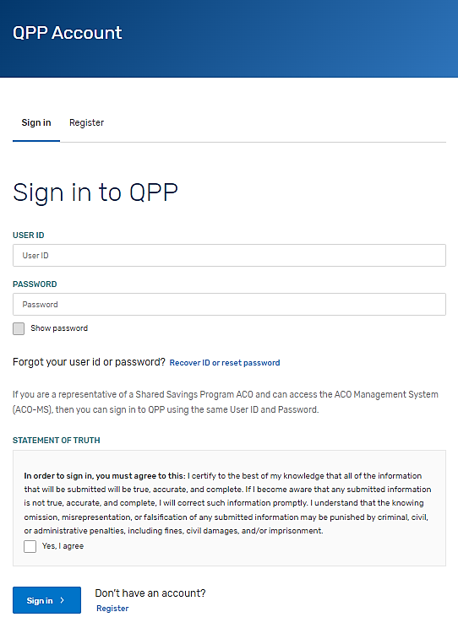
Extreme and Uncontrollable Circumstances Application Process: Application Steps
Step 1: Sign in to Your QPP Account
Sign in to your QPP Account at qpp.cms.gov with your HARP credentials.
Note: If you haven’t signed into qpp.cms.gov before, you must register for an account to obtain your HARP credentials.
*The screenshots included in this user guide were based on the QPP test environment. Because we are always working to incorporate feedback and improve experience, there may be differences between these screenshots and what you see on qpp.cms.gov.

Slide 18
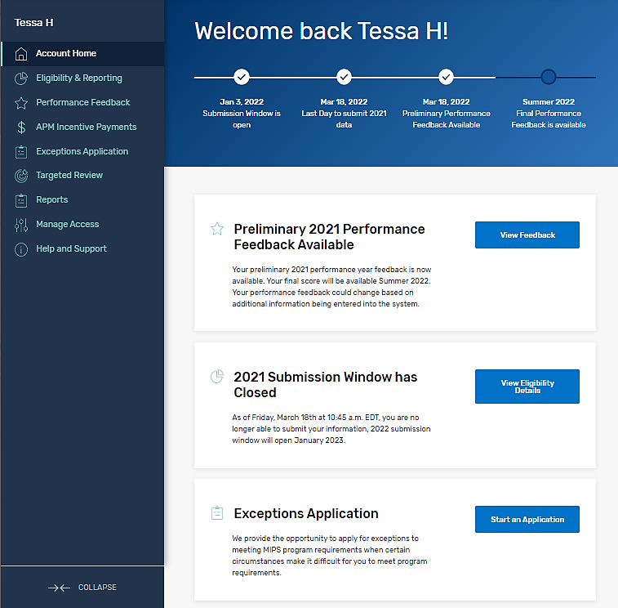
Extreme and Uncontrollable Circumstances Application Process: Application Steps
Step 2: Navigate to Your Exception Applications
Once you are signed into your account select:​
  The Exception Application tab in the left-hand navigation menu, then click + Add New QPP Exception​
        OR​
  The Start an Application quick link on the home page.
You can create and submit a new exception request until 8 p.m. ET on January 3, 2023.
*The screenshots included in this user guide were based on the QPP test environment. Because we are always working to incorporate feedback and improve experience, there may be differences between these screenshots and what you see on qpp.cms.gov.

Slide 19
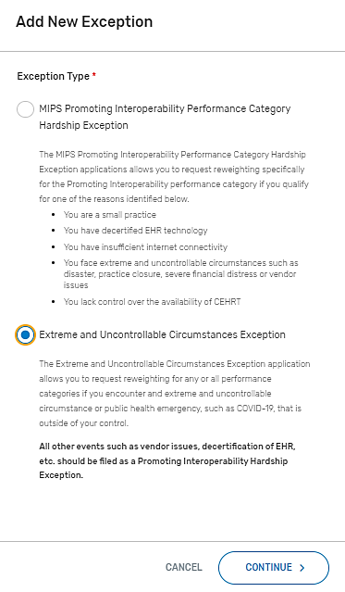
Extreme and Uncontrollable Circumstances Application Process: Application Steps
Step 3: Select Extreme and Uncontrollable Circumstances Exception
Select the Extreme and Uncontrollable Circumstances Exception, then click Continue.
*The screenshots included in this user guide were based on the QPP test environment. Because we are always working to incorporate feedback and improve experience, there may be differences between these screenshots and what you see on qpp.cms.gov.

Slide 20
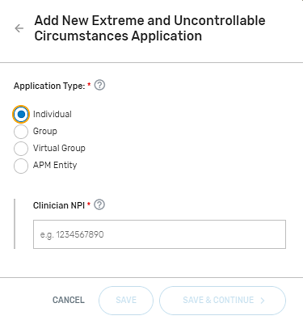
Extreme and Uncontrollable Circumstances Application Process: Application Steps
Step 4: Select Application Type
Select the participation level at which you intend (or intended) to participate in MIPS.
*The screenshots included in this user guide were based on the QPP test environment. Because we are always working to incorporate feedback and improve experience, there may be differences between these screenshots and what you see on qpp.cms.gov.

Slide 21
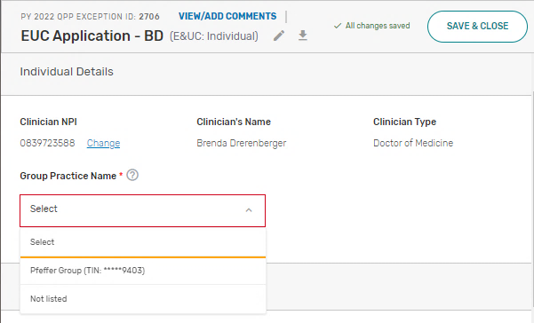
Extreme and Uncontrollable Circumstances Application Process: Application Steps
Step 5: Enter Participation Level Information
Enter the required participation level information.
The required information for each participation level is as follows:
Participation Level | Required Information
Individual Clinician | National Provider Identifier (NPI) Practice Affiliation
Group | Taxpayer Identification Number (TIN)
Virtual Group | Virtual Group Identifier
APM Entity | APM Entity ID
Note: If you’re an individual clinician, group, or virtual group requesting reweighting of only 1 or 2 MIPS performance categories and intend to submit data for others, it is critical that you select the application type that aligns with the level at which you intend to submit data to MIPS (i.e. at the individual, group or virtual group level).
*The screenshots included in this user guide were based on the QPP test environment. Because we are always working to incorporate feedback and improve experience, there may be differences between these screenshots and what you see on qpp.cms.gov.

Slide 22
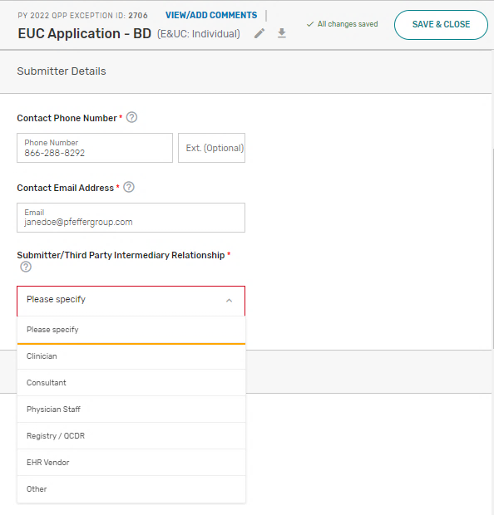
Extreme and Uncontrollable Circumstances Application Process: Application Steps
Step 6: Enter Submitter Details
Enter your contact information (as the submitter) and identify your relationship to the party identified in the application.
*The screenshots included in this user guide were based on the QPP test environment. Because we are always working to incorporate feedback and improve experience, there may be differences between these screenshots and what you see on qpp.cms.gov.

Slide 23
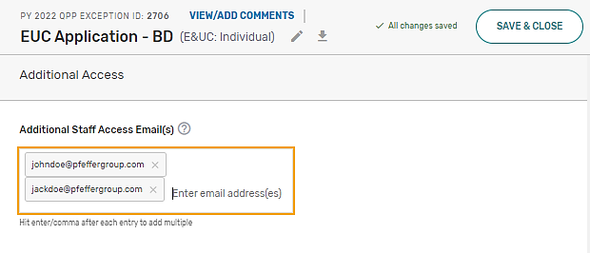
Extreme and Uncontrollable Circumstances Application Process: Application Steps
Step 7: Enter Additional Staff in the Additional Access Section
You can identify additional users to receive notifications about the application in the Additional Access section.
If there’s a HARP account associated with the email address(es) you provide, the person will be able to sign in to their QPP Account on qpp.cms.gov and access the application.
*The screenshots included in this user guide were based on the QPP test environment. Because we are always working to incorporate feedback and improve experience, there may be differences between these screenshots and what you see on qpp.cms.gov.

Slide 24
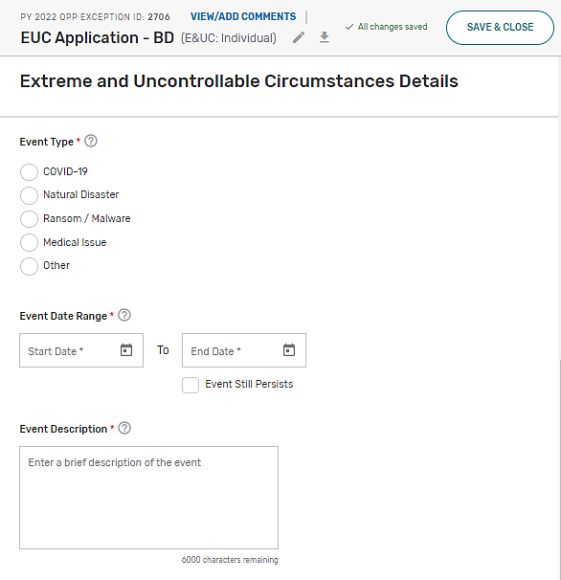
Extreme and Uncontrollable Circumstances Application Process: Application Steps
Step 8: Enter the Extreme and Uncontrollable Circumstances Event Type
Select the appropriate Event Type for the extreme and uncontrollable circumstance you experienced.
Then, enter the timeframe for which you were impacted by the extreme and uncontrollable event by completing the Event Date Range. If you continue to be impacted by the event, select Event Still Persists.
*The screenshots included in this user guide were based on the QPP test environment. Because we are always working to incorporate feedback and improve experience, there may be differences between these screenshots and what you see on qpp.cms.gov.

Slide 25
Extreme and Uncontrollable Circumstances Application Process: Application Steps
Step 9: Provide a Brief Description of the Challenges You Experienced
Provide a brief description about the data collection challenges that you experienced due to the extreme and uncontrollable event and how your 2022 performance data will be impacted.
Note: You don’t need to submit supporting documentation with your application.
However, you should retain documentation of the circumstances supporting your application for your own records in the event that you are selected by CMS for data validation or an audit.
See our 2022 MIPS Data Validation Criteria Guide (ZIP) for information on the data validation and audit process.
*The screenshots included in this user guide were based on the QPP test environment. Because we are always working to incorporate feedback and improve experience, there may be differences between these screenshots and what you see on qpp.cms.gov.

Slide 26
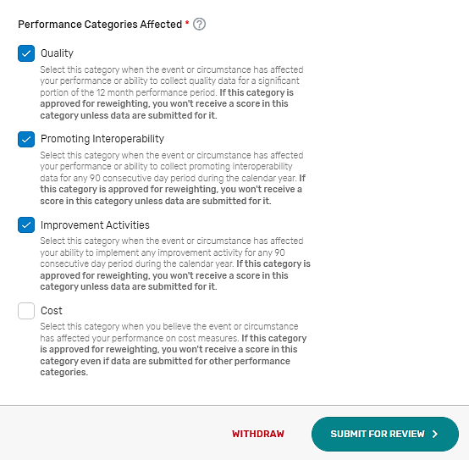
Extreme and Uncontrollable Circumstances Application Process: Application Steps
Step 10: Select MIPS Performance Categories
Select each MIPS performance category for which you are requesting reweighting by checking the corresponding box next to the category name, then select Submit for Review.
Note: All performance categories will be automatically selected for APM Entity applications.
*The screenshots included in this user guide were based on the QPP test environment. Because we are always working to incorporate feedback and improve experience, there may be differences between these screenshots and what you see on qpp.cms.gov.

Slide 27
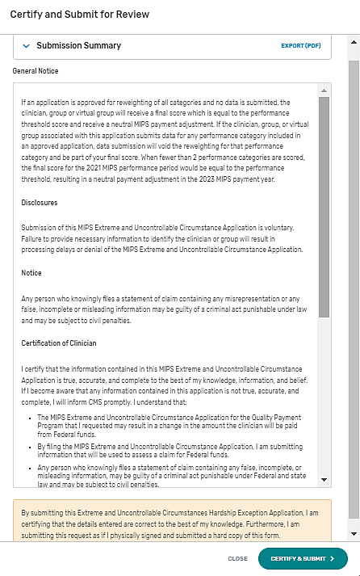
Extreme and Uncontrollable Circumstances Application Process: Application Steps
Step 11: Submit Extreme and Uncontrollable Circumstances Application
Once you are done with your application, review the disclosures, then select the Submit for Review button.
*The screenshots included in this user guide were based on the QPP test environment. Because we are always working to incorporate feedback and improve experience, there may be differences between these screenshots and what you see on qpp.cms.gov.

Slide 28
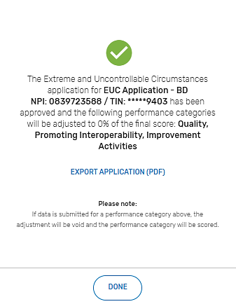
Extreme and Uncontrollable Circumstances Application Process: Application Steps
Extreme and Uncontrollable Circumstances Exception Application Submission Confirmation
After you submit your application, you will receive a message stating that your application has been successfully submitted and is pending review. You will also receive an email notification.
*The screenshots included in this user guide were based on the QPP test environment. Because we are always working to incorporate feedback and improve experience, there may be differences between these screenshots and what you see on qpp.cms.gov.

Slide 29
Help, Resources, and Version History

Slide 30
Help, Resources, and Version History
Where Can You Go for Help?
Contact the Quality Payment Program at 1-866-288-8292, Monday through Friday, 8 a.m.-8 p.m. ET or by e-mail at: QPP@cms.hhs.gov.
Customers who are hearing impaired can dial 711 to be connected to a TRS Communications Assistant.
Visit the Quality Payment Program website for other help and support information, to learn more about MIPS, and to check out the resources available in the QPP Resource Library.

Slide 31
Help, Resources, and Version History
Additional Resources
  The Quality Payment Program Resource Library houses fact sheets, measure specifications, specialty guides, technical guides, user guides, helpful videos, and more. We will update this table as more resources become available.
Resource
2022 Automatic Extreme and Uncontrollable Circumstances Policy Fact Sheet (PDF)
2022 MIPS Promoting Interoperability Hardship Exception Application Guide (PDF)

Slide 32
Help, Resources, and Version History
Version History
If we need to update this document, changes will be identified here.
Date | Description
10/06/2022 | Updated deadline to request an exception to January 3, 2023, at 8 p.m. ET (slides 6 and 18)
05/02/2022 | Original Posting.

Slide 33
Appendices

Slide 34
Appendices
Appendix A1: 2022 Performance Year MIPS Performance Category Weight Redistribution Policies for Individual Clinicians, Groups, Virtual Groups, and APM Entities Reporting Traditional MIPS
The table below illustrates the 2022 performance category weights and reweighting policies that CMS will apply to clinicians, groups, and virtual groups reporting traditional MIPS. (Small practices should refer to Appendix A2.)
Refer to Appendix B for reweighting policies for APM Entities reporting the APP. APM Entities reporting traditional MIPS can only request reweighting for all performance categories.
If fewer than 2 performance categories can be scored (meaning 1 performance category is weighted at 100%, or all performance categories are weighted at 0%), the clinician, group, or virtual group will receive a final score equal to the performance threshold and the MIPS eligible clinicians will receive a neutral payment adjustment in the 2024 payment year.
MIPS Performance Category Reweighting Scenario | Quality Category Weight | Cost Category Weight | Improvement Activities Category Weight | Promoting Interoperability Category Weight
No Reweighting
Standard Weighting under traditional MIPS | 30% | 30% | 15% | 25%
Reweight 1 Performance Category
No Cost (Cost → Quality and Promoting Interoperability) | 55% | 0% | 15% | 30%
No Improvement Activities (Improvement Activities → Quality) | 45% | 30% | 0% | 25%
No Promoting Interoperability (Promoting Interoperability → Quality) | 55% | 30% | 15% | 0%
No Quality (Quality → Promoting Interoperability) | 0% | 30% | 15% | 55%
Table continues on the following slide.

Slide 35
Appendices
Appendix A1: 2022 Performance Year MIPS Performance Category Weight Redistribution Policies for Individual Clinicians, Groups, Virtual Groups, and APM Entities Reporting Traditional MIPS (continued)
MIPS Performance Category Reweighting Scenario | Quality Category Weight | Cost Category Weight | Improvement Activities Category Weight | Promoting Interoperability Category Weight
Reweight 2 Performance Categories
No Cost + No Promoting Interoperability (Cost + Promoting Interoperability → Quality) | 85% | 0% | 15% | 0%
No Cost + No Quality (Cost + Quality → Promoting Interoperability) | 0% | 0% | 15% | 85%
No Cost + No Improvement Activities (Cost + Improvement Activities → Promoting Interoperability + Quality) | 70% | 0% | 0% | 30%
No Promoting Interoperability + No Quality (Promoting Interoperability + Quality → Cost + Improvement Activities) | 0% | 50% | 50% | 0%
No Promoting Interoperability + No Improvement Activities (Promoting Interoperability + Improvement Activities → Quality) | 70% | 30% | 0% | 0%
No Quality + No Improvement Activities (Quality + Improvement Activities → Promoting Interoperability) | 0% | 30% | 0% | 70%
Reweight 3 Performance Categories
If you have multiple performance categories reweighted to 0% so that a single performance category is weighted at 100% of your final score, you will receive a score equal to the performance threshold regardless of any data submitted or not and receive a neutral payment adjustment.
Reweight 4 Performance Categories
If all performance categories are reweighted to 0%, you will receive a score equal to the performance threshold regardless of any data submitted or not and receive a neutral payment adjustment.

Slide 36
Appendices
Appendix A2. MIPS Performance Category Weight Redistribution Policies Under Traditional MIPS Finalized for the 2022 Performance Year: Small Practices
The table below illustrates the 2022 performance category weights and reweighting policies that CMS will apply to small practices.
Refer to Appendix B for reweighting policies that apply to APM Entities reporting the APP. APM Entities reporting traditional MIPS can only request reweighting for all performance categories.
MIPS Performance Category Reweighting Scenario | Quality Category Weight | Cost Category Weight | Improvement Activities Category Weight | Promoting Interoperability Category Weight
No Reweighting
Standard Weighting under traditional MIPS for small practices | 30% | 30% | 15% | 25%
Reweight 1 Performance Category
No Cost (Cost → Quality and Promoting Interoperability) | 55% | 0% | 15% | 30%
No Improvement Activities (Improvement Activities → Quality) | 45% | 30% | 0% | 25%
No Promoting Interoperability (Promoting Interoperability → Quality and Improvement Activities) | 40% | 30% | 30% | 0%
No Quality (Quality → Promoting Interoperability) | 0% | 30% | 15% | 55%
*Table continues on next slide.

Slide 37
Appendices
Appendix A2. MIPS Performance Category Weight Redistribution Policies Under Traditional MIPS Finalized for the 2022 Performance Year: Small Practices (continued)
MIPS Performance Category Reweighting Scenario | Quality Category Weight | Cost Category Weight | Improvement Activities Category Weight | Promoting Interoperability Category Weight
Reweight 2 Performance Categories
No Cost + No Promoting Interoperability (Cost + Promoting Interoperability → Quality and Improvement Activities) | 50% | 0% | 50% | 0%
No Cost + No Quality (Cost + Quality → Promoting Interoperability) | 0% | 0% | 15% | 85%
No Cost + No Improvement Activities (Cost + Improvement Activities → Promoting Interoperability + Quality) | 70% | 0% | 0% | 30%
No Promoting Interoperability + No Quality (Promoting Interoperability + Quality → Cost + Improvement Activities) | 0% | 50% | 50% | 0%
No Promoting Interoperability + No Improvement Activities (Promoting Interoperability + Improvement Activities → Quality) | 70% | 30% | 0% | 0%
No Quality + No Improvement Activities (Quality + Improvement Activities → Promoting Interoperability) | 0% | 30% | 0% | 70%
Note: If you have multiple performance categories reweighted to 0% so that a single performance category is weighted at 100% of your final score, you will receive a score equal to the performance threshold regardless of any data submitted or not submitted. See next slide for additional information.

Slide 38
Appendices
Appendix B. 2022 Performance Year MIPS Performance Category Weight Redistribution Policies for APM Entities and APM Participants Reporting the APP
The table below illustrates the 2022 performance category weights and reweighting policies that CMS will apply to APM Entities reporting traditional MIPS and to individual clinicians, groups and APM Entities reporting via the APP.
Reminder: APM Entities can only submit an EUC Application for all performance categories.
Reminders:
    Cost isn’t scored under the APP.
    There are no reporting requirements for the improvement activities performance category under the APP for performance year 2022. Participants reporting via the APP will automatically receive full credit for the improvement activities performance category.
    Participants reporting via the APP will follow the same reporting requirements as traditional MIPS for the Promoting Interoperability performance category.
MIPS Performance Category Reweighting Scenario | Quality Category Weight | Cost Category Weight | Improvement Activities Category Weight | Promoting Interoperability Category Weight
No Reweighting
Standard Weighting under the APP | 50% | 0% | 20% | 30%
Reweight 1 Performance Category
No Promoting Interoperability (Promoting Interoperability → Quality) | 75% | 0% | 25% | 0%
No Quality (Quality → Promoting Interoperability) | 0% | 0% | 25% | 75%
Reweight 2+ Performance Categories
If you have multiple performance categories reweighted to 0% so that a single performance category is weighted at 100% of your final score, you will receive a score equal to the performance threshold regardless of any data submitted or not and receive a neutral payment adjustment.

Slide 39





Appendices
Appendix C. MIPS Promoting Interoperability Hardship Exception Application Status Descriptions
The table below provides a description of each application status in the order of which they occur.
Draft in Progress | Submitted – Pending Approval | Approved / Denied | Withdrawn
You are currently working on your application and haven’t submitted it yet. Select Manage to continue working on your application. | You have successfully completed and submitted your application. Applications are reviewed in the order of which they are received. | We completed our review of your application and approved your request. | You have withdrawn your application. You can withdraw your application at any point in the process. An application can’t be reopened after being withdrawn. You’ll need to complete a new application.
 |  | We completed our review of your application and denied your request.

