Slide 1


REGISTRATION INTAKE
LANGUAGE UPDATES
All Needs Flow

Slide 2
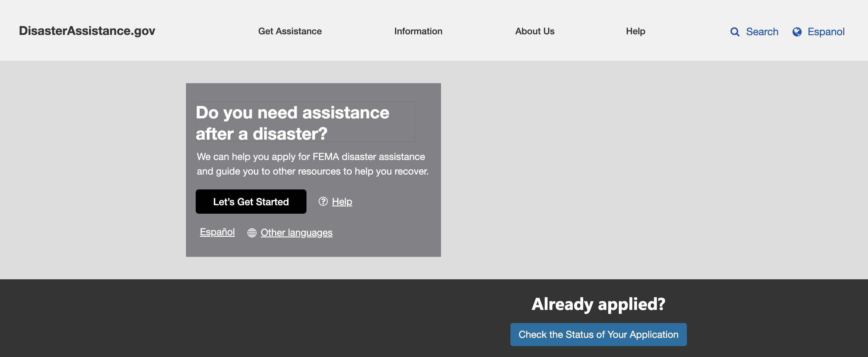
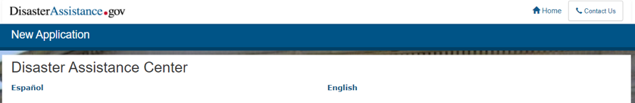
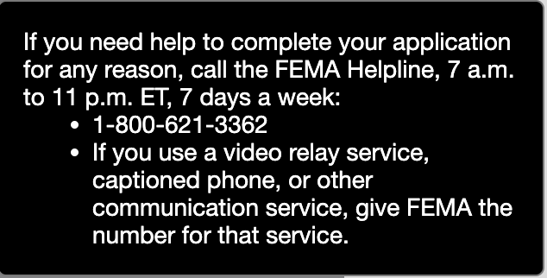
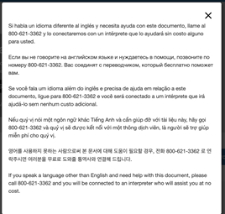
Language Selection
Directing the user to select their language they wish to continue in.
Proposed Flow | Related Features on Current Screen
Located on the homepage. | Located after the CAPTCHA in the beginning of a new application.
Notes:
Sewer, Water or Electricity Outages Only Flow slide # 292

Slide 3
Language Changes
Proposed language: Do you need assistance after a disaster? We can help you apply for FEMA disaster assistance and guide you to other resources to help you recover. Let’s Get Started [Button] English/Spanish If you need help to complete your application for any reason, call the FEMA Helpline, 7 a.m. to 11 p.m. ET, 7 days a week: 1-800-621-3362 If you use a video relay service, captioned phone, or other communication service, give FEMA the number for that service. (Other Languages pop-up) Si habla un idioma diferente al inglés y necesita ayuda con este documento, llame al 800-621-3362 y lo conectaremos con un intérprete que lo ayudará sin costo alguno para usted. Если вы не говорите на английском языке и нуждаетесь в помощи, позвоните по номеру 800-621-3362. Вас соединят с переводчиком, который бесплатно поможет вам. Se você fala um idioma além do inglês e precisa de ajuda em relação a este documento, ligue para 800-621-3362 e você será conectado a um intérprete que irá ajudá-lo sem nenhum custo adicional. Nếu quý vị nói một ngôn ngữ khác Tiếng Anh và cần giúp đỡ với tài liệu này, hãy gọi 800-621-3362 và quý vị sẽ được kết nối với một thông dịch viên, là người sẽ trợ giúp miễn phí cho quý vị. 영어를 사용하지 못하는 사람으로써 본 문서에 대해 도움이 필요할 경우, 전화 800-621-3362 로 연락주시면 여러분을 무료로 도와줄 통역사와 연결해 드립니다. If you speak a language other than English and need help with this document, please call 800-621-3362 and you will be connected to an interpreter who will assist you at no cost. | Current language: English Spanish

Slide 4
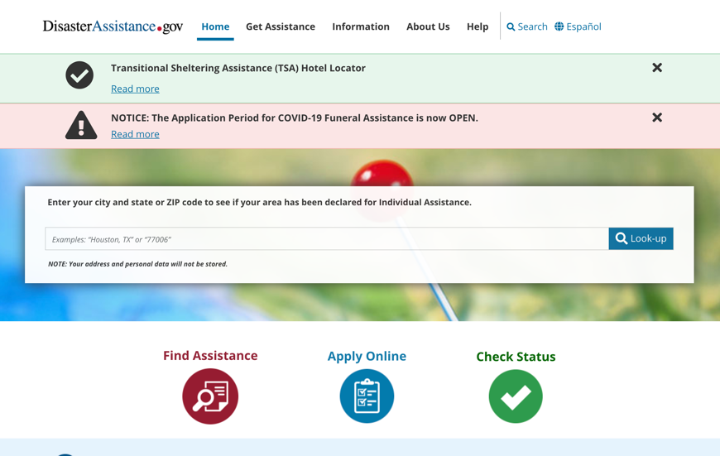
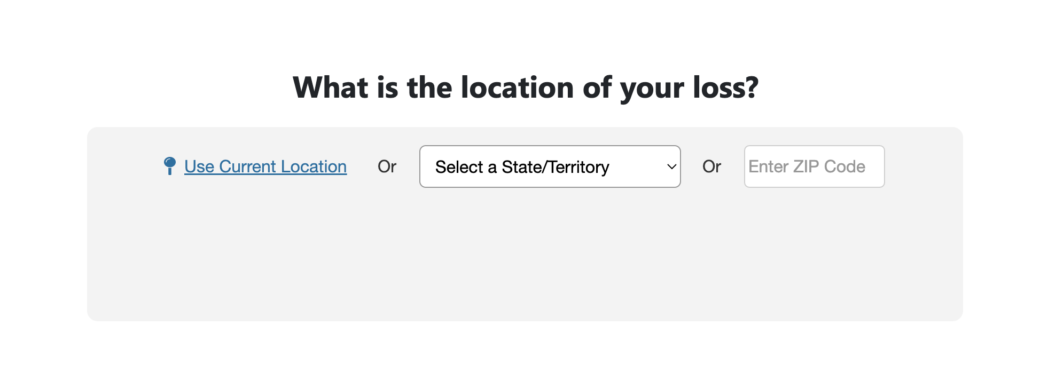
Location Search
Directing the user to enter their location to see what kind of assistance we can offer them.
Proposed Flow | Related Features on Current Screen
Located on the 2nd screen after selecting the language they wish to continue in | Located on the Homepage
Notes:
Sewer, Water or Electricity Outages Only Flow slide # 291

Slide 5
Language Changes
Proposed language: What is the location of your loss? Use Current Location (hyperlink) Or Select a State/Territory (Drop-down menu) Or [Enter ZIP Code] (Text Field) Enter City (Text Field which appears if State is selected) | Current language: Enter your city and state or ZIP code to see if your area has been declared for Individual Assistance. NOTE: Your address and personal data will not be stored.

Slide 6
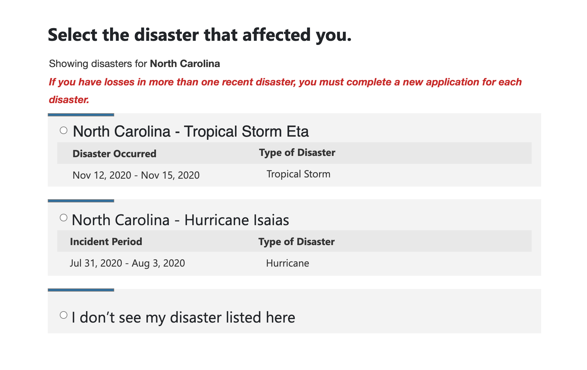
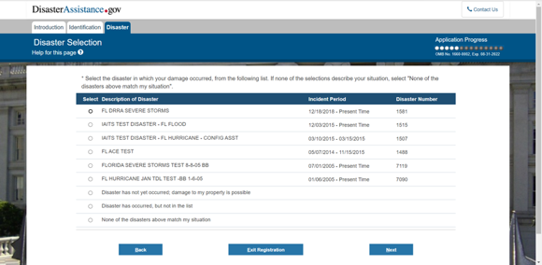
Disaster Selection
The user must select the disaster that affected them.
Proposed Flow | Related Features on Current Screen
Located after the user enters their location. | Located on the 2nd screen after the Identification tab, and after the instructions on this section of the application.

Slide 7
Language Changes
Proposed language: Select the disaster that affected you. Showing disasters for (State Selected) If you have losses in more than one recent disaster, you must complete a new application for each disaster. I don’t see my disaster listed here. | Current language: * Select the disaster in which your damage occurred, from the following list. If none of the selections describe your situation, select "None of the disasters above match my situation".

Slide 8
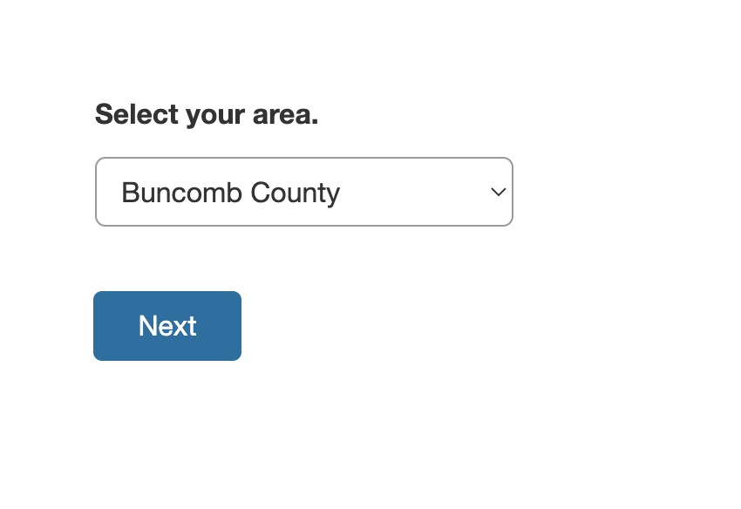
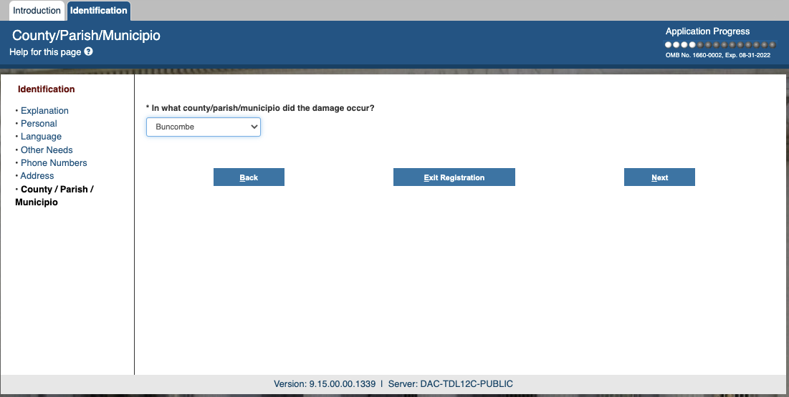
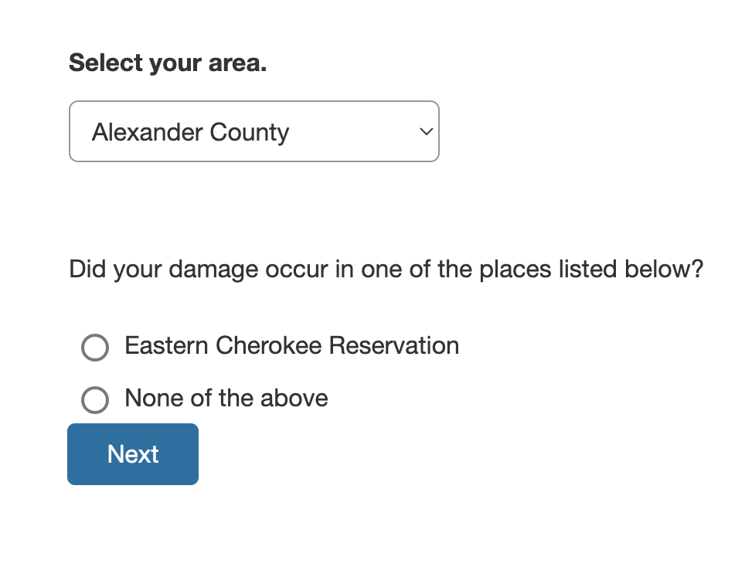
Disaster Selection
The user must select the county where the damage occurred.
Proposed Flow | Related Features on Current Screen
Located after the user enters their location.

Slide 9
Language Changes
Proposed language: Select your area. [Drop-down menu] If user selects a different county: Did your damage occur in one of the places listed below? [Button] Next | Current language: In what county/parish/municipio did the damage occur? [Drop-down menu]

Slide 10
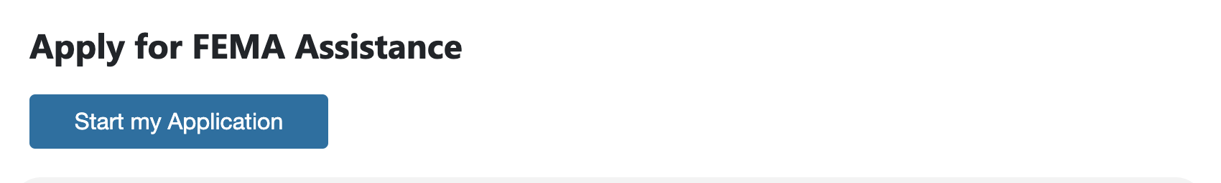
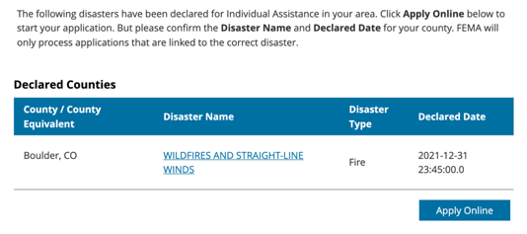
Declared Disaster – Step 1
User sees if they are eligible for FEMA assistance/applies
Proposed Flow | Related Features on Current Screen
Located after Disaster Selection | Located after entering damage location

Slide 11
Language Changes
Proposed language: Apply for FEMA Assistance Start My Application [Button] | Current language: The following disasters have been declared for Individual Assistance in your area. Click Apply Online below to start your application. But please confirm the Disaster Name and Declared Date for your county. FEMA will only process applications that are linked to the correct disaster.

Slide 12
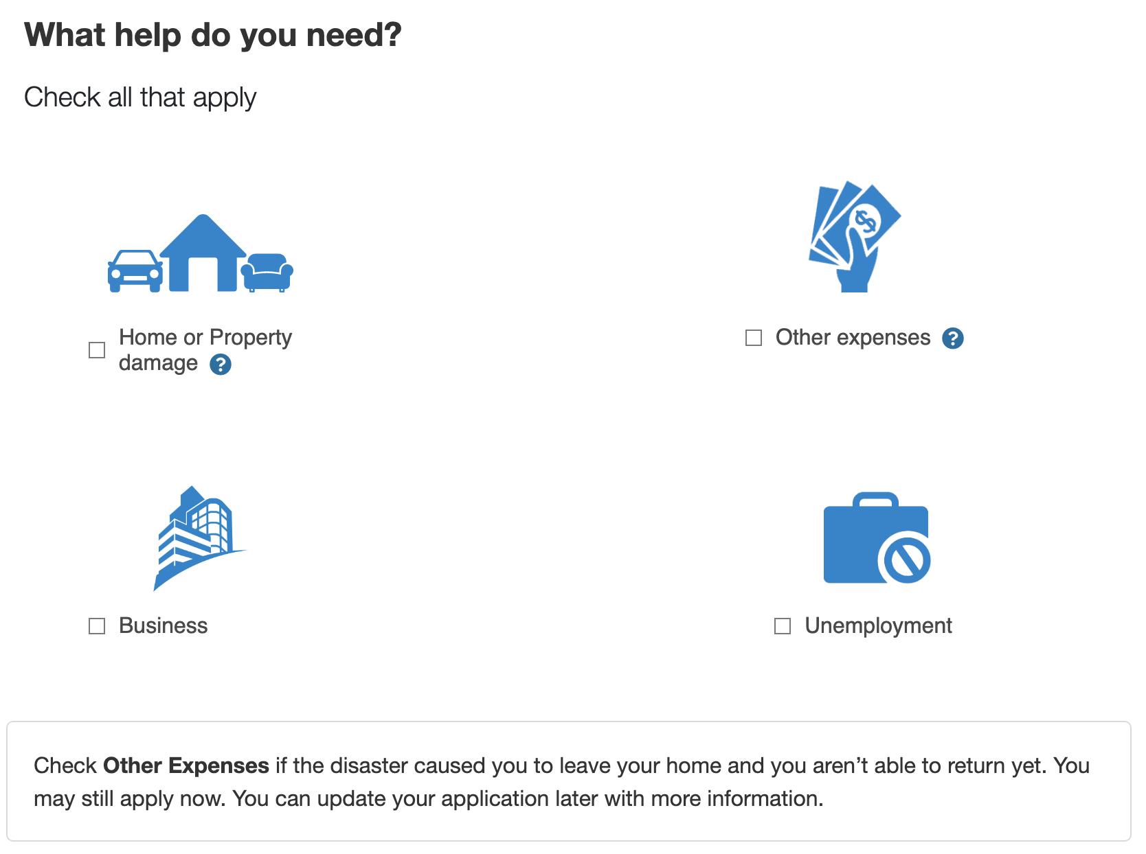
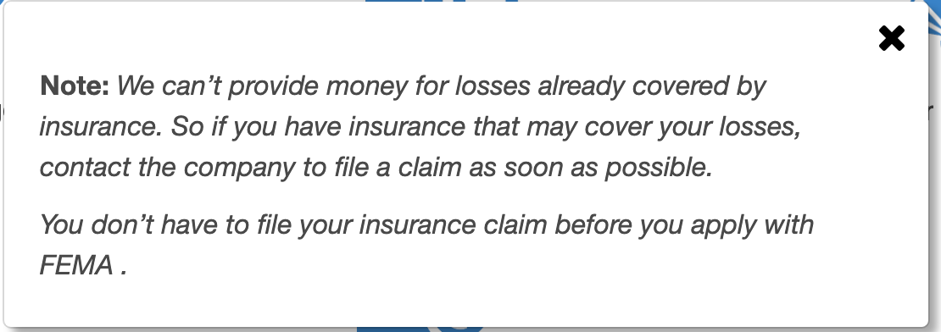
Declared Disaster – Step 2
User selects type of damage they experienced.
Proposed Flow | Related Features on Current Screen
 | This is a new Screen. We are attempting to filter out users depending on their needs and pointing them to available resources
Located after Declared Disaster screen/clicking “apply” button | Located after Financial Explanation

Slide 13
Language Changes
Proposed language: What help do you need? Check all that apply. Home or Property damage [Checkbox] Other expenses [Checkbox] Business losses [Checkbox] Unemployment [Checkbox] Check Other Expenses if the disaster caused you to leave your home and you aren’t able to return yet. You may still apply now. You can update your application later with more information. Note: We can’t provide money for losses already covered by insurance. So, if you have insurance that may cover your losses, contact the company to file a claim as soon as possible. You don’t have to file your insurance claim before you apply with FEMA. Back [Link] Next [Button] | Current language:

Slide 14
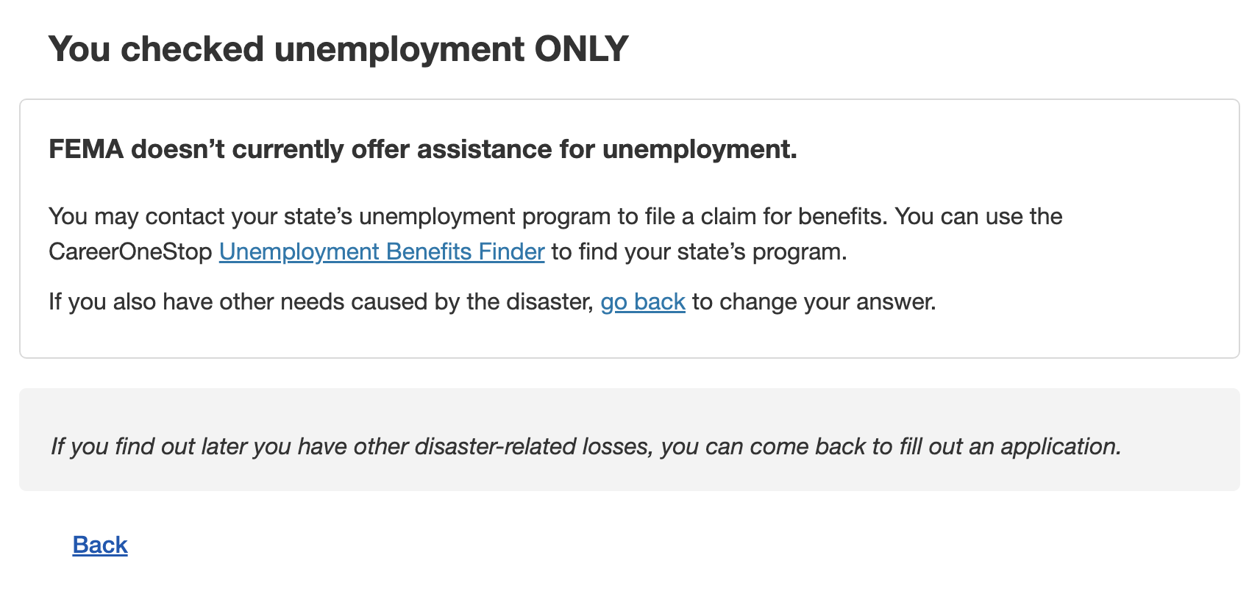
Declared Disaster – Step 3
User selects UNEMPLOYMENT only.
Proposed Flow | Related Features on Current Screen
 | N/A

Slide 15
Language Changes
Proposed language: You checked unemployment ONLY. FEMA doesn’t currently offer assistance for unemployment. You may contact your state’s unemployment program to file a claim for benefits. You can use the CareerOneStop Unemployment Benefits Finder to find your state’s program. If you also have other needs caused by the disaster, go back to change your answer. If you find out later you have other disaster-related losses, you can come back to fill out an application. | Current language: N/A If they select Unemployment ONLY, the intention is to not take the registration.

Slide 16
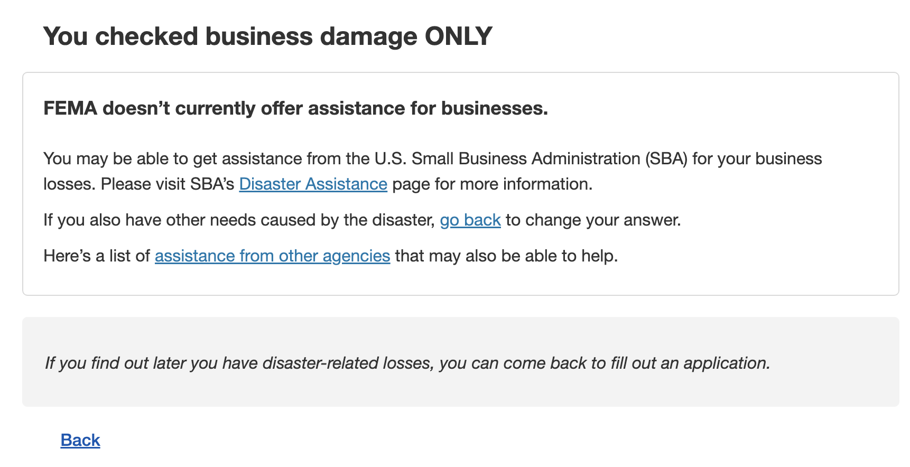
Declared Disaster – Step 3
User selects BUSINESS damage only.
Proposed Flow | Related Features on Current Screen
 | N/A

Slide 17
Language Changes
Proposed language: You checked business damage ONLY. FEMA doesn’t currently offer assistance for businesses. You may be able to get assistance from the U.S. Small Business Administration (SBA) for your business losses. Please visit SBA’s Disaster Assistance page for more information. If you also have other needs caused by the disaster, go back to change your answer. Here’s a list of assistance from other agencies that may also be able to help. If you find out later you have other disaster-related losses, you can come back to fill out an application. | Current language: N/A If they select Business Damage ONLY, the intention is to not take the registration.

Slide 18
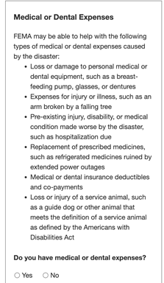
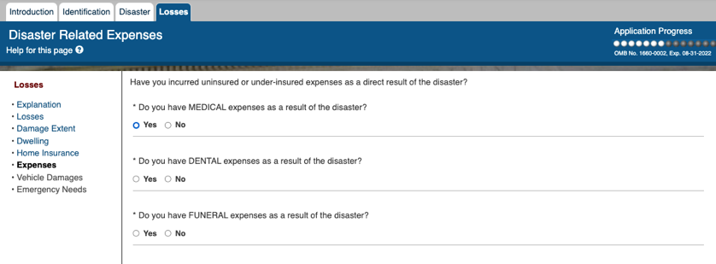
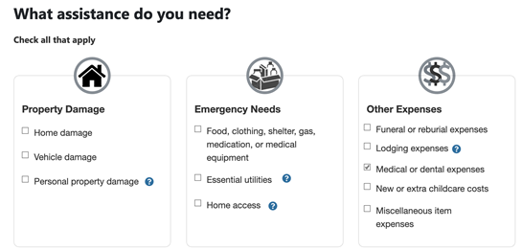
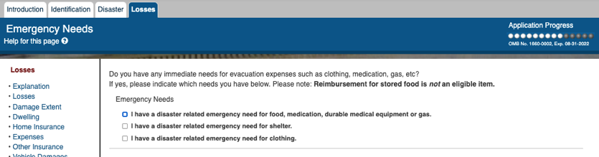
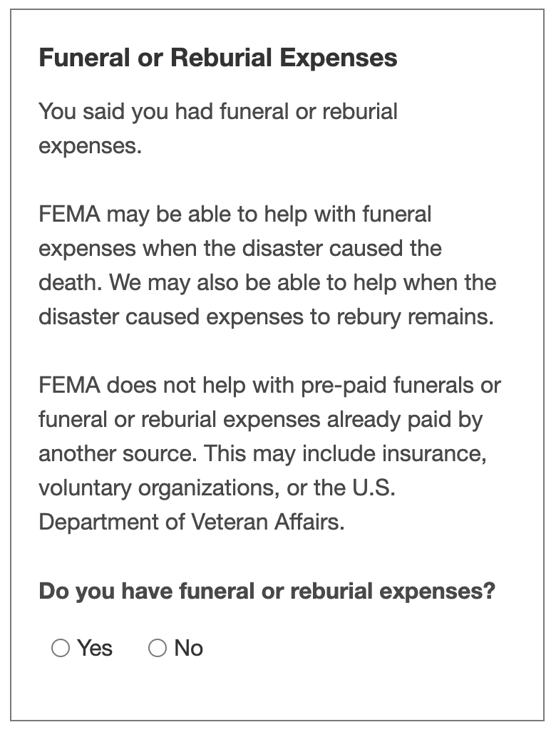
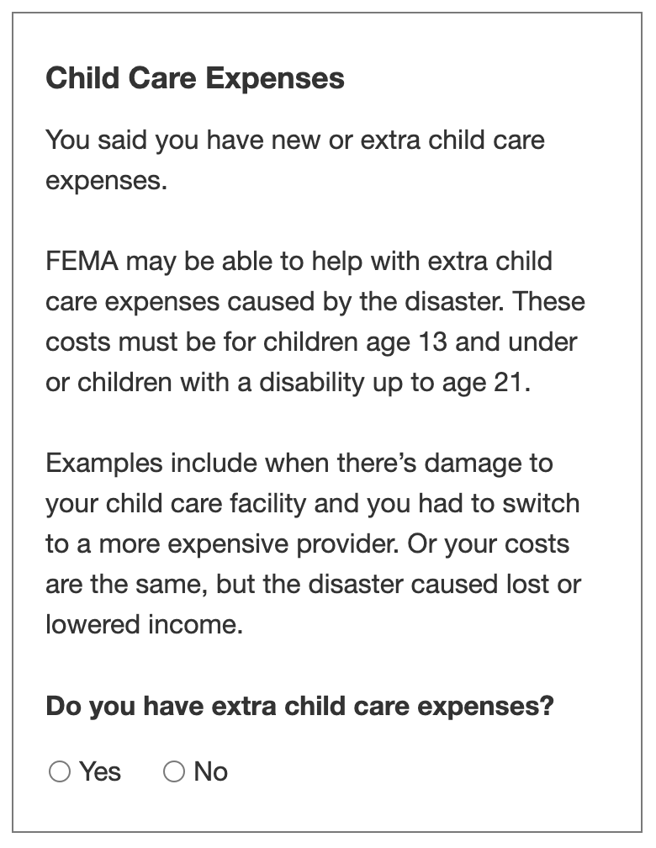
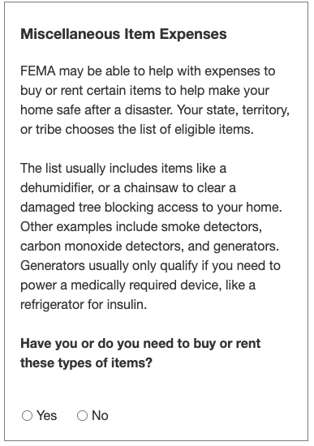
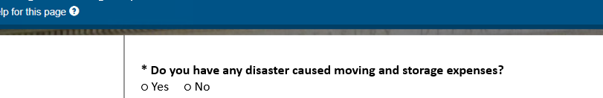
Needs Assessment
Several needs questions appear on multiple screens in the current flow but were merged into one Needs Assessment page
Proposed Flow | Related Features on Current Screen
Located after the type of disaster is selected. | Medical, Dental, Funeral located after Home Insurance. Emergency Needs located after Add Vehicles. Moving & Storage located after the Insurance page.
Notes:
Sewer, Water or Electricity Outages Only Flow slide # 298

Slide 19
Language Changes
Proposed language: What assistance do you need? Check all that apply. Property Damage Home damage [Checkbox] Vehicle damage [Checkbox] Personal property damage [Checkbox] Emergency Needs Food, clothing, gas, medication, or medical equipment [Checkbox] Essential utilities [Checkbox] Home access Other Expenses Funeral or reburial expenses [Checkbox] If user checks... [Funeral or Reburial Expenses You said you had funeral or reburial expenses. FEMA may be able to help with funeral expenses when the disaster caused the death. We may also be able to help when the disaster caused expenses to rebury remains. FEMA does not help with pre-paid funerals or funeral or reburial expenses already paid by another source. This may include insurance, voluntary organizations, or the U.S. Department of Veteran Affairs. Do you have funeral or reburial expenses? Radio Buttons - Yes/No] Lodging expenses [Checkbox] Medical or dental expenses [Checkbox] If user checks... FEMA may be able to help with the following types of medical or dental expenses caused by the disaster: Loss or damage to personal medical or dental equipment, such as a breast-feeding pump, glasses, or dentures Expenses for injury or illness, such as an arm broken by a falling tree Pre-existing injury, disability, or medical condition made worse by the disaster, such as hospitalization due Replacement of prescribed medicines, such as refrigerated medicines ruined by extended power outages Medical or dental insurance deductibles and co-payments Loss or injury of a service animal, such as a guide dog or other animal that meets the definition of a service animal as defined by the Americans with Disabilities Act Do you have medical or dental expenses? Yes No New or extra child care costs [Checkbox] If user checks... [You said you have new or extra child care costs. FEMA may be able to help with extra child care expenses caused by the disaster. These costs must be for children age 13 and under or children with a disability up to age 21. Examples include when there’s damage to your child care facility and you had to switch to a more expensive provider. Or your costs are the same, but the disaster caused lost or lowered income. Do you have extra child care expenses? Radio Buttons - Yes, No] Miscellaneous item expenses [Checkbox] If user checks... [Miscellaneous Item Expenses FEMA may be able to help with expenses to buy or rent certain items to help make your home safe after a disaster. Your state, territory, or tribe chooses the list of eligible items. The list usually includes items like a dehumidifier, or a chainsaw to clear a damaged tree blocking access to your home. Other examples include smoke detectors, carbon monoxide detectors, and generators. Generators usually only qualify if you need to power a medically required device, like a refrigerator for insulin. Have you or do you need to buy or rent these types of items? Radio Buttons - Yes/No] | Current language: Emergency Needs Do you have any immediate needs for evacuation expenses such as clothing, medication, gas, etc? If yes, please indicate which needs you have below. Please note: Reimbursement for stored food is not an eligible item. Disaster Related Expenses I have a disaster related emergency need for food, medication, durable medical equipment or gas. [Checkbox] I have a disaster related emergency need for shelter. [Checkbox] I have a disaster related emergency need for clothing. [Checkbox] Have you incurred uninsured or under-insured expenses as a direct result of the disaster? *Do you have MEDICAL expenses as a result of the disaster? Yes No [Radio Buttons] *Do you have DENTAL expenses as a result of the disaster? Yes No [Radio Buttons] *Do you have FUNERAL expenses as a result of the disaster? Yes No [Radio Buttons] ______ Moving and Storage Expenses * Do you have any disaster caused moving and storage expenses? ○ Yes ○ No

Slide 20
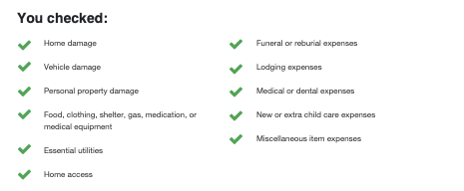
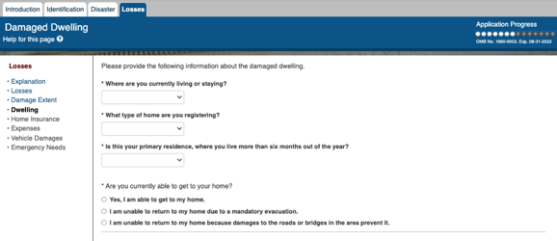

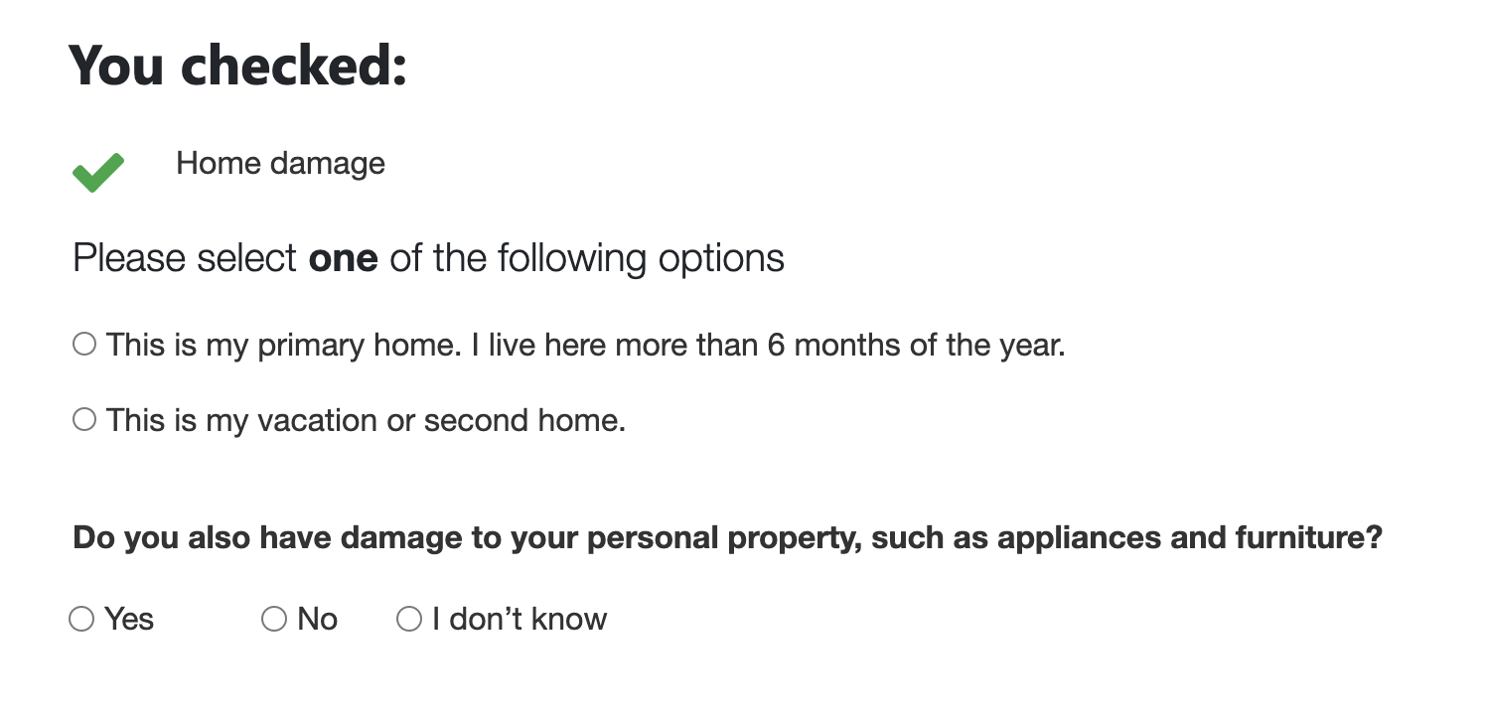
Needs Selection Verification
The user does not have damage at a primary residence.
Proposed Flow | Related Features on Current Screen
Located after Needs Assessment – displays the needs selected by the user

Slide 21
Language Changes
Proposed language: You checked: Home damage Vehicle damage Personal property damage Food, clothing, shelter, gas, medication or medical equipment Essential utilities Home access Funeral or reburial expenses Lodging expenses Medical or dental expenses New or extra child care expenses Miscellaneous item expenses Please select one of the following options This is my primary home. I live here more than 6 months of the year [radio button] This is my vacation or second home [radio button] | Current language: Is this your primary residence, where you live more than six months out of the year? No (Secondary) Yes (Primary) [Drop-down]

Slide 22
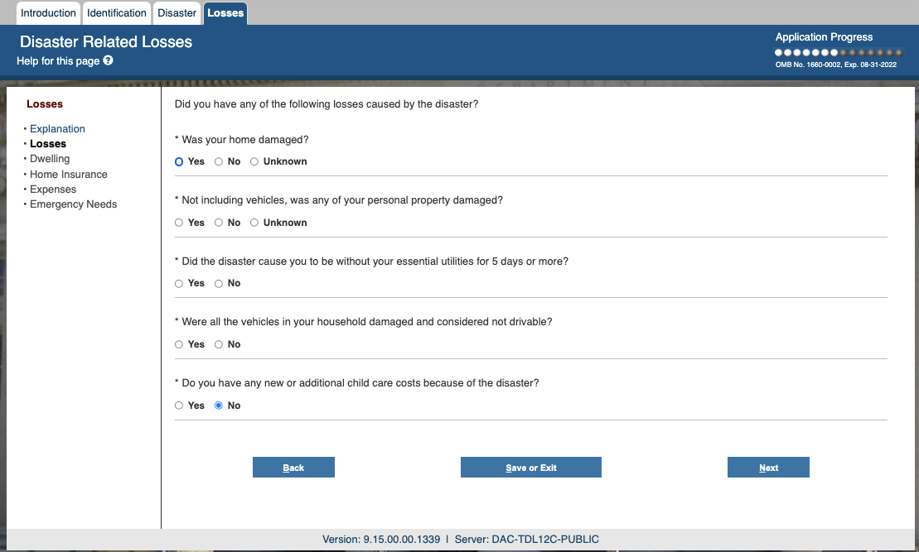
Personal Property
If user selects Home damage but not personal property damage

Slide 23
Language Changes
Proposed language: You checked Home damage. Please select one of the following options: This is my primary home. I live here more than 6 months of the year. [Radio Button] This is my vacation or second home. [Radio Button] Do you also have damage to your personal property, such as appliances and furniture? Yes No I don’t know [Radio Button] | Current language: Is this your primary residence, where you live more than six months out of the year? No (Secondary) Yes (Primary) [Drop-down] Not including vehicles, was any of your personal property damaged? Yes No Unknown [Radio Buttons]

Slide 24
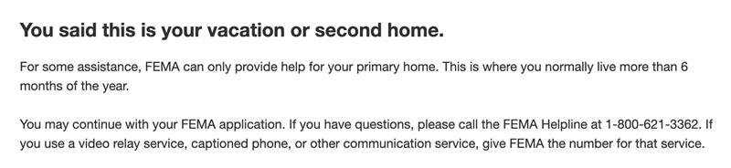
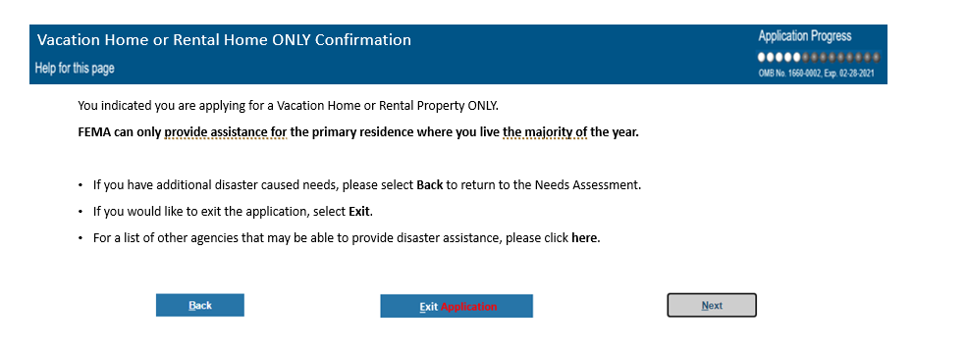
Primary Residence Verification
The user does not have damage at a primary residence.
Proposed Flow | Related Features on Current Screen
If user selects “Vacation or second home” option | New screen for vacation or second home

Slide 25
Language Changes
Proposed language: Please select one of the following options This is my primary home. I live here more than 6 months of the year. [Radio Button] This is my vacation or second home. [Radio Button] You said this is your vacation or second home. For some assistance, FEMA can only provide help for your primary home. This is where you normally live more than 6 months of the year. You may continue with your FEMA application. If you have questions, please call the FEMA Helpline at 1-800-621-3362. If you use a video relay service, captioned phone, or other communication service, give FEMA the number for that service. | Current language: Is this your primary residence, where you live more than six months out of the year? No (Secondary) Yes (Primary) [Drop-down] Vacation Home or Rental Home ONLY Confirmation You indicated you are applying for a Vacation Home or Rental Property ONLY FEMA can only provide assistance for the primary residence where you live the majority of the year. If you have additional disaster caused needs, please select Back to return to the Needs Assessment. If you would like to exit the application, select Exit. For a list of other agencies that may be able to provide disaster assistance, please click here.

Slide 26
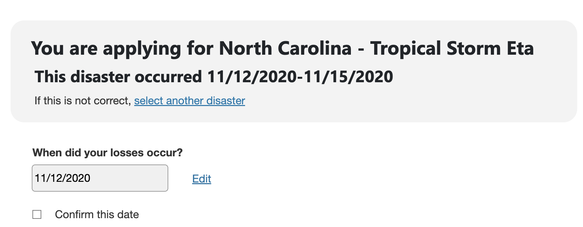
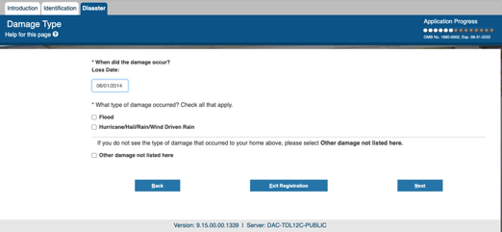
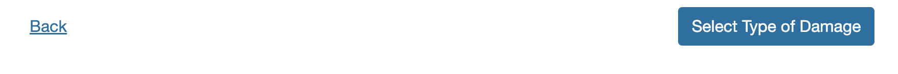
Disaster Confirmation
Confirms the damage date and ensures user picks correct disaster
Proposed Flow | Related Features on Current Screen
Located after needs verification screens. | Located after Disaster Selection

Slide 27
Language Changes
Proposed language: You are applying for North Carolina – Tropical Storm Eta. This disaster occurred 11/12/2020-11/15/2020. If this is not correct, please pick another disaster. (hyperlink) When did your losses occur? [Text Field] Confirm this date [Button] | Current language: Damage Type *When did the damage occur? Loss Date: [Text Field]

Slide 28
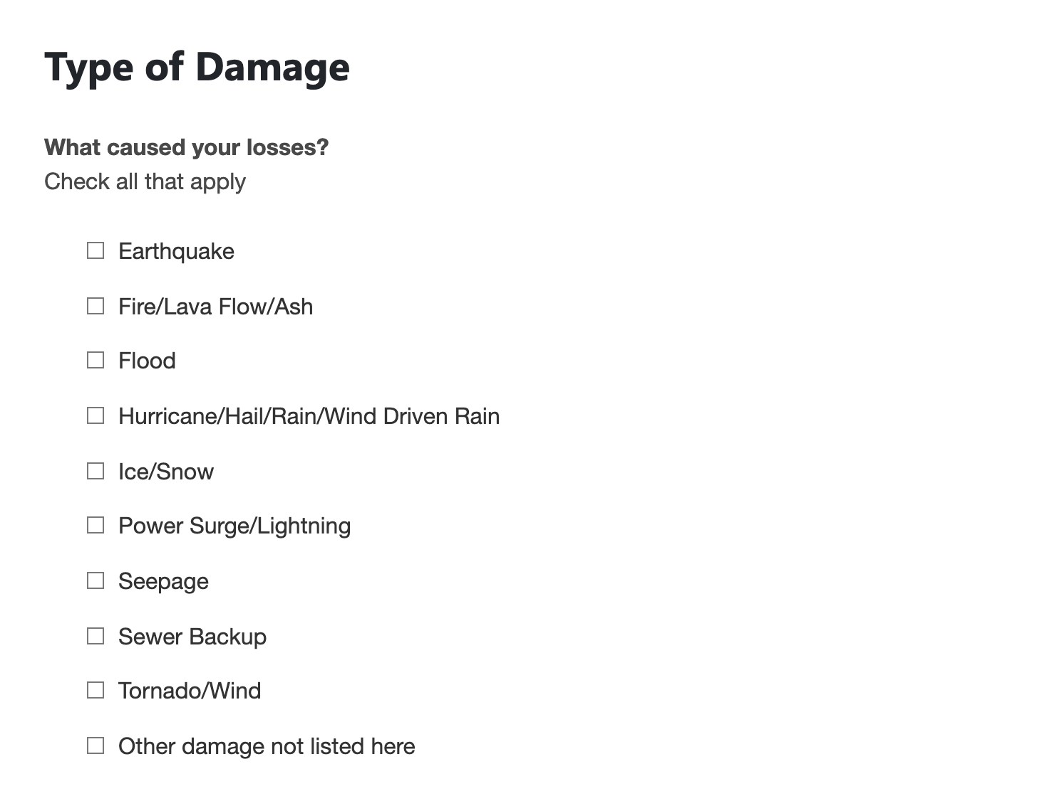
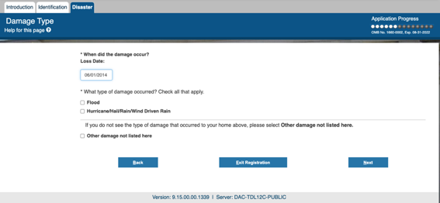
Type of Damage
User selects type of damage that occurred
Proposed Flow | Related Features on Current Screen
Located after disaster confirmation | Located after Disaster Selection

Slide 29
Language Changes
Proposed language: Type of Damage What caused your losses? Check all that apply. Earthquake [Checkbox] Fire, Lava Flow, Ash [Checkbox] Flood [Checkbox] Hurricane, Hail, Rain, Wind-driven Rain [Checkbox] Ice, Snow [Checkbox] Power Surge, Lightning [Checkbox] Seepage [Checkbox] Sewer Backup [Checkbox] Tornado, Wind [Checkbox] Other damage not listed here [Checkbox] This list updates depending on the disaster type | Current language: Damage Type What type of damage do you have? Check all that apply Flood [Checkbox] Hurricane/Hail/Rain/Wind Driven Rain [Checkbox] _____ If you do not see the type of damage that occurred to your home above, please select Other damage not listed here. Other damage not listed here [Checkbox]

Slide 30
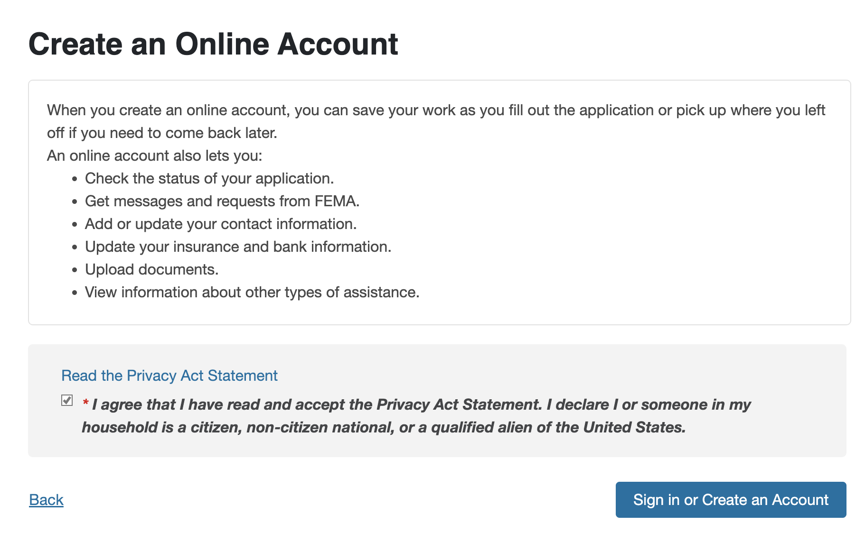
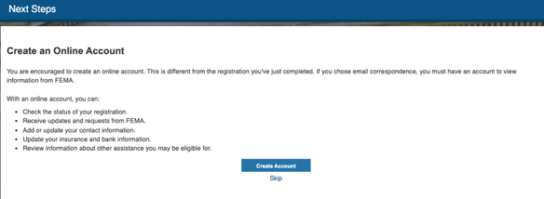
Create an Account
User needs to create an account to proceed with application
Proposed Flow | Related Features on Current Screen
Located after Needs Assessment – You Selected screen. | Located after Conclusion/Registration Submission

Slide 31
Language Changes
Proposed language: Create an Online Account When you create an online account, you can save your work as you fill out the application or pick up where you left off if you need to come back later. An online account also lets you: Check the status of your application. Get messages and requests from FEMA. Add or update your contact information. Update your insurance and bank information. Upload documents. View information about other types of assistance. Read the Privacy Act Statement [hyperlink – see next slide]. *I agree that I have read and accept the Privacy Act Statement. I declare I or someone in my household is a citizen, non-citizen national, or a qualified alien of the United States. [Checkbox] [Opens Privacy Statement and requires user to scroll to the bottom to view the whole statement.] Sign In or Create an Account [Button appears if you click the agreement statement] | Current language: Create an Online Account You are encouraged to create an online account. This is different from the registration you've just completed. If you chose email correspondence, you must have an account to view information from FEMA. With an online account, you can: Check the status of your registration. Receive updates and requests from FEMA. Add or update your contact information. Update your insurance and bank information. Review information about other assistance you may be eligible for. Create Account [Button] Skip [Link]

Slide 32
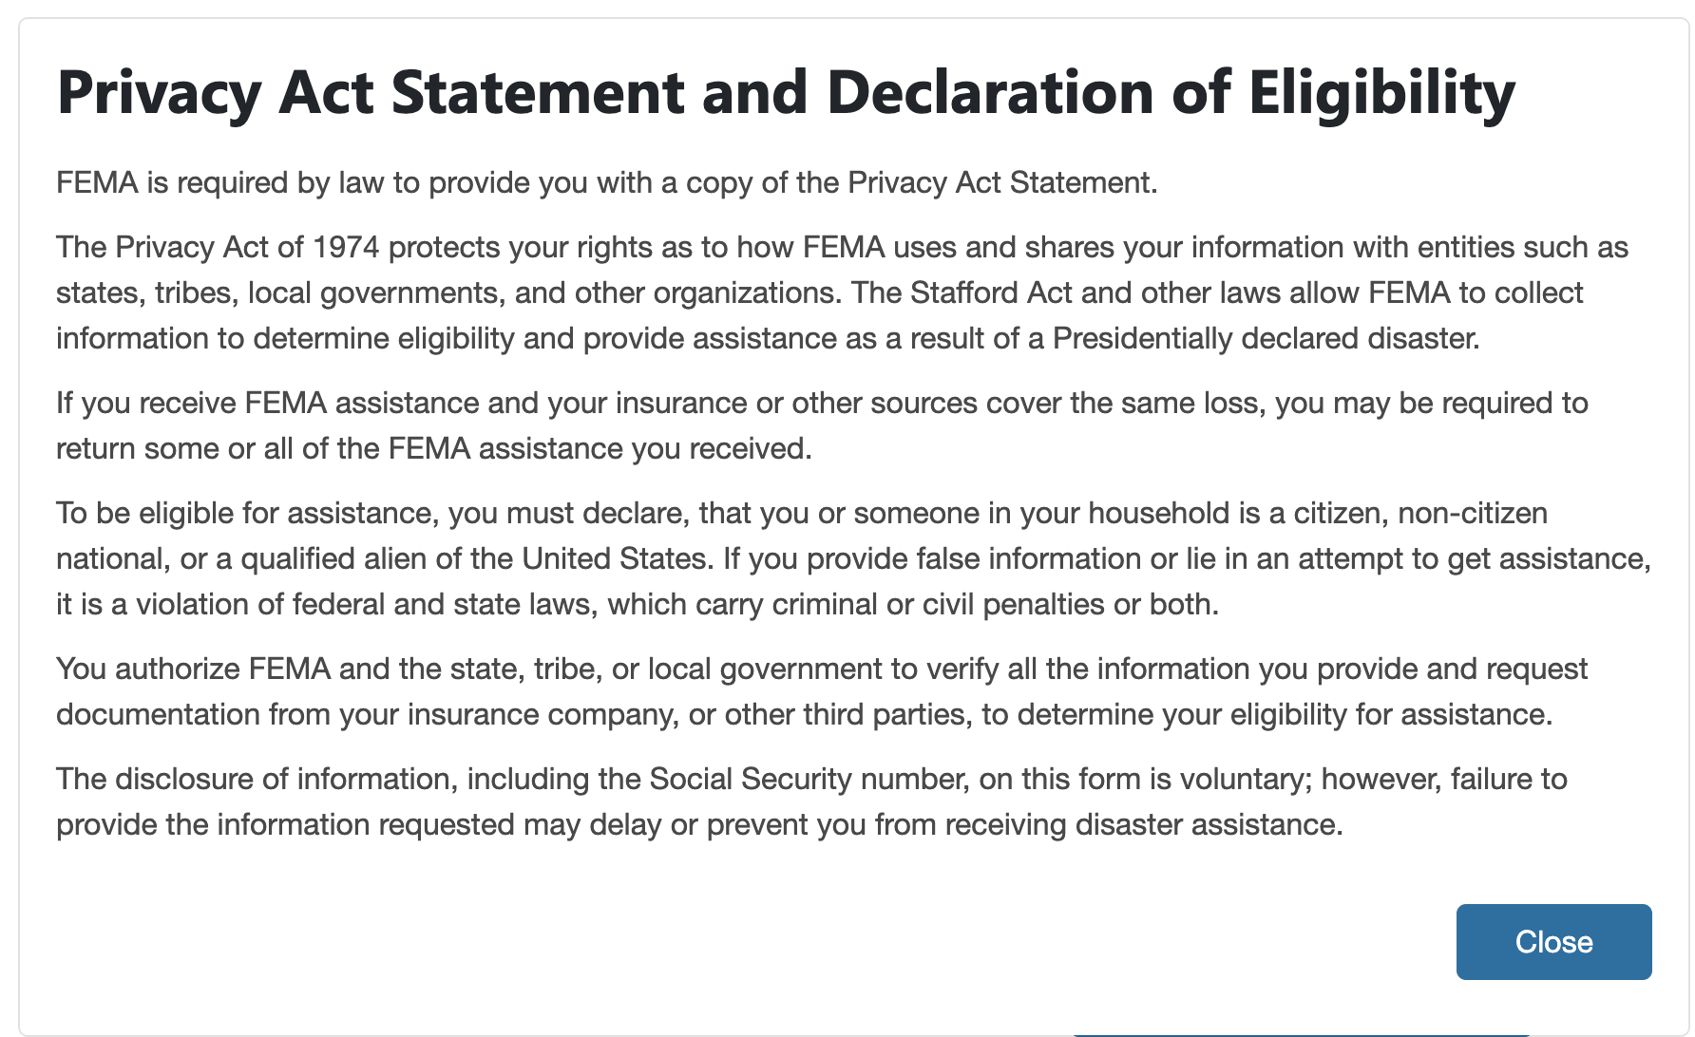
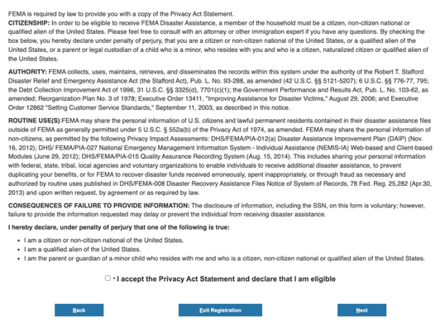
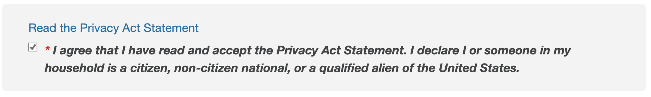
Privacy Act
Required Privacy Act info
Proposed Flow | Related Features on Current Screen
When user clicks on "Read the Privacy Act Statement" on the Account Creation page, they see this pop-up

Slide 33
Language Changes
Proposed language: Privacy Act Statement and Declaration of Eligibility FEMA is required by law to provide you with a copy of the Privacy Act Statement. The Privacy Act of 1974 protects your rights as to how FEMA uses and shares your information with entities such as states, tribes, local governments, and other organizations. The Stafford Act and other laws allow FEMA to collect information to determine eligibility and provide assistance as a result of a Presidentially declared disaster. If you receive FEMA assistance and your insurance or other sources cover the same loss, you may be required to return some or all of the FEMA assistance you received. To be eligible for assistance, you must declare, that you or someone in your household is a citizen, non-citizen national, or a qualified alien of the United States. If you provide false information or lie in an attempt to get assistance, it is a violation of federal and state laws, which carry criminal or civil penalties or both. You authorize FEMA and the state, tribe, or local government to verify all the information you provide and request documentation from your insurance company, or other third parties, to determine your eligibility for assistance. The disclosure of information, including the Social Security number, on this form is voluntary; however, failure to provide the information requested may delay or prevent you from receiving disaster assistance. | Current language: FEMA is required by law to provide you with a copy of the Privacy Act Statement. CITIZENSHIP: In order to be eligible to receive FEMA Disaster Assistance, a member of the household must be a citizen, non-citizen national or qualified alien of the United States. Please feel free to consult with an attorney or other immigration expert if you have any questions. By checking the box below, you hereby declare under penalty of perjury, that you are a citizen or non-citizen national of the United States, or a qualified alien of the United States, or a parent or legal custodian of a child who is a minor, who resides with you and who is a citizen, naturalized citizen or qualified alien of the United States. AUTHORITY: FEMA collects, uses, maintains, retrieves, and disseminates the records within this system under the authority of the Robert T. Stafford Disaster Relief and Emergency Assistance Act (the Stafford Act), Pub. L. No. 93-288, as amended (42 U.S.C. §§ 5121-5207); 6 U.S.C. §§ 776-77, 795; the Debt Collection Improvement Act of 1996, 31 U.S.C. §§ 3325(d), 7701(c)(1); the Government Performance and Results Act, Pub. L. No. 103-62, as amended; Reorganization Plan No. 3 of 1978; Executive Order 13411, "Improving Assistance for Disaster Victims," August 29, 2006; and Executive Order 12862 "Setting Customer Service Standards," September 11, 2003, as described in this notice. ROUTINE USE(S):FEMA may share the personal information of U.S. citizens and lawful permanent residents contained in their disaster assistance files outside of FEMA as generally permitted under 5 U.S.C. § 552a(b) of the Privacy Act of 1974, as amended. FEMA may share the personal information of non-citizens, as permitted by the following Privacy Impact Assessments: DHS/FEMA/PIA-012(a) Disaster Assistance Improvement Plan (DAIP) (Nov. 16, 2012); DHS/ FEMA/PIA-027 National Emergency Management Information System - Individual Assistance (NEMIS-IA) Web-based and Client-based Modules (June 29, 2012); DHS/FEMA/PIA-015 Quality Assurance Recording System (Aug. 15, 2014). This includes sharing your personal information with federal, state, tribal, local agencies and voluntary organizations to enable individuals to receive additional disaster assistance, to prevent duplicating your benefits, or for FEMA to recover disaster funds received erroneously, spent inappropriately, or through fraud as necessary and authorized by routine uses published in DHS/FEMA-008 Disaster Recovery Assistance Files Notice of System of Records, 78 Fed. Reg. 25,282 (Apr.30, 2013) and upon written request, by agreement or as required by law. CONSEQUENCES OF FAILURE TO PROVIDE INFORMATION: The disclosure of information, including the SSN, on this form is voluntary; however, failure to provide the information requested may delay or prevent the individual from receiving disaster assistance. I hereby declare, under penalty of perjury that one of the following is true: I am a citizen or non-citizen national of the United States. I am a qualified alien of the United States. I am the parent or guardian of a minor child who resides with me and who is a citizen, non-citizen national or qualified alien of the United States. * I accept the Privacy Act Statement and declare that I am eligible

Slide 34
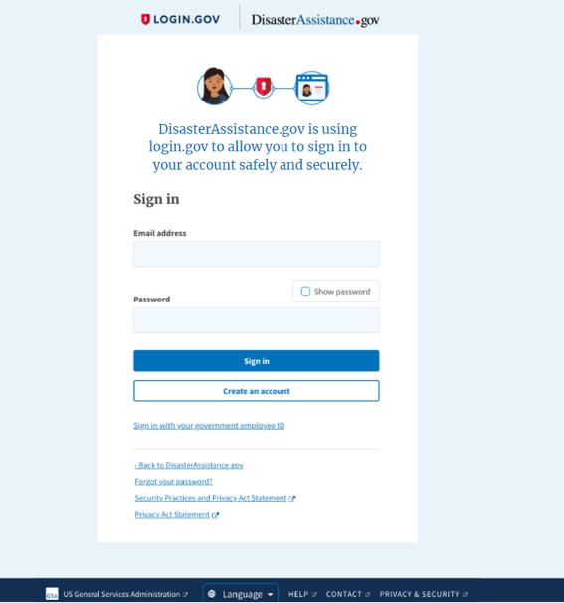
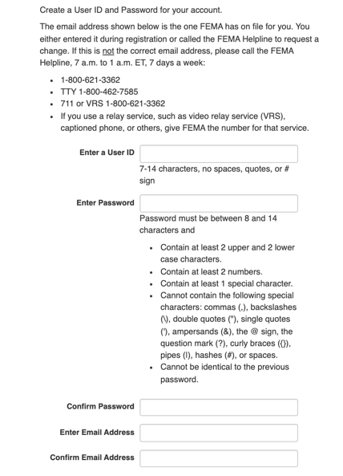
Login.gov
User is now directed to Login.gov to create their account
Proposed Flow | Related Features on Current Screen
Located after Create Account screen
Notes:
New slide

Slide 35
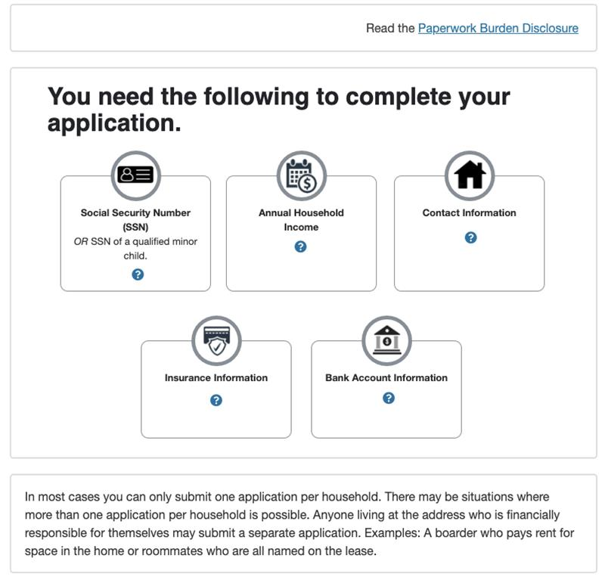
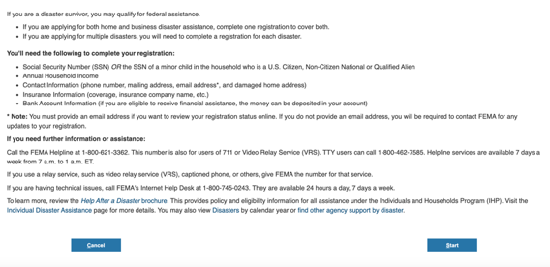
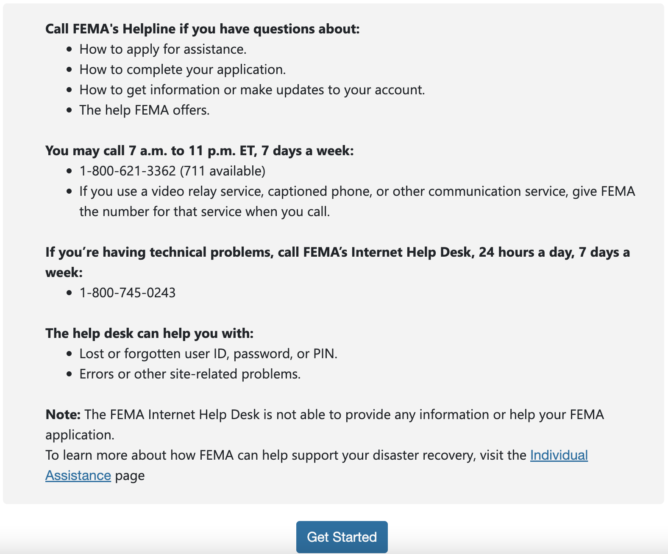
Application Intro
Introduction with details of what the user will need to fill the application as well as some helpful contact numbers
Proposed Flow | Related Features on Current Screen
Located after CAPTCHA | Located after CAPTCHA Note: Statement to submit separate applications for different disasters Sentence about applying for federal assistance found here

Slide 36
Language Changes
Proposed language: Read the Paperwork Burden Disclosure. (hyperlink; example text) You need the following to complete your application: Social Security Number (SSN) OR SSN of a qualified minor child (Minor child must live in the household and be a U.S. citizen, non-citizen national, or qualified alien.) Annual Household Income Contact Information Insurance Information Bank Account Information In most cases you can only submit one application per household. There may be situations where more than one application per household is possible. Anyone living at the address who is financially responsible for themselves may submit a separate application. Examples: A boarder who pays rent for space in the home or roommates who are all named on the lease. Call FEMA's Helpline if you have questions about: How to apply for assistance. How to complete your application. How to get information or make updates to your account. The help FEMA offers. You may call 7 a.m. to 11 p.m. ET, 7 days a week: 1-800-621-3362 (711 available) If you use a video relay service, captioned phone, or other communication service, give FEMA the number for that service when you call. If you’re having technical problems, call FEMA’s Internet Help Desk, 24 hours a day, 7 days a week: 1-800-745-0243 The help desk can help you with: Lost or forgotten user ID, password, or PIN. Errors or other site-related problems. Note: The FEMA Internet Help Desk is not able to provide any information or help with your FEMA application. To learn more about how FEMA can help support your disaster recovery, visit the Individual Assistance page. Get Started [Button] | Current language: If you are a disaster survivor, you may qualify for federal assistance. If you are applying for both home and business disaster assistance, complete one registration to cover both. If you are applying for multiple disasters, you will need to complete a registration for each disaster. You'll need the following to complete your registration: Social Security Number (SSN) OR the SSN of a minor child in the household who is a U.S. Citizen, Non-Citizen National or Qualified Alien Annual Household Income Contact Information (phone number, mailing address, email address*, and damaged home address) Insurance Information (coverage, insurance company name, etc.) Bank Account Information (if you are eligible to receive financial assistance, the money can be deposited in your account) * Note: You must provide an email address if you want to review your registration status online. If you do not provide an email address, you will be required to contact FEMA for any updates to your registration. If you need further information or assistance: Call the FEMA Helpline at 1-800-621-3362. This number is also for users of 711 or Video Relay Service (VRS). TTY users can call 1-800-462-7585. Helpline services are available 7 days a week from 7 a.m. to 1 a.m. ET. If you use a relay service, such as video relay service (VRS), captioned phone, or others, give FEMA the number for that service. If you are having technical issues, call FEMA's Internet Help Desk at 1-800-745-0243. They are available 24 hours a day, 7 days a week. To learn more, review the Help After a Disaster brochure. This provides policy and eligibility information for all assistance under the Individuals and Households Program (IHP). Visit the Individual Disaster Assistance page for more details. You may also view Disasters by calendar year or find other agency support by disaster.

Slide 37
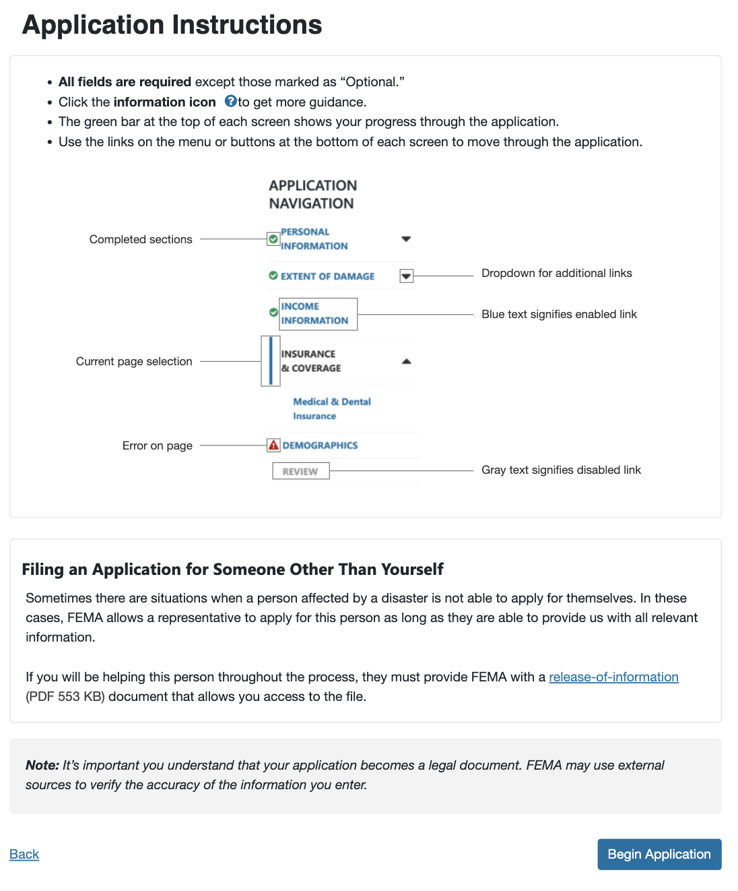
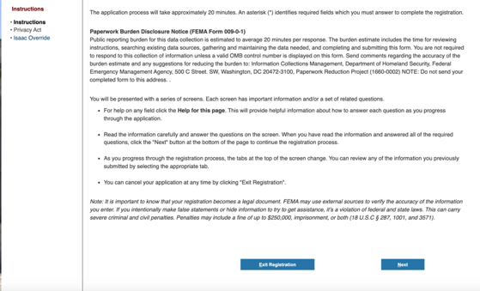
Application Instructions
Application Instructions with graphic for the navigation
Proposed Flow | Related Features on Current Screen
Located after Privacy Act Statement

Slide 38
Language Changes
Proposed language: Application Instructions All fields are required except those marked as “Optional.” Click the information icon to get more guidance. The green bar at the top of each screen shows your progress through the application. Use the links in the menu or buttons at the bottom of each screen to move through the application. (Graphical depiction of form navigation) Filing an Application for Someone Other Than Yourself Sometimes there are situations when a person affected by a disaster is not able to apply for themselves. In these cases, FEMA allows a representative to apply for this person as long as they are able to provide us with all relevant information. If you will be helping this person throughout the process, they must provide FEMA with a release-of-information (PDF, 553 KB) document that allows you access to the file. Note: It’s important you understand that your application becomes a legal document. FEMA may use external sources to verify the accuracy of the information you enter. Begin Application [Button] | Current language: You will be presented with a series of screens. Each screen has important information and/or a set of related questions. For help on any field click the Help for this page. This will provide helpful information about how to answer each question as you progress through the application. Read the information carefully and answer the questions on the screen. When you have read the information and answered all of the required questions, click the "Next" button at the bottom of the page to continue the registration process. As you progress through the registration process, the tabs at the top of the screen change. You can review any of the information you previously submitted by selecting the appropriate tab. You can cancel your application at any time by clicking "Exit Registration". Note: It is important to know that your registration becomes a legal document. FEMA may use external sources to verify the accuracy of the information you enter. If you intentionally make false statements or hide information to try to get assistance, it’s a violation of federal and state laws. This can carry severe criminal and civil penalties. Penalties may include a fine of up to $250,000, imprisonment, or both (18 U.S.C § 287, 1001, and 3571).

Slide 39
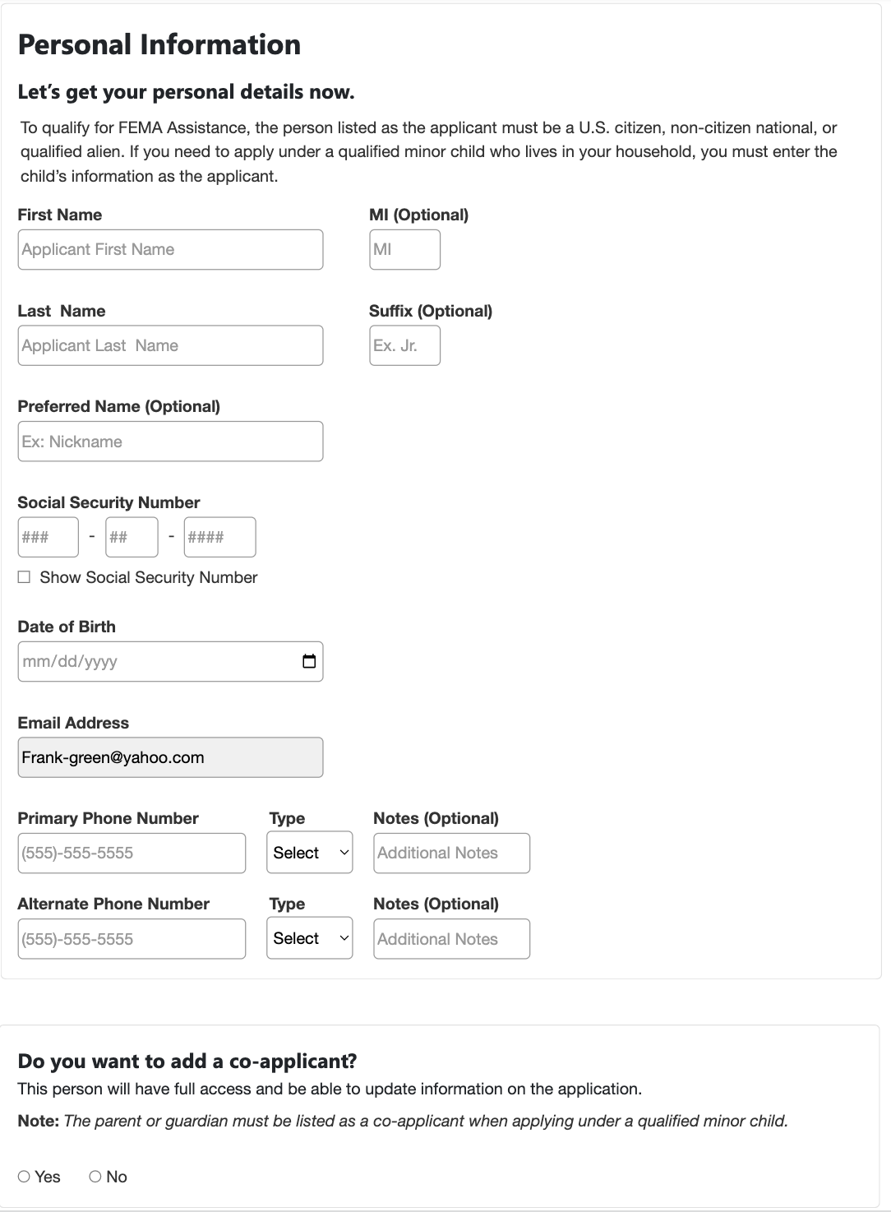
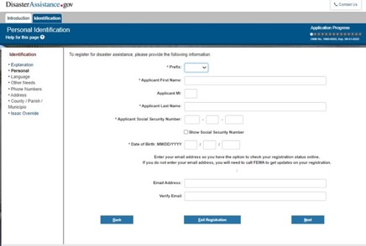


Form PII
User enters in their personal information
Proposed Flow | Related Features on Current Screen
Combined the information from the Personal Identification and Phone screens. Added Co-applicant information to this screen as well

Slide 40
Language Changes
Proposed language: Personal Information Let’s get your personal details now. To qualify for FEMA Assistance, the person listed as the applicant must be a U.S. citizen, non-citizen national, or qualified alien. If you need to apply under a qualified minor child who lives in your household, you must enter the child’s information as the applicant. First Name [Text Field] MI (Optional) [Text Field] Last Name [Text Field] Suffix (Optional) [Text Field] Preferred Name (Optional) [Text Field] Social Security Number [Text Field] Show Social Security Number [Checkbox] Date of Birth [Text Field] Email Address [Text Field] Primary Phone Number [Text Field] Type [Dropdown] Cell Home Office Other Notes (Optional) [Text Field] Alternate Number (Optional) [Text Field] Type [Dropdown] Cell Home Office Other Notes (Optional) [Text Field] Do you want to add a co-applicant? This person will have full access and be able to update information on the application. Note: The parent or guardian must be listed as a co-applicant when applying under a qualified minor child. Yes No [Radio Buttons] First Name [Text Field] MI (Optional) [Text Field] Last Name [Text Field] Suffix (Optional) [Text Field] Preferred Name (Optional) [Text Field] Social Security Number (Optional) [Text Field] Show Social Security Number [Checkbox] Co-Applicant Date of Birth [Text Field] | Current language: To register for disaster assistance, please provide the following information: * Prefix: MR/MS * Applicant First Name: Applicant MI: * Applicant Last Name: * Applicant Social Security Number: Show Social Security Number * Date of Birth: MM/DD/YYYY Enter your email address so you have the option to check your registration status online. If you do not enter your email address, you will need to call FEMA to get updates on your registration. Email Address: Verify Email Please provide the phone number used in the damaged dwelling whether it is working or not and current/alternate phone number(s) in case we need to contact you regarding your registration for disaster assistance. Damage Dwelling Phone: My Current Phone is the same as my Damaged Dwelling Phone - If selected, please do not provide Current Phone. Current Phone: Cell Phone: Alternate Phone: Note: adding a co-applicant question requesting the information at this point. The reason for the change is that not all flows/scenarios will ask for occupant information and that is currently where the co-app is entered.

Slide 41


Form PII Funeral
User enters in their personal information. Text in red appears if funeral expenses was checked off.
Proposed Flow | Related Features on Current Screen
Located after Application Intro

Slide 42
Language Changes
Proposed language: Personal Information Let’s get your personal details now. If you are applying for funeral expenses, we are sorry for your loss. To apply for funeral assistance, use the name and Social Security number (SSN) of the person responsible for the deceased person’s funeral costs. First Name [Text Field] MI (Optional) [Text Field] Last Name [Text Field] Suffix (Optional) [Text Field] Preferred Name (Optional) [Text Field] Social Security Number [Text Field] Show Social Security Number [Checkbox] Date of Birth [Text Field] Email Address [Text Field] Primary Phone Number [Text Field] Type [Dropdown] Cell Home Office Other Notes (Optional) [Text Field] Alternate Number (Optional) [Text Field] Type [Dropdown] Cell Home Office Other Notes (Optional) [Text Field] Do you want to add a co-applicant? This person will have full access and be able to update information on the application. If another person also paid for funeral costs, they should be included as the co-applicant. Yes No [Radio Buttons] First Name [Text Field] MI (Optional) [Text Field] Last Name [Text Field] Suffix (Optional) [Text Field] Preferred Name (Optional) [Text Field] Social Security Number (Optional) [Text Field] Show Social Security Number [Checkbox] Co-Applicant Date of Birth [Text Field] | Current language: Personal Identification To register for disaster assistance, please provide the following information: * Prefix: [Dropdown] MR / MS * Applicant First Name: [Text Field] Applicant MI: [Text Field] * Applicant Last Name: [Text Field] * Applicant Social Security Number: [Text Field] Show Social Security Number [Checkbox] * Date of Birth: MM/DD/YYYY / [Text Field] Enter your email address so you have the option to check your registration status online. If you do not enter your email address, you will need to call FEMA to get updates on your registration. Email Address: [Text Field] Verify Email [Text Field] Contact Phone Numbers Please provide the phone number used in the damaged dwelling whether it is working or not and current/alternate phone number(s) in case we need to contact you regarding your registration for disaster assistance. Damage Dwelling Phone: My Current Phone is the same as my Damaged Dwelling Phone - If selected, please do not provide Current Phone. Current Phone: Cell Phone: Alternate Phone: Note: adding a co-applicant question requesting the information at this point. The reason for the change is that not all flows/scenarios will ask for occupant information and that is currently where the co-app is entered.

Slide 43







Form Address
User enters information on the address where damage occurred
Proposed Flow | Related Features on Current Screen
Located after PI screen
Home Type –
Owner Options
Home Type –
Renter Options

Slide 44
Language Changes
Proposed language: Where Did Your Losses Occur? Enter the full physical street address of your home. Include the house or building number, the street name, and any unit number. Do not abbreviate street names or enter a P.O. Box. ZIP Code [Text Field] ZIP +4 (Optional) [Text Field] Street Address [Text Field] Unit # (Optional) [Text Field] City [Text Field] State [Text Field] County, Parish, Municipality, Tribal Nation [Text Field] What type of home was damaged? [Drop Down] Boat Condo House-Single/Duplex Mobile Home Townhouse Travel Trailer Other Do you own or rent this home? [Radio Buttons] Own Rent Is this your current mailing address? (If you get your mail at a P.O. Box, select No.) Yes No [Radio Buttons] [If No is selected, the following will appear] Enter the full physical street address or a P.O. box where you can get your mail. Include the house or building number, street name, and any unit number. Do not abbreviate street names. In Care Of [Text Field] ZIP [Text Field] Street Address [Text Field] Unit # [Text Field] City [Text Field] State [Text Field] | Current language: Please provide the full physical street address where the damage occurred, including the house or building number, the street name and any apartment or lot number. Do not abbreviate street names or enter a PO Box. Use the information in the Help for this page (located at the top of the page) if: You have an uncommon address (no street name, house number, city, etc,) OR Your mailing address is different from your home address * ZIP ZIP+4 [Text Field] * Street Address [Text Field] * City [Drop-down] *State [Drop-down] * Do you own this home or do you rent it? Own Rent [Drop-down] Is the address above also your mailing address? [Drop-down] (If you receive your mail at a P.O. Box, please select No) ___ Please provide the full physical street address or a PO Box where you receive your mail. When entering a street address, include the house or building number, street name and any apartment or lot number. Do not abbreviate street names. In Care Of [Text Field] * ZIP ZIP+4 [Text Field] * Street Address [Text Field] * City [Drop-down]

Slide 45






Extent of Damage
User selected the extend of damage
Proposed Flow | Related Features on Current Screen

Slide 46
Language Changes
Proposed language: Extent of Damage You said your home or personal property were damaged. We would like to know the type of damage the disaster caused. Read each option carefully and select the one that most applies to you. Minor Damage I have minor damage, but I’m able to live in my home. Some damage to or missing roof shingles, siding, gutters, etc. Some cracked or broken windows. Minor cracks in floor, walls, or ceilings. Flood water or sewer backup entered my home but was less than 3 inches deep. Cleaning supplies and equipment OR professional services are needed to clean and sanitize my home. Moderate Damage I have moderate damage that requires a lot of repairs. I may not be able to live in my home. Flood water entered my home and was between 3 inches and 2 feet deep. Damage to roof covering (shingles or metal) caused damage inside my home. Damage to exterior doors, windows, siding, or foundation. Damage to well, septic, or HVAC (central air and heat). Damage to accessibility aids (lift, ramp, etc.) prevents safe access. Debris or over-hanging trees prevent safe access. Damage to or loss of some household appliances or furnishings. Major Damage I have major damage that requires substantial repairs. I’m not able to live in my home. Flood water entered my home and was above 2 feet deep on first occupied floor. Major structural damage to roof, ceilings, walls, or foundation. Damage to private road or bridge prevents access to my home. Immediate threat to my home’s stability from landslide or erosion. Loss of most or all appliances and furnishings. Unsafe to live in until completion of home repairs. Complete Loss My home is a complete loss. Leveled or completely collapsed. Washed away. Burned to the ground. Beyond repair, there’s no saving my home. Unsure I’m unsure or have unknown damage to my home. Unsure which option best fits my damage. Can’t get to or access my home to see damage. I left my home under mandatory evacuation, don't know the damage. | Current language: You indicated your home or personal property was damaged. FEMA would like to understand the damage the disaster caused. Please read each option and select the one that best matches your situation. If, after reading the options, you are unsure about what category your damage falls under, you may ask for examples. [Please click Help for this page for examples.] I had minor damage, but I am able to live in my home. Some damaged or missing roof shingles, siding, gutters, etc. Some cracked or broken window glass. Minor cracks in floor, walls, or ceilings. Flood water or sewer backup entered my home, but was less than 3 inches deep. You need(ed) to purchase cleaning supplies and equipment to clean and sanitize your home OR hire(d) a professional to do so. I had damage to my home or personal property that requires a lot of repairs. I may not be able to live in my home. Flood water entered my home, and was between 3 inches and 2 feet deep. Damage to roof covering (shingles or metal) that resulted in interior damage. Damage to exterior doors, windows, siding, or foundation. Damage to well, septic, or HVAC (central air and heat).Debris or over-hanging trees that prevents safe access to my home. Loss of or repair to some household appliances or furnishings. I had damage to my home or personal property that requires major repairs. I am not able to live in my home. Flood water was above 2 feet deep on first occupied floor. Major structural damage to roof, ceilings, walls, or foundation. Private road or bridge damage that prevents access to my home. An immediate threat to the stability of the home due to land slide or erosion. Lost most or all appliances and furnishings. My home was completely destroyed. Home was leveled or completely collapsed. Home was washed away. Home was burned to the ground. Unknown Unsure which category best describes my damages. Mandatory evacuation and don't know damages. Please provide the following information about the damaged dwelling Where are you currently living or staying? (Drop-down) My Home, Family/Friends, Motel/Hotel, Mass Shelter, Church/House of Worship, Homeless, FEMA provided unit, New Permanent Rental, New Temporary Rental, Purchased New Home, Place of Employment, RV/Camper, Secondary Residence, My Vehicle, Tent What type of home are you registering? (Home Type -Owner) Boat, Condo, House- Single/Duplex, Mobile Home, Other, Townhouse, Travel Trailer Home Type- Rental) Apartment, Assisted Living Facility, Boat, College Dormitory, Condo, Correctional Facility, House- Single/Duplex, Military Housing, Mobile home, Other, Townhouse, Travel Trailer Are you currently able to get to your home?(Radio buttons) Yes, I am able to get to my home I am unable to return to my home due to mandatory evacuation. I am unable to return to my home because damages to the roads or bridges in the area prevent it.

Slide 47




Extent of Damage
User indicated their level of Home Accessibility
Proposed Flow | Related Features on Current Screen
Moving & Storage is a new catergory

Slide 48
Language Changes
Proposed Language: Home Accessibility Are you safely able to get to your home or leave if you need to? Yes, I am able to both get to and leave my home. [Radio button] No, I can’t, because of flooding or damage to public roads, bridges, or docks. [Radio button] No, I can’t, because of damage to a privately-owned road, bridge, or dock. [Radio button] No, I can’t, because my medical or accessibility features are damaged. (Such as a ramp, elevator, etc.) [Radio button] No, I can’t, due to mandatory evacuation. [Radio button] Where are you currently staying? [Drop-down menu] My Home Family or Friends Hotel or Motel Mass Shelter Church or House of Worship Homeless FEMA-provided Unit New Permanent Rental New Temporary Rental Place of Employment Bought a New Home RV or Camper Second Home My Vehicle Tent If your housing situation changes, sign in to your account or contact FEMA to update your application. You said you have temporary lodging expenses. Do you get assistance with temporary lodging expenses from any other source? This may include homeowners insurance, voluntary organizations, etc. Yes No I don’t know [radio buttons] FEMA may be able to help with moving and storage expenses if the disaster caused you to move. Eligible expenses include costs to move and store furniture while repairing your damaged home. Or costs to move from a damaged home or apartment to a new or temporary home. FEMA does not assist with any costs to move or store items to avoid damage before the disaster. Do you have a need for help with moving and storage expenses after the disaster? Yes No [radio buttons] | Current Language: Where are you currently living or staying? [Drop-down menu] My Home Family/Friends Hotel/Motel Mass Shelter Church/House of Worship Homeless FEMA-provided Unit New Permanent Rental New Temporary Rental Purchased New Home Place of Employment RV or Camper Second Residence My Vehicle Tent Are you currently able to get to your home? Yes, I am able to get to my home [Radio Button] I am unable to return to my home due to a mandatory evacuation. [Radio Button] I am unable to return to my home because damages to the roads or bridges in the area prevent it. [Radio Button]

Slide 49


Extent of Damage
User enters their Critical Needs
Proposed Flow | Related Features on Current Screen

Slide 50
Language Changes
Proposed Language: Critical Needs Do you need money to help with any of the following critical needs? Check all that apply. [Checkboxes] Costs to get to a shelter or other place, because my home is unsafe Infant formula, diapers, personal hygiene items, or gas Water, food, medication, or durable medical equipment I don’t have any critical needs. | Current Language: Do you have any immediate needs for evacuation expenses such as clothing, medication, gas, etc? If yes, please indicate which needs you have below. Please note: Reimbursement for stored food is not an eligible item. Emergency Needs I have a disaster related emergency need for food, medication, durable medical equipment or gas. [Check Box] I have a disaster related emergency need for shelter. [Check Box] I have a disaster related emergency need for clothing. [Check Box]

Slide 51


Form Utilities
User enters their experience with utilities.
Proposed Flow | Related Features on Current Screen

Slide 52
Language Changes
Proposed language: Essential Utilities Did the disaster cause your utilities to be out for 3 or more days? Yes No I don’t know [Radio Buttons] Are your utilities out now? Yes No I don’t know [Radio Buttons] | Current language: Essential Utilities Have your essential utilities been out for 3 days or more due to the disaster? ( Yes or No radio button) Are your essential utilities currently our due to the disaster? (Yes, No, Or Unknown Radio Button) Are your essential utilities privately owned (I.e., well or septic) or publicly owned? (Private, Public, Unknown Radio Button)

Slide 53




Form Insurance - Home
User enters home insurance information
Proposed Flow | Related Features on Current Screen

Slide 54
Language Changes
Proposed language: Home Insurance Now we need to know the type of insurance you have. Check all that apply. Note: You may give us the insurance company name later if you don’t have it right now. [Checkboxes] Homeowner’s Insurance Homeowners Insurance with a Sewer Backup Rider Renter’s Insurance Flood Insurance Condo or Townhouse Unit Insurance Condo or Townhouse Unit Insurance with an Earthquake Rider Mobile Home Insurance Contents Only Insurance Earthquake Contents Insurance Earthquake Structure Insurance I don’t have home or personal property insurance [Warning text appears if user has previously said they own the home, and, on this screen selects "I don't have home or personal property] You said you own your home, but now say you don’t have insurance. If you have a mortgage, it’s likely you also have insurance. If you’re certain you don’t have insurance, you must check the box below to confirm. Please review your answers and change them if you need to. *I confirm that I do not have any of the following insurance on my home or personal property: contents only insurance, flood insurance, homeowners insurance, homeowners insurance with a sewer backup rider, mobile home insurance, or personal property insurance. | Current language: *What type of insurance do you currently have for your Home and/or Personal Property? Contents Only Insurance Flood Insurance Homeowners Insurance Mobile Home Insurance I have no insurance for my home or personal property. Previously you told us that you owned your home but now you are indicating that you have no homeowners insurance. Since most home owners have a mortgage, this seems unlikely. Please review your answers and modify it if applicable. If you are certain that you do not have insurance, you must check the box immediately below to affirm that fact Under penalty of perjury, I affirm that I do not have any of the following insurance on my home or personal property: Contents Only Insurance, Flood Insurance, Homeowners Insurance, Homeowners Insurance with a Sewer Backup Rider, Mobile Home Insurance, or Personal Property Insurance.

Slide 55







Form Occupants
User indicates if there is another occupant they are applying for
Proposed Flow | Related Features on Current Screen

Slide 56
Language Changes
Proposed language: Occupants We need to know about everyone living in your home at the time of the disaster. We use your occupant information to identify and process the assistance you need, so it must be as accurate as possible. Include the names of everyone who considers this to be their main home, even if they submitted a separate application. This may include boarders, children, landlords, students, roommates, etc. Include full-time students who consider this to be their main home, even if they live at school. DO NOT include anyone who was just visiting at the time and lives elsewhere. Click Add Occupant below to add each person separately. Add Occupant First Name: MI (Optional): Last Name: Relationship to Applicant (drop-down): Boarder, Co-applicant, Friend or Relative, Immediate Family, Landlord, Other Age: [If Funeral expenses are also selected, user will see additional screen for adding deceased person information] For funeral or reburial expenses, please provide information for each deceased person. Click Add Deceased Person below to add each person separately. Add Deceased Person [Button] | Current language: Occupants Information You can only submit one application per household, but now we need to know about everyone living in your home at the time of the disaster. We use your occupant information to identify and process the assistance you need, so it must be as accurate as possible. Include a co-applicant only if you want to allow them to have full access to your application, just like you have. A co-applicant is able to request status and update information on the application. Include the names of everyone who considers this to be their primary home. This may include: boarders, children, landlords, students, etc. Include full-time students who consider this to be their primary home, even if they live at school. DO NOT Include anyone who was just visiting at the time and lives elsewhere. If you’re not sure who to list, please click Help for this page for more details. You must click Add below to add each person separately. Note: You must enter a Social Security number (SSN) only for the co-applicant. Do not add SSNs for anyone else. If you need to make any changes, just click Edit next to the name you need to update. If you need to remove someone from this list, just click Delete on the line with their name. Add Edit Last Name – First Name – MI – Relationship – Social Security Number – Age – This will need to change to whatever the new “help” link will be. Occupants Please list all the people living in your home at the time of the disaster. If you are unsure who to list as an occupant, please click the Help for this page for more information. The occupant information is used to identify and process the type(s) of assistance you need. It is important this information is as accurate as possible. Each person will have to be added separately using the “Add” button below. Add Edit. Last Name. First Nam. MI. Relationship. Social Security Number. Age. Delete Update Occupant Enter household occupant information below. NOTE: ONLY the co-applicant’s Social Security Number (SSN) I required. Please do not add social Security Numbers (SNNs) for any other occupants. What is this person’s last name? What is this person’s first name? What is this person’s middle initial? What is the relationship you have with this person? (drop-down): Boarder, Co-Applicant, Friend/Relative, Immediate Family, Landlord, Other What I this person’s age?

Slide 57




Form Disability Needs
Disability questions
Proposed Flow | Related Features on Current Screen

Slide 58
Language Changes
Proposed language: Disability Needs The Americans with Disabilities Act (ADA) defines disability as "a physical or mental impairment that substantially limits one or more of the major life activities of such individual," 42 USC 12102(2)(A). If this definition applies to you or someone in your household , select Yes. If yes, select all disabilities that apply or select Prefer Not to Answer. Do you or anyone in your household have a disability? This includes any condition that affects your ability to perform activities of daily living or requires an assistive device. Yes No [Radio Buttons] Check all that apply. Mobility Cognitive or Developmental Disabilities Mental Health Hearing or Speech Vision Self-care Independent Living Other Prefer Not to Answer Did the disaster damage, disrupt, or cause you loss of any assistive devices or medically required equipment, supplies, or support services? Yes No [Radio Buttons] Check all that apply. Power or manual wheelchair Scooter Prosthesis Oxygen or respiratory equipment Medical equipment that depends on electricity Assistive technology device for hearing or vision, such as hearing aid, screen enlarging software, etc. Personal-care devices such as shower bench, bedside commode, Hoyer lift, or lift chair Environmental control or alerting devices Adaptive van or vehicle Walker, cane, or crutches Medication or medical supplies including adult briefs and catheters Service animal Personal assistance services or in-home care Dialysis Other | Disability Needs Do you or anyone in your household have a disability that affects your ability to perform activities of daily living or requires an assistive device? (NOTE: An assistive device can include wheelchair, walker, cane, hearing aid, communication device, service animal, personal care attendant, oxygen, dialysis, etc.) (drop-down Yes/No) Please select from the following the disability that affects your ability to perform activities of daily living (select all that apply). Mobility , Cognitive/Developmental Disabilities, Mental Health, Hearing or Speech, Vision, Self-Care, Independent Living, Other (fill in), Prefer Not to Answer Did you have any disability-related assistive devices or medically required equipment/supplies/support services damaged, destroyed, lost, or disrupted because of the disaster? (drop-down Yes/No) What was damaged, destroyed, lost, or disrupted because of the disaster? (select all that apply) Power or manual wheelchair, Scooter, Prothesis, Oxygen or respiratory equipment, Medical equipment that depends on electricity, Assistive technology device for hearing or vision, such as hearing aid, screen enlarging software, etc. , Personal-care devices such as shower bench, bedside commode, Hoyer lift, or lift chair , Environmental control or alerting devices, Adaptive van or vehicle , Walker, cane, or crutches, Medication or medical supplies including adult briefs and catheters, Service animal , Personal assistance services/in-home care, Dialysis, Other

Slide 59





Vehicle Damage
User enters their indicated vehicle damage information
Proposed Flow | Related Features on Current Screen
Located after disability needs screens if vehicle damage is selected

Slide 60
Language Changes
Proposed language: Vehicle Damage How many total vehicles does your household have? This should include only vehicles that were drivable before the disaster. [Number Field] After the disaster, how many of those vehicles are drivable? [Number Field] Please provide a full list of ALL vehicles owned by you and everyone in your household that were drivable before the disaster. You must add each vehicle separately. Add Vehicle Year [Text Field] Make [Text Field] Model [Text Field] Was it damaged by disaster? [Radio Button] Yes/No Is it drivable? [Radio Button] Yes/No Is it registered? [Radio Button] Yes/No Is it covered by comprehensive (full coverage) insurance? [Radio Button] Yes/No (if Yes) Insurance Company Name (Optional) Is it covered by liability insurance? [Radio Button] Yes/No (if Yes) Insurance Company Name (Optional) Does it have any accessibility related features? These may include wheelchair lifts and ramps, pedal or seatbelt extenders, hand-control and steering devices, etc. [Radio Button] Yes/No | Current language: Damaged Vehicle(s) How many vehicles does your household own that were drivable before the disaster? -1 -2 -3+ Did any of the damaged vehicles have disability related accessibility features (i.e., wheelchair lifts and ramps, pedal or seat belt extenders, hand control and steering devices, etc.)? ○ Yes ○ No Vehicle Please provide a full list of all vehicles owned by you or anyone in your household. Add Button Edit Year Make Model Damaged Drivable Comprehensive Insurance Liability Insurance Registered Delete Update Vehicle Enter information about each vehicle in the household separately. Year Make Model Was this vehicle damaged by the disaster? (Yes No) Is this vehicle currently drivable? (Yes No) Is this vehicle covered by comprehensive (full coverage) insurance? (yes No) What is the insurance company name? Is this vehicle covered by liability insurance? (Yes No) Is this vehicle currently registered? (Yes No)

Slide 61

Form Confirm Needs
User confirms their needs
Proposed Flow | Related Features on Current Screen
 | New screen.
Located after insurance forms
This screen will only appear if the hasn’t selected all the Needs

Slide 62
Language Changes
Proposed language: Confirm Your Needs Before you complete your application, do you have any other disaster losses you need assistance with? Check all that apply. [checkboxes] Personal property damage (Example: furniture, electronic equipment, etc.) Lodging expenses (Example: hotel, motel, etc.) Medical or dental expenses Funeral or reburial expenses New or additional child care costs I don’t need any other assistance right now. (You may call the FEMA Helpline to update your application later if you find other needs.) | N/A
This screen will only appear if the hasn’t selected all the Needs

Slide 63



Form Income Info
User enters income information
Proposed Flow | Related Features on Current Screen
Located after child care/vehicle if selected, or after essential utilities | Located after Child Care.

Slide 64
Language Changes
Proposed language: Income Information Your household annual gross income is the combined amount of all income before any deductions. This includes wages, unemployment payments, Social Security, assistance from other government agencies (except Supplemental Nutrition Assistance Program [SNAP] benefits), child support, stocks, interest, annuities, etc. Please give us your household’s pre-disaster annual gross income. This reduces processing time and directs your application to the best programs to meet your needs. What is your household's pre-disaster annual gross income? Enter numbers only. No dollar signs, no commas, no decimal point or cents. Example: Enter income as "55000" NOT "55,000.00" [Text Field] Is your household’s main source of income from self-employment? Yes No [Radio Button] How many dependents do you have, including yourself? [Text Field] | Current language: Financial Information This next section is about your household income and business information before the disaster. Income Your household annual gross income is the amount before any deductions are subtracted. This includes wages, unemployment payments, social security, welfare, child support, stocks, interest, annuities, etc. Please provide your household annual gross income at the time of the disaster, and your choice for electronic funds transfer. Providing us with your pre-disaster annual gross income, reduces the processing time and directs your application to the programs best suited to meet your needs. How many dependents do you have including yourself? [Textbox] Before Taxes are deducted, what is your family's pre-disaster income? Enter numbers only, no dollar signs, no commas, no decimal point or cents. Example: Enter income as "55000" NOT "55,000.00“ [Textbox] If you are found eligible for FEMA assistance, would you like funds directly deposited into your bank account? There is no charge for this service Yes/No

Slide 65



Form Bank Information
Direct Deposit is now Bank Information page.
Proposed Flow | Related Features on Current Screen
Located after confirming your needs | Direct Deposit located after Text Messaging page. EFT located after direct deposit page.

Slide 66
Language Changes
Proposed language: If you qualify for assistance, you can choose to have us transfer money directly to your account. You need to enter your account information, including routing number, for FEMA to deposit money into your account. If you don’t have this information now, you can provide it later. This is the fastest and most reliable way to receive FEMA assistance. If you prefer to receive money by check, you can choose to have us send a check by mail. Note: If you request direct deposit to an account other than checking or savings – for example, a pre-paid card – your payment may be delayed. If you qualify for FEMA assistance, how do you want to get your money? There is no fee for direct deposit. Direct Deposit or other direct payment options Check in the mail. [Radio Buttons] Name of your bank or financial institution [Text Field] Type of Account[Radio Button] Checking Savings Other 9-digit Routing Number [Text Field] Account Number[Text Field] Verify Account Number: [Text Field] | Current language: If you are eligible for assistance, you can choose to have the funds transferred directly to your bank account. You will need to provide your bank account information, including routing numbers to complete the direct transfer. Or, you can receive a check in the mail. You will not need to include your bank information. NOTE: If you request the funds be transferred to an account other than checking or savings – for example a pre-paid card – your payment may be delayed. *If you are found eligible for FEMA assistance, would you like funds directly deposited into your bank account? There is no charge for this service. (Dropdown) ___ You have chosen to participate in direct deposit. The name on the identified checking or saving accounts must match the applicant or co-applicant. You must have a valid routing number and account number; FEMA cannot deposit funds to a pre-paid card. *What is the name of your bank or financial institution? (Text Field) *What type of account is this? (Checking or Savings dropdown) (Text Field) *What is the 9 digit routing number for this account? (Text Field) *What s the account number? (Text Field) *Please repeat the account number. (Text Field)

Slide 67





Notification Preferences
Letters and Documents is an informational page describing notification methods. These descriptions have been combined with the Notifications Preferences page.
Proposed Flow | Related Features on Current Screen
Located after Bank Information page. | Located after Financial Information.

Slide 68
Language Changes
Proposed language: Choose how you want to get alerts and information from FEMA. Language English, Spanish [Drop-down] Delivery Method [Radio buttons] Postal Mail Email/Online Account (If user picks email) You chose to get notifications by email. This means you will not get any documents by postal mail. Email will alert you when you have new information in your account. Email Address Provided: [Pre-Pop email] Would you also like to get text notifications? (radio buttons) Yes No (If yes, the following appears) You chose to get text notifications. You will get a text message from 43362 to confirm your request. Phone Number Provided [Pre-Pop Phone Number] Text Message Terms • FEMA texts do not replace postal mail or email. • FEMA’s text messaging number is 43362. o Note: You may also get a text from a FEMA inspector to schedule an appointment. • Standard text message rates apply. * I accept the text messaging service terms. [Checkbox] | Current language: Correspondence Preferences How would you like to receive alerts from FEMA? [Drop-down] English, Spanish Do you prefer to receive traditional postal mail or electronic notification? (radio buttons) Postal Mail E-mail (If user picks email) You have chosen to receive e-mail updates from FEMA. You will not receive any FEMA updates by postal mail. You must create a Disaster Assistance account to receive email updates. You will need to go to DisasterAssistance.gov to create an account. Please provide your E-mail address. [Text box] Email Address [Text box] Verify E-mail Address SMS Correspondence Summary *Would you like to receive additional updates using text messaging? (Yes/no radio buttons) If yes is selected, the following appears: You choose to receive text messages from FEMA. You will get a text message from 4FEMA (43362) to confirm your request. Please verify the mobile phone number to be used: [Drop-down] *Mobile Phone Number (Previous) *Mobile Phone Number: *Verify Mobile Phone Number: - FEMA text messages do not replace postal mail or e-mail - FEMA’s text messaging number is 4FEMA (43362). Please note that you may also receive a text message from a FEMA inspector to schedule an appointment for your inspection. -Standard text message rates apply. *Do you agree to the terms of text messaging? (radio buttons) - Yes, I agree to the terms of text messaging and want to receive status notifications, - No, I do not agree to the terms of text messaging, I understand I will not receive status notifications.

Slide 69



Additional Needs
User enters any additional needs
Proposed Flow | Related Features on Current Screen
Located after notification preference screen

Slide 70
Language Changes
Proposed language: Do you have a disability or language need that may require help to communicate with FEMA staff or access our programs and services? What do you need? Check all that apply. I don’t have any other needs. Assistive listening device Braille CART (Communication Access Real-time Translation in person or remote) Face-to-face assistance (reader or writer) Language other than English [drop-down] (Select a language- Arabic/Haitian/ Creole/Mandarin/Other/Russian/Samoan/Spanish/Vietnamese ) Large print Sign language interpreter Text messages to communicate Wheelchair access Other [Text field] | Current language: * Do you have a disability or language need that requires an accommodation to interact with FEMA staff and/or access FEMA programs? No / Yes What do you need? (please select all that apply) Sign language interpreter CART (Communication Access Real-time Translation) (in person or remote) Text messages to communicate Assistive listening device Braille Large print Face-to-face assistance (reader or writer) Wheelchair access Language other than English Arabic/Haitian/ Creole/Mandarin/Other/Russian/Samoan/Spanish/Vietnamese Other

Slide 71








Demographics
When the Registrant indicates “Yes” to provide demographic data on the Demographics page; Demographic questions are displayed.
Proposed Flow | Related Features on Current Screen
Located after Additional Needs page. | Privacy Act Statement – Demographics is located after Electronic Transfer Funds page. Demographics is located after Privacy Act page.

Slide 72
Language Changes
Proposed language: Demographics We are collecting this information to analyze demographic data only. The answers you provide do not affect your ability to get assistance. Are you willing to provide demographic data? Yes No [Radio Button] Are you Hispanic or Latino? This is a person of Cuban, Mexican, Puerto Rican, South or Central American, or other Spanish culture or origin, regardless of race. Yes No Prefer not to answer [Radio Button] What race(s) do you most identify with? Check all that apply. (Checkbox) American Indian or Alaskan Native, Asian, Black or African American, Native Hawaiian or Other Pacific Islander, White, Prefer not to answer What is your gender? (Drop-down) Female, Male, Another Identity (e.g. transgender, non-binary, or gender variant), Prefer not to Answer Are you an enrolled member of a Tribal Nation? Yes No Prefer not to answer [Radio Button] What is your highest level of education? (Drop-down) Did not complete high school, High school graduate GED, Some college, Associate’s Degree, Bachelor’s Degree, Master’s Degree, Doctoral Degree, Prefer not to answer What is your marital status? (Drop-down) Divorced, Married or living with partner, Never married, Separated, Widowed, Prefer not to answer __________ AUTHORITY: FEMA collects, uses, maintains, retrieves, analyzes, and disseminates the records within this system under the authority of the Robert T. Stafford Disaster Relief and Emergency Assistance Act (the Stafford Act), Section 308 Nondiscrimination in Disaster Assistance, 42 U.S.C. 5151. PRINCIPAL PURPOSE(S): This information is being collected for the purpose of analyzing demographic data to determine if any inequities exist in the distribution of disaster assistance and to assess changes to policies and procedures to better assist underserved communities if such inequities are found. ROUTINE USE(S): FEMA may share the personal information of U.S. citizens and lawful permanent residents contained in their disaster assistance files outside of FEMA as generally permitted under 5 U.S.C. § 552a(b) of the Privacy Act of 1974, as amended. FEMA may share the personal information of non-citizens, as permitted by the following Privacy Impact Assessments: DHS/FEMA/PIA-012(a) Disaster Assistance Improvement Plain (DAIP) (Nov. 16, 2012); DHS/FEMA/PIA-027 National Emergency Management Information System - Individual Assistance (NEMIS-IA) Web-based and Client-based Modules (June 29, 2012); DHS/FEMA/PIA-015 Quality Assurance Recording System (Aug. 15, 2014). VOLUNTARY RESPONSE: Providing responses to the demographic questions is voluntary. There are no consequences for not providing the information. Failure to provide demographic data will not affect your potential eligibility for disaster assistance. Responses provided to the questions will not be used to decide the eligibility of your application. | Current language: Demographics * Are you willing to provide demographic data? (Yes No Drop-down) *Are you Hispanic or Latino? (A person of Cuban, Mexican, Puerto Rican, South or Central American, or other Spanish culture or origin, regardless of race) (No, Prefer not to answer, Yes Drop-down) *Please select the racial category or categories that you most closely identify with. Select as many as apply. - American Indian or Alaska Native - Asian - Black or African American - Native Hawaiian or Other Pacific Islander - White - Prefer not to answer *Is your gender… (Drop-down with Female, Male, Another Identity (e.g. transgender, non-binary, or gender variant, prefer not to answer) *Are you an enrolled member of a tribal nation? (Yes, No, Prefer not to answer drop-down) *Which of the following best describes your highest level of formal education? (drop-down with Did not complete high school, High school graduate GED, Some college, Associate’s Degree, Bachelor’s Degree, Master’s Degree, Doctoral Degree, Prefer not to answer) * Is your marital status… (drop-down with Divorced, Married or living with partner, Never married, Separated, Widowed, Prefer not to answer) ___ AUTHORITY: FEMA collects, uses, maintains, retrieves, analyzes, and disseminates the records within this system under the authority of the Robert T. Stafford Disaster Relief and Emergency Assistance Act (the Stafford Act), Section 308 Nondiscrimination in Disaster Assistance, 42 U.S.C. 5151. PRINCIPAL PURPOSE(S): This information is being collected for the purpose of analyzing demographic data to determine if any inequities exist in the distribution of disaster assistance and to assess changes to policies and procedures to better assist underserved communities if such inequities are found. ROUTINE USE(S): FEMA may share the personal information of U.S. citizens and lawful permanent residents contained in their disaster assistance files outside of FEMA as generally permitted under 5 U.S.C. § 552a(b) of the Privacy Act of 1974, as amended. FEMA may share the personal information of non-citizens, as permitted by the following Privacy Impact Assessments: DHS/FEMA/PIA-012(a) Disaster Assistance Improvement Plain (DAIP) (Nov. 16, 2012); DHS/FEMA/PIA-027 National Emergency Management Information System - Individual Assistance (NEMIS-IA) Web-based and Client-based Modules (June 29, 2012); DHS/FEMA/PIA-015 Quality Assurance Recording System (Aug. 15, 2014). VOLUNTARY RESPONSE: Providing responses to the demographic questions is voluntary. There are no consequences for not providing the information. Failure to provide demographic data will not affect your potential eligibility for disaster assistance

Slide 73




Review
Review application.
Proposed Flow | Related Features on Current Screen

Slide 74
Language Changes
Proposed language: Review Your Application You are about to submit your application to FEMA. Please review all information very carefully. You will only be able to make limited changes after you submit your application. If you need to make changes, click Edit and go to the page(s) you need. After you correct and save the information, you will return to this review. Once everything is correct, click Submit Application. By clicking “Submit Application,“ I certify that: • The information I entered on my FEMA application is true and correct to the best of my knowledge. I understand that FEMA or the state, territory, or tribal authorities may require me to return some or all funds issued to me if any of the following statements are true: • I received funds from insurance or other sources for the same loss. • I did not use FEMA, state, territory, or tribal funds for its intended purpose. • I received the funds in error. I authorize FEMA to verify all information I entered on my application about my main home, income, identity, and dependents to determine eligibility for assistance. I authorize FEMA, state, territory, or tribal authorities to request my personal information from sources such as my insurance company or financial institution. It is important that you understand your registration becomes a legal document. FEMA may use external sources to verify the accuracy of the information you enter. If you intentionally hide information to get assistance, it’s a violation of federal and state laws. This can carry severe criminal and civil penalties. Penalties may include a fine of up to $250,000, imprisonment, or both (18 U.S.C § 287, 1001, and 3571). | Current language: Review Your Application You are about to submit your FEMA registration. Please carefully review the information below. Click Edit to make changes or click Submit to submit your registration to FEMA. You will only be able to make limited changes after you submit your registration. By clicking Submit below I certify that: I have only submitted one (1) application for my household. The information I entered on my FEMA application is true and correct to the best of my knowledge. I will return any disaster aid money I received from FEMA or the State if I receive insurance or other money for the same loss, or if I do not use FEMA disaster aid money for the purpose for which it was intended. You must understand that if you intentionally lie or hide any information in an attempt to obtain disaster assistance, it is a violation of federal and State lows, which carry severe fines and or imprisonment. You must understand that if you received FEMA Assistance and have insurance that covers the same loss or receive other assistance for the same loss, you may be required to return some or all of the FEMA Assistance provided to you. You must authorize FEMA to verify all information given by you about your primary residence, income, identity and dependents in order to determine your eligibility for disaster assistance. You must authorize FEMA and/or the State to request your personal information from entities such as your insurance company, or financial institution. It is important that your registration becomes a legal document. FEMA may use externa sources to verify the accuracy of the information you enter. If you intentionally make false statements or hide information to get assistance, it’s a violation of federal and state laws. This can carry severe criminal and civil penalties. Penalties may include a fine of up to $250,000, imprisonment, or both (18 U.S.C § 287, 1001, and 3571).

Slide 75


Conclusion
Application submission.
Proposed Flow | Related Features on Current Screen

Slide 76
Success Submission Page
Proposed language: Success Your application is complete and you’ve submitted it to FEMA. Application ID: 13-0829386 – Disaster: 1594 Please SAVE these numbers and keep them handy. You will need your application ID whenever you talk with FEMA. This helps avoid processing delays. Do not submit another application for the same disaster. To get more information, click Next. FEMA will mail you a packet with information about program and agency referrals and a copy of your application. You can check your status or make updates to your application anytime online. If you don’t have an account, FEMA will mail your status information. Or you may call the FEMA Helpline to get your status or update your application if your situation changes. You can call 7 a.m. to 11 p.m. ET, 7 days a week: 1-800-621-3362 If you use a video relay service, captioned phone, or other communication services, give FEMA the number for that service. *hyperlink print a copy for your records* | Current language: Conclusion Your application has been submitted to FEMA. Your FEMA Registration ID is #13-0829386 in disaster #1594. Please make a note of these numbers. Please be sure to have FEMA registration ID available when contacted. Otherwise, there may be a delay in processing your case. You can view and print a copy of the registration for your records. Do not complete another registration this could delay processing. Click Continue for more information about your FEMA registration. Your application is complete. You may be able to create an online account from DisasterAsistance.gov to check the status of your application. If you are not able to create an account, call the FEMA Helpline to get updates. 1-800-621-3362 (also for 711 & VRS) TTY 1-800-462-7585

