Slide 1
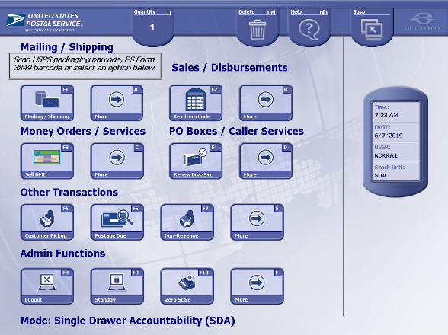
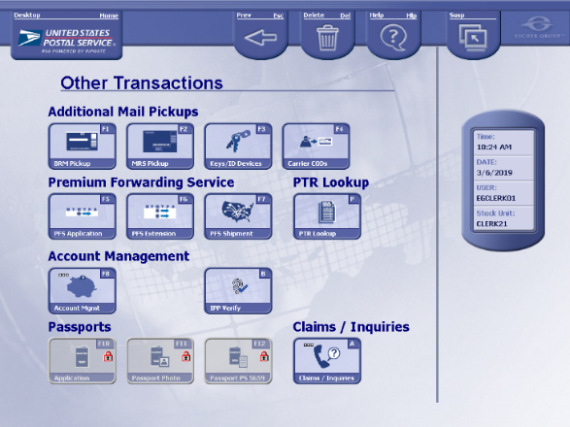
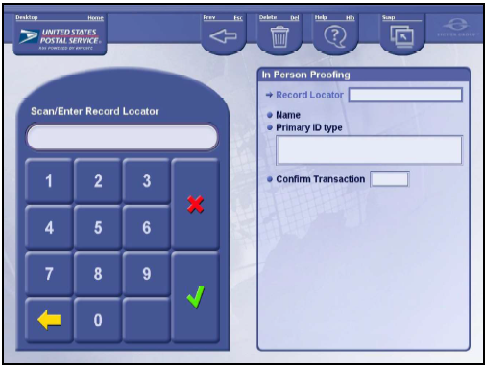
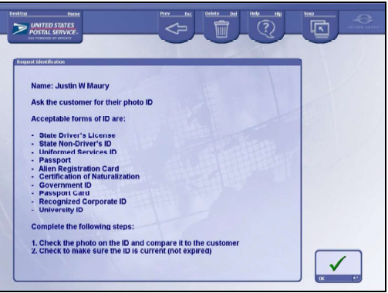
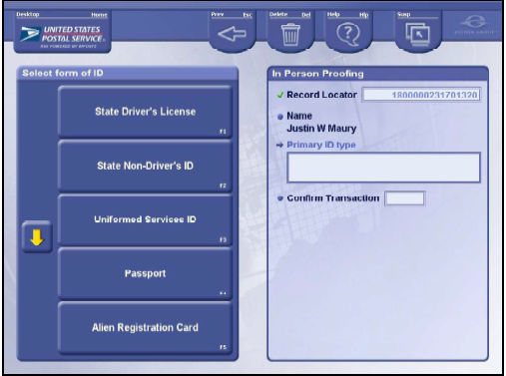
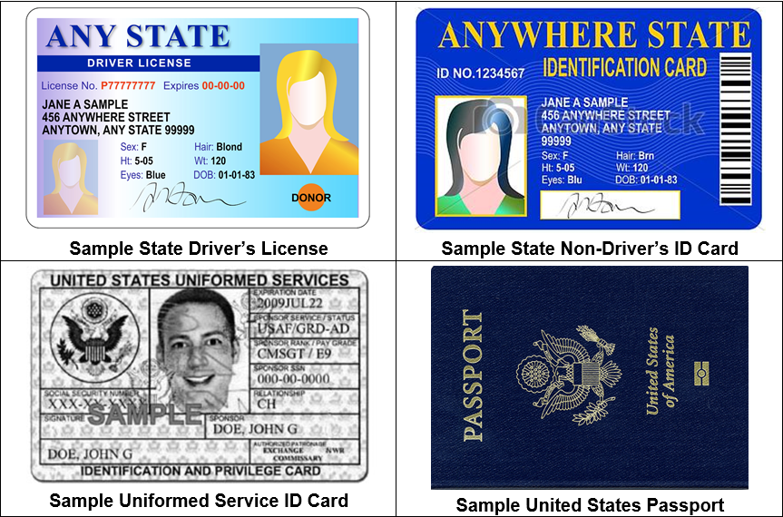
SSA RSS IPP Verify Process Flow
1
2
3
Find “IPP Verify” on RSS
Click “More” under “Other Transactions” from the Main Screen
Select “IPP Verify”
Search for Customer Info
Scan Barcode (printed or on cell phone) presented by customer
Social Security Administration Acceptable forms of ID
The RSS “IPP Verify” lists IDs that are not accepted by the SSA. Clerks are to only accept IDs from the following SSA approved list. Failure to do so will result in a failed IPP transaction.
Primary ID (provide 1) | US Government-issued ID with current address* State Driver’s License State Non-Driver’s ID Uniformed Services ID US Passport* *requires secondary form of ID
Secondary ID | Mortgage, Lease, or Dead of Trust Voter Registration Vehicle Registration Card Home or Vehicle Insurance Policy
4
5
Confirm Customer’s Info
Follow instructions on screen to verify customer’s photo ID and select “OK”
Select Primary Form of ID Customer presents one primary form of ID

Slide 2
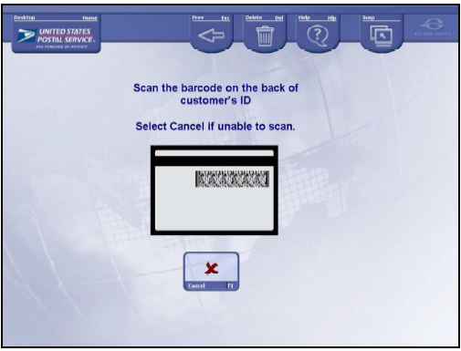
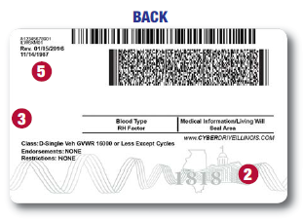
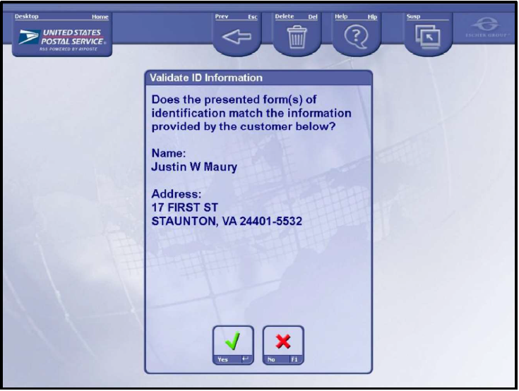
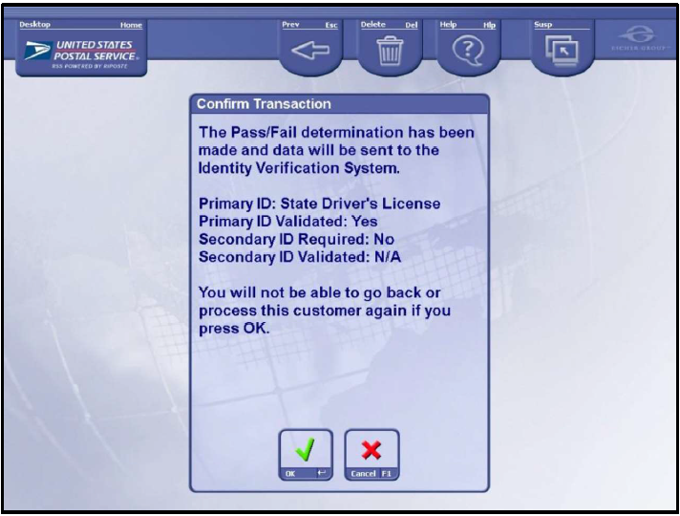
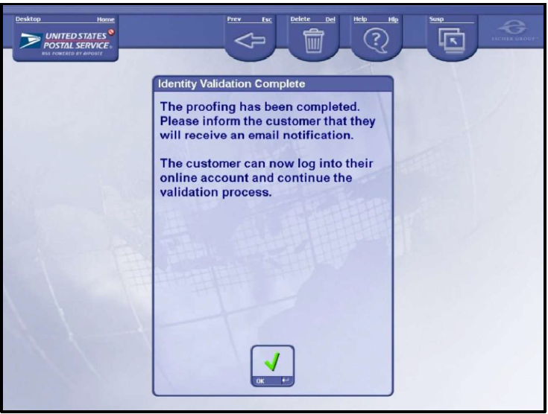
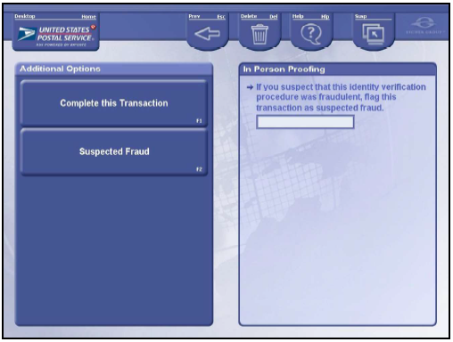
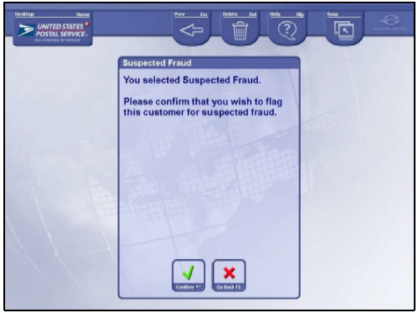
SSA RSS IPP Verify Process Flow
6
7
8
For State Driver’s Licenses that have two barcodes on the back, scan the second barcode
Enter Customer ID Info
For State Driver’s License, State Non-Driver’s ID, and Military Issued ID scan barcode on back of ID. For other primary IDs, confirm photo matches customer and enter secondary ID
Validate Customer Info
Select “Yes” if customer ID matches. If “No” system will prompt you to enter secondary ID
Confirm Transaction
Select “OK” to confirm transaction
Optional
9
10
11
Complete Transaction
Select “OK” to complete transaction, and thank customer for their visit
Determine if Fraud Suspected
Select either “Complete the Transaction” or “Suspected Fraud”
Confirm Fraud Suspected
Select “Confirm” to flag and finalize transaction

Slide 3
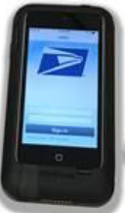
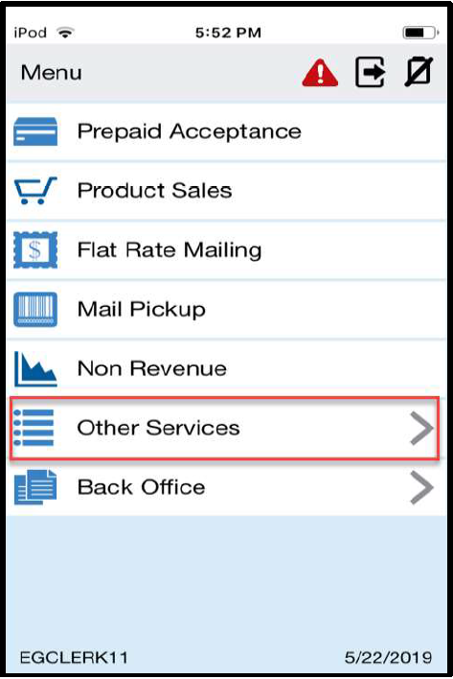
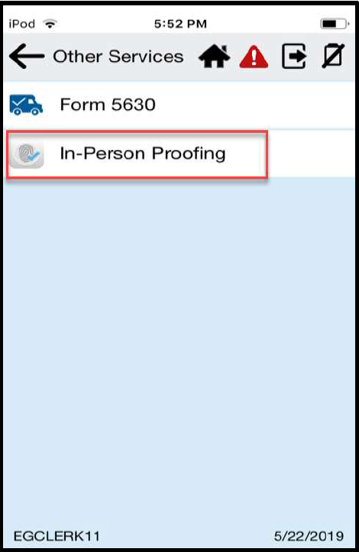
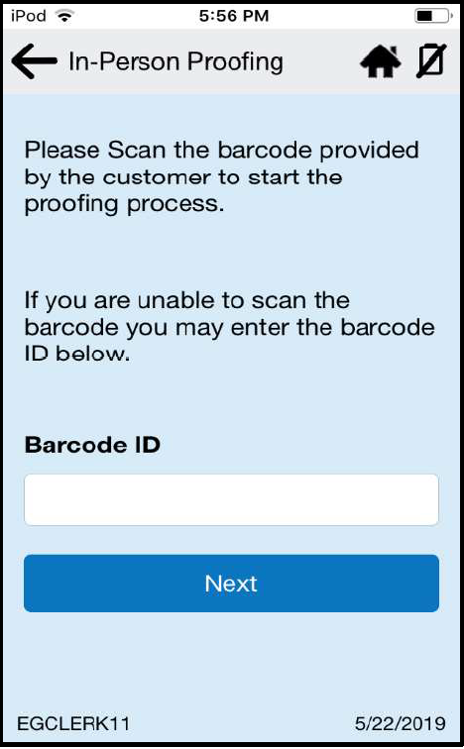
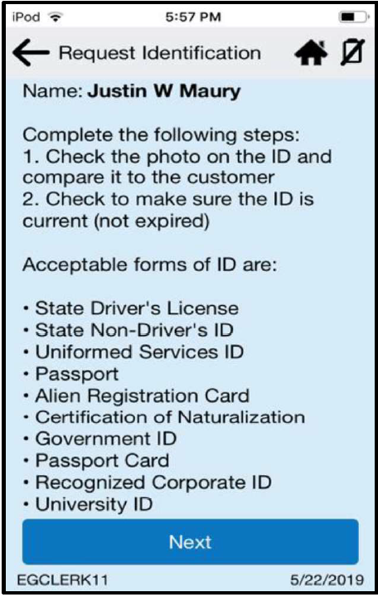
SSA RSS mPOS App Process Flow
1
Find RSS Application on mPOS
From the main screen of the mPOS, select “RSS App” located on the bottom left
2
Select “Other Services”
3
Select “In-Person Proofing”
Social Security Administration Acceptable forms of ID
The RSS mPOS App lists IDs that are not accepted by the SSA. Clerks are to only accept IDs from the following SSA approved list. Failure to do so will result in a failed IPP transaction.
Primary ID (provide 1) | US Government-issued ID with current address* State Driver’s License State Non-Driver’s ID Uniformed Services ID US Passport* *requires secondary form of ID
Secondary ID | Mortgage, Lease, or Dead of Trust Voter Registration Vehicle Registration Card Home or Vehicle Insurance Policy
4
Scan Barcode
Scan customer’s barcode (printed or on cell phone). If barcode will not scan, manually enter and click “Next”
5
Request Customer’s ID
Customer presents one primary form of ID, and then select “Next”

Slide 4
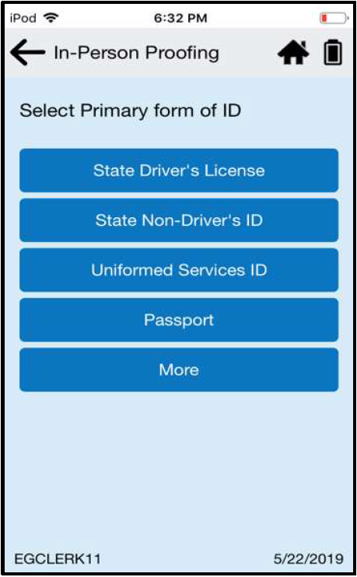
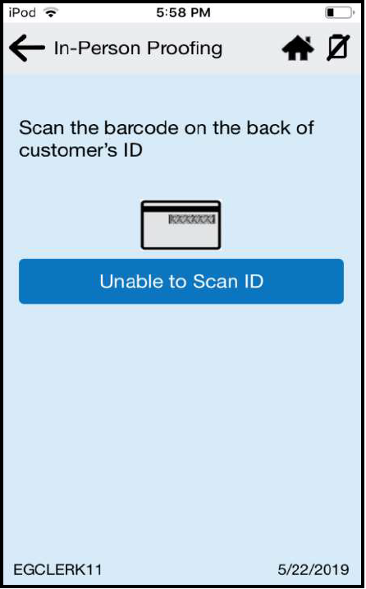
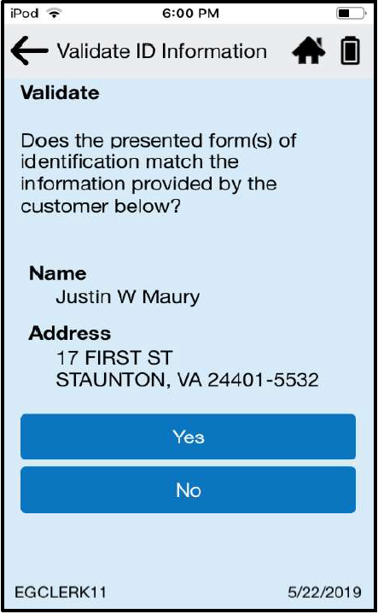
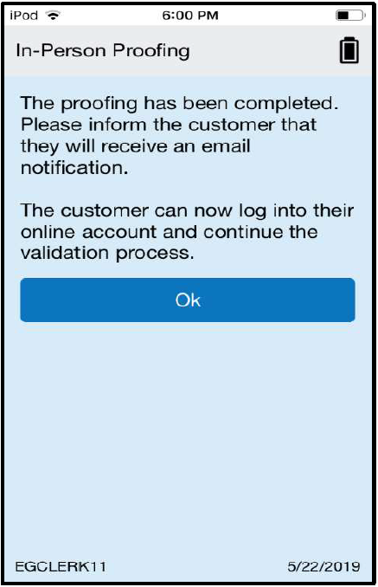
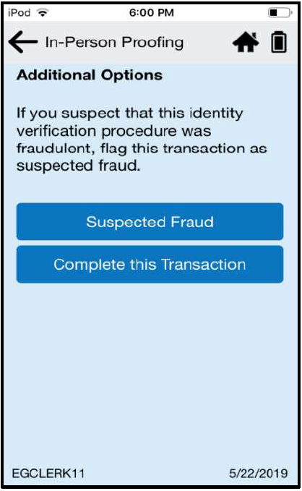
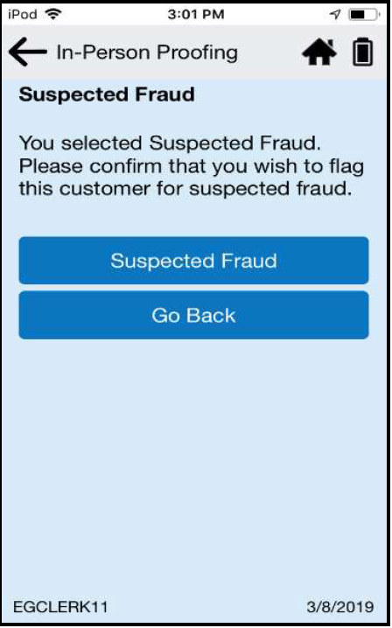
SSA RSS mPOS App Process Flow
6
Select ID
Select the form of ID presented by customer, and scan it
7
Enter Customer ID Info
For State Driver’s License, State Non-Driver’s ID, and Military Issued ID scan barcode on back of ID. For other primary IDs, confirm photo matches customer and enter secondary ID
8
Validate Information
Select “Yes” to confirm customer ID matches info on screen. If “No” enter secondary ID information
For State Driver’s Licenses that have two barcodes on the back, scan the second barcode
Optional
9
Complete Transaction
Inform the customer that the proofing is complete and that they will receive a confirmation email with their results. Select “Continue”
10
Determine if Fraud Suspected Select either “Complete this Transaction” or “Suspected Fraud”
11
Confirm Fraud Suspected
If fraud suspected, select “Suspected Fraud” to confirm and finalize transaction

Slide 5
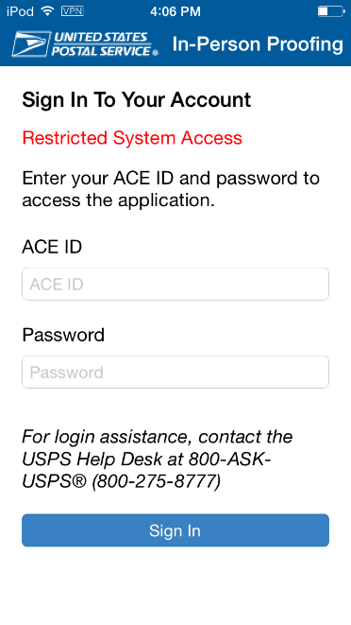
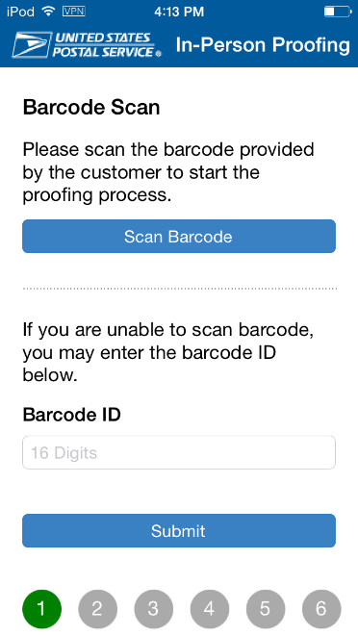
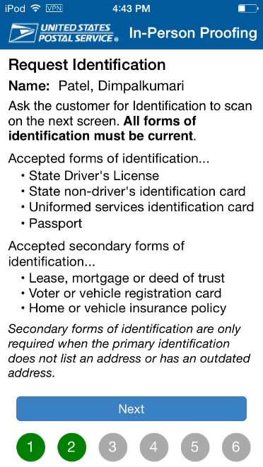
SSA mPOS IVS App Process Flow
1
Find IVS Application on mPOS
From the main screen of the mPOS, the IVS App is located on the bottom right
2
Select IVS
Application
3
Sign In
Enter your ACE ID and Password, and then select “Sign In”
Social Security Administration Acceptable forms of ID
4
5
Clerks are to only accept IDs from the following SSA approved list:
Primary ID (provide 1) | US Government-issued ID with current address* State Driver’s License State Non-Driver’s ID Uniformed Services ID US Passport* *requires secondary form of ID
Secondary ID | Mortgage, Lease, or Dead of Trust Voter Registration Vehicle Registration Card Home or Vehicle Insurance Policy
Scan Barcode
Scan customer’s barcode (printed or on cell phone). If barcode will not scan, manually enter and click “Submit”
Request Customer’s ID
Customer presents one primary form of ID, and then select “Next”

Slide 6
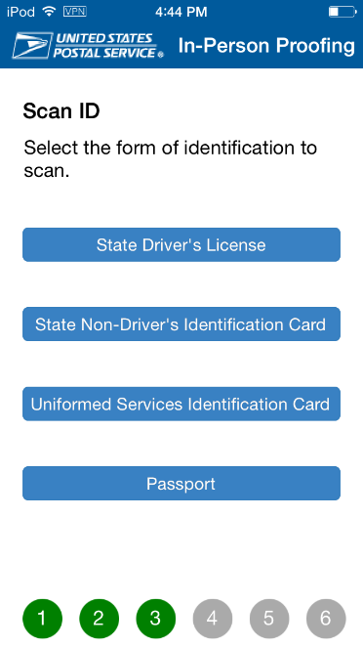
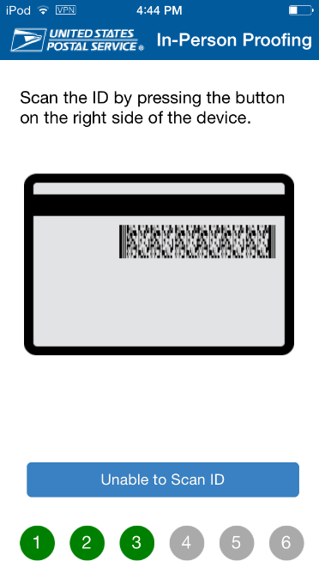
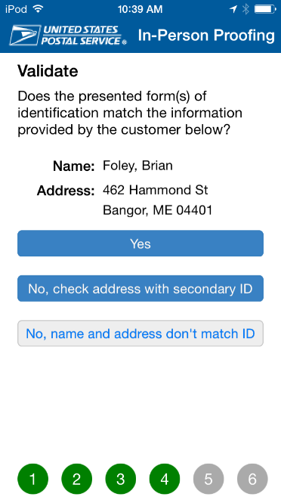
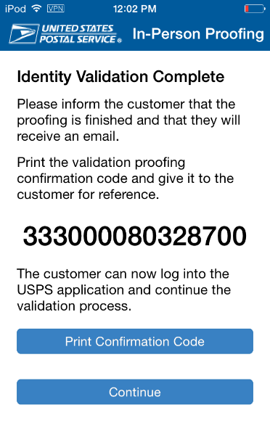
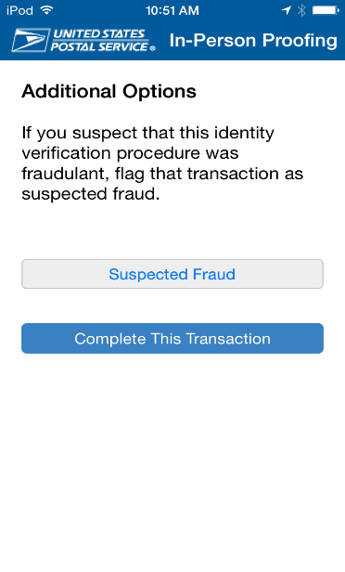
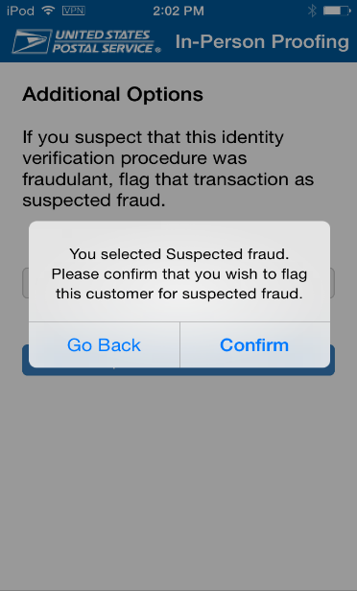
SSA mPOS IVS App Process Flow
6
Select ID
Select the form of ID presented by customer, and scan it
7
Enter Customer ID Info
For State Driver’s License, State Non-Driver’s ID, and Military Issued ID scan barcode on back of ID. For other primary IDs, confirm photo matches customer and enter secondary ID
8
Validate Information
Select “Yes” to confirm customer ID matches info on screen. If “No” enter secondary ID information
For State Driver’s Licenses that have two barcodes on the back, scan the second barcode
Optional
9
Complete Transaction
Inform the customer that the proofing is complete and that they will receive a confirmation email with their results. Select “Continue”
10
Determine if Fraud Suspected Select either “Complete the Transaction” or “Suspected Fraud”
11
Confirm Fraud Suspected
If fraud suspected, select “Confirm” to flag and finalize transaction

