Slide 1
§ 48(e): Energy Credits Online (ECO) Application Wireframes
July 13, 2023

Slide 2
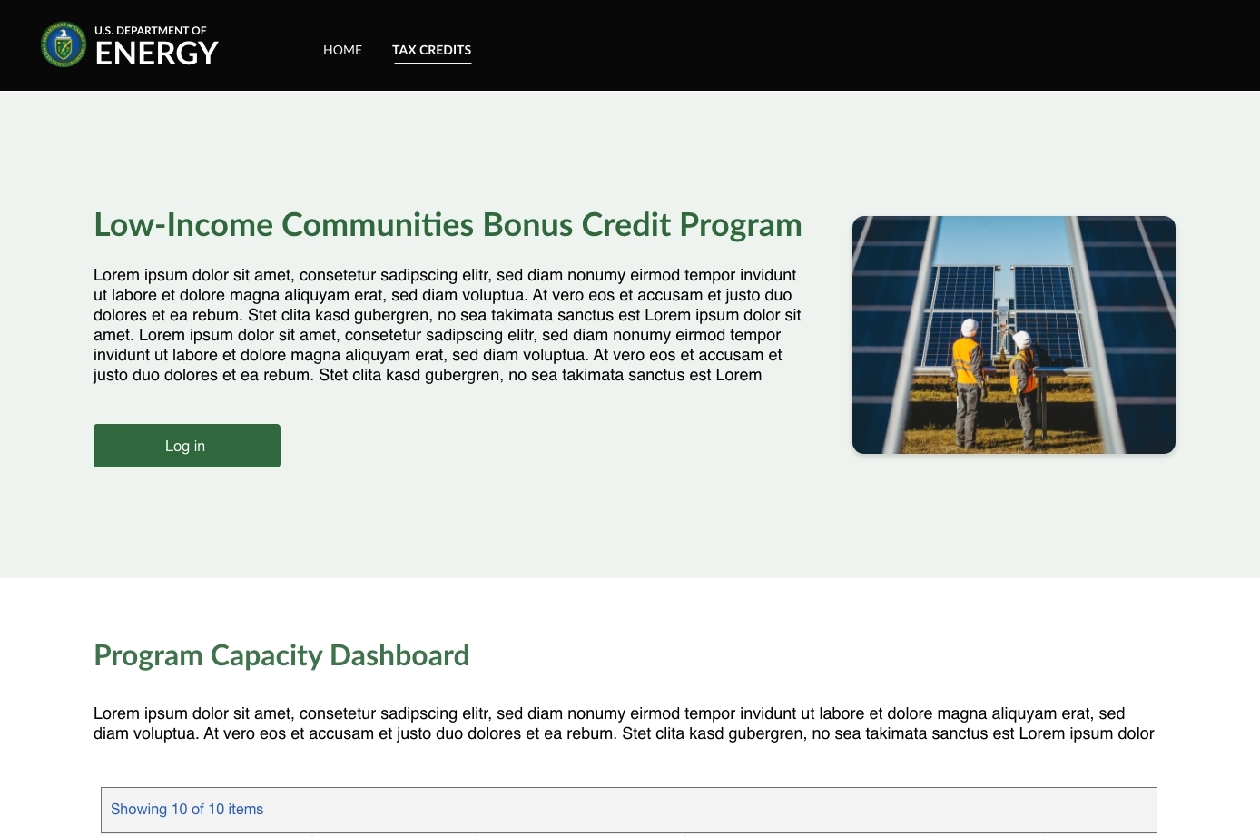
Contents
North Star: To provide an efficient, transparent, streamlined, and reportable process for organizations to access the tax credits to benefit low-income Americans with lower energy costs.​
Registration
Portal Homepage
Application for Allocation
Request for Tax Credit
Internal Users
NREL
IRS

Slide 3
User Registration Workflow

Slide 4
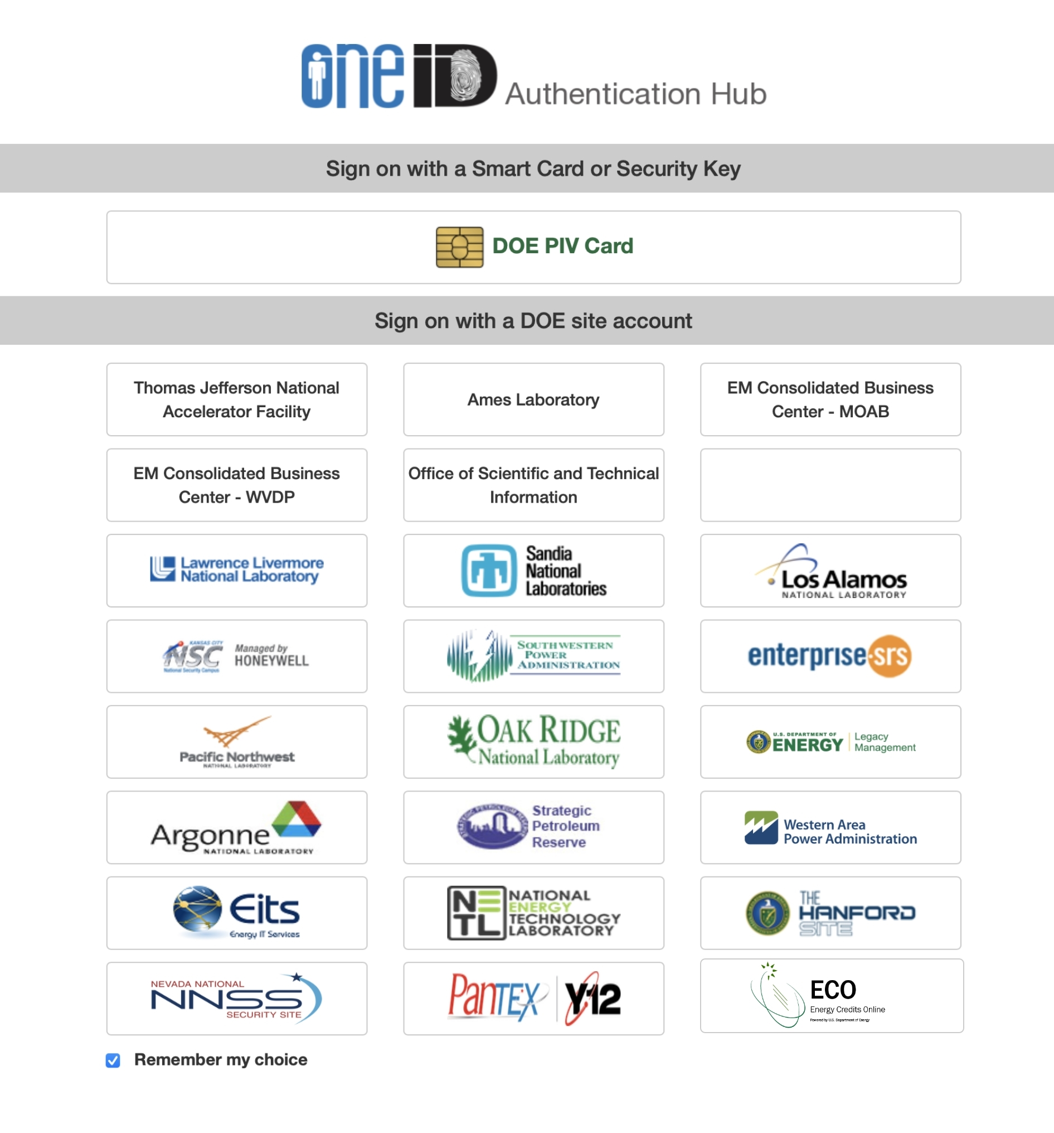
User Registration Workflow – Landing Page
From an Energy.gov Landing Page, applicants will select a call-to-action button which will redirect them to an ECO Portal Registration Page. Applicants will then select register and be navigated to DOE ONE ID Authentication hub where they will select the 48(e) ECO Application tile.
Energy.gov Landing Page
ECO Registration Landing Page

Slide 5
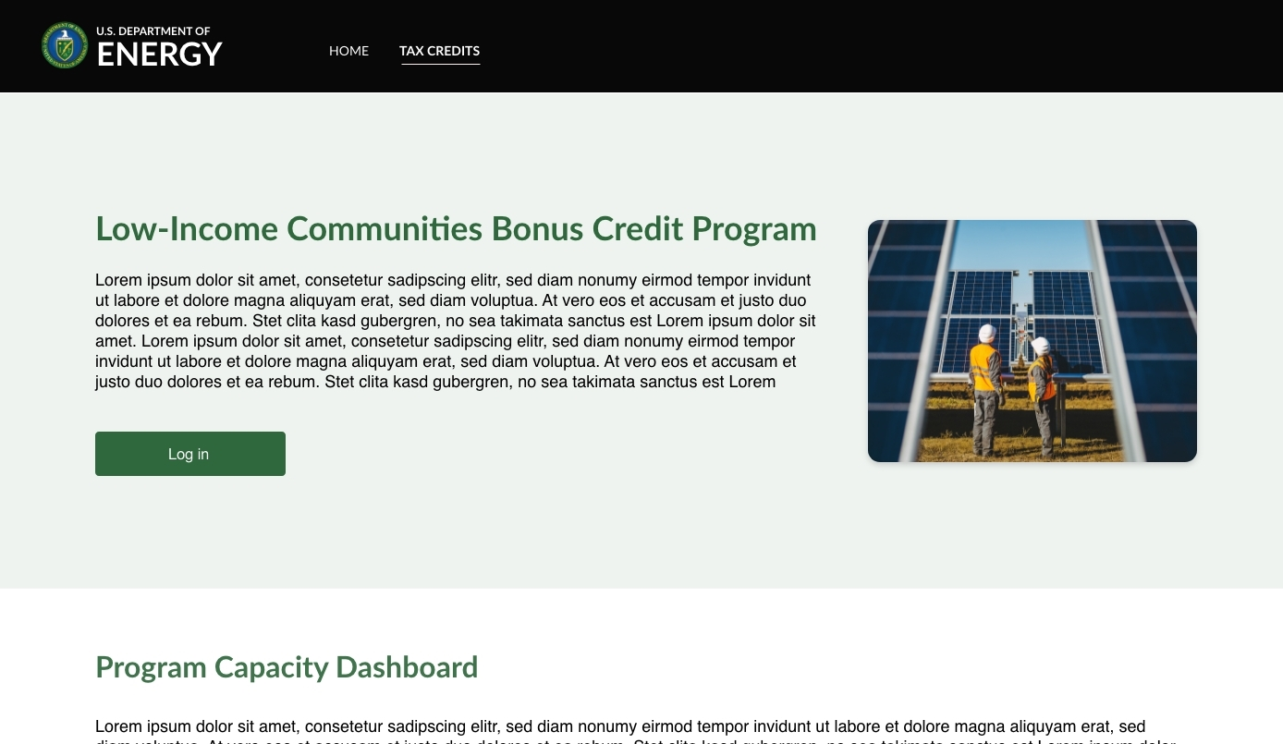
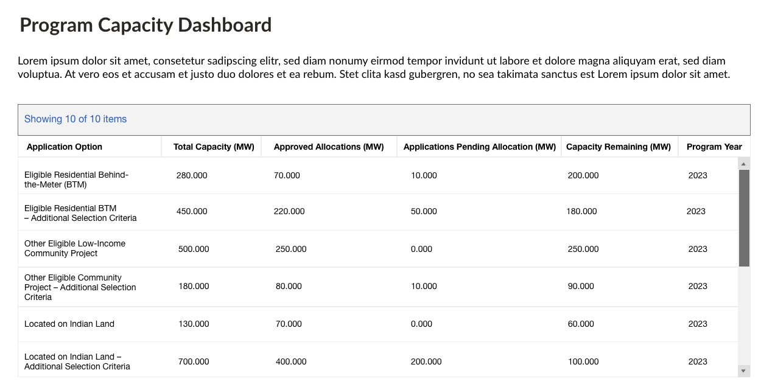
User Registration Workflow – ECO Landing Page
Applicants will be redirected from an Energy.gov website to the Low-Income Communities Bonus Credit Program landing page where they can view a program overview and Program Capacity Dashboard.

Slide 6
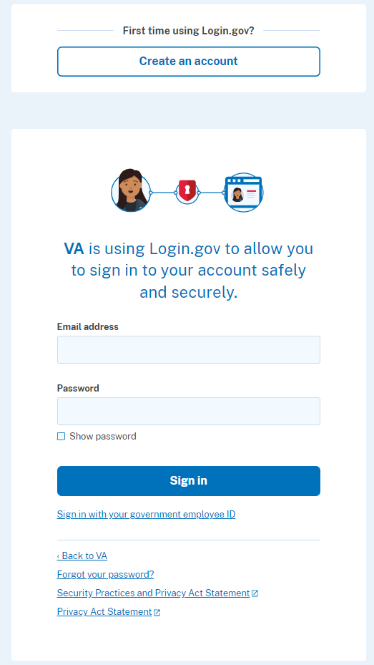
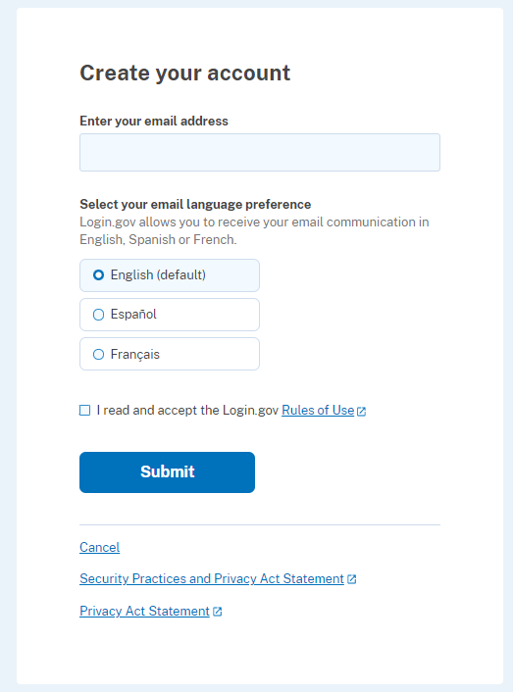
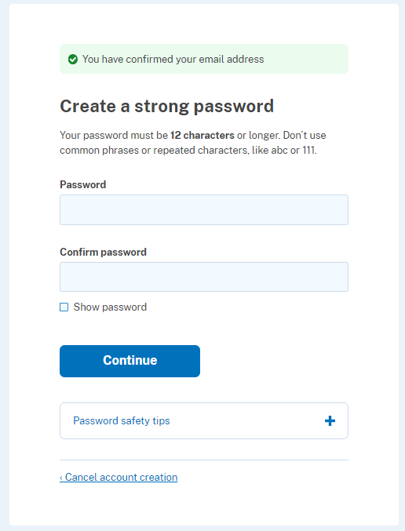
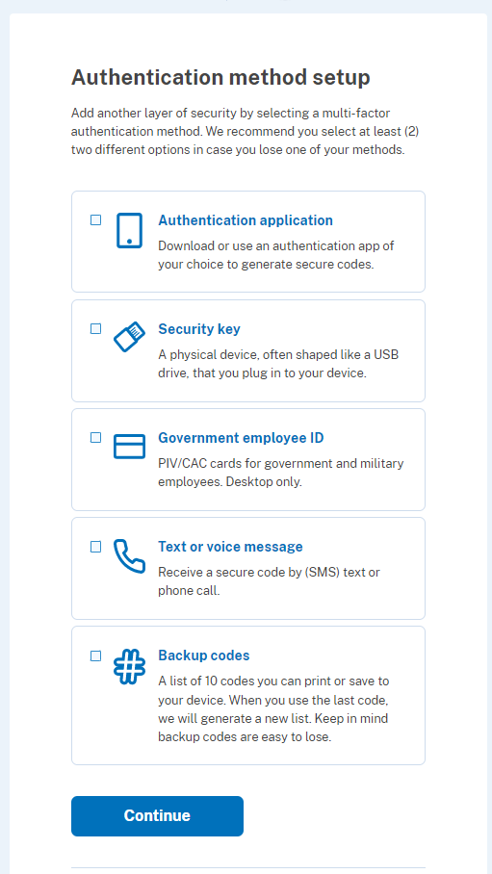
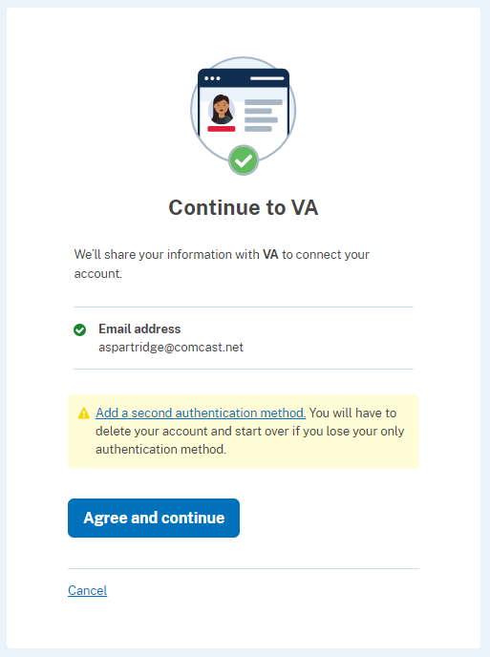
User Registration Workflow – Login.gov
After selecting the 48(e) ECO Application tile on DOE ONE ID portal, new users will be prompted to register via Login.gov. Outlined below is a high-level overview of new applicant registration via Login.gov.
DOE
DOE
test@testemail.com
Back to DOE
*Returning users will log in with their existing email and password
*User will confirm dual-factor authentication via selected method(s) (e.g., text/voice)

Slide 7
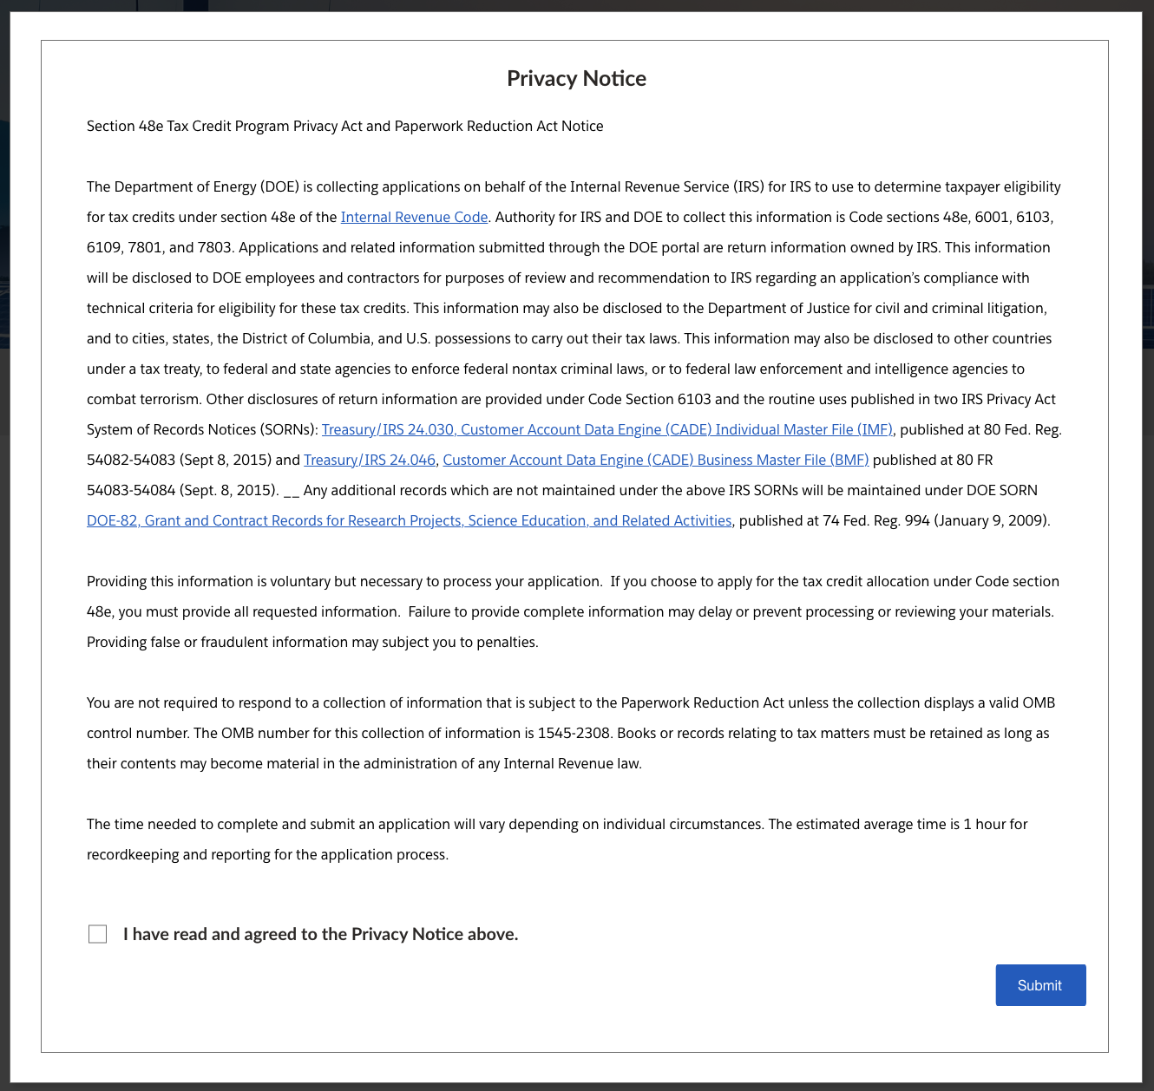
User Registration Workflow – Privacy Notice
During registration, applicants will be prompted with a Privacy Act and Paperwork Reduction Act Notice. Applicants must acknowledge this notice prior to submitting any applications.

Slide 8
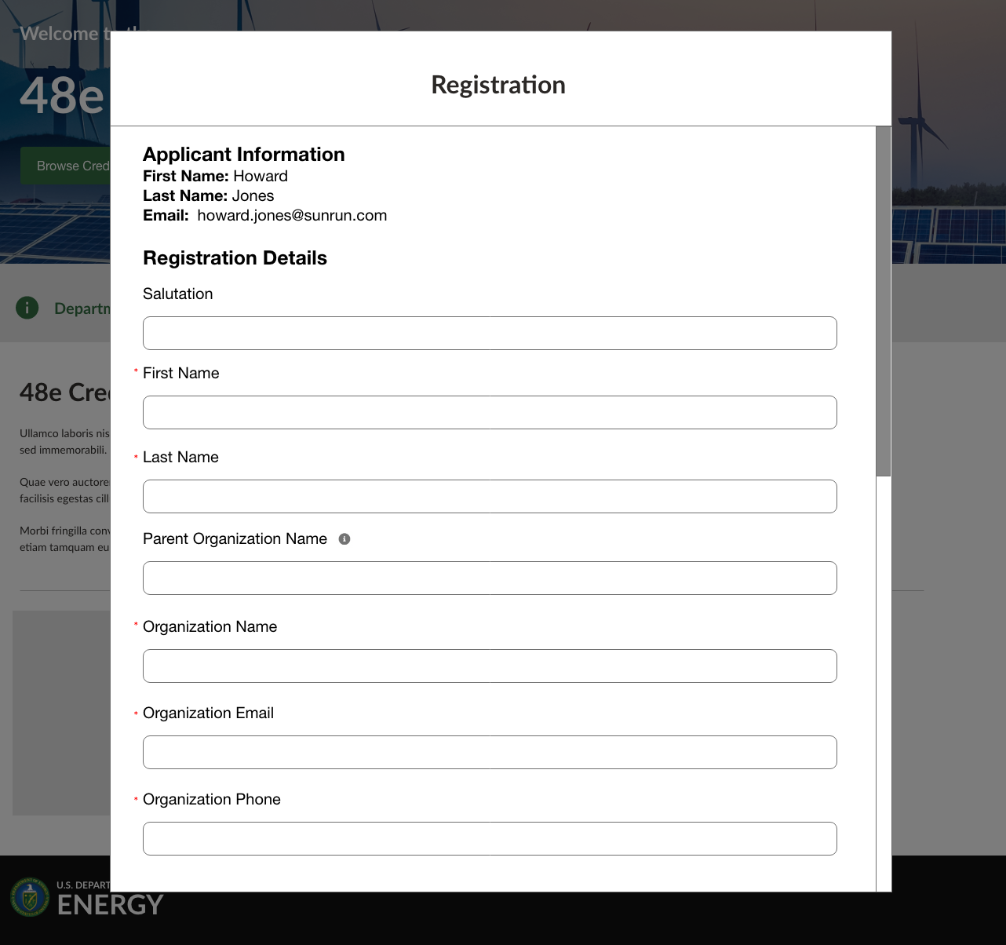
User Registration Workflow – Portal Registration
Once redirected from Login.gov, new users will be redirected to the registration page in the Portal where they will enter Contact Information, Organization Tax Information, Organization Address, and Organization Type.

Slide 9
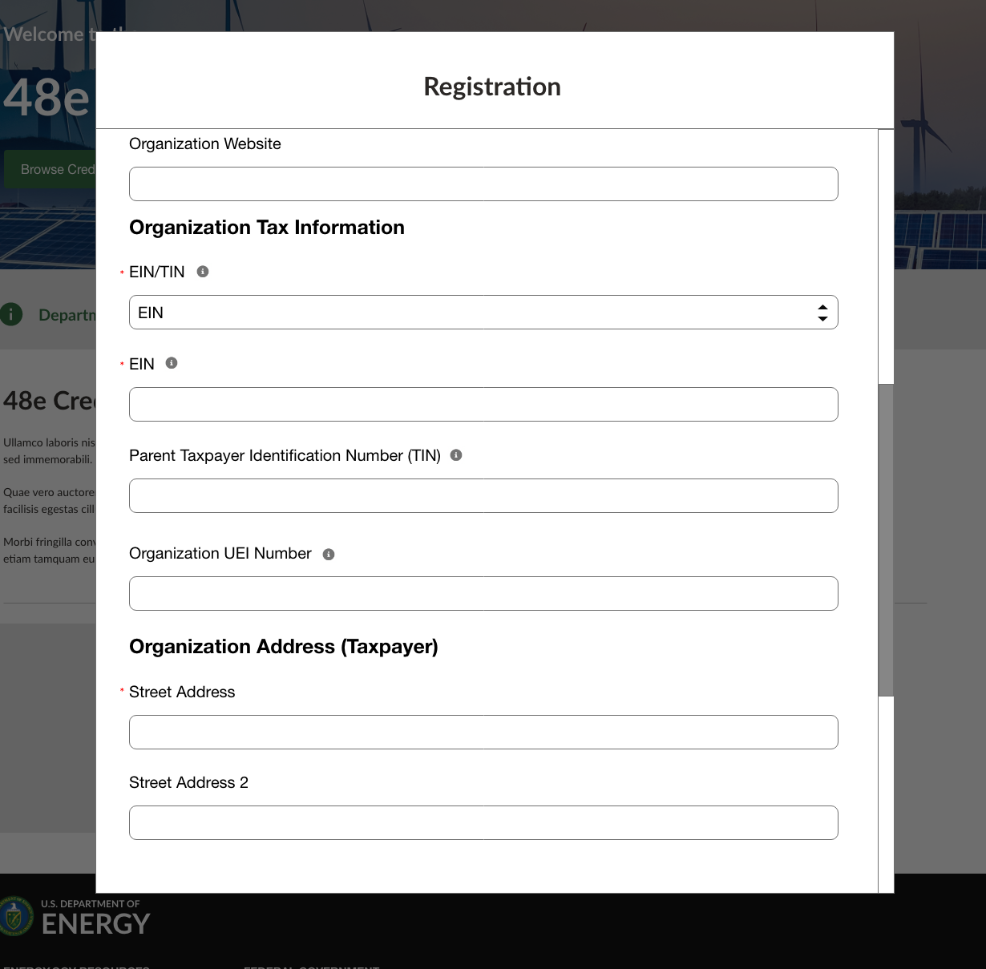
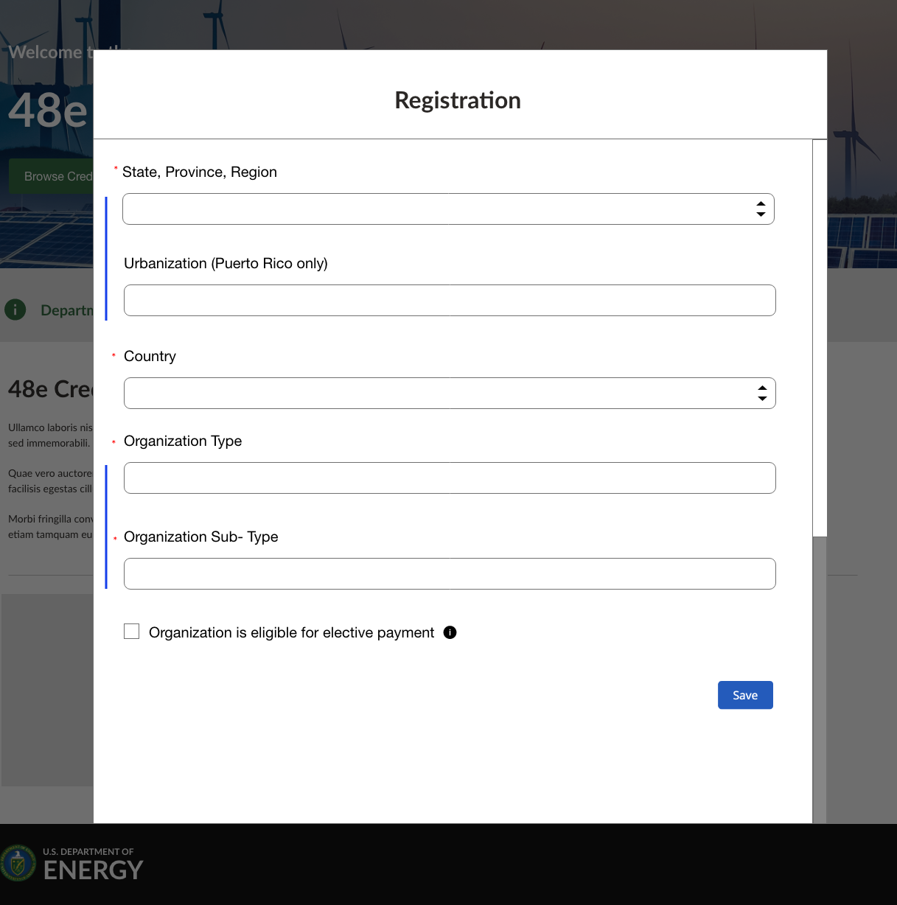
User Registration Workflow – Portal Registration
Once all required fields have been completed new users will select Save to save their contact information and organization details.

Slide 10
Portal Homepage
Newly registered (or returning) applicants will be navigated to the authenticated portal homepage.
Applicants can navigate to the Homepage, Credit Applications page, Previous Applications, or Help Resources via the top navigation.
Homepage will include a direct call-to-action to submit new applications.
General information including links to relevant internal (portal) or external (IRS or DOE sites) resources can be provided on the homepage.
Applicants will be able to view high-level capacity allocation reporting including capacity totals, capacity applied for, capacity remaining per category.

Slide 11
Portal Homepage (Cont’d)
Newly registered (or returning) applicants will be navigated to the authenticated portal homepage.
Pages will include relevant security markings and reference OMB Control Number: 1545-2308.
The footer will include links to the Energy Credits Online (ECO) Homepage, Department of Energy, National Renewable Energy Laboratory, and Department of Energy Privacy Notice information.

Slide 12
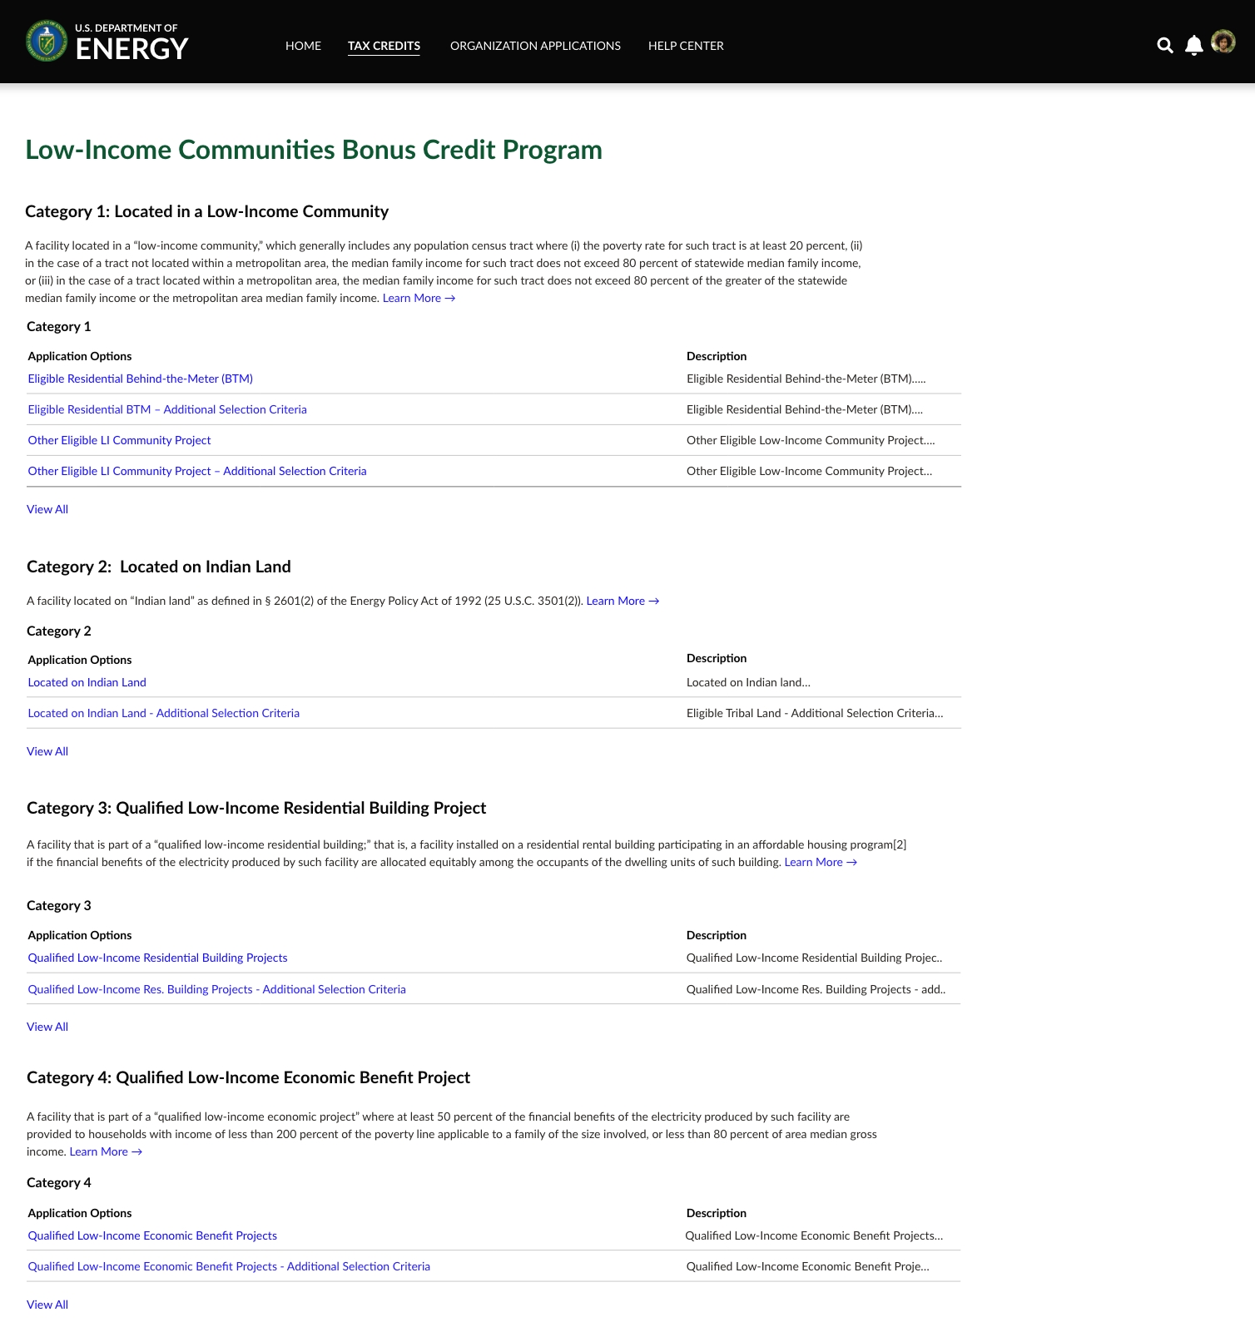
Application for Allocation
By selecting the call-to-action or Tax Credits navigation on the homepage, applicants can access 48(e) credit applications.
Applicants will have the ability to choose the category and application option for which they are applying. By selecting the application option hyperlink applicants will launch the application flow. Note: the following slides showcase Category 1 application option: Eligible Residential Behind-the-Meter (BTM). To view conditional pages for the remainder of Categories 1-4 see the appendix.

Slide 13
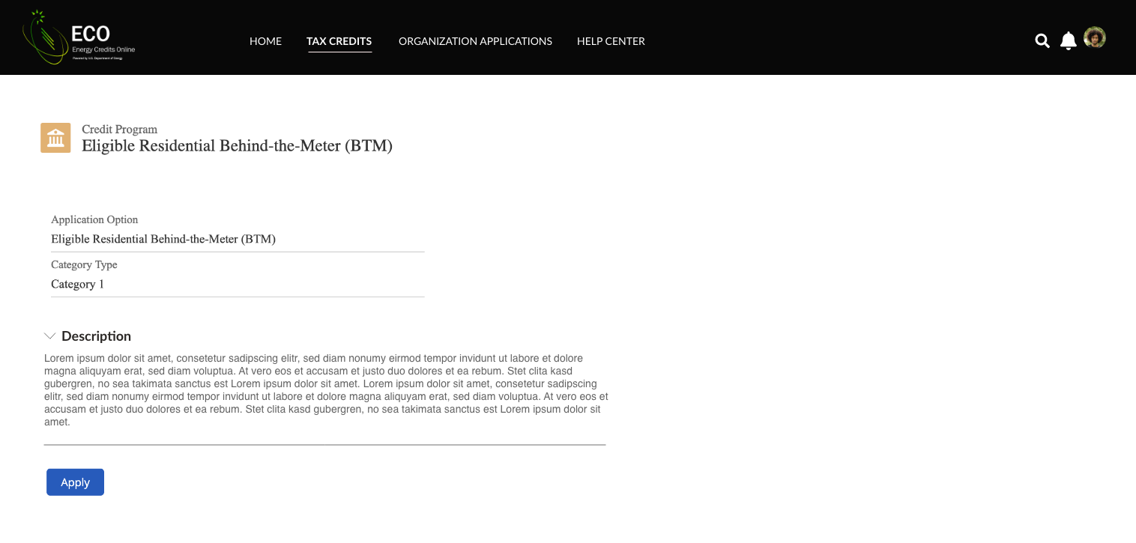
Application for Allocation
Once applicants select the sub-category they wish to apply for, they will be brought to an overview page that provides additional details and requirements on the category and/or sub-category.
Applicants can review a summary of the tax credit category and sub-category prior to beginning the application process.
Applicants will select Apply to begin their application.

Slide 14
Application for Allocation
1a
Applicants will be prompted to enter all Facility Information and Details including address, latitude/longitude, technology type, facility size, cost, etc.
Applicants will enter all Facility Identification Details including optional Project Name and Facility Street Address. Note: The Development Team is investigating reordering of fields (e.g., moving Country to be near State).

Slide 15
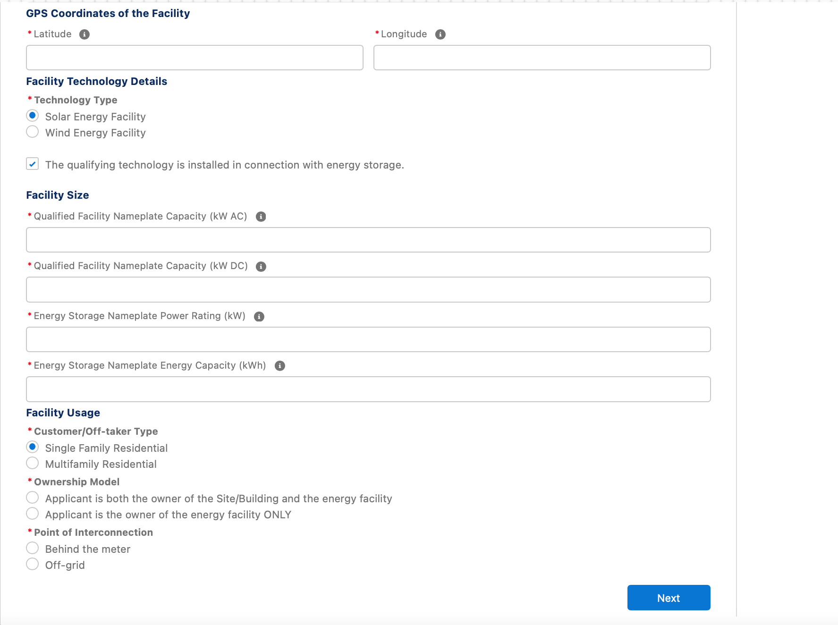
Application for Allocation
1a
Applicants will be prompted to enter all Facility Information and Details including address, latitude/longitude, technology type, facility size, cost, etc.
Applicants will enter the facility Latitude and Longitude.
Applicants will select the facility Technology Type (Solar or Wind) and identify if the facility includes Energy Storage.
Applicants will enter the energy generating capacity of the facility.
Note: fields are conditional based on the technology type selected and energy storage identification. For example, if I select Wind and no energy storage, I will be prompted to complete only Energy Generating Capacity (kW AC).
Applicants will be prompted to enter Facility Usage details including Customer Type, Ownership Model, Point of Interconnection, and Additional Selection Criteria.
Note: Facility Usage is conditional for each subcategory based on requirements outlined in guidance. Questions and response options will differ across each subcategory.
Once all required fields have been completed, applicants will select Next to move on to required documentation.

Slide 16
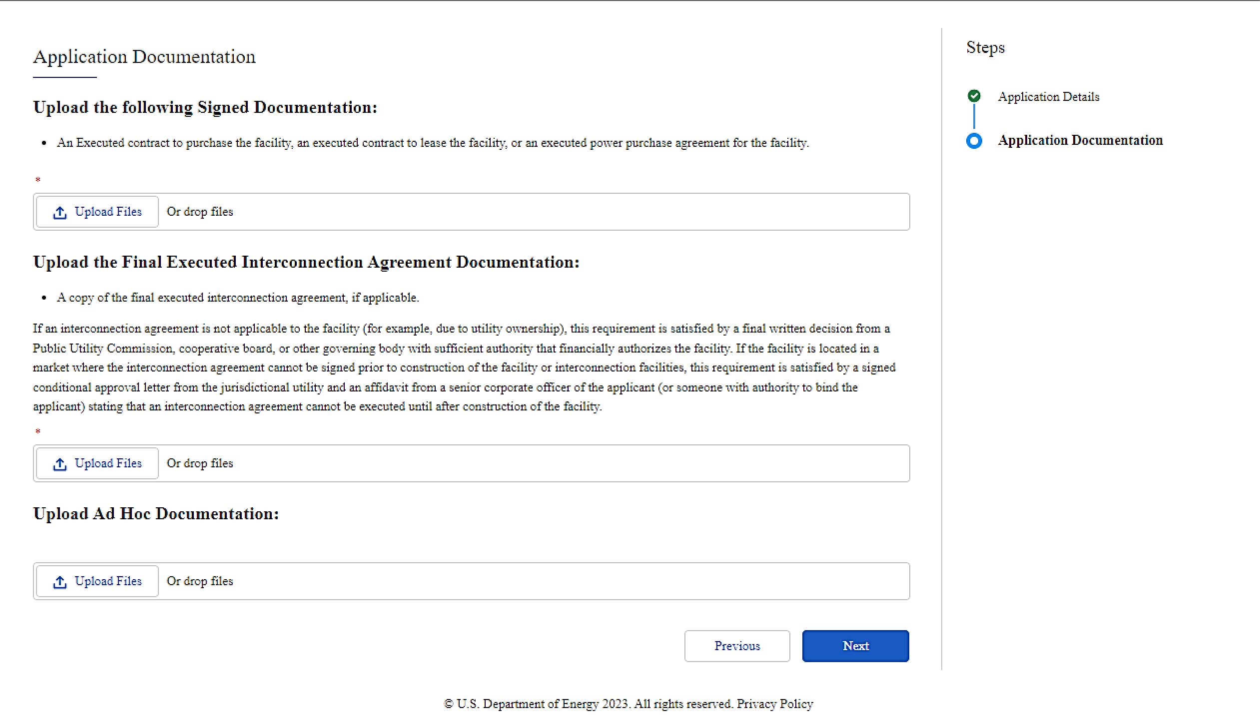
Application for Allocation
1a
Applicants will be prompted to attach all required documents.
executed
Applicants will be prompted to attach all required documents per category requirements outlined in the NPRM.
Note: Documentation requirements are conditional based on subcategory chosen by the applicant.
Once required documents have been attached, applicants will select Next to review their application prior to submission.

Slide 17
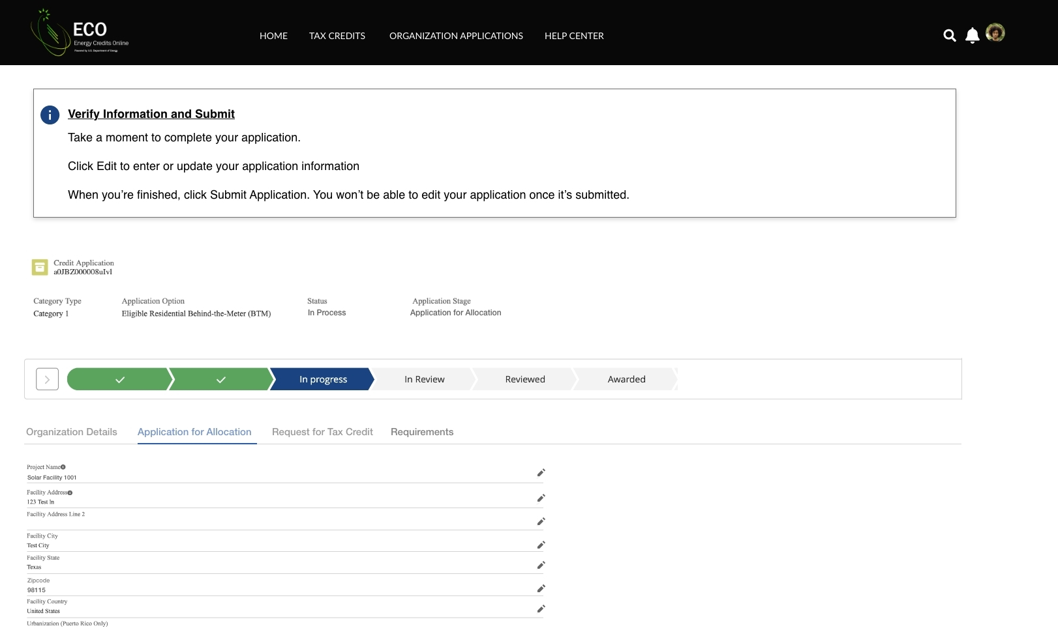
Application for Allocation
Applicants will be prompted to review all information prior to submission.
Applicants will be prompted to review all information for accuracy prior to application submission.
Applicants can view their application progress/status.
Applicants can make any necessary updates using the pencil edit feature.

Slide 18
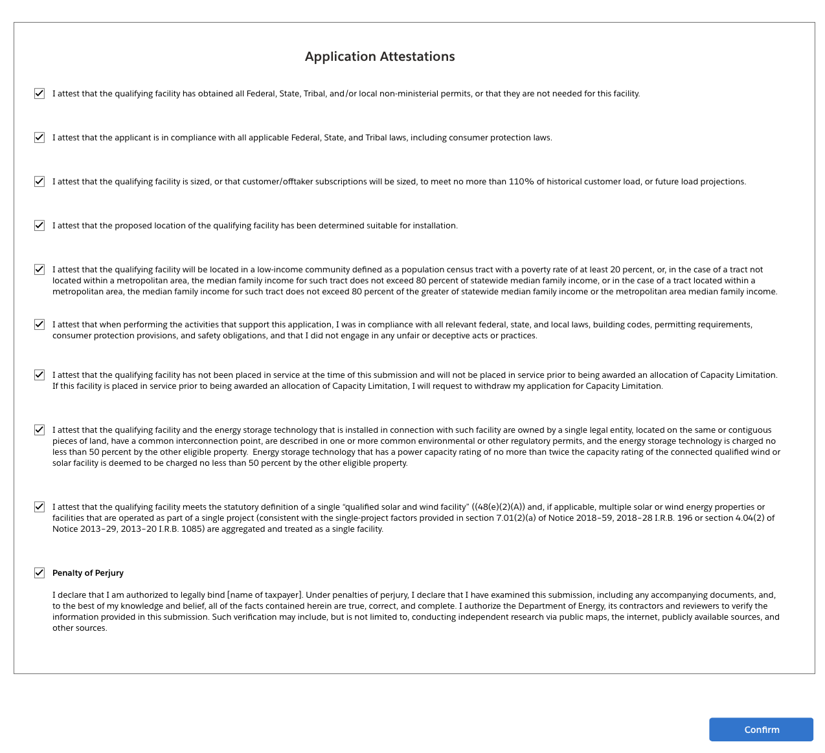
Application for Allocation
1a
Applicants will be prompted to review all information prior to submission.
Applicants will select Submit and be prompted to agree to required Attestations.
Applicants will be required to Attest to all required Attestations prior to submission. Note: all Attestations are conditional based on subcategory selected and applicant responses.
Once applicants have attested, they can confirm submission of their 48(e) application for allocation

Slide 19
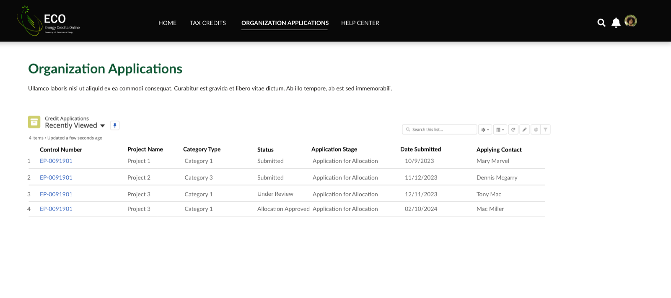
Request for Tax Credit
When an applicant’s facility is placed in service after it has been award an allocation, applicants will return to their previously submitted applications to submit their Request for Tax Credit (Placed in Service) application.
Applicants will select Organization Applications to view previously submitted applications.
Applicants will locate the Application for Allocation they wish to submit a Request for Tax Credit for upon the facility being placed in service.

Slide 20
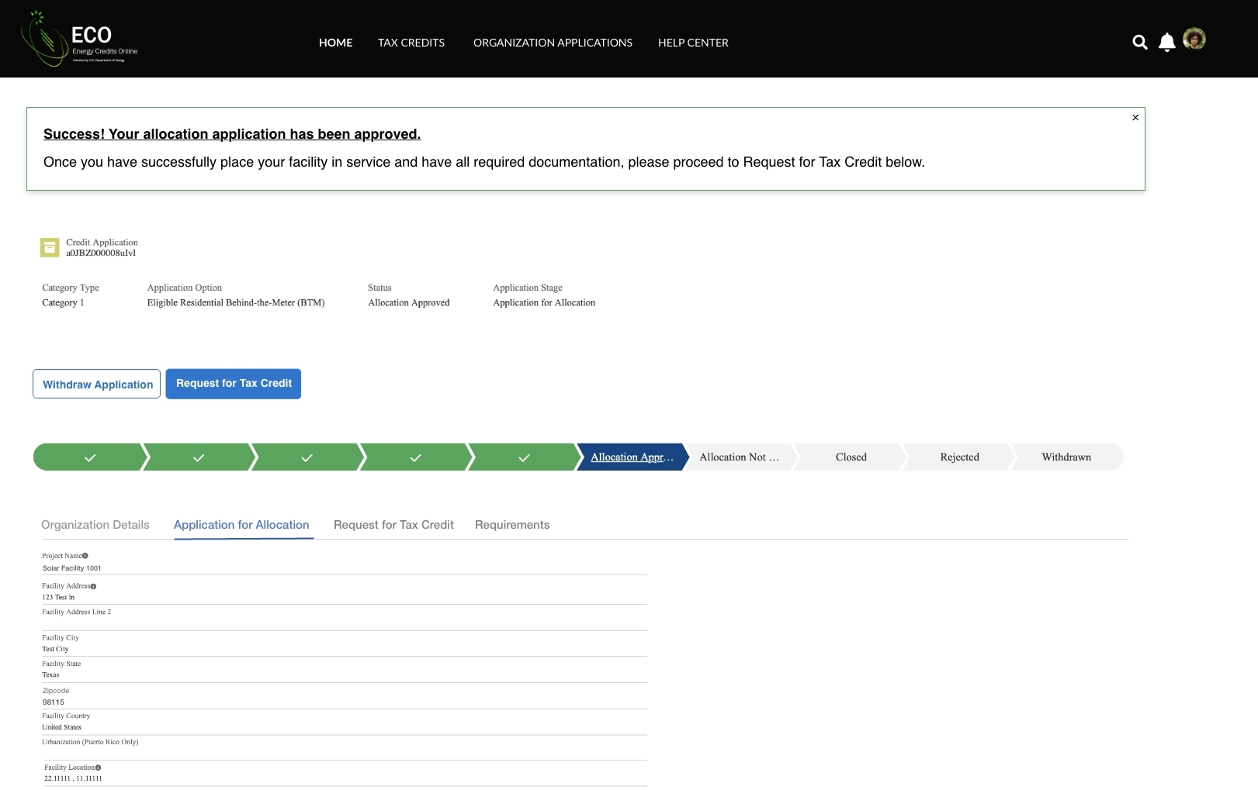
Request for Tax Credit
When an applicant’s facility is placed in service after it has been award an allocation, applicants will return to their previously submitted applications to submit their Request for Tax Credit (Placed in Service) application.
Applicants will select Request for Tax Credit to begin the placed in service application flow.
Applicants can review previously submitted information from their initial Application for Allocation prior to beginning their Request for Tax Credit application.

Slide 21
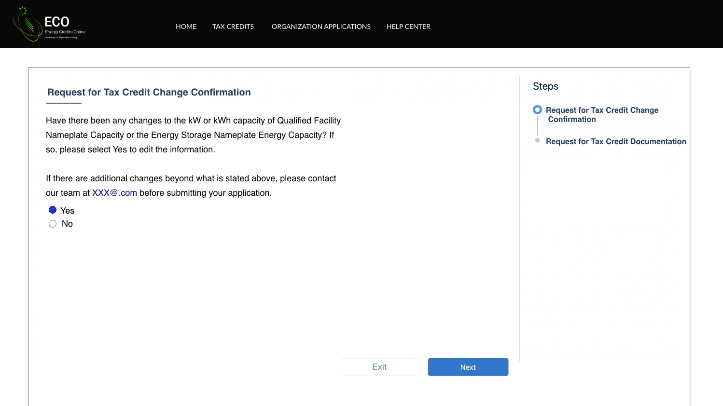
Request for Tax Credit
Once an applicant Apply, they will be prompted to identify if information from their original application has changed.
Applicants will select Yes or No to move forward to the next step of the application process.
Applicants will select Next to move forward.

Slide 22
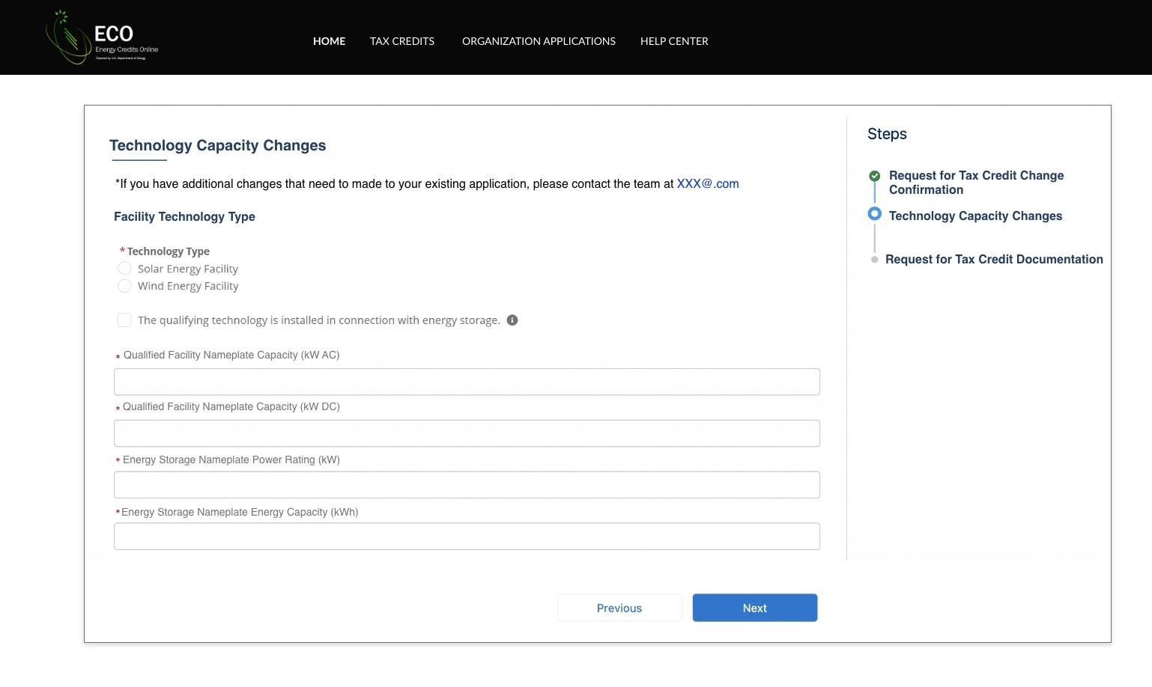
Request for Tax Credit
If they select Yes, applicants will be allowed to enter certain non-material changes on their Request for Tax Credit application and select Next to move forward.
Applicants are able to make certain non-material changes to information including Nameplate Capacity or Energy Storage.
Note: fields are conditional based on the technology type selected and energy storage identification. For example, if I select Wind and no energy storage, I will be prompted to complete only Nameplate Capacity (kW AC).
Note: Other changes are not allowable within the application, and applicant will be directed to reach out to the help desk for further guidance on eligibility. If an applicant selects No on prior screen they will move directly to documentation.
Applicants will select Next to upload required documentation.

Slide 23
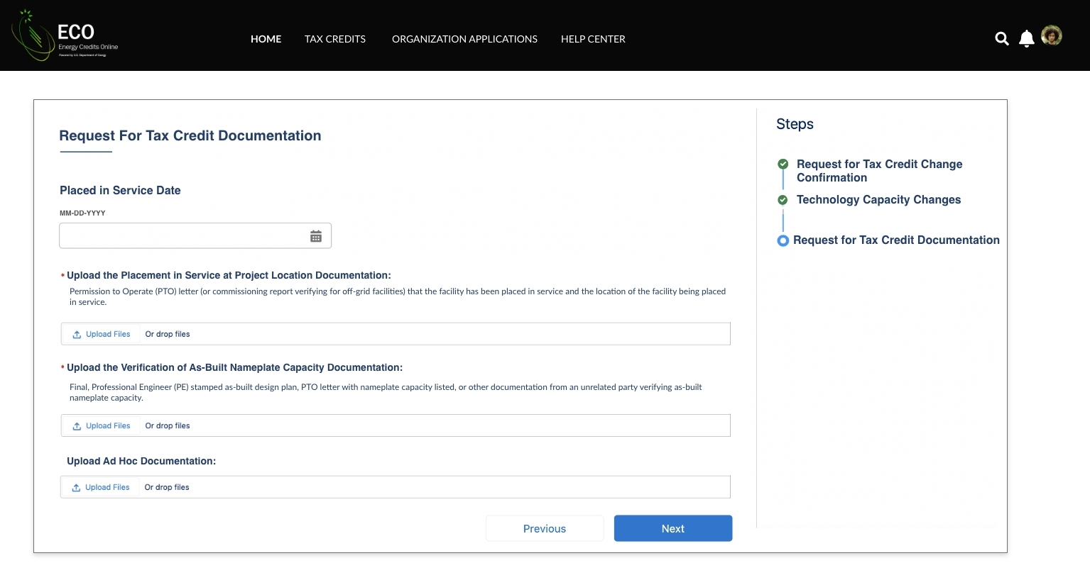
Request for Tax Credit
Applicants will be prompted to enter their Placed in Service Date and upload all required placed in service documentation outlined in the NPRM.
Applicants will be prompted to enter their Placed in Service Date.
Applicants will be prompted to attach all required documentation for the placed in service phase as outlined in the NPRM.
Applicants will select Next to move forward and review their application prior to submission.

Slide 24
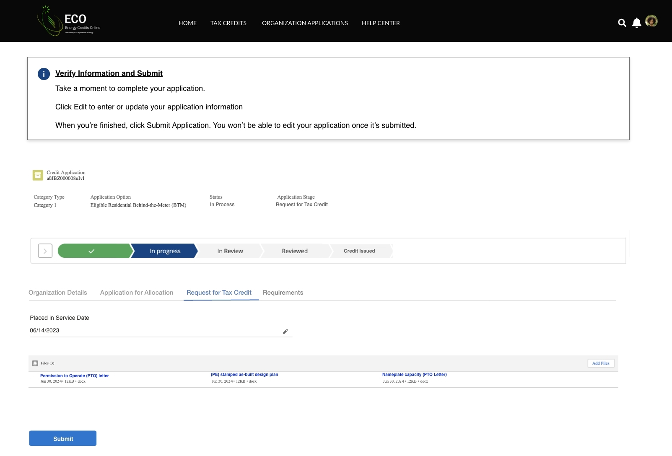
Request for Tax Credit
Applicants will be prompted to review all information prior to submission.
Applicants will be prompted to review all information for accuracy prior to application submission.
Applicants can view their application progress/status.
Applicants can make any necessary updates using the pencil edit feature.
Applicants will select Submit and be prompted to agree to required Attestations.

Slide 25
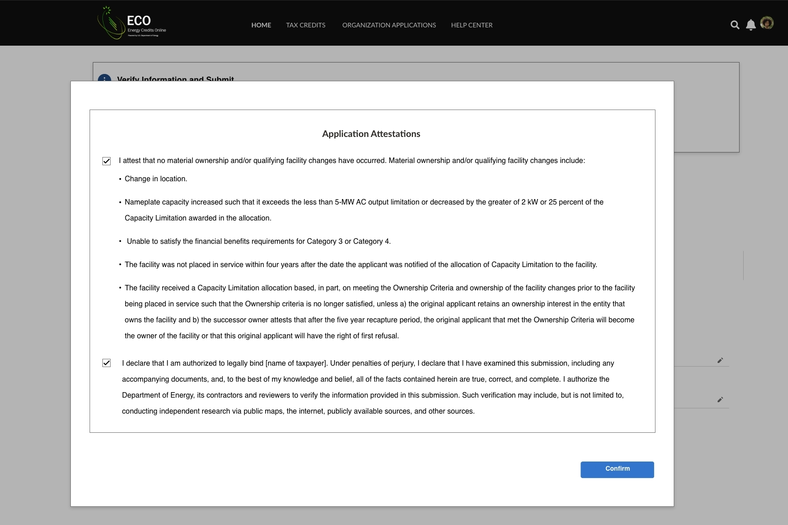
Request for Tax Credit
Applicants will be prompted to review all information prior to submission.
Applicants will be required to Attest to all required Attestations prior to submission.
Once applicants have attested, they can confirm submission of their 48(e) request for tax credit.

Slide 26
Appendix
Conditional Questions, Documentation, and Attestations for:
Categories 1b – 1d
Categories 2a – 2b
Categories 3a – 3b
Categories 4a – 4b

Slide 27
Application for Allocation
1b
Applicants will be prompted to enter all Facility Information and Details including address, latitude/longitude, technology type, facility size, cost, etc.
Applicants will enter all Facility Identification Details including optional Project Name and Facility Street Address.

Slide 28
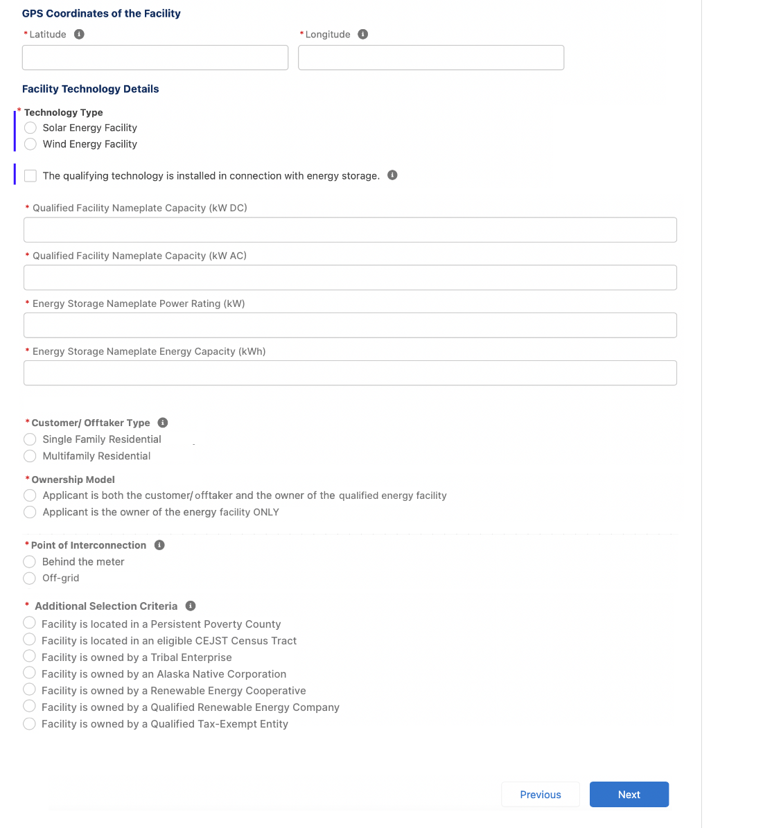
Application for Allocation
1b
Applicants will be prompted to enter all Facility Information and Details including address, latitude/longitude, technology type, facility size, cost, etc.
Applicants will enter the facility Latitude and Longitude.
Applicants will select the facility Technology Type (Solar or Wind) and identify if the facility includes Energy Storage.
Applicants will enter the energy generating capacity of the facility.
Note: fields are conditional based on the technology type selected and energy storage identification. For example, if I select Wind and no energy storage, I will be prompted to complete only Nameplate Capacity (kW AC)
Applicants will be prompted to enter Facility Usage details including Customer Type, Ownership Model, Point of Interconnection, and Additional Selection Criteria.
Note: Facility Usage is conditional for each subcategory based on requirements outlined in guidance. Questions and response options will differ across each subcategory.
Once all required fields have been completed, applicants will select Next to move on to required documentation.

Slide 29
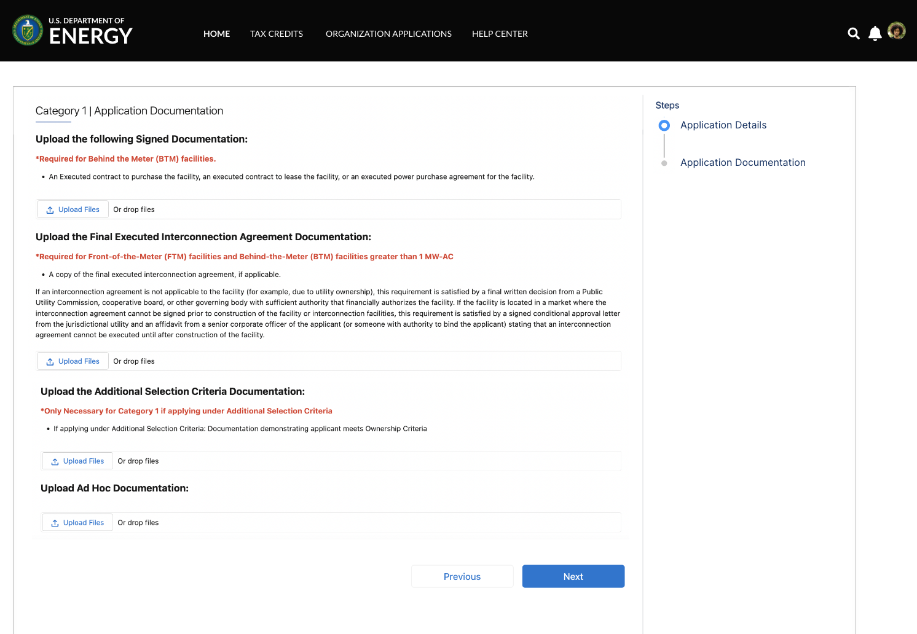
Application for Allocation
1b
Applicants will be prompted to attach all required documents.
executed
Applicants will be prompted to attach all required documents per category requirements outlined in the NPRM.
Note: Documentation requirements are conditional based on subcategory chosen by the applicant.
Once required documents have been attached, applicants will select Next to review their application prior to submission.

Slide 30
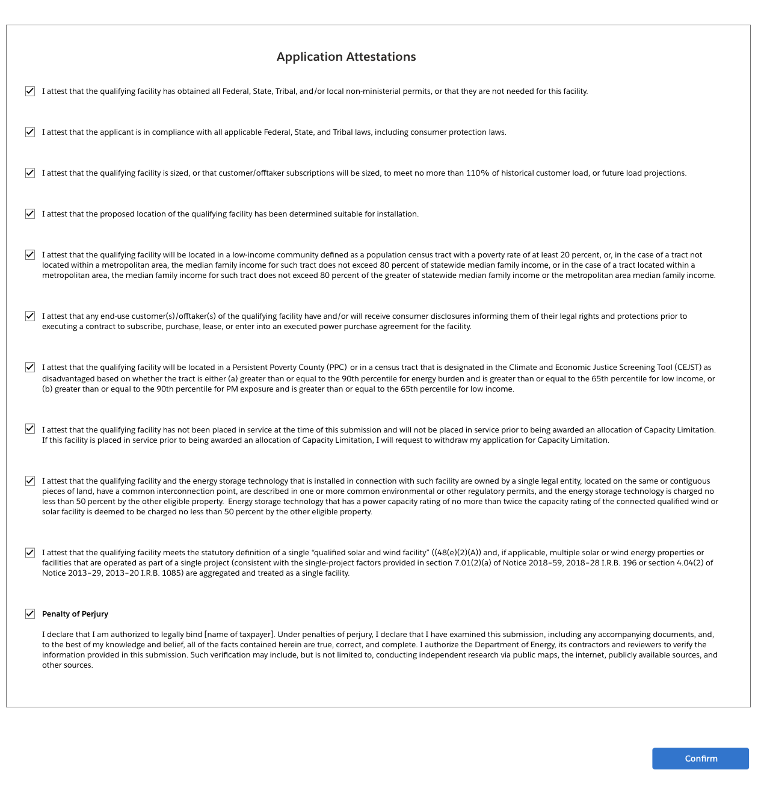
Application for Allocation
1b
Applicants will be prompted to review all information prior to submission.
Applicants will select Submit and be prompted to agree to required Attestations.
Applicants will be required to Attest to all required Attestations prior to submission. Note: all Attestations are conditional based on subcategory selected and applicant responses.
Once applicants have attested, they can confirm submission of their 48(e) application for allocation

Slide 31
Application for Allocation
1c
Applicants will be prompted to enter all Facility Information and Details including address, latitude/longitude, technology type, facility size, cost, etc.
Applicants will enter all Facility Identification Details including optional Project Name and Facility Street Address.

Slide 32
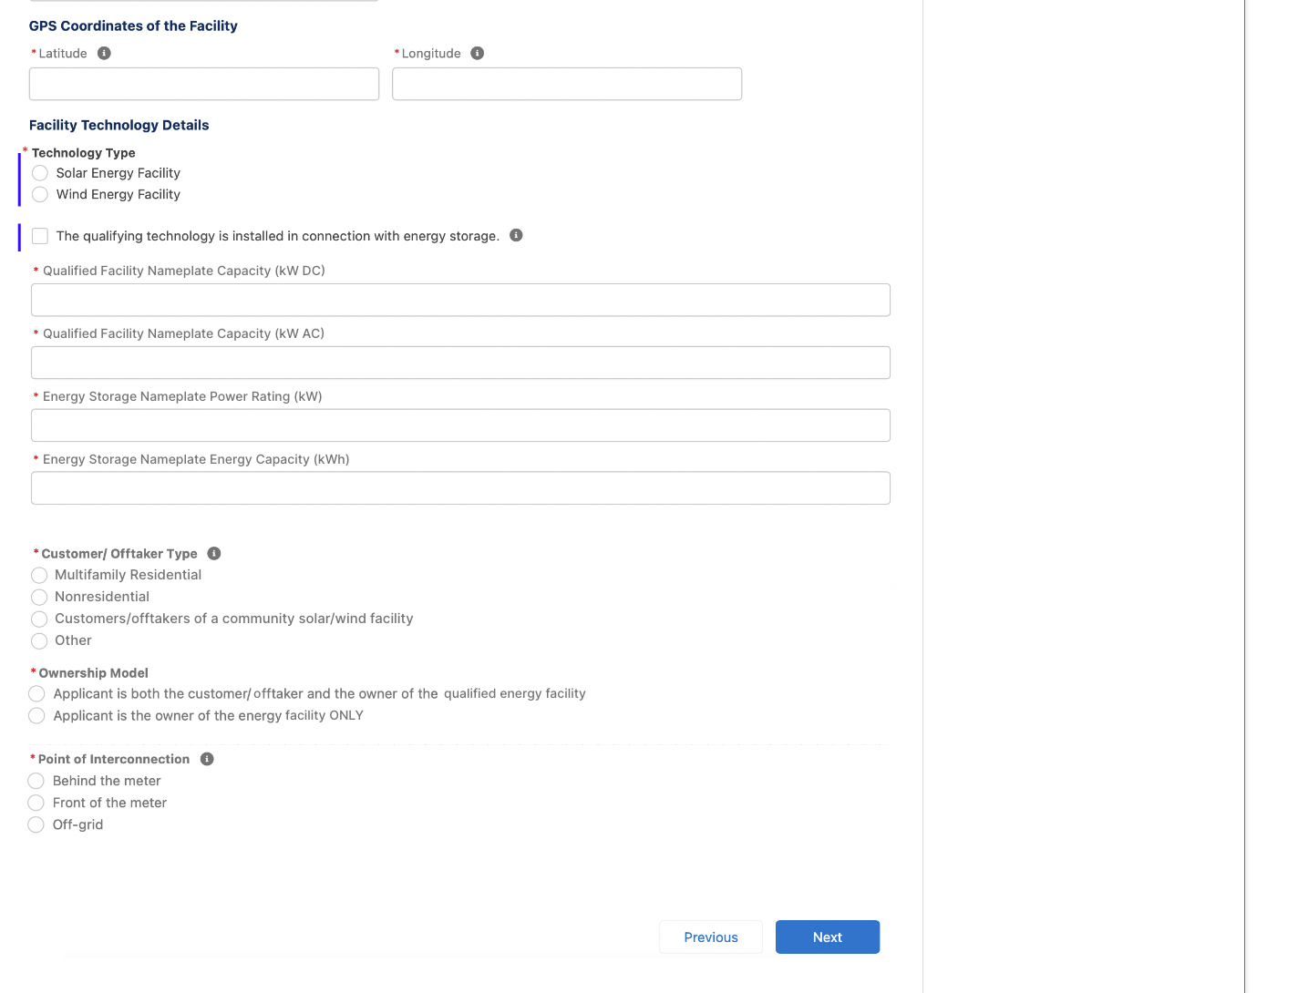
Application for Allocation
1c
Applicants will be prompted to enter all Facility Information and Details including address, latitude/longitude, technology type, facility size, cost, etc.
Applicants will enter the facility Latitude and Longitude.
Applicants will select the facility Technology Type (Solar or Wind) and identify if the facility includes Energy Storage.
Applicants will enter the energy generating capacity of the facility.
Note: fields are conditional based on the technology type selected and energy storage identification. For example, if I select Wind and no energy storage, I will be prompted to complete only Nameplate Capacity (kW AC)
Applicants will be prompted to enter Facility Usage details including Customer Type, Ownership Model, Point of Interconnection, and Additional Selection Criteria.
Note: Facility Usage is conditional for each subcategory based on requirements outlined in guidance. Questions and response options will differ across each subcategory.
Once all required fields have been completed, applicants will select Next to move on to required documentation.

Slide 33
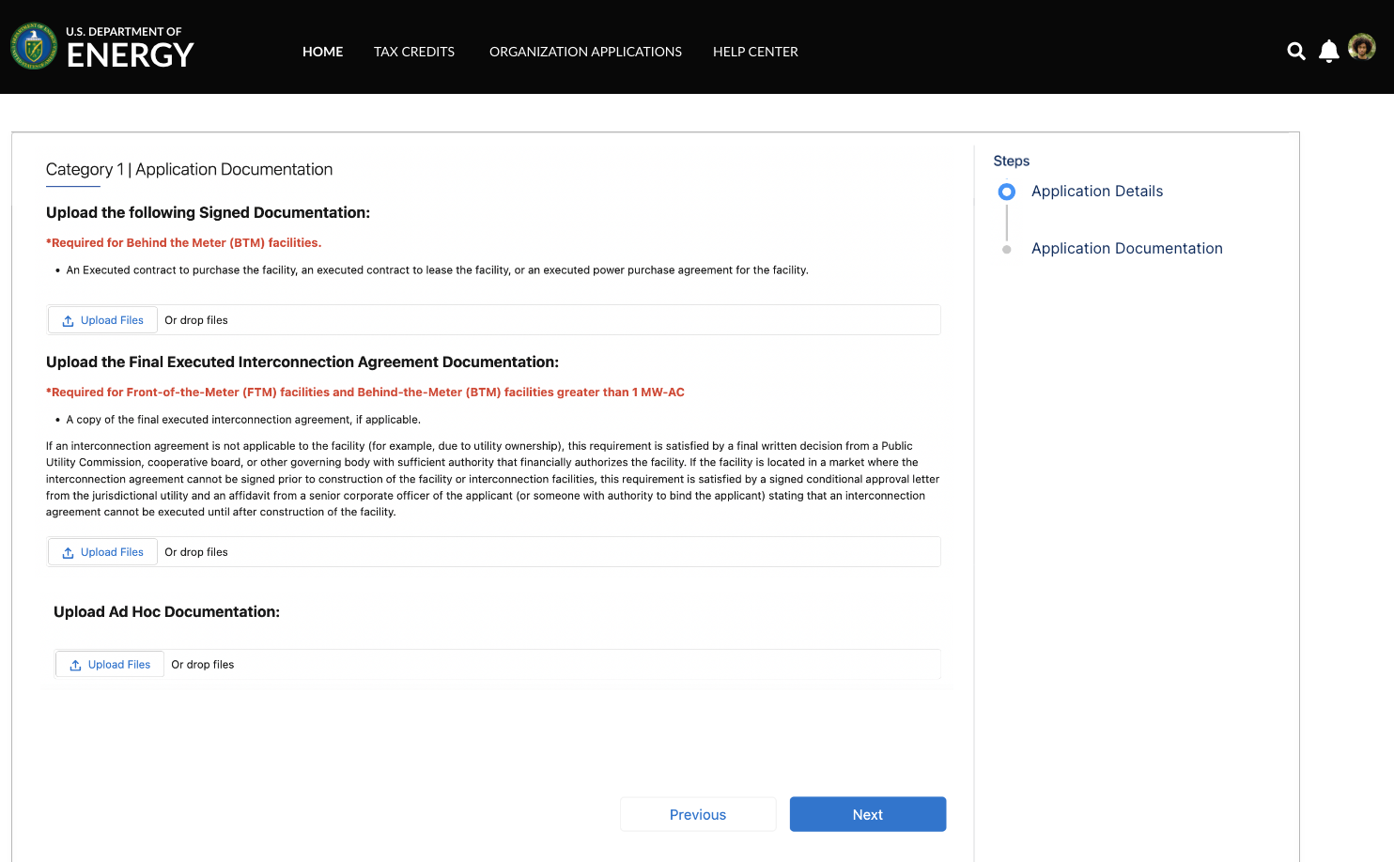
Application for Allocation
1c
Applicants will be prompted to attach all required documents.
executed
Applicants will be prompted to attach all required documents per category requirements outlined in the NPRM.
Note: Documentation requirements are conditional based on subcategory chosen by the applicant.
Once required documents have been attached, applicants will select Next to review their application prior to submission.

Slide 34
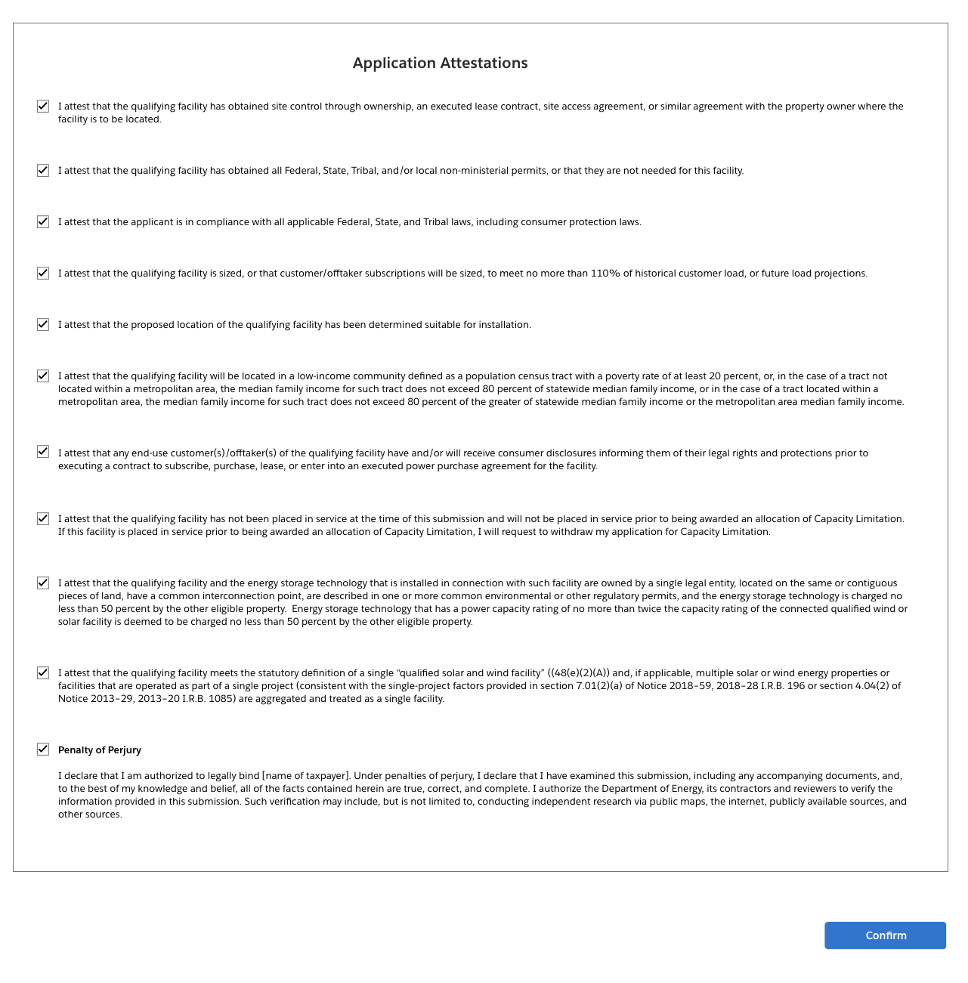
Application for Allocation
1c
Applicants will be prompted to review all information prior to submission.
Applicants will select Submit and be prompted to agree to required Attestations.
Applicants will be required to Attest to all required Attestations prior to submission. Note: all Attestations are conditional based on subcategory selected and applicant responses.
Once applicants have attested, they can confirm submission of their 48(e) application for allocation

Slide 35
Application for Allocation
1d
Applicants will be prompted to enter all Facility Information and Details including address, latitude/longitude, technology type, facility size, cost, etc.
Applicants will enter all Facility Identification Details including optional Project Name and Facility Street Address.

Slide 36
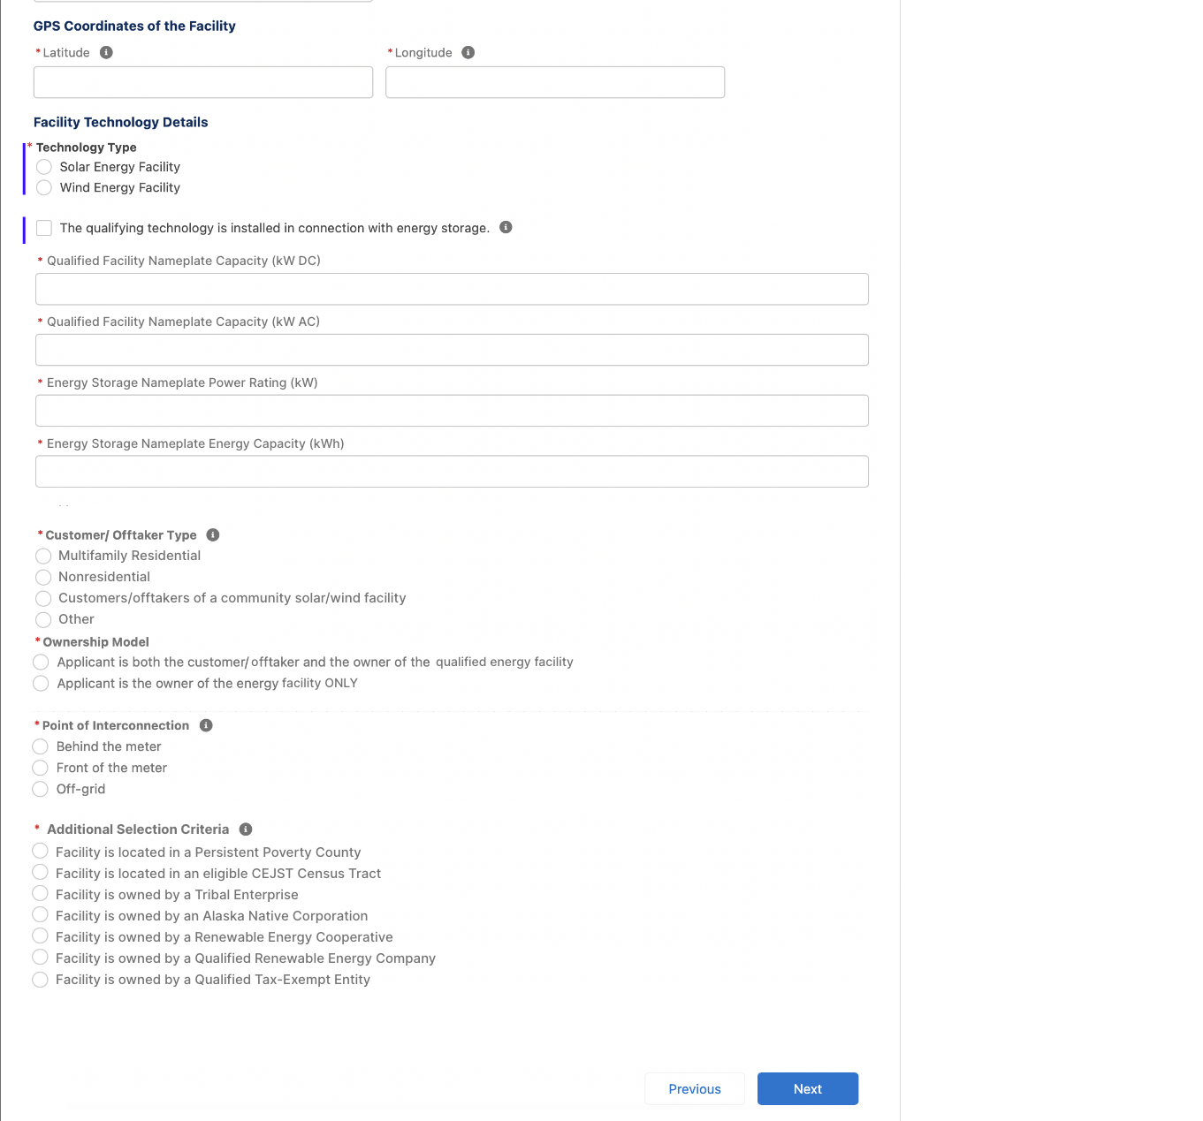
Application for Allocation
1d
Applicants will be prompted to enter all Facility Information and Details including address, latitude/longitude, technology type, facility size, cost, etc.
Applicants will enter the facility Latitude and Longitude.
Applicants will select the facility Technology Type (Solar or Wind) and identify if the facility includes Energy Storage.
Applicants will enter the energy generating capacity of the facility.
Note: fields are conditional based on the technology type selected and energy storage identification. For example, if I select Wind and no energy storage, I will be prompted to complete only Nameplate Capacity (kW AC)
Applicants will be prompted to enter Facility Usage details including Customer Type, Ownership Model, Point of Interconnection, and Additional Selection Criteria.
Note: Facility Usage is conditional for each subcategory based on requirements outlined in guidance. Questions and response options will differ across each subcategory.
Once all required fields have been completed, applicants will select Next to move on to required documentation.

Slide 37
Application for Allocation
1d
Applicants will be prompted to attach all required documents.
executed
Applicants will be prompted to attach all required documents per category requirements outlined in the NPRM.
Note: Documentation requirements are conditional based on subcategory chosen by the applicant.
Once required documents have been attached, applicants will select Next to review their application prior to submission.

Slide 38
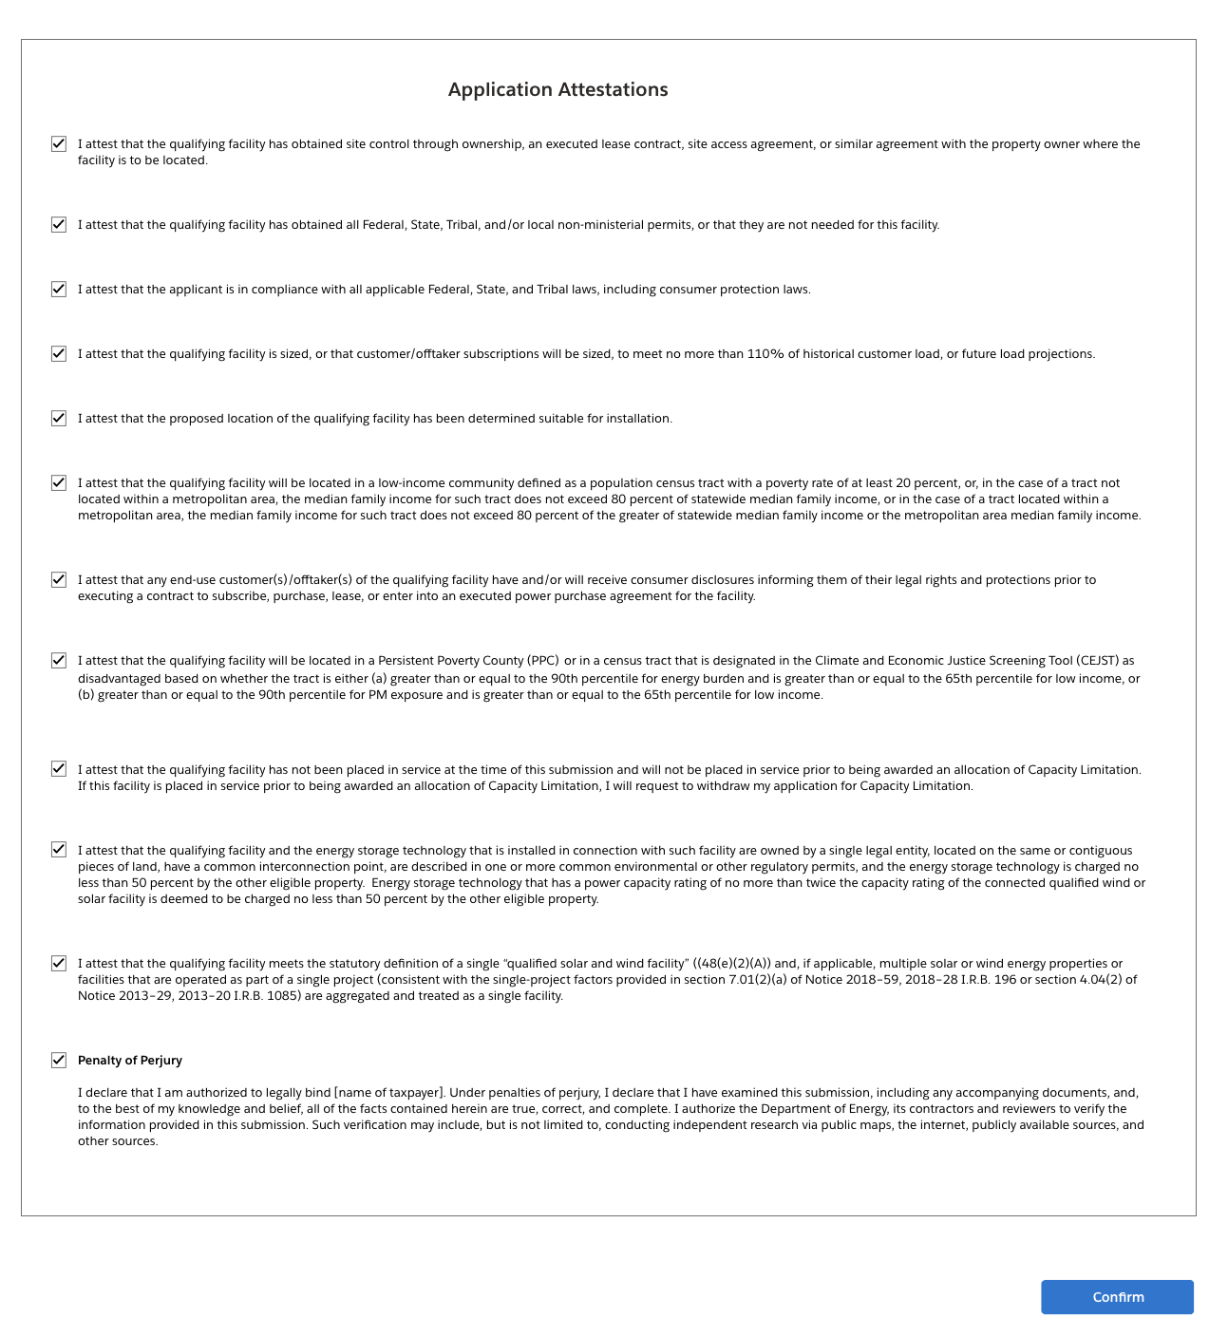
Application for Allocation
1d
Applicants will be prompted to review all information prior to submission.
Applicants will select Submit and be prompted to agree to required Attestations.
Applicants will be required to Attest to all required Attestations prior to submission. Note: all Attestations are conditional based on subcategory selected and applicant responses.
Once applicants have attested, they can confirm submission of their 48(e) application for allocation

