Slide 1
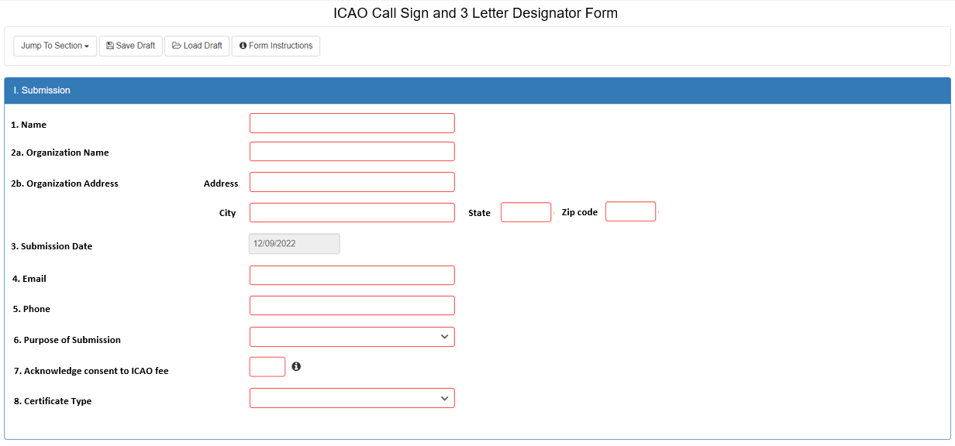
Proposed Call Sign Form

Slide 2
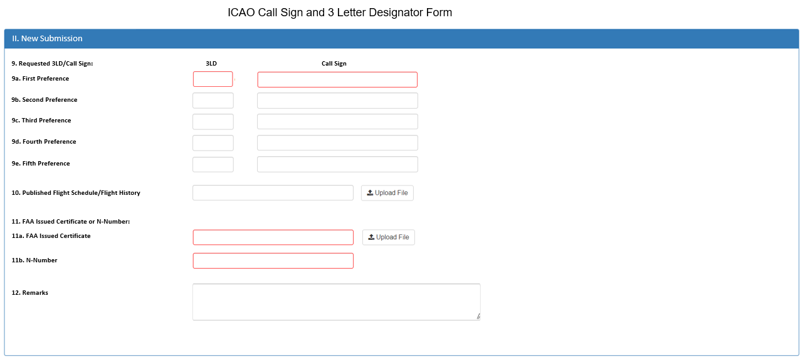
Proposed Call Sign Form

