Slide 1


Immigration Records and Identity Services Directorate
myE-Verify Screens
Updated: October 21, 2020

Slide 2
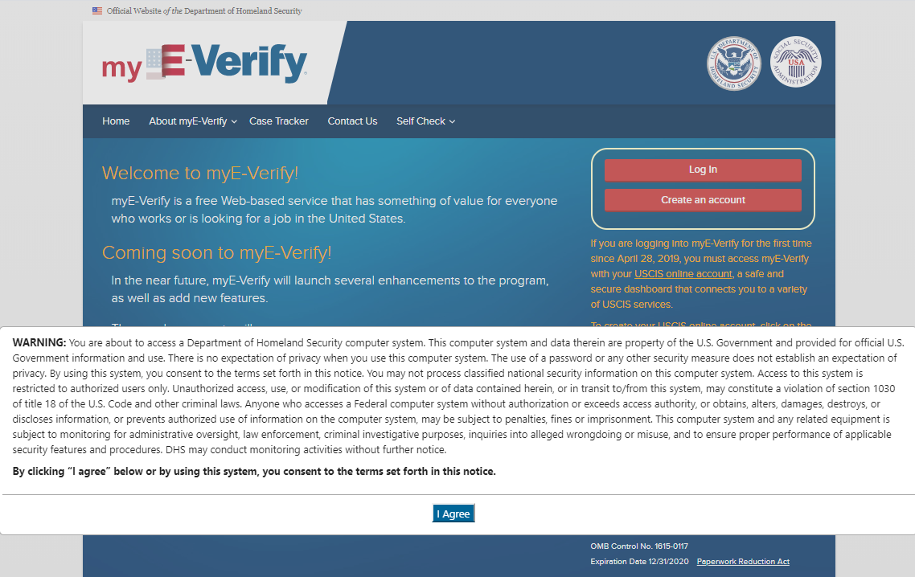
myE-Verify – System Security Warning
Notes:
Click “I Agree”

Slide 3
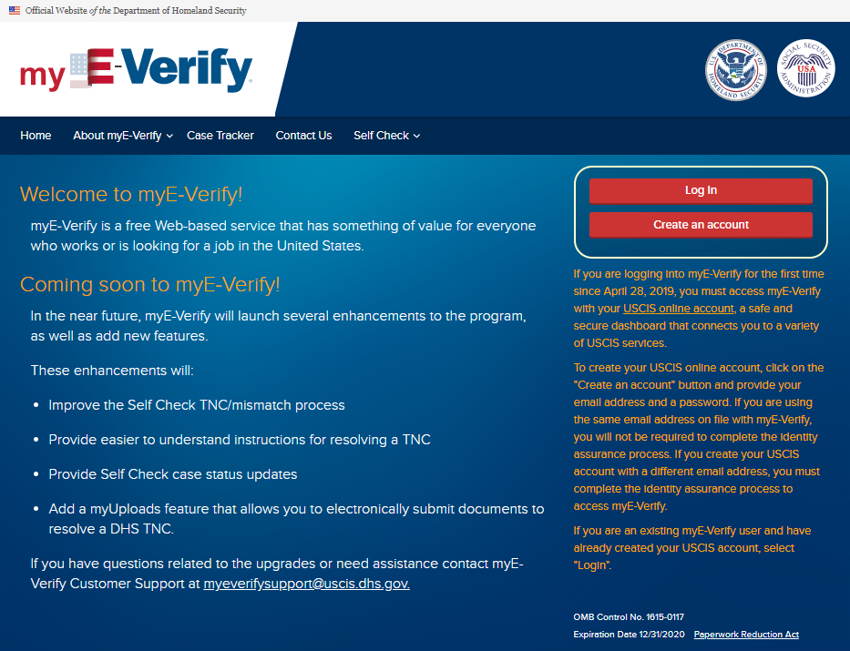
myE-Verify Home Page
Notes:
Click Log In – Takes user to slide 4
Click Create an Account – Takes user to slide 11

Slide 4
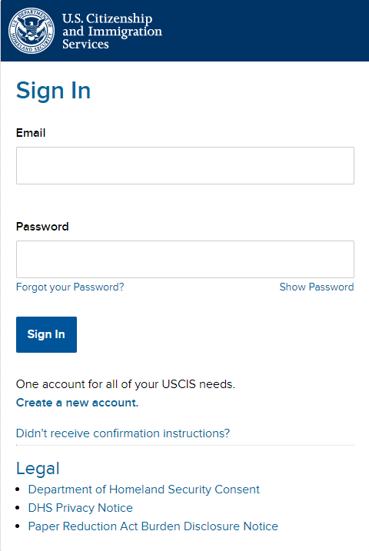
myAccount Login/Create Account
Self Service tool to reset password
Notes:
Enter email address and password
“Forgot your Password” – see Slide 7

Slide 5
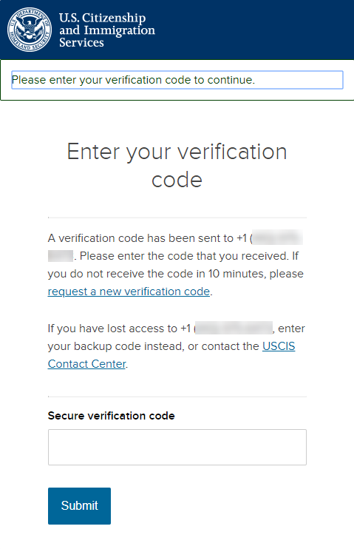
myAccount Login – Two-Step Verification
Notes:
Verification code will be sent to the preferred method the user selected during account creation (text, email, or authenticator app)

Slide 6
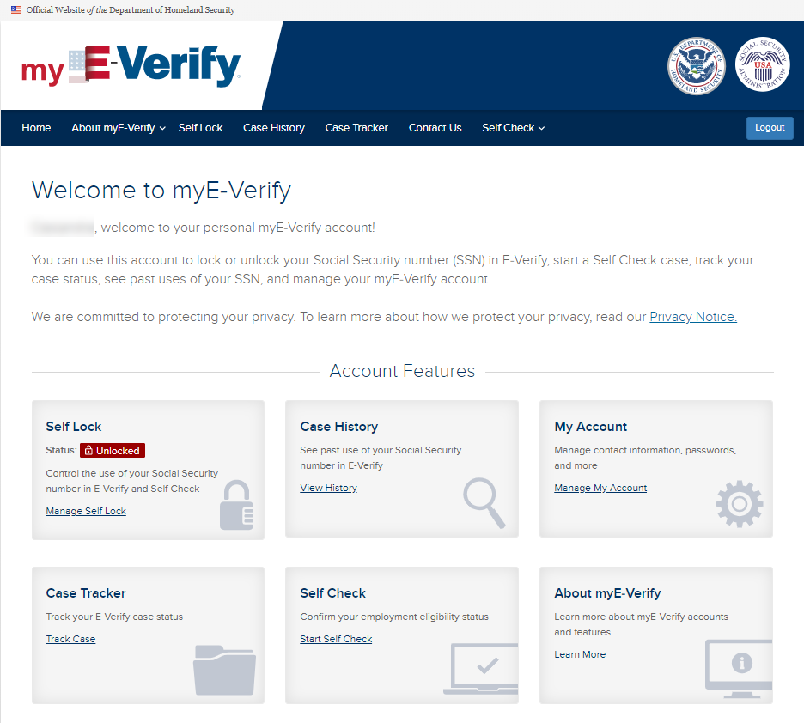
myE-Verify Sign In – Existing User

Slide 7
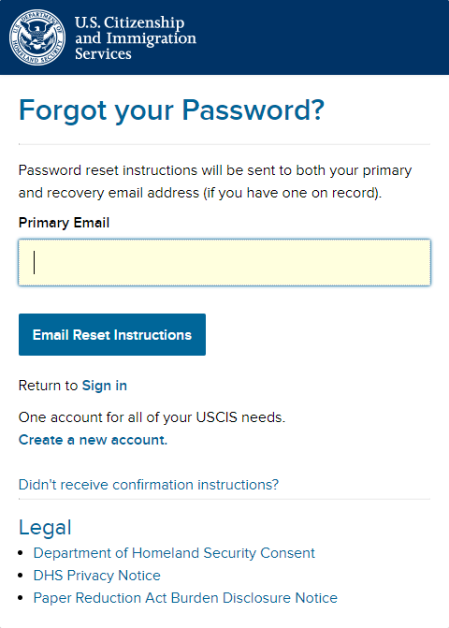
myAccount – Forgot Password
Notes:
Enter email address used to create the account. A link will be sent to this email address.
If the user can no longer access the email account, they will not be able to reset their password and must create a new account.

Slide 8
myAccount – Forgot Password Email Link
From:
MyAccount@uscis.dhs.gov
Subject:
Password reset instructions
Date:
Mar 20, 2020 03:02:33 AM UTC
To:
qaicam+pwd_sms@gmail.com
You have asked USCIS to reset your password to log in to your USCIS Account. To confirm your request, please click on the link below, or copy and paste the entire link into your browser.
https://myaccount-dt.uscis.dhs.gov/users/password/edit?reset_password_token=MhBdAs-BG1yRLttji2Bz
Please note that this confirmation link expires in 6 hours and may require your immediate attention if you wish to access your online account in the future.
PLEASE DO NOT REPLY TO THIS MESSAGE
Notes:
Click on the link to continue with the password reset.

Slide 9
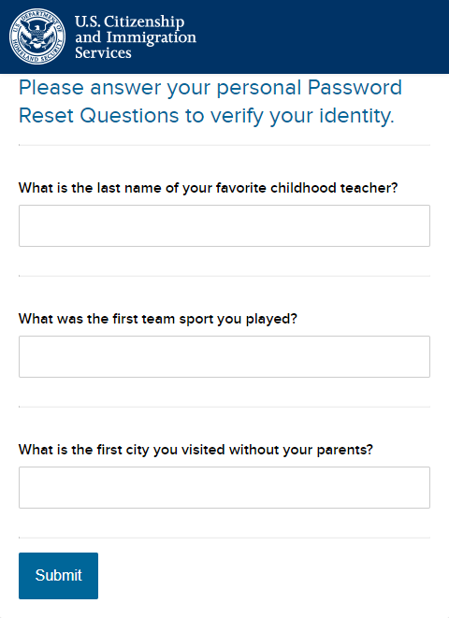
myAccount – Forgot Password
Notes:
Answer the password reset challenge questions established during account creation.

Slide 10
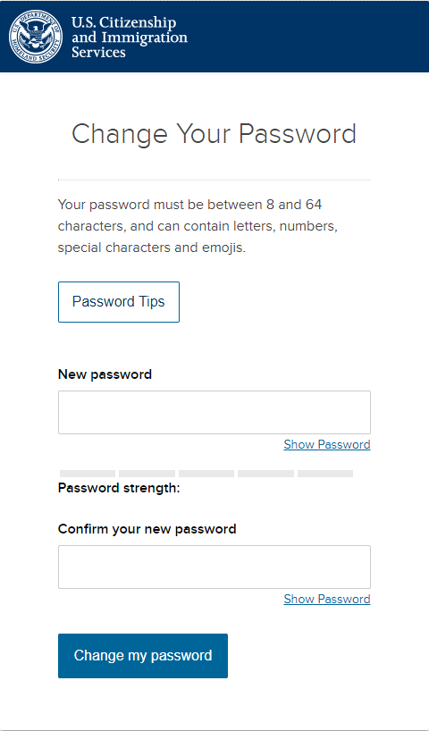
myAccount – Forgot Password
Notes:
Enter the new password.

Slide 11
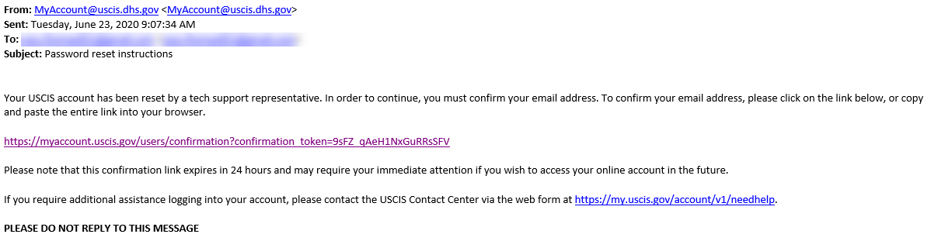
myAccount – Tech Support PW Reset
Notes:
Enter the new password.

Slide 12
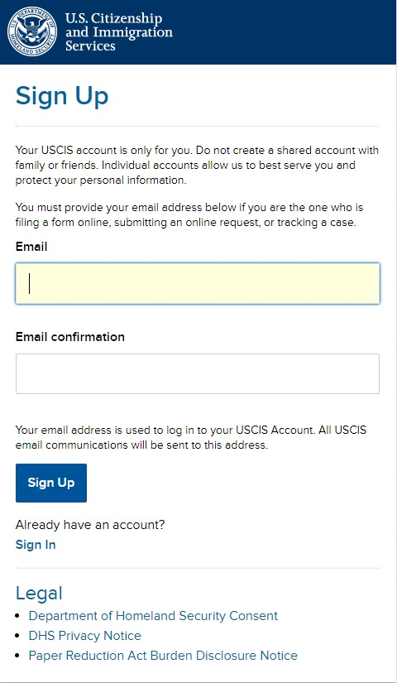
myAccount – Sign Up
Notes:
See Slides 2 and 3 for the myE-Verify Home Page and the “Create an Account” button.
Enter valid email address. Be sure this is your email and you can access anytime.
A myAccount is required to access myE-Verify. myAccount provides a single sign on experience for myE-Verify, myUSCIS, and FIRST. Users must request access to each program individually.

Slide 13
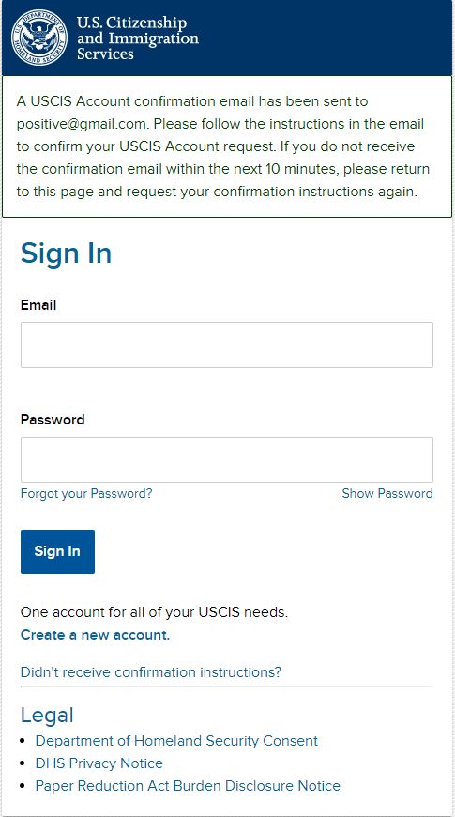
myAccount – Confirm Email
Notes:
A link is sent to the email address entered on screen 11.

Slide 14
myAccount – Confirm Email
To continue creating your USCIS Account, you must confirm your email address. To confirm your email address, please click on the link below, or copy and paste the entire link into your browser.
https://myaccount-dt.uscis.dhs.gov/users/confirmation?confirmation_token=S8ijo6puKF-a6dP-gNBq
Please note that this confirmation link expires in 24 hours and may require your immediate attention if you wish to access your online account in the future.
If you require additional assistance logging into your account, please contact the USCIS Contact Center via the web form at https://my.uscis.gov/account/v1/needhelp.
PLEASE DO NOT REPLY TO THIS MESSAGE
Notes:
Click on the link to continue with account creation.

Slide 15
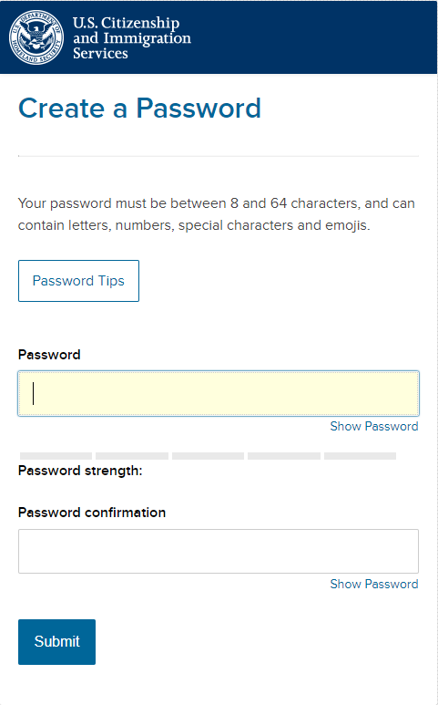
myAccount – Create Password
Notes:
Enter a valid password.

Slide 16
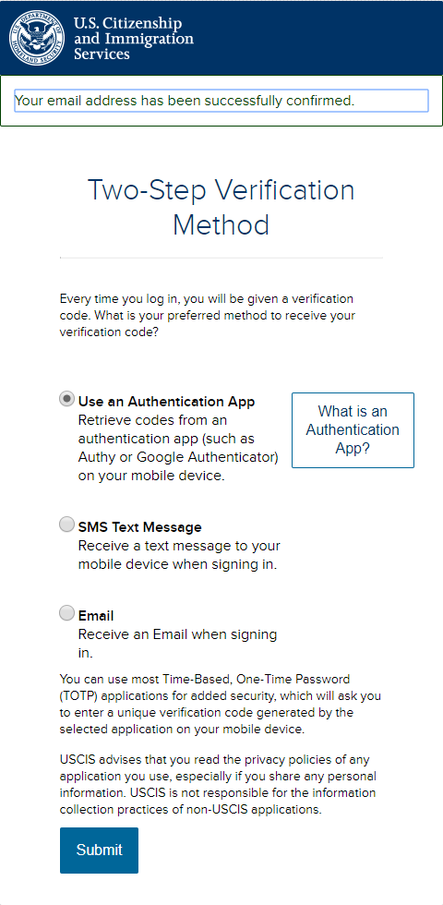
myAccount – Two-Step Verification
Notes:
Two-Step Verification is used each time you log into myE-Verify. A code is sent to the method you choose on this screen. You can change your preferred method anytime after logging into your account and updating your account information.

Slide 17
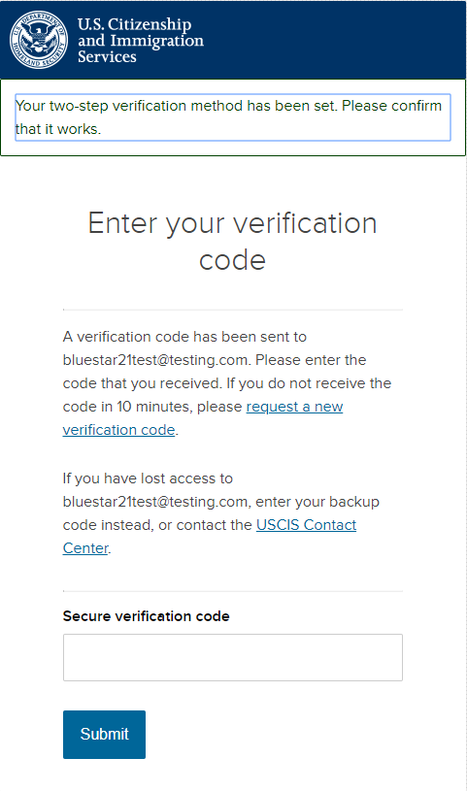
myAccount – Verification Code
Notes:
Enter the verification code.

Slide 18
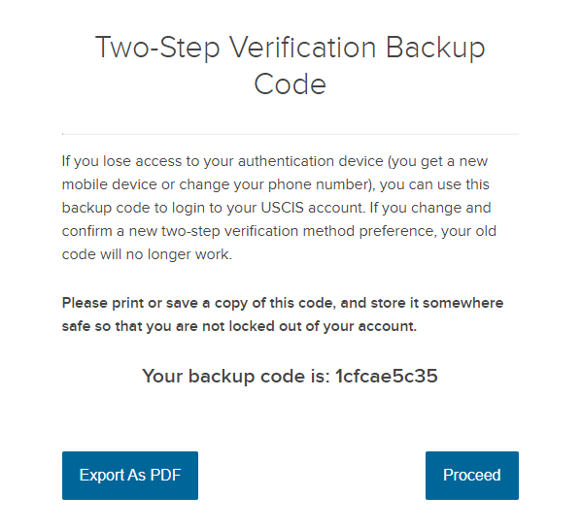
myAccount – Verification Backup Code
Notes:
A Two-Step Backup Code is provided in case you get a new mobile device or change your phone number. If you are not able to receive the two-step verification code sent during login, you can enter this backup code instead.

Slide 19
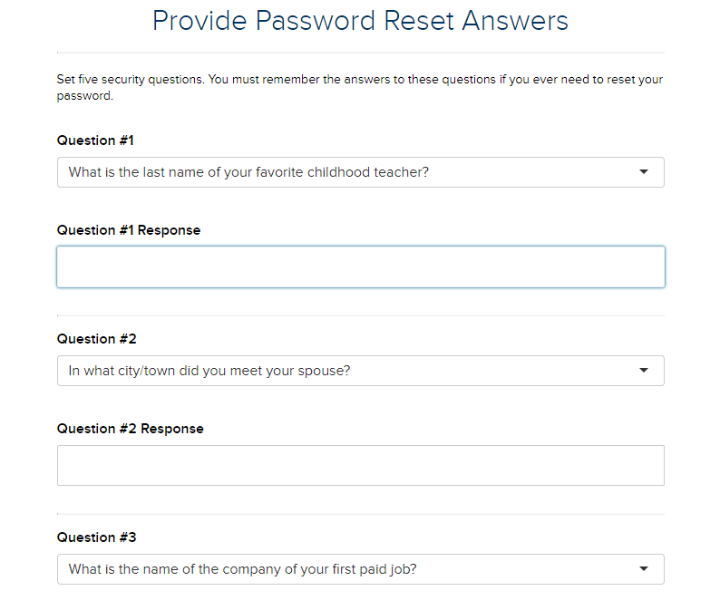
myAccount – Password Reset QAs
Notes:
Select password challenge questions and provide answers for each question. Users are restricted from entering “A” in the response field.

Slide 20
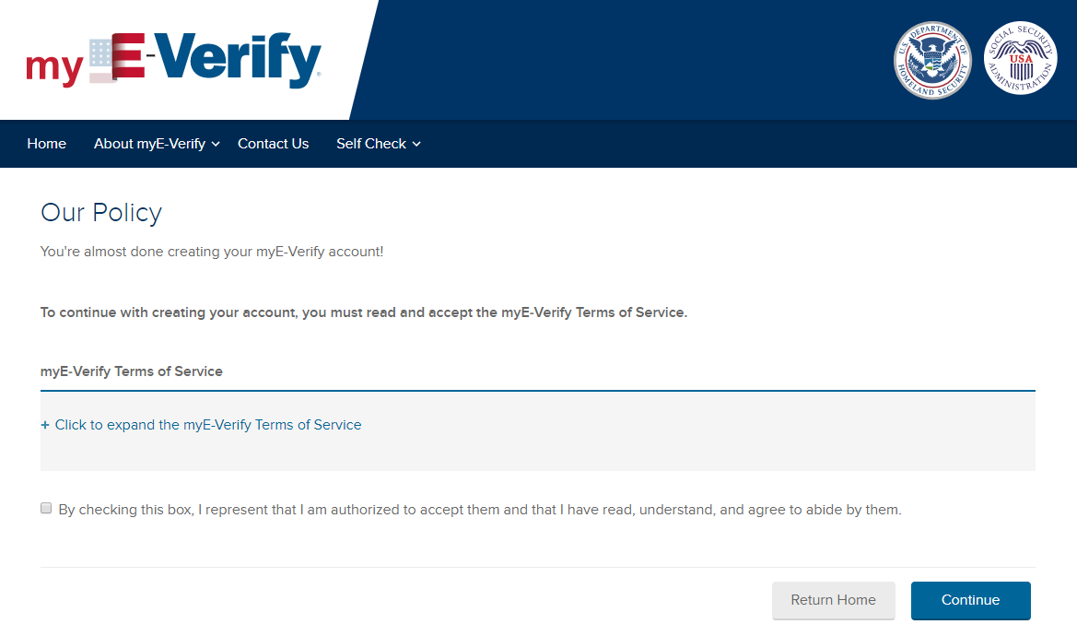
Terms of Service
Notes:
Agree to the myE-Verify Terms of Service.

Slide 21
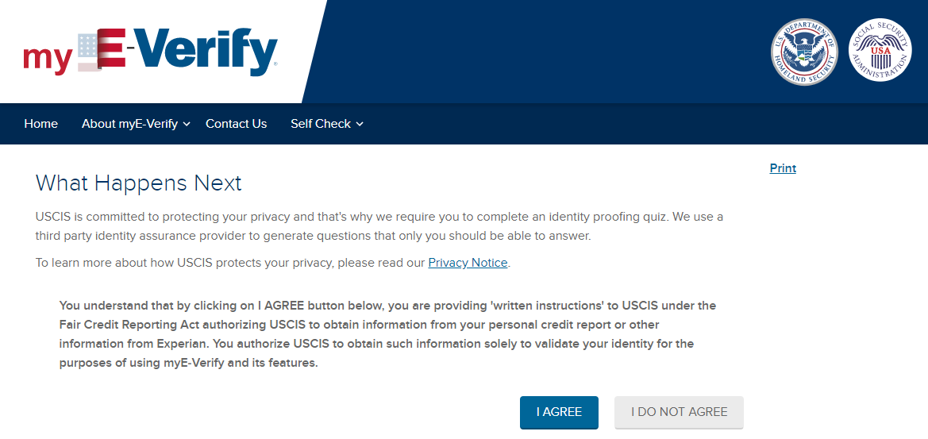
What Happens Next for New Users
Notes:
Information on identity proofing. All users must complete and pass identity proofing before gaining access to myE-Verify. USCIS uses an external third-party vendor for this service and we do not know the questions you are asked or the answers you provide. We also do not have insight into why you may not pass identity proofing.

Slide 22
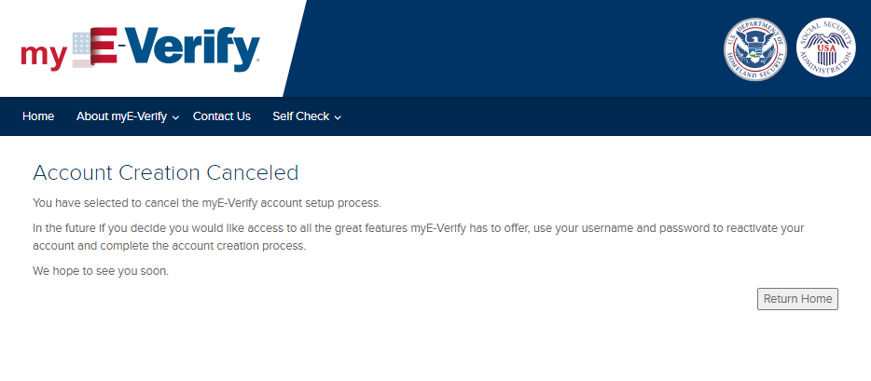
What Happens Next – Do Not Agree
Notes:
Enter identifying information. The information entered on this screen cannot be changed after completing and passing the quiz. This prevents misuse of the system.

Slide 23
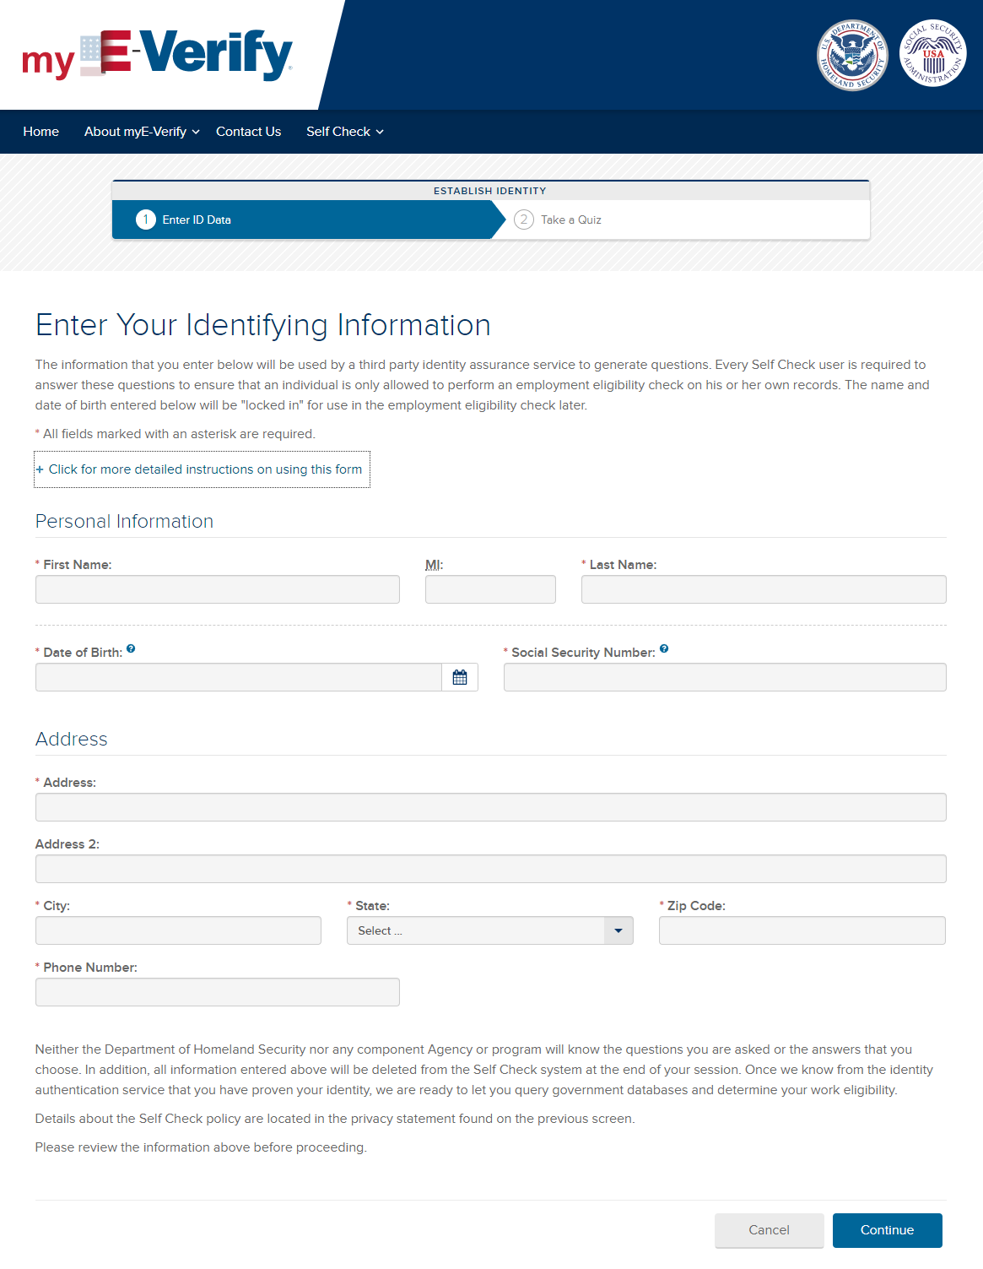
Identity Proofing Quiz
Notes:
Enter identifying information. The information entered on this screen cannot be changed after completing and passing the quiz. This prevents misuse of the system.

Slide 24
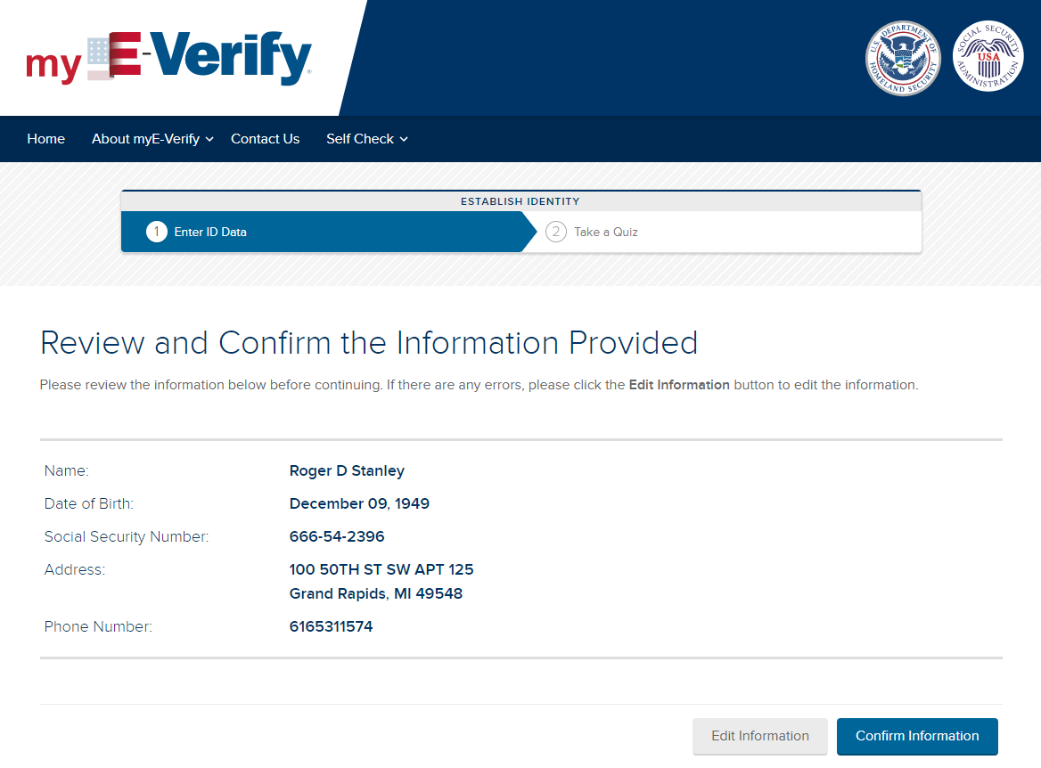
Identity Proofing Quiz

Slide 25
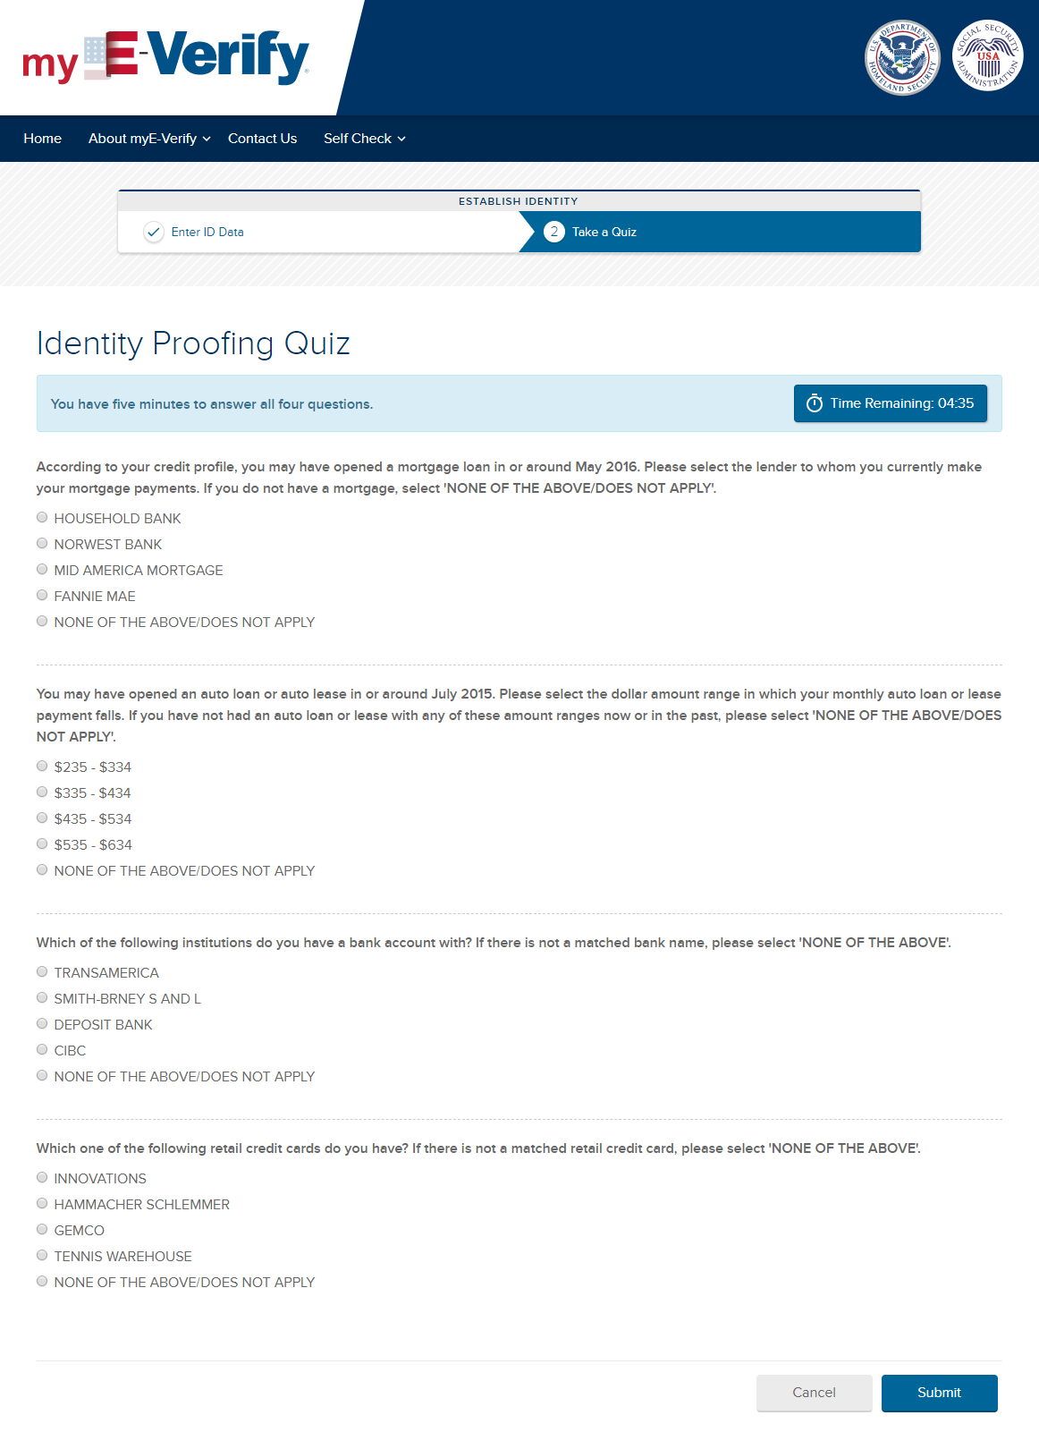
Identity Proofing Quiz
Notes:
Total of four questions. User must successfully answer ? (2 or 3)

Slide 26
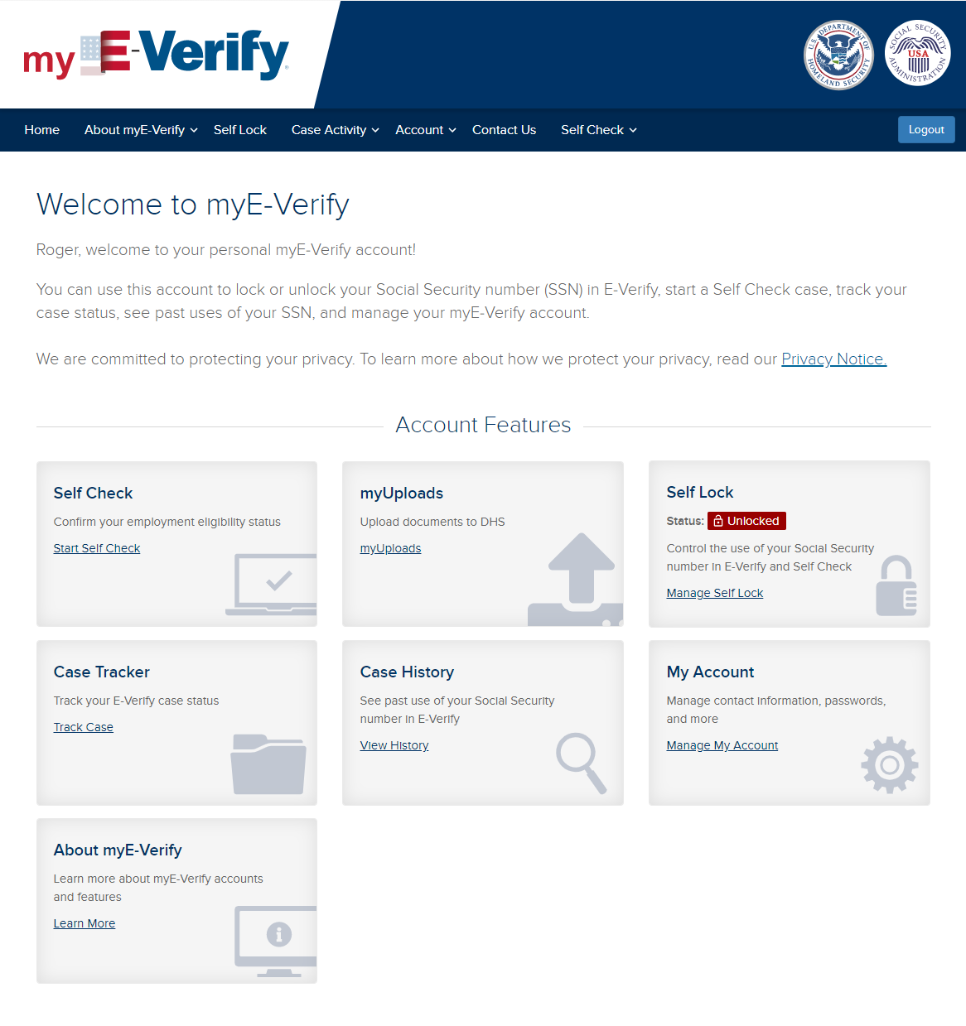
Identity Proofing Quiz – Pass Successful

Slide 27
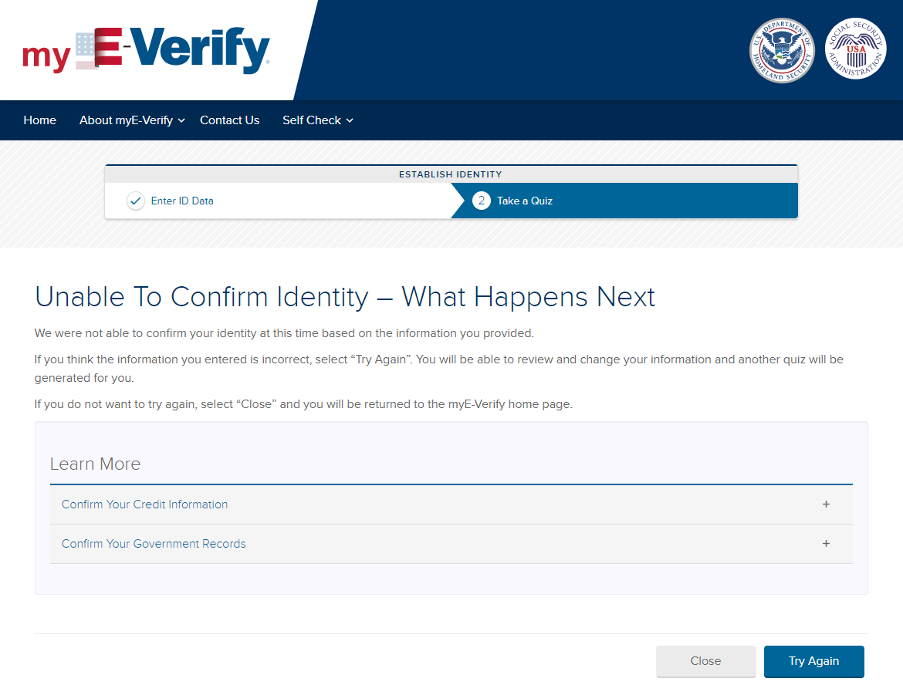
Identity Proofing Quiz – Fail
Notes:
User can attempt the quiz again. If they fail a second time they have to wait 72 hours to try again.

Slide 28
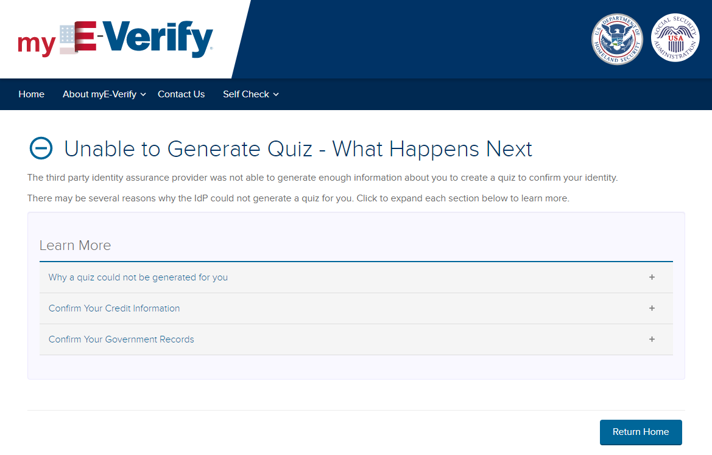
Identity Proofing Quiz – Unable to Generate Quiz
Notes:
This appears when the provider is not able to generate a quiz – typically this happens when the name, DOB, and/or SSN do not match or the person does not have enough credit history or financial footprint in the U.S. to generate at least 3 questions that can be validated.

Slide 29
myE-Verify Dashboard – Self Check

Slide 30
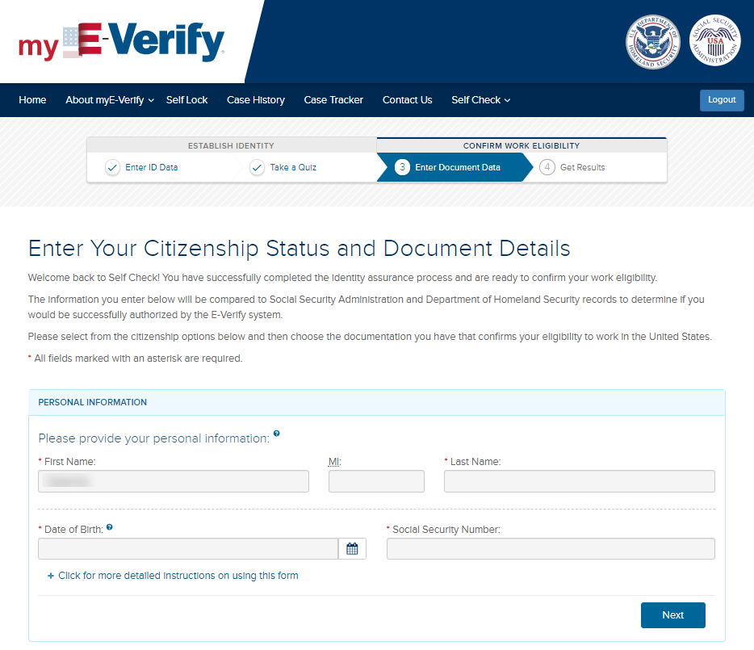
Self Check – Enter Personal Data

Slide 31
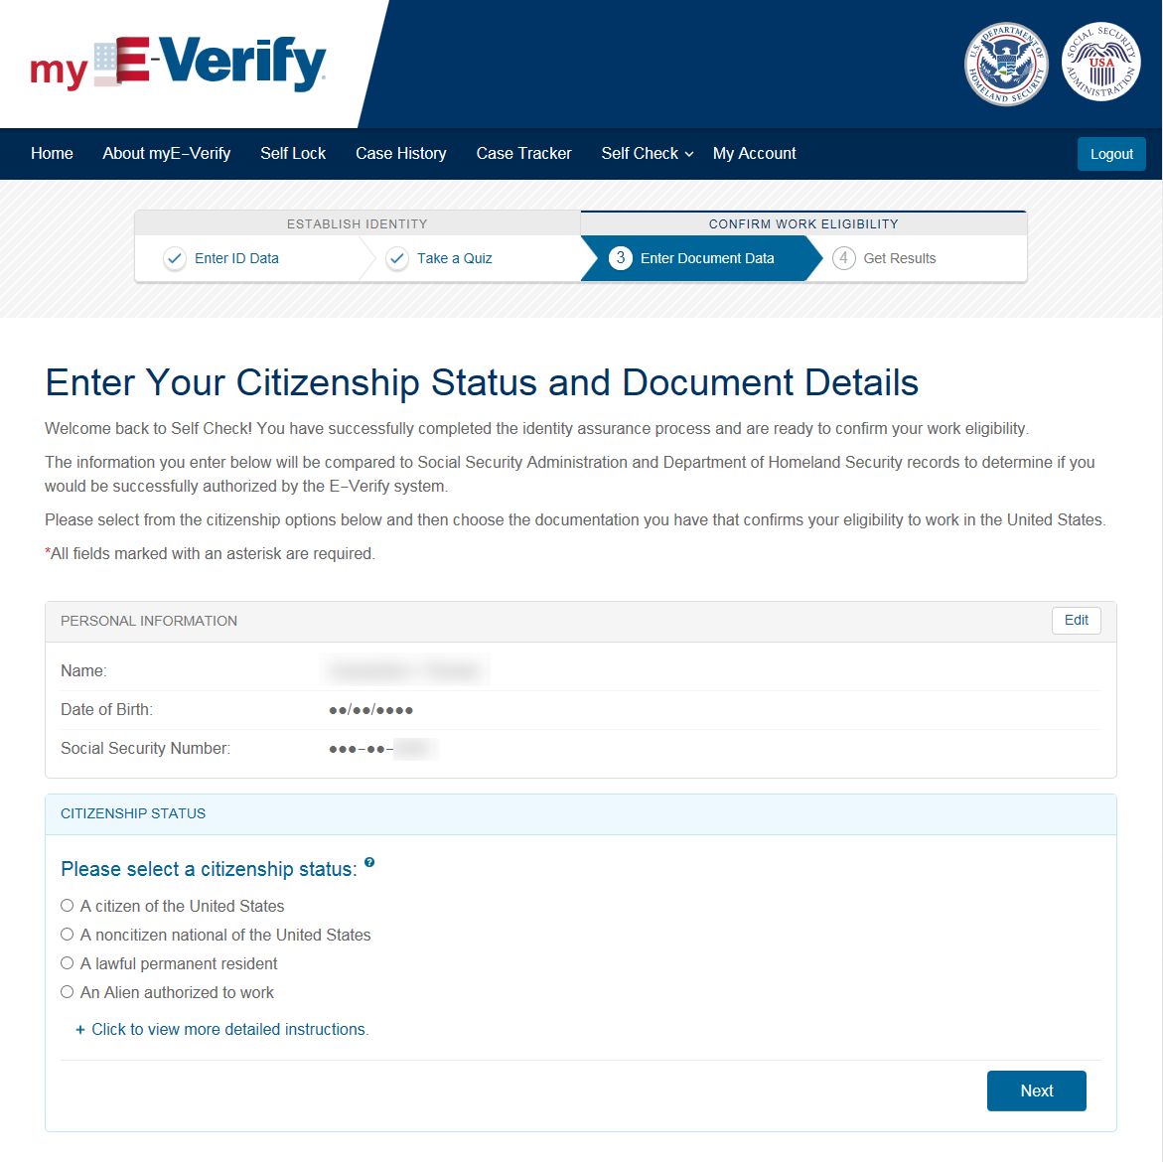
Self Check – Citizenship Selection

Slide 32
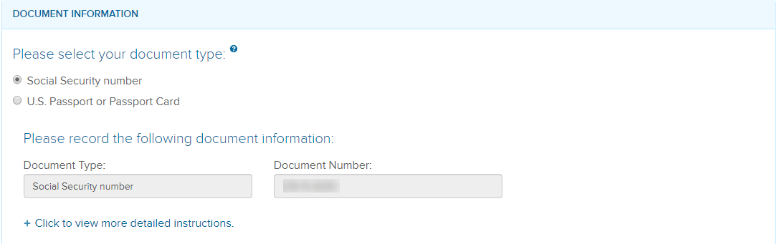
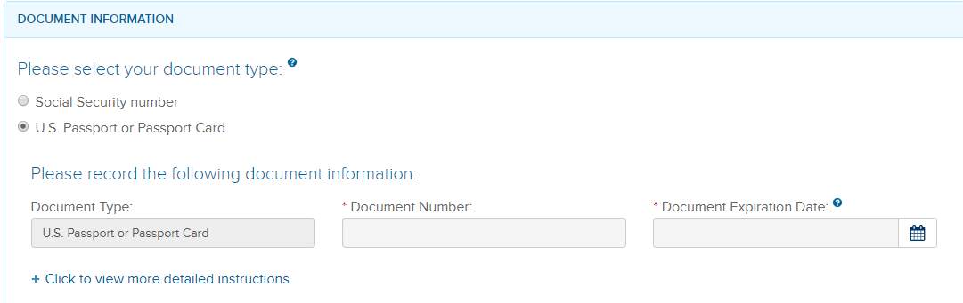
Self Check – Document Selection
U.S. Citizen
U.S. Citizen can choose SSN or U.S. Passport or Passport Card

Slide 33
Self Check – Document Selection
Noncitizen National of the United States
Noncitizen National of the United States can choose SSN or U.S. Passport or Passport Card

Slide 34
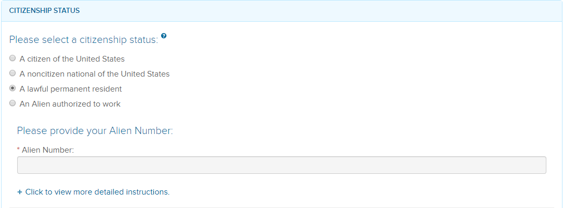
Self Check – Document Selection
Lawful Permanent Resident
LPR must provide A#
1

Slide 35
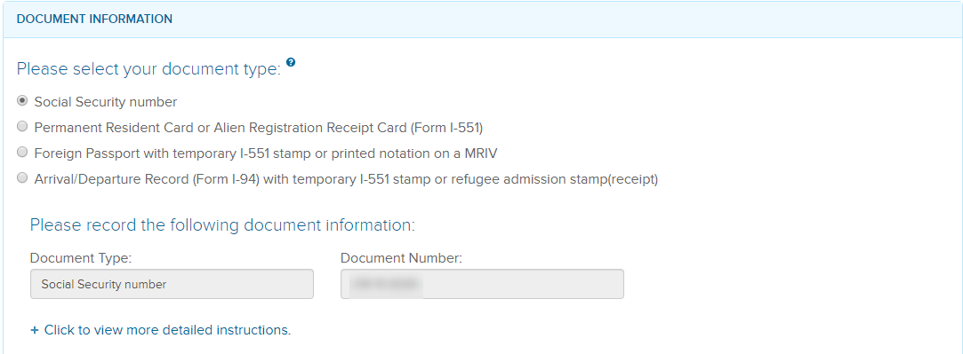
Self Check – Document Selection
Lawful Permanent Resident
After entering the A#, LPR can select from these documents
2A

Slide 36
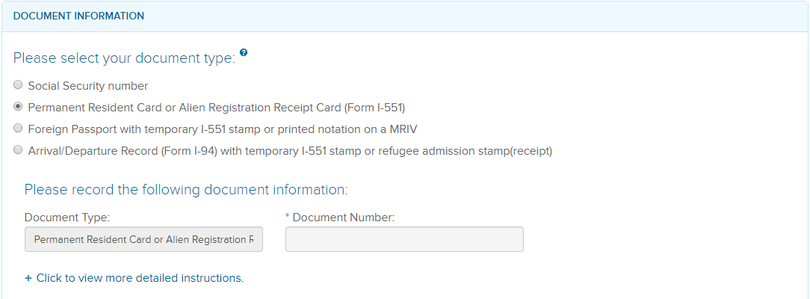
Self Check – Document Selection
Lawful Permanent Resident
2B

Slide 37
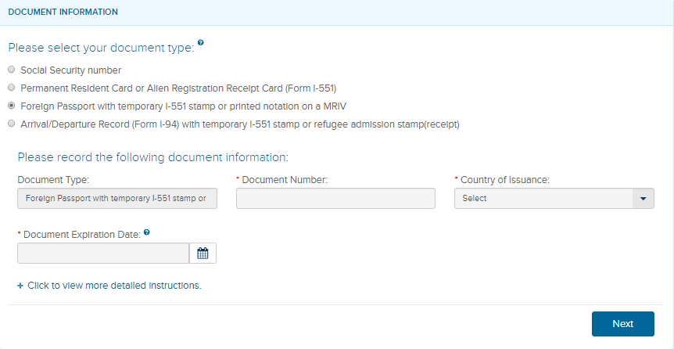
Self Check – Document Selection
Lawful Permanent Resident
2C

Slide 38
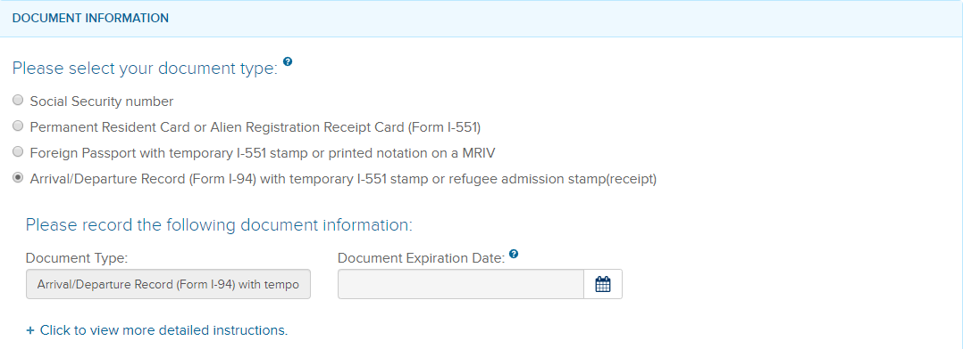
Self Check – Document Selection
Lawful Permanent Resident
2D

Slide 39
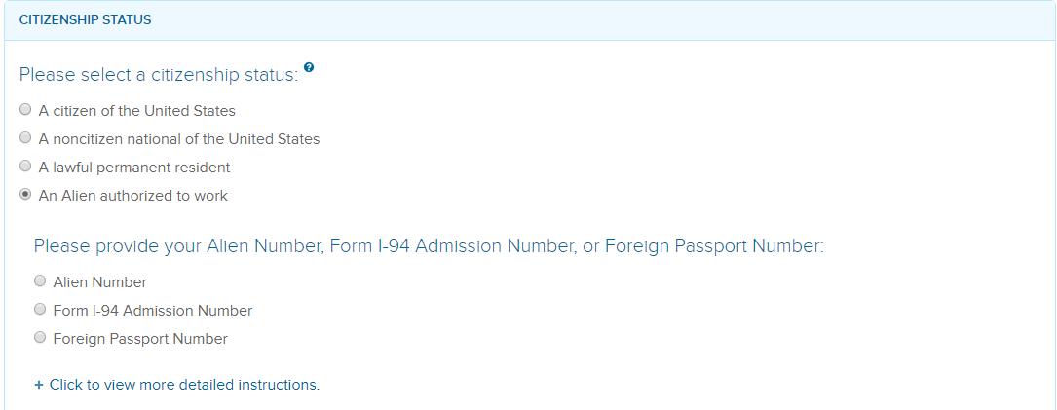
Self Check – Document Selection
Alien Authorized to Work
1
Alien Authorized to Work must provide A#, I-94 #, or Foreign Passport Number

Slide 40
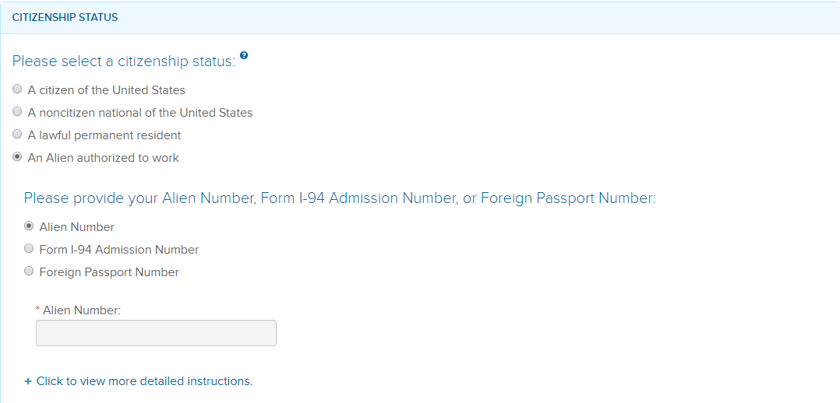
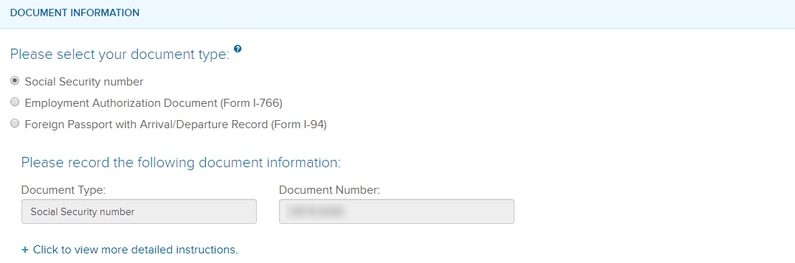
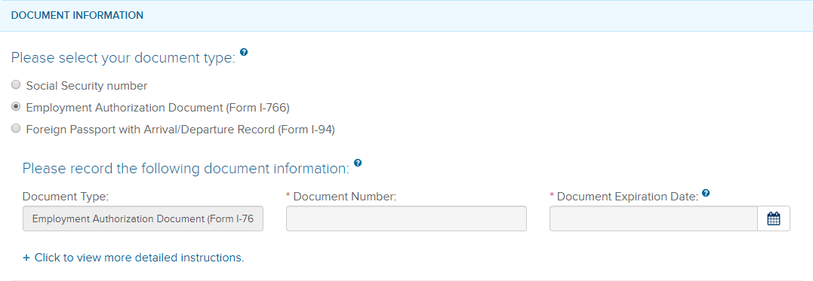
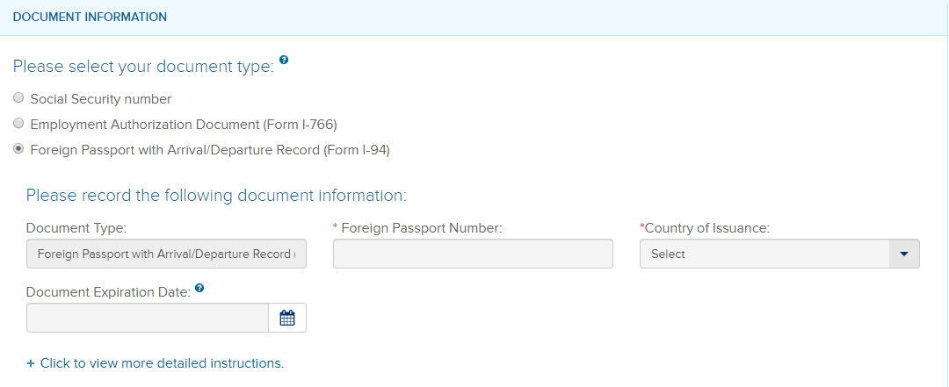
Self Check – Document Selection
Alien Authorized to Work
2A
1
2B
Alien Authorized to Work chooses A#, they can provide the following document types: Social Security Number, Employment Authorization Document, or Foreign Passport with Arrival/Departure Record
2C

Slide 41
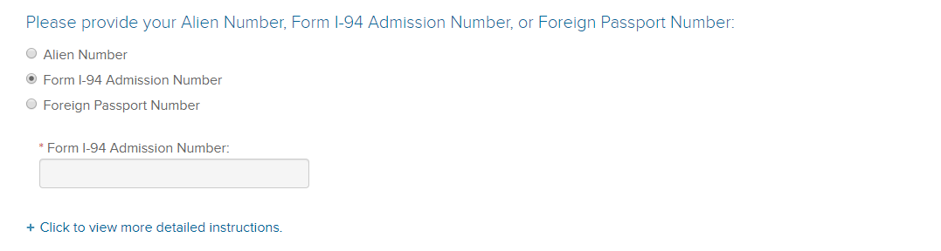
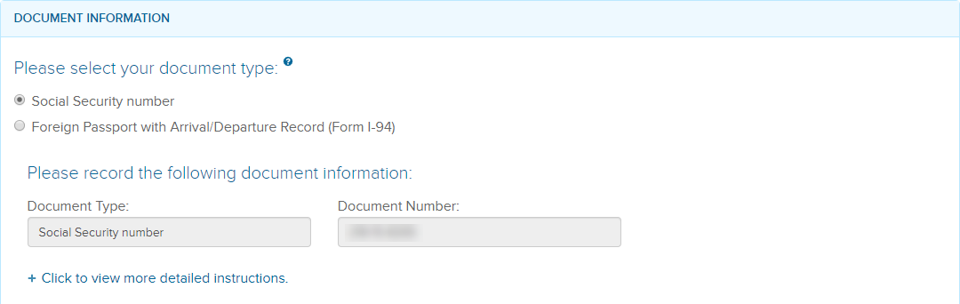
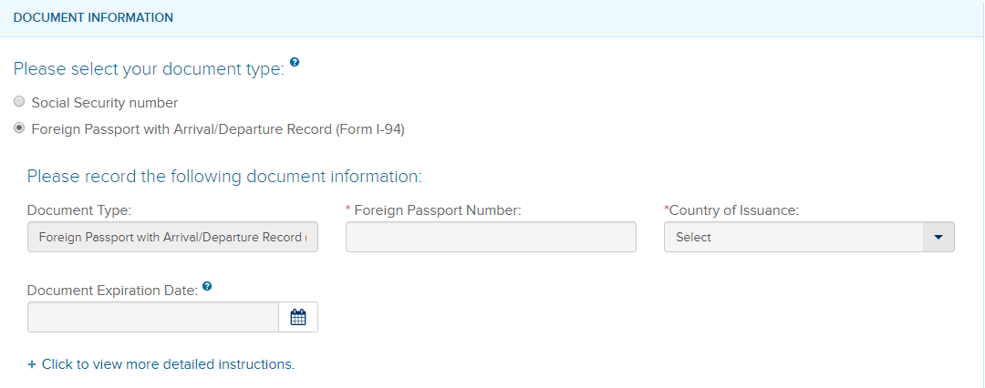
Self Check – Document Selection
Alien Authorized to Work
1
2A
Alien Authorized to Work chooses Form I-94#, they can provide the following document types: Social Security Number or Foreign Passport with Arrival/Departure Record
2B

Slide 42
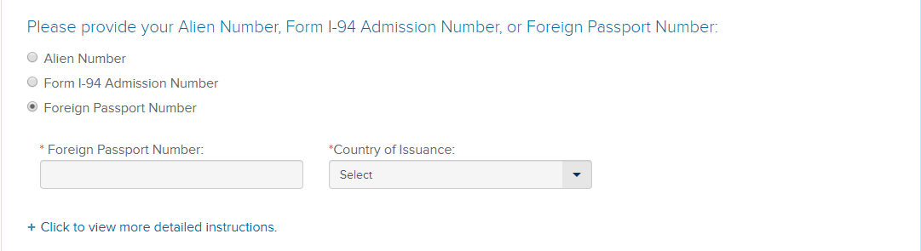
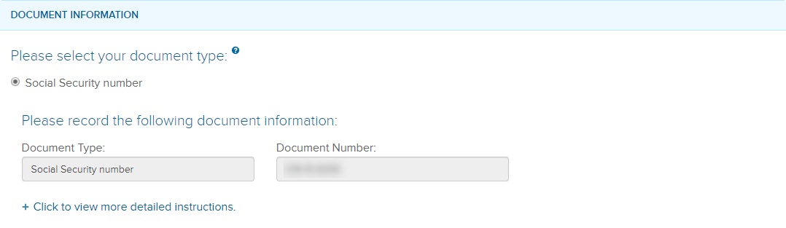
Self Check – Document Selection
Alien Authorized to Work
1
2
Alien Authorized to Work chooses A#, they can provide the following document types: Social Security Number.

Slide 43
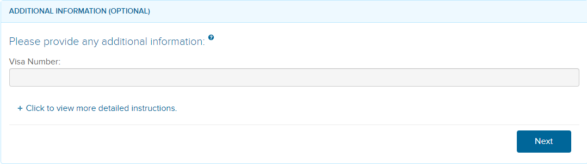
Self Check – Document Selection
Visa Number – Optional
LPR: Foreign Passport with temporary I-551 stamp or printed notation on a MRIV
Alien Authorized to Work: Alien Number: Foreign Passport with Arrival/Departure Record (Form I-94)
Alien Authorized to Work: Form I-94 Admission Number: Foreign Passport with Arrival/Departure Record (Form I-94)

Slide 44
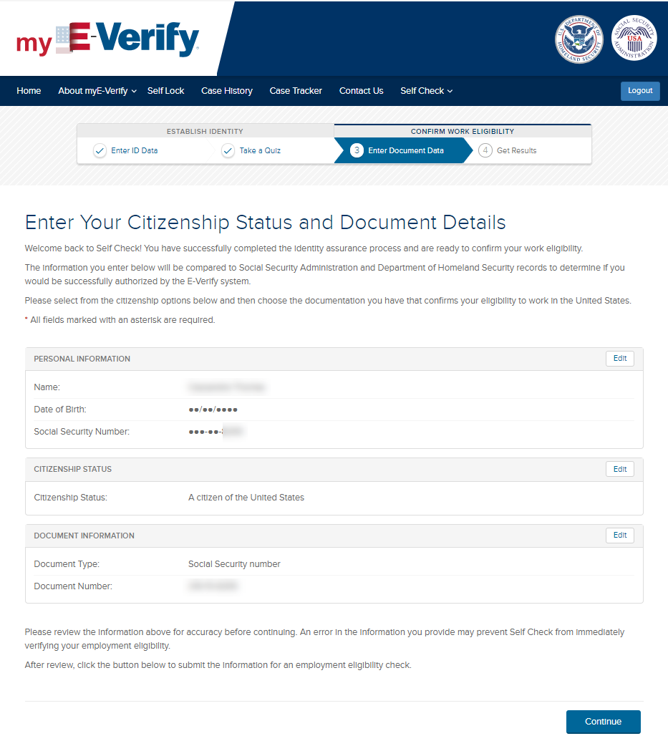
Self Check – Confirm Information

Slide 45
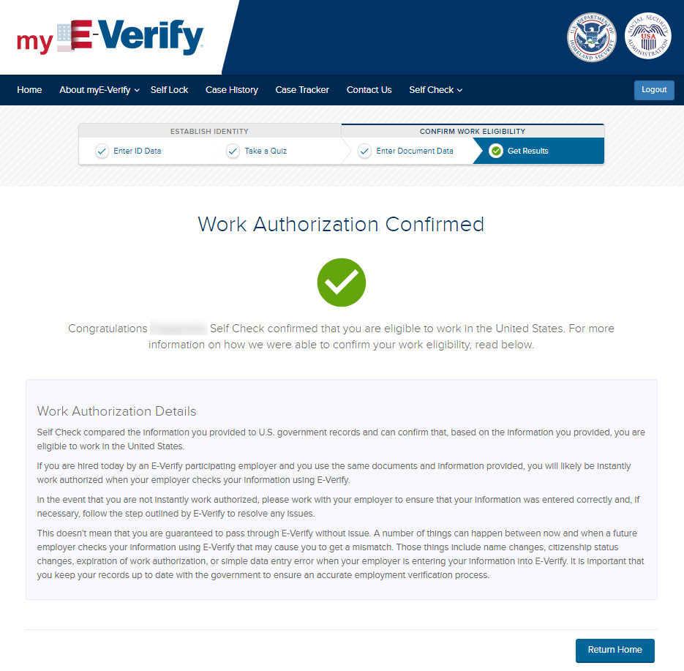
Self Check – Case Results
Employment Authorized

Slide 46
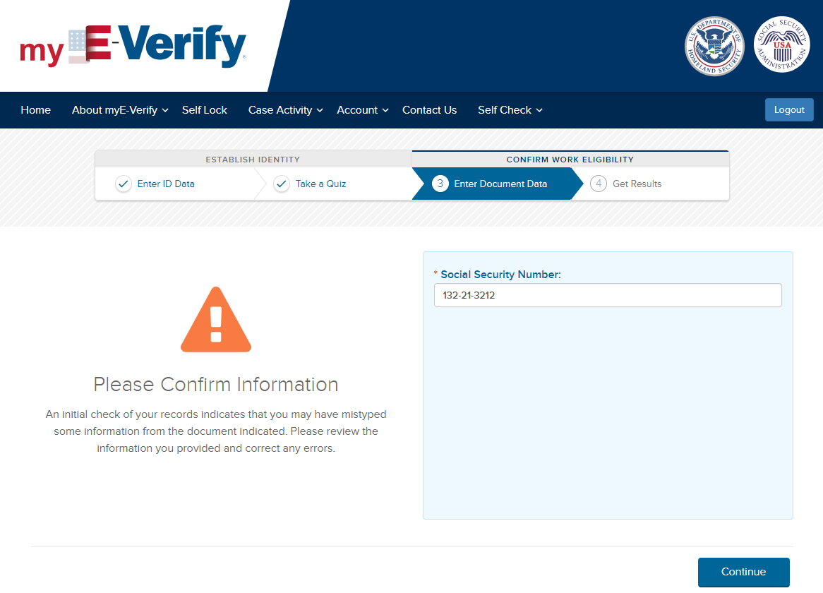
Self Check – Case Results
SSA Pre-Tentative Nonconfirmation

Slide 47
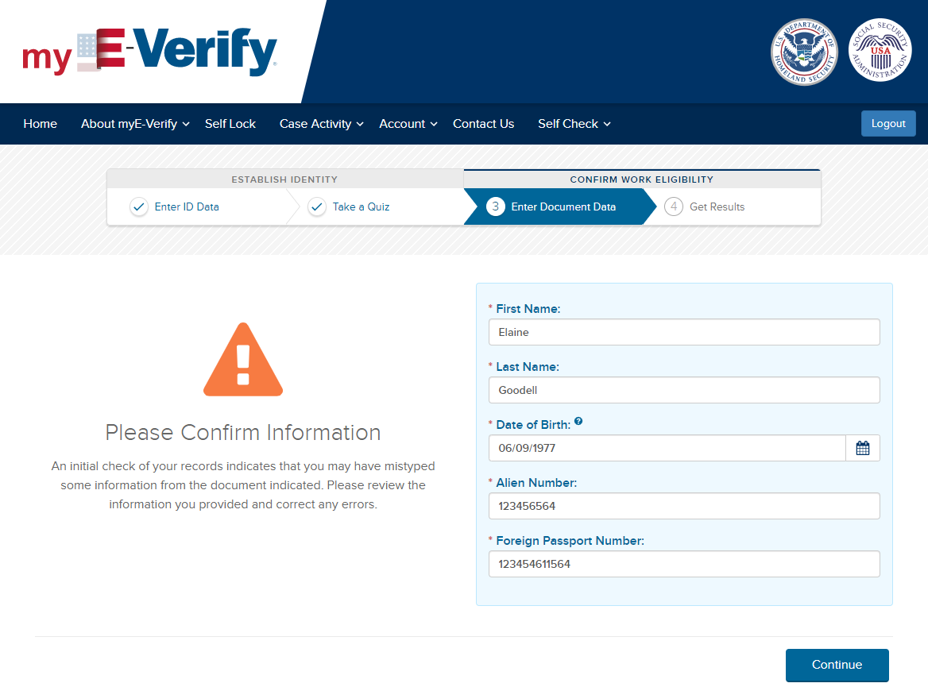
Self Check – Case Results
DHS Pre-Tentative Nonconfirmation

Slide 48
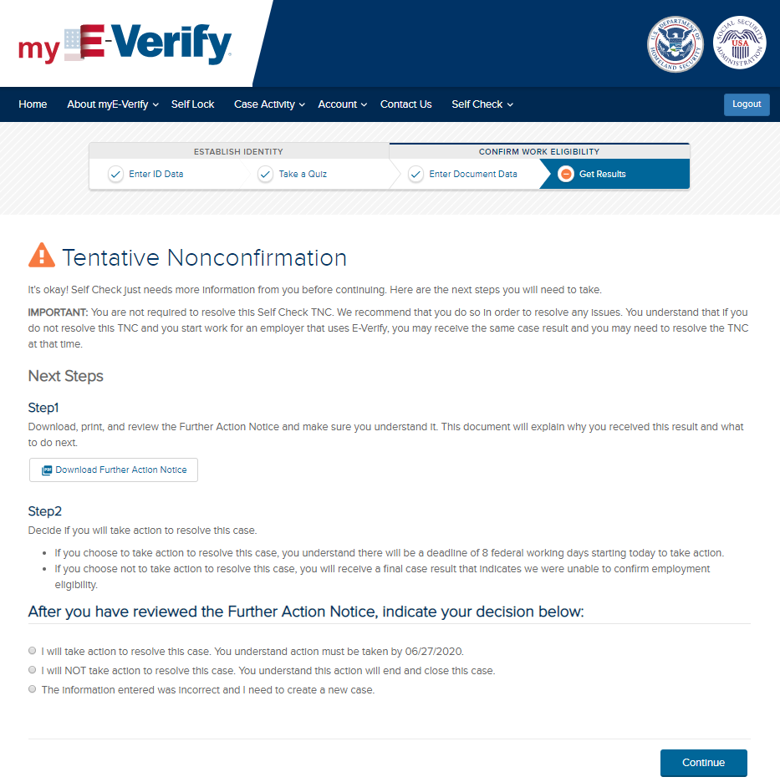
Self Check – Case Results
Tentative Nonconfirmation

Slide 49

Self Check – Case Results
Tentative Nonconfirmation – Take Action

Slide 50


Self Check – Case Results
Tentative Nonconfirmation – Do Not Take Action

Slide 51


Self Check – Case Results
Tentative Nonconfirmation – Information Entered was Incorrect
Text on button changes to Close Case

Slide 52

Self Check – Case Overview
Notes:
This is the screen that users will see if they come back to Self Check before their case is resolved. The case status will update for DHS, SSA, or Dual. Once the case is resolved, or not resolved, it will show Employment Authorized or Final Nonconfirmation. Users will be able to create another Self Check case after the open case is resolved and closed.

Slide 53


myE-Verify – Case Tracker

Slide 54

myE-Verify – Case History

Slide 55

myE-Verify – Case History

Slide 56

myE-Verify – Self Lock

Slide 57

myE-Verify – Self Lock - Lock

Slide 58

myE-Verify – Self Lock - Lock

Slide 59

myE-Verify – Self Lock Unlock

Slide 60

myE-Verify – Self Lock Unlock

Slide 61
myE-Verify – myUploads
This feature is not live in production yet. Plan to deploy in November 2020.

Slide 62

myE-Verify – myUploads

Slide 63

myE-Verify – myUploads
Driver’s License Data Mismatch

Slide 64

myE-Verify – myUploads
U.S. Passport Data Mismatch

Slide 65

myE-Verify – myUploads
Other Immigration Data Mismatch

Slide 66

myE-Verify – myUploads
Self Lock

Slide 67

myE-Verify – myUploads
Self Lock and Driver’s License Data Mismatch

Slide 68

myE-Verify – myUploads
Self Lock and U.S. Passport Data Mismatch

Slide 69

myE-Verify – myUploads
Self Lock and Other Immigration Data Mismatch

Slide 70

myE-Verify – Manage my Account
Notes:
This takes the user back to the USCIS Online Account screen where they can update their primary email address, add a recovery email address, change their password, update the two-step verification method, add a mobile number, view/edit the two-factor backup code, change or update their password reset questions, and view their account activity (last login, etc.).

