Slide 1
Immigration Records and Identity Services Directorate
E-Verify NextGen Screens
Updated: September 27, 2023

Slide 2
DHS Privacy Notice
AUTHORITIES: The information requested on this form, and the associated documents, are collected under the Immigration Reform and Control Act of 1986, Pub. L. 99-603 (8 USC 1324a).
PURPOSE: The primary purpose for providing the requested information on this form is for employers to verify your identity and employment authorization. Consistent with the requirements of the Immigration Reform and Control Act of 1986, employers use the Form I-9 to document the verification of the identity and employment authorization for new employees to prevent the unlawful hiring, or recruiting or referring for a fee, of aliens who are not authorized to work in the United States. This form is completed by both the employer and employee and is ultimately retained by the employer.
ROUTINE USES: This information will be used by employers as a record of their basis for determining eligibility of an individual to work in the United States. The employer must retain this completed form and make it available for inspection by authorized officials of the Department of Homeland Security, Department of Labor, and Department of Justice, Civil Rights Division, Immigrant and Employee Rights Section. USCIS does not store Form I-9 or retrieve its data via a personal identifier. Therefore, no Privacy Act System of Records Notice (SORN) coverage is required. DHS follows the data handling parameters of the published privacy impact assessment [DHS/USCIS/PIA-036(b) - Form I-9 Employment Eligibility Verification Update]. DHS may also share this information, as appropriate, for law enforcement purposes or in the interest of national security.
DISCLOSURE: The information you provide is voluntary. However, failure to provide the requested information, including your Social Security number (if applicable), and any requested evidence, may result in termination of employment. Failure of the employer to ensure proper completion of this form may result in the imposition of civil or criminal penalties against the employer. In addition, knowingly employing individuals who are not authorized to work in the United States may subject the employer to civil and/or criminal penalties.

Slide 3
Paperwork Reduction Act
USCIS may not conduct or sponsor an information collection, and you are not required to respond to a collection of information, unless it displays a currently valid Office of Management and Budget (OMB) control number. The public reporting burden for this collection of information is estimated at 28 minutes per response, including the time for completing the form, gathering the required documentation and information, uploading necessary documentation, and submitting the form. Send comments regarding this burden estimate or any other aspect of this collection of information, including suggestions for reducing this burden, to: U.S. Citizenship and Immigration Services, Office of Policy and Strategy, Regulatory Coordination Division, 5900 Capital Gateway Drive, Mail Stop #2140, Camp Springs, MD 20588-0009; OMB No. 1615-XXXX. Do not mail your completed Form I-9 to this address.

Slide 4
Employer Creates Case Request

Slide 5
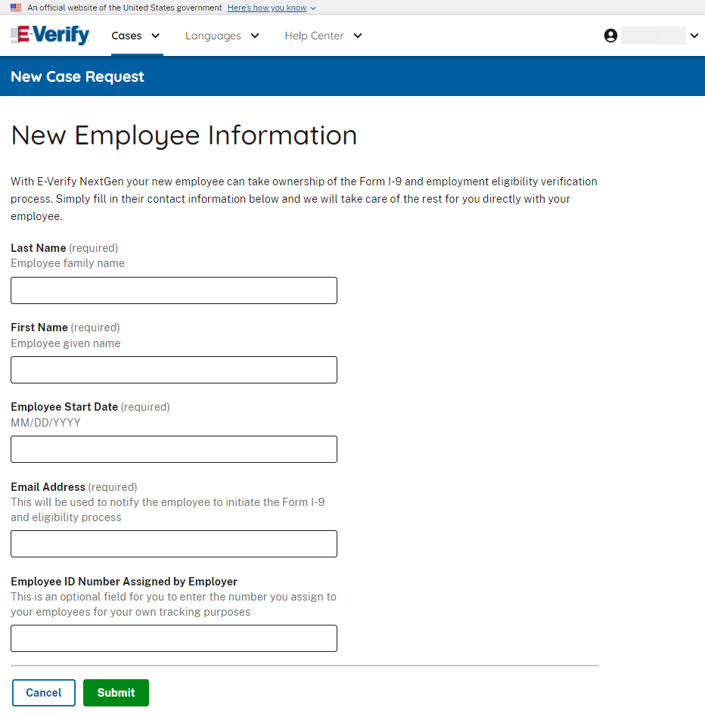
E-Verify – Enter New Employee Information

Slide 6
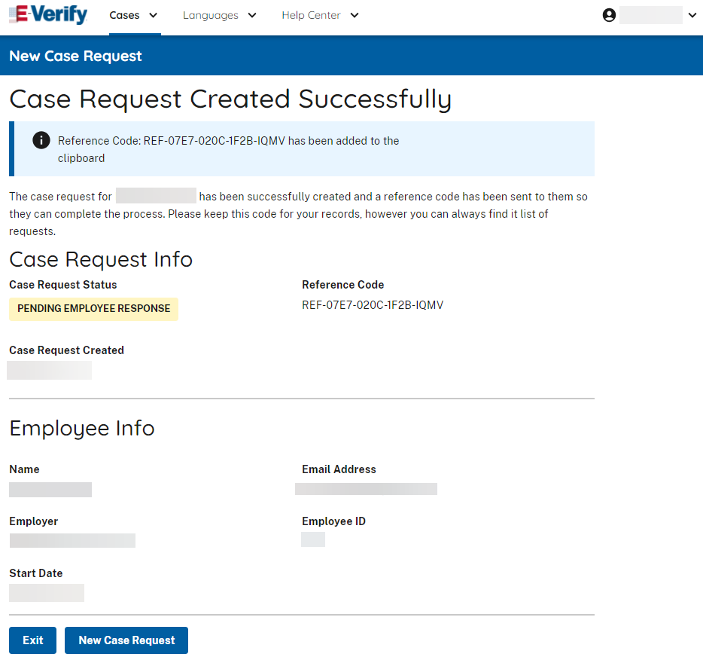
E-Verify – Case Request Created Successfully

Slide 7
Employee Login
to myE-Verify

Slide 8
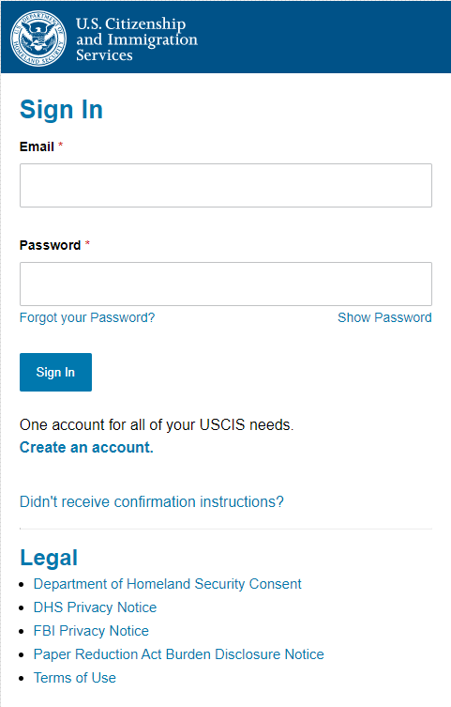
myE-Verify Login/Create Account

Slide 9
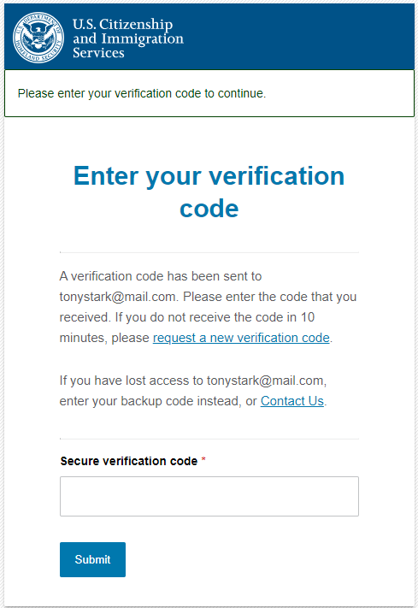
myE-Verify Login – Two-Step Verification

Slide 10
Employee Forgot Password

Slide 11
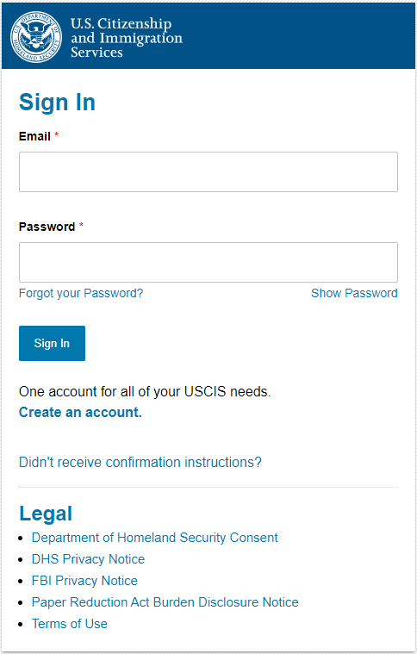
Forgot Password

Slide 12
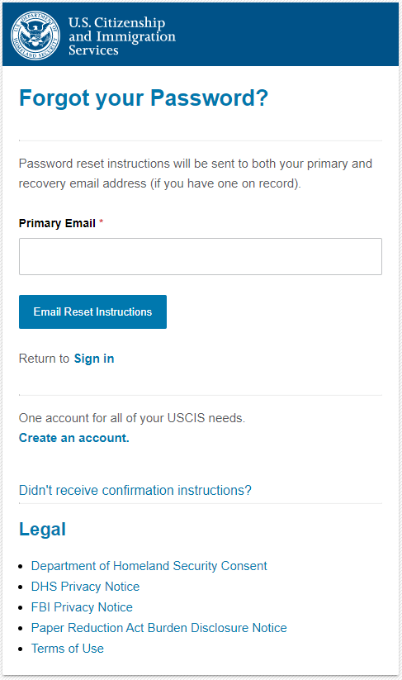
Forgot Password - Email Reset

Slide 13
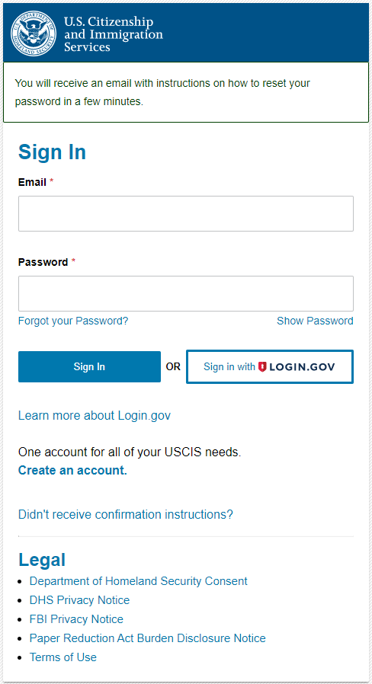
Forgot Password - Email Notification

Slide 14
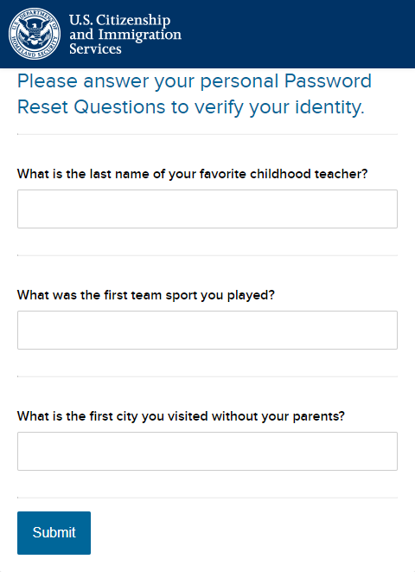
Forgot Password – Password Reset Questions

Slide 15
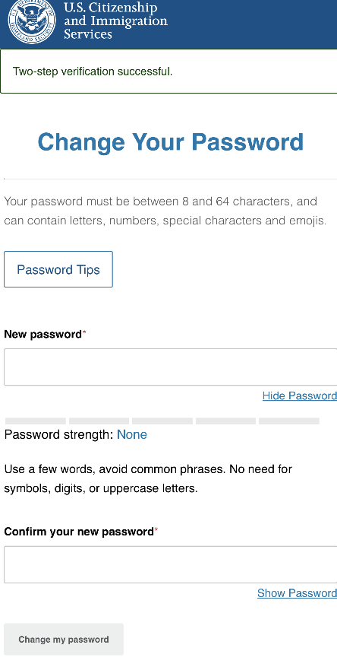
Forgot Password - Password Reset

Slide 16
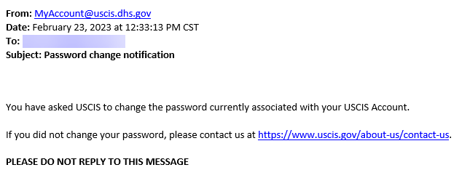
myAccount – PW Reset Notification

Slide 17
Employee Sign Up
(USCIS Account)

Slide 18
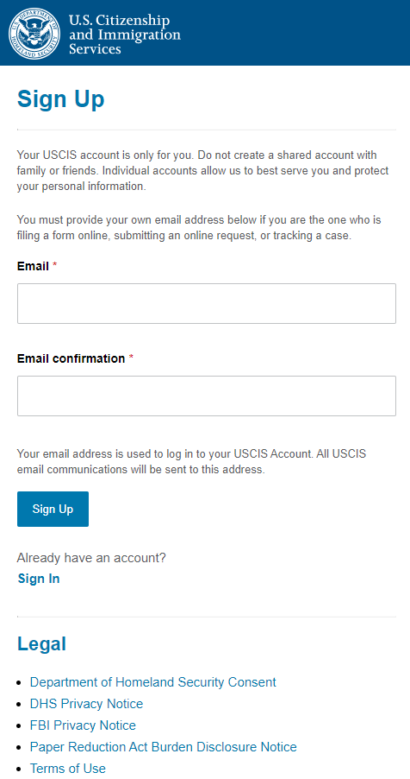
Sign Up (USCIS Account)

Slide 19
Sign Up – Confirmation Email
To continue creating your USCIS Account, you must confirm your email address. To confirm your email address, please click on the link below, or copy and paste the entire link into your browser.
https://myaccount-dt.uscis.dhs.gov/users/confirmation?confirmation_token=S8ijo6puKF-a6dP-gNBq
Please note that this confirmation link expires in 24 hours and may require your immediate attention if you wish to access your online account in the future.
If you require additional assistance logging into your account, please contact the USCIS Contact Center via the web form at https://my.uscis.gov/account/v1/needhelp.
PLEASE DO NOT REPLY TO THIS MESSAGE

Slide 20
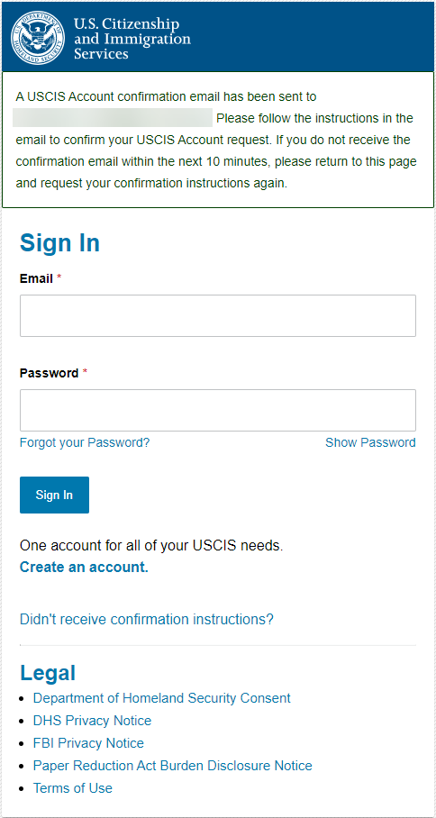
Sign Up – Confirmation Email Sent

Slide 21
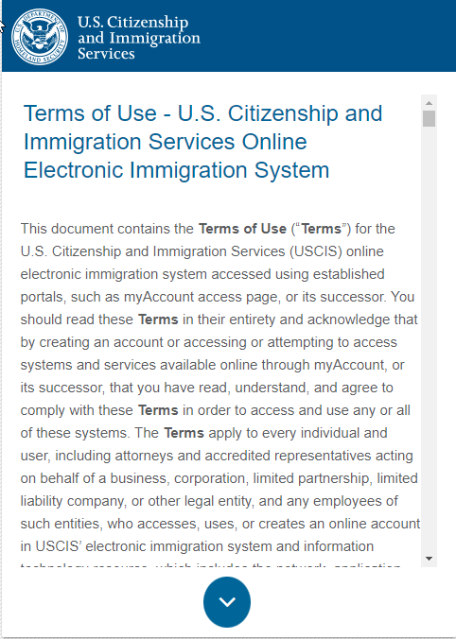
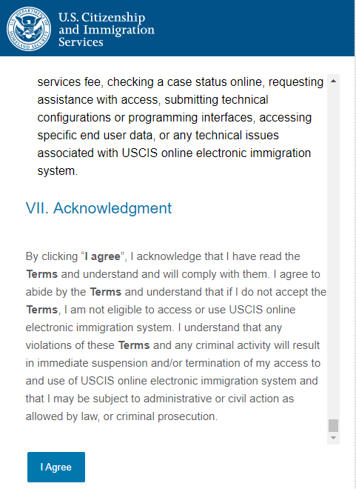
Sign Up – Terms of Use

Slide 22
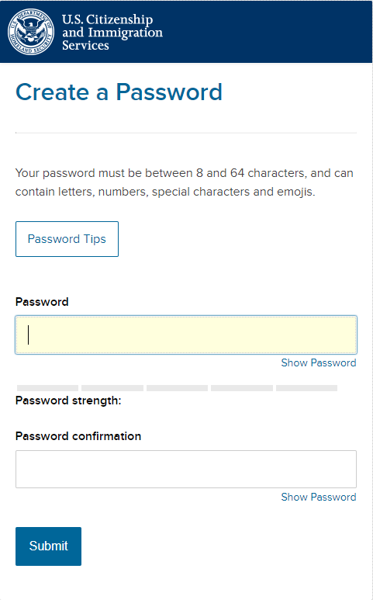
Sign Up – Create Password

Slide 23
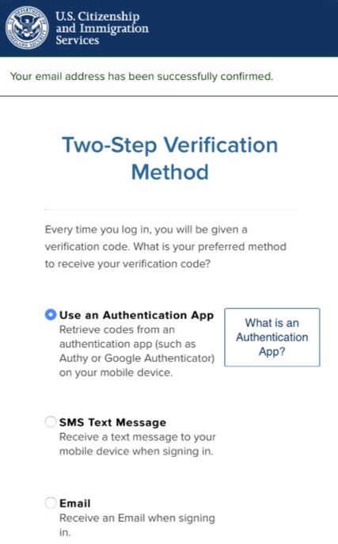
Sign Up – Two-Step Verification

Slide 24
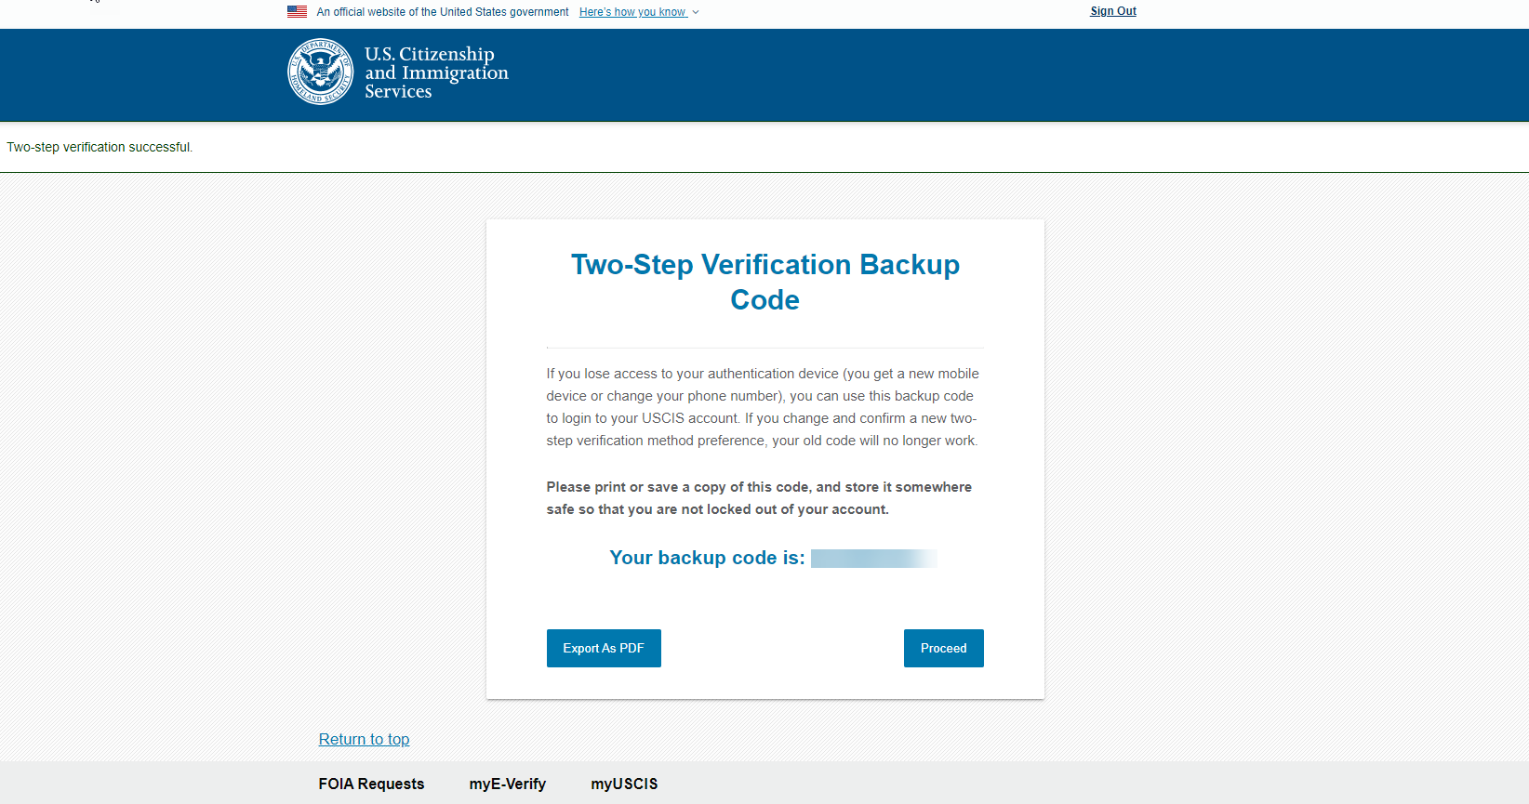
Sign Up – Two-Step Verification Backup Code

Slide 25
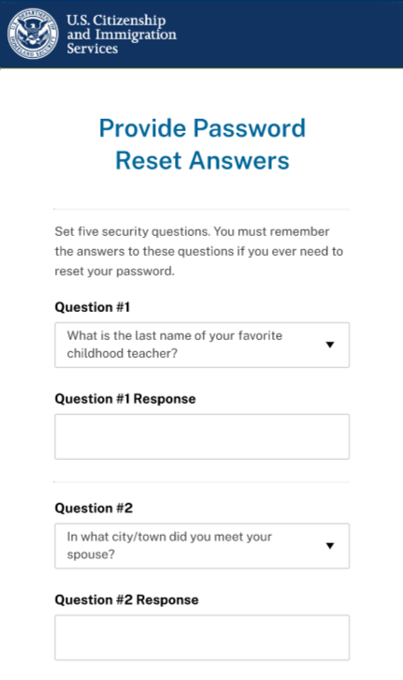
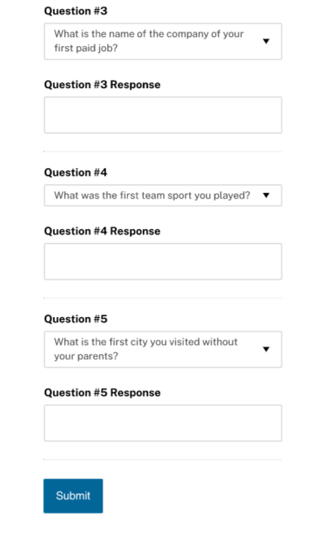
Sign Up – Password Reset Answers

Slide 26
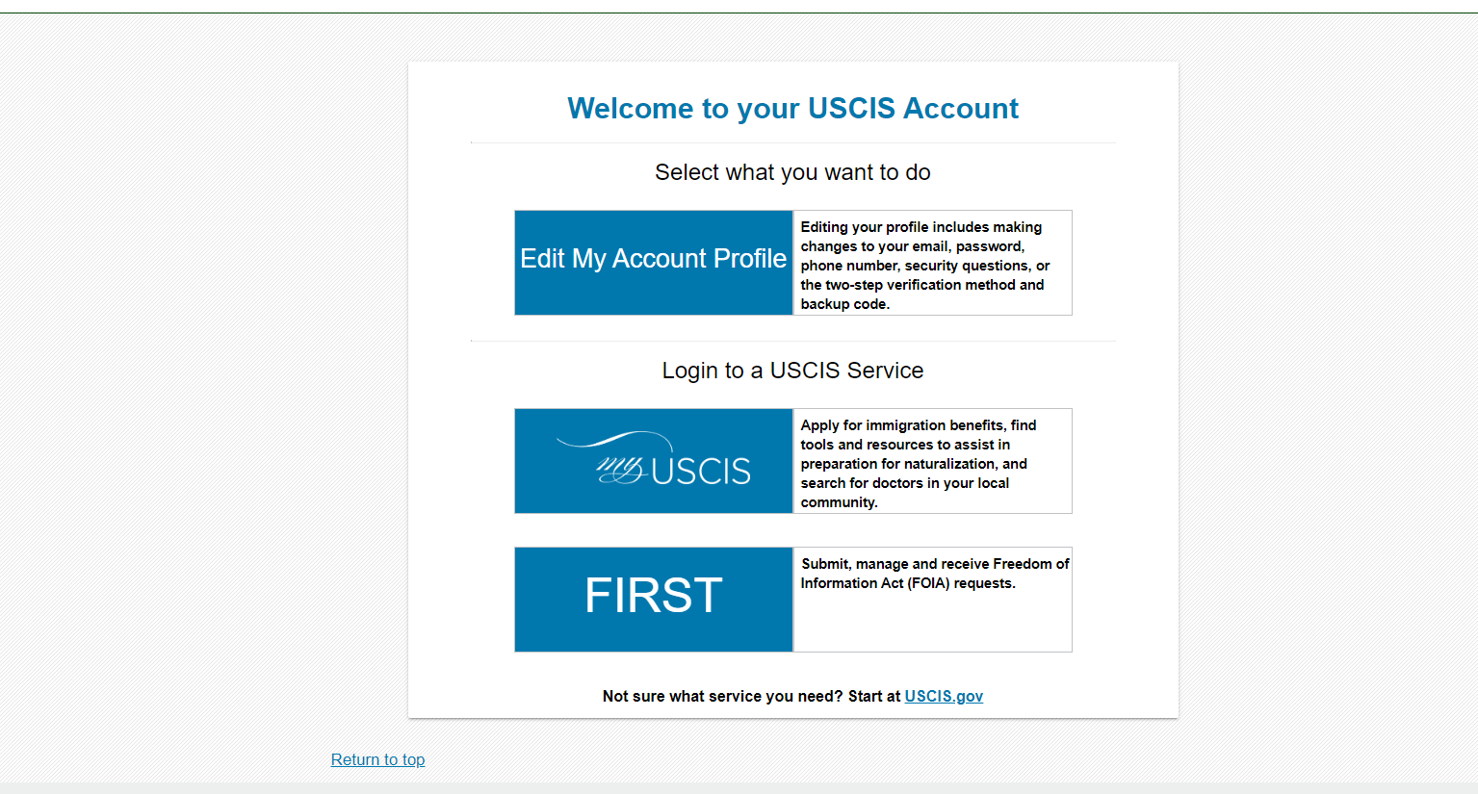
Sign Up – USCIS Account

Slide 27
Employee NextGen
Profile Creation

Slide 28
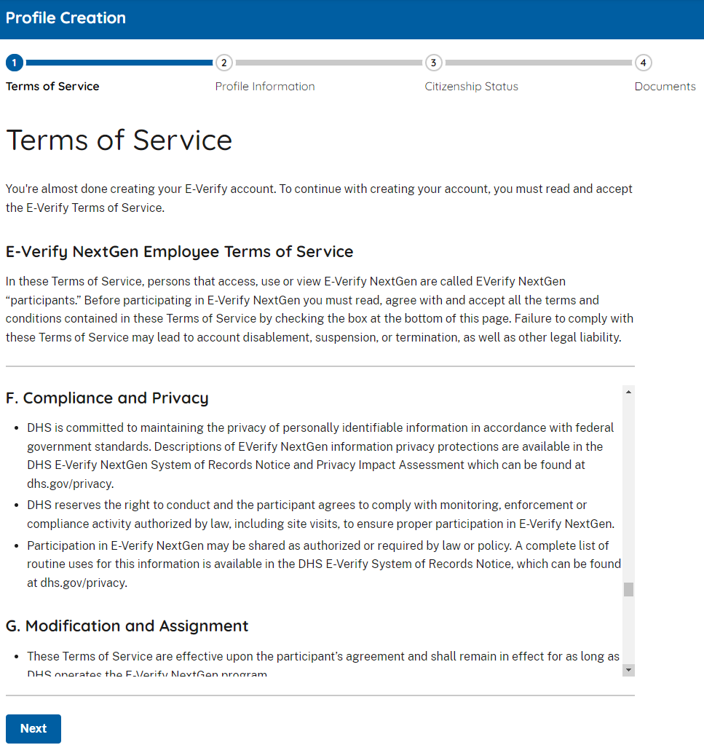
Profile Creation – Terms of Service

Slide 29
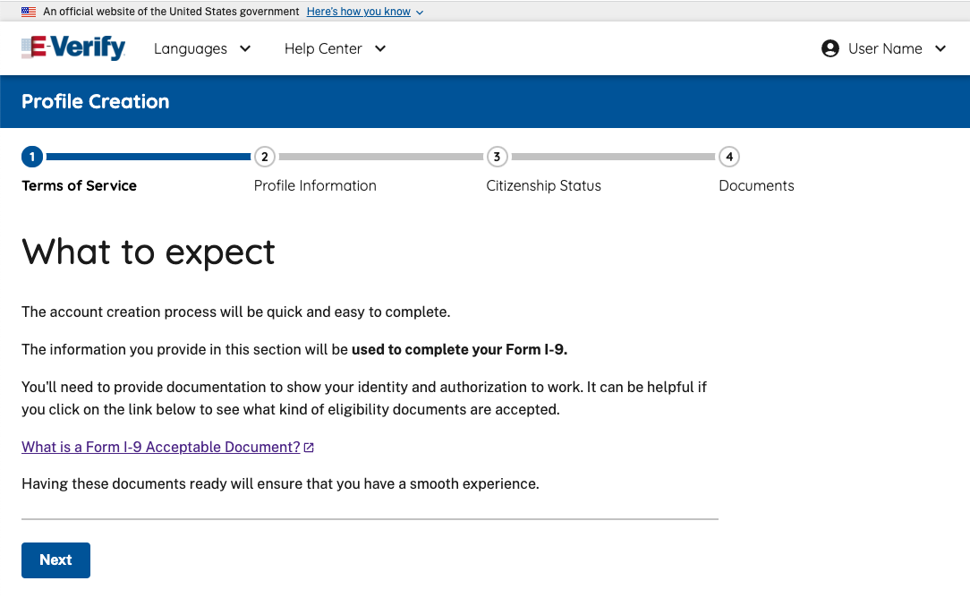
Profile Creation – What to Expect

Slide 30
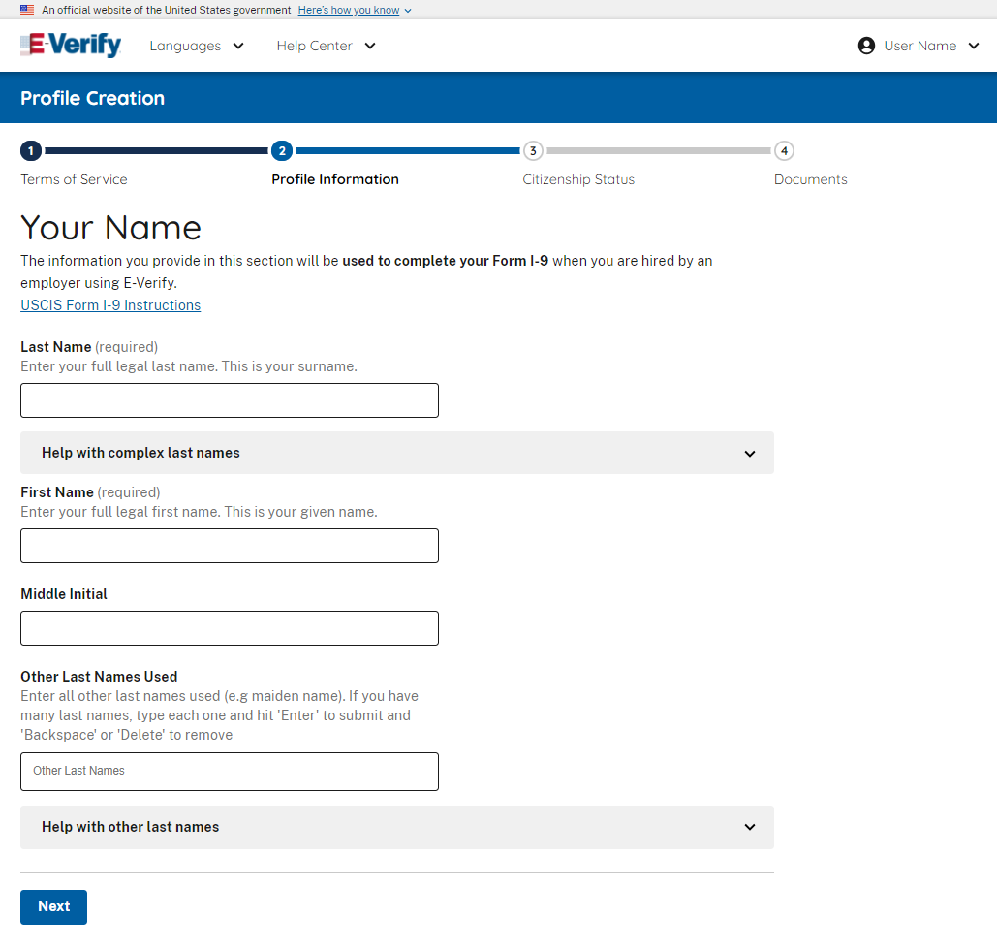
Profile Creation – Enter Personal Info (Name)

Slide 31
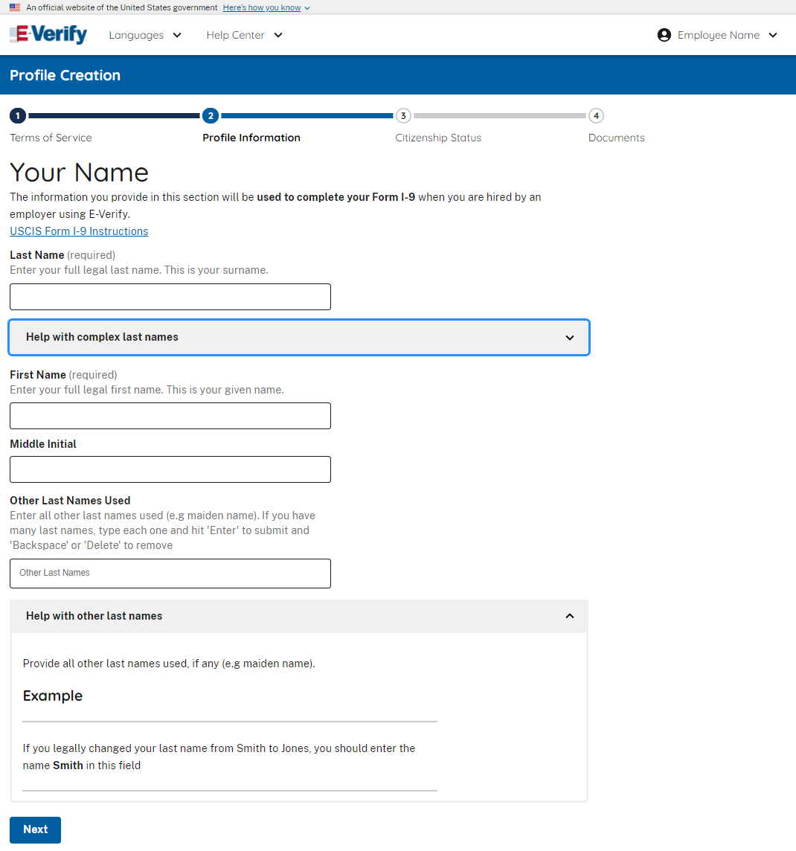
Profile Creation – Enter Personal Info (Helper Text Accordion Example)

Slide 32
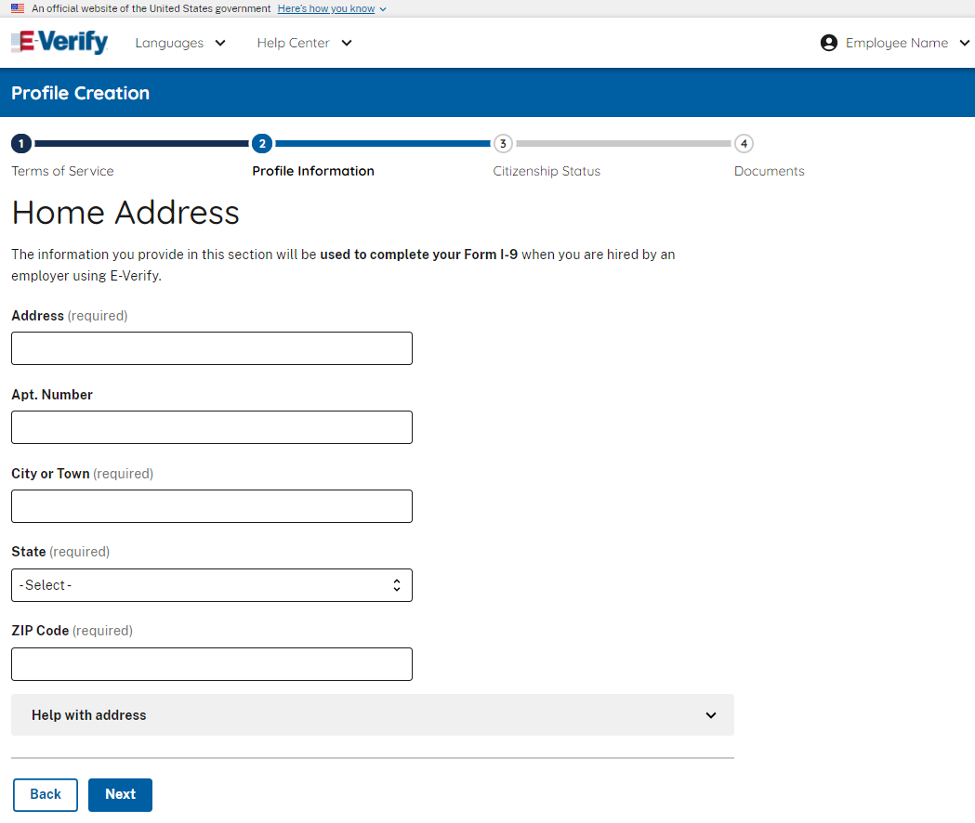
Profile Creation – Enter Personal Info (Home Address)

Slide 33
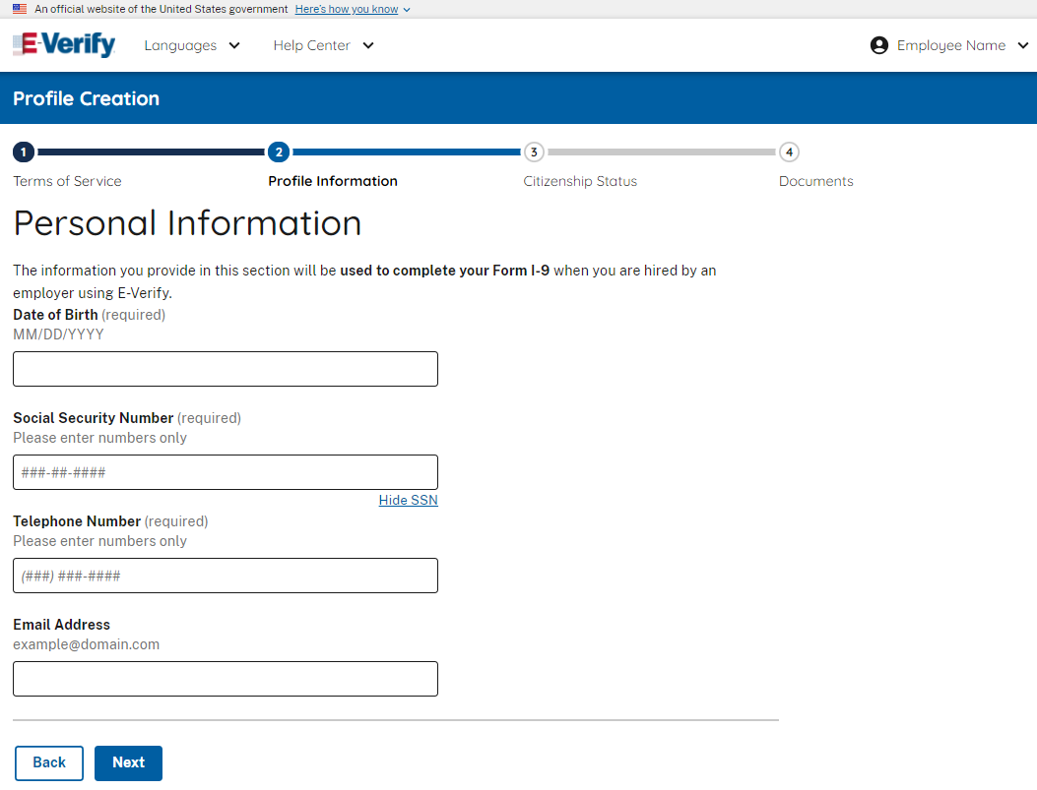
Profile Creation – Enter Personal Info (Other Info)

Slide 34
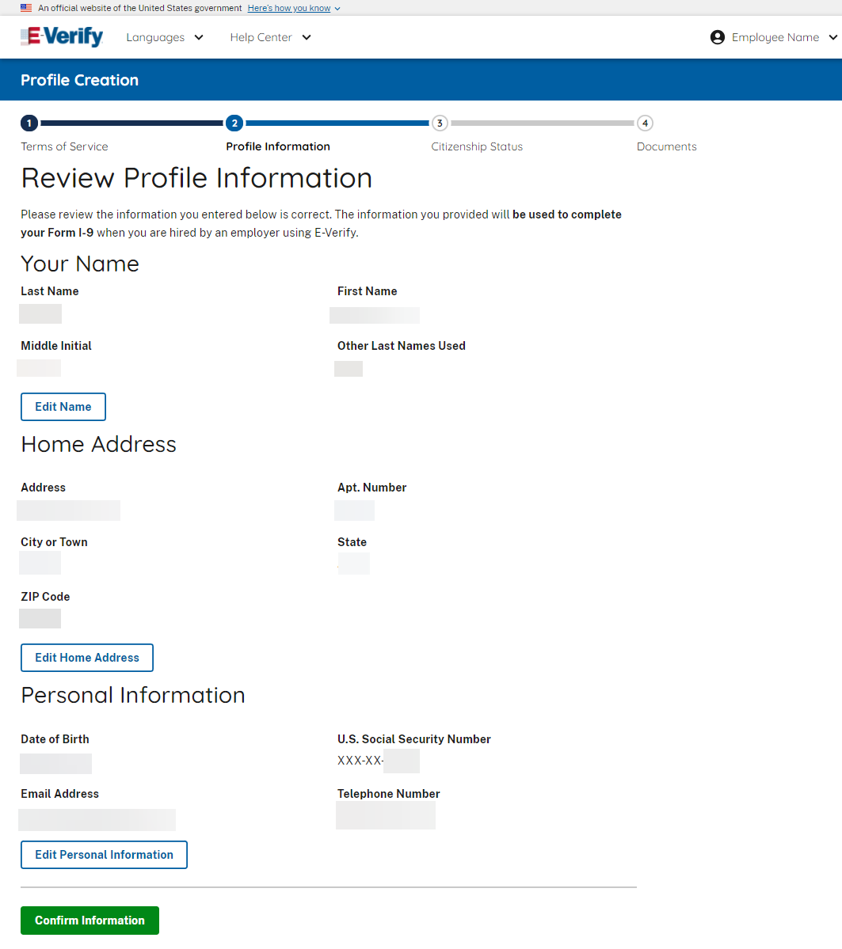
Profile Creation – Review Personal Info

Slide 35
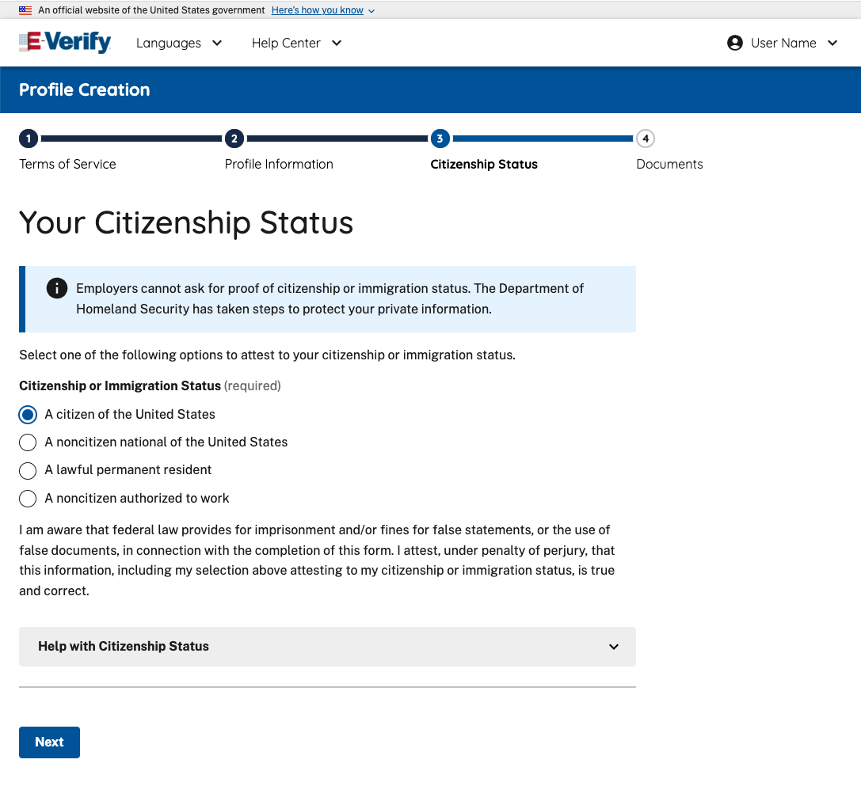
Profile Creation – Enter Citizenship Status

Slide 36
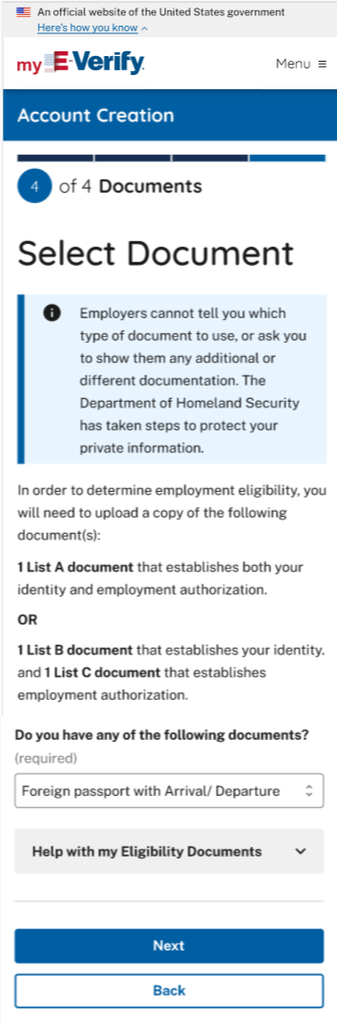
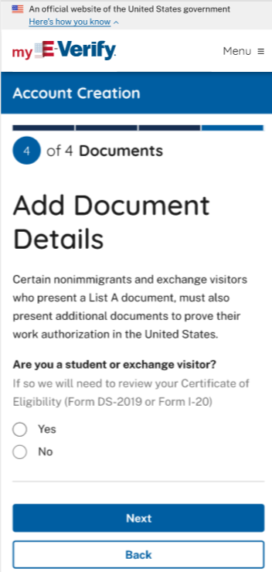
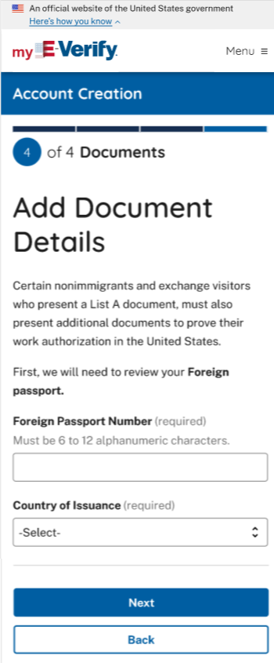
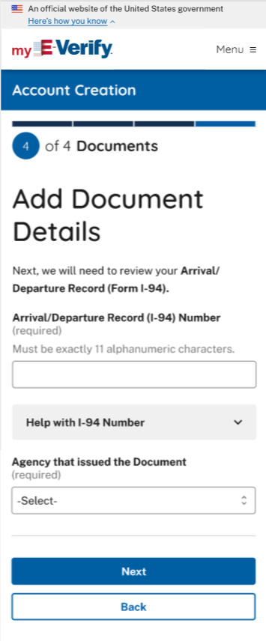
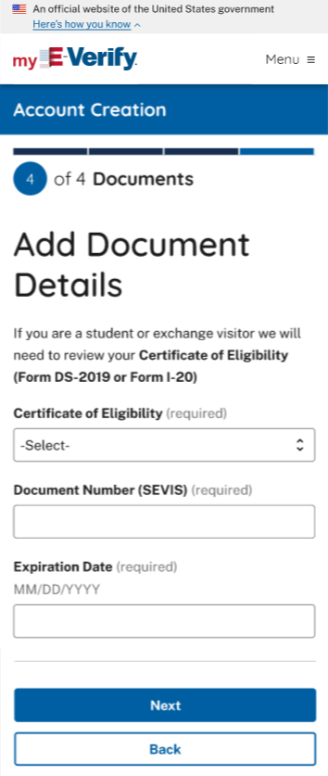
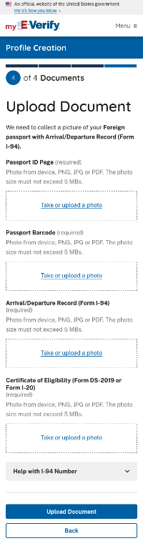
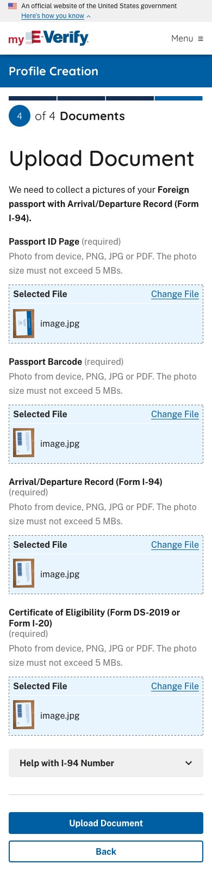
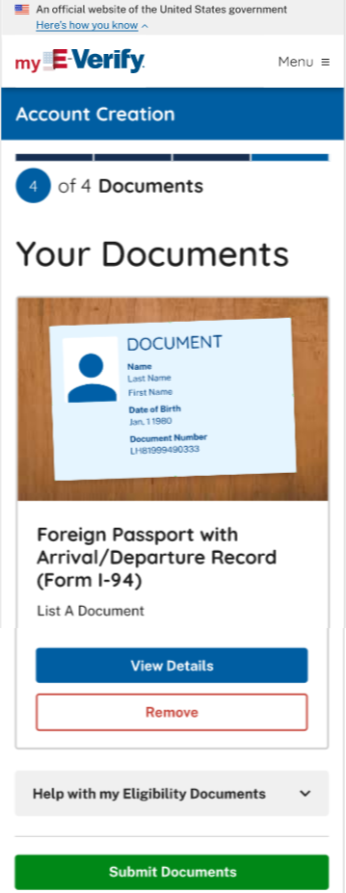
Profile Creation – Document Upload (List A Multiple Document Example)

Slide 37
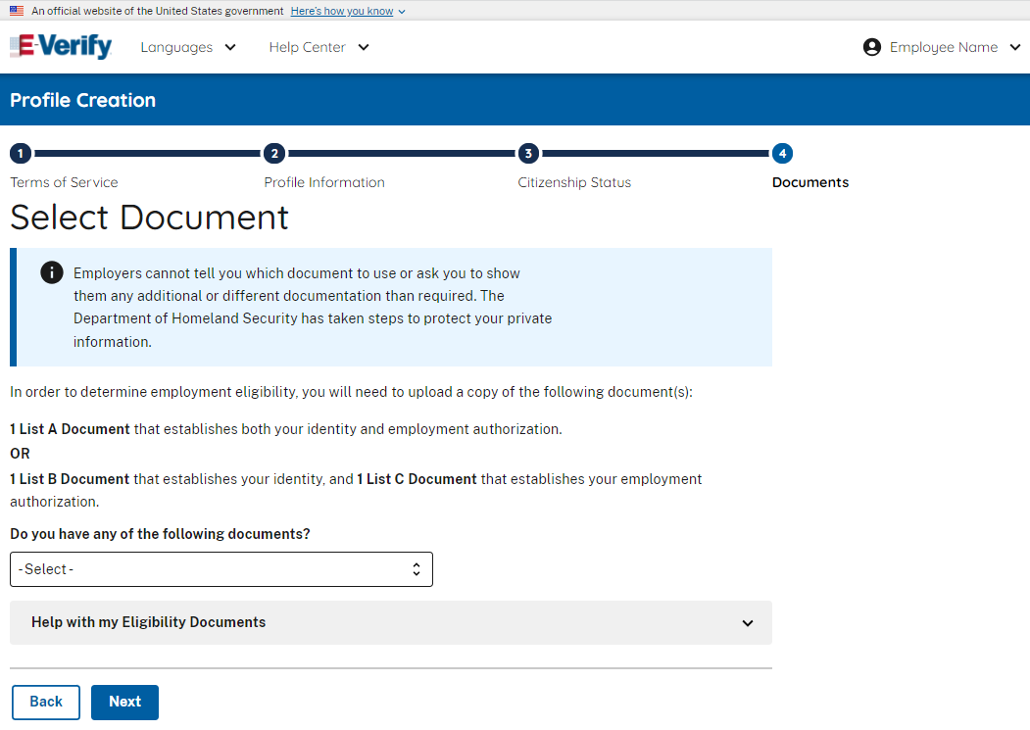
Profile Creation – Document Upload
(List B Example)

Slide 38
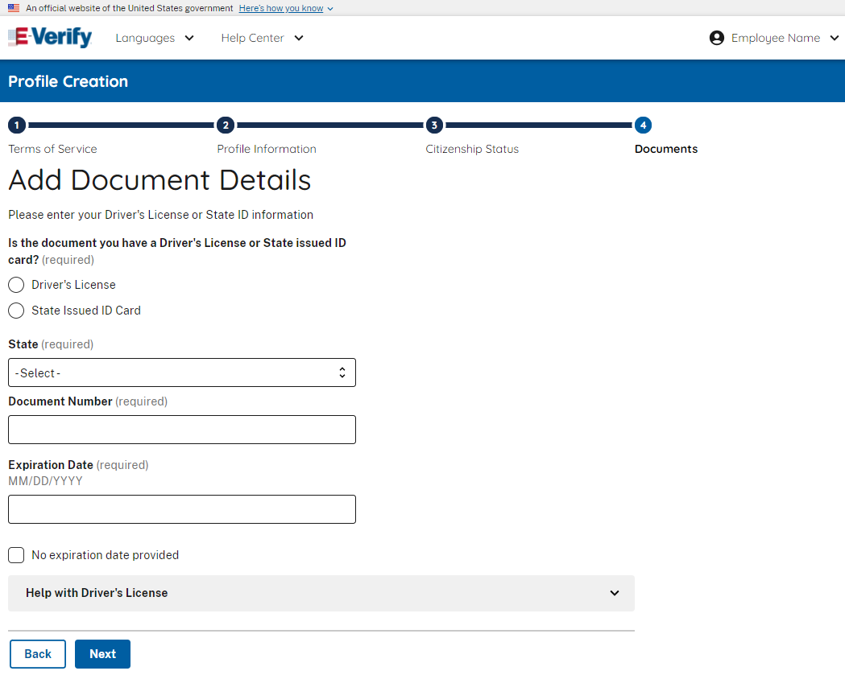
Profile Creation – Add Document
(List B Example)

Slide 39
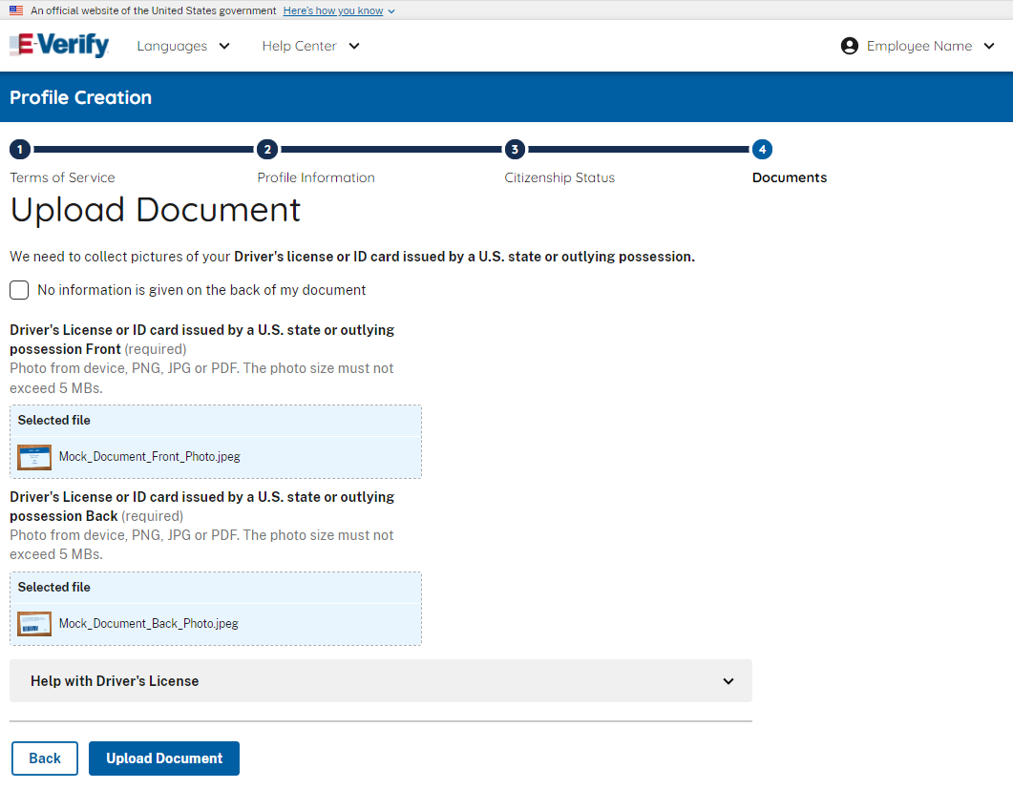
Profile Creation – Document Photos
(List B Example)

Slide 40
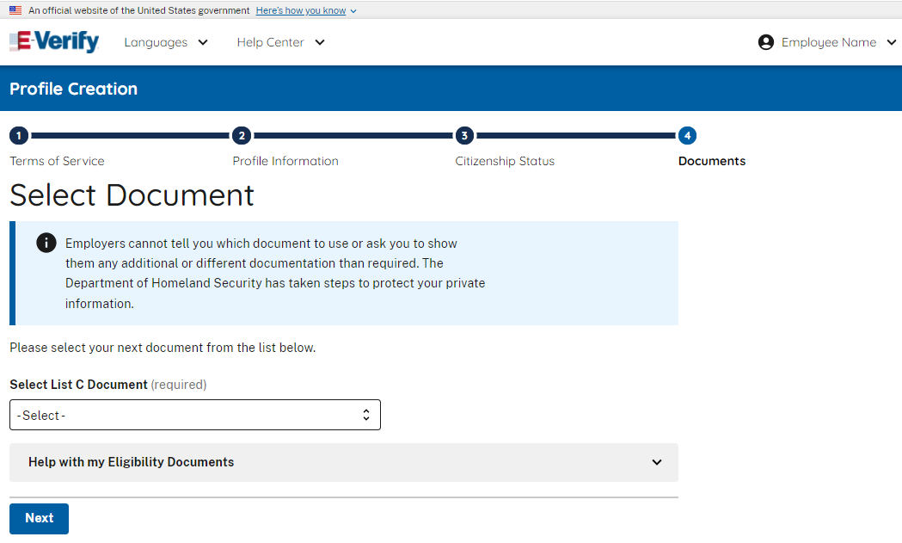
Profile Creation – Add Document
(List C Example)

Slide 41
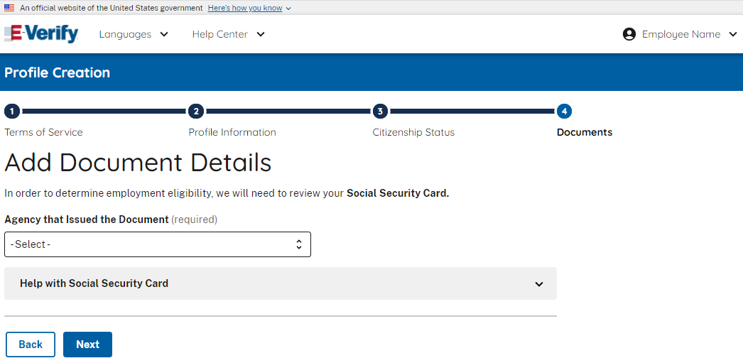
Profile Creation – Document Upload (Issuing Authority – List C Example)

Slide 42
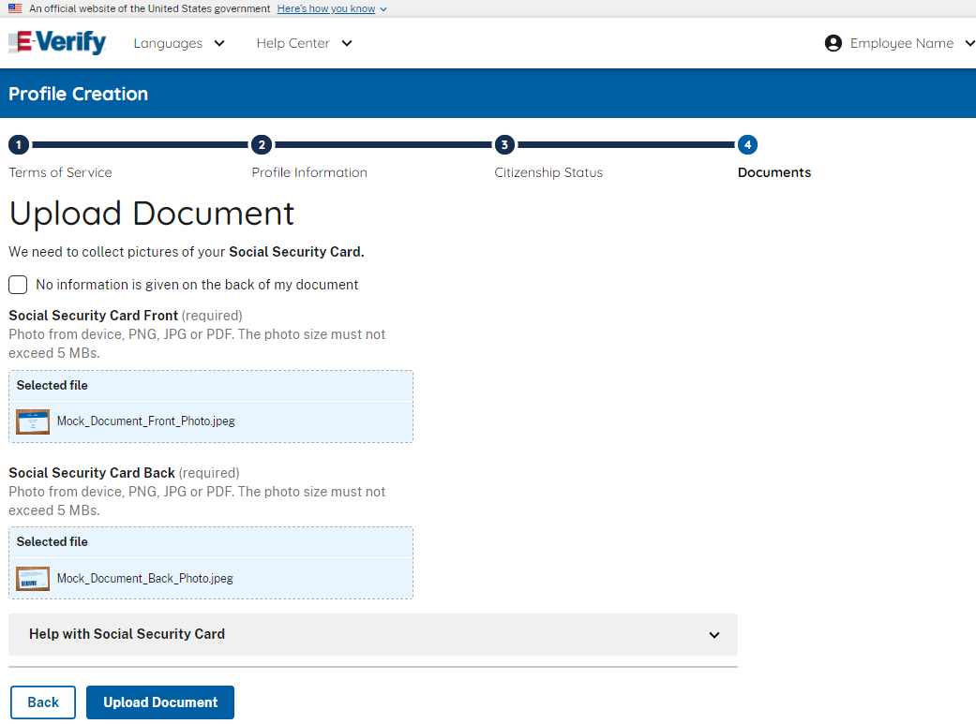
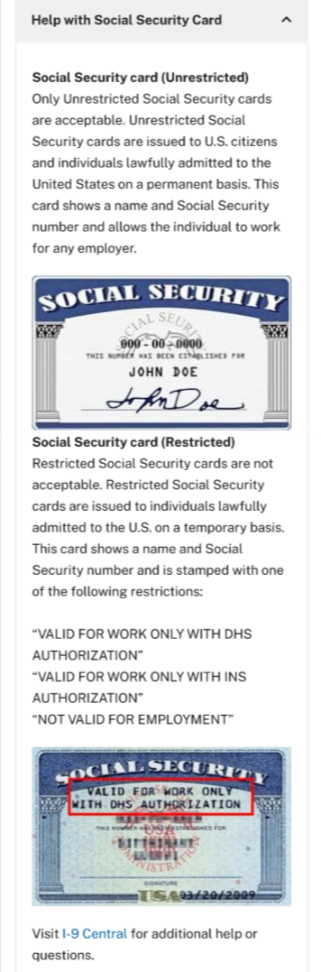
Profile Creation – Document Upload (Document Photos– List C Example)

Slide 43
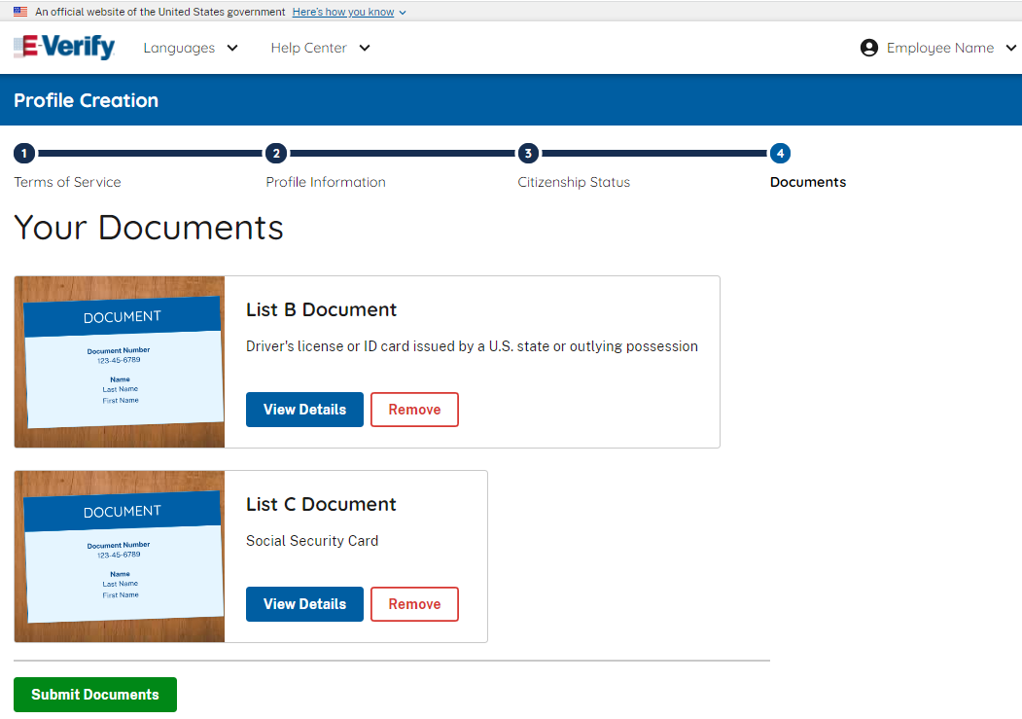
Profile Creation – Document Upload
(Document Review List B and List C Documents)

Slide 44
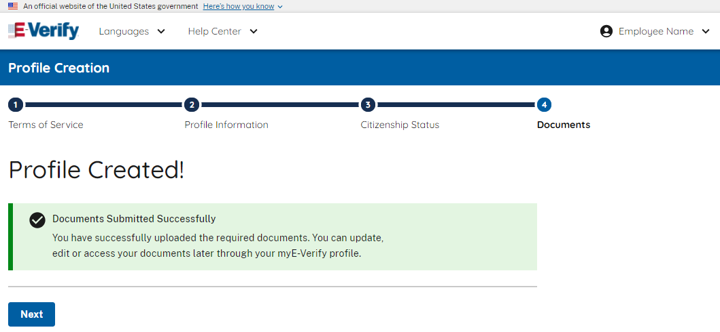
Profile Creation – Profile Created
(Document Submitted Successfully)

Slide 45
Employee Form I-9 Completion

Slide 46
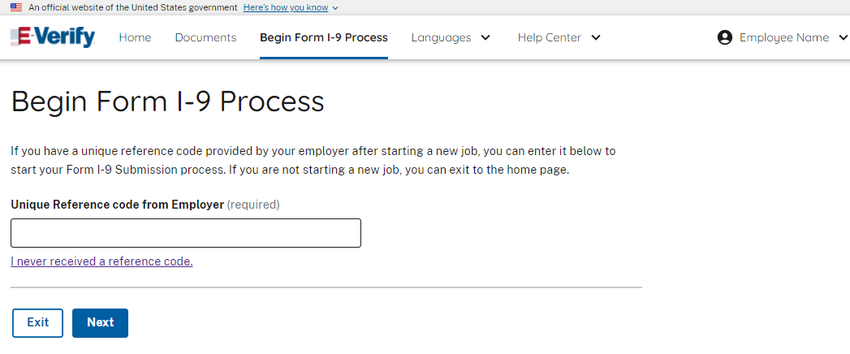
Form I-9 Process – Enter Reference Code from Employer

Slide 47
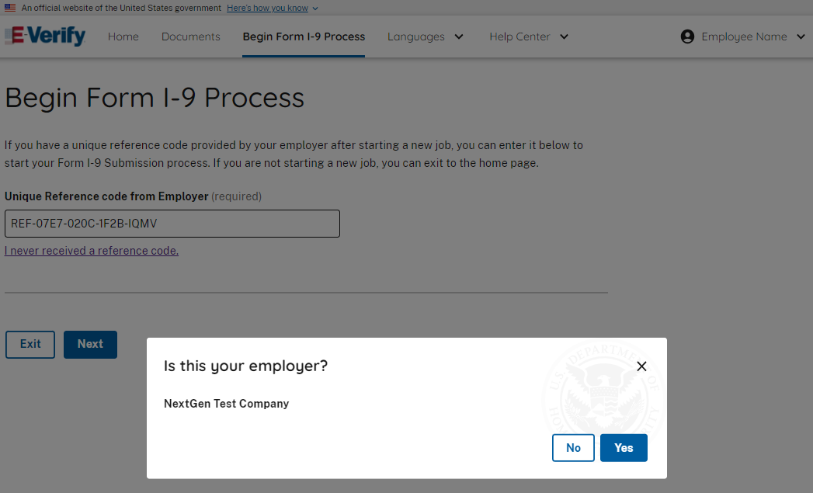
Form I-9 Process – Confirm Employer

Slide 48
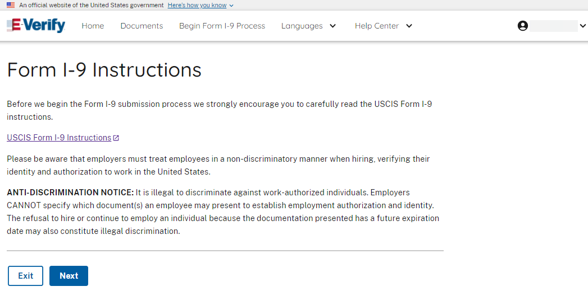
Form I-9 Process – Form I-9 Instructions

Slide 49
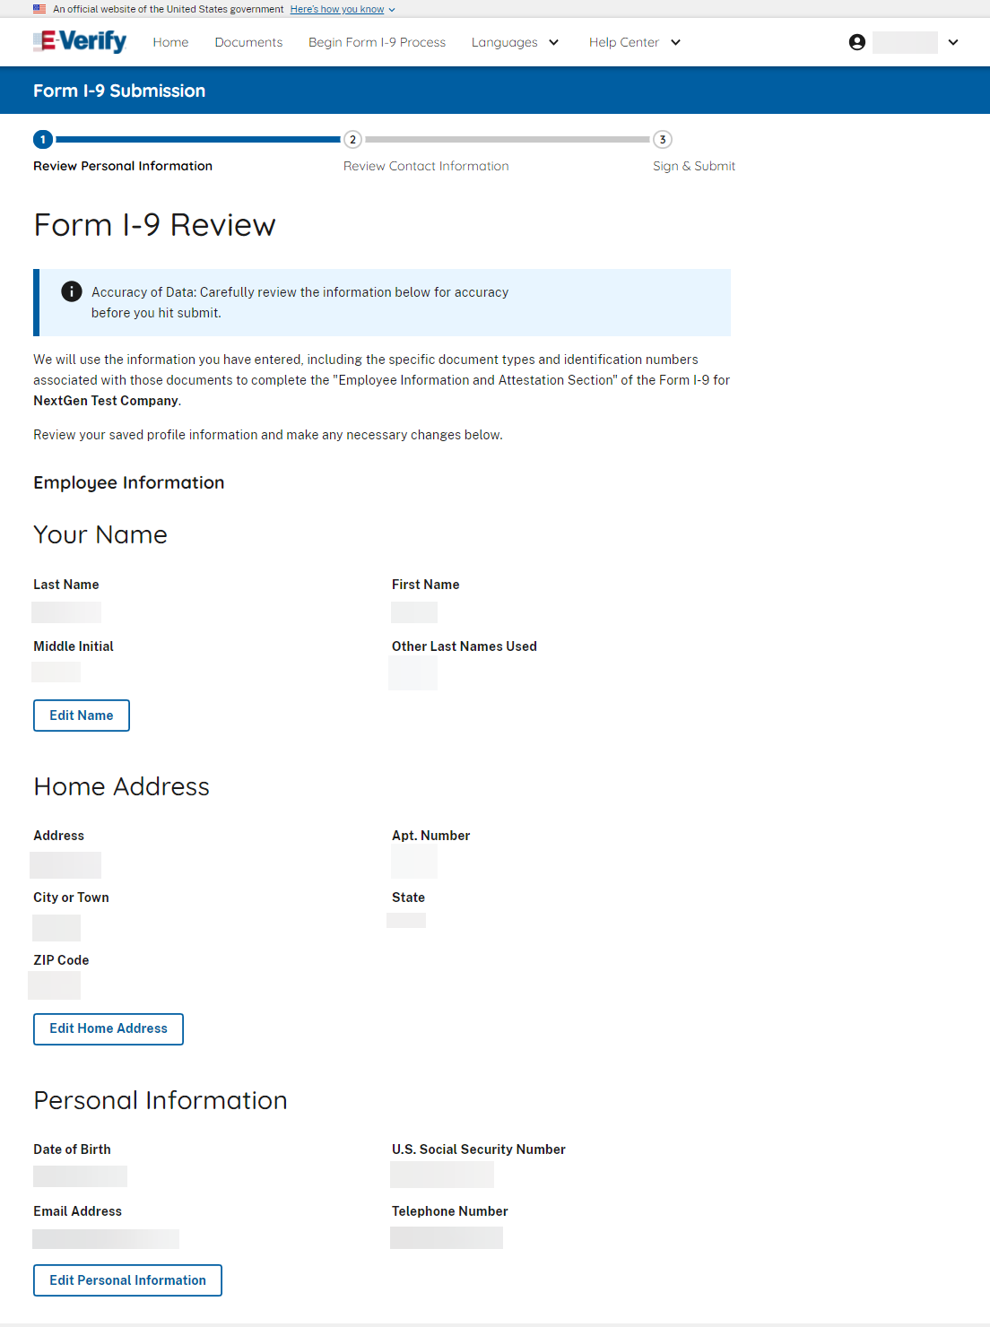
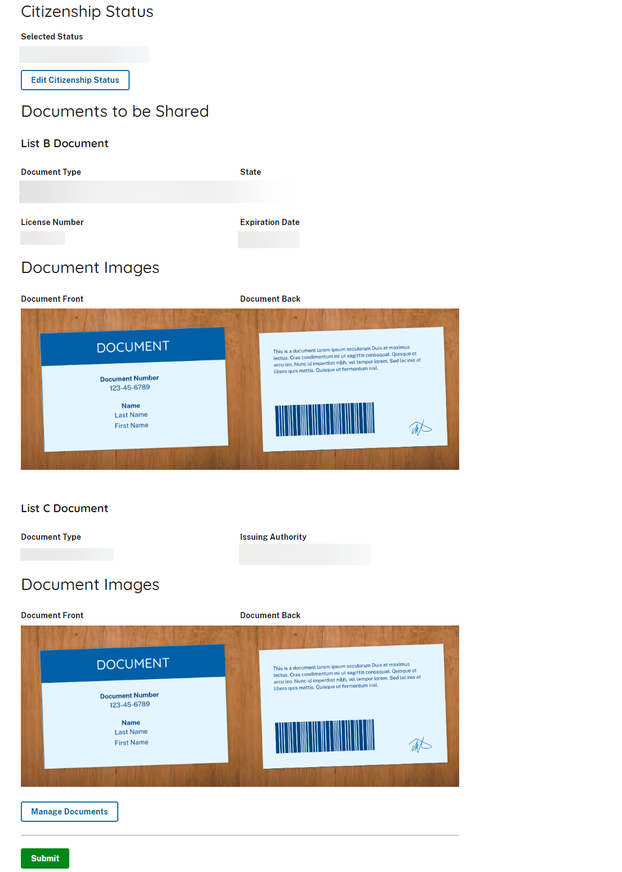
Form I-9 Process – Form I-9 Review

Slide 50

Form I-9 Process – Form I-9 Submission Review Contact Information

Slide 51

Form I-9 Process–Sign & Submit Form I-9

Slide 52

Form I-9 Process – Download Form I-9

Slide 53

Form I-9 Process – Form I-9 PDF

Slide 54

Form I-9 Process – Form I-9 Submitted

Slide 55


Account Features – Employment Eligibility Pending Employer Review & After Review

Slide 56
E-Verify Employer Experience

Slide 57

E-Verify Home Page (Employer Experience)

Slide 58

E-Verify – Form I-9 Ready For Review

Slide 59

E-Verify– Review Employee Information

Slide 60


E-Verify– Review Employee Documents

Slide 61

E-Verify – Confirm Document
(Photo Matching)

Slide 62


E-Verify – Review & Sign Form I-9

Slide 63

E-Verify– Download Form I-9 & View Case
Download I-9 Disclaimer

Slide 64
Employee Mismatch

Slide 65

Mismatch – Employment Eligibility Update (Further Action Needed)

Slide 66

Mismatch – Employment Eligibility (Verification in Progress)

Slide 67

Mismatch – Employment Eligibility
(SSA Mismatch)

Slide 68

Mismatch – Employment Eligibility
(DHS Mismatch)

Slide 69

Mismatch – Employment Eligibility
(Dual Mismatch)

Slide 70

Mismatch – Employment Eligibility
(SSA Not Confirmed)

Slide 71

Mismatch – Employment Eligibility
(DHS Not Confirmed)

Slide 72
Employee Receipt Process

Slide 73

Profile Creation – Document Upload
(Receipt Selection Example)

Slide 74

Profile Creation – Document Upload
(Add Receipt Details Example)

Slide 75

Profile Creation – Document Upload
(Upload Receipt Example)

Slide 76

Profile Creation – Document Upload
(Receipt Review Example)

Slide 77

Profile Creation – Document Upload
(Receipt Submitted Successfully Example)

Slide 78

Account Features – Employment Eligibility Warning
(Employee Home Page View)

Slide 79
Employer Receipt Process

Slide 80

E-Verify – Form I-9 Ready For Review

Slide 81

E-Verify– Review Employee Information

Slide 82


E-Verify– Review Employee Documents

Slide 83
E-Verify – Review & Sign Form I-9

Slide 84
E-Verify– Download Form I-9 & View Case
Download I-9 Disclaimer

Slide 85

E-Verify– Pending Official Document
Temporary Authorization

Slide 86
Employee No SSN Process

Slide 87






Account Creation – No SSN Scenario
(Employee applied for SSN but has not received it)

