Slide 1
How do you create your account username and password?

Slide 2
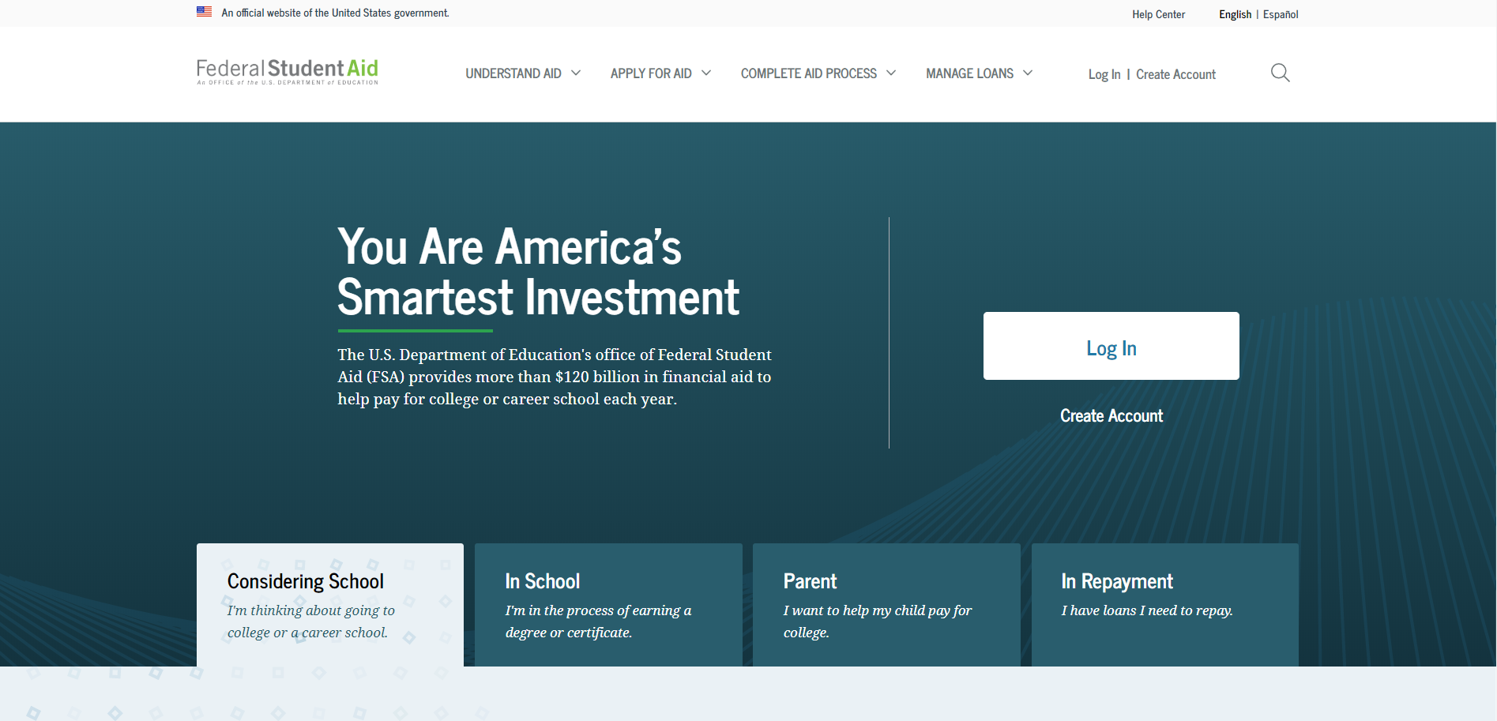
Getting started
Go to StudentAid.gov.
Select the “Create Account” button

Slide 3
Getting started
On the “Create an Account (FSA ID)” page, select the “Get Started” button.

Slide 4
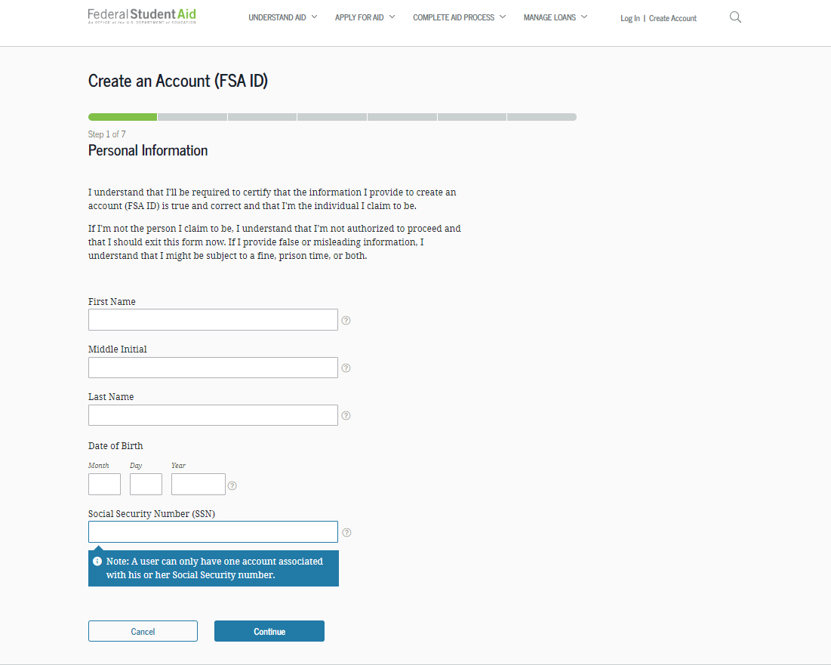
Provide Personal Identification Information
Make sure your Social Security number (SSN), date of birth, and name match what’s on your Social Security card.
You must have an SSN to create an account username and password.

Slide 5
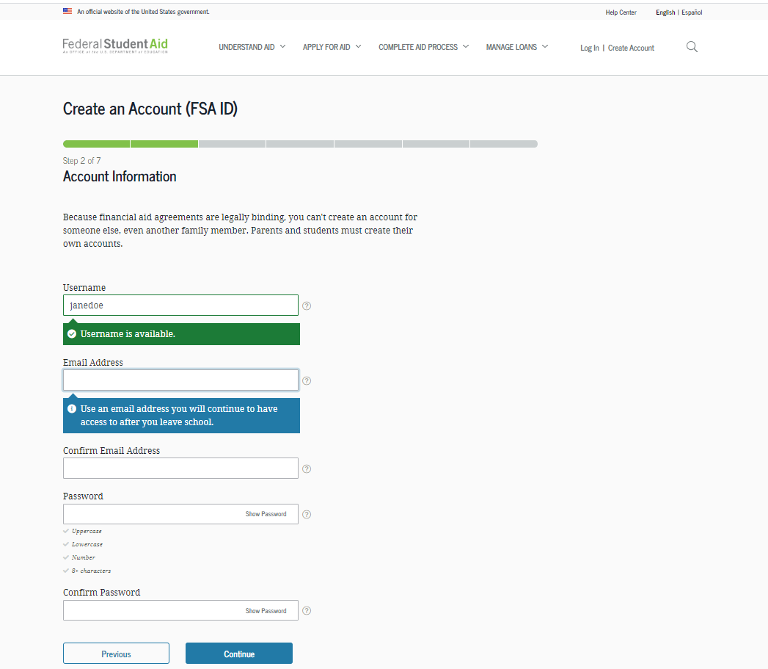
Create Your account username and password
Username:
Don’t include personal info such as date of birth or name.
If you see a message “The username you entered is already in use,” then someone has already used that username.
Password:
Your password must be between 8 and 30 characters in length, and must contain at least one uppercase letter, one lowercase letter, and one number.
Your password is case-sensitive.

Slide 6
Provide Contact information
To sign up for mobile phone account recovery, provide a mobile phone number on this screen.
Make sure your information is correct; any errors could result in delays in receiving financial aid (or in the repayment of your federal student loans).

Slide 7
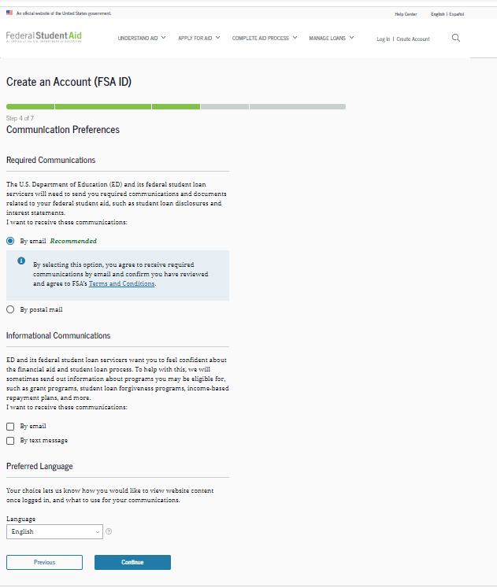
Select communication preferences
You must select whether to receive required communications by email or postal mail.
You can opt in to receive informational emails and/or text messages regarding programs you may be eligible for.

Slide 8
Select challenge questions and answers
Answering your challenge questions is one way to unlock your account or retrieve your username or password.
Your answer is not case-sensitive.

Slide 9
Review Info and Agree to Terms
Review and confirm your information.
If you need to make a correction, use the “Edit” button within that tile of information.
Review and agree to FSA’s terms and conditions.

Slide 10
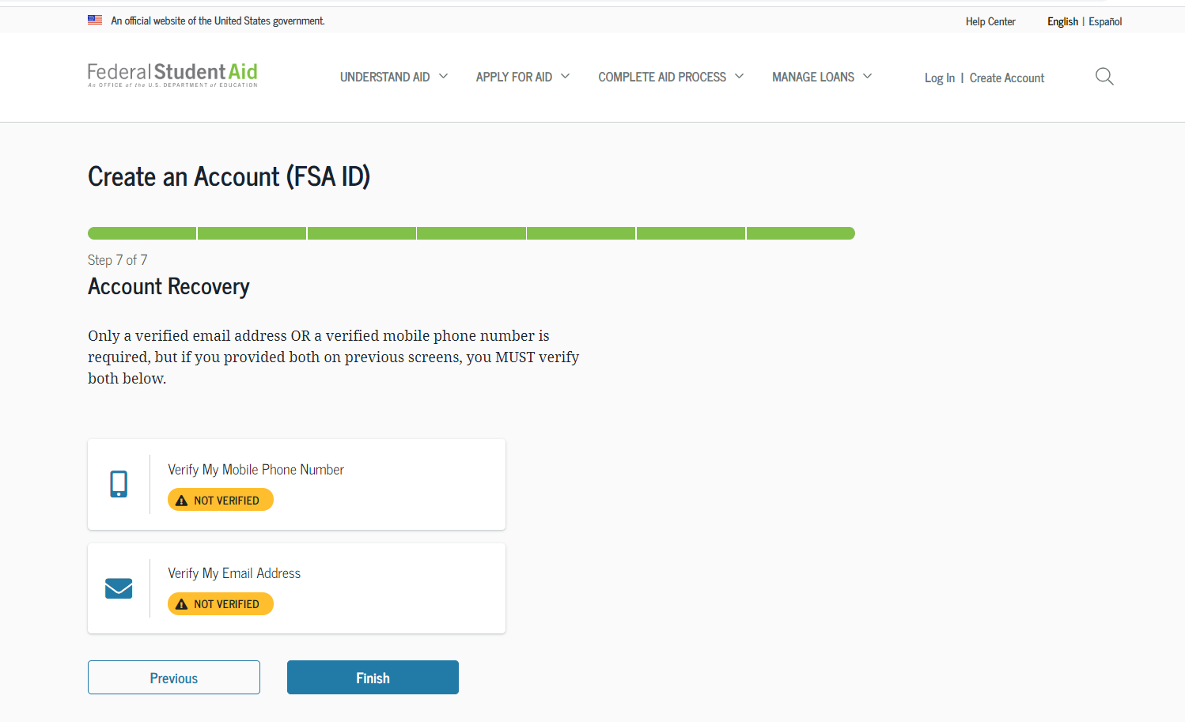
Verify your contact information
Only a verified email address OR a verified mobile phone number is required, but if you provided both on previous screens, you MUST verify both on the “Account Recovery” page.
Select the “Verify My Mobile Phone Number” button to verify your mobile phone number.
Select the “Verify My Email Address” button to verify your email address.

Slide 11
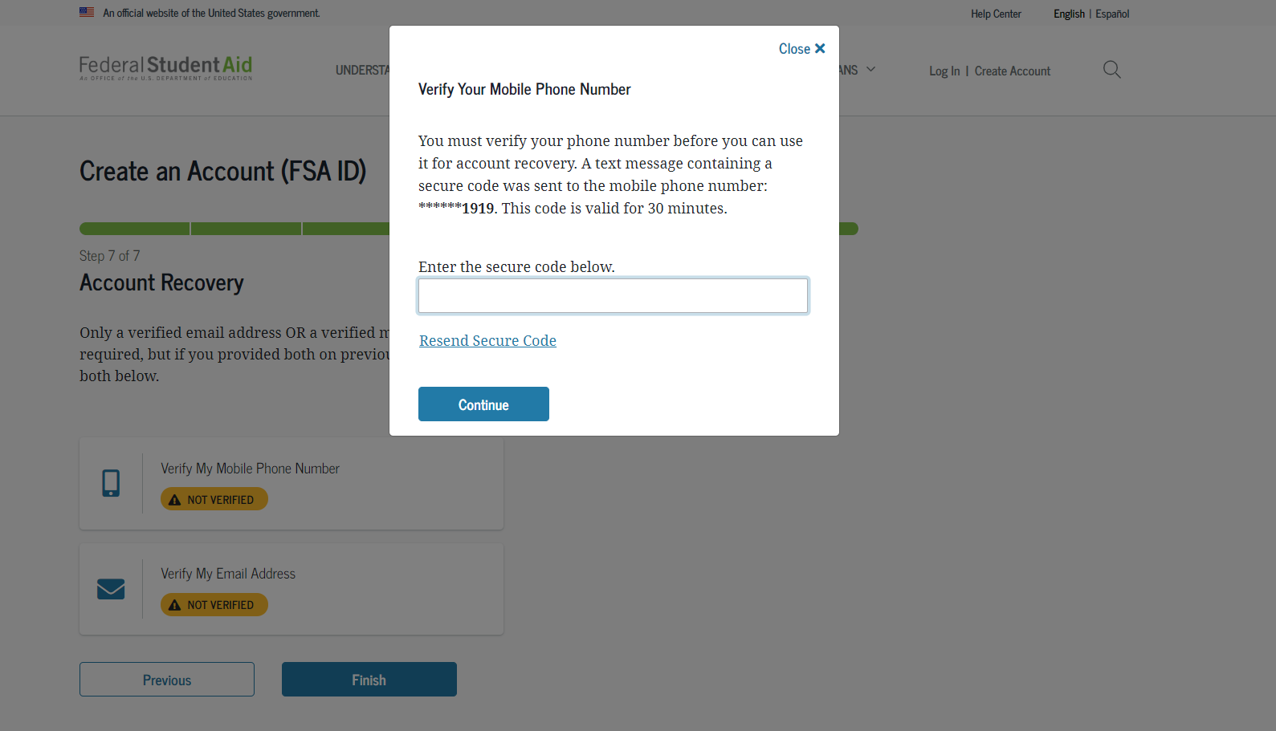
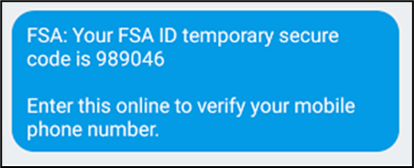
Verify your mobile phone number
After selecting the “Verify My Mobile Phone Number” button, you will be sent a text message with the six-digit numerical secure code.
Enter your secure code in the “Verify Your Mobile Phone Number” modal and select “Continue”.
Once you verify your mobile phone number, you can use it to log in, unlock your account, retrieve your username, or reset your password.
NOTE: You MUST verify your information before continuing.
Text Message With Your Secure Code

Slide 12
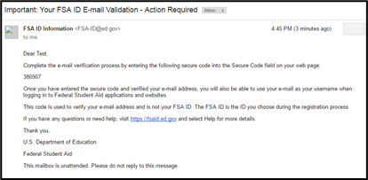
Verify your Email address
After selecting the “Verify My Email Address” button, you will be sent an email with the six-digit numerical secure code.
Enter your secure code in the “Verify Your Email Address” modal and select “Continue”.
Once you verify your email, you can use it to log in, unlock your account, retrieve your username, or reset your password.
NOTE: You MUST verify your information before continuing.
Email With Your Secure Code

Slide 13
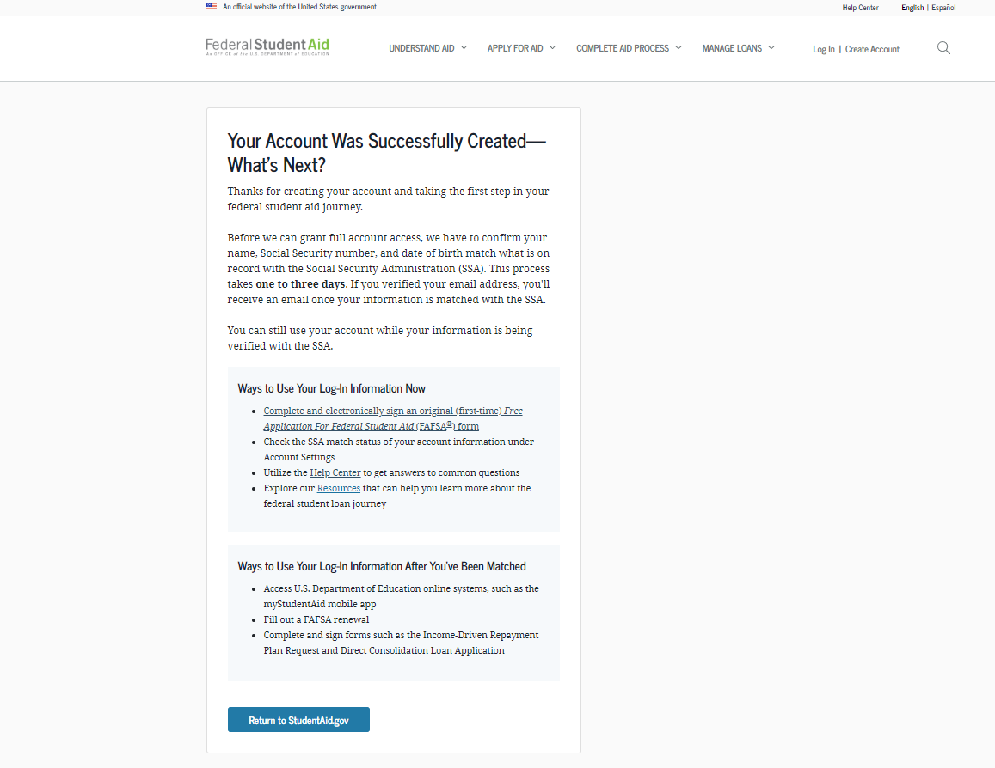
Your account is created!
If you provided an email address, you’ll receive a confirmation email.
Using Your Account Username and Password
You can immediately use your account username and password to sign an original (first-time) FAFSA form.
Your info will be sent to the Social Security Administration (SSA) for confirmation.
SSA review will take 1–3 days.
Until your info is verified, you won’t be able to take certain actions, such as correcting your FAFSA form, submitting a FAFSA Renewal, or signing forms such as the Income-Driven Repayment Plan Request and Direct Consolidation Loan Application.

