Slide 1
Attachment 7: P2 Grants Electronic Reporting System

Slide 2
PRA Burden Statement
This collection of information is approved by OMB under the Paperwork Reduction Act, 44 U.S.C. 3501 et seq. (OMB Control No. 2070-NEW). Responses to this collection of information are mandatory for certain persons, as specified at 42 U.S.C 13101 and 15 U.S.C.3701. An agency may not conduct or sponsor, and a person is not required to respond to, a collection of information unless it displays a currently valid OMB control number. The public reporting and recordkeeping burden for this collection of information is estimated to be approximately 14 - 20 hours per response on average. Send comments on the Agency’s need for this information, the accuracy of the provided burden estimates and any suggested methods for minimizing respondent burden to the Regulatory Support Division Director, U.S. Environmental Protection Agency (2821T), 1200 Pennsylvania Ave., NW, Washington, D.C. 20460. Include the OMB control number in any correspondence. Do not send the completed form to this address.

Slide 3
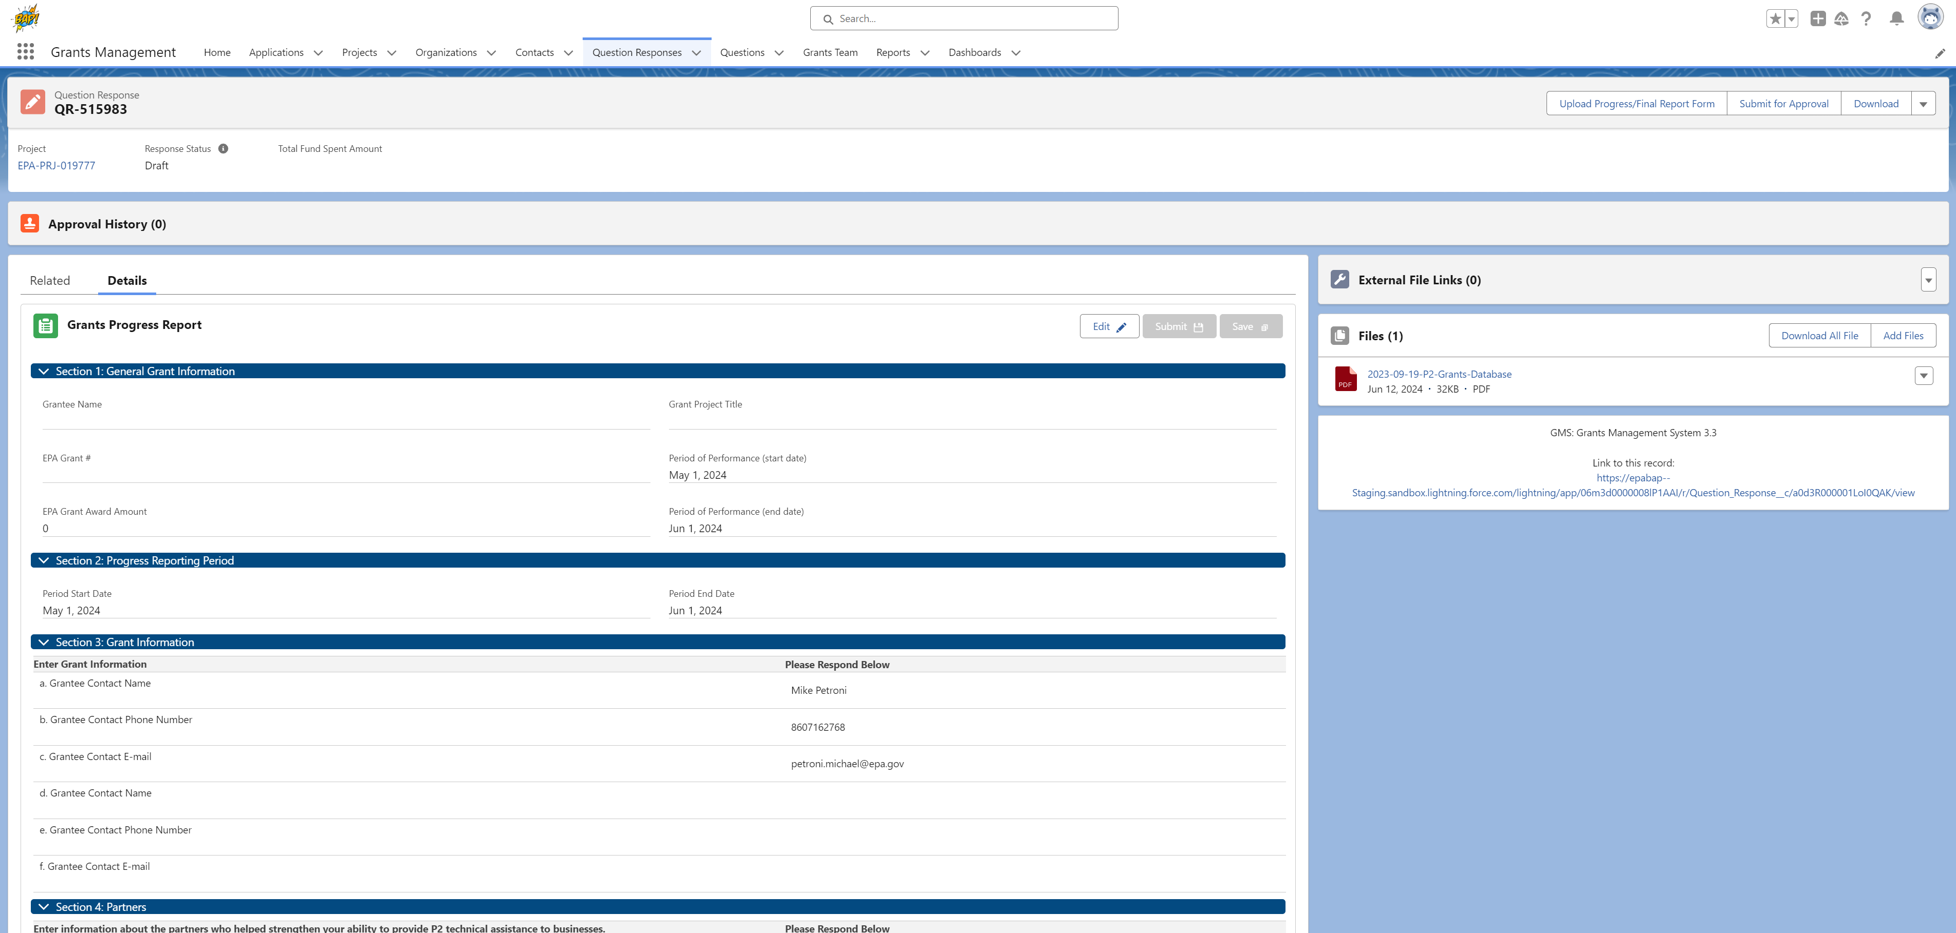
Grant Management
OMB Control No. 2070-NEW
Expiration Date: xx/xx/xxxx
EPA Form Nos. 9600-047,048, 055, 056

Slide 4
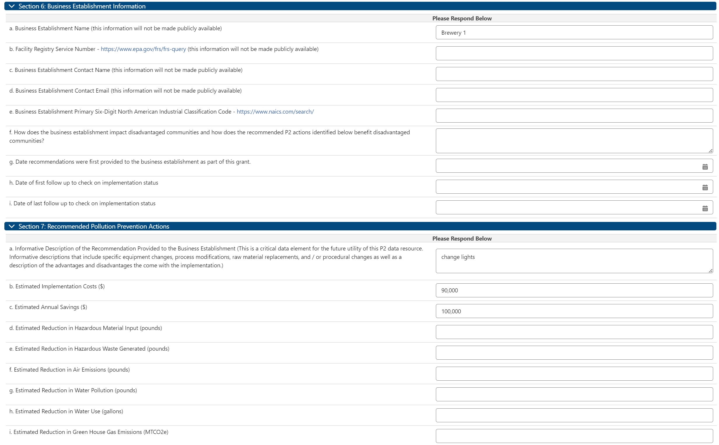
Grant Progress Report Information
OMB Control No. 2070-NEW
Expiration Date: xx/xx/xxxx
EPA Form Nos. 9600-047,048, 055, 056

Slide 5
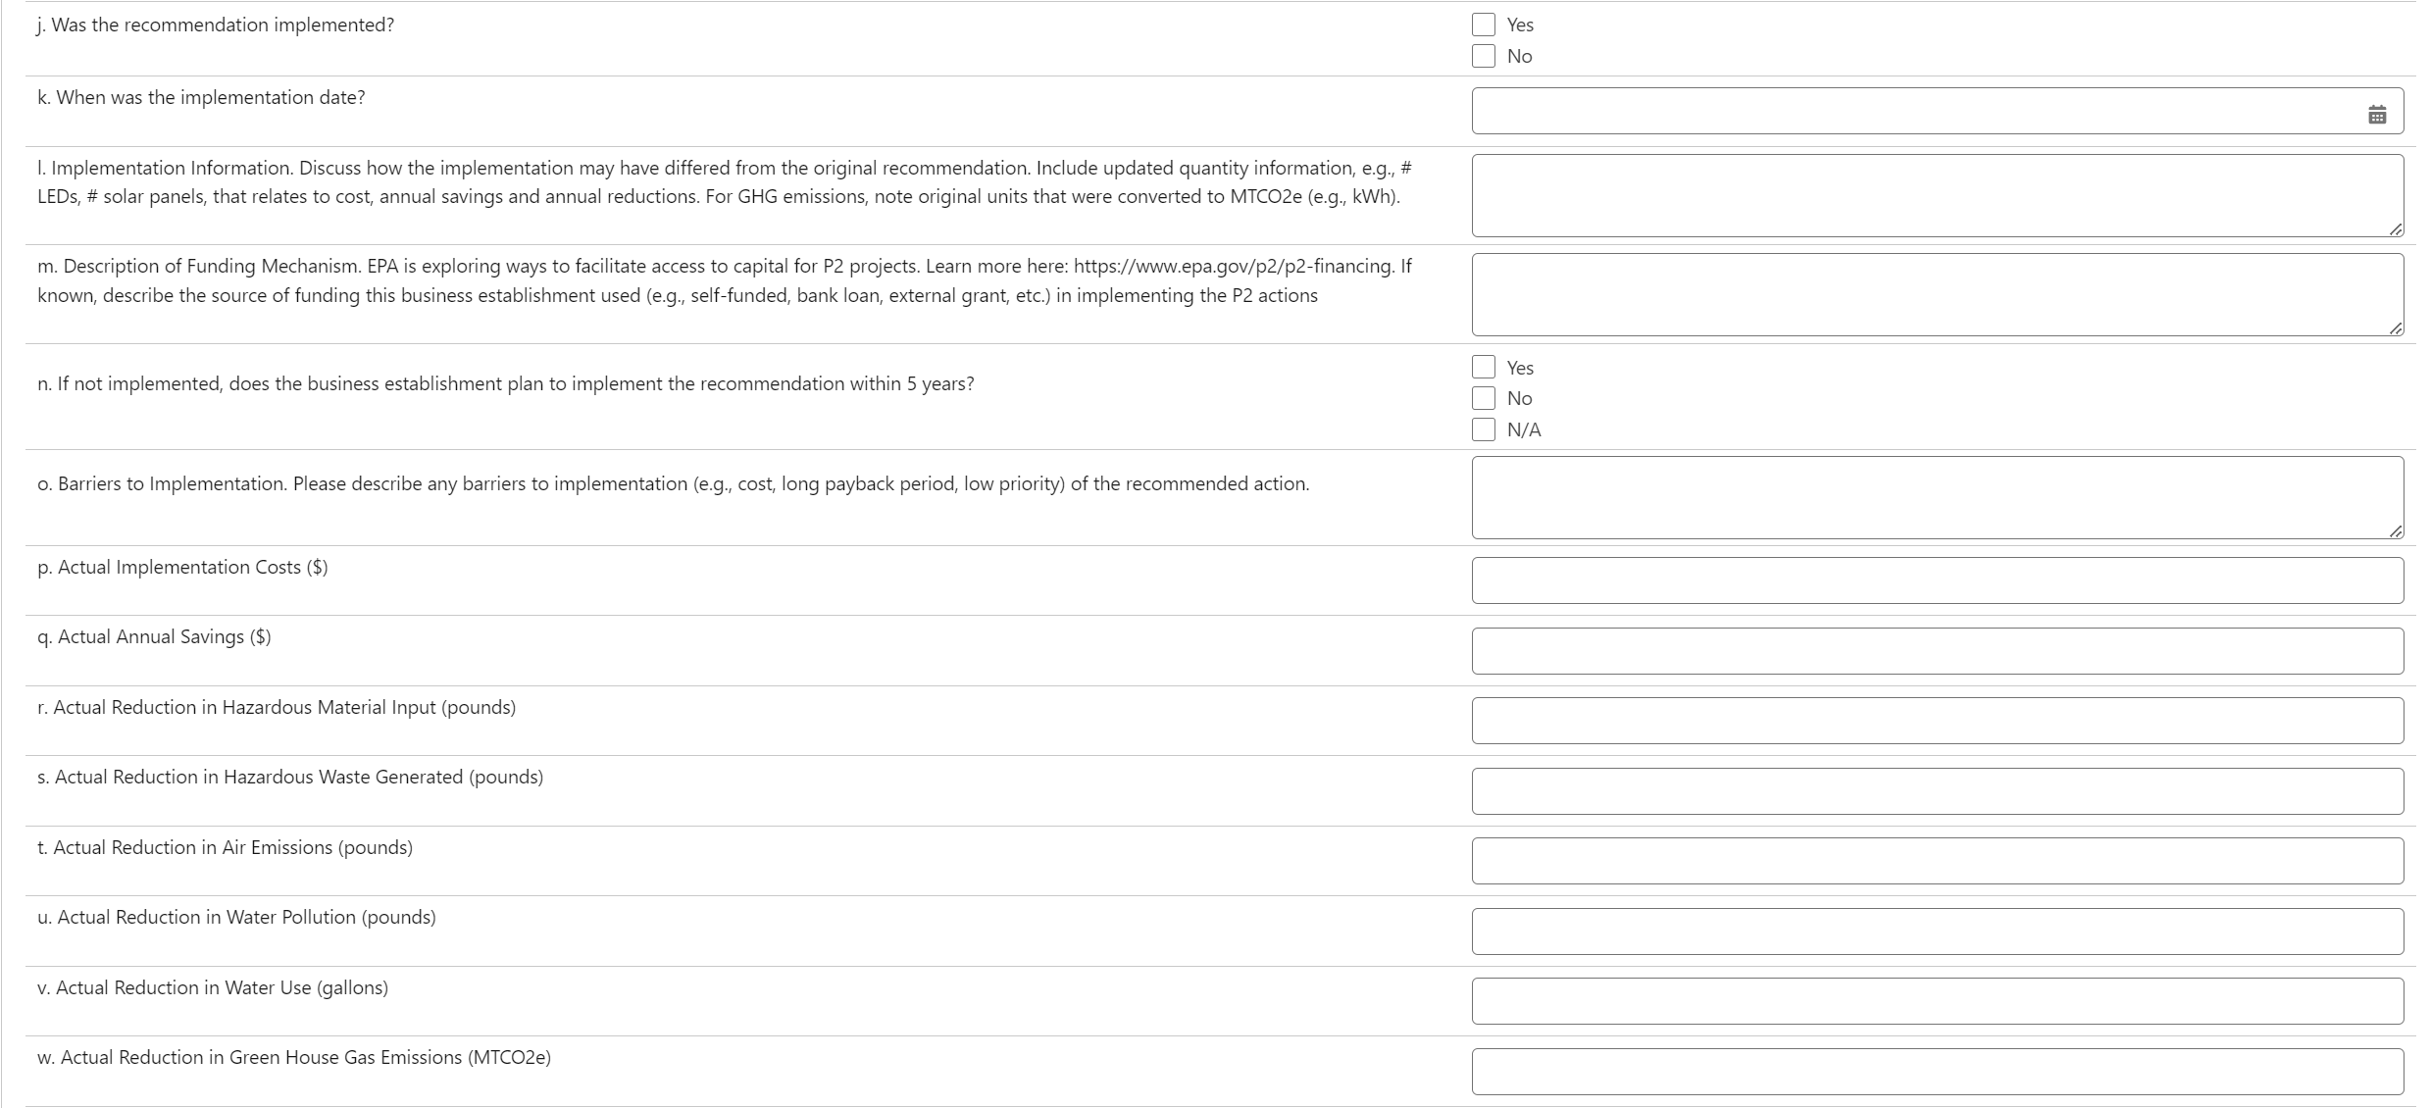
Business Establishment Information and P2 Actions
OMB Control No. 2070-NEW
Expiration Date: xx/xx/xxxx
EPA Form Nos. 9600-047,048, 055, 056

Slide 6
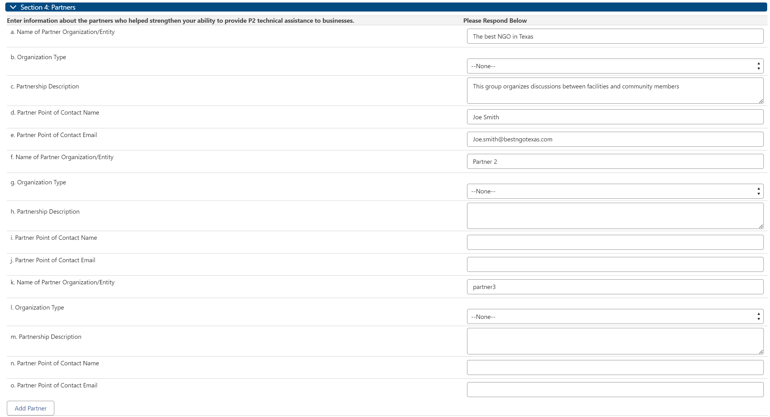
Grant Partners
OMB Control No. 2070-NEW
Expiration Date: xx/xx/xxxx
EPA Form Nos. 9600-047,048, 055, 056

Slide 7
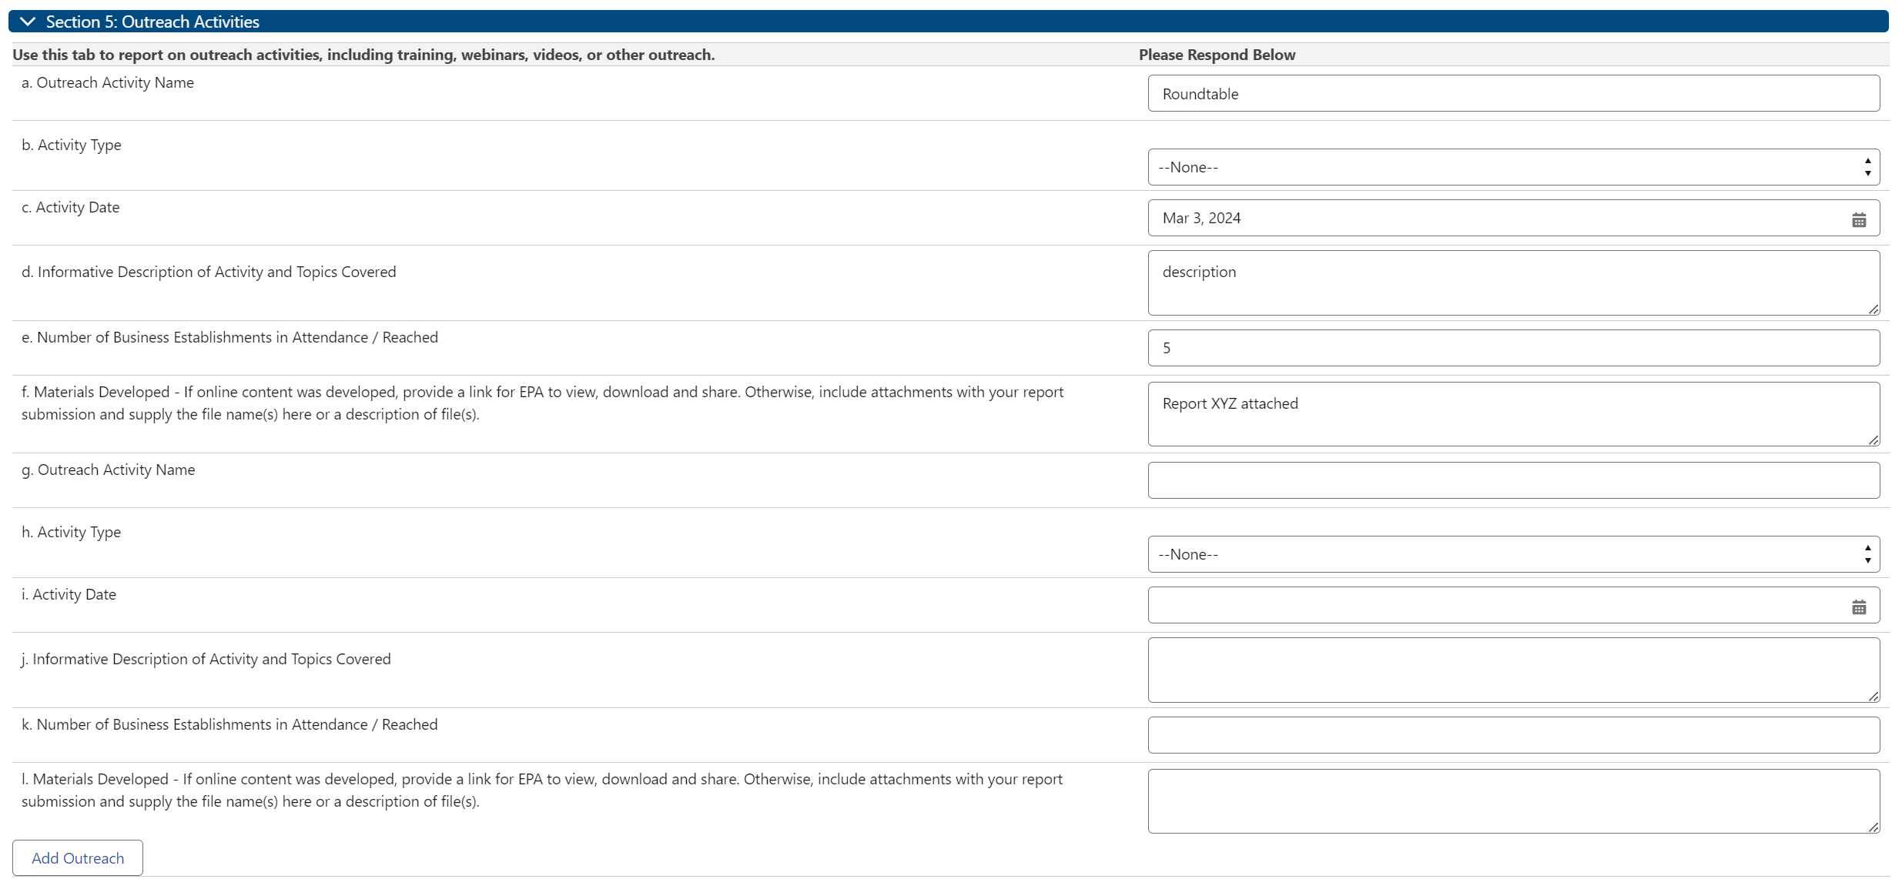
Outreach Activities
OMB Control No. 2070-NEW
Expiration Date: xx/xx/xxxx
EPA Form Nos. 9600-047,048, 055, 056

