Slide 1
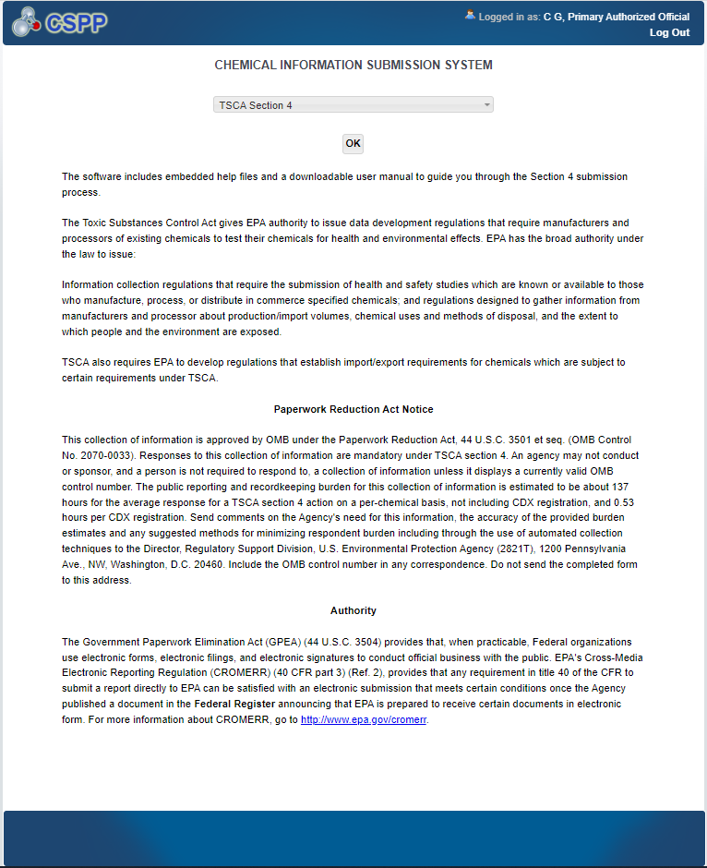
Section 4 CISS Landing Screen

Slide 2
Section 4 Fees Certification Screen

Slide 3
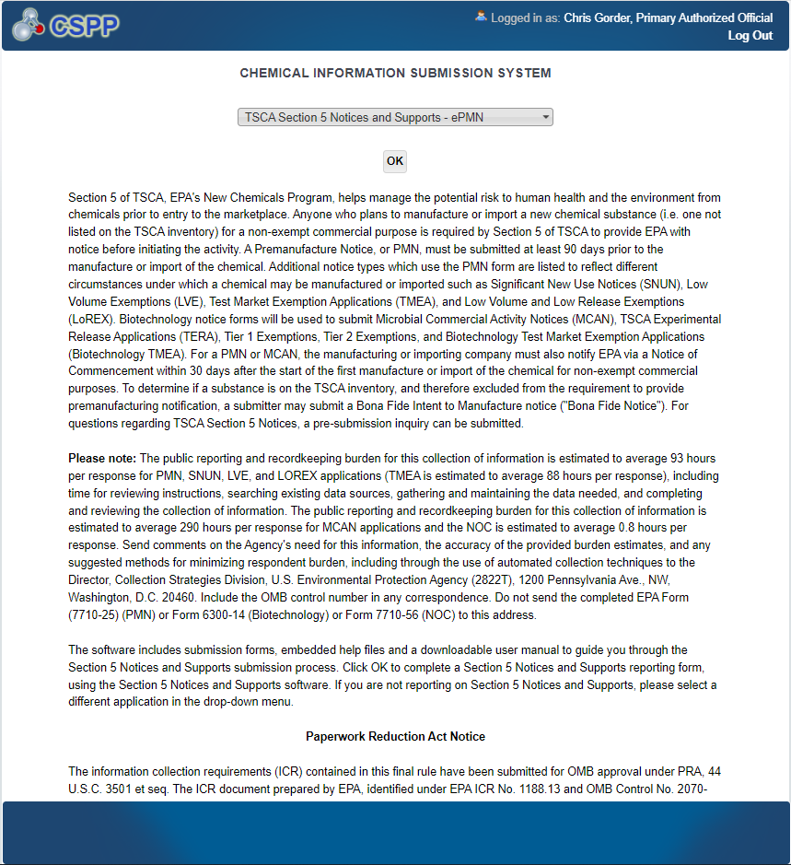
Section 5 CISS Landing Screen 1 of 2

Slide 4
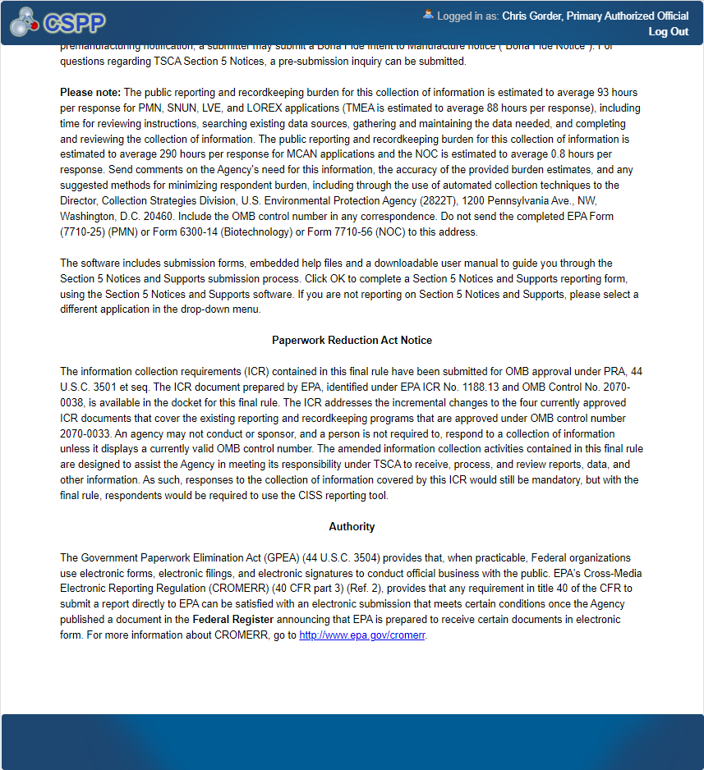
Section 5 CISS Landing Screen 2 of 2

Slide 5
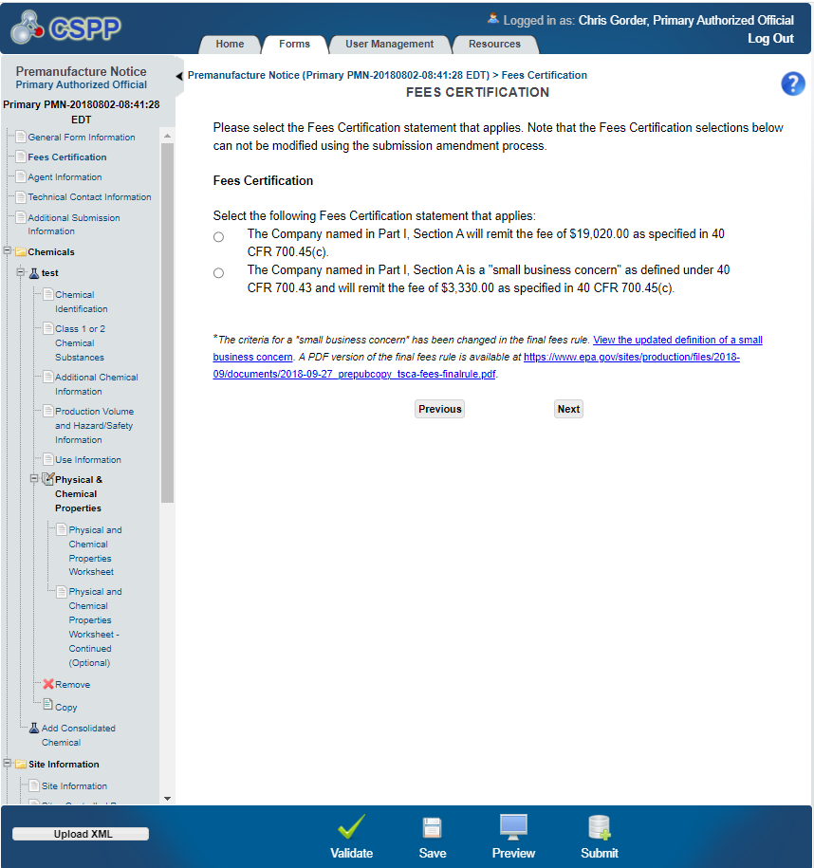
Section 5 Fees Certification Screen for PMN Submissions

Slide 6
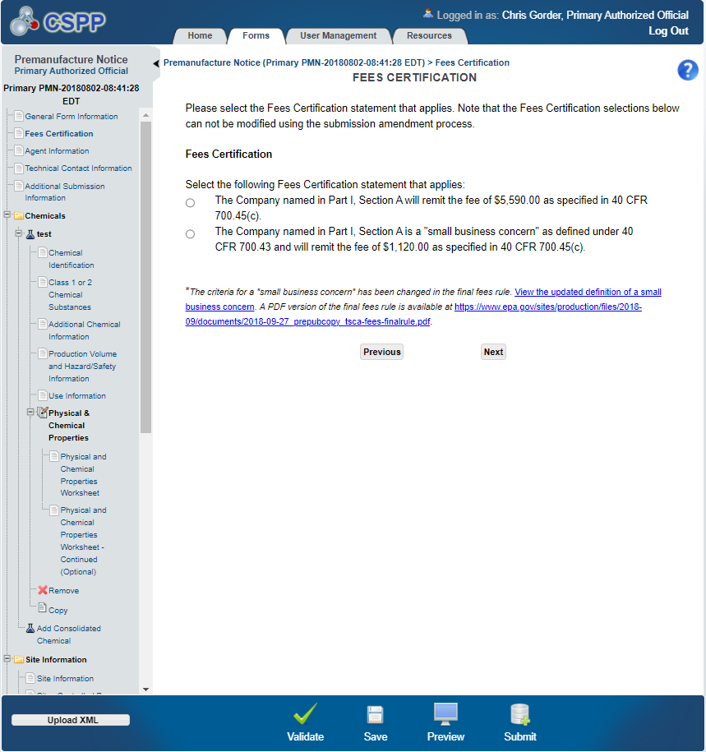
Section 5 Fees Certification Screen for Exemptions

Slide 7
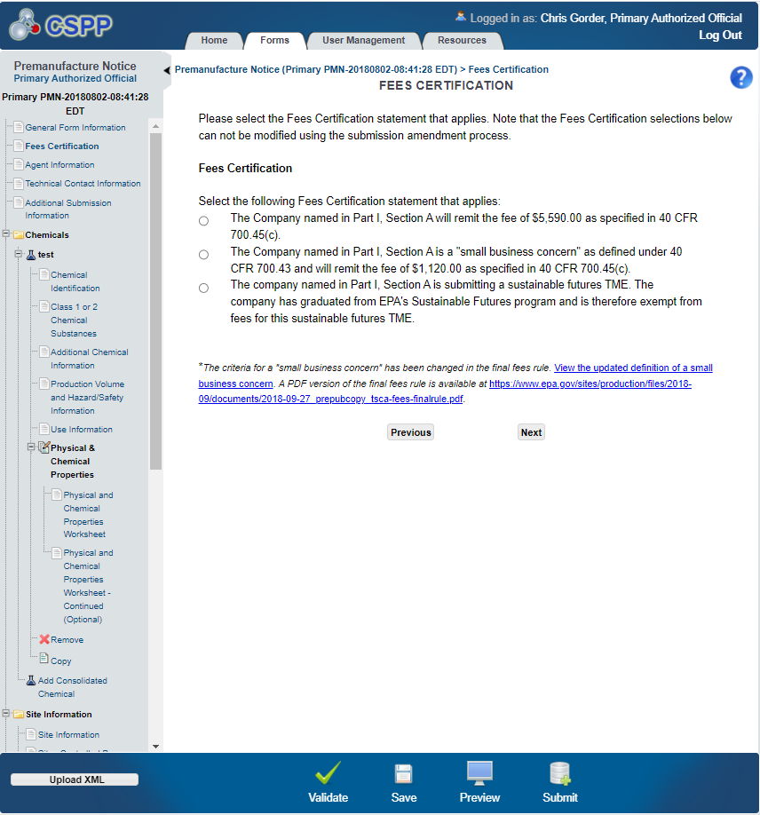
Section 5 Fees Certification Screen for TME Exemptions

Slide 8
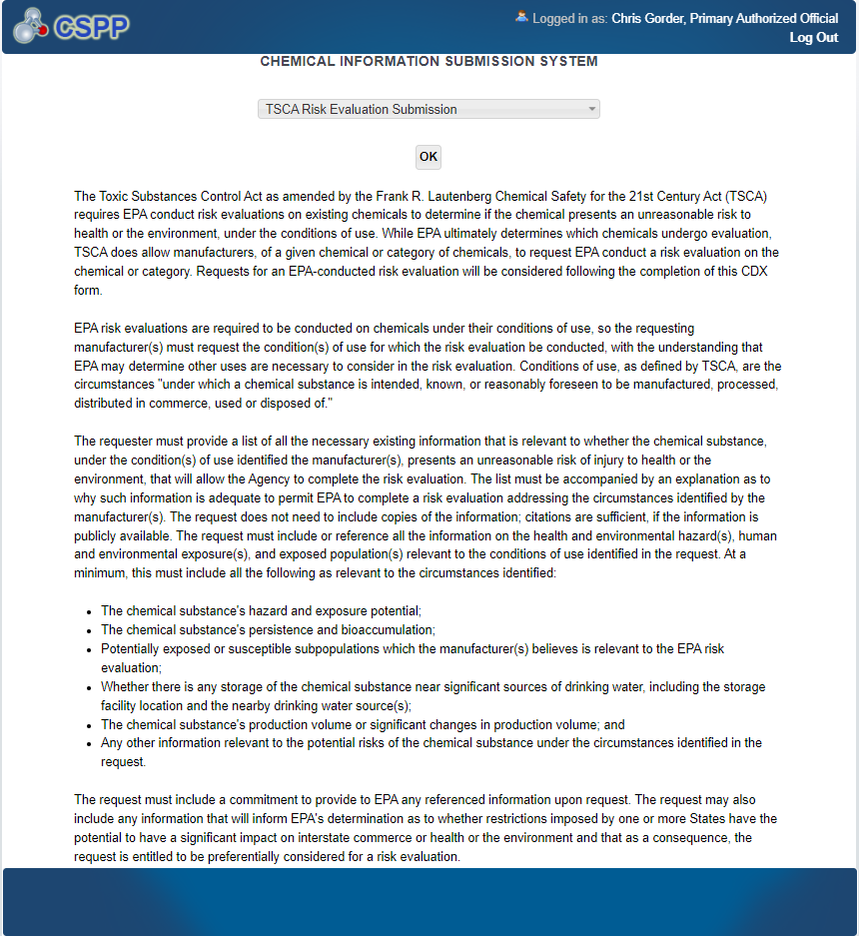
Section 6 CISS Landing Screen 1 of 2

Slide 9
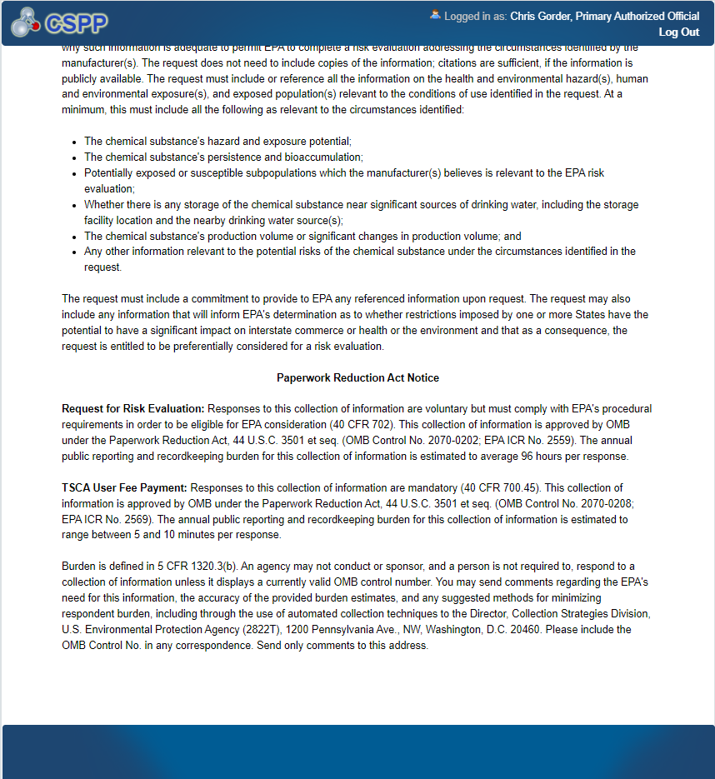
Section 6 CISS Landing Screen 2 of 2

Slide 10
Section 6 Fees Certification Screen

Slide 11
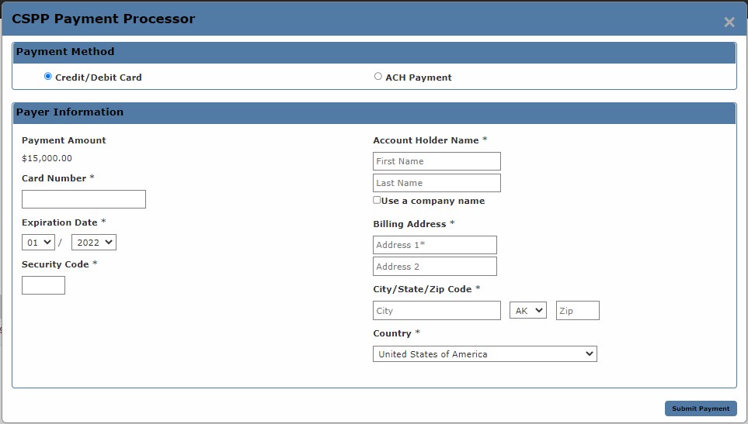
Section 4, 5, and 6 Invoice Payment Widget
(amount automatically populated according to generated invoice or predetermined fee amounts)

