Slide 1
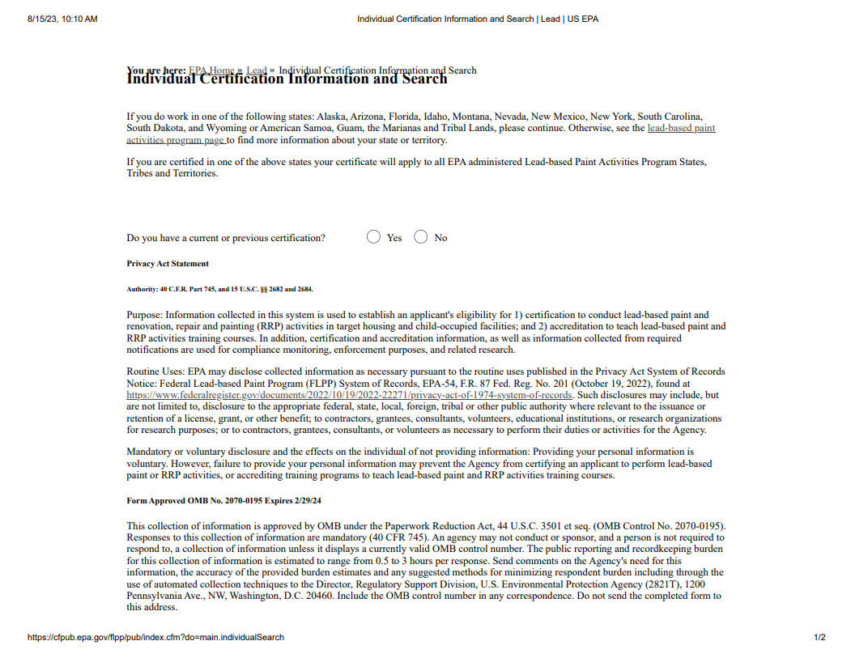
Individual Certification 1
OMB Control No. 2070-0195
Expiration Date: 2/29/2024
EPA From No. 747-B-99-002

Slide 2
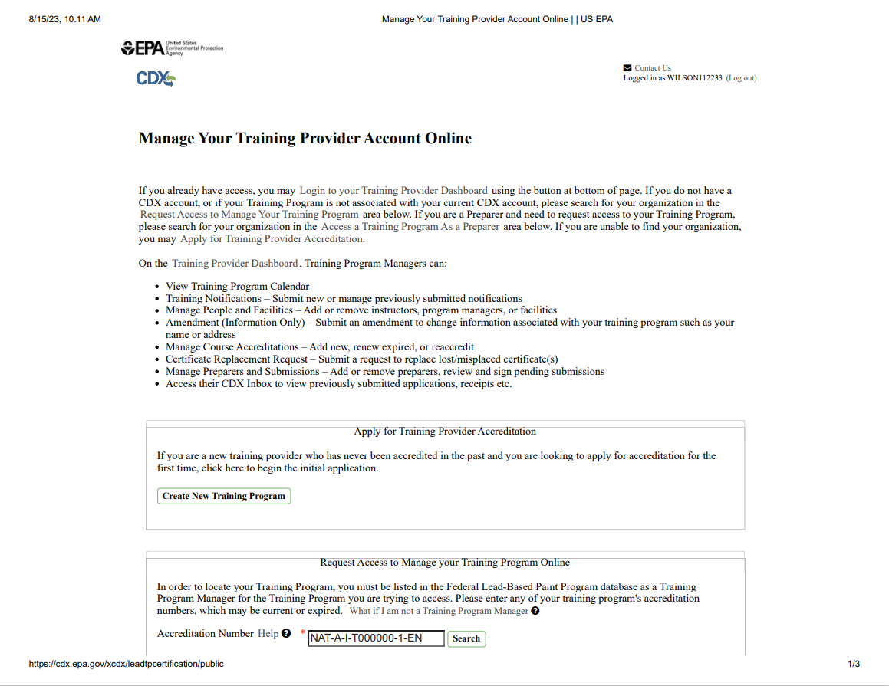
OMB Control No. 2070-0195
Expiration Date: 2/29/2024
Training Provider Accreditation 1 of 3
EPA From 8500-25

Slide 3
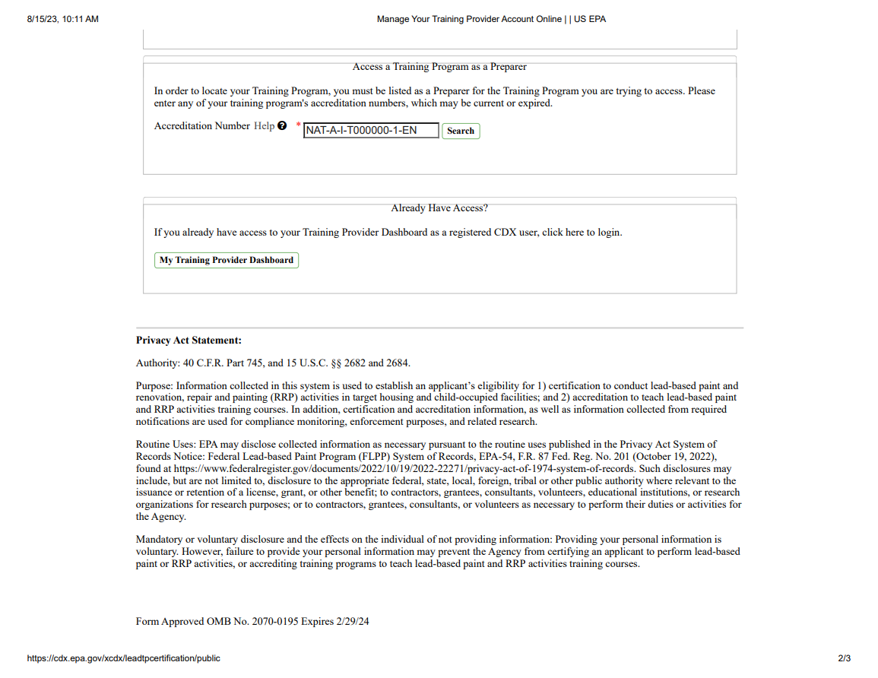
OMB Control No. 2070-0195
Expiration Date: 2/29/2024
Training Provider Accreditation 2 of 3
EPA From 8500-25

Slide 4
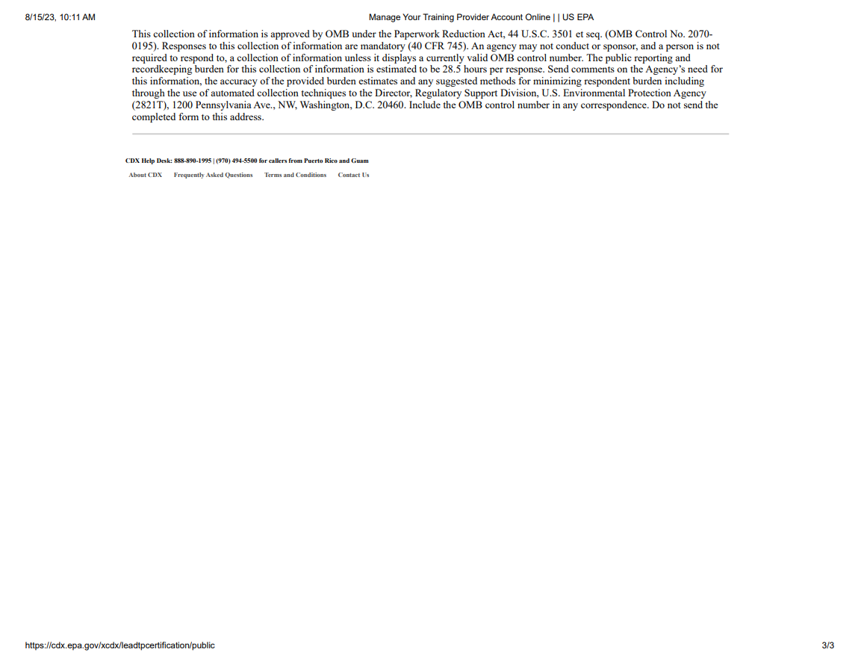
OMB Control No. 2070-0195
Expiration Date: 2/29/2024
Training Provider Accreditation 3 of 3
EPA From 8500-25

Slide 5
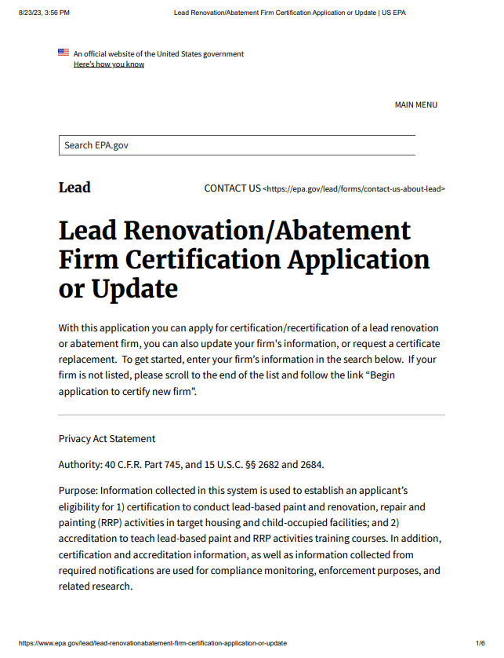
OMB Control No. 2070-0195
Expiration Date: 2/29/2024
Firm Application 1 of 3
EPA From 8500-27

Slide 6
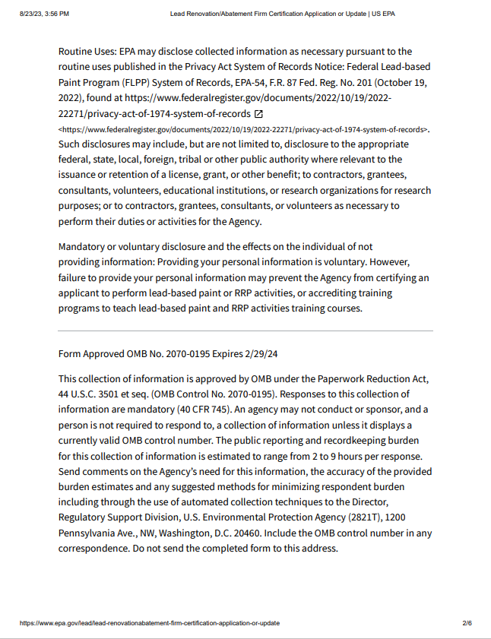
OMB Control No. 2070-0195
Expiration Date: 2/29/2024
Firm Application 2 of 3
EPA From 8500-27

Slide 7
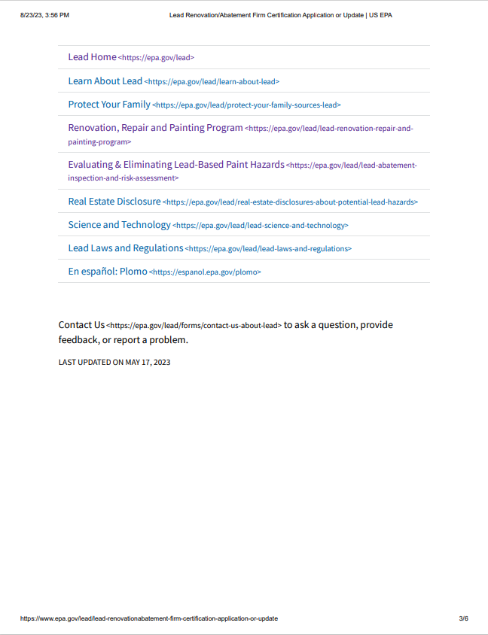
OMB Control No. 2070-0195
Expiration Date: 2/29/2024
Firm Application 2 of 3
EPA From 8500-27

Slide 8
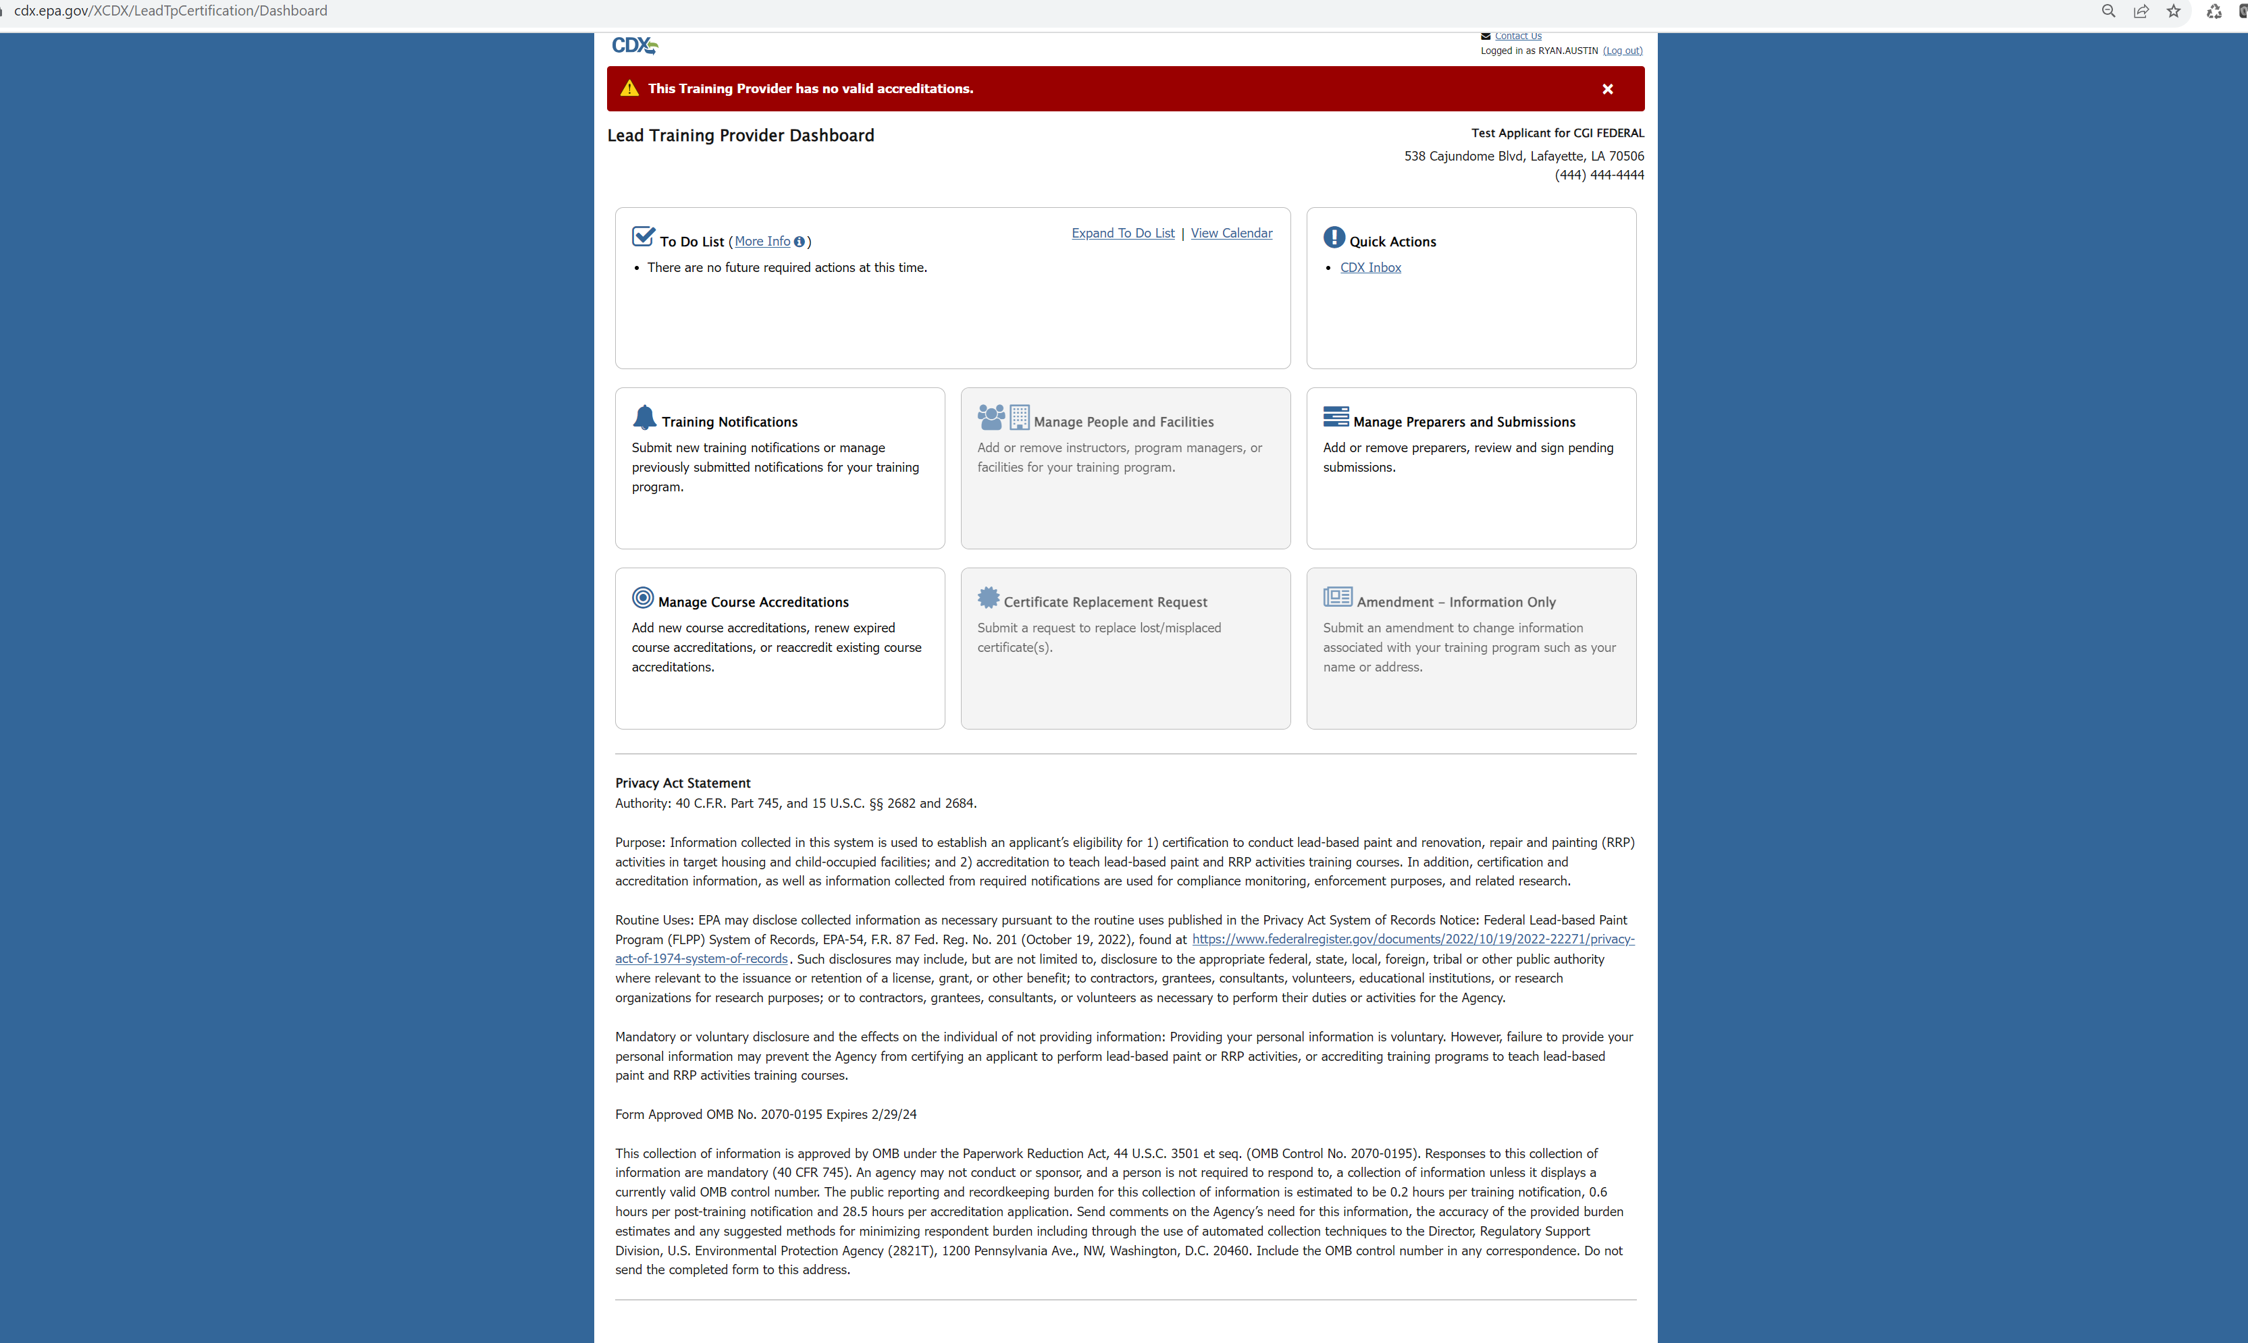
OMB Control No. 2070-0195
Expiration Date: 2/29/2024
Training Provider PAS
EPA From 8500-25

Slide 9
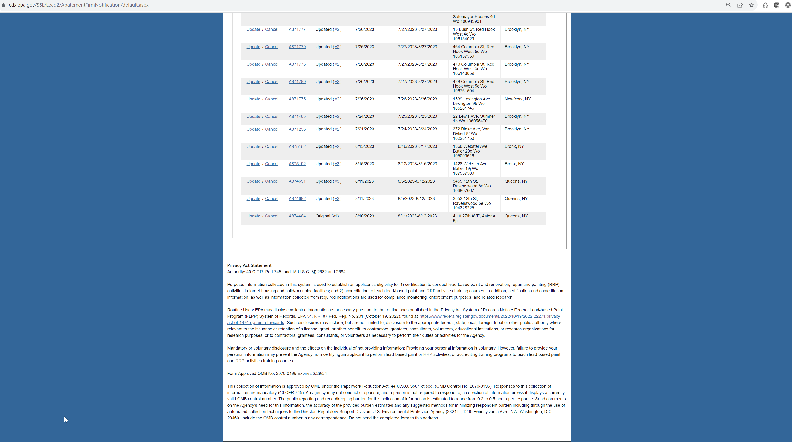
OMB Control No. 2070-0195
Expiration Date: 2/29/2024
Abatement Firm Notification PAS
EPA From 8500-27

