Slide 1
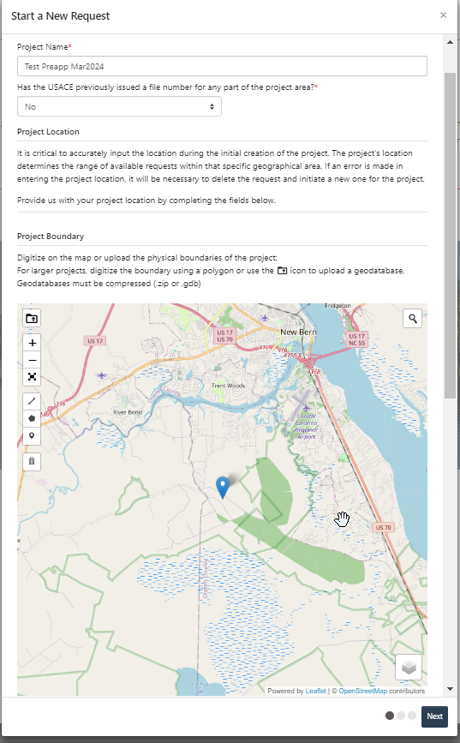
Starting a New Request
Users are asked to name their request and provide information on the location of the project – asked first so we know which district to route it to. Location information gets included in Section II

Slide 2
After the RRS determines where to route, requestors are are asked what type of Request they want. See the list of available options.

Slide 3
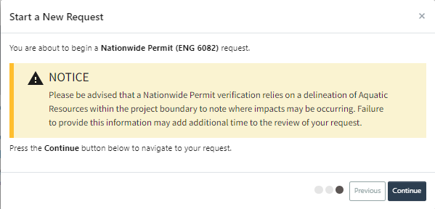
Once an option is selected, they get this intro screen (unique to each request type), then enter the information in that is used to generate the forms

Slide 4
Some forms are embedded in information sections such as contacts or property owner sections. These two forms are viewed and filled out prior to upload.

Slide 5
General Project Information
Information goes in section III, blocks 2 - 6

Slide 6
Contact Information
Information goes in Section 1A or IB

Slide 7
Property Owners
Information goes in block IC

Slide 8
Supporting Information (if any) not required

Slide 9
Certify, Sign, and Submit
Signature at the bottom of the form. Has language about submitting a request

Slide 10
Generated documents are shown on the left-hand side of the menu – paper icon circled in purple.

