Slide 1

CBP One
TM
Traveler > Air > Request Advance Travel Authorization
(Mobile)
P1.3: September 27, 2022

Slide 2
CBP One – Traveler > Air > Advance Travel Authorization
Default flow, first-time user using a NON-EPASSPORT (no ECHIP)

Slide 3
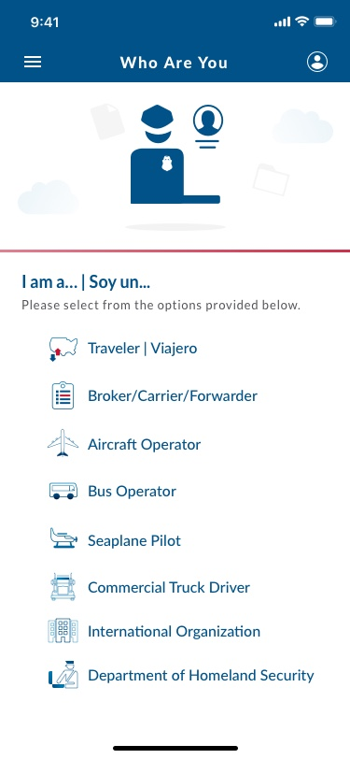
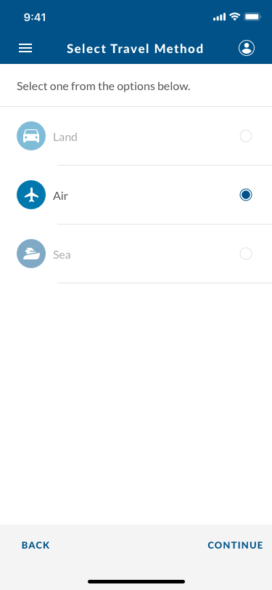
CBP One – Traveler > Air > Advance Travel Authorization: Request Advance Travel Authorization (NO ECHIP)

Slide 4
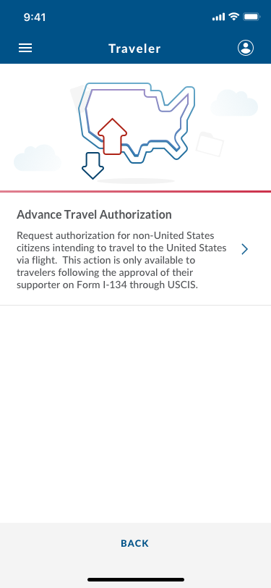
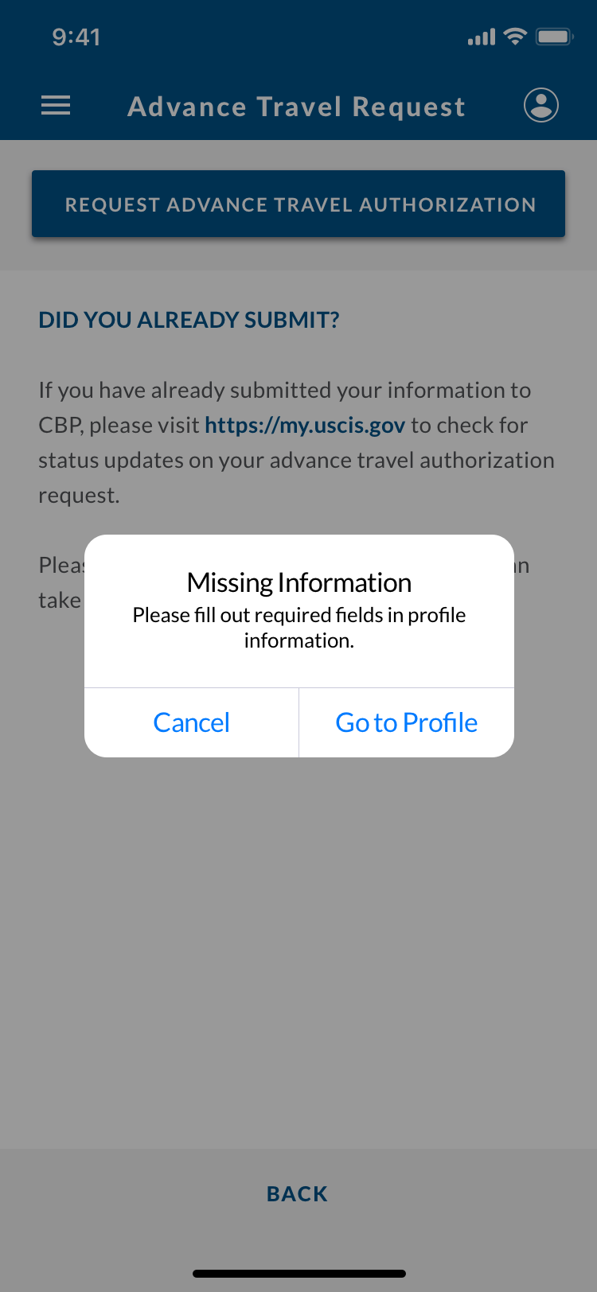
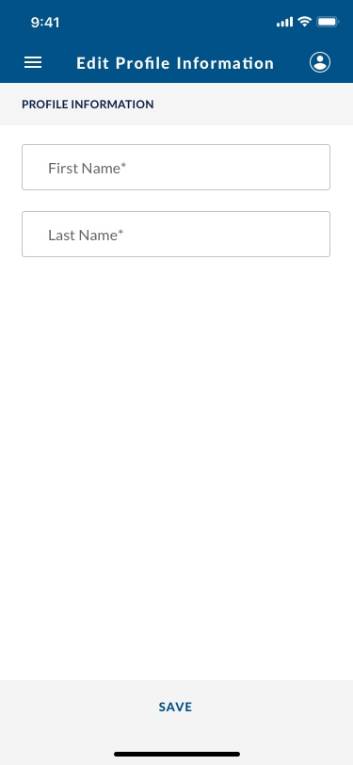
CBP One – Traveler > Air > Advance Travel Authorization: Request Advance Travel Authorization (NO ECHIP)
Pop-up appears if user has not filled out profile information prior.

Slide 5
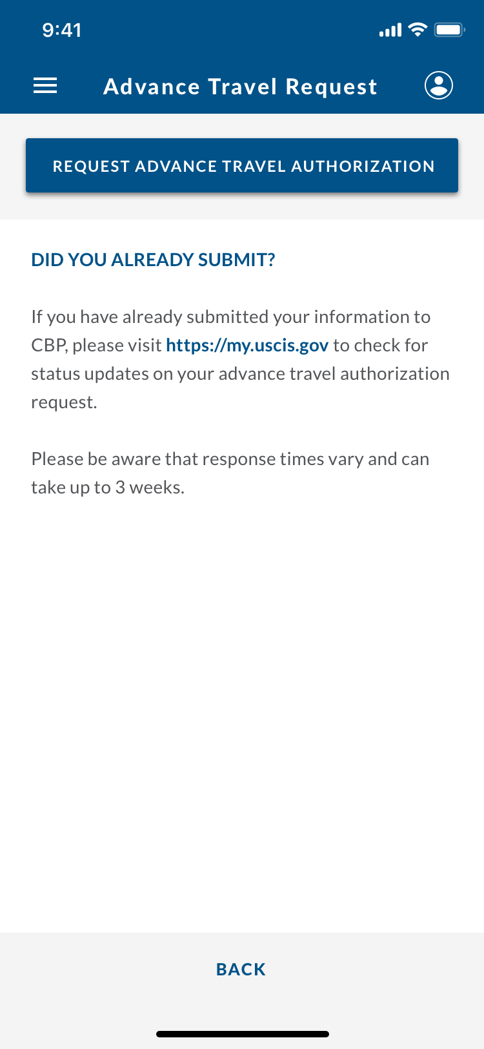
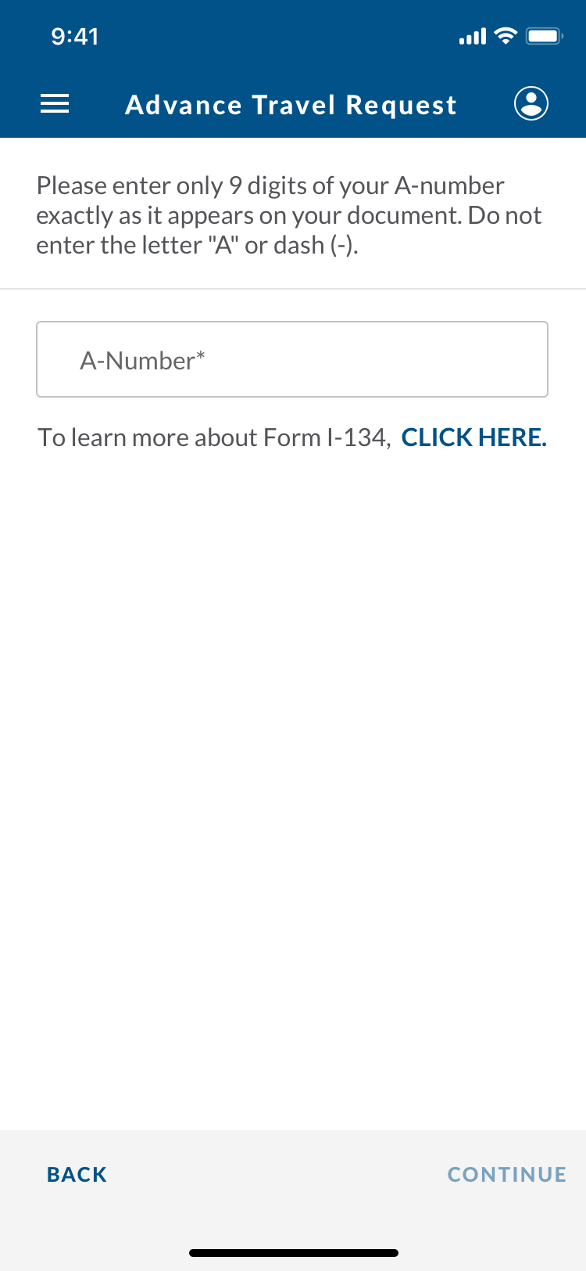
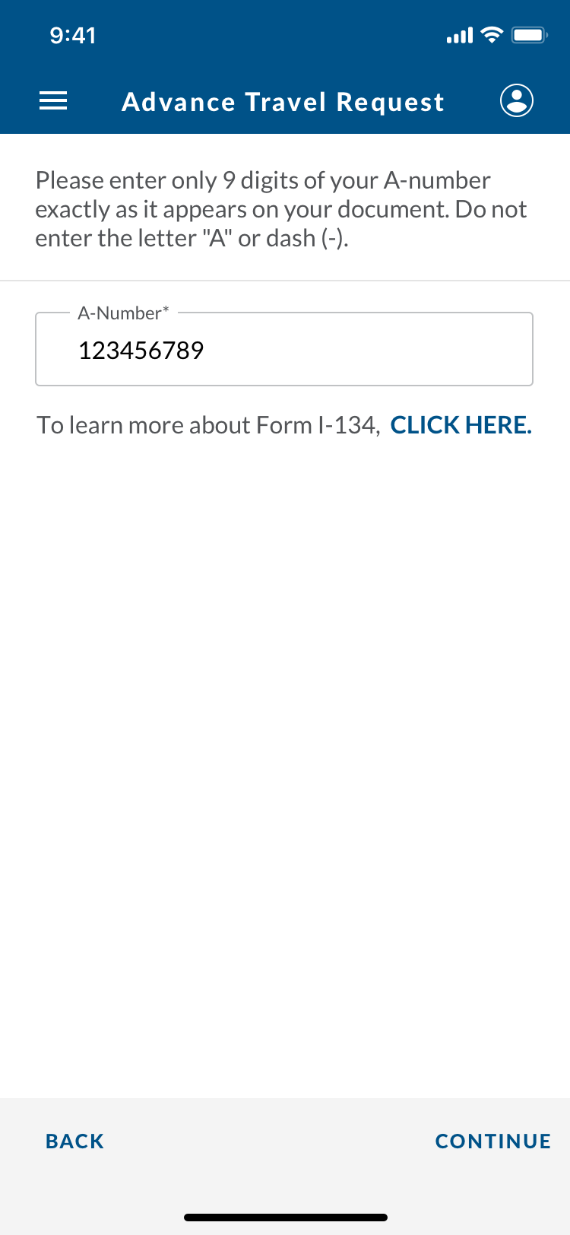
CBP One – Traveler > Air > Advance Travel Authorization: Request Advance Travel Authorization (NO ECHIP)

Slide 6
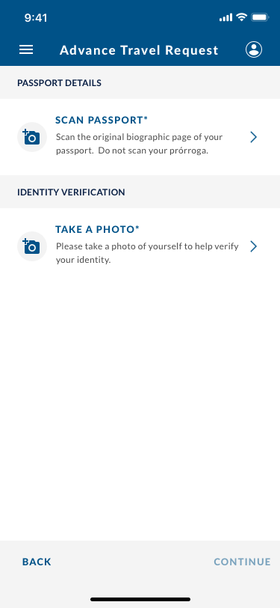
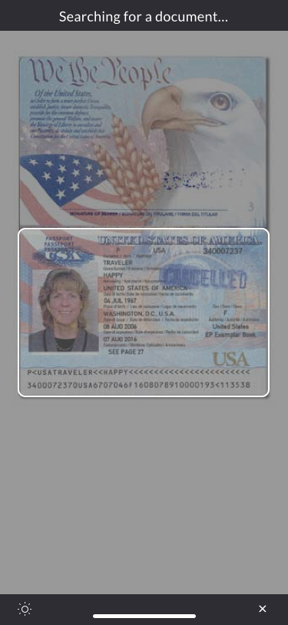
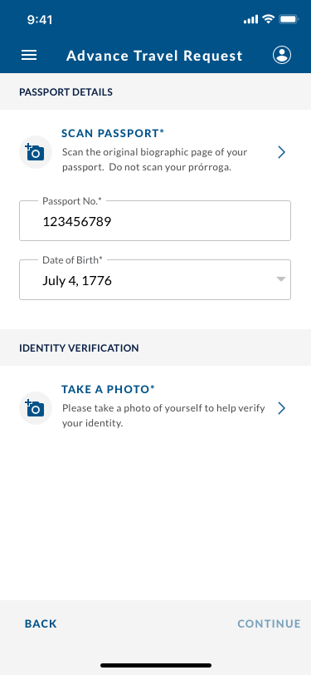
CBP One – Traveler > Air > Advance Travel Authorization: Request Advance Travel Authorization (NO ECHIP)
MRZ scanner detects if passport has an ECHIP or not.
This passport does NOT, so backend needs to gather passport photo of traveler.

Slide 7

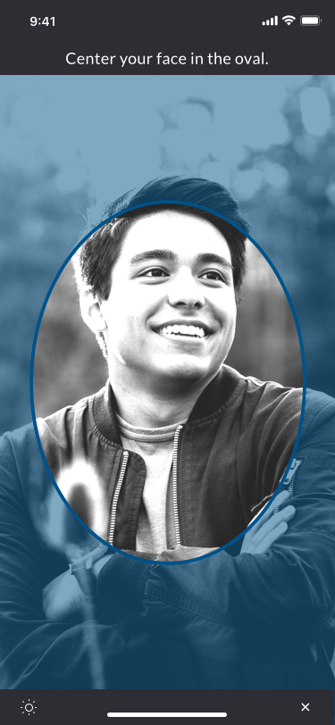
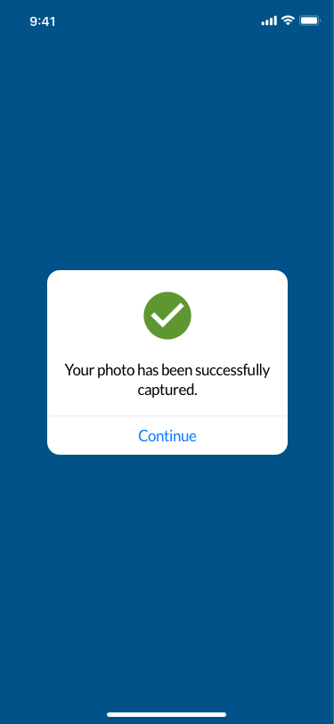
CBP One – Traveler > Air > Advance Travel Authorization: Request Advance Travel Authorization (NO ECHIP)

Slide 8
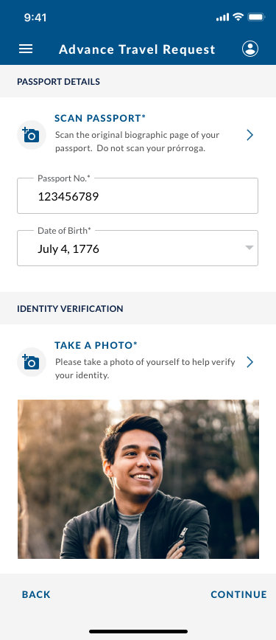
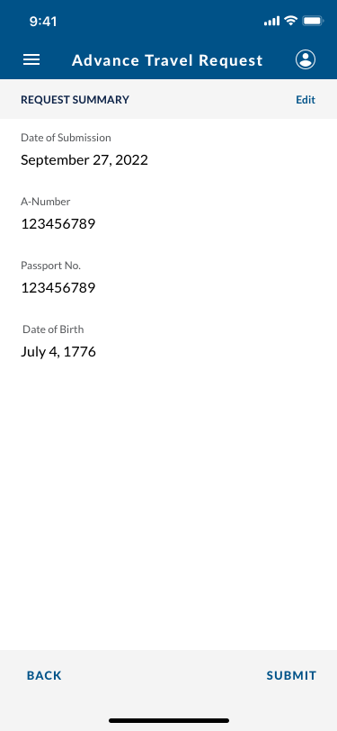
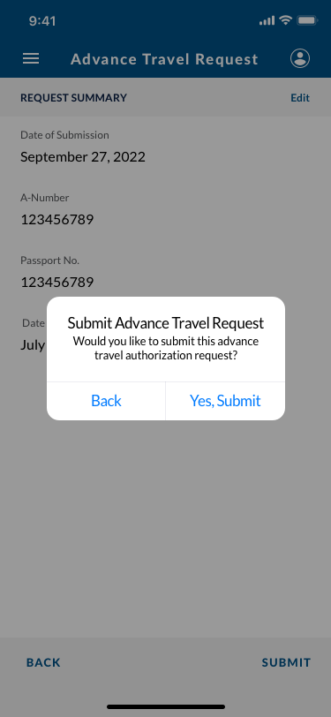
CBP One – Traveler > Air > Advance Travel Authorization: Request Advance Travel Authorization (NO ECHIP)

Slide 9
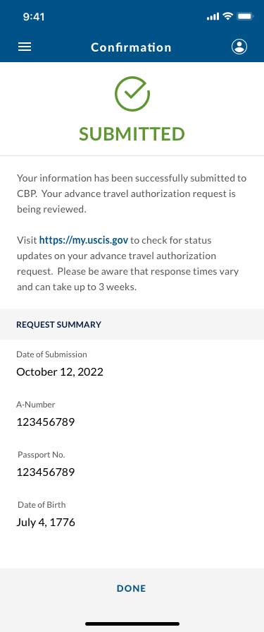
CBP One – Traveler > Air > Advance Travel Authorization: Request Advance Travel Authorization (NO ECHIP)
BACK should take the user back to the Air Traveler action list.

Slide 10
CBP One – Traveler > Air > Advance Travel Authorization
Default flow, first-time user using an EPASSPORT (yes ECHIP)

Slide 11
CBP One – Traveler > Air > Advance Travel Authorization: Request Advance Travel Authorization (with ECHIP)

Slide 12
CBP One – Traveler > Air > Advance Travel Authorization: Request Advance Travel Authorization (with ECHIP)
Pop-up appears if user has not filled out profile information prior.

Slide 13
CBP One – Traveler > Air > Advance Travel Authorization: Request Advance Travel Authorization (with ECHIP)

Slide 14
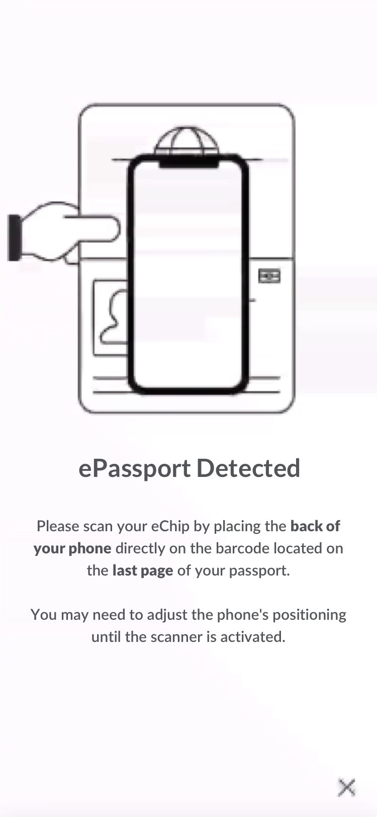
CBP One – Traveler > Air > Advance Travel Authorization: Request Advance Travel Authorization (with ECHIP)
MRZ scanner detects if passport has an ECHIP or not.
This passport DOES, so user is automatically directed to scan ECHIP.

Slide 15
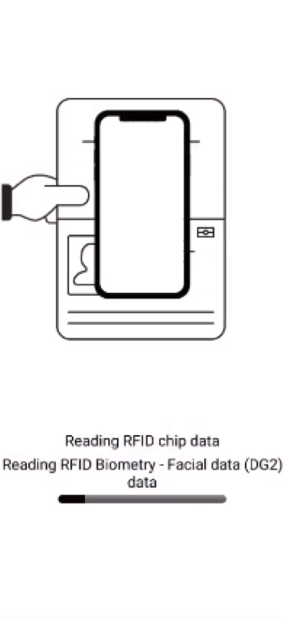
CBP One – Traveler > Air > Advance Travel Authorization: Request Advance Travel Authorization (with ECHIP)

Slide 16
CBP One – Traveler > Air > Advance Travel Authorization: Request Advance Travel Authorization (with ECHIP)

Slide 17
CBP One – Traveler > Air > Advance Travel Authorization: Request Advance Travel Authorization (with ECHIP)

Slide 18
CBP One – Traveler > Air > Advance Travel Authorization: Request Advance Travel Authorization (with ECHIP)
BACK should take the user back to the Air Traveler action list.

Slide 19
Edgecase 1
User selects “To learn more about Form I-134, CLICK HERE.”

Slide 20
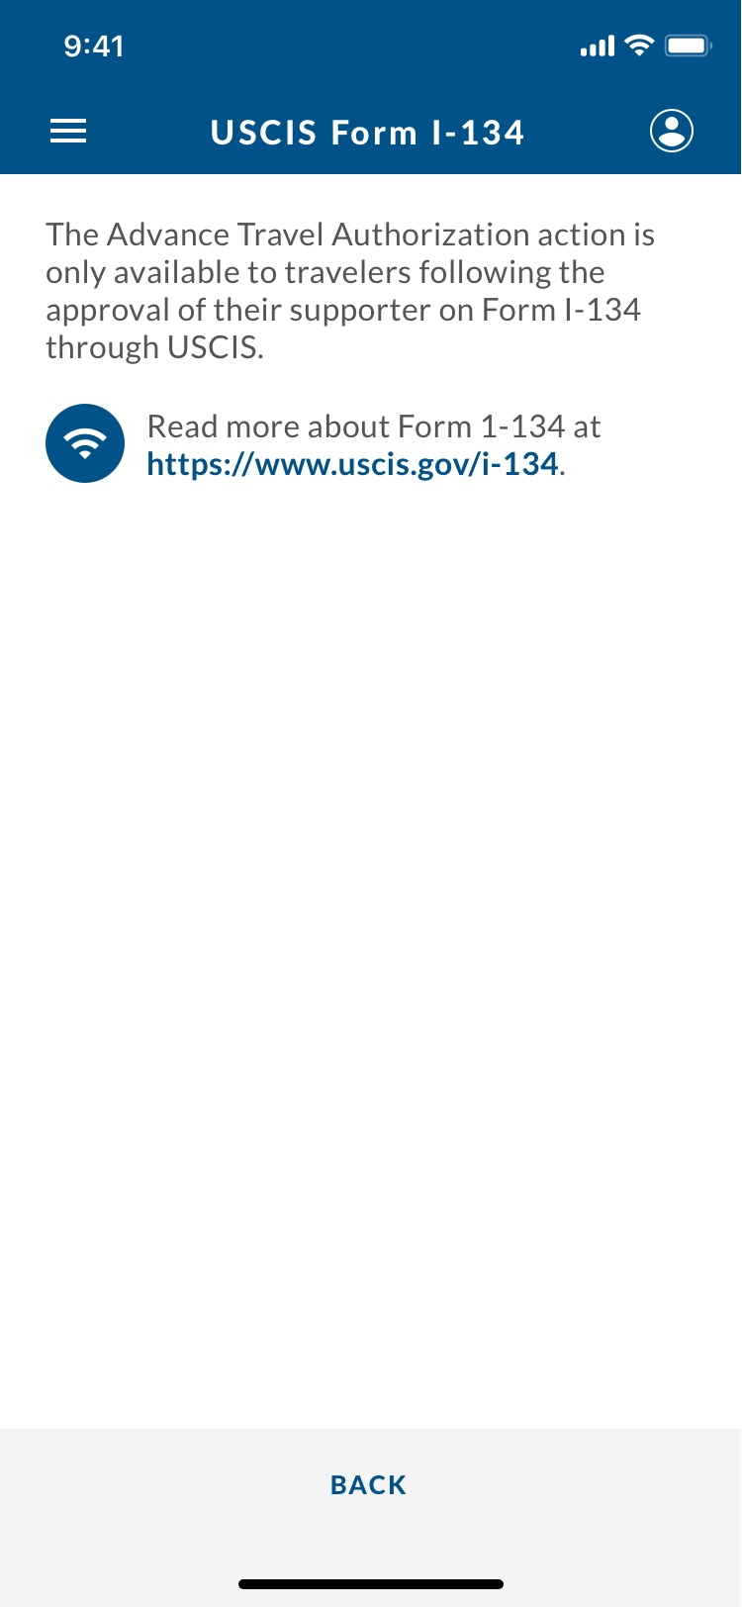
CBP One – Traveler > Air > Advance Travel Authorization: Edgecase 1

Slide 21
Edgecase 2
Information issue upon submission.

Slide 22
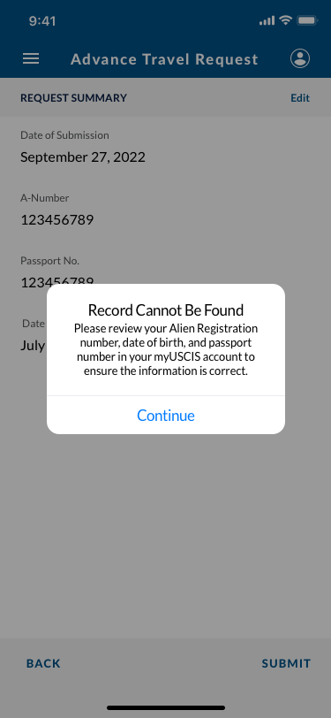
CBP One – Traveler > Air > Advance Travel Authorization: Edgecase 2

Slide 23
Edgecase 3
Liveness Detection fails.

Slide 24
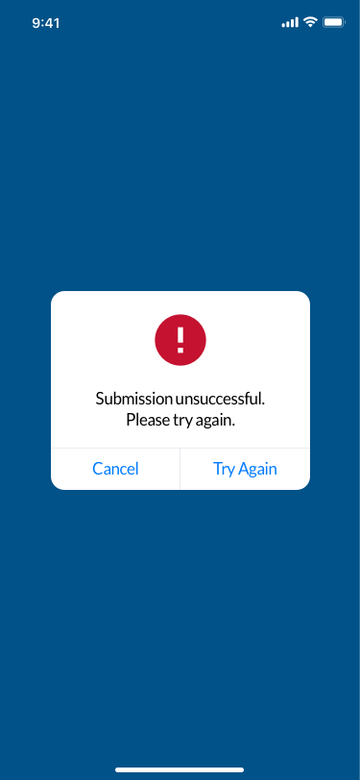
CBP One – Traveler > Air > Advance Travel Authorization: Edgecase 3

Slide 25
Edgecase 4
ECHIP scan fails.

Slide 26
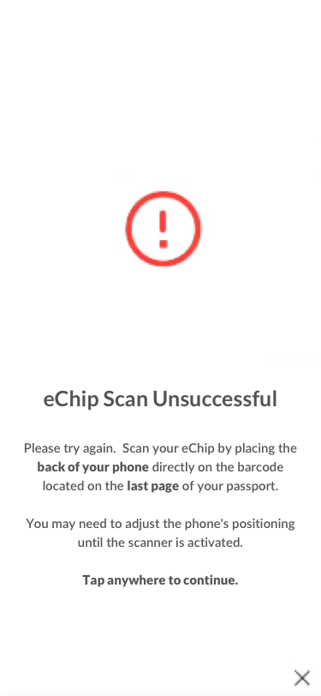
CBP One – Traveler > Air > Advance Travel Authorization: Edgecase 4

