Slide 1
Peace Corps Returned Volunteer Impact Survey
Online Survey Instrument – Screen Captures

Slide 2
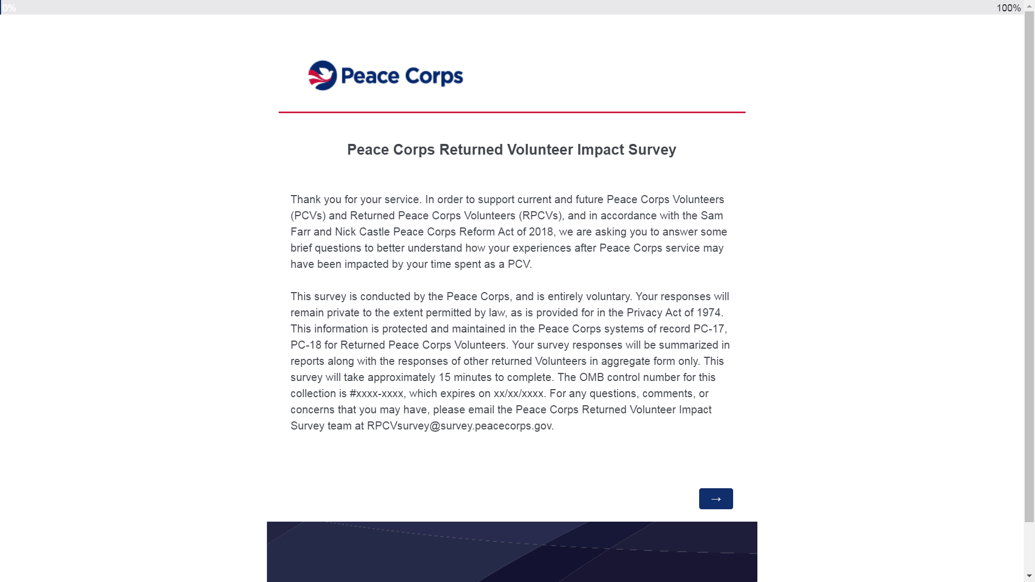
Screen 1

Slide 3
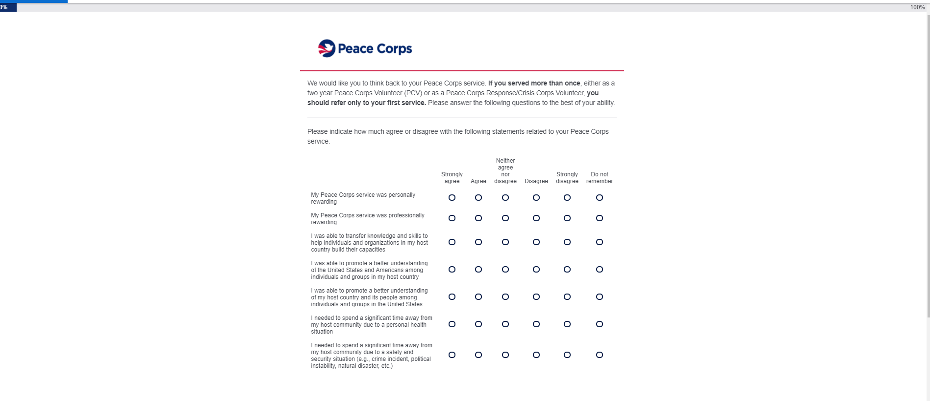
Screen 2

Slide 4
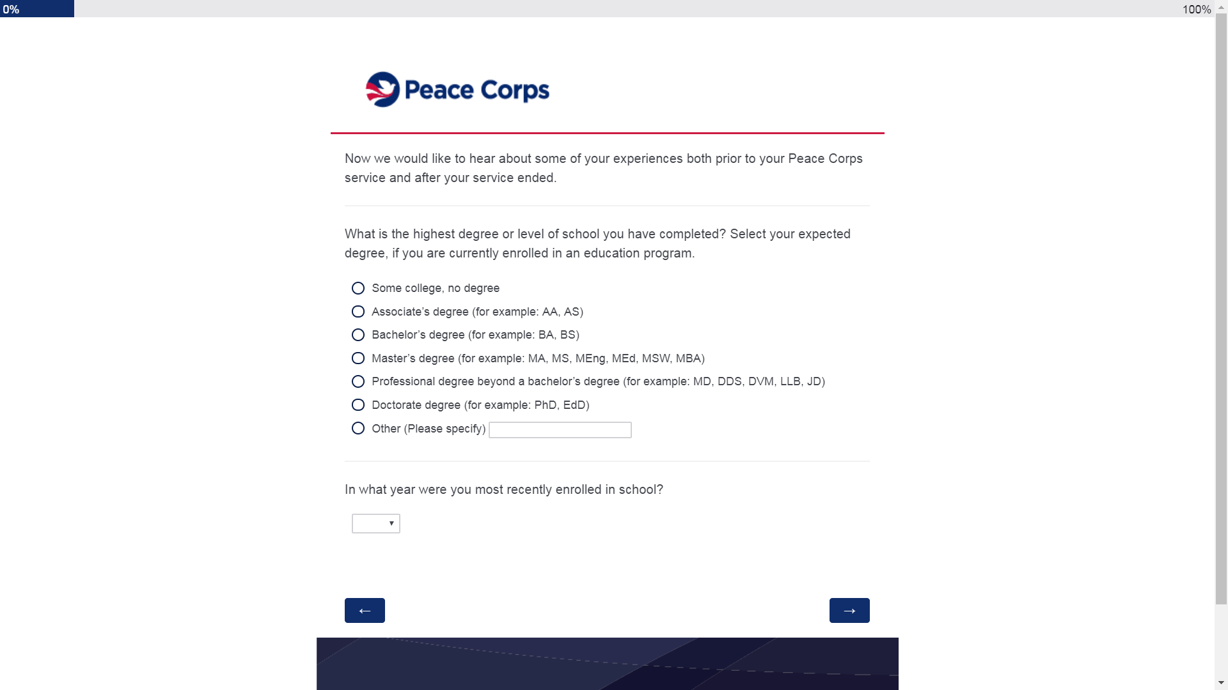
Screen 3

Slide 5
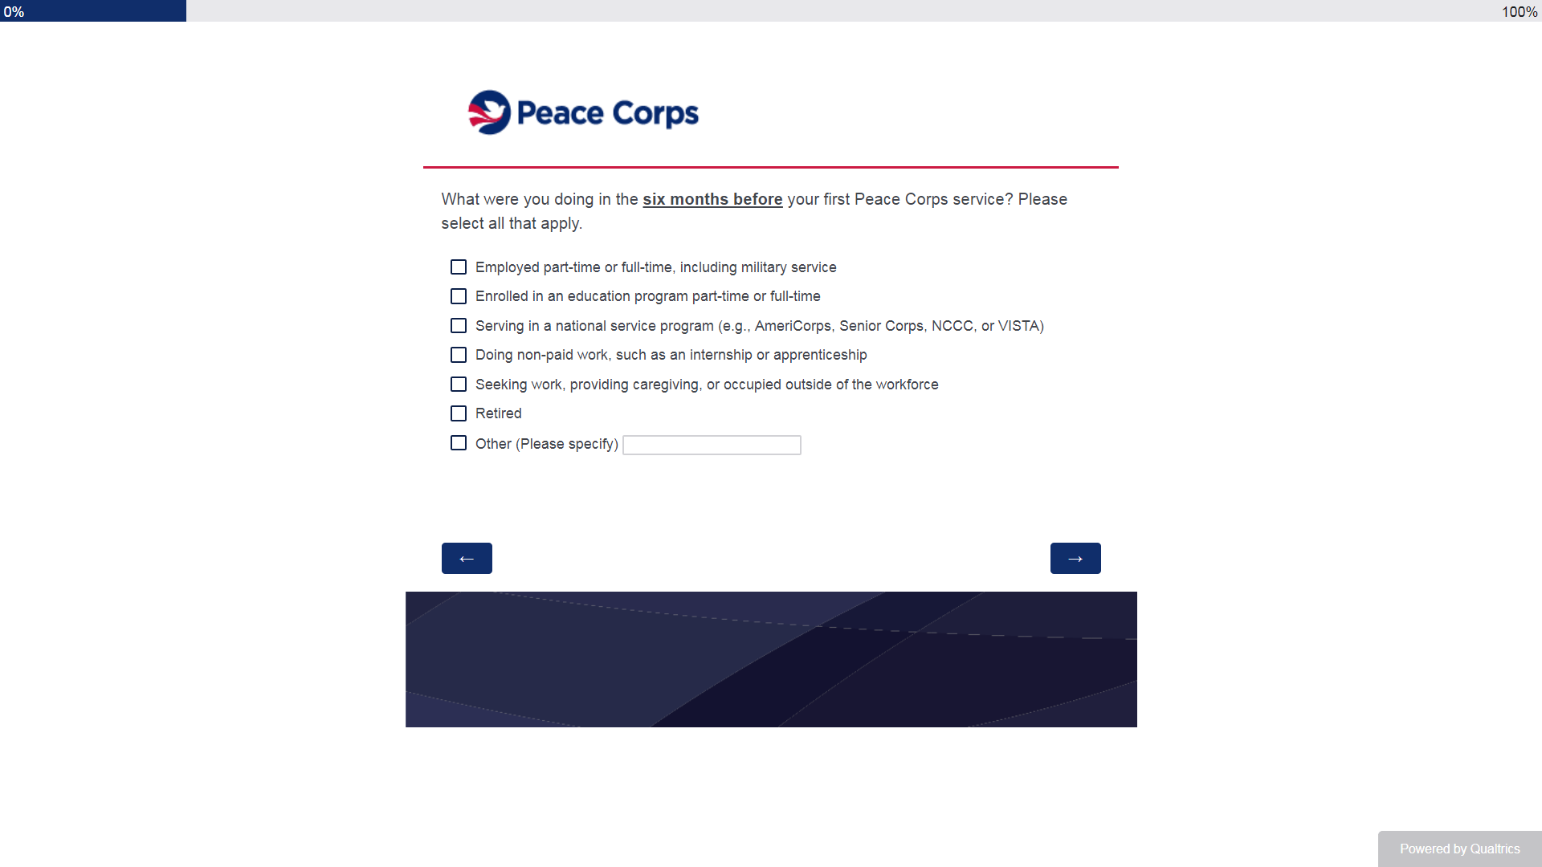
Screen 4

Slide 6
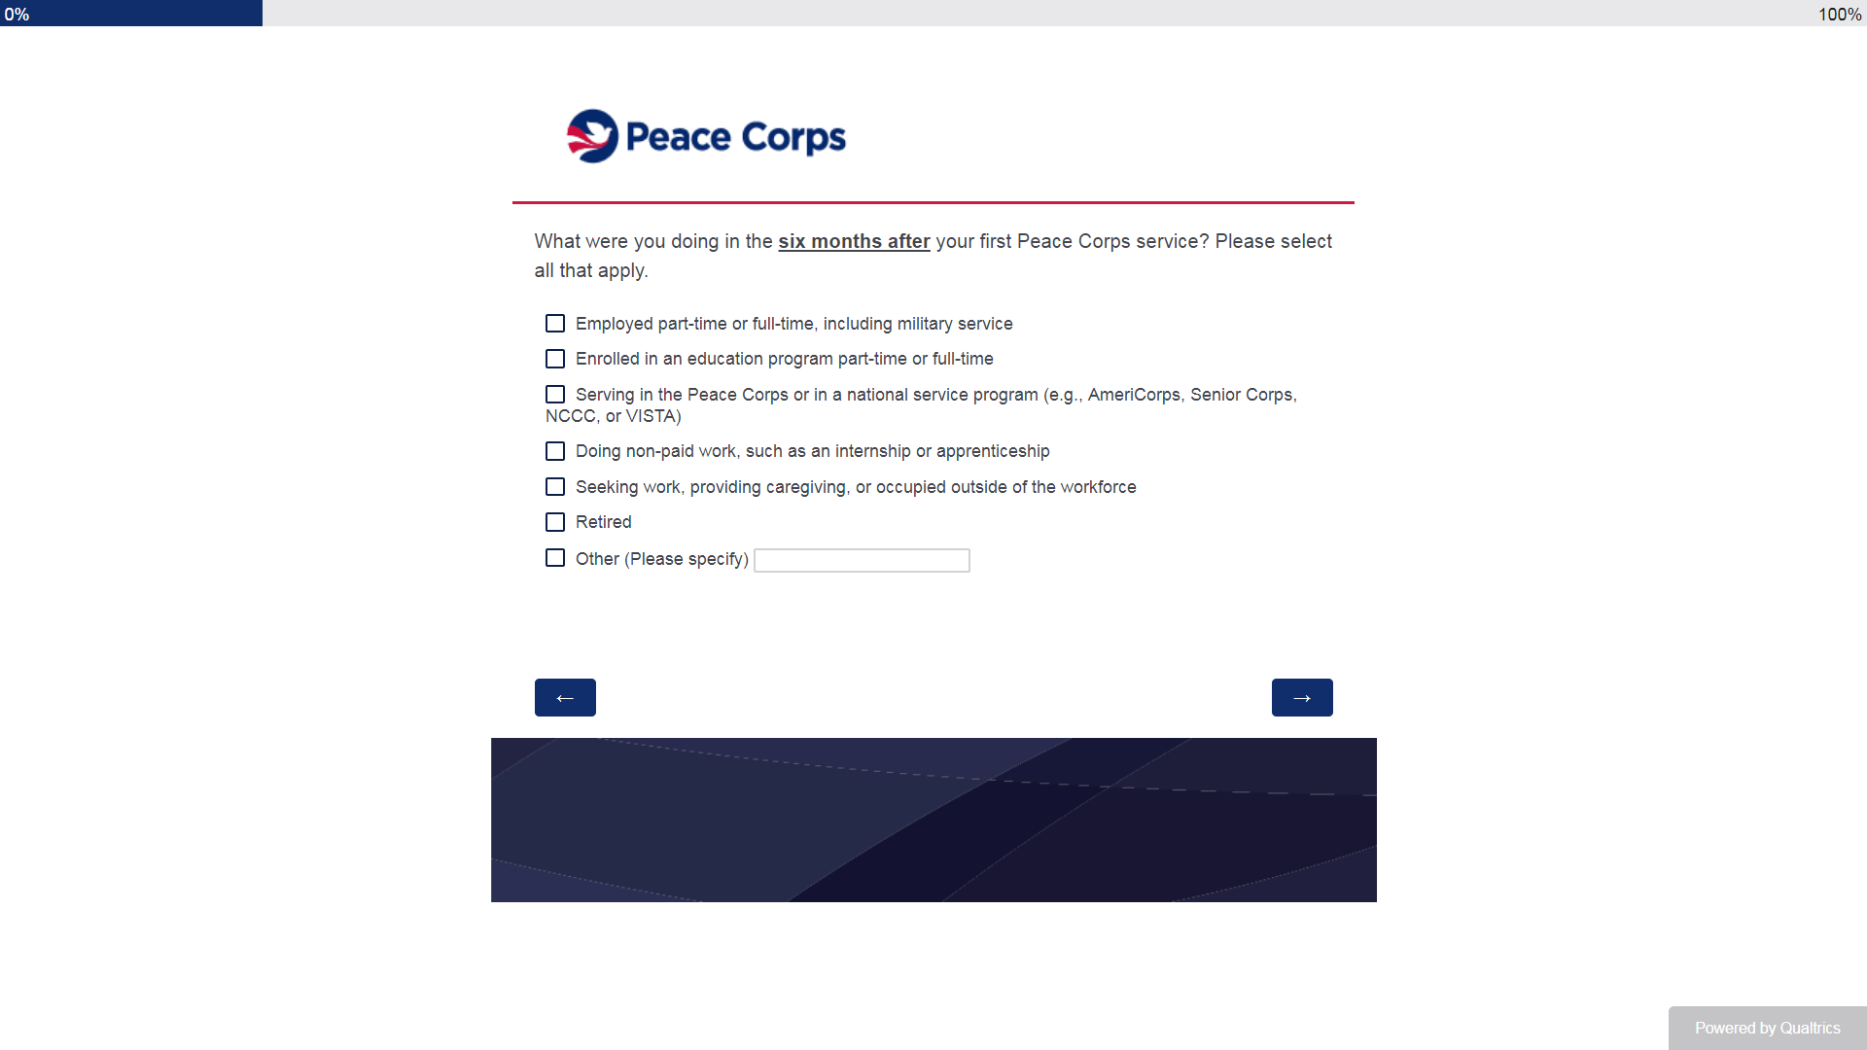
Screen 5

Slide 7
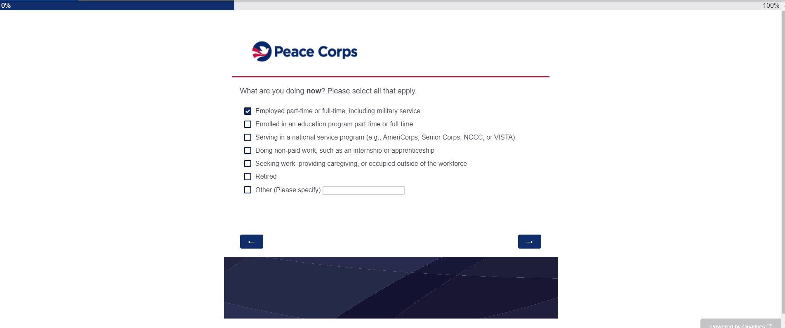
Screen 6

Slide 8
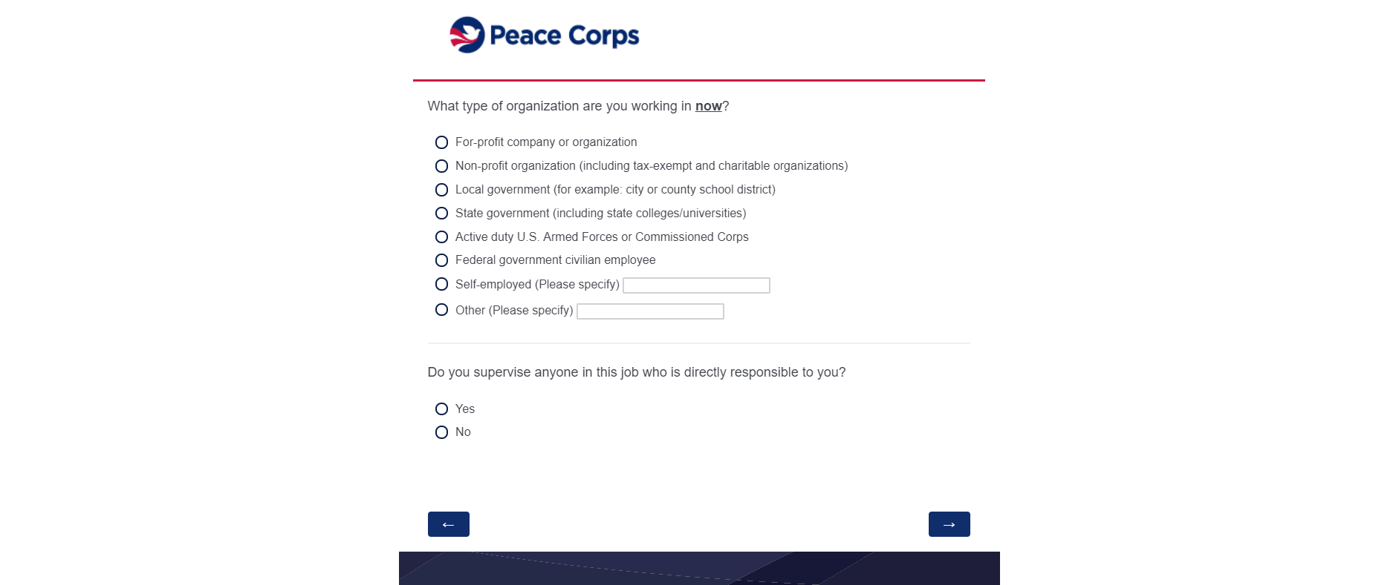
Screen 7

Slide 9
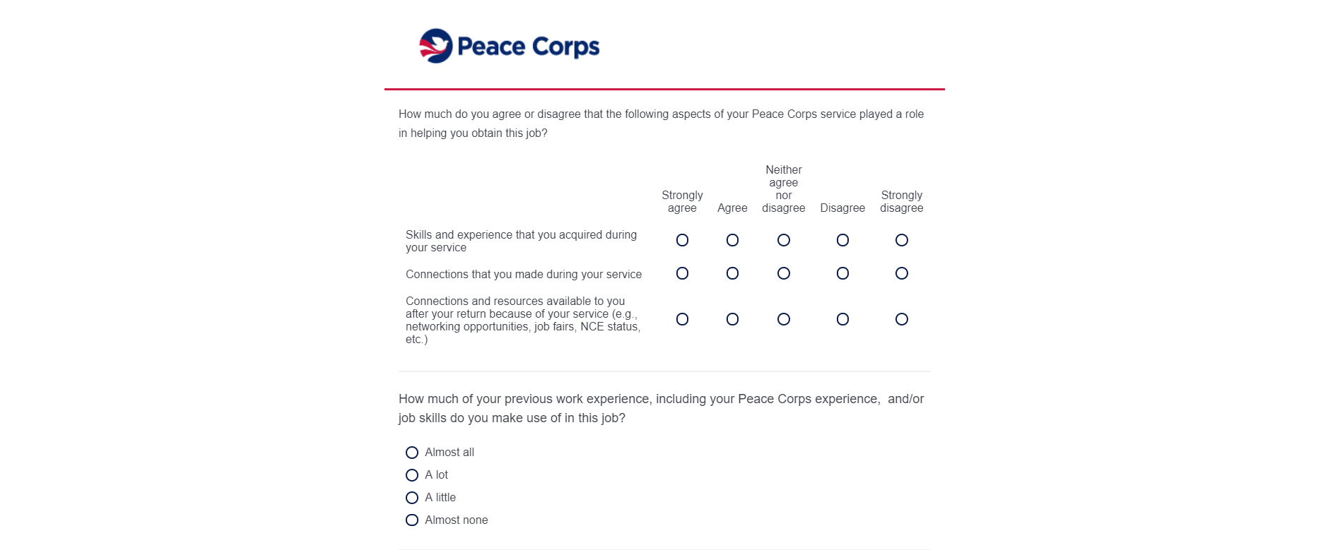
Screen 8 (top)

Slide 10
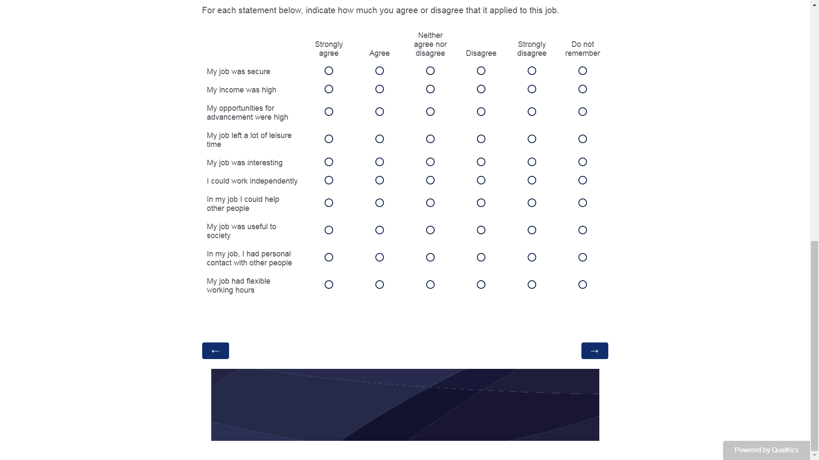
Screen 8 (bottom)

Slide 11
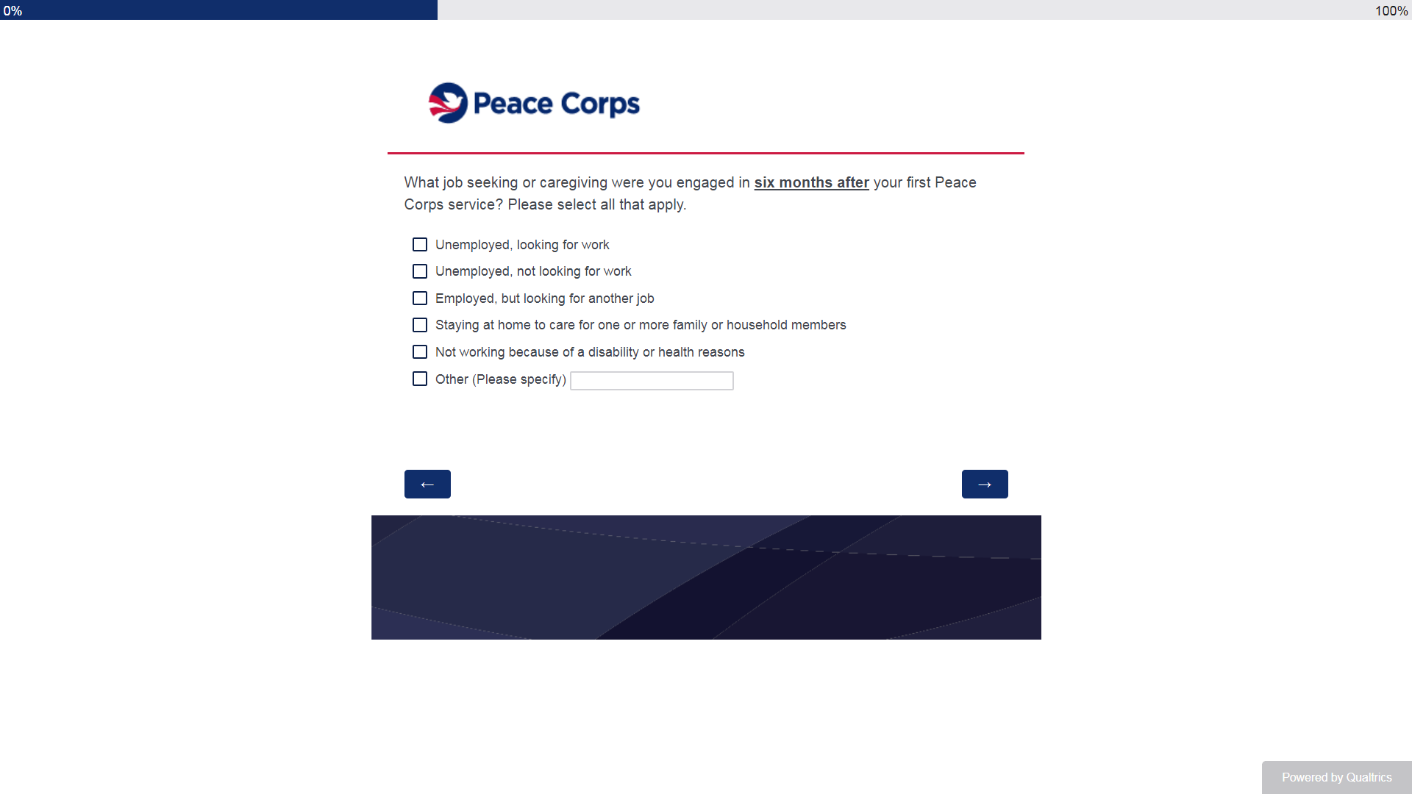
Screen 9

Slide 12
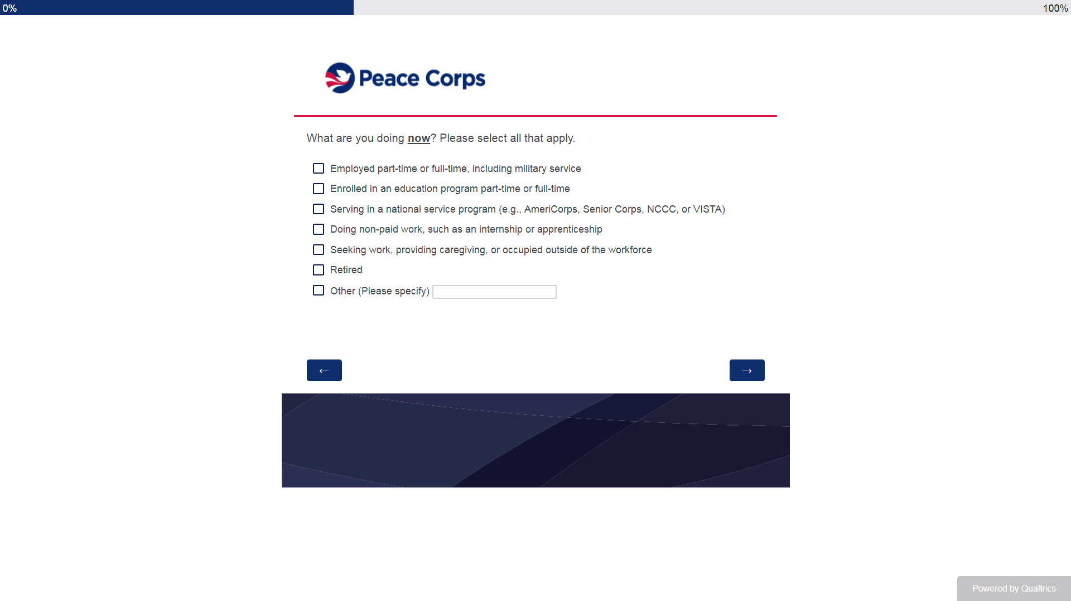
Screen 10

Slide 13
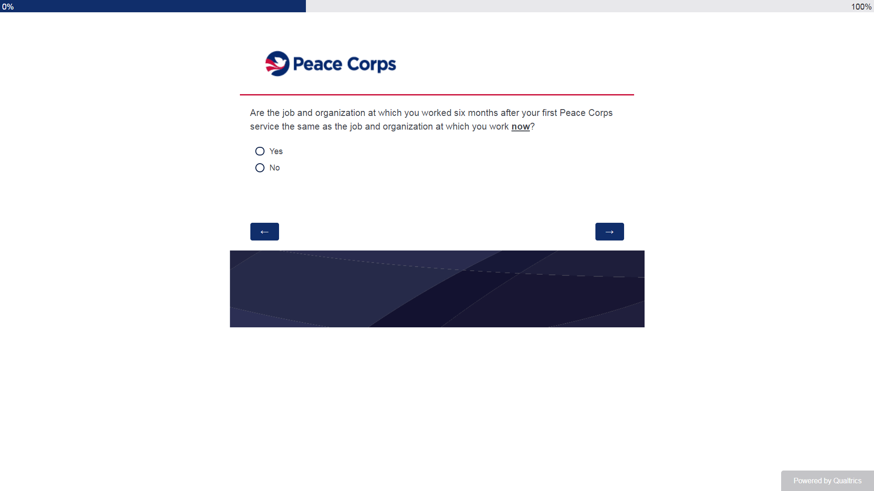
Screen 11

Slide 14
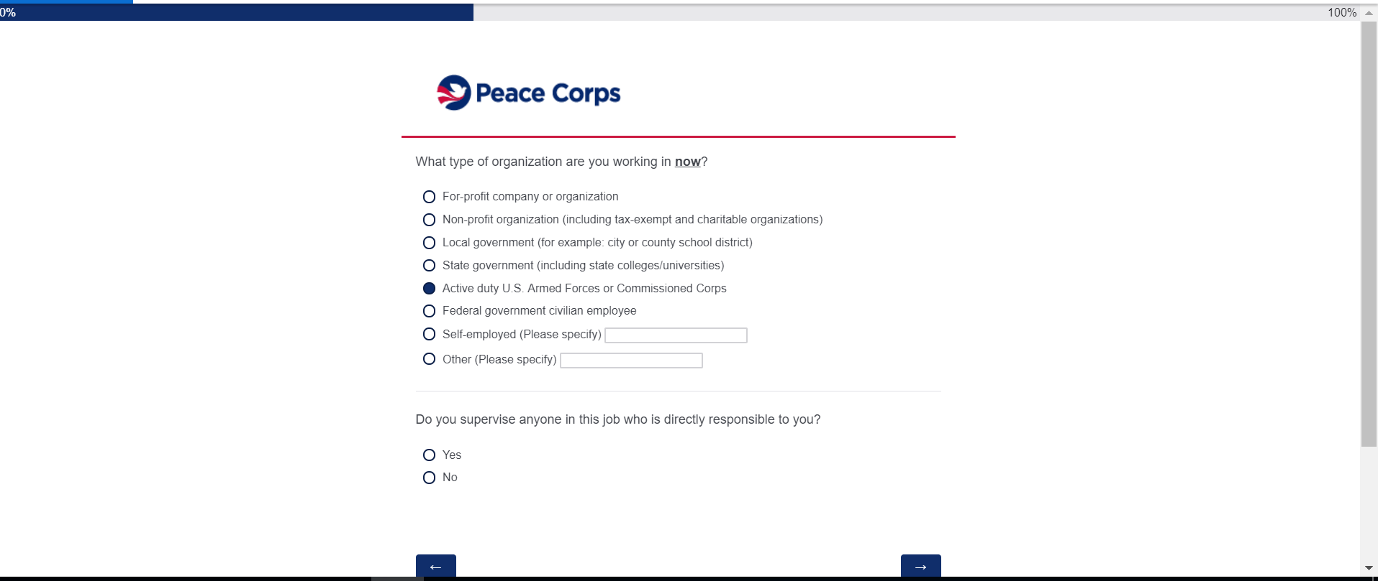
Screen 12

Slide 15
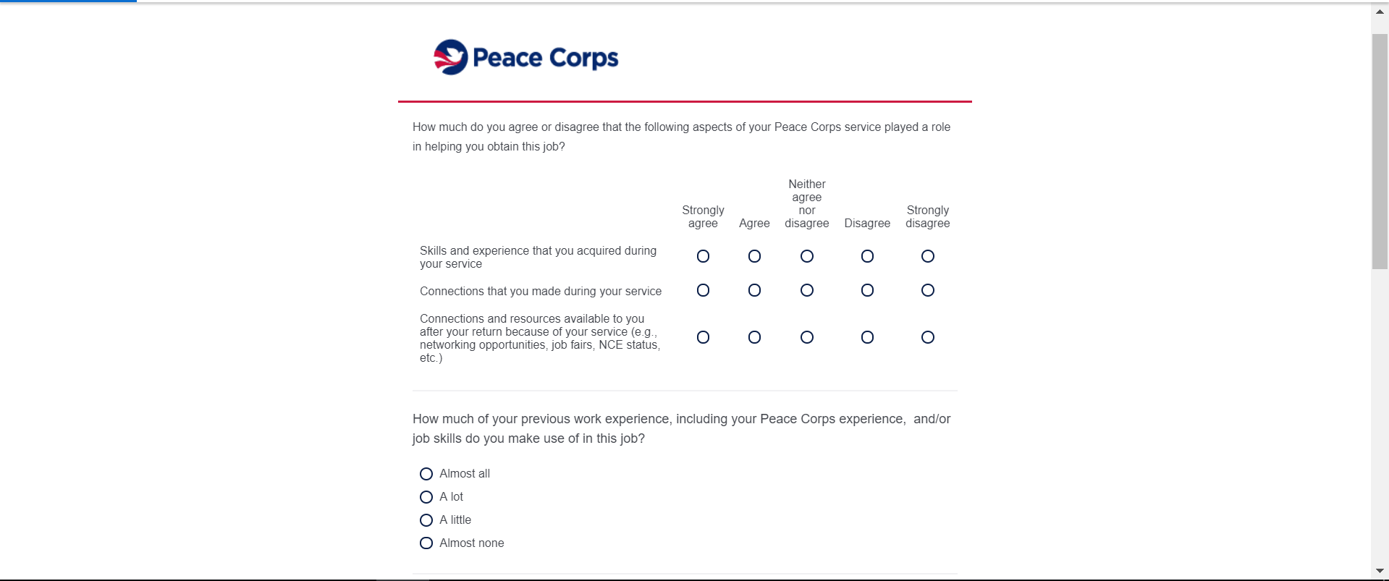
Screen 13 (Top)

Slide 16
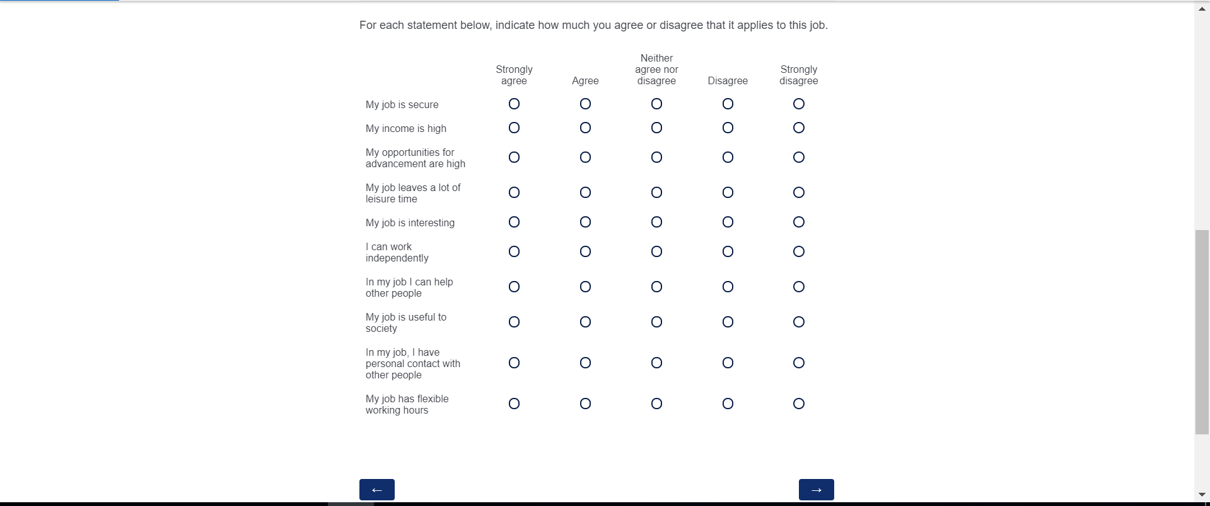
Screen 13 (bottom)

Slide 17
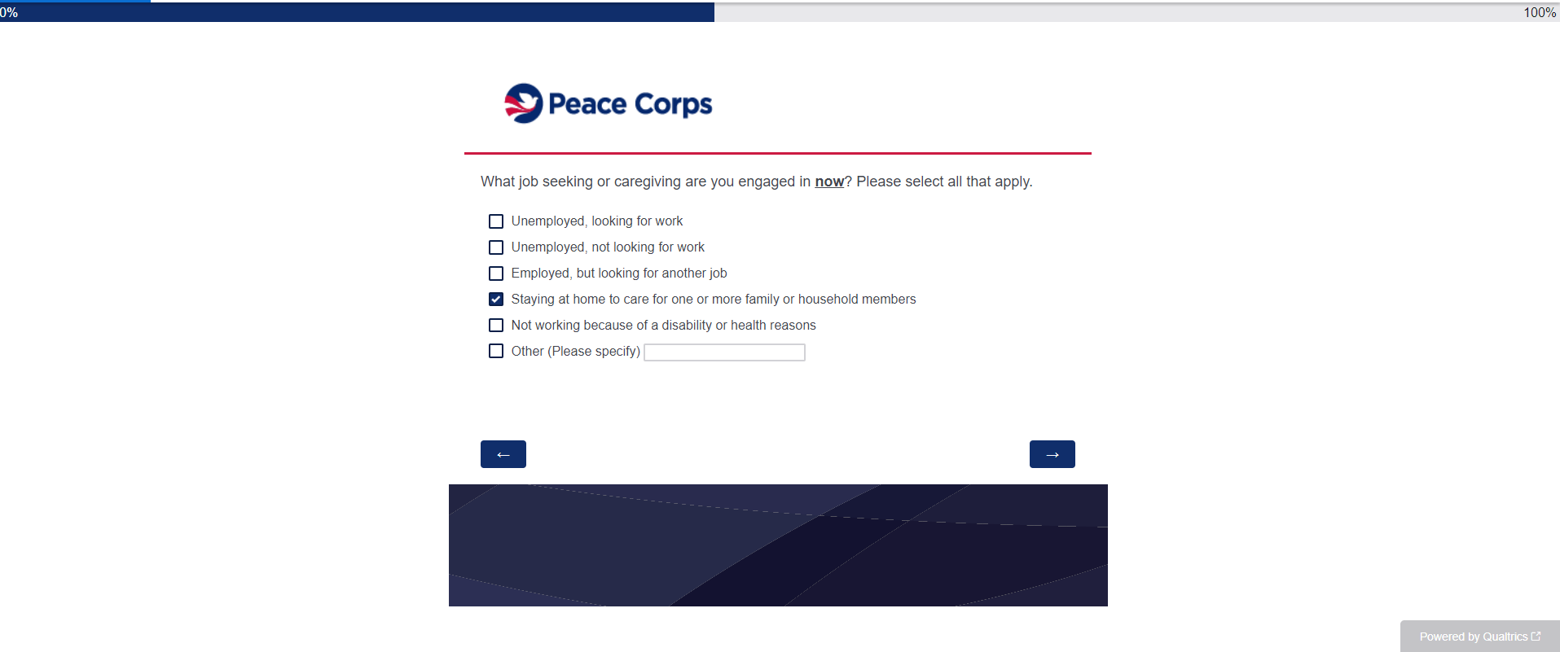
Screen 14

Slide 18
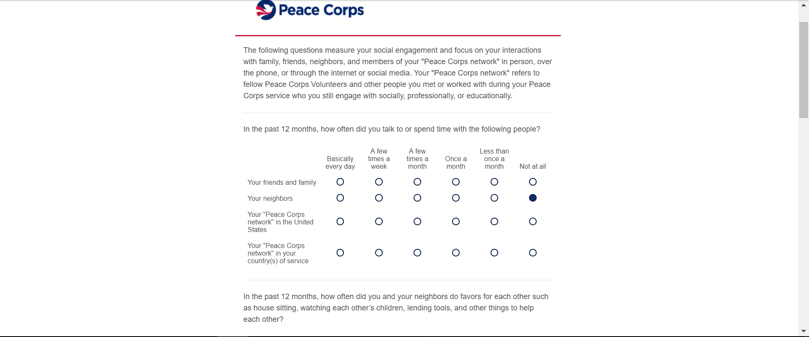
Screen 15 (top)

Slide 19
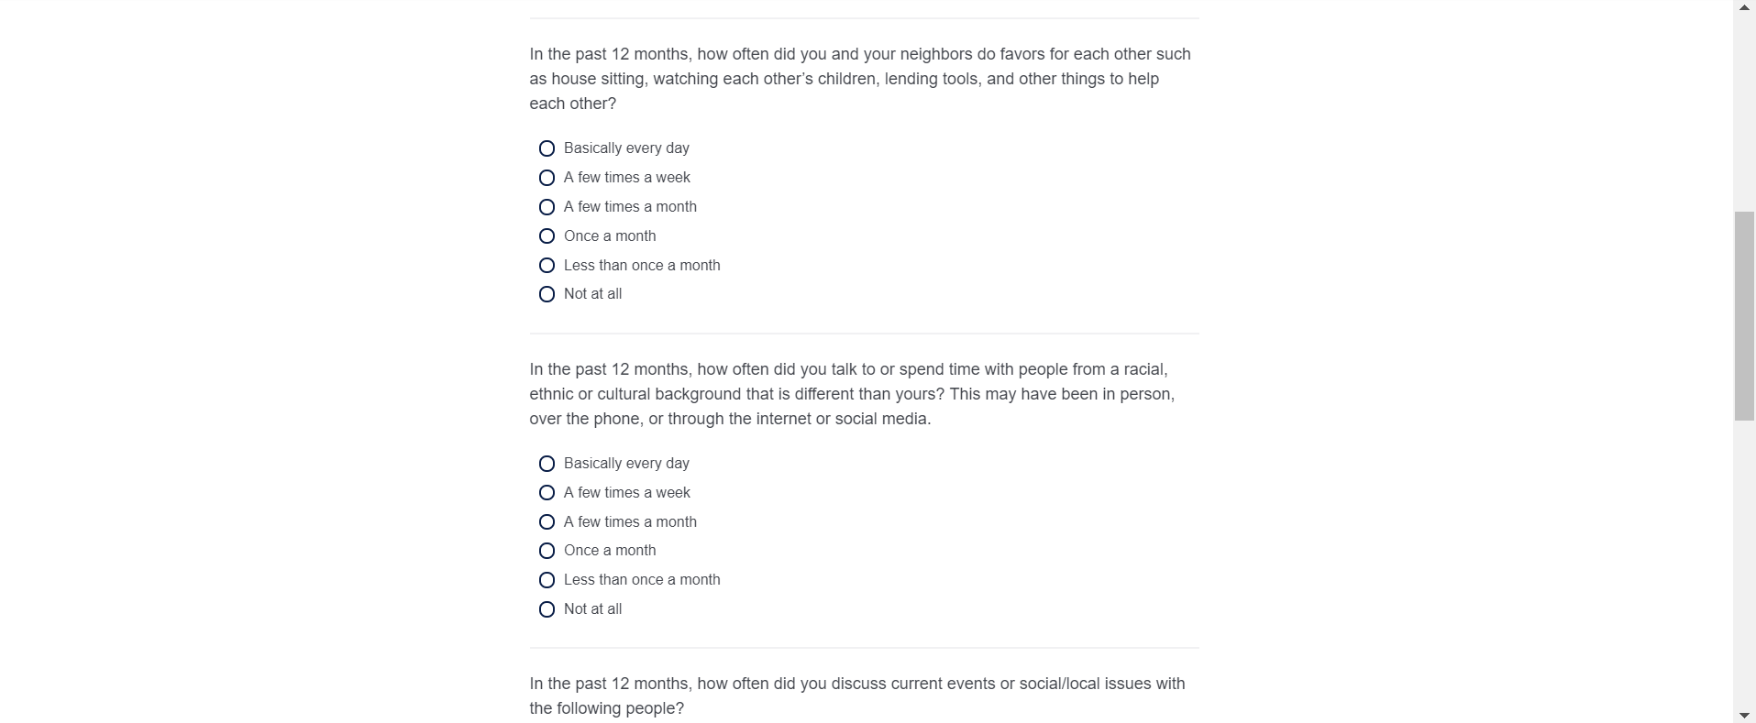
Screen 15 (middle)

Slide 20
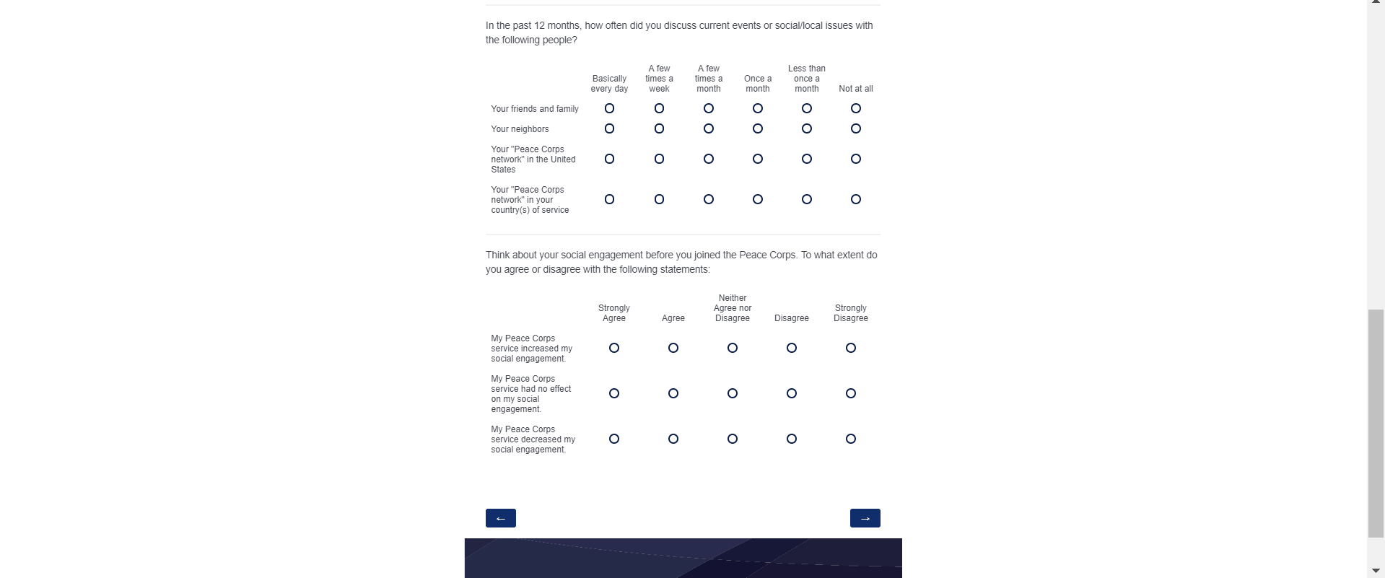
Screen 15 (bottom)

Slide 21
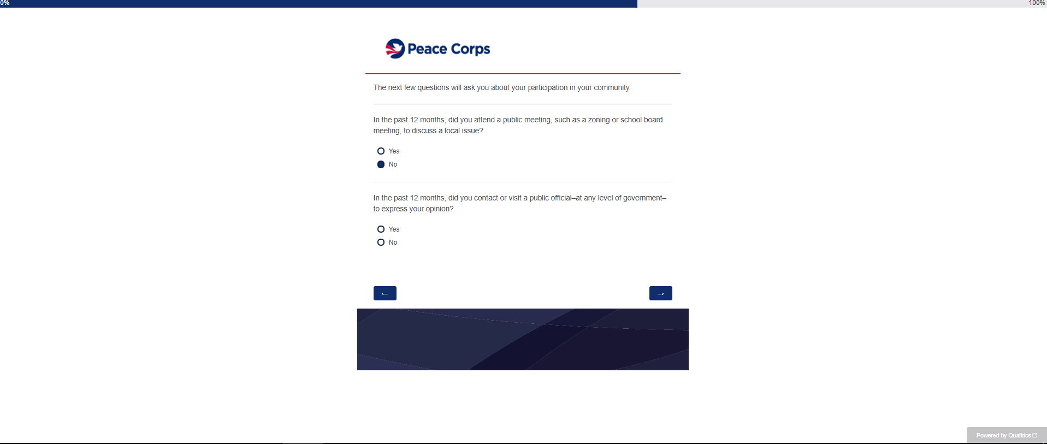
Screen 16

Slide 22
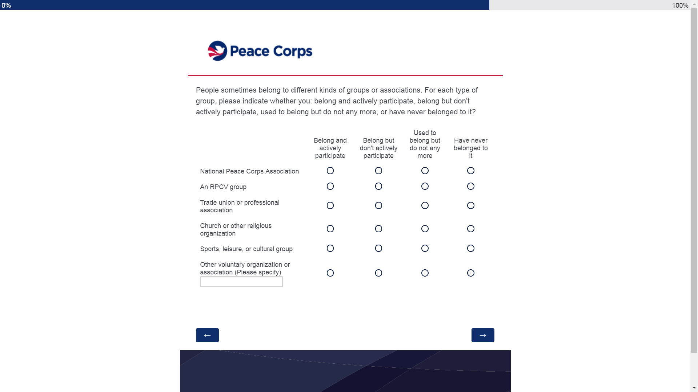
Screen 17

Slide 23
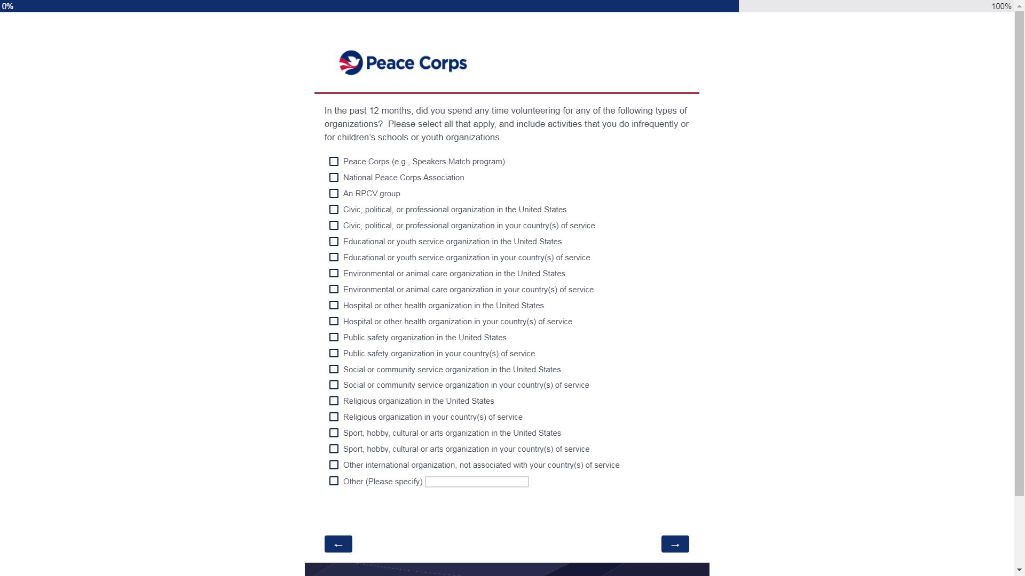
Screen 18

Slide 24
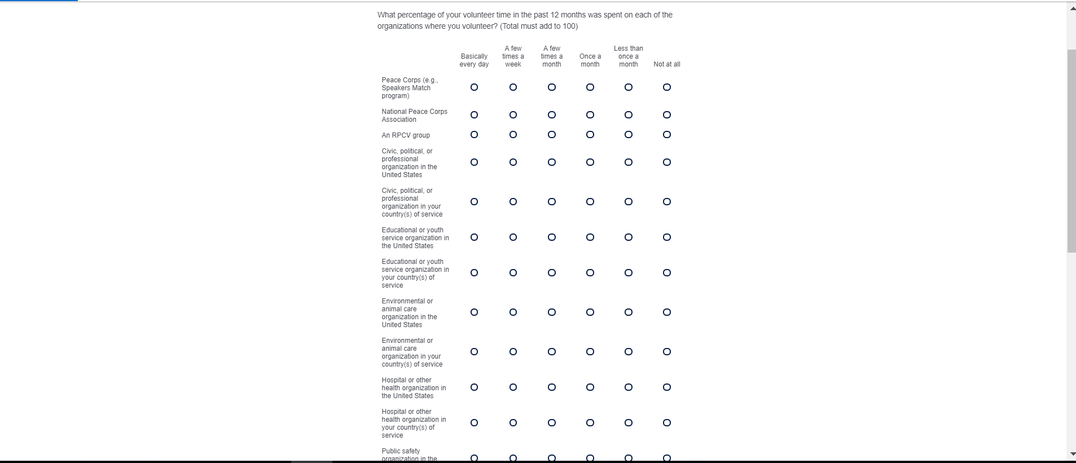
Screen 19 (top)

Slide 25
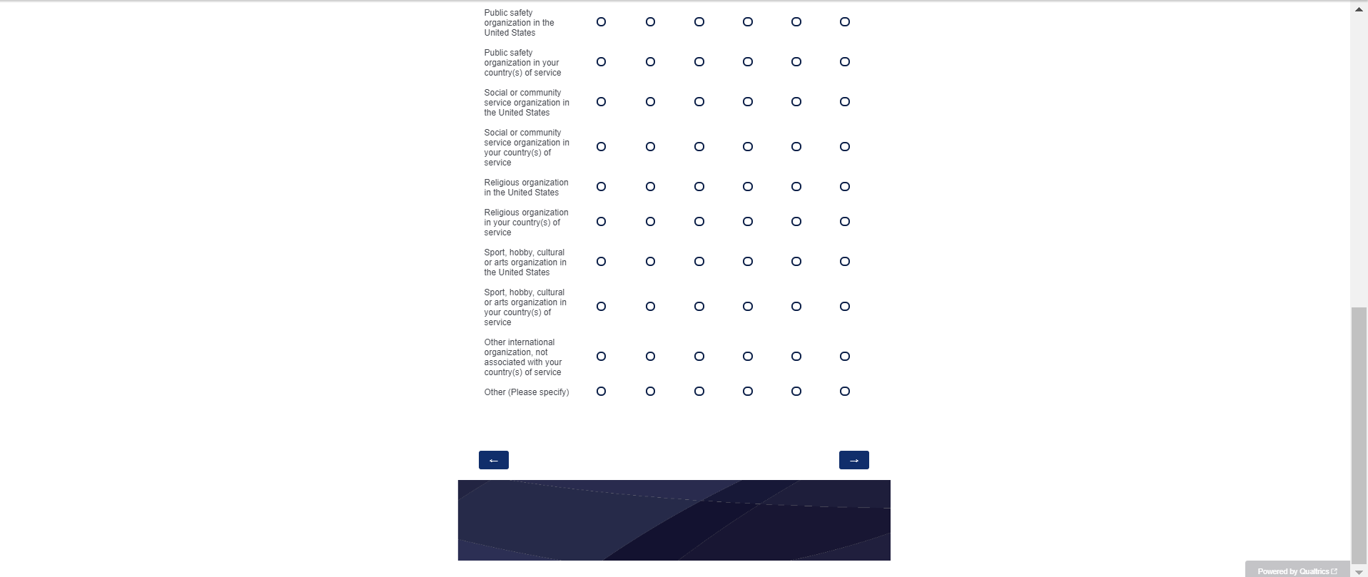
Screen 19 (bottom)

Slide 26
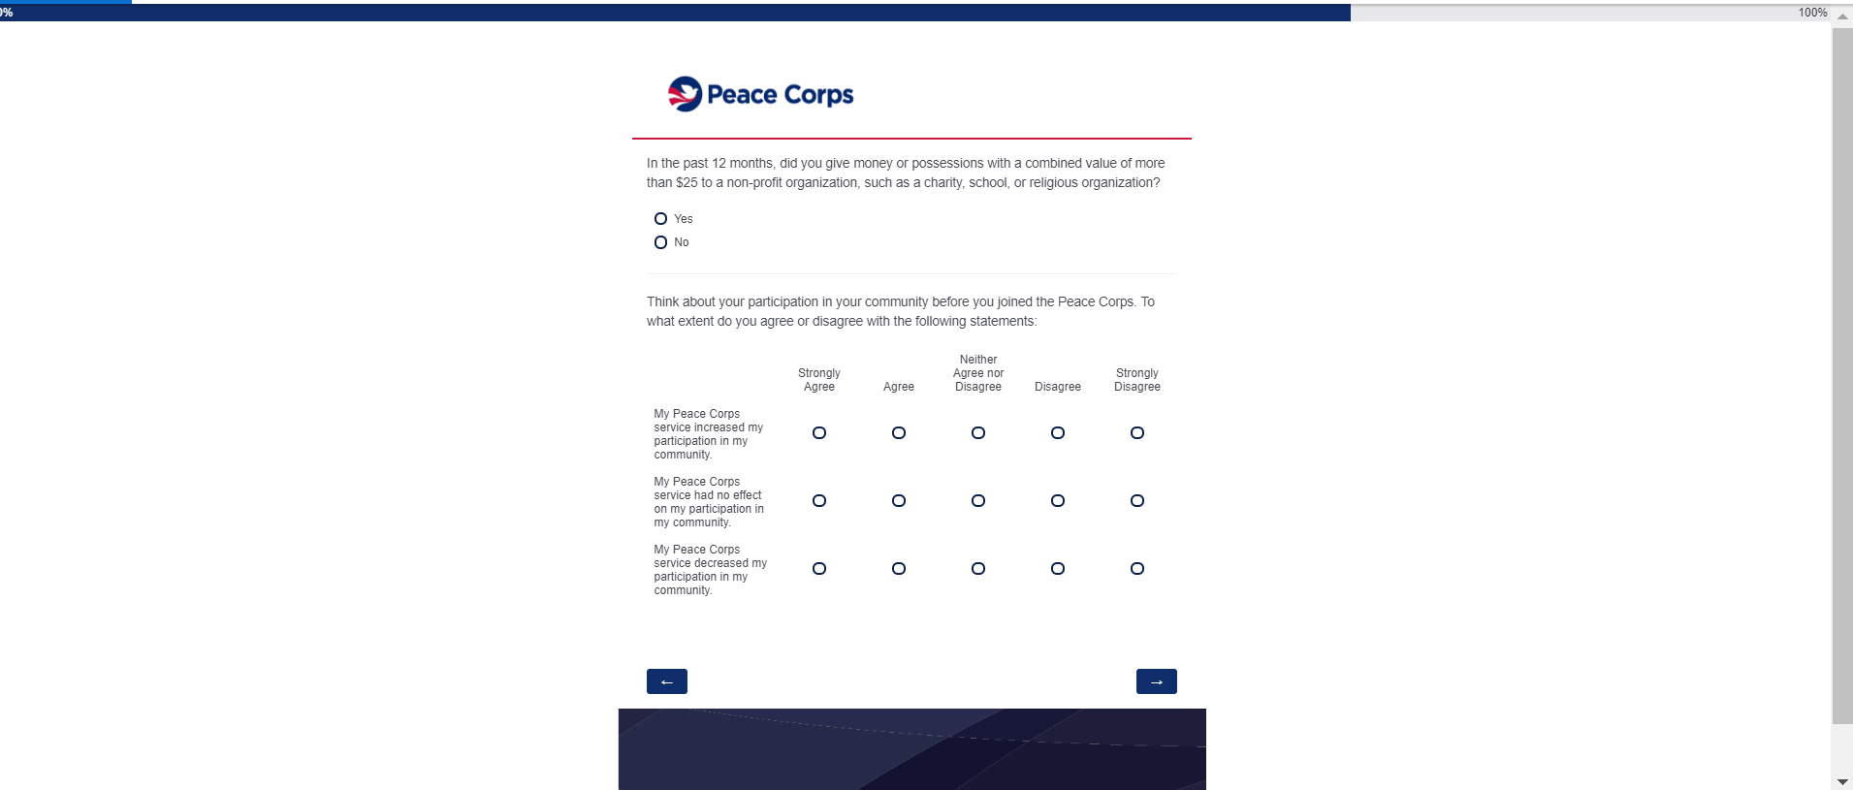
Screen 20

Slide 27
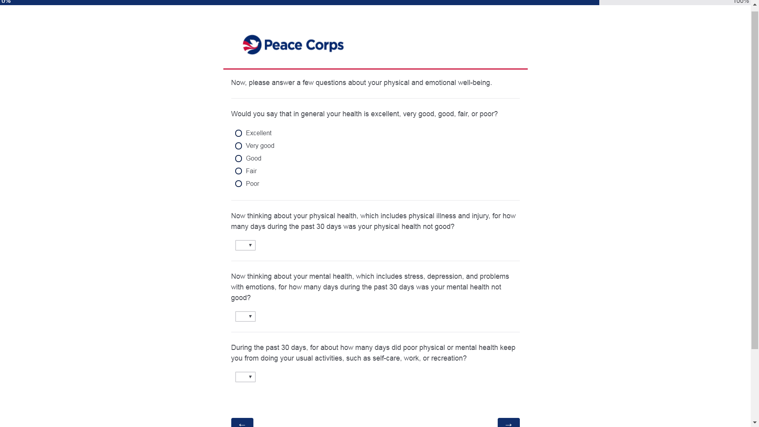
Screen 21 (top)

Slide 28
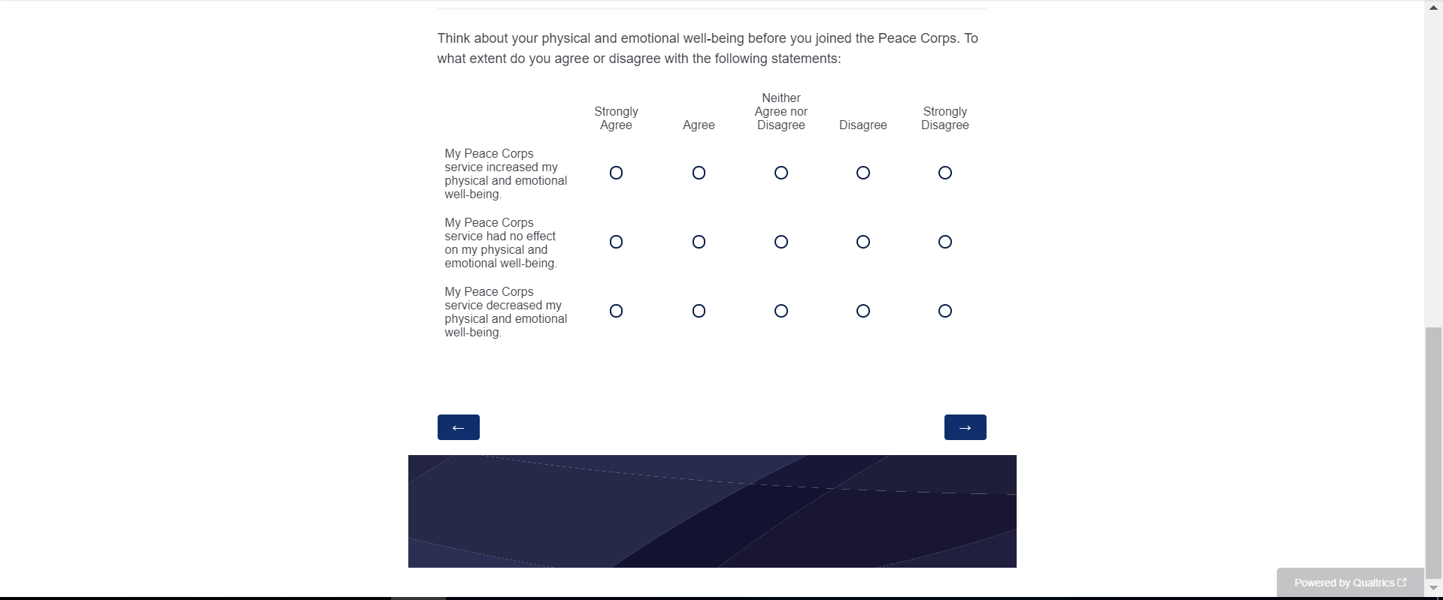
Screen 21 (bottom)

Slide 29
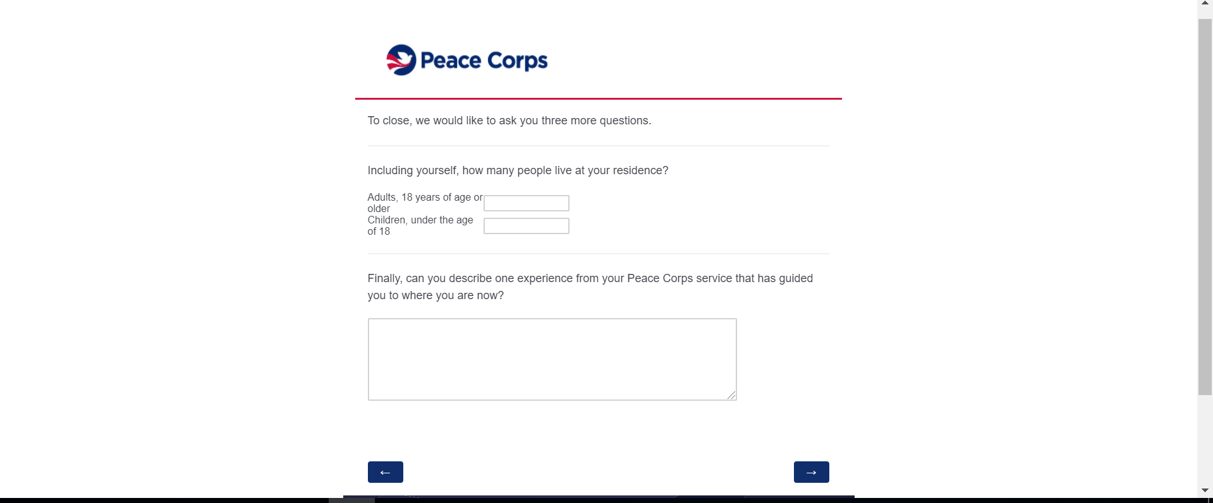
Screen 22

Slide 30
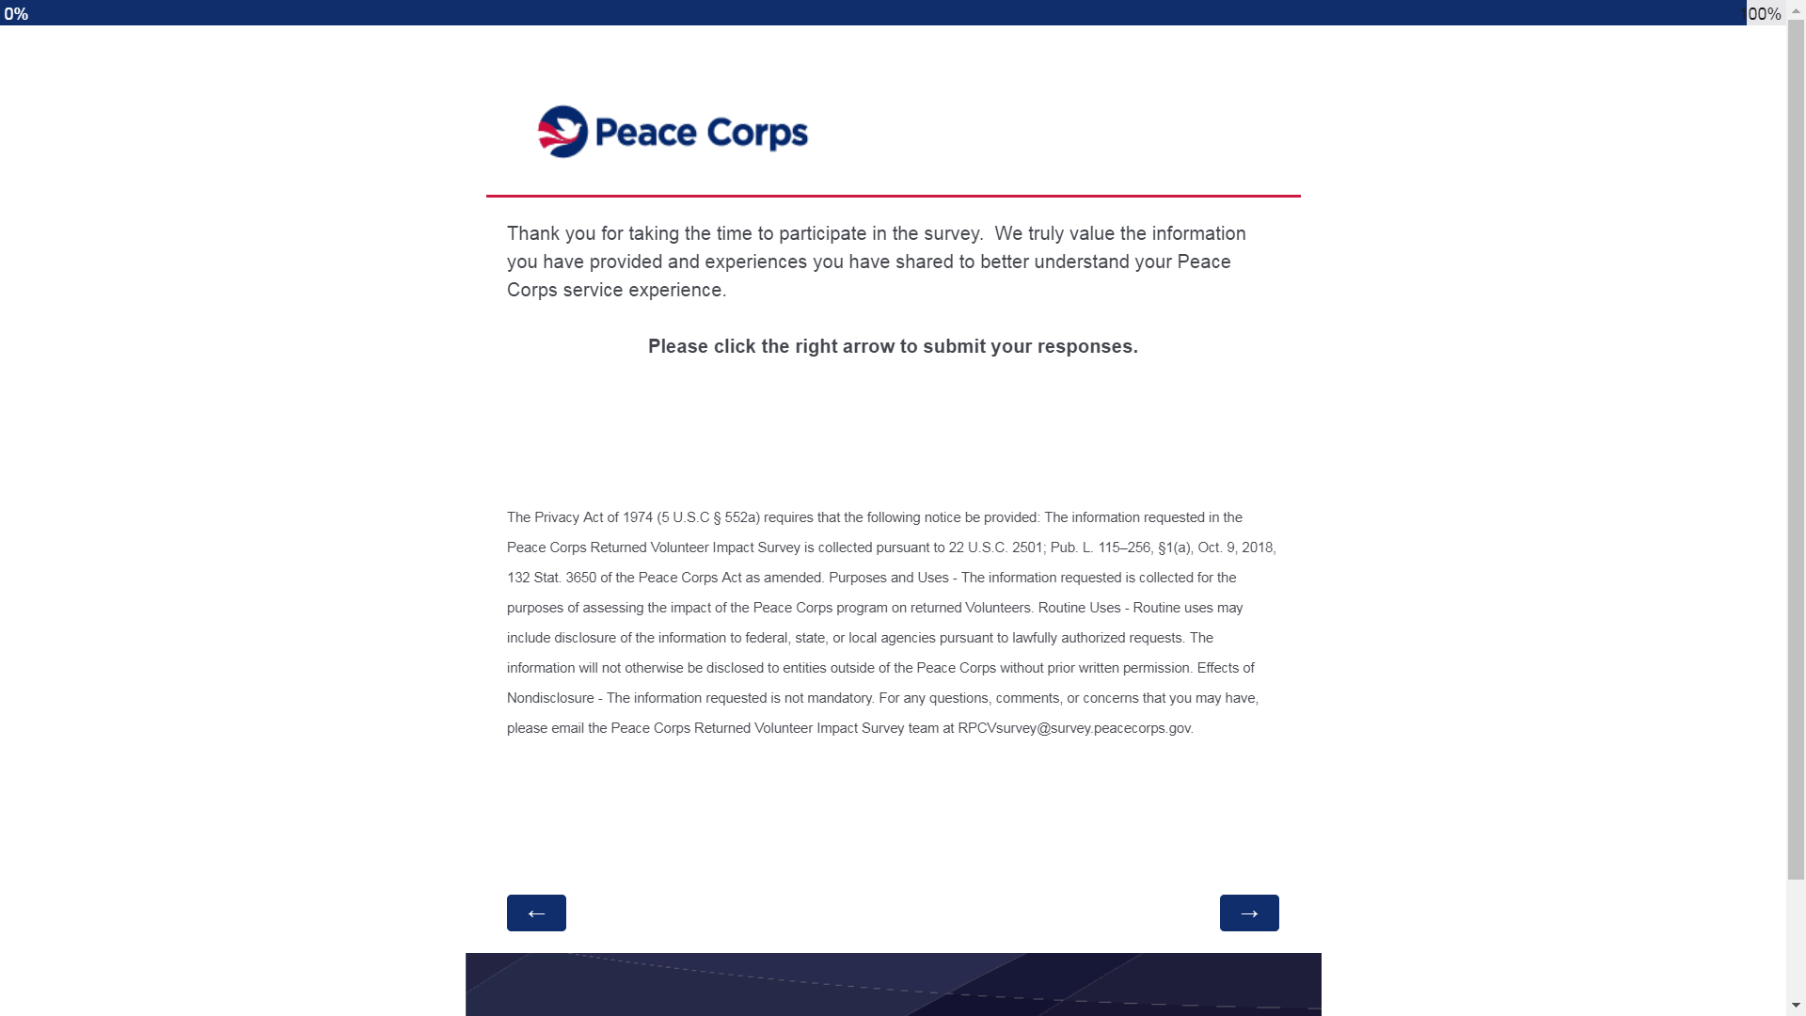
Screen 24
Screen 23

Slide 31
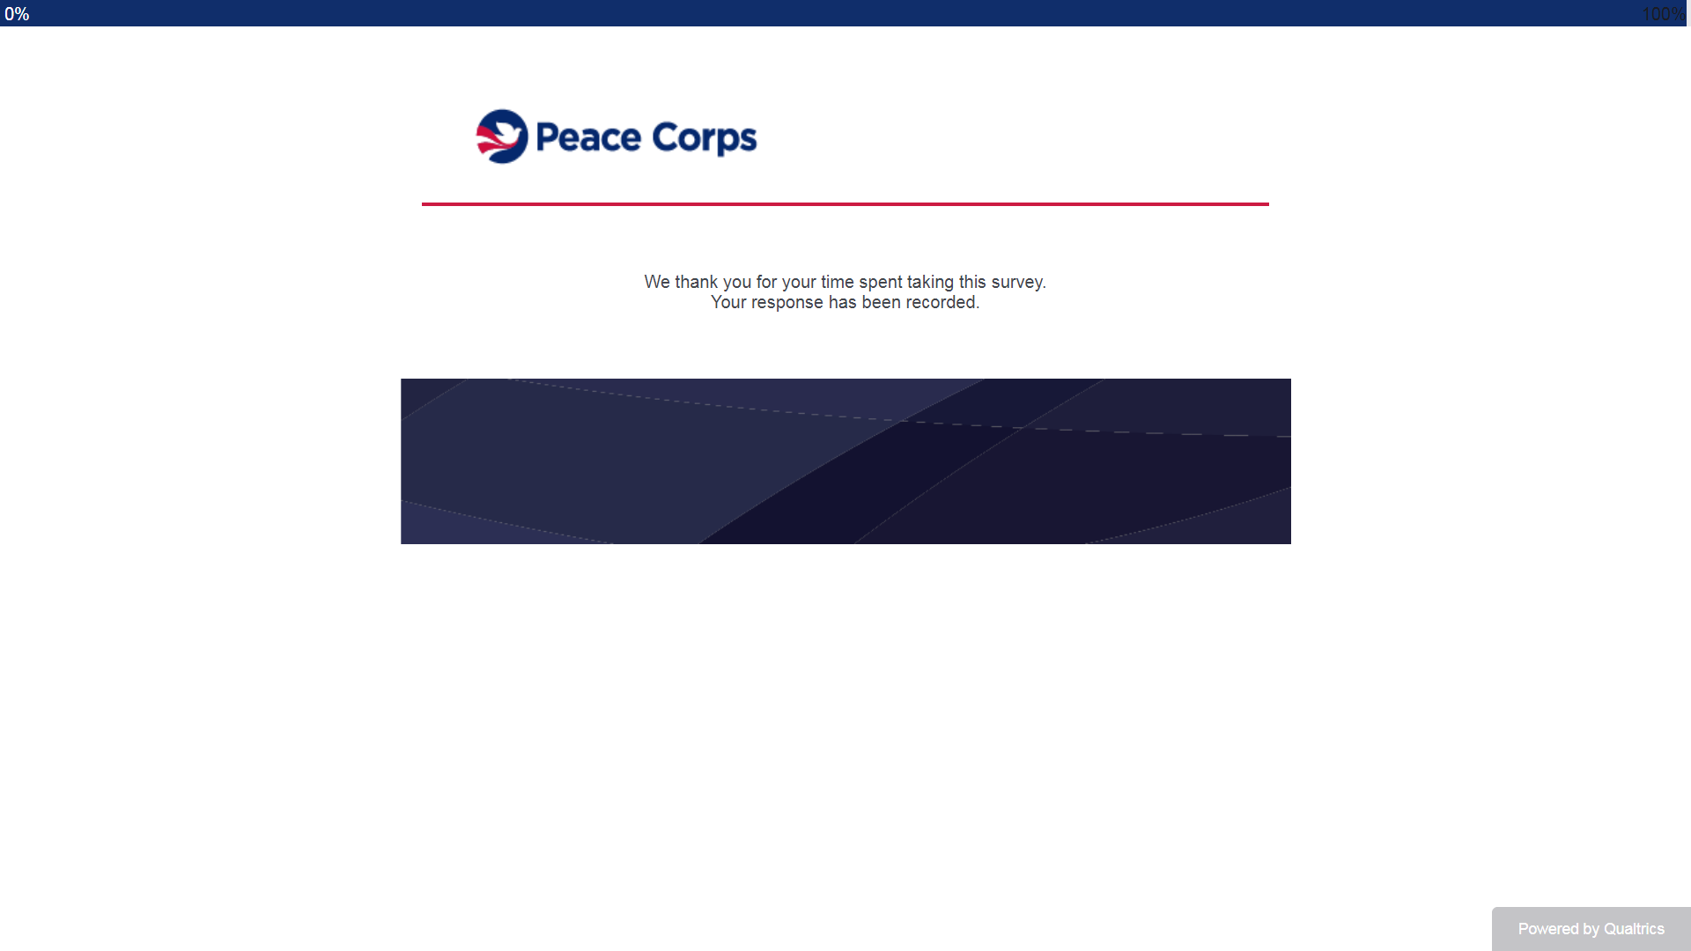
Screen 24

