Slide 1
The FEMA Operations Center Presents:
ENS!
Roster User training course

Slide 2
PRIVACY ACT STATEMENT
Authority: The Homeland Security Act of 2002, Pub. L. No. 109-295, §§ 501-521; the Robert T. Stafford Disaster Relief and Emergency Assistance Act as amended, 42 U.S.C. §§ 5121-5207; National Security Presidential Directive (NSPD)-51/Homeland Security Presidential Directive (HSPD)-20; Federal Continuity Directive (FCD)-1; and FEMA Directive 262-3 authorize the collection of this information.
Purpose: FEMA is collecting this information to ensure that the Emergency Notification System (ENS) has the most current personal contact information for emergency responders in the event of a man-made disaster, a natural disaster, or planned exercise.
Routine Uses: FEMA will use this information to send notifications, alerts, and/or activations and to relay critical updates and guidance to DHS personnel, other federal departments, and other agencies or non-governmental organizations in response to an emergency scenario or exercise.
Disclosure: Furnishing this information is voluntary; however, failure to provide accurate information may delay or prevent the individual from receiving notifications in the event of an emergency.

Slide 3
Expectations from this presentation
A general understanding of ENS
The ability to edit your contact information
How to respond to activations
Where to find your Point of Contact for ENS
When this course is finished you should have good working knowledge of ENS, be able to edit your contact information, and respond to scenarios when activated.

Slide 4
ENS Capabilities
ENS is capable of notifying people via:
Telephone: Work, home, cell or other
Email
Text
Qualification methods are available through Email, Telephone, and Text.

Slide 5
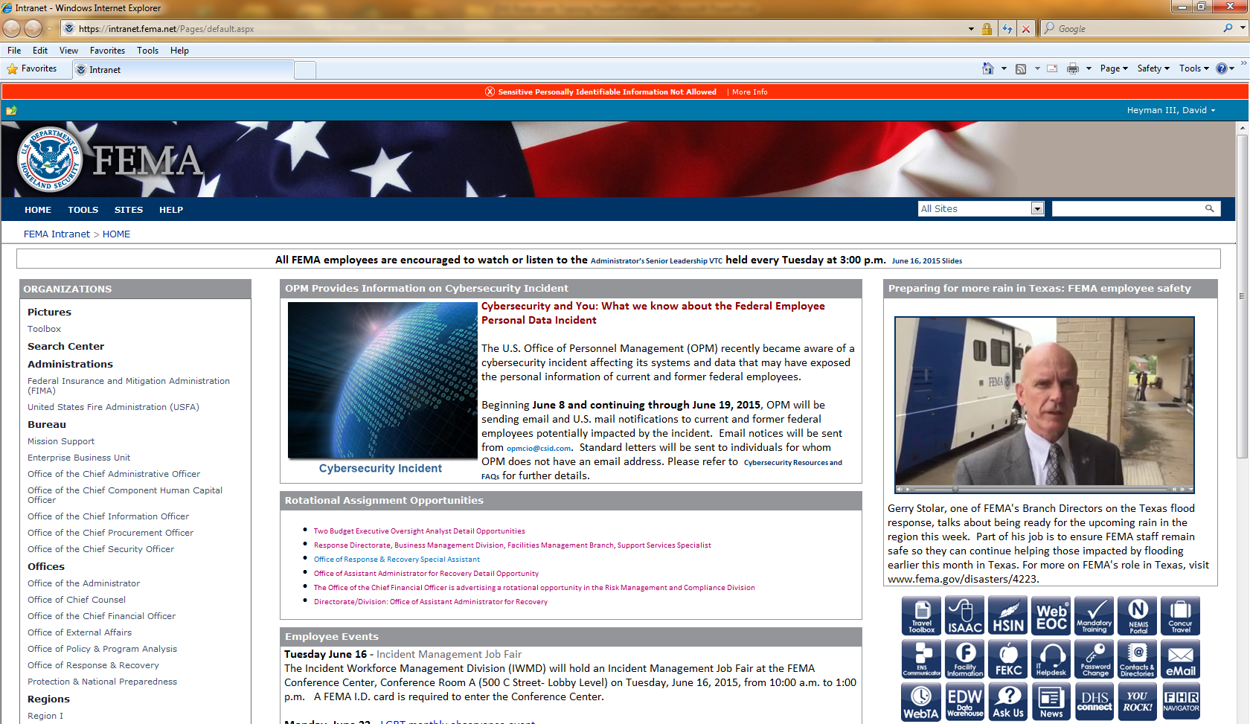
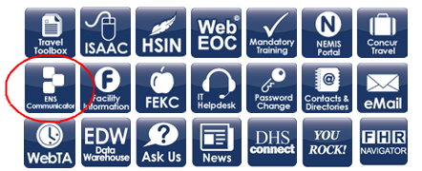
How to find ENS
https://ens1auth.dhs.gov/

Slide 6
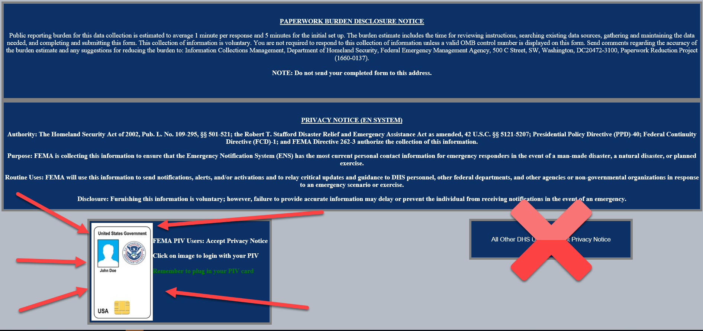
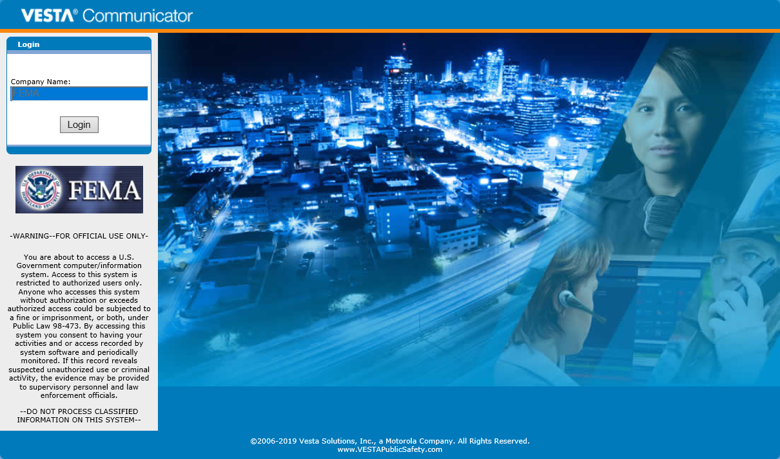
Login Page
The ENS Communicator link will take you to the following screen.
Click the PIV badge to access the Login screen.

Slide 7
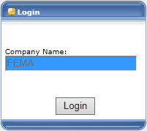
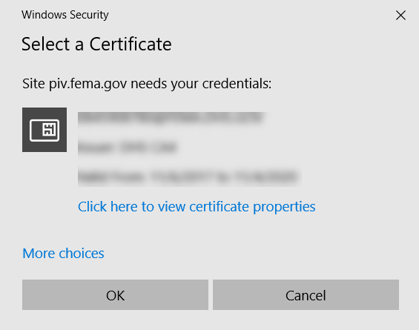
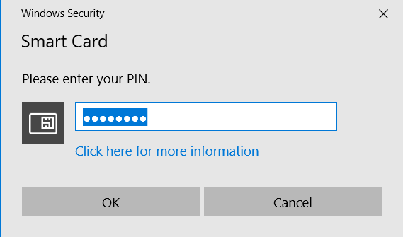
To login with PIV credentials you will need to do the following:
Insert your PIV badge and give it a few seconds
Click on the login button and follow the pop-up prompts (selecting your certificate and entering your PIN)
If you have issues logging in with your PIV badge please contact the ENS-Admin Team.

Slide 8
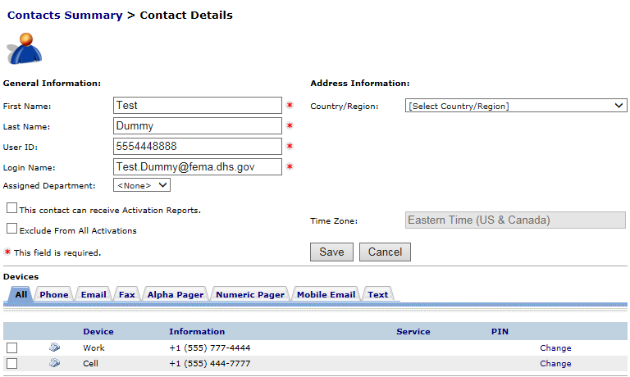
Roster Users
As a roster user in the system you will have access to your own contact information.
Once you log in to the system you should see your contact details, similar to the image here. You will have access to change your name, location, and devices. All other information is handled by the POCs or the ENS-Admin team.

Slide 9
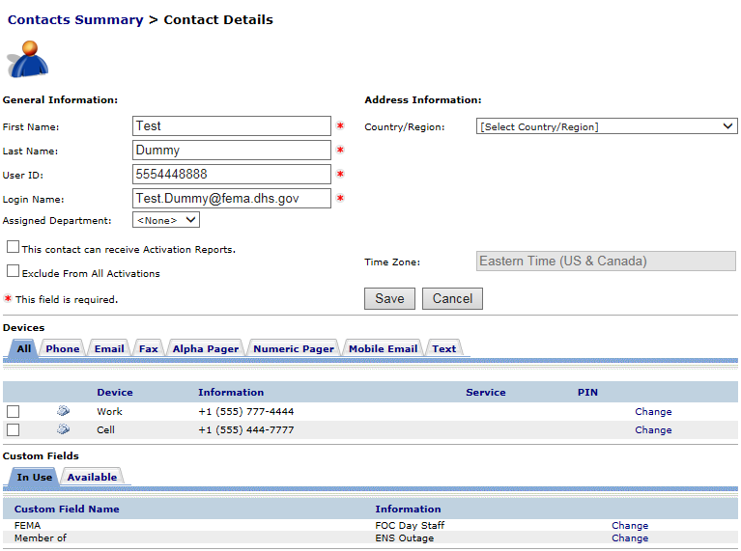
Contact information
This is the basic layout for contact information. The top section is your general information. The middle section is where your devices are maintained. The bottom section is for custom fields, which are associated with groups for notification. We ask that you do not modify custom field information as it affects your ability to be notified.
In the following section we will be going over the contact information section in detail.

Slide 10
Contacts have a set of basic information that must be filled out to be in ENS.
First Name
Last Name
User ID
Login Name
User ID is typically your phone number (Home, Cell, or Work in that order).
The User ID is used when responding to a notification over the phone, so it is important to remember it.
Login Name should be your FEMA email address. If this changes, contact your ENS POC or the ENS-Admin team.
Devices are the way in which you are contacted by ENS during a scenario. Typical devices include:
Phones (Work, Cell, Home)
Email
Text

Slide 11
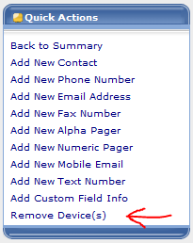
From the Devices section of the Contact Information page you will see tabs for each of the devices ENS can contact you. The animation below will show you how to add and edit different device information in ENS.
To remove a device click the check box next to the device and click on the Remove device link on the quick actions menu. It will appear with an “Are you sure?” pop-up, where you can click yes to remove the device.

Slide 12
How to respond
During all activations you will be expected to respond to the message, either through email, phone, or SMS.
To respond to the email instructions are provided with every activation:
As it states in the beginning of the email, “To respond to this notification, reply with YES in the top of this email.”
DO NOT change the subject line or anything below the first line of the email. Simply click reply, type YES, and hit send.

Slide 13
To respond via phone you can either respond to the call coming to you, or you can call into the system.
When responding to an incoming phone call from ENS you must speak a clear greeting into the phone, such as Hello. This confirms that an individual is on the line rather than an answering machine or voicemail. Once the system recognizes a person is on the line it will follow through the call. Simply follow through the prompts, enter your user ID if necessary, acknowledge the receipt of the message and stay on the line. The system will hang up on you when the call is finished. If you hang up early it may contact you again.
When calling back into the system you will have to enter in your user ID and follow through the prompts. Much like the incoming call you must listen to the whole message and acknowledge receipt of the message, otherwise the system may not count you as qualified for the activation. The phone number to call into ENS is usually provided in the email.

Slide 14
With your Text information in the system you can respond via Text to activations that take place as well. Once you receive the notification text message on your phone device you can reply to the notification with a “Yes” and it will qualify you for the scenario. If the information you receive in the text message is unclear or incomplete, we highly recommend you call back into the system to hear the whole message, or check for the email.
It is important to reply to notifications as they take place as it will qualify you for the scenario. Once you’ve qualified for a scenario the system will stop contacting you for that scenario. There are times when multiple scenarios are active and you have to qualify once for each, but be sure you’re reading and understanding the information in each notification. It’s also to your benefit to qualify as some supervisors review scenario reports to see who has qualified.

Slide 15
Additional resources
For ENS POC information Click here!
Be sure to contact your POC for concerns or issues with your contact information or with the program. We also have documents on our page for how to respond to activations and how to change your contact information.

Slide 16
You can also visit the ENS Collaboration site here!
Here you can find additional updated information on ENS, training information, and a training video for you as a roster user.
If you have any questions about the site you may contact the ENS-Admin group at ENS-Admin@fema.dhs.gov.

Slide 17
Questions?
Contact your ENS POC, or the ENS Admin team at ENS-Admin@fema.dhs.gov with any questions you may have.

