Slide 1
UNCLASSIFIED
Defense Biometric Identification System
(DBIDS)
Overview
UNCLASSIFIED

Slide 2
Self Registration
UNCLASSIFIED
This will be an open web application for anyone to pre register from any internet computer.
Continue next slide
UNCLASSIFIED

Slide 3
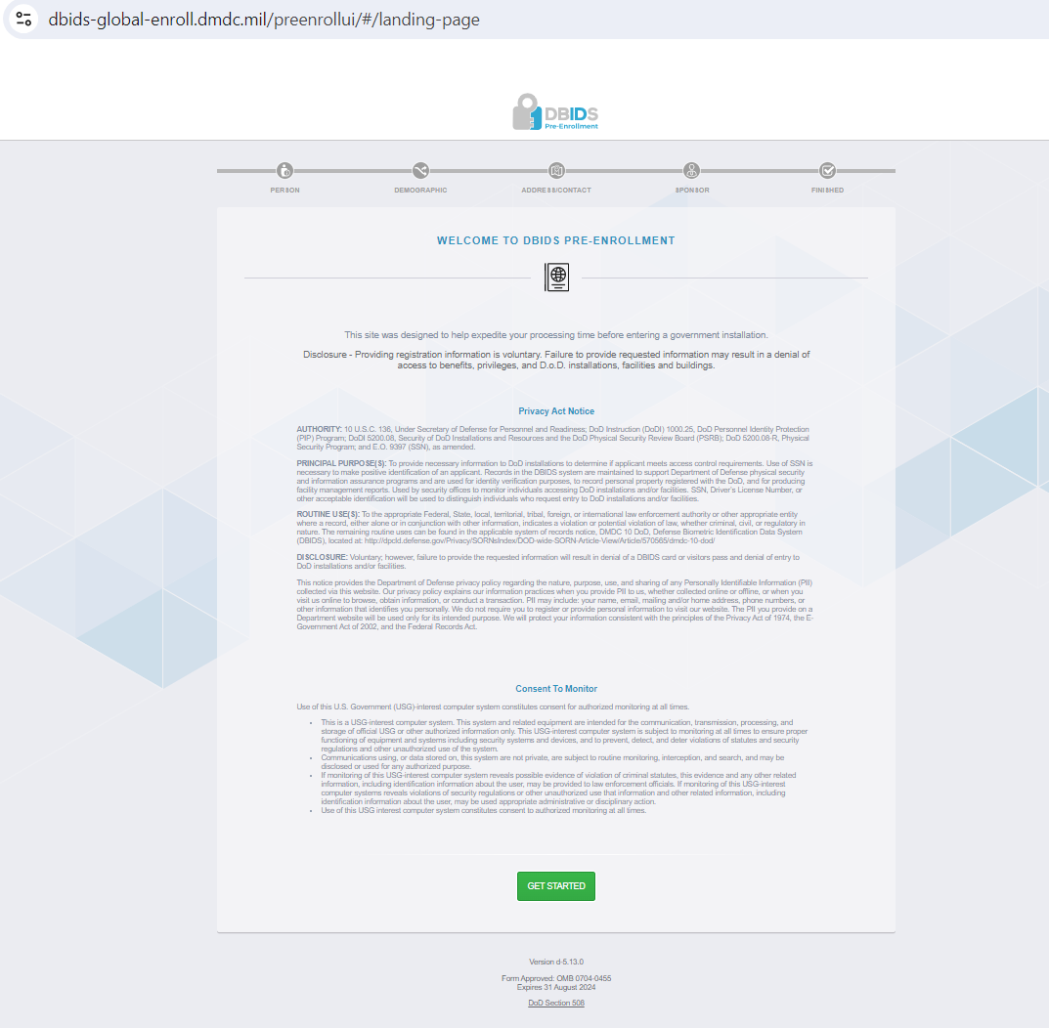

Slide 4
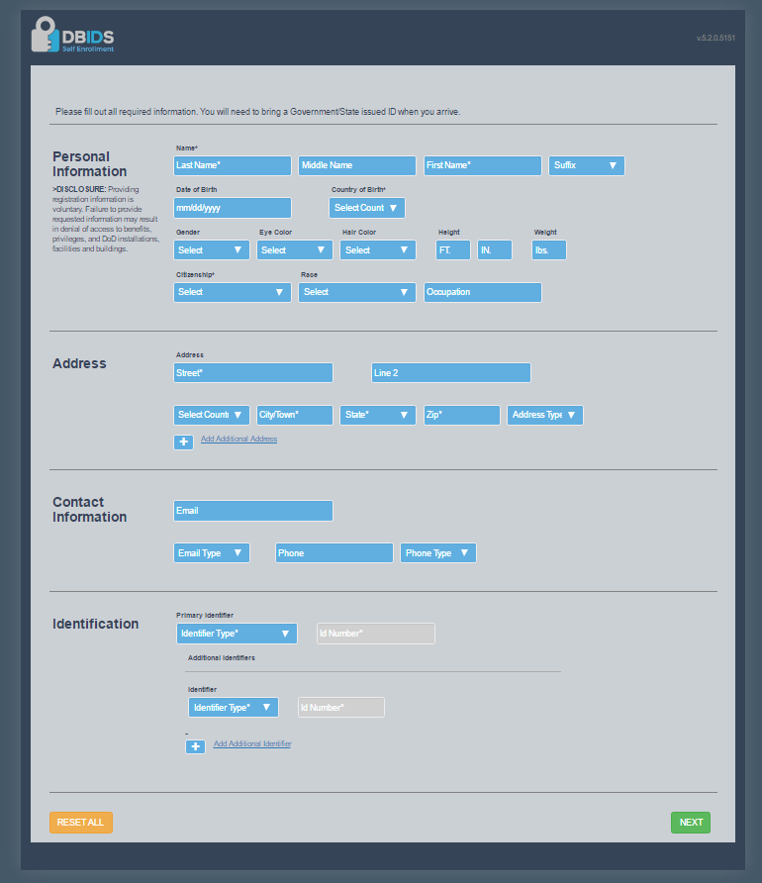

Slide 5
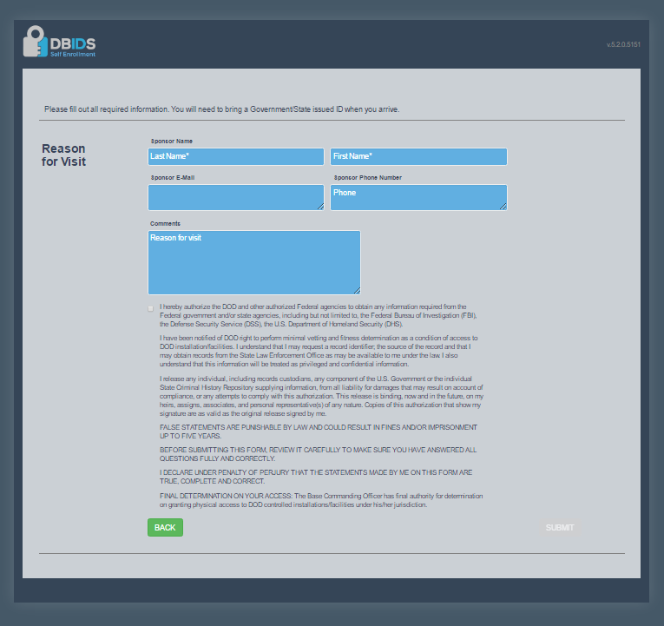

Slide 6
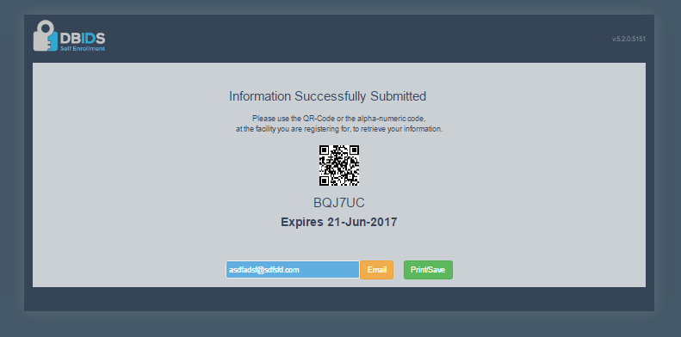

Slide 7
Official Workstation - Person
UNCLASSIFIED
This will be DOD application for provisioned users to register applicants from specific DOD computers.
Continue to next slide for person registration
UNCLASSIFIED

Slide 8
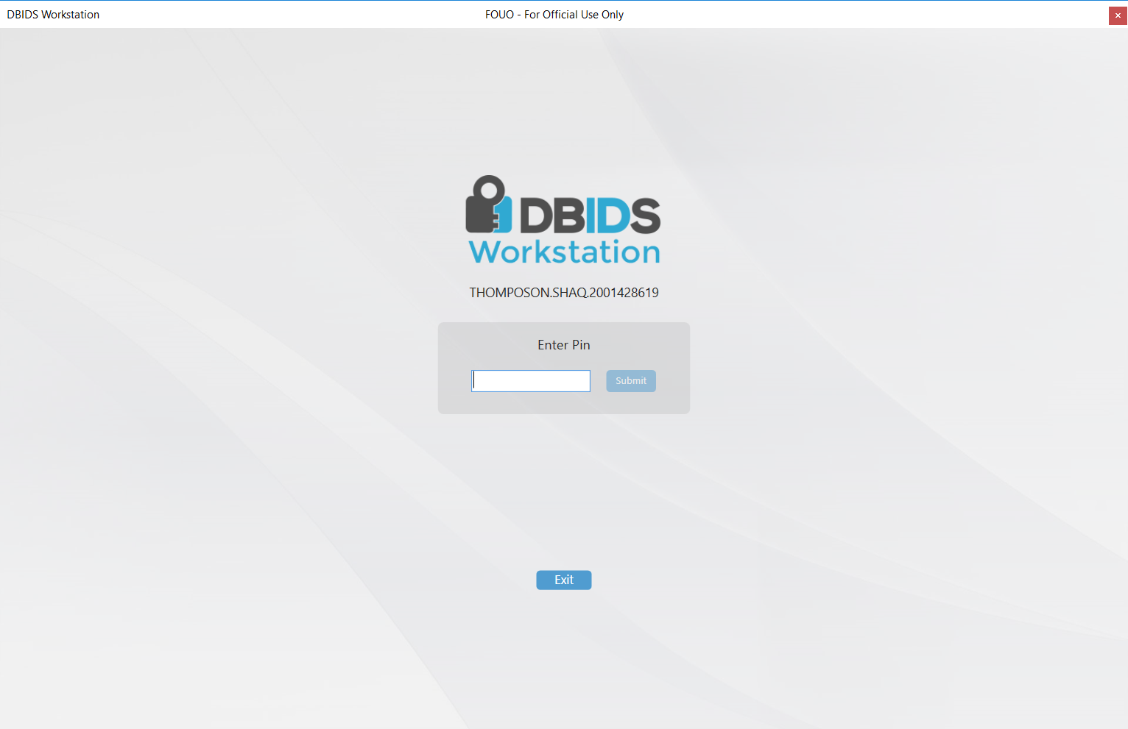
Login Screen

Slide 9
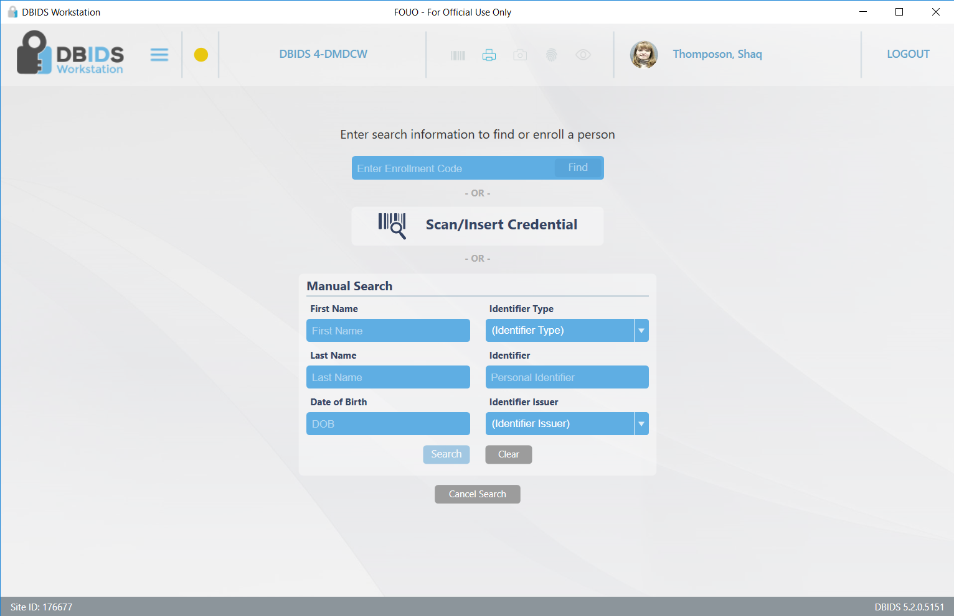
Registration (verify person is new)

Slide 10
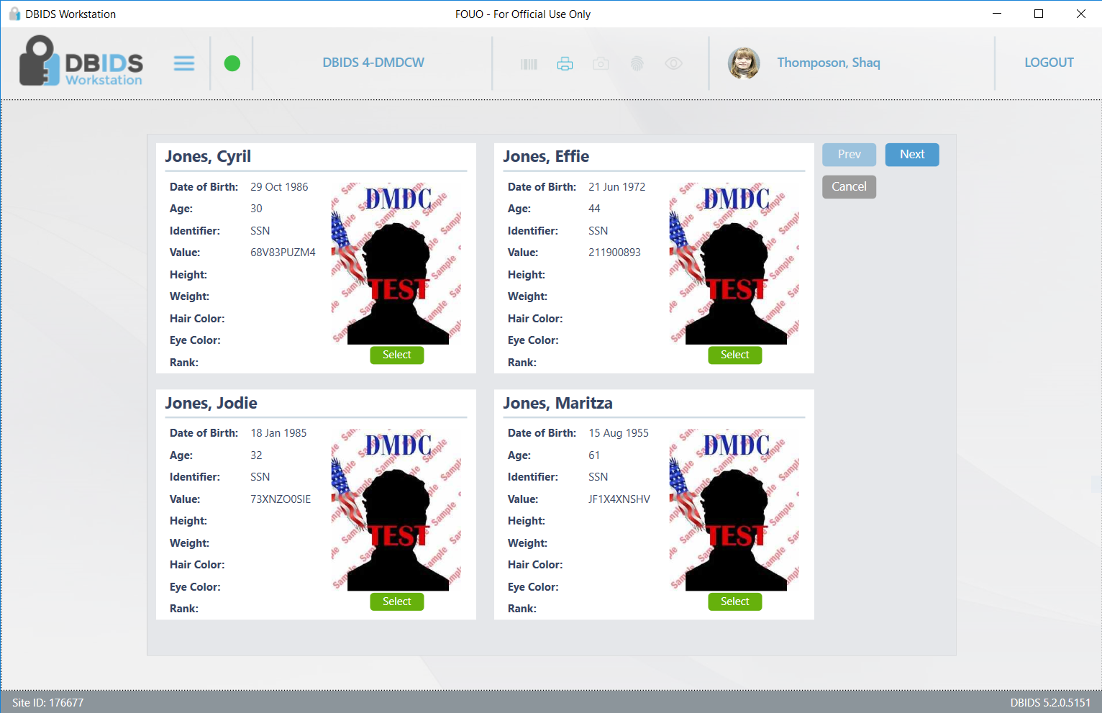

Slide 11
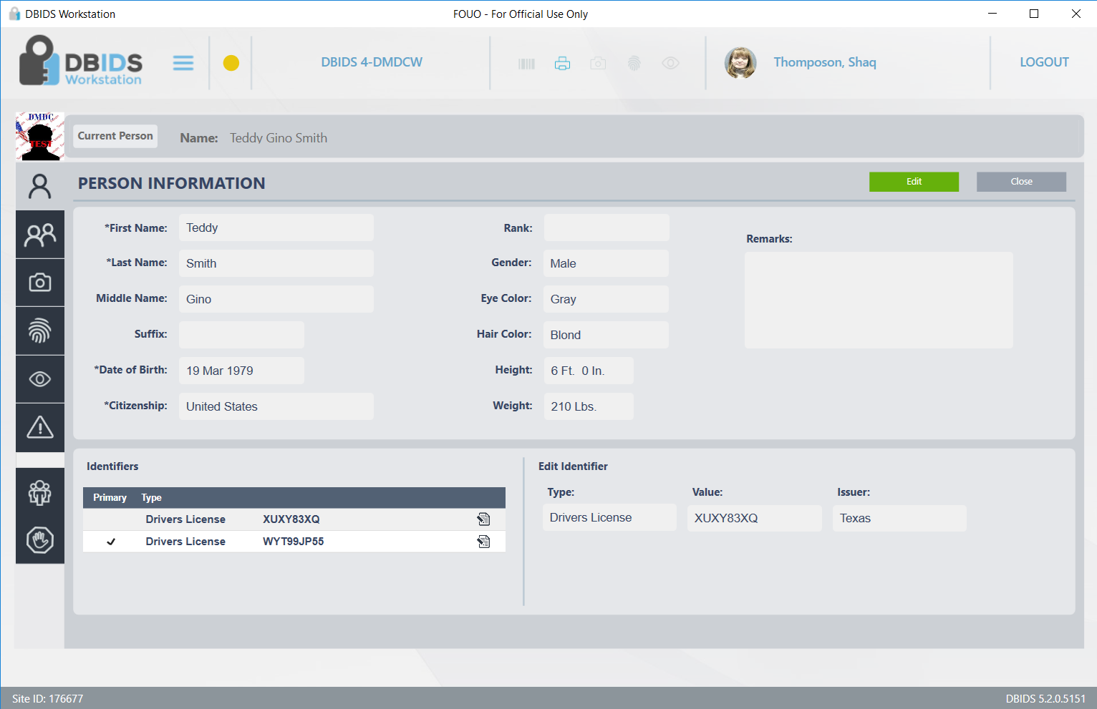

Slide 12
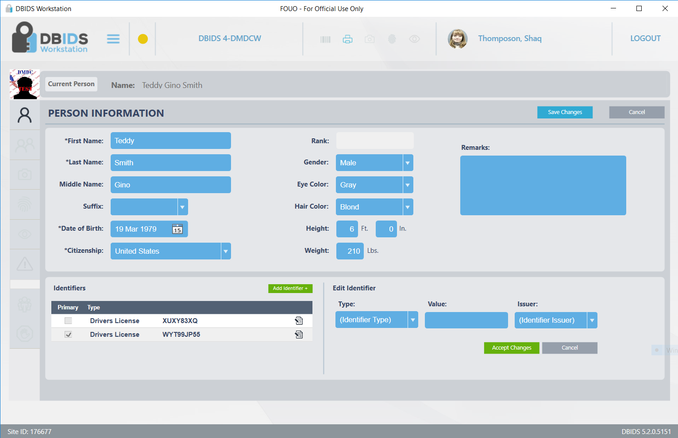

Slide 13
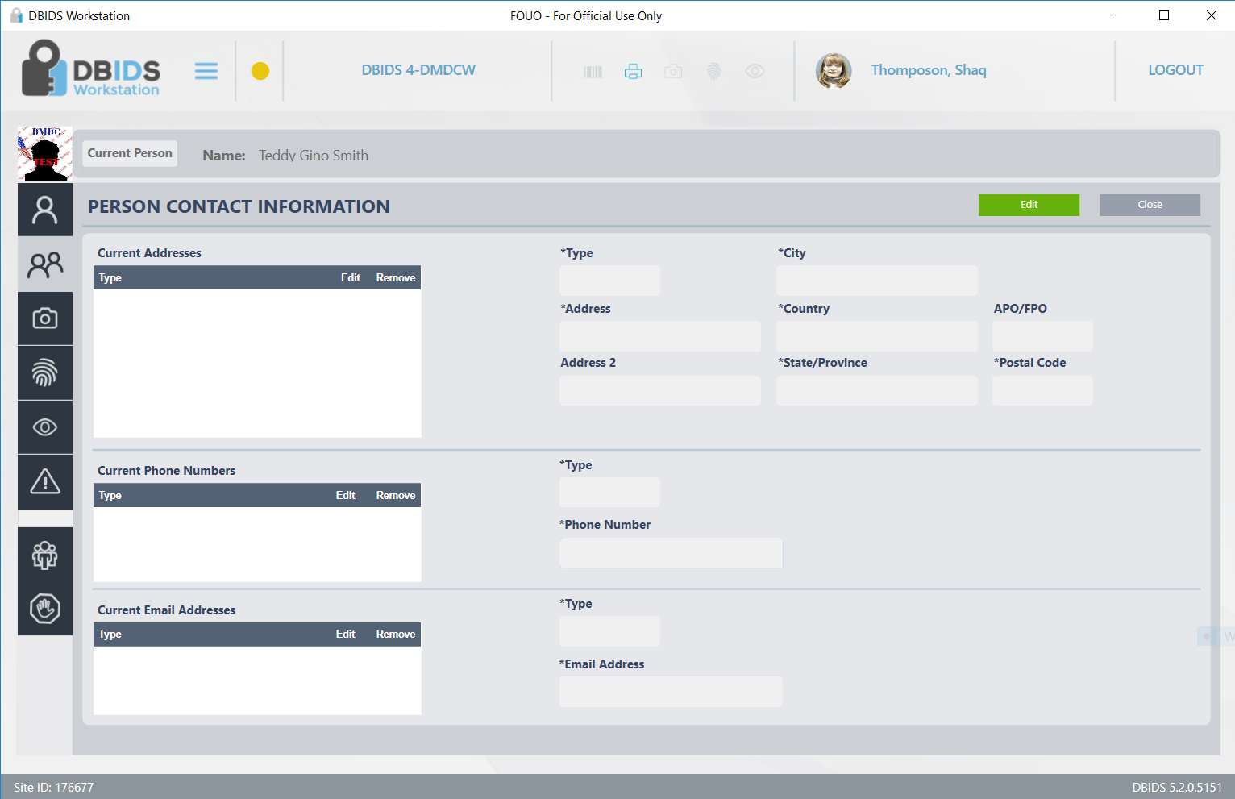

Slide 14
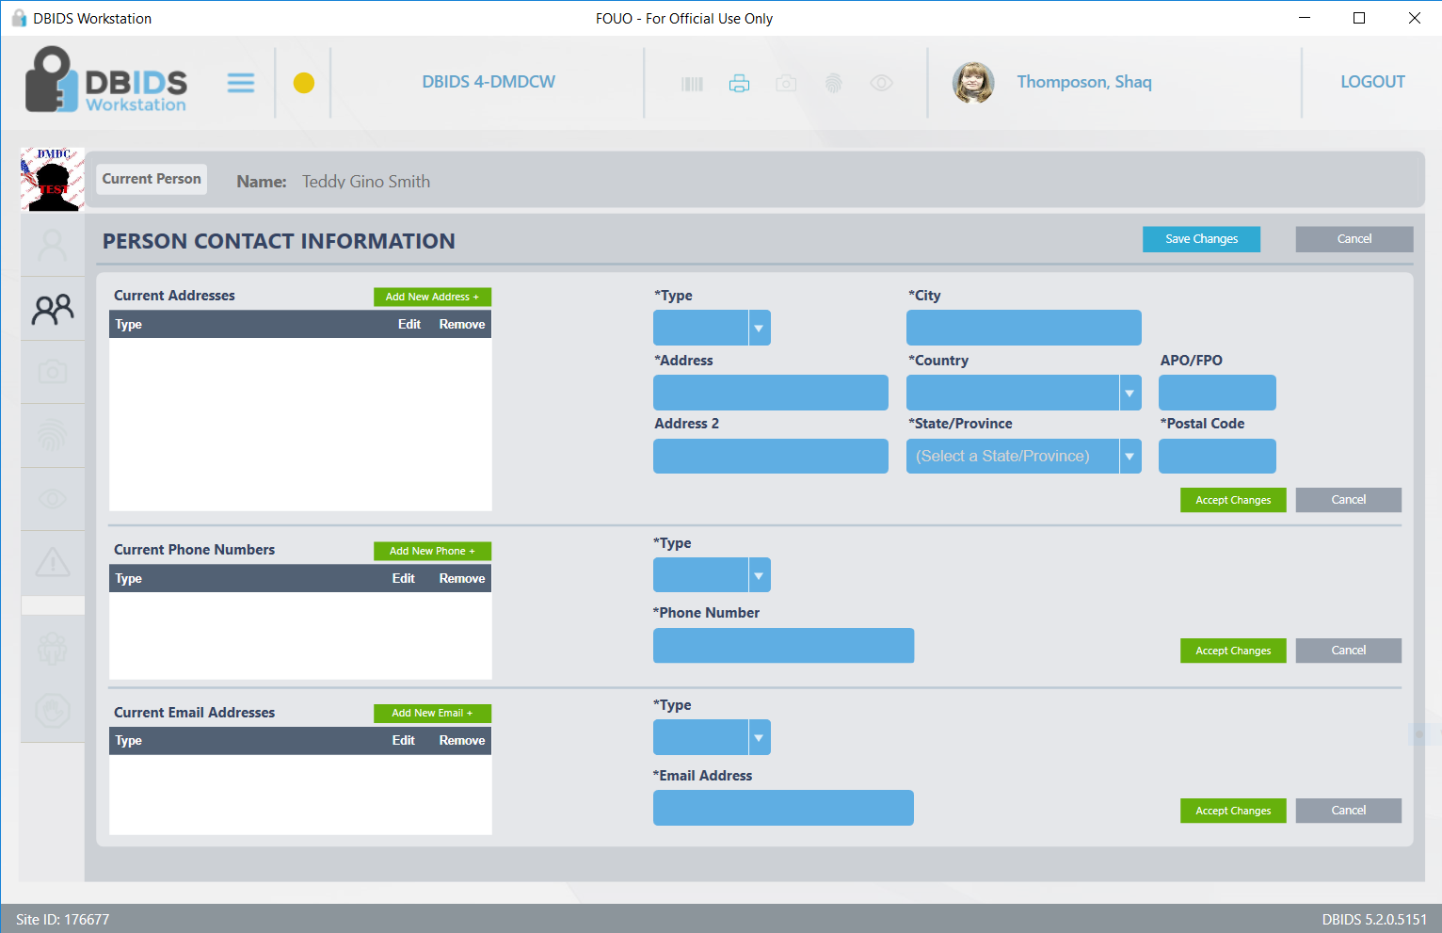

Slide 15
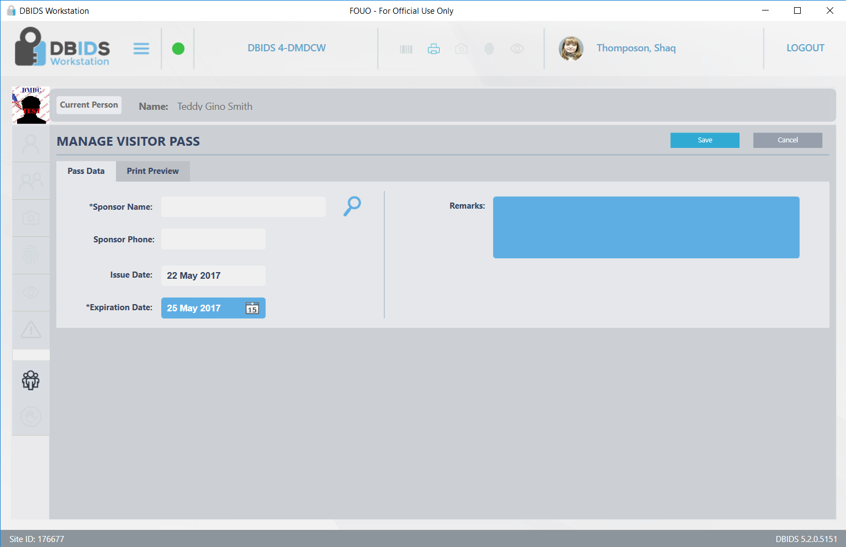

Slide 16
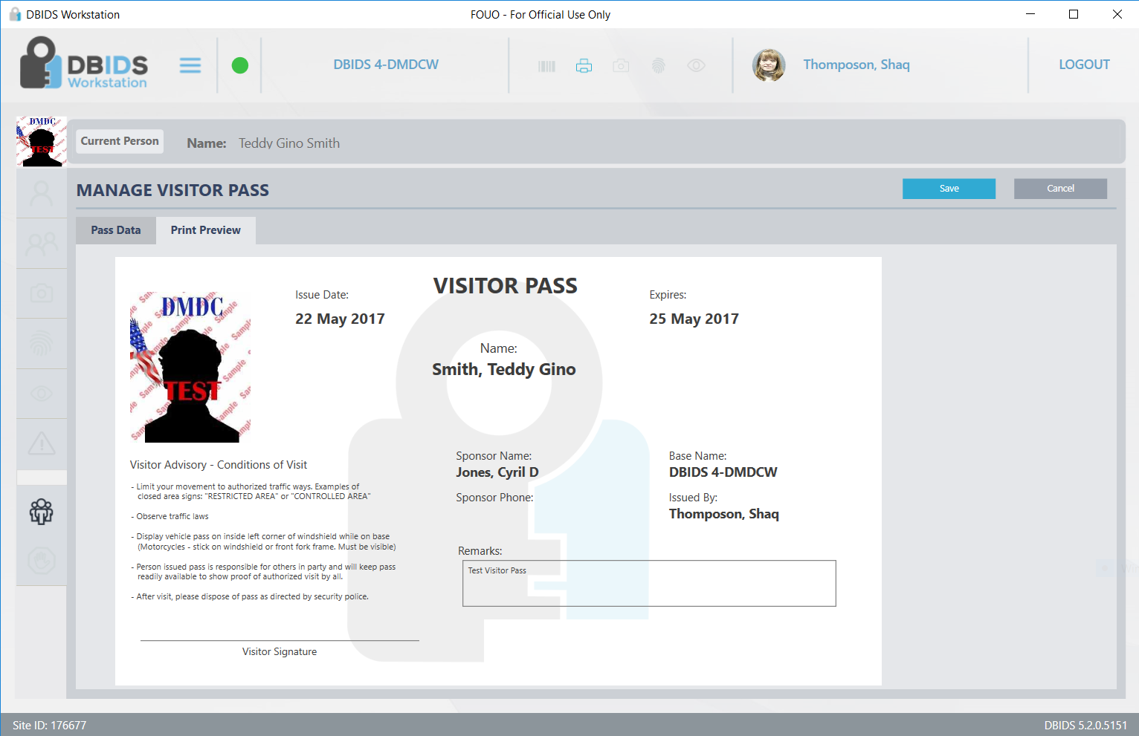

Slide 17
Official Workstation - Vehicle
UNCLASSIFIED
This will be DOD application for provisioned users to register applicants from specific DOD computers.
Continue to next slide for Vehicle registration
UNCLASSIFIED

Slide 18
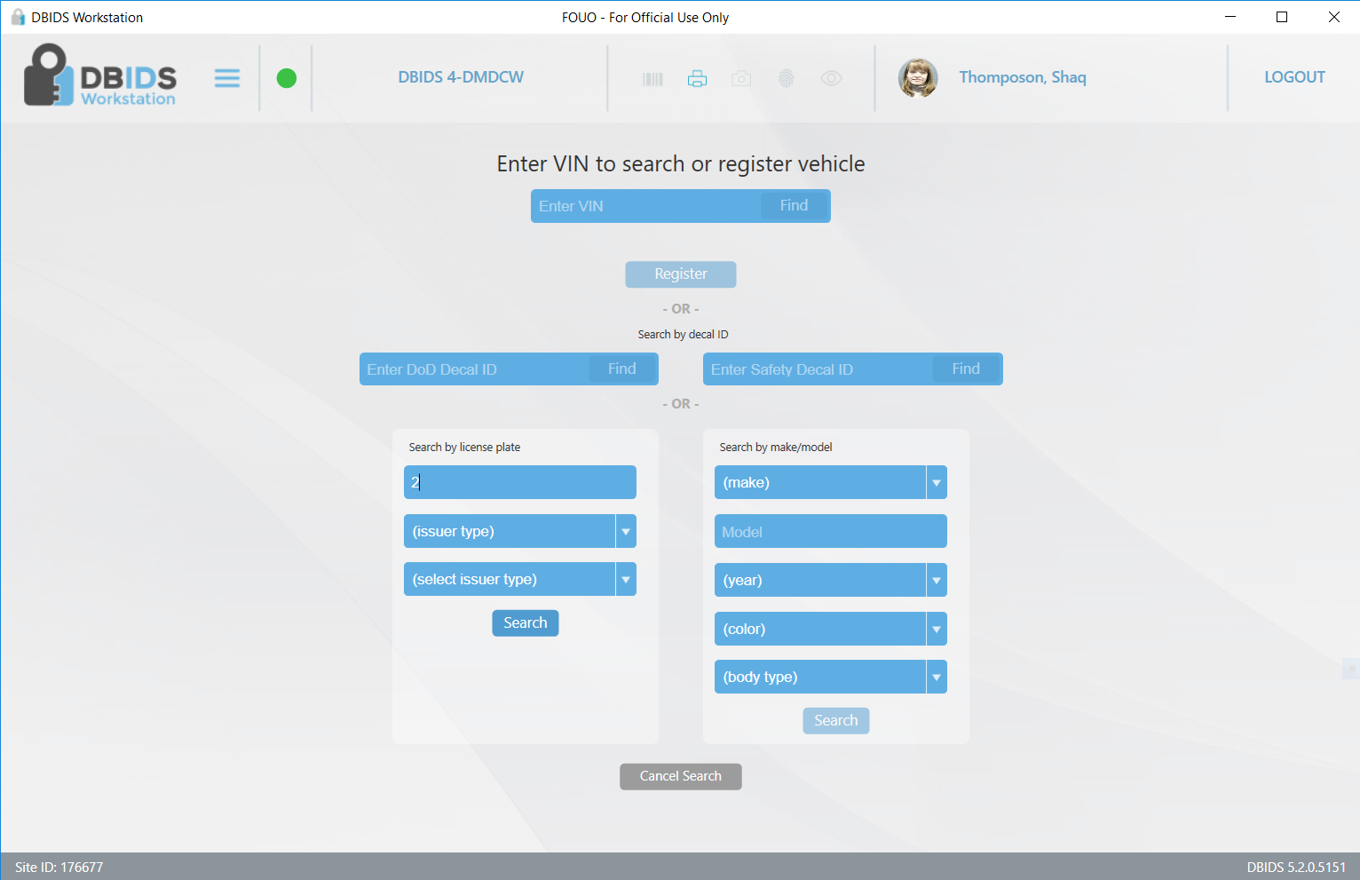

Slide 19
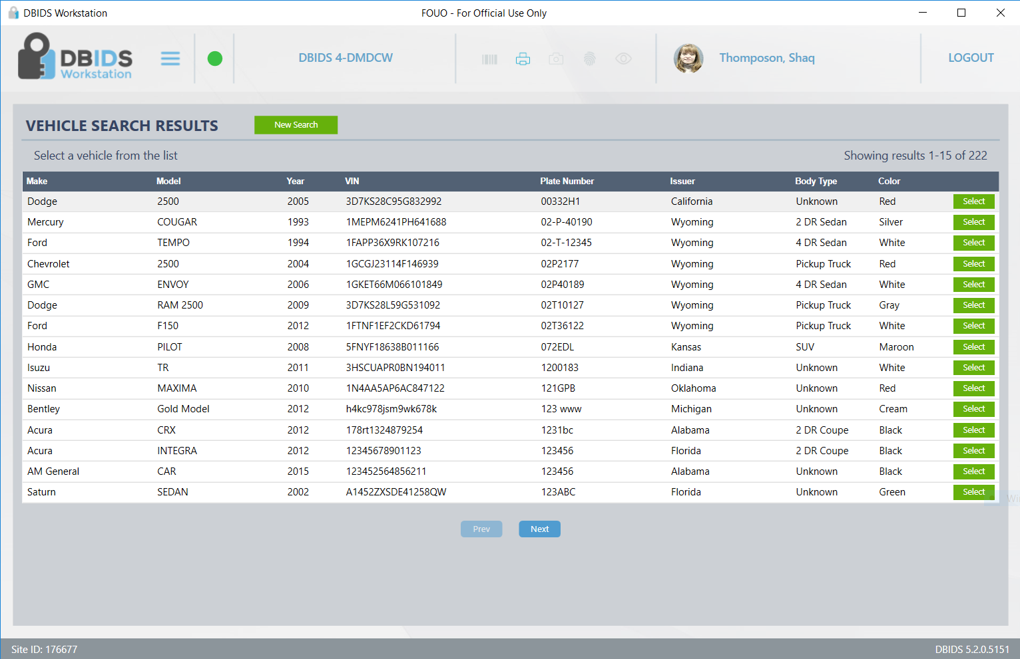

Slide 20
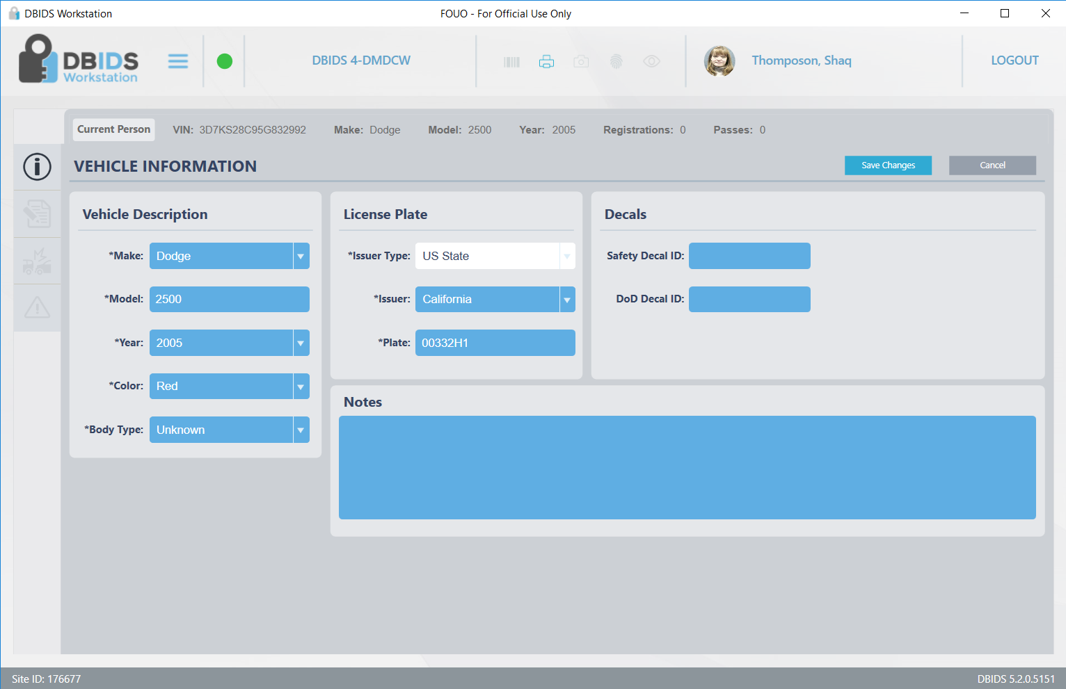

Slide 21
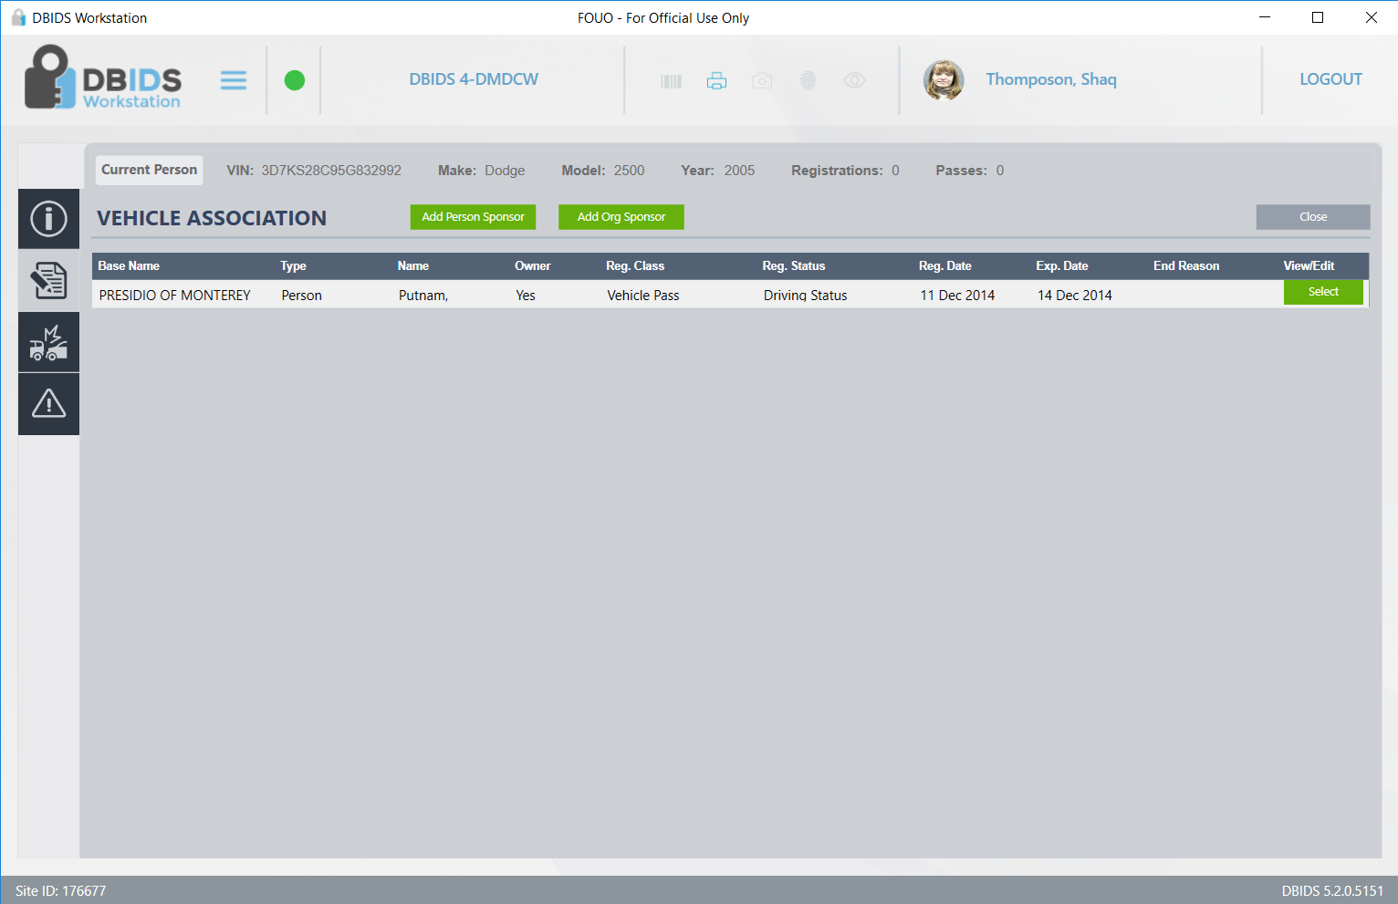

Slide 22
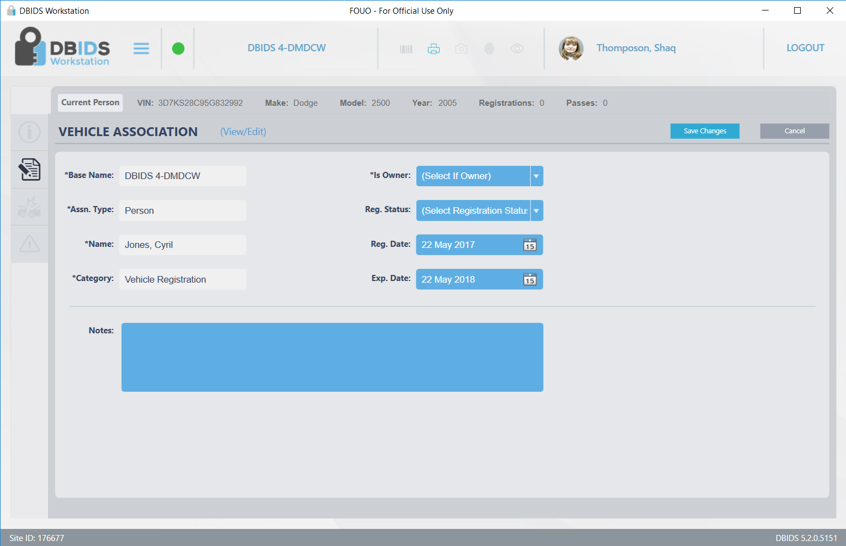

Slide 23
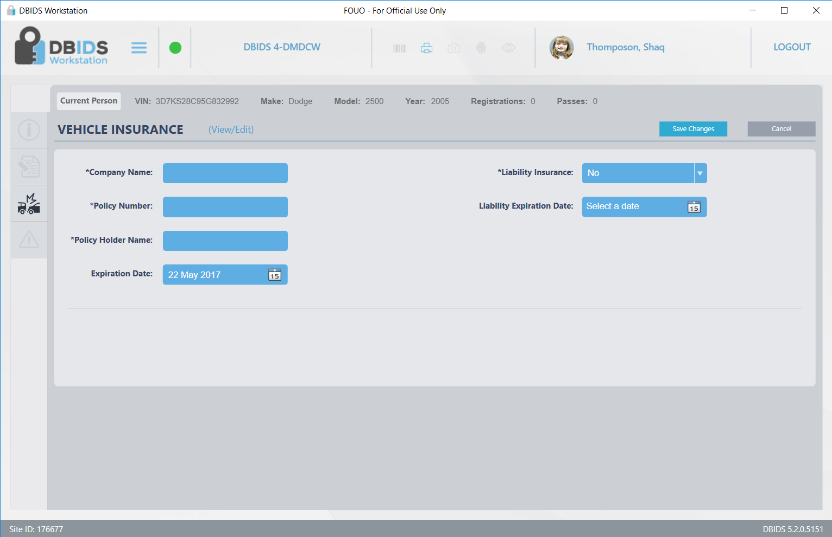

Slide 24
Official Workstation - Search
UNCLASSIFIED
This will be DOD application for provisioned users to register applicants from specific DOD computers.
Continue to next slide for Person Search
UNCLASSIFIED

Slide 25
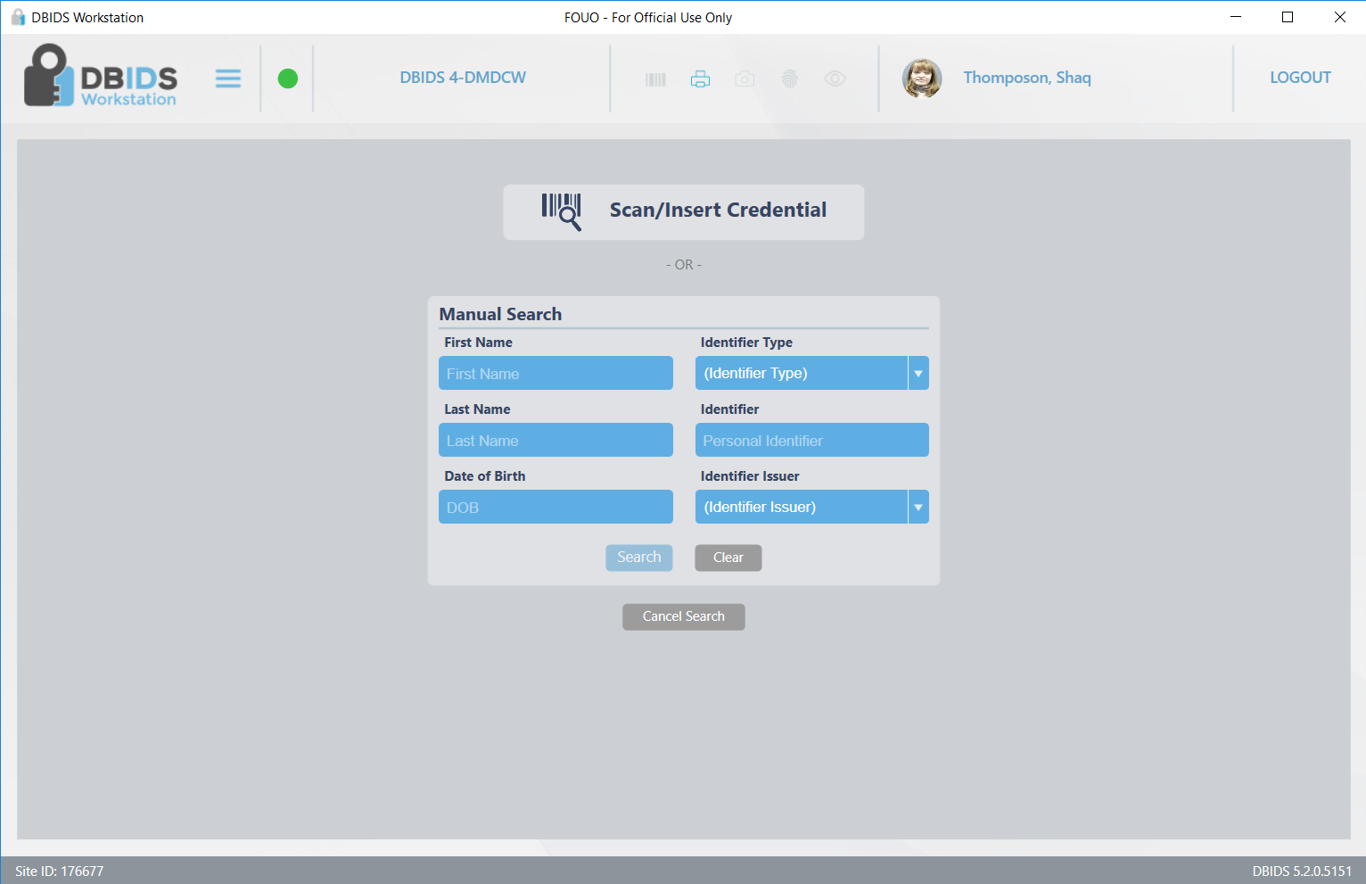

Slide 26
