Slide 1

CPRG Grants Progress Report
Template
June 3, 2024

Slide 2
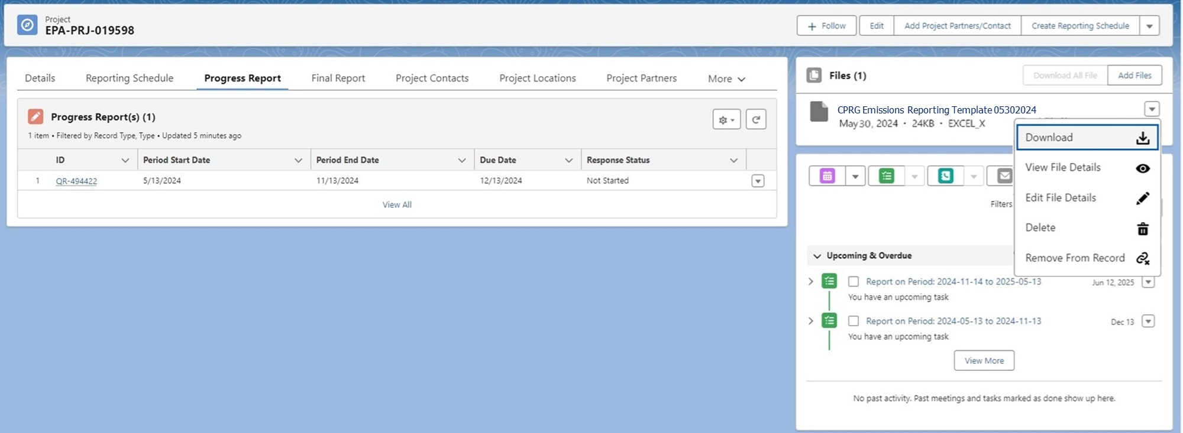
Progress Report View with Uploaded Emissions Reporting Template document
Grantee will Download the Emissions Reporting Template, clicking the arrow in the upper right corner and clicking Download.

Slide 3
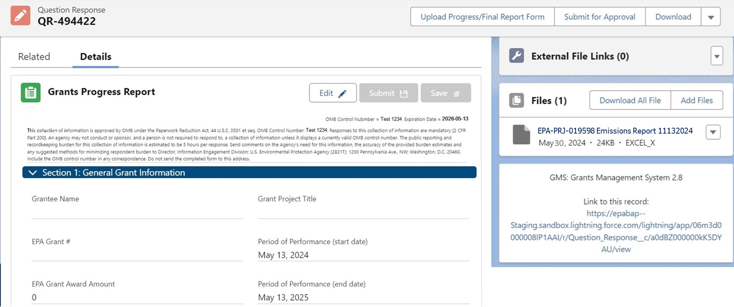
General Grant Information and Emissions Report document upload
Information in the Section 1: General Grant Information section will be automatically added from the Project Details.
The Grantee can complete the attached Emissions Report template and click the Add Files button to upload the completed document to their Grants Progress Report. This is an attached file to provide further information for the Grants Progress report.

Slide 4
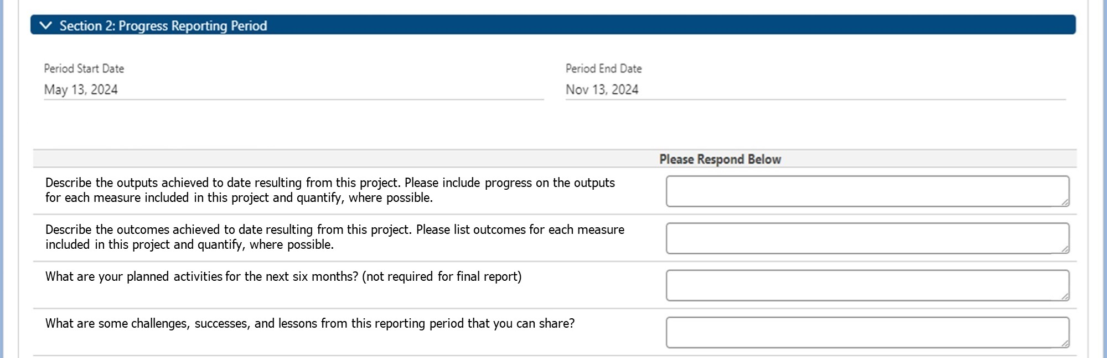
Progress Reporting Period and Reporting Period Summary
Progress Reporting Period automatically added from the Project Details section.
Grantee will complete the Reporting Period Summary section.

Slide 5
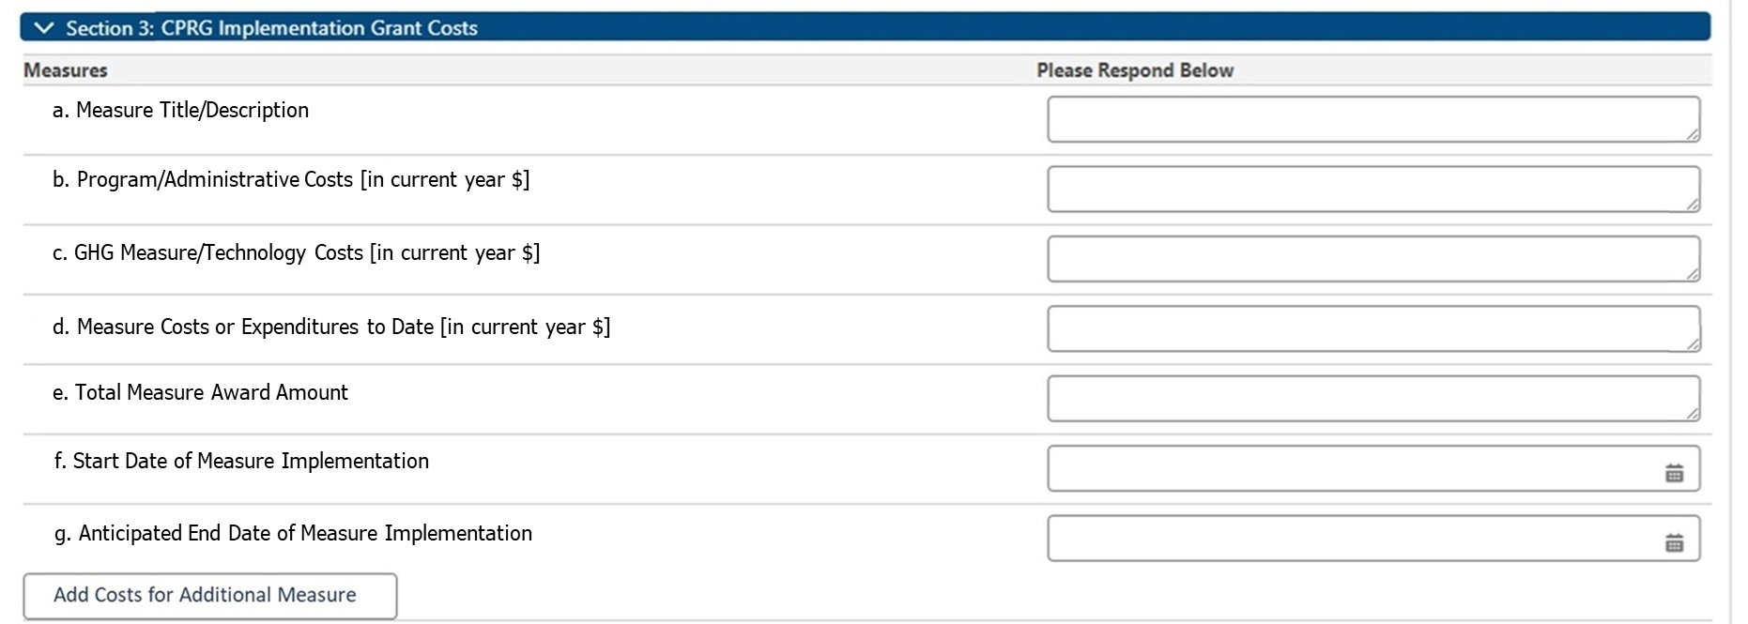
CPRG Implementation Grant Costs
Measures
The Grantee will click the Add Costs for Additional Measure button to create additional Measures entries.

Slide 6
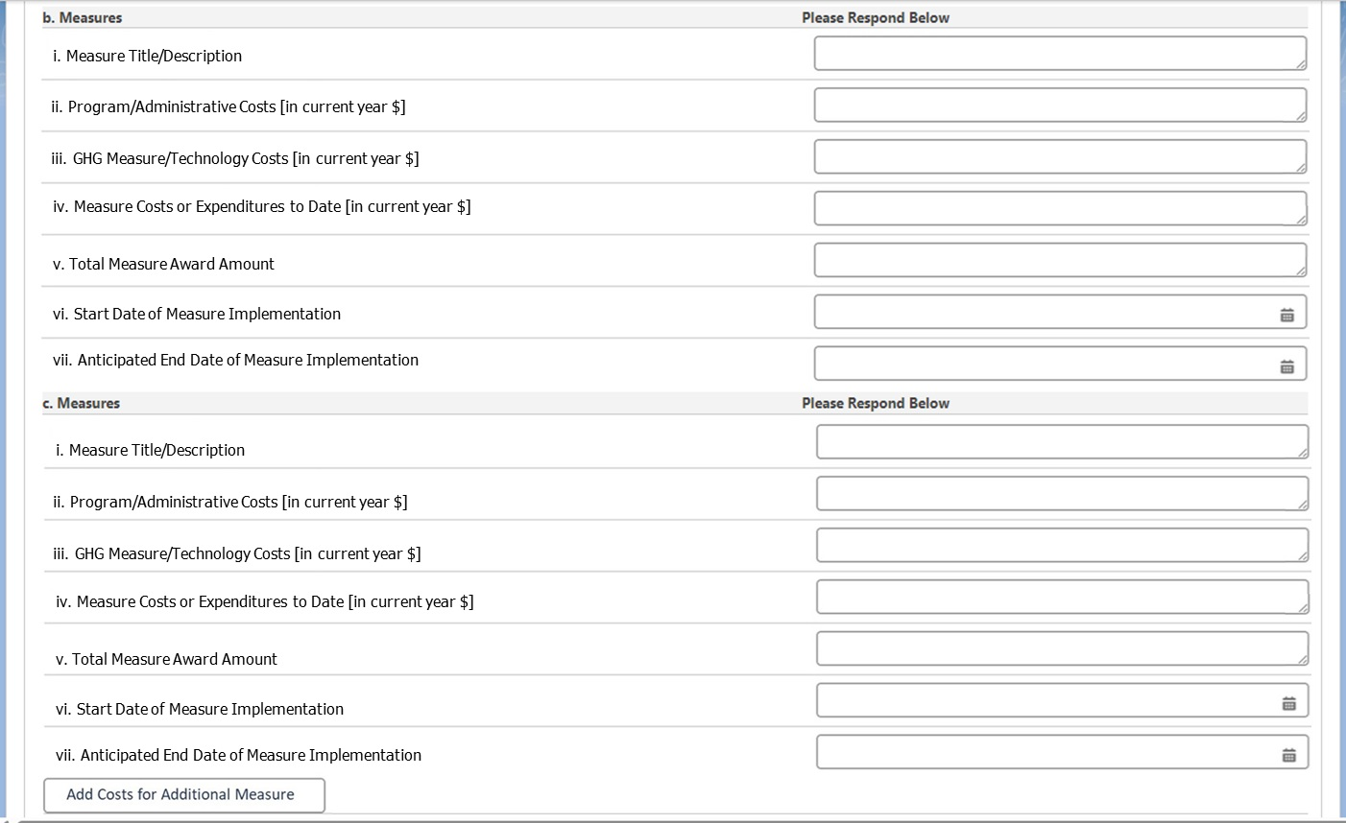
CPRG Implementation Grant Costs
Measures
Additional Measures added by the Grantee.

Slide 7
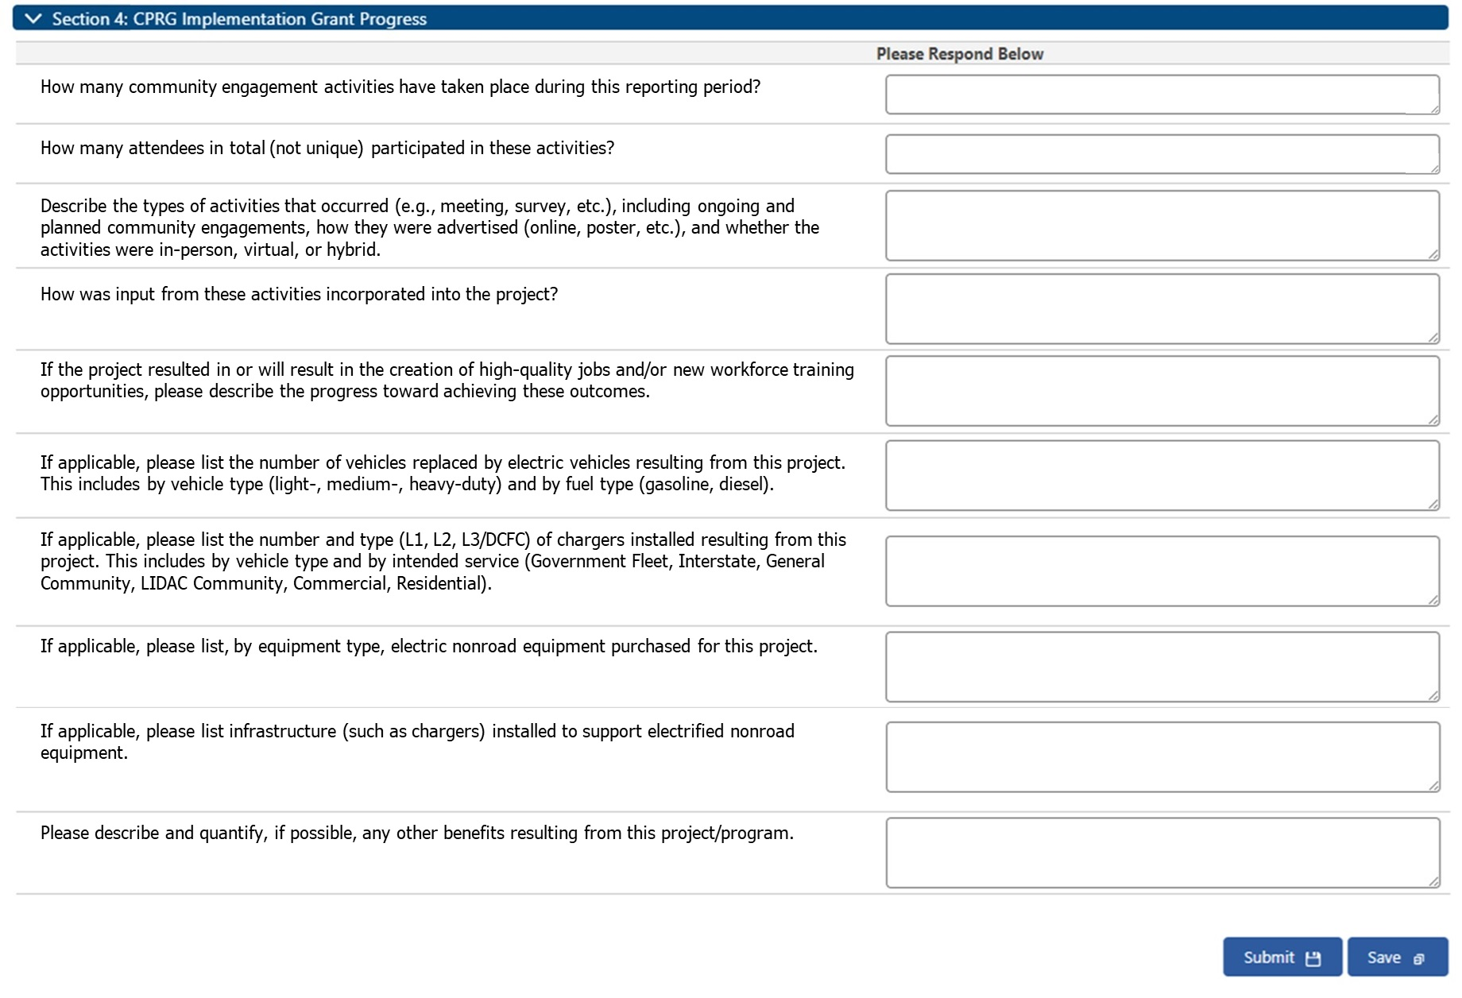
CPRG Implementation Grant Progress

Slide 8
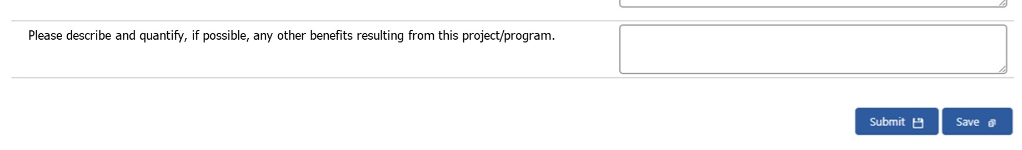
Save or Submit
The Grant Progress Report can be Saved by clicking the Save button.
Once complete, the Grants Progress Report can be Submitted by clicking the Submit button.

Slide 9
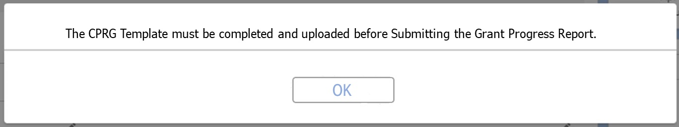
Proposed Upload Required
There is proposed future functionality that would include adding a warning, if the Grantee has not uploaded the Emissions Report prior to clicking Submit. It is also proposed that the Grantee would be blocked from Submitting the Grant Progress Report until the upload is complete.

