Slide 1
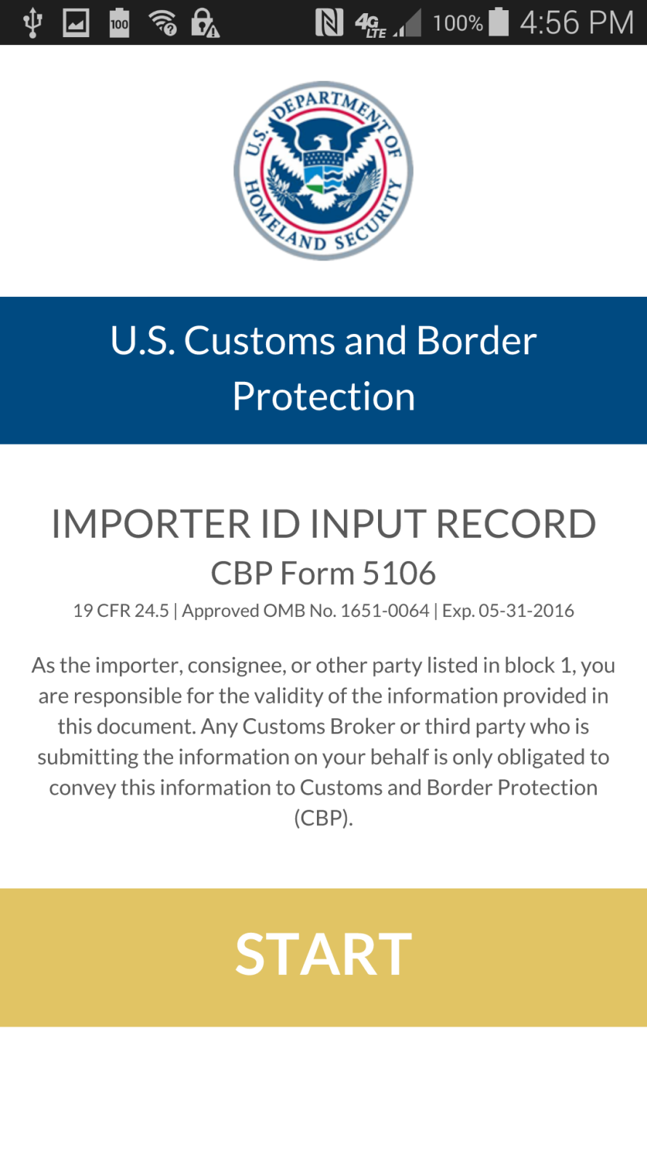
PAPERWORK REDUCTION ACT STATEMENT: An agency may not conduct or sponsor an information collection and a person is not required to respond to this information unless it displays a current valid OMB control number and an expiration date. The control number for this collection is 1651-0064. The estimated average time to complete this application is 45 minutes. If you have any comments regarding the burden estimate you can write to U.S. Customs and Border Protection, Office of International Trade, Regulations and Rulings, 90 K Street NE, Washington DC 20229-1177.

Slide 2
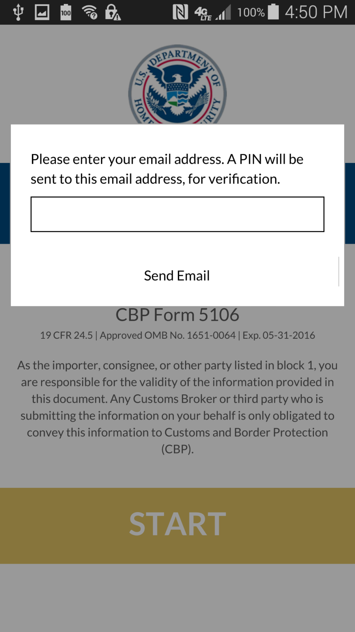

Slide 3
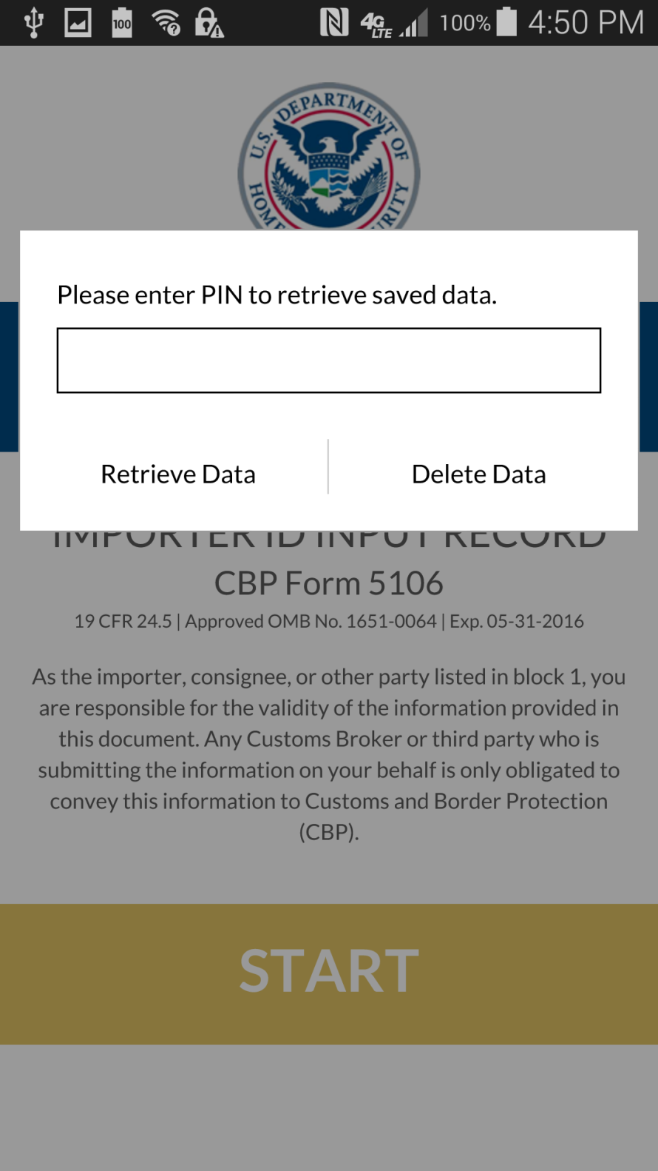

Slide 4
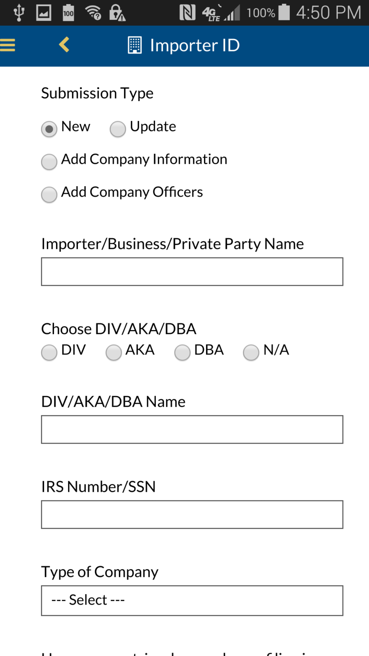

Slide 5
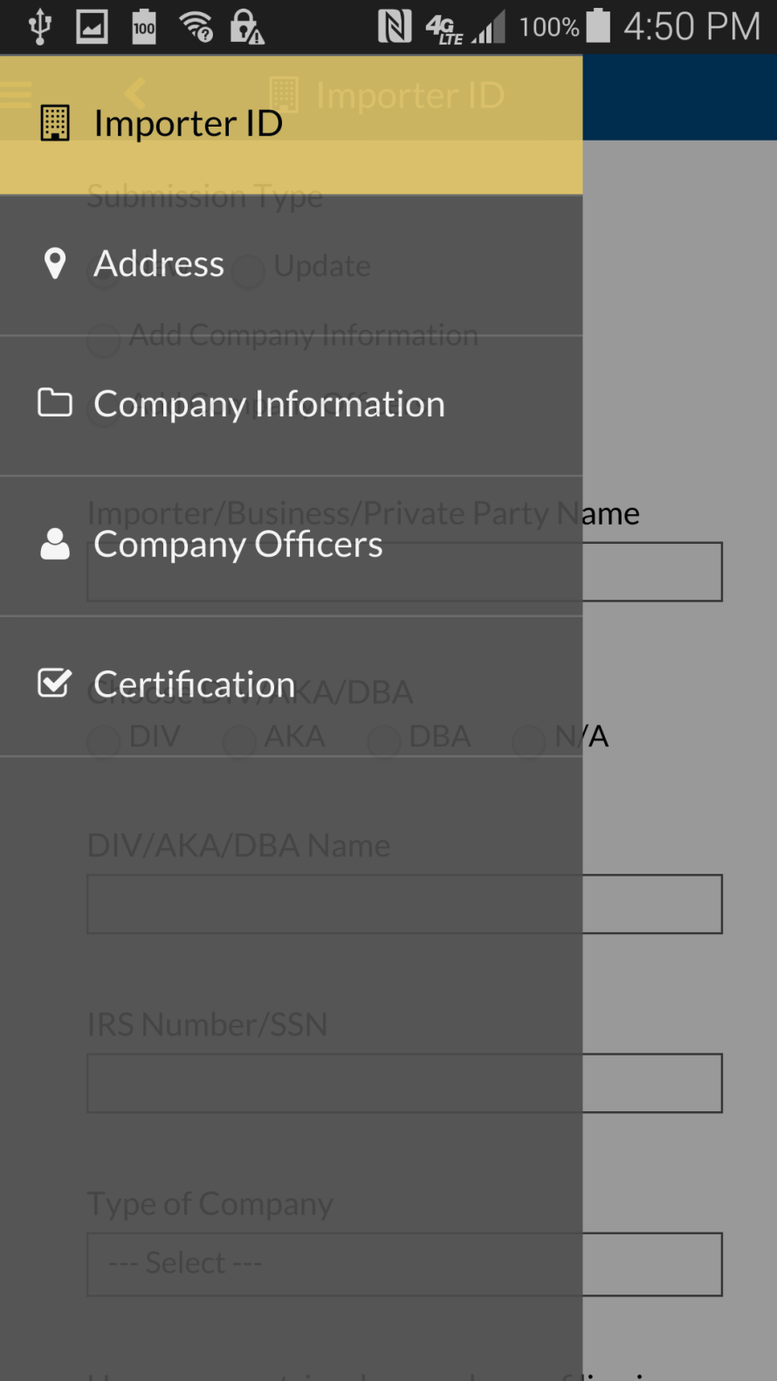

Slide 6
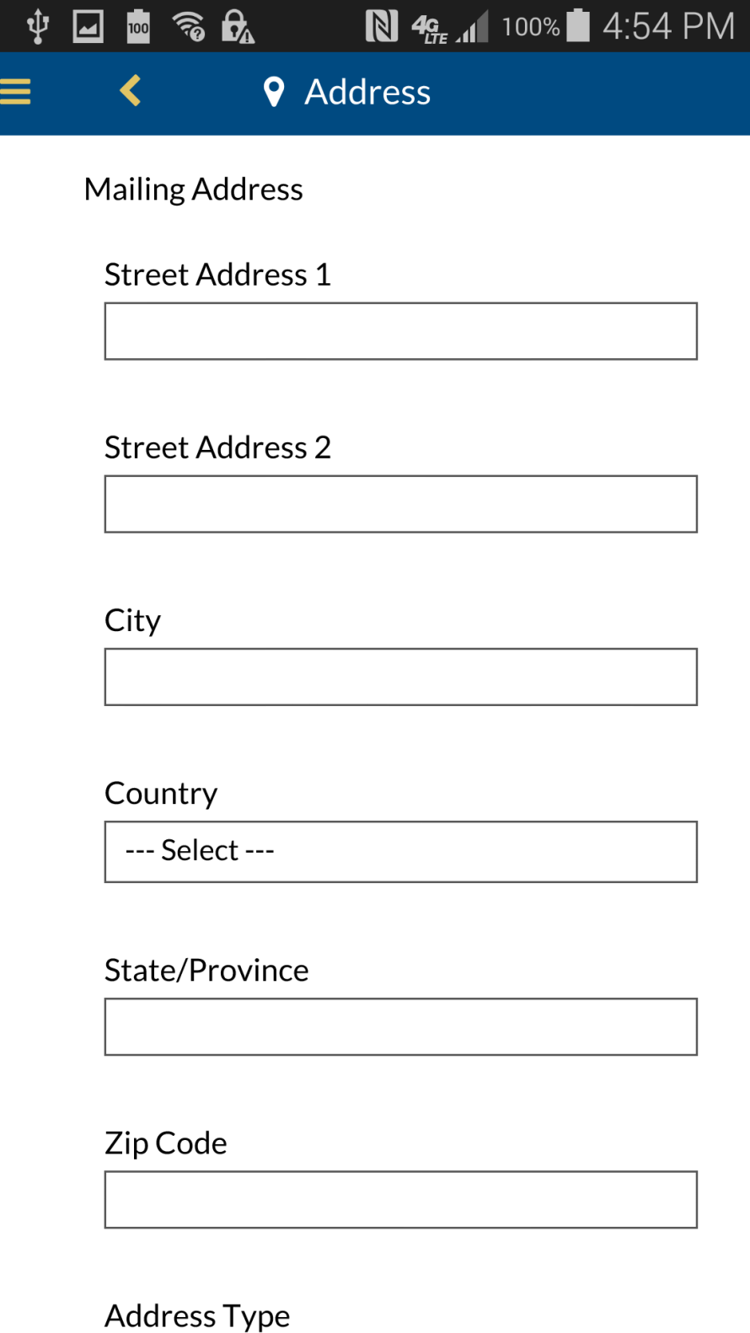

Slide 7
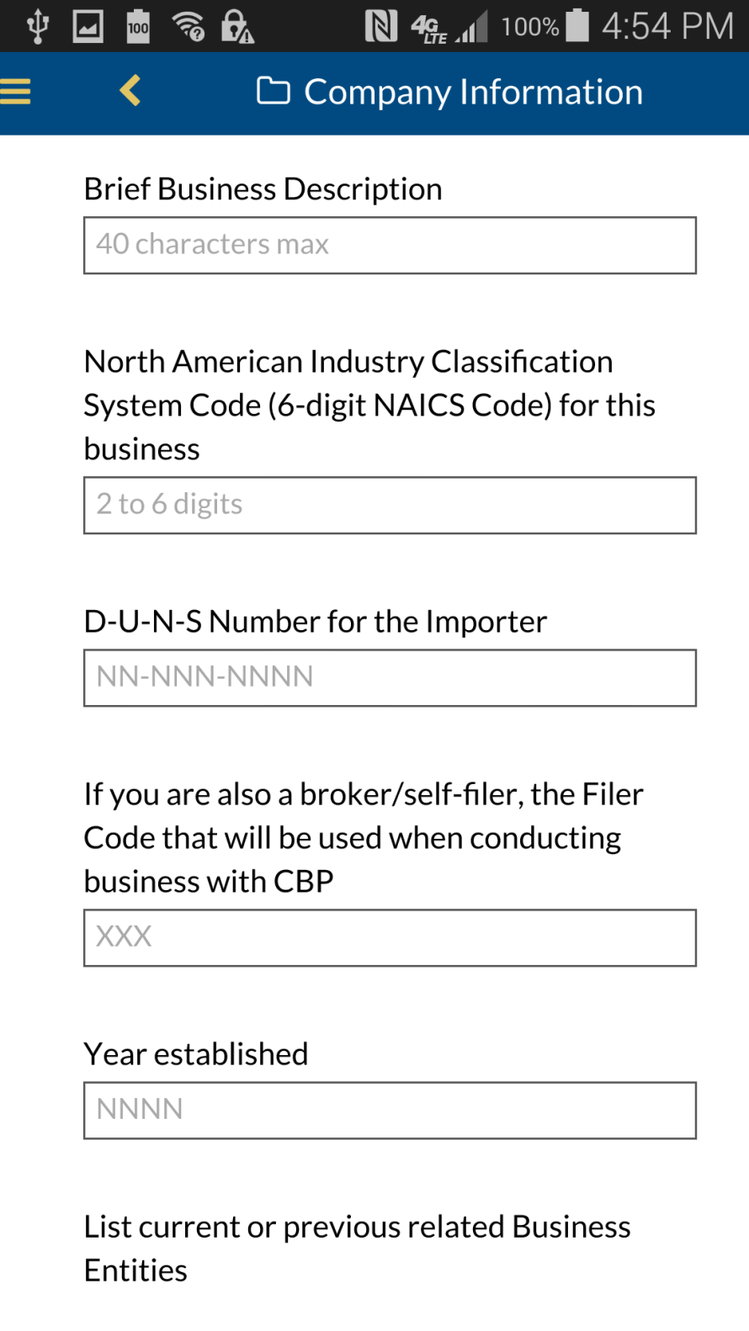

Slide 8
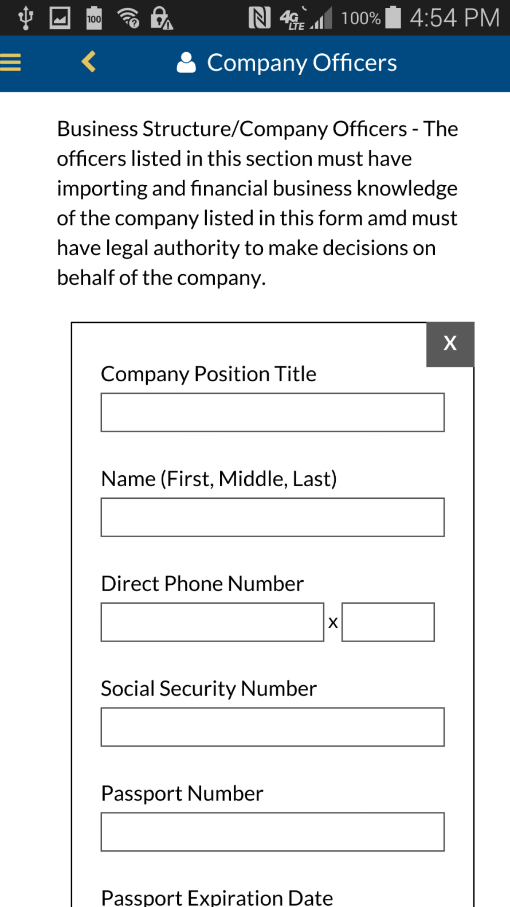

Slide 9
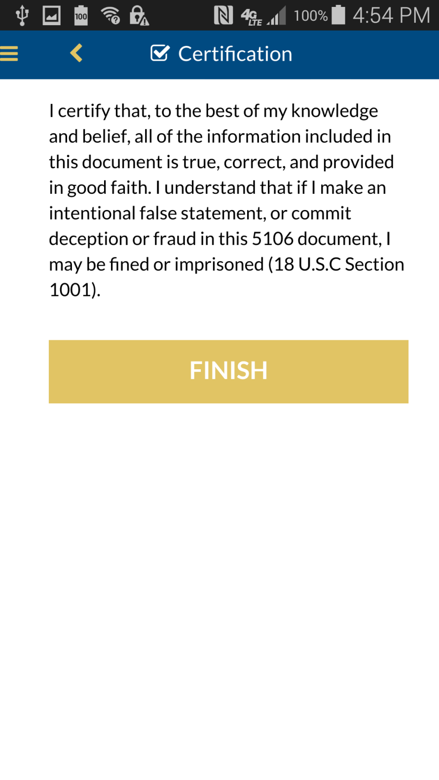

Slide 10
