Slide 1
The Early Childhood Longitudinal Study, Kindergarten Class of 2023-24 (ECLS-K:2024) Presentation for Teachers

Slide 2
What is the Early Childhood Longitudinal Study, Kindergarten Class of 2023-24 (ECLS-K:2024)?
The ECLS is a national education program that provides important information about children’s knowledge, skills, and development from birth through elementary school.
The ECLS-K:2024 is a new study in the program that will gather information from children, parents/guardians, teachers, and school administrators to provide a complete picture of children’s learning experiences.

Slide 3
Who conducts the ECLS-K:2024?
The ECLS-K:2024 is conducted by the National Center for Education Statistics (NCES), within the U.S. Department of Education’s Institute of Education Sciences (IES).
NCES is working with Westat, a U.S.-based research organization, to conduct the study across the country. You may be contacted by Westat study staff, who will provide you with additional details about the study.

Slide 4
Who will be asked to take part in the ECLS-K:2024?
The ECLS-K:2024 team sampled approximately 25 kindergarten students (including transitional kindergarten and pre-first grade students) from our school to participate in the study.
School administrators, teachers, and parents/guardians of these selected students will be asked to complete surveys as part of the study.
The study is longitudinal, so the ECLS-K:2024 team will return to our school at several points in the future as well.

Slide 5
When will the study be conducted?
For most schools, the ECLS-K:2024 team conducted the first phase of the study in schools over the course of 2 to 3 days between August and December 2023, when the selected children were in kindergarten.
The ECLS-K:2024 team will visit schools again in the spring of 2024, and then in the spring of 2025 when most of the selected children will be in first grade.
The study will continue for the selected children during the spring of 2027 and spring of 2029. This will allow us to learn about changes for these children and their education over time.

Slide 6
What will my students do?
In each phase of the study, your students, with their parents’ or guardians’ consent, will answer engaging, age-appropriate reading-, math-, and memory-related questions in one-on-one sessions with a trained ECLS-K:2024 team member.
The study team member will read and show illustrated tasks to the student, who can respond verbally or by pointing to their answer. Children have enjoyed answering these types of questions in previous ECLS studies.
The sessions will take place at school, during school hours, in a room such as the gym or library. School staff and parents are welcome to be in the room during their students’ sessions.
The sessions are untimed but are expected to last about 1 hour for most children.
In some schools, all selected children will also have their height and weight measured to learn about their physical development.
Children can skip any questions they do not want to answer. Any child who does not
want to work with the ECLS-K:2024 team member will not have to do so.

Slide 7
As a teacher, what will I do?
The ECLS-K:2024 team is asking all kindergarten teachers (including transitional kindergarten and pre-first grade teachers) in our school to participate.
This spring, you will be asked to complete a web survey about you and your classroom. The survey will take about 20 minutes to complete.
You will not be asked to conduct the study activities with students.

Slide 8
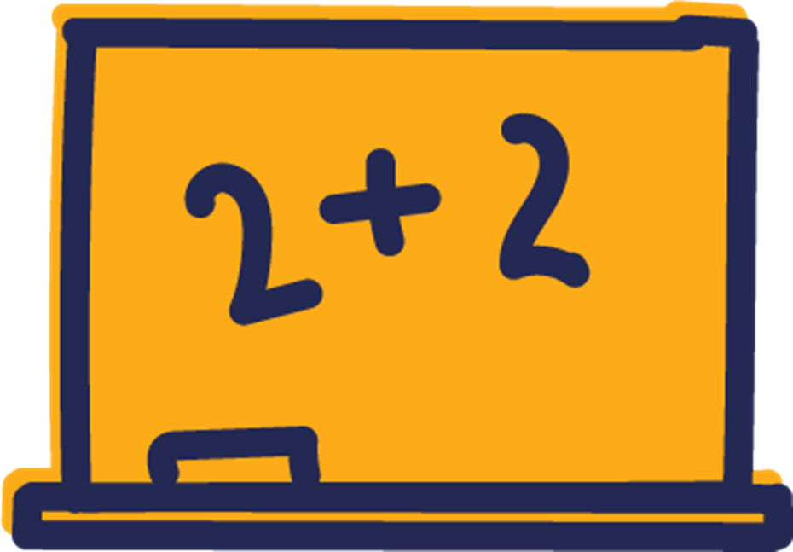
As a teacher, what will I do?
Teachers who teach the selected students will also be asked to complete a web survey about the skills and knowledge of each of the students selected for the study in each phase of the study. The survey is expected to take about 15 minutes to complete for each selected student.
In the springs of 2025, 2027, and 2029, when most of the students have progressed to first, third, and fifth grades, their teachers will be asked to complete similar surveys about their background, classroom, and selected students.

Slide 9
What will my students’ parents or guardians do?
Selected students’ parents or guardians will also complete web surveys in each phase of the study. Each survey will take about 45 minutes to complete.
The survey will ask parents questions about their families, their child’s experiences, and more to gain a better understanding of their child’s learning and development.

Slide 10
How can the ECLS-K:2024 help my students and our school?
The ECLS program explores how different factors—at home and at school—relate to children’s development and learning. Through reports from the U.S. Department of Education and others, you can learn about topics such as:
How well do kindergarten programs prepare students for later grades?
What educational activities do students do at home and with their families?
What support do parents and families need to be more involved in their child’s education?

Slide 11
How will privacy be protected for me, my students, and their families?
Teachers, schools, students, and families will not be identified in any ECLS-K:2024 reports. Information will be combined from all participants to produce reports for the nation as a whole.
All of the information provided by children, families, teachers, and principals may be used only for statistical purposes and may not be disclosed, or used, in identifiable form for any other purpose except as required by law (20 U.S.C. §9573 and 6 U.S.C. §151). All staff working on the study have signed an affidavit of non-disclosure where they swear to abide by this law.
This means that—unless ordered by a court—no information you provide that identifies you or your students and their families can be shared outside of the ECLS-K:2024 project. All staff working on the study have signed an agreement where they swear to abide by this law and face serious penalties, including jail time, if they knowingly reveal information that identifies you or your family.

Slide 12
Where can I find more information?
You can learn more about the ECLS-K:2024 study at MyECLS.ed.gov.
You can see examples of questions from previous ECLS studies, find study reports, and learn more about the ECLS program at nces.ed.gov/ecls/.
You can call the ECLS information number, 1-855-898-2018, or send an email to ECLS@westat.com.
Thank you for your time and efforts in helping to make the ECLS-K:2024 a success!

