Slide 1
CPSC at Imports
Certificate Requirements, eFiling, and 1USG Notifications
Arthur Łaciak eFiling Program Specialist Office of Import Surveillance

Slide 2
Any product that is subject to a consumer product safety rule, ban, similar rule, standard, or regulation, and which is imported for consumption or warehousing, or distributed in commerce must be certified.
Certification is the responsibility of the importer; however, importers and manufacturers should have a clear understanding of exactly which standards need to be met.
Foreign manufacturers/suppliers should insist on a list of which mandatory and consensus standards apply.
What Must be Certified?
Notes:
Material on this slide has already been 6B cleared.

Slide 3
Types of Certificates
Children's Product Certificate (CPC) - the manufacturer or importer certifies that its children's product complies with all applicable children's product safety rules (bans, standards, similar rules, or regulations). https://www.cpsc.gov/Testing-Certification/Childrens-Product-Certificate-CPC
General Certificate of Conformity (GCC) – the manufacturer or importer that its general use product (non-children’s product) comply with all appliable consumer product safety rules. https://www.cpsc.gov/Business--Manufacturing/Testing-Certification/General-Certificate-of-Conformity-GCC
Notes:
Material on this slide has already been 6B cleared.

Slide 4
Products Requiring a Children’s Product Certificate |  |  | Products Requiring a General Certificate of Conformity
Children’s Products: ASTM F-963 Lead Paint Lead Content Small parts Phthalates (child care) ATVs (Youth) Activity Centers Baby Changing Products Bassinets and Cradles Bedside Sleepers Bicycles (Youth) Bicycle Helmets (Youth) Bouncer Seats Booster Seats Bunk Beds Carpets and Rugs Children's Furniture Children’s Folding Chairs and Stools Clacker Balls Clothing & General Wearing Apparel Cribs Dive Sticks Electrically Operated Toys/Articles | Hand-held Infant Carriers Highchairs Frame Child Carriers Gates and Enclosures Infant Bath Seats Infant Swings Infant Walkers Mattresses – Crib and Youth Size (open Flame) Mattresses – Crib and Youth Size (smoldering) Pacifiers Paint and surface coatings Play Yards Portable Bed Rails Portable Hook-On Chairs Rattles Sleepwear sizes 0-6X Sleepwear sizes 7-14 Sling Carriers Small Parts Soft Infant and Toddler Carriers Toddler Beds Toys Toys with Magnets Wearing Apparel – Children’s Vinyl Plastic Film in Children’s Apparel |  | Architectural Glazing Artificial Emberizing Materials* ATVs Bicycles Bicycle Helmets Bunk Beds Candles with Metal Wicks Carpets and Rugs CB Antennas Cellulose Insulation Cigarette Lighters Contact Adhesives Consumer Patching Compounds* Drywall Fireworks Garage Door Openers Inclined Infant Sleep Products* | Lawnmowers Lawn Darts* Matchbooks Mattresses (open Flame) Mattresses (smoldering) Metal Candle Wicks* Multi-purpose Lighters Paint and Similar Surface Coatings* Packaging Subject to the Poison Prevention Packaging Act Portable Gas Containers Pool and Spa Drain Covers Refuse Bins* Refrigerator Doors Swimming Pool Slides Vinyl Plastic Film Wearing Apparel (Flammability) *Products subject to ban Updated 9/2/2022
ATVs Activity Centers Bassinets and Cradles Bedside Sleepers Bicycles Bicycle Helmets Bouncer Seats | Mattresses – Crib and Youth Size (smoldering) Pacifiers Paint and surface coatings Play Yards Portable Bed Rails |  | Candles with Metal Wicks | Packaging Subject to the Poison Prevention Packaging Act
Booster Seats | Rattles |  | Carpets and Rugs
Bunk Beds | Sleepwear sizes 0-6X Sleepwear sizes 7-14 |  | CB Antennas | Portable Gas Containers Pool and Spa Drain Covers
Carpets and Rugs Carriers (Infant & Toddler) | Sling Carriers Small Parts Soft Infant and Toddler Carriers |  | Cellulose Insulation | Refuse Bins
Children's Furniture Clacker Balls | Toddler Beds Toys Toys with Magnets |  | Cigarette Lighters | Refrigerator Doors
Cribs Dive Sticks | Wearing Apparel – Children’s |  | Contact Adhesives Drywall | Swimming Pool Slides Vinyl Plastic Film
Electrically Operated Toys/Articles | Vinyl Plastic Film in Children’s Apparel |  | Fireworks Garage Door Openers | Wearing Apparel
https://cpsc.gov/Business--Manufacturing/Testing-Certification
Notes:
Material on this slide has already been 6B cleared.

Slide 5
Certificates Must include
Identification of the finished product
Each consumer product safety rule to which the finished product has been certified
Date and place the finished product was manufactured
Date when and place where the finished product was most recently tested for compliance
Contact information for person maintaining test records
Party certifying compliance
Notes:
Material on this slide has already been 6B cleared.

Slide 6
eFiling is a CPSC initiative to enable importers of regulated consumer products to file electronically (eFile) with U.S. Customs and Border Protection (CBP) certain data elements from a certificate of compliance, via a Partner Government Agency (PGA) Message Set.
What is eFiling?
Notes:
Material on this slide has already been 6B cleared.

Slide 7
Why eFiling?
Currently, CPSC only asks for certificate data once a product has been identified for exam and, therefore, cannot use certificate data in its risk assessment and targeting in advance of a shipment arriving. Once rulemaking is completed, importers of regulated consumer products will electronically file certain certificate of compliance data elements with CPSC via the PGA Message Set at Entry, or at Entry Summary if both Entry and Entry Summary are filed together.
Notes:
Material on this slide has already been 6B cleared.

Slide 8
2008
CPSIA requires importers to test and certify children’s and other general use products and provide certificates upon request (Codified under 16 CFR 1110).
2013
NPR published that would, among other things, require the electronic filing of certificates of compliance at the time of entry.
2016
Alpha Pilot conducted with eight participants that tested the PGA Message Set and Product Registry.
2017
Certificate Study analyzed risk potential of certificate data elements.
2020
Commission approves of Staff Briefing Package and Beta Pilot.
History
Notes:
Material on this slide has already been 6B cleared.

Slide 9
1,212 Products in Registry
8 Participants
15,165 Reference Message Sets
164 Full Message Sets
<1% Error Rate
6 Months
Alpha Pilot Results
Participants indicated required data was relatively easy to gather.
Data successfully integrated into RAM.
Product Registry reduced the burden and time of filing.
Notes:
For more information, please read through the Staff Briefing Package.
https://cpsc.gov/s3fs-public/CPSC-Plan-to-Create-an-eFiling-Program-for-Imported-Consumer-Products.pdf?BYXOLX2gJmF4NaAN1LCMmqiXRISuaRkr=

Slide 10
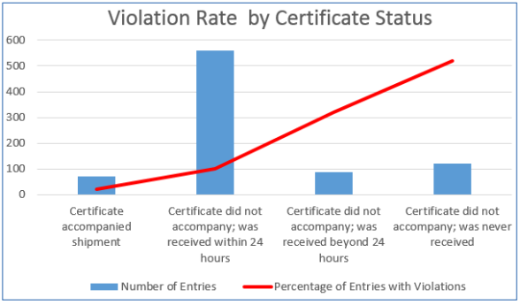
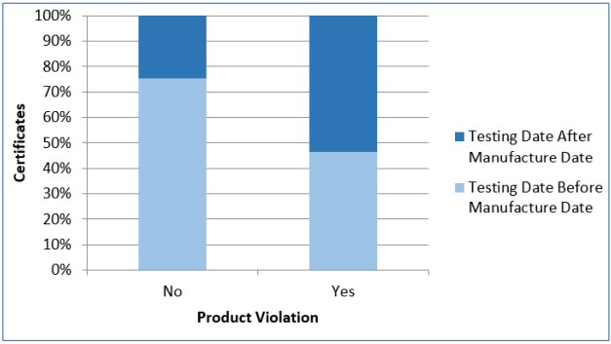
Certificate Study Results
Notes:
For more information, please read through the Staff Briefing Package.
https://cpsc.gov/s3fs-public/CPSC-Plan-to-Create-an-eFiling-Program-for-Imported-Consumer-Products.pdf?BYXOLX2gJmF4NaAN1LCMmqiXRISuaRkr=

Slide 11
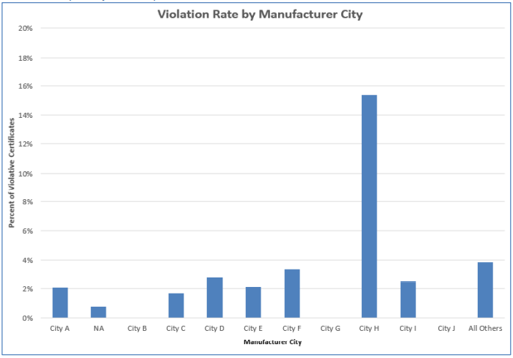
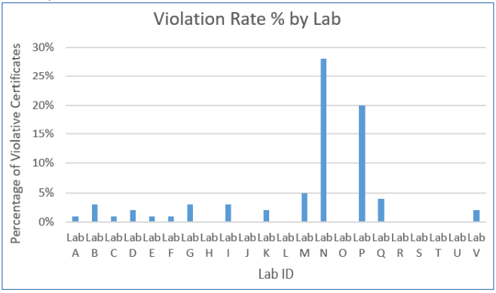
Certificate Study Results
Notes:
For more information, please read through the Staff Briefing Package.
https://cpsc.gov/s3fs-public/CPSC-Plan-to-Create-an-eFiling-Program-for-Imported-Consumer-Products.pdf?BYXOLX2gJmF4NaAN1LCMmqiXRISuaRkr=

Slide 12
What is the Beta Pilot?
CPSC will conduct a Beta Pilot test, in conjunction with CBP, scheduled to begin in fall 2023.
The Beta Pilot test will include up to 50 volunteer participants, allowing for more entry lines than the Alpha Pilot test and for CPSC to develop, test, and implement processes and procedures for an eFiling requirement for imported, regulated consumer products.
Notes:
Material on this slide has already been 6B cleared.

Slide 13
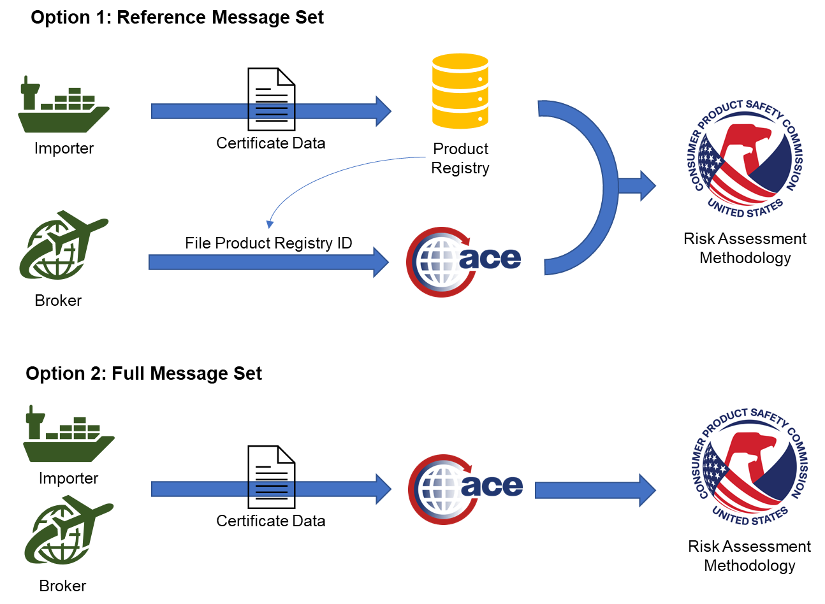
Notes:
Material on this slide has already been 6B cleared.

Slide 14
Timeline
Fall 2022 Begin IT development
Spring 2023 PGA Message Set development
Fall 2023 Begin Beta Pilot
Summer 2023 Testing and volunteer onboarding
Spring 2024 End Beta Pilot
End of Year 2024 Finalize rulemaking
Winter 2022/23 Receive iterative feedback
Winter 2023/24 Receive iterative feedback

Slide 15
PGA Message Set Development
November - February Initial CATAIR draft
June - August Certification Environment Test
March - May PGA Message Set and Software Development
September Production Environment Test
October Beta Pilot Begins

Slide 16
How will industry benefit?
CPSC expects industry to experience improvements in risk assessment, enforcement, and trade facilitation, because the agency will be better able to incorporate the presence or lack of a certificate, as well as the data elements provided, into CPSC’s targeting algorithms. Risk scores will decrease for importers who electronically file valid data elements, resulting in fewer examinations of their cargo at the port.
Notes:
Material on this slide has already been 6B cleared.

Slide 17
Participation in the Beta Pilot
Email your interest to eFilingPilot@cpsc.gov, including your Importer of Record number and products you primarily import.
Brokers, software developers, and labs are able to participate, but ideally would do so in collaboration with an importer.
CPSC is seeking a subset of 9 volunteers to participate in advising the IT development.
Visit www.cpsc.gov/eFiling for more information.
Notes:
Material on this slide has already been 6B cleared.

Slide 18
CPSC and CBP are modernizing the exchange of messages to coordinate the exam process.
Automates the notification using ACE protocols and CBP messaging structures.
Allows CPSC the necessary time to indicate that an examination is required.
May delay the notification of a 1USG release for these products.
Does not impact the flow of goods through the border, unless CPSC determines that an intensive examination is required at the port.
The HTS codes for product groupings affected are listed in guidance on our website – www.cpsc.gov/imports.
1USG Notifications via ACE

Slide 19
Methods Message Flow
Filer receives an “Under Review” message from ACE signifying that CPSC is electronically reviewing that entry.
At the same time, CPSC will receive notification of an incoming product of interest.
If, after review, CPSC determines that a shipment requires examination, either at the port or at the importer’s premises, trade will receive additional messaging through ACE.
If, after review, no such determination is made, a “May Proceed” will be sent by CPSC through ACE to the trade.

Slide 20
Methods
The vast majority of shipments will receive a “May Proceed” message. They will be automated system-to-system messages.
During their review, CPSC staff co‐located at the ports, or in coordination with CBP, can signal an intent to examine through either a:
Hold Intact Notice,
Document Review (a type of Hold Intact),
Intensive Exam Request,
Documents Required Request (a type of Intensive Exam).

Slide 21
Automated Clock
Entry Filed: | 3 or more Business Days Before Est. Date of Arrival | 3 or more Business Days Before Actual Arrival | Fewer than 3 Business Days Before Actual Arrival
Entity with: | Compliant CPSC History | Unknown or Poor CPSC Compliance History | Unknown or Poor CPSC Compliance History, OR Entry has additional risk factors
Air and Truck | 8 Business Hours after Entry is Filed | 5 Minutes after Actual Arrival event message received | 8 Business Hours after the latter of Actual Arrival or CPSC receiving the Entry
Ocean | 16 Business Hours after Entry is Filed | 5 Minutes after Actual Arrival event message received | 16 Business Hours after the latter of Actual Arrival or CPSC receiving the Entry
Other | Not Subject to CPSC 1USG

Slide 22
Thank You!
Arthur Łaciak eFiling Program Specialist alaciak@cpsc.gov (240) 444-5946
Questions about the eFiling Beta Pilot: www.cpsc.gov/eFiling or eFilingPilot@cpsc.gov
Questions about 1USG Notification and other inquiries: www.cpsc.gov/imports or ImportTeam@cpsc.gov

