Slide 1
Appendix BB. FPRS Screenshots
FNS- 152, FNS-153, and FNS- 668
FNS- 44, FNS-10, FNS-191 and FNS-292

Slide 2
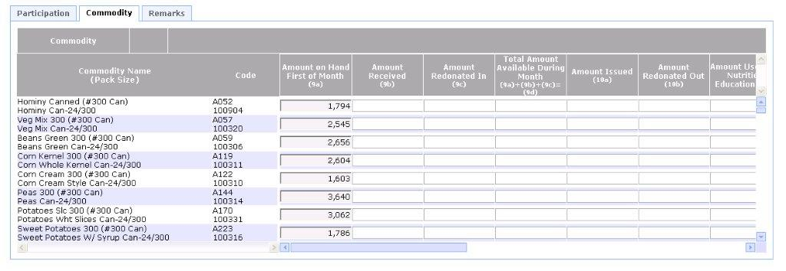
Attachment BB- FNS-152 FPRS Screen Shot

Slide 3
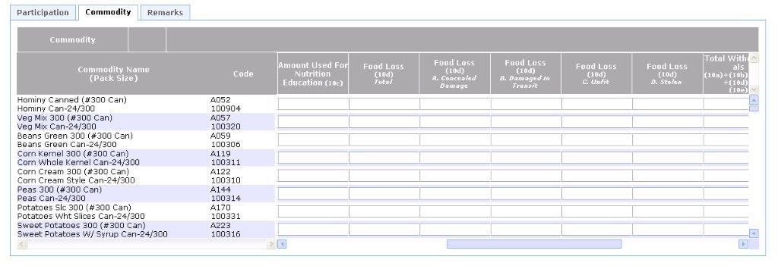
Attachment BB- FNS-152 FPRS Screen Shot

Slide 4
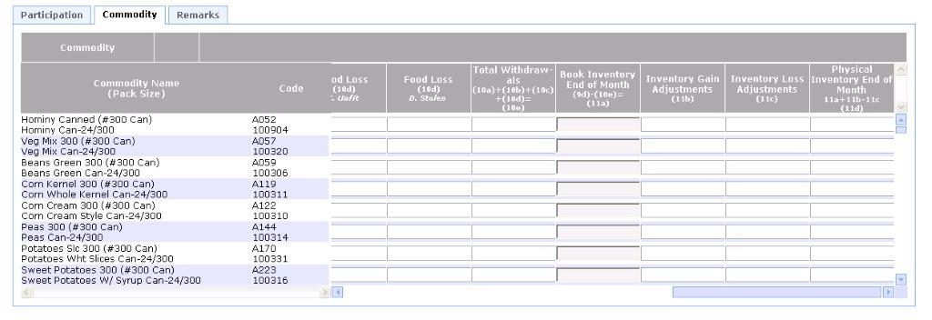
Attachment BB- FNS-152 FPRS Screen Shot

Slide 5

Attachment BB- FNS-152 FPRS Screen Shot

Slide 6
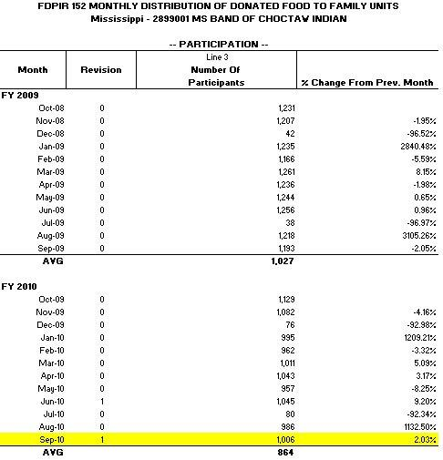
Attachment BB- FNS-152 FPRS Screen Shot

Slide 7
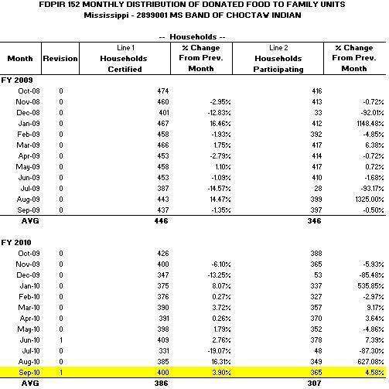
Attachment BB- FNS-152 FPRS Screen Shot

Slide 8
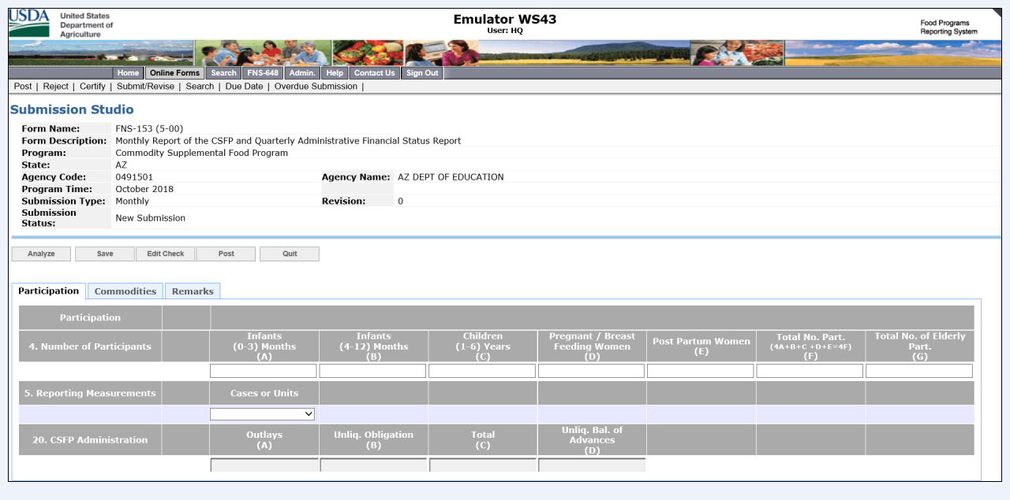
Attachment BB- FNS-153 FPRS Screen Shots

Slide 9
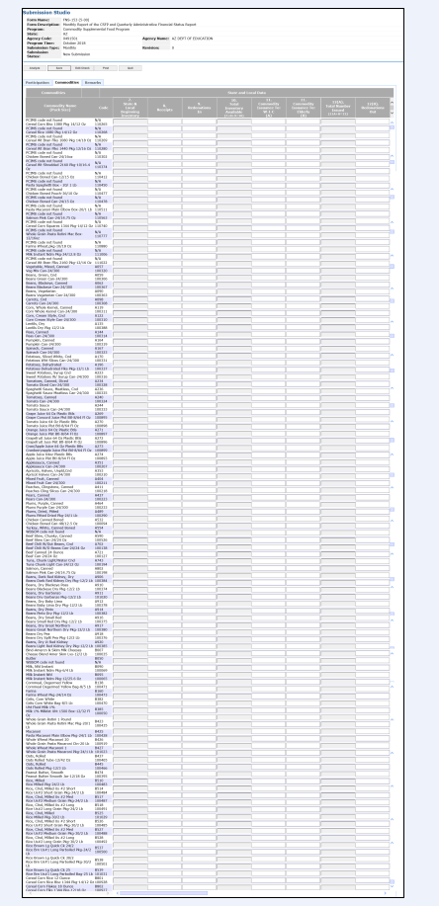
Attachment BB- FNS-153 FPRS Screen Shots

Slide 10
Attachment BB- FNS-668 FPRS Screen Shot

Slide 11
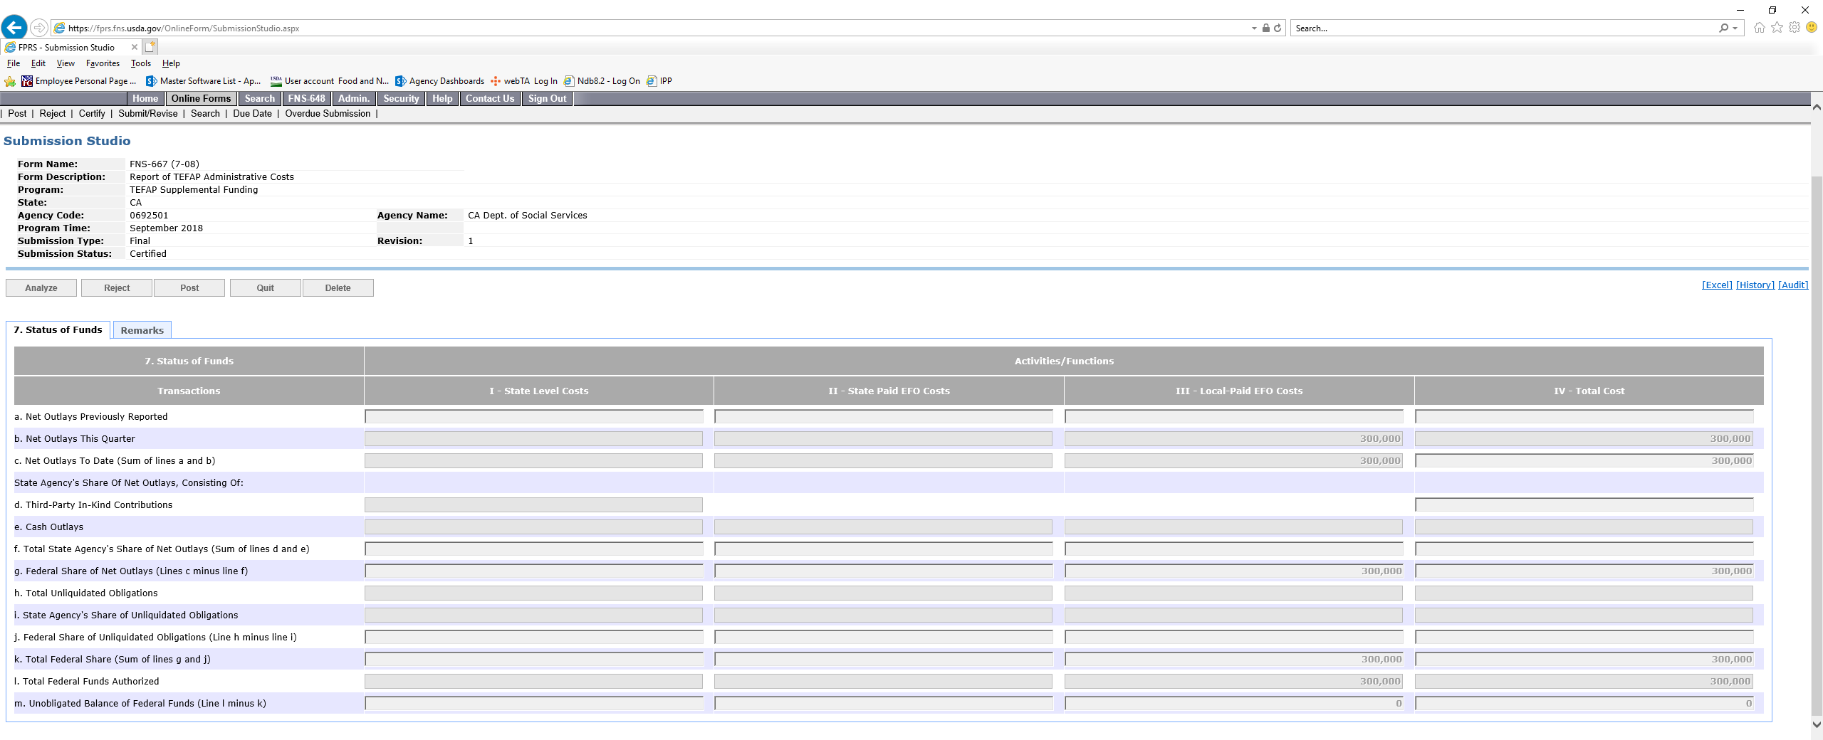
Attachment BB- FNS-668 FPRS Screen Shot

Slide 12
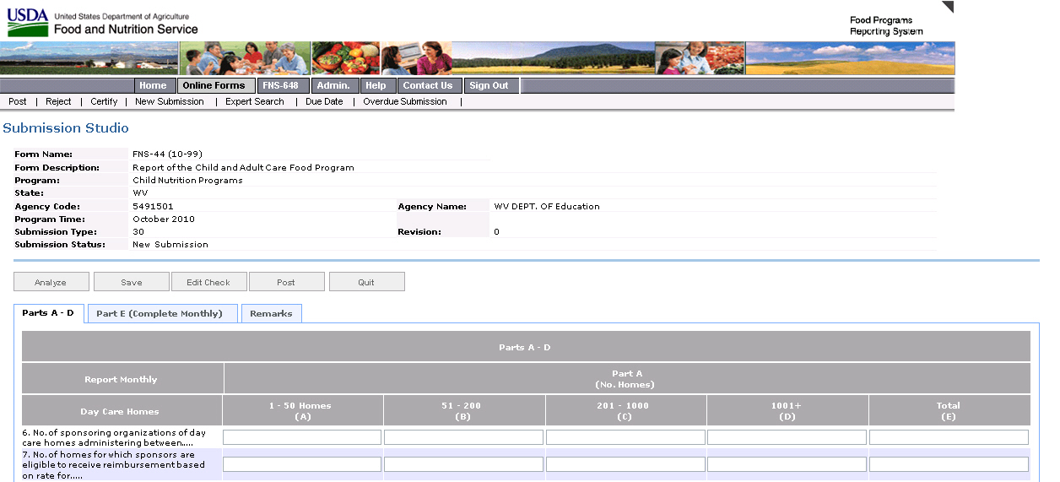
Attachment BB- FNS-44 FPRS Screen Shot

Slide 13
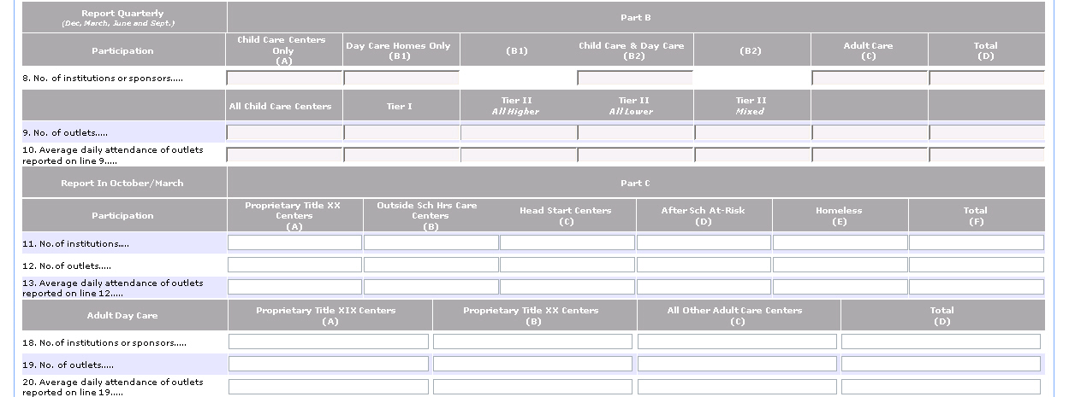
Attachment BB- FNS-44 FPRS Screen Shot

Slide 14
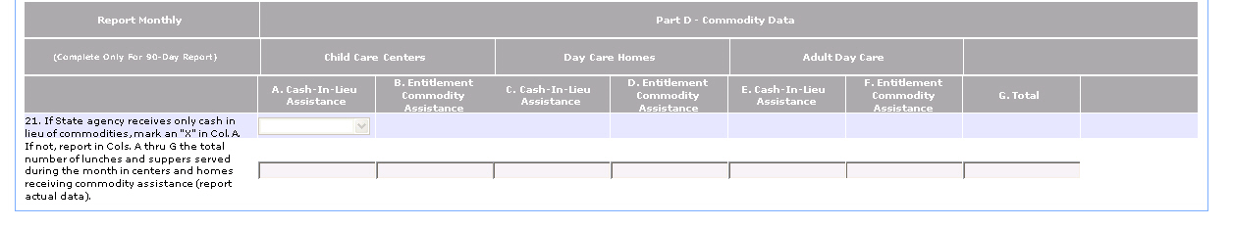
Attachment BB- FNS-44 FPRS Screen Shot

Slide 15
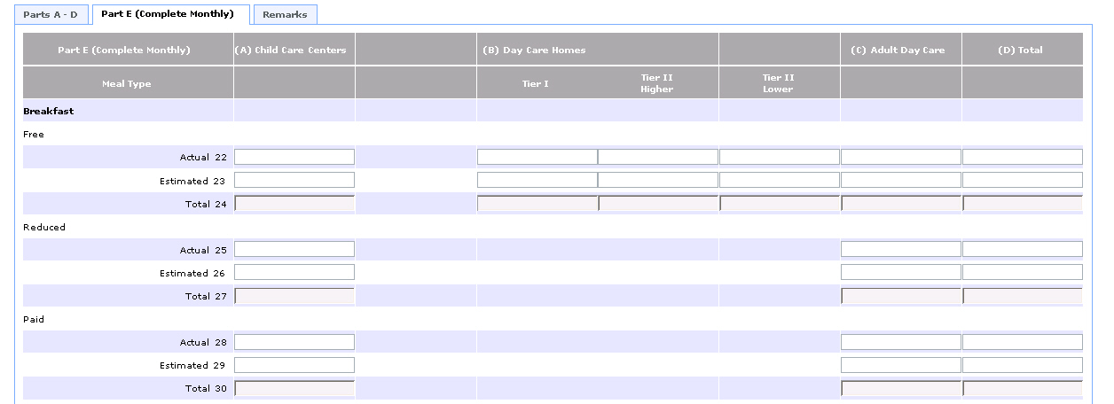
Attachment BB- FNS-44 FPRS Screen Shot

Slide 16
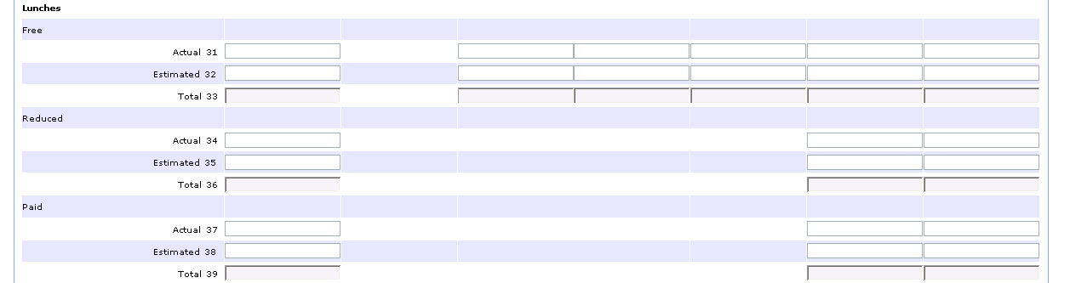
Attachment BB- FNS-44 FPRS Screen Shot

Slide 17
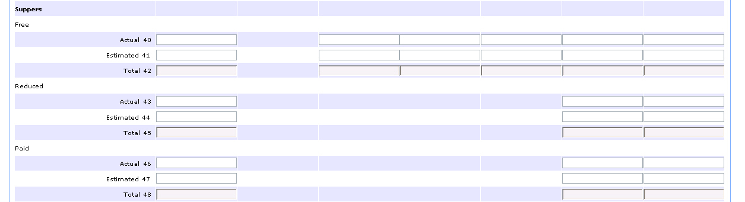
Attachment BB- FNS-44 FPRS Screen Shot

Slide 18
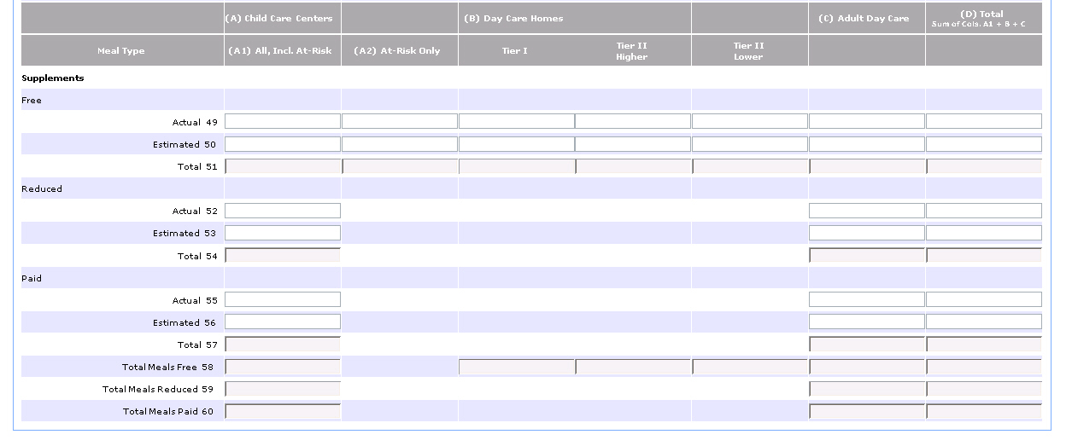
Attachment BB- FNS-44 FPRS Screen Shot

Slide 19
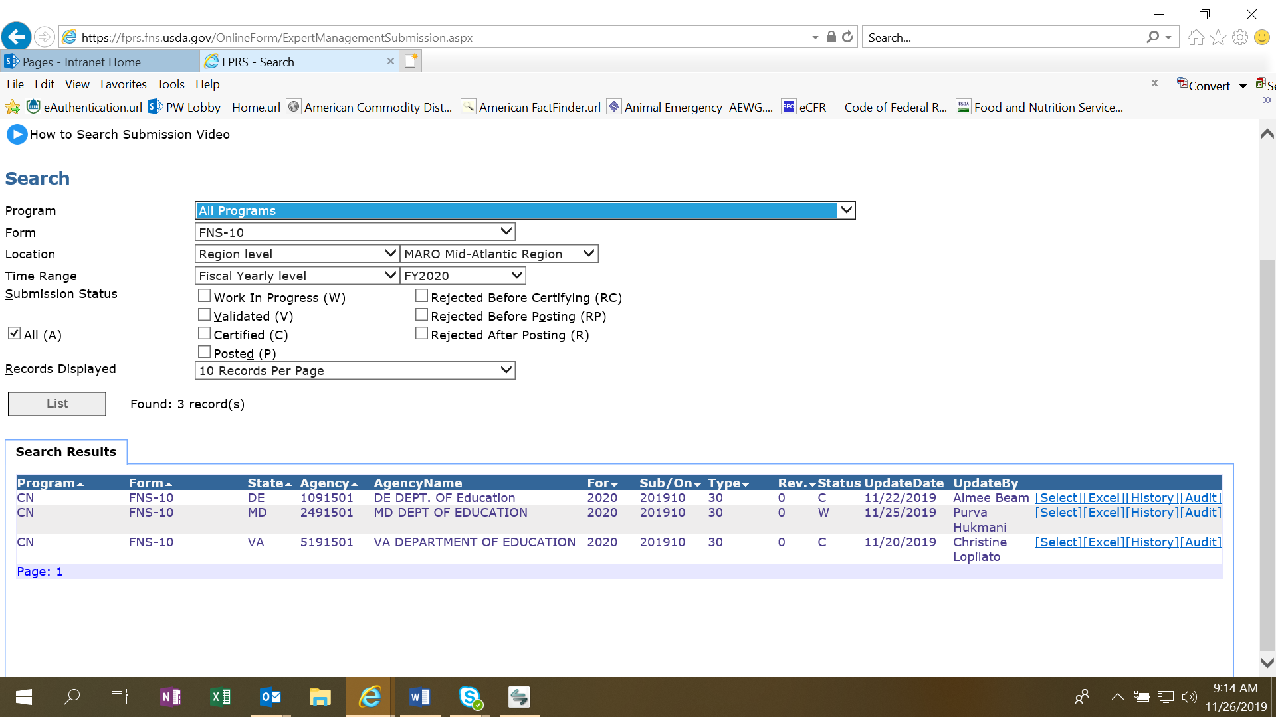
Attachment BB- FNS-10

Slide 20
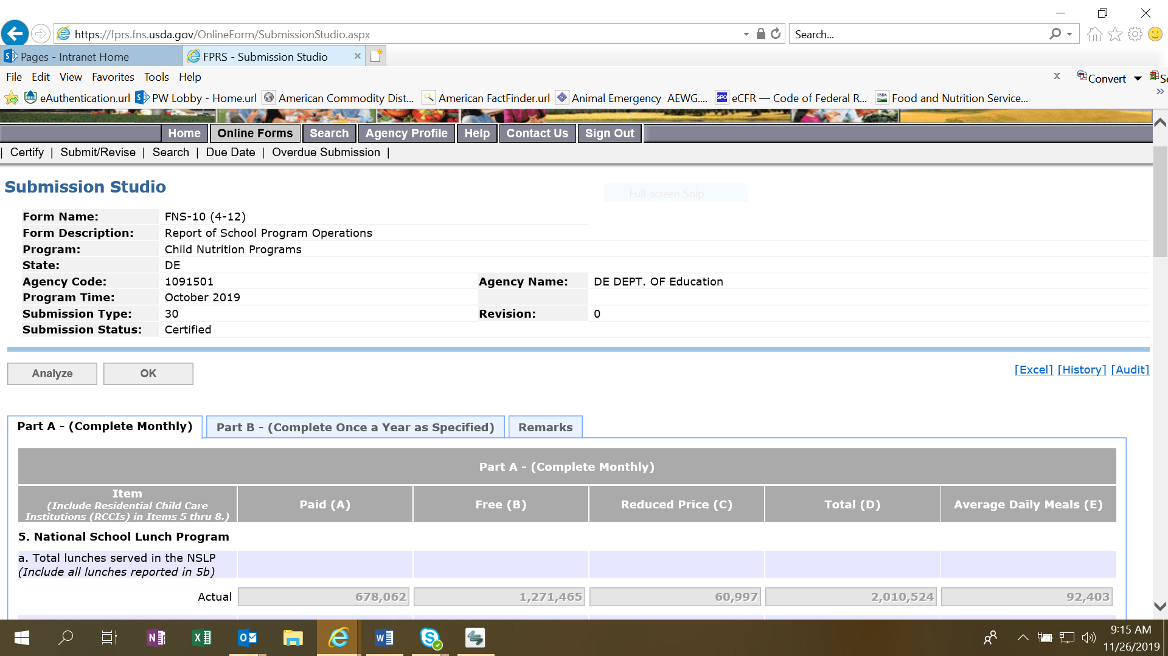
Attachment BB- FNS-10

Slide 21
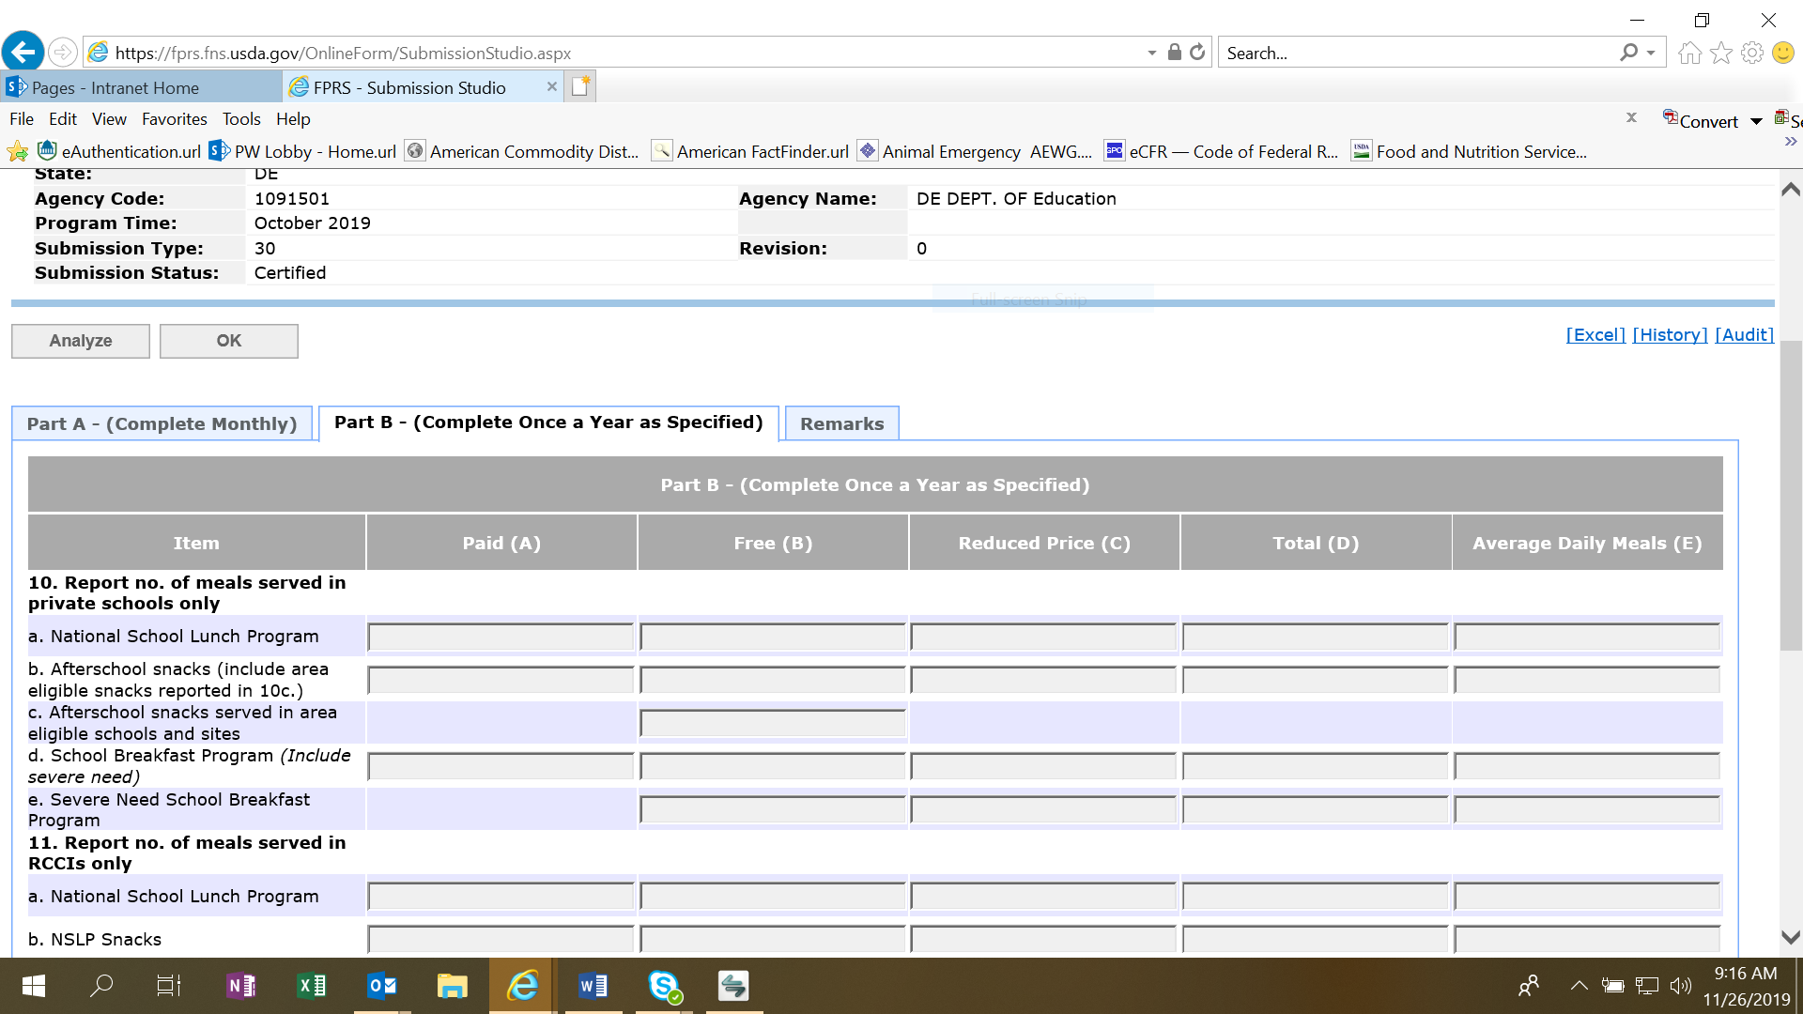
Attachment BB- FNS-10

Slide 22
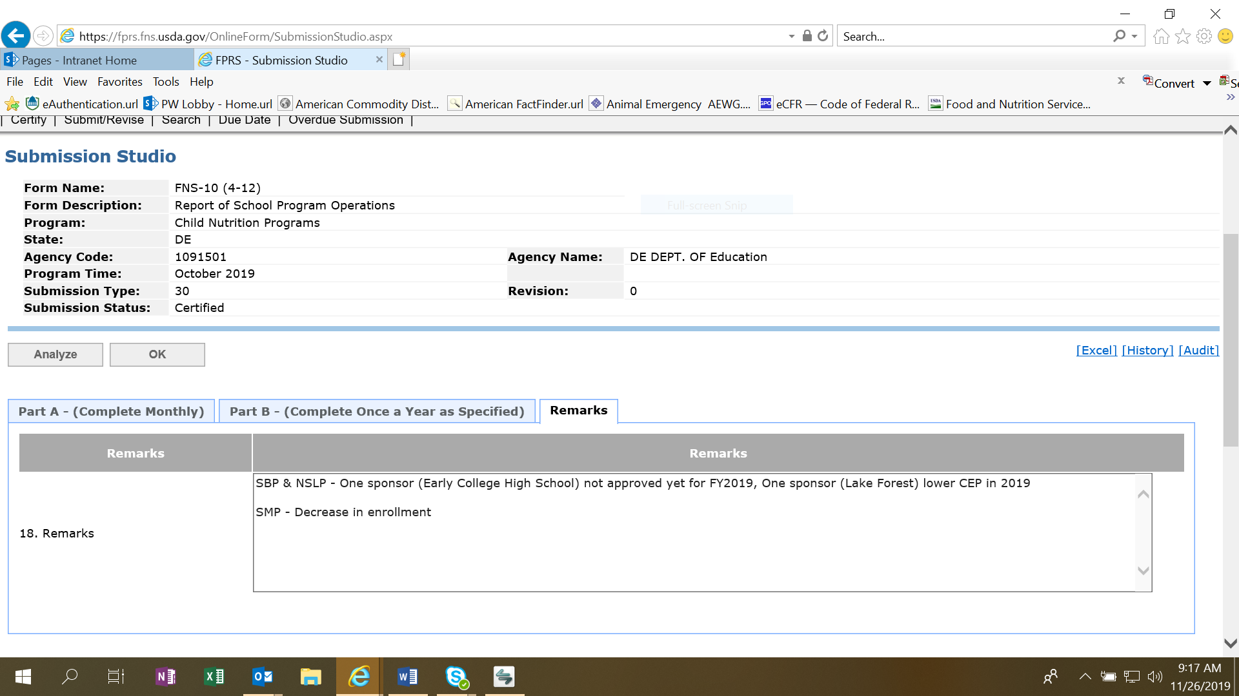
Attachment BB- FNS-10

Slide 23
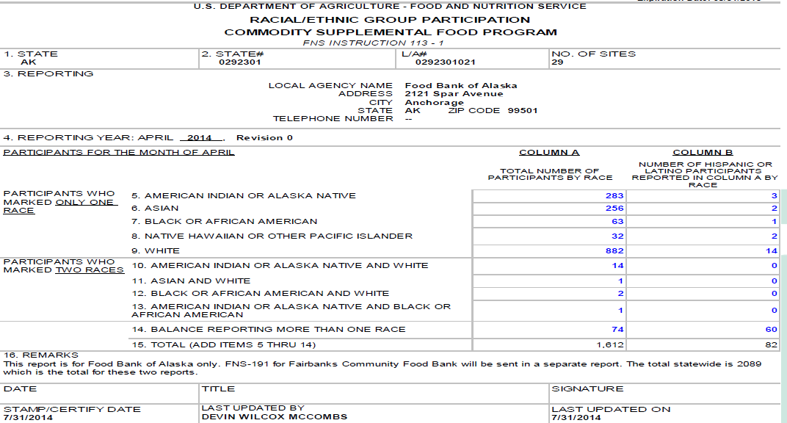
Attachment BB- FNS- 191

Slide 24
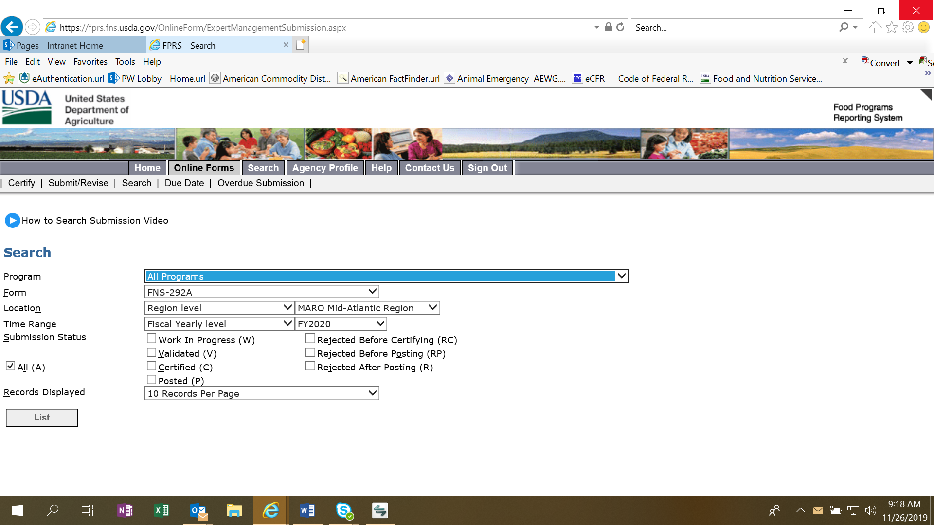
Attachment BB- FNS-292A

Slide 25
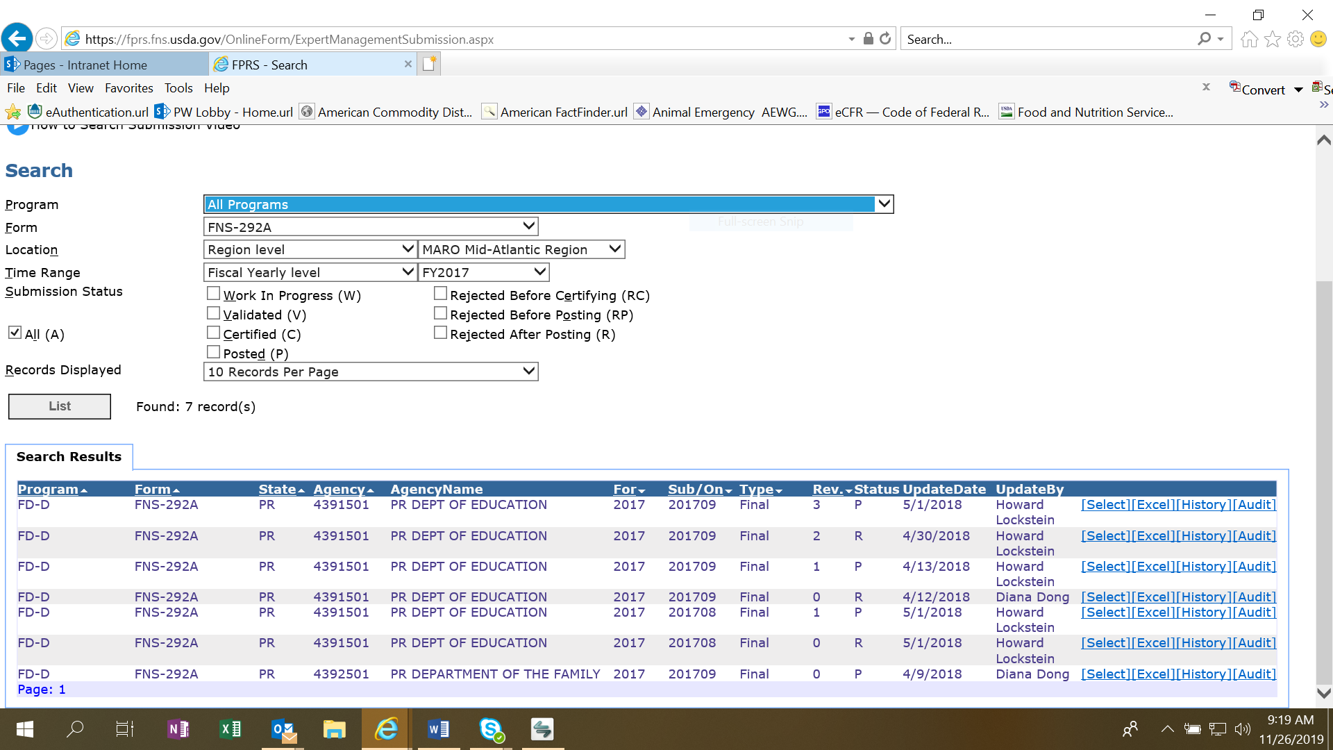
Attachment BB- FNS-292A

Slide 26
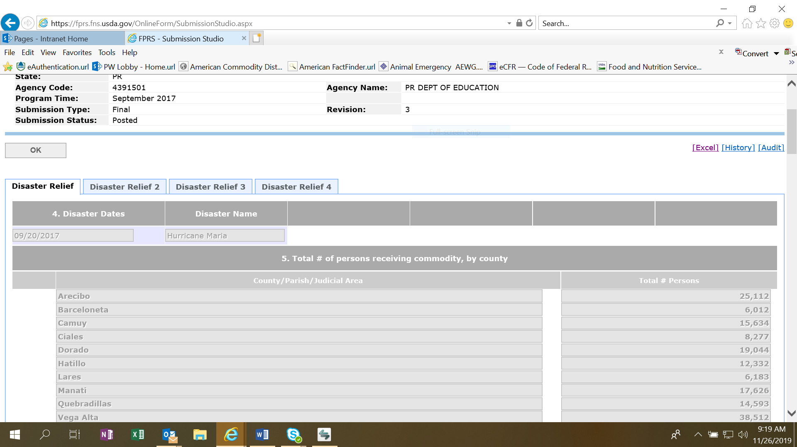
Attachment BB- FNS-292A

Slide 27
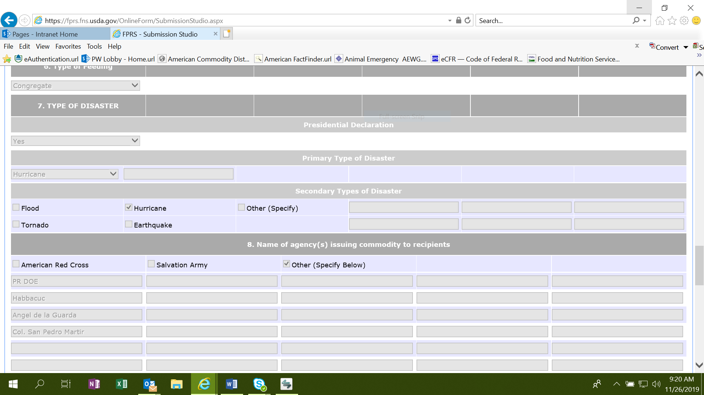
Attachment BB- FNS-292A

Slide 28
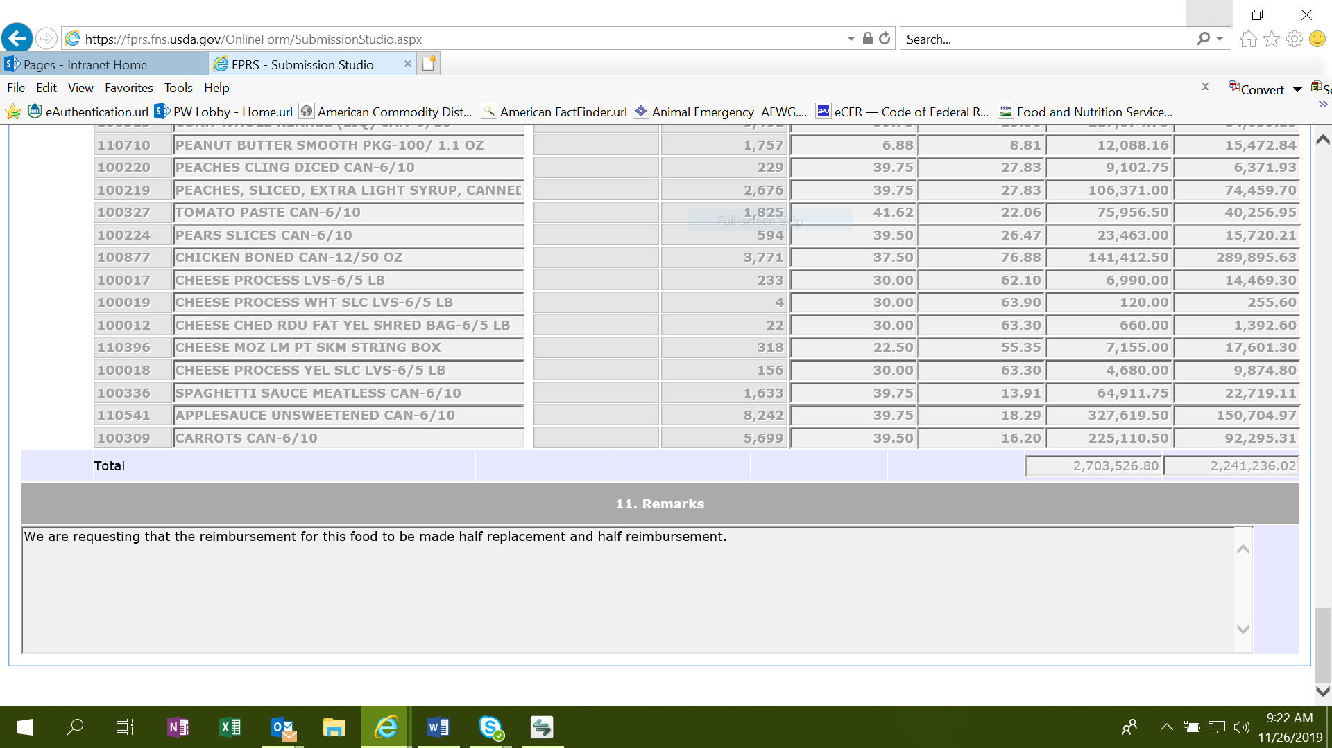
Attachment BB- FNS-292A

