Slide 1
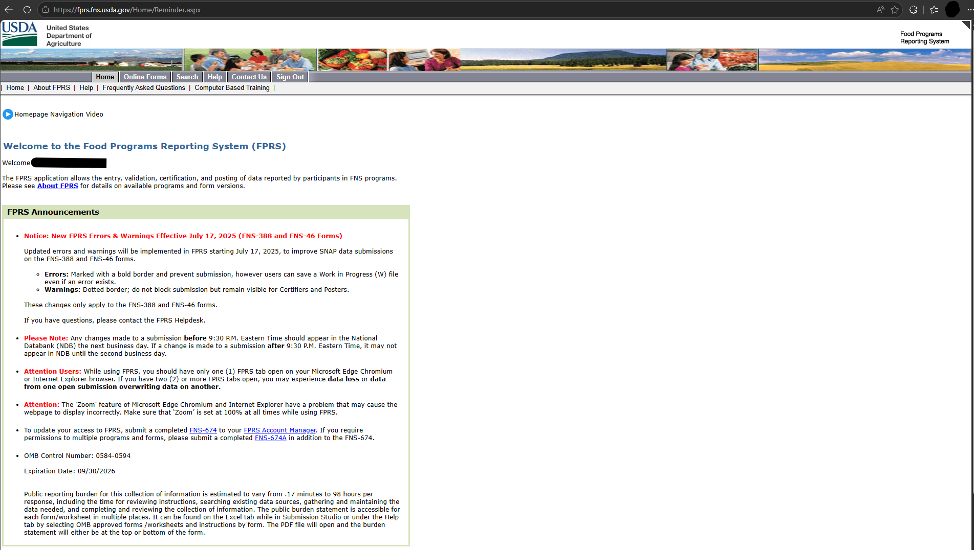

Foods Program Reporting System (FPRS) Homepage

