Slide 1
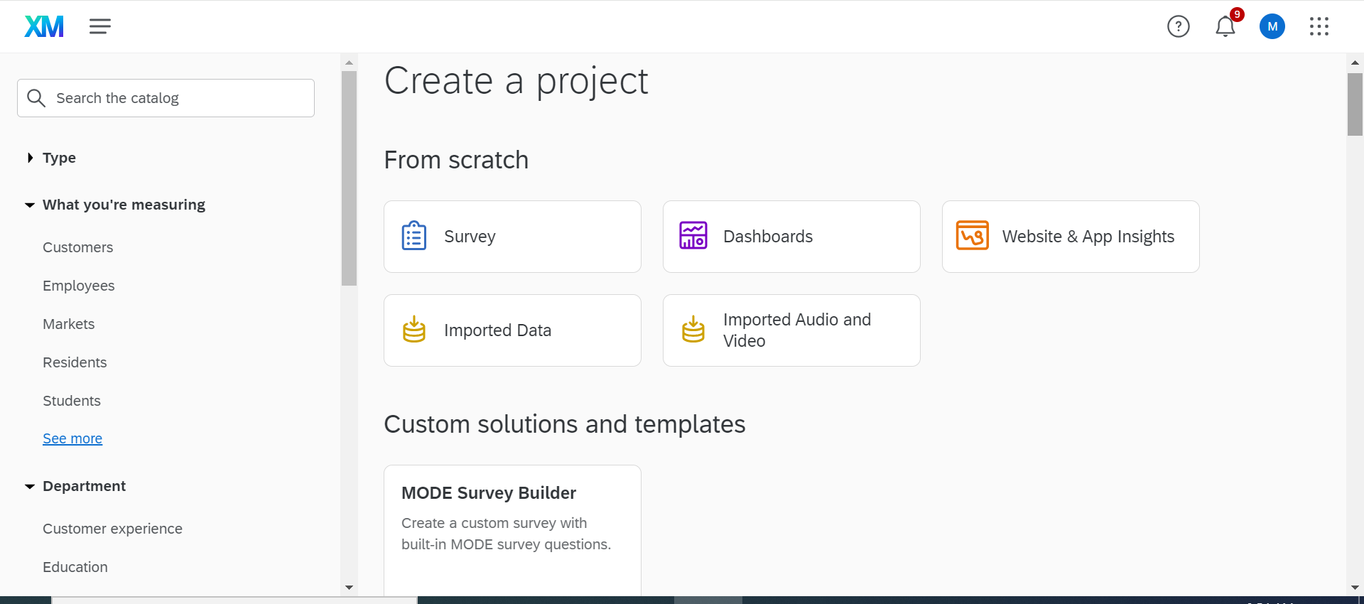
MODE Survey Builder
Notes:
User should create a new project and select “MODE Survey Builder” when given the option for type of project.

Slide 2
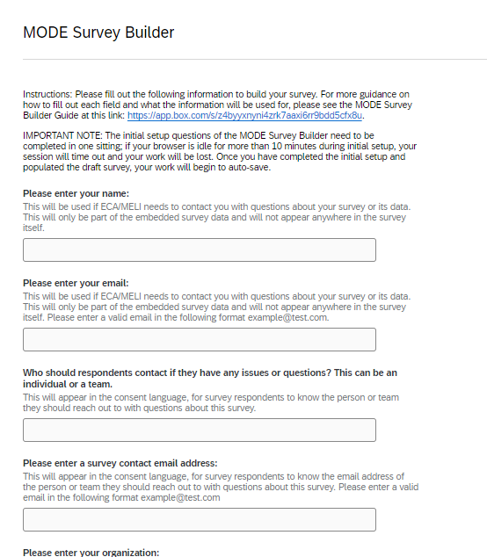
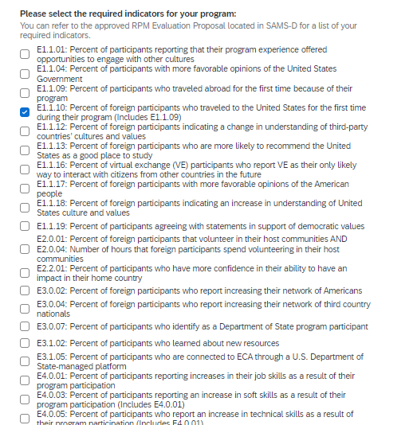
MODE Survey Builder
Notes:
Builder will request a variety of intake information, and then ask users to select the pre-programmed MODE questions relevant to their program.

Slide 3
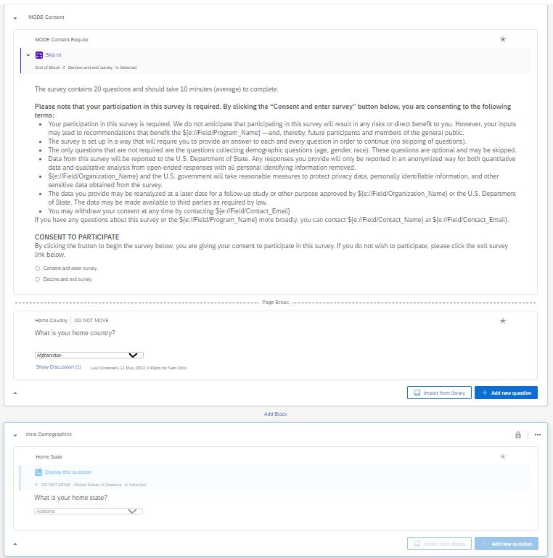
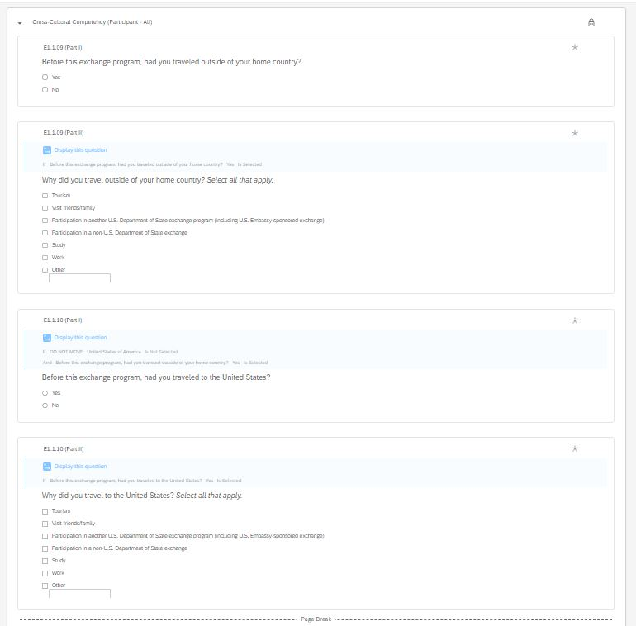
MODE Survey Builder
Notes:
Example of consent screen, demographic questions, and selected MODE questions configured for survey.

Slide 4
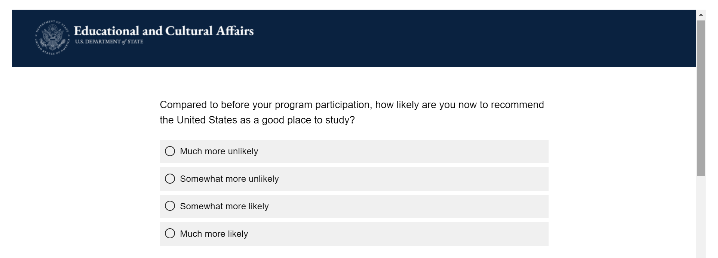
MODE Survey Builder
Notes:
Example of selected MODE question, as displayed for respondent.

Slide 5


MODE Participant Dashboard
Sample data for illustrative presentation purposes only
Notes:
Example of aggregated data in the MODE Master Dashboard.

