Slide 1

I-736 Web Application
U.S. Customs and Border Protection
Program Manager: Brian McGill
Program Manager Assistant: Soraena Giles-Outlaw
May 2018

Slide 2
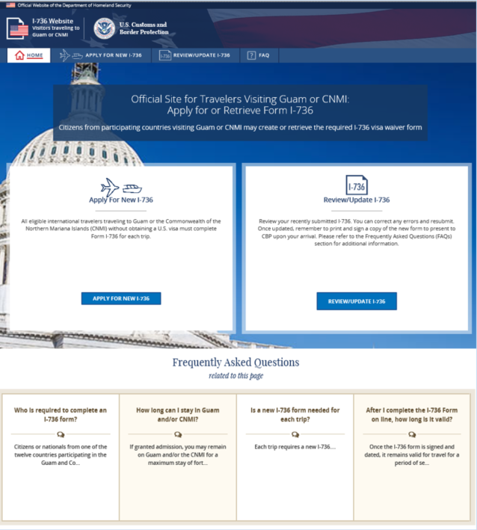

Travelers visiting Guam or Commonwealth of the Northern Marianas Island (CNMI) can use this site to create and retrieve the required I-736 visa waiver form.
I-736 Home Page:
Apply for a new I-736
Review/ Update an existing I-736
Frequently asked Questions are related to this homepage

Slide 3
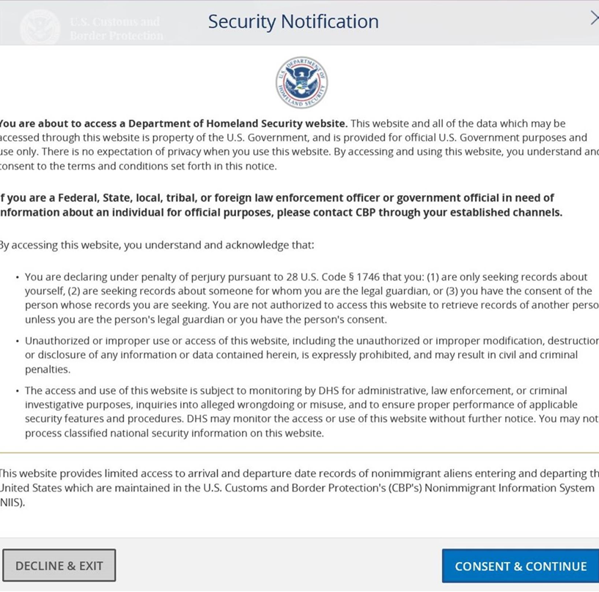
I-736 Security Notice
Travelers must consent before proceeding to the next page.

Slide 4
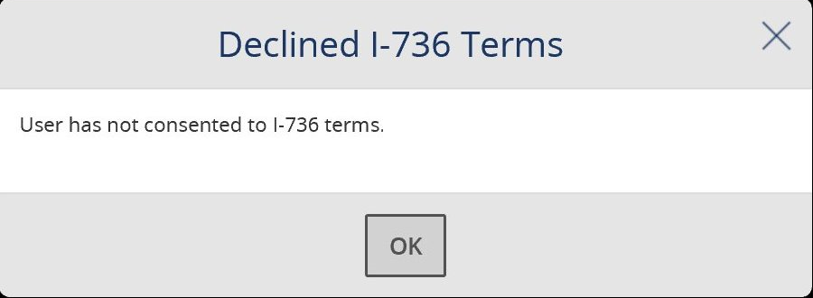
I-736 Security Notice
Decline warning message

Slide 5
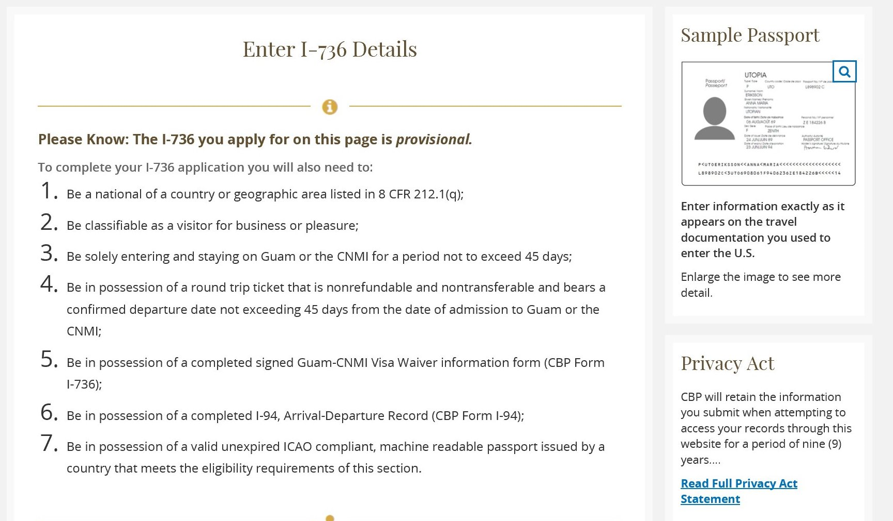
Apply for an I-736
Eligibility information
Sample Passport Details
Privacy Act Notice

Slide 6
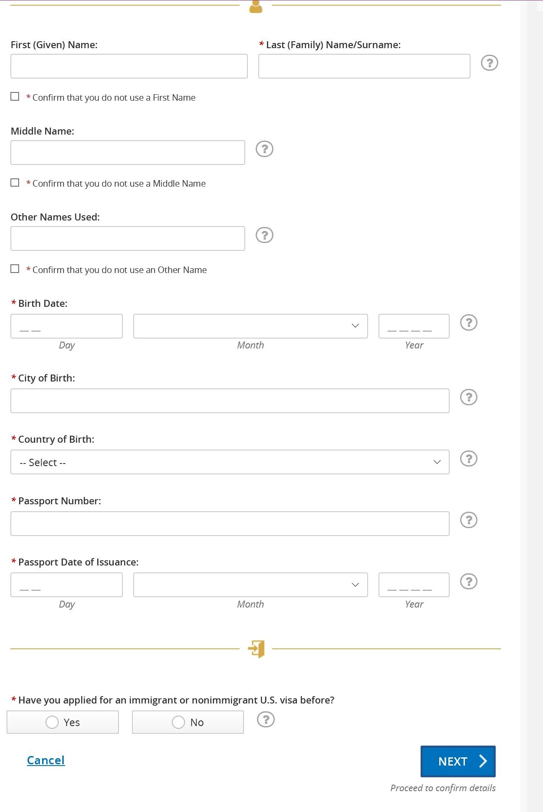
Apply for an I-736
Exact copy of the I-736 paper form
Question mark hovers for key questions

Slide 7
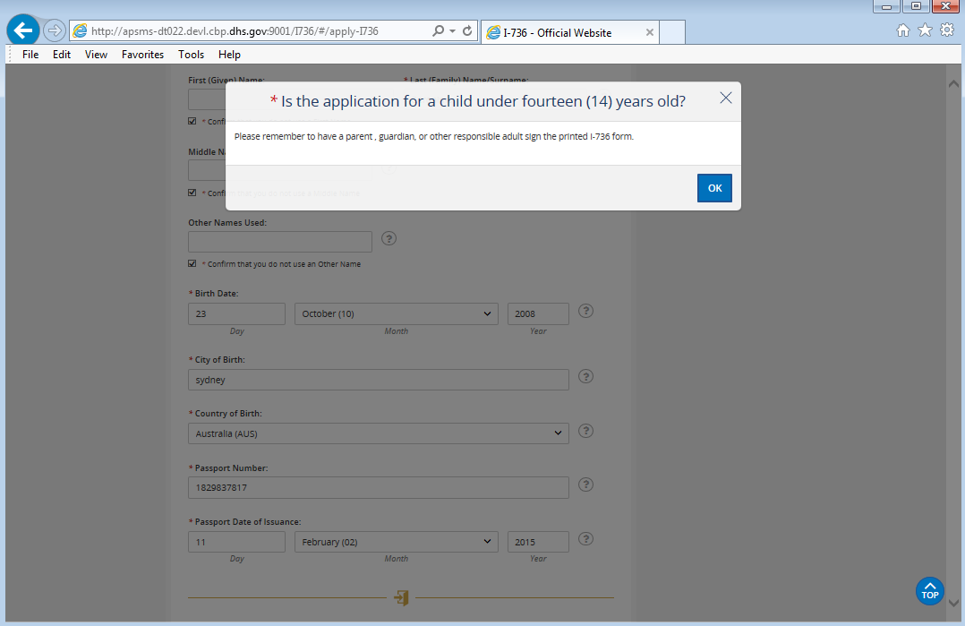
Apply for an I-736
If an applicant is under 14 years old, a popup message will appear before continuing.

Slide 8
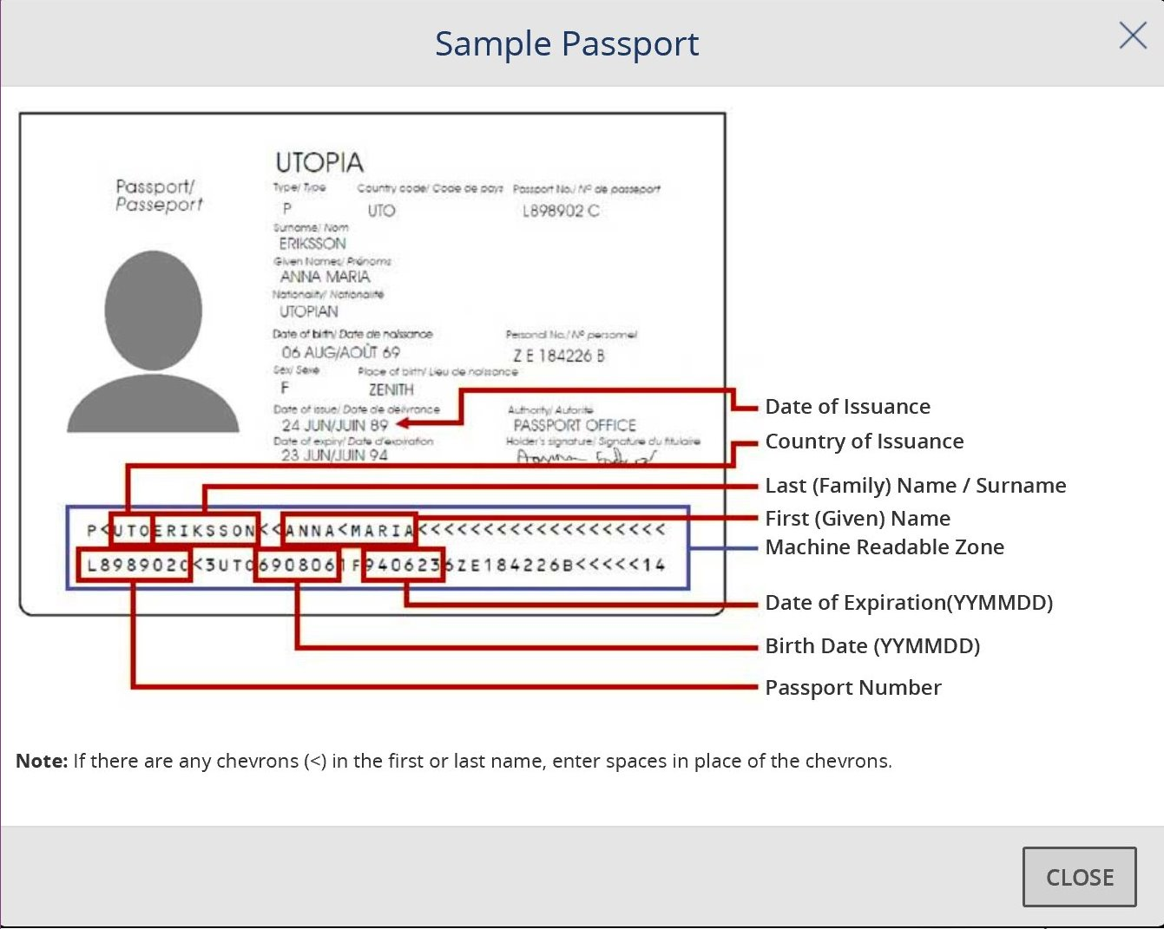
Sample Passport
Passport Details

Slide 9
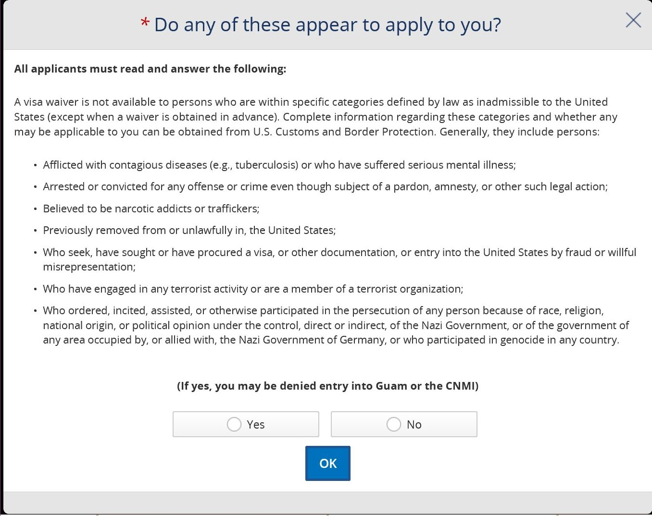
Apply for an I-736
Final declaration

Slide 10
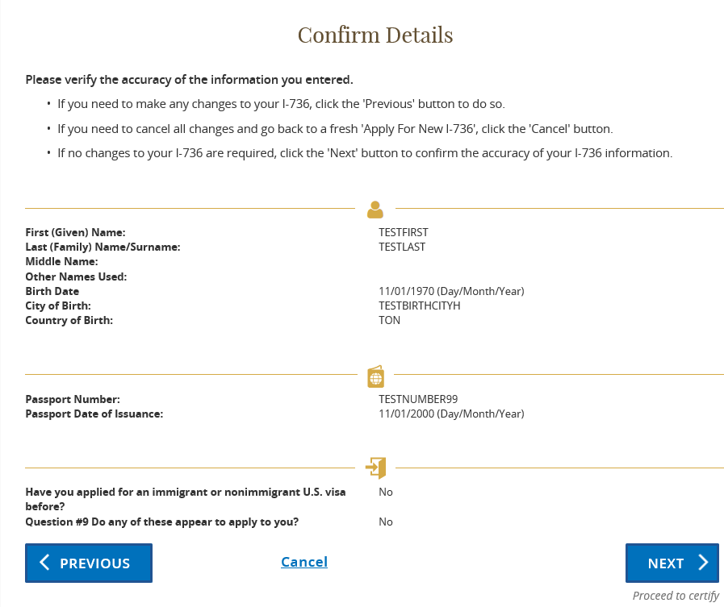
Confirmation Page
Review and certify the details
(Cancel) button will return travelers to the homepage

Slide 11
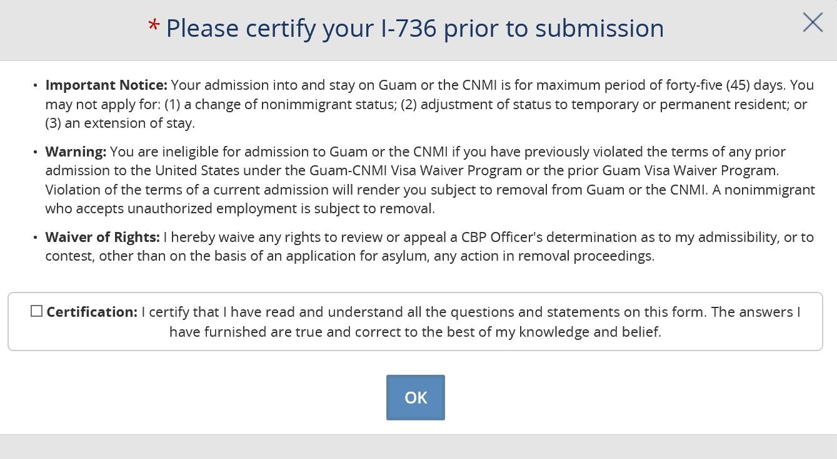
Certification Page Notice
Certification Checkbox
(OK) button not clickable until checkbox is checked

Slide 12
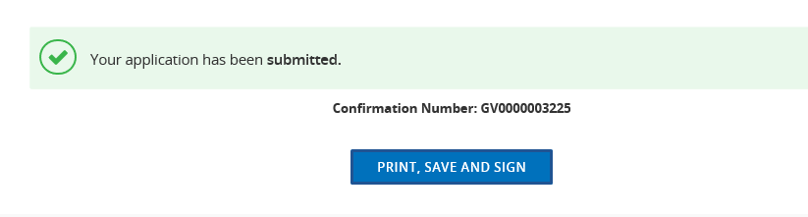
Apply for an I-736
Confirmation Number is provided
(Print, Save and Sign) button will show the completed I-736 form as a PDF

Slide 13
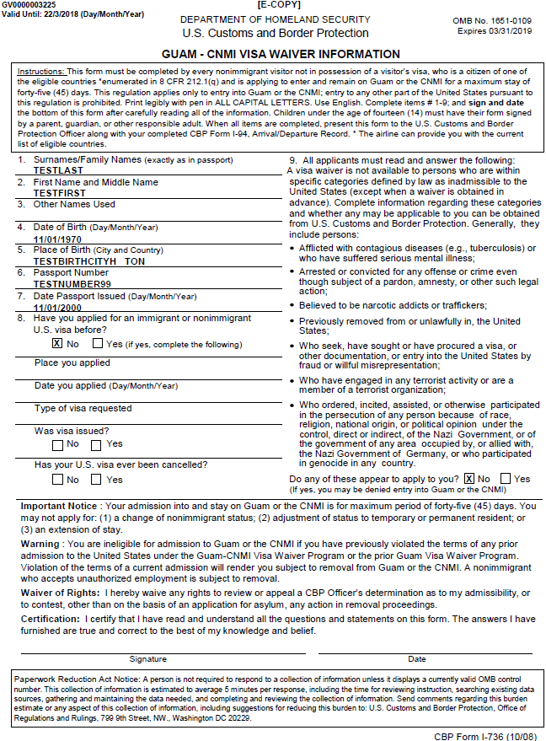
PDF Document
Data from I- 736 application included on the PDF document
PDF format allow travelers to save and/or print
[E-COPY] Mark to differentiate form the I-736 paper form
The top left, shows the expiration date, 7 days from creation date
Travelers certify the form by signing and dating

Slide 14
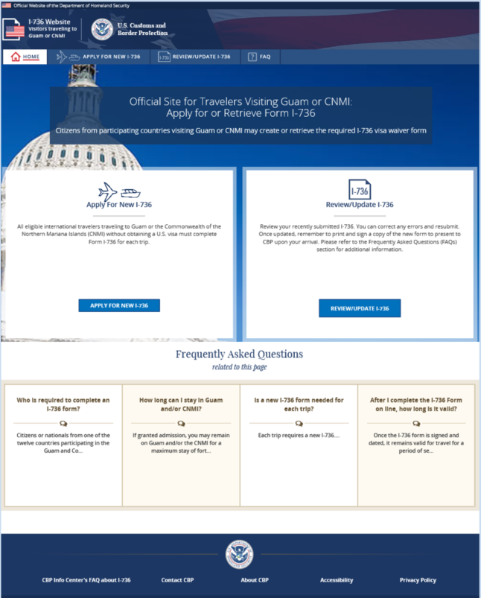
Review/ Update I-736 on the Homepage

Slide 15
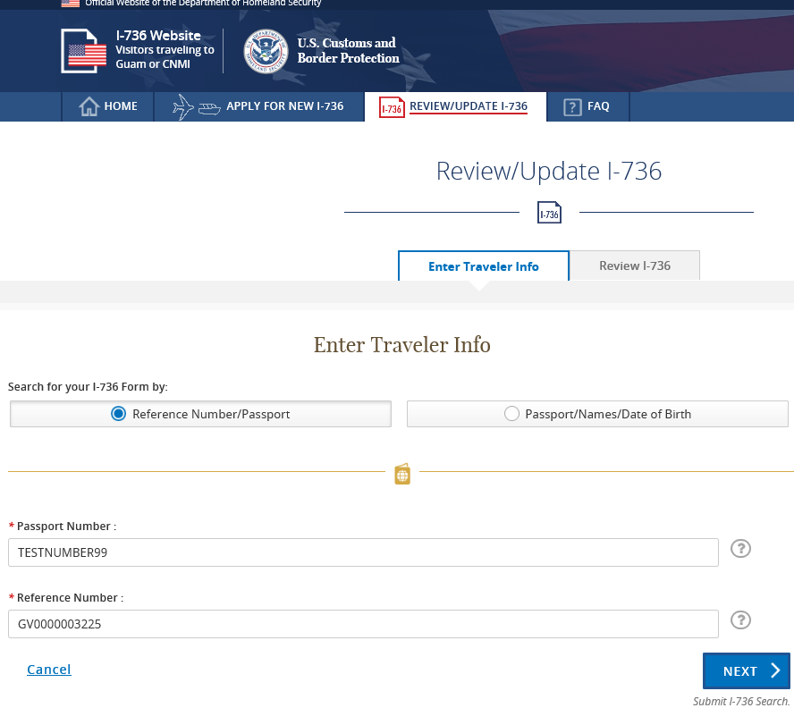
Review/Update Existing I-736 Form
Search by Reference Number/ Passport
OR
Search by Passport/Names/Date of Birth
(Cancel) button will return travelers back to homepage

Slide 16
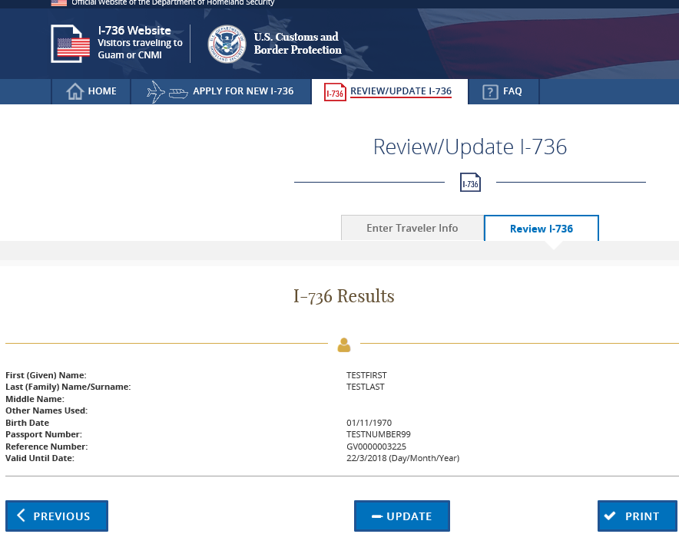
Review/Update Existing I-736 Form
Verification Page
(Previous) button will return travelers back to homepage
(Update) button will take travelers to the existing application
(Print) button prints PDF form

Slide 17
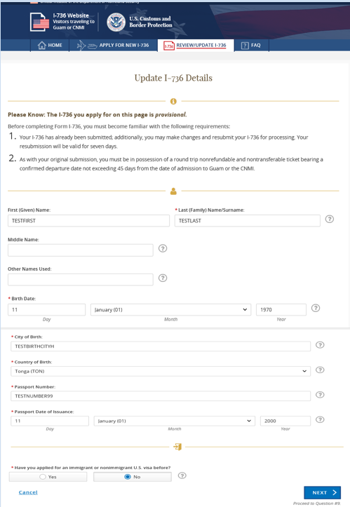
Update I-736 Form
Traveler existing form

Slide 18
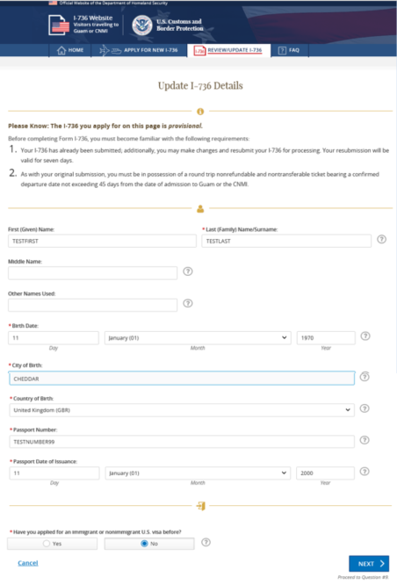
Review/Update I-736 (Update)
On this page Travelers can make changes
Traveler changed both “Country of Birth” and “City of Birth”

Slide 19
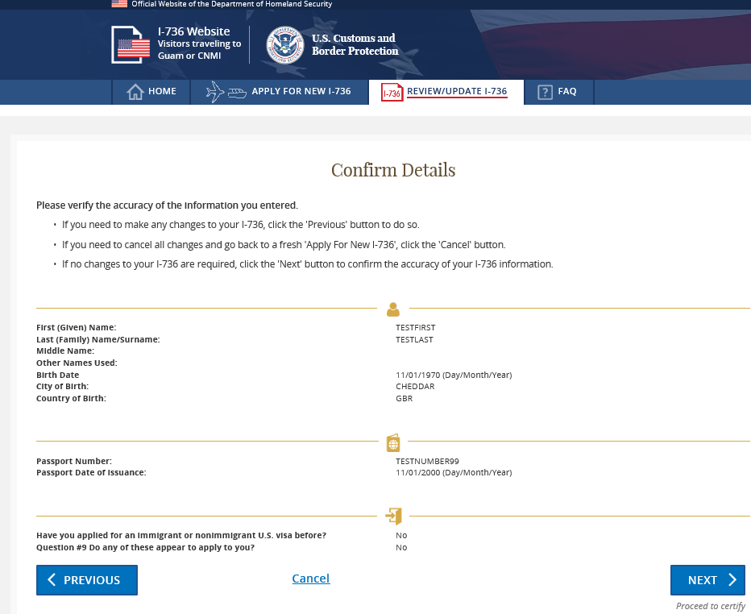
Confirmation Page
Travelers verify then certified the changes
(Cancel) button will return travelers to the homepage

Slide 20
Confirmation Number Page
Confirmation Number is still the same
(Print, Save and Sign) button will show I-736 form as a PDF

Slide 21
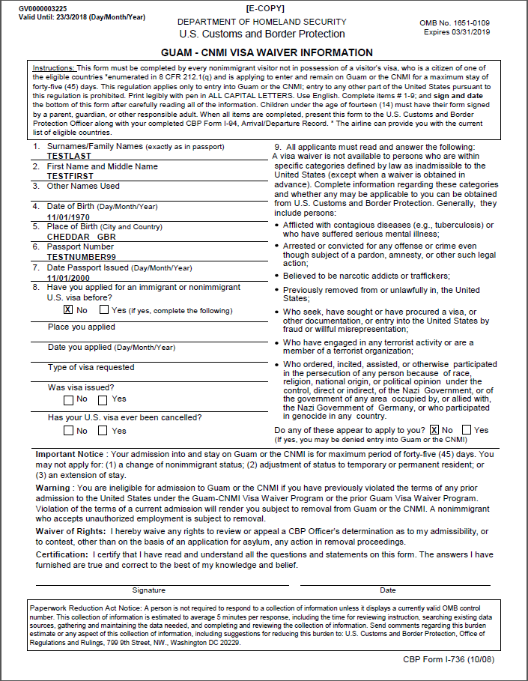
Updated PDF Document
Updated Data from I- 736 application included on the PDF document
PDF format allow travelers to save and/or print
[E-COPY] Mark to differentiate form the I-736 paper form
The top left, will show the new expiration date, 7 days from the last saved date
Travelers certify the form by signing and dating

Slide 22
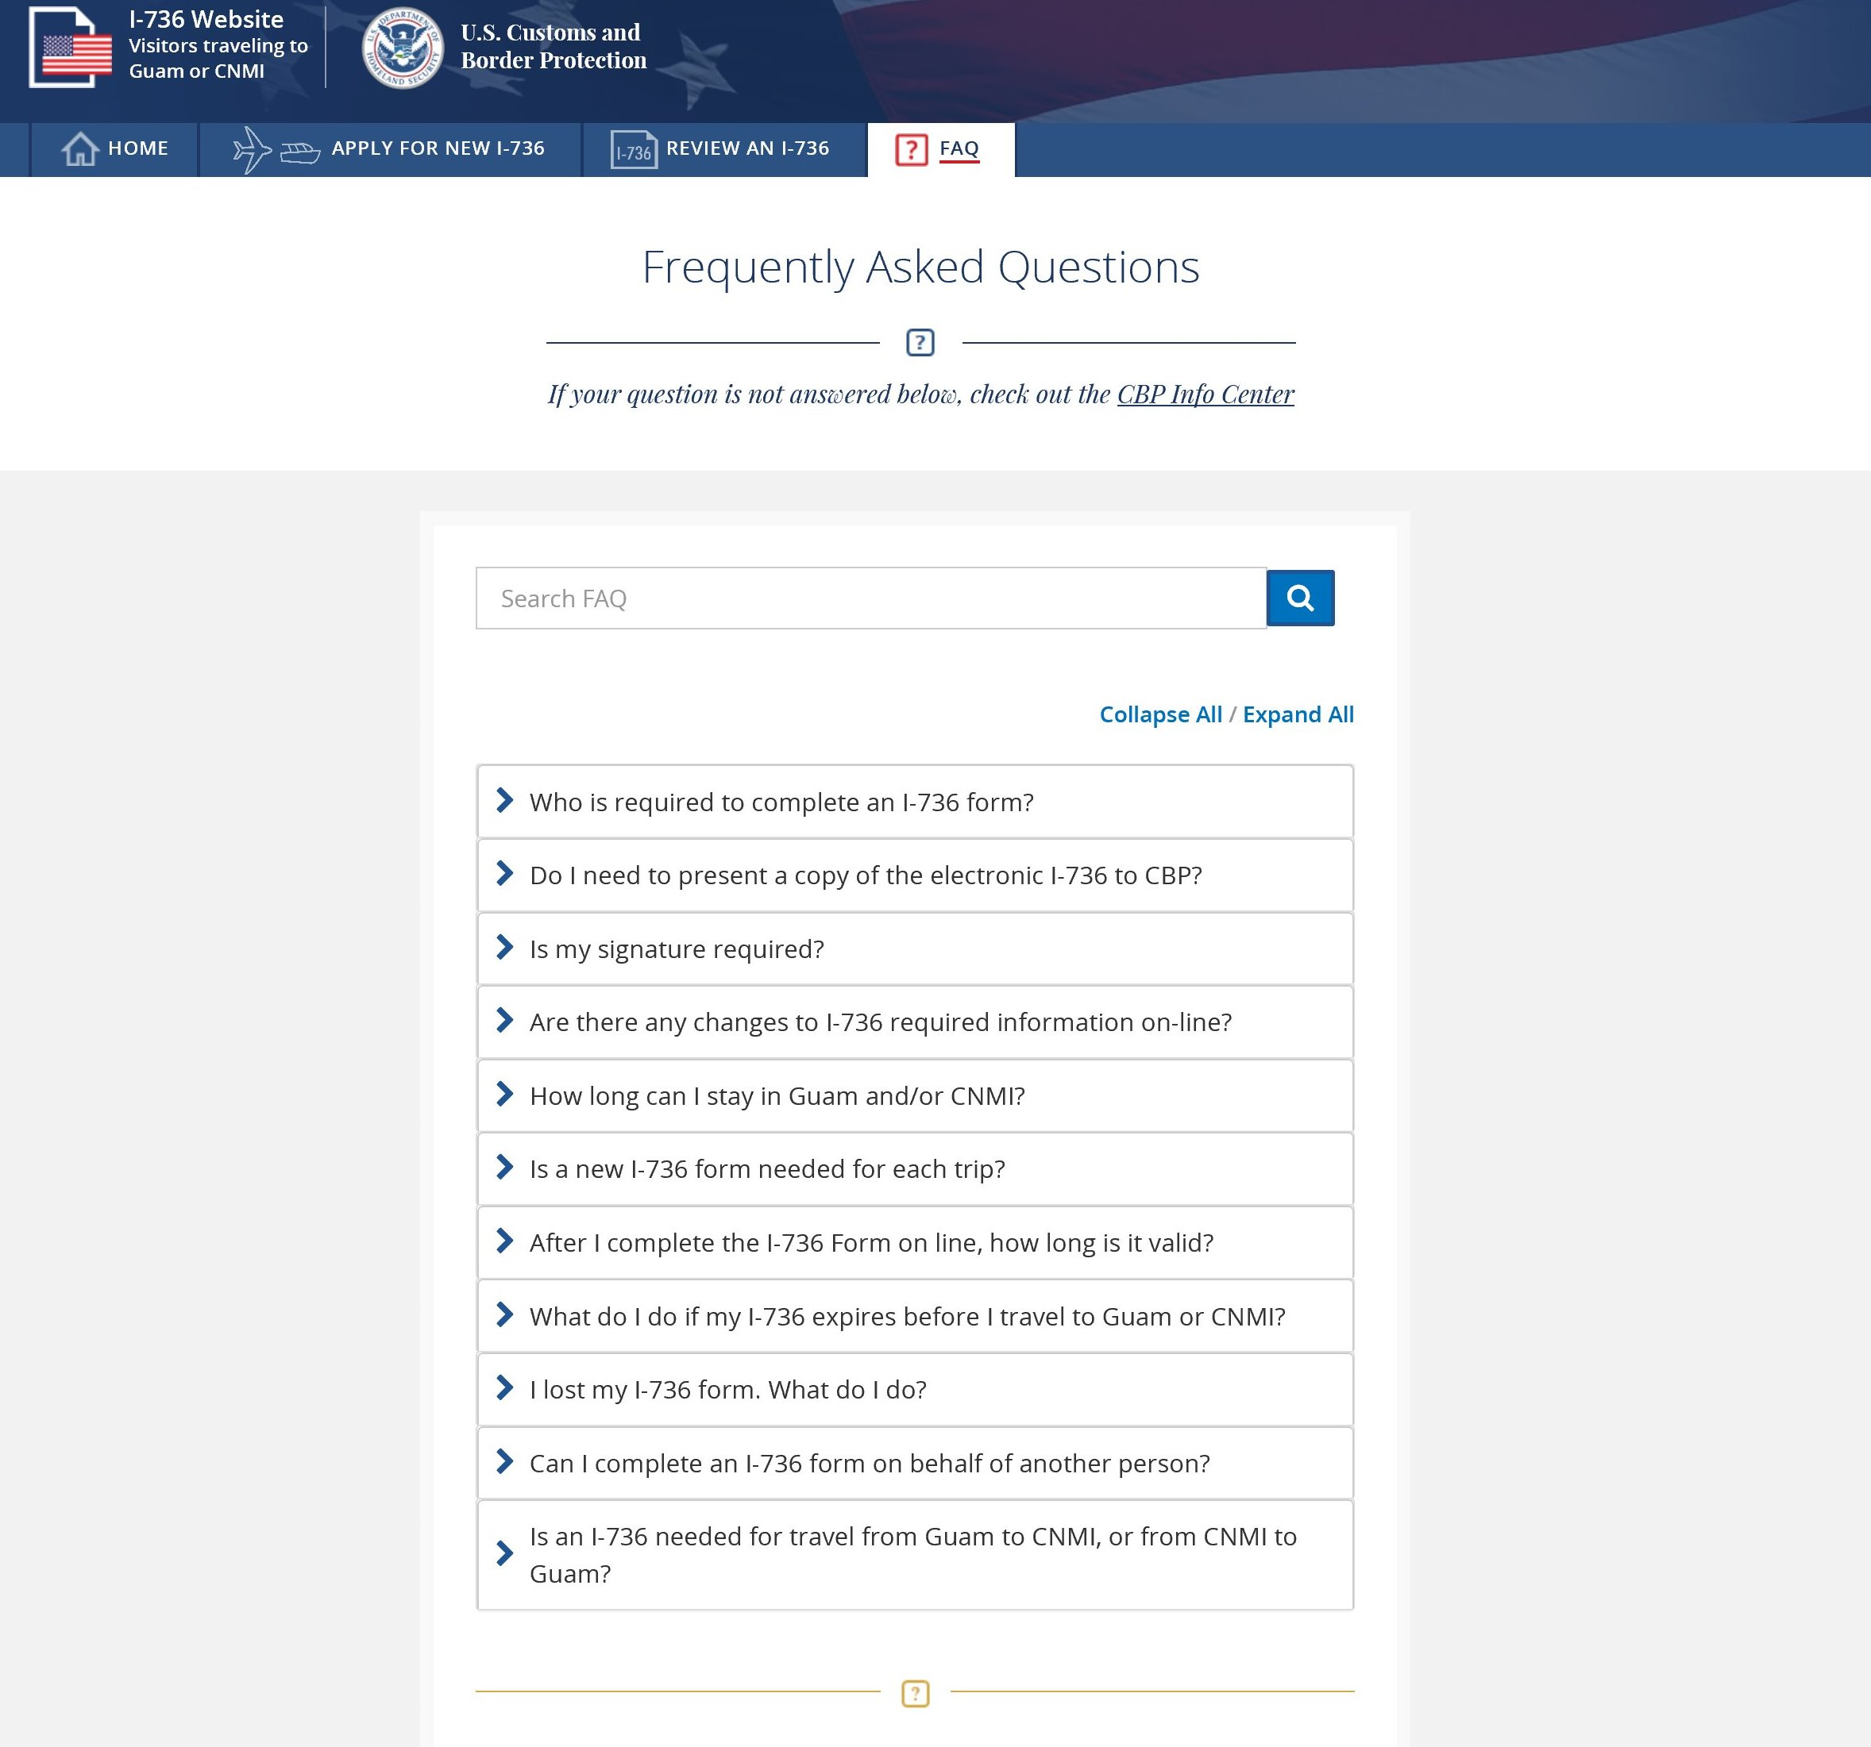
I-736 Frequently Asked Questions
Linked from the menu bar
Questions and Answers
Search feature

Slide 23
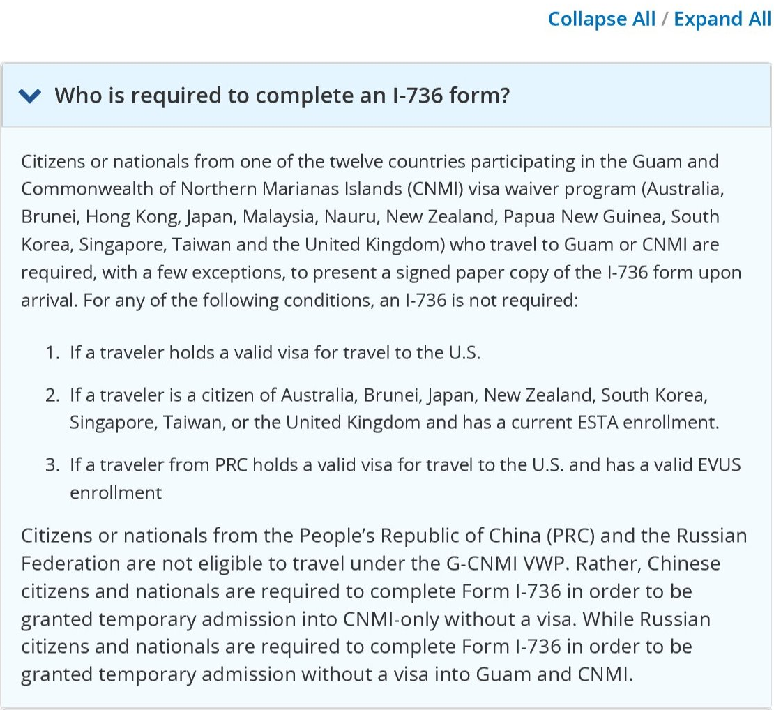
I-736 Frequently Asked Questions (example expanded):
Questions can be expanded/collapsed

Slide 24
Last updated by: Soraena Giles-Outlaw May 2018

