Slide 1
OMB Control No. 0693-0032
Expiration Date – December 31, 2024
A Federal agency may not conduct or sponsor, and a person is not required to respond to, nor shall a person be subject to a penalty for failure to comply with an information collection subject to the requirements of the Paperwork Reduction Act of 1995 unless the information collection has a currently valid OMB Control Number. The approved OMB Control Number for this information collection is 0693-0032. Without this approval, we could not conduct this survey/information collection. Public reporting for this information collection is estimated to be approximately 22 hours for the Quarterly Review, 6 hours for the Semi-Annual Review, 30 hours for the Annual Review and 80 hours for the Panel Review, including the time for reviewing instructions, searching existing data sources, gathering and maintaining the data needed, and completing and reviewing the information collection. All responses to this information collection are required to obtain benefits. Send comments regarding this burden estimate or any other aspect of this information collection, including suggestions for reducing this burden to NIST MEP, attention mepinfo@nist.gov

Slide 2
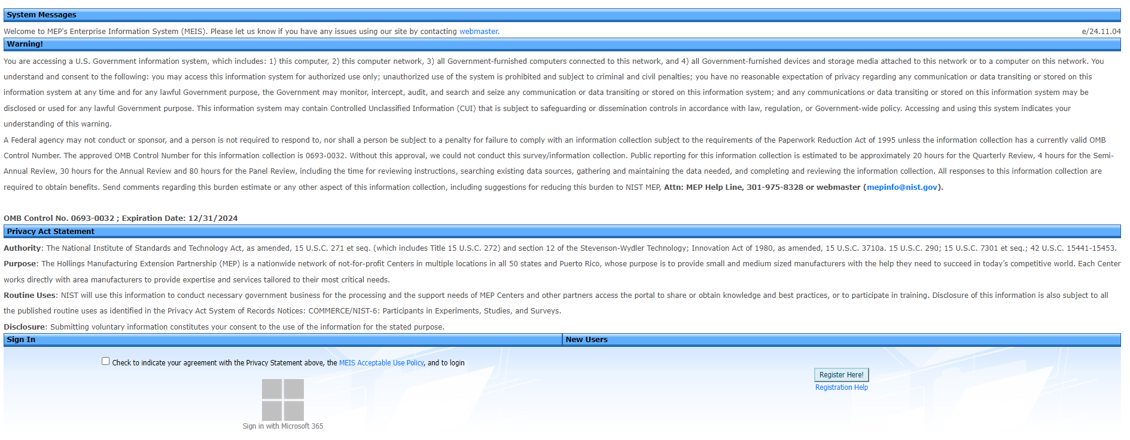
MEIS Registration Page
Notes:
Screenshot of MEP’s Enterprise Information System (MEIS) registration page, including OMB Control No. 0693-0032 with expiration date of 12/31/2024.

Slide 3
Why is Reporting Necessary?
Used for CAR performance management, annual/panel reviews and reporting the program’s performance to Congress
Generate standard sets of reports
Cooperative Agreement Requirement
Notes:
Reporting is necessary
Determine CAR performance management, annual/panel reviews and reporting the program’s performance to Congress
Generate standard sets of reports
Cooperative Agreement Requirement

Slide 4
NIST MEP Reporting, Survey Confirmation and Survey process is a continuous cycle.
Reporting
Survey Confirmation
Survey
Outlier Verification
Data Analysis Knowledge Sharing
Notes:
NIST MEP Reporting, Survey and Data Analysis Process is a continual cycle starting with:
Reporting which is the submission of Client Information Files or (CIFs) and Project Information Files or (PIFs) into the MEIS system either manually, via CSV file submission or Salesforce. Reporting also includes submitting the quarterly required elements (e.g., staff, locations, contacts, partners,) etc. at anytime.
Survey Confirmation occurs one month prior to the Survey being conducted, When the Survey Confirmation period opens Centers will have the ability to review the clients that will be surveyed in the next month. This will be your opportunity to:
1. Change the Estimated Impact Span (EIS)
2. Change CAR Key Personnel
3. Change Client Contact Information
4. Check to confirm projects are correctly assigned to client
During the Survey period Clients will be surveyed by a third-party contractor.
After survey results are returned from the third-party contactor, the data is analyzed to identify very large impacts, this is known as Outlier Verification and Centers will be notified to confirm any outliers within MEIS.
Once all data has been validated, both NIST MEP and centers can perform Data Analysis and Knowledge Sharing. Center IMPACT Metrics are published approximately two weeks after the MEP Client Survey results have been imported into MEIS.

Slide 5
Reporting Schedule
 | Quarter 1 | Quarter 2 | Quarter 3 | Quarter 4
Period | January 1 – March 31 | April 1 – June 30 | July 1 – September 30 | October 1 – December 31
Deadline | January 31 | April 30 | July 31 | October 31
BUT… You can report anytime!
Notes:
Instead of thinking of reporting as being open for one month each quarter when everything is due, centers need to think of reporting as being a reporting period that is a 3-month span. For example: Reporting will be open from April 1 through April 30, however you can report at any time and as many times between April 1 through June 30 for any reporting element except for Progress Plans and Progress Data.
NIST MEP is expecting to see that all reporting elements are reported on at least once during the reporting month but updated throughout the quarter as necessary. But there are nuances….
Progress Plans are due no later than 30 days after the end of the time period covered in the report. The time period and date are determined by Grants and are detailed in your Special Award Conditions (SACs) in your cooperative agreement. It is up to you to know when it is due; and the date may or may not fall nicely into the traditional “reporting month”.
Centers are expected to submit at least one Success Story submitted per quarter; however, centers can submit more than one to receive extra credit on their IMPACT Metrics.
Progress Data reports are all tied directly to a year/quarter and can only be submitted once per quarter.

Slide 6
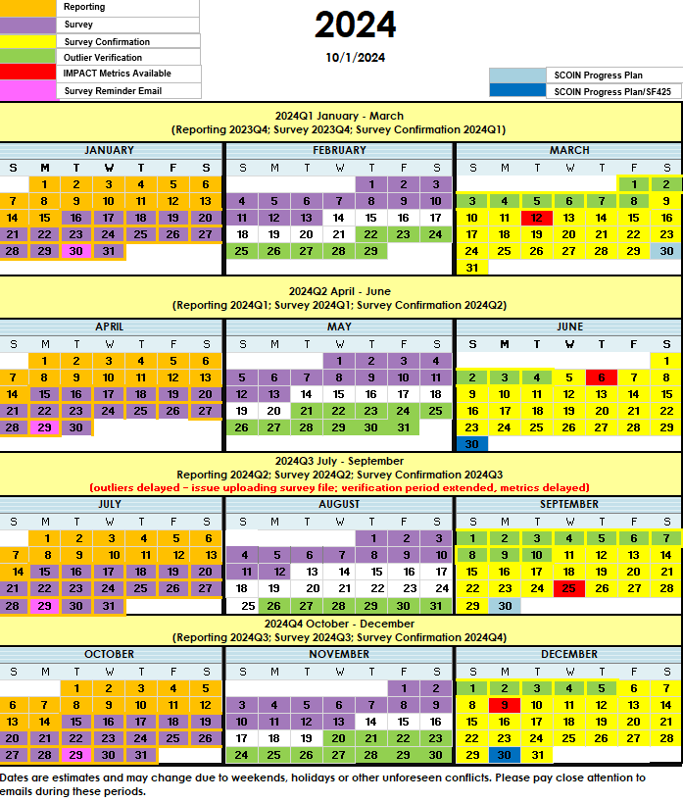
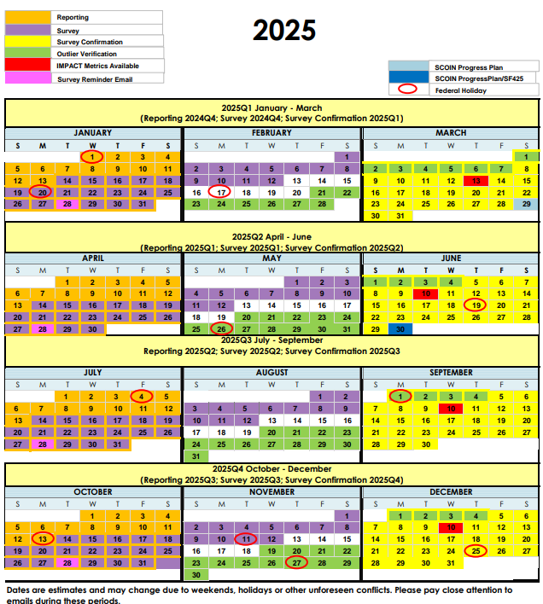
Reporting/Survey Calendar
Notes:
Reporting Calendar showing the Reporting, Survey and Survey Confirmation, Outlier Verification and IMPACT Metrics periods. The reporting calendar can be found in MEIS on the MEP Dashboard, under the MEP Documents widget.
Note that reporting, survey confirmation or survey is happening with very little time where there is a lull in the process.
Federal Holidays have been added for 2025.

Slide 7
Reporting Elements
Minimal Required Reporting Frequency
Quarterly and When Changes Occur
Center Information
Center Locations
Center Staff
Center Contacts
Center Partners
Center Board of Directors
Center State Funding Partners
Projects and Events
  Title
  Description
  Project type and delivery mode
  Intensity (hours)
  Center vs. Third party delivery distribution (hours)
  Total project value
Semi Annually
Progress Plan/Technical Report
  Narrative update on progress under awards
Budget Actuals
Quarterly
Client Success Stories (Min One)
Progress Data
  FTE Count
  Manufacturers Interacted with
Third Party Client Survey
  New Sales & Retained Sales
  Jobs Created and Retained
  New Investment
  Cost Savings
  Client Challenges
  Reasons for engaging with MEP Center
As Needed
Operating Outcomes
  Interactions with very small, rural, start-up manufacturers
Clients
  Client Name & Location
  Client Size & Industry
  Client Contacts (including phone & e-mail)
  C-Level Engagement
  Transformational Engagement
  Participates in DOD
Notes:
This is a list of the required reporting elements and their frequency. Some are reported quarterly some semi-annually and others as needed.
However, we encourage centers to update the information in MEIS whenever a change occurs. For example, if you have a staff member that has left the center, you will want to archive their account so they will no longer have access to Center data.

Slide 8
Performance Overview
Performance on the IMPACT Metrics is one of several inputs into the performance measurement, management and evaluation approach of MEP. Other inputs include
  Annual Reviews
  Panel Reviews
  Secretarial Reviews
The rationale behind the IMPACT Metrics is to include a mix of leading, trailing, and client satisfaction measures
  Leading – Clients
  Trailing – Impacts
  Customer Satisfaction – Net Promoter Score (NPS), Percent Improving Competitiveness
  Normalized by federal funding to allow for comparison across Centers of varying sizes
The rationale behind the Panel Reviews is to focus on trends and patterns to diagnose the causes for strong and weak performances
  Evaluates performance as it relates to market penetration, economic impact and financial sustainability
  Evaluates Center’s Performance & Evaluation Management System
  Promotes the sharing of distinctive practices across National Network
Notes:
The NIST MEP client impact survey collects information on the impact of the program regarding sales, jobs, investments, and cost savings, which are keystones of the Program. This information is valuable to understand how the services delivered improve client performance and what services and methods should be used more extensively by the Program.
IMPACT metrics report consists of important quantitative measures of performance and provides a consistent approach to examining Center performance. The IMPACT metrics cover many of the key aspects of performance including impact and market penetration and provide for Center to Center comparisons as well as trend information.
The new Panel Review process and report that focuses on performance trends of a Center.
The Program has also periodically undertaken formal impact evaluations that involve comparing the performance of MEP clients to non-clients and has used the results to inform program strategies and objectives.

Slide 9
Funding Programs
Center Operations (Base Award)
Manufacturing USA Institutes - Embedding
MEP Expansion Award Pilot – MEAPP – Supply Chain Optimization and Intelligence Network (SCOIN)
Rolling Competitive Award Program (RCAP)
Manufacturing Disaster Assistance Program (MDAP)
Supplemental Competitive Award Program (SCAP)
DefenseCyber
Coronavirus, Aid, Relief, and Economic Security Act (CARES)
Advanced Manufacturing Technical Services (AMTS)
Coronavirus, Adi, Relief, and Economic Security Act (CARES)
Each award has its own requirements
  Center Operations typically has the most extensive requirements
  Special Funding Program reporting is separate.
Notes:
In addition to the Center Operations (base award) NIST MEP has made available some additional funding.
Manufacturing U.S.A. Embedding funding was awarded to several centers as a pilot project that embeds staff from MEP centers at fourteen institutes within The Manufacturing USA (f/k/a National Network for Manufacturing Innovation or NNMI) network.
Rolling Competitive Award Program (RCAP) is a performance-based rolling Notice of Funding Opportunity for pilot projects to allow MEP Centers to submit proposals on an on-going basis throughout a given fiscal year.
Manufacturing Disaster Assistance Program (MDAP) funding was awarded to a few centers after the devastation of Hurricanes Harvey, Irma and Maria.
The Supplemental Competitive Award Program (SCAP) funding was awarded to one center Oklahoma and was a unique funding opportunity based on some supplemental funds provided to MEP.
DefenseCyber award went to the Michigan Manufacturing Technology Center to provide outreach, education, and technical assistance to U.S. manufacturers who supply products within DoD supply chains and who must implement adequate cybersecurity protections as required by DoD.
Coronavirus, Aid, Relief and Economic Security Act (CARES) funding was awarded to all Centers to assist manufacturing during the COVID-19 pandemic.
Advanced Manufacturing Services (AMTS) funding was provided
Lastly, MEP’s Supply Chain Optimization Intelligence Network (SCOIN) provided funds to each center to

Slide 10
Reporting Elements by Award Type
Reporting Element | Center Operations | Embedding | RCAP | MDAP | SCAP | Defense Cyber | CARES Act | AMTS |  | SCOIN
Board of Directors | Shared Across All Awards
CAR Information | Shared Across All Awards
Clients | Yes | Yes* | Yes* | Yes* | Yes* | Yes* | Yes* | Yes* | Yes*
Contacts | Yes | Yes | Yes | Yes | Yes | Yes | Yes | Yes | Yes
Locations | Shared Across All Awards
Partners | Shared Across All Awards
Progress Plan | Yes | Yes | Yes | Yes | Yes | Yes | Yes | Yes | Yes
Projects | Yes | Yes* | Yes* | Yes* | Yes* | Yes* | Yes* | Yes* | Yes*
State Funding Partners | Shared Across All Awards
Staff | Yes | Yes | Yes | Yes | Yes | Yes | Yes | Yes | Yes
Sub-Recipients | Yes | No | No | No | No | No | No | No | No
Success Stories | Yes | No | No | No | No | No | No | No | No
Center Operations (Base Award)
Manufacturing USA Institutes - Embedding
Rolling Competitive Award Program (RCAP)
Manufacturing Disaster Assistance Program (MDAP)
Supplemental Competitive Award Program (SCAP)
DefenseCyber
Coronavirus, Aid, Relief, and Economic Security Act (CARES)
Advanced Manufacturing Technical Services (AMTS)
Each award has its own requirements
Center Operations typically has the most extensive requirements
Supply Chain Optimization and Intelligence Network (SCOIN)
*Special Funding Program reporting is separate.

Slide 11
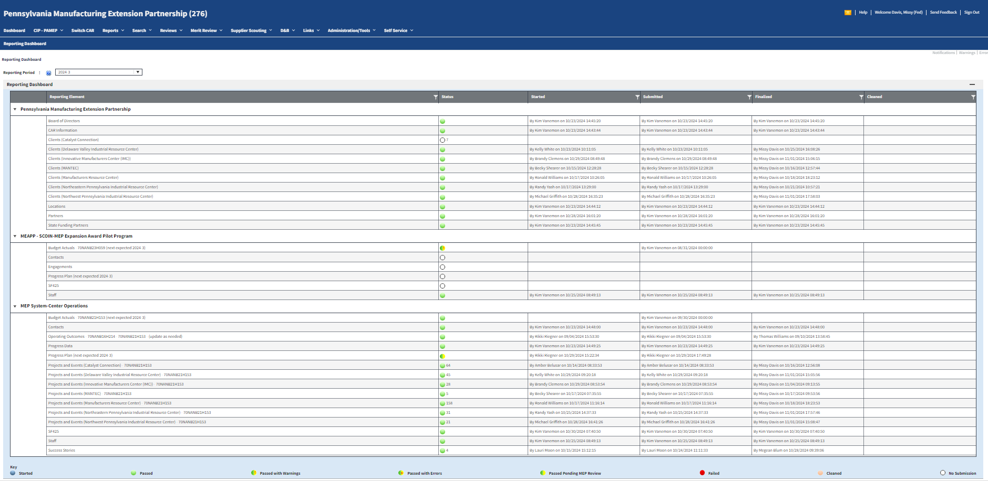
Reporting Dashboard
Notes:
This slide shows the Reporting Dashboard in MEIS and the status of each reporting element for the chosen reporting period.
There is a color-coded key at the bottom of the page for the meaning of each colored status icon.

Slide 12
Reporting Elements – Information
(Quarterly and When Changes Occur)
Purpose:
  Intended to provide NIST MEP with general CAR contact information such as address, telephone, fax number, and email address
  MEP will use this information in communications with stakeholders and for publishing CAR information in marketing materials and web sites, Center Performance Management and Reviews.
  Feeds MEP Public Site – Center Near You , MEP Quick List, State One Pager
How to Report:
  Click CIP, hover over Information, Submit Quarterly Reports, review data on the various tabs, click Actions Submit for Reporting to submit your changes to NIST MEP.
    Highly recommend that you update this information as soon as something changes, no need to wait for a reporting month.
    Centers cannot change CAR Name or Organization Type
Notes:
The CAR Information reporting element is intended to provide NIST MEP with general contact information such as address, telephone number, email address, etc.
This information feeds into the MEP Public Site for the Center Near You Map, MEP Quick List and your State One Pagers so you want to make sure this information is current and accurate.
From the MEIS dashboard, click on CIP, hover over Information, then click Submit Quarterly Reports. Make the necessary changes or updates, then click Actions, Submit for Reporting. Given that MEIS follows a similar pattern for each reporting element, I will not go over the detailed instructions for submitting although the instructions are included for each element in this presentation.
You do not need to wait until a Reporting period is open to make these changes.

Slide 13
Reporting Elements – Information
(Quarterly and When Changes Occur)
Related Reports: Either data used in report or clickable from page
  CAR Information
  CAR List
  BIR Report (clickable from Information Tab)
  One Pager Fact Sheet, Covid-19 Response and Distinctive Practice (clickable from One Pager Tab)
  County Business Pattern Data (Export from Counties Tab)
  CBP Information
  MEP Quick List (Center contact information)
Notes:
There are several related reports that include data from the CAR Information module. Some reports are available under Reports, CAR Reports and others are clickable from the CAR Information page.

Slide 14
Reporting Elements – Information
(Quarterly and When Changes Occur)
Did you know:
  Information Tab – you can view your D&B BIR if already created by your Federal Program Manager (FPM) as well as cohort characteristics
  One Pager Tab – each one-pager can have a Success Story – centers can choose the Success Story that show in the Success Story module
    Fact Sheet
    Covid-19 MEP Response
    Distinctive Practice
  Staff Tab – edit other user account records with the Reporting Role. Useful when - new center email addresses, center moved.
  Counties Tab – CBP data and rural export
  Dun & Bradstreet Tab – your center record is there; we use this information for renewal packages. Have you ever looked at this record?
Notes:
Did you know…
You can view your D&B BIR report from the Information page, by clicking on the document link. And you can view your center’s cohort characteristics by clicking on the arrows.
The one-pager fact sheet, COVID-19 response and Distinctive Practice can be viewed from the Information page, one-pager tab.
By clicking on the “Staff” tab, you can edit other user account records, if you have been assigned the reporting role.
On the Counties tab you can view and export Census County Business Pattern data and rural continuum codes by county.
You can also view your Center’s Dun & Bradstreet record by clicking on the D&B Tab.

Slide 15
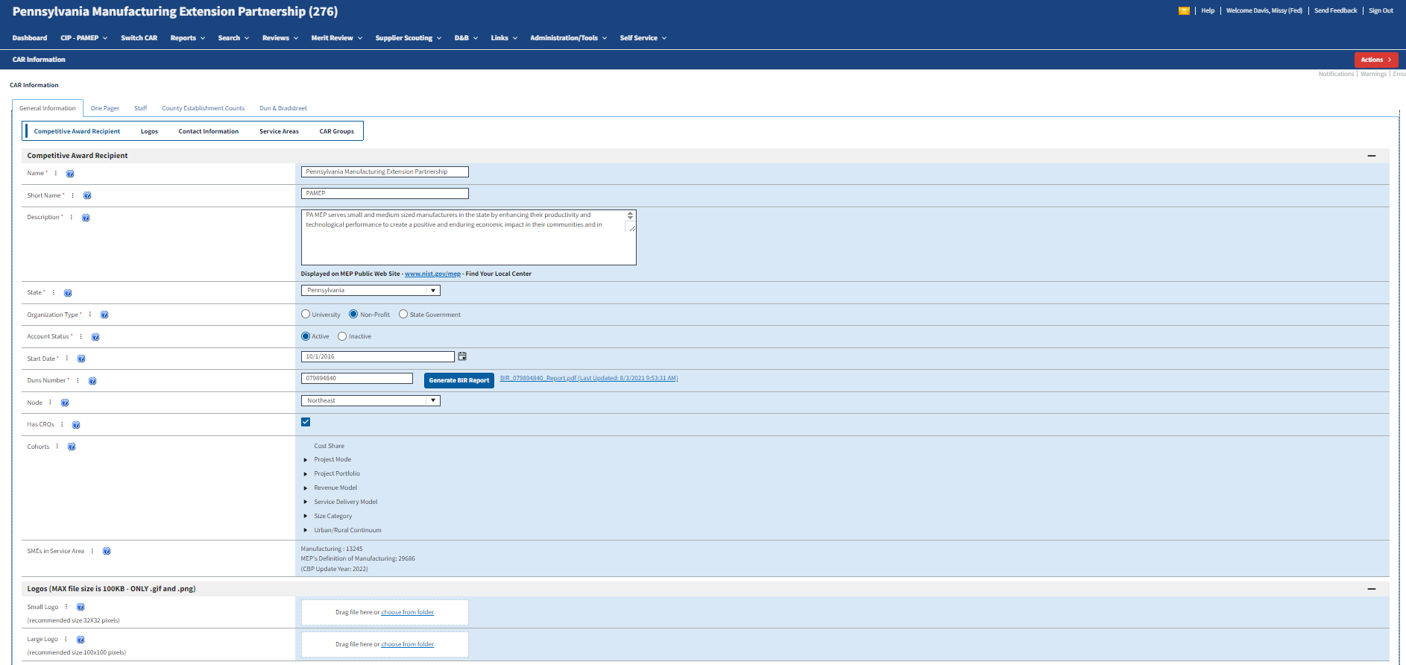
CAR Information Resources – Information Tab
General Information Tab
Edit CAR Description
Upload CAR Logos
View Cohort Characteristics
Notes:
Here is a screenshot of the General Information Tab.

Slide 16
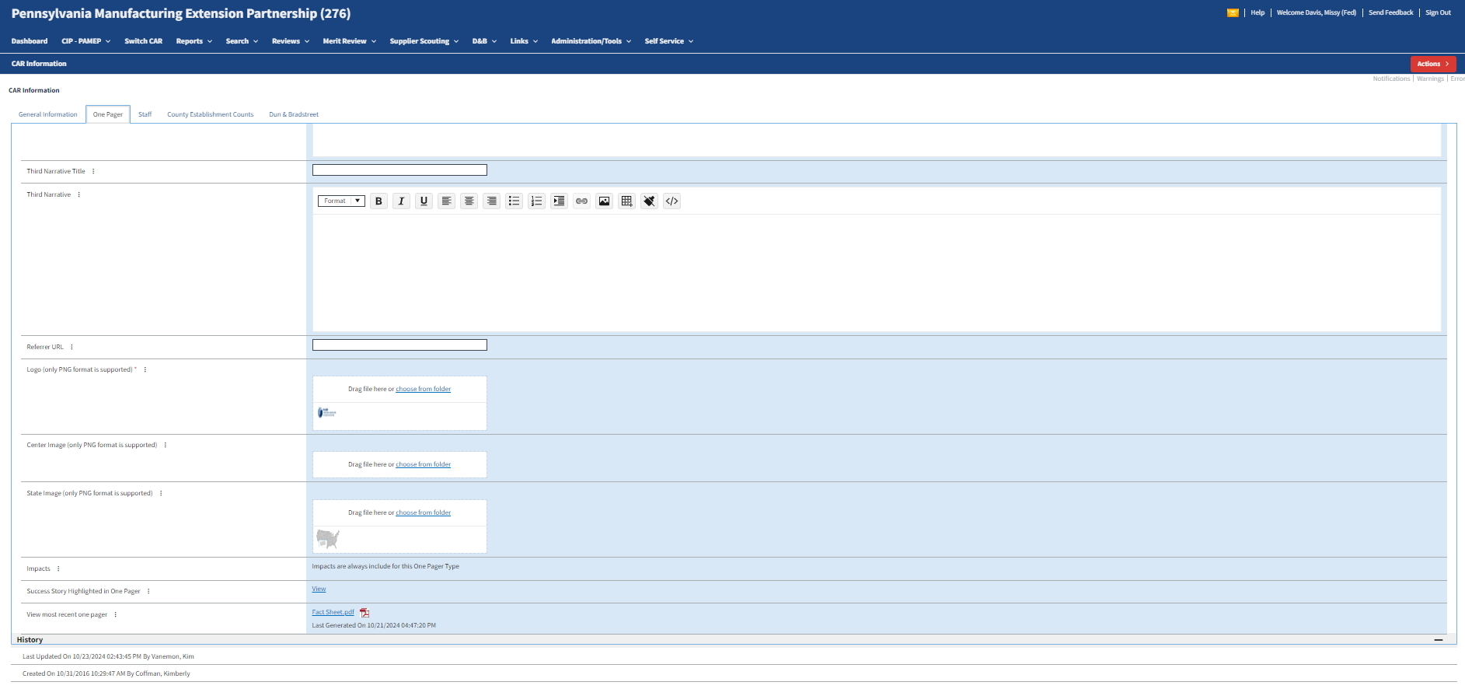
One Pager Tab
Fact Sheet
Click on One-Pager Tab
View Success Story
View and Print One Pager
Notes:
Here is a screenshot of the One Pager Tab defaulting to the Fact Sheet.

Slide 17
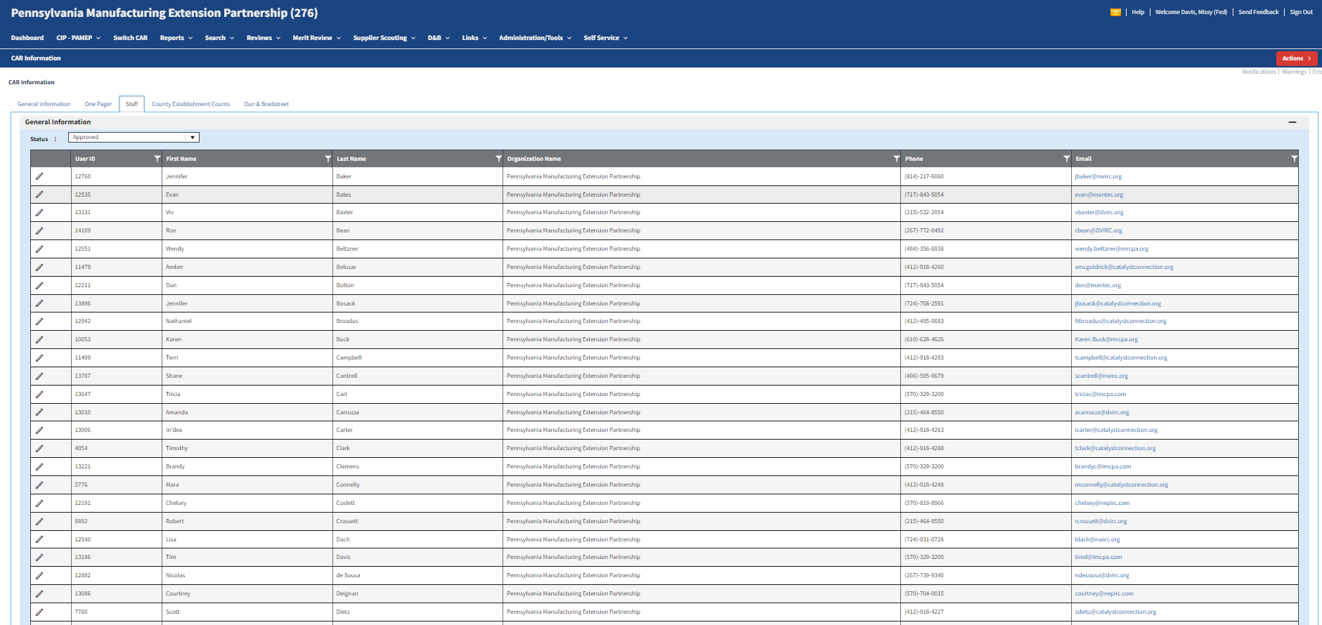
CAR Information Resources – Staff Tab
Click on Staff Tab
Click Edit icon to open user profile
Notes:
Here is a screenshot of the Staff Tab which lists all employees of the CAR.

Slide 18
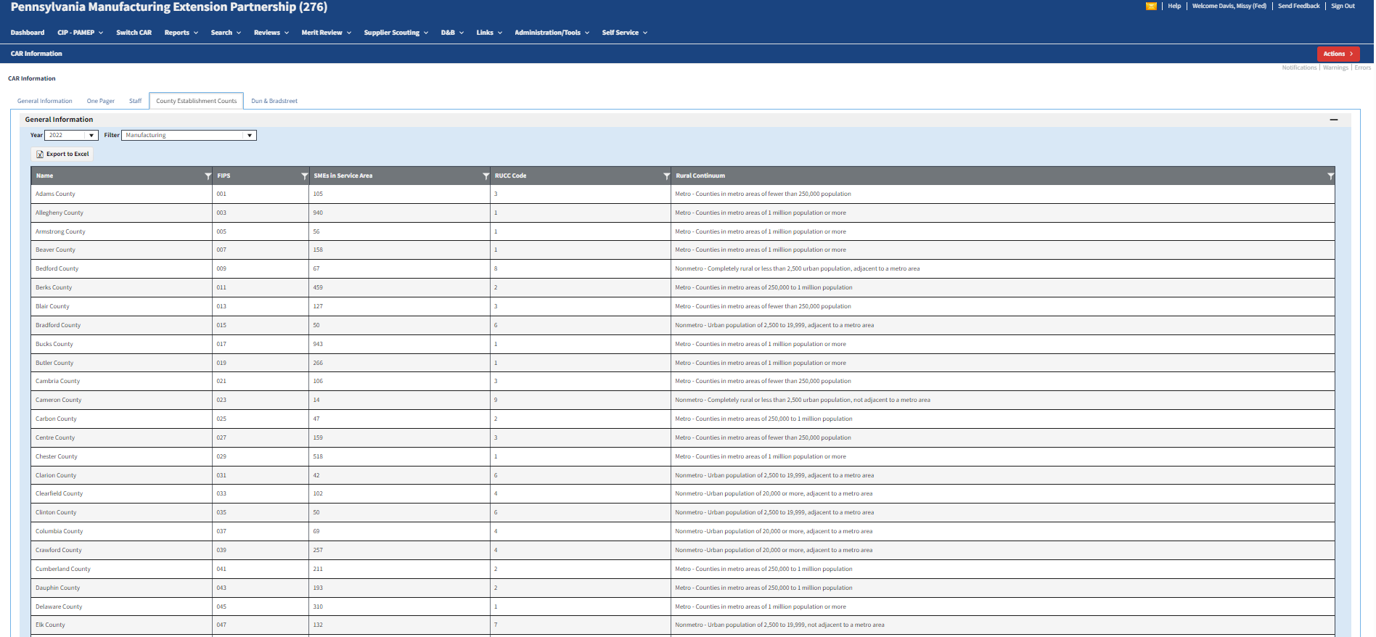
CAR Information Resources – Counties Tab
Click on Counties Tab
Export data to Excel
SME count by size
Rural Continuum description
Notes:
Provided for your convenience in the CIP, Information section under the Counties Tab is access to Census County Business Pattern data and the United States Department of Agriculture Rural Continuum Code. The data from these resources is used in several reports including the Center Performance and Profile Report (CPPR), market penetration indicators, and Operating Outcome Client Engagement Goals. This data can be exported into Excel from this page.
Note – the way census aggregates their data, any county that has 3 establishments or less will show as blank – drill down by clicking the arrow to view those establishments.

Slide 19
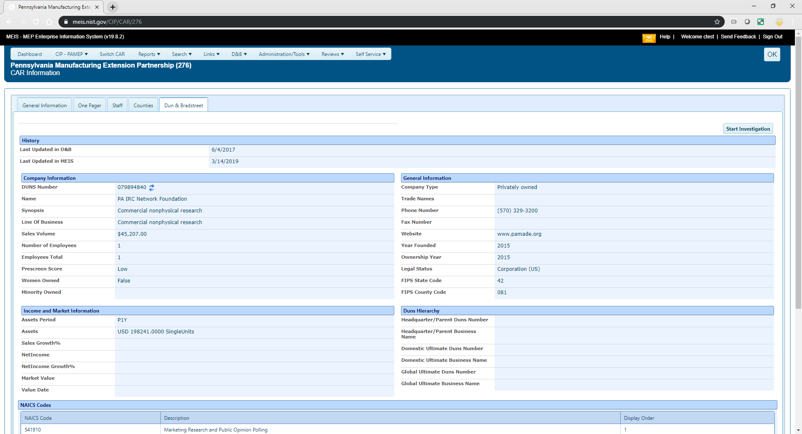
CAR Information Resources – Dun & Bradstreet Tab
Click on Dun & Bradstreet Tab
Click to launch D&B investigation
Notes:
Here is a screenshot of the Dun & Bradstreet Tab showing the D&B record for your center. If information needs to be updated, you can launch a D&B investigation.

Slide 20
Reporting Elements – Locations
(Quarterly and When Changes Occur)
Purpose:
  Locations are physical addresses where CAR, sub-recipient, or partner staff are based or deliver services
  The locations are intended to provide NIST MEP with general contact information such as address and phone information
  MEP uses this information to communicate our national coverage area with our various stakeholders, Center Performance Management and Reviews.
How to Report:
  Click CIP, hover over Locations, Submit Quarterly Reports, review Sub-recipient Agreements, Field Offices, and partners as service delivery locations,
  Click Actions, Add to add a new location. Complete the form. Click OK to Save.
  Click Actions Submit for Reporting to submit your changes to NIST MEP
  NOTE: We need centers to look at Locations closely, remove duplicates. Some centers have a location as a field office, SRA, and partner. These locations are being double, and triple counted. Only your FPM can add/edit an SRA.
Notes:
Locations are physical addresses where CAR, sub-recipients, field offices, CROs or partners that deliver services are located.
It is important to keep this information updated as MEP will use this information to communicate our national coverage area with our various stakeholders.
Make sure that you have removed duplicates so locations are not double counted. For example, you should not have sub-recipients also listed as Locations.
Note that only your Federal Program Officer can add/edit an SRA.

Slide 21
Reporting Elements – Locations
(Quarterly and When Changes Occur)
Related Reports: Either data used or clickable from page
  CAR Information
  CAR Locations
  CAR Summary (CAR Locations Map)
Did you Know:
  In order to update Partners as Service Delivery Location, you must do so from the Partners page
  Adding or marking records inactive can be done either from the List or Submit Quarterly Reporting Forms
Notes:
There are a couple of related reports that include data from the CAR Information module. These reports are available under Reports, CAR Reports.
Did you know…
In order to update Partners as Service Delivery locations, you must do so from the Partners Page.
Adding or marking records inactive can be accomplished from either the List or Submit Quarterly Reporting Forms.

Slide 22
Reporting Elements – Staff
(Quarterly and When Changes Occur)
Purpose:
  The staff element provides the CAR a mechanism for reporting on its labor resources
  The staff listing is a compilation of registered users associated with the CAR
  Used for Center Performance Management and Reviews.
How to report:
  Click CIP, hover over Staff, Submit Quarterly Reports, review data, click Actions Submit for Reporting
    Verify that the Staff list is current and complete and that all staff are assigned to the appropriate funding agreements
    To the right on the Staff grid, columns of checkboxes are visible for each Funding Agreement, click the checkbox for each Funding Agreement a staff member is working
    To add a staff member, staff self-register at https://meis.nist.gov. Click Register Here
    To remove a staff member, click the archive checkbox to the right on the Staff grid
Notes:
The Staff reporting element is intended to provide the CAR a mechanism for reporting on its current workforce.
Centers cannot add a Staff member in MEIS, new staff MUST first register at https://meis.nist.gov and click Register Here. Center staff will register as Type = Center and choose the Center name from the dropdown.
Don’t forget to archive staff who are no longer with your center immediately and not wait until the next reporting period. We do not want staff no longer employed by the National Network to have access to data on MEIS or MEP Connect.

Slide 23
Reporting Elements – Staff
(Quarterly and When Changes Occur)
Related Reports: Either data is used in report or clickable from page
  CAR Contacts Detail
  CAR List
  Clients and Projects
  Clients/Projects/Impacts
  MEP Quick List (Center Director)
  Users
  Survey Confirmation (All Tab)
Notes:
There are several related reports that include data from the Staff module. Reports are available under Reports, CAR Reports.

Slide 24
Reporting Elements – Staff
(Quarterly and When Changes Occur)
Did you know:
  Anyone associated to the CAR, either as an employee or sub-recipient providing part of a partner’s cash or in-kind is considered part of the CARs staff and should be reported
  Each CAR staff member is responsible for maintaining his or her own record
    Contact information
    Skills profile
  CAR Staff members are automatically associated to a center when they register for access to the MEP MEIS but they are not automatically assigned to a funding program and will not appear in the Staff Listing until a funding program is assigned
  Staff cannot be associated with a project unless they are tied to the appropriate funding agreement
Notes:
Did you know…
Anyone devoted to a CAR, either as an employee or sub-recipient providing part of a partner’s cash or in-kind contributions, as delineated in the CARs current statement of work, is considered part of the CARs staff and should be reported.
It is the responsibility of the staff member to maintain their contact information (address, phone, email, etc.), however, person(s) at the Center with the reporting role do have access to staff records and can also maintain that information.
You must first associate the staff member to a funding program before they will appear in the Staff Listing or can be listed as CAR Key Staff on a project.

Slide 25
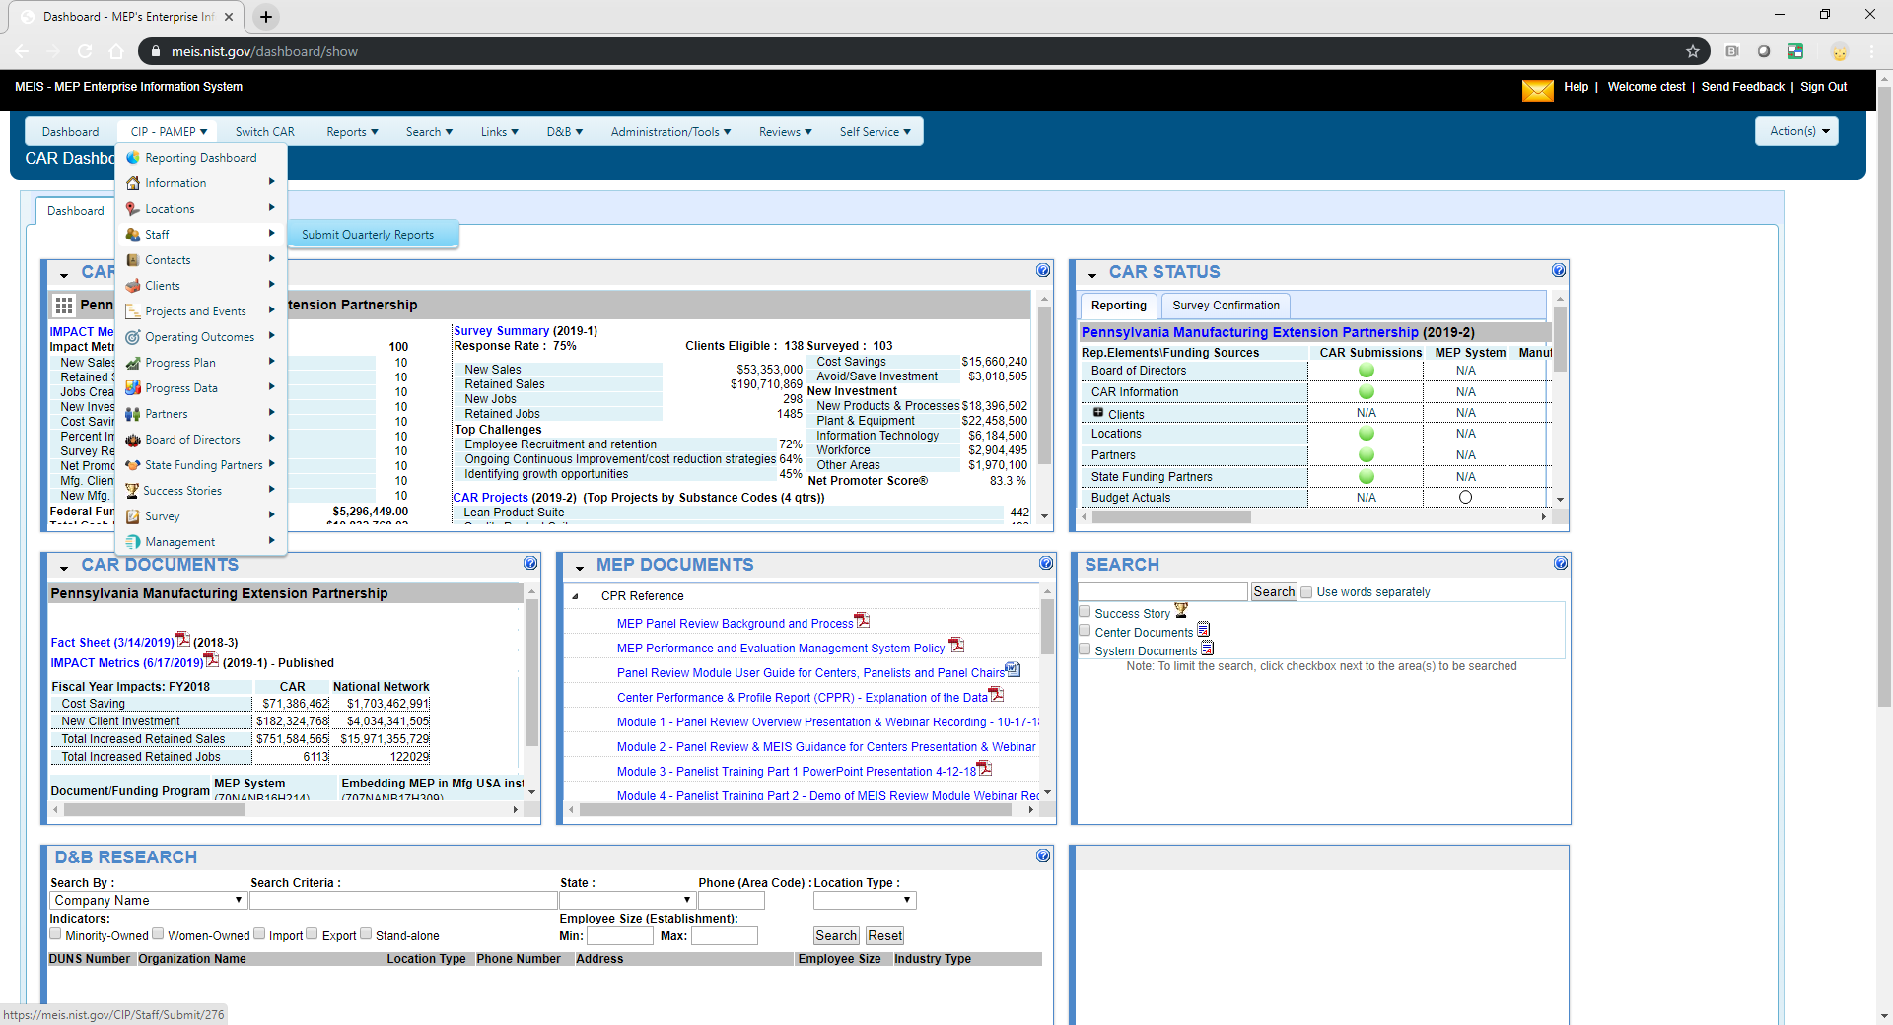
Assign Staff to Funding Program
Click CIP, Staff, Submit Quarterly Reports
Notes:
To assign staff to a funding program, they must first register for a MEIS account.
Once they have an approved account, a staff member with the Reporting role will need to associate the new staff member to one or more funding programs they are supporting. Click on CIP, Staff, Submit Quarterly Reports

Slide 26
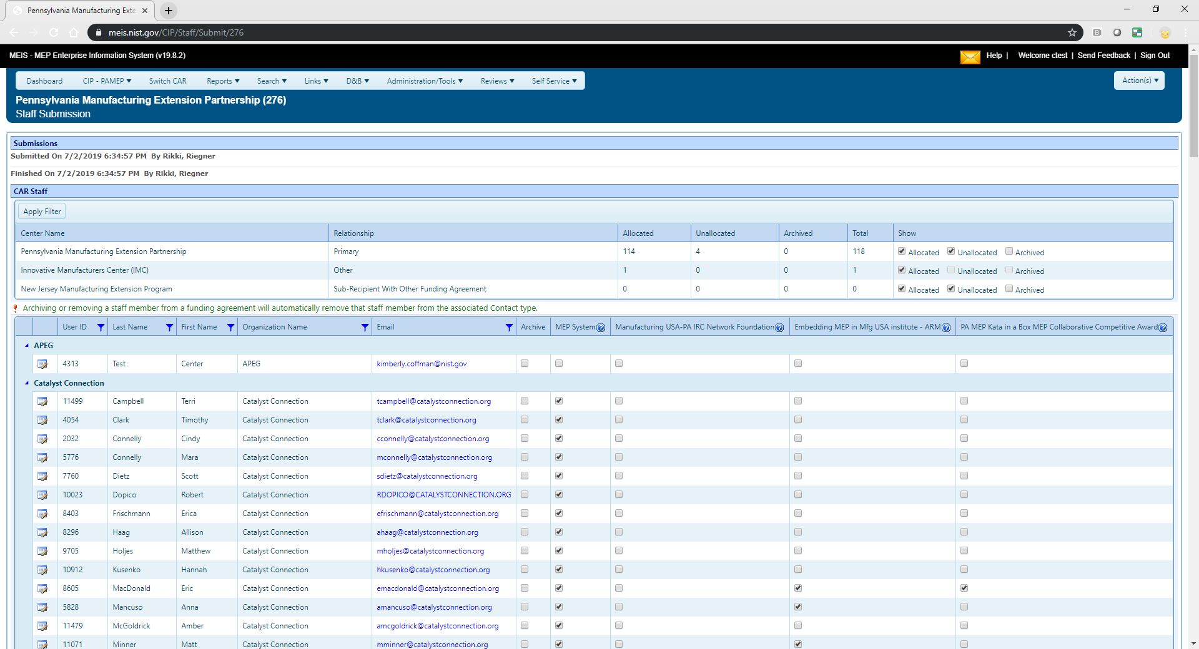
Assign Staff to Funding Program / Archive Staff
Click checkbox to associate staff with funding agreement
Click checkbox to archive staff
Notes:
Find the staff member, click the appropriate radio button(s) for each Funding Program, click Actions, Submit for Reporting . The new staff member will NOT show in the staff listing until this step is performed.
You can also click the “Archive” radio button to archive staff that are no longer a center staff.

Slide 27
Reporting Elements – Contacts
(Quarterly and When Changes Occur)
Purpose:
  Contacts are CAR officials with specific responsibilities for which there is the opportunity to communicate as a group
  Contacts are used to communicate with the correct CAR staff through mailing lists and working group membership
  Centers report on Contacts as part of Center Performance Management.
How to report:
  Click CIP, hover over Contacts, Submit Quarterly Reports, review different contact types, edit/add contacts, click Actions Submit for Reporting
Notes:
The Contacts reporting element is used for CAR officials with specific responsibilities and to communicate with the correct CAR staff through email, postal mail and working groups.

Slide 28
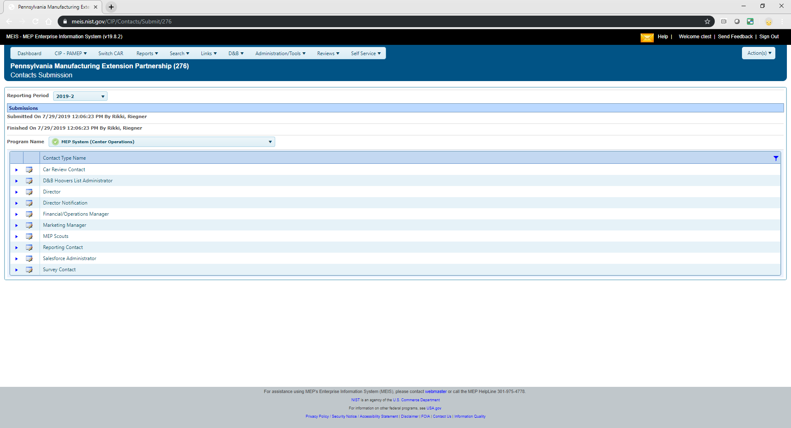
Adding Contacts
Click view/edit icon to add contact to contact type
Notes:
To add a Contact to a Contact Type, click on CIP, click the View/Edit icon for the appropriate Contact Type.

Slide 29
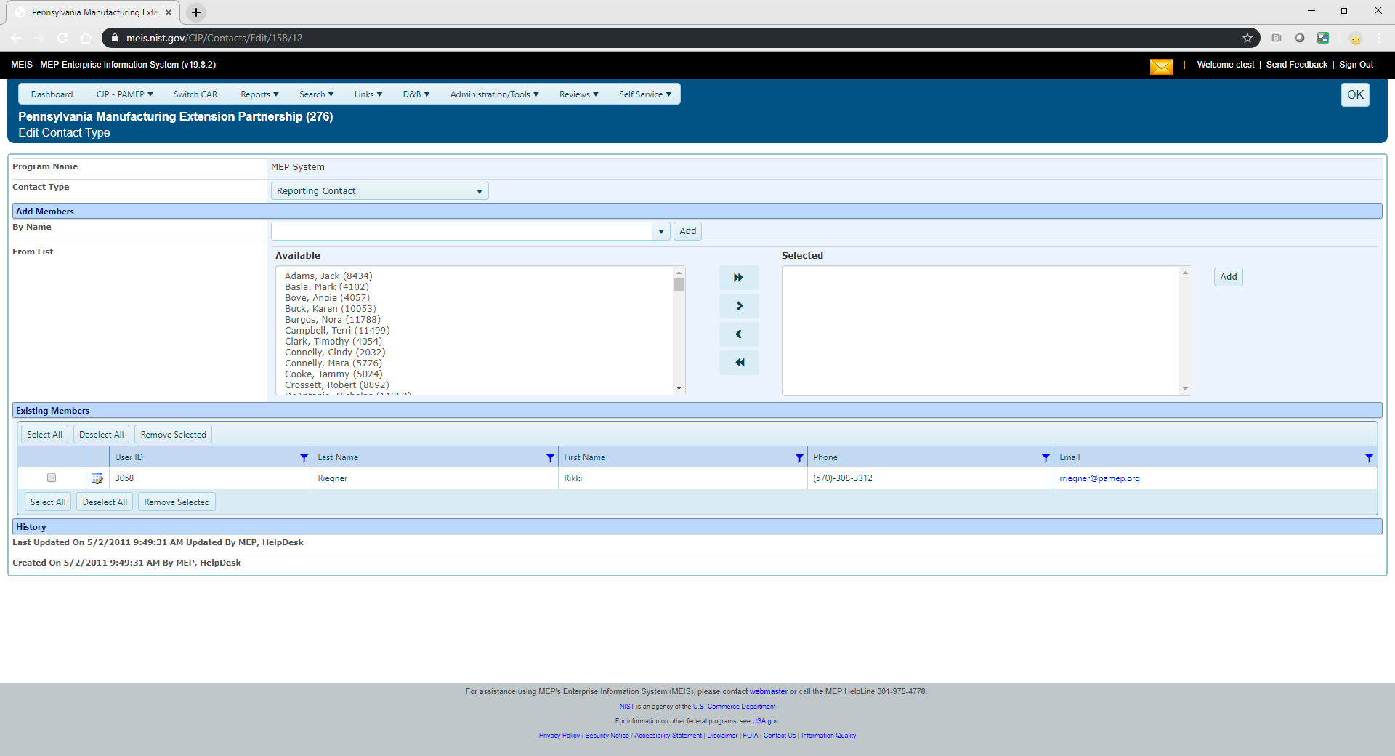
Adding Contacts
Can search users through MEIS or select from a list. Must use “Add” button
Can change contact type using dropdown
Notes:
Choose the contact type from the drop-down menu. Search users by name through MEIS and click ADD to add the staff to the available list. Or if the user is already showing in the available list, choose the name and move to the ‘selected’ list using the arrows. Click OK.

Slide 30
Reporting Elements – Contact Types Explained
CAR Review Contact – user will receive email related to center annual and panel reviews.
Chumura JobsEQ Administrator – staff person with Chumura JobsEQ login credentials; will receive emails related to Churura JobsEQ (Limit 1 person)
D&B Hoovers List Administrator – staff person with Hoovers login credentials; will receive emails related to D&B Hoovers (Limit 1 person)
Director – center director should be assigned to this contact to ensure emails sent to all center directors are received. (Limit 1 person)
Director Notification – user will receive all emails sent to Director Contact
Director, Director Notification and CRO Director Contacts will also be used to allow access to certify survey outliers each quarter
Financial/Operations Manager – user will receive emails related to financial, budget, etc.
Marketing Manager – user will receive emails related to all marketing correspondence.
Notes:
There are many different contact types.
CAR Review Contact is used as a communication channel for panel reviews
D&B Hoovers – Center representative holding D&B license key
The Director contact type can only be assigned to the Center Director or the designated Acting Director. This information feeds into the MEP Public Site and MEP Quick Lists. Directors are also notified via email of MEP Client Survey contact changes and approval is assumed if no further communication is made from the Center Director to NIST MEP.
Director Notification contact type – allows the center to designate staff to receive the same notifications as the center director without feeding the MEP Public Site or MEP Quick Lists.
New in 2024 – NIST MEP uses Director, Director Notification, or CRO Director Contacts in MEIS to allow access to certify survey outliers each quarter.
Financial/Operations Manager is used to support CFO communications and leveraged by grants and your FPM to get updated information and documents out like new guidelines or terms and conditions. CFO and COO are also notified via email of MEP Client Survey contact changes and approval is assumed if no further communication is made from the Center CFO/COO to NIST MEP.
Marketing Manager – Provides a focused list of marketing managers and is used to support marketing manager communications

Slide 31
Reporting Elements – Contact Types Continued
MEP Scouts – user will receive emails on all Supplier Scouting Opportunities and Supplier Scouting correspondence.
Reporting Contact – user will receive any emails related to Reporting activities in MEIS.
Salesforce Administrator – user will receive emails related to Salesforce; also used as POC in the event there are problems with the Salesforce mapping from center CRM to MEIS.
Survey Contact – user will receive any emails related to client survey.
Note: Special Awards have an identified subset of the Contacts listed above
Notes:
There are many different contact types.
MEP Scouts is used for the Supplier Scouting group on the MEP Connect site
Reporting Contact is used to send out communications about the opening and closing of reporting cycles. Also used to communicate any updates to the reporting requirements, structure, guidelines, etc.
Salesforce Administrator – Center representative for Salesforce/MEIS configuration
Survey Contact is used to send out communications about Survey, Survey Confirmation, and outlier duties

Slide 32
Reporting Elements – Contacts
(Quarterly and When Changes Occur)
Related Reports: Either data is used in report or clickable from page
  CAR Contacts Detail
  CAR List
  MEP Quick List (Center Director)
Notes:
There are several related reports that include data from the Contacts module. Reports are available under Reports, CAR Reports.

Slide 33
Reporting Elements – Contacts
(Quarterly and When Changes Occur)
Did you know:
  MEP list server distribution lists - available to be used by anyone with a MEIS account, messages are monitored (see PEEI Group for list server email address)
  Changes made to contacts will be immediate and automatically transferred to the appropriate MEP mailing lists that correspond to those positions
Notes:
Did you know…
The MEP list server is available to be used by anyone with a MEIS account. Messages are monitored.
Changes made to any Contact will be immediate and automatically updated in the corresponding MEP mailing list.

Slide 34
Reporting Elements – Progress Data
(Quarterly – One per Quarter)
Purpose:
  This reporting element is intended to collect quantifiable data for the award
  This information is used to respond to stakeholders and may be used for Center Performance Management, Reviews, and research purposes
How to report :
  Click CIP, hover over Progress Data, Submit Quarterly Reports, enter FTE and CME counts, click Actions Submit for Reporting
    An FTE is full-time equivalent (Includes Center and SRAs)
    CME is client manufacturing establishment
Notes:
The Progress Data reporting element is intended to provide the CAR a mechanism for reporting on its active full-time equivalents (FTEs) and clients served in the last 12 months.
NIST MEP uses the FTE counts in capacity utilization calculations found within your Center Performance and Profile Report. This number MUST include both Center and SRA staff counts. The CMEs served number is used to report to various stakeholders to show the breadth of the touches for the National Network. This number is not the same as the number of clients attempted to be surveyed.

Slide 35
Reporting Elements – Progress Data
(Quarterly – One per Quarter)
Related Reports: Either data used in report or clickable from page
  CAR Summary (capacity utilization charts)
Did you know:
  The CME count found in this section is used in many different NIST MEP publications
  Official source of all FTE counts
Notes:
There are several related reports that include Progress Data. Reports are available under Reports, CAR Reports.
The Cohort Comparison chart is a great way to compare your Center’s performance against other Centers that may or may not have similar characteristics such as (federal funding, region, service delivery model etc.
You choose your cohort.

Slide 36
Reporting Elements – Board of Directors
(Quarterly and When Changes Occur)
Purpose:
  The information contained in the Board of Directors section is intended to provide NIST MEP with general information about the Board and Board members
  NIST MEP will use this information in the day-to-day role as a consultant to the CAR
  Used for Center Performance Management and Annual and Panel Reviews
How to report
  Click CIP, hover on Board of Directors, Submit Quarterly Reports, review Board and Board Members, click Actions Add to add new Board, click Actions Submit for Reporting
    Centers are responsible for updating both the Board and Board Member record
    Remove Board by marking it inactive
    Remove Board Member by selecting the X under the Remove from Board column
      Can also mark inactive in the Member profile
Notes:
The Board of Directors reporting element is intended to provide the CAR a mechanism for reporting on its active Board of Directors. You can add one or more boards, this is especially useful if you have both a fiduciary and advisory board. Or if you are a center with center regional offices. Each one of your offices can have its own board or boards.
After you have created the board, do not forget to add members. You will be asked to indicate if the member is the board chair, their tenure and if their organization is a small manufacturer.
To remove a board or board member record, mark the status as inactive.

Slide 37
Reporting Elements – Board of Directors
(Quarterly and When Changes Occur)
Related Reports: Either data used in report or clickable from page
  Board of Directors
  CAR List
Did you know:
  The Board Chair contact information is used in the Review Module for Annual and Panel Reviews as well as communications from the Director and other working groups, so it is important to keep this information up to date.
    This is done by checking Chairperson in the Board Member record
    Board Chair is an active participant in a Panel Review
    Board tenure and Small manufacturer background information up to date in the Board Member record
  Boards have Board Member records that need to be maintained
  Centers can create MEIS accounts for Board Members
    Access levels are determined by the center
Notes:
There are several related reports that include Board of Director information. Reports are available under Reports, CAR Reports.
Did you know….
Boards have Board Members, do not forget to review and update this list periodically.
That the board chair contact information is used by MEP Management to send notifications about the program. The Board Chair is designated by name during the Panel Review and is expected to be an active participant in the Panel Review process.
Centers can choose to request MEIS and MEP Connect accounts for any of their board members.

Slide 38
Reporting Elements – Board of Directors
(Quarterly and When Changes Occur)
Did you know:
  A CAR may have two types of Boards – a fiduciary board and/or an advisory board
    A fiduciary board exists for all freestanding non-profit organizations
      A fiduciary board will have a charter document and/or bylaws describing the duties and terms of the board members
    An advisory board is usually a less formal body, and can be affiliated with any type of organization
      The roles and responsibilities of advisory boards may be like fiduciary boards, or they may be more focused on areas such as client needs
  Board Bylaws are a required document upload.
Notes:
Did you know…
Centers can create more than one type of Board records.
Fiduciary boards are typical for non-profit organizations.
Advisory boards are less formal than fiduciary and provide oversight to centers.
Board Bylaws are a required document.

Slide 39
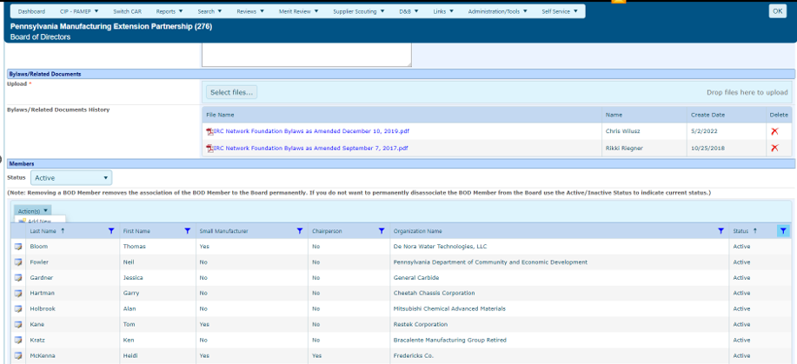
Creating a User Account for Board Members
Board Bi-Laws are a required document.
Click Actions, Add New to add a new board member.
Click checkbox to create MEIS account for Board Member
Notes:
To Create a User account for Board Members, from the MEIS dashboard, click on CIP, hover on Board of Directors, Submit Quarterly Reports, click the View/Edit icon for the Board, under the Create MEIS Account column, click the link Create MEIS Login , you will be prompted to confirm that you want a MEIS/MEP Connect account created and that the board member will have access to some of your center data. As soon as you click create account, the board member will receive an email indicating an account has been created for them. Please make sure you notify the board member to expect to receive this email.
If your Center encourages Board Members to have MEIS access, how much transparency is provided as far as access to data? Do they use the account?

Slide 40
Reporting Elements – Partners
(Quarterly and As Changes Occur)
Purpose:
  The Partner submission provides the CAR a readily available mechanism for reporting on its formal and informal relationships with other organizations
  Partners show the extent of a CAR’s reach beyond its own resources
  This information is used to show that MEP CARs are working with partner organizations to deliver the best possible services and products to its clients through formal and informal agreements
  CARs are expected to have a documented performance management process for its partners.
  Used in Annual and Panel Reviews (top 5 Key Partners) as well as for Center Performance Management.
Notes:
The Partner reporting element is intended to provide the CAR a mechanism for reporting on its formal and informal relationships with other organizations and to show the extend of a CARs reach beyond it’s own resources.
NIST MEP uses this information in Annual and Panel reviews to show that MEP CARs are working with partner organizations to deliver the best possible products and services to it’s clients.

Slide 41
Reporting Elements – Partners
(Quarterly and As Changes Occur)
How to report:
  Click CIP, hover over Partners, Submit Quarterly Reports, review Partners, click Actions Add to add new partner, click Actions Submit for Reporting
    Partners – Defined as an organization that contributes or aligns resources (human, monetary, office space, incubators, etc.) through a long-term formal or informal agreement.
      Sub-recipient – explicitly identified in a CARs Cooperative Agreement and maintained by your FPM in CIP, Funding Programs, Awards, Period of Performance. SRAs are displayed but Centers cannot update this information.
      Third-party Contributors – there is a formal agreement
      Other Partners – no formal agreement – CAR wants to list the Partner as a resource
Notes:
From the MEIS dashboard, click on CIP, hover over Partners, Submit Quarterly Reports. Review Partners, make necessary changes or updates, then click Actions, Submit for Reporting. To add a new Partner, Click Actions, Add, enter the information for the new Partner, then click Actions, Submit for Reporting.
Given that MEIS follows a similar pattern for each reporting element, I will not go over the detailed instructions for submitting although the instructions are included for each element in this presentation.

Slide 42
Reporting Elements – Partners
(Quarterly and As Changes Occur)
Related Reports: Either data used in report or clickable from page
  CAR Information
  CAR Summary
  CPPR
  Partners
Did you know:
  Remove a Partner by marking the organization inactive
  Adding/removing records can be done either from the List or Submit Quarterly Reporting options
  Centers MUST designate Partners as Key Partners (up to five) that are listed in the CPPR. Key Partners typically have a formal agreement and provide services such as delivery, marketing, developing products, etc.
  State Funding Partners (SFP) are people associated to Partner organizations. To deactivate a Partner with a State Funding Partner association, you must disassociate the SFP before the Partner can be deactivated.
NOTE: Please review this list and ONLY include Partners that add value. More is not always better; we need quality as this is a common data pull.
Notes:
Reports related to Partners reporting are listed on this slide.
Did you know…
You can remove a Partner by marking the organization inactive?
Adding and removing partner records can be accomplished either from the List or Submit Quarterly Reporting options
Centers MUST designate Partners as Key Partners (up to five). Key Partners typically have a formal agreement and provide services such as delivery, marketing, developing products, etc.
Only Partners that add value should be added to this list.

Slide 43
Reporting Elements – State Funding Partner
(Quarterly and As Changes Occur)
Purpose:
  Intended to provide the CAR a readily available mechanism for reporting on its relationships with State and Local Government Officials that provide funding and are interested in Center Performance.
  State Funding Partners are the primary funding decision officials for the program within the state or local government for the CAR
  Used in Annual and Panel Reviews as well as for Center Performance Management.
How to report:
  Click CIP, hover over State Funding Partner, Submit Quarterly Reports, review State Funding Partners, click Actions Add to add new State Funding Partner, click Actions Submit for Reporting
    All State Funding Partners must relate back to a Partner organization that is reported in the Partners element
    Remove State Funding Partners by marking them inactive
Notes:
The State Funding Partner reporting element is intended to provide the CAR a mechanism for reporting on its relationships with State and Local Government Officials.
State Funding Partners are the primary funding decision officials for the program within the state of local government for the CAR.
From the MEIS dashboard, click on CIP, hover over State Funding Partners, Submit Quarterly Reports. Review State Funding Partners, make necessary changes or updates, then click Actions, Submit for Reporting. To add a new State Funding Partner, Click Actions, Add, enter the information for the new State Funding Partner, then click Actions, Submit for Reporting.

Slide 44
Reporting Elements – State Funding Partner
(Quarterly and As Changes Occur)
Related Reports: Either data used in report or clickable from page
  CAR Information
  State Funding Partners
Did you know:
  Centers can create MEIS accounts for State Funding Partners
    Access levels are determined by the center
Question: Why is this element not used by centers often? Is it misunderstood or there just are not that many State Government Organizations/People that your center partners with?
Notes:
Reports related to State Funding Partner reporting are listed on this slide.
Did you know…
Centers are able to create MEIS accounts for State Funding Partners? Access levels are determined by the center.
To Create a User account for State Funding Partner, from the MEIS dashboard, click on CIP, hover over State Funding Partner, Submit Quarterly Reports, click Actions, Add. Enter information for State Funding Partner, under the Create MEIS Login Account row, check the checkbox to Create MEIS Login Account. You will be prompted to confirm that you want a MEIS/MEP Connect account created and that the State Funding Partner will have access to some of your center data. As soon as you click create account, the State Funding Partner will receive an email indicating an account has been created for them. Please make sure you notify the State Funding Partner to expect to receive this email.

Slide 45
Reporting Elements – Clients
(As Needed)
Purpose:
  NIST MEP uses client records for the purpose of conducting an in-house project impact survey measuring the realized impacts (sales, investment, employment, cost of goods sold, etc.) of our services to our clients
  Client information may also be used for other purposes such as market and industry research
  Used in the calculation of New and Unique Clients Served metrics.
  Used in Center Performance Management and Center Annual and Panel Reviews.
How to report:
  Click CIP, hover over Clients, click Submit Quarterly Reports. Centers now have four options for submitting client information.
    Add New (one at a time) click Add New
    Click Select Files to upload a Client Information File (CIF) XML or CSV file (requires one time setup of field mapping to work)
    Click Goto Spreadsheet to use the spreadsheet interface
    Click Validate/Submit from Salesforce using the Salesforce/MEIS Utility (requires one time setup of field mapping to work)
  A unique client ID is assigned to each client. The CIF is the Client Information File Template and is found on MEIS
  For Center Operations, the client must have a manufacturing (31-33) or R&D NAICS Code (541711 or 541712) and a valid DUNS Number (unless included in NIST MEP Definition of Manufacturing – DOM)
    MEP uses Dun and Bradstreet for NAICS Code verification
    Just because the client previously existed in MEIS does not mean you should not update the record in MEIS on a regular basis
Notes:
The Client reporting element is used by the centers to report clients to whom they have provided services. NIST MEP uses the client records for the purpose of conducting an in-house project impact survey measuring the realized impacts of our services to clients. Client counts which are driven by projects submitted are used in the calculation of two of the Performance Impact Metrics – New and Unique Clients.
From the MEIS dashboard, click on CIP, hover over Clients, then click Submit Quarterly Reports.
There are currently four ways to report Clients in MEIS.
Add New (one at a time) click Add New
Click Select Files to upload a CIF XML or CSV file (requires one time setup of field mapping to work)
Click Goto Spreadsheet to use the spreadsheet interface
Click Validate/Submit from Salesforce using the Salesforce/MEIS Utility (requires one time setup of field mapping to work)
Once a new client is submitted, MEIS assigns a unique client ID.
Please remember that just because the client exists in MEIS does not mean you should not update the client record in MEIS. Just last quarter we had a client record that could not be imported into Fors Marsh Portal because the record did not have primary and secondary contact emails. The record was obviously not opened during Survey Confirmation and it had not be touched (last updated date in MEIS) since we made email a required field. That was over 8 years ago.
We plan on retiring the XML option in 2019Q4.

Slide 46
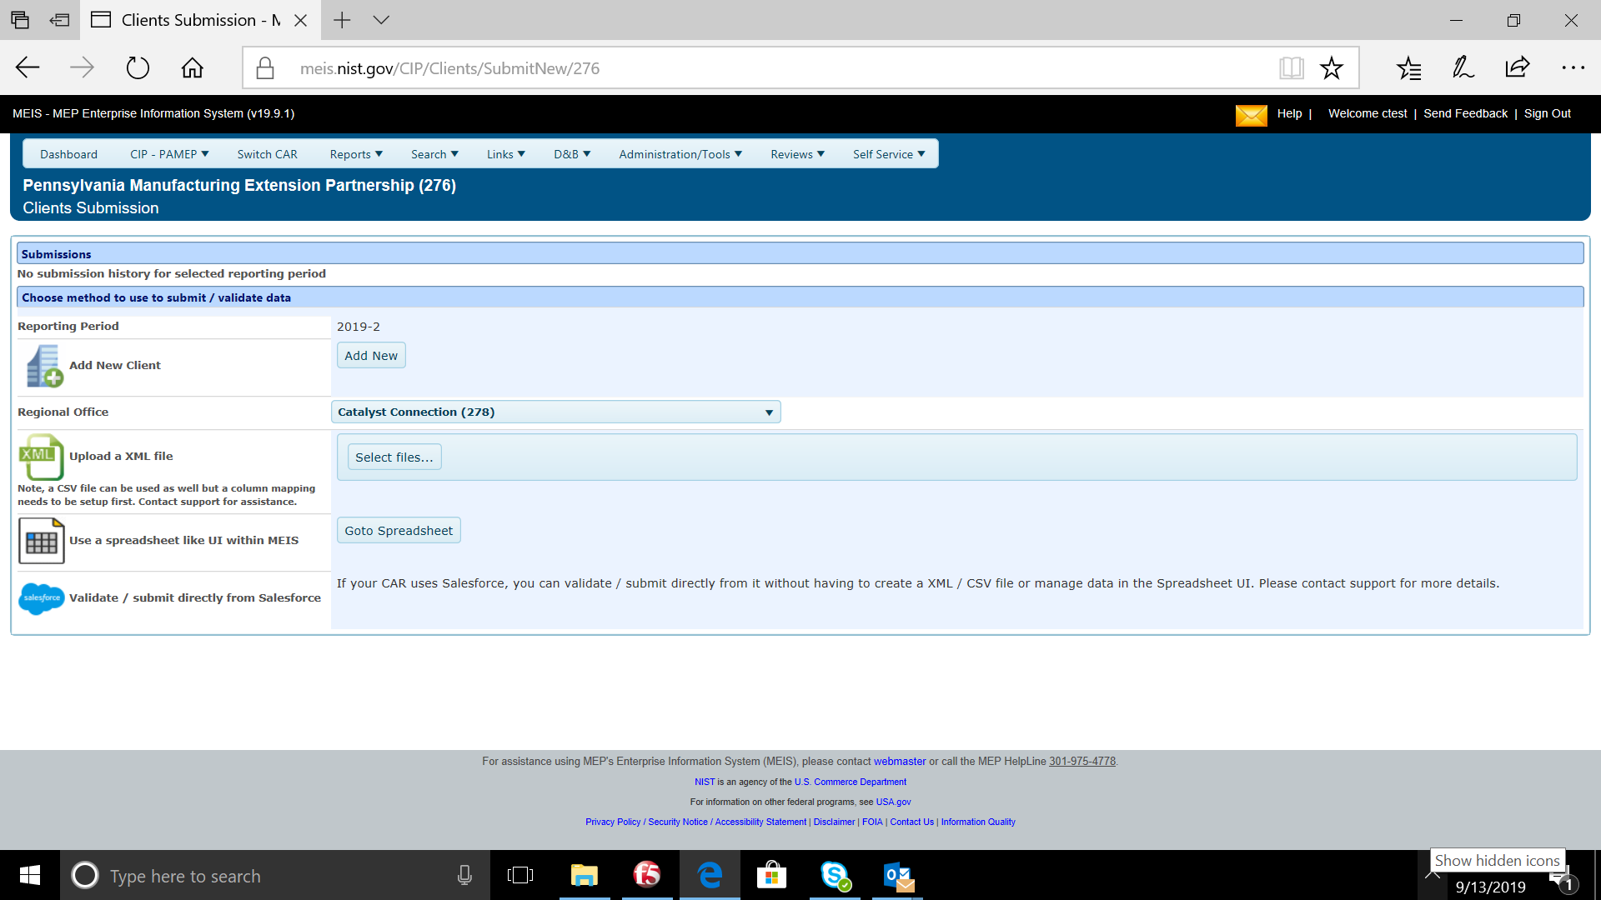
Reporting Elements – Clients
(As Needed)
Notes:
As mentioned in the previous slide, centers have four ways to report Clients in MEIS.
- Add New (one at a time) click Add New
- Click Select Files to upload a CIF XML or CSV file (requires one time setup of field mapping to work)
- Click Goto Spreadsheet to use the spreadsheet interface
- Click Validate/Submit from Salesforce using the Salesforce/MEIS Utility (requires one time setup of field mapping to work)

Slide 47
Reporting Elements – Clients
(As Needed)
Workflow:
  There is a workflow if clients are submitted as a batch submission (CSV or XML), use the Spreadsheet Interface, or from Salesforce as opposed to manually entered.
  Add New (One by One)
    Center is responsible for ensuring that a duplicate client record (same company two different CAR Client IDs) is NOT being created.
    MEIS will report an error if a duplicate CAR Client ID is used but will not give an error if the same company name is used with a different CAR Client ID
    Click OK to save
  Salesforce/MEIS Utility
    Click Validate from Salesforce. Any errors are displayed.
    If the utility returns errors, the issues will need to be corrected in your Salesforce System. Repeat this process until the utility passes validation with no errors. You will then need to submit for reporting
    Click Submit from Salesforce. The information in Salesforce is submitted to the MEIS database
    You are redirected to the CAR Dashboard. If you have successfully submitted Client information – the Status Icon will be half green/half yellow indicating the submission is “Passed Pending MEP Review”
    A MEP staff member reviews and finalizes the submission to achieve the “Passed” icon
Notes:
There is a workflow if clients are submitted as a batch submission (CSV or XML), use the Spreadsheet Interface, or from Salesforce as opposed to manually entered.
When entering the hard way (One by One) click Add New
Center is responsible for ensuring that a duplicate client record (same company two different CAR Client IDs) is NOT being created.
MEIS will report an error if a duplicate CAR Client ID is used but will not give an error if the same company name is used with a different CAR Client ID
Click OK to save
If you are using the Salesforce/MEIS Utility
Click Validate from Salesforce. Any errors are displayed.
If the utility returns errors, the issues will need to be corrected in your Salesforce System. Repeat this process until the utility passes validation with no errors. You will then need to submit for reporting
Click Submit from Salesforce. The information in Salesforce is submitted to the MEIS database
You are redirected to the CAR Dashboard. If you have successfully submitted Client information – the Status Icon will be half green/half yellow indicating the submission is “Passed Pending MEP Review”
A MEP staff member then has to review and finalize the submission to achieve the “Passed” icon

Slide 48
Reporting Elements – Clients
(As Needed)
Workflow:
  CSV or XML Upload
    XML Upload
      CIF Template with macro to convert to XML option – MACRO is no longer supported by NIST MEP
      But if you are going to use this time, CIF must be converted to XML
        XML is an open standard for describing data and is an ideal solution for transferring structured data from server-to-client, server-to-server or application-to-application on any platform
        NIST MEP provides a CIF Template with an easy add-in to convert to XML
      Click Select File, choose the proper XML file
      Click Submit for Validation. Any errors with the file are displayed. When a file is submitted for validation, the file is checked to ensure validity and consistency. Field level validation ensures that the data entered in all record fields are correct. However, this type of validation does not validate against client records already existing in the MEIS database. This is achieved through validation at the database level
      If the file fails with errors, the XML file will need to be corrected and re-uploaded using the same process. Repeat this process until the file passes with no errors. You will then need to submit for reporting
      Click Submit to System. The information in the file is submitted to the MEIS database
      You are redirected to the CAR Dashboard. If you have successfully submitted Client information – the Status Icon will be half green/half yellow indicating the submission is “Passed Pending MEP Review”
      A MEP staff member then has to review and finalize the submission to achieve the “Passed” icon
Notes:
If using one of the two file upload format’s CSV or XML the instructions are similar just different file formats. CSV is a new option that was created to eliminate the CIF Excel file with Macro that has become less stable on the various Microsoft Windows Operating System and Microsoft Office versions.
XML Upload (The CIF Template with macro to convert to XML option was eliminated in 2019Q4 – you can still use this option, but the macro isn’t supported by NIST) But if you are going to use this time, CIF must be converted to XML.
Click Select File, choose the proper XML file
Click Submit for Validation. Any errors with the file are displayed. When a file is submitted for validation, the file is checked to ensure validity and consistency. Field level validation ensures that the data entered in all record fields are correct. However, this type of validation does not validate against client records already existing in the MEIS database. This is achieved through validation at the database level
If the file fails with errors, the XML file will need to be corrected and re-uploaded using the same process. Repeat this process until the file passes with no errors. You will then need to submit for reporting
Click Submit to System. The information in the file is submitted to the MEIS database
You are redirected to the CAR Dashboard. If you have successfully submitted Client information – the Status Icon will be half green/half yellow indicating the submission is “Passed Pending MEP Review”
A MEP staff member then has to review and finalize the submission to achieve the “Passed” icon

Slide 49
Reporting Elements – Clients
(As Needed)
    CSV Upload
      Create CSV file (Microsoft Comma Delimited)
      Click Select File, choose the proper CSV file
      Click Submit for Validation. Any errors with the file are displayed. When a file is submitted for validation, the file is checked to ensure validity and consistency. Field level validation ensures that the data entered in all record fields are correct. However, this type of validation does not validate against client records already existing in the MEIS database. This is achieved through validation at the database level
      If the file fails with errors, the CSV file will need to be corrected and re-uploaded using the same process. Repeat this process until the file passes with no errors. You will then need to submit for reporting
      Click Submit to System. The information in the file is submitted to the MEIS database
      You are redirected to the CAR Dashboard. If you have successfully submitted Client information – the Status Icon will be half green/half yellow indicating the submission is “Passed Pending MEP Review”
      A MEP staff member then has to review and finalize the submission to achieve the “Passed” icon
Notes:
CSV Upload
Click Select File, choose the proper CSV file
Click Submit for Validation. Any errors with the file are displayed. When a file is submitted for validation, the file is checked to ensure validity and consistency. Field level validation ensures that the data entered in all record fields are correct. However, this type of validation does not validate against client records already existing in the MEIS database. This is achieved through validation at the database level
If the file fails with errors, the CSV file will need to be corrected and re-uploaded using the same process. Repeat this process until the file passes with no errors. You will then need to submit for reporting
Click Submit to System. The information in the file is submitted to the MEIS database
You are redirected to the CAR Dashboard. If you have successfully submitted Client information – the Status Icon will be half green/half yellow indicating the submission is “Passed Pending MEP Review”
A MEP staff member then has to review and finalize the submission to achieve the “Passed” icon

Slide 50
Reporting Elements – Clients
(As Needed)
    Spreadsheet Interface
      Click Goto Spreadsheet
      Enter data (typing or cut/paste) into the appropriate fields.
      Simple data errors such as an 11 digit phone number, will result in a pop-up error message displayed. Complex data errors such as an invalid D&B number will be displayed after validation.
      If adding multiple rows, select the number of rows to add
      Click Submit for Validation. Any errors in the spreadsheet will be displayed. When the spreadsheet is submitted for validation, the data is checked to ensure validity and consistency. .
      If the spreadsheet fails with errors, the issues will need to be corrected. Repeat this process until the spreadsheet passes validation with no errors. You will then need to submit for reporting
      Click Submit to System. The information in the spreadsheet is submitted to the MEIS database
      You are redirected to the CAR Dashboard. If you have successfully submitted Client information – the Status Icon will be half green/half yellow indicating the submission is “Passed Pending MEP Review”
      A MEP staff member then has to review and finalize the submission to achieve the “Passed” icon
Notes:
Finally, the Spreadsheet Interface
Click Goto Spreadsheet
Enter data (typing or cut/paste) into the appropriate fields.
If adding multiple rows, select the number of rows to add
Simple data errors such as an 11 digit phone number, will result in a pop-up error message displayed. Complex data errors such as an invalid D&B number will be displayed after validation.
Click Submit for Validation. Any errors in the spreadsheet will be displayed. When the spreadsheet is submitted for validation, the data is checked to ensure validity and consistency. .
If the spreadsheet fails with errors, the issues will need to be corrected. Repeat this process until the spreadsheet passes validation with no errors. You will then need to submit for reporting
Click Submit to System. The information in the spreadsheet is submitted to the MEIS database
You are redirected to the CAR Dashboard. If you have successfully submitted Client information – the Status Icon will be half green/half yellow indicating the submission is “Passed Pending MEP Review”
A MEP staff member then has to review and finalize the submission to achieve the “Passed” icon

Slide 51
Reporting Elements – Clients
(As Needed)
Explanation of Key
  Blue Circle – Started (In Process but not submitted by Center)
  Green Circle – Passed (data is in MEIS)
  Green/Yellow Circle with Exclamation Point - Passed with Warnings (most likely Non-Manufacturing NAICS)
  Green/Yellow Circle with Asterisk – Passed with Errors (Not used for Clients)
  Green/Yellow Circle – Passed Pending MEP Review (waiting on NIST MEP review)
  Red Circle – Failed (invalid file format)
  Pink Circle – Cleaned (NIST MEP deleted a submission)
  White Circle – No Submission (No activity as of yet)
Notes:
This slide explains the reporting dashboard key.
Blue Circle – Started (In Process but not submitted by Center)
Green Circle – Passed (data is in MEIS)
Green/Yellow Circle with Exclamation Point - Passed with Warnings (most likely Non-Manufacturing NAICS)
Green/Yellow Circle with Asterisk – Passed with Errors (Not used for Clients)
Green/Yellow Circle – Passed Pending MEP Review (waiting on NIST MEP review)
Red Circle – Failed (invalid file format)
Pink Circle – Cleaned (NIST MEP deleted a submission)
White Circle – No Submission (No activity as of yet)

Slide 52
NIST MEP Definition of Manufacturing
(Expanded NAICS Codes)
Current NAICS Codes
31-33 - Manufacturing
423510 - Metal Service Centers and Other Metal Merchant Wholesalers
488991 - Packing and Crating
541330 - Engineering Services
541380 - Testing Laboratories
54171X – Research and Development
561910 - Packaging and Labeling Services
811310 - Commercial and Industrial Machinery & Equipment (except Automotive & Electronic) Repair & Maintenance
NAICS Codes in Next Expansion
Supply chain related
  4841 – General Freight Trucking
  4842 – Specialized Freight Trucking
  488510 – Freight Transportation Arrangement
  4931xx – Warehousing and Storage
Technology services related
  541420 – Industrial Design Services
  541511 – Custom Computer Programming Services
  541512 – Computer Systems Design Services

Slide 53
Reporting Elements – Clients
(As Needed)
Related Reports: Either data used in report or clickable from page
CAR Summary
CAR Survey Results
Client Counts
Clients and Projects
Clients/Projects/Impacts
Cohort Comparison
Impact Analysis
IMPACT Metrics
IMPACT Metrics Detail
IMPACT Metrics Summary
Industry Profile
New/Repeat Clients
Success Story Details
Success Story Marketing
Survey Confirmation
Survey Continuity (Clients and Projects)
Survey Impact Allocation by Hours
Survey Outliers
Survey Results
Survey Summary
Notes:
The reports listed are related to Client reporting. You can access these reports by clicking CAR Reports from the top menu bar on your MEIS dashboard.
The Reports highlighted in blue are either new or have new features that you might want to check out.
CAR Summary – CPPR without the narratives, can be run at anytime
New/Repeat Clients – tool to determine new and repeat (single report pulled from IMPACT Metrics Detail) and data shown is not based on availability of Survey Results
Survey Continuity – Added the All tab to allow centers to chart survey management intensity by CAR Key Staff
Survey Impact Allocation by Hours – ability for centers to allocate impact to CAR Key Staff or Third Parties

Slide 54
Reporting Elements – Clients
(As Needed)
Did you know:
  Common errors on the CIF include:
    Potential duplicates that require reconciliation prior to FINISH by NIST MEP
      Typos
      Change in naming conventions but do not update MEIS and instead create duplicates
    Clients that do not meet the MEP DOM
    Typos in D&B number
  The clients (or CIF) must be uploaded before the projects or Project Information File (PIF) can be uploaded
Notes:
Did you know…
The Excel template for the CIF can be downloaded from the MEIS website from your Center Dashboard, in the MEP Documents widget?
The instructions for using the CIF template are included in the Excel file on the Help worksheet?
The CIF must be uploaded before the PIF can be uploaded?

Slide 55
Reporting Elements – Clients
(As Needed)
Did you know:
  The client file has two tabs – one contains the information that the CAR has provided about the client and the other contains information that is pulled from the mydnb.com database
    A ! beside any field, means that the data that you entered differs from D&Bs data
    You can hover over the ! and right click to accept the data if you believe it to be accurate.
  MEIS has a D&B portal which helps with obtaining DUNS Numbers and NAICS Codes and researching your clients
Notes:
Did you know…
The client file has two tabs, one contains the information provided by the Cooperative Agreement recipient about the client and the second tab contains information that is pulled from the D&B database.
A red exclamation point beside any field is an indication that the data you entered is different from D&Bs data
Hover over the red exclamation point and right click to accept the data if you believe it to be accurate.
MEIS has a D&B portal which helps with obtaining DUNS numbers and NAICS codes and with conducting research on potential clients.

Slide 56
Client Information Collected from Center or Calculated/Designated in MEIS
Client data based on what is provided by Center
  CAR Client ID
  D&B Number (extremely important for data integrity)
  Participates in DOD Supply Chain (regular data request from DOC and DOD)
  C – Level Engagement (conversations with Federal Program Manager)
  Transformation and Coaching (progress towards Operating Outcome Transformational Goal)
  Primary Contact Information for MEP Client Survey
  Secondary Contact Information for MEP Client Survey
Calculated in MEIS or Designated by NIST MEP
  MEIS Client ID
  Client Since (based on completion year/quarter of first project)
  Next Expected Survey Year/Quarter
  NAICS Impact Driver (first MEP DOM NAICS from D&B, used in Industry reports and charts)
  MEP Waived (approved Center request to waive meeting D&B NAICS requirement)
  MEP Special Client (SBIR – designated by NIST MEP based on SBIR data resource)
  Out of Business (verified by NIST MEP after Center indicates company is no longer active)
Notes:
The Client reporting element is used by the centers to report information on Clients. Some data is provided by Centers while other is Calculated based on information within MEIS or designated by NIST MEP.
The Next Expected Survey Year/Quarter is a calculated field recently added to help centers determine when a client will be surveyed next. Use this field to help determine why or why not a client is showing/not showing up in Survey Confirmation.
MEP has a waiver process. If a client is a manufacturer but does not have a valid NAICS code for whatever reason, centers can complete a form requesting the company be waived from the DOM requirement. We currently have about 200 waivers in process. This is not our preference, but sometimes it has to happen. We also have been waiving companies if the new artificial intelligence gathering processes used by D&B have resulted in a change to the record that resulted in the removal of an obviously correct NAICS code. We are actively working with D&B to resolve this issue and based on the relationship with NIST MEP and Centers they are “making their algorithms smarter”. We expect these unexpected changes to NAICS to be reduced over the next year or two.

Slide 57
Client Information Collected using D&B
NIST MEP relies on D&B for client background information
  Address 1 and 2
  City
  State
  County
  Zip
  NAICS (determines if project can be submitted for client)
  Number of Employees (progress towards Operating Outcomes Very Small Goal)
  FIPS State/County (for rural mapping to USDA RUCC)
  Year Founded (progress towards Operating Outcome Startup Goal)
  Prescreen Score (D&B proprietary algorithm to provide simple indicator of credit worthiness)
  Corporate Hierarchy
Notes:
The Client reporting element is used by the centers to report information on Clients. And some data is provided by D&B based on the D&B number provided by Centers and pulled automatically from the D&B Direct Service. It is very important that the D&B number be entered accurately and is correct for that organization. Typographical errors in the D&B number can and do result in companies without an appropriate NAICS and not located where expected when displayed on maps.

Slide 58
Reporting Elements – Projects and Events
(Quarterly and As Changes Occur)
Purpose:
  Project/Event information is collected for the purpose of conducting an in-house project impact survey measuring the realized impacts (sales, investment, employment, cost of goods sold, etc.) of services to our clients
  Surveys are conducted six months after the completion of the project for new clients. The survey period could vary for repeat clients
  All projects and events reported to NIST MEP will be surveyed
  Used in Center Performance Management and Center Annual and Panel Reviews.
How to report:
  Click CIP, hover over Projects and Events, click Submit Quarterly Reports. Centers now have four options for submitting client information.
    Add New (one at a time) click Add New
    Click Select Files to upload a Project Information File (PIF) XML or CSV file (requires one time setup of field mapping to work)
    Click Goto Spreadsheet to use the spreadsheet interface
    Click Validate/Submit from Salesforce using the Salesforce/MEIS Utility (requires one time setup of field mapping to work)
    Clients must be in the system before submitting projects
    Each individual project/event reported on the PIF must be assigned a unique project/event identifier. This unique id will identify each interaction
    Each Project/Event will be directly associated to one of the Funding Agreement Ids
    Projects are reported with a single Client ID and Events have multiple Client IDs per record
Notes:
The Projects and Events reporting element is used by the centers to report clients to whom they have provided services. NIST MEP uses project records for the purpose of conducting an in-house project impact survey measuring the realized impacts of our services to clients.
From the MEIS dashboard, click on CIP, hover over Projects and Events, then click Submit Quarterly Reports.
There are currently four ways to report Projects and Events in MEIS.
Add New (one at a time) click Add New
Click Select Files to upload a PIF XML or CSV file (requires one time setup of field mapping to work)
Click Goto Spreadsheet to use the spreadsheet interface
Click Validate/Submit from Salesforce using the Salesforce/MEIS Utility (requires one time setup of field mapping to work)
Once a new Project or Event is submitted, MEIS assigns a unique client ID. Clients must be in the MEIS system before submitting projects.
Each project/event will be directly associated to one of the Funding Agreement IDs. Projects are reported with a single Client ID; however, Events have multiple Client IDs per record.
.
We plan on retiring the XML option in 2019Q4.

Slide 59
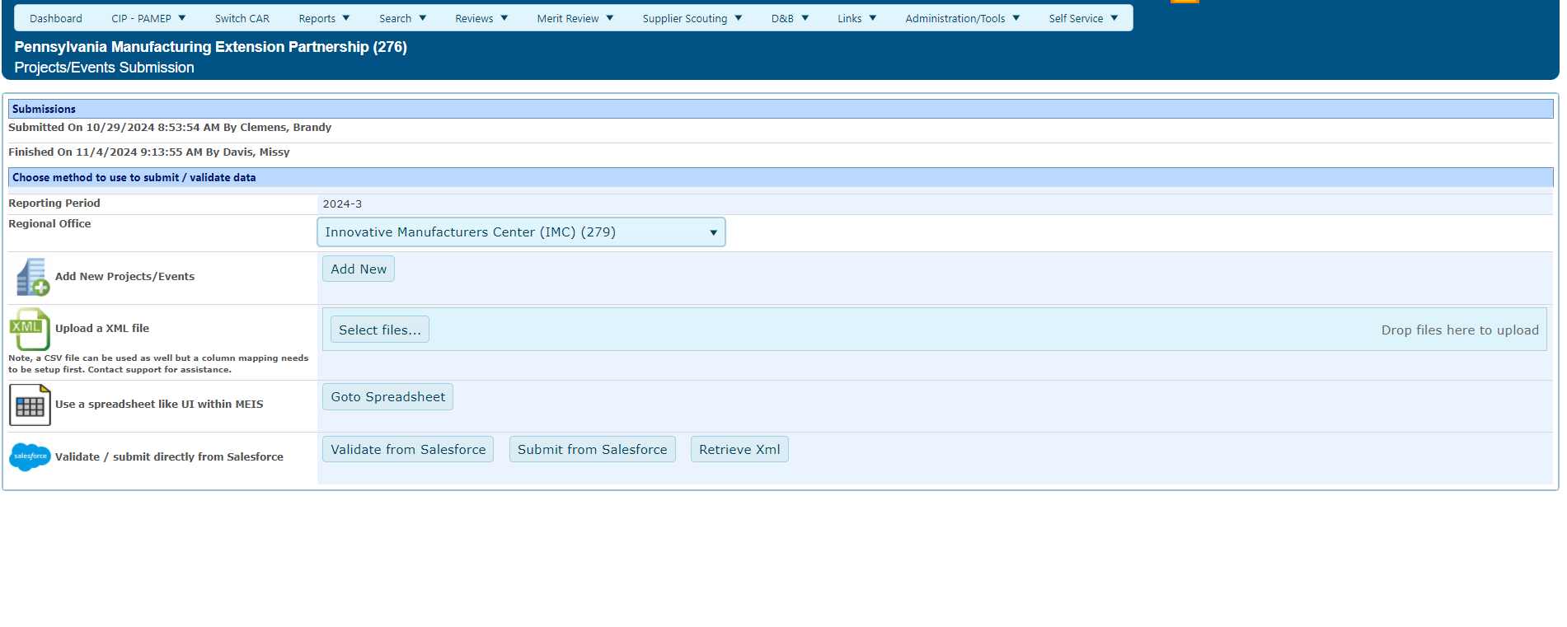
Reporting Elements – Projects and Events
(Quarterly and As Changes Occur)

Slide 60
Reporting Elements – Projects and Events
(Quarterly and As Changes Occur)
Workflow:
  There is a workflow if clients are submitted as a batch submission (CSV or XML), use the Spreadsheet Interface, or from Salesforce as opposed to manually entered.
  Add New (One by One)
    Center is responsible for ensuring that a duplicate Project/Event record (same Project, two different CAR Project Ids on a client) is NOT being created.
    MEIS will report an error if a duplicate CAR Project ID is used but will not give an error if the same Project/Event Title is used with a different CAR Project ID
    Click OK to save
  Salesforce/MEIS Utility
    Click Validate from Salesforce. Any errors are displayed.
    If the utility returns errors, the issues will need to be corrected in your Salesforce System. Repeat this process until the utility passes validation with no errors. You will then need to submit for reporting
    Click Submit from Salesforce. The information in Salesforce is submitted to the MEIS database
    You are redirected to the CAR Dashboard. If you have successfully submitted Project and Event information – the Status Icon will be half green/half yellow indicating the submission is “Passed Pending MEP Review”
    A MEP staff member then has to review and finalize the submission to achieve the “Passed” icon
Notes:
There is a workflow if Projects and Events are submitted as a batch submission (CSV or XML), use the Spreadsheet Interface, or from Salesforce as opposed to manually entered.
When entering the hard way (One by One) click Add New
Center is responsible for ensuring that a duplicate project record (same Project/Event two different CAR Project IDs) is NOT being created.
MEIS will report an error if a duplicate CAR Project ID is used but will not give an error if the same Project/Event Title is used with a different CAR Project ID
Click OK to save
If you are using the Salesforce/MEIS Utility
Click Validate from Salesforce. Any errors are displayed.
If the utility returns errors, the issues will need to be corrected in your Salesforce System. Repeat this process until the utility passes validation with no errors. You will then need to submit for reporting
Click Submit from Salesforce. The information in Salesforce is submitted to the MEIS database
You are redirected to the CAR Dashboard. If you have successfully submitted Project/Event information – the Status Icon will be half green/half yellow indicating the submission is “Passed Pending MEP Review”
A MEP staff member then has to review and finalize the submission to achieve the “Passed” icon

Slide 61
Reporting Elements – Projects and Events
(Quarterly and As Changes Occur)
Workflow:
  CSV or XML Upload
    XML Upload
      PIF Template with macro to convert to XML option WILL BE eliminated in 2019Q4
      But if you are going to use this time, PIF must be converted to XML using the Excel Template
        XML is an open standard for describing data and is an ideal solution for transferring structured data from server-to-client, server-to-server or application-to-application on any platform
        NIST MEP provides a PIF Template with an easy add-in to convert to XML
      Click Select File, choose the proper XML file
      Click Submit for Validation. Any errors with the file are displayed. When a file is submitted for validation, the file is checked to ensure validity and consistency. Field level validation ensures that the data entered in all record fields are correct. However, this type of validation does not validate against Project and Event records already existing in the MEIS database. This is achieved through validation at the database level
      If the file fails with errors, the XML file will need to be corrected and re-uploaded using the same process. Repeat this process until the file passes with no errors. You will then need to submit for reporting
      Click Submit to System. The information in the file is submitted to the MEIS database
      You are redirected to the CAR Dashboard. If you have successfully submitted Project and Event information – the Status Icon will be half green/half yellow indicating the submission is “Passed Pending MEP Review”
      A MEP staff member then has to review and finalize the submission to achieve the “Passed” icon
Notes:
If using one of the two file upload format’s CSV or XML the instructions are similar just different file formats. CSV is a new option that was created to eliminate the CIF Excel file with Macro that has become less stable on the various Microsoft Windows Operating System and Microsoft Office versions.
XML Upload (The PIF Template with macro to convert to XML option WILL BE eliminated in 2019Q4) But if you are going to use this time, PIF must be converted to XML using the Excel Template
Click Select File, choose the proper XML file
Click Submit for Validation. Any errors with the file are displayed. When a file is submitted for validation, the file is checked to ensure validity and consistency. Field level validation ensures that the data entered in all record fields are correct. However, this type of validation does not validate against Project and Event records already existing in the MEIS database. This is achieved through validation at the database level
If the file fails with errors, the XML file will need to be corrected and re-uploaded using the same process. Repeat this process until the file passes with no errors. You will then need to submit for reporting
Click Submit to System. The information in the file is submitted to the MEIS database
You are redirected to the CAR Dashboard. If you have successfully submitted Project and Event information – the Status Icon will be half green/half yellow indicating the submission is “Passed Pending MEP Review”
A MEP staff member then has to review and finalize the submission to achieve the “Passed” icon

Slide 62
Reporting Elements – Projects and Events
(Quarterly and As Changes Occur)
    CSV Upload
      Create CSV file (Microsoft Comma Delimited)
      Click Select File, choose the proper CSV file
      Click Submit for Validation. Any errors with the file are displayed. When a file is submitted for validation, the file is checked to ensure validity and consistency. Field level validation ensures that the data entered in all record fields are correct. However, this type of validation does not validate against Project and Event records already existing in the MEIS database. This is achieved through validation at the database level
      If the file fails with errors, the CSV file will need to be corrected and re-uploaded using the same process. Repeat this process until the file passes with no errors. You will then need to submit for reporting
      Click Submit to System. The information in the file is submitted to the MEIS database
      You are redirected to the CAR Dashboard. If you have successfully submitted Project and Event information – the Status Icon will be half green/half yellow indicating the submission is “Passed Pending MEP Review”
      A MEP staff member then has to review and finalize the submission to achieve the “Passed” icon
Notes:
CSV Upload
Click Select File, choose the proper CSV file
Click Submit for Validation. Any errors with the file are displayed. When a file is submitted for validation, the file is checked to ensure validity and consistency. Field level validation ensures that the data entered in all record fields are correct. However, this type of validation does not validate against Project and Event records already existing in the MEIS database. This is achieved through validation at the database level
If the file fails with errors, the CSV file will need to be corrected and re-uploaded using the same process. Repeat this process until the file passes with no errors. You will then need to submit for reporting
Click Submit to System. The information in the file is submitted to the MEIS database
You are redirected to the CAR Dashboard. If you have successfully submitted Project and Event information – the Status Icon will be half green/half yellow indicating the submission is “Passed Pending MEP Review”
A MEP staff member then has to review and finalize the submission to achieve the “Passed” icon

Slide 63
Reporting Elements – Projects and Events
(Quarterly and As Changes Occur))
    Spreadsheet Interface
      Click Goto Spreadsheet
      Enter data (typing or cut/paste) into the appropriate fields.
      Simple data errors such as an inactive National Account, will result in a pop-up error message displayed. Complex data errors such as a duplicate Project will be displayed after validation
      If adding multiple rows, select the number of rows to add
      Click Submit for Validation. Any errors in the spreadsheet will be displayed. When the spreadsheet is submitted for validation, the data is checked to ensure validity and consistency. .
      If the spreadsheet fails with errors, the issues will need to be corrected. Repeat this process until the spreadsheet passes validation with no errors. You will then need to submit for reporting
      Click Submit to System. The information in the spreadsheet is submitted to the MEIS database
      You are redirected to the CAR Dashboard. If you have successfully submitted Project and Event information – the Status Icon will be half green/half yellow indicating the submission is “Passed Pending MEP Review”
      A MEP staff member then has to review and finalize the submission to achieve the “Passed” icon
Notes:
And now we want to introduce our new Spreadsheet Interface
Click Goto Spreadsheet
Enter data (typing or cut/paste) into the appropriate fields.
If adding multiple rows, select the number of rows to add
Simple data errors such as an inactive National Account will result in a pop-up error message displayed. Complex data errors such as a duplicate project will be displayed after validation.
Click Submit for Validation. Any errors in the spreadsheet will be displayed. When the spreadsheet is submitted for validation, the data is checked to ensure validity and consistency. .
If the spreadsheet fails with errors, the issues will need to be corrected. Repeat this process until the spreadsheet passes validation with no errors. You will then need to submit for reporting
Click Submit to System. The information in the spreadsheet is submitted to the MEIS database
You are redirected to the CAR Dashboard. If you have successfully submitted Project and Event information – the Status Icon will be half green/half yellow indicating the submission is “Passed Pending MEP Review”
A MEP staff member then has to review and finalize the submission to achieve the “Passed” icon

Slide 64
Reporting Elements – Projects and Events
(Quarterly and As Changes Occur)
Explanation of Key
  Blue Circle – Started (In Process but not submitted by Center)
  Green Circle – Passed (data is in MEIS)
  Green/Yellow Circle with Exclamation Point - Passed with Warnings (not likely to appear with Projects and Events)
  Green/Yellow Circle with Asterisk – Passed with Errors (Not Used for Projects/Events)
  Green/Yellow Circle – Passed Pending MEP Review (waiting on NIST MEP review)
  Red Circle – Failed (invalid file format)
  Pink Circle – Cleaned (NIST MEP deleted a submission)
  White Circle – No Submission (No activity as of yet)

Slide 65
Reporting Elements – Projects and Events
(Quarterly and As Changes Occur)
Related Reports: Either data used in report or clickable from page
CAR List
CAR Survey Results - detailed
Clients and Projects
Clients/Projects/Impacts
Cohort Comparison
Impact Analysis
IMPACT Metrics
IMPACT Metrics Detail
IMPACT Metrics Summary
Industry Profile
New/Repeat Clients
Success Story Details
Success Story Marketing
Survey Confirmation
Survey Continuity (Clients and Projects)
Survey Impact Allocation by Hours
Survey Outliers
Survey Results
Survey Summary
Notes:
The reports listed are related to Project and Event reporting. You can access these reports by clicking CAR Reports from the top menu bar on your MEIS dashboard.

Slide 66
Reporting Elements – Projects and Events
(Quarterly and As Changes Occur)
Did you know:
  Common errors when reporting Projects and Events include:
    Date format
    Cutting and pasting into project description – strange characters
      Textpad can be a useful tool to avoid this. Download TextPad at www.textpad.com
    Total Project Value field only accepts whole values – no decimals
    Staff name in CAR Key Staff MUST be their MEIS User ID number
    Incorrect email format
    Using incorrect Funding Agreement Number
  PIF files may be tested for validation as many times as needed by clicking Submit for Validation, but in order for the submission to be finalized the file MUST be submitted as final by clicking Submit to System
Notes:
Did you know…
Listed on this slide are common errors received when submitting PIF for validation.
PIF files may be tested for validation as may times as needed by clicking “Submit for Validation” but in order for the submission to be finalized, the file must be submitted as final by clicking “Submit to System”.
How Centers report CAR Hours and Third Party Hours is important and is reflected in several of the Capacity Utilization charts in the CAR Summary and CPPR Reports such as Hours per Project and In-House Vs Third Party Delivery.

Slide 67
Projects and Events Information Collected From Center
Client ID/Name Association
CAR Project ID
Funding Agreement Number
Substance (14 choices)
Delivery Mode (Project or Event)
Project Mode (Assessment, Training, Implementation, or Light Interaction)
Project Title
Project Description
Initiated Date
Completed Date
Estimated Impact Span (EIS)
National Account
CAR Key Staff
CAR Hours
Third Party Organization
Third Party Hours
Total Project Value
Project Cost Share (Direct or Facilitated)
Notes:
The Projects and Events Reporting element is used by the centers to report information on services delivered to clients in the form of Projects and Events. Some data is provided by Centers. We want to highlight the fields in blue.
Estimated Impact Span – the number of times the project will be surveyed. Use this field strategically. This will be discussed in more detail in the Survey Confirmation module.
National Account – this field has become very important with the award of Special Projects. We will discuss further when we go over reporting for Special Projects.
CAR Hours and Third Party Hours – used in capacity utilization charts – please report accurately
Third Party Organization – used for capacity utilization and also to show centers working together. If you contract with another center to deliver services for you please make sure the Center delivering the service is given credit for the work by entering their organizational name in this field.
Project Cost Share (Direct or Facilitated) – projects directly expensed to the cooperative agreement including matching funds vs projects that are made possible by virtue of the cooperative agreement and the power of the network brand with other government agencies. This field will also be touched on in more detail later this afternoon when we present on …

Slide 68
Projects and Events Information Calculated/Designated by NIST MEP
MEIS Project ID
MEP Special Project (Supply Chain Optimization, ExportTech)
Reported Date – (Year/Quarter project reported – primarily used for troubleshooting purposes)
Completed Period – (Year/Quarter project completed- determines when client counts as unique and new or repeat and when selected for survey)
Total Hours (calculated sum of CAR and Third Party Hours)
Notes:
And some data is Calculated based on information within MEIS or designated by NIST MEP. We want to highlight the fields in blue.

Slide 69
CIF and PIF Reporting Suggestions
Surveys are triggered off the project completion date, not the reporting period
If you report a project, it will be surveyed, with the exception of Light Interactions which are captured for market penetration analyses
Minimize the burden on clients – before reporting the project, try to decide if you can determine impact for the activity. If you cannot, then do not expect clients to be able to either
Use Project EIS field to your advantage
Use Project Cost Share (Direct or Facilitated) to your advantage
Notes:
Some suggestions and reminders for submitting CIF and PIFs are:
- Survey’s are triggered of project completion date, not the reporting date
- If you report a project, it will be surveyed 6 months after the completion date of the project
Before reporting the project, try to determine impact for the activity and use the project Estimated Impact Span (EIS) to your advantage.
Get “credit” for all the work your Center does. Report facilitated projects to improve Unique and New/Repeat Client counts. If the project is initiated based on a joint agreement with another agency, perhaps that agency could benefit from the NIST MEP robust client survey process. Share the aggregate impact results for these projects with the other agencies.

Slide 70
Operating Outcomes, Progress Plan and Budget Actuals are Intertwined
Feed Performance Metrics and Annual, Panel, and Secretarial Reviews
Operating Outcome Statements
  Proposal/Statement of Work (SOW)
  Narratives (3000 character limit)
  Goals ( Client and Engagement)
Progress Plan (aka Technical Report)
  Narrative response to Operating Outcome Statement (3000 character limit)
  SF425
  Other Resources
Budget Actuals
  Revenue and expenses based on an as of date
  Reporting Set (construct in MEIS to allow NIST MEP to evaluate center performance based on the likely 10-year period between competitions 3-2, 3-2)
Notes:
There are three interrelated Reporting Components within the MEP Partnership Model, the Operating Outcomes Statement, Progress Plan and Budget Actuals.
Operating Outcome Statements provide the Center’s plan related to several operational areas over the first three years of the cooperative agreement, prior to the first panel review or the last two years of the cooperative agreement. Operating outcomes should be submitted anytime there is a change in narratives or the Client and Engagement goals need to be adjusted. Typically changes are identified during the Annual Review process.
Progress plans are to be submitted bi-annually and will include any changes to the budget as part of the required upload of the SF426 Financial Form.
While the SF425 details the award cumulative budget, the Budget Actuals detail the revenues and expenses for the Period of Performance.

Slide 71
NIST MEP Partnership Model Timeline
3rd Year Panel Review
8th Year Panel Review
Secretarial Review
Decision to Renew
Secretarial Review
Competition Initiated
1
2
3
4
5
6
7
8
9
End Year 5
End Year 10
3 Year Operating Plan & Budget
3 Year Operating Plan & Budget
2 Year Operating Plan & Budget
2 Year Operating Plan & Budget
Annual Reviews in Green
Notes:
The timeline above shows the major events that will likely occur for the Center during the 10 year cycle until guaranteed competition..

Slide 72
Operating Outcome Statements
(As Needed)
Purpose:
Creation of mutually agreed upon strategy and goals between NIST MEP (Federal Program Manager (FPM)) and the Center
Streamline documentation for CAR Response to Federal Funding Opportunity (FFO), renewals, annual reviews, panel reviews, best practices, performance measurement.
Workflow:
  Initially your FPM enters the information at the time your award is finalized into MEIS
  Center either on their own or due to a conversation with their FPM determines that an update to the existing Operating Outcomes is needed.
  Upon submittal the FPM is notified that a modification has occurred.
  FPM reviews the changes
    CLEAN – deletes the submission due to unnecessary submission
    RESET– FPM sends the Operating Outcome back to Center for changes. Notification includes reason for RESET.
    FINISH – FPM approves the changes. A notification goes out to the Center, FPM and sometimes Grants
Notes:
The Operating Outcome Statements describe the Center strategy and goals mutually agreed upon by the Center and the NIST MEP Resource Manager. The categories found within the Operating Outcome Statements are consistent with other documentation that a Center will need to provide throughout the life of the award including Federal Financial Opportunity, renewal documentation, Annual Reviews, Panel Review, Best Practices and Performance Measurement.
Centers MUST prepare an approved Operating Outcome Statement within 90 days of award approval. Initially the Operating Outcome Statements are entered by your Federal Program Officer into MEIS. Centers either on their own or due to a conversation with your FPM determine that the Operating Outcome Statements need to be updated.
The Center updates the narratives and/or Client Engagement Goals within MEIS. Centers will be required to enter an explanation as to what pieces of the Operating Outcome Statement were changed. When finished, the FPM is notified that a change has been submitted. It is the responsibility of the FPM to approve the changes. Once approved, MEIS will send a notification to the Center that their updates have been approved.
If the changes are not accepted, the FPM may choose to CLEAN the submission which deletes any record that updates were made or the FPM can RESET the submission effectively sending it back to the Center for additional editing. Regardless in any action taken, Centers will be notified of the status of their submission.

Slide 73
Operating Outcomes are to be updated as needed. - most likely prior to an annual/panel review.
How to update:
Click CIP Operating Outcomes, Submit Updates, edit the information, click Actions Submit
  Update the Proposal/SOW (previous versions are maintained)
  Update the Narrative – only enter information for the sections you wish to change. If you enter “No Changes” then the words “No Changes” are going to overwrite what is currently stored in MEIS
  Modify the Client or Engagement Goals – adjust the estimated goals as needed and circumstances change
  Reviewed by your FPM and will either be accepted or reset (sent back for additional clarification). Once approved a notification is made to the FPM and Grants acknowledging that the changes have been excepted.
Notes:
To update your Operating Outcome Statements, click CIP, Operating Outcomes, Submit Updates, edit the information (either the narratives or the goal estimates), provide an explanation of changes, Click Actions, Submit to notify your Federal Program Manager that changes to the current Operating Outcome Statements have been made.
Centers CANNOT update the Proposal/Statement of Work (SOW) using this mechanism. The Proposal/SOW is an official document and must go through an approval process that includes both NIST MEP and Grants. If changes are required to this document, Centers MUST submit these changes through email to your Federal Program Officer.
To make it easier to update the Narratives, the current version for each category is displayed. Centers and insert, delete and modify content as needed. Do not enter “No Changes” as that will replace the existing content with the words “No Changes”. If there are NO CHANGES needed, simply leave the existing content as is.
To adjust the estimated Client and Engagement Goals edit one or more of the categories in the table. Make sure you are editing the applicable time period within the Reporting Set so that your changes are reflected as desired.
An email is sent to the FPM when Centers update these statements. The changes will be Reviewed by your FPM and will either be accepted (aka FINISHED) or sent back to the center for additional work (RESET_

Slide 74
Operating Outcomes
(As Needed)
Related Reports:
  To be determined – are they necessary? What would be useful?
Did you know…
  Visible within your Progress Plan
  Center is also responsible for information in the Operating Outcomes. Click on this element, read it, make sure the information entered is accurate.. If not you, make sure your Center Director and/or others on your management team know about this section.
  Operating Outcomes mirror the narratives that you will respond to in your semi-annual Progress Plan.
  Operating Outcomes will be used in your Annual/Panel reviews.
Notes:
At this time MEIS does not provide a standard Operating Outcome Statements report. Would this be helpful? Lease let us know what you think. We do output in the Clients/Projects Report, the status of each project as relates to the Client and Engagement Goals. Run the report and scroll all the way to the right to see if a particular client/project submitted met one or more of these goals.
Did you Know….
That your current Operating Outcome Statements are visible within your Progress Plan for reference as you complete the Progress Plan/Technical Report submission. Click the link Show/Hide Operating Outcomes Statement above each category to see the current narratives on file.
Did you know that as a Center you are responsible for the accuracy of the Operating Outcome Statements. Click on this element, read the content, review the Client and Engagement Goals, make sure the information entered is accurate.. If ti is not what was expected, make sure your Center Director is aware and initiates a conversation with your FPM to update.
Did you know that the categories in the Operating Outcome Statements mirror the categories Centers are required to respond to in their semi-annual Progress Plan submissions?
And finally, did you know these same categories will also be used in your Annual and Panel Reviews.
This is the goal of the MEP Partnership Model, alignment across proposal, reporting, review, and renewals with the MEP Strategy.

Slide 75
Client Goals - Very Small, Rural, Start-up and SMEs Served – All D&B Based
Definitions provided in Operating Outcome documents
  Very Small = <20 employees
  Rural = Using USDA Rural Continuum Code
  Start-up = established within last 5 years
  Other SME’s not captured in one of the specific groupings above
  Total unique clients
Within the Progress Plan narratives, describe the overall program progress describing center strategy for serving these clients. NIST MEP does not want just a list of company names.
Data in table is calculated based on what was submitted in your Projects.
Without a project, a client alone does not count towards these goals.
NOTE: Client goals are based on what the current D&B record in MEIS states. Records are updated automatically if the last update date is older than 6 months. As soon as a project is Finalized by NIST MEP the tracking of progress to goal occurs.
These are not mutually exclusive categories, in other words a client might count in several of these at one time
Notes:
Client counts are triggered by project/event completion dates. If there is no project, there can not be a client that meets a goal. Progress to Very Small, Rural and Start-up goals will be validated based on Dun and Bradstreet (D&B) data.
Very small clients – establishment employment <20 employees
Rural clients – located in counties designated as rural according to the United States Department of Agricultural Rural Continuum Code (RUCC). County is determined by D&B FIPS State and County Codes
Startup – company established (year founded) within the last 5 years
Other SMEs – if a client served does not meet one of the designations for Very Small, Rural, Startup as defined on this slide or Transformation as defined on the next slide, then it is an “Other SME” As an example, a manufacturing client with employees = 232 or a client located in a county designated as urban
Total Unique Clients – distinct count of clients (Duns number)
In addition to the progress towards client engagement goals, Centers must address as part of their Progress Plan narrative a response to meeting these goals.
Please remember, as previously stated, without a project, a client alone does not count towards these goals and is validated based on D&B data. If D&B data in MEIS is older than 6 months an automatic update from the D&B servers is initiated. As soon as a project is finalized by NIST MEP, the tracking of progress to goals occurs.
If a center submits their Clients (CIF) and Projects/Events (PIF) prior to completing the Progress Narrative, progress for each Year/Quarter will be displayed on your Progress Plan.
Please note, these are not mutually exclusive categories, a client might count in several categories at one time (ex. Very Small and Rural).
And finally, Centers can run the Client/Project report, scroll to the far right, to see the counts of clients/projects that meet each of these definition

Slide 76
Client Goals – What is a transformational client?
Definition used by NIST MEP
  “In Client record Centers select “Yes” or “No” to indicate if a client is considered to be in an ongoing transformative relationship with the center…Yes: Indicates the center has established a long-term, coaching relationship with the client and is helping the client transform.”
Your center decides which Clients/Projects fit this definition
Within the Progress Plan narratives describe your center’s overall program progress describing the center’s strategy for serving transformational clients. This is to be detailed description as to how your center is transforming clients. This MUST not be just a list of company names
Data in table is calculated based on what was submitted in your Projects.
NOTE: A client MUST be marked as transformational before you submit a project. As soon as a project is Finalized by NIST MEP the tracking of progress to goal occurs.
Notes:
In order for a client to be counted as transformation, the client record MUST be marked as Transformation prior to the submission of the Project/Event. It is up to the Center along with your FPM to determine the appropriate definition of a transformation client.
Centers MUST also include a narrative in response to the Center’s strategy for serving transformational clients.
Please note, a client MUST be marked as Transformational prior to submission of the project/event. Centers can run the Client/Project report, scroll to the far right, to see the counts of clients/projects that meet each of these definition.

Slide 77
Engagement Goals - Top Line/Bottom Line Growth
The Progress Plan includes two separate narrative sections related to engagement goals. The determination of a project falling under Top Line or Bottom Line Growth is aligned with the NIST MEP substance codes. Centers determine which projects fit where in the mix.
  Progress Narrative, overall program progress, not just a list of services
  Data in table is calculated based on what was submitted in your Projects.
  Percentage of all projects submitted in the quarter/time period
Top Line Growth | Bottom Line Growth
25 - Growth Services/Product Development Services | 23 – Lean Product Suite
26 - Sustainability Services Suite | 24 – Quality Product Suite
27 - Strategic/Business, Mgmt./Planning Services Suite | 31 - Engineering Services/Plant Layout
28 - Technology/Advanced Manufacturing Services | 32 - Information Technology (IT)/Cybersecurity Services
29 - Financial Analysis/Assistance Services Suite | 33 - Workforce Services
30 - Sales/Marketing/Business Development Services Suite | 34 – Supply Chain Services
Notes:
Engagement goals are based on the Substance Code assigned to the project by the Center. The NIST MEP Substance Codes are assigned to either contribute to Top Line or Bottom Line Growth.
In addition to the percent of total projects completed per Year/Quarter that are Top Line or Bottom Line can be viewed in the Center Progress Plan.
Centers can run the Client/Project report, scroll to the far right, to see the counts of clients/projects that meet each of this definition

Slide 78
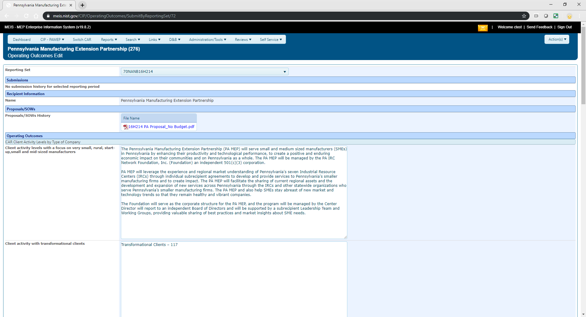
Operating Outcome Statements
Proposal/SOW
Narrative
Notes:
Here is a screenshot of the Operating Outcome Statements update page. Please note that Centers can click on Proposal/SOW documents but cannot upload them.

Slide 79
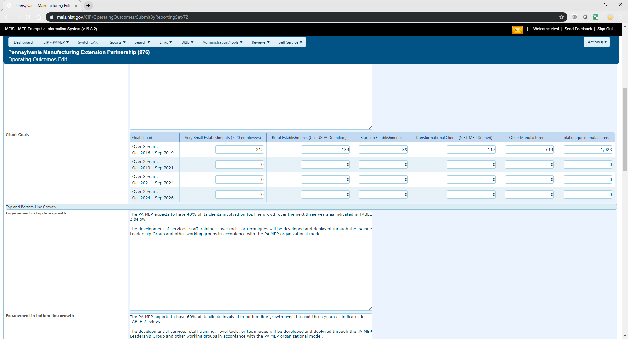
Operating Outcomes
Client Goals
Notes:
This screenshot shows the table for the Client Goals that can be edited as needed. Most Centers have been through a Panel Review. Post Panel, has your Center updated the Center Operating Outcome Goals?

Slide 80
Reporting Elements – Progress Plan
(Semi-annually)
Purpose:
  Technical Report – cooperative agreement requirement including the SF425
  Narrative for NIST MEP staff outside of your FPM to be familiar with your Center activities
  Used in Center Performance Management and Feeds Annual/Panel Reviews
How to Report:
Click CIP, Progress Plan, Submit Quarterly Reports, enter information (oh if only it were that easy), Click Actions Submit for Reporting
  Enter your narrative response for each major section. If there is nothing new to report for the period, let your FPM know that you did not just skip the section. (3000 characters)
  Attach your SF 425
  Make sure you check all of the acknowledgements (official of CAR, change budget with Grants, change OO with NIST MEP), otherwise MEIS will not allow you to submit.
  If there is additional information to be included, attach document(s) in Related Documents.
Most complex and time-consuming reporting element.
Notes:
The Progress Plan/Technical Report is specifically called out in your cooperative agreement as a required submission that MUST be received by your Grants Specialist in the NIST Grants Office no later than 30 days after the end of the time period covered. The specifics of this are detailed in your Special Award Conditions (SACs). This report is a formal mechanism for communicating Center activities to NIST MEP Management and your Regional Team (Federal Program Manager and Grants Specialist).

Slide 81
Reporting Elements – Progress Plan
(Semi-annually)
Workflow:
Once submitted, an email is sent to your FPM and Grants Specialist to notify them that the report is ready for review.
FPM has initial review and will either:
  FINISH – accept submission, no longer editable by the center (email is sent to Center, FPM and Grants)
  RESET – Center is able to edit again to make revisions, an email is sent to all parties indicating the submission has been RESET, process begins again
  CLEAN – Submission is deleted, an email is sent to all parties
  Grants has a reconciliation review which may/may not be going on simultaneously Typically look at SF425 and will RESET if the form submitted is not correct/reasonable
  When Finished (approved by the FPM) the entire package including PDFs of the narrative, SF425 and supplemental documents are sent to Grants, FPM and Center.
Related Reports: Either data used in report or clickable from page
  Progress Plan – from the Progress Plan List – Click Actions, Print
  MEIS Dashboard – CAR Documents Widget – link to most recent report
Notes:
Once submitted an email is sent to your Federal Program Manager and Grants Specialist notifying them that the report is ready for review.
Your Federal Program Manager will review the document for compliance and will either:
Approve (FINISH) by the Federal Program Officer. Once both approvals are logged, an email will be sent to the Center Director, Center Reporting Contact, Federal Program Manager and Grants Specialist indicating the report is final.
RESET the submission if it is incomplete or incorrect which then opens the report up for editing by the Center again. Once the report has been remedied the Center will SUBMIT again starting the workflow over.
CLEAN – the submission is deleted as it was unnecessary and an email is sent to all parties with an explanation.
When all approvals have been received, the entire package including PDFs of the narratives, SF425, and supplemental documents are sent to Grants, Federal Program Manager and the Center for filing purposes.
At the same time that your Federal Program Manager is reviewing your Progress Plan submission, so is the Grants Specialist. The Grants Specialist is primarily looking at he SF425 financial form for compliance with regulations.
While the Grants Specialist will not RESET your submission and return it to you directly, they might contact your Federal Program Officer and ask them to RESET so that you can fix and resubmit or they may contact you directly. Because of timing this could happen after you are already received an acceptance email.
A printable version of the Progress Plan can be generated from the Progress Plan list page. Click Actions, Print and export to PDF.
Until the Budget Actuals are entered by the Center, this information in the View Budget link from the Progress Plan will not appear in the report.

Slide 82
Reporting Elements – Progress Plan
(Semi-annually)
Did you know:
  You can read your Proposal/Statement of Work from within your Progress Plan.
  Click to view/hide Operating Outcome Statements
  Click to view/hide Previous Progress Plan narratives
  Click to view but not edit your Budget Table
  Click to view/hide Client and Engagement Goals
  Click on the Year/Qtr links to see clients identified by name that meet each goal
  You can attach additional documents to provide more information to NIST MEP about the project (Schedules, Gantt Charts, Graphs, Images, Narratives)
Notes:
Did you know that the Progress Plan has lots and lots of clickable links that display all kinds of useful information including:
Proposal/Statement of Work (SOW) history and clickable/downloadable links
Click the View/Hide Operating Outcome Statement for each category
Click the View/Hide Previous Progress Plan narratives
The View Budget link to display the Actual and Estimated budgets across all known awards and includes variance and total calculations.
Click the View/Hide link to display Client and Engagement Goals, when you click this link a table appears, click the Year/Quarter link to see which Clients and Projects are included in the counts for each.
And if you have additional information you want to convey to NIST MEP that require supporting documentation, upload a variety of electronic file formats in the Related Document section.

Slide 83
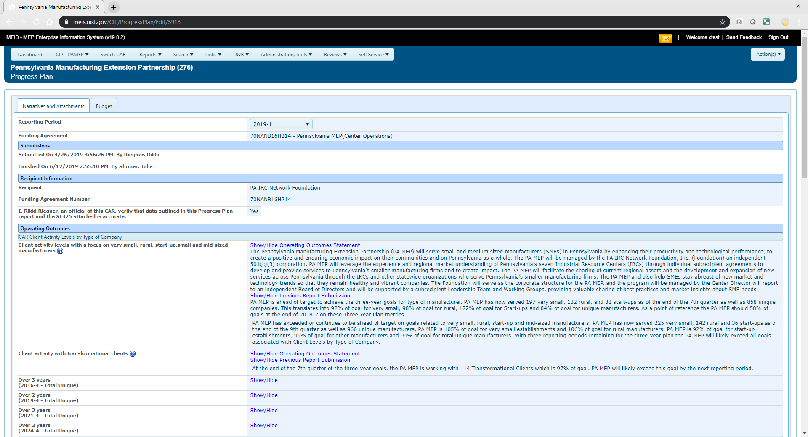
Progress Plan – Semi-annual response to Operating Outcomes
View OO statement and if available previous PP submission.
Narrative Response
Notes:
This is a screenshot showing where to click to Show/Hide Operating Outcome Statement as well as a sample narrative response to the Car Client Activity Levels by type of Company.

Slide 84
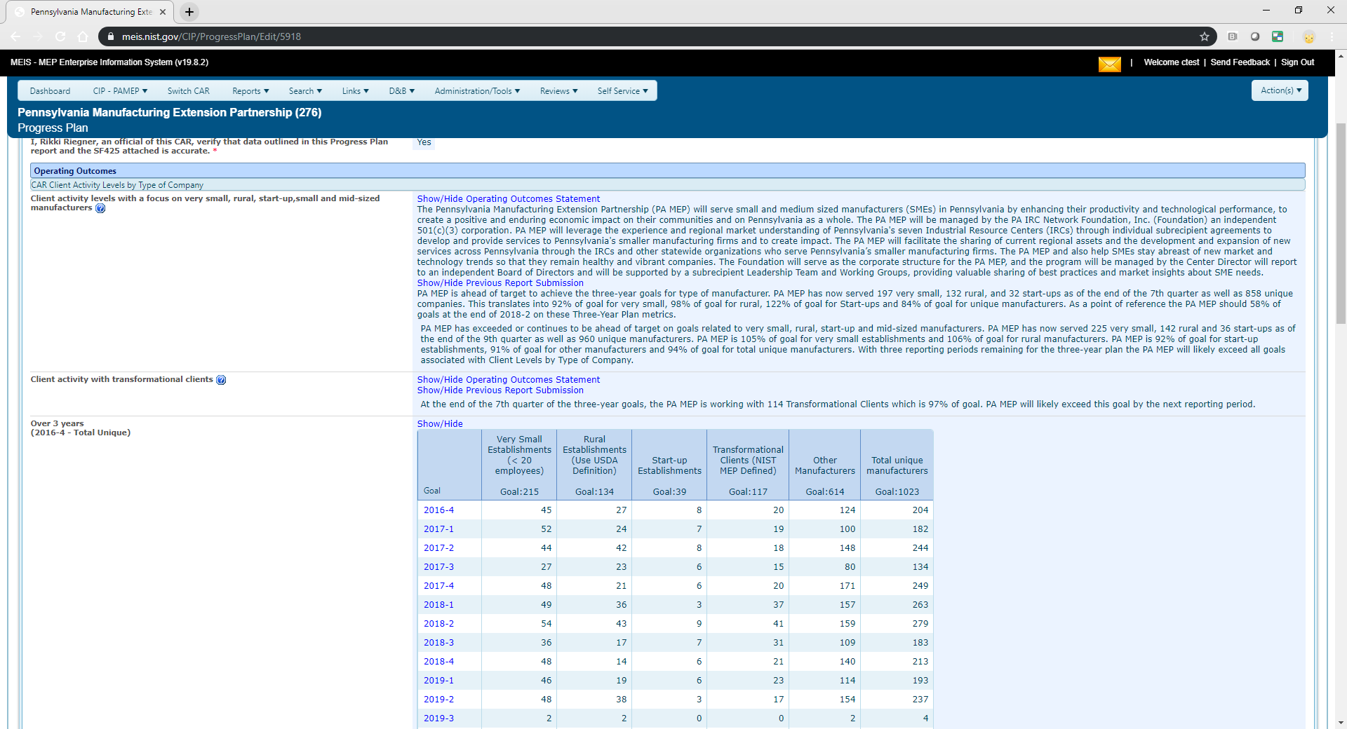
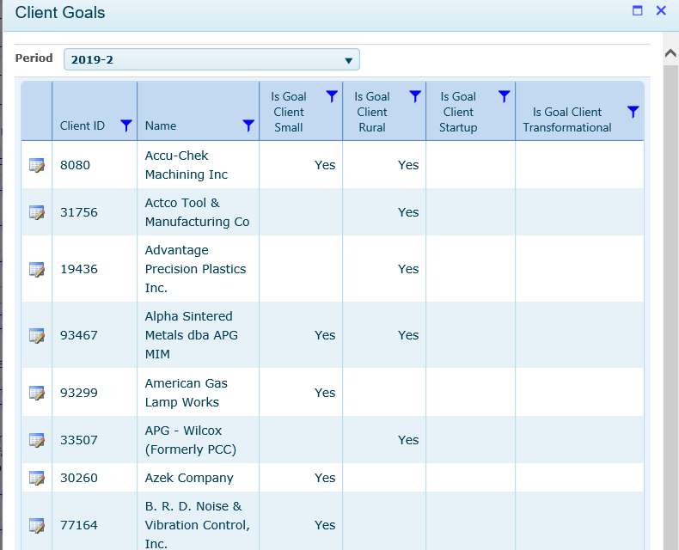
Progress Plan – Semi-annual response to Operating Outcomes (Continued)
Change year/quarter
Show/Hide Table
Client Goals - details
Link to client details
Notes:
This screenshot shows where to click to View/Hide the Client Goals, drill down to Year/Quarter and then the details. The number at the bottom is a unique count across the time period (3 or 2 years).

Slide 85
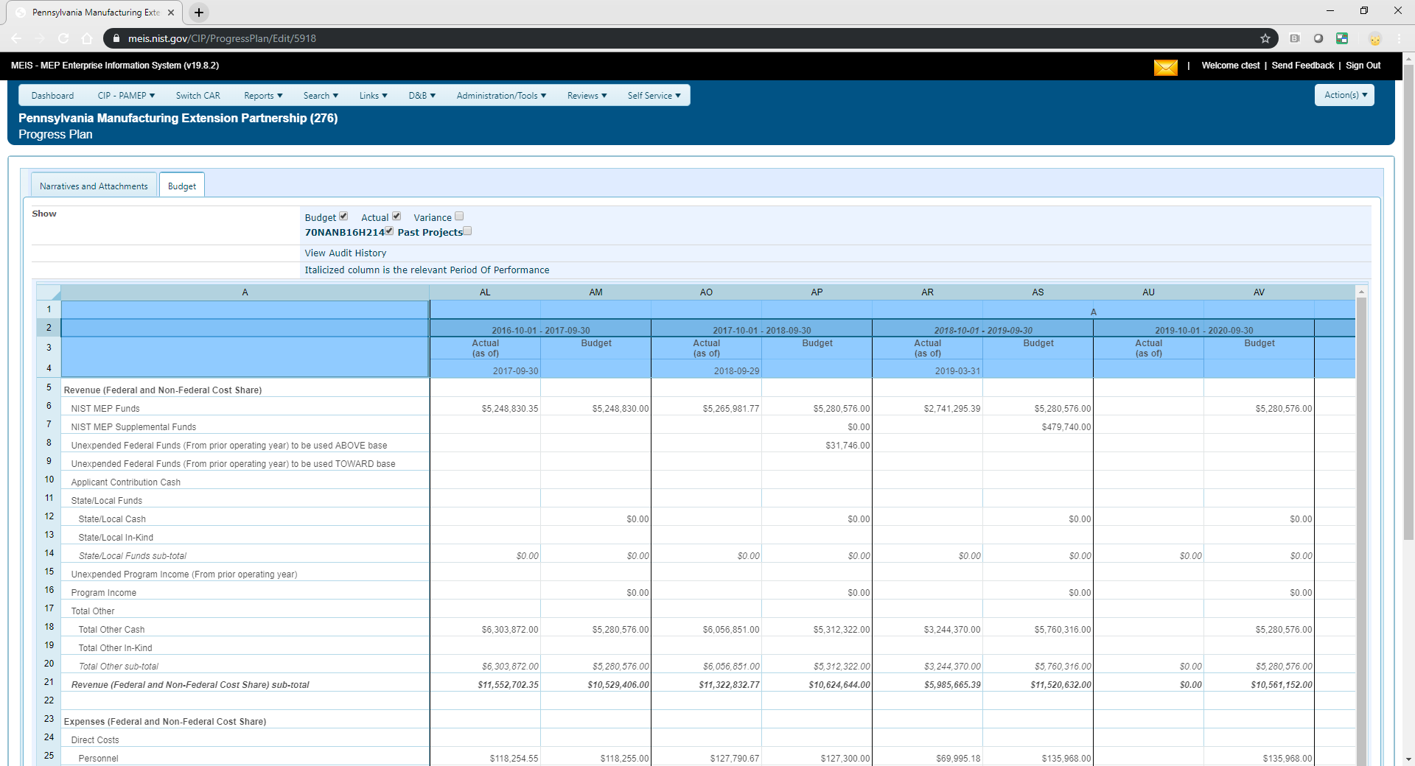
Progress Plan – Semi-annual response to Operating Outcomes (Continued)
Budget Table
Use checkboxes to display Estimated Budgets and Variance for one of more awards
Display of POP Actuals and POP Budget
Center enters actuals for reporting period
Notes:
Click the Budget Tab to view Actual Budget by Period of Performance (POP) and use the checkboxes to display Estimated Budgets and Variance for one or more awards.

Slide 86
Budget Actuals
(Semi-annually and Prior to Panel Review)
Purpose:
Communication of detailed Revenue and Expenses during the reported time period.
Used in Center Performance Management and Center Annual and Panel Reviews.
Workflow:
  Centers enter Budget Actuals as frequently as needed for activities happening such as a Panel Review where current financials are important to be stated
  Notifications are sent to Centers, Federal Program Manager. Please note Mailbox icon at top right of MEIS dashboard, if notifications are pending there will be a count shown in red if:
    Budget Actuals are >180 days old
    Budget Actuals have been recently changed
    Budget Actual As of Date does not equal end date of the Period of Performance and it is greater than 30 days after the end of the Period of Performance
    Budget Actuals As of Date does not equal end date of the Award and is greater than 90 days after the end of the Award
Notes:
The Budget Actuals entity is used to communicate detailed current Revenue and Expenses during the reported time period.
Centers enter Budget Actuals as frequently as needed for activities happening such as a Panel Review where current financials are imported to be stated and analyzed.
Due to the importance of having access to recent Budget Actual information, various notification are visible when updates are needed or changes have recently occurred.
Please note the Envelope icon at the top right of the MEIS dashboard, if notifications are pending, there will be a count shown in red. If:
Budget Actuals are >180 days old
Budget Actuals have been recently changed
Budget Actual As of Date does not equal end date of the Period of Performance and it is greater than 30 days after the end of the Period of Performance
Budget Actuals As of Date does not equal end date of the Award and is greater than 90 days after the end of the Award

Slide 87
Budget Actuals are to be updated when and as often as needed. Though most likely when submitting a Progress Plan and prior to an annual/panel review.
How to report:
Click CIP, Management, Budget Actuals, click on appropriate Reporting Set, enter the information for As of Date, Revenues and Expenses, automatically saved on entry
Related Reports:
  To be determined – are they necessary? What would be useful?
Did you know…
  Visible within CIP, Progress Plan
  Visible within CIP, Funding Program, Budget Tab
  Used within your Center Profile and Performance Report (CPPR)
Notes:
Budget Actuals are to be updated when and as often as needed though most like when submitting a Progress Plan due to complimentary nature and prior to an Annual or Panel Review.
To update your Budget Actuals, click CIP, Budget Actuals, click on appropriate Reporting Set, enter the information for As of Date, Revenues and Expenses. Changes are automatically saved on entry and clicking or tabing to next field.
This is a newish process so there is still significant confusion among NIST MEP and Centers as to when and how to enter this information. As such there are no standard reports developed yet, though there will be some in the near future.
Did you know that Budget Actual information is visible within the Progress Plan and Funding Program elements.

Slide 88
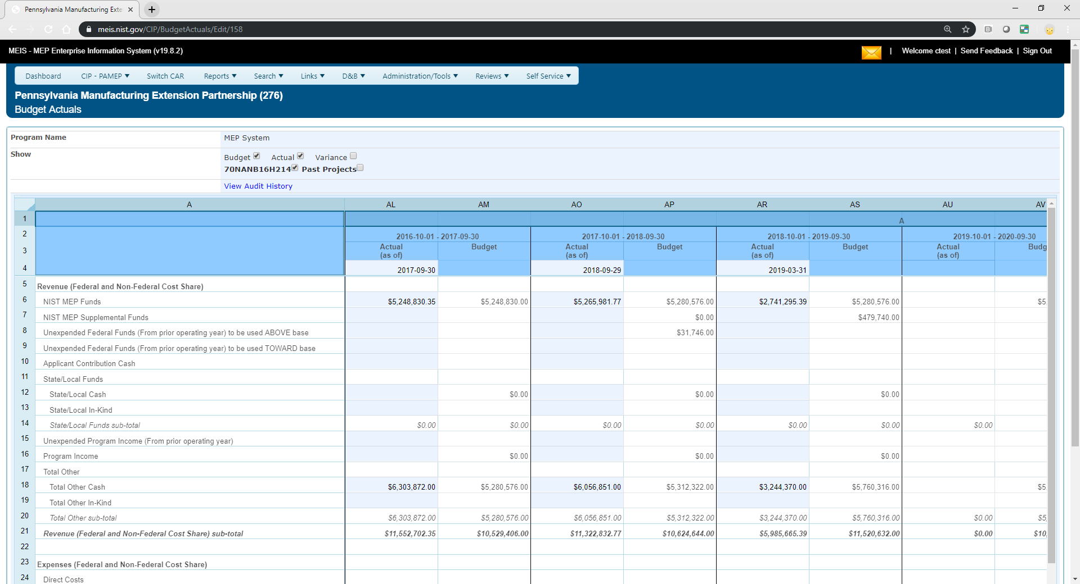
Budget Actuals
Notes:
Here is a screenshot.

Slide 89
Budget Actuals Key - Explained
Centers have asked that there be a visual on their Reporting Dashboard.
The following key applies:
  Green – Budget Actuals was submitted >= 1 <= 90 days
  Passed with Warnings – Budget Actuals was submitted between >90 <= 180 days
  Red – Last Budget Actuals was submitted > 180 days
  Clear/White – No submission
Notes:
Since Budget Actuals are not a Reporting Element, there was no status assigned on the Reporting Dashboard. Centers found this confusing and wanted to have a status displayed for consistency.
The following key applies to ONLY Budget Actuals.
Green – Budget Actuals was submitted >= 1 <= 90 days
Passed with Warnings – Budget Actuals was submitted between >90 <= 180 days
Red – Last Budget Actuals was submitted > 180 days
Clear/White – No submission

Slide 90
Reporting Elements – Success Story
(Quarterly)
Purpose:
  Success Stories reflect the variety and depth of impacts companies realize and are one of the most effective tools to communicate the value of MEP services
  Success Stories share experiences and communicate the value of MEP’s services to stakeholders and potential clients, and are often used as part of presentations for the budgeting process to demonstrate the effectiveness of the system and how it operates
  NIST and MEP create promotional materials using Success Stories that best describe the value and quality of their services to potential clients
  Posted on NIST MEP public website (last 5 years)
How to report:
  Click CIP, hover over Success Stories, Submit Quarterly Reports, review Success Stories, click Actions Add to add new Success Story, click Actions Submit for Reporting
    At least one Success Story is required every quarter
    Success Stories should be based on projects or events that were completed with small manufacturing establishments
    The project cannot be over 3 years old
    The primary NAICS codes of the SMEs must meet the MEP DOM.
Notes:
The purpose of the Success Story reporting element is to reflect the variety and depth of impacts that companies realize and are one of the most effective tools to communicate the value of the MEP services to stakeholders and potential clients. NIST and MEP use Success Stories in their promotional materials.
Centers are required to submit at least one Success Story every reporting quarter. The project cannot be over 3 years old and are posted on the NIST MEP Public Website.
From the MEIS dashboard, click on CIP, hover over Success Stories, Submit Quarterly Reports, review Success Stories, click Actions, Add to add a new Success Story. Click Actions, Submit for Reporting.

Slide 91
Reporting Elements – Success Story
(Quarterly)
Workflow:
  Each time the CAR submits a Success Story a NIST MEP staff person will review the material. A story may be accepted or rejected. A story is accepted if it meets all requirements and if it is well written. A story will be rejected if it is missing required information or if it is not well written. At least two quantified impacts are required.
  If the story is rejected, the CAR staff person that submitted the story, the Marketing Contact and the CAR Director will be notified by e-mail and given the reason(s) for rejection. The CAR will then edit the story online from the CAR Information Page and submit it again. If the story is accepted, the CAR staff person assigned the CAR Reporting Role will be notified of the acceptance by e-mail.
  There will be two separate versions of a Success Story. One will be submitted to the CAR Information Page, which will serve as a record that the CAR met its reporting requirements. The second copy will become the working copy edited by NIST MEP for publication. After a story has been edited the two copies will not match. CARs will not be allowed to directly edit a story after it has been accepted
  NIST MEP will review and, if necessary, edit the story. The story will be showcased after completion and made available in MEIS (https://meis.nist.gov) and on the MEP Public Site (http://nist.gov/mep)
Notes:
Each time as Success Story is submitted for reporting, there is a workflow that needs to be followed.
Once a Success Story is submitted, it is reviewed and accepted or rejected by a NIST MEP staff person. A story will be rejected if it is missing required information, not written well, or does not include at least one required quantified impact.
If a story is rejected the CAR staff person that submitted the story, the Marketing contact and the CAR Director will be notified by email and given the reason for rejection. The CAR will then edit the story online from the CAR Information Page and resubmit. If the story is accepted, the CAR staff person assigned with the Reporting Role will be notified of the acceptance by email.
There will be two separate versions of the Success Story. Once will be submitted to the CAR Information Page, which will serve as a record that the CAR met it’s reporting requirements. The second copy will become the working copy that will be edited by NIST MEP for Success Story publication. After a story has been edited, the two copies will not match. CARs will not be allowed to directly edit a story from the CAR Information Page after it has been accepted.
Success Stories will be showcased after acceptance ad made available in MEIS and on the MEP Public Site.

Slide 92
Reporting Elements – Success Story
(Quarterly)
Related Reports: Either data used or clickable from page
  Clients/Projects/Impacts
  Success Story Details
  One Pager (Documents/Communications)
  MEP Public Site
  Success Story – Marketing
  Success Story - Original
Did you know:
  The project must be accepted by NIST MEP and in MEIS as “finished” before it is available to be written about in a Success Story.
  Before submitting a Success Story for public use, the CAR must obtain the client’s written approval to release the information contained in the story
  NIST MEP encourages CARs to create the narrative portions of the Success Story report using a word processing program and then cut and paste the information into the online form. You would not want to compose long narratives on the web and then have a network problem cause you to lose the information.
  All formatting is stripped when submitted so no need to make it “pretty”. Bullets etc. cannot be supported.
  If corrections are needed after the Success Story has been submitted to NIST MEP, contact the NIST MEP Success Story Administrator
Notes:
Useful reports related to Success Stories are listed on this slide.
Did you know…
The project must be accepted by NIST MEP and in MEIS as “finished” before it is available to be written about in a Success Story?
Before submitting a Success Story for public use, the CAR must obtain the client’s written approval to release the information contained in the story?
NIST MEP encourages CARs to create the narrative portions of the Success Story report using a word processing program and then cut and paste the information into the online form? This is to prevent Centers from composing long narratives on the web and then have a network problem cause you to lose the information.
All formatting is stripped when submitted so no need to make it “pretty”?
If corrections are needed after the Success Story has been submitted to NIST MEP, you must contact the NIST MEP Success Story Administrator?

Slide 93
Center Can Choose a Success Story for your One Pager
The Center One Page fact sheet provides a brief overview of the Center plus highlights a Success Story
To choose which story is highlighted in the Success Story, the user must go to MEIS→ CIP→ Click Success Stories
From the Success Story list page click the radio button of the story you are interested in
Click Success Story Highlighted in One Pager→ Actions → Save

Slide 94
Success Stories: A Few More Things to Remember
Clients cannot be the subject of repeated success stories within a two-year span.
Stories will be edited to fit to one marketing page.
Success stories must follow the guidelines in the next slide and include information for each element. Each section is represented in MEIS.

Slide 95
Success Story Required Elements
Company Description: The description should be a concise, substantive description of the company including name, city/state, number of employees, branches/other facilities, key products and markets, and indicate if it’s family/woman-owed, etc.
Situation: Provide a brief explanation of the company’s challenge, whether high-level decision makers were involved, and why the company needed your assistance.
Solution: Briefly describe how you helped resolve the company’s challenge, including services provided and an overview of the process used to implement them, whether you brought in other resources, etc. Summarize actions taken.
Results: This section should feature 2-5 high-level impacts, with the most significant impact reported first. At least two should be a quantifiable increase in sales, jobs, or investment, or commercialization of new products and/or expansion into new markets. Centers can include data on cost savings or other changes in company performance metrics. Qualitative results could include such results as: the introduction of new technology, entering new markets, launching a new product, improving safety, etc.
Testimonial: Provide a short testimonial about the client’s experience working with your center and/or the impacts they have achieved as a result. A C-suite executive provides the most credibility.

Slide 96
Funding Programs

Slide 97
Centers can only view data in Funding Programs. It is a great place to look at budget, reporting sets, and quarterly allocations for IMPACT Metrics
Purpose:
  Centers need to be familiar with the information in this module as it is affects your ability to report and how your center’s performance is measured
    General Information about the award
    Contacts – who is who at NIST MEP and Grants on your Cooperative Agreement
    Federal Quarterly Allocation – Used in metric calculations.
    Total Cash Quarterly Allocation – Displayed on The CARD.
    Budget – read only view of all budget information
    Reporting Set – construct necessary for reporting and to look at center performance over 10 year period prior to competition
How to report:
  Not a direct submission by Centers though Budget Table Actuals are updated by Progress Plan submission
Notes:
Centers can only view data in the Funding Programs entity. This module has a wealth of information about Center Cooperative Agreement Awards, Periods of Performance, NIST MEP Contacts and Sub-recipient Agreements.

Slide 98
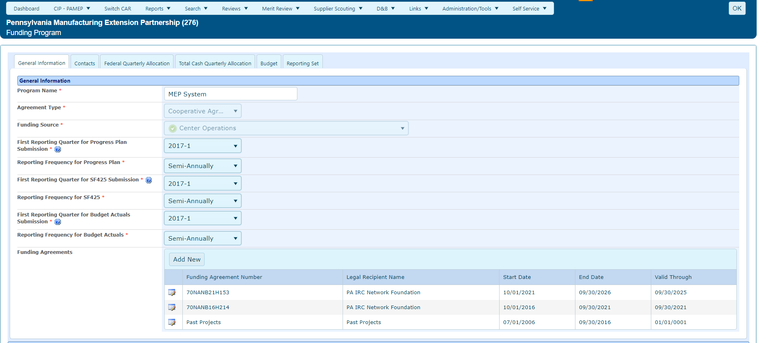
Funding Programs – General Information – Funding Agreement (Awards)
Click view/edit icon to see funding agreement award information
Notes:
This is a screenshot of the Funding Agreements (also known as Awards) list showing reporting frequency for the Progress Plan/Technical Report. Centers can drill down to see award information.

Slide 99
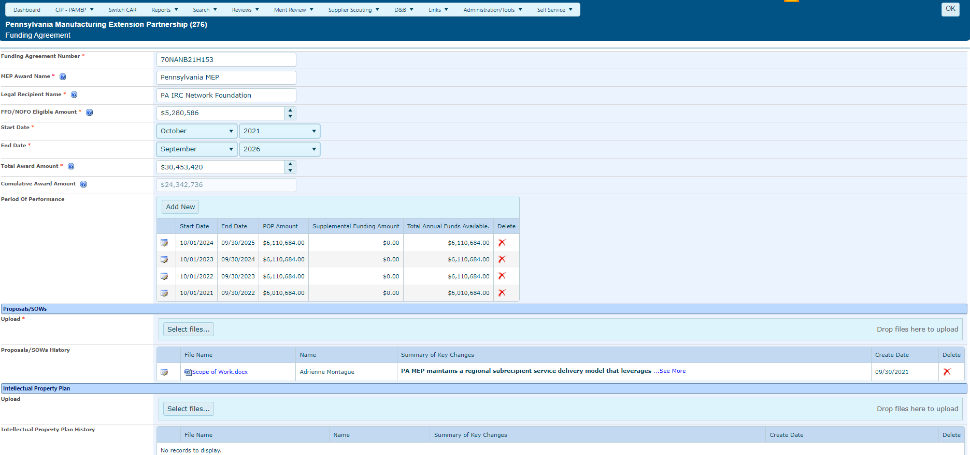
Funding Programs – General Information – Funding Agreement (Awards)
Period of Performances – click view/edit icon to drill down
Link to Proposal
Notes:
The Funding Agreement (Awards) record displays the Agreement Number (necessary for Project reporting, recipient name, start and end date of the multi-year award, Periods of Performances and associated Proposals/Statements of work.

Slide 100
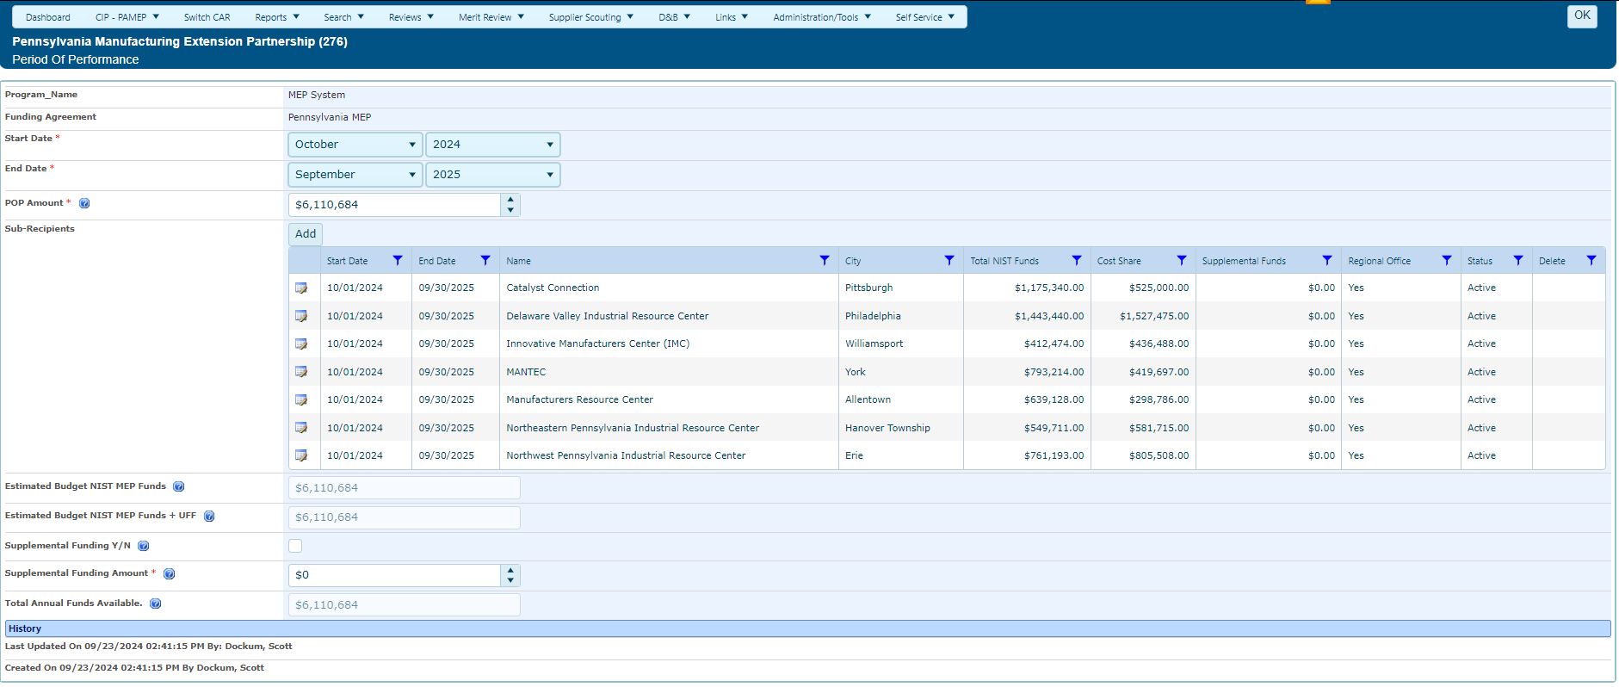
Funding Programs – General Information - Period of Performance
Listing of sub-recipients for this funding agreement
Notes:
From the Funding Program (Awards) list, Centers can drill down into the Periods of Performance (POPs) for each award. Within each Period of Performance are any Sub-recipients who have a legal and financial responsibility to the Center on the Cooperative Agreement.
The Sub-recipients identified here are included on Center Locations maps within MEIS and the CPPR.

Slide 101
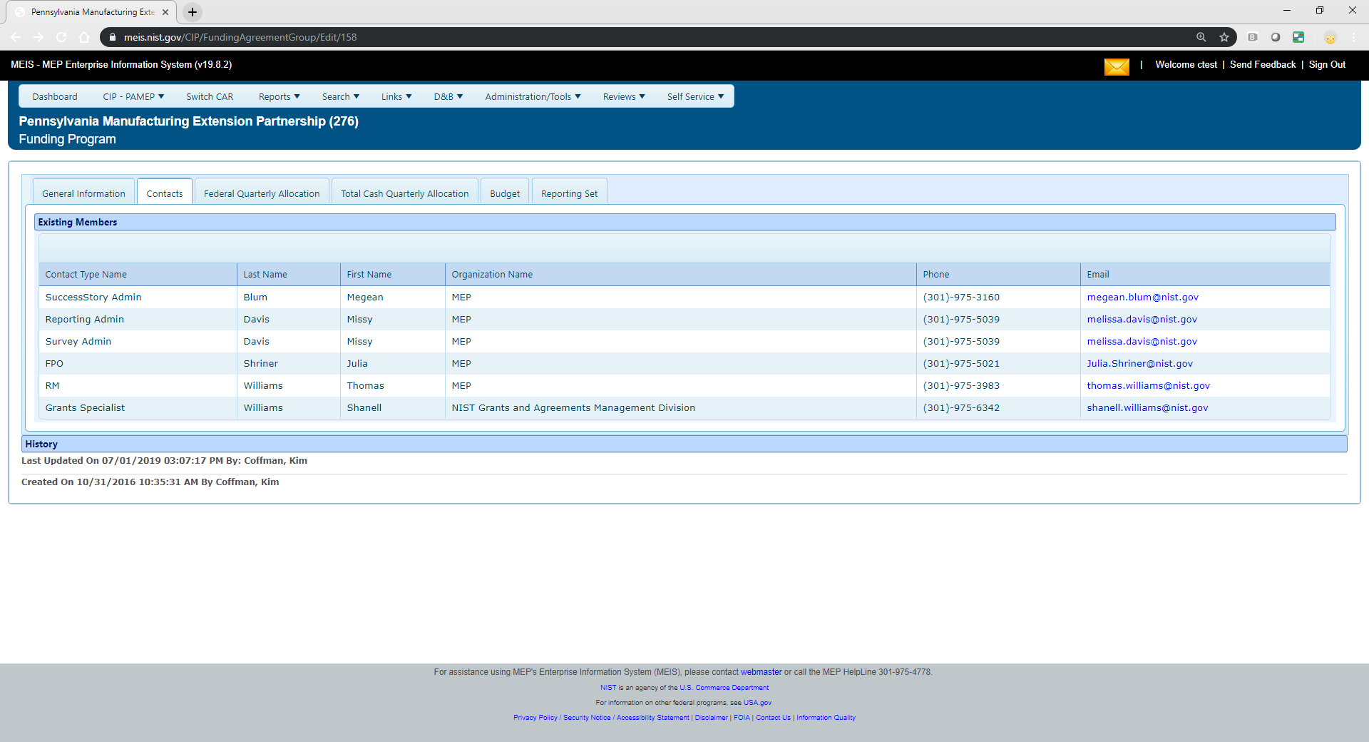
Funding Programs – Contacts
Notes:
The Contacts tab provides the Center with a list of all relevant NIST and NIST MEP staff on the award (example Federal Program Manager and Grants Specialist).

Slide 102
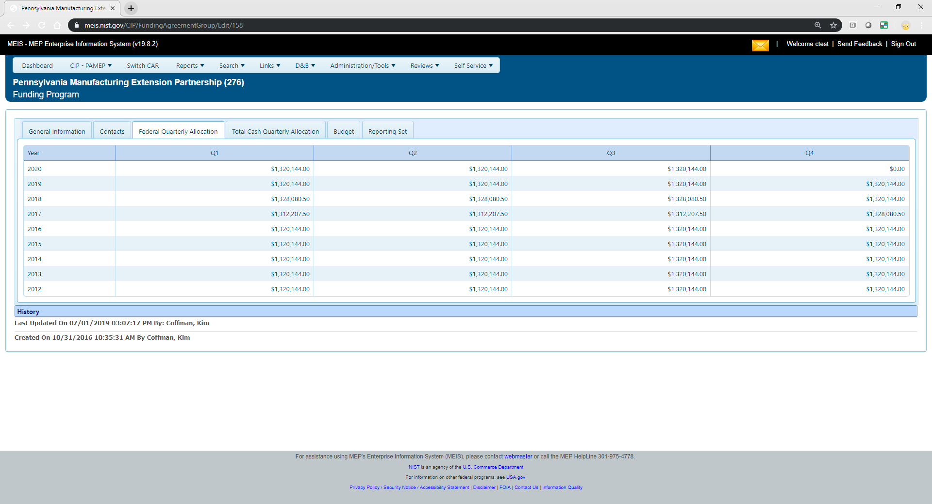
Funding Programs – Federal Quarterly Allocation
Notes:
If you have ever wondered how NIST MEP calculates your Federal Dollar allocation used in many indicators including IMPACT Metrics, the amounts are listed here. The Federal Dollar allocation includes the SUM of NIST MEP Funds, Unexpended Federal Funds Above Base and Unexpended Federal Funds Towards base.

Slide 103
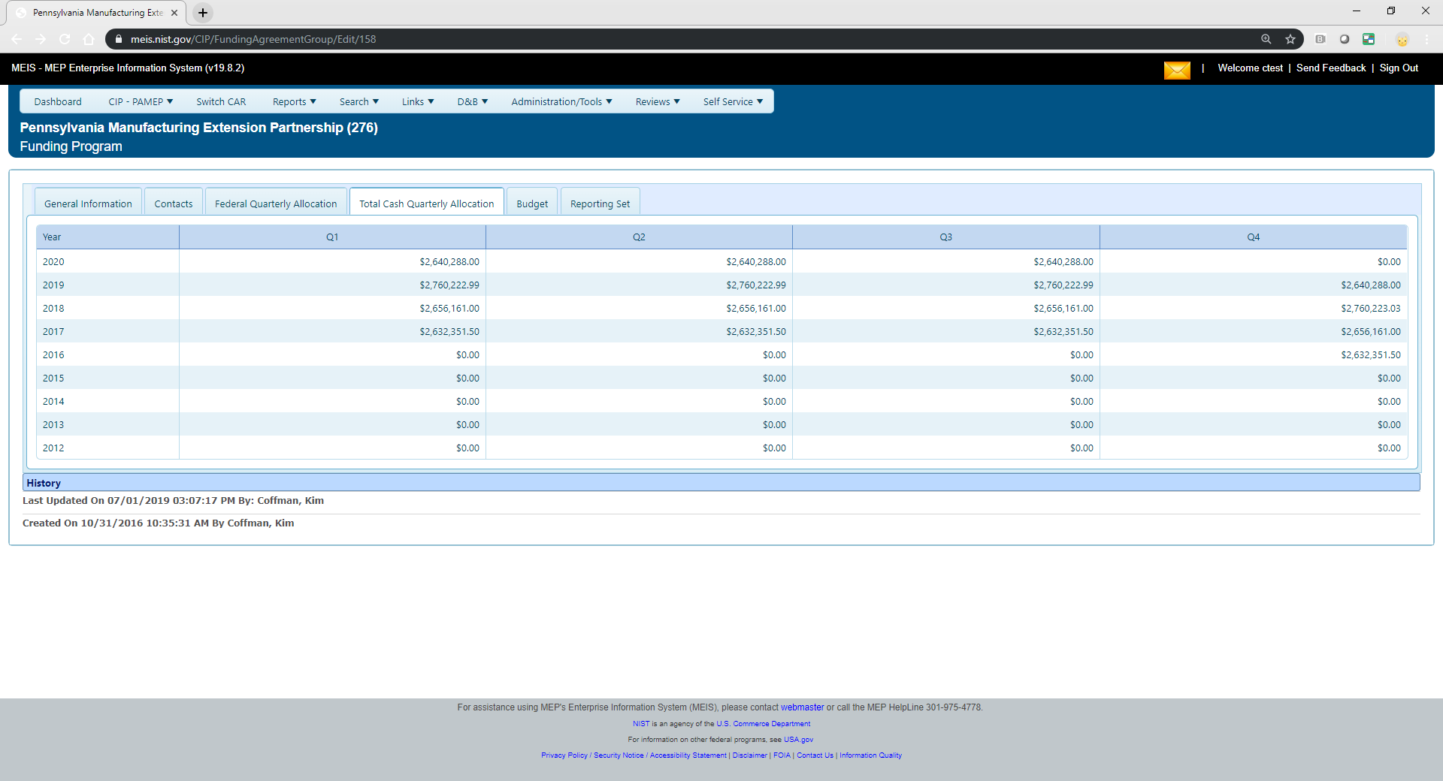
Funding Programs – Total Cash Quarterly Allocation
Notes:
If you have ever wondered how NIST MEP calculates your Total Cash Quarterly Allocation displayed on IMPACT Metrics, the amounts are listed here. The Total Cash Quarterly Allocation Dollar includes the SUM of NIST MEP Funds, Unexpended Federal Funds Above Base, Unexpended Federal Funds Towards base, Program Income, State/Local Cash and Other Cash

Slide 104
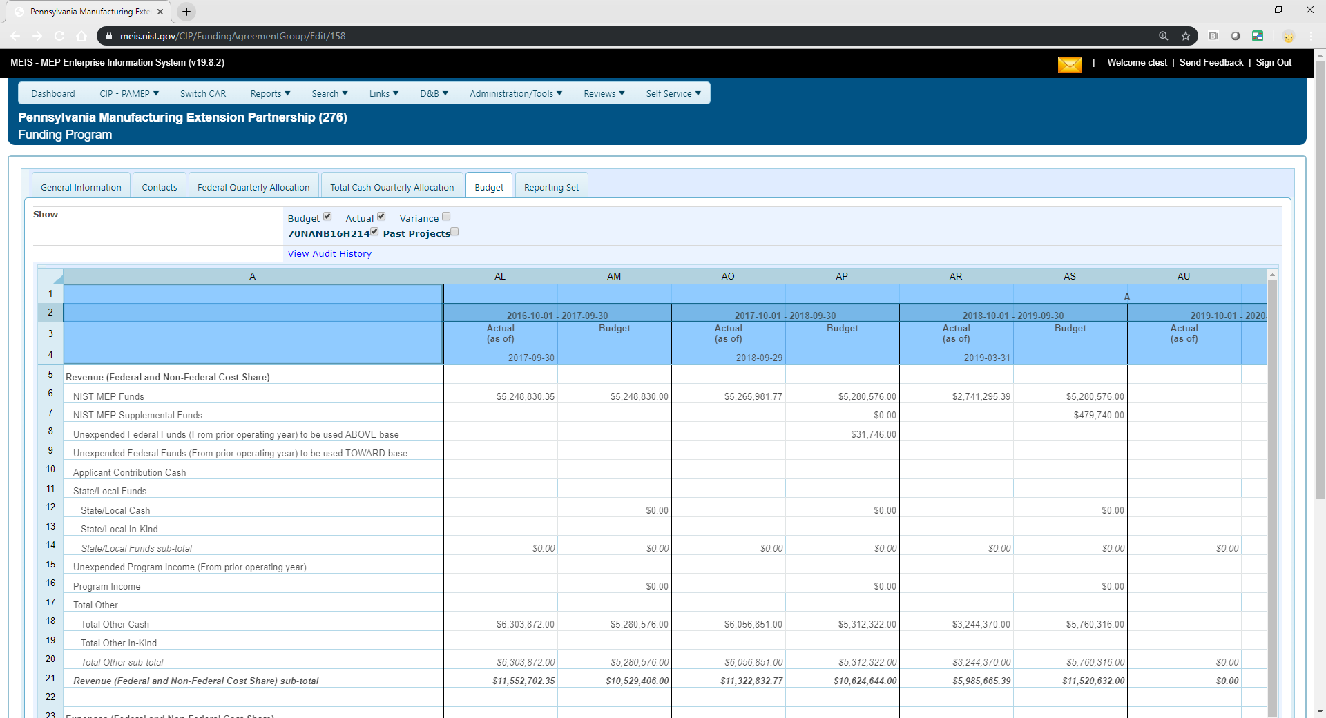
Funding Programs – Budget
Notes:
The Budget tab provides Centers with a READ ONLY view of their Estimated Budget. The checkboxes can be used to display additional awards, show actuals and show the variance as needed. This report is pulling a significant amount of data so the time to load the page is a bit greater than other pages within MEIS. Scroll all the way to the right and the Total Budget for the entirely of the Award is displayed.

Slide 105
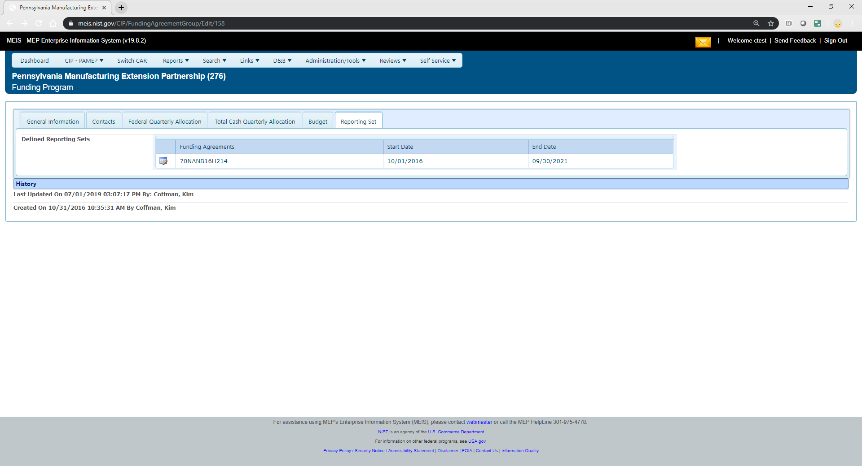
Funding Programs – Reporting Set
Notes:
The Reporting Set is a construct in MEIS to allow NIST MEP to evaluate center performance based on the likely 10 year period between competitions 3-2, 3-2. There is nothing the Center needs to do other than let your Federal Program Officer know if the Reporting Set contains the incorrect Awards.

Slide 106
Documents & Communications
(Non-Reporting Element)
The Documents & Communications section of MEIS is a repository of information directly relating to your center
Documents found in this section include:
  IMPACT Metrics – Published Versions
  Operating Plan
  State Fact Sheets
  Review Documents

Slide 107
Special Projects

Slide 108
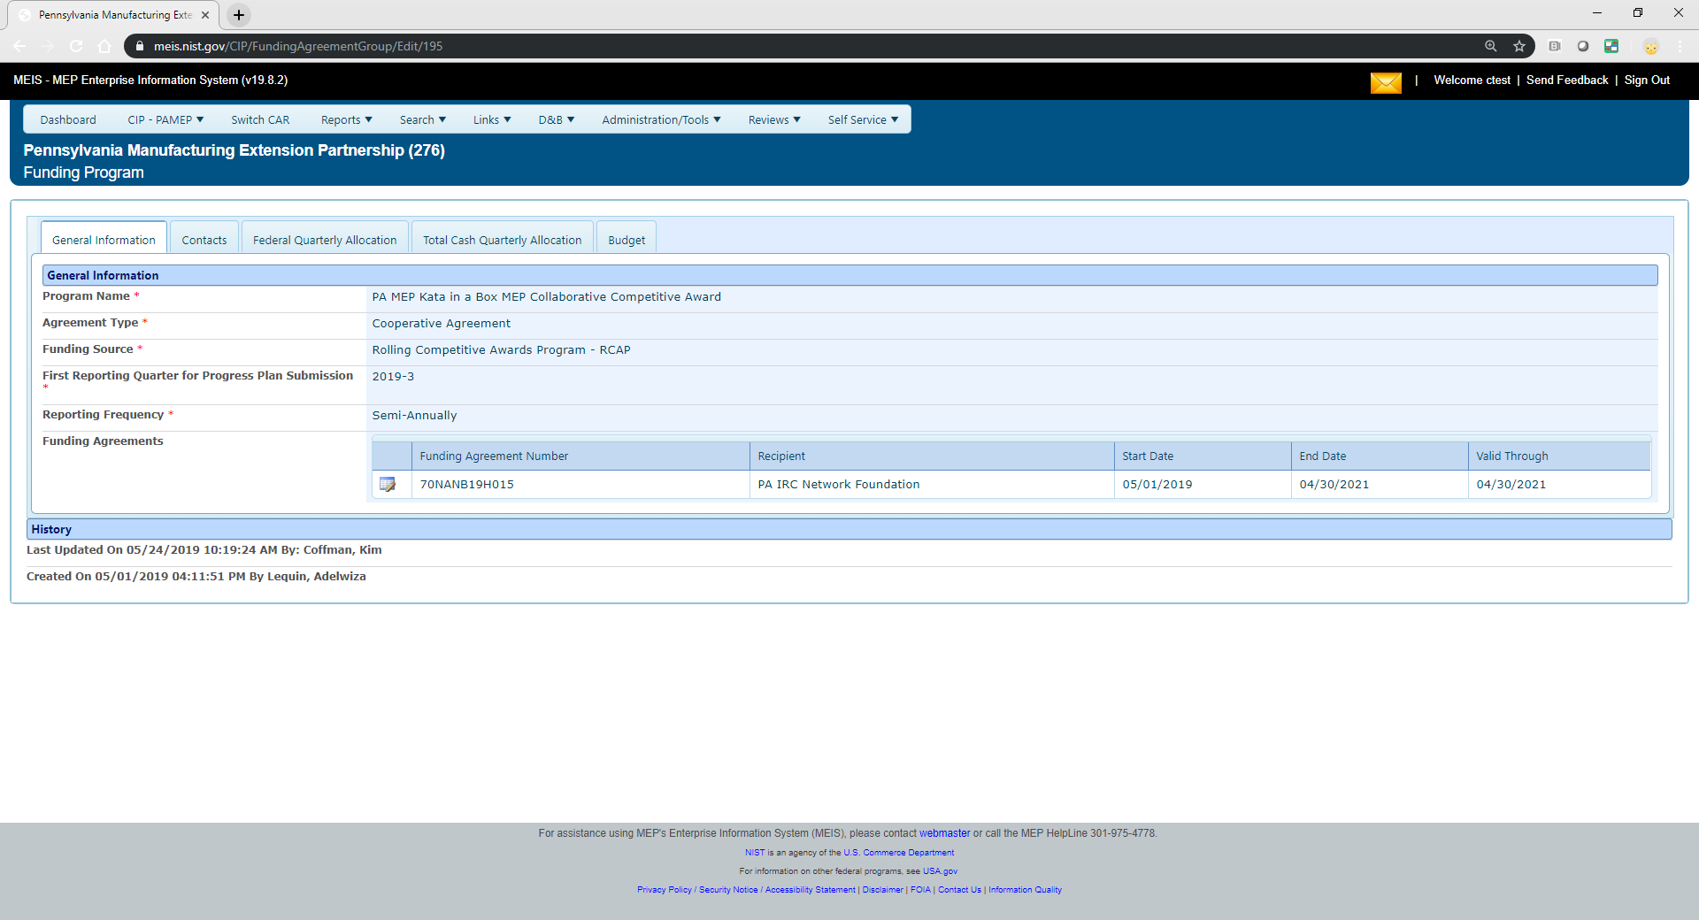
Special Award Programs (RCAPs, MDAPs, DefenseCyber, CARES, MFG USA Embedding)
Notes:
The Special Project funding programs once active are added to your configuration in MEIS.

Slide 109
Special Projects – National Account Field
Projects will be reported on your Center Operations base award.
Repurpose the National Account field. If you do not already have this field in your CRM – Project entity you will need to create.
Your National Network Partners will also be able to use these tags to submit projects they deliver. A center working with many Special Project awardees can submit projects for each and every award.
Notes:
Special Projects will be reported on your Center Operations base award.
The National Account field has been repurposed to include the new Special Project Name tags. You will need to create this field in your CRM systems in order to report.
Your National Network Partners will also be able to use these tags to submit projects they deliver.

Slide 110
Special Projects – List of National Account Codes
CARES | "RCAP" - GAMEP - FSMA | "RCAP" - NIE - Trusted Advisors
MEAPP - SCOIN | “RCAP” – GAMEP – FTA Supplier Forum | "RCAP" - NJMEP - FSMA
“AMTS” – CMTC – Industry 4.0 | “RCAP” – GAMEP – Machine Shop | "RCAP" - NJMEP - QSENN
“AMTS” – MMTC – AMTS D3+ | “RCAP” – GENEDGE – MedAccred | "RCAP" - NVIE - STAT-P
“AMTS” – PurdueMEP – ISMART | "RCAP" - GENEDGE - MEDMMAP-2 | "RCAP" - NYMEP - MFG Readiness
"AMTS" - TMAC - AAMT | "RCAP" - GENEDGE - NN Cyber VA | "RCAP" - OHMEP - Digi Maturity
"AMTS" – NJMEP – SupplyChain | “RCAP” – HTDC – Smart Talent | "RCAP" - OMEP - ITAP
"DefenseCyber" | "RCAP" - MassMEP - Barometrics | "RCAP" - OMEP - ITAP Phase2
"MDAP" – PRIMEX-EARTHQUAKE | "RCAP" - MMEC - FSMA | "RCAP" - PAMEP - Kata in a Box
“MDAP” – TMAC – Hurricane Laura | "RCAP" - MMEP - AddMfg | "RCAP" - PRIMEX - Industry 4.0
"RCAP" - CMTC - NN Cyber CA | "RCAP" - MMTC - Cybersecurity | "RCAP" - SD MEP - Technology Adoption
"RCAP" - CONNSTEP - Mfg Skills for CT | "RCAP" - MMTC - NN Cyber MI | "RCAP" - TNMEP - Adv Tech Team
"RCAP" - FloricaMakes - I4.0 Baldrige | "RCAP" - MO MEP - America Works | "RCAP" - URIRF - ICDM
"RCAP" - FloridaMakes - Aeroflex | "RCAP" - MO MEP - FSMA | "RCAP"- NYMEP - CRIRC
"RCAP" - GAMEP - CMMC Training | "RCAP" - NCMEP - Digital Supply Chain | "RCAP" - NJMEP - FSMA
Notes:
Here is the complete list of National Accounts for “active” Special Projects as of today.

Slide 111
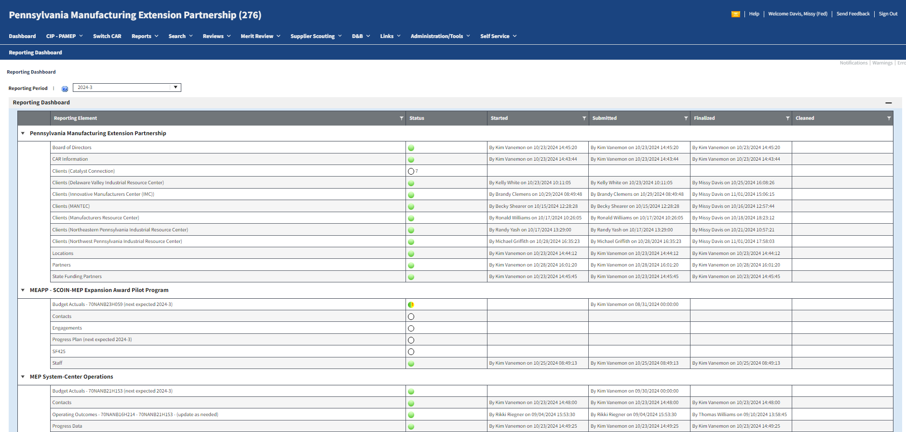
All Special Project required elements will appear on your Reporting Dashboard
Staff and Contacts are funding program specific and must be reported quarterly
First Progress Plan Due Date
Notes:
All required elements will appear on your Reporting Dashboard.

Slide 112
Immediate quarterly reporting requirements
Staff – assign staff to work on the new awards
  Click CIP, Staff, Submit Quarterly Reports, check the box for staff/award, click Actions – Submit for Reporting
Contacts – associate staff to be responsible for certain tasks like project management, reporting, survey so that they can be easily contacted via phone or email
  Click CIP, Contacts, Submit Quarterly Reports, Select the Program Name from the dropdown, click the View/Edit icon for the Contact Type, use the Available/Selected Box to designate staff to the Contact Type, Click Add, click OK to save
    Project Manager
    Reporting Contact
    Survey Contact
Notes:
Staff and Contacts reporting elements can and should be completed now and updated anytime there is a change.
Contacts are added so staff associated with the new awards can be easily be contacted via phone or email.

Slide 113
Special Projects will be reporting on project progress based on the requirements of the award.
Examples include:
Program Status: (Provide narrative that details the status of your program. Specific details that discuss project specific stages (Define, Design, Develop, Deploy), partnerships developed, coordination made, challenges and next steps)
Status Outcomes: (includes Results/ Accomplishments, Lessons learned and best practices)
Progress Plans will be reviewed by the NIST MEP Project Manager and the FPM and sent to Grants once finalized.
Notes:
You will be reporting on progress based on Program status and Status Outcomes. In the Program Status field, you will provide specific details on the status of your program, project stages, partnerships development, challenges and next steps as detailed in the Progress Plan form. Click on the question mark (HELP) icon for specific instructions and guidance.

Slide 114
All parties get to share in the success of these projects.
Scenario – GA MEP partners with Oregon MEP to deliver food safety services to a food manufacturer in Oregon. Oregon delivers the services and submits the project for survey, tagging the project with National Account “RCAP” – GAMEP – FSMA.
  Aggregate client and project counts along with impacts rolled up to the “RCAP” – GAMEP – FSMA.
  Oregon MEP is also credited with the client and project counts and impacts related to the RCAP. Reflected in The IMPACT metrics.
  This ONLY works if projects are properly tagged.
Notes:
All parties get to share in the project success. For example, GA MEP partners with Oregon MEP to deliver food safety services to a food manufacturer in Oregon. Oregon delivers the services and submits the project for survey, tagging the project with the National Account “RCAP” – GAMEP – FSMA tag.
The aggregate client and project counts along with the impacts rolled up to the RCAP – GAMEP FSMA and the Oregon MEP center is also credited with the client and project counts and impacts related to the RCAP projects that they deliver. These impacts are reflected in the IMPACT metrics.
This only works if projects are properly tagged.

Slide 115
Who is responsible to ensure Special projects are being tagged?
Project Manager at the Lead MEP Center
Reporting Contact at the Lead MEP Center
Project Manager at NIST MEP
Communication will be key. It is important that the PM for the Lead Center make sure the delivering Center is properly educated (CD, sales, delivery, and reporting staff) in the way to report the project. And that the Lead Center PM follows-up to make sure projects are reported properly. If it is not marked it is not counted.
Notes:
The project manager and reporting contact at the Lead MEP Center and the Project Manager at NIST MEP are responsible for making sure the projects are being properly tagged. It is important for the Project Manger for the Lead Center to make sure the delivering center is properly educated in the way to report the project. If projects are not tagged with the National Account Code, they will not be counted as an RCAP project

Slide 116
Survey Confirmation Schedule
Quarter | Survey Confirmation Dates Open in MEIS
Quarter 1 | March 1 – March 31
Quarter 2 | June 1 – June 30
Quarter 3 | September 1 – September 30
Quarter 4 | December 1 – December 31
Notes:
The schedule for the Survey Confirmation process is shown in this slide.

Slide 117
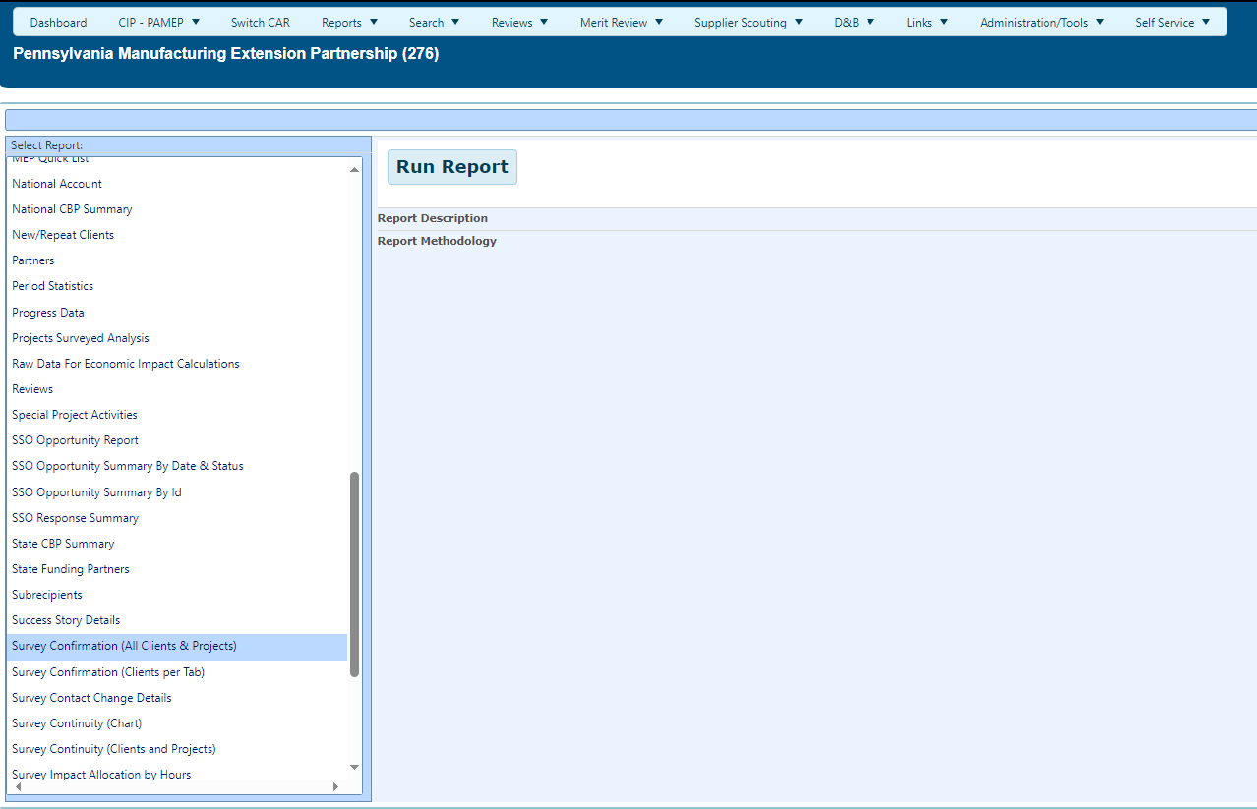
Take Advantage of the Many MEIS Reports
Survey Confirmation – 2 Reports
Notes:
There are 2 survey confirmation reports available to assist you.
Survey Confirmation (All Clients & Projects) – Lists clients and projects that went to survey in any given period of time, based on your selection criteria.
Survey Confirmation (Clients per Tab) – lists clients and projects for any given period of time, based on your selection criteria, on separate tab, if exported to Excel.

Slide 118
Survey Confirmation
Clients and Project data is submitted well before the survey occurs.
CARs are given one month immediately prior to the survey to review client contact information and make changes.
Opportunity to update information needed to conduct the survey and ensure that the materials sent to the client appear as professional as possible.
Most CARS involve their field staff in the review process since it is the field staff that are most aware of changes.
All client records with valid manufacturing MEP DOM NAICS Codes will be sent to survey regardless of whether the CAR has completed the confirmation process. MEP refreshes the record with current D&B information if >6 months aged at the time Survey Confirmation is opened.
Notes:
Each quarter, NIST MEP will use the client and project information to select clients for survey. The client unique identifier will be used to identify the clients that will be surveyed as well as the associated Projects and Events that will appear on the project list.
After the clients and projects/events are selected, CARs will then be able to confirm and correct the data before the survey begins. This process is called Survey Confirmation.
One month prior to the survey occurring, CARS will review and confirm the information used in conducting the survey. This is an opportunity for CARs to edit the following fields:
Client information such as: name, address, and phone number.
Client primary and secondary contact information such as: salutation, first name, last name, position, phone, and email.
CARs should take advantage of the data confirmation process to ensure every piece of information that will be seen by the client is correct and presents a professional image.
In many cases, CARs may want to involve field staff in reviewing the information and appropriate arrangements should be made to ensure that field staff understand the process and are able to complete it in the time allotted.
All Client records with a valid manufacturing MEP DOM NAICS code will be sent to survey regardless of whether the CAR has completed the confirmation process. MEP refreshes the record with current D&B information at the time Survey Confirmation is opened if the last updated date is > 6 months aged.

Slide 119
Survey Confirmation Suggestions
Use this one-month period as a time to reconnect with clients. Go over project(s) up for survey to discuss expected impacts and investigate current needs and look for new opportunities with the customer.
Use this period to initiate a D&B Investigation for any clients that do not have an acceptable NAICS Code. They are marked with a red exclamation point !
Let clients know that you are trying to minimize the burden on them. Provide clients with third-party survey vendor name, survey schedule, and describe the process in detail to set expectations.
Emphasize taking the web-based survey and that it should not take more than 15 minutes of their time if the field agent has already had a project close-out/feedback session where it was determined the success of the project.
Notes:
Suggestions for Survey Confirmation:
Use this one-month period as a time to reconnect with Clients. Review projects up for survey to discuss expected impacts and investigate current needs and possible new opportunities with the customer.
Use this period to initiate a D&B investigation for any clients that do not have an acceptable NAICS code. They are marked with a red exclamation point.
Let clients know that you are trying to minimize the burden on them. Provide clients with third-party survey vendor name, survey schedule, and describe the process in detail to set expectations.
Emphasize taking the web-based survey and that it should not take more than 15 minutes of their time if the field agent has already had a project close-out/feedback session with them.

Slide 120
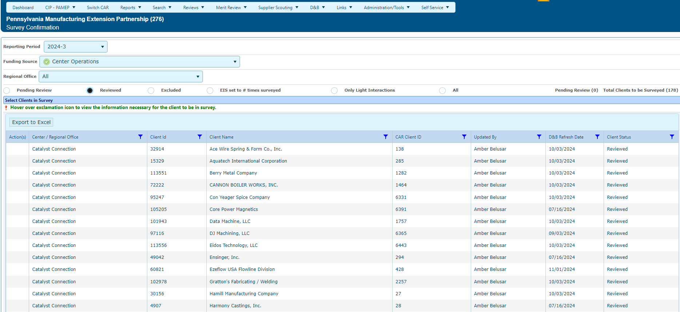
During Survey Confirmation, centers can update client contact information and manage the number of times a project is surveyed (EIS)
As client/project records are reviewed, the client moves from Pending Review to either Reviewed, Excluded or EIS set to # times surveyed.
Notes:
During Survey Confirmation, centers can update client contact information and manage the number of times a project is surveyed by updating Estimated Impact Span (EIS). Use it to your advantage.
As client/project records are reviewed, the client moves from “Pending Review” to either “Reviewed” or :”EIS set to # times surveyed”. A client can ONLY be moved to “Excluded” by contacting the NIST MEP Survey
Administrator.
It is important to remember that projects trigger surveys, so a client may be surveyed on more than one project. If you are a client where EIS was set too high, centers MUST make sure that the EIS is set to equal the number of times surveyed for every project identified to be surveyed.

Slide 121
Outlier Verification
Notes:
Moving on to Outlier Verifications.

Slide 122

Outlier Verification Process
After survey closes, third-party contractor exports data from their system
Data are imported into MEIS.
Outliers flagged and confirmed by centers:
  >5M Total$
  >250 Total Job Impacts
Notes:
After the Survey closes, the third party contractor exports data from their system. Data are then imported into MEIS.
NIST MEP will examine the survey responses to identify survey results requiring verification, also known as outliers.
All survey responses with a total quantified dollar impact amount of $5 million or more, and/or total job impact of 250 or more will require verification.

Slide 123
Reporting Elements – Outlier Verification
Purpose:
Sometimes clients report significant impacts that NIST MEP requires be validated by the Center by communicating with the client to make sure what was reported is accurate.
Outliers are flagged and confirmed by Centers by indicating the method for communication with the client and a short paragraph describing the work and why the large impact was realized as a result.
  >5M Total$
  >250 Jobs
How to report:
  Click CIP, hover over Survey, Survey Outliers
    Click on the View edit icon for the appropriate impact verification record.
    Click the radio button to indicate the Verification Type
    Click the radio button to indicate the Verification Status
    Make any changes necessary to the quantified amounts.
    Enter the narrative justification (minimum 500 characters)
  Click Save Outlier
Notes:
Sometimes clients report significant impacts that NIST MEP requires be validated by the Center by communicating with the client to make sure what was reported is accurate.
Outliers (>$5M Total, >250 Jobs) are flagged and confirmed by Centers by indicating the method for communication with the client and a short paragraph describing the work and why the large impact was realized as a result.

Slide 124
Reporting Elements – Outlier Verification
Workflow:
  Centers are notified via email when Outliers need to be verified including a deadline for verification
  Centers edit the Outlier records in MEIS. When complete, the record is saved and an email is generated and sent to the NIST MEP Survey Administrator, Center Survey Contact, Center Director and NIST MEP Manager for Program Evaluation.
  The NIST MEP Survey Administrator reviews the information provided and adjusts the impacts if necessary.
  Once all Outliers have been reviewed and adjusted, the IMPACT Metrics reports are run and distributed to Centers.
Notes:
Each time an Outlier Verification is identified for review, there is a workflow that needs to be followed.
Centers are notified via email when Outliers need to be verified including a date when verifications MUST be entered into MEIS>
Centers edit the Outlier records in MEIS. When complete, the record is saved and an email is generated and sent to the NIST MEP Survey Administrator, Center Survey Contact, Center Director and NIST MEP Manager for Program Evaluation.
The NIST MEP Survey Administrator reviews the information provided and adjusts the impacts if necessary.
Once all Outliers have been reviewed and adjusted, the IMPACT Metrics reports are run and distributed to Centers.

Slide 125
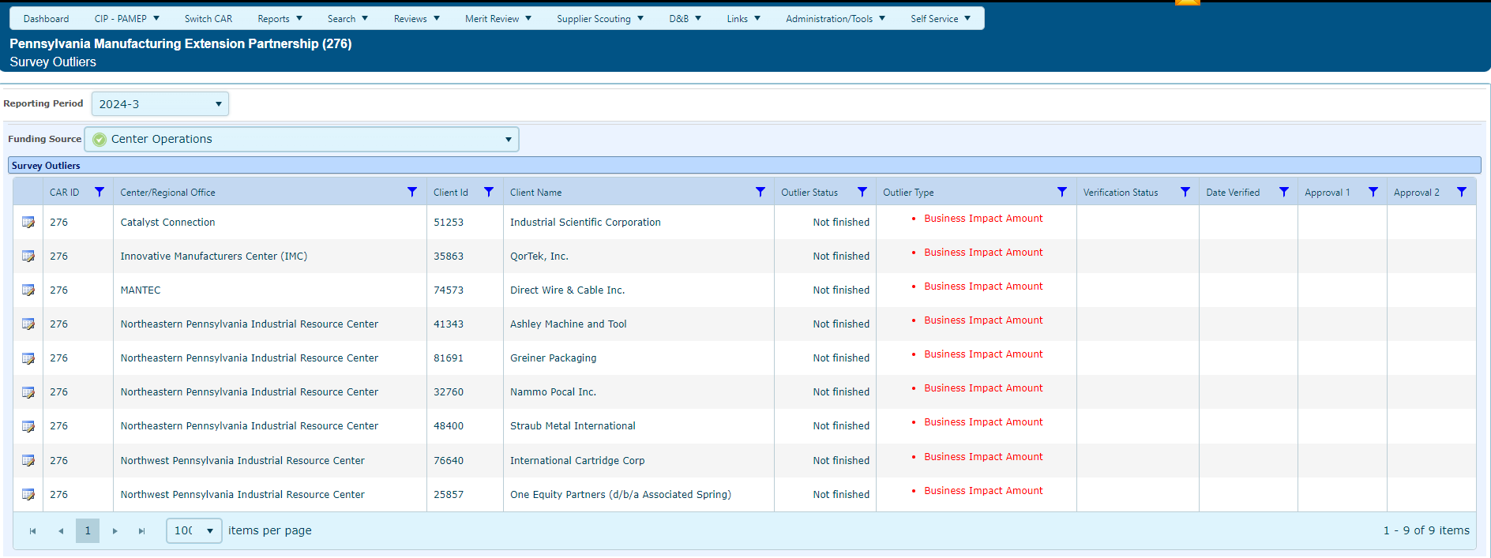
Outlier Verification
List of Outliers to be reviewed.
IMPACT based on $ or Jobs
Notes:
This screen shot indicates the Outliers to be verified.

Slide 126
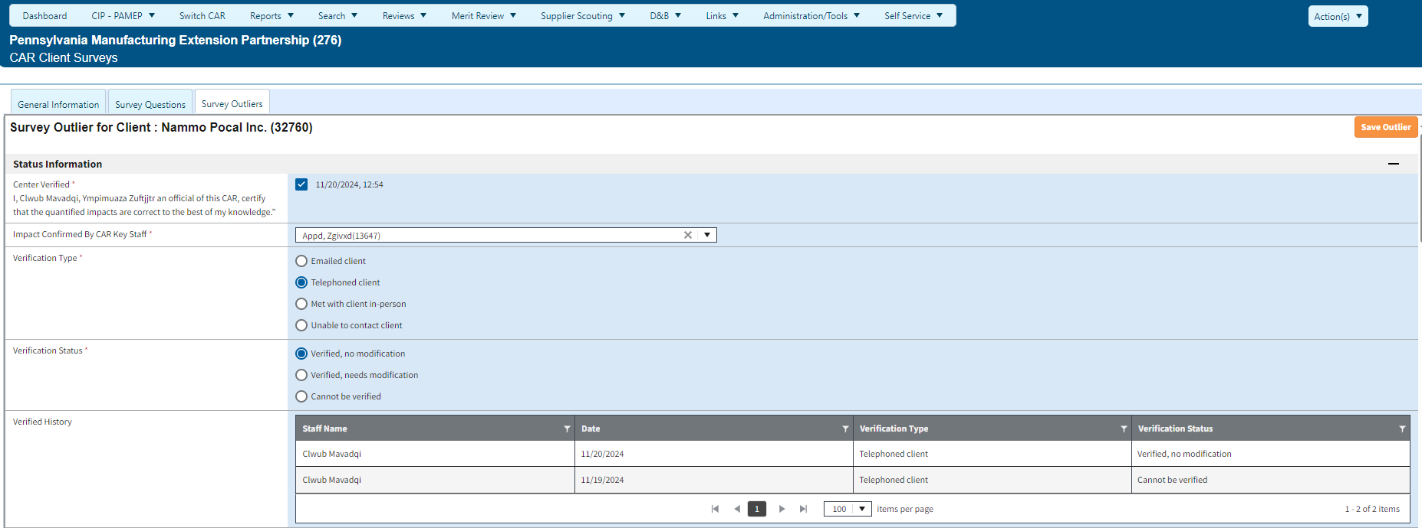
Outlier Verification
Outlier certifier must be assigned to Director, Director Notification or CRO Director Contacts in MEIS
Radio buttons to indicate Verification Type and Status.
This section shows verification history
Notes:
This screenshot shows the two radio buttons that have to be clicked on to display the Verification Type and Status. Impacts that are incorrectly reported can ONLY be changed downward. Impacts cannot be increased.

Slide 127
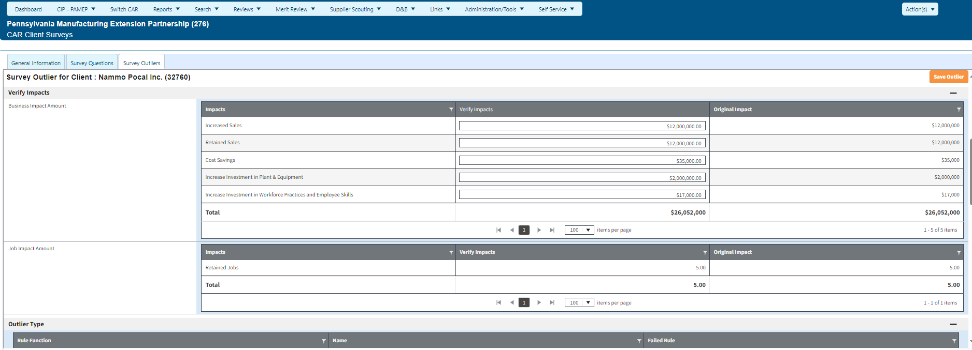
Outlier Verification
Center staff verify that the impacts were entered correctly. If not, outlier amounts can be decreased.
This column shows the impacts that were reported by the client
Notes:
This screenshot shows the inclusion of a narrative justifying the large impacts. This has been recently changed to require 500 characters at a minimum.
A justification is not needed if the impacts are reduced to <$5M and <250 Jobs.

Slide 128
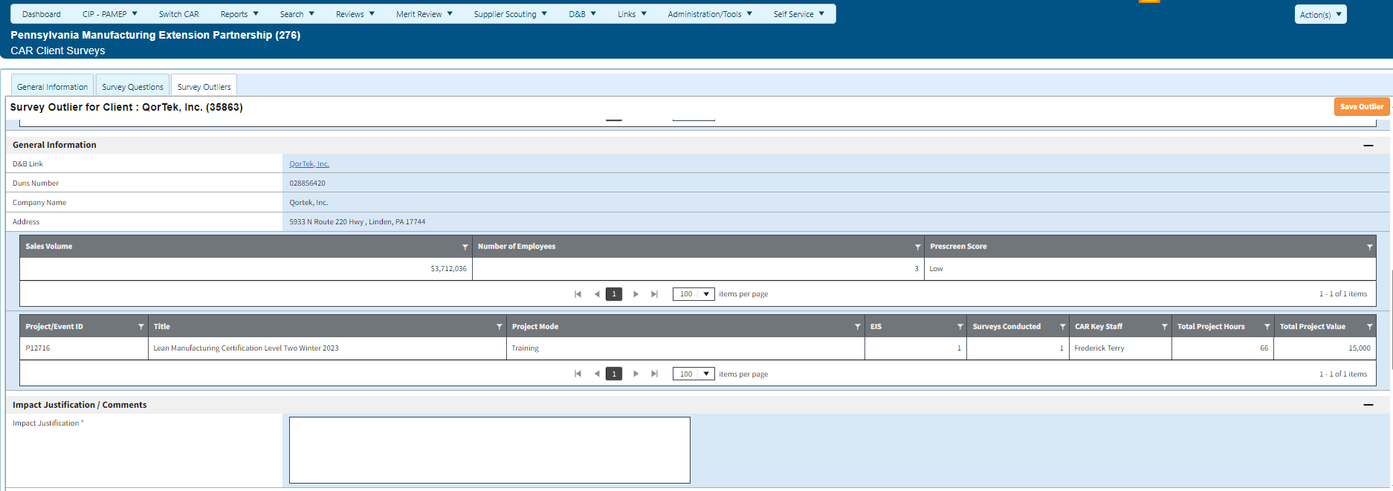
Outlier Verification (continued)
Link to Dun & Bradstreet record
Lists projects in survey this quarter
Impact Justification required for all outliers.

Slide 129
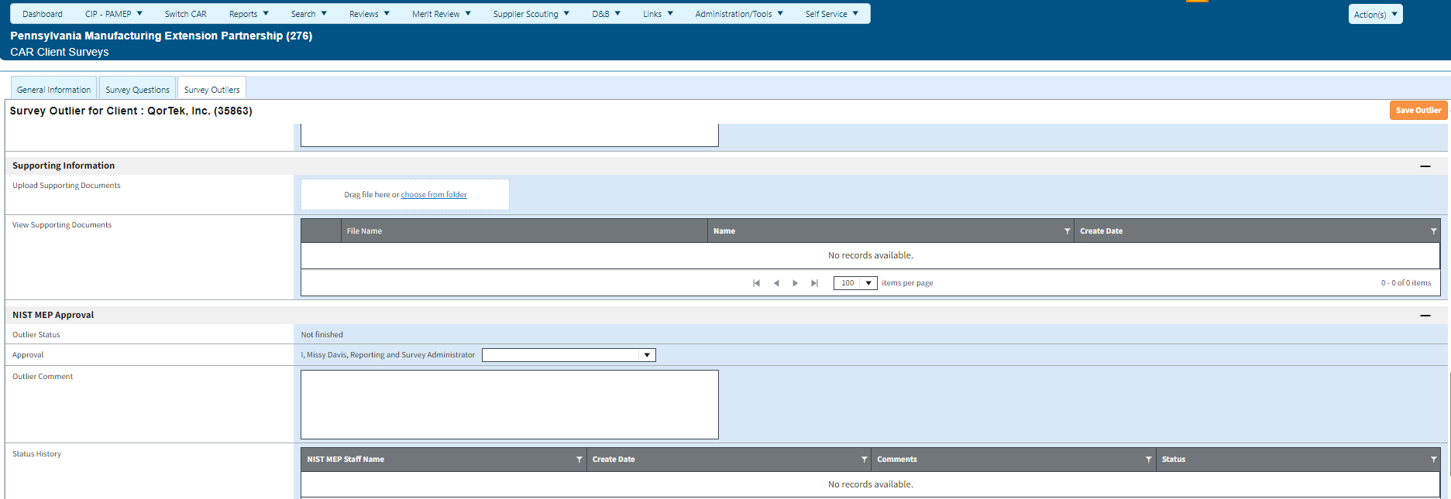
Outlier Verification (continued)
Upload supporting documentation
There will be two NIST MEP approvers for each outlier.

Slide 130
Post-Survey Data Analysis - Knowledge Sharing
Notes:
The final step in the survey process is data analysis and sharing of knowledge with the National Network, our stakeholders and your clients.

Slide 131

Post-Survey Data Analysis - Knowledge Sharing
After all survey outliers have been verified, the data is ready to be analyzed
Centers’ survey results are made available
Analysis
Notes:
Once required outlier verifications are complete, CAR’s survey results data files will be available for download from their CAR Browser.
In addition to making the raw data files available to CARs, NIST MEP will load the data files into a database for permanent storage. Output reports derived from this database will be available to CARs under the security of their CAR Browser on the MEIS Web Site.

Slide 132
Post-Survey Data Analysis Suggestions
Take advantage of the survey results reports in MEIS.
Review the data you receive from the survey.
Analyze the impacts, your response rate, Net Promoter Score™, client comments, answers to challenges question, etc.
The more you can learn from your clients the more efficiently you can respond to their needs.
Notes:
Post-Survey suggestions:
Take advantage of the Survey Results (Quarter) report by clicking Reports>CAR Reports in MEIS.
Review the data received from the survey.
Analyze the impacts, your response rate, Net Promoter Score™, clients comments and answers to challenge questions.
The more you can learn from your clients, the more efficiently you can respond to their needs.

Slide 133
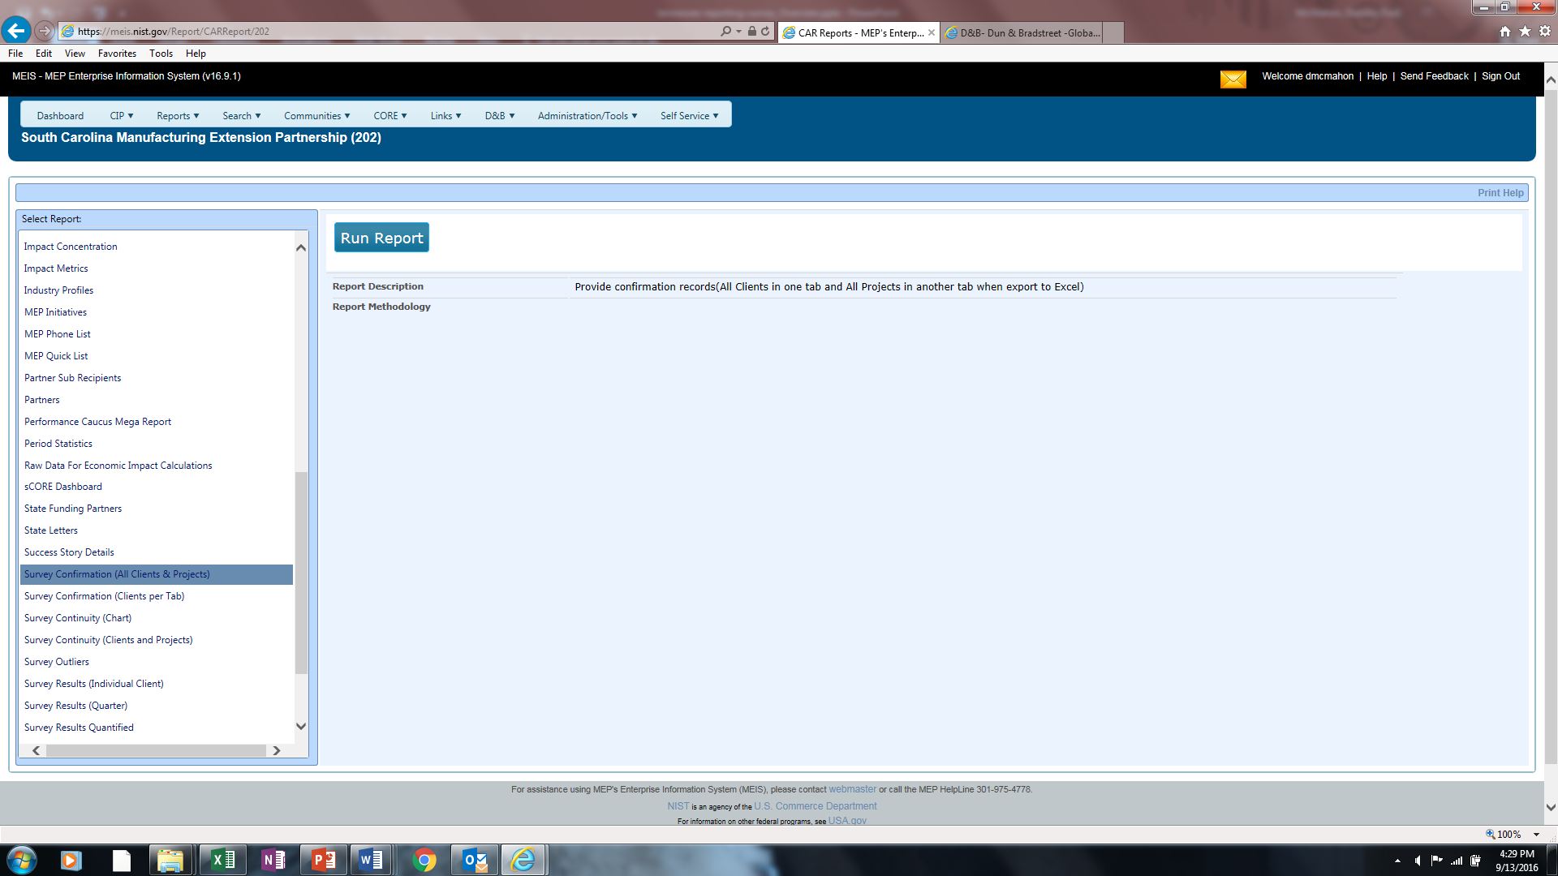
Take Advantage of the Many MEIS Reports
Survey Confirmation – 2 Reports
Notes:
There are 2 survey confirmation reports available to assist you.
Survey Confirmation (All Clients & Projects) – Lists clients and projects that went to survey in any given period of time, based on your selection criteria.
Survey Confirmation (Clients per Tab) – lists clients and projects for any given period of time, based on your selection criteria, on separate tab, if exported to Excel.

Slide 134
Panel Reviews (A Data Perspective)

Slide 135
Purpose of the Performance Panel Reviews
The intent of the Performance Panel Reviews:
  Satisfy Statutory Requirement (American Innovation & Competitiveness Act);
  Assess their overall performance as it relates to market penetration, economic impact, and financially sustainability to improve the productivity and performance of the U.S. manufacturing;
  Focusing on trends and patterns to diagnose the causes for strong and weak performances;
  Include evaluation of a Center’s own Performance Management System effectiveness and use, including self-assessment;
  Provide feedback on Center strengths and opportunities for performance improvement, including deficiency areas, if any, as defined in the Performance Policy;
  Promotes the sharing of information across the National Network; and
  Identify common Center performance gaps so the program can leverage internal and/or external resources to assist the National Network in improving performance.
  Conducted during the 3rd & 8th Year of Center Operation
Notes:
NIST MEP is required to measure the performance of the Center against the following which are identified in detail in the AICA language.
8 Objectives:
‘(c) OBJECTIVE.—The objective of the Program shall be to enhance competitiveness, productivity, and technological performance in United States manufacturing through—
1) the transfer of manufacturing technology and techniques developed at the Institute to Centers and, through them, to manufacturing companies throughout the United States;
2) the participation of individuals from industry, institutions of higher education, State governments, other Federal agencies, and, when appropriate, the Institute in cooperative technology transfer activities;
3) efforts to make new manufacturing technology and processes usable by United States-based small and medium-sized companies;
4) the active dissemination of scientific, engineering, technical, and management information about manufacturing to industrial firms, including small and medium-sized manufacturing companies;
5) the utilization, when appropriate, of the expertise and capability that exists in Federal agencies, other than the Institute, and federally-sponsored laboratories;
6) the provision to community colleges and area career and technical education schools of information about the job skills needed in manufacturing companies, including small and medium-sized manufacturing businesses in the regions they serve;
7) the promotion and expansion of certification systems offered through industry, associations, and local colleges when appropriate, including efforts such as facilitating training, supporting new or existing apprenticeships, and providing access to information and experts, to address workforce needs and skills gaps in order to assist small- and medium sized manufacturing businesses; and
8) the growth in employment and wages at United States-based small and medium-sized companies.

Slide 136
Center Performance Panel Review Inputs
Center’s Panel Presentation
CPPR & Strategic Plan
Center Performance Panel Reviews
Center’s Response to Pre-Panel Questions
Centers PY Annual/Panel Review Reports
Notes:
There are several key inputs to the Panel Review:
CPPR/Strategic Plan
PY Annual/Panel Review Reports
Centers Response to Pre-Panel Questions
Centers Performance Management System Overview (Presentation)
The structure of the CPPR is intended to provide:
a consistent review structure across the National Network;
an opportunity to assess a Center’s overall performance across three elements: 1.) market penetration 2.) effective and efficient use of Center capacity and financial resources, and. 3.) trends on Center generated economic impact and financial viability;
trends and appropriate comparisons between the National Network, State and the Center’s performance to support diagnosis of potential causes for high or low performance; and
brief, factual background information such as a brief history of the Center, location, governance, size, services, market, financial structure and partnerships.
Data charts distributed throughout CPPR are intended to show potential indicators for the results seen in the 10 metrics on the IMPACT.
Note: Information pre-populated in the CPPR has been leveraged from MEIS. Focus is to ask for information we do not have readily available to extract from MEIS.
Annual Review Reports - The Annual Review focus on the Center’s strategic alignment to NIST MEP’s overall program objectives, the Center’s activities, progress and performance in implementing the NIST MEP award, lessons learned, monitoring of subrecipients, resource expenditures, activities planned for the next year, and any proposed changes to the project plan or budget.
Centers Response to Pre-Panel Questions – Through the pre-panel discussion a series of questions or clarifying points will be identified by the panel. The center will be asked to provide a written response. The additional information gathered through this Q&A will provide additional context for the Centers performance and profile to assist the panel in completing their evaluation of the Centers performance.
Pre-Panel conference will take place approximately two weeks ahead of review.
Provides another layer of center structural and performance information to allow panel to effectively evaluate the Center’s performance.
Centers Performance & Evaluation Management System Overview (Presentation during panel review)
In preparation for the Performance Panel Review, the Center will be asked to present on the following areas:
Center Strategy (2 Slides)
Performance Management System (Maximum 5 Slides)
Describe your Performance Management System
What do you collect/measure/monitor? Why?
How does your Center analyze/use the data to evaluate your Center’s performance?
Based on the information above, what is your assessment of your Center’s performance to date?

Slide 137
Center Performance & Profile Report
CPPR
Center Profile
Market Understanding
Performance Measurement and Management
Financial Viability
Business Model and Management
National Network
Citizen
6 Categories
Notes:
The CPPR is composed of 7 distinct categories. Within the Performance Measurement & Mgmt., Org structure & Mgmt., Market Understanding, Business Model and Financial Viability categories are support data graphs/charts to support the information represented within this category as it relates to performance.
Performance Measurement & Management
Identifies trends and gaps across the 10 impact metrics and benchmark center performance
Center Strengths and Challenges
Identifies key Center attributes and challenges that may effect the Centers ability to be a high performing center
Organizational Structure & Management
Provides a snapshot of the Center Structure including number/type of FTE’s (Delivery/Mgmt/Other), key partners (including SRA’s) that influence the Center’s performance.
Market Understanding
Identifies the Center’s service territory, key stakeholder mandates; and the Center’s clients across three areas – company size, industry, and geography
Business Model
Identifies the service delivery model and the Center’s product/service mix, client mix and capacity utilization indicators.
Financial Viability
Provides a snapshot of the Centers Cost Share portfolio and utilization of the NIST MEP Federal Funding to support the overall operation of the Center.
National Network Citizen
Identifies how the Center is actively sharing knowledge and expertise both from a contributor and recipient perspective.
-----------------------------------------------------
The first category in the CPPR is Performance Measurement and Management. The Centers IMPACT is presented in this category.
Performance on The IMPACT is one of several inputs into the NIST MEP performance management approach: Annual reviews, Panel reviews, etc
HIGHLIGHT HOW ALL THE DATA PRESENTED INTER-RELATES AND EXPLAINS HOW A CENTER GOT TO WHERE IT IS PERFORMANCE WISE. THE ADDITIONAL DATA PROVIDES SOME INSIGHT AS POTENTIAL INDICATORS FOR THE RESULTS.
The IMPACT provides a high-level view of performance based on client and project work
Measures performance on 10 different indicators based on center submitted clients and projects plus third party surveys of those projects
Trend scores of the overall IMPACT score and individual indicators over time are included
Allows for benchmarking across the National Network
To re-emphasize, the data charts distributed throughout CPPR are intended to show potential indicators for the results seen in the 10 metrics on the IMPACT.
They also show how the center is addressing the 3 key elements (Market Penetration, Impact and Financial Viability).
The data itself is not being assessed, but used in assessing performance on The IMPACT as it relates to the three key elements previously mentioned.
Completing projects with clients is what drives success in the measures on The IMPACT
Decisions on how to approach completing these projects matter in performance - Aligning Structure, Business Model, Strategy, etc with the quantitative results
Which activities are amplifying impacts?
Which activities need changed or resourced differently?
-----------------------------------------------------
The Business Model ties the Operating Environment/Financial Viability/Sustainability AND Market Understanding/Analysis together in an effort to drive the Center towards generating impacts.
The business model forms a way to move from your environment and market understanding/analysis to establishment of an effective business model which hopefully leads to actual performance impacts.
The information presented in the Business Model category is designed to assess the existing and changing needs of clients and services being requested. This section is designed to have the Center consider/highlight how this information can assist in strategies moving forward to develop more clients and generate more projects as well as leveraging the associated impacts.
It highlights the Centers Service delivery model, types of project (by substance code and bottom vs top line).
What is the process the Center uses to identify new products/services? How is the use of staff or use of contractors executed to implement new products/services. How does the Center manage SRA’s so the brand of the Center and MEP National Network is present? If the Center were to start operations today, what does their business model look like? What factors does the Center use to determine the use of 3rd Party Providers, why? What is the Centers client engagement model?
Also provided in this category are data/graphics around capacity utilization indicators. They provide different measures of capacity utilization over time and against the national network. They are usage of delivery staff, clients/projects per delivery staff, hours per project, portfolio mix of the intensity of projects and revenue generation
Data Elements:
Service Delivery: 3rd Party vs In-House
Project by Substance Code
Projects by Bottom Line vs Top-Line
Capacity Utilization Indicators:
Clients Per Delivery FTE
Projects Per Delivery FTE
Project Per Client
Projects Per $M Fed
Hours Per Delivery FTE
Revenue Per Delivery FTE
-----------------------------------------------------------------------
Organizational Structure & Management and Financial Viability:
We also want to highlight the importance of a strong foundation, environment and financial structure.
Understanding the Centers current operating environment, strengths/challenges, financial portfolio, how they are leveraging the federal investment and the way in which the Center leverages peer resources and helps others puts into context how and why the center structured their business model the way they did.
It also provides a picture of the overall Center Structure to better assess the center performance and possible indicators as to why they may be having the results they are.
We also ask the Center to identify potential challenges/barriers for meeting the programs cost share requirement. Identify any state funding the center receives and how that affects the centers programming, market penetration or impact achievement. Does your center anticipate building capacity for investing in new initiatives in the future, if so how? How does the Center see their cost share portfolio going forward, steady? Fluctuating? How will this impact the center?
Lastly, How is the Center leveraging the resources of their peers? What are they doing to contribute to the national network to better the overall performance of the network.
Data Elements:
FTE Distribution
FTE Per $M Fed
Center Fed$ and Cost Share
Center Fed$ (Requested vs Expended)
---------------------------------------------------------------------------------
Market Understanding:
Understanding/Analyzing the Centers Market is critical. We need to understand the geography, size, industries, client challenges while also provide a comparison to the State distribution.
Within the Marketing Understanding section of the CPPR, we are highlighting the Center’s Service Territory by identifying regional offices, rural and number of Mfg Establishments.
We have also provided an opportunity for the Center to highlight key stakeholder mandates and/or requirements – such as having to focus on a specific industry or size of manufacturer. This will help the reader understand why the Center may have choose to focus in a certain direction or type of project/client. It will also help the panel understand whether the Center had specific requirements for the utilization of state funding, etc.
The information presented in the Marketing Understanding category is intended to highlight the centers ability to achieve impacts and market penetration. It also identifies the types of businesses working with the Center. These types are compared to the overall State distribution and examine market penetration across types.
The information in this particular section provides a comparison across employment size and NAICS codes.
Additionally, based on the Centers analysis of their current market, how does that impact and/or inform the centers approach for targeting certain types of clients.
How has the center responded to the challenges identified by the clients.
How does this analysis inform and/or change the Centers Strategy. When was the Centers last market analysis completed and how does the center regularly update this information.
Data Elements:
Manufacturing Density & Location Map
Client Mix by Size vs State Distribution
Client Mix by Industry vs State Distribution
Client Mix by Geography vs State Distribution
Client Challenges

Slide 138
Center Performance Panel Review – Output
Center Performance Panel Review Summary Report
Distinctive Practices
Opportunities for Performance Improv.
Significant Performance Deficiencies
Re-evaluation (within 12 months) (if applicable)
Leverage NIST MEP & National Network Resources to Assist Centers
Center Success Plan (as appropriate
NIST MEP Determination of continued Coop. Agreement or State Re-Competition
Notes:
Following each evaluation, a Center Performance Summary Report will be provided to the Center, noting the panel’s independent observations, deficiencies (if any), and recommendations for improvement and commendations on the Center’s performance. Centers will have 30 days to provide comments in response to the report. Following receipt and consideration of the comments from the Center, MEP will notify the Center in writing of the final recommendations stemming from the panel evaluation.
If a Center receives a positive performance evaluation from the Panel or Secretarial Evaluations, the Secretary may continue to provide financial assistance in accordance with 15 U.S.C. 278k(g)(4).
If a Center receives other than a positive performance evaluation, the Center shall be placed on probation and NIST will follow the provisions set forth in 15 U.S.C. 278k(g)(5). This includes but is not limited to development and implementation of a success plan and quarterly reviews of progress against the plan. A reevaluation of the Center shall take place no later than 12 months after the Center has been notified that it is on probation. In the event a Center is unable to remedy any deficiencies or demonstrate significant improvement in performance before the end of the probation period, a competition for a new operator for that Center shall be initiated.
Additionally, the Panel may identify distinctive practices that may be beneficial to share with the MEP network. Any common weaknesses identified across multiple panel reviews will be leveraged as input to NIST MEP to identify internal and/or external resources to assist the networks overall performance.
If a Center receives an evaluation that is other than positive, the evaluation panel or Secretary, as applicable, shall— (i) notify the Center of the reason, including any deficiencies in the performance of the Center identified during the evaluation;
(ii) assist the Center in remedying the deficiencies by providing the Center, not less frequently than once every 3 months, an analysis of the Center, if considered appropriate by the panel or Secretary, as applicable; and
(iii) reevaluate the Center not later than 1 year after the date of the notice under clause (i).
(C) Continued support during period of probation (i) In general The Secretary may continue to provide financial assistance under subsection (e) for a Center during the probation period.
(ii) Post probation After the period of probation, the Secretary shall not provide any financial assistance unless the Center has received a positive evaluation under subparagraph (B)(iii).
(6) Failure to remedy may result in a recompetition

Slide 139
Center Performance Panel Review Process
Center Performance Panel Review
(Review to take place NLT 8 months into Year 3/8)
Center Performance & Profile Report (CPPR) Guidance issued to Center/Panel Review Guidance Provided to Panelists
(Upon confirmation by Center & Panelists) Typically NLT 3 months prior to Review Date)
Completion of CPPR (NLT 37 days before Panel Review)
Panel Pre-Discussion (NLT 17 days before Panel Review)
Panel Questions Developed & Provided to Center (NLT 9 days before Panel Review)
Panelist Questions Prepared in advance of Pre-Panel Discussion (NLT 20 days before Panel Review)
Centers Response to Questions & Presentation provided to Panel (NLT 3 days before Panel Review)
Center Performance Panel Review
Center Performance Summary Report Provided to Center (NLT 3 weeks post Panel Review)
Centers Response to Center Performance Summary Report (NLT 4 weeks upon receipt) IF APPLICABLE
Development of Observations & Recommendations and Post Review Teleconference (NLT 4 days post Panel Review)
Note: The larger circles identify the key milestones for the Center undergoing the review. The smaller circles identify the activities of the panel members and NIST MEP representatives.
Notes:
This slide outlines the Center Performance Panel Review Process.
Larger circles identify key milestones for the Center undergoing the review.
Smaller circles identify the activities of the panel members and NIST MEP representatives.

Slide 140
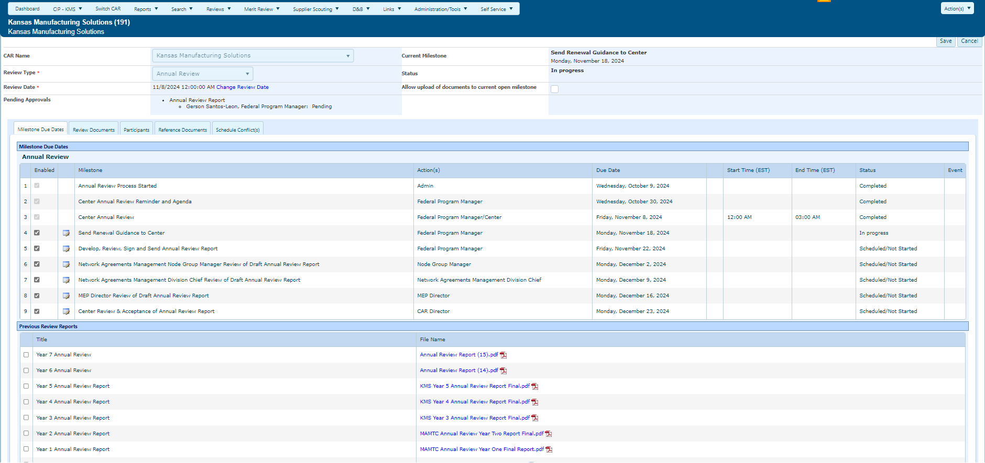
MEIS – Review Module
Status of Review Milestone
All Documents are clickable links
Add events to your calendar by clicking the calendar icon in the “Event” column.
Notes:
The Panel Review detail page provides several pieces of information as it relates to the Panel Review. It provides logistical information for key teleconferences, names of key participates in the review, training material for both the Center and Panel Members and lastly it provides access to all key review documentation.

Slide 141
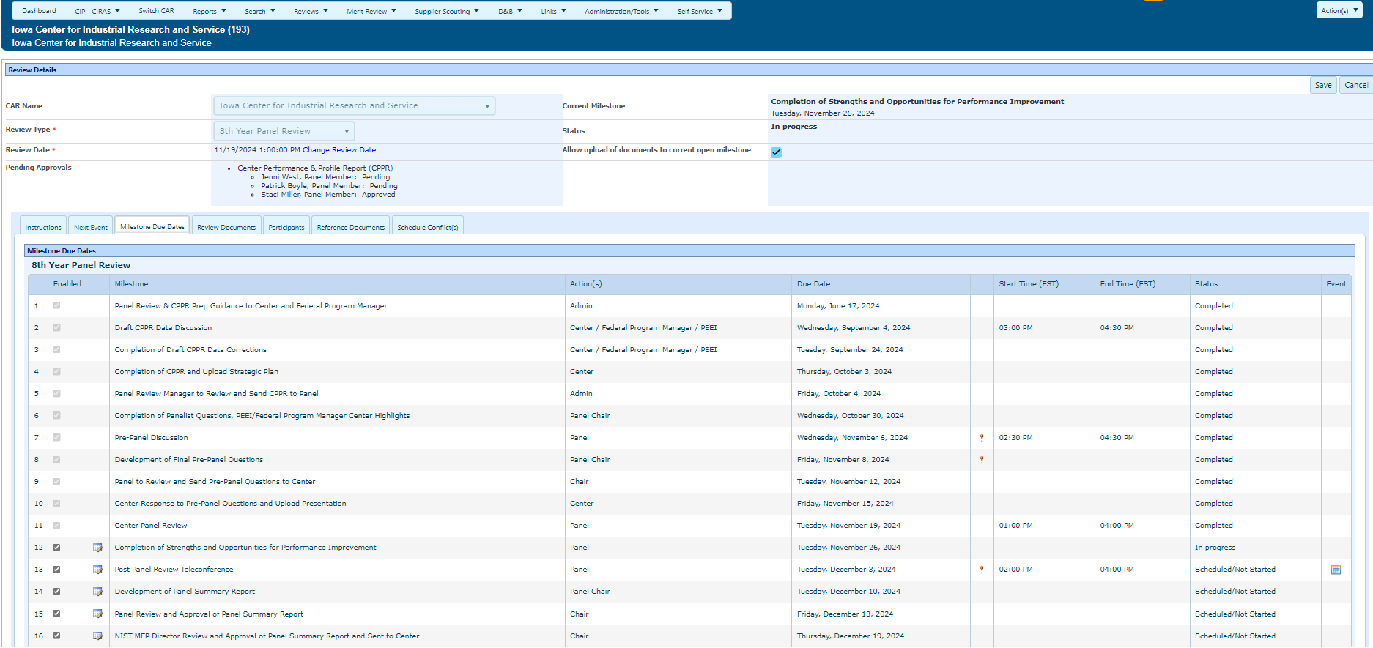
MEIS – Review Module
Add events to your calendar by clicking the calendar icon in the “Event” column.
Notes:
This is a screenshot of the Panel Review milestones. You will be able to view all key due dates and the 3 key events taking place during the overall process. This section assists the Center and Panel Members in keeping apprise of key events and deliverables.
You can add events to your calendar by selecting the calendar icon in the “Event” column. Once you click on the icon, you will receive a pop-up at the bottom of your screen prompting you to open and save. Select open and then save to your calendar. All logistics will be included in the calendar event.

