Slide 1
Direct Claims Self Service (DCSS)
DoD
Proposed Approach, presented Nov 2021

Slide 2
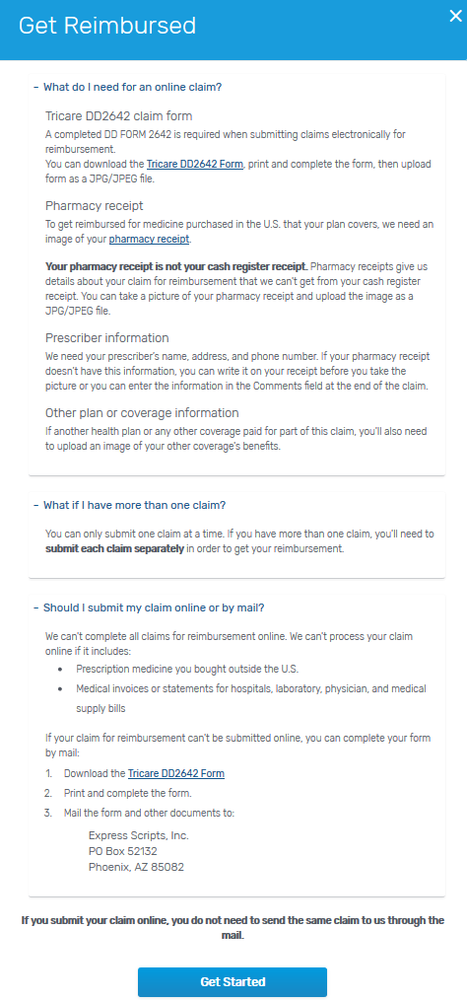
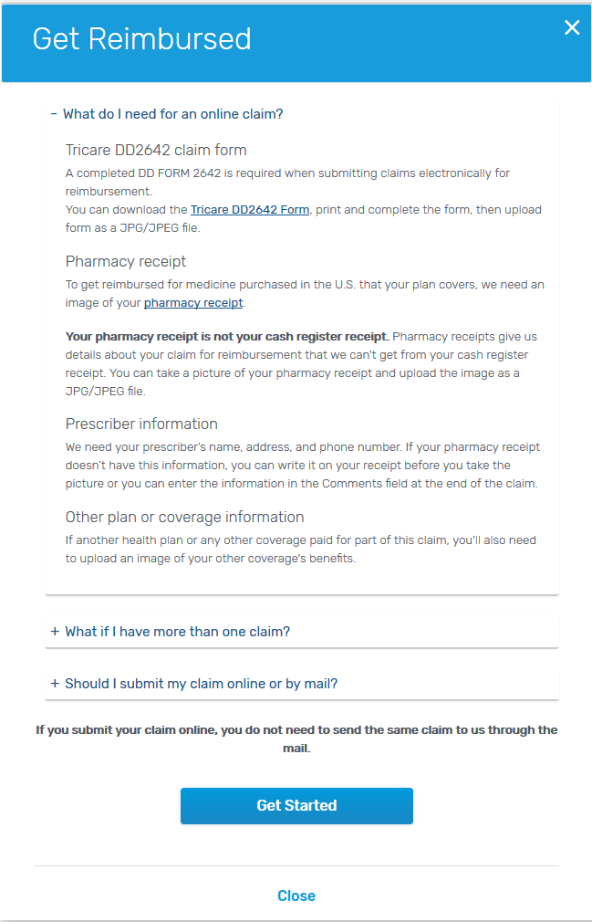
Informational Claim Page
Requirements
Beneficiaries can submit an electronic direct claim if:
It is a single-ingredient drug
It is a compound drug
It was purchased in the US
Coordination of benefits (COB)
They are registered on express-scripts.com

Slide 3
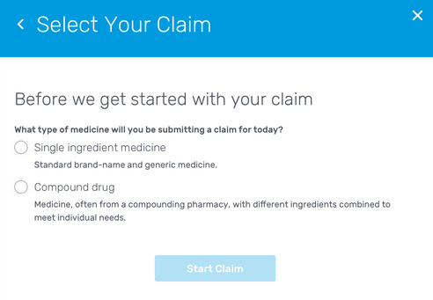
Starting a Direct Claim – Select Your Claim
Select claim type:
Single-ingredient medicine
Compound drug

Slide 4
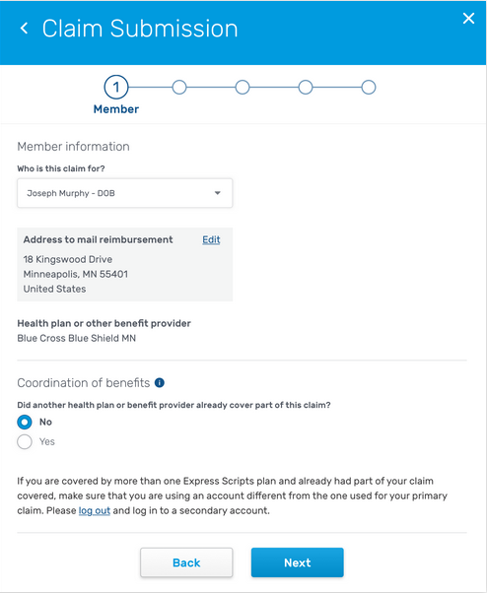
Starting a Direct Claim – Regular vs COB
Regular vs COB (Coordination of Benefits) claim
By selecting Yes or No beneficiary indicates claim type

Slide 5
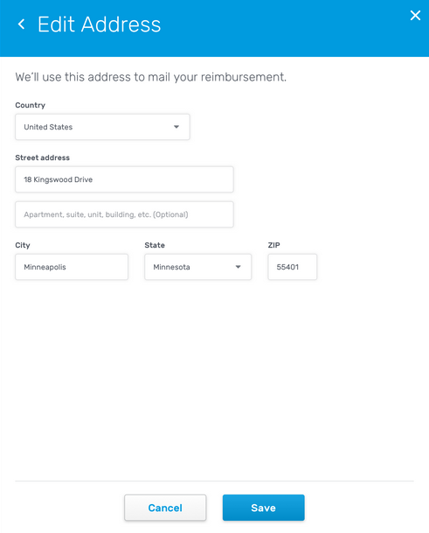
Starting a Direct Claim - Regular
Getting Started (regular claim)
Beneficiaries eligibility address is the default address.
The address can be changed but will only be used for reimbursement.
The beneficiary can’t submit the claim under any other benefit except the one they are logged in under.

Slide 6
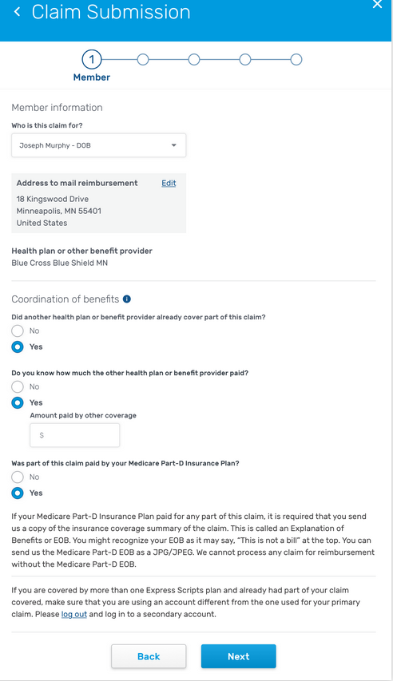
Starting a Direct Claim - COB
Getting Started (Coordination of Benefits claim)
Beneficiary can submit an electronic claim for a COB, where they have their Rx claim already covered by their primary coverage and they're submitting it under a secondary coverage.

Slide 7
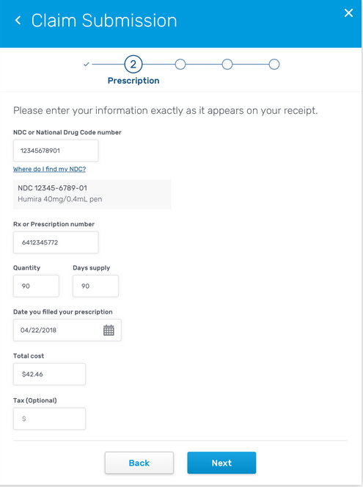
Prescription Information
Completing each step – Single ingredient drug
Beneficiary enters all the information from their pharmacy receipt.
A progress bar lets them know where they are in the process.

Slide 8
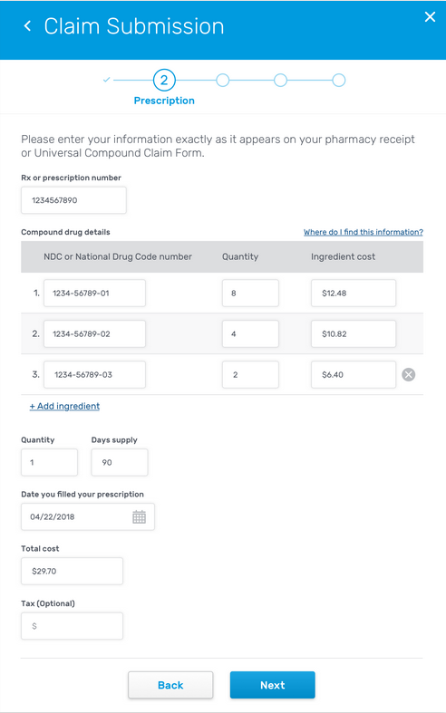
Prescription Information
Completing each step – Compound drug
Beneficiary enters all the information from their pharmacy receipt or Universal Compound Claim Form.
A progress bar lets them know where they are in the process.

Slide 9
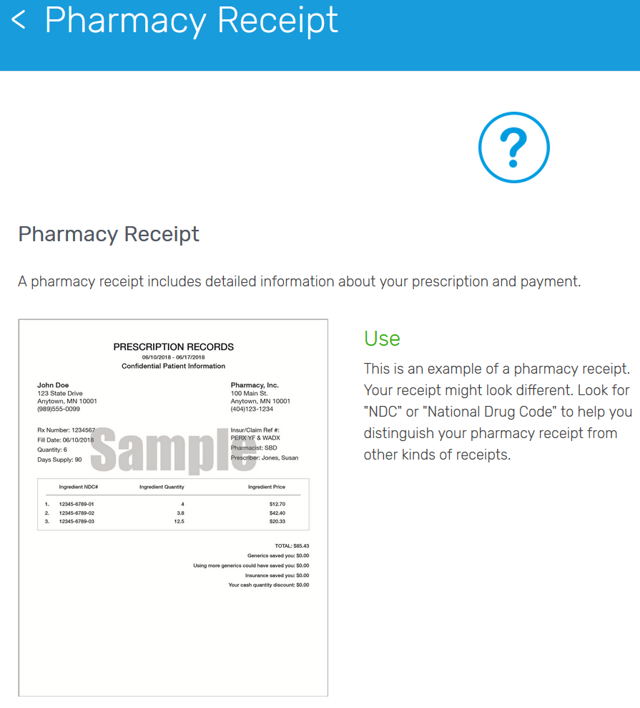
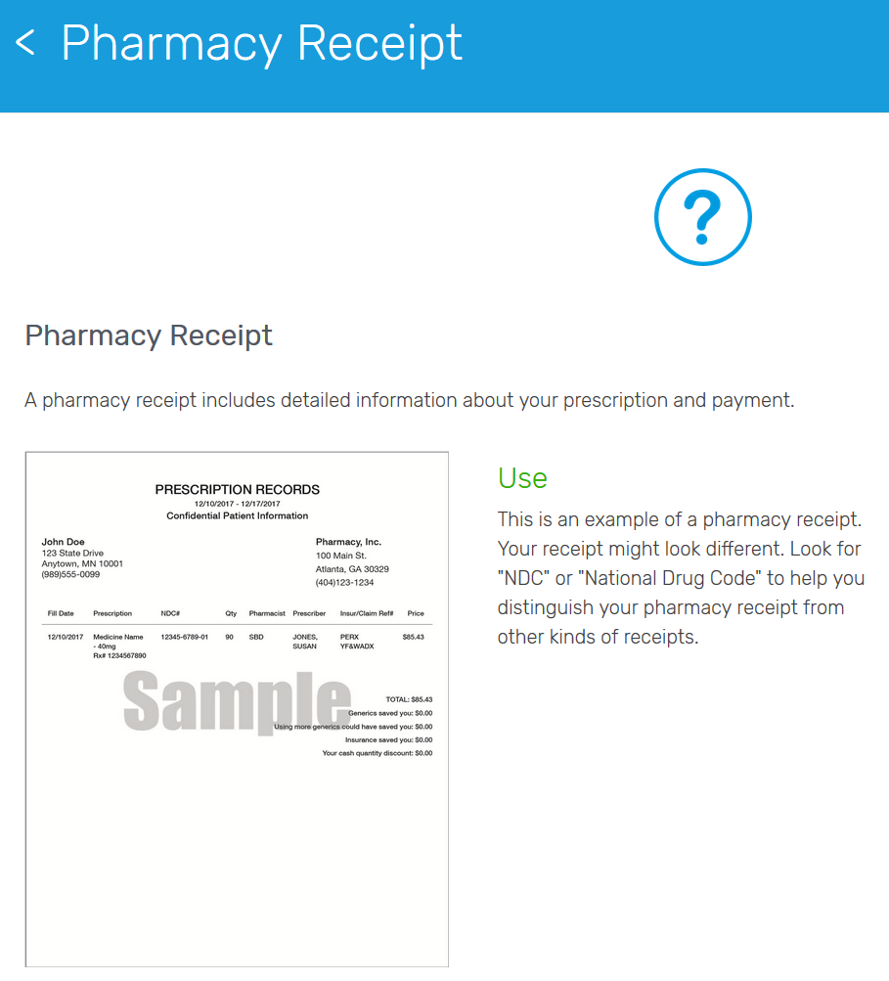
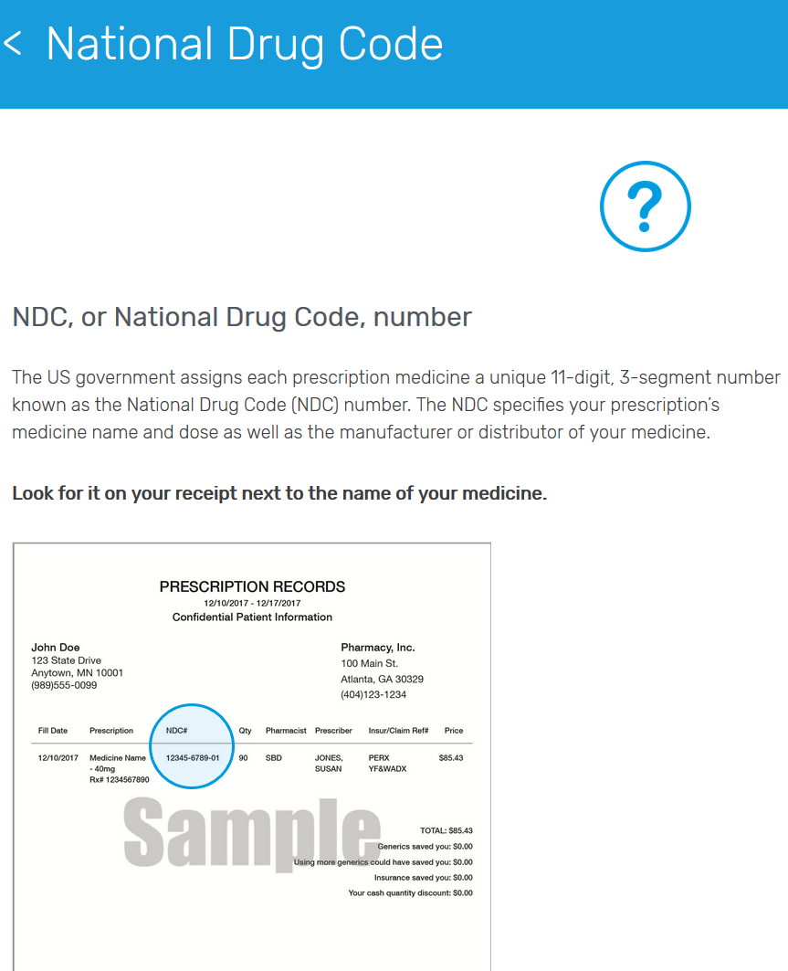
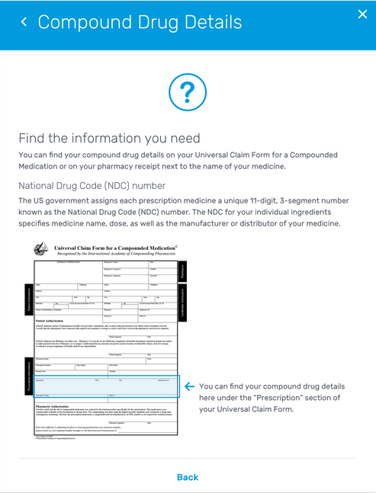
Contextual Help
Beneficiaries are given contextual help throughout the process, showing them where different fields can be found on a typical pharmacy receipt.
This will help in reducing beneficiary abandonment and confusion.

Slide 10
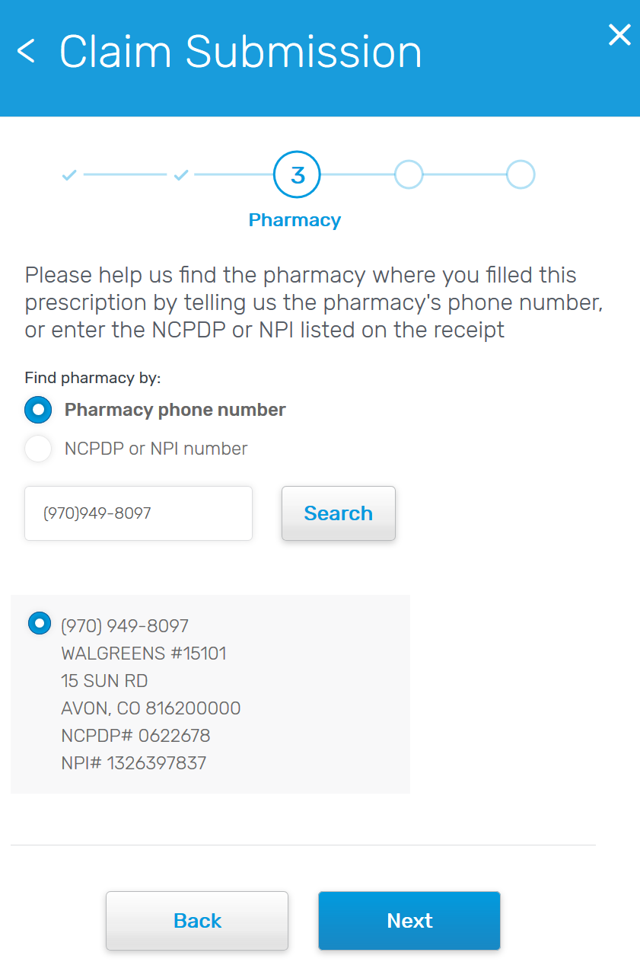
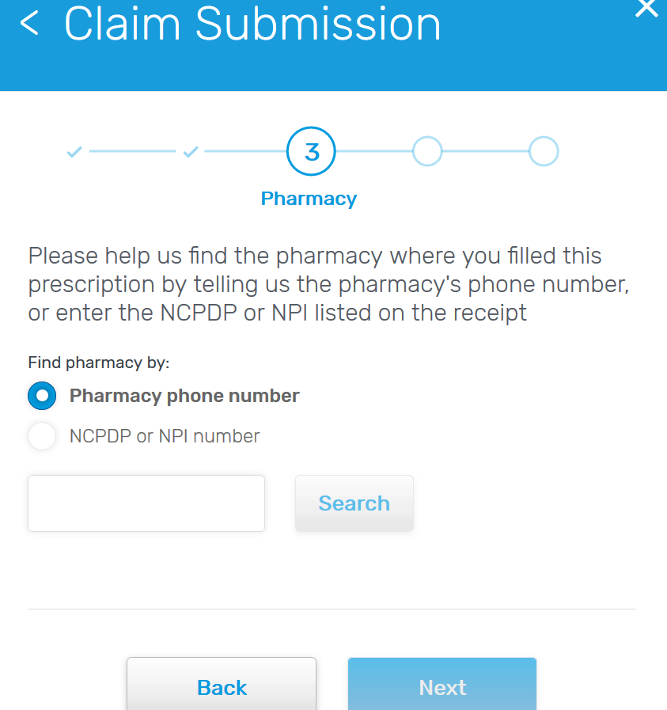
Retail Pharmacy
Beneficiary enters a NCPDP or NPI number from their receipt
OR
They must enter the phone number of the pharmacy that filled the Rx

Slide 11
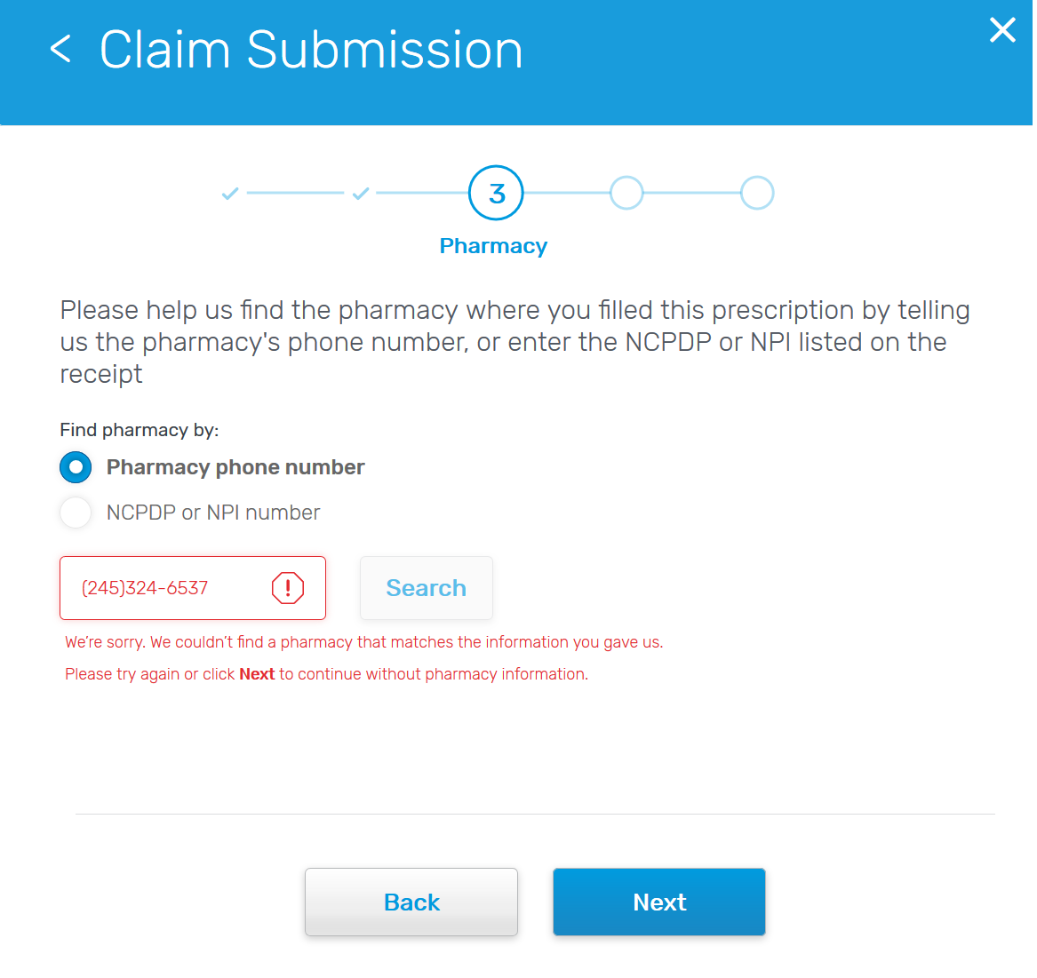
Retail Pharmacy
If no pharmacy returned for entered phone number or NPI, beneficiary can proceed with claim submission without pharmacy.
In this case default pharmacy information will be passed to the back-end by the system.

Slide 12
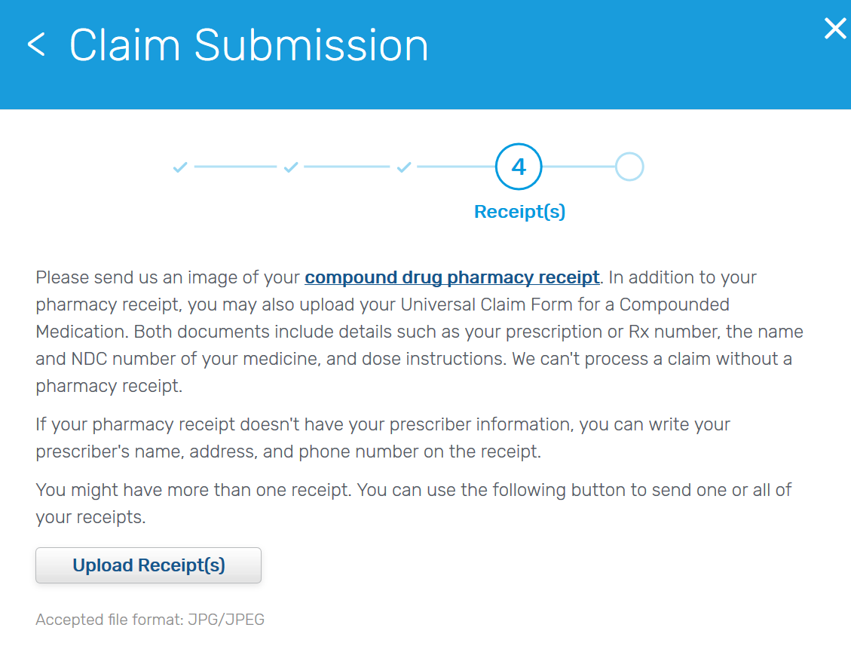
Receipt Upload
The beneficiary must upload at least one receipt to attach to the claim.
Please note: Currently, beneficiaries are only able to upload JPG/JPEG files. We will be extending this to additional files in the future.

Slide 13
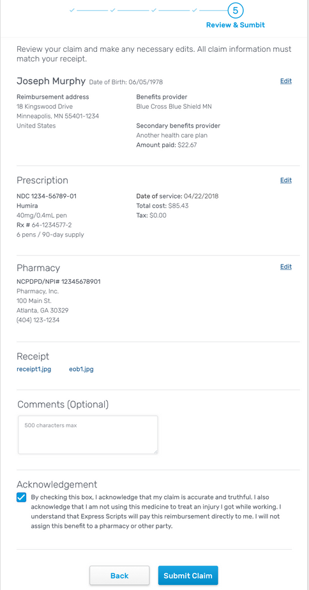
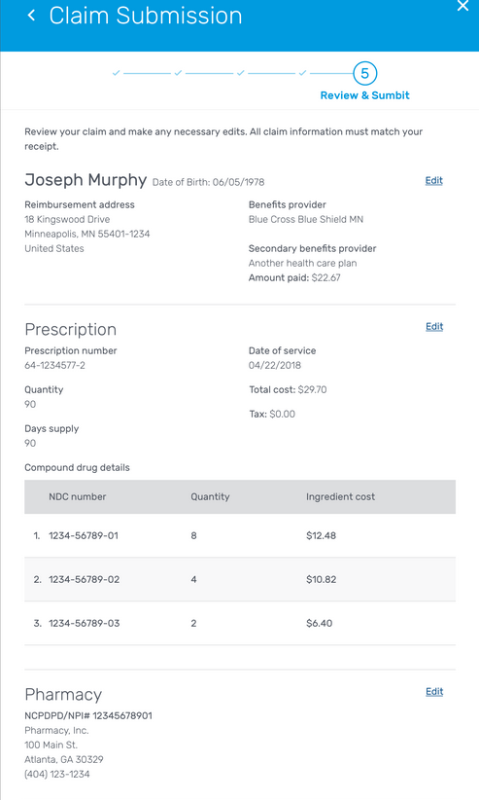
Review & Submit
Beneficiary has the opportunity to make edits, view the receipt they’ve uploaded and submit their claim.
The beneficiary must agree to the legal terms before they can submit the claim.
Compound vs Single Ingredient drug view

Slide 14
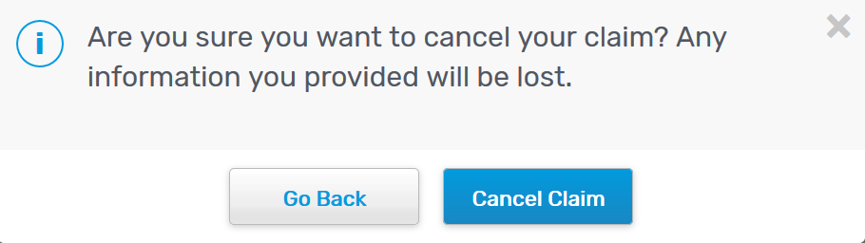
Close Prompt
If the beneficiary chooses the close button at any point, the beneficiary will receive this message asking them if they wish to close out of the application.

Slide 15
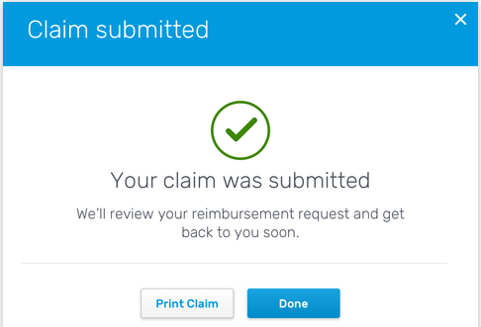
Confirmation
Beneficiary can print the claim information that they submitted, if desired.
Once beneficiary clicks Done, the application closes and the beneficiary is returned to the member website page they started from.

Slide 16
Pending Additions
The following will be presented on a new screen, either at the beginning of the process or the final submission screen:
  Privacy Act Statement
  OMB Approval Number
  OMB Approval Expiration Date
  Agency Disclosure Notice

