Slide 1
Merit-based Incentive Payment System (MIPS)
OMB control number: 0938-134
Expiration Date: 02/28/2027
2024 MIPS Promoting Interoperability Performance Category Hardship Exception Application Guide

Slide 2

Table of Contents
How To Use This Guide 3
MIPS Promoting Interoperability Performance Category Hardship
Exception Application Overview 5
MIPS Promoting Interoperability Performance Category Hardship
Exception Information 7
MIPS Promoting Interoperability Performance Category Hardship
Exception: Frequently Asked Questions 12
MIPS Promoting Interoperability Performance Category Hardship
Exception: Application Steps 14
Help and Version History 30
Appendices 33
Purpose: This guide will provide general information about the MIPS Promoting Interoperability Performance Category Hardship Exception application and provide step-by-step instructions on how to complete the application.
Already know what MIPS is? Skip ahead by clicking the links in the Table of Contents.

Slide 3
How to Use This Guide
3

Slide 4

How to Use This Guide
OVERVIEW
Table of Contents
The Table of Contents is interactive. Click on a Chapter in the Table of Contents to read that section. You can also click on the icon on the bottom left to go back to the Table of Contents.
Please Note: This guide was prepared for informational purposes only and isn’t intended to grant rights or impose obligations. The information provided is only intended to be a general summary. It isn’t intended to take the place of the written law, including the regulations. We encourage readers to review the specific statutes, regulations, and other interpretive materials for a full and accurate statement of their contents.
Hyperlinks
Hyperlinks to the Quality Payment Program website are included throughout the guide to direct the reader to more information and resources.

Slide 5
MIPS Promoting Interoperability Performance Category Hardship Exception Application Overview
5

Slide 6
Overview
MIPS PROMOTING INTEROPERABILITY PERFORMANCE CATEGORY HARDSHIP EXCEPTION APPLICATION OVERVIEW
What | MIPS Promoting Interoperability Hardship Exception applications allow you to request that your MIPS Promoting Interoperability performance category be reweighted to 0%.
Who | Individual clinicians, groups, and virtual groups reporting via traditional MIPS, MIPS Value Pathways (MVPs) or the Alternative Payment Model (APM) Performance Pathway (APP). Third party intermediaries can submit an application with permission from the clinician or practice. APM Entities can’t submit an application at the APM Entity level. If you qualify for automatic reweighting, you don’t need to apply for a MIPS Promoting Interoperability Hardship Exception. See Appendix A for information about the clinicians, groups, and virtual groups that automatically qualify for reweighting of this performance category.
Why | You can submit an application to have your MIPS Promoting Interoperability performance category reweighted to 0% if: You have insufficient Internet connectivity. You have decertified electronic health record (EHR) technology (decertified under the Office of the National Coordinator for Health Information Technology's (ONC) Health IT Certification Program). You lack control over the availability of certified EHR technology (CEHRT). Simply lacking CEHRT functionality that meets ONC’s certification criteria in 45 CFR 170.315 doesn’t qualify as a reason to submit an exception application. You face extreme and uncontrollable circumstances such as a disaster, practice closure, severe financial distress or vendor issues. If you experience an extreme and uncontrollable circumstance that impacts multiple performance categories, the Extreme and Uncontrollable Circumstances Exception application may be more suitable for your given circumstance.
When | The Promoting Interoperability Hardship Exception application will close at 8 p.m. ET on December 31, 2024.
Where | Sign in to the Quality Payment Program (QPP) website with your HCQIS Access and Roles Profile (HARP) account. For more information on HARP accounts, please refer to the Register for a HARP Account document in the QPP Access User Guide (ZIP, 3MB).
How | Register for a HARP account. Sign in to the QPP website. Select ‘Exceptions Application’ on the left-hand navigation. | Select ‘Add New Exception.’ Select ‘Promoting Interoperability Hardship Exception.’ Complete the application for individual, group, or virtual group participation.
Note: We automatically reweight Promoting Interoperability for small practices. See page 8 for more information.
See Appendix B (traditional MIPS) and Appendix C (APP) for more information on performance category reweighting.

Slide 7
MIPS Promoting Interoperability Performance Category Hardship Exception Information
7

Slide 8
Overview
MIPS PROMOTING INTEROPERABILITY PERFORMANCE CATEGORY HARDSHIP EXCEPTION INFORMATION
You may automatically qualify for reweighting in this performance category.
See Appendix A.
If you automatically quality for reweighting, you don’t need to submit a Hardship Exception application.
You’ll complete the Hardship Exception application at the level for which you’ll report data to MIPS for other performance categories.
If you’re reporting data at the individual level, complete the Hardship Exception application at the individual level.
If you’re reporting data at the group level, complete the Hardship Exception application at the group level.
Note, a group Hardship Exception application will only apply at the group level.
If clinicians in your practice participate in MIPS at the individual level, don’t complete the Hardship Exception application at the group level. You’ll complete the Hardship Exception application at the individual level for each clinician (who doesn’t automatically qualify for reweighting) to be considered for reweighting.
If you’re reporting an MVP as a subgroup, an approved group level Hardship Exception will apply to the subgroup participants.
You can still submit data for the MIPS Promoting Interoperability performance category.
If your circumstances change and you’re able to collect and submit Promoting Interoperability data, we’ll disregard your Hardship Exception application and you’ll be scored in this performance category.
You’ll also be scored in this performance category if you attest to any data, such as selecting performance period dates or responding to attestation statements, during the submission period. The submission of data cancels a hardship exception and automatic reweighting
Did You Know? Subgroups can’t submit a Promoting Interoperability Hardship Exception application at the subgroup level but a subgroup will inherit any reweighting approved for their affiliated group.
Reminder: Small practices qualify for automatic reweighting of the Promoting Interoperability performance category.

Slide 9
Overview (Continued)
MIPS PROMOTING INTEROPERABILITY PERFORMANCE CATEGORY HARDSHIP EXCEPTION INFORMATION
You aren’t required to submit documentation with your application.
However, clinicians, groups, and virtual groups should retain documentation of their circumstances supporting their application for their own records in the event they’re selected by CMS for data validation or audit. See our 2024 MIPS Data Validation Criteria (ZIP, 2MB) for details on the data validation process.
You can apply for a MIPS Promoting Interoperability performance category hardship exception if you switch CEHRT vendors during the performance period.
You would indicate an extreme and uncontrollable circumstances hardship exception and select vendor issues within the application.
The following circumstances qualify as extreme and uncontrollable circumstances for a MIPS Promoting Interoperability performance category hardship exception:
A natural disaster resulting in damage to or destruction of your CEHRT
Practice closure
Severe financial distress resulting in bankruptcy or debt restructuring
Vendor issues (such as a change in vendors during the performance period or errors with your CEHRT that your vendor is unable to address)
You may still be able to report if your EHR product is decertified under ONC’s Health IT Certification Program during the 2024 performance year.
You can submit your Promoting Interoperability performance category measures collected in your now-decertified EHR product if your performance period ended before the decertification occurred.
If your performance period ended after the EHR decertification occurred, you can apply for a MIPS Promoting Interoperability performance category hardship exception and select decertified EHR technology.

Slide 10
Groups and Virtual Groups
MIPS PROMOTING INTEROPERABILITY PERFORMANCE CATEGORY HARDSHIP EXCEPTION INFORMATION
To submit an application on behalf of a group, every office location/practice site within the taxpayer identification number (TIN) must experience the hardship for the group to qualify for the Promoting Interoperability performance category hardship exception.
For example, if one office location is within a broadband availability area but the other office(s) for the practice is not, the office with broadband availability would not qualify for the MIPS Promoting Interoperability performance category hardship exception and must report for those clinicians for whom they have data.
To submit an application on behalf of a virtual group, every office location/practice site for each TIN within the virtual group must experience the hardship for the virtual group to qualify for the Promoting Interoperability performance category hardship exception.
For example, if one TIN is within a broadband availability area but the other TIN(s) in the virtual group is not, the TIN with broadband availability would not qualify for the MIPS Promoting Interoperability performance category hardship exception and must report for those clinicians for whom they have data.

Slide 11
MIPS APM Participants
MIPS PROMOTING INTEROPERABILITY PERFORMANCE CATEGORY HARDSHIP EXCEPTION INFORMATION
MIPS eligible clinicians and groups participating in a MIPS APM can apply for hardship exceptions and qualify for automatic reweighting.
If you’re participating in MIPS at the APM Entity level (either reporting traditional MIPS or the APP), you can complete the application as an individual or group.
If approved, the MIPS eligible clinician will receive the APM Entity’s score, but will be excluded from the calculation when we create an average Promoting Interoperability score for the APM Entity.
APM Entities reporting the APP or traditional MIPS can’t submit a Promoting Interoperability Hardship Exception application on behalf of the entire APM Entity.
MIPS eligible clinicians in the APM Entity would need to submit the MIPS Promoting Interoperability Performance Category Hardship Exception application at the individual or group level, as appropriate to their circumstances.
A MIPS Promoting Interoperability performance category hardship exception doesn’t exempt you from reporting on any CEHRT activities as may be required by your APM.
Reminder: The Promoting Interoperability Performance Category Hardship Exception application isn’t available to APM Entities.

Slide 12
MIPS Promoting Interoperability Performance Category Hardship Exception: Frequently Asked Questions
12

Slide 13
MIPS PROMOTING INTEROPERABILITY PERFORMANCE CATEGORY HARDSHIP EXCEPTION: FREQUENTLY ASKED QUESTIONS
Question | Answer
Where Can I Look for a Status Update on My MIPS Promoting Interoperability Performance Category Hardship Exception Application? | You can monitor your application status in your QPP Account on the QPP website.
Can Additional Staff Members Access/Receive Notifications About the Status of the MIPS Promoting Interoperability Performance Category Hardship Exception Application? | Yes, you can add additional staff or representatives who should receive notifications about the status of the application. In the Additional Access section of the application, provide the email address(es) of additional staff or representatives who you would like to receive email notifications. Please note: the additional staff or representatives must have HARP credentials to see the application on the QPP website.
How Can I Correct a Mistake Made on Our MIPS Promoting Interoperability Performance Category Hardship Exception Application? | If you identify an error with your application, please contact the Quality Payment Program Service Center by email at QPP@cms.hhs.gov, by creating a QPP Service Center ticket, or by phone at 1-866-288-8292 (Monday-Friday, 8 a.m. - 8 p.m. ET).
13

Slide 14
MIPS Promoting Interoperability Performance Category Hardship Exception: Application Steps
14

Slide 15
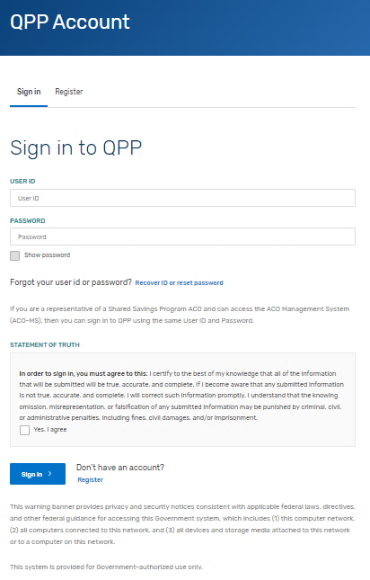
Step 1: Sign in to Your QPP Account
MIPS PROMOTING INTEROPERABILITY PERFORMANCE CATEGORY HARDSHIP EXCEPTION: APPLICATION STEPS
With your HARP credentials, sign in to your QPP Account on the QPP website.
Note: If you haven’t signed in on the QPP website before, you must register for an account to obtain your HARP credentials. See our QPP Account Access Guide (ZIP, 3MB) for information on creating an account.
*The screenshots included in this user guide were based on the QPP test environment. Because we are always working to incorporate feedback and improve the experience, there may be differences between these screenshots and what you see on the QPP website.

Slide 16
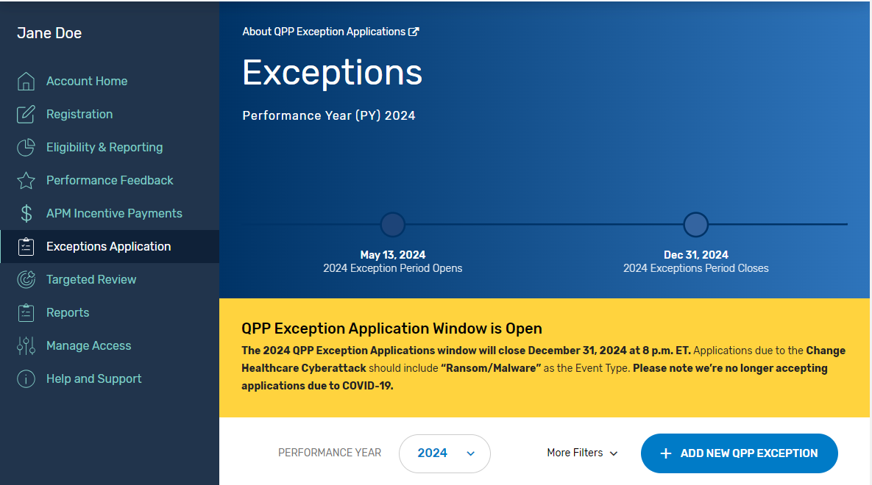
Step 2: Navigate to Your Exception Applications
MIPS PROMOTING INTEROPERABILITY PERFORMANCE CATEGORY HARDSHIP EXCEPTION: APPLICATION STEPS
Once you’re signed into your account, select:
The Exception Application tab in the left-hand navigation menu, then click + Add New QPP Exception
OR
The Start an Application quick link on the home page.
You can create and submit a new exception request until 8 p.m. ET on December 31, 2024.
*The screenshots included in this user guide were based on the QPP test environment. Because we are always working to incorporate feedback and improve the experience, there may be differences between these screenshots and what you see on the QPP website.

Slide 17
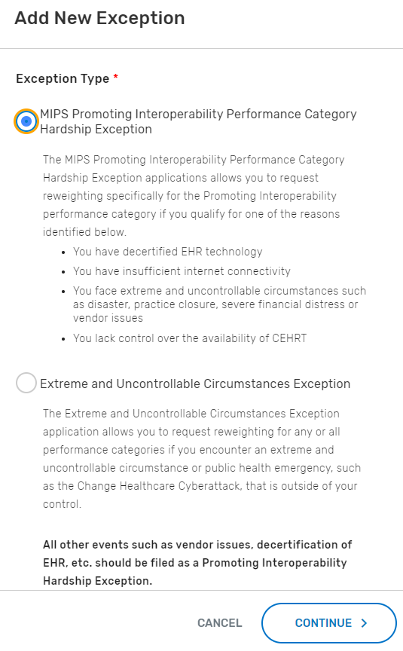
Step 3: Select the Exception Application
MIPS PROMOTING INTEROPERABILITY PERFORMANCE CATEGORY HARDSHIP EXCEPTION: APPLICATION STEPS
Select the MIPS Promoting Interoperability Performance
Category Hardship Exception, then click Continue.
*The screenshots included in this user guide were based on the QPP test environment. Because we are always working to incorporate feedback and improve the experience, there may be differences between these screenshots and what you see on the QPP website.

Slide 18
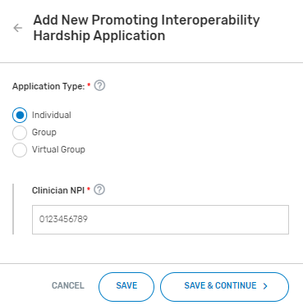
Step 4: Select Application Type
MIPS PROMOTING INTEROPERABILITY PERFORMANCE CATEGORY HARDSHIP EXCEPTION: APPLICATION STEPS
Select the participation level at which you intend (or intended) to participate in MIPS, then select Save & Continue.
*The screenshots included in this user guide were based on the QPP test environment. Because we are always working to incorporate feedback and improve the experience, there may be differences between these screenshots and what you see on the QPP website.
(Image features application at the individual level)

Slide 19
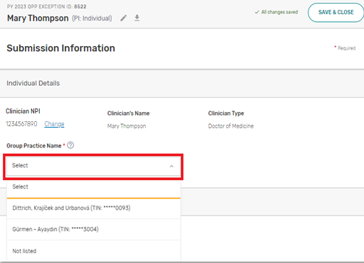
Step 5: Enter Participation Level Information
MIPS PROMOTING INTEROPERABILITY PERFORMANCE CATEGORY HARDSHIP EXCEPTION: APPLICATION STEPS
Enter the required participation level information.
The required information for each participation level is as follows:
Participation Level | Required Information
Individual Clinician | National Provider Identifier (NPI) Practice Affiliation
Group | Taxpayer Identification Number (TIN)
Virtual Group | Virtual Group Identifier
*The screenshots included in this user guide were based on the QPP test environment. Because we are always working to incorporate feedback and improve the experience, there may be differences between these screenshots and what you see on the QPP website.
(Image features application at the individual level)

Slide 20
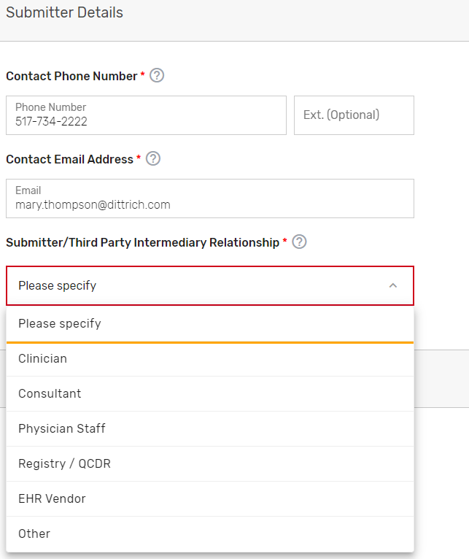
Step 6: Enter Submitter Details
MIPS PROMOTING INTEROPERABILITY PERFORMANCE CATEGORY HARDSHIP EXCEPTION: APPLICATION STEPS
Enter your contact information (as the submitter) and identify your relationship to the party identified in the application.
*The screenshots included in this user guide were based on the QPP test environment. Because we are always working to incorporate feedback and improve the experience, there may be differences between these screenshots and what you see on the QPP website.

Slide 21
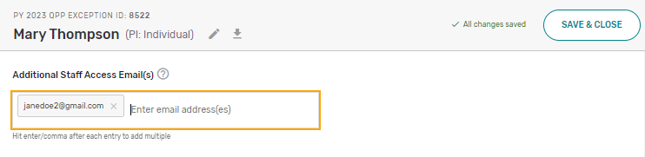
Step 7: Enter Additional Staff in Additional Access Section
MIPS PROMOTING INTEROPERABILITY PERFORMANCE CATEGORY HARDSHIP EXCEPTION: APPLICATION STEPS
You can identify additional users to receive notifications about the application in the Additional Access section.
If there’s a HARP account associated with the email address(es) you provide, the person will be able to sign in to their own account on the QPP website and access the application.
*The screenshots included in this user guide were based on the QPP test environment. Because we are always working to incorporate feedback and improve the experience, there may be differences between these screenshots and what you see on the QPP website.

Slide 22
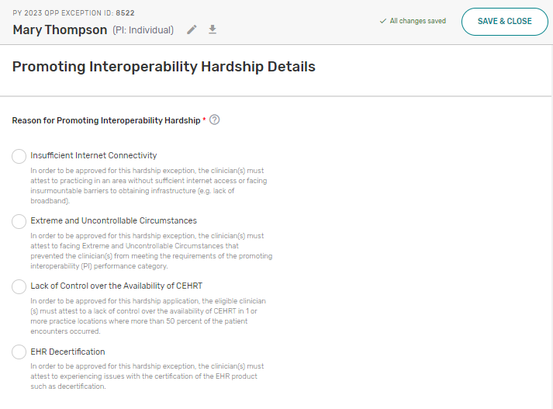
Step 8: Select the Reason for the MIPS Promoting Interoperability Hardship
MIPS PROMOTING INTEROPERABILITY PERFORMANCE CATEGORY HARDSHIP EXCEPTION: APPLICATION STEPS
Select the option that aligns with your reason for submitting a MIPS Promoting Interoperability Hardship Exception application.
Note: You don’t need to submit supporting documentation with your application. However, you should retain documentation of the circumstances supporting your application for your own records in case you are selected by CMS for data validation or an audit. See our 2024 MIPS Data Validation Criteria (ZIP, 2MB) for details on the data validation process.
*The screenshots included in this user guide were based on the QPP test environment. Because we are always working to incorporate feedback and improve the experience, there may be differences between these screenshots and what you see on the QPP website.

Slide 23
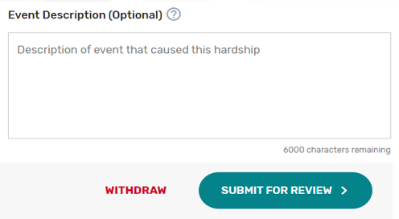
Step 9: Complete Attestation and Provide Event Description
MIPS PROMOTING INTEROPERABILITY PERFORMANCE CATEGORY HARDSHIP EXCEPTION: APPLICATION STEPS
Before submitting your application, you must complete the attestation (differs for each reason option).
Insufficient Internet Connectivity
Extreme and Uncontrollable Circumstances
Lack of Control Over the Availability of CEHRT
EHR Decertification
You also can provide an optional brief description on the hardship you experienced and how performance data is impacted.
*The screenshots included in this user guide were based on the QPP test environment. Because we are always working to incorporate feedback and improve the experience, there may be differences between these screenshots and what you see on the QPP website.

Slide 24
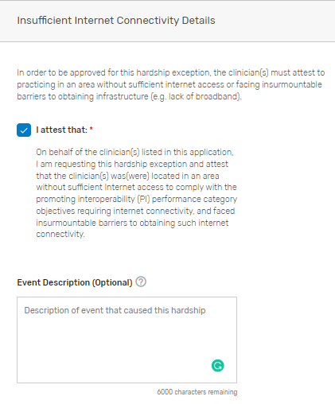
Step 9: Complete Attestation and Provide Event Description (Continued)
MIPS PROMOTING INTEROPERABILITY PERFORMANCE CATEGORY HARDSHIP EXCEPTION: APPLICATION STEPS
Reason Option 1: Insufficient Internet Connectivity
Review the attestation statement and select “I attest.”
You can provide an optional description of the hardship event.
*The screenshots included in this user guide were based on the QPP test environment. Because we are always working to incorporate feedback and improve the experience, there may be differences between these screenshots and what you see on the QPP website.

Slide 25
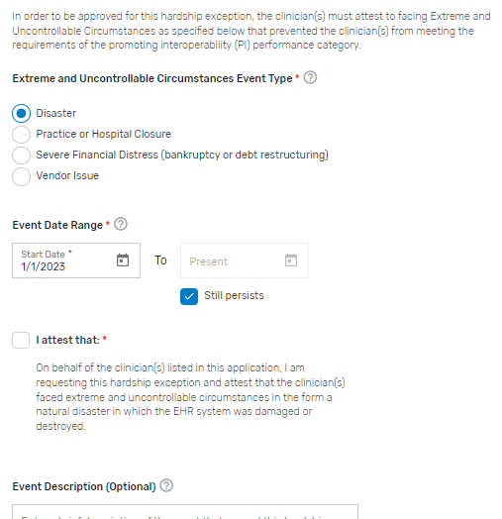
Step 9: Complete Attestation and Provide Event Description (Continued)
MIPS PROMOTING INTEROPERABILITY PERFORMANCE CATEGORY HARDSHIP EXCEPTION: APPLICATION STEPS
Reason Option 2: Extreme and Uncontrollable Circumstances
Select the extreme and uncontrollable circumstances event type that applies to you, enter the event dates, then review the attestation statement and select “I attest.”
You can provide an optional description of the hardship event.
*The screenshots included in this user guide were based on the QPP test environment. Because we are always working to incorporate feedback and improve the experience, there may be differences between these screenshots and what you see on the QPP website.

Slide 26
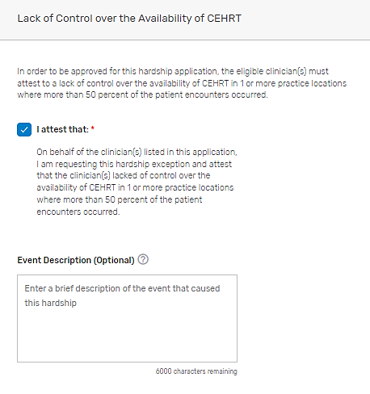
Step 9: Complete Attestation and Provide Event Description (Continued)
MIPS PROMOTING INTEROPERABILITY PERFORMANCE CATEGORY HARDSHIP EXCEPTION: APPLICATION STEPS
Reason Option 3: Lack of Control Over the Availability of CEHRT
Review the attestation statement and select “I attest.”
You can provide an optional description of the hardship event.
*The screenshots included in this user guide were based on the QPP test environment. Because we are always working to incorporate feedback and improve the experience, there may be differences between these screenshots and what you see on the QPP website.

Slide 27
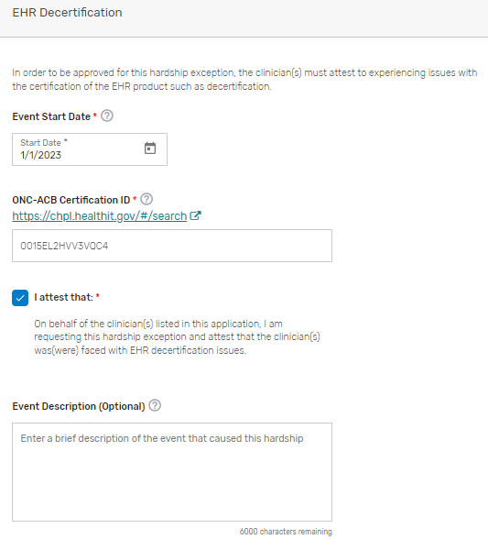
Step 9: Complete Attestation and Provide Event Description (Continued)
MIPS PROMOTING INTEROPERABILITY PERFORMANCE CATEGORY HARDSHIP EXCEPTION: APPLICATION STEPS
Reason Option 4: EHR Decertification
Enter the date that your EHR was decertified (under ONC’s Health IT Certification Program) and your ONC-ACB Certification ID. Then, review the attestation statement and select “I attest.”
You can provide an optional description of the hardship event.
*The screenshots included in this user guide were based on the QPP test environment. Because we are always working to incorporate feedback and improve the experience, there may be differences between these screenshots and what you see on the QPP website.

Slide 28
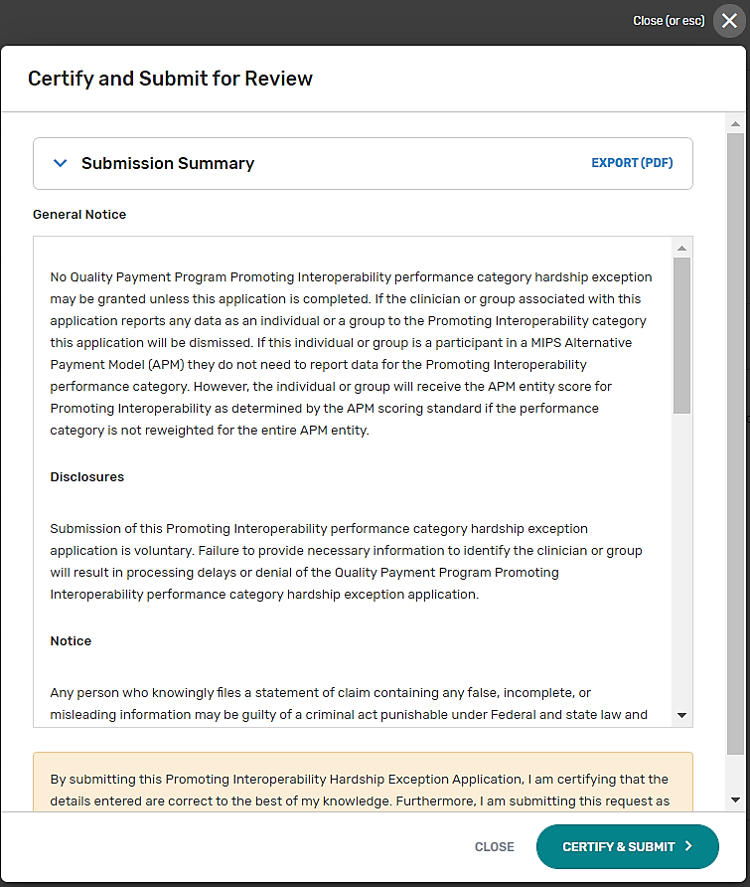
Step 10: Submit MIPS Promoting Interoperability Hardship Exception Application
MIPS PROMOTING INTEROPERABILITY PERFORMANCE CATEGORY HARDSHIP EXCEPTION: APPLICATION STEPS
Once you’re done with your application, review the disclosures, then select Certify & Submit.
*The screenshots included in this user guide were based on the QPP test environment. Because we are always working to incorporate feedback and improve the experience, there may be differences between these screenshots and what you see on the QPP website.

Slide 29
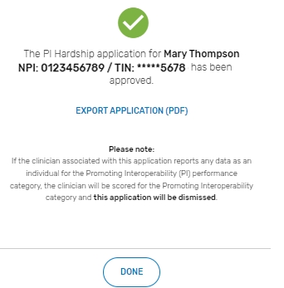
MIPS Promoting Interoperability Hardship Exception Application Submission Confirmation
MIPS PROMOTING INTEROPERABILITY PERFORMANCE CATEGORY HARDSHIP EXCEPTION: APPLICATION STEPS
After you submit your MIPS Promoting Interoperability Hardship Exception application, you’ll receive a message stating that your Hardship Exception application has been successfully submitted and is pending review.
You’ll also receive an email notification.
See Appendix D for information on the various application statuses.
*The screenshots included in this user guide were based on the QPP test environment. Because we are always working to incorporate feedback and improve the experience, there may be differences between these screenshots and what you see on the QPP website.

Slide 30
Help and Version History
30

Slide 31
Where Can You Go for Help?
HELP AND VERSION HISTORY
Contact the Quality Payment Program Service Center by email at QPP@cms.hhs.gov, by creating a QPP Service Center ticket, or by phone at 1-866-288-8292 (Monday through Friday,
8 a.m. - 8 p.m. ET). People who are deaf or hard of hearing can dial 711 to be connected to a TRS Communications Assistant.
Visit the Quality Payment Program website for other help and support information, to learn more about MIPS, and to check out the resources available in the Quality Payment Program Resource Library.
31

Slide 32
Version History
HELP AND VERSION HISTORY
If we need to update this document, changes will be identified here.
DATE | DESCRIPTION
08/30/2024 | Added OMB control number and expiration date on slide 1 and updated PRA disclosure language on slide 32.
06/25/2024 | Updated to include PRA disclosure language.
05/13/2024 | Original Posting.
According to the Paperwork Reduction Act of 1995 (44 U.S.C. 3501 et seq.), no persons are required to respond to a collection of information unless it displays a valid OMB control number. The valid OMB control number for this information collection is 0938-1314 (Expiration date: 2/28/2027). This information collection is the tool to request that MIPS Promoting Interoperability Hardship Exception applications allow you to request that your MIPS Promoting Interoperability performance category be reweighted to 0%. The time required to complete this information collection is estimated to average .25 hours per response, including the time to review instructions, search existing data resources, gather the data needed, to review and complete the information collection. This information collection is voluntary and all information collected will be kept private in accordance with regulations at 45 CFR 155.260, Privacy and Security of Personally Identifiable Information. Pursuant to this regulation, CMS may only use or disclose personally identifiable information to the extent that such information is necessary to carry out their statutory and regulatory mandated functions. If you have comments concerning the accuracy of the time estimate(s) or suggestions for improving this form, please write to: CMS, 7500 Security Boulevard, Attn: PRA Reports Clearance Officer, Mail Stop C4-26-05, Baltimore, MD 21244-1850. If you have questions or concerns regarding where to submit your documents, please contact QPP at qpp@cms.hhs.gov.
Under the Privacy Act of 1974 (5 U.S.C. 552a) any personally identifying information obtained will be kept private to the extent of the law.
32

Slide 33
Appendices
33

Slide 34
Appendix A. Automatic Reweighting in the MIPS Promoting Interoperability Performance Category
APPENDICES
Reason for Reweighting (Individual Clinicians) | Action Needed by the Individual
You're the following clinician type or have one of these Special Statuses: Clinical Social Worker Small Practice; Ambulatory Surgical Center (ASC)-based; Hospital-based; or Non-patient facing | None – You’re automatically excepted from having to submit data for this performance category as an individual, though you may still choose to do so. You’ll be scored in this performance category if your practice is participating as a group or virtual group and doesn’t qualify for reweighting.
Reason for Reweighting (Groups and Virtual Groups) | Action Needed by the Group or Virtual Group
You have one of these Special Statuses: ASC-based. Small Practice Hospital-based: Group or virtual group must have more than 75% of clinicians designated as hospital-based. Non-patient facing: Group or virtual group must have more than 75% of clinicians designated as non-patient facing. | You’ll be scored in this performance category if your practice is participating as a group or virtual group and doesn’t qualify for reweighting.
All of the MIPS eligible clinicians in your group or virtual group qualify for reweighting as individuals (through any combination of special statuses, clinician type, and approved hardship exceptions). | You’ll be scored in this performance category if your practice is participating as a group or virtual group and doesn’t qualify for reweighting.
34

Slide 35
Appendix B. MIPS Performance Category Weight Redistribution Policies Under Traditional MIPS and MVPs Finalized for the 2024 Performance Year: Individual Clinicians, Groups, and Virtual Groups
APPENDICES
The table below illustrates the 2024 performance category weights and reweighting policies that CMS will apply to clinicians, groups, and virtual groups reporting via traditional MIPS or MVPs.
Refer to Appendix D for reweighting policies that apply to APM Entities.
Important Reminders:
Individual Clinicians, Groups, Virtual Groups: If fewer than 2 performance categories can be scored (meaning 1 performance category is weighted at 100%, or all performance categories are weighted at 0%), the clinician, group, or virtual group will receive a final score equal to the performance threshold and the MIPS eligible clinicians will receive a neutral payment adjustment in the 2026 payment year.
MIPS Performance Category Reweighting Scenario | Quality Category Weight | Cost Category Weight | Improvement Activities Category Weight | Promoting Interoperability Category Weight
No Reweighting
Standard Weighting under traditional MIPS | 30% | 30% | 15% | 25%
Reweight 1 Performance Category
No Cost (Cost → Quality and Promoting Interoperability) | 55% | 0% | 15% | 30%
No Improvement Activities (Improvement Activities → Quality) | 45% | 30% | 0% | 25%
No Promoting Interoperability (Promoting Interoperability → Quality) | 55% | 30% | 15% | 0%
No Quality (Quality → Promoting Interoperability) | 0% | 30% | 15% | 55%
Note: Small practices have a different performance category weight distribution policy than individual clinicians, larger groups, and virtual groups.
*Table continues on next slide.
35

Slide 36
Appendix B. MIPS Performance Category Weight Redistribution Policies Under Traditional MIPS and MVPs Finalized for the 2024 Performance Year: Individual Clinicians, Groups, and Virtual Groups (Continued)
APPENDICES
MIPS Performance Category Reweighting Scenario | Quality Category Weight | Cost Category Weight | Improvement Activities Category Weight | Promoting Interoperability Category Weight
Reweight 2 Performance Categories
No Cost + No Promoting Interoperability (Cost + Promoting Interoperability → Quality) | 85% | 0% | 15% | 0%
No Cost + No Quality (Cost + Quality → Promoting Interoperability) | 0% | 0% | 15% | 85%
No Cost + No Improvement Activities (Cost + Improvement Activities → Promoting Interoperability + Quality) | 70% | 0% | 0% | 30%
No Promoting Interoperability + No Quality (Promoting Interoperability + Quality → Cost + Improvement Activities) | 0% | 50% | 50% | 0%
No Promoting Interoperability + No Improvement Activities (Promoting Interoperability + Improvement Activities → Quality) | 70% | 30% | 0% | 0%
No Quality + No Improvement Activities (Quality + Improvement Activities → Promoting Interoperability) | 0% | 30% | 0% | 70%
Note: If you have multiple performance categories reweighted to 0% so that a single performance category is weighted at 100% of your final score, you’ll receive a score equal to the performance threshold regardless of any data submitted. See next slide for additional information.
*Table continues on next slide.
36

Slide 37
Appendix B. MIPS Performance Category Weight Redistribution Policies Under Traditional MIPS and MVPs Finalized for the 2024 Performance Year: Individual Clinicians, Groups, and Virtual Groups (Continued)
APPENDICES
MIPS Performance Category Reweighting Scenario | Quality Category Weight | Cost Category Weight | Improvement Activities Category Weight | Promoting Interoperability Category Weight
Reweight 3 Performance Categories
If you have multiple performance categories reweighted to 0% so that a single performance category is weighted at 100% of your final score, you’ll receive a score equal to the performance threshold regardless of any data submitted and you’ll receive a neutral payment adjustment.
Reweight 4 Performance Categories
If all performance categories are reweighted to 0%, you’ll receive a score equal to the performance threshold regardless of any data submitted and you’ll receive a neutral payment adjustment.
37

Slide 38
Appendix C. MIPS Performance Category Weight Redistribution Policies Under Traditional MIPS Finalized for the 2024 Performance Year: Small Practices
APPENDICES
The table below illustrates the 2024 performance category weights and reweighting policies that CMS will apply to small practices.
Refer to Appendix D for reweighting policies that apply to APM Entities reporting the APP. APM Entities reporting traditional MIPS or MVPs can only request reweighting for all performance categories.
MIPS Performance Category Reweighting Scenario | Quality Category Weight | Cost Category Weight | Improvement Activities Category Weight | Promoting Interoperability Category Weight
No Reweighting
Standard Weighting under traditional MIPS | 30% | 30% | 15% | 25%
Reweight 1 Performance Category
No Cost (Cost → Quality and Promoting Interoperability) | 55% | 0% | 15% | 30%
No Improvement Activities (Improvement Activities → Quality) | 45% | 30% | 0% | 25%
No Promoting Interoperability (Promoting Interoperability → Quality and Improvement Activities) | 40% | 30% | 30% | 0%
No Quality (Quality → Promoting Interoperability) | 0% | 30% | 15% | 55%
*Table continues on next slide.
38

Slide 39
Appendix C. MIPS Performance Category Weight Redistribution Policies Under Traditional MIPS Finalized for the 2024 Performance Year: Small Practices
APPENDICES
MIPS Performance Category Reweighting Scenario | Quality Category Weight | Cost Category Weight | Improvement Activities Category Weight | Promoting Interoperability Category Weight
Reweight 2 Performance Categories
No Cost + No Promoting Interoperability (Cost + Promoting Interoperability → Quality and Improvement Activities) | 50% | 0% | 50% | 0%
No Cost + No Quality (Cost + Quality → Promoting Interoperability) | 0% | 0% | 15% | 85%
No Cost + No Improvement Activities (Cost + Improvement Activities → Promoting Interoperability + Quality) | 70% | 0% | 0% | 30%
No Promoting Interoperability + No Quality (Promoting Interoperability + Quality → Cost + Improvement Activities) | 0% | 50% | 50% | 0%
No Promoting Interoperability + No Improvement Activities (Promoting Interoperability + Improvement Activities → Quality) | 70% | 30% | 0% | 0%
No Quality + No Improvement Activities (Quality + Improvement Activities → Promoting Interoperability) | 0% | 30% | 0% | 70%
Note: If you have multiple performance categories reweighted to 0% so that a single performance category is weighted at 100% of your final score, you’ll receive a score equal to the performance threshold regardless of any data submitted and you’ll receive a neutral payment adjustment.
39

Slide 40
Appendix D. MIPS Performance Category Weight Redistribution Policies for APM Entities and the APP Finalized for the 2024 Performance Year
APPENDICES
The table below illustrates the 2024 performance category weights and reweighting policies that apply to individual clinicians, groups, and APM Entities reporting via the APP.
Reminders:
The cost performance category weight is zero percent for clinicians scored through the APP.
There are no reporting requirements for the improvement activities performance category under the APP for the 2024 performance year. Participants reporting via the APP will automatically receive full credit for the improvement activities performance category for the 2024 performance year.
MIPS participants reporting via the APP will follow the same reporting requirements as traditional MIPS for the Promoting Interoperability performance category.
MIPS Performance Category Reweighting Scenario under the APP | Quality Category Weight | Cost Category Weight | Improvement Activities Category Weight | Promoting Interoperability Category Weight
No Reweighting
Standard Weighting under the APP | 50% | 0% | 20% | 30%
Reweight 1 Performance Category
No Promoting Interoperability (Promoting Interoperability → Quality) | 75% | 0% | 25% | 0%
No Quality (Quality → Promoting Interoperability) | 0% | 0% | 25% | 75%
Reweight 2 + Performance Categories
If you have multiple performance categories reweighted to 0% so that a single performance category is weighted at 100% of your final score, you’ll receive a score equal to the performance threshold regardless of any data submitted and you’ll receive a neutral payment adjustment.
40

Slide 41





Appendix E. MIPS Promoting Interoperability Hardship Exception Application Status Descriptions
APPENDICES
The table below provides a description of each application status in the order of which they occur.
Draft in Progress | Submitted – Pending Approval | Approved / Denied | Withdrawn
You’re currently working on your application and haven’t submitted it yet. Select Manage to continue working on your application. | You’ve successfully completed and submitted your application. Applications are reviewed in the order of which they’re received. | We completed our review of your application and approved your request. | You’ve withdrawn your application. You can withdraw your application at any point in the process. An application can’t be reopened after being withdrawn. You’ll need to complete a new application.
 |  | We completed our review of your application and denied your request.
41

