Slide 1
Merit-based Incentive Payment System (MIPS)
OMB control number: 0938-134
Expiration Date: 02/28/2027
2024 MIPS Value Pathways (MVP) Registration Guide

Slide 2

Table of Contents
How To Use This Guide 3
MVP Registration Overview 5
MVP Registration: Registration Steps 8
Group Registration 14
Individual Registration 17
APM Entity Registration 21
Subgroup Registration 25
MVP Registration: Frequently Asked Questions 32
Help and Version History 36
Purpose: This resource provides guidance on how to register for MVP reporting for the 2024 performance year.
Skip ahead by clicking the links in the Table of Contents.

Slide 3
How to Use This Guide
3

Slide 4

How to Use This Guide
OVERVIEW
Table of Contents
The Table of Contents is interactive. Click on a Chapter in the Table of Contents to read that section. You can also click on the icon on the bottom left to go back to the Table of Contents.
Please Note: This guide was prepared for informational purposes only and isn’t intended to grant rights or impose obligations. The information provided is only intended to be a general summary. It isn’t intended to take the place of the written law, including the regulations. We encourage readers to review the specific statutes, regulations, and other interpretive materials for a full and accurate statement of their contents.
Hyperlinks
Hyperlinks to the Quality Payment Program website are included throughout the guide to direct the reader to more information and resources.

Slide 5
MVP Registration: Overview
5

Slide 6
Overview
MVP REGISTRATION: OVERVIEW
MVPs are one way to meet your MIPS reporting requirements for the 2024 performance year. You must register in advance to report an MVP.
NEW FOR 2024: To register, you’ll sign in to the QPP website with your HCQIS Access and Roles Profile (HARP) account. This is different from the 2023 process of completing an Excel form and emailing the QPP Service Center.
You must have a HARP account and QPP Security Official role to complete the MVP Registration.
For more information on HARP accounts, please refer to the Register for a HARP Account document in the QPP Access User Guide (ZIP, 3MB).
For more information on obtaining the QPP Security Official role, review the Connect to an Organization document in the QPP Access User Guide (ZIP, 3MB).
MVP Implementation Guide
For more information about MVP reporting, refer to the 2024 MVP Implementation Guide (PDF)
6

Slide 7






Overview (Continued)
MVP REGISTRATION: OVERVIEW
2024 MVP Registration Timeline
April 1, 2024
July 1, 2024
December 2, 2024
MVP Registration opens April 1, 2024
To report the CAHPS for MIPS Survey as part of an MVP, you must complete your MVP registration by July 1, 2024, to align with the CAHPS for MIPS registration deadline.
You must separately register to participate in the CAHPS for MIPS Survey.
CAHPS for MIPS Survey registration closes at 8pm ET, July 1, 2024.
MVP registration deadline for those not reporting the CAHPS for MIPS Survey.
Registration closes at 8pm ET, December 2, 2024.
7

Slide 8
MVP Registration: Registration Steps
8

Slide 9
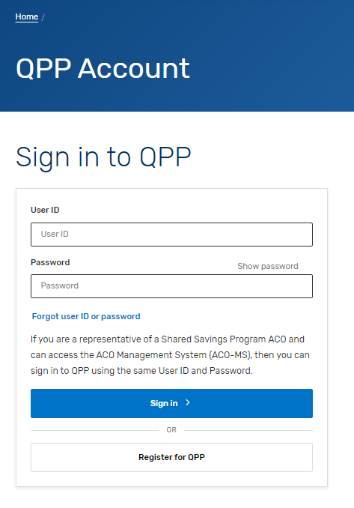
Sign into Your QPP Account
MVP REGISTRATION: REGISTRATION STEPS
With your HARP credentials, sign into your QPP Account on the QPP website.
MVP and subgroup registration is limited to users with the QPP Security Official role for the practice (Tax Identification Number [TIN]) or APM Entity.
Security officials for the practice (TIN) can complete individual, group and subgroup registrations.
Don’t have a HARP ID or the QPP Security Official role? Refer to this FAQ for more information
*The screenshots included in this user guide were based on the QPP test environment. Because we are always working to incorporate feedback and improve the experience, there may be differences between these screenshots and what you see on the QPP website.
9

Slide 10
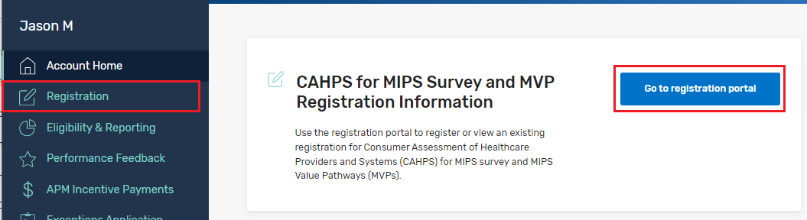
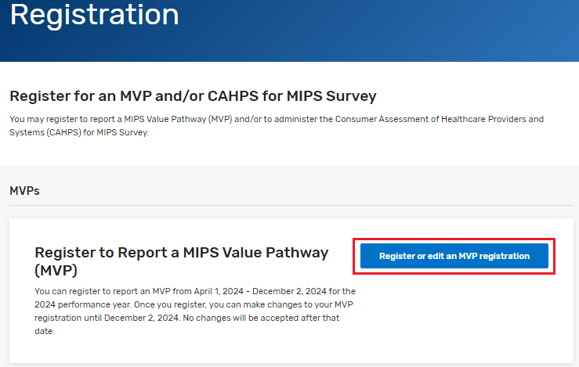
Navigate to the Registration Portal
MVP REGISTRATION: REGISTRATION STEPS
Once you’re signed into your account, select:
The Registration tab in the left-hand navigation menu, then click + Register or edit an MVP registration
OR
The Go to registration portal quick link on the home page then click + Register or edit an MVP registration
*The screenshots included in this user guide were based on the QPP test environment. Because we are always working to incorporate feedback and improve the experience, there may be differences between these screenshots and what you see on the QPP website.
10

Slide 11
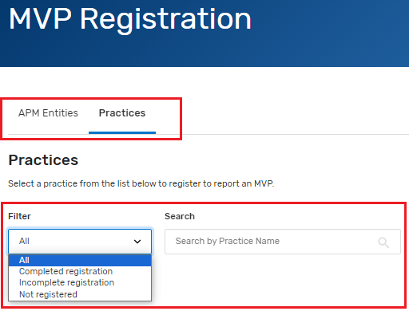
Select Your Organization
MVP REGISTRATION: REGISTRATION STEPS
Find the organization for which you are wanting to register for MVP reporting. Most users will only have access to one organization type.
If you have access to multiple organization types, you will see them tabbed across the top of the page. Click an organization type to view the list of associated organizations you can access.
Once an organization type is selected, choose the organization registering to report MVP. You can filter by registration status or search by the Practice Name, if you have multiple organizations on your account.
If registering for an Alternative Payment Model (APM) Entity, skip ahead to that section.
*The screenshots included in this user guide were based on the QPP test environment. Because we are always working to incorporate feedback and improve the experience, there may be differences between these screenshots and what you see on the QPP website.
11

Slide 12
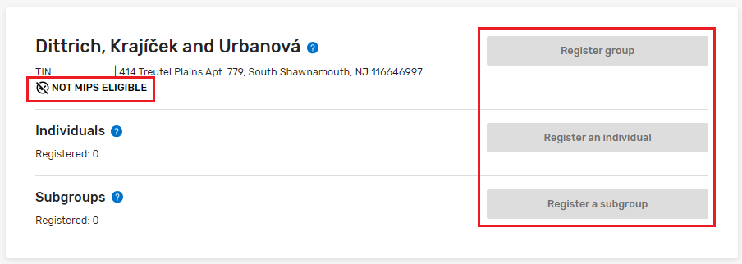
Select Your Organization (Continued)
MVP REGISTRATION: REGISTRATION STEPS
v
You can’t voluntarily report or opt-in to MVP reporting; you must be MIPS eligible to report an MVP. Participants not eligible to register for MVP reporting will see Not MIPS Eligible and the register options, will be greyed out. Virtual Groups are not able to register to report for MVP reporting.
*The screenshots included in this user guide were based on the QPP test environment. Because we are always working to incorporate feedback and improve the experience, there may be differences between these screenshots and what you see on the QPP website.
12

Slide 13
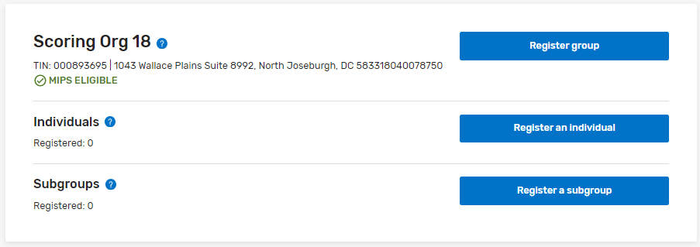
Select MVP Reporting Option
MVP REGISTRATION: REGISTRATION STEPS
Select the appropriate reporting option, for the selected Practice. Select the reporting option below, to jump ahead in this guide
Register Group
Register an Individual
Register a Subgroup
Register an Alternative Payment Model (APM) Entity
*The screenshots included in this user guide were based on the QPP test environment. Because we are always working to incorporate feedback and improve the experience, there may be differences between these screenshots and what you see on the QPP website.
NOTE: For more information about the MVP reporting options, refer to the 2024 MVP Implementation Guide (PDF)
13

Slide 14
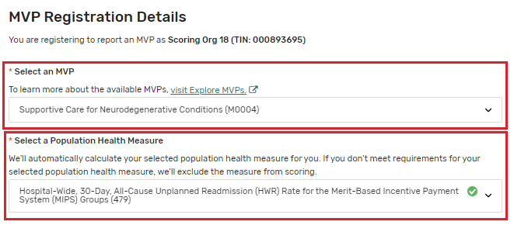

MVP Registration – Group
MVP REGISTRATION: REGISTRATION STEPS
You’ll need to identify the MVP being selected for reporting along with the population health measure the MVP participant wishes to be evaluated on.
Scoring reminder: If the MVP participant doesn’t meet requirements for the population health measure selected during registration, the measure will be excluded from scoring.
Items marked with a red asterisk (*), are required fields.
Changes will be automatically saved as the MVP registration is completed, as indicated, at the top of the screen.
*The screenshots included in this user guide were based on the QPP test environment. Because we are always working to incorporate feedback and improve the experience, there may be differences between these screenshots and what you see on the QPP website.
14

Slide 15
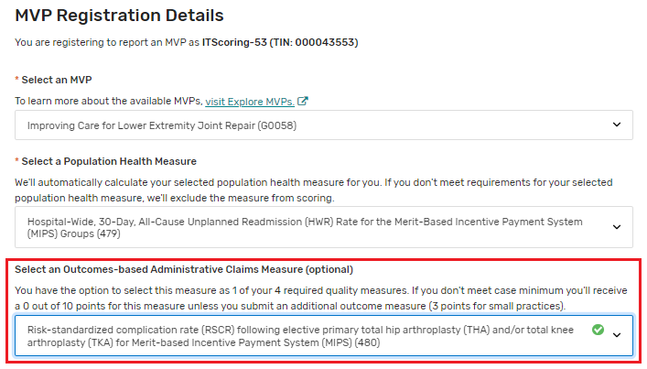
MVP Registration – Group (Continued)
MVP REGISTRATION: REGISTRATION STEPS
When registering for an MVP that includes an outcomes-based administrative claims measure, you’ll be prompted to indicate whether the MVP participant would like to be evaluated on it as 1 of their quality measures.
Scoring reminder: If the MVP participant doesn’t meet case minimum for the outcomes-based administrative claims measure, they’ll receive 0 out of 10 points for the required outcome measure unless they submit another outcome measure.
*The screenshots included in this user guide were based on the QPP test environment. Because we are always working to incorporate feedback and improve the experience, there may be differences between these screenshots and what you see on the QPP website.
15

Slide 16
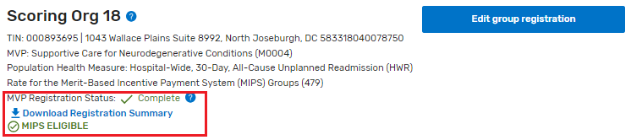

MVP Registration – Group (Continued)
MVP REGISTRATION: REGISTRATION STEPS
After all required fields are completed, select Back to MVP Registration, to be taken back to the MVP Registration page. The practice for which the MVP Registration was completed, will now display an MVP Registration Status with Complete. A Registration Summary may also be download, for your records.
If no other types of MVP registrations are needed, skip ahead in this guide, to the Frequently Asked Questions section.
NOTE: If at any point during the registration process, you want to delete your MVP registration, select Delete Registration, at the top of the page. Registrations may be deleted or edited until the deadline of closes Monday, December 2, 2024, at 8 p.m. ET
*The screenshots included in this user guide were based on the QPP test environment. Because we are always working to incorporate feedback and improve the experience, there may be differences between these screenshots and what you see on the QPP website.
16

Slide 17
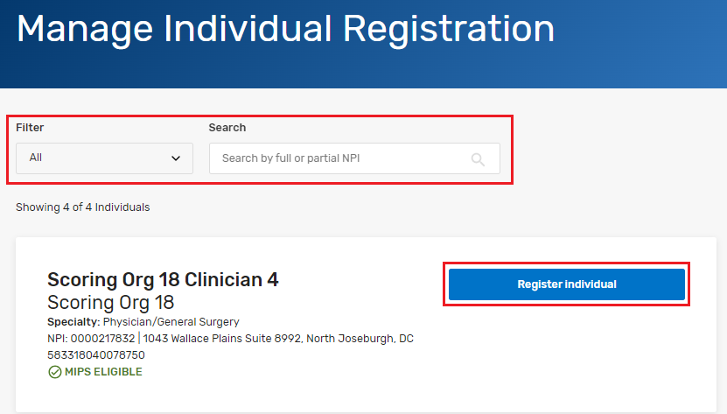
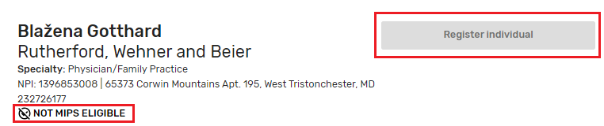
MVP Registration – Individual
MVP REGISTRATION: REGISTRATION STEPS
Individual National Provider Identifier (NPI)s, are displayed, on the Manage Individual Registration page. You can narrow results, by searching for a full or partial NPI. The page also allows for filtering based on the status of their MVP registration
Select Register Individual on the NPI the MVP registration is being completed for.
NOTE: Participants not eligible to register for MVP reporting will be labeled Not MIPS Eligible and the register option, will be grayed out.
*The screenshots included in this user guide were based on the QPP test environment. Because we are always working to incorporate feedback and improve the experience, there may be differences between these screenshots and what you see on the QPP website.
17

Slide 18
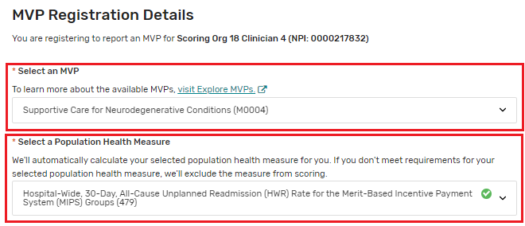
MVP Registration – Individual (Continued)
MVP REGISTRATION: REGISTRATION STEPS
You’ll need to identify the MVP being selected for reporting along with the population health measure the MVP participant wishes to be evaluated on.
Scoring reminder: If the MVP participant doesn’t meet requirements for the population health measure selected during registration, the measure will be excluded from scoring.
Items marked with a red asterisk (*), are required fields.
Changes will be automatically saved as the MVP registration is completed, as indicated, at the top of the screen.
*The screenshots included in this user guide were based on the QPP test environment. Because we are always working to incorporate feedback and improve the experience, there may be differences between these screenshots and what you see on the QPP website.
18

Slide 19
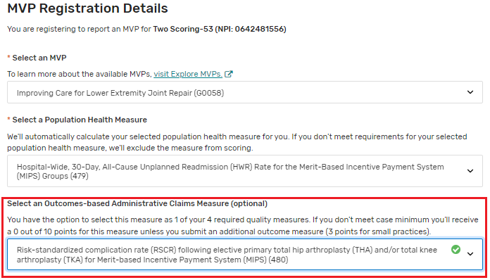
MVP Registration – Individual (Continued)
MVP REGISTRATION: REGISTRATION STEPS
When registering for an MVP that includes an outcomes- based administrative claims measure, you’ll be prompted to indicate whether the MVP participant would like to be evaluated on it as 1 of their quality measures.
Scoring reminder: If the MVP participant doesn’t meet case minimum for the outcomes-based administrative claims measure, they’ll receive 0 out of 10 points for the required outcome measure unless they submit another outcome measure.
*The screenshots included in this user guide were based on the QPP test environment. Because we are always working to incorporate feedback and improve the experience, there may be differences between these screenshots and what you see on the QPP website.
19

Slide 20
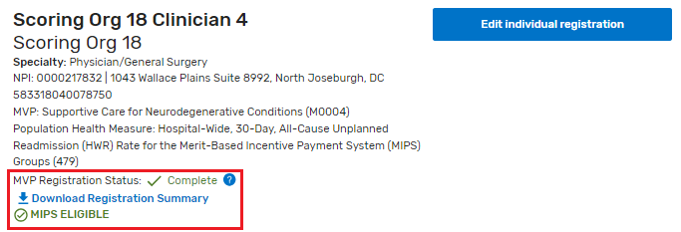
MVP Registration – Individual (Continued)
MVP REGISTRATION: REGISTRATION STEPS
After all required fields are completed, select Back to MVP Registration, to be taken back to the MVP Registration page. The NPI for which the MVP Registration was completed, will now display an MVP Registration Status with Complete. A Registration Summary may also be download, for your records.
If no other types of MVP registrations are needed, skip ahead in this guide, to the Frequently Asked Questions section.
NOTE: If at any point during the registration process, you want to delete your MVP registration, select Delete Registration, at the top of the page. Registrations may be deleted or edited until the deadline of closes Monday, December 2, 2024 at 8 p.m. ET
*The screenshots included in this user guide were based on the QPP test environment. Because we are always working to incorporate feedback and improve the experience, there may be differences between these screenshots and what you see on the QPP website.
20

Slide 21
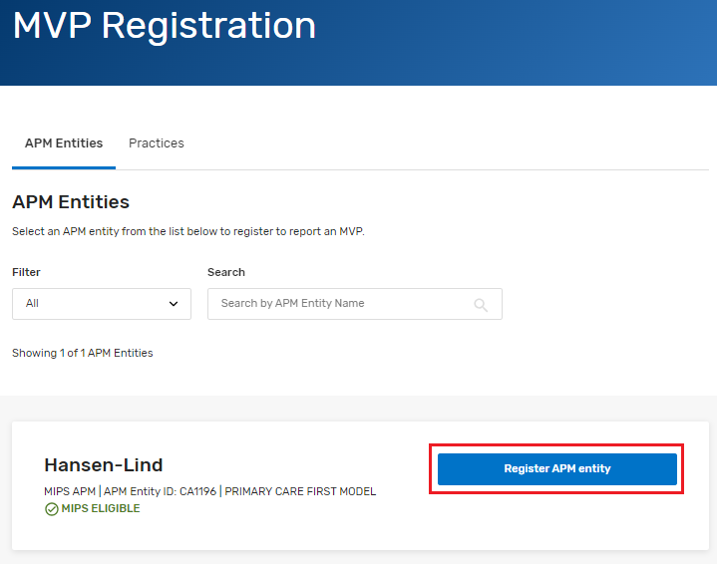
MVP Registration – APM Entity
MVP REGISTRATION: REGISTRATION STEPS
Select Register APM Entity for the APM entity an MVP registration is being completed for.
If you have multiple APM Entities on your account, you can search by the APM Entity name or filter by MVP registration status.
*The screenshots included in this user guide were based on the QPP test environment. Because we are always working to incorporate feedback and improve the experience, there may be differences between these screenshots and what you see on the QPP website.
21

Slide 22
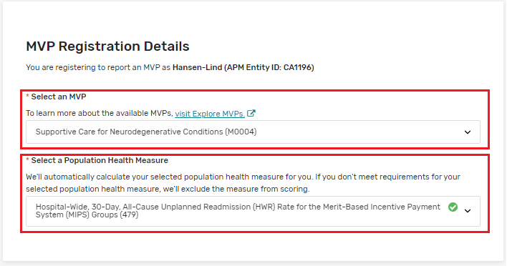
MVP Registration – APM Entity
MVP REGISTRATION: REGISTRATION STEPS
You’ll need to identify the MVP being selected for reporting along with the population health measure the MVP participant wishes to be evaluated on.
Scoring reminder: If the MVP participant doesn’t meet requirements for the population health measure selected during registration, the measure will be excluded from scoring.
Items marked with a red asterisk (*), are required fields.
Changes will be automatically saved as the MVP registration is completed, as indicated, at the top of the screen.
*The screenshots included in this user guide were based on the QPP test environment. Because we are always working to incorporate feedback and improve the experience, there may be differences between these screenshots and what you see on the QPP website.
22

Slide 23
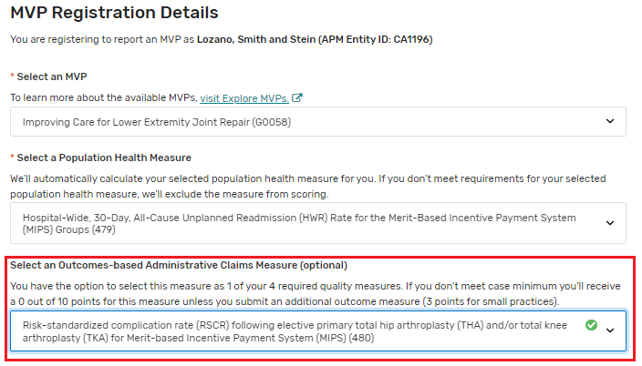
MVP Registration – APM Entity (Continued)
MVP REGISTRATION: REGISTRATION STEPS
When registering for an MVP that includes an outcomes- based administrative claims measure, you’ll be prompted to indicate whether the MVP participant would like to be evaluated on it as 1 of their quality measures.
Scoring reminder: If the MVP participant doesn’t meet case minimum for the outcomes-based administrative claims measure, they’ll receive 0 out of 10 points for the required outcome measure unless they submit another outcome measure.
*The screenshots included in this user guide were based on the QPP test environment. Because we are always working to incorporate feedback and improve the experience, there may be differences between these screenshots and what you see on the QPP website.
23

Slide 24
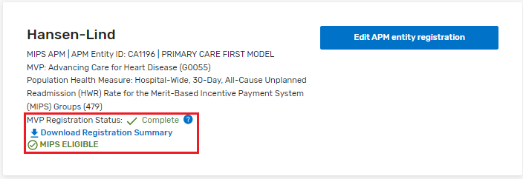
MVP Registration – APM Entity (Continued)
MVP REGISTRATION: REGISTRATION STEPS
After all required fields are completed, select Back to MVP Registration, to be taken back to the MVP Registration page. The APM Entity for which the MVP Registration was completed, will now display an MVP Registration Status with Complete. A Registration Summary may also be download, for your records.
If no other types of MVP registrations are needed, skip ahead in this guide, to the Frequently Asked Questions section.
NOTE: If at any point during the registration process, you want to delete your MVP registration, select Delete Registration, at the top of the page. Registrations may be deleted or edited until the deadline of closes Monday, December 2, 2024 at 8 p.m. ET
*The screenshots included in this user guide were based on the QPP test environment. Because we are always working to incorporate feedback and improve the experience, there may be differences between these screenshots and what you see on the QPP website.
24

Slide 25
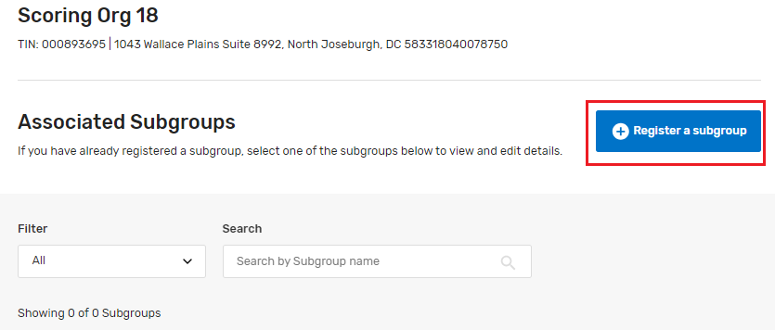
MVP Registration – Subgroup
MVP REGISTRATION: REGISTRATION STEPS
On the Manage Subgroup Registration page, select Register a subgroup
Items marked with a red asterisk (*), are required fields.
Changes will be automatically saved as the MVP registration is completed, as indicated, at the top of the screen.
*The screenshots included in this user guide were based on the QPP test environment. Because we are always working to incorporate feedback and improve the experience, there may be differences between these screenshots and what you see on the QPP website.
25

Slide 26
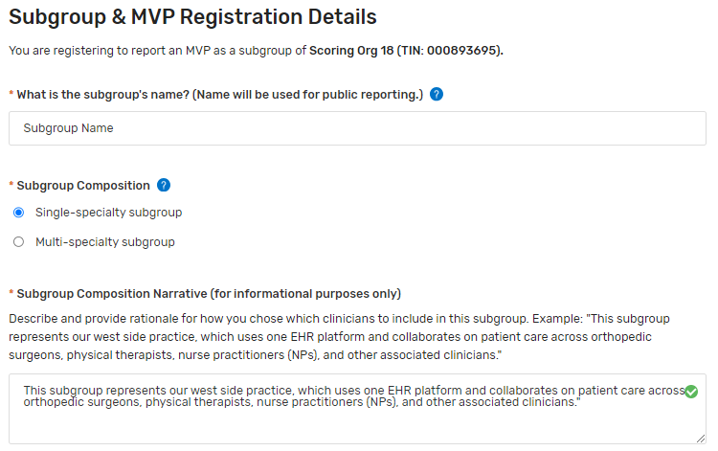
MVP Registration – Subgroup (Continued)
MVP REGISTRATION: REGISTRATION STEPS
Subgroups require additional information, beyond what a Group or Individual require. For these categories, do not include Personal Identifiable Information (PII) or your Tax Identification Number (TIN).
Subgroup Name: This is the name that would be used for public reporting on Medicare Care Compare.
Subgroup Composition: Select single-specialty or multi-specialty, based on the composition of your subgroup.
Subgroup Composition Narrative (Informational Purposes Only): Describe and provide rationale for how you chose which clinicians to include in this subgroup. Example: "This subgroup represents our west side practice, which uses one EHR platform and collaborates on patient care across orthopedic surgeons, physical therapists, nurse practitioners (NPs), and other associated clinicians."
NOTE: After entering a Subgroup name, press Tab on your keyboard or click outside of the subgroup name field, to advance to the remaining Subgroup information.
TIP: After the Subgroup Name is entered, a Subgroup ID will be generated by the system. This unique ID will be needed during data submission time, so it’s important to make note of it.
*The screenshots included in this user guide were based on the QPP test environment. Because we are always working to incorporate feedback and improve the experience, there may be differences between these screenshots and what you see on the QPP website.
26

Slide 27
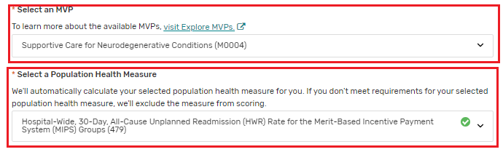
MVP Registration – Subgroup (Continued)
MVP REGISTRATION: REGISTRATION STEPS
You’ll need to identify the MVP being selected for reporting along with the population health measure the MVP participant wishes to be evaluated on.
Population health measures:
Scoring reminder: If the MVP participant doesn’t meet requirements for the population health measure selected during registration, the measure will be excluded from scoring.
Subgroups will be evaluated on the selected population health measure at the affiliated group level (all clinicians in the practice).
*The screenshots included in this user guide were based on the QPP test environment. Because we are always working to incorporate feedback and improve the experience, there may be differences between these screenshots and what you see on the QPP website.
27

Slide 28
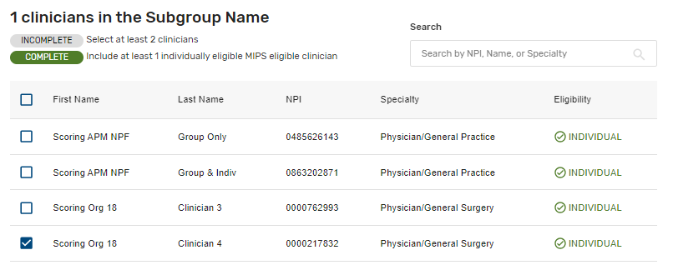

MVP Registration – Subgroup (Continued)
MVP REGISTRATION: REGISTRATION STEPS
Add clinicians to the subgroup
Check the box next to each clinician to be included in the subgroup. Your subgroup must include at least 2 clinicians and at least one individually eligible MIPS eligible clinician (identified by Individual status in the Eligibility column).
The Incomplete status will update to complete as the two requirements are met
*The screenshots included in this user guide were based on the QPP test environment. Because we are always working to incorporate feedback and improve the experience, there may be differences between these screenshots and what you see on the QPP website.
28

Slide 29
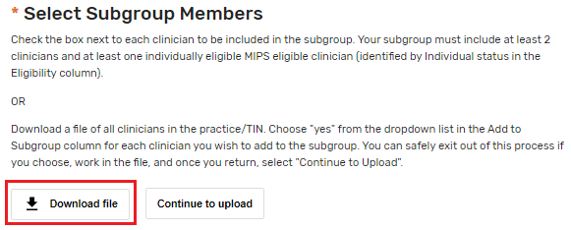
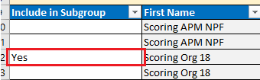
MVP Registration – Subgroup (Continued)
MVP REGISTRATION: REGISTRATION STEPS
Another way to add clinicians to the subgroup is to download a file of all clinicians in the practice/TIN.
Within the file, choose "yes" from the dropdown, in column A, Include in Subgroup. Save the workbook to your computer and select Continue to upload within the Select Subgroup Members, section in the Registration Portal.
Upload the file.
The Incomplete status will update to complete as the two requirements are met
*The screenshots included in this user guide were based on the QPP test environment. Because we are always working to incorporate feedback and improve the experience, there may be differences between these screenshots and what you see on the QPP website.
29

Slide 30
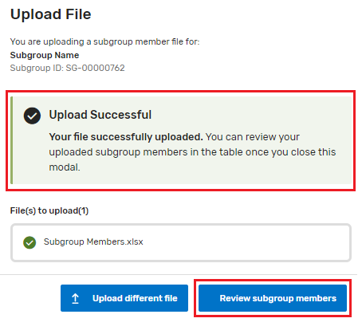
MVP Registration – Subgroup (Continued)
MVP REGISTRATION: REGISTRATION STEPS
Upload the file by either dragging and dropping the file or navigating to the location the file is saved, on your computer. After a successful upload, select Review subgroup members, to confirm the changes, to the listed clinicians, on the screen.
Note: Uploading a file will overwrite any existing subgroup composition.
The Incomplete status will update to complete as the two requirements are met
*The screenshots included in this user guide were based on the QPP test environment. Because we are always working to incorporate feedback and improve the experience, there may be differences between these screenshots and what you see on the QPP website.
30

Slide 31
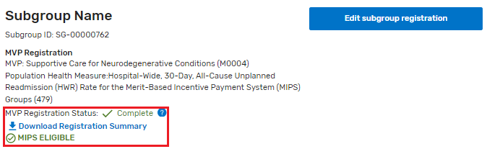

MVP Registration – Subgroup (Continued)
MVP REGISTRATION: REGISTRATION STEPS
After all required fields are completed, select Back to Manage Subgroup Registration, to be taken back to the Manage Subgroup Registration page. The practice for which the MVP Registration was completed, will now display an MVP Registration Status with Complete. A Registration Summary may also be download, for your records.
NOTE: If at any point during the registration process, you want to delete your MVP registration, select Delete MVP and Subgroup Registration, at the top of the page. Registrations may be deleted or edited until the deadline of closes Monday, December 2, 2024 at 8 p.m. ET
*The screenshots included in this user guide were based on the QPP test environment. Because we are always working to incorporate feedback and improve the experience, there may be differences between these screenshots and what you see on the QPP website.
31

Slide 32
MVP Registration: Frequently Asked Questions
32

Slide 33
Frequently Asked Questions
MVP REGISTRATION: FREQUENTLY ASKED QUESTIONS
What do I do if I don’t have a HARP ID or QPP Security Official role?
You need both a HARP ID and the QPP Security Official role for your organization to submit an MVP registration.
The Security Official for a Practice organization can submit an MVP registration on behalf of an individual, subgroup or group MVP registration.
The Security Official for an APM Entity organization can submit an APM Entity MVP registration.
To learn about HARP account registration, review Step 1. Register for a HARP Account in the Quality Payment Program Access Guide (ZIP 3MB).
To learn about QPP roles, review Step 2a. Connect as an Organization in the Quality Payment Program Access Guide (ZIP 3MB).
Can our third party intermediary complete our MVP (and subgroup if applicable) registration?
No. Only the practice or APM Entity Security Official can complete MVP registration.
Can we update our registration?
Yes, you can update your registration on the QPP Website until the deadline on Monday, December 2, 2024 at 8 p.m. ET.
33

Slide 34
Frequently Asked Questions
MVP REGISTRATION: FREQUENTLY ASKED QUESTIONS
Once we’re registered for an MVP, do we have to report it?
No. Even if you register to report an MVP, you can still choose to report traditional MIPS (or the APM Performance Pathway, APP, if applicable) instead (or in addition to your MVP reporting). As a reminder, the subgroup participation option is only available for MVP reporting; MIPS eligible clinicians that registered to report as a subgroup would need to report traditional MIPS or the APP as individuals, as a group or as an APM Entity (if applicable) if they don’t report the MVP.
If you complete an MVP registration but don’t ultimately report the MVP, you’ll receive the highest final score that can be attributed to you from any reporting option and participation option, with the exception of virtual groups.
We would like to submit the Consumer Assessment of Healthcare Providers and Systems (CAHPS) for MIPS Survey for 1 of our 4 required quality measures, how do we do this?
If the MVP you’ve registered for, includes the CAHPS for MIPS Survey as an available quality measure, you’ll need to complete a separate registration by July 1, 2024, at 8p.m. ET. Visit the QPP website to learn more about CAHPS for MIPS Survey registration.
Groups, subgroups*, and APM Entities that are registered to report the following 3 MVPs and intend to administer the CAHPS for MIPS Survey as 1 of their 4 quality measures:
Adopting Best Practices and Promoting Patient Safety within Emergency Medicine MVP (MVP ID: G0057)
Advancing Cancer Care MVP (MVP ID: M0001)
Value in Primary Care MVP (MVP ID: M0005)
34

Slide 35
Frequently Asked Questions
MVP REGISTRATION: FREQUENTLY ASKED QUESTIONS
Can we register and then become ineligible for reporting the MVP we registered for?
Yes, if you register to report an MVP as an individual or group*. You can’t voluntarily report or opt-in to MVP reporting; you must be MIPS eligible to report an MVP.
Eligibility timeline:
Initial 2024 MIPS eligibility was available in December 2023, before the 2024 MVP registration period.
Final 2024 eligibility will be available by early December 2024.
Just as with traditional MIPS, individuals and groups that register for an MVP must confirm their final eligibility for the 2024 performance year when it’s published on the QPP Participation Status tool.
An individual (identified by TIN/NPI combination) or group (identified by TIN) that becomes ineligible or opt-in eligible when final eligibility is released can’t report the MVP they registered for.
Instead, they can:
Voluntarily report traditional MIPS.
Opt-in to traditional MIPS reporting (if applicable).
Do nothing/don’t report. (Ineligible and opt-in eligible clinicians and groups aren’t required to report.)
*Please note that this doesn’t apply to subgroups. We only use initial eligibility results to determine a subgroup’s eligibility to register for and report an MVP (83 FR 70043). If the subgroup’s affiliated group becomes ineligible, or opt-in eligible, when final eligibility is released, the subgroup can still report the MVP for which they registered. If the subgroup reports, the MIPS eligible clinicians in the subgroup will receive the associated payment adjustment.
Where can I learn more about eligibility?
You can learn more about eligibility and how it can change by reviewing the QPP website and the 2024 MIPS Eligibility and Participation Quick Start Guide (PDF, 1MB).
35

Slide 36
Help and Version History
36

Slide 37
Where Can You Go for Help?
HELP AND VERSION HISTORY
Contact the Quality Payment Program Service Center by email at QPP@cms.hhs.gov, by creating a QPP Service Center ticket, or by phone at 1-866-288-8292 (Monday through Friday, 8 a.m. - 8 p.m. ET).
People who are deaf or hard of hearing can dial 711 to be connected to a TRS Communications Assistant.
Visit the Quality Payment Program website for other help and support information, to learn more about MIPS, and to check out the resources available in the Quality Payment Program Resource Library.
Visit the Small Practices page of the Quality Payment Program website where you can sign up for the monthly QPP Small Practices Newsletter and find resources and information relevant for small practices.
37

Slide 38
Version History
HELP AND VERSION HISTORY
If we need to update this document, changes will be identified here.
DATE | DESCRIPTION
08/30/2024 | Added OMB control number and expiration date on slide 1 and updated PRA disclosure language on slide 38.
06/25/2024 | Updated to include PRA disclosure language.
05/17/2024 | Updated to add new FAQ (p. 35)
04/01/2024 | Original Posting.
According to the Paperwork Reduction Act of 1995 (44 U.S.C. 3501 et seq.), no persons are required to respond to a collection of information unless it displays a valid OMB control number. The valid OMB control number for this information collection is 0938-1314 (Expiration date: 2/28/2027). This information collection is the tool to register as an MVP to meet MIPS reporting requirements. The time required to complete this information collection varies per response, including the time to review instructions, search existing data resources, gather the data needed, to review and complete the information collection. This information collection is mandatory (Medicare Access and CHIP Reauthorization Act of 2015 (MACRA) (Pub. L. 114-10, April 16, 2015)) and all information collected will be kept private in accordance with regulations at 45 CFR 155.260, Privacy and Security of Personally Identifiable Information. Pursuant to this regulation, CMS may only use or disclose personally identifiable information to the extent that such information is necessary to carry out their statutory and regulatory mandated functions. If you have comments concerning the accuracy of the time estimate(s) or suggestions for improving this form, please write to: CMS, 7500 Security Boulevard, Attn: PRA Reports Clearance Officer, Mail Stop C4-26-05, Baltimore, MD 21244-1850. If you have questions or concerns regarding where to submit your documents, please contact QPP at qpp@cms.hhs.gov.
Under the Privacy Act of 1974 (5 U.S.C. 552a) any personally identifying information obtained will be kept private to the extent of the law.
38

