Slide 1
§ 48E(h): Clean Electricity Low-Income Communities Bonus Credit Program Application Wireframes
November 21, 2024 – Updated December 13, 2024

Slide 2
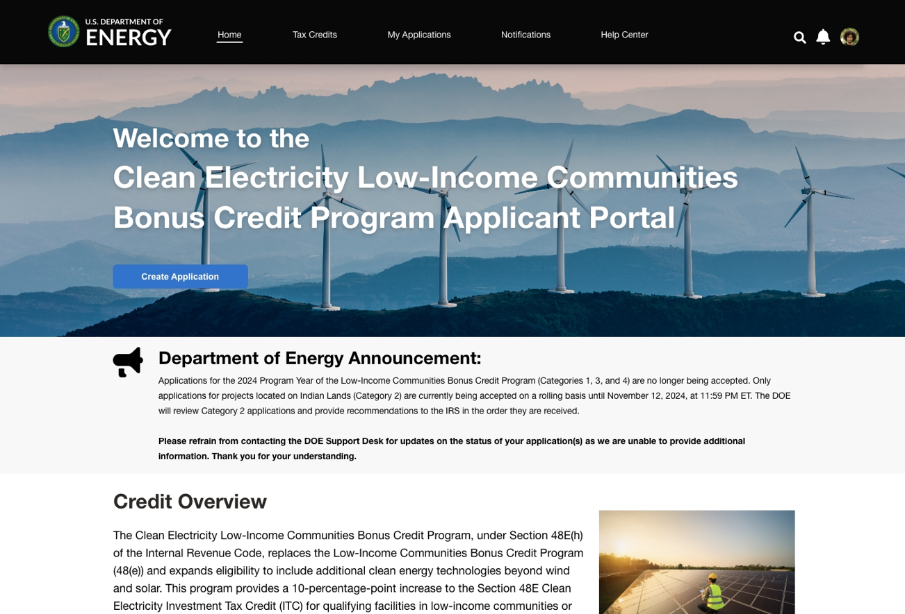
Contents
Registration
Portal Homepage
Application for Allocation
Placed in Service
Appendix

Slide 3
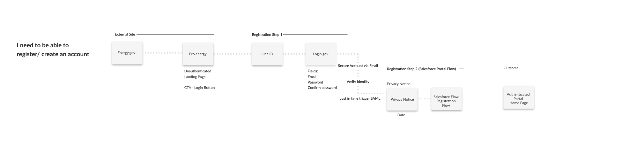
User Registration Workflow
IRS.gov

Slide 4
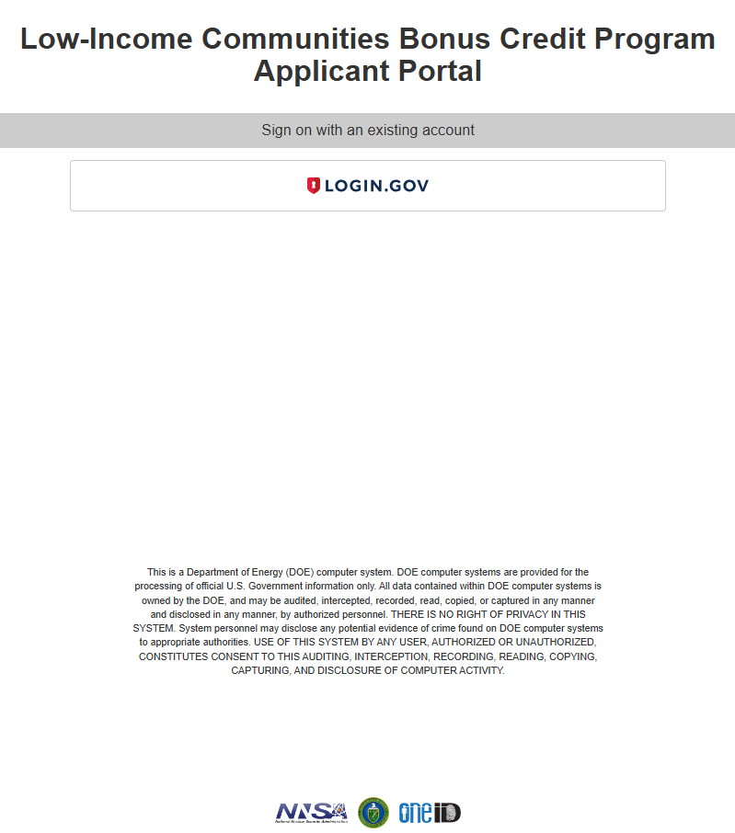
User Registration Workflow – Landing Page
From an IRS.gov Landing Page, applicants will select a call-to-action button which will redirect them to the unauthenticated Clean Electricity Low-Income Communities Bonus Credit Program Homepage. Applicants will then select ‘Login’ and be navigated to DOE ONE ID Authentication hub where they will login via Login.gov.
Clean Electricity Low-Income Communities Bonus Credit Program Applicant Portal
IRS.gov Landing Page
Applicant Portal Homepage Login

Slide 5
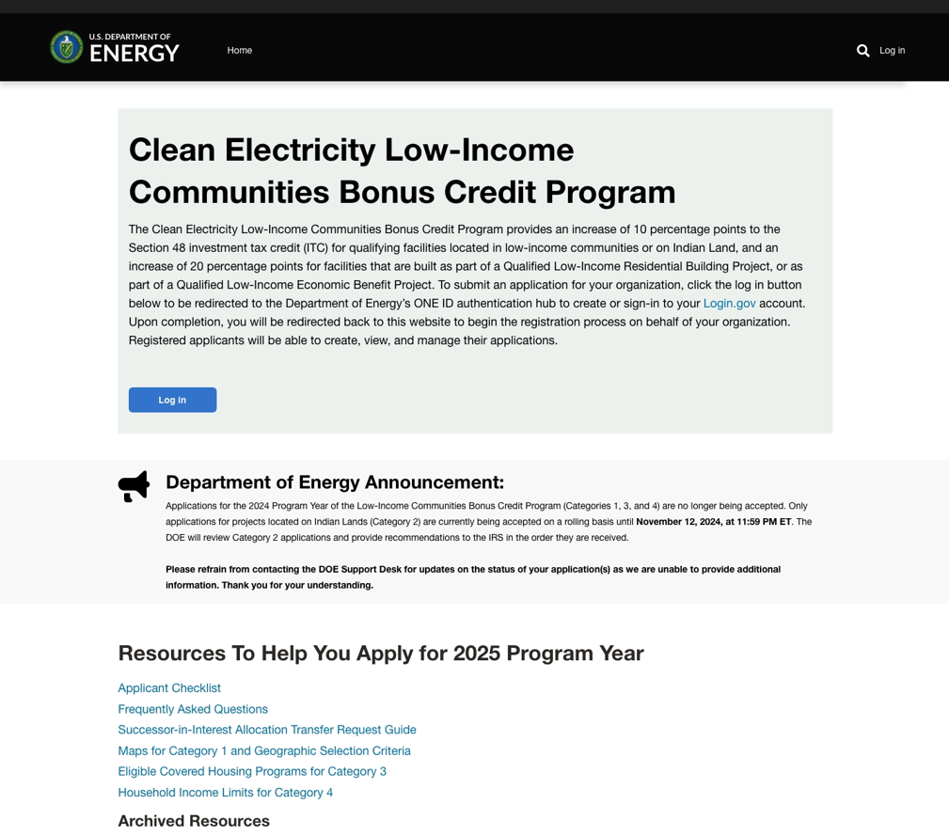
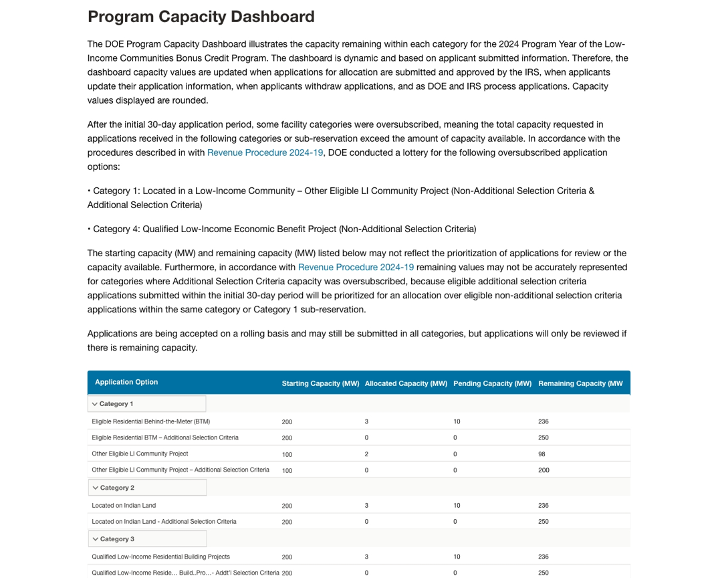
User Registration Workflow – Unauthenticated Homepage
Applicants will be redirected from an IRS.gov website to the Clean Electricity Low-Income Communities Bonus Credit Program landing page where they can view a program overview and Program Capacity Dashboard.

Slide 6
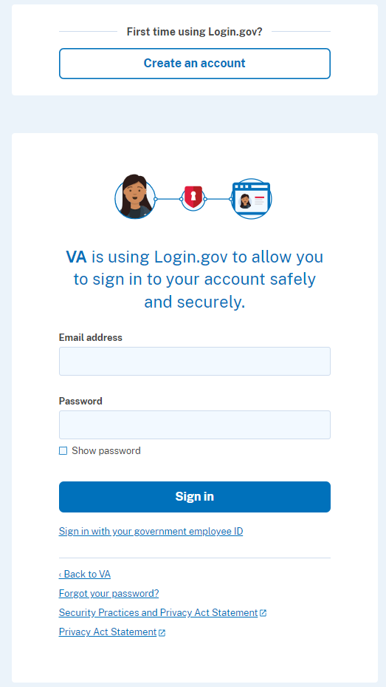
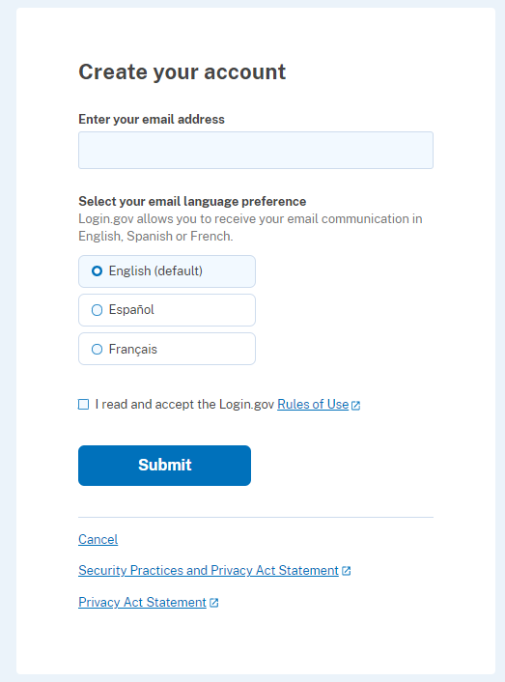
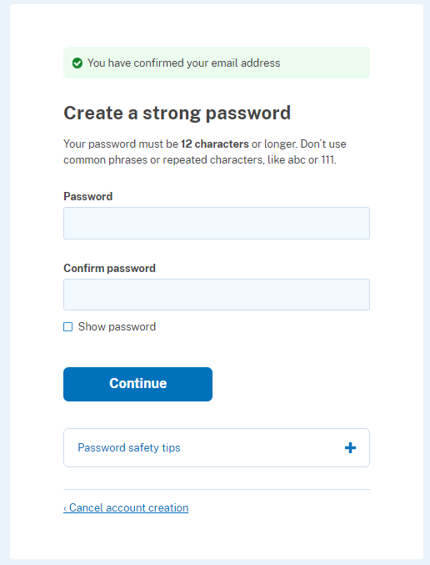
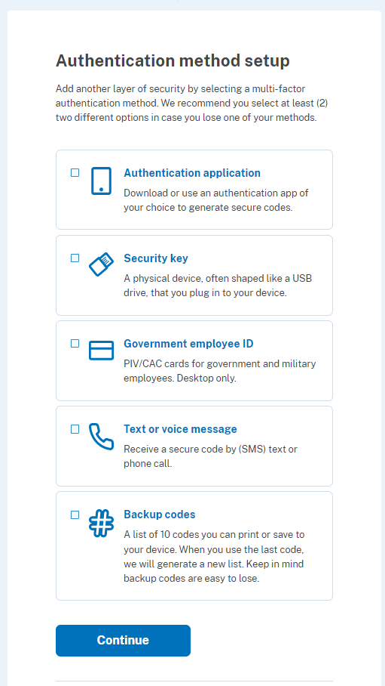
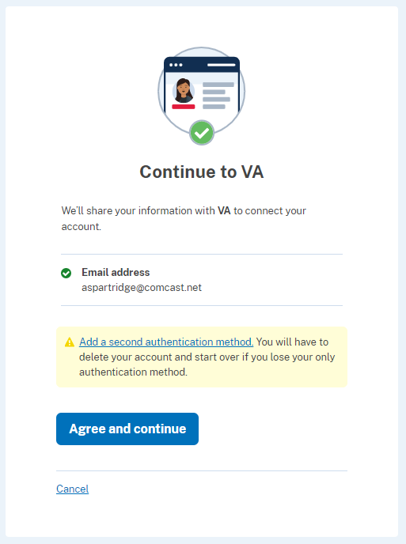
User Registration Workflow – Login.gov
After selecting the “Login” call to action, new users will be prompted to register via Login.gov. Outlined below is a high-level overview of new applicant registration via Login.gov.
DOE
DOE
test@testemail.com
Back to DOE
*Returning users will log in with their existing email and password
*User will confirm dual-factor authentication via selected method(s) (e.g., text/voice)

Slide 7
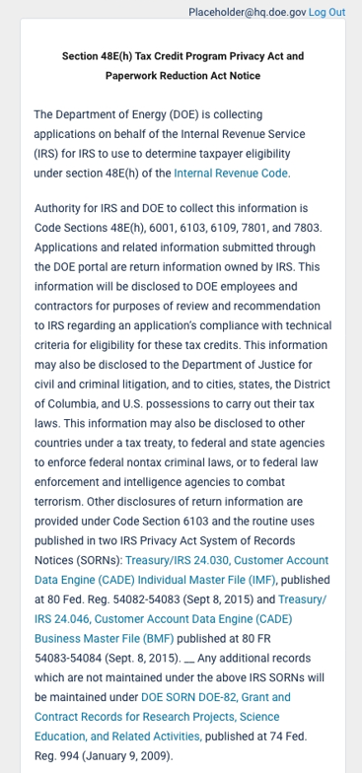
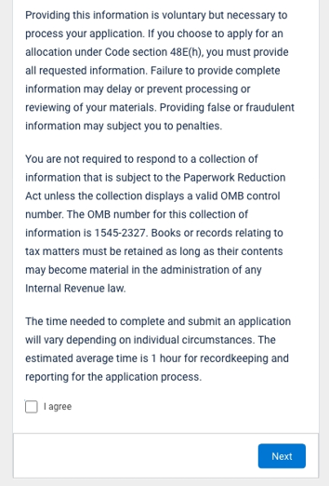
User Registration Workflow – Privacy Notice
During registration, applicants will be prompted with a Privacy Act and Paperwork Reduction Act Notice. Applicants must acknowledge this notice prior to submitting any applications.
I acknowledge

Slide 8
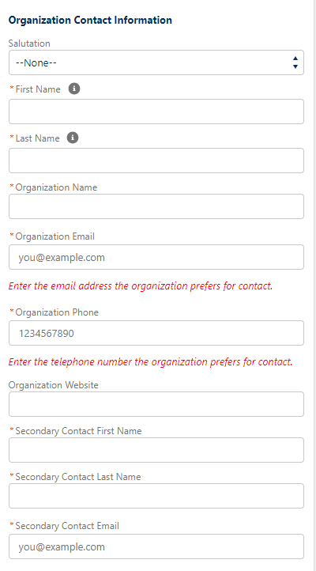
User Registration Workflow – Portal Registration
Once redirected from Login.gov, new users will be redirected to the registration page in the Portal where they will enter Contact Information, Organization Tax Information, Organization Address, and Organization Type.

Slide 9
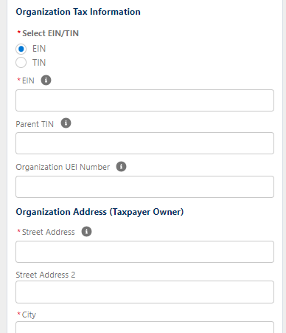
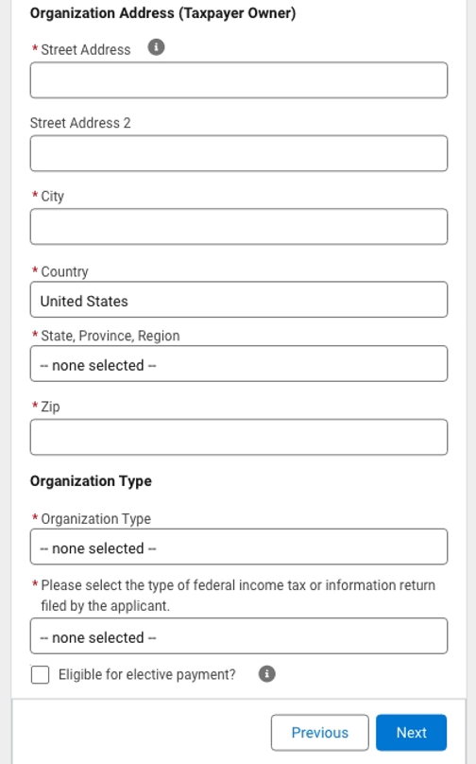
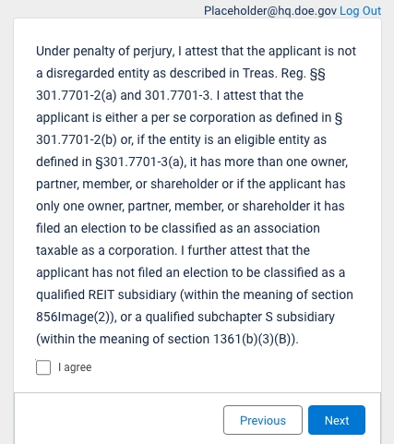
User Registration Workflow – Portal Registration
Once all required fields have been completed new users will select Next to save their contact information and organization details.

Slide 10

Portal Homepage
Newly registered (or returning) applicants will be navigated to the authenticated portal homepage.
Applicants can navigate to the Homepage, Credit Applications page, Previous Applications, or Help Resources via the top navigation.
Homepage will include a direct call-to-action to submit new applications.
General information including links to relevant internal (portal) or external (IRS or DOE sites) resources can be provided on the homepage.
Applicants will be able to view high-level capacity allocation reporting including capacity totals, capacity applied for, capacity remaining per category.

Slide 11
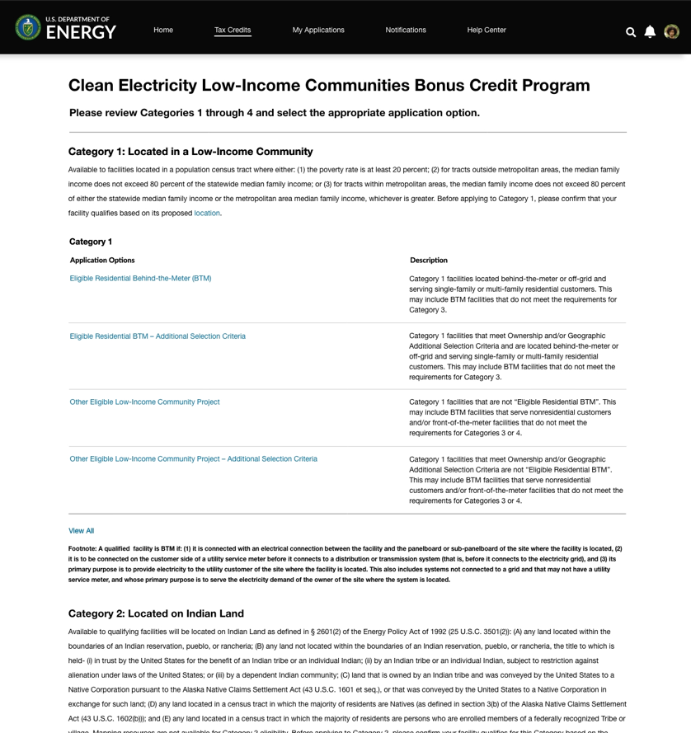
Application for Allocation
By selecting the call-to-action or Tax Credits navigation on the homepage, applicants can access 48E(h) credit applications.
Applicants will have the ability to choose the category (1-4) and application option for which they are applying. By selecting the application option hyperlink applicants will launch the application flow.
Note: the following slides showcase Category 1 application option: Eligible Residential Behind-the-Meter (BTM). To view conditional pages for the remainder of Categories 1-4 see the appendix.

Slide 12
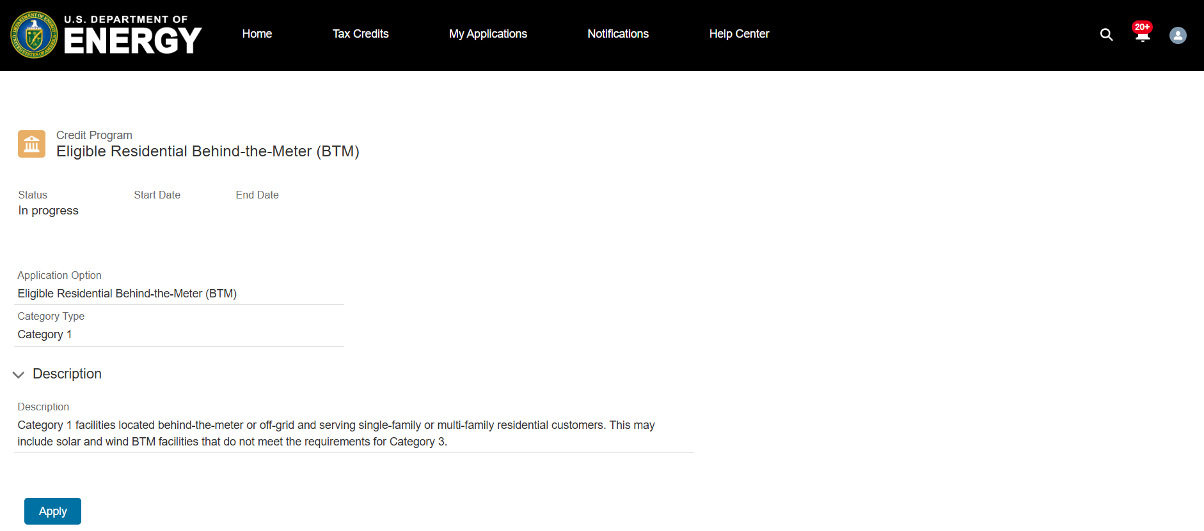
Application for Allocation
Once applicants select the sub-category they wish to apply for, they will be brought to an overview page that provides additional details and requirements on the category and/or sub-category.
Applicants can review a summary of the tax credit category and sub-category prior to beginning the application process.
Applicants will select Apply to begin their application.

Slide 13
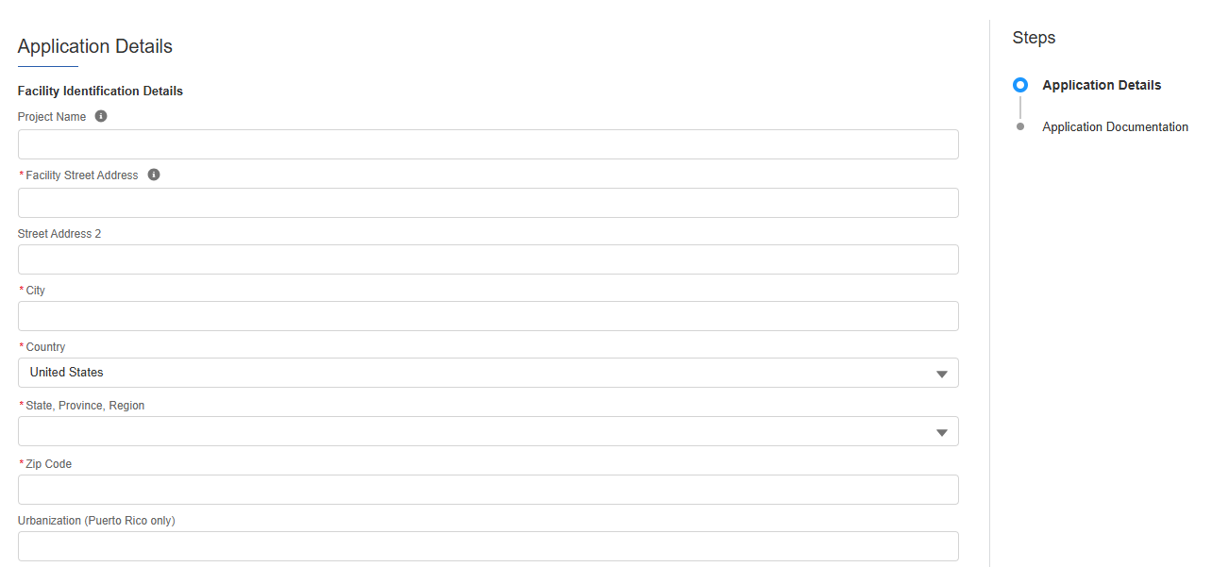
Application for Allocation
1a
Applicants will be prompted to enter all Facility Information and Details including address, latitude/longitude, technology type, facility size, cost, etc.
Applicants will enter all Facility Identification Details including optional Project Name and Facility Street Address.

Slide 14
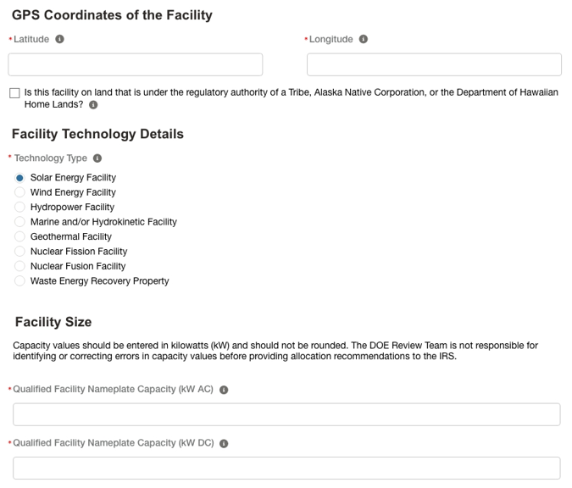
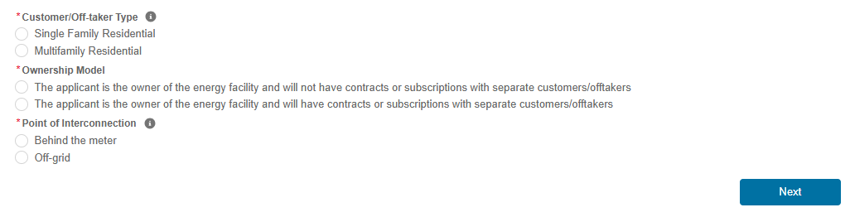
Application for Allocation
1a
Applicants will be prompted to enter all Facility Information and Details including address, latitude/longitude, technology type, facility size, cost, etc.
Applicants will enter the facility Latitude and Longitude and identify if the facility is located on land under Tribal Regulatory Authority.
Applicants will select the facility Technology Type
Applicants will enter the energy generating capacity of the facility.
Note: fields are conditional based on the technology type selected. For example, if the applicant selects Wind Energy Facility, the applicant will be prompted to complete only Energy Generating Capacity (kW AC).
Applicants will be prompted to enter Facility Usage details including Customer Type, Ownership Model, Point of Interconnection, and Additional Selection Criteria.
Note: Facility Usage is conditional for each subcategory based on requirements outlined in guidance. Questions and response options will differ across each subcategory.
Once all required fields have been completed, applicants will select Next to move on to required documentation.

Slide 15
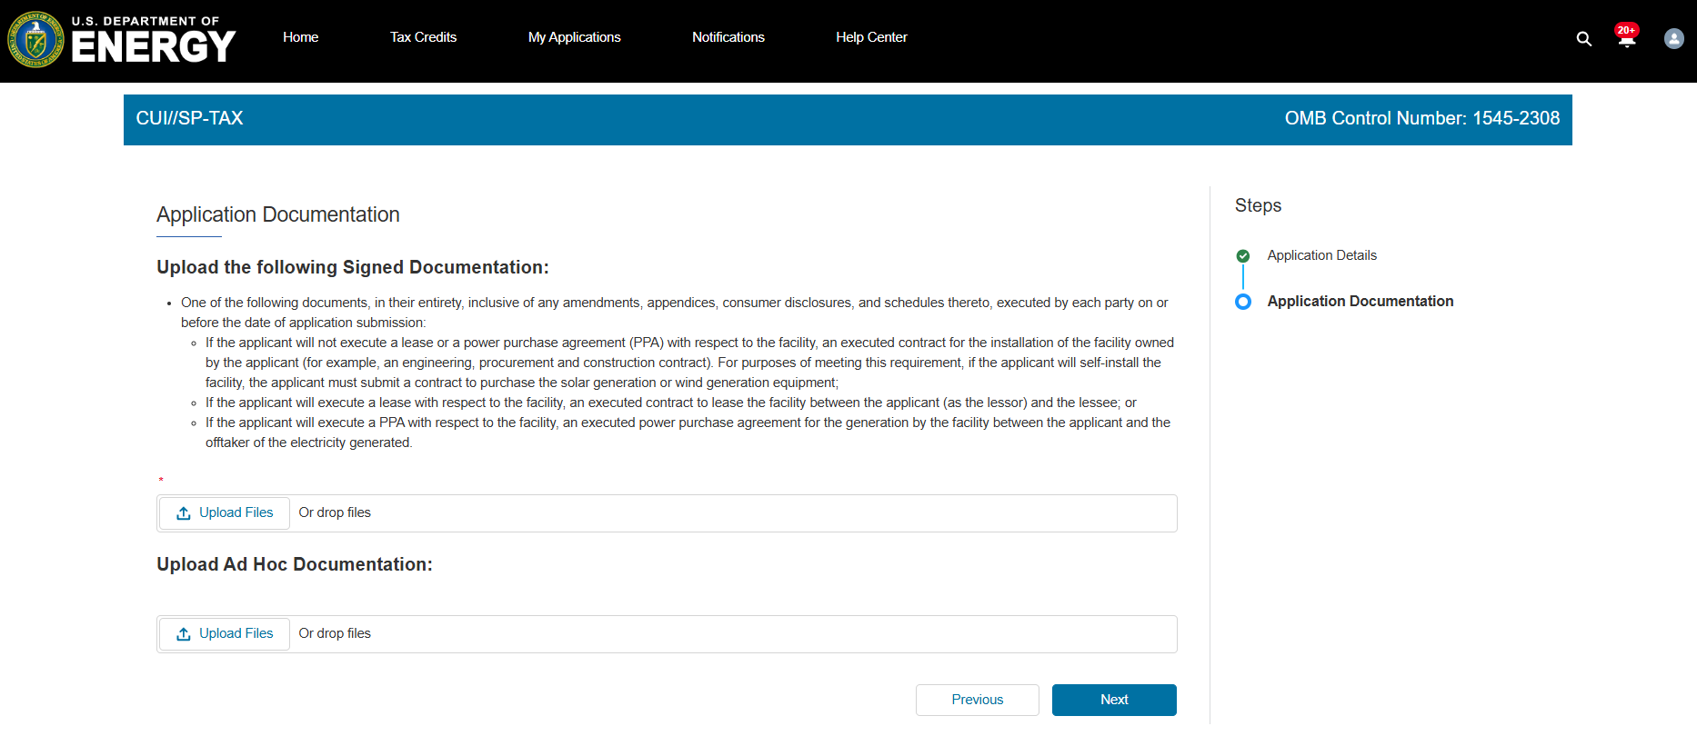
Application for Allocation
1a
Applicants will be prompted to attach all required documents.
OMB Control Number: 1545-2327
Applicants will be prompted to attach all required documents per category requirements outlined in the current Revenue Procedure.
Note: Documentation requirements are conditional based on subcategory chosen by the applicant.
One of the following documents, in its entirety, inclusive of any amendments, appendices, consumer disclosures, and schedules thereto, executed by each party on or before the date of application submission:
1) If the applicant will not execute a lease or a power purchase agreement (PPA) with respect to the facility, an executed contract for the installation of the facility owned by the applicant (for example, an engineering, procurement, and construction contract). For purposes of meeting this requirement, if the applicant will self-install the facility, the applicant must submit a contract to purchase the energy generation equipment.
2) If the applicant will execute a lease with respect to the facility, an executed contract to lease the facility between the applicant (as the lessor) and the lessee.
3) If the applicant will execute a PPA with respect to the facility, an executed power purchase agreement for the generation by the facility between the applicant and the offtaker of the electricity generated.
Once required documents have been attached, applicants will select Next to review their application prior to submission.

Slide 16
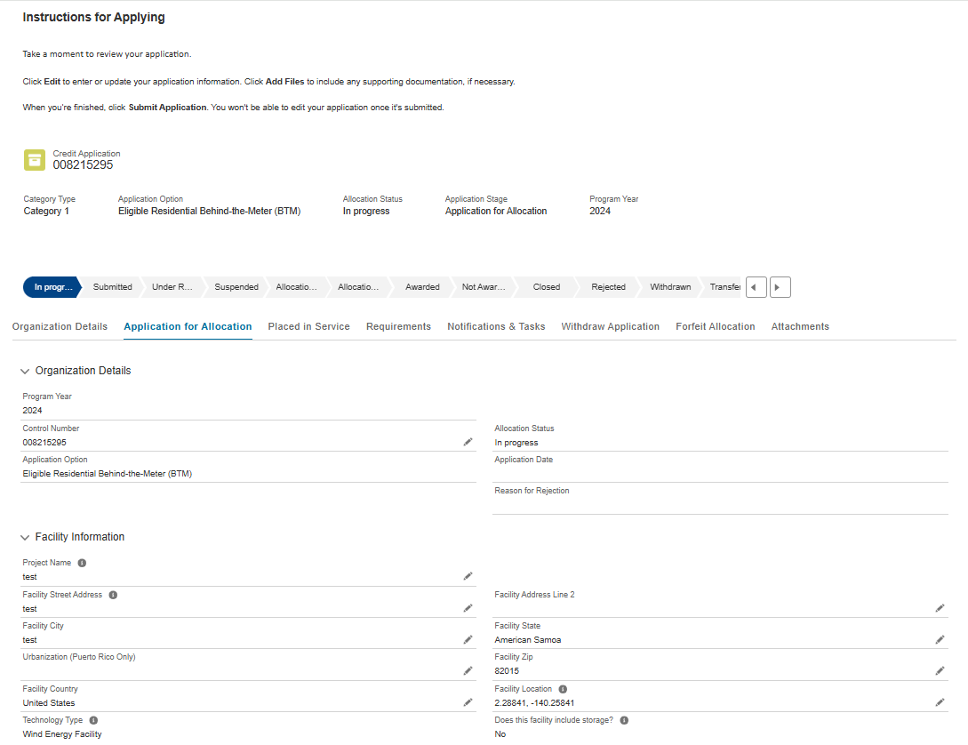
Application for Allocation
Applicants will be prompted to review all information prior to submission.
Applicants will be prompted to review all information for accuracy prior to application submission.
Applicants can view their application progress/status.
Applicants can make any necessary updates using the pencil edit feature.

Slide 17
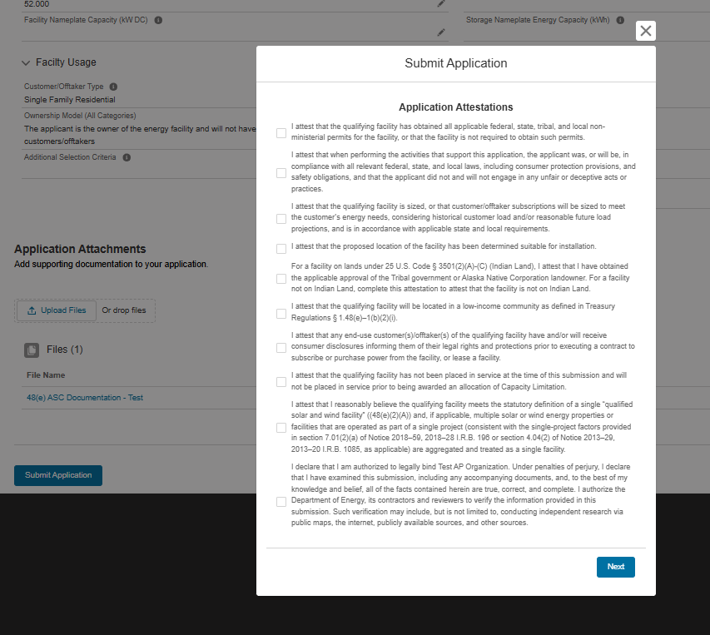
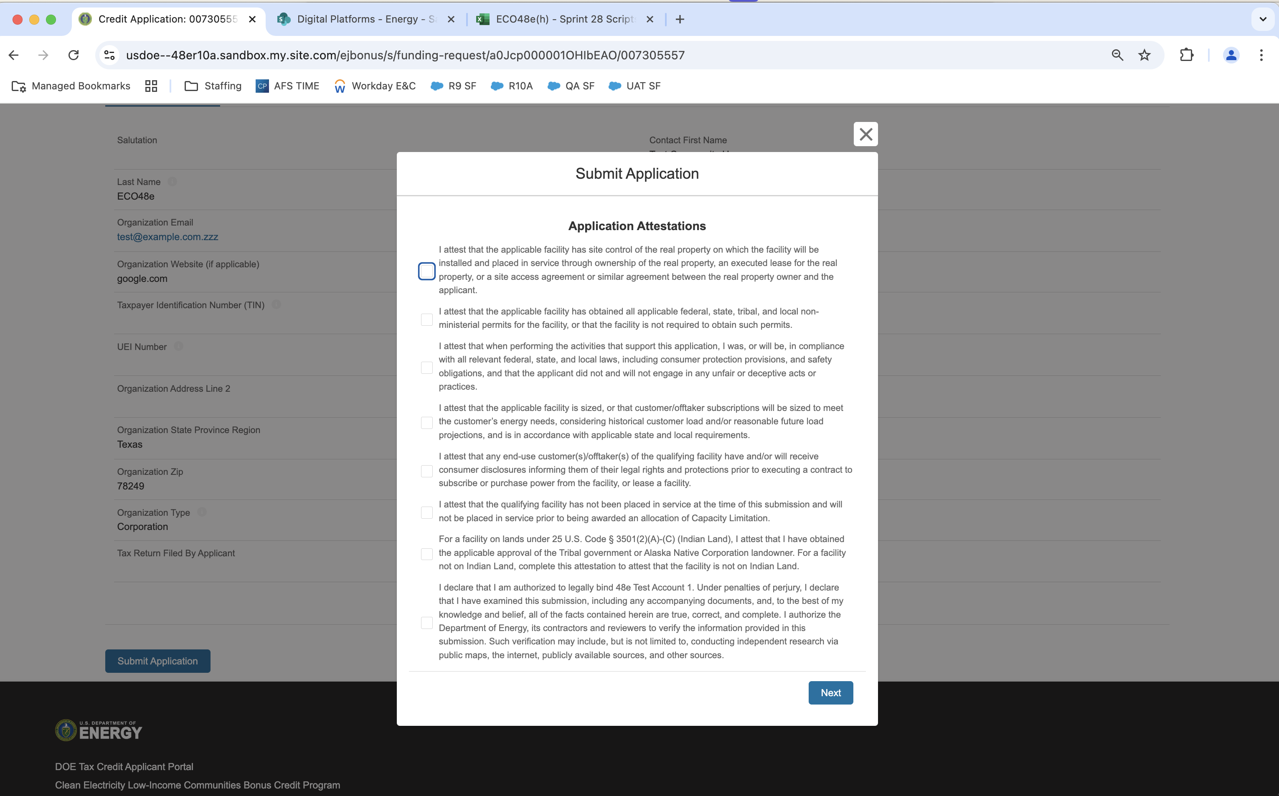
Application for Allocation
1a
Applicants will be prompted to review all information prior to submission.
Applicants will select Submit Application and be prompted to agree to required Attestations.
Applicants will be required to Attest to all required Attestations prior to submission.
Note: Some attestations are conditional based on subcategory selected and applicant responses.
[Organization Name]
Once applicants have attested, they can confirm submission of their 48E(h) application for allocation by selecting Next

Slide 18
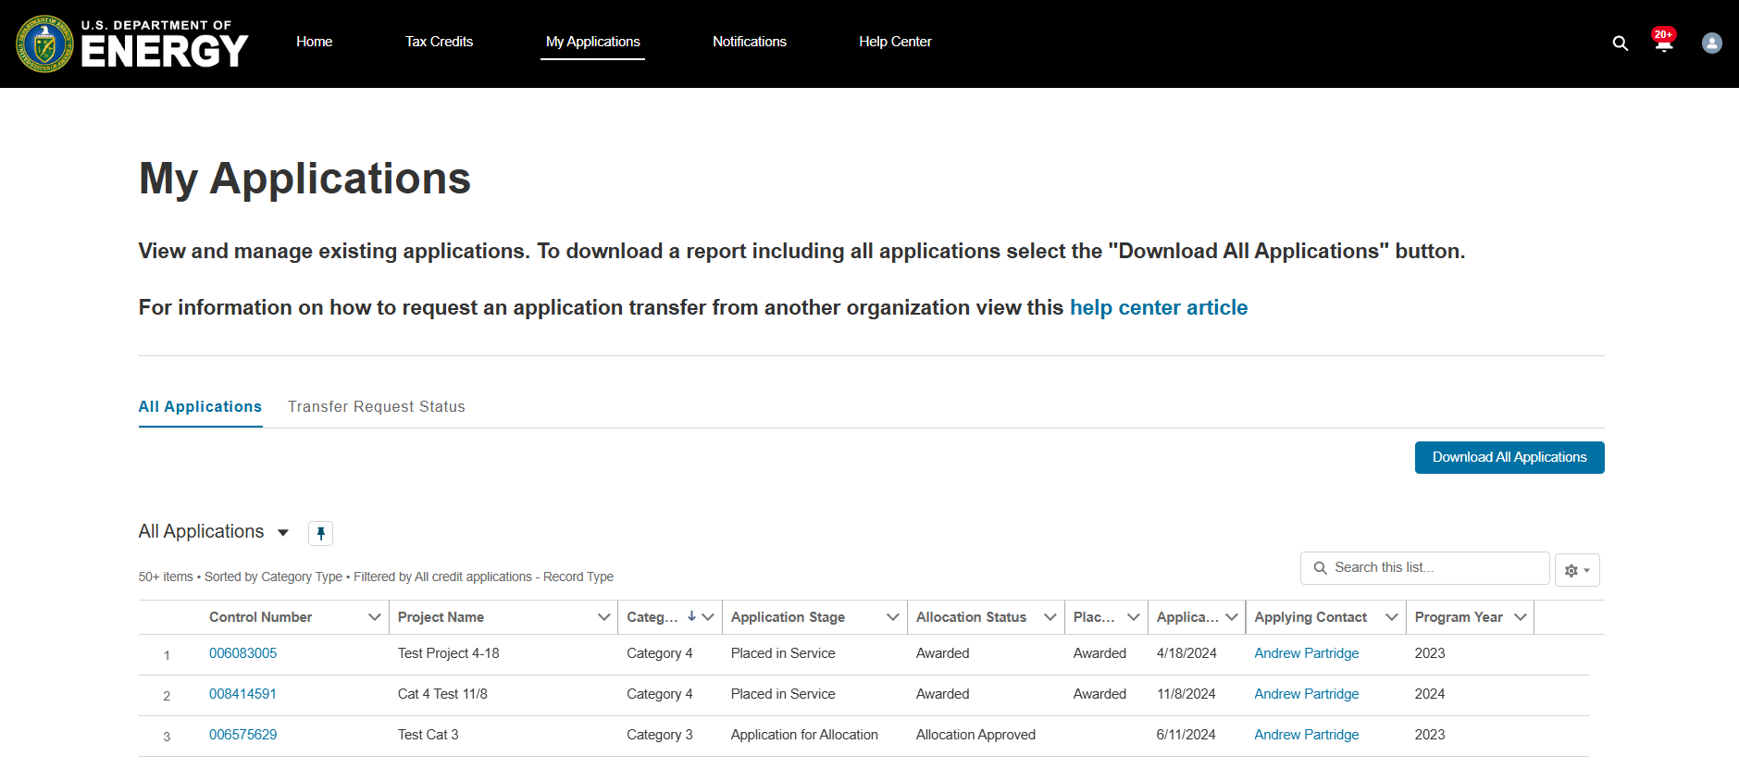
Placed in Service
When an applicant’s facility is placed in service after it has been awarded an allocation, applicants will return to their previously submitted applications to submit their Placed in Service information.
Applicants will select My Applications to view previously submitted applications.
Jon Doe
Applicants will locate the Application for Allocation they wish to submit Placed in Service information for upon the facility being placed in service.
Jon Doe
Jon Doe

Slide 19
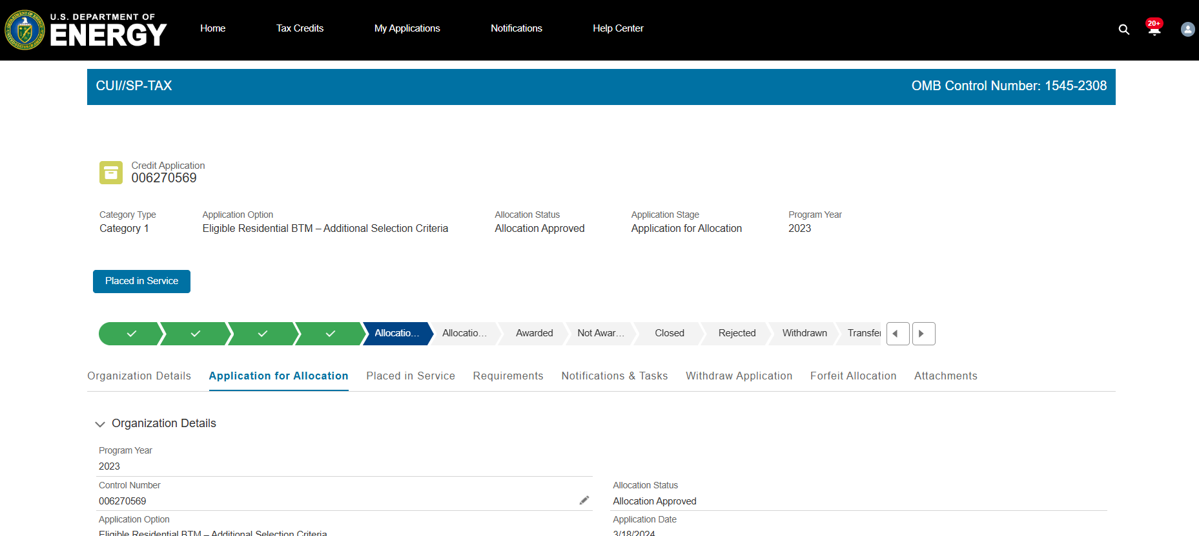
Placed in Service
When an applicant’s facility is placed in service after it has been awarded an allocation, applicants will return to their previously submitted applications to submit their Placed in Service information.
OMB Control Number: 1545--2327
Applicants will select Placed in Service to begin the placed in-service application flow.
Applicants can review previously submitted information from their initial Application for Allocation prior to beginning their Placed in Service application.

Slide 20
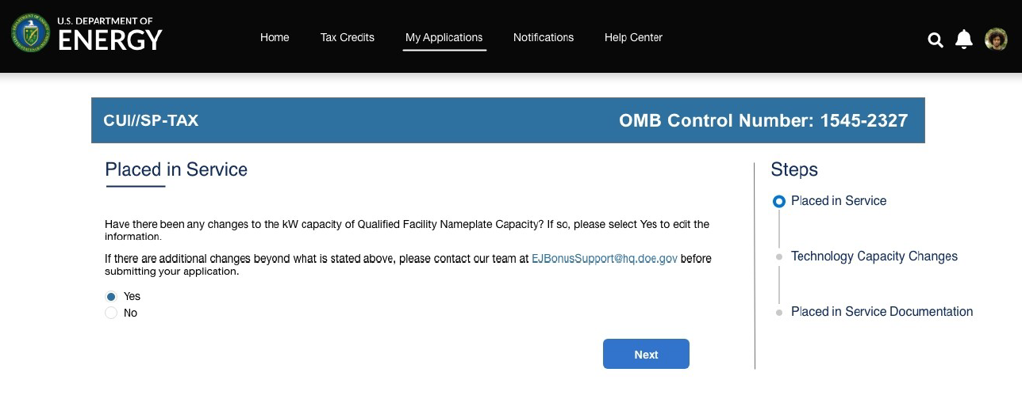
Placed in Service
Applicants will be prompted to identify if information from their original application has changed.
OMB Control Number: 1545-2327
Have there been any changes to the kW capacity of Qualified Facility Nameplate Capacity? If so, please select Yes to edit the information.
If there are additional changes beyond what is stated above, please contact our team at LICBonusSupport@hq.doe.gov before submitting your application.
Applicants will select Yes or No to move forward to the next step of the application process.
Applicants will select Next to move forward.

Slide 21
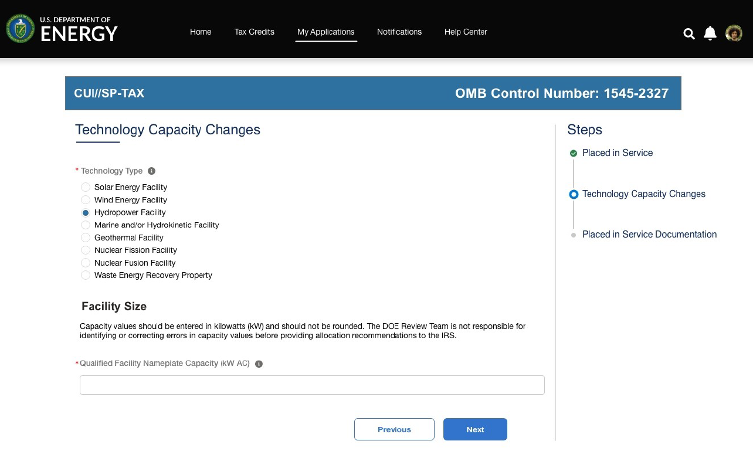
Placed in Service
If they select Yes, applicants will be allowed to enter certain non-material changes on their Placed in Service application and select Next to move forward.
Applicants are able to make certain non-material changes to information including Nameplate Capacity.
Note: fields are conditional based on the technology type selected and energy storage identification. For example, if the applicant selects Hydropower Facility, the applicant will be prompted to complete only Nameplate Capacity (kW AC).
Note: Other changes are not allowable within the application, and applicant will be directed to reach out to the help desk for further guidance on eligibility. If an applicant selects No on prior screen they will move directly to documentation.
OMB Control Number: 1545-2327
Applicants will select Next to upload required documentation.

Slide 22
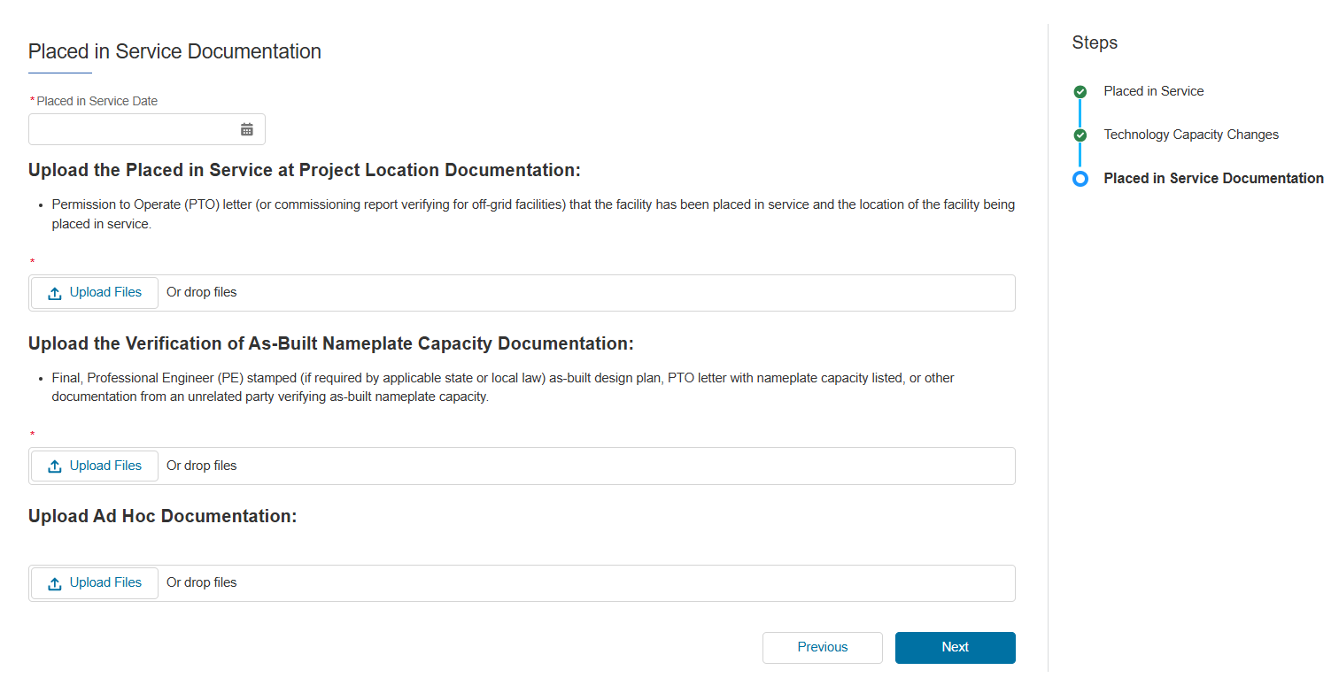
Placed in Service
Applicants will be prompted to enter their Placed in Service Date and upload all required placed in service documentation outlined in the applicable Revenue Procedure.
Applicants will be prompted to enter their Placed in Service Date.
Permission to Operate (PTO) letter (or commissioning report verifying for off-grid facilities) confirming the location of the facility being placed in service.
Applicants will be prompted to attach all required documentation for the placed in service phase as outlined in the applicable Revenue Procedure.
A Final, Professional Engineer (PE) stamped (if required by applicable state or local law) as-built design plan, PTO letter with nameplate capacity listed, or other documentation from an unrelated party verifying as-built nameplate capacity. If a PE stamped as-built design plan is not mandated by local jurisdiction, then a signed statement from the facility owner confirming the final facility size or upload of a single-line diagram if accurate to final build.
Applicants will select Next to move forward and review their application prior to submission.

Slide 23
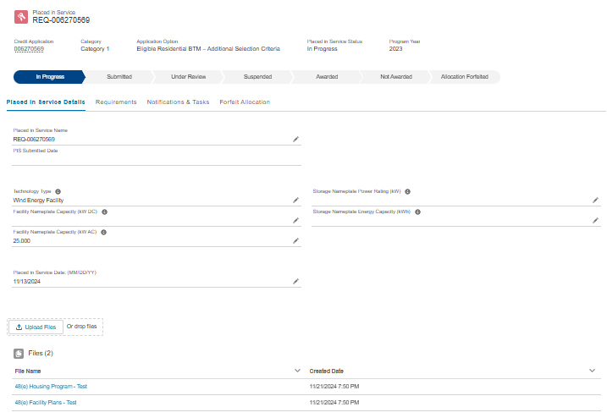
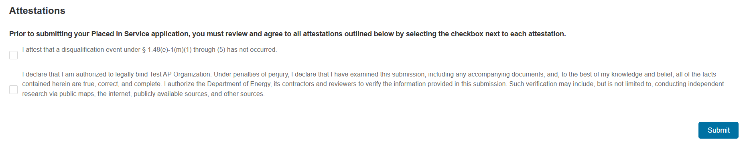
Placed in Service
Applicants will be prompted to review all information prior to submission.
Applicants can view their application progress/status.
Applicants can make any necessary updates using the pencil edit feature.
Applicants will be required to Attest to all required Attestations prior to submission. Applicants will select Submit and be prompted to agree to required Attestations.

Slide 24
Appendix
Conditional Questions, Documentation, and Attestations for:
Categories 1b – 1d
Categories 2a – 2b
Categories 3a – 3b
Categories 4a – 4b

Slide 25
Application for Allocation
1b
Applicants will be prompted to enter all Facility Information and Details including address, latitude/longitude, technology type, facility size, cost, etc.
Applicants will enter all Facility Identification Details including optional Project Name and Facility Street Address.

Slide 26
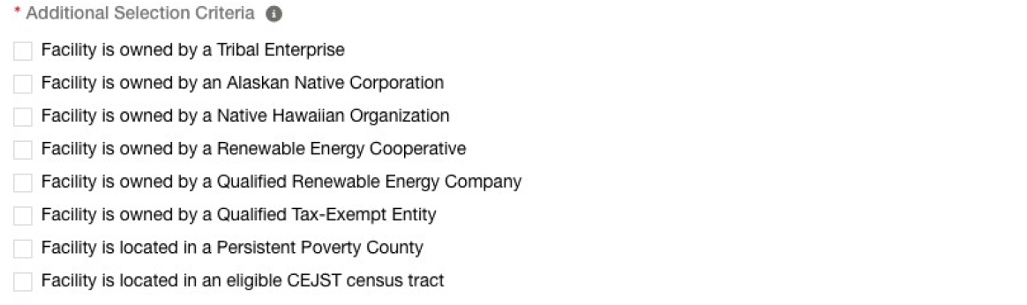

Application for Allocation
1b
Applicants will be prompted to enter all Facility Information and Details including address, latitude/longitude, technology type, facility size, cost, etc.
Applicants will enter the facility Latitude and Longitude and identify if the facility is located on land under Tribal Regulatory Authority.
Applicants will select the facility Technology Type
Applicants will enter the energy generating capacity of the facility.
Note: fields are conditional based on the technology type selected. For example, if the applicant selects Wind Energy Facility, the applicant will be prompted to complete only Energy Generating Capacity (kW AC).
Applicants will be prompted to enter Facility Usage details including Customer Type, Ownership Model, Point of Interconnection, and Additional Selection Criteria.
Note: Facility Usage is conditional for each subcategory based on requirements outlined in guidance. Questions and response options will differ across each subcategory.
Once all required fields have been completed, applicants will select Next to move on to required documentation.

Slide 27
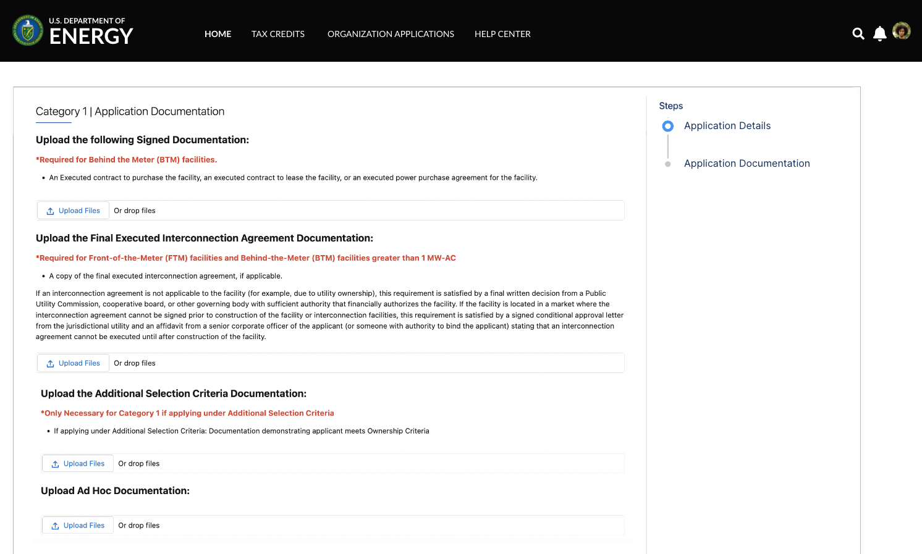
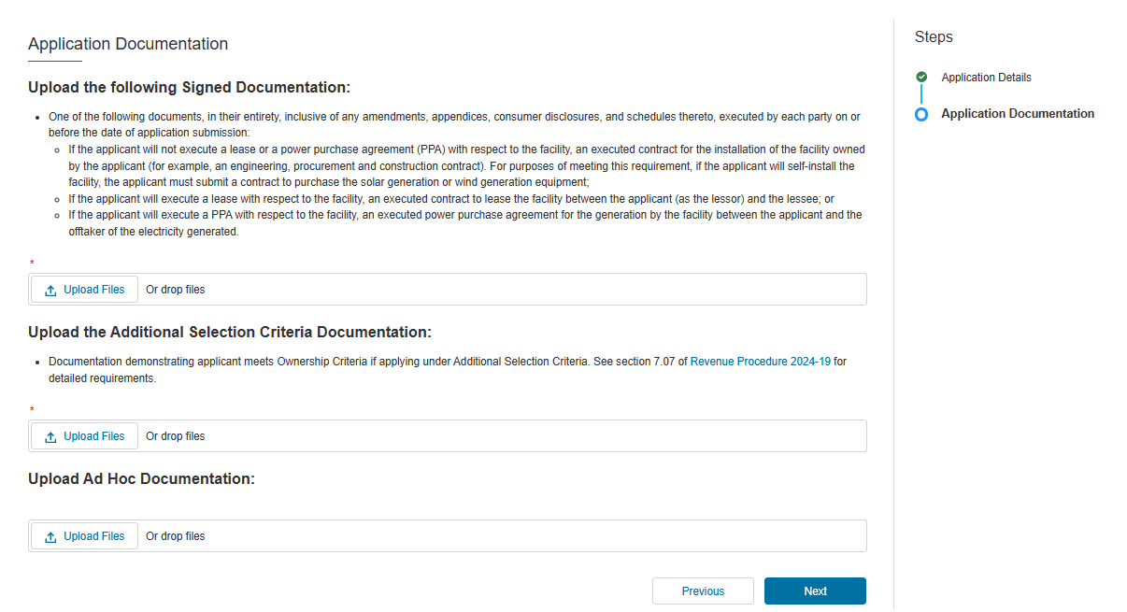
Application for Allocation
1b
Applicants will be prompted to attach all required documents.
One of the following documents, in its entirety, inclusive of any amendments, appendices, consumer disclosures, and schedules thereto, executed by each party on or before the date of application submission:
1) If the applicant will not execute a lease or a power purchase agreement (PPA) with respect to the facility, an executed contract for the installation of the facility owned by the applicant (for example, an engineering, procurement, and construction contract). For purposes of meeting this requirement, if the applicant will self-install the facility, the applicant must submit a contract to purchase the energy generation equipment.
2) If the applicant will execute a lease with respect to the facility, an executed contract to lease the facility between the applicant (as the lessor) and the lessee.
3) If the applicant will execute a PPA with respect to the facility, an executed power purchase agreement for the generation by the facility between the applicant and the offtaker of the electricity generated.
executed
Applicants will be prompted to attach all required documents per category requirements outlined in the current Revenue Procedure.
Note: Documentation requirements are conditional based on subcategory chosen by the applicant.
Documentation demonstrating applicant meets Ownership Criteria if applying under Additional Selection Criteria. See section 7.07 of the 2025 Revenue Procedure for detailed requirements.
Once required documents have been attached, applicants will select Next to review their application prior to submission.

Slide 28
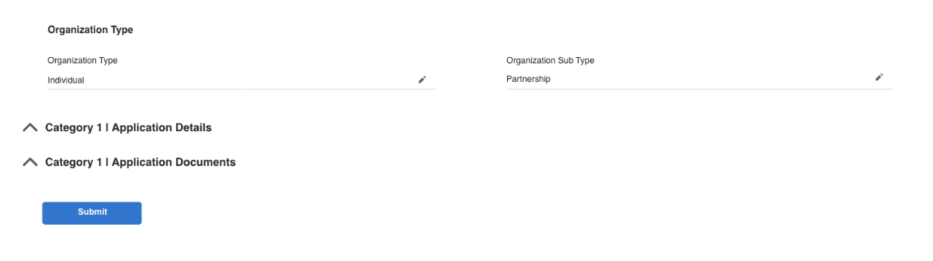
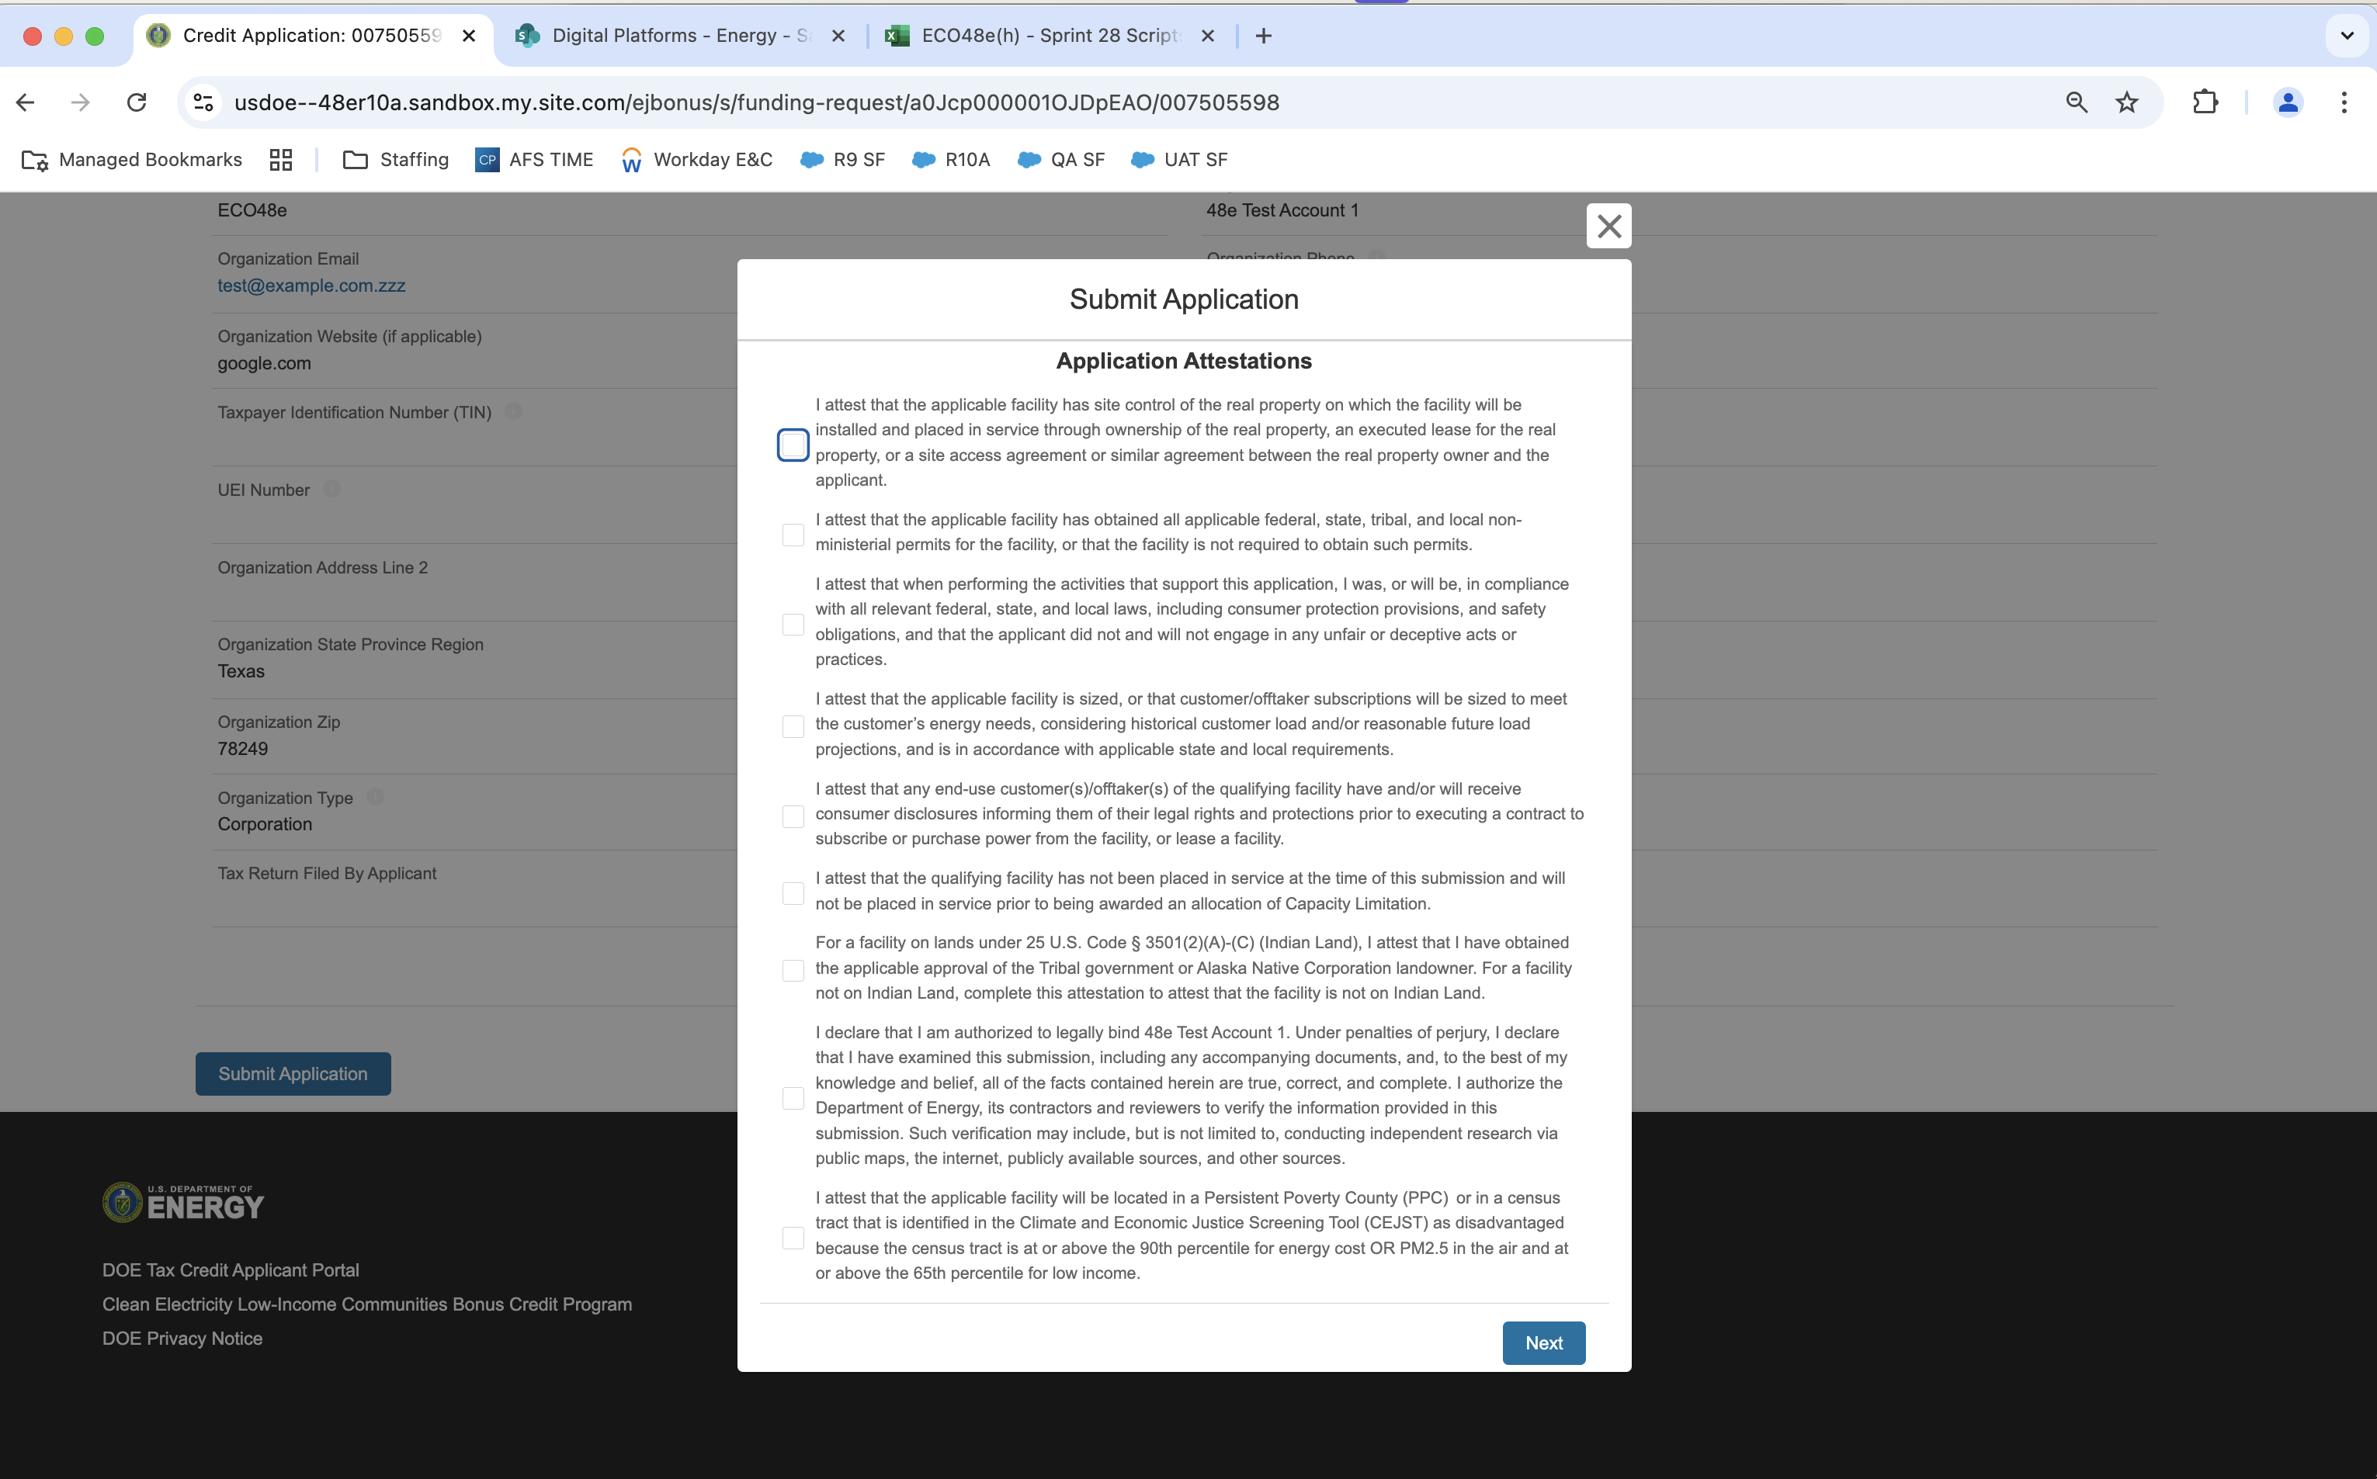
Application for Allocation
1b
Applicants will be prompted to review all information prior to submission.
Applicants will be prompted to review all information prior to submission.
Applicants will be prompted to review all information prior to submission.
Applicants will select Submit and be prompted to agree to required Attestations.
Applicants will be required to Attest to all required Attestations prior to submission.
Note: Some attestations are conditional based on subcategory selected and applicant responses.
[Organization Name]
Once applicants have attested, they can confirm submission of their 48E(h) application for allocation

Slide 29
Application for Allocation
1c
Applicants will be prompted to enter all Facility Information and Details including address, latitude/longitude, technology type, facility size, cost, etc.
Applicants will enter all Facility Identification Details including optional Project Name and Facility Street Address.

Slide 30
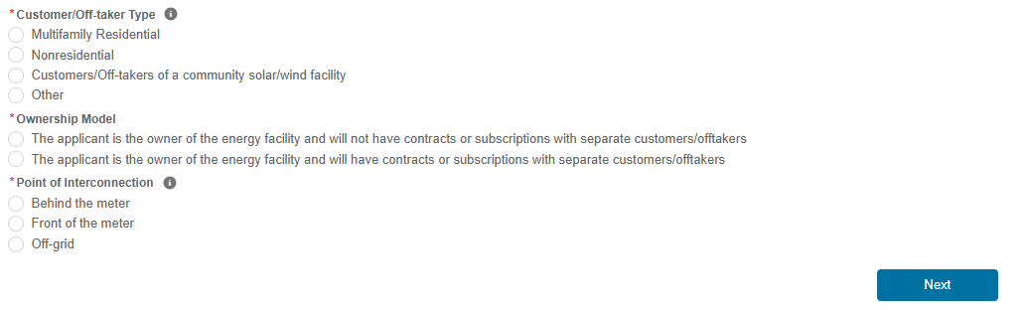
Application for Allocation
1c
Applicants will be prompted to enter all Facility Information and Details including address, latitude/longitude, technology type, facility size, cost, etc.
Applicants will enter the facility Latitude and Longitude and identify if the facility is located on land under Tribal Regulatory Authority.
Applicants will select the facility Technology Type
Applicants will enter the energy generating capacity of the facility.
Note: fields are conditional based on the technology type selected. For example, if the applicant selects Wind Energy Facility, the applicant will be prompted to complete only Energy Generating Capacity (kW AC).
Applicants will be prompted to enter Facility Usage details including Customer Type, Ownership Model, Point of Interconnection, and Additional Selection Criteria.
Note: Facility Usage is conditional for each subcategory based on requirements outlined in guidance. Questions and response options will differ across each subcategory.
Once all required fields have been completed, applicants will select Next to move on to required documentation.

Slide 31
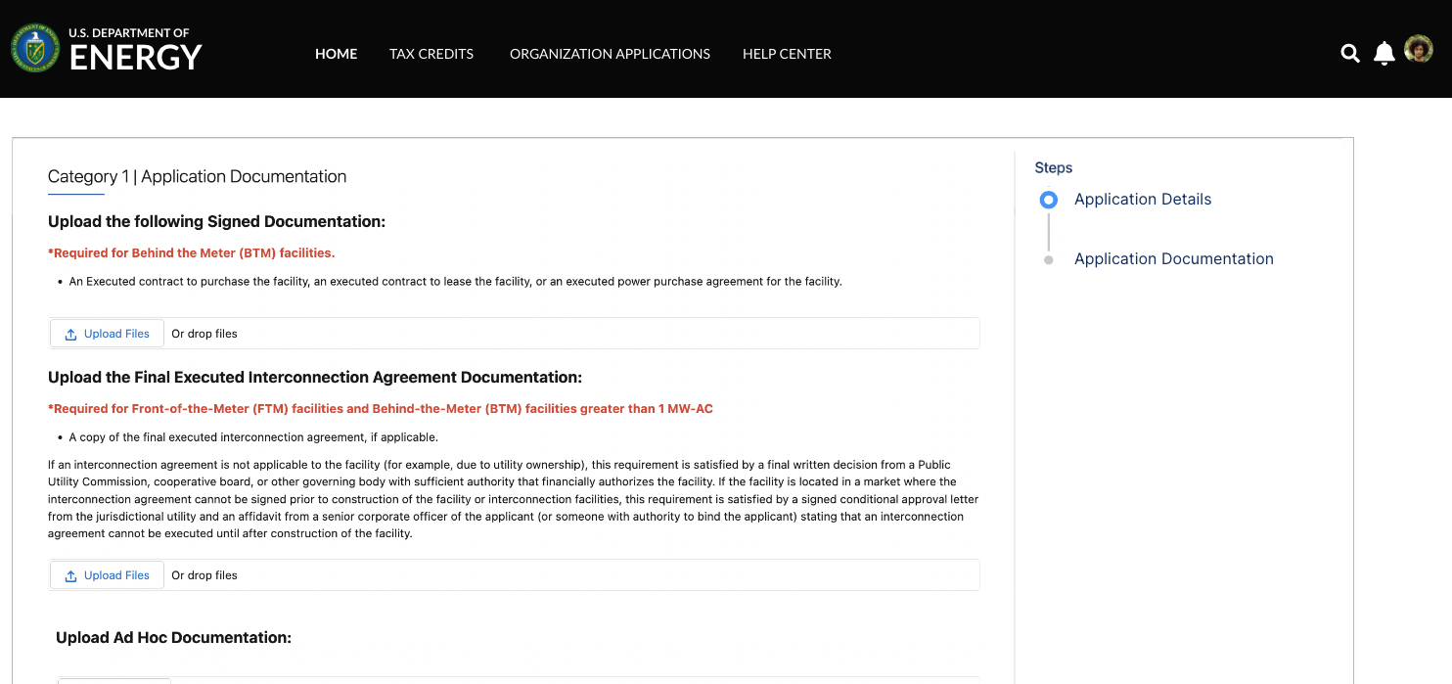
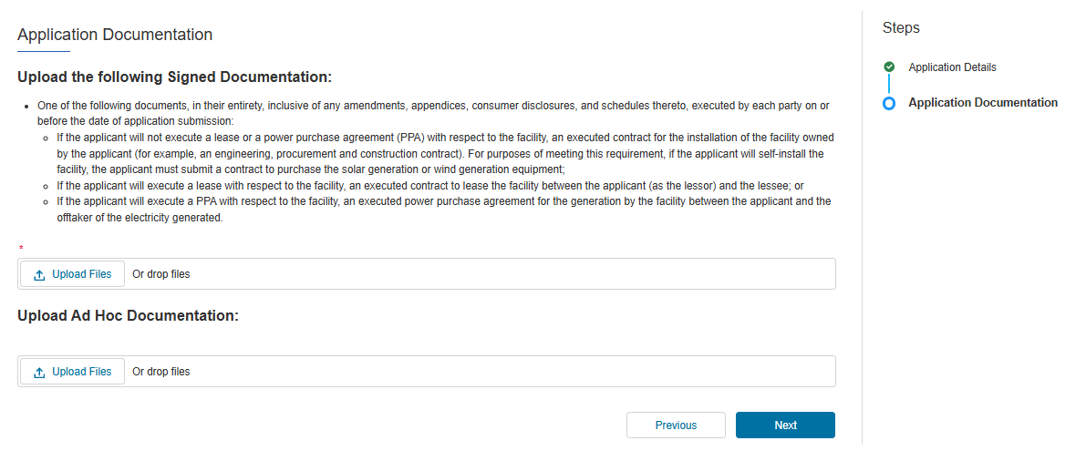
Application for Allocation
1c
Applicants will be prompted to attach all required documents.
One of the following documents, in its entirety, inclusive of any amendments, appendices, consumer disclosures, and schedules thereto, executed by each party on or before the date of application submission:
1) If the applicant will not execute a lease or a power purchase agreement (PPA) with respect to the facility, an executed contract for the installation of the facility owned by the applicant (for example, an engineering, procurement, and construction contract). For purposes of meeting this requirement, if the applicant will self-install the facility, the applicant must submit a contract to purchase the energy generation equipment.
2) If the applicant will execute a lease with respect to the facility, an executed contract to lease the facility between the applicant (as the lessor) and the lessee.
3) If the applicant will execute a PPA with respect to the facility, an executed power purchase agreement for the generation by the facility between the applicant and the offtaker of the electricity generated.
executed
Applicants will be prompted to attach all required documents per category requirements outlined in the current Revenue Procedure.
Note: Documentation requirements are conditional based on subcategory chosen by the applicant.
Once required documents have been attached, applicants will select Next to review their application prior to submission.

Slide 32
Application for Allocation
1c
Applicants will be prompted to review all information prior to submission.
Applicants will be prompted to review all information prior to submission.
Applicants will select Submit and be prompted to agree to required Attestations.
Applicants will be required to Attest to all required Attestations prior to submission.
Note: Some attestations are conditional based on subcategory selected and applicant responses.
[Organization Name]
Once applicants have attested, they can confirm submission of their 48E(h) application for allocation

Slide 33
Application for Allocation
1d
Applicants will be prompted to enter all Facility Information and Details including address, latitude/longitude, technology type, facility size, cost, etc.
Applicants will enter all Facility Identification Details including optional Project Name and Facility Street Address.

Slide 34
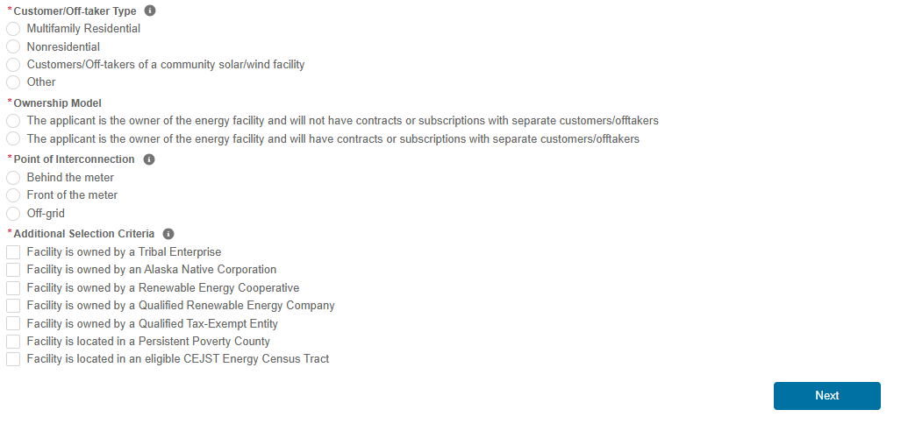
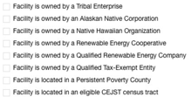
Application for Allocation
1d
Applicants will be prompted to enter all Facility Information and Details including address, latitude/longitude, technology type, facility size, cost, etc.
Applicants will enter the facility Latitude and Longitude and identify if the facility is located on land under Tribal Regulatory Authority.
Applicants will select the facility Technology Type
Applicants will enter the energy generating capacity of the facility.
Note: fields are conditional based on the technology type selected. For example, if the applicant selects Wind Energy Facility, the applicant will be prompted to complete only Energy Generating Capacity (kW AC).
Applicants will be prompted to enter Facility Usage details including Customer Type, Ownership Model, Point of Interconnection, and Additional Selection Criteria.
Note: Facility Usage is conditional for each subcategory based on requirements outlined in guidance. Questions and response options will differ across each subcategory.
Once all required fields have been completed, applicants will select Next to move on to required documentation.

Slide 35
Application for Allocation
1d
Applicants will be prompted to attach all required documents.
One of the following documents, in its entirety, inclusive of any amendments, appendices, consumer disclosures, and schedules thereto, executed by each party on or before the date of application submission:
1) If the applicant will not execute a lease or a power purchase agreement (PPA) with respect to the facility, an executed contract for the installation of the facility owned by the applicant (for example, an engineering, procurement, and construction contract). For purposes of meeting this requirement, if the applicant will self-install the facility, the applicant must submit a contract to purchase the energy generation equipment.
2) If the applicant will execute a lease with respect to the facility, an executed contract to lease the facility between the applicant (as the lessor) and the lessee.
3) If the applicant will execute a PPA with respect to the facility, an executed power purchase agreement for the generation by the facility between the applicant and the offtaker of the electricity generated.
executed
Applicants will be prompted to attach all required documents per category requirements outlined in the current Revenue Procedure.
Note: Documentation requirements are conditional based on subcategory chosen by the applicant.
Documentation demonstrating applicant meets Ownership Criteria if applying under Additional Selection Criteria. See section 7.07 of the 2025 Revenue Procedure for detailed requirements.

Slide 36
Application for Allocation
1d
Applicants will be prompted to review all information prior to submission.
Applicants will be prompted to review all information prior to submission.
Applicants will select Submit and be prompted to agree to required Attestations.
Applicants will be required to Attest to all required Attestations prior to submission.
Note: some Attestations are conditional based on subcategory selected and applicant responses.
[Organization Name]
Once applicants have attested, they can confirm submission of their 48E(h) application for allocation

