Slide 1
§ 48E(h): Clean Electricity Low-Income Communities Bonus Credit Program Application Wireframes
November 21, 2024 – Updated December 13, 2024

Slide 2
Appendix
Conditional Questions, Documentation, and Attestations for:
Categories 1b – 1d
Categories 2a – 2b
Categories 3a – 3b
Categories 4a – 4b

Slide 3
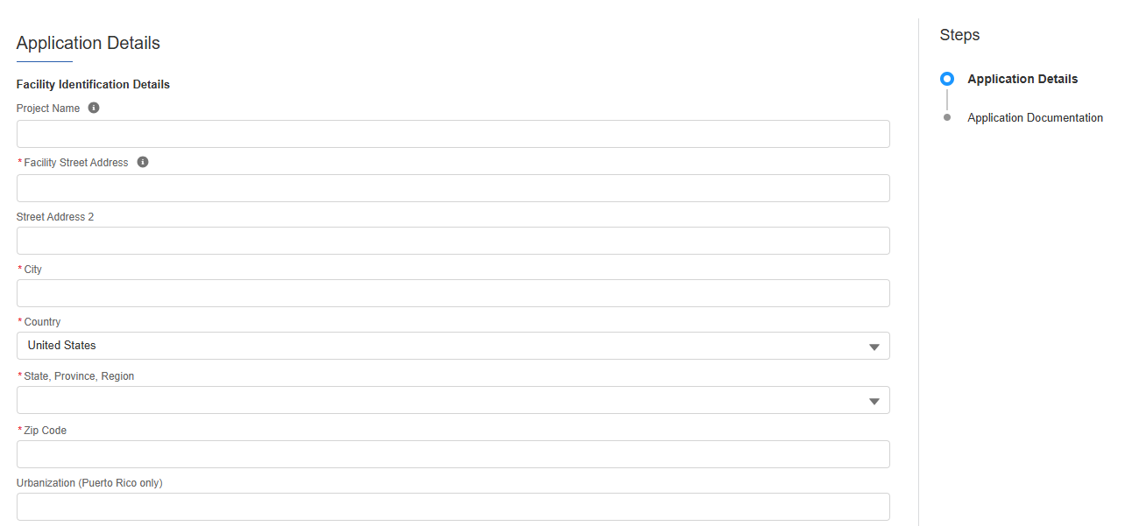
Application for Allocation
2a
Applicants will be prompted to enter all Facility Information and Details including address, latitude/longitude, technology type, facility size, cost, etc.
Applicants will enter all Facility Identification Details including optional Project Name and Facility Street Address.

Slide 4
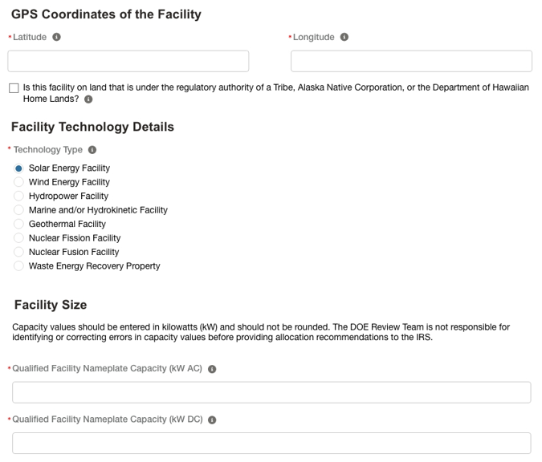
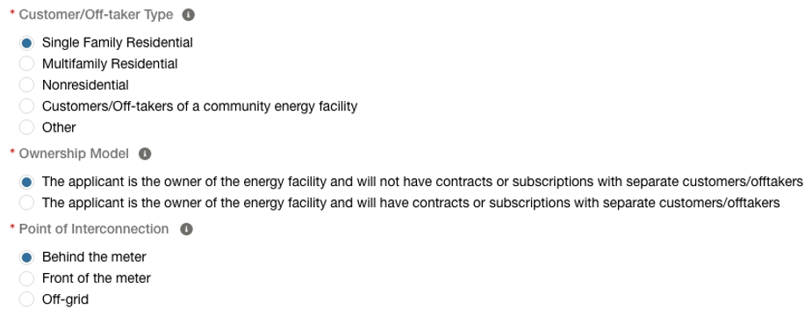
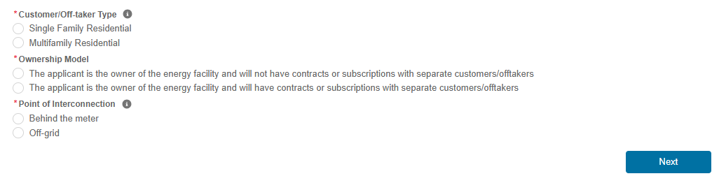
Application for Allocation
2a
Applicants will be prompted to enter all Facility Information and Details including address, latitude/longitude, technology type, facility size, cost, etc.
Applicants will enter the facility Latitude and Longitude and identify if the facility is located on land under Tribal Regulatory Authority.
Applicants will select the facility Technology Type
Applicants will enter the energy generating capacity of the facility.
Note: fields are conditional based on the technology type selected. For example, if the applicant selects Wind Energy Facility, the applicant will be prompted to complete only Energy Generating Capacity (kW AC).
Applicants will be prompted to enter Facility Usage details including Customer Type, Ownership Model, Point of Interconnection, and Additional Selection Criteria.
Note: Facility Usage is conditional for each subcategory based on requirements outlined in guidance. Questions and response options will differ across each subcategory.
Once all required fields have been completed, applicants will select Next to move on to required documentation.

Slide 5
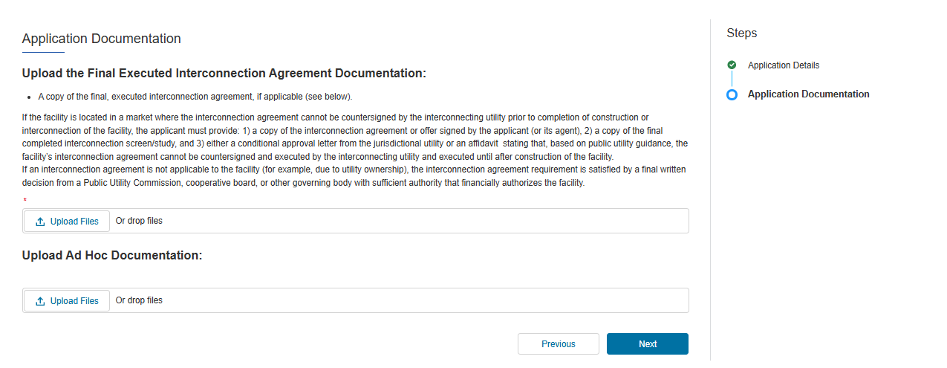
Application for Allocation
2a
Applicants will be prompted to attach all required documents.
A copy of the final, executed interconnection agreement, if applicable (see below) executed by each party on or before the date of application submission.
If the facility is located in a market where the interconnection agreement cannot be countersigned by the interconnecting utility prior to completion of construction or interconnection of the facility, the applicant must provide:
1) a copy of the submitted interconnection agreement with proof of submission
2) a copy of the final completed interconnection screen/study, and
3) either a conditional approval letter that identifies the specific facility from the interconnecting utility or an affidavit stating that, based on the interconnecting utility’s guidance, the facility’s interconnection agreement cannot be countersigned by the interconnecting utility and executed until after construction of the facility.
Applicants will be prompted to attach all required documents per category requirements outlined in the current Revenue Procedure.
Note: Documentation requirements are conditional based on subcategory chosen by the applicant.
Once required documents have been attached, applicants will select Next to review their application prior to submission.

Slide 6
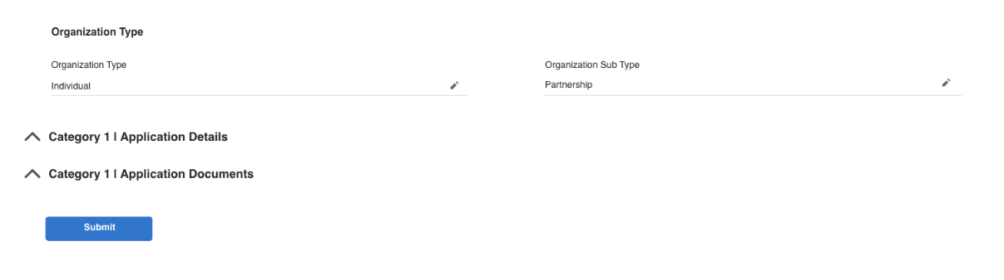
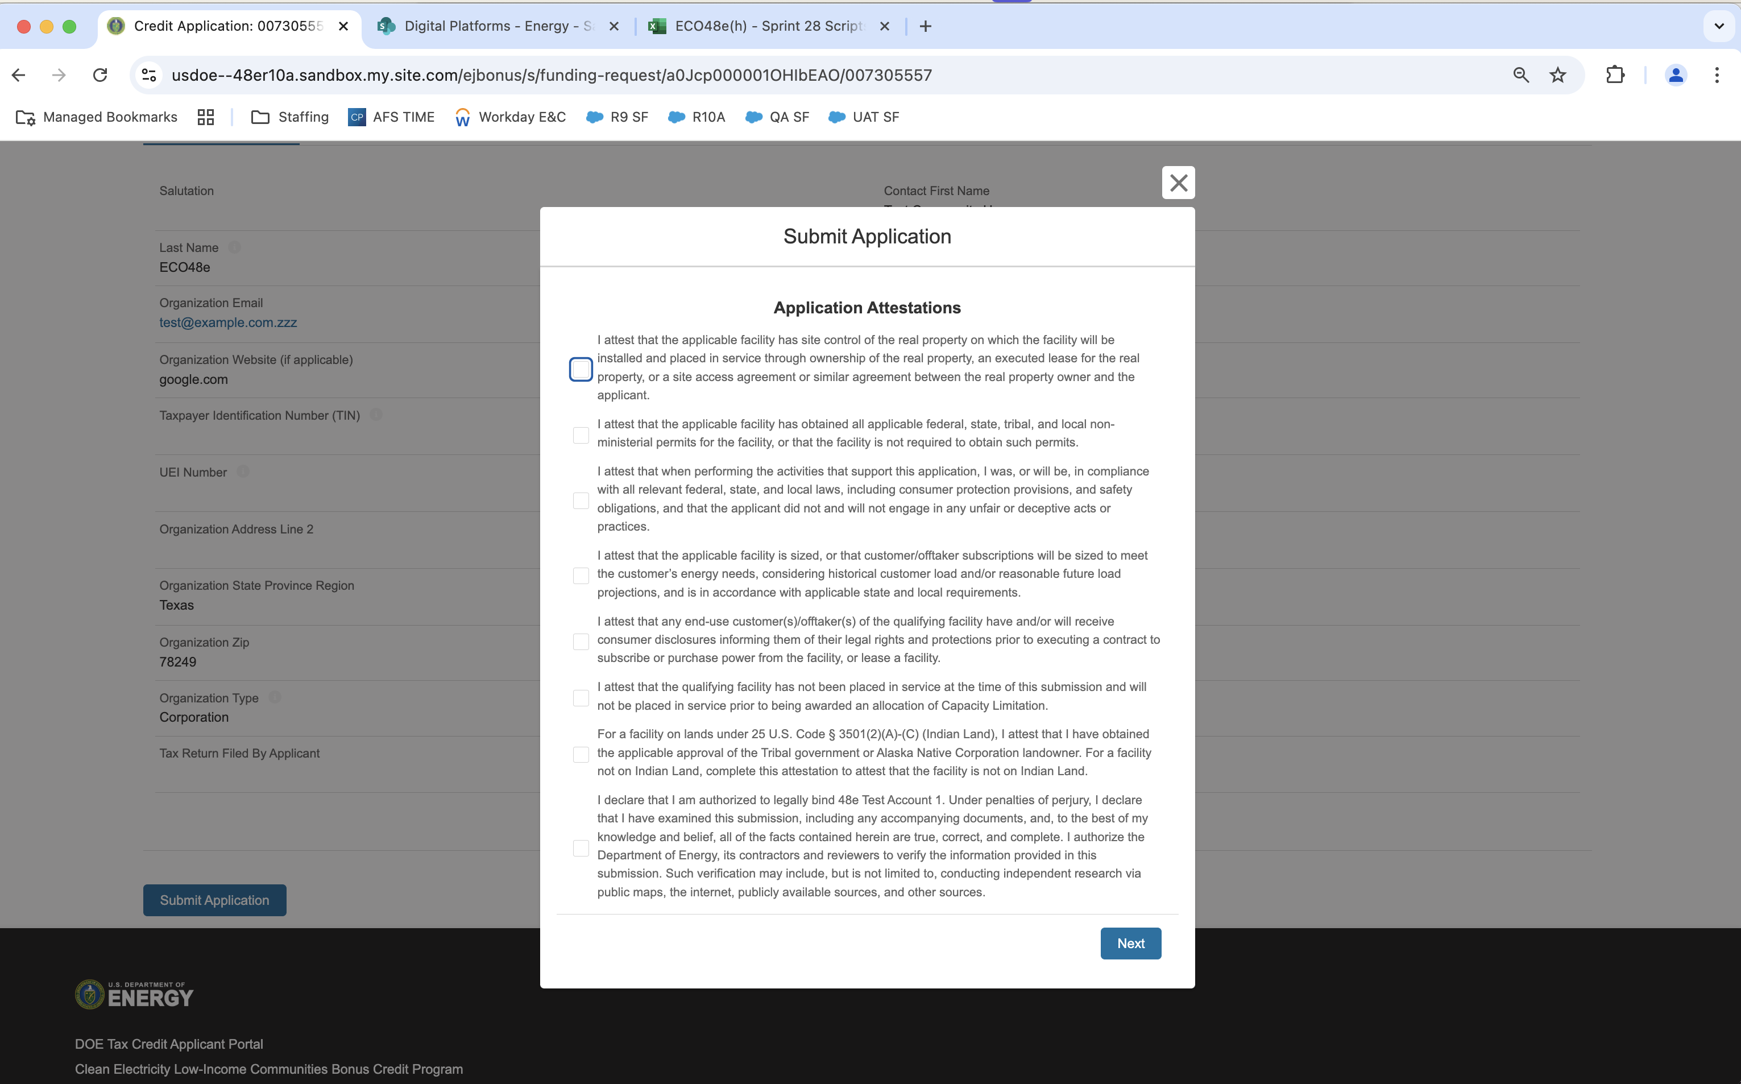
Application for Allocation
2a
Applicants will be prompted to review all information prior to submission.
Applicants will be prompted to review all information prior to submission.
Applicants will select Submit and be prompted to agree to required Attestations.
Applicants will be required to Attest to all required Attestations prior to submission.
Note: Some attestations are conditional based on subcategory selected and applicant responses.
[Organization Name]
Once applicants have attested, they can confirm submission of their 48E(h) application for allocation

Slide 7
Application for Allocation
2b
Applicants will be prompted to enter all Facility Information and Details including address, latitude/longitude, technology type, facility size, cost, etc.
Applicants will enter all Facility Identification Details including optional Project Name and Facility Street Address.

Slide 8
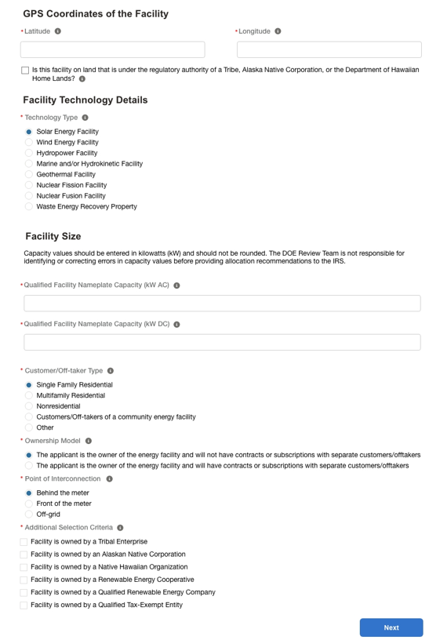
Application for Allocation
2b
Applicants will be prompted to enter all Facility Information and Details including address, latitude/longitude, technology type, facility size, cost, etc.
Applicants will enter the facility Latitude and Longitude and identify if the facility is located on land under Tribal Regulatory Authority.
Applicants will select the facility Technology Type
Applicants will enter the energy generating capacity of the facility.
Note: fields are conditional based on the technology type selected. For example, if the applicant selects Wind Energy Facility, the applicant will be prompted to complete only Energy Generating Capacity (kW AC).
Applicants will be prompted to enter Facility Usage details including Customer Type, Ownership Model, Point of Interconnection, and Additional Selection Criteria.
Note: Facility Usage is conditional for each subcategory based on requirements outlined in guidance. Questions and response options will differ across each subcategory.
Once all required fields have been completed, applicants will select Next to move on to required documentation.

Slide 9
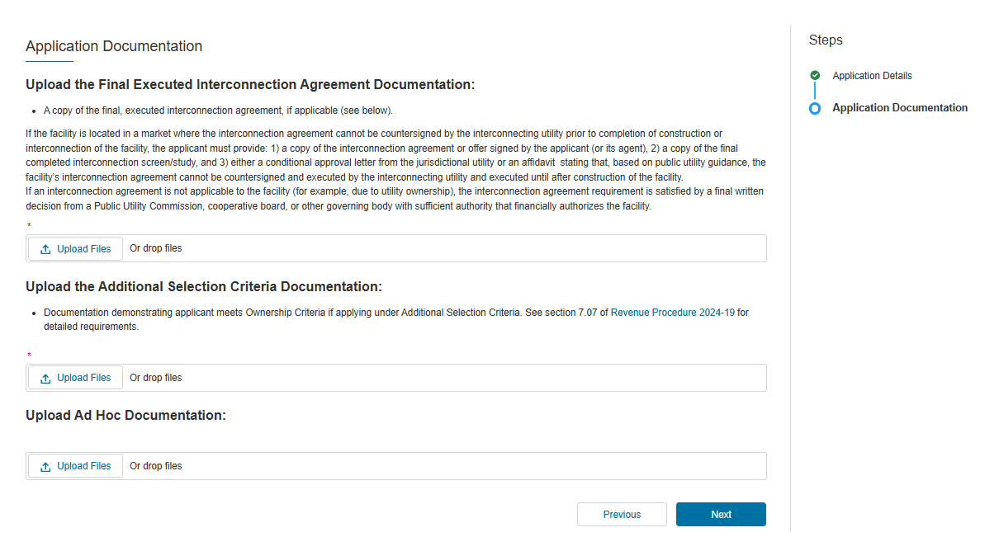
Application for Allocation
2b
Applicants will be prompted to attach all required documents.
A copy of the final, executed interconnection agreement, if applicable (see below) executed by each party on or before the date of application submission.
If the facility is located in a market where the interconnection agreement cannot be countersigned by the interconnecting utility prior to completion of construction or interconnection of the facility, the applicant must provide:
1) a copy of the submitted interconnection agreement with proof of submission
2) a copy of the final completed interconnection screen/study, and
3) either a conditional approval letter that identifies the specific facility from the interconnecting utility or an affidavit stating that, based on the interconnecting utility’s guidance, the facility’s interconnection agreement cannot be countersigned by the interconnecting utility and executed until after construction of the facility.
Applicants will be prompted to attach all required documents per category requirements outlined in the current Revenue Procedure.
Note: Documentation requirements are conditional based on subcategory chosen by the applicant.
Documentation demonstrating applicant meets Ownership Criteria if applying under Additional Selection Criteria. See section 7.07 of the 2025 current Revenue Procedure for detailed requirements.
Once required documents have been attached, applicants will select Next to review their application prior to submission.

Slide 10
Application for Allocation
2b
Applicants will be prompted to review all information prior to submission.
Applicants will be prompted to review all information prior to submission.
Applicants will be prompted to review all information prior to submission.
Applicants will select Submit and be prompted to agree to required Attestations.
Applicants will be required to Attest to all required Attestations prior to submission.
Note: Some attestations are conditional based on subcategory selected and applicant responses.
[Organization Name]
Once applicants have attested, they can confirm submission of their 48E(h) application for allocation

Slide 11
Application for Allocation
3a
Applicants will be prompted to enter all Facility Information and Details including address, latitude/longitude, technology type, facility size, cost, etc.
Applicants will enter all Facility Identification Details including optional Project Name and Facility Street Address.

Slide 12
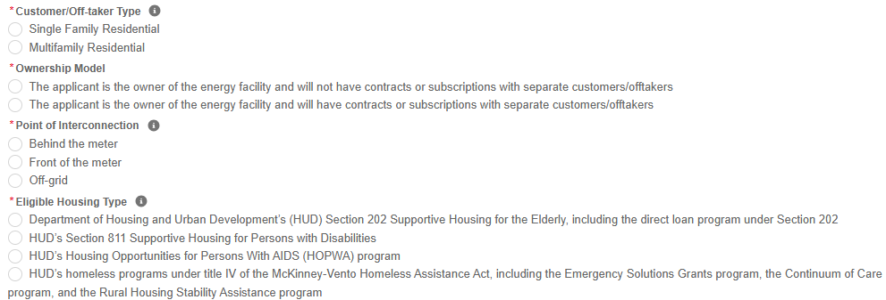
Application for Allocation
3a
Applicants will be prompted to enter all Facility Information and Details including address, latitude/longitude, technology type, facility size, cost, etc.
Applicants will enter the facility Latitude and Longitude and identify if the facility is located on land under Tribal Regulatory Authority.
Applicants will select the facility Technology Type
Applicants will enter the energy generating capacity of the facility.
Note: fields are conditional based on the technology type selected. For example, if the applicant selects Wind Energy Facility, the applicant will be prompted to complete only Energy Generating Capacity (kW AC).
Applicants will be prompted to enter Facility Usage details including Customer Type, Ownership Model, Point of Interconnection, and Additional Selection Criteria.
Note: Facility Usage is conditional for each subcategory based on requirements outlined in guidance. Questions and response options will differ across each subcategory.

Slide 13
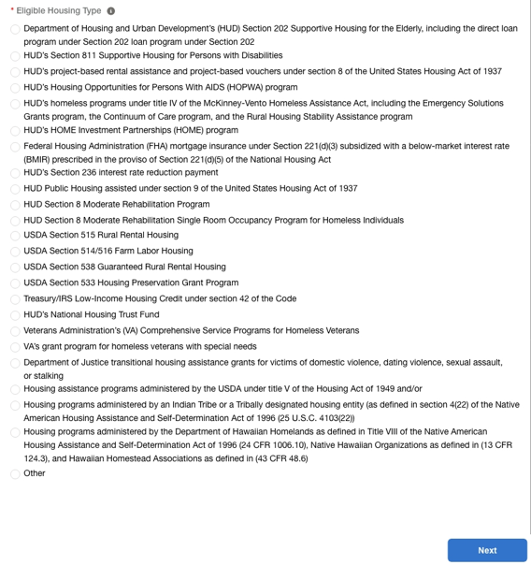
Application for Allocation
3a
Applicants will be prompted to enter all Facility Information and Details including address, latitude/longitude, technology type, facility size, cost, etc.
Applicants will select the applicable eligible housing type for their facility.
Once all required fields have been completed, applicants will select Next to move on to required documentation.

Slide 14
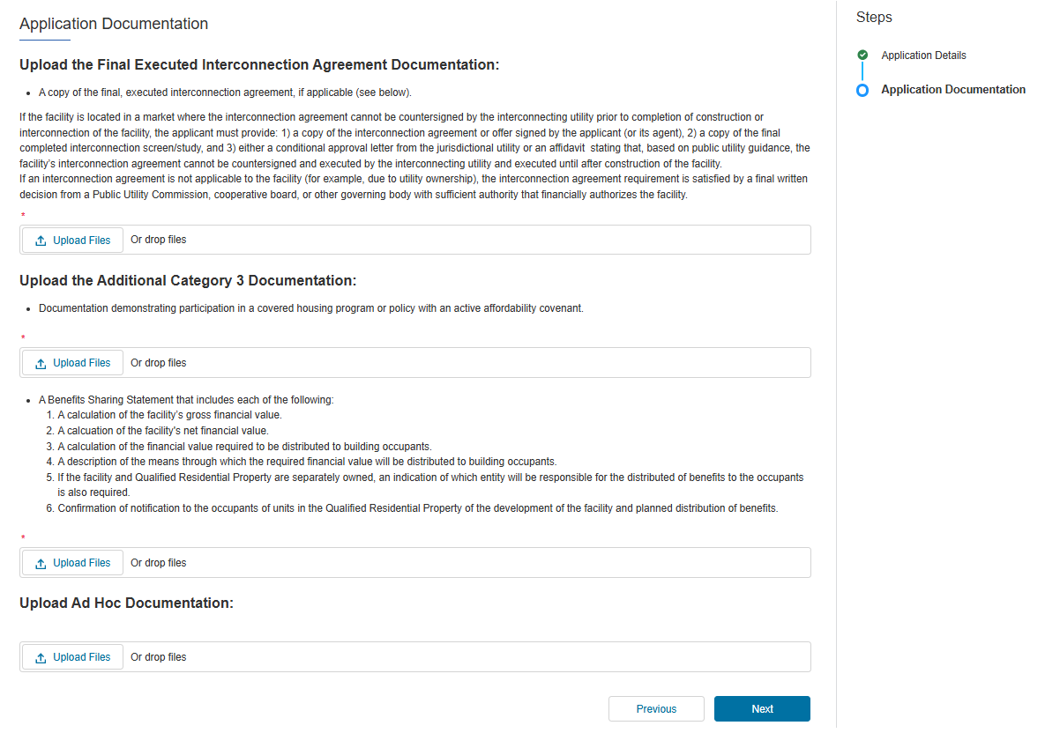
Application for Allocation
3a
Applicants will be prompted to attach all required documents.
A copy of the final, executed interconnection agreement, if applicable (see below) executed by each party on or before the date of application submission.
If the facility is located in a market where the interconnection agreement cannot be countersigned by the interconnecting utility prior to completion of construction or interconnection of the facility, the applicant must provide:
1) a copy of the submitted interconnection agreement with proof of submission
2) a copy of the final completed interconnection screen/study, and
3) either a conditional approval letter that identifies the specific facility from the interconnecting utility or an affidavit stating that, based on the interconnecting utility’s guidance, the facility’s interconnection agreement cannot be countersigned by the interconnecting utility and executed until after construction of the facility.
Applicants will be prompted to attach all required documents per category requirements outlined in the current Revenue Procedure.
Note: Documentation requirements are conditional based on subcategory chosen by the applicant.
Documentation demonstrating that the property will be installed on an eligible residential rental building, and not just its tenants, participates in a covered housing program.
A Draft Benefits Sharing Statement that includes the information described in the current Revenue Procedure. A template Benefits Sharing Statement template is linked on the Program homepage.
Once required documents have been attached, applicants will select Next to review their application prior to submission.

Slide 15
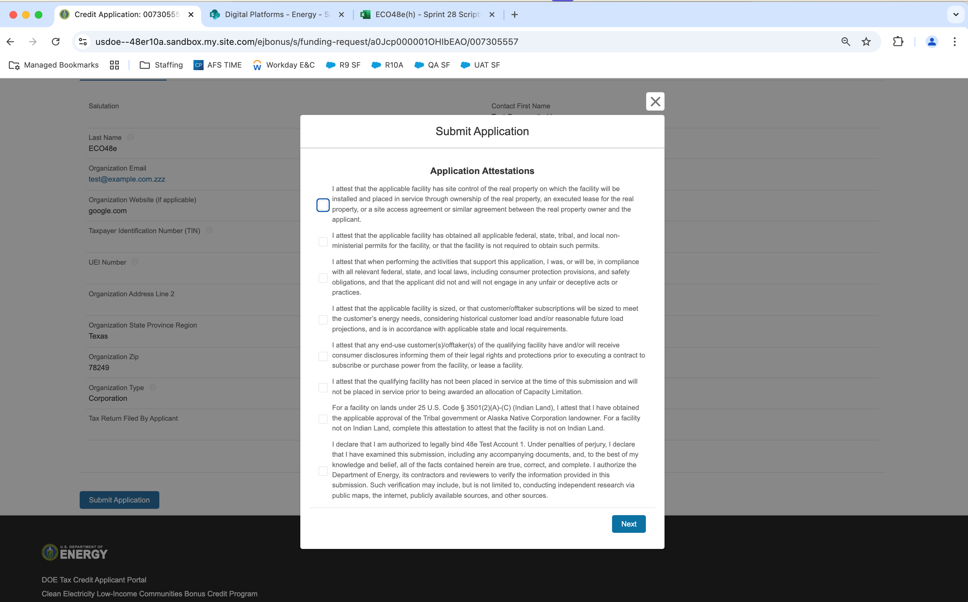
Application for Allocation
3a
Applicants will be prompted to review all information prior to submission.
Applicants will be prompted to review all information prior to submission.
Applicants will select Submit and be prompted to agree to required Attestations.
Applicants will be required to Attest to all required Attestations prior to submission.
Note: Some attestations are conditional based on subcategory selected and applicant responses.
[Organization Name]
Once applicants have attested, they can confirm submission of their 48E(h) application for allocation

Slide 16
Application for Allocation
3b
Applicants will be prompted to enter all Facility Information and Details including address, latitude/longitude, technology type, facility size, cost, etc.
Applicants will enter all Facility Identification Details including optional Project Name and Facility Street Address.

Slide 17
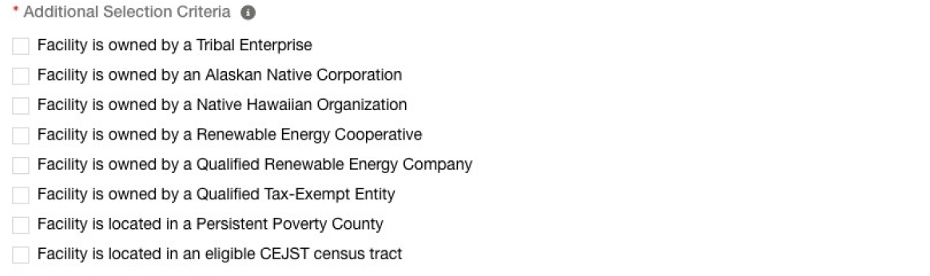
Application for Allocation
3b
Applicants will be prompted to enter all Facility Information and Details including address, latitude/longitude, technology type, facility size, cost, etc.
Applicants will enter the facility Latitude and Longitude and identify if the facility is located on land under Tribal Regulatory Authority.
Applicants will select the facility Technology Type
Applicants will enter the energy generating capacity of the facility.
Note: fields are conditional based on the technology type selected. For example, if the applicant selects Wind Energy Facility, the applicant will be prompted to complete only Energy Generating Capacity (kW AC).
Applicants will be prompted to enter Facility Usage details including Customer Type, Ownership Model, Point of Interconnection, and Additional Selection Criteria.
Note: Facility Usage is conditional for each subcategory based on requirements outlined in guidance. Questions and response options will differ across each subcategory.

Slide 18
Application for Allocation
3b
Applicants will be prompted to enter all Facility Information and Details including address, latitude/longitude, technology type, facility size, cost, etc.
Applicants will select the applicable eligible housing type for their facility.
Once all required fields have been completed, applicants will select Next to move on to required documentation.

Slide 19
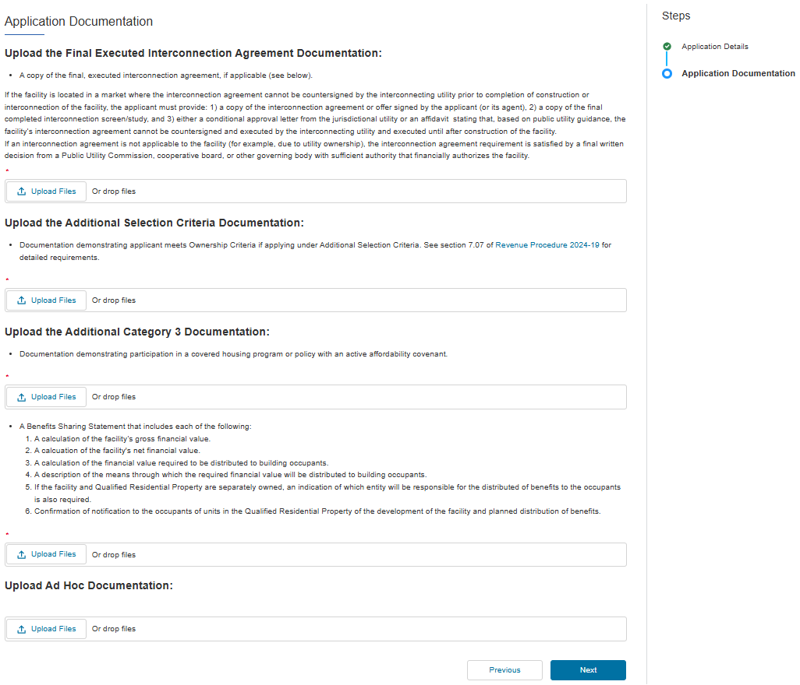
Application for Allocation
3b
Applicants will be prompted to attach all required documents.
A copy of the final, executed interconnection agreement, if applicable (see below) executed by each party on or before the date of application submission.
If the facility is located in a market where the interconnection agreement cannot be countersigned by the interconnecting utility prior to completion of construction or interconnection of the facility, the applicant must provide:
1) a copy of the submitted interconnection agreement with proof of submission
2) a copy of the final completed interconnection screen/study, and
3) either a conditional approval letter that identifies the specific facility from the interconnecting utility or an affidavit stating that, based on the interconnecting utility’s guidance, the facility’s interconnection agreement cannot be countersigned by the interconnecting utility and executed until after construction of the facility.
Documentation demonstrating applicant meets Ownership Criteria if applying under Additional Selection Criteria. See section 7.07 of the 2025 current Revenue Procedure for detailed requirements.
Applicants will be prompted to attach all required documents per category requirements outlined in the current Revenue Procedure.
Note: Documentation requirements are conditional based on subcategory chosen by the applicant.
Documentation demonstrating that the property will be installed on an eligible residential rental building, and not just its tenants, participates in a covered housing program.
A Draft Benefits Sharing Statement that includes the information described in the current Revenue Procedure. A template Benefits Sharing Statement template is linked on the Program homepage.
Once required documents have been attached, applicants will select Next to review their application prior to submission.

Slide 20
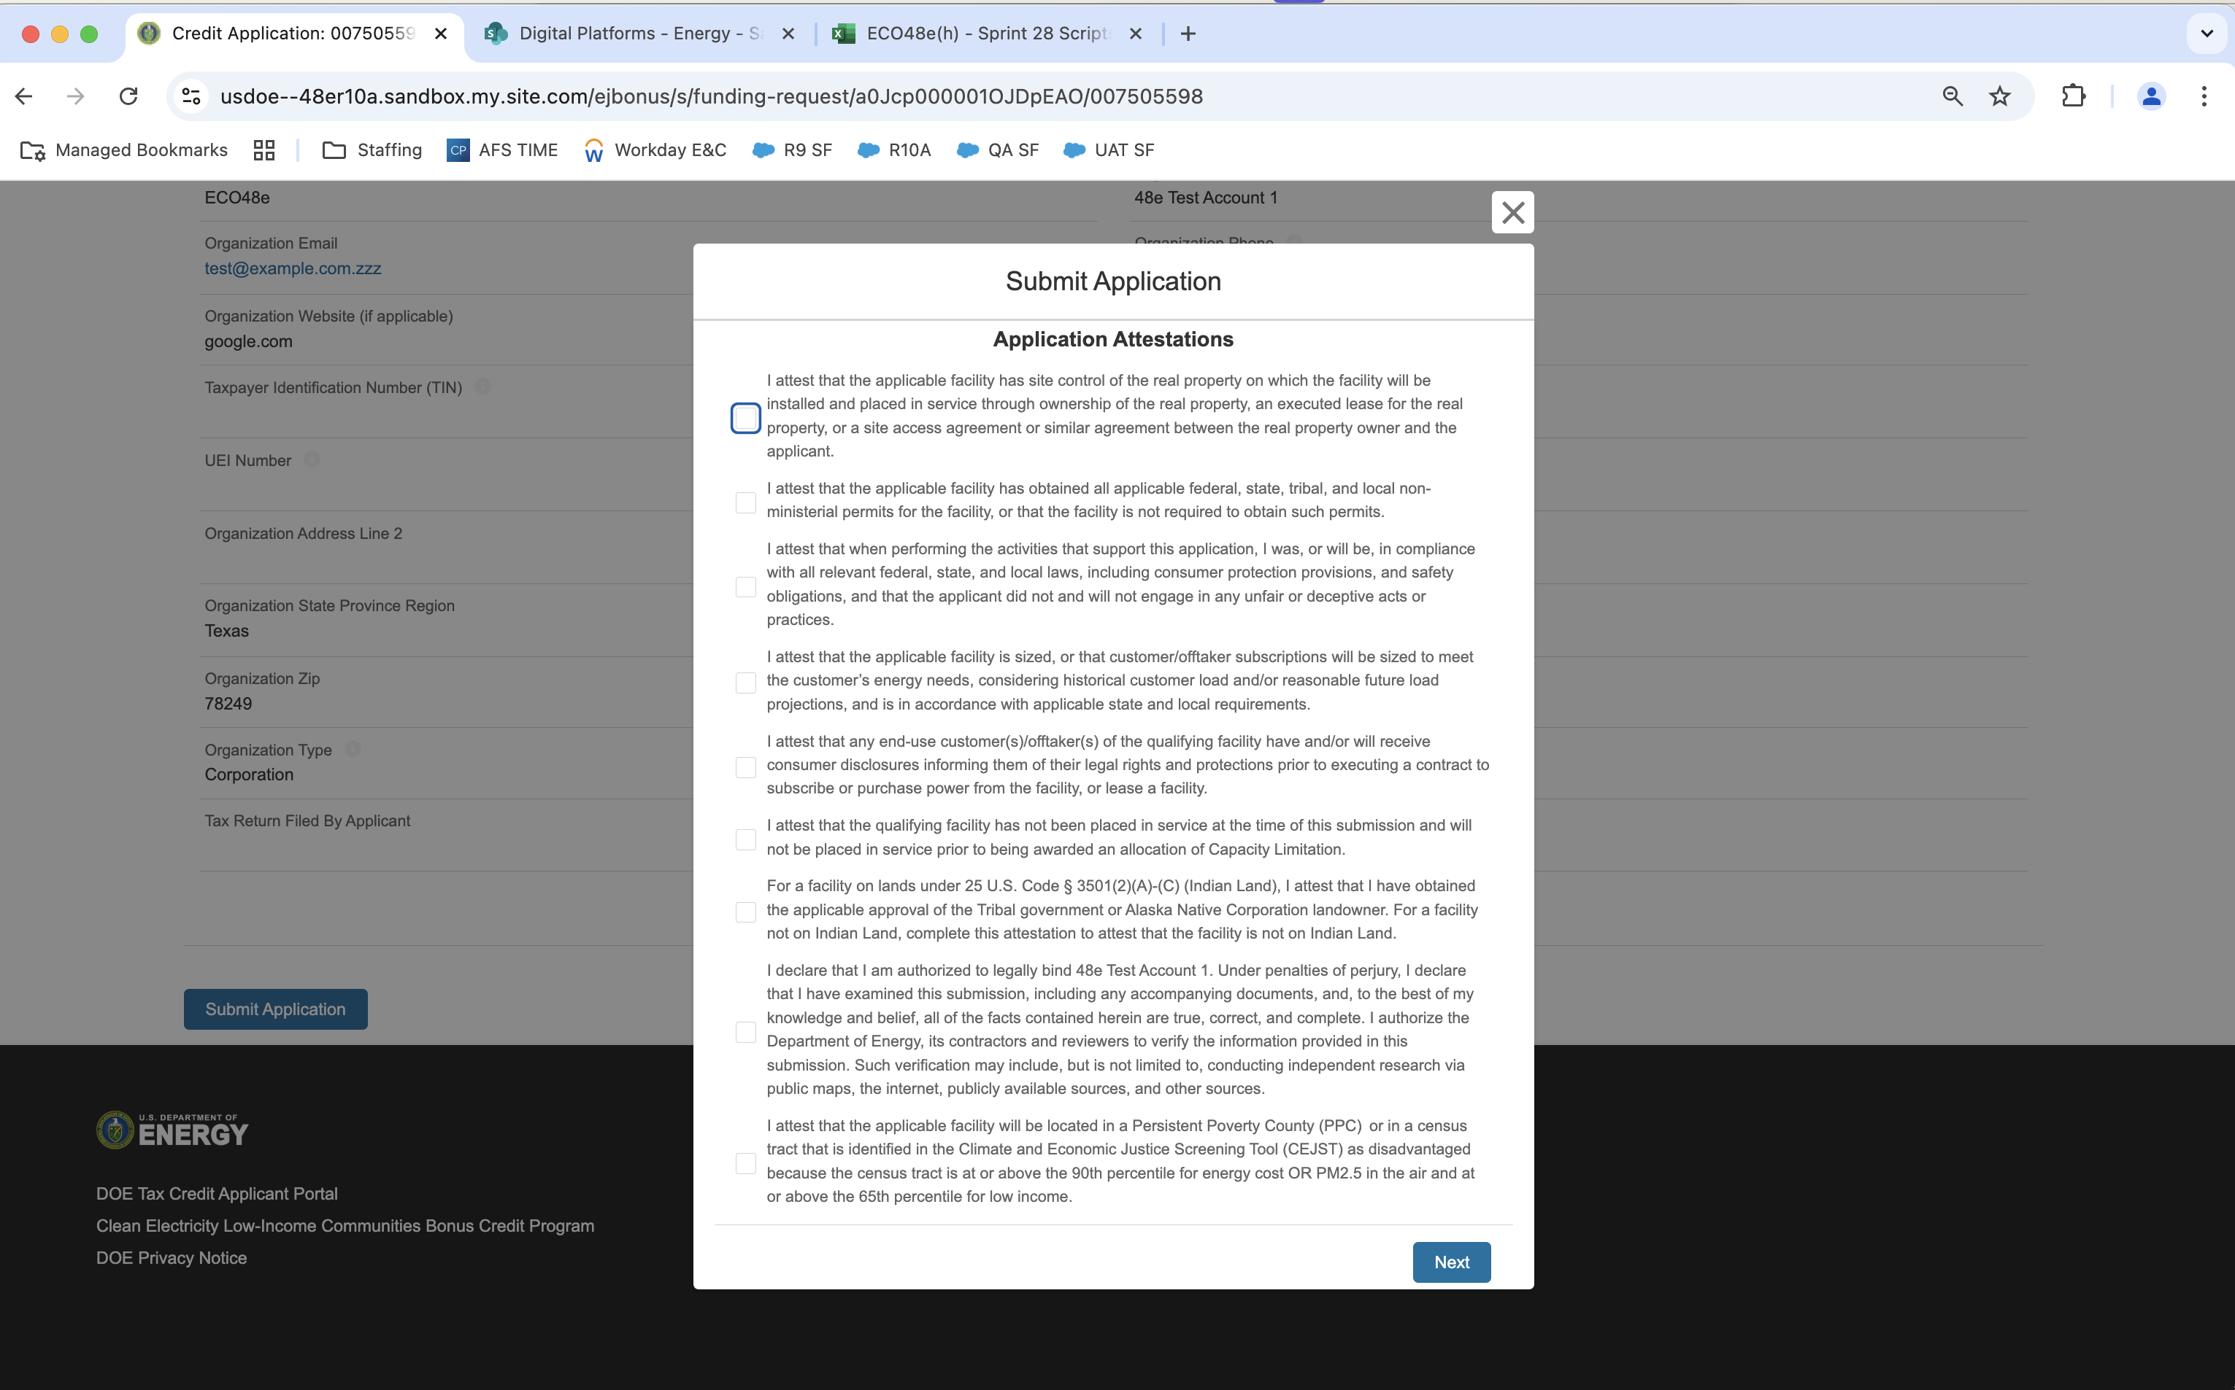
Application for Allocation
3b
Applicants will be prompted to review all information prior to submission.
Applicants will be prompted to review all information prior to submission.
Applicants will select Submit and be prompted to agree to required Attestations.
Applicants will be required to Attest to all required Attestations prior to submission.
Note: Some attestations are conditional based on subcategory selected and applicant responses.
[Organization Name]
Once applicants have attested, they can confirm submission of their 48E(h) application for allocation

Slide 21
Application for Allocation
4a
Applicants will be prompted to enter all Facility Information and Details including address, latitude/longitude, technology type, facility size, cost, etc.
Applicants will enter all Facility Identification Details including optional Project Name and Facility Street Address.

Slide 22
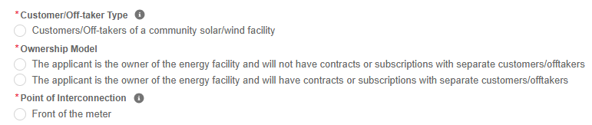
Application for Allocation
4a
Applicants will be prompted to enter all Facility Information and Details including address, latitude/longitude, technology type, facility size, cost, etc.
Applicants will enter the facility Latitude and Longitude and identify if the facility is located on land under Tribal Regulatory Authority.
Applicants will select the facility Technology Type
Applicants will enter the energy generating capacity of the facility.
Note: fields are conditional based on the technology type selected. For example, if the applicant selects Wind Energy Facility, the applicant will be prompted to complete only Energy Generating Capacity (kW AC).
Applicants will be prompted to enter Facility Usage details including Customer Type, Ownership Model, Point of Interconnection, and Additional Selection Criteria.
Note: Facility Usage is conditional for each subcategory based on requirements outlined in guidance. Questions and response options will differ across each subcategory.
Once all required fields have been completed, applicants will select Next to move on to required documentation.

Slide 23
Application for Allocation
4a
Applicants will be prompted to attach all required documents.
A copy of the final, executed interconnection agreement, if applicable (see below) executed by each party on or before the date of application submission.
If the facility is located in a market where the interconnection agreement cannot be countersigned by the interconnecting utility prior to completion of construction or interconnection of the facility, the applicant must provide:
1) a copy of the submitted interconnection agreement with proof of submission
2) a copy of the final completed interconnection screen/study, and
3) either a conditional approval letter that identifies the specific facility from the interconnecting utility or an affidavit stating that, based on the interconnecting utility’s guidance, the facility’s interconnection agreement cannot be countersigned by the interconnecting utility and executed until after construction of the facility.
Applicants will be prompted to attach all required documents per category requirements outlined in the current Revenue Procedure.
Note: Documentation requirements are conditional based on subcategory chosen by the applicant.
Once required documents have been attached, applicants will select Next to review their application prior to submission.

Slide 24
Application for Allocation
4a
Applicants will be prompted to review all information prior to submission.
Applicants will be prompted to review all information prior to submission.
Applicants will select Submit and be prompted to agree to required Attestations.
Applicants will be required to Attest to all required Attestations prior to submission.
Note: Some attestations are conditional based on subcategory selected and applicant responses.
[Organization Name]
Once applicants have attested, they can confirm submission of their 48E(h) application for allocation

Slide 25
Application for Allocation
4b
Applicants will be prompted to enter all Facility Information and Details including address, latitude/longitude, technology type, facility size, cost, etc.
Applicants will enter all Facility Identification Details including optional Project Name and Facility Street Address.

Slide 26

Application for Allocation
4b
Applicants will be prompted to enter all Facility Information and Details including address, latitude/longitude, technology type, facility size, cost, etc.
Applicants will enter the facility Latitude and Longitude and identify if the facility is located on land under Tribal Regulatory Authority.
Applicants will select the facility Technology Type
Applicants will enter the energy generating capacity of the facility.
Note: fields are conditional based on the technology type selected. For example, if the applicant selects Wind Energy Facility, the applicant will be prompted to complete only Energy Generating Capacity (kW AC).
Applicants will be prompted to enter Facility Usage details including Customer Type, Ownership Model, Point of Interconnection, and Additional Selection Criteria.
Note: Facility Usage is conditional for each subcategory based on requirements outlined in guidance. Questions and response options will differ across each subcategory.
Once all required fields have been completed, applicants will select Next to move on to required documentation.

Slide 27
Application for Allocation
4b
Applicants will be prompted to attach all required documents.
A copy of the final, executed interconnection agreement, if applicable (see below) executed by each party on or before the date of application submission.
If the facility is located in a market where the interconnection agreement cannot be countersigned by the interconnecting utility prior to completion of construction or interconnection of the facility, the applicant must provide:
1) a copy of the submitted interconnection agreement with proof of submission
2) a copy of the final completed interconnection screen/study, and
3) either a conditional approval letter that identifies the specific facility from the interconnecting utility or an affidavit stating that, based on the interconnecting utility’s guidance, the facility’s interconnection agreement cannot be countersigned by the interconnecting utility and executed until after construction of the facility.
Applicants will be prompted to attach all required documents per category requirements outlined in the current Revenue Procedure.
Note: Documentation requirements are conditional based on subcategory chosen by the applicant.
Documentation demonstrating applicant meets Ownership Criteria if applying under Additional Selection Criteria. See section 7.07 of the 2025 current Revenue Procedure for detailed requirements.
Once required documents have been attached, applicants will select Next to review their application prior to submission.

Slide 28
Application for Allocation
4b
Applicants will be prompted to review all information prior to submission.
Applicants will be prompted to review all information prior to submission.
Applicants will select Submit and be prompted to agree to required Attestations.
Applicants will be required to Attest to all required Attestations prior to submission.
Note: Some attestations are conditional based on subcategory selected and applicant responses.
[Organization Name]
Once applicants have attested, they can confirm submission of their 48E(h) application for allocation

