Slide 1
Traveler > Land > Schedule an Appointment at a Port of Entry
V2: August 13, 2024
Received developer approval from Nathan Stec and Alex Eun on August 8, 2024 via Teams.
Received stakeholder approval from Trish Kennedy and Jim O'Donnell during Sprint Planning on August 28, 2024.

Slide 2
Table of Contents
Context
User Schedules an Appointment
User Cancels an Appointment
User Views and Edits Their Profile
User Adds a Traveler to Their Profile
User Views a Traveler from Their Profile
User Edits a Traveler from Their Profile
User Delete a Traveler from Their Profile
Edgecases

Slide 3
Context
COM-7799
This is a new action for land travelers used by low-risk documented and non-documented travelers at the primarily (but not only) the northern border of the United States.
All submissions go thru USEC (downstream system), no matter if the person is documented or not.
This user flow copies Traveler > Land > Submit Advance Information but collects bare minimum information and the user can select a date on the calendar and schedule an appointment.
User flow is mobile-only. User flow is English-only.
User flow does not do geofencing, facial matching, or liveness detection.
Mockups on Figma: https://www.figma.com/file/LKRQtgPjVlHbsSntZ5iioW/CBP-One-Mobile-Mockups?type=design&node-id=1297-37752&mode=design&t=PZYit2hxNAjPpFC8-4

Slide 4
User Flow 1
User schedules an appointment as a first-time user.

Slide 5
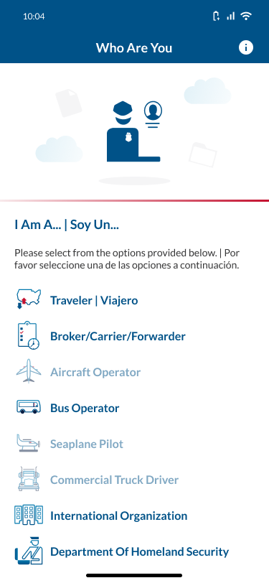
Traveler > Land > Schedule an Appointment at a Port of Entry: Schedule Appointment
ACTION: User selects Traveler | Viajero.

Slide 6
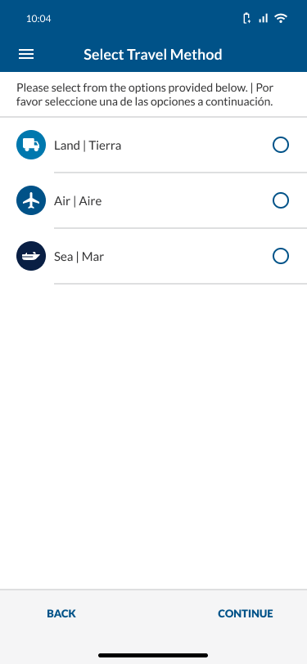
Traveler > Land > Schedule an Appointment at a Port of Entry: Schedule Appointment
ACTION: User selects Land | Tierra.

Slide 7

Traveler > Land > Schedule an Appointment at a Port of Entry: Schedule Appointment
ACTION: User selects CONTINUE.

Slide 8
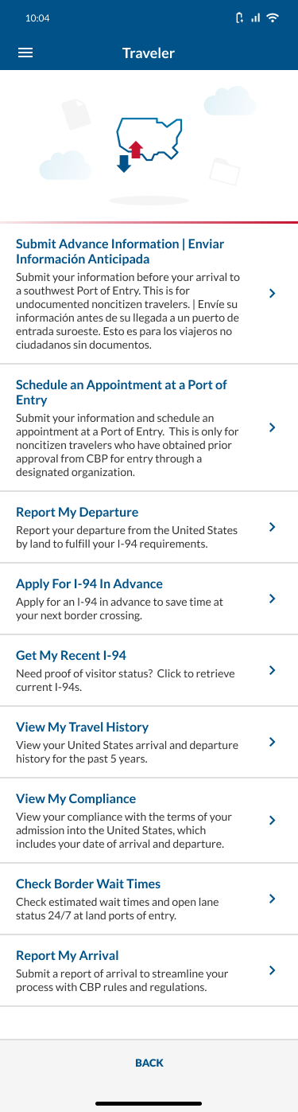
Traveler > Land > Schedule an Appointment at a Port of Entry: Schedule Appointment
ACTION: User selects Schedule an Appointment at a Port of Entry.

Slide 9
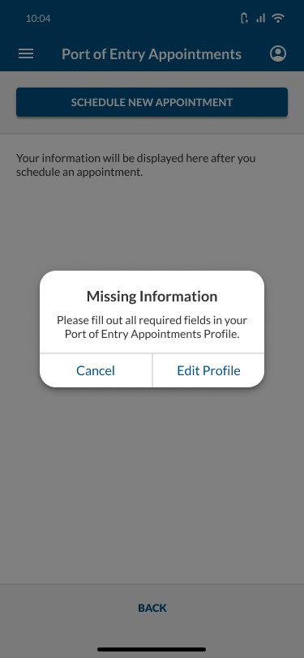
Traveler > Land > Schedule an Appointment at a Port of Entry: Schedule Appointment
NOTE: This pop-up only appears if user has not already filled out their profile.
ACTION: User selects Edit Profile.

Slide 10
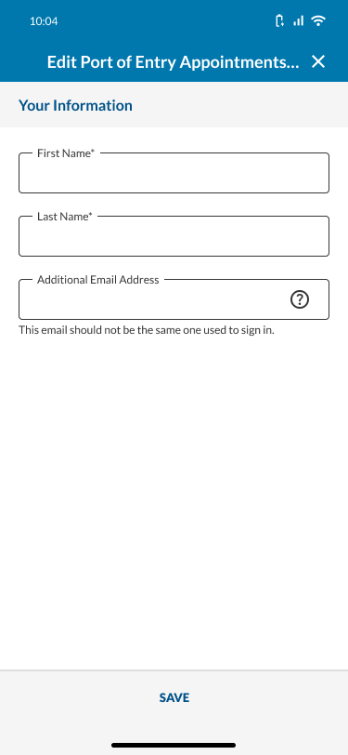
Traveler > Land > Schedule an Appointment at a Port of Entry: Schedule Appointment
Title should read “Edit Port of Entry Appointments Profile”, truncated to 1 line.
ACTION: User selects the tooltip icon.

Slide 11
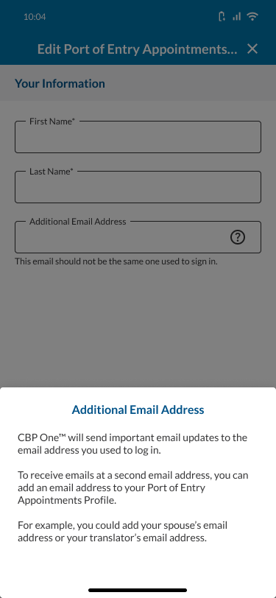
Traveler > Land > Schedule an Appointment at a Port of Entry: Schedule Appointment
ACTION: User taps off the tooltip.

Slide 12
Traveler > Land > Schedule an Appointment at a Port of Entry: Schedule Appointment
ACTION: User fills out the required fields.

Slide 13
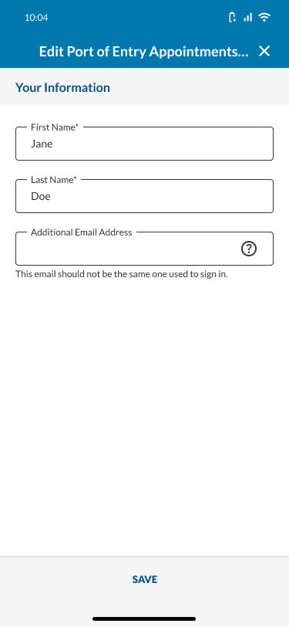
Traveler > Land > Schedule an Appointment at a Port of Entry: Schedule Appointment
ACTION: User selects SAVE.

Slide 14
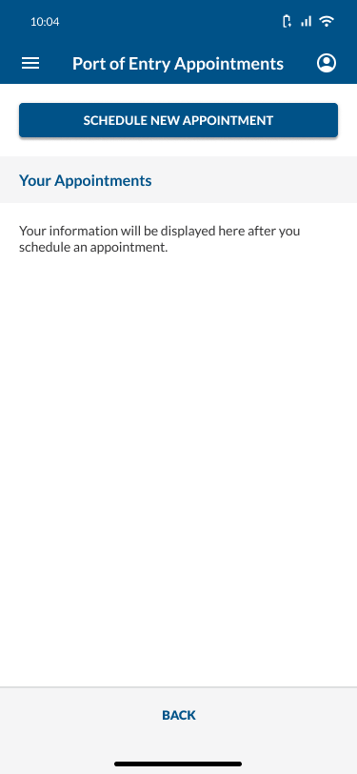
Traveler > Land > Schedule an Appointment at a Port of Entry: Schedule Appointment
NOTE: Title should say “Port of Entry Appointments” and truncate to 1 line.
ACTION: User selects SCHEDULE AN APPOINTMENT.

Slide 15
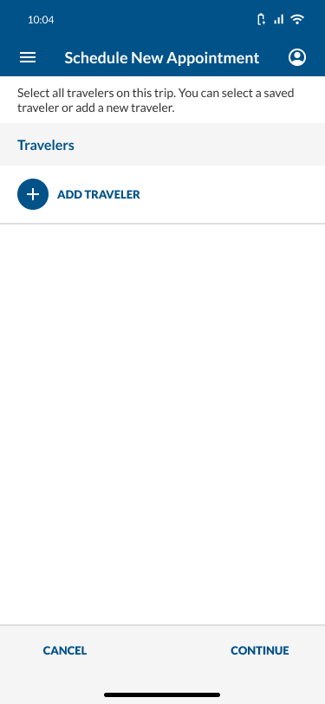
Traveler > Land > Schedule an Appointment at a Port of Entry: Schedule Appointment
To see what happens if user selects CONTINUE when a traveler has not been selected yet, click here.
ACTION: User selects ADD TRAVELER.

Slide 16
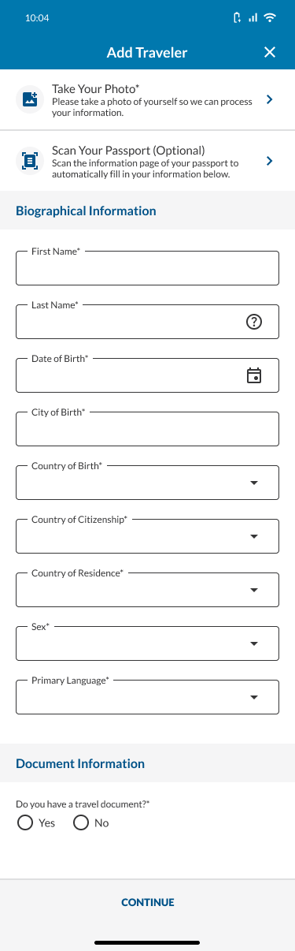
Traveler > Land > Schedule an Appointment at a Port of Entry: Schedule Appointment
NOTE: This is like Traveler > Land > Submit Advance Information, but some of the language was updated for better UX/accessibility.
ACTION: User selects Take Your Photo.

Slide 17
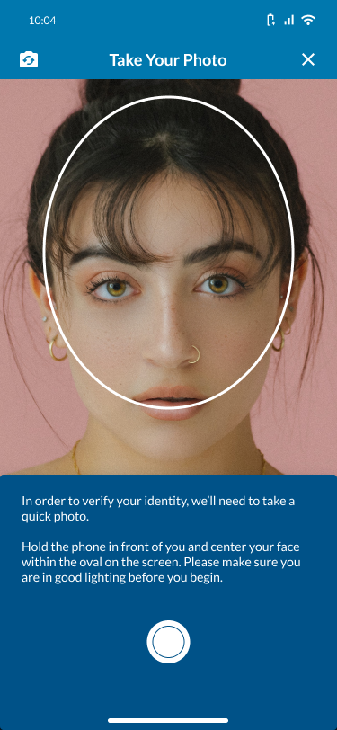
Traveler > Land > Schedule an Appointment at a Port of Entry: Schedule Appointment
ACTION: User takes a photo.

Slide 18
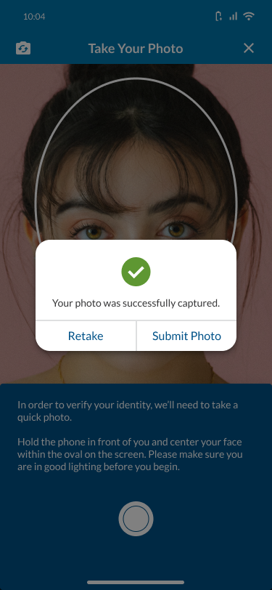
Traveler > Land > Schedule an Appointment at a Port of Entry: Schedule Appointment
To see what happens if the user’s photo is too low-quality, click here.
ACTION: User selects Submit Photo.

Slide 19
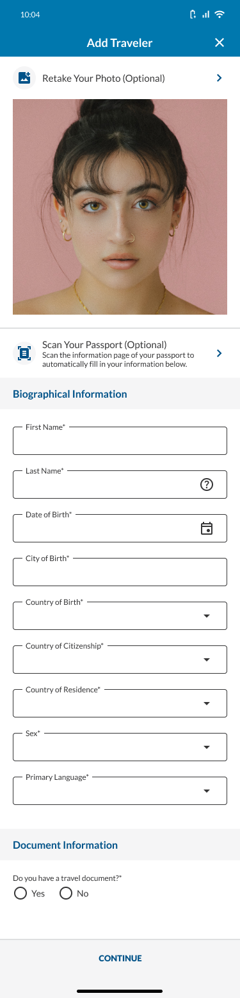
Traveler > Land > Schedule an Appointment at a Port of Entry: Schedule Appointment
ACTION: User selects Scan Your Passport (Optional).

Slide 20
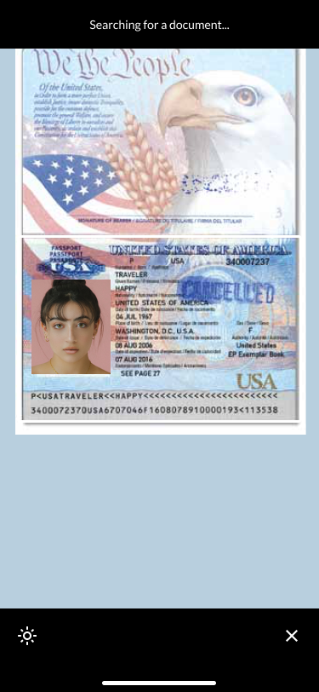
Traveler > Land > Schedule an Appointment at a Port of Entry: Schedule Appointment
ACTION: User scans their passport.

Slide 21
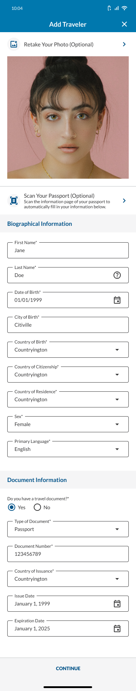
Traveler > Land > Schedule an Appointment at a Port of Entry: Schedule Appointment
To see what happens if user’s passport fails to scan, click here.
To see what happens if user tries to scan something that is not a passport, click here.
ACTION: User selects CONTINUE.

Slide 22
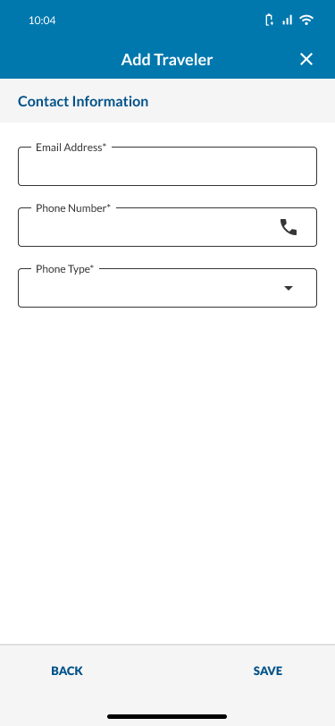
Traveler > Land > Schedule an Appointment at a Port of Entry: Schedule Appointment
ACTION: User fills out the required fields.

Slide 23
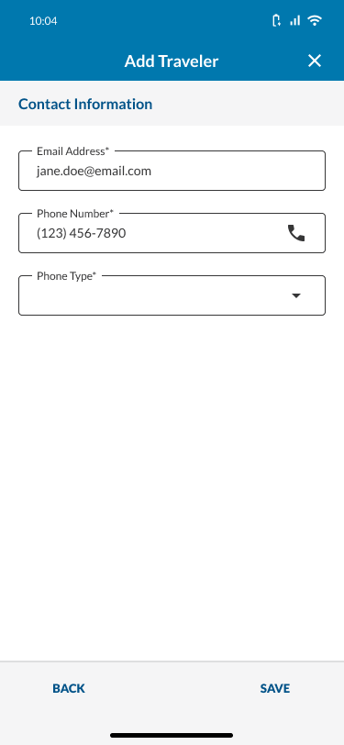
Traveler > Land > Schedule an Appointment at a Port of Entry: Schedule Appointment
ACTION: User selects the Phone Type dropdown.

Slide 24
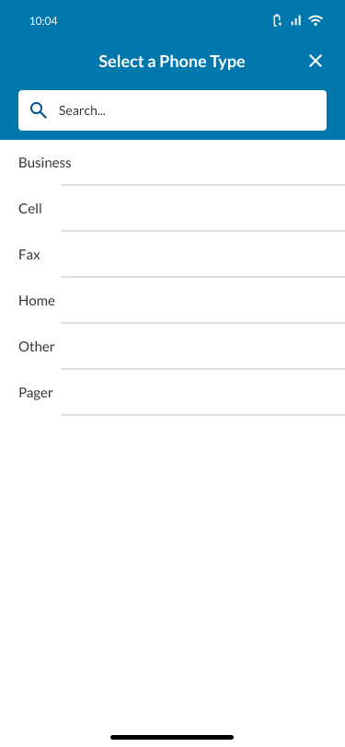
Traveler > Land > Schedule an Appointment at a Port of Entry: Schedule Appointment
ACTION: User selects Cell.

Slide 25
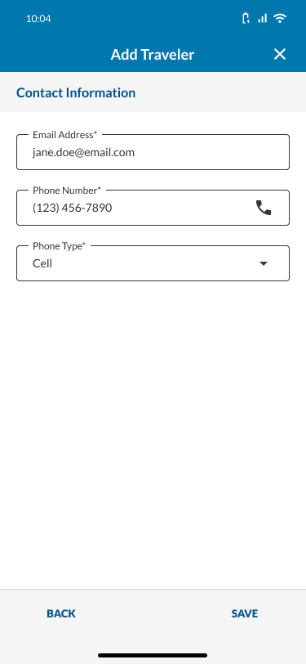
Traveler > Land > Schedule an Appointment at a Port of Entry: Schedule Appointment
ACTION: User selects SAVE.

Slide 26
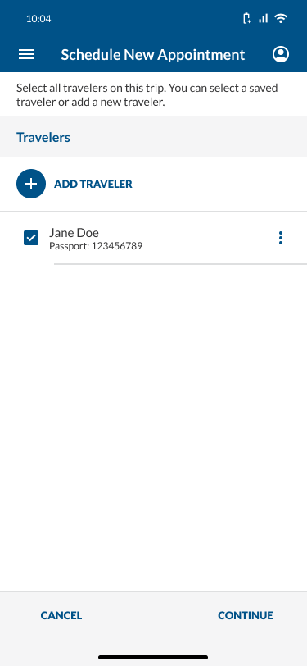
Traveler > Land > Schedule an Appointment at a Port of Entry: Schedule Appointment
To see what happens if user selects the 3 vertical dots icon, click here.
NOTE: Since the traveler was just added, the checkbox is automatically selected.
NOTE: All travelers added in this user flow are saved to the user’s profile.
ACTION: User selects CONTINUE.

Slide 27
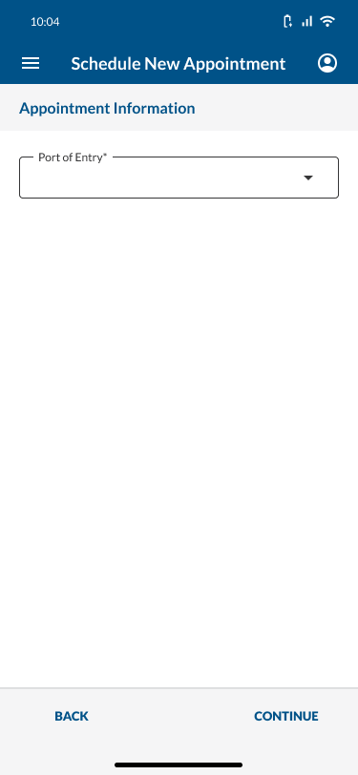
Traveler > Land > Schedule an Appointment at a Port of Entry: Schedule Appointment
ACTION: User selects the Port of Entry dropdown.

Slide 28
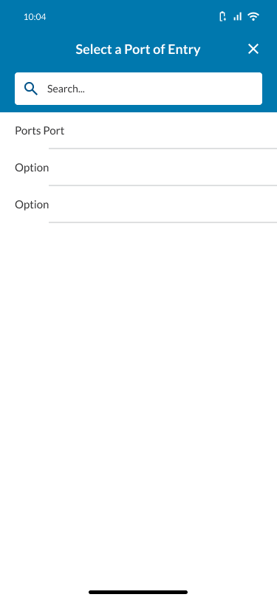
Traveler > Land > Schedule an Appointment at a Port of Entry: Schedule Appointment
ACTION: User selects a Port of Entry.

Slide 29
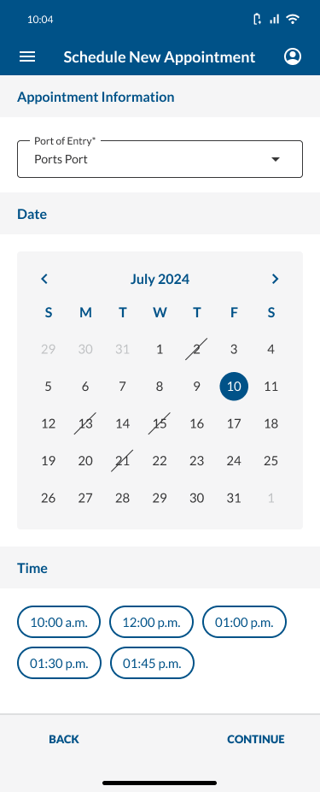
Traveler > Land > Schedule an Appointment at a Port of Entry: Schedule Appointment
ACTION: User selects a date.

Slide 30
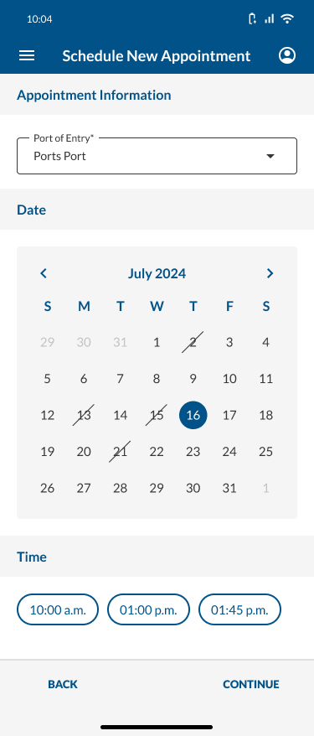
Traveler > Land > Schedule an Appointment at a Port of Entry: Schedule Appointment
ACTION: User selects a time.

Slide 31
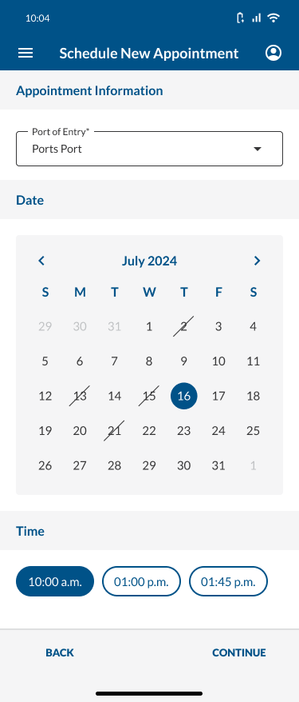
Traveler > Land > Schedule an Appointment at a Port of Entry: Schedule Appointment
ACTION: User selects CONTINUE.

Slide 32
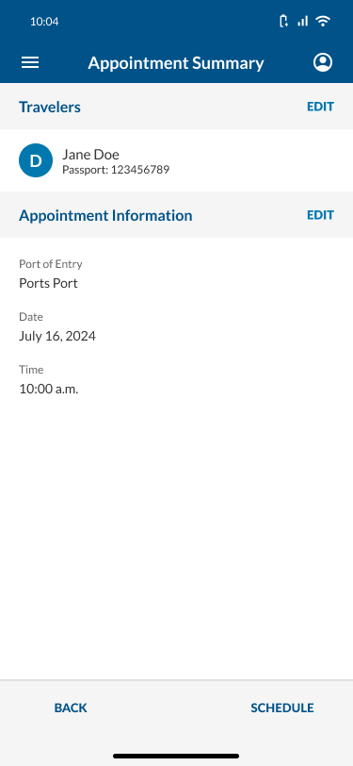
Traveler > Land > Schedule an Appointment at a Port of Entry: Schedule Appointment
To see what happens if user tries to leave an appointment before scheduling fully, click here.
ACTION: User selects SCHEDULE.

Slide 33
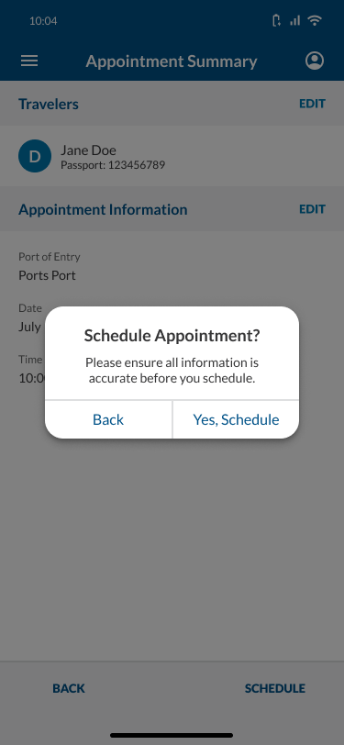
Traveler > Land > Schedule an Appointment at a Port of Entry: Schedule Appointment
ACTION: User selects Yes, Schedule.

Slide 34
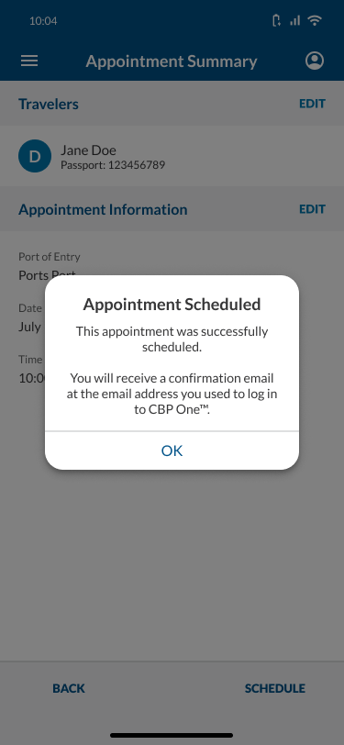
Traveler > Land > Schedule an Appointment at a Port of Entry: Schedule Appointment
ACTION: User selects OK.

Slide 35
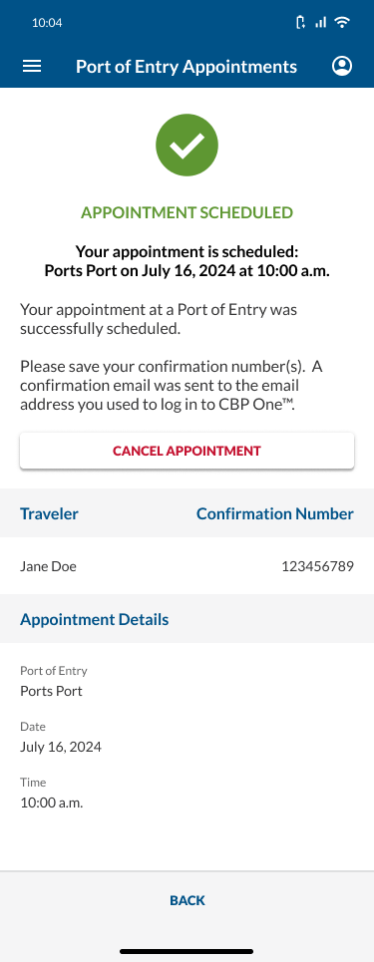
Traveler > Land > Schedule an Appointment at a Port of Entry: Schedule Appointment
An email was sent to the email address used to log into CBP One and to any Additional Email Addresses in the profile.
For email verbiage, please see “T > L > SaAaaPoE” tab in the Translations Tracker.
To see what this page looks like if the user has more than 1 traveler on an appointment, click here.
ACTION: User selects OK.

Slide 36
User Flow 2
User cancels an appointment.

Slide 37
Traveler > Land > Schedule an Appointment at a Port of Entry: Cancel Appointment
ACTION: User selects Traveler | Viajero.

Slide 38
Traveler > Land > Schedule an Appointment at a Port of Entry: Cancel Appointment
ACTION: User selects Land | Tierra.

Slide 39
Traveler > Land > Schedule an Appointment at a Port of Entry: Cancel Appointment
ACTION: User selects CONTINUE.

Slide 40
Traveler > Land > Schedule an Appointment at a Port of Entry: Cancel Appointment
ACTION: User selects Schedule an Appointment at a Port of Entry.

Slide 41
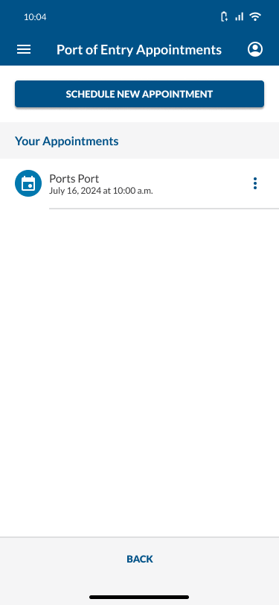
Traveler > Land > Schedule an Appointment at a Port of Entry: Cancel Appointment
To see what this page should look like if the user has more than 1 appointment, click here.
To see what happens if user selects the 3 dots icon, click here.
ACTION: User selects their appointment.

Slide 42

Traveler > Land > Schedule an Appointment at a Port of Entry: Cancel Appointment
ACTION: User selects CANCEL APPOINTMENT.

Slide 43
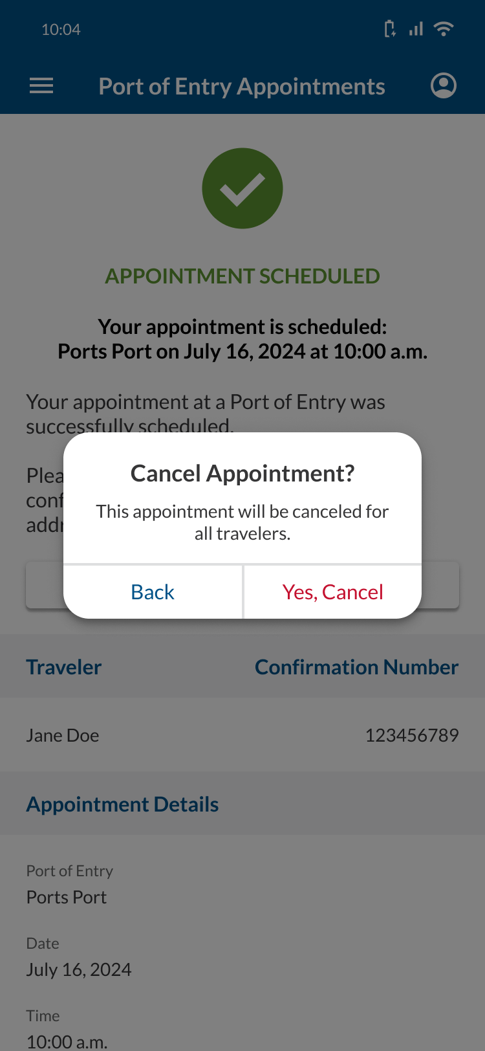
Traveler > Land > Schedule an Appointment at a Port of Entry: Cancel Appointment
ACTION: User selects Yes, Cancel.

Slide 44
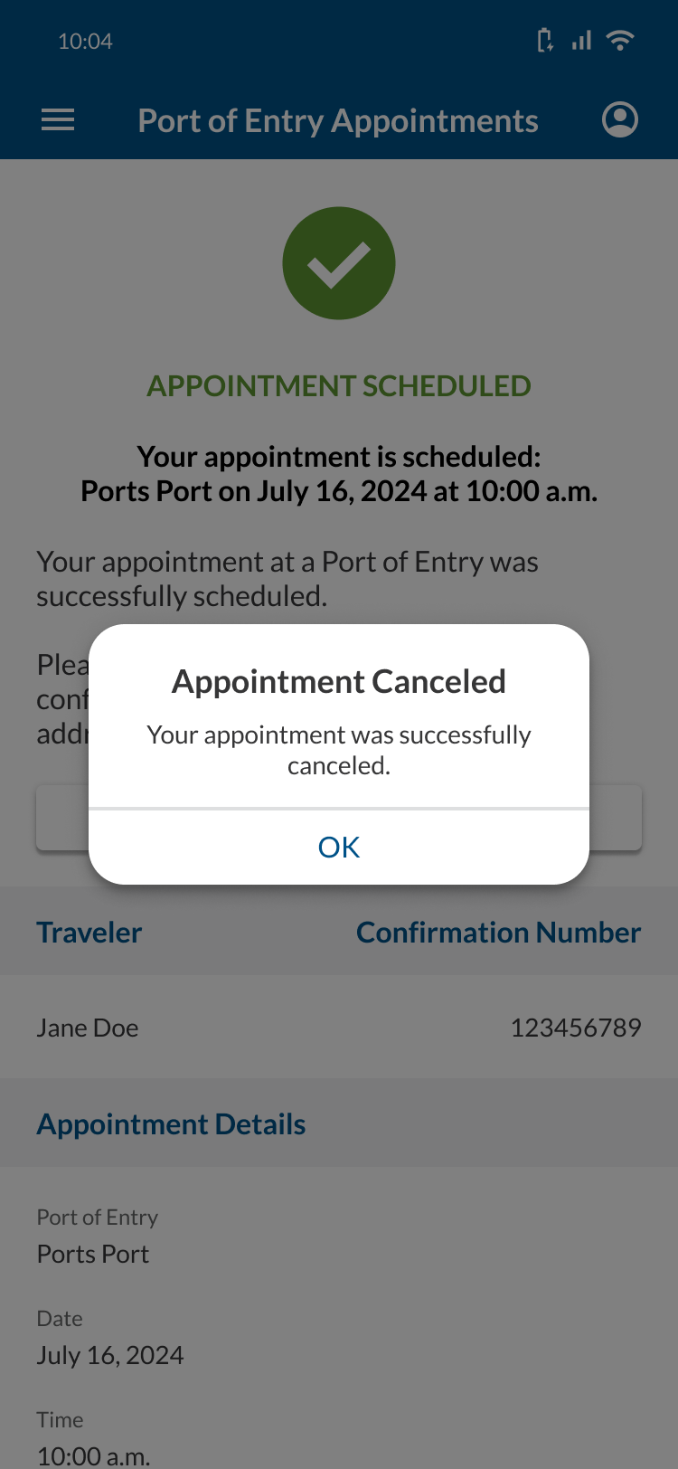
Traveler > Land > Schedule an Appointment at a Port of Entry: Cancel Appointment
ACTION: User selects OK.

Slide 45

Traveler > Land > Schedule an Appointment at a Port of Entry: Cancel Appointment
An email was sent to the email address used to log into CBP One and to any Additional Email Addresses in the profile.
For email verbiage, please see “T > L > SaAaaPoE” tab in the Translations Tracker.

Slide 46
User Flow 3
User views and edits their profile.

Slide 47

Traveler > Land > Schedule an Appointment at a Port of Entry: View/Edit Profile
ACTION: User selects the profile icon.

Slide 48
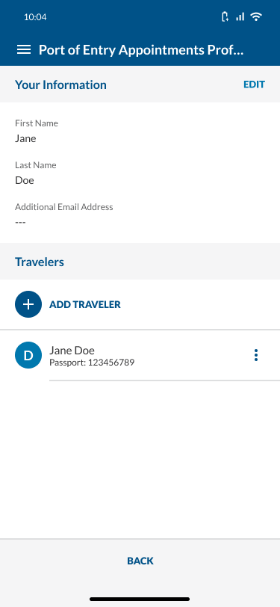
Traveler > Land > Schedule an Appointment at a Port of Entry: View/Edit Profile
Any travelers previously-added in the Schedule an Appointment at a Port of Entry user flow will appear in this profile.
To see what this page should look like if user hasn’t added a traveler yet, click here.
ACTION: User selects EDIT.

Slide 49

Traveler > Land > Schedule an Appointment at a Port of Entry: View/Edit Profile
ACTION: User selects SAVE.

Slide 50

Traveler > Land > Schedule an Appointment at a Port of Entry: View/Edit Profile

Slide 51
User Flow 4
User adds a traveler to their profile.

Slide 52

Traveler > Land > Schedule an Appointment at a Port of Entry: Add Traveler to Profile
ACTION: User selects the profile icon.

Slide 53

Traveler > Land > Schedule an Appointment at a Port of Entry: Add Traveler to Profile
ACTION: User selects ADD TRAVELER.

Slide 54
Traveler > Land > Schedule an Appointment at a Port of Entry: Add Traveler to Profile
ACTION: User selects Take Your Photo.

Slide 55
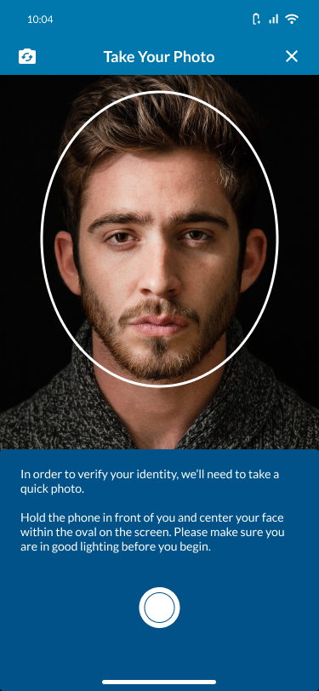
Traveler > Land > Schedule an Appointment at a Port of Entry: Add Traveler to Profile
ACTION: User takes a photo.

Slide 56
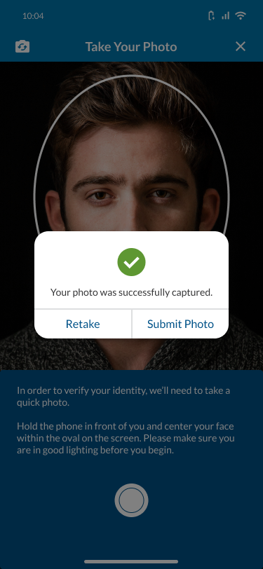
Traveler > Land > Schedule an Appointment at a Port of Entry: Add Traveler to Profile
ACTION: User selects Submit Photo.

Slide 57
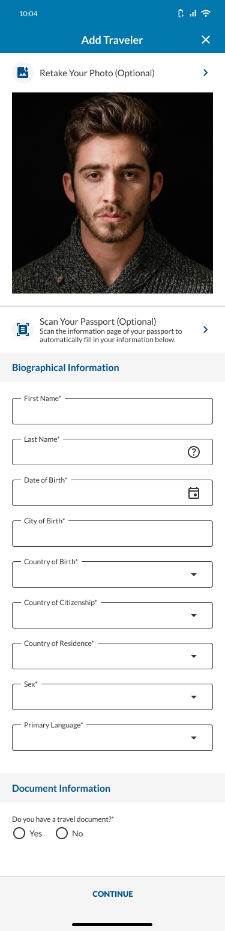
Traveler > Land > Schedule an Appointment at a Port of Entry: Add Traveler to Profile
ACTION: User selects Scan Your Passport (Optional).

Slide 58
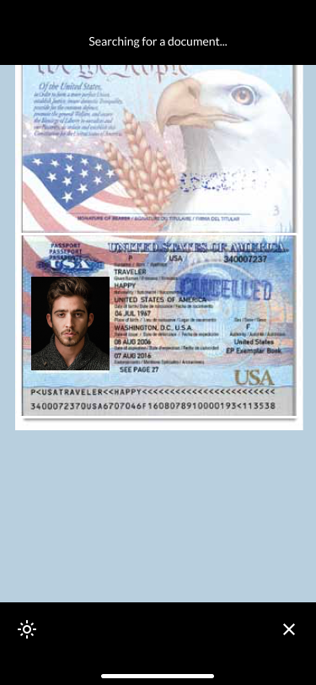
Traveler > Land > Schedule an Appointment at a Port of Entry: Add Traveler to Profile
ACTION: User scans their passport.

Slide 59
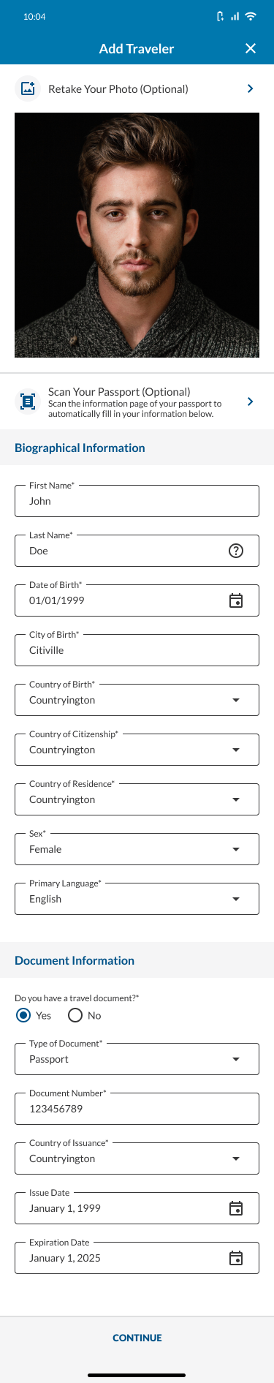
Traveler > Land > Schedule an Appointment at a Port of Entry: Add Traveler to Profile
ACTION: User selects CONTINUE.

Slide 60
Traveler > Land > Schedule an Appointment at a Port of Entry: Add Traveler to Profile
ACTION: User fills out the required fields.

Slide 61

Traveler > Land > Schedule an Appointment at a Port of Entry: Add Traveler to Profile
ACTION: User selects the Phone Type dropdown.

Slide 62
Traveler > Land > Schedule an Appointment at a Port of Entry: Add Traveler to Profile
ACTION: User selects Cell.

Slide 63

Traveler > Land > Schedule an Appointment at a Port of Entry: Add Traveler to Profile
ACTION: User selects SAVE.

Slide 64
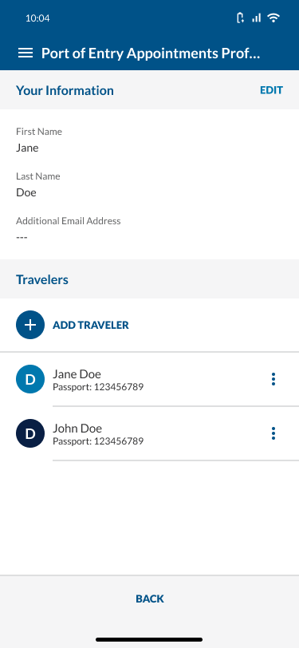
Traveler > Land > Schedule an Appointment at a Port of Entry: Add Traveler to Profile

Slide 65
User Flow 4.5
User views a traveler from their profile.

Slide 66

Traveler > Land > Schedule an Appointment at a Port of Entry: View Traveler from Profile
ACTION: User selects the profile icon.

Slide 67

Traveler > Land > Schedule an Appointment at a Port of Entry: View Traveler from Profile
ACTION: User selects the 3 dots icon next to a traveler.

Slide 68
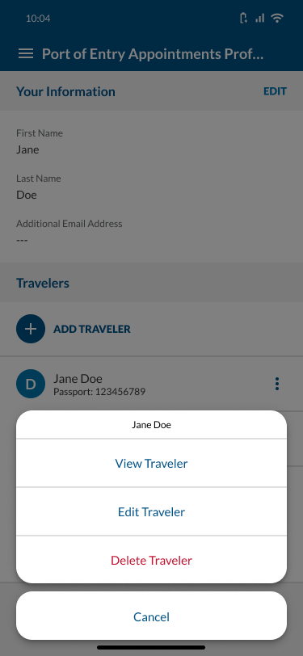
Traveler > Land > Schedule an Appointment at a Port of Entry: View Traveler from Profile
ACTION: User selects VIew Traveler.

Slide 69
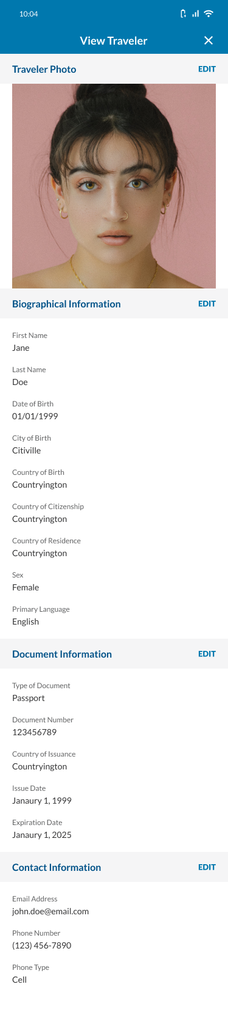
Traveler > Land > Schedule an Appointment at a Port of Entry: View Traveler from Profile
To see what happens if user selects EDIT on any of these sections, click here.

Slide 70
User Flow 5
Users edits a traveler from their profile.

Slide 71
Traveler > Land > Schedule an Appointment at a Port of Entry: Edit Traveler from Profile
ACTION: User selects the profile icon.

Slide 72
Traveler > Land > Schedule an Appointment at a Port of Entry: Edit Traveler from Profile
ACTION: User selects the 3 dots icon next to a traveler.

Slide 73
Traveler > Land > Schedule an Appointment at a Port of Entry: Edit Traveler from Profile
ACTION: User selects Edit Traveler.

Slide 74

Traveler > Land > Schedule an Appointment at a Port of Entry: Edit Traveler from Profile
Note that the title says “Edit”, not “Add”.
ACTION: User selects CONTINUE.

Slide 75
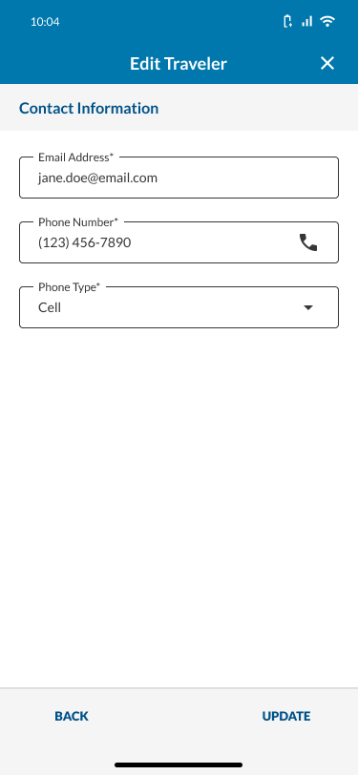
Traveler > Land > Schedule an Appointment at a Port of Entry: Edit Traveler from Profile
ACTION: User selects UPDATE.

Slide 76
Traveler > Land > Schedule an Appointment at a Port of Entry: Edit Traveler from Profile

Slide 77
User Flow 6
Users deletes a traveler from their profile.

Slide 78
Traveler > Land > Schedule an Appointment at a Port of Entry: Delete Traveler from Profile
ACTION: User selects the profile icon.

Slide 79
Traveler > Land > Schedule an Appointment at a Port of Entry: Delete Traveler from Profile
ACTION: User selects the 3 dots icon next to a traveler.

Slide 80
Traveler > Land > Schedule an Appointment at a Port of Entry: Delete Traveler from Profile
ACTION: User selects Delete Traveler.

Slide 81
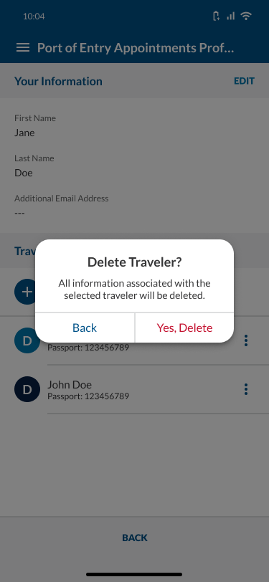
Traveler > Land > Schedule an Appointment at a Port of Entry: Delete Traveler from Profile
ACTION: User selects Yes, Delete.

Slide 82

Traveler > Land > Schedule an Appointment at a Port of Entry: Delete Traveler from Profile

Slide 83
Edgecases
Misc. screens not covered by other sections in this presentation.

Slide 84
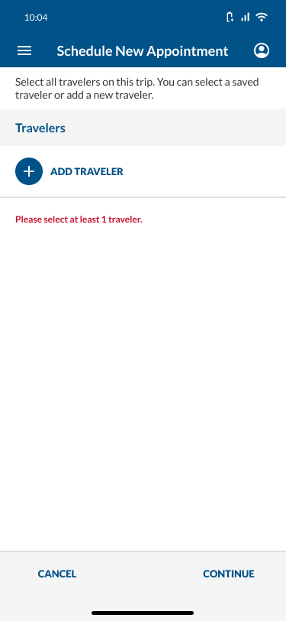
Edgecase: User Tries to Continue Without Adding a Traveler

Slide 85
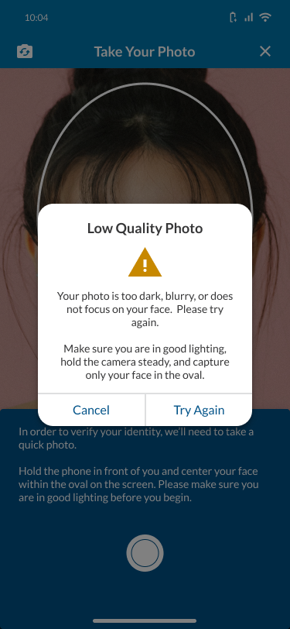
Edgecase: User Takes a Low-Quality Photo While Adding a Traveler

Slide 86
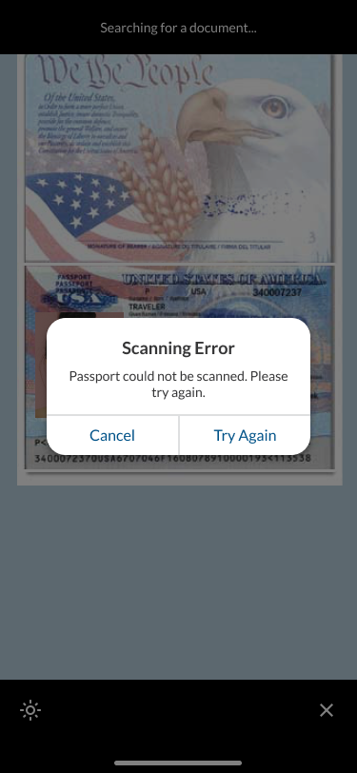
Edgecase: User’s Passport Can’t Be Scanned While Adding a Traveler

Slide 87
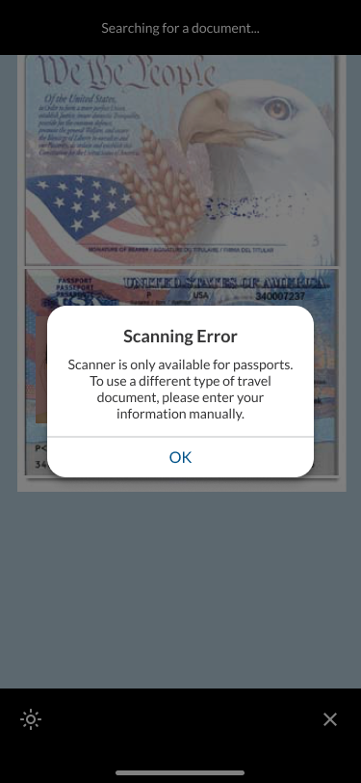
Edgecase: User Tries to Scan a Travel Document That Is Not a Passport While Adding a Traveler

Slide 88
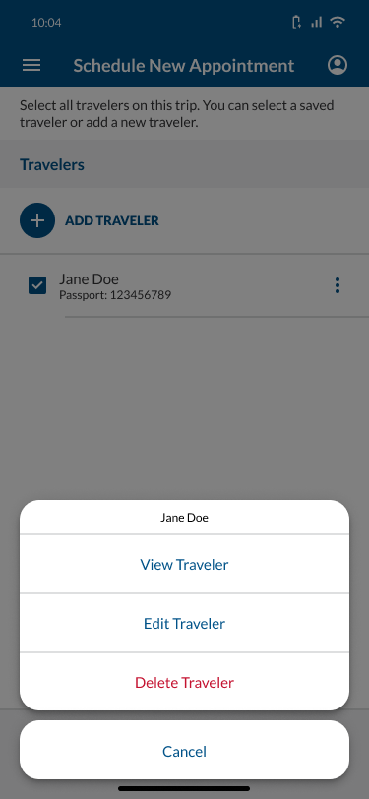
Edgecase: User Selects the 3 Vertical Dots Icon On a Traveler While Scheduling an Appointment.
To see what happens if user selects View Traveler, click here.
To see what happens if user selects Edit Traveler, click here.
To see what happens if user selects Delete Traveler, click here.

Slide 89
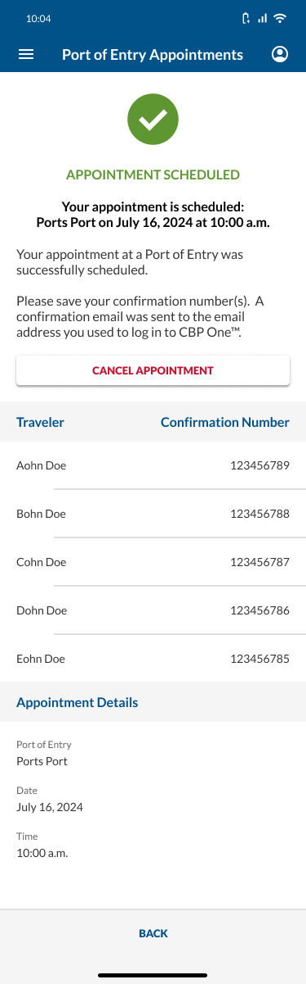
Edgecase: User has more than 1 person on an appointment.

Slide 90
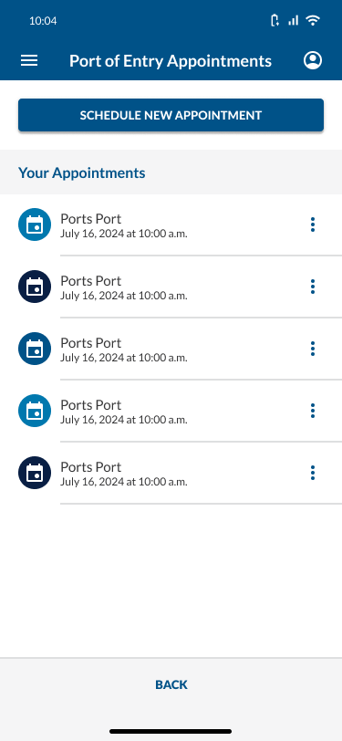
Edgecase: User has more than 1 appointment.

Slide 91

Edgecase: User has not added any travelers to their profile.

Slide 92

Edgecase: User tries to leave before they finished scheduling a new appointment.

Slide 93

Edgecase: User selected the 3 dots icon on an appointment.
To see what happens if user selects View Appointment, click here.
To see what happens if user selects Cancel Appointment, click here.

