Slide 1
Attachment 2: Documentation of the Institutional Certification form, including changes since 2019 PRA approval

Slide 2
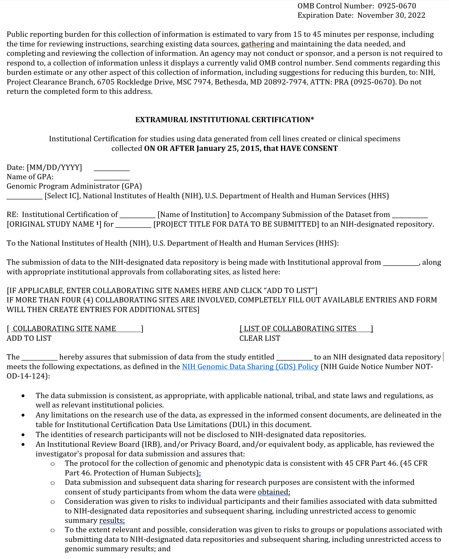
Submitting Investigator
Form is now addressed to NIH/HHS instead of a GPA

Slide 3
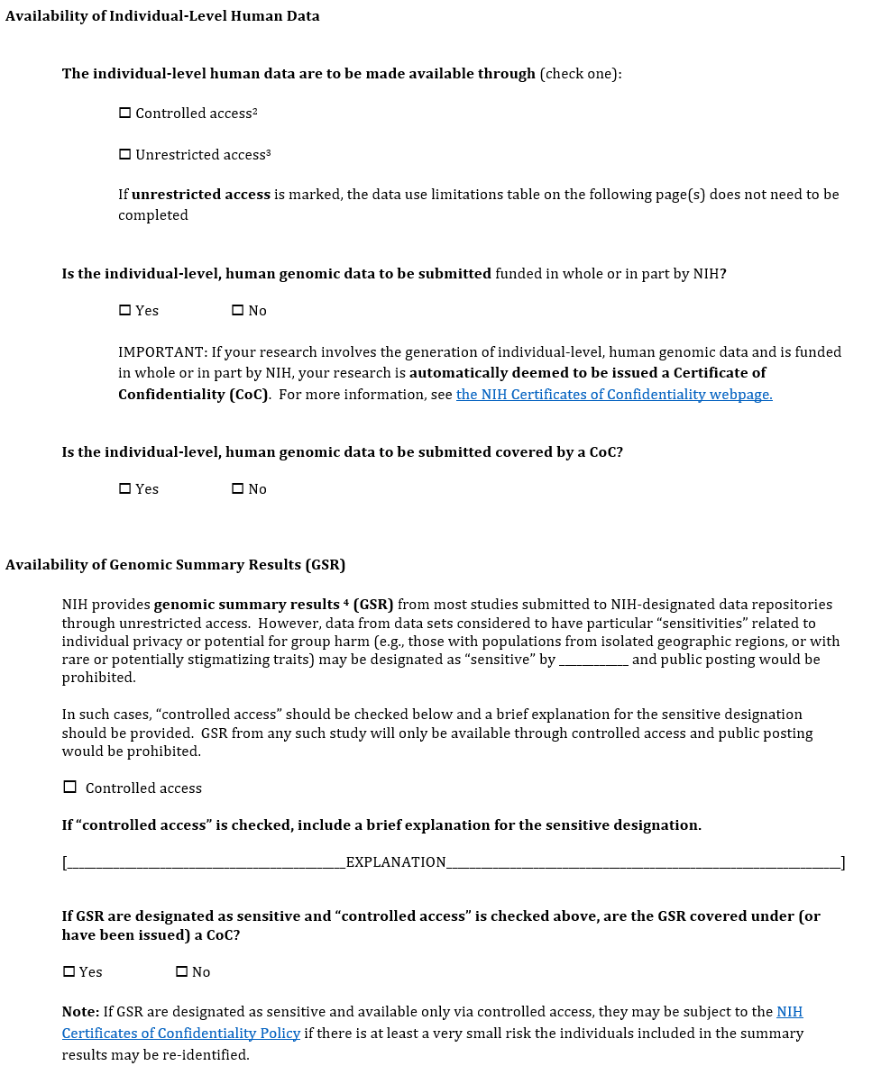
Submitting Investigator
2 new questions added related to Certificates of Confidentiality and individual-level data
New language added prohibiting public posting in certain instances
Added new question & note regarding Certificates of Confidentiality for sensitive genomic summary results

Slide 4
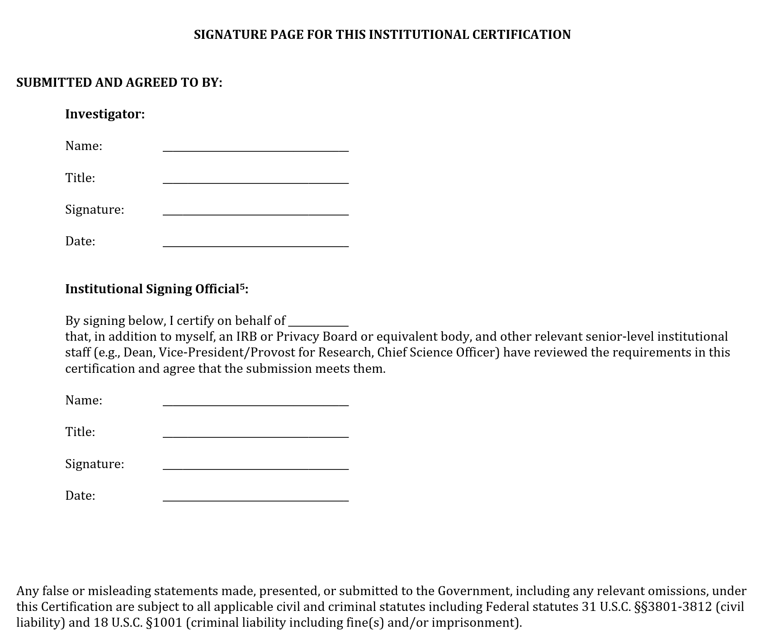
Submitting Investigator
Added a warning against making false or misleading statements

Slide 5
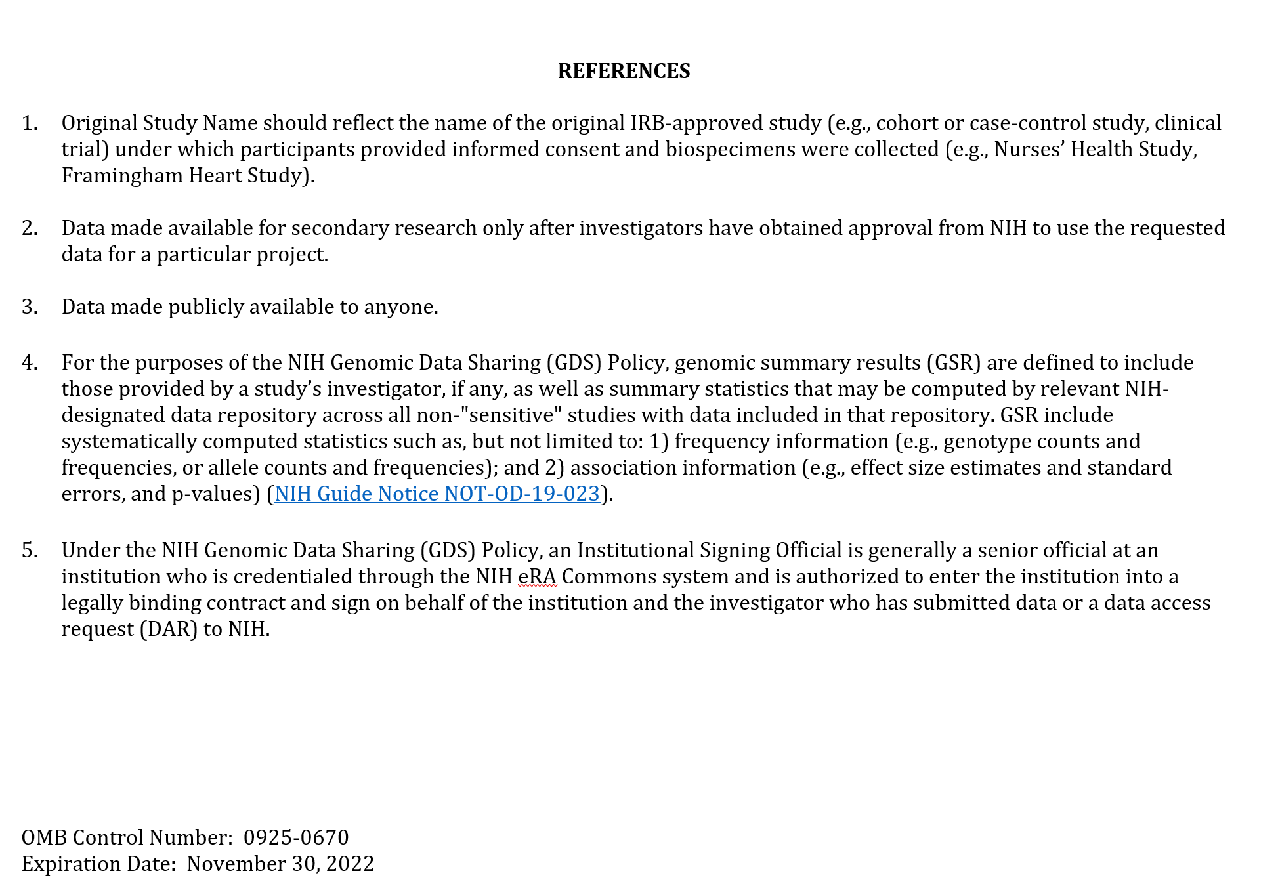
Submitting Investigator
Reference #4 has been rewritten for clarity, but no content changed

Slide 6
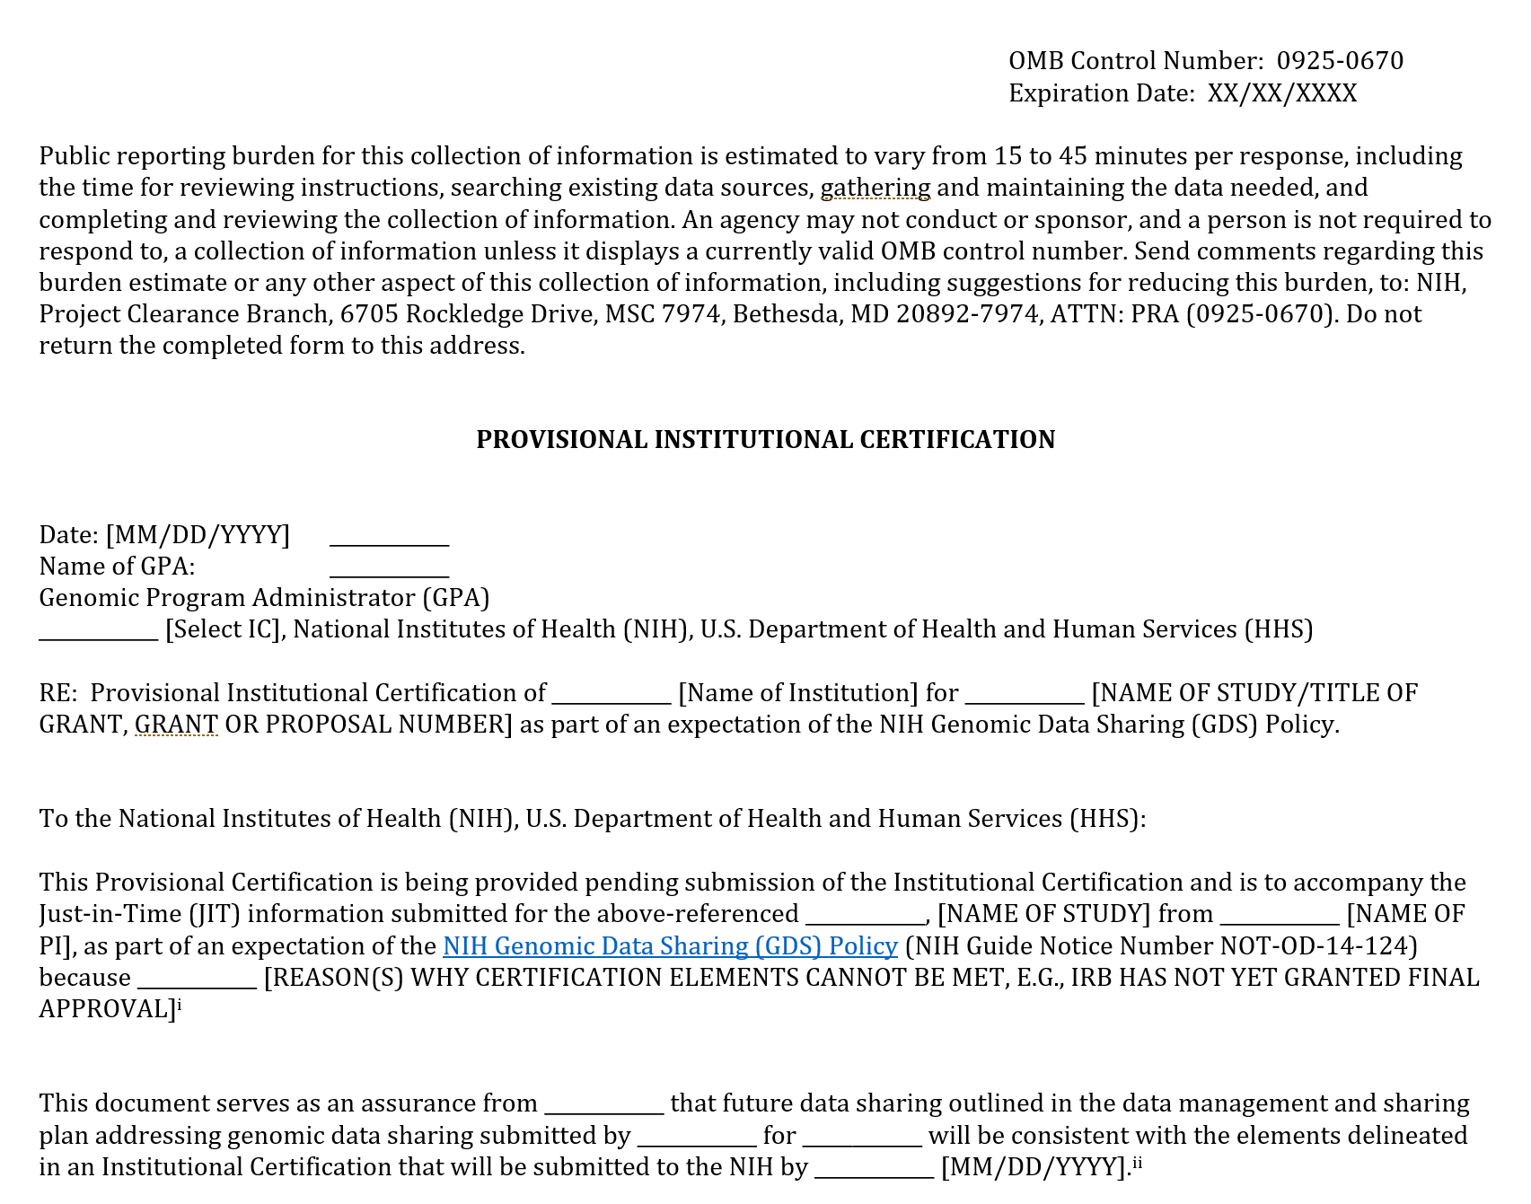
Submitting Investigator
New form created for submitting investigators who are waiting for IRB approval
Form continues on next slide

Slide 7
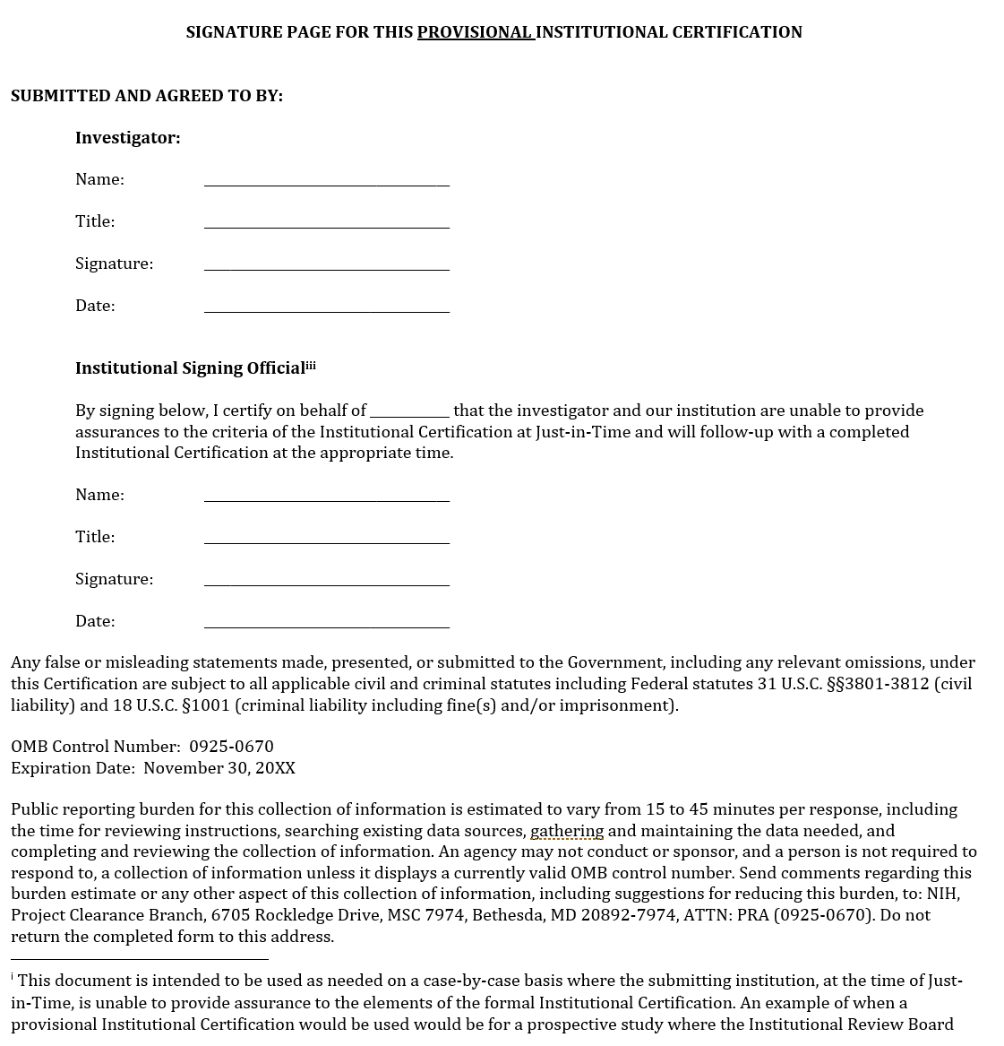
Submitting Investigator
New form created for submitting investigators who are waiting for IRB approval
Form continues on next slide

Slide 8
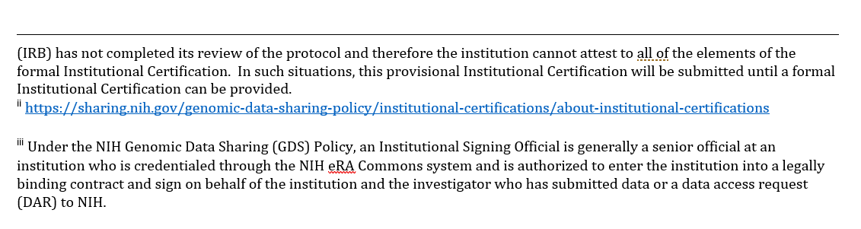
Submitting Investigator
New form created for submitting investigators who are waiting for IRB approval

