Slide 1
Attachment 1: Documentation of the dbGaP registration and access system web forms, including changes since 2019 PRA approval

Slide 2
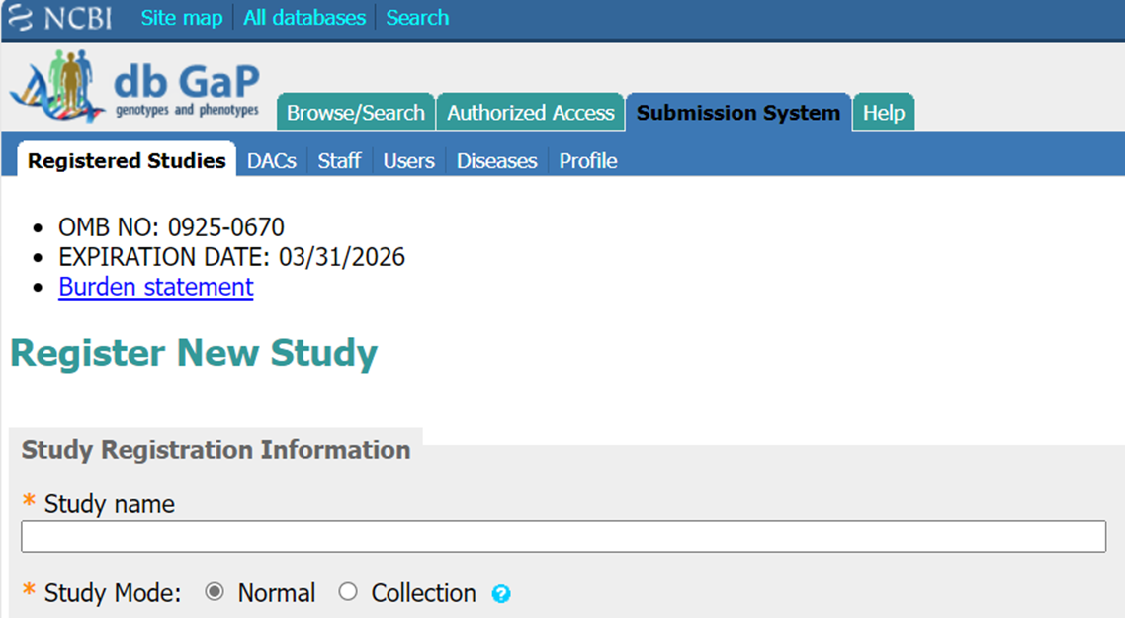
Submitting Investigator: Registration Web Form

Slide 3
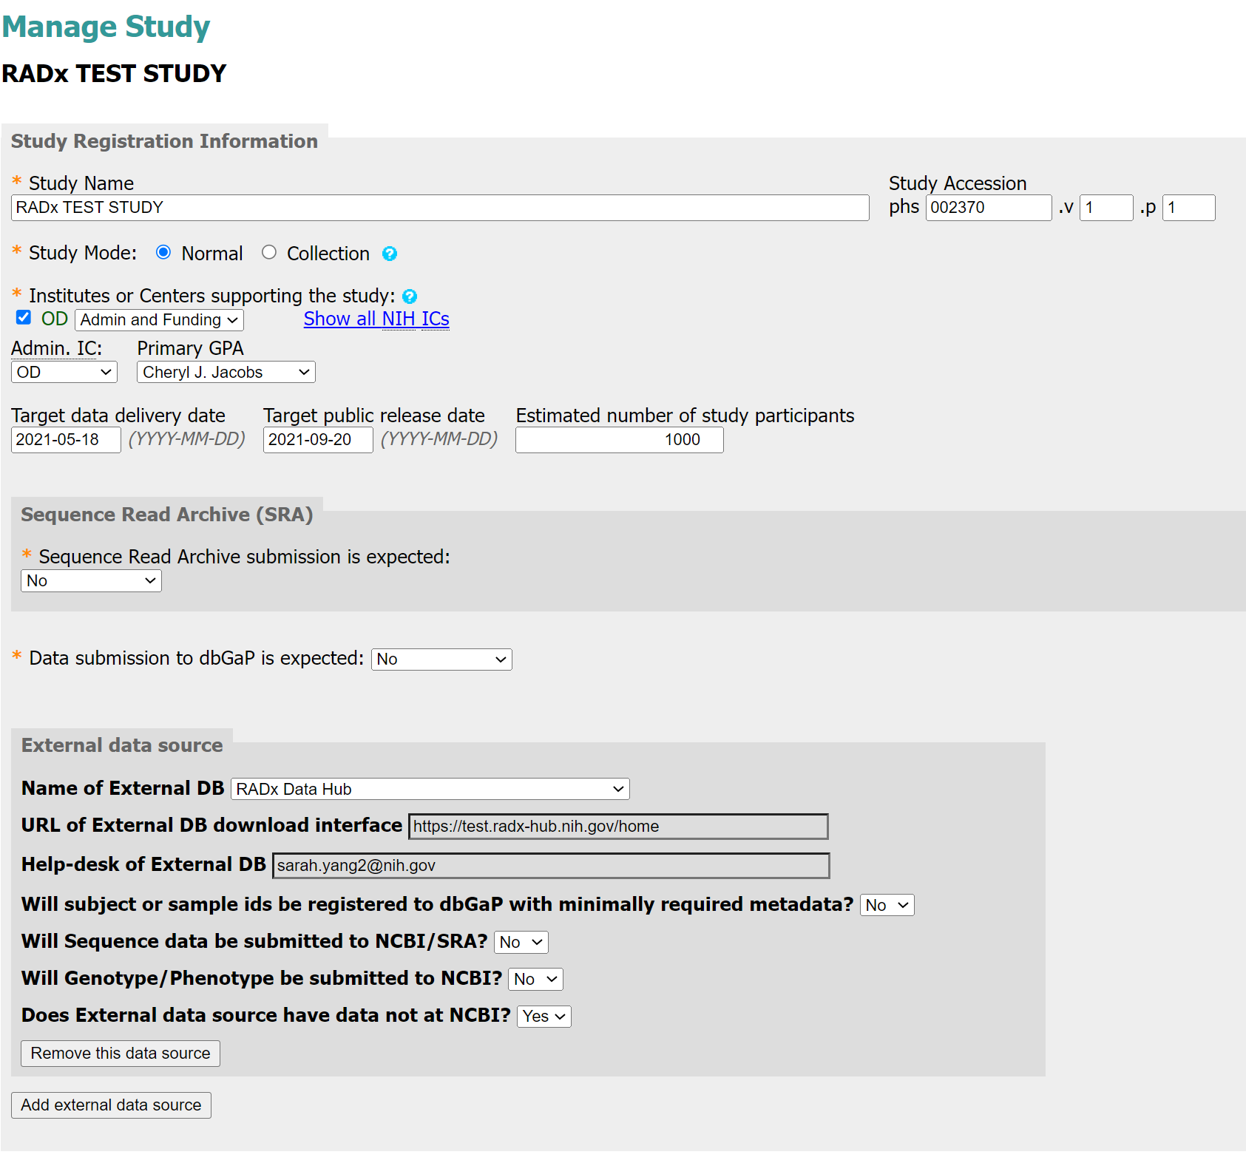
Submitting Investigator: Registration Web Form
Added the option to add an external data source
Page continues on next slide

Slide 4
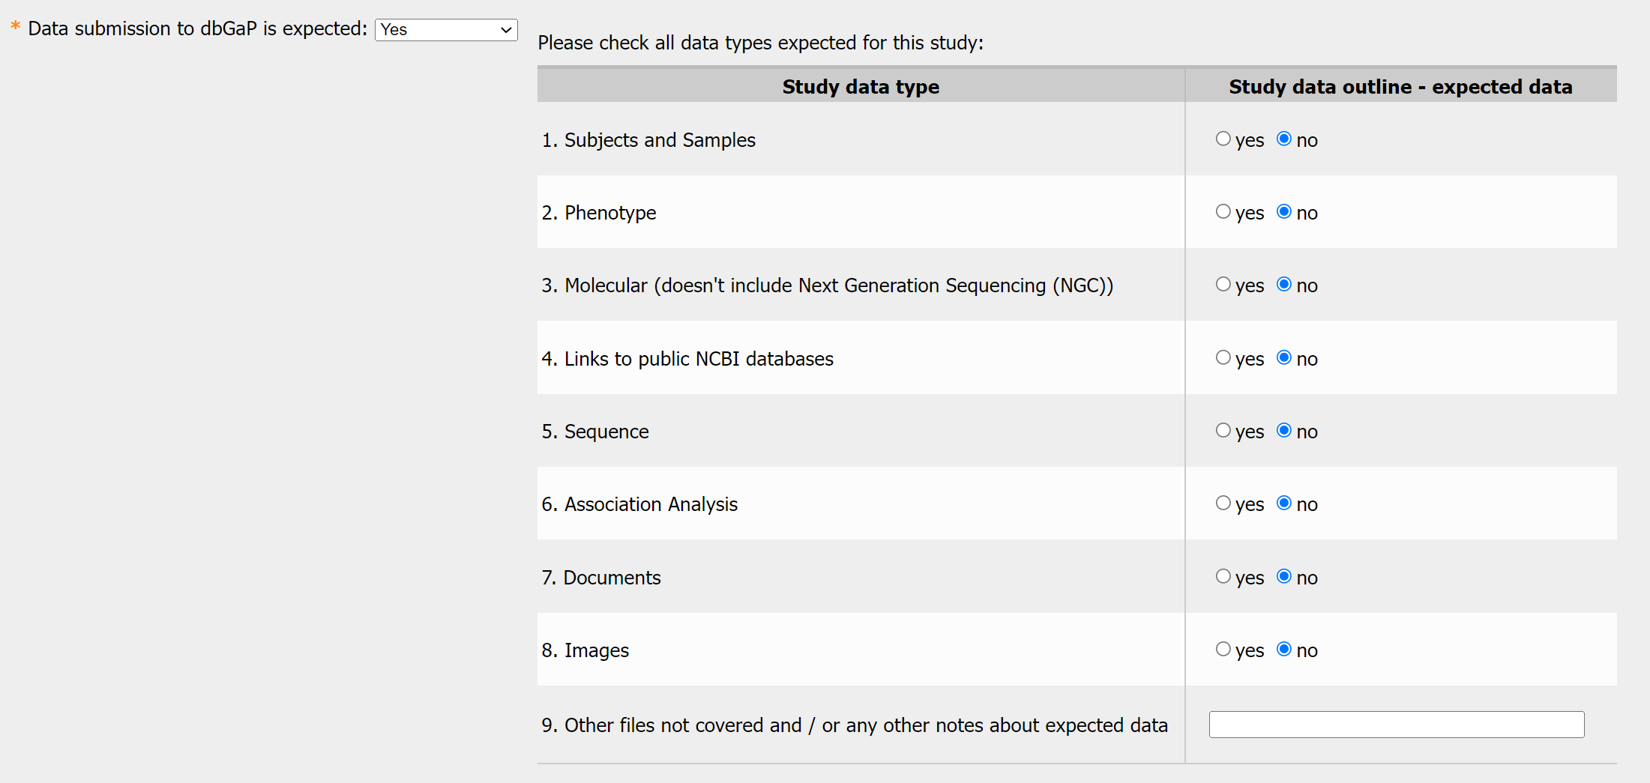
Submitting Investigator: Registration Web Form
Added new radio button selector for data types for those submitting data to dbGaP

Slide 5
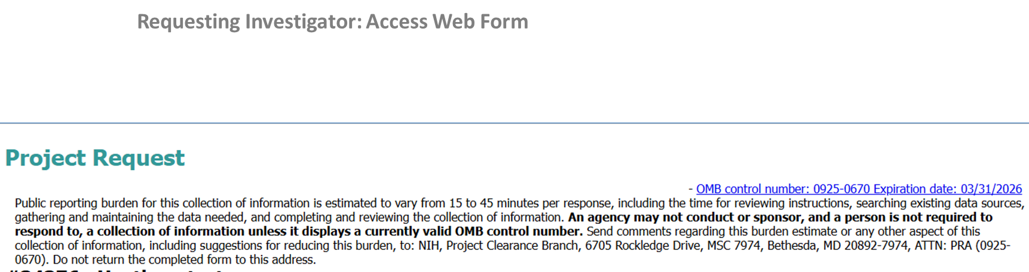

Slide 6
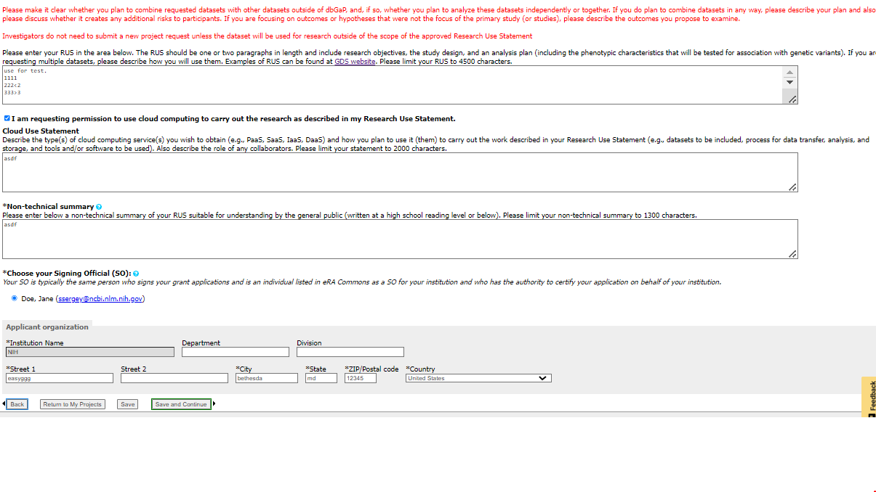
Requesting Investigator: Access Web Form
Encryption options removed from page because encryption is now automatic
New select box

Slide 7
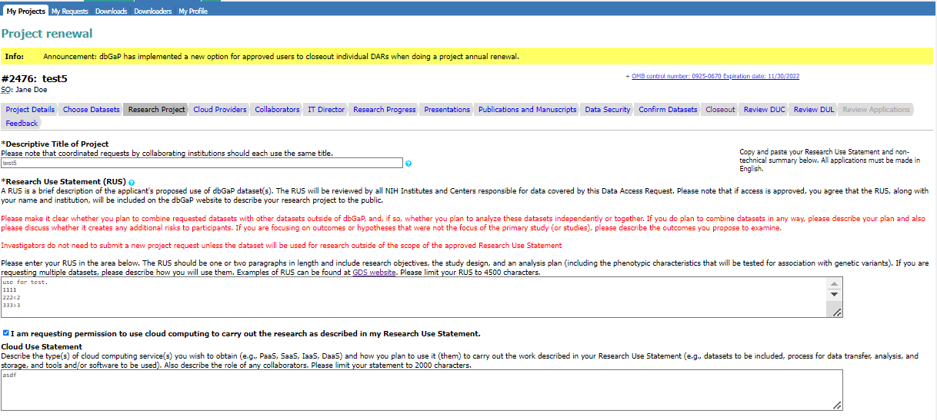
Requesting Investigator: Access Web Form
“Types of research” checkboxes removed
Added of attestation of NIH Security Best Practices for Users of Controlled-Access Data
NIH expects that Approved Users of NIH controlled-access data under the GDS Policy systems comply with NIH Security Best Practices for Users of Controlled-Access Data and maintain such data on institutional IT systems, cloud service providers, and/or third-party IT systems with security standards that meet or exceed NIST SP 800-171 "Protecting Controlled Unclassified Information in Nonfederal Information Systems and Organizations“ or the equivalent ISO/IEC 27001/27002 standards
  By checking this box, I, as the PI requesting access to this data, attest that data will be secured, at a minimum, in accordance with NIST SP 800-171 or the equivalent ISO/IEC 27001/27002 standards as stipulated by the NIH Security Best Practices for Users of Controlled-Access Data.
By checking this box, I am requesting permission to use cloud computing to carry out the research as described in my Research Use Statement and attest that the cloud service provider and/or third-party IT system used for data analysis and/or storage will secure data, at a minimum, in accordance with NIST SP 800-171 or the equivalent ISO/IEC 27001/27002 standards as stipulated by the NIH Security Best Practices for Users of Controlled-Access Data.
Cloud Use Statement State the name of the cloud service provider and/or third-party IT system, their security standard, and how they will be used to carry out the work described in your Research Use Statement. Also, if applicable, describe the role of any collaborators. Please limit your statement to 2000 characters.

Slide 8
Requesting Investigator: Access Web Form
Updated Cloud Use Checkbox
NIH expects that Approved Users of NIH controlled-access data under the GDS Policy systems comply with NIH Security Best Practices for Users of Controlled-Access Data and maintain such data on institutional IT systems, cloud service providers, and/or third-party IT systems with security standards that meet or exceed NIST SP 800-171 "Protecting Controlled Unclassified Information in Nonfederal Information Systems and Organizations“ or the equivalent ISO/IEC 27001/27002 standards
  By checking this box, I, as the PI requesting access to this data, attest that data will be secured, at a minimum, in accordance with NIST SP 800-171 or the equivalent ISO/IEC 27001/27002 standards as stipulated by the NIH Security Best Practices for Users of Controlled-Access Data.
By checking this box, I am requesting permission to use cloud computing to carry out the research as described in my Research Use Statement and attest that the cloud service provider and/or third-party IT system used for data analysis and/or storage will secure data, at a minimum, in accordance with NIST SP 800-171 or the equivalent ISO/IEC 27001/27002 standards as stipulated by the NIH Security Best Practices for Users of Controlled-Access Data.
Cloud Use Statement State the name of the cloud service provider and/or third-party IT system, their security standard, and how they will be used to carry out the work described in your Research Use Statement. Also, if applicable, describe the role of any collaborators. Please limit your statement to 2000 characters.

Slide 9
Requesting Investigator: Access Web Form
NIH expects that Approved Users of NIH controlled-access data under the GDS Policy systems comply with NIH Security Best Practices for Users of Controlled-Access Data and maintain such data on institutional IT systems, cloud service providers, and/or third-party IT systems with security standards that meet or exceed NIST SP 800-171 "Protecting Controlled Unclassified Information in Nonfederal Information Systems and Organizations“ or the equivalent ISO/IEC 27001/27002 standards
  By checking this box, I, as the PI requesting access to this data, attest that data will be secured, at a minimum, in accordance with NIST SP 800-171 or the equivalent ISO/IEC 27001/27002 standards as stipulated by the NIH Security Best Practices for Users of Controlled-Access Data.
Updated language in Cloud Use Statement
By checking this box, I am requesting permission to use cloud computing to carry out the research as described in my Research Use Statement and attest that the cloud service provider and/or third-party IT system used for data analysis and/or storage will secure data, at a minimum, in accordance with NIST SP 800-171 or the equivalent ISO/IEC 27001/27002 standards as stipulated by the NIH Security Best Practices for Users of Controlled-Access Data.
Cloud Use Statement State the name of the cloud service provider and/or third-party IT system, their security standard, and how they will be used to carry out the work described in your Research Use Statement. Also, if applicable, describe the role of any collaborators. Please limit your statement to 2000 characters.

Slide 10
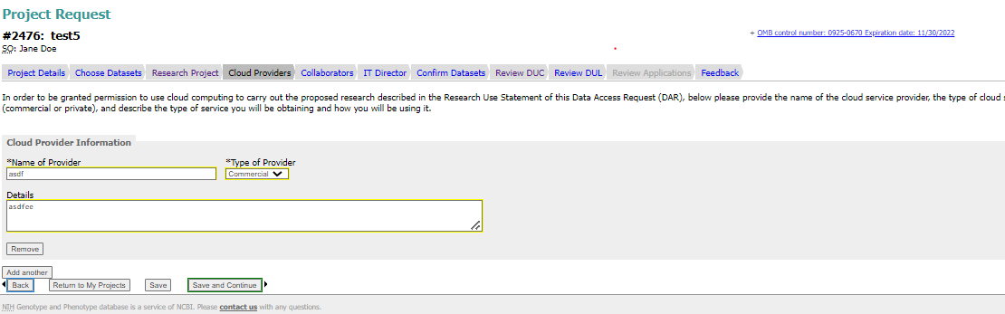
Requesting Investigator: Access Web Form
New tab added for investigators who choose to use cloud platforms for data analysis

Slide 11
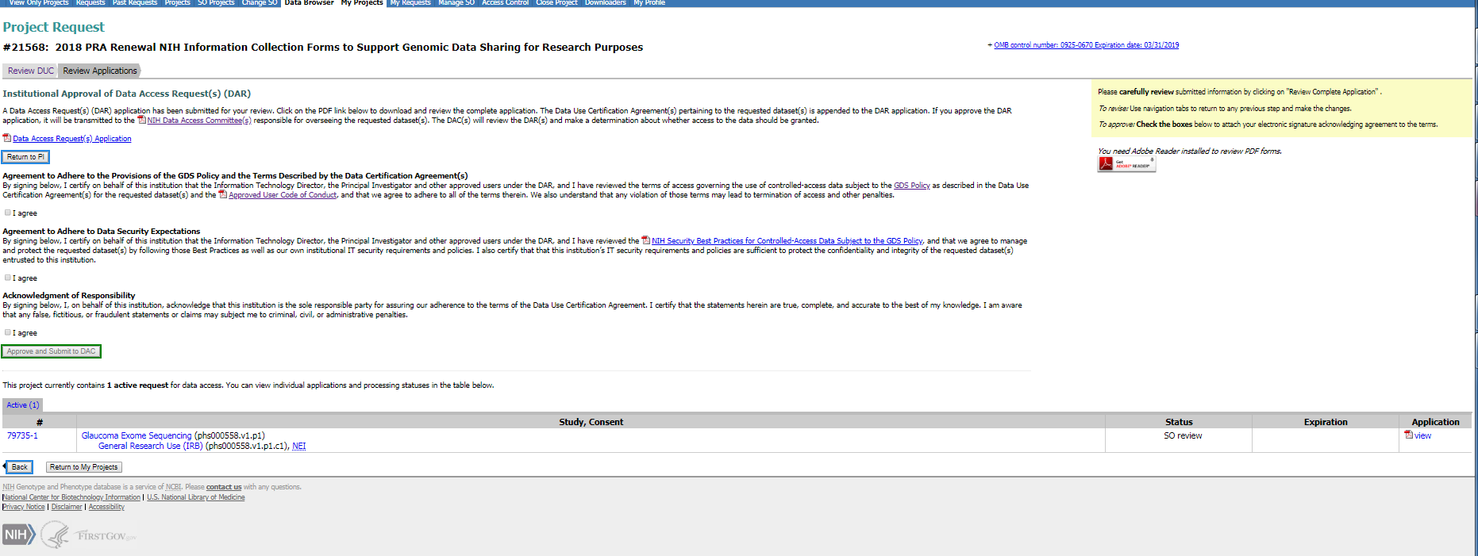
Institutional Signing Official: Access Web Form
Updated language in Agreement to Adhere to Data Security Expectations
Attestation on Adhering to Data Security Expectations
By checking this box, I attest on behalf of this institution that all institutional IT systems, cloud service providers, and/or third-party IT systems used for data analysis and/or storage will secure the requested data, at a minimum, in accordance with NIST SP 800-171 or the equivalent ISO/IEC 27001/27002 standards as stipulated by the NIH Security Best Practices for Users of Controlled-Access Data.

Slide 12
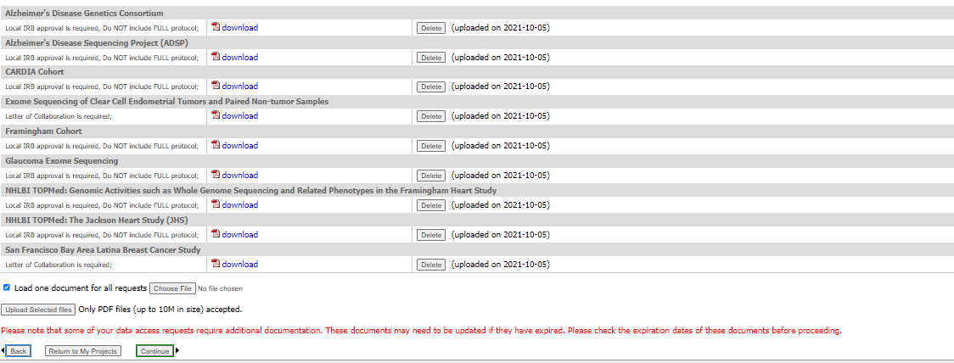
Requesting Investigator: Access Web Form
New check box allows requesting investigators to upload one document for multiple requests

Slide 13
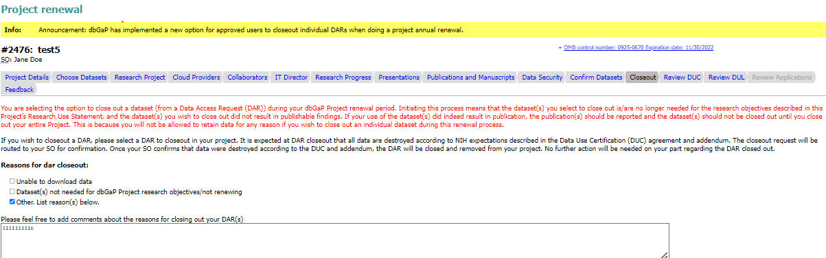
Requesting Investigator: Access Web Form
New tab added to allow user to close out some DARs within a project during a project renewal.

Slide 14
Institutional Signing Official: Renewal
Updated language in Agreement to Adhere to Data Security Expectations
Attestation on Adhering to Data Security Expectations
By checking this box, I attest on behalf of this institution that all institutional IT systems, cloud service providers, and/or third-party IT systems used for data analysis and/or storage will secure the requested data, at a minimum, in accordance with NIST SP 800-171 or the equivalent ISO/IEC 27001/27002 standards as stipulated by the NIH Security Best Practices for Users of Controlled-Access Data.

Slide 15
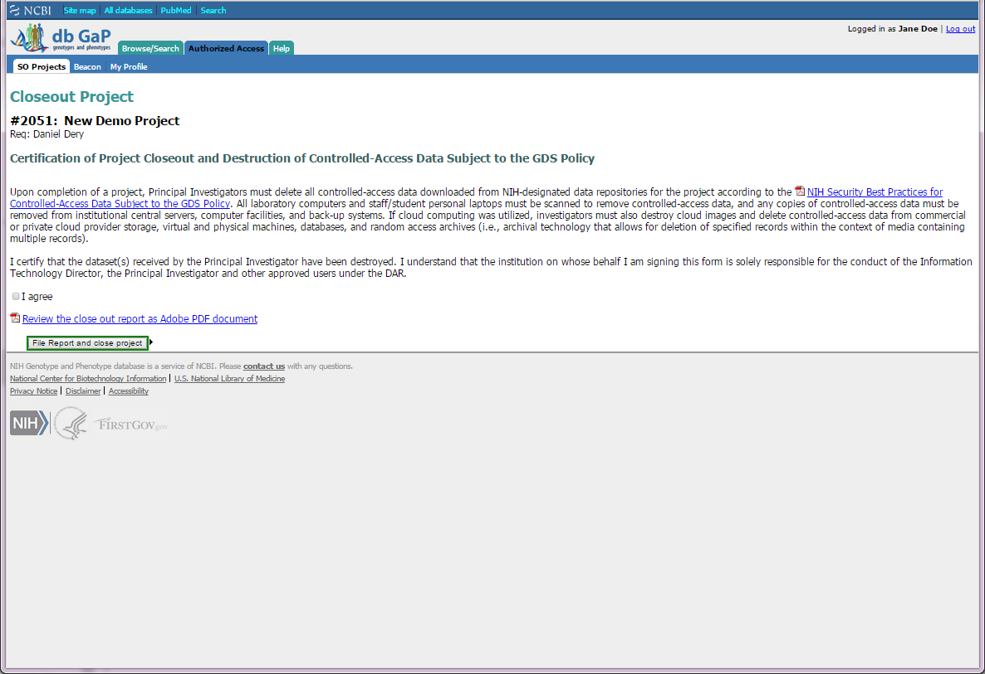
Institutional Signing Official: Closeout

