Slide 1
Attachment 1: Documentation of the dbGaP registration and access system web forms, including changes since 2019 PRA approval

Slide 2
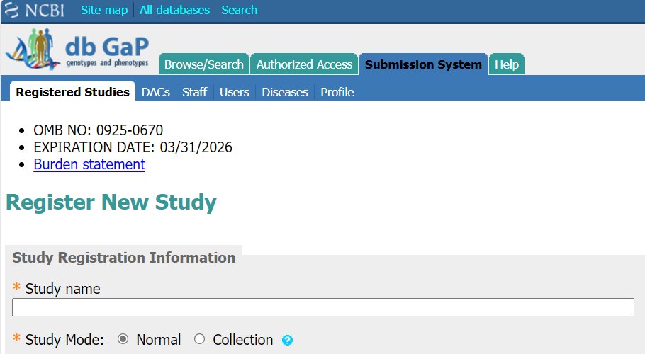
Submitting Investigator: Registration Web Form

Slide 3
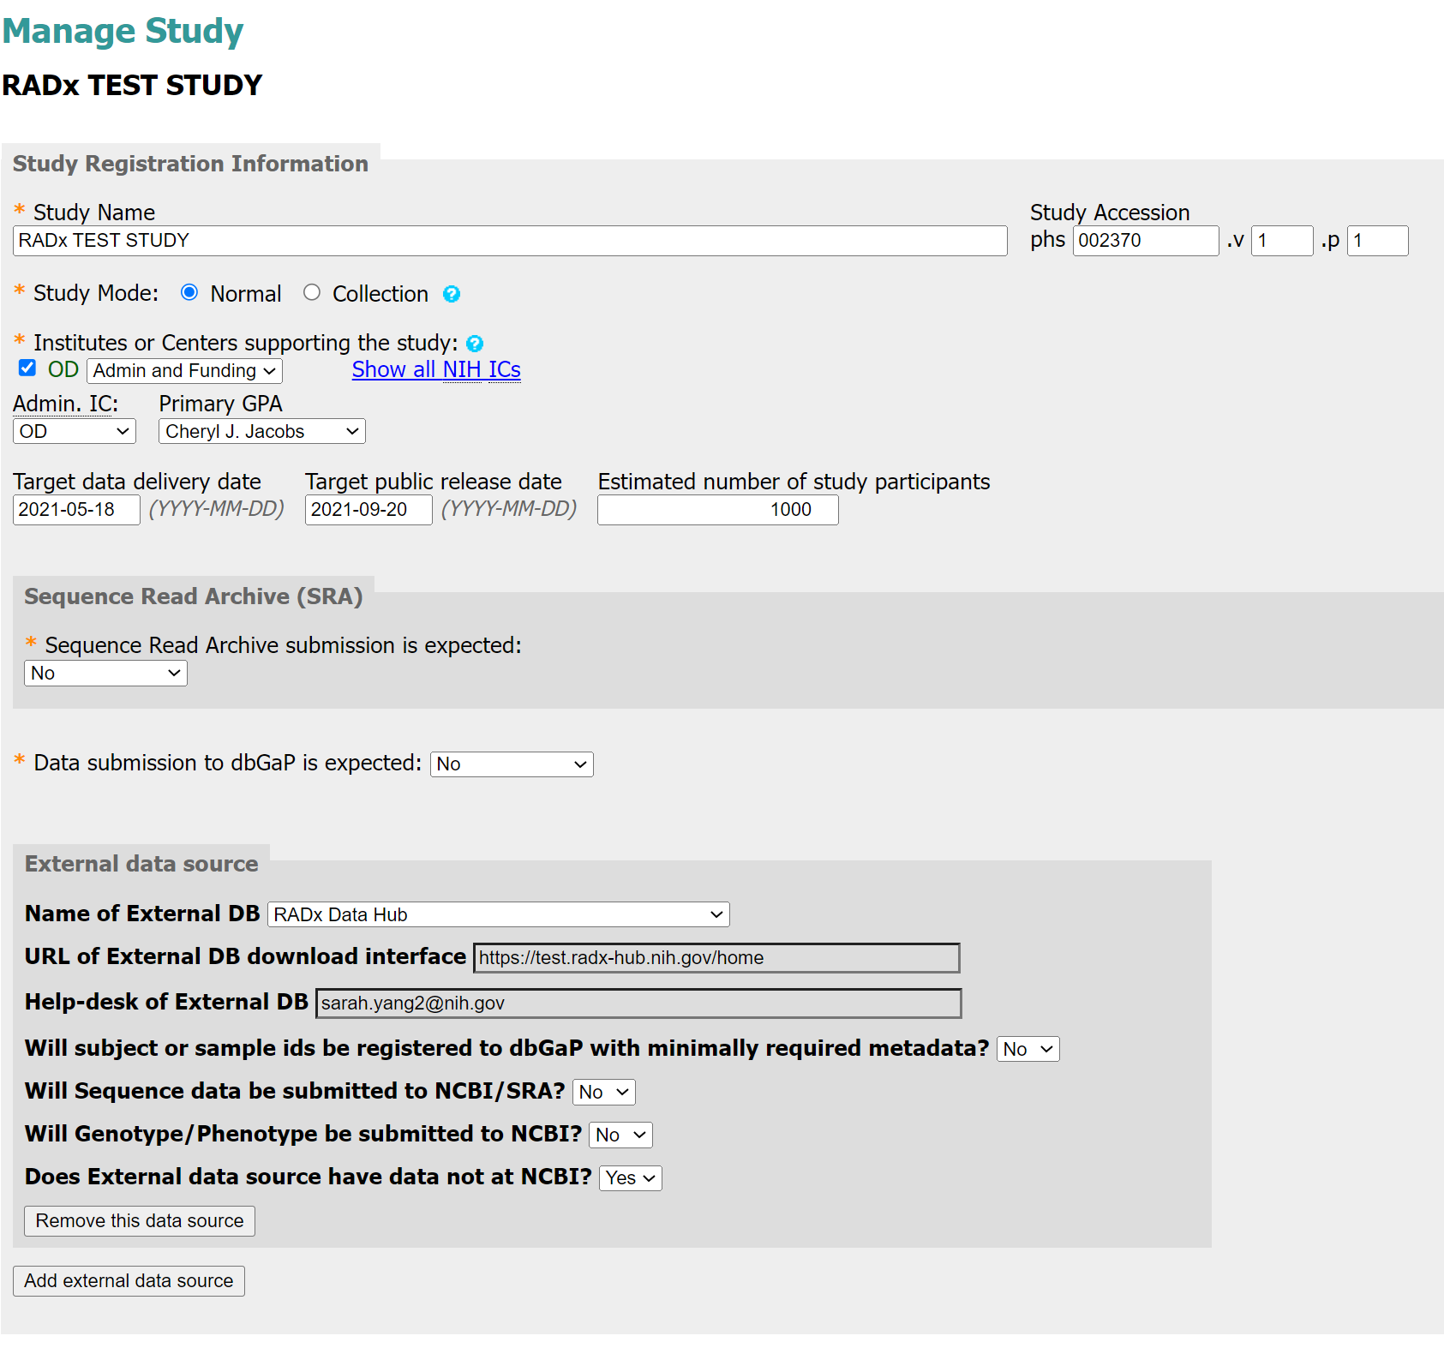
Submitting Investigator: Registration Web Form
Added the option to add an external data source
Page continues on next slide

Slide 4
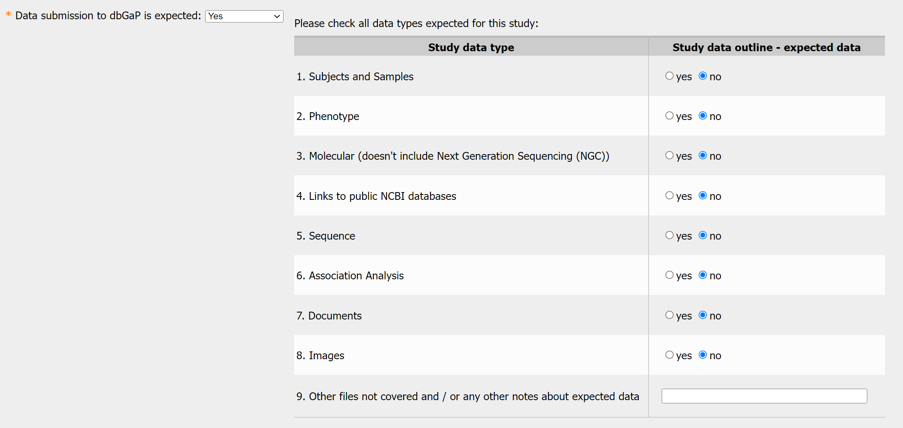
Submitting Investigator: Registration Web Form
Added new radio button selector for data types for those submitting data to dbGaP

Slide 5
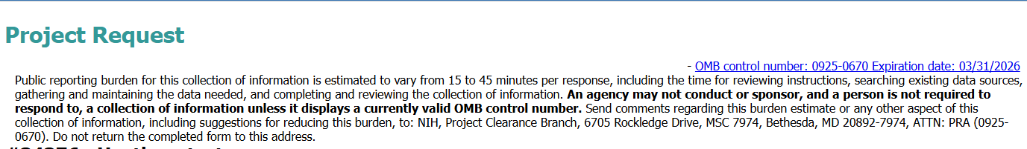
Requesting Investigator: Access Web Form

Slide 6
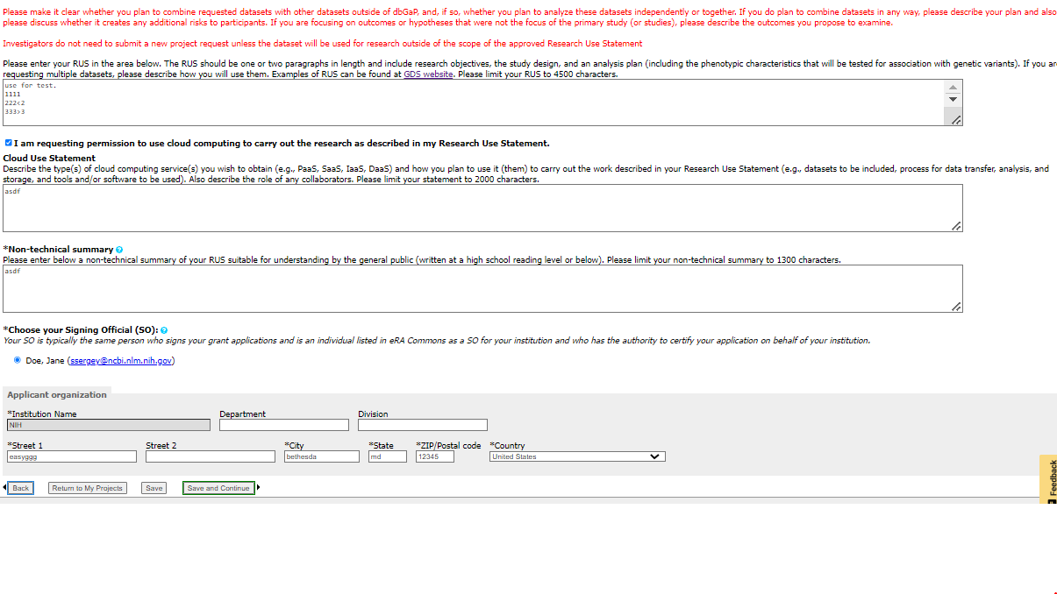
Requesting Investigator: Access Web Form
Encryption options removed from page because encryption is now automatic
New select box

Slide 7
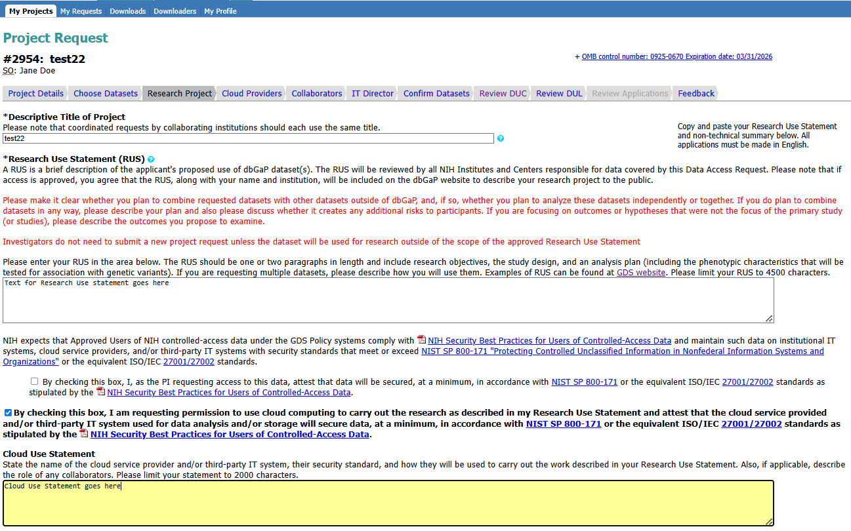
*NEW*
Requesting Investigator: Access Web Form

Slide 8
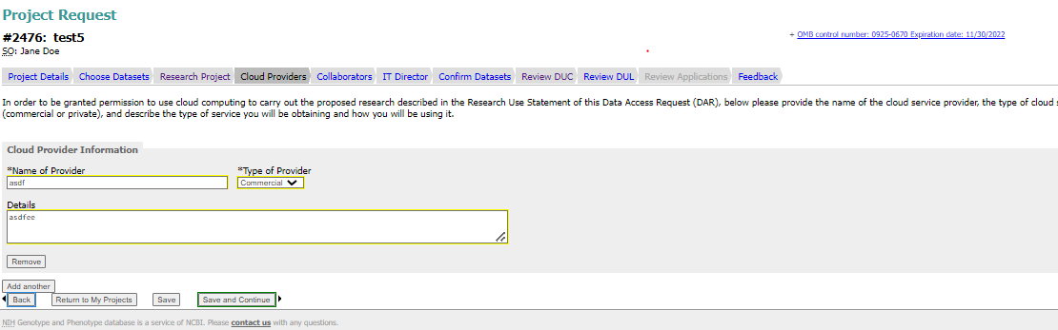
Requesting Investigator: Access Web Form
New tab added for investigators who choose to use cloud platforms for data analysis

Slide 9
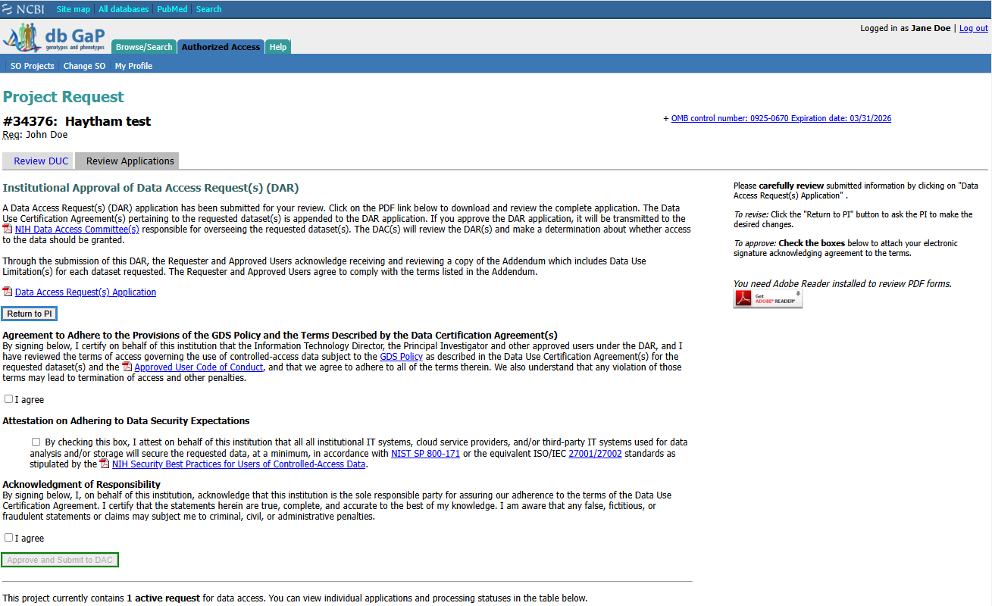
*NEW*
Institutional Signing Official: Access Web Form

Slide 10
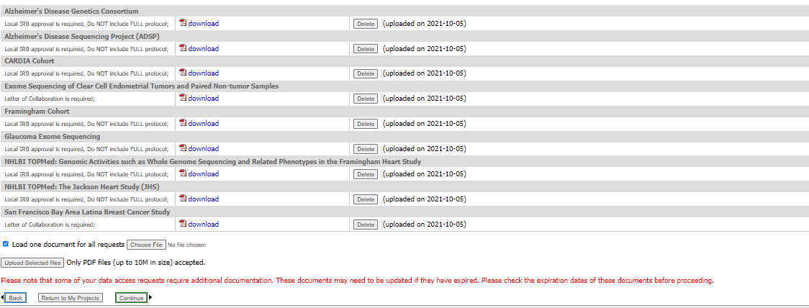
Requesting Investigator: Access Web Form
New check box allows requesting investigators to upload one document for multiple requests

Slide 11
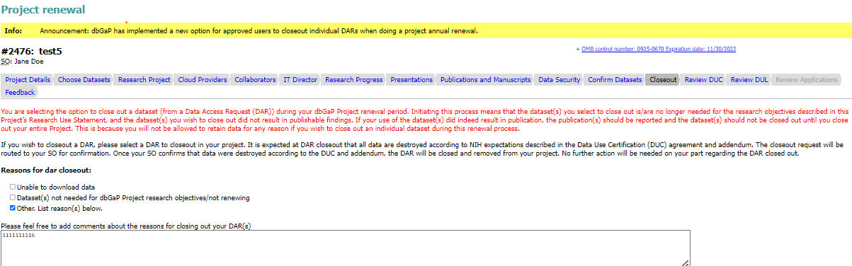
Requesting Investigator: Access Web Form
New tab added to allow user to close out some DARs within a project during a project renewal.

Slide 12
*NEW*
Institutional Signing Official: Renewal

Slide 13
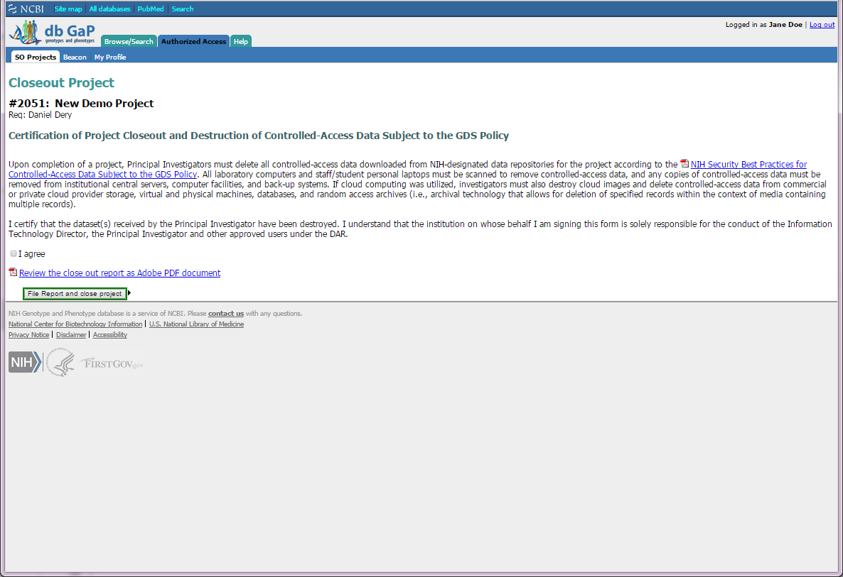
Institutional Signing Official: Closeout

