Slide 1
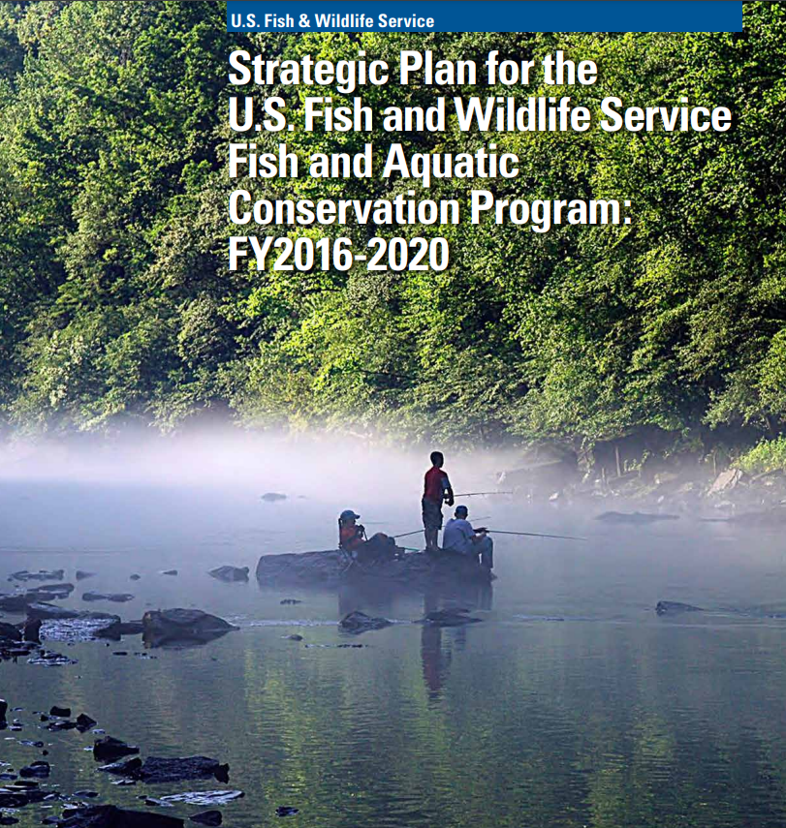
FAC Strategic Plan Development
Status Update and Inputs from Partners
August 2024

Slide 2
Paperwork Reduction Act
OMB Control No. 1090-0012
Expires 02/28/2027
Paperwork Reduction Act Statement: We are collecting this information subject to the Paperwork Reduction Act (44 U.S.C. 3501 et seq.) to incorporate feedback on existing efforts and program priorities from those who partner with and are served by FAC. Your response is voluntary and will not be shared publicly. We may not conduct or sponsor an information collection, and you are not required to respond to a collection of information, unless it displays a currently valid OMB Control Number. OMB has reviewed and approved this survey and assigned OMB Control Number 1090-0012.
Estimated Burden Statement: We estimate the survey will take you 90 minutes to complete, including time to read instructions, gather information, and complete and submit your response. You may submit comments on any aspect of this information collection to the Service Information Collection Clearance Officer, U.S. Fish and Wildlife Service, 5275 Leesburg Pike, MS PRB (JAO/3W), Falls Church, VA 22041-3803, or via email at Info_Coll@fws.gov.
Notes:
In addition to this webinar, we are also reaching out to the following key partner groups to get an understanding of current value of FAC efforts, future program priorities, changes in the conservation landscape, and, most importantly, the niche our partners see us filling in larger conservation efforts. The feedback collected during this time will help shape the second draft of the strategic vision, mission, and goals.
We are also reaching out directly to existing advisory groups to seek their collective wisdom (Sport Fishing and Boating Partnership Council, National Fish Habitat Partnership, Aquatic Nuisance Species Task Force, etc.) and have a complementary effort underway to reach out to tribes and tribal interests befitting their status as sovereign nations.

Slide 3
Why We Are Updating Our Strategic Plan
Improve collaborative conservation approaches with our partners.
Build awareness of conservation benefits.
Expand our efforts to new partners.
Innovate how we deliver our program.

Slide 4
Strategic Planning Process Overview
Gathered Feedback from FAC Employees
SPRING 2024
JULY -AUGUST 2024
Revise vision, mission, goals, and objectives
Engage Partners
Fill in gaps, conduct research, begin drafting
Engage Partners
SEPTEMBER 2024
OCTOBER - NOVEMBER 2024
Continue drafting
Opportunity for review and feedback
JANUARY 2025
Finalize draft plan
FEBRUARY/ MARCH 2025
Plan rollout
Notes:
This timeline provides a high-level overview of the core strategic planning team’s process. Earlier this year, the core team and Council Oak developed a survey distributed to the entire FAC community asking for input on the strategic vision, mission, and goals of the previous strategic plan. This input was discussed at the March FMT meeting and will be taken into account as the strategic planning process moves forward.
The next stage of this process, taking place this summer, involves engaging other stakeholders, both inside and outside of the federal government. At this stage, we are reaching out to program stakeholders to get a better understanding of FAC’s perceived niche and how to better support partner needs with the next iteration of strategic goals and activities.
Following the conclusion of the interviews, the strategic planning small team will begin drafting the new plan, and is planning for periodic feedback from and review from the larger FMT.

Slide 5
FAC Strategic Plan Guiding Tenets
Informed by a wide variety of perspectives
Survey of FAC Personnel
Interviews and engagement with partners/stakeholders
Outreach and engagement to tribes and tribal consortia
Feedback from existing federal advisory committees
Focused on where we can catalyze, fill a particular niche or leverage our resources
Opportunity for review of draft plan
Notes:
We recognize that we cannot do everything, everywhere.
As such we are taking great pains to understand what activities or parts of existing activities are of highest value to our partners, have the largest opportunity to catalyze, plus up or leverage other’s activities.
There will be an opportunity this fall to review the draft plan after we have concluded this feedback-gathering phase.

Slide 6
Our Key Program Areas
Aquatic Ecosystem Restoration
Hatcheries / Aquaculture
Fish Health and Medicines
Managing Aquatic Nuisance Species
Sport Fishing, Boating & Recreation
Tribal Trust Responsibilities
Federal Agency Mitigation Support
Assessment and Monitoring
Notes:
We will be gathering feedback on the following, which we consider to be FAC’s key program areas.

Slide 7
Key External Partner Groups
State Fish and Wildlife Agencies
Tribal Consultation
Cooperating Federal Agencies and Programs
Conservation NGOs
Fishing and Boating Interests
Fish Health, Fish Tech, and Aquaculture
Federal Advisory Groups
Notes:
In addition to this webinar, we are also reaching out to the following key partner groups to get an understanding of current value of FAC efforts, future program priorities, changes in the conservation landscape, and, most importantly, the niche our partners see us filling in larger conservation efforts. The feedback collected during this time will help shape the second draft of the strategic vision, mission, and goals.
We are also reaching out directly to existing advisory groups to seek their collective wisdom (Sport Fishing and Boating Partnership Council, National Fish Habitat Partnership, Aquatic Nuisance Species Task Force, etc.) and have a complementary effort underway to reach out to tribes and tribal interests befitting their status as sovereign nations.

Slide 8
Seeking Feedback on Following Themes
Strengths and weaknesses of current FAC activities
FAC’s most unique/important offerings
New focus/innovation areas
What does success look like in 10 years?
Notes:
We are looking for feedback on the following general themes (and will discuss more specific questions in a few minutes).
What strengths or weaknesses do you see with the current FAC activities within our key program areas?
What do you think are the most important program offerings that FAC provides? What do we do that is unique or irreplaceable?
What new areas of focus, activity or innovation do you think FAC should consider?
What does a highly successful USFWS Fish and Aquatic Conservation Program look like in 10 years?
Should this tie back to the "Key Program Areas?"
If not, do we need to be more explicit on "activities?" e.g., "FAC activities within our Key Program Areas."

Slide 9
Letter from AD-Miko to State Directors with cc to Fish Chiefs seeking initial interview request.
Draft plan will be available for to review in late October/early November
Thank you!
Notes:
We appreciate your willingness to be a part of this important effort. There will be opportunities this fall (likely late October/early November) to review the draft plan and provide feedback.
Thank you for your time today!

