Slide 1

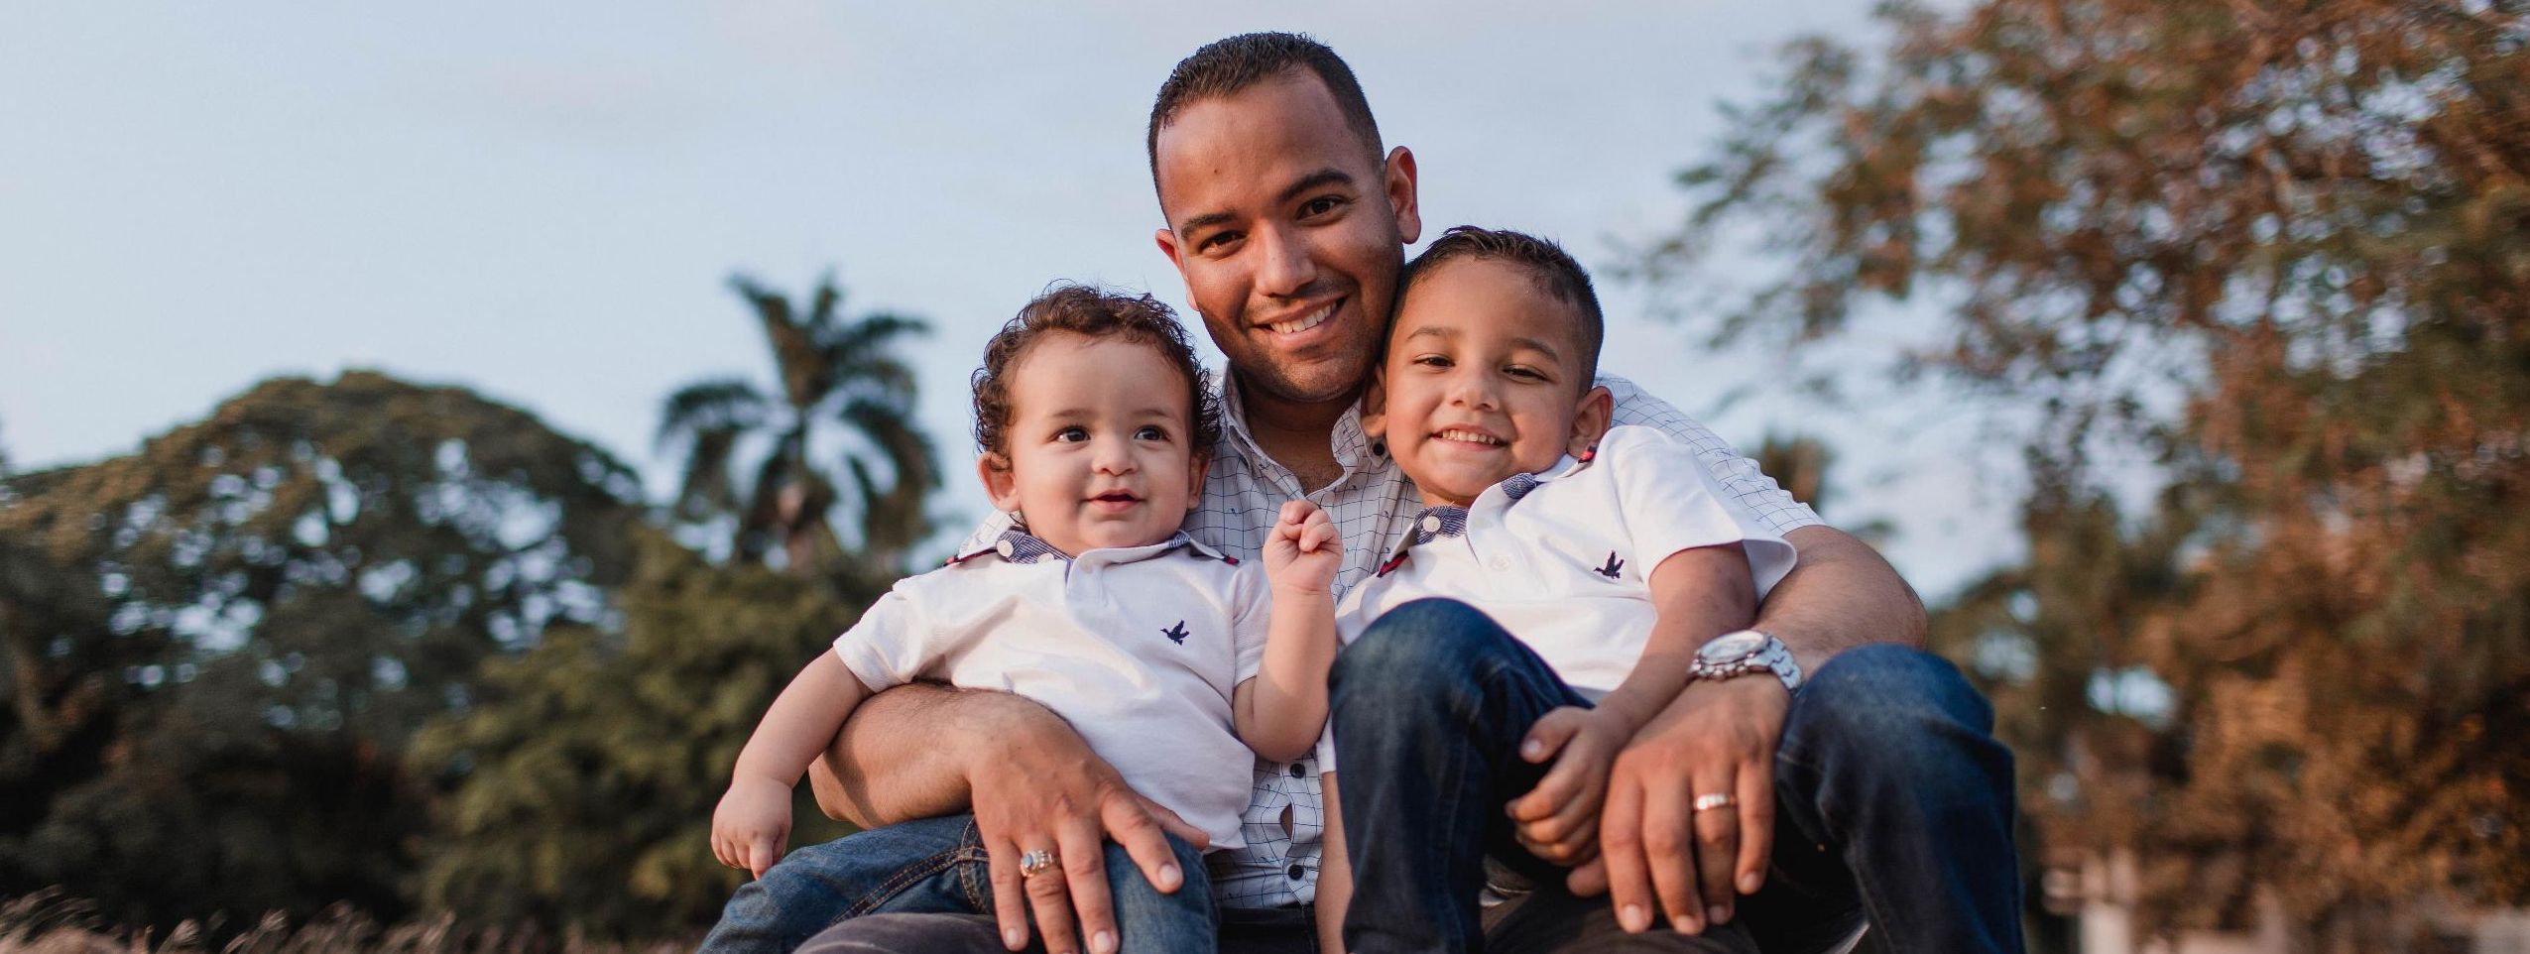



Date
Fatherhood TIES
Photovoice
Training
Sub-title

Slide 2
Agenda
Welcome
3
Fatherhood TIES Study
4
Your Role in the Study
6
Using Photos for Research
11
Wrap-Up
14

Slide 3
Welcome
Why did you decide to join participate in the Fatherhood TIES Photovoice study?

Slide 4
Fatherhood T.I.E.S. Study
Testing Identified Elements for Success in Fatherhood Programs
Notes:
Sundjata

Slide 5
Overview of the Fatherhood TIES Study
The study focuses on testing “program elements” of fatherhood programs – how and where they are most effective at improving the lives of fathers and their children.
TIES hopes to improve:
  Father well-being
  Father-child relationships
  Co-parenting relationships
  Economic stability

Slide 6
Goals of the Photovoice Study
Explore how the program elements of fatherhood program affects fathers' lives
Empower fathers to:
  Document and share your experiences
  Identify concerns with systems and how they affect your lives
  Bring your voice to the attention of decision makers
What are your hopes for this project?

Slide 7
Photovoice Activities
TIES Photovoice Activities
1. Photovoice Training
2. Photo Collection
3. Analysis Meeting
4. Photo Exhibit

Slide 8
Your Role in the Study

Slide 9


Researcher-Participant Role
Researcher
Participant
Take and analyze photos
Must maintain research ethics
Share information about yourself and your opinions
Have certain protections

Slide 10
Researcher- Participant Role
Researchers are held responsible for maintaining ethical standards when conducting research.
Maintaining ethical principles is important for protecting the dignity, rights, safety, and well-being of research participants.

Slide 11

Ethical Principles for Human Subjects Research
What is Human Subjects Research?
“Living individuals about whom an investigator conducting research obtains: data through intervention or interaction with the individual, or identifiable private information.
In other words… Human subjects are the people participating in studies like TIES
Federal regulations govern the treatment of human subjects.

Slide 12
Ethical Principles for Human Subjects Research
Belmont Principles
Respect for Persons
Beneficence
Justice
Voluntary participation
Informed consent
Maximize potential benefits and minimize potential harms
Fair distribution of the benefits and burdens of research
Fair selection of research subjects
Notes:
Respect for persons - People must have enough information about the study to make an educated decision about whether they would like to participate.
2. Beneficence – Research must ensure the least possible harm is done to achieve good, and the good must outweigh the harm.
3. All research subjects should be treated equally; costs and rewards of the research must be distributed fairly.

Slide 13
Using Photovoice

Slide 14
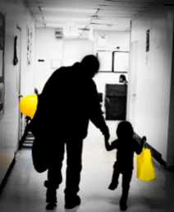
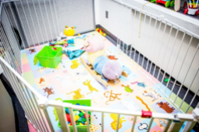
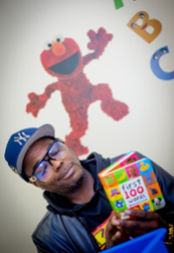
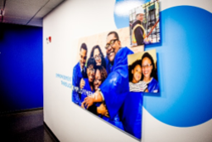
Using Photos to Tell a Story
Notes:
Photo Credit: Bright Sarfo

Slide 15
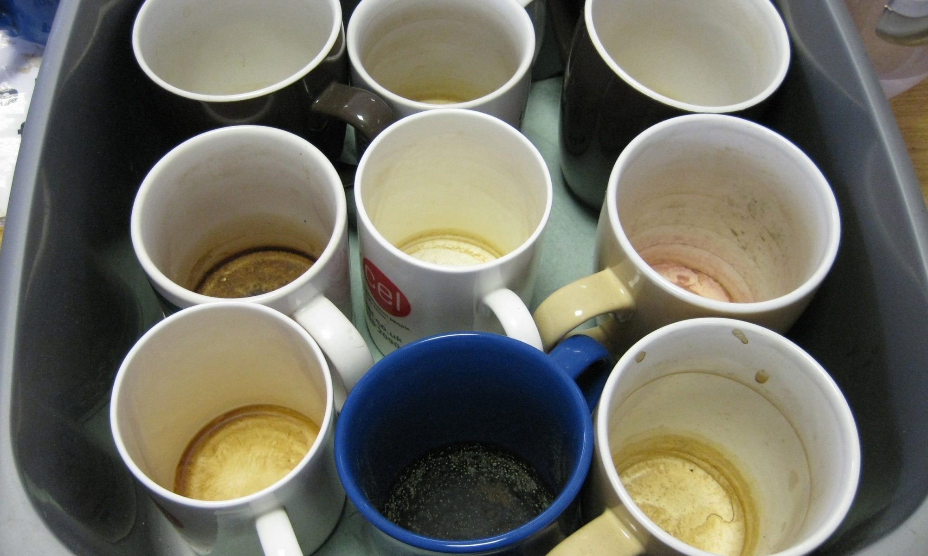

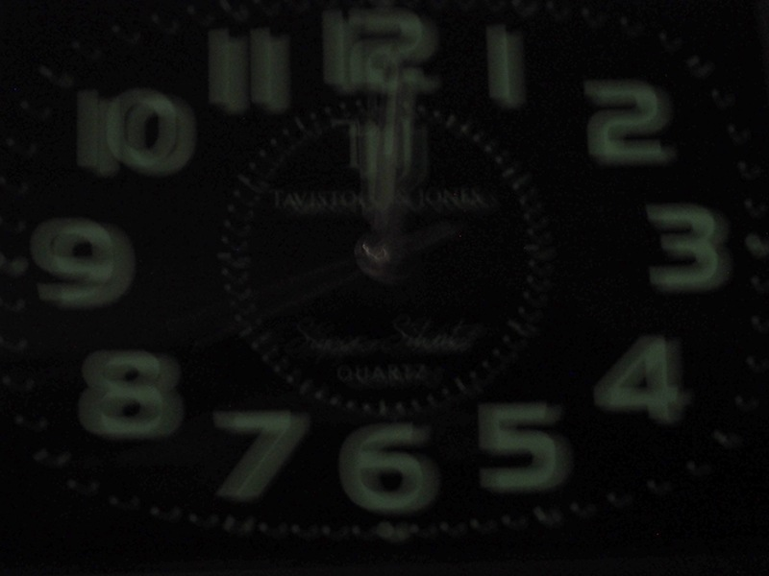
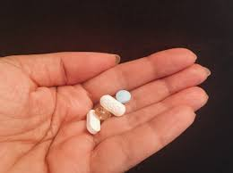
Using Photos to Tell a Story

Slide 16
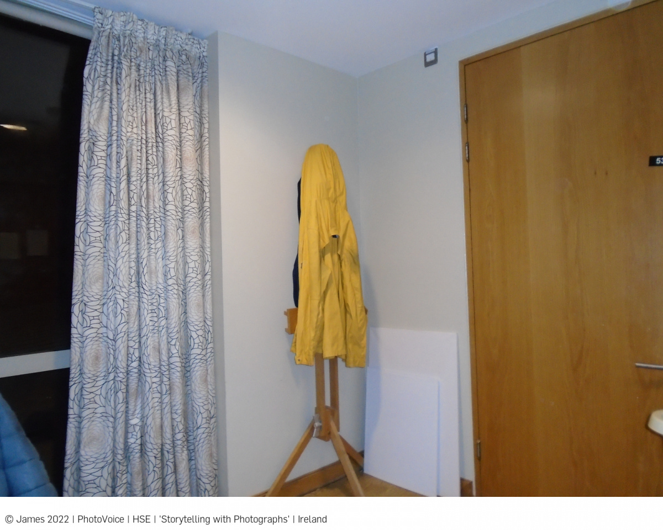
Color
“I’m looking forward to moving, to going back where I was living before. I’ve got this yellow coat which I’ve not worn since I got here, and it makes me think of being in a different place where they don’t have full time nursing, so you get a little bit more freedom. The reason I moved here is because I became quite unwell, but I feel like I’m recovering a bit more. The coat is hanging on an easel. I like painting - sometimes it works for me and sometimes it doesn’t.”

Slide 17
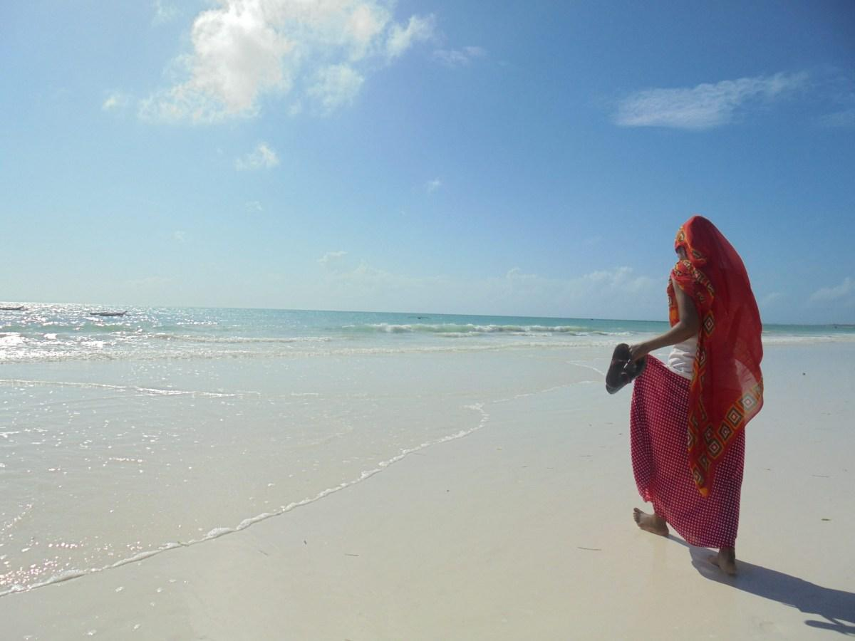
Rule of Thirds
“Life at Paje Beach. I took this photo because I find the environment beautiful. I enjoy taking walks by the beach and looking at the scenery. It is calm with a very gentle breeze.”

Slide 18
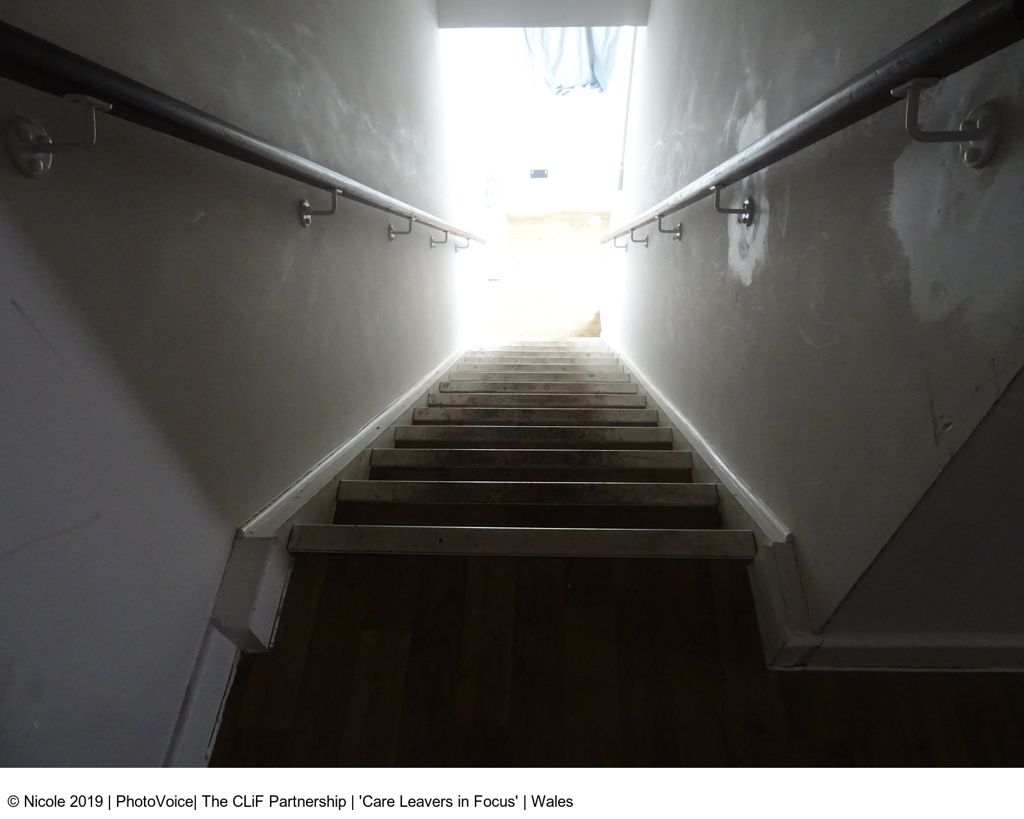
Perspective
“The steps I’m taking towards the light.
The light for me will be moving into my own home in September.”

Slide 19
The research question:
How has the parent coaching you received affected your:
Parenting goal, skills, or habits
Relationship with your child/children
Relationship with co-parent
Personal mental health and well-being

Slide 20
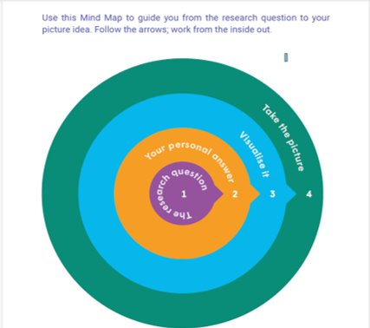
Getting from the research question to your picture idea
Think about the research question
Come up with a personal answer
Visualize
Take the picture

Slide 21
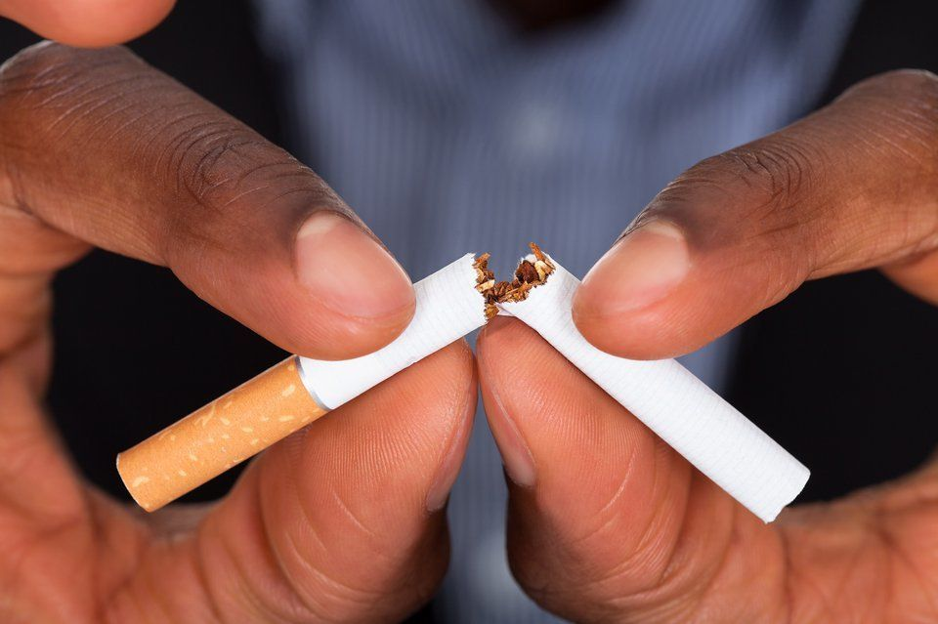
Example
“...I had to quit (cigarettes) to save money to get a life insurance policy for my daughter- you can only have one and which one is more important- it's my relationship with me children"

Slide 22
How to Submit Photos
For the next 3 weeks, you will take at least one photo each week in response to the study research question
Click on the link to a web page sent to you via email or cell phone and upload your picture(s) along with a caption.
Let the study team if you have any questions or problems uploading your photos

Slide 23
Photo Release Forms
For You
For Your Children
For Others

Slide 24
Photo Permission Stoplight
Do not submit photos of:
Illegal activities
Identifiable people who don’t want their photo used
Get a photo release for photos of:
An identifiable person in a place where they have a reasonable expectation of privacy
minors
Submit photos freely of:
Any adult or object in a public place
Self-portraits
Things around your home
Abstract photos

Slide 25
Photo and photo release submission

Slide 26
Wrap Up/Time for Questions

Slide 27

Timeline
Virtual gallery launch
Today
Photo voice Training
XX/XX-XX/XX
Photo Collection
XX/XX
Photo analysis meeting
Debrief
XX/XX
XX/XX

Slide 28
Thank you
Dara Lewis Dara.Lewis@MDRC.org
Niko Leiva
Rose Palma

Slide 29
Fatherhood TIES Study

Slide 30
Agenda
To change the date, go to “View > Slide Master” and change the date on the first slide! Then click “Close Master View”

Slide 31
Agenda

Slide 32
To change the date, go to “View > Slide Master” and change the date on the first slide! Then click “Close Master View”

Slide 33
Fatherhood TIES Photovoice Orientation

Slide 36

