Slide 1

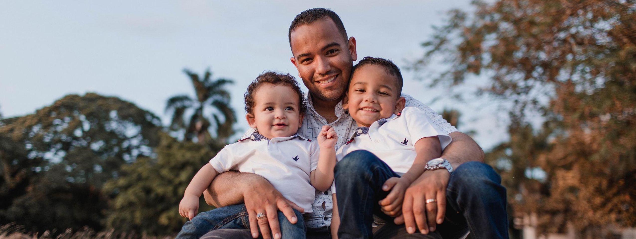



Date
Fatherhood TIES
Focus Group
Training
Sub-title

Slide 2
Agenda
Welcome and ice breaker
Overview of the Fatherhood TIES study
Research Ethics
Focus Group Co-Facilitation
Questions and Next Steps

Slide 3
ICE Breaker

Slide 4
Fatherhood T.I.E.S. Study
Testing Identified Elements for Success in Fatherhood Programs
Notes:
Sundjata

Slide 5
Overview of the TIES Study
The study focuses on testing fatherhood program elements – to see how and where they are most effective at improving the lives of fathers and their children.
TIES hopes to learn how programs can improve:
  Father well-being
  Father-child relationships
  Co-parenting relationships
  Economic stability

Slide 6
Focus Group Co-Facilitation

Slide 7
Steps for Facilitating a Focus Group
Steps | Person Responsible
1. Getting consent from participants | TIES team member only
2. Creating Community Agreements for the focus group | FA and TIES team member
3. Building Connection with participants | FA and TIES team member
4. Facilitating Discussion | FA and TIES team member

Slide 8
1. Informed Consent
Informed consent is both a process and a form
The Fatherhood TIES research team member and Father Advisor’s role is to inform, not influence or coerce.
We share enough detailed information about the study and focus group that fathers can make an informed choice.
We ask fathers if they want to participate in the Fatherhood TIES focus group
  It is their choice to participate (or not)
  If they agree to participate, they can also choose what information to share in the group

Slide 9
1. How to get informed consent?
Use the informed consent form and focus group scripts to explain the following to fathers:
You are being asked to participate in a focus group for the Fatherhood TIES study
Length of participation: About 1 hour
Participation is voluntary
  No penalties for not participating such as loss of services or service quality
  You can choose to not answer questions or drop out any time
Risks and benefits
Protection of personally identifiable information, as well as any exceptions to privacy
To change the date, go to “View > Slide Master” and change the date on the first slide! Then click “Close Master View”

Slide 10
2. Creating Community Agreements
Community agreements represent how members of the focus group want to interact with and be treated by each other during the focus group (and after).
Can pose as a question: "What do you need from every person in this group in order to feel safe, supported, open, and productive?”

Slide 11

Steps for creating Community Agreements
What we say here, stays here. What we learn here, leaves here. Don’t share what’s said in the group, outside of the group. However, what we learn from the group discussion will be used for research.
Make space, Take space. Be aware of how much you are talking (or not talking) and allow others to talk.
What else?
Explain Community Agreements
2. Share examples
3. Ask for additional agreements

Slide 12
3. Building Connections with fathers
Participants as experts
Awareness of community and sensitive topics
Your role as the co-facilitator
Recognizing and expressing gratitude to participants for their time and contributions
Source: Omni Institute (2013), “Toolkit for Conducting Focus Groups”

Slide 13
4. Facilitating the Discussion
Follow the Focus Group Guide
Repeat the question – repetition gives more time to think.
Pause for the answer – a thoughtful nod or expectant look can convey that you want a fuller answer.
Repeat the reply – hearing it again sometimes stimulates conversation
Ask when, what, where, which, and how questions – they provoke more detailed information
Use neutral comments – “Anything else?”
Source: Omni Institute (2013), “Toolkit for Conducting Focus Groups”

Slide 14
Tips for Guiding the Discussion
Use Listening Skills
Probing and Clarifying Questions
Time Management
Record the Discussion
Source: Omni Institute (2013), “Toolkit for Conducting Focus Groups”

Slide 15
Listening Skills
Active listening
Body language and facial expressions
Importance of neutrality
Allowing silence
Source: Omni Institute (2013), “Toolkit for Conducting Focus Groups”

Slide 16
Using Probes and Asking Clarifying Questions
Examples of probes
  “Please say more about that…”
  “Could you explain what you mean by…”
  “Could you give an example of what you mean by…”
  “Has anyone else had a difference experience/opinion?”
Summarizing and reflecting back what is said
  What I’m hearing you say… is that right?
Avoid asking leading questions
  “Don’t you think…”
Source: Omni Institute (2013), “Toolkit for Conducting Focus Groups”

Slide 17
Time Management
Keeping the focus group moving
Checking in with participants
Not rushing participants
Familiarity with the focus group questions and using it efficiently
Source: Omni Institute (2013), “Toolkit for Conducting Focus Groups”

Slide 18
Recording and Note taking
The project team member co-facilitating with you will take care of all recordings and notes during the focus group.

Slide 19
Co-Facilitation Practice
Let's practice what we've learned in breakout rooms.

Slide 20
Research Ethics
What are they and why do they matter?

Slide 21
Research Ethics 101
WHAT: Research Ethics are standards that govern the conduct of scientific researchers. Maintaining ethical principles is important for protecting the dignity, rights, and welfare of research participants.
WHY: 1) Research ethics promote research goals such as knowledge and truth, 2) Research ethics support values such as trust, mutual respect and fairness, and 3) Research ethics ensure that researchers can be held accountable to the public.
Sources: WHO website (2023), Resnik, D. (2020)

Slide 22
Key Principles for treatment of Human Subjects in Research
Respect for Persons
Beneficence
Justice
Voluntary participation
Informed consent
Maximize potential benefits and minimize potential harms
Fair distribution of the benefits and burdens of research
Fair selection of research subjects
Belmont Principles:
Research Principles are rules or guidelines for doing research with people participating in research studies like Fatherhood TIES or “Human Subjects”
Human Subjects are:
    “Living individuals about whom an investigator conducting research obtains: data through intervention or interaction with the individual, or identifiable private information."
    Federal regulations govern the treatment of human subjects.

Slide 23
Privacy
You have an obligation to keep focus group participants’ information private.
You can help assure people that the information they share will remain private.
  Never share any information about specific people in the focus group except with MDRC team members. This means:
    Not telling friends or family members who attended the group.
    Not telling friends or family members what was said in the group.

Slide 24
Questions and Next Steps

