Slide 1
Performance Measurement Tool (PMT)
Data Entry Pages for Drug Court Program–Joint and Enhancement

Slide 2
PMT Data Entry Pages
Log In
General Award Information Page (one-time data entry)
Program Characteristics (one-time data entry)
Data Entry (quarterly data entry)
Create A Report (This is not a data entry page. Upon initiating the creation of this report it helps the grantee to pull saved data into a downloadable report to submit to OJJDP. It is created once a year or 2 times per year, depends on the grant program).
Notes:
2

Slide 3
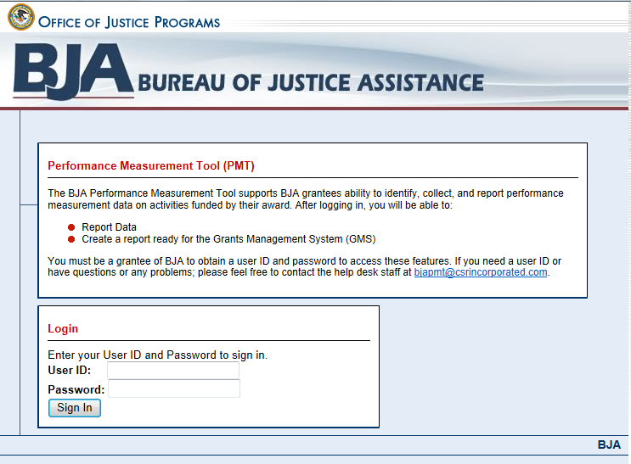
Log In
PMT Website
https://www.bjaperformancetools.org
Enter your user ID and password to enter the system.

Slide 4
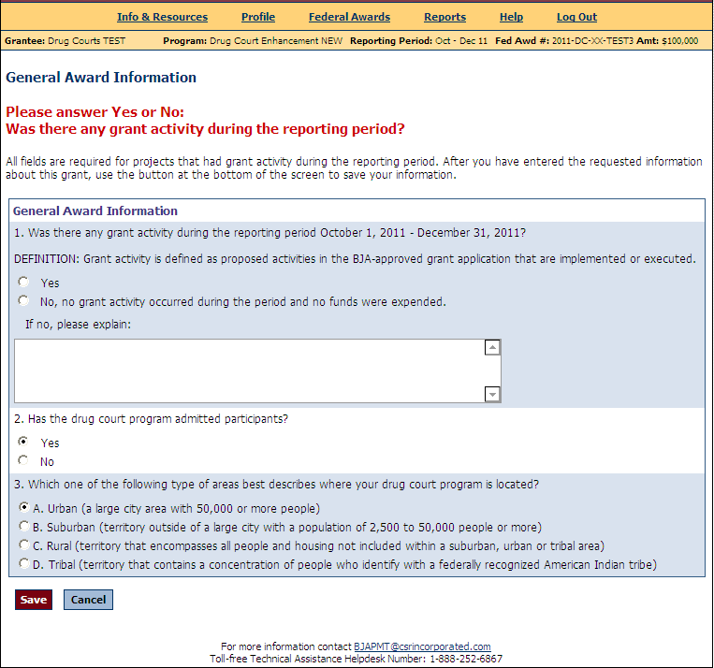
General Award Information
ONE TIME SETUP
Responses are carried over to the next reporting period
The General Award Information page is intended to capture info about the location and population served with this award.

Slide 5
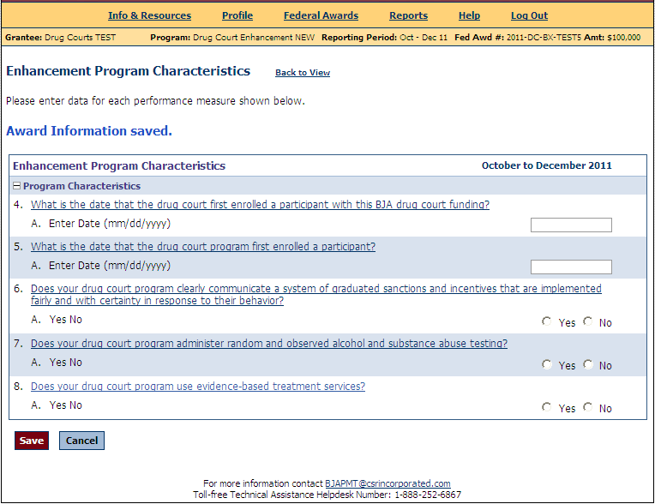
Program Characteristics
ONE TIME DATA ENTRY
Responses are carried over to the next reporting period
Program characteristics are intended to capture information specific to your program and are only asked once (referred to as baseline data).
Notes:
5

Slide 6
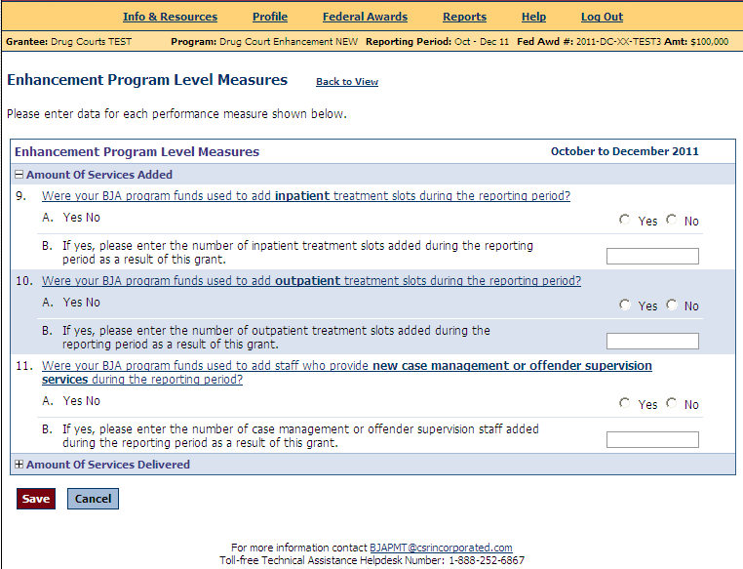
Data Entry
QUARTERLY DATA ENTRY

Slide 7
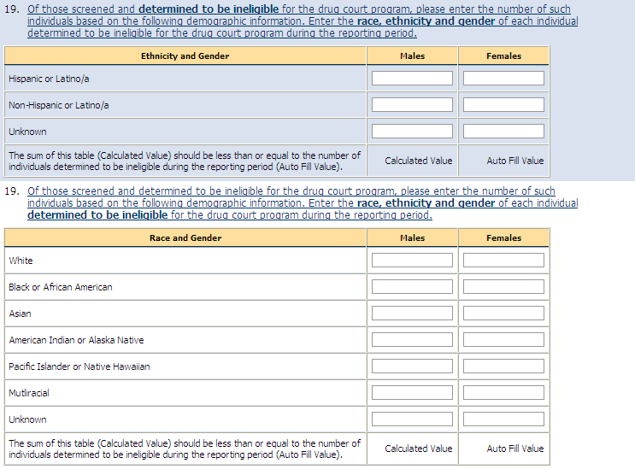
Data Entry
QUARTERLY DATA ENTRY

Slide 8
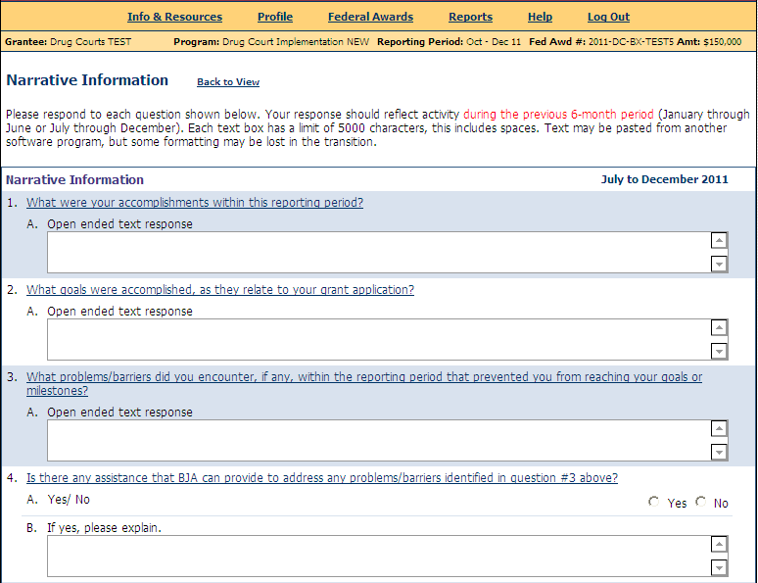
Narrative
There are 7 narrative questions.
Grantee provides responses
2 times per year.
When entering data for the October–December and April–June reporting periods, you are asked to answer 7 narrative questions required of all BJA grantees. The questions are based on the previous 6 months of activity, regardless of whether or not your award was considered “operational.”

