Slide 1
Hazardous Materials Endorsement (HME)
Information Collection/Paperwork Reduction Act Enrollment Workflow

Slide 2
Contents
Introduction: TSA HME Workflow Trees & Disclosure Statements
Part 1: Pre-Enrollment Workflow
Part 2: Standard Enrollment Workflow
Part 3: Online Renewal Workflow
Part 4: Post-Enrollment Survey

Slide 3
Introduction
HME Workflow Trees

Slide 4
Workflows: Pre-Enrollment, Standard Enrollment & Renewal
Pre-Enrollment (Optional)
Standard Enrollment
Online
Renewal
Program/Location
Biographic Information
Select State
Biographic Information
Biographic Information
Notices
Notices
Citizenship
Citizenship
Citizenship
Attributes
Documents
Attributes
Address Information
Attributes
Employment Information
Employment Information
Employment Information
Acknowledgements
Biometrics
Acknowledgements
Documents
Acknowledgements
Fee Payment
Appointment
Fee Payment
Survey
Survey
Confirmation
Submission/
Confirmation
Submission/
Confirmation
All applicants may pre-enroll online or via call center representative and provide required enrollment information and schedule appointment for biometric collection.
All Items except Biometrics, Fee Payment, and the Post Enrollment Survey may be done during pre-enrollment.
Eligible applicants may renew online unless they have had a change in biographic information or have been informed they must submit additional biometrics or documentation.

Slide 5
Agent v. Non-Agent
Agent States:
TSA and its enrollment provider (i.e., Agent) collect biometric (i.e., fingerprints) and biographic information from applicants in 43 States, including the District of Columbia, (“Agent States”).
TSA’s provider submits the biometrics to the Federal Bureau of Investigation (FBI) for a fingerprint-based criminal history records check (CHRC). The provider channels or sends the results of the CHRC to TSA for vetting purposes.
TSA uses the applicant’s information and FBI criminal history records information (CHRI) to vet and adjudicate the individual’s HME application in accordance with 49 CFR 1572 Subpart B, Standards for Security Threat Assessments.
The TSA Agent State enrollment process is outlined in the Pre-Enrollment (optional), Standard Enrollment, and Online Renewal workflows depicted on slide #4.
Non-Agent States:
Eight (8) Non-Agent States, not including outlying U.S. possessions, do not send applicant fingerprints to TSA.
49 CFR part 1572.15(b)(2), Procedures for HME security threat assessment, permits States to collect the fingerprints and biographic information from applicants directly, transmit fingerprints to the FBI, and provide this information, as well as the resulting FBI CHRI information, to TSA electronically for purposes of conducting the security threat assessment.
While each Non-Agent State’s enrollment process may vary, these States must generally adhere to the TSA Agent’s Standard Enrollment process depicted on the previous slide #4 to collect and transit the required applicant data specified in 49 CFR 1572.9.
Note: TSA Non-Agent State applicants are not eligible for the Pre-Enrollment and Online Renewal options that are provided by TSA via its enrollment provider, at this time.

Slide 6
Introduction
HME Disclosures

Slide 7
Disclosure: Privacy Act Statement
PRIVACY ACT STATEMENT
Authority: 6 U.S.C. § 1140, 46 U.S.C. § 70105; 49 U.S.C. §§ 106, 114, 5103a, 40103(b)(3), 40113, 44903, 44935-44936, 44939, and 46105; the Implementing Recommendations of the 9/11 Commission Act of 2007, § 1520 (121 Stat. 444, Public Law 110-52, August 3, 2007); and Executive Order 9397, as amended.
Purpose: The Department of Homeland Security (DHS) will use your information to conduct a security threat assessment. Your fingerprints and associated information will be provided to the Federal Bureau of Investigation (FBI) for the purpose of comparing your fingerprints to other fingerprints in the FBI’s Next Generation Identification (NGI) system or its successor systems including civil, criminal, and latent fingerprint repositories. The FBI may retain your fingerprints and associated information in NGI after the completion of this application and, while retained, your fingerprints may continue to be compared against other fingerprints submitted to or retained by NGI. DHS will also transmit your fingerprints for enrollment into Automated Biometrics Identification System (IDENT). If you provide your Social Security Number (SSN), DHS may provide your name and SSN to the Social Security Administration (SSA) to compare that information against SSA records to ensure the validity of the information.
Routine Uses: This system may disclose information in accordance with the Privacy Act, 5 U.S.C. 552a(b), including as a routine use pursuant to 5 U.S.C. 552a(b)(3) with third parties during the course of a security threat assessment, employment investigation, or adjudication of a waiver or appeal request to the extent necessary to obtain information pertinent to the assessment, investigation, or adjudication of your application under the TSA system of records notice (SORN) DHS/TSA 002, Transportation Security Threat Assessment System, or DHS/TSA 021, HME Threat Assessment Program for applicants to that program. Disqualifying criminal offenses uncovered during your application limit your ability to access TSA PreCheck expedited screening. For as long as your fingerprints and associated information are retained in NGI, your information may be disclosed pursuant to your consent or without your consent as permitted by the Privacy Act of 1974 and all applicable Routine Uses as may be published at any time in the Federal Register, including the Routine Uses for the NGI system and the FBI’s Blanket Routine Uses.
Disclosure: Furnishing this information (including your SSN) is voluntary; however, if you do not provide your SSN or any other information requested, DHS may be unable to complete your application for a security threat assessment.

Slide 8
Disclosure: Paperwork Reduction Act Statement
PAPERWORK REDUCTION ACT STATEMENT
Statement of Public Burden: This is a voluntary collection of information, but failure to provide the information may result in an inability to approve your eligibility for the requested TSA program or benefit. TSA estimates that the total average burden per response associated with these information collections is approximately 30 minutes for online renewals; 2 hours for enrollment; 7.5 minutes for online survey; and 6 hours for appeals and waiver. An agency may not conduct or sponsor, and a person is not required to respond to, a collection of information unless it displays a valid OMB control number. The control number for this collection is OMB 1652-0027, which expires 04/30/2022. Send comments regarding this burden estimate or collection to: TSA-11, Attention: PRA 1652-0027 Security Threat Assessment for Individuals Applying for a Hazardous Materials Endorsement for a Commercial Driver’s License, 6565 Springfield Center Drive, Springfield, VA 20598-6011.

Slide 9
Part 1
HME Online Pre-Enrollment Workflow (Optional)

Slide 10
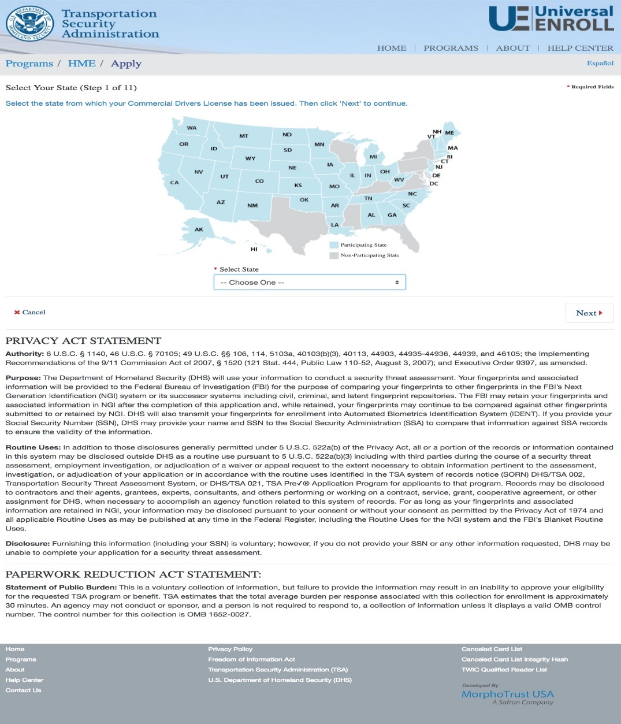
HME Pre-Enrollment
START
Select State
Biographic Information
Citizenship
Attributes
Address Information
Employment Information
Acknowledgements
Documents
Appointment
Confirmation
FINISH

Slide 11
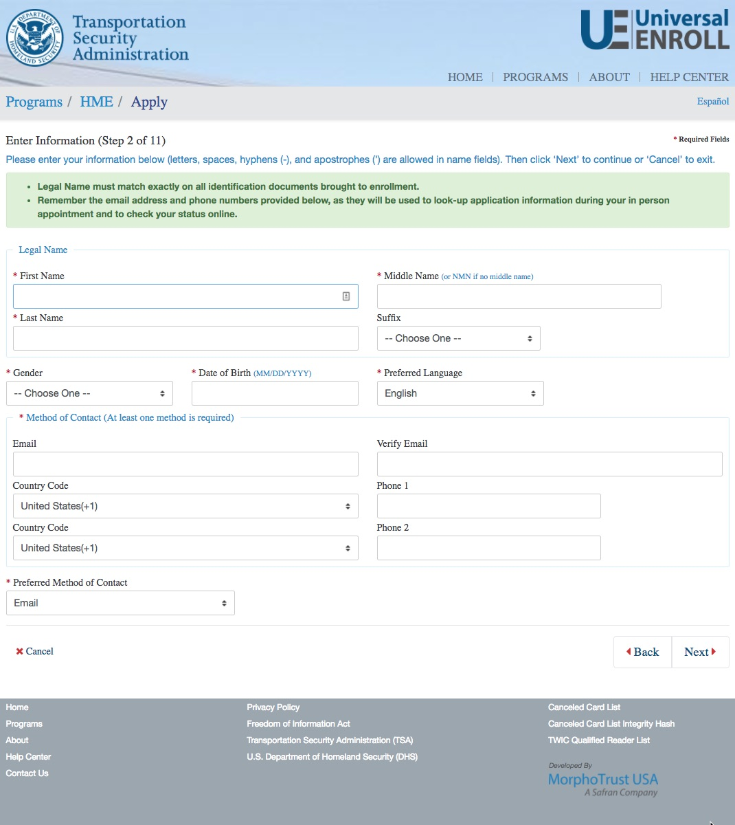
HME Pre-Enrollment
START
Select State
Biographic Information
Citizenship
Attributes
Address Information
Employment Information
Acknowledgements
Documents
Appointment
Confirmation
FINISH

Slide 12
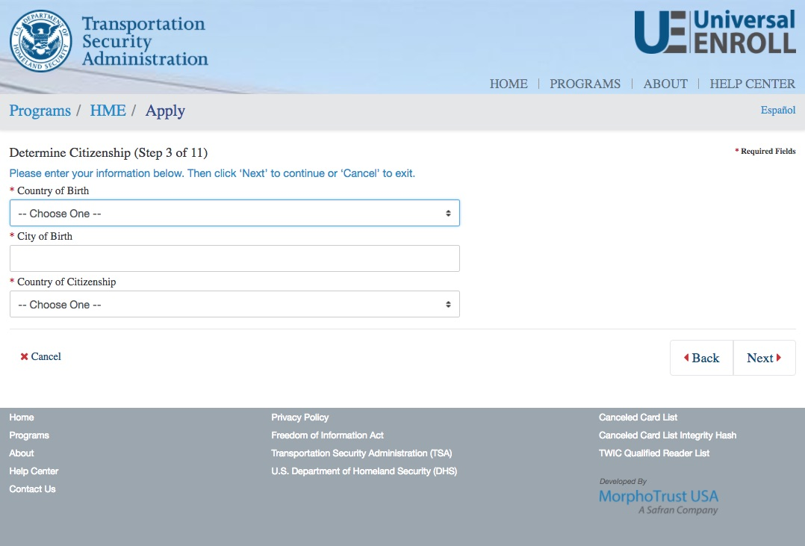
HME Pre-Enrollment
START
Select State
Biographic Information
Citizenship
Attributes
Address Information
Employment Information
Acknowledgements
Documents
Appointment
Confirmation
FINISH

Slide 13
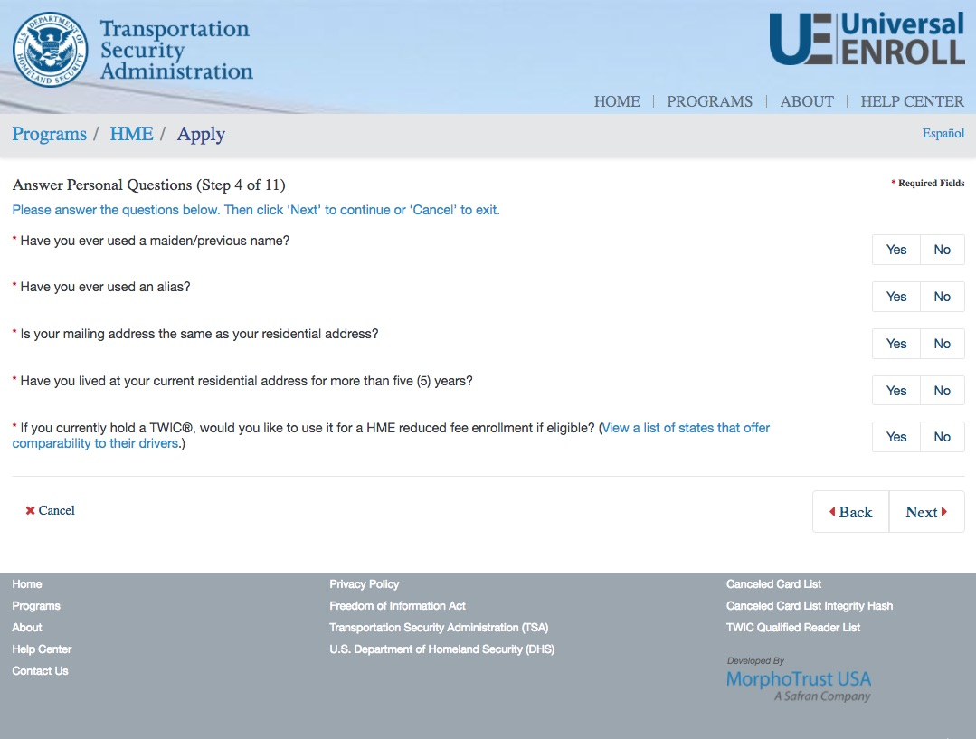
HME Pre-Enrollment
START
Select State
Biographic Information
Citizenship
Attributes
Address Information
Employment Information
Acknowledgements
Documents
Appointment
Confirmation
FINISH

Slide 14
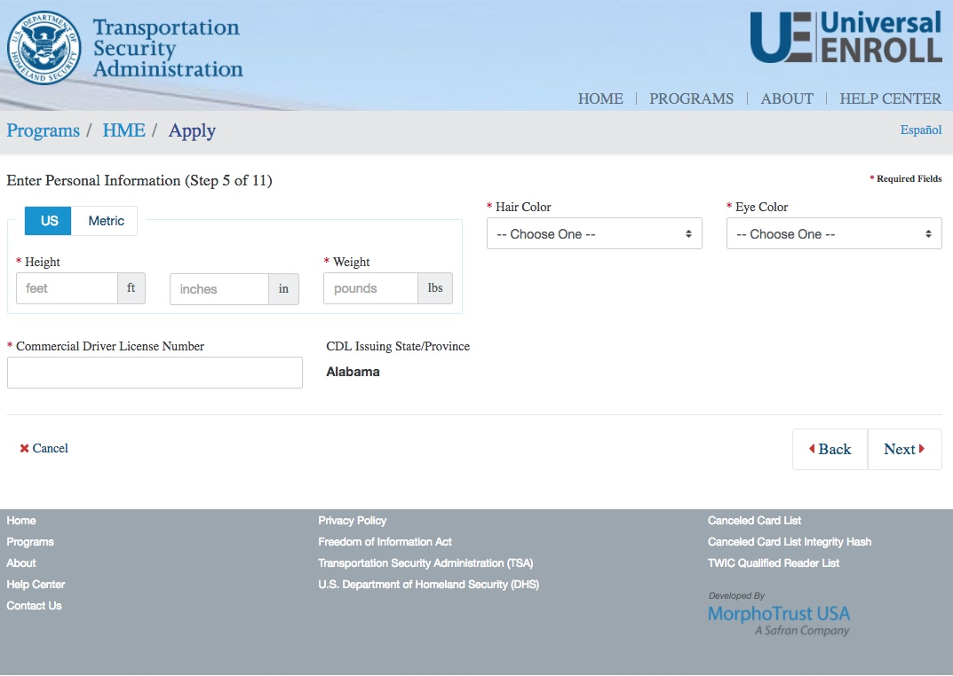
HME Pre-Enrollment
START
Select State
Biographic Information
Citizenship
Attributes
Address Information
Employment Information
Acknowledgements
Documents
Appointment
Confirmation
FINISH

Slide 15
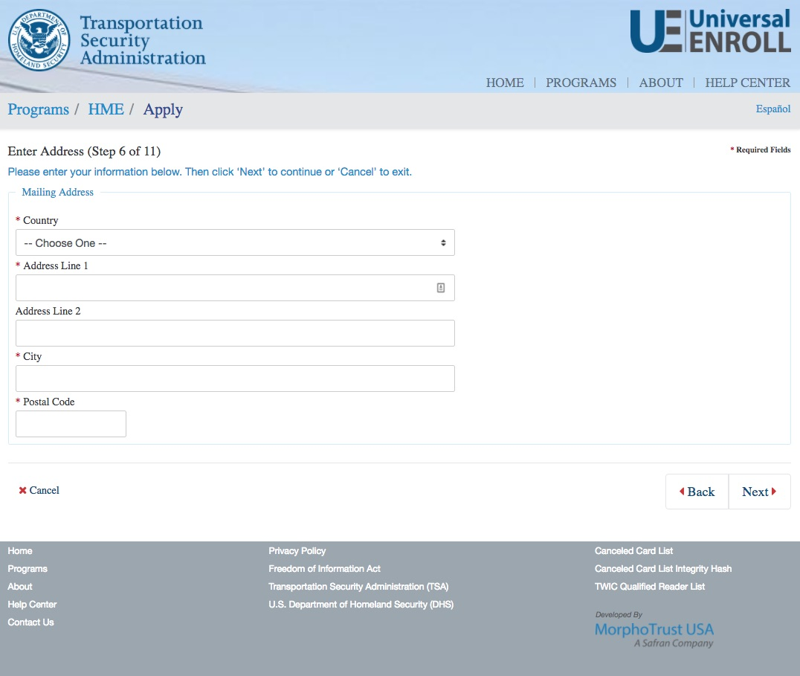
HME Pre-Enrollment
START
Select State
Biographic Information
Citizenship
Attributes
Address Information
Employment Information
Acknowledgements
Documents
Appointment
Confirmation
FINISH

Slide 16
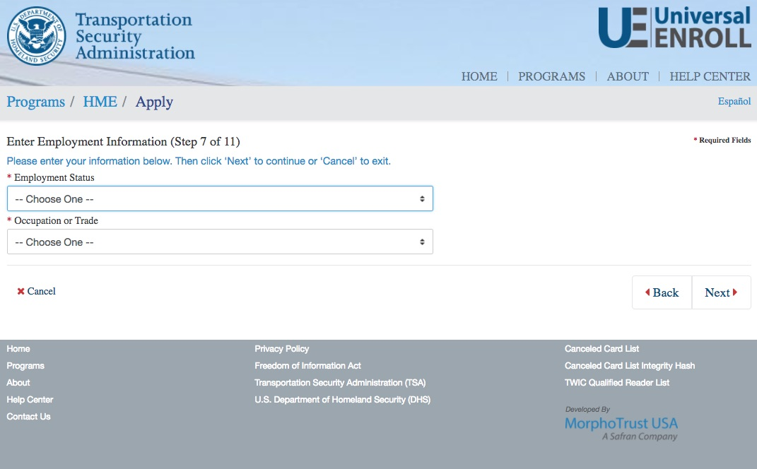
HME Pre-Enrollment
START
Select State
Biographic Information
Citizenship
Attributes
Address Information
Employment Information
Acknowledgements
Documents
Appointment
Confirmation
FINISH

Slide 17
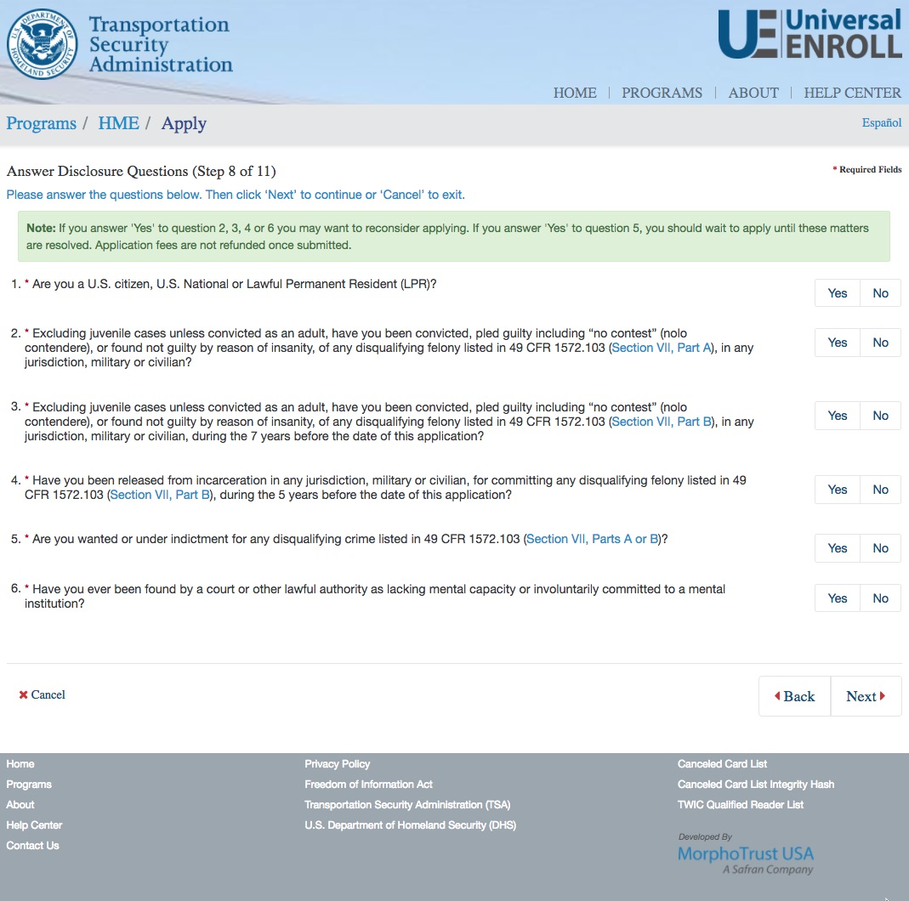
HME Pre-Enrollment
START
Select State
Biographic Information
Citizenship
Attributes
Address Information
Employment Information
Acknowledgements
Documents
Appointment
Confirmation
FINISH

Slide 18
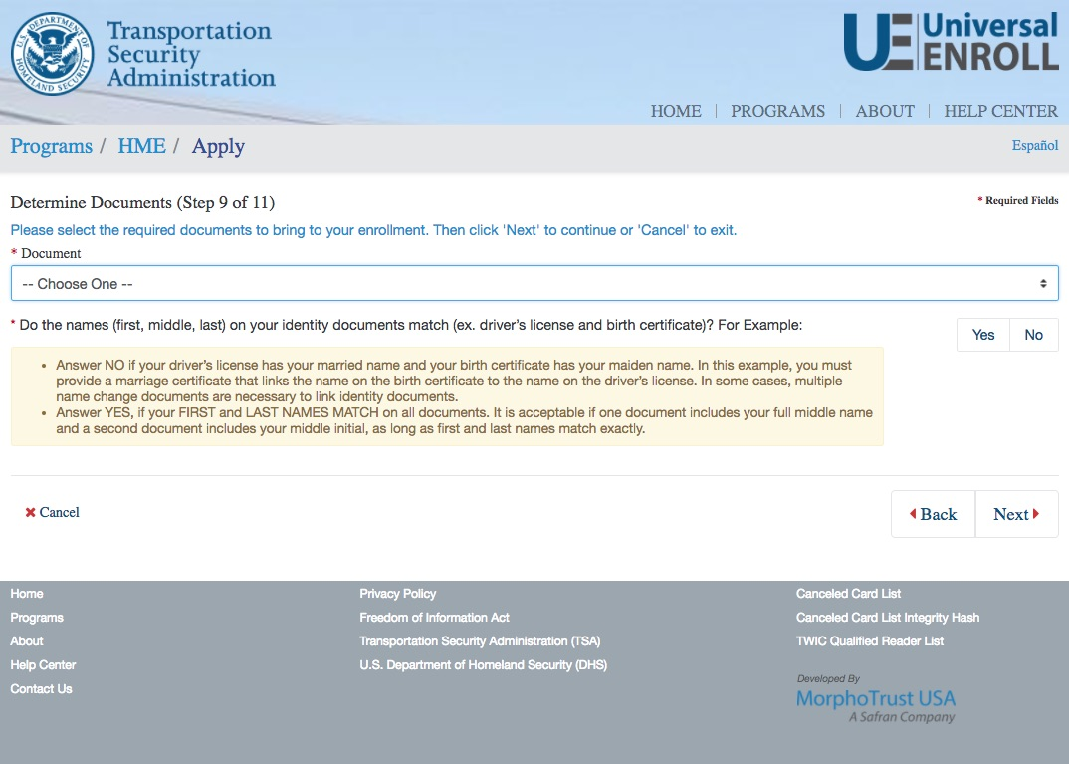
HME Pre-Enrollment
START
Select State
Biographic Information
Citizenship
Attributes
Address Information
Employment Information
Acknowledgements
Documents
Appointment
Confirmation
FINISH

Slide 19
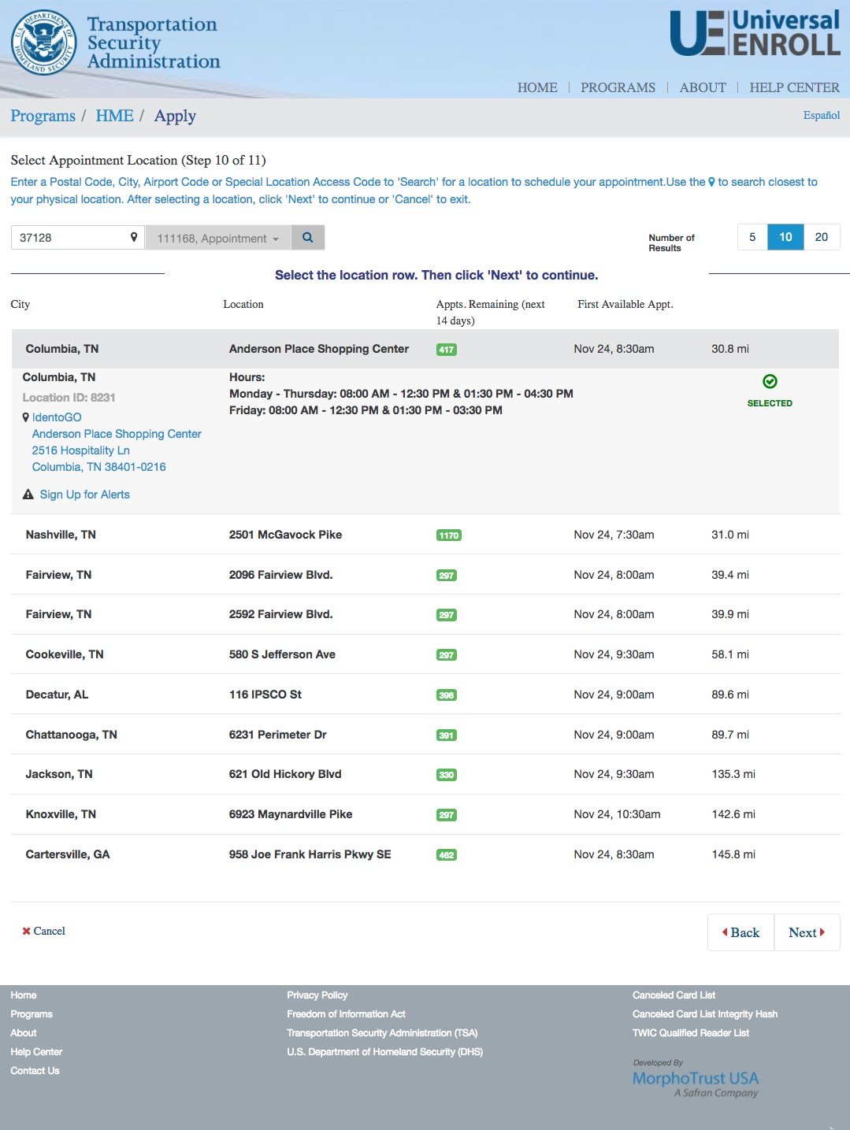
HME Pre-Enrollment
START
Select State
Biographic Information
Citizenship
Attributes
Address Information
Employment Information
Acknowledgements
Documents
Appointment
Confirmation
FINISH

Slide 20
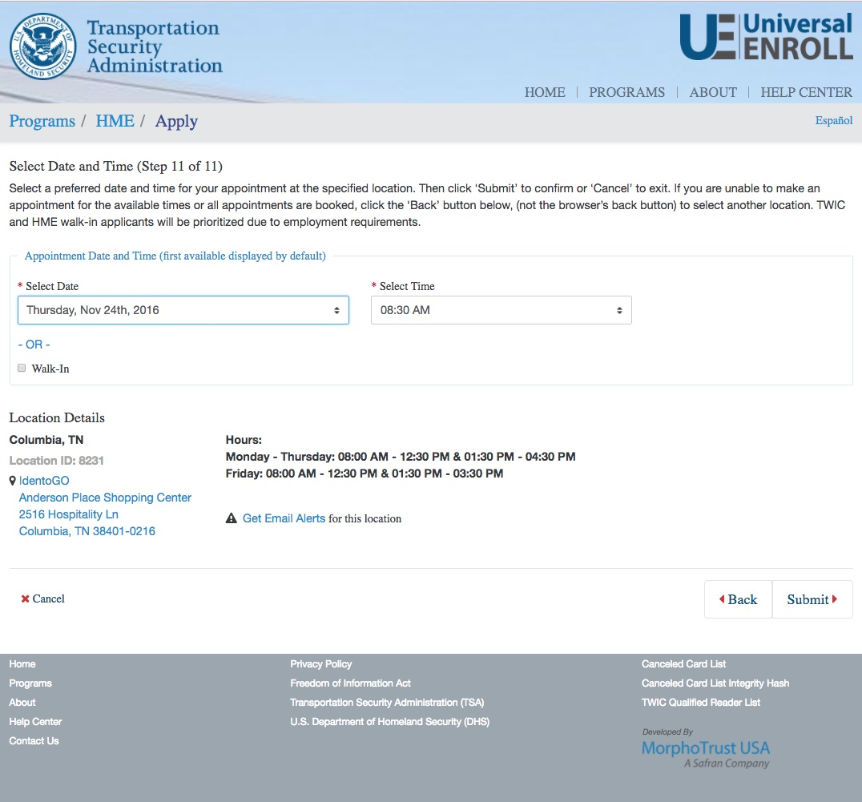
HME Pre-Enrollment
START
Select State
Biographic Information
Citizenship
Attributes
Address Information
Employment Information
Acknowledgements
Documents
Appointment
Confirmation
FINISH

Slide 21
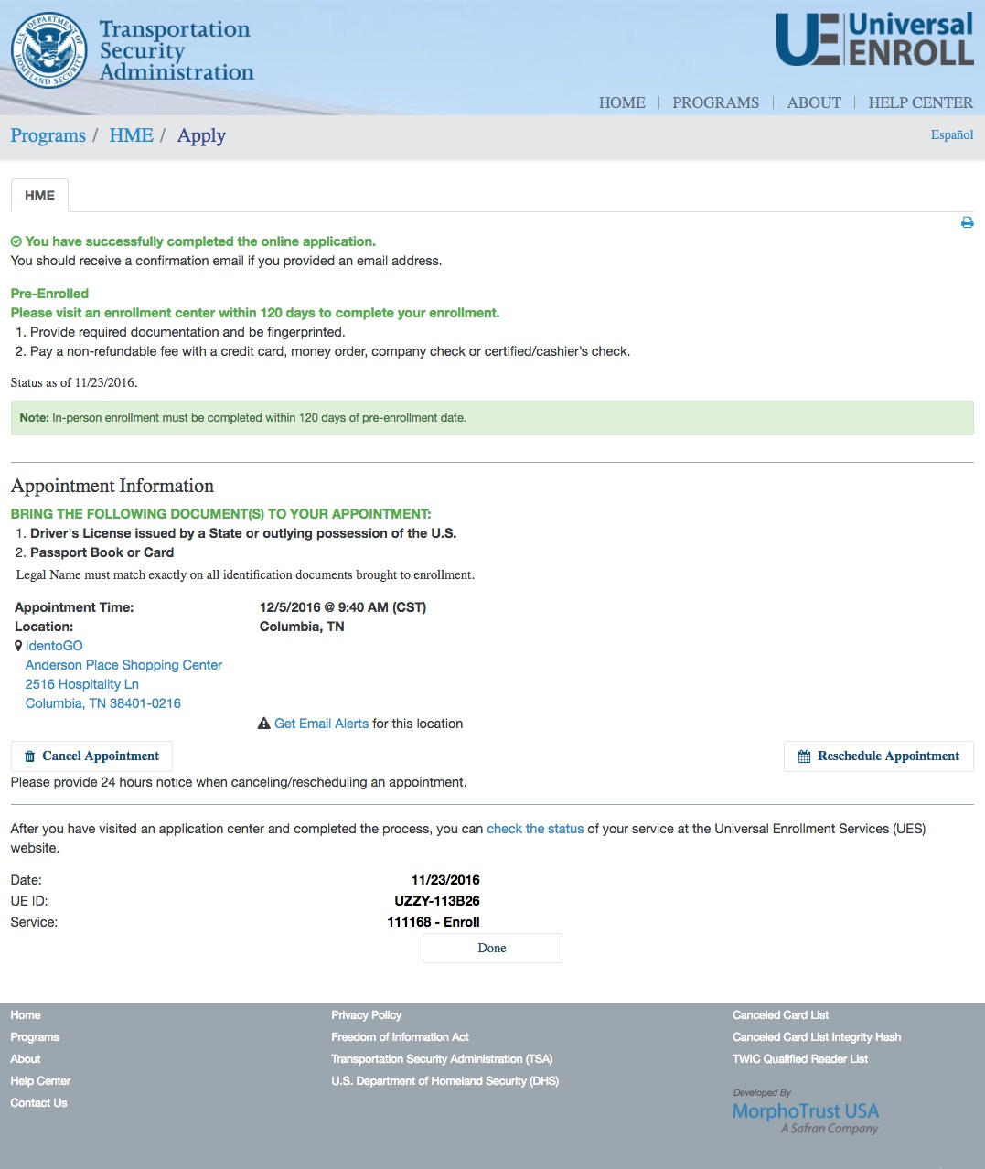
HME Pre-Enrollment
START
Select State
Biographic Information
Citizenship
Attributes
Address Information
Employment Information
Acknowledgements
Documents
Appointment
Confirmation
FINISH

Slide 22
Part 2
HME In-Person Standard (New) Enrollment Workflow

Slide 23
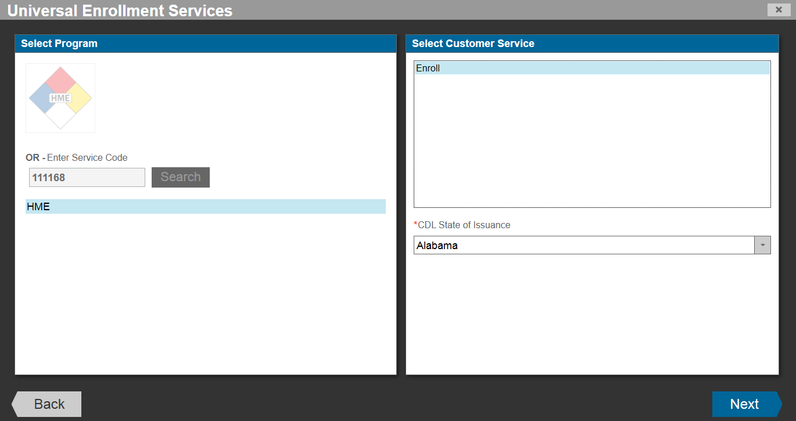
HME Standard Enrollment
START
Program/Location
Biographic Information
Notices
Citizenship
Documents
Attributes
Employment Information
Biometrics (Fingerprints)
Acknowledgements
Fee Payment
Survey
Submission/
Confirmation
FINISH

Slide 24
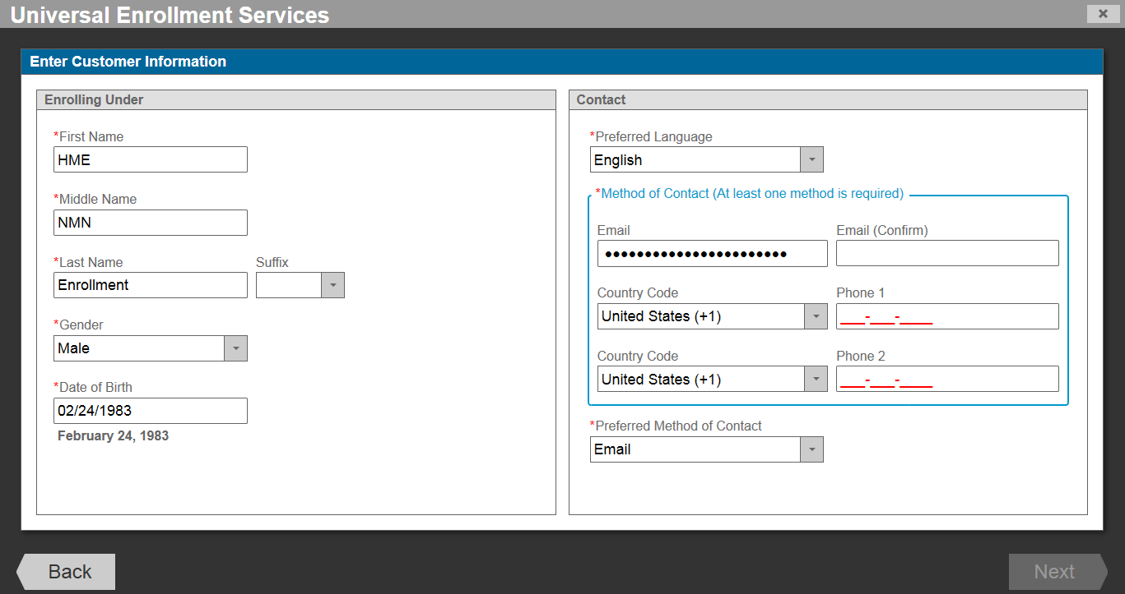
HME Standard Enrollment
START
Program/Location
Biographic Information
Notices
Citizenship
Documents
Attributes
Employment Information
Biometrics (Fingerprints)
Acknowledgements
Fee Payment
Survey
Submission/
Confirmation
FINISH

Slide 25
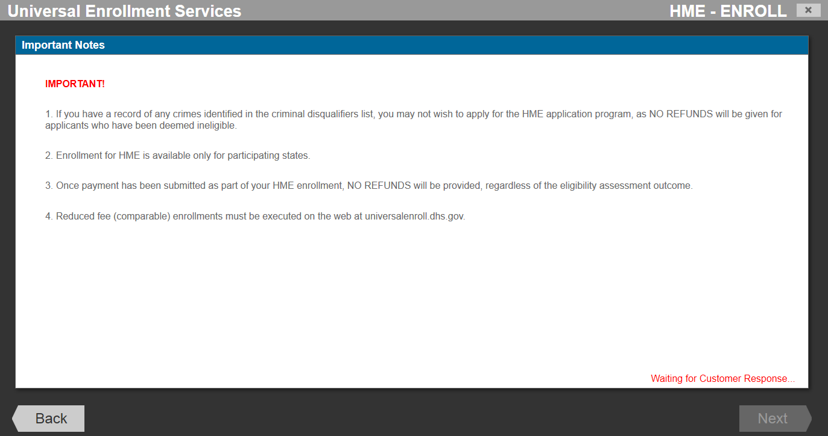
HME Standard Enrollment
START
Program/Location
Biographic Information
Notices
Citizenship
Documents
Attributes
Employment Information
Biometrics (Fingerprints)
Acknowledgements
Fee Payment
Survey
Submission/
Confirmation
FINISH

Slide 26
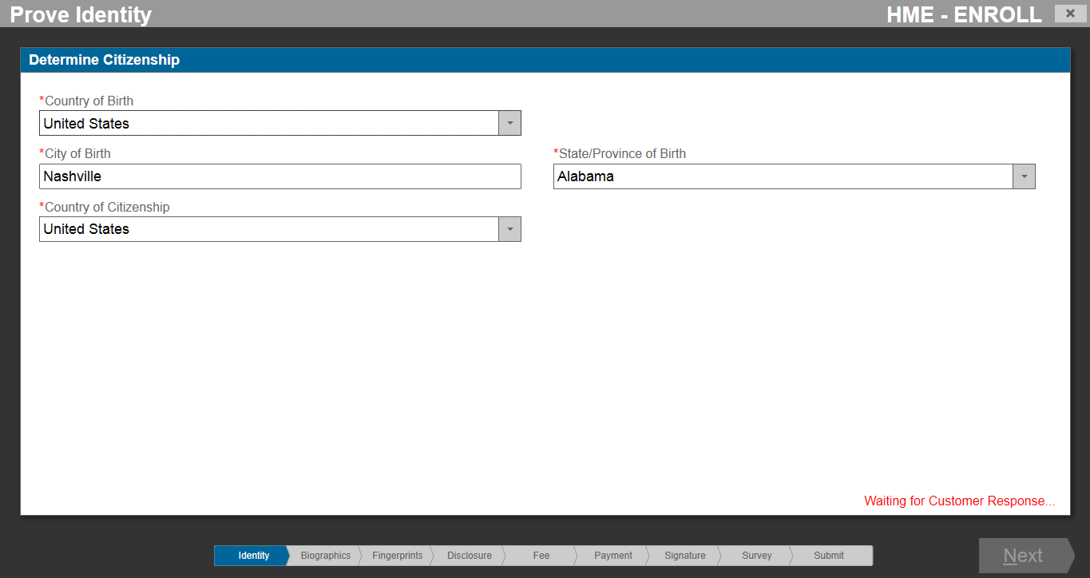
HME Standard Enrollment
START
Program/Location
Biographic Information
Notices
Citizenship
Documents
Attributes
Employment Information
Biometrics (Fingerprints)
Acknowledgements
Fee Payment
Survey
Submission/
Confirmation
FINISH

Slide 27
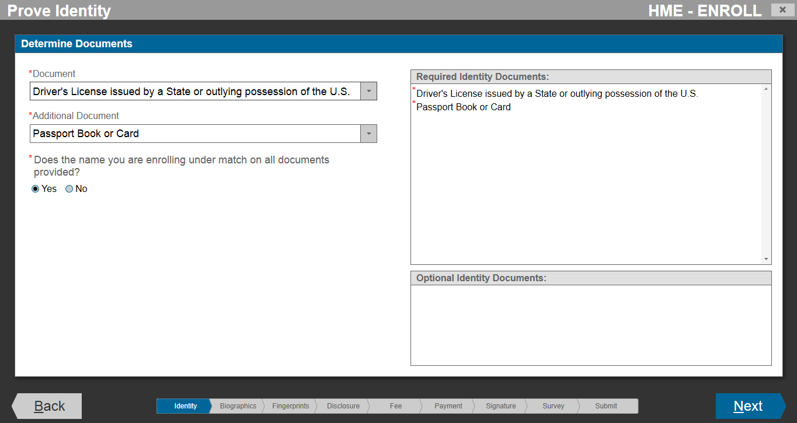
HME Standard Enrollment
START
Program/Location
Biographic Information
Notices
Citizenship
Documents
Attributes
Employment Information
Biometrics (Fingerprints)
Acknowledgements
Fee Payment
Survey
Submission/
Confirmation
FINISH

Slide 28
HME Standard Enrollment
START
Program/Location
Biographic Information
Notices
Citizenship
Documents
Attributes
Employment Information
Biometrics (Fingerprints)
Acknowledgements
Fee Payment
Survey
Submission/
Confirmation
FINISH

Slide 29
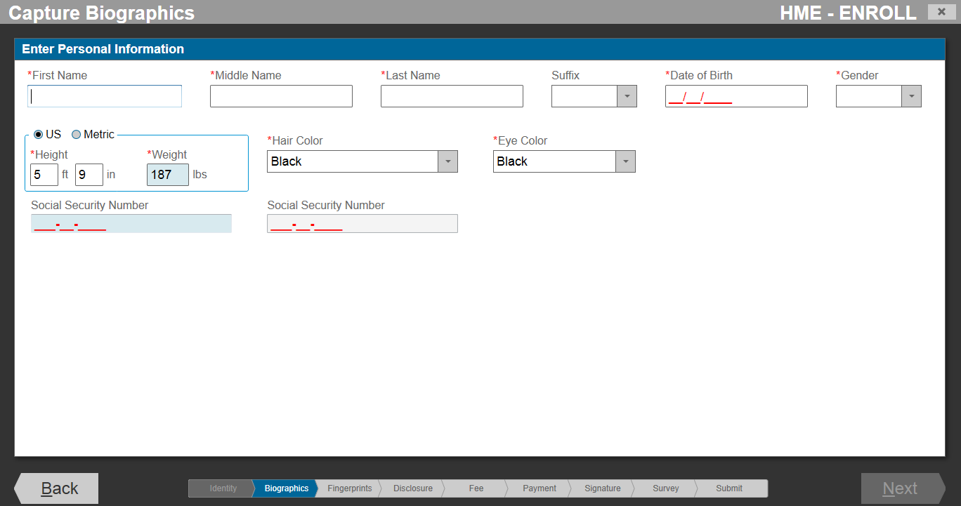
HME Standard Enrollment
START
Program/Location
Biographic Information
Notices
Citizenship
Documents
Attributes
Employment Information
Biometrics (Fingerprints)
Acknowledgements
Fee Payment
Survey
Submission/
Confirmation
FINISH

Slide 30
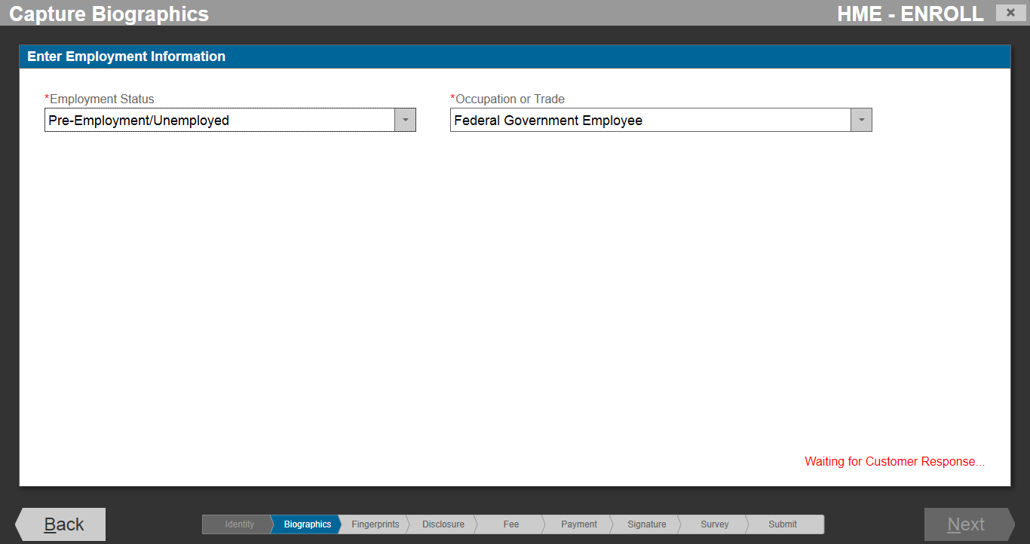
HME Standard Enrollment
START
Program/Location
Biographic Information
Notices
Citizenship
Documents
Attributes
Employment Information
Biometrics (Fingerprints)
Acknowledgements
Fee Payment
Survey
Submission/
Confirmation
FINISH

Slide 31
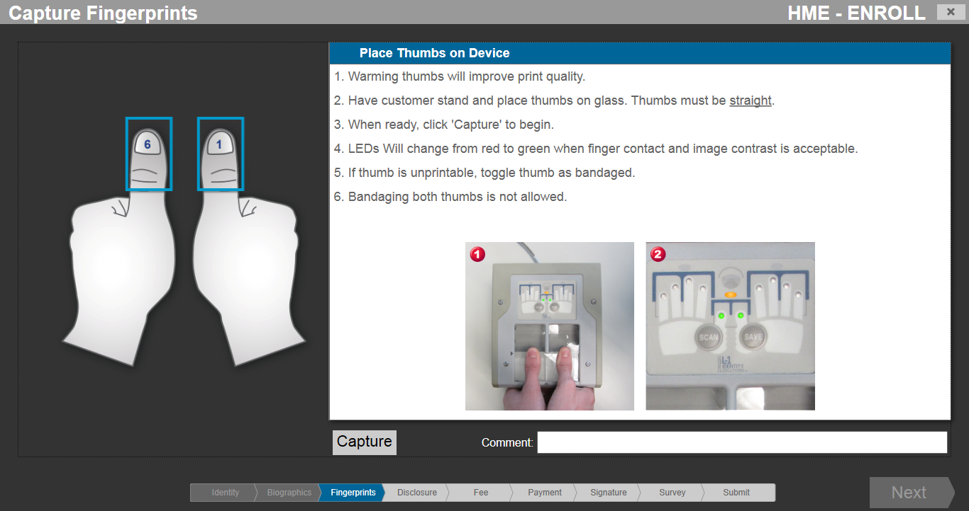
HME Standard Enrollment
START
Program/Location
Biographic Information
Notices
Citizenship
Documents
Attributes
Employment Information
Biometrics (Fingerprints)
Acknowledgements
Fee Payment
Survey
Submission/
Confirmation
FINISH

Slide 32
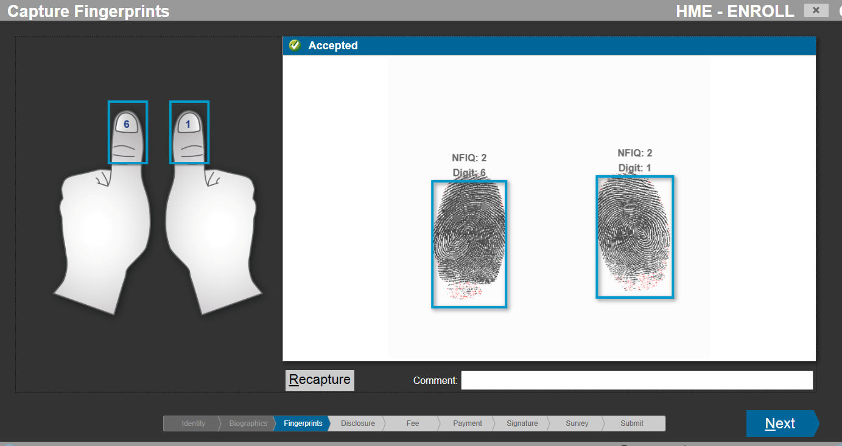
HME Standard Enrollment
START
Program/Location
Biographic Information
Notices
Citizenship
Documents
Attributes
Employment Information
Biometrics (Fingerprints)
Acknowledgements
Fee Payment
Survey
Submission/
Confirmation
FINISH

Slide 33
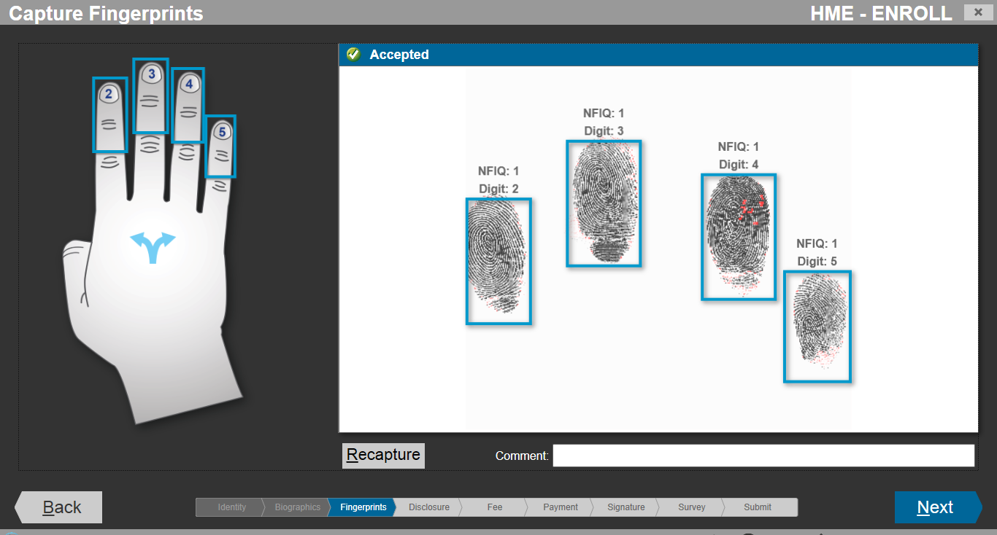
HME Standard Enrollment
START
Program/Location
Biographic Information
Notices
Citizenship
Documents
Attributes
Employment Information
Biometrics (Fingerprints)
Acknowledgements
Fee Payment
Survey
Submission/
Confirmation
FINISH

Slide 34
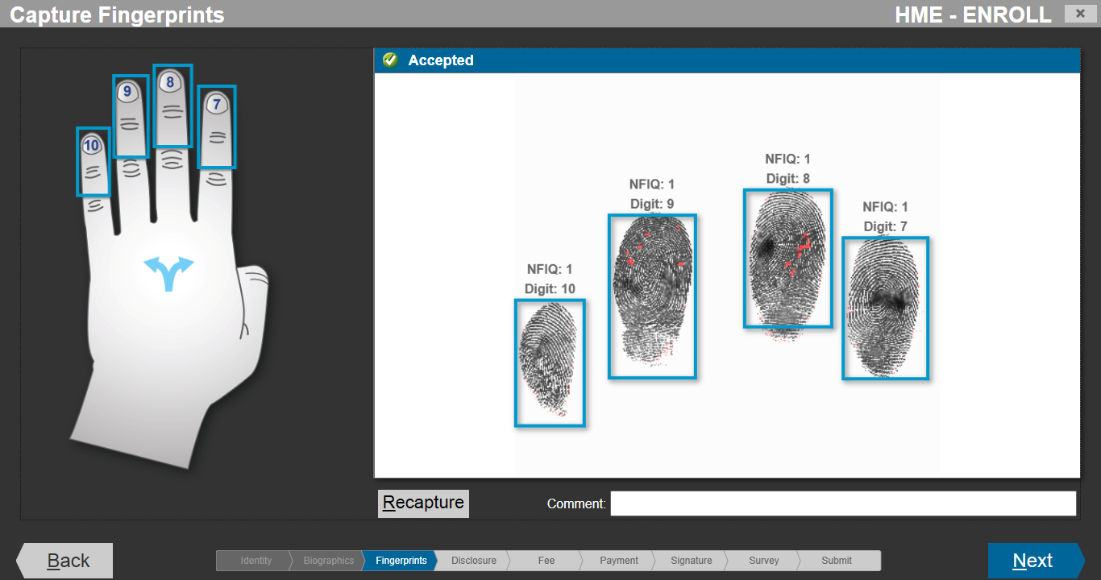
HME Standard Enrollment
START
Program/Location
Biographic Information
Notices
Citizenship
Documents
Attributes
Employment Information
Biometrics (Fingerprints)
Acknowledgements
Fee Payment
Survey
Submission/
Confirmation
FINISH

Slide 35
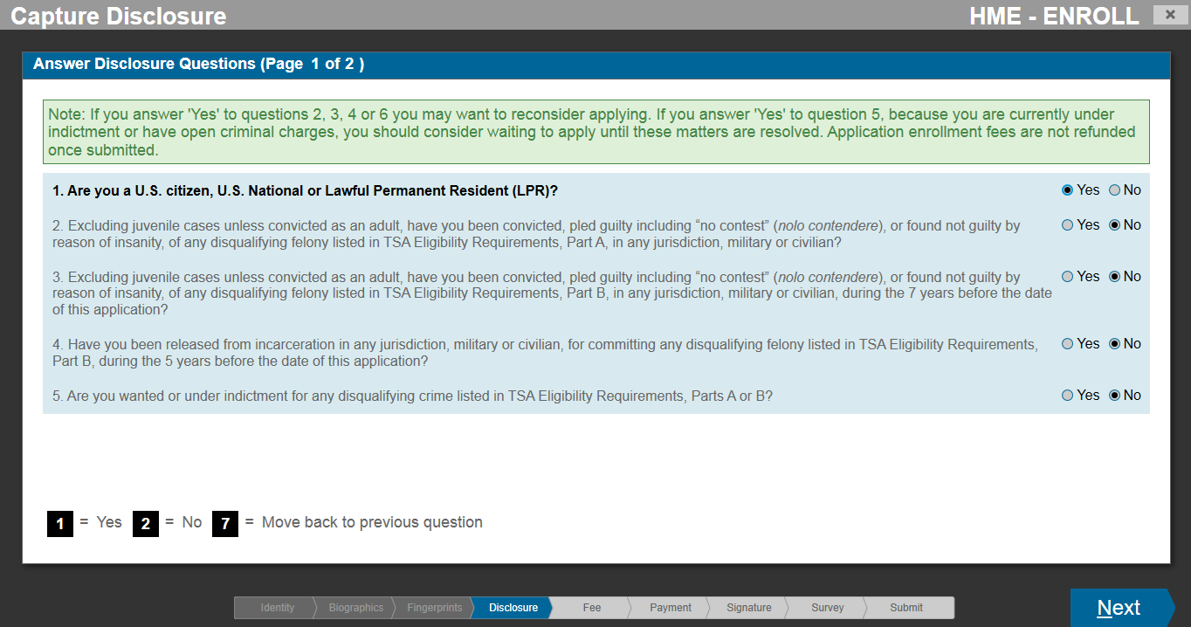
HME Standard Enrollment
START
Program/Location
Biographic Information
Notices
Citizenship
Documents
Attributes
Employment Information
Biometrics (Fingerprints)
Acknowledgements
Fee Payment
Survey
Submission/
Confirmation
FINISH

Slide 36
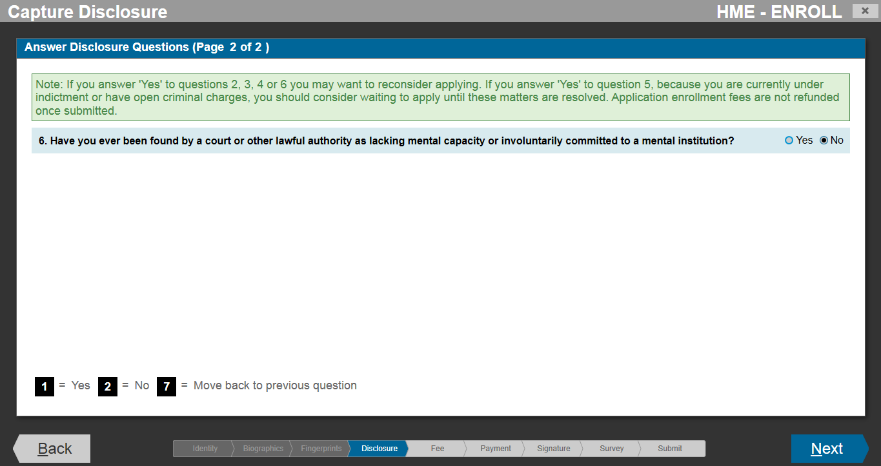
HME Standard Enrollment
START
Program/Location
Biographic Information
Notices
Citizenship
Documents
Attributes
Employment Information
Biometrics (Fingerprints)
Acknowledgements
Fee Payment
Survey
Submission/
Confirmation
FINISH

Slide 37
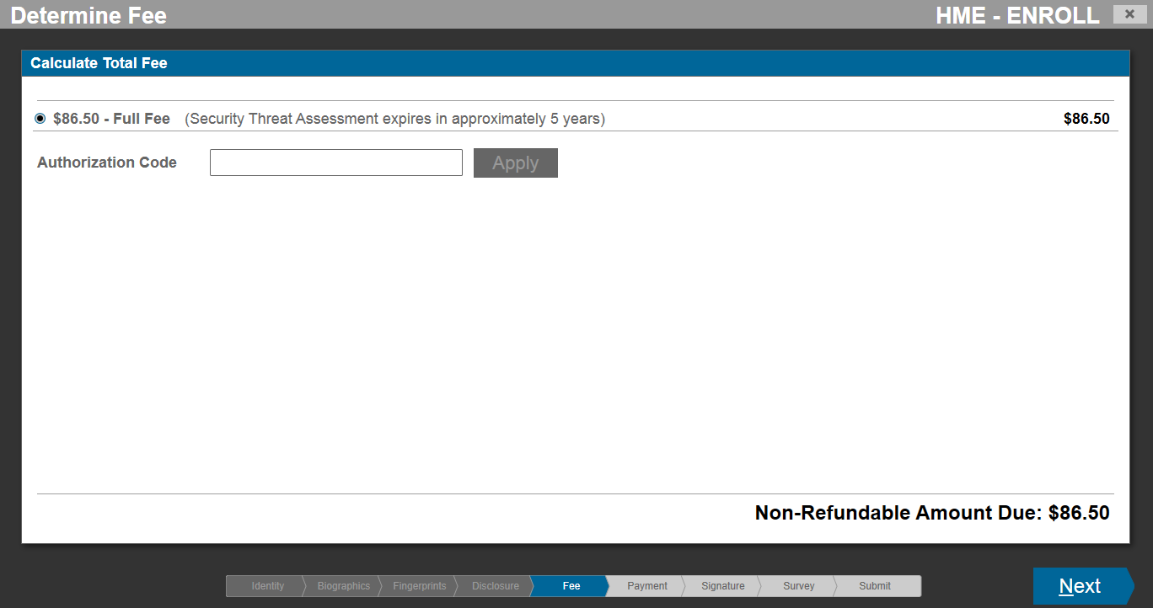
HME Standard Enrollment
START
Program/Location
Biographic Information
Notices
Citizenship
Documents
Attributes
Employment Information
Biometrics (Fingerprints)
Acknowledgements
Fee Payment
Survey
Submission/
Confirmation
FINISH

Slide 38
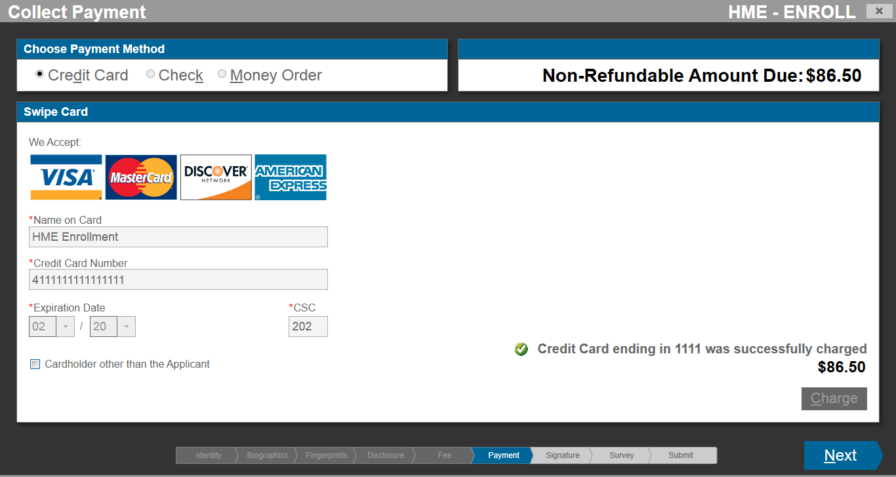
HME Standard Enrollment
START
Program/Location
Biographic Information
Notices
Citizenship
Documents
Attributes
Employment Information
Biometrics (Fingerprints)
Acknowledgements
Fee Payment
Survey
Submission/
Confirmation
FINISH

Slide 39
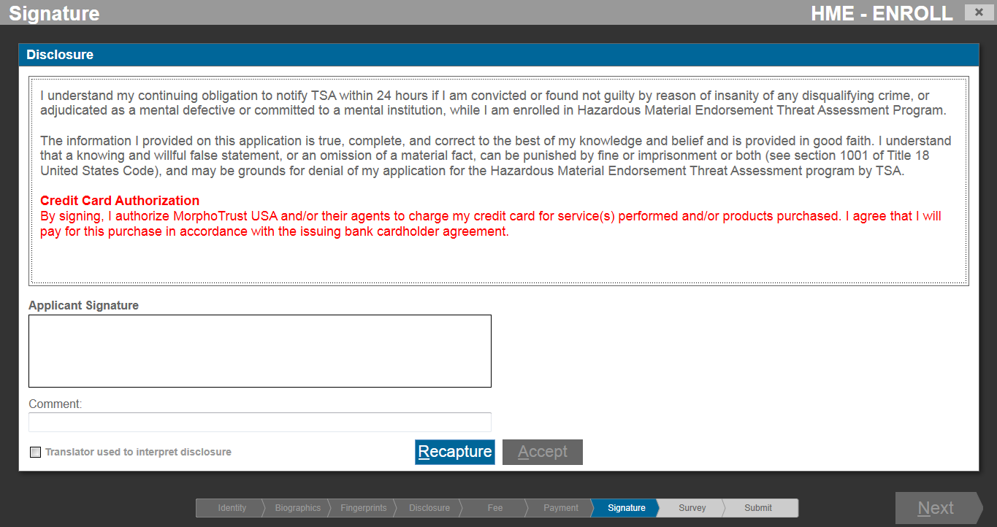
HME Standard Enrollment
START
Program/Location
Biographic Information
Notices
Citizenship
Documents
Attributes
Employment Information
Biometrics (Fingerprints)
Acknowledgements
Fee Payment
Survey
Submission/
Confirmation
FINISH

Slide 40
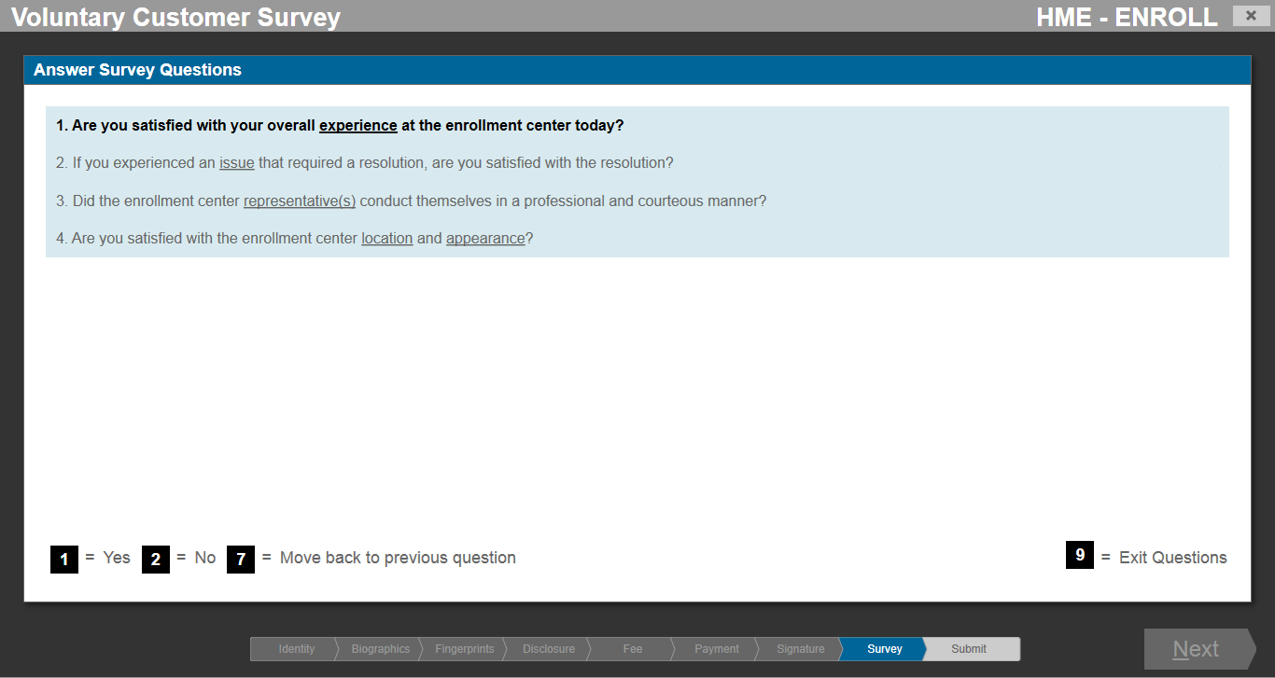
HME Standard Enrollment
START
Program/Location
Biographic Information
Notices
Citizenship
Documents
Attributes
Employment Information
Biometrics (Fingerprints)
Acknowledgements
Fee Payment
Survey
Submission/
Confirmation
FINISH

Slide 41
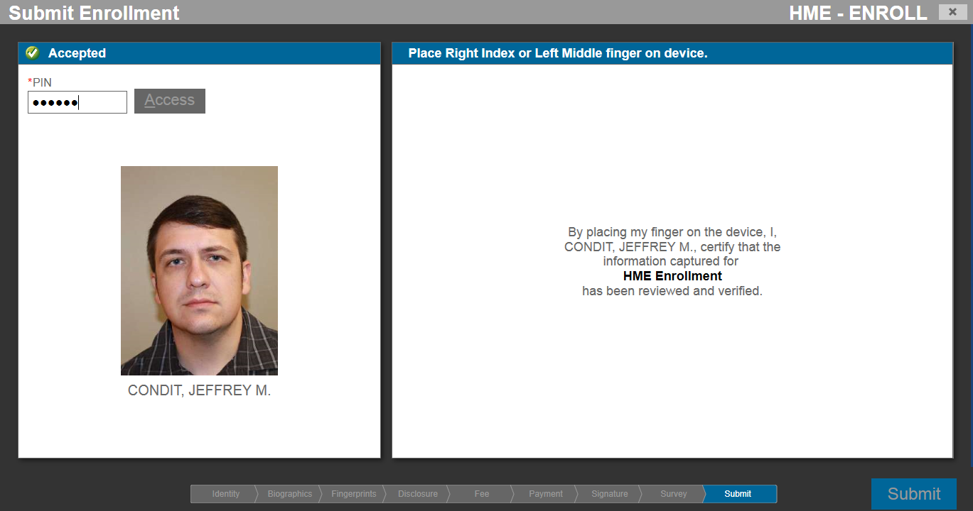
HME Standard Enrollment
START
Program/Location
Biographic Information
Notices
Citizenship
Documents
Attributes
Employment Information
Biometrics (Fingerprints)
Acknowledgements
Fee Payment
Survey
Submission/
Confirmation
FINISH

Slide 42
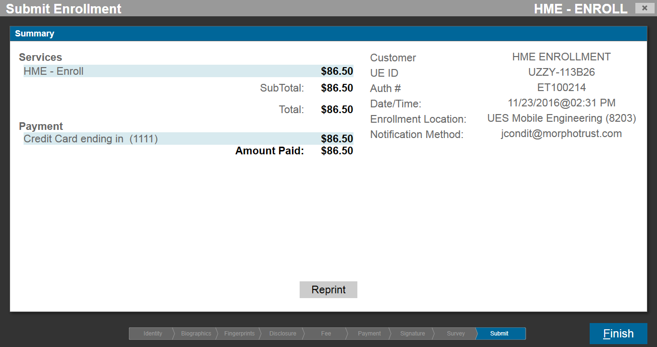
HME Standard Enrollment
START
Program/Location
Biographic Information
Notices
Citizenship
Documents
Attributes
Employment Information
Biometrics (Fingerprints)
Acknowledgements
Fee Payment
Survey
Submission/
Confirmation
FINISH

Slide 43
Part 3
HME Online Renewal Workflow (Proposed)

Slide 44
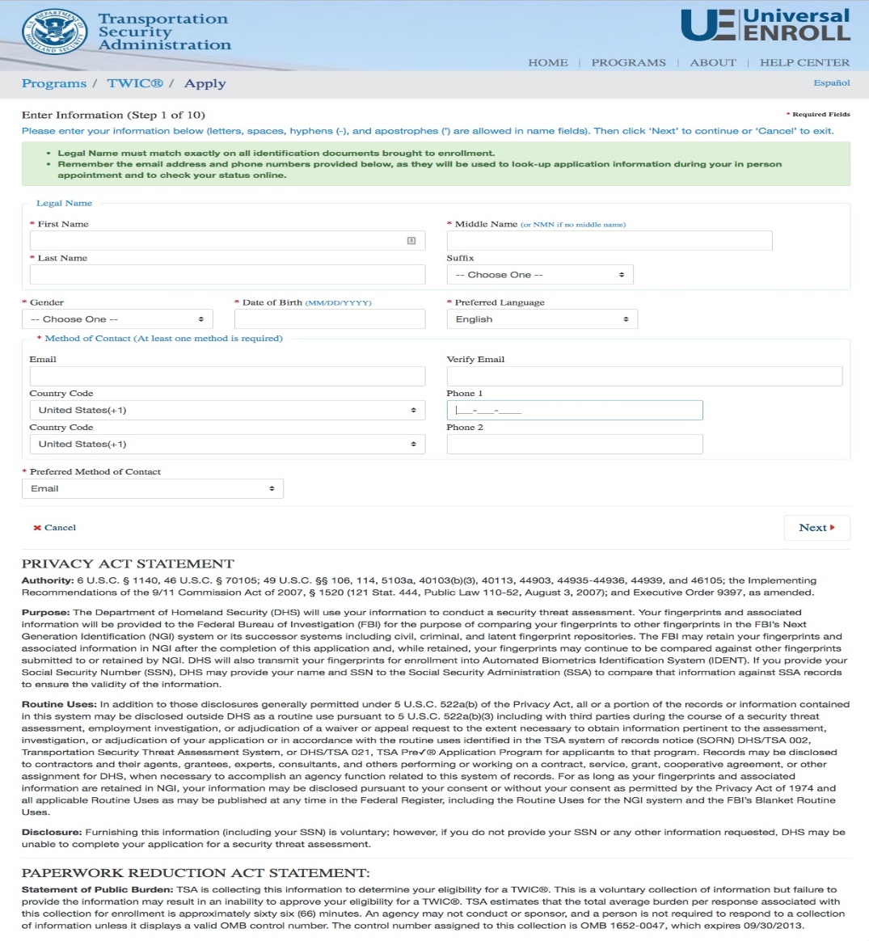
HME Online Renewal
*Screenshots are examples only and actual online renewal screens may differ based on development considerations.
START
Biographic Information
Notices
Citizenship
Applicants may be required to enter their current or expired CDL State of License and the CDL identification number, to confirm the applicant’s information.
Attributes/State
Employment Information
Acknowledgements
Fee Payment
Submission/
Confirmation
Survey
FINISH

Slide 45
HME Online Renewal
*Screenshots are examples only and actual online renewal screens may differ based on development considerations.
START
Biographic Information
Notices
Citizenship
Attributes/State
Employment Information
Acknowledgements
Fee Payment
Submission/
Confirmation
Survey
FINISH

Slide 46
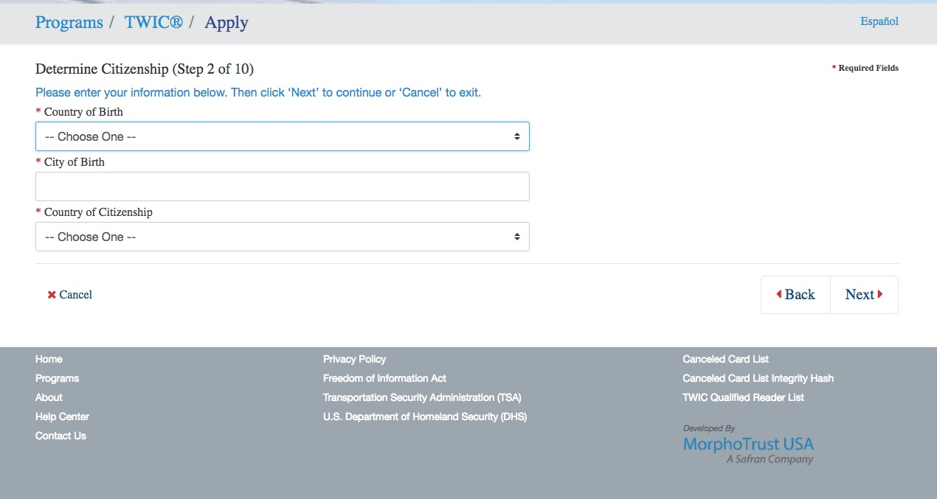
HME Online Renewal
*Screenshots are examples only and actual online renewal screens may differ based on development considerations.
START
Biographic Information
Notices
Citizenship
Attributes/State
Employment Information
Acknowledgements
Fee Payment
Submission/
Confirmation
Survey
FINISH

Slide 47
HME Online Renewal
*Screenshots are examples only and actual online renewal screens may differ based on development considerations.
START
Biographic Information
Notices
Citizenship
Attributes/State
Employment Information
Acknowledgements
Fee Payment
Applicants may be required to notify TSA if their State of license has changed since the previous enrollment for a TSA STA. If so, a new field or screen may be generated requesting that the applicant select their new State of license.
Submission/
Confirmation
Survey
FINISH

Slide 48
HME Online Renewal
*Screenshots are examples only and actual online renewal screens may differ based on development considerations.
START
Biographic Information
Notices
Citizenship
Attributes/State
Employment Information
Acknowledgements
Fee Payment
Submission/
Confirmation
Survey
FINISH

Slide 49
HME Online Renewal
*Screenshots are examples only and actual online renewal screens may differ based on development considerations.
START
Biographic Information
Notices
Citizenship
Attributes/State
Employment Information
Acknowledgements
Fee Payment
Submission/
Confirmation
Survey
FINISH

Slide 50
HME Online Renewal
*Screenshots are examples only and actual online renewal screens may differ based on development considerations.
START
Biographic Information
Notices
Citizenship
Attributes/State
Employment Information
Acknowledgements
Fee Payment
Submission/
Confirmation
Survey
FINISH

Slide 51
HME Online Renewal
*Screenshots are examples only and actual online renewal screens may differ based on development considerations.
START
Biographic Information
Notices
Citizenship
*Note: The HME online renewal fee may be reduced to reflect the enrollment segment costs of online transaction. (The example depicts the HME standard enrollment fee.)
Applicants may enter an Authorization Code for payment if obtained from TSA or another Federal agency.
Attributes/State
Employment Information
Acknowledgements
Fee Payment
Submission/
Confirmation
Survey
FINISH

Slide 52
HME Online Renewal
*Screenshots are examples only and actual online renewal screens may differ based on development considerations.
START
Biographic Information
Notices
*Note: The HME online renewal fee may be reduced to reflect the enrollment segment costs of online transaction. (The example depicts the HME standard enrollment fee.)
Applicants may enter an Authorization Code for payment if obtained from TSA or another Federal agency.
Citizenship
Attributes/State
Employment Information
Acknowledgements
Fee Payment
Submission/
Confirmation
Survey
FINISH

Slide 53
HME Online Renewal
*Screenshots are examples only and actual online renewal screens may differ based on development considerations.
START
Biographic Information
Notices
Citizenship
*Note: The HME online renewal fee may be reduced to reflect the enrollment segment costs of online transaction. (The example depicts the HME standard enrollment fee.)
Applicants may enter an Authorization Code for payment if obtained from TSA or another Federal agency.
Attributes/State
Employment Information
Acknowledgements
Fee Payment
Submission/
Confirmation
Survey
FINISH

Slide 54
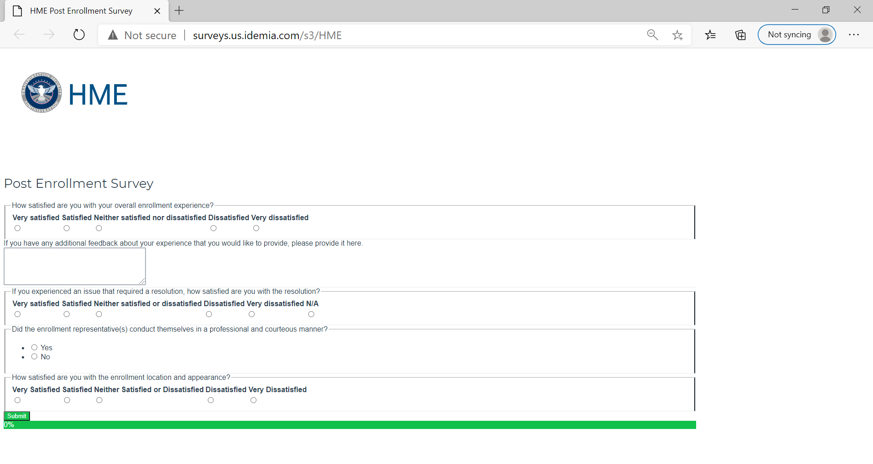
HME Online Renewal
*Screenshots are examples only and actual online renewal screens may differ based on development considerations.
START
Biographic Information
Notices
Citizenship
Attributes/State
Employment Information
Acknowledgements
Fee Payment
Submission/
Confirmation
Survey
FINISH

Slide 55
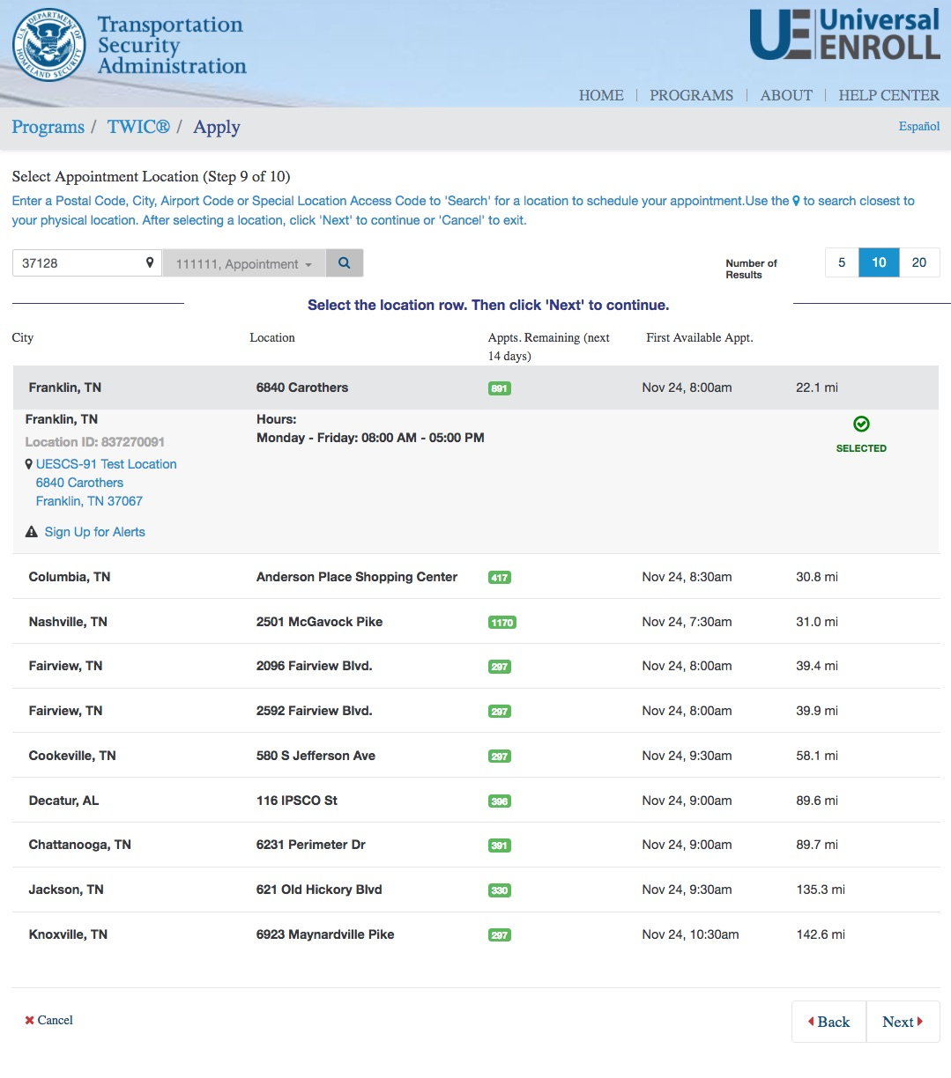
HME Online Renewal
*Screenshots are examples only and actual online renewal screens may differ based on development considerations.
If during the online renewal process TSA determines that the applicant is required to visit an enrollment center in-person to provide updated biographic or biometric information, the applicant will have the opportunity to schedule an appointment.

Slide 56
Part 4
HME Post-Enrollment Survey

Slide 57
HME Post-Enrollment Survey
*Screenshots are examples only and actual online screens may differ based on development considerations.
Do you want to participate in this optional survey?
YES
NO
All applicants receive the option to complete a post-enrollment survey. Currently, this survey is offered during the in-person standard enrollment workflow at the enrollment workstation.
TSA plans to transition the optional survey to a web-based survey that will be sent to HME applicants who use TSA’s enrollment provider via e-mail or hyperlink following submission of their enrollment. Applicants will have the ability to complete the optional survey after departing the enrollment site.

