Slide 1
Application and Instructions for Firms Applying for Certification to Conduct Lead-Based Paint Activities and/or Renovations
OMB Control No. 2070-0195

Slide 2
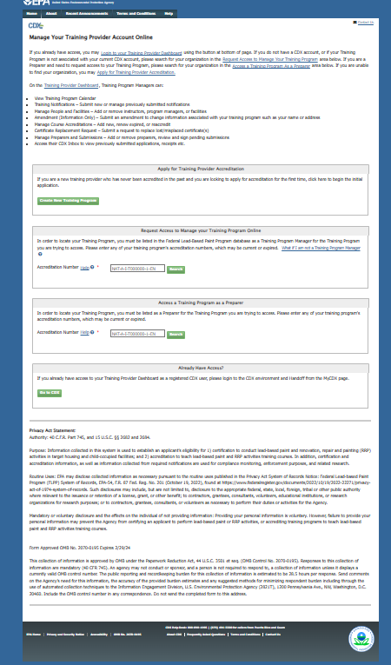
OMB Control No. 2070-0195
Expiration: 2/28/2025
EPA Form 8500-27
Notes:
Training Provider

Slide 3
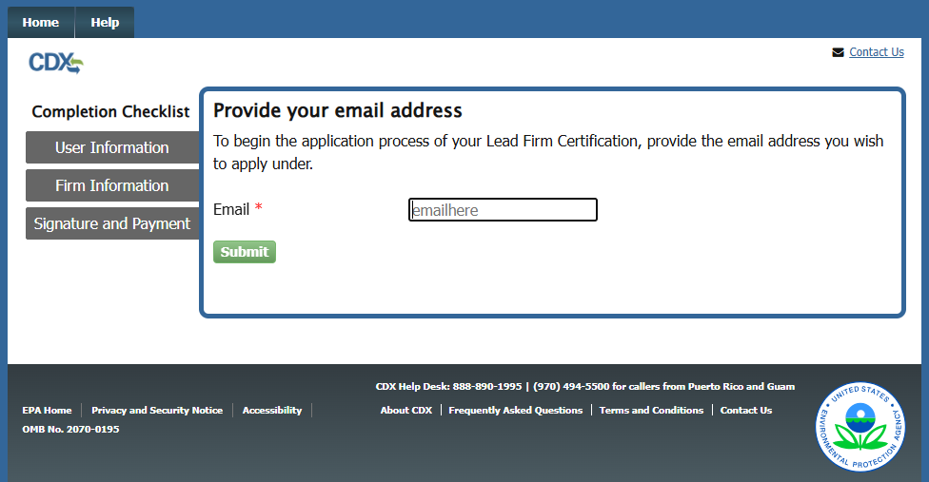
OMB Control No. 2070-0195
Expiration: 2/28/2025
EPA Form No. 8500-027
Notes:
Validating account

Slide 4
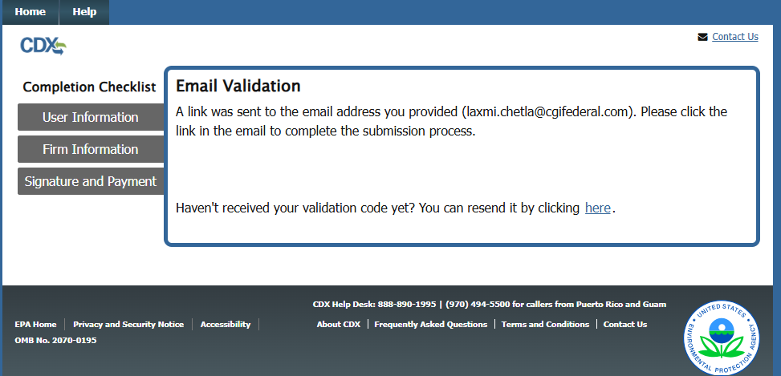
OMB Control No. 2070-0195
Expiration: 2/28/2025
EPA Form No. 8500-027
Notes:
Validating account

Slide 5
OMB Control No. 2070-0195
Expiration: 2/28/2025
EPA Form No. 8500-027
Notes:
Validating account

Slide 6
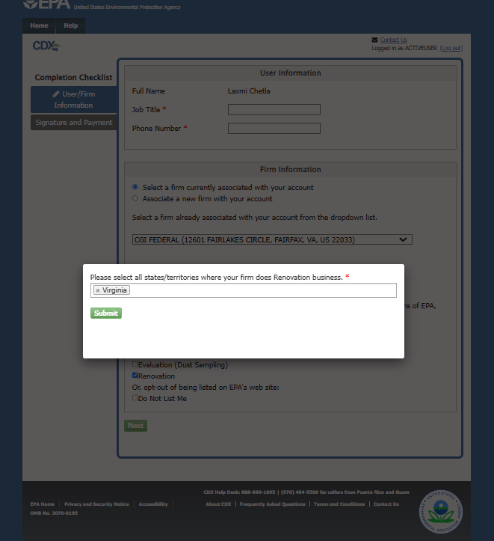
OMB Control No. 2070-0195
Expiration: 2/28/2025
EPA Form No. 8500-027
Notes:
Firm application Process

Slide 7
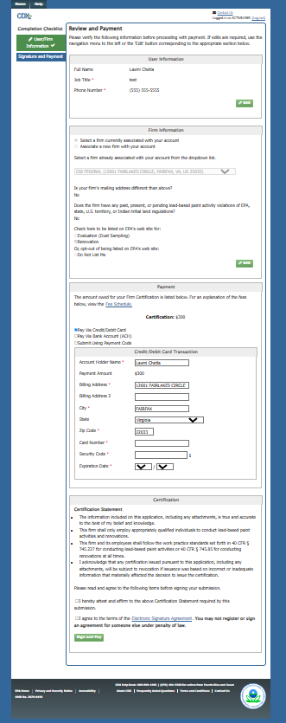
OMB Control No. 2070-0195
Expiration: 2/28/2025
EPA Form No. 8500-027
Notes:
Review and Payment

Slide 8
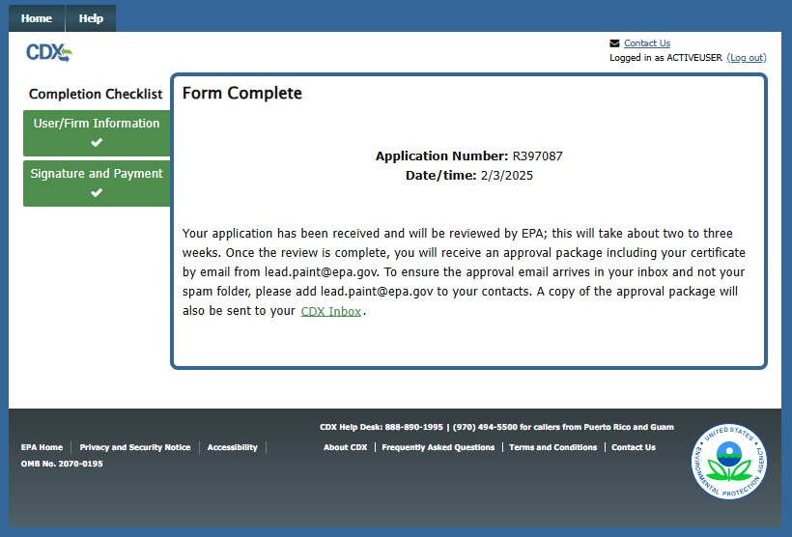
OMB Control No. 2070-0195
Expiration: 2/28/2025
EPA Form No. 8500-027
Notes:
Review and Payment

Slide 9
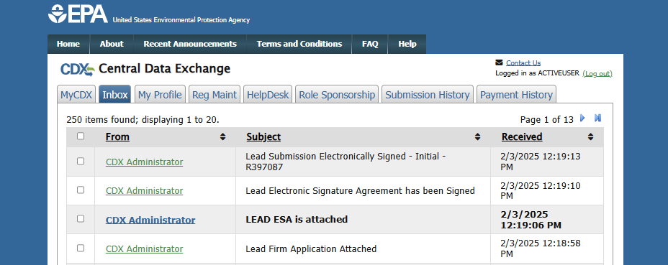
OMB Control No. 2070-0195
Expiration: 2/28/2025
EPA Form No. 8500-027
Notes:
User receives Firm application, ESA and receipt

