Slide 1
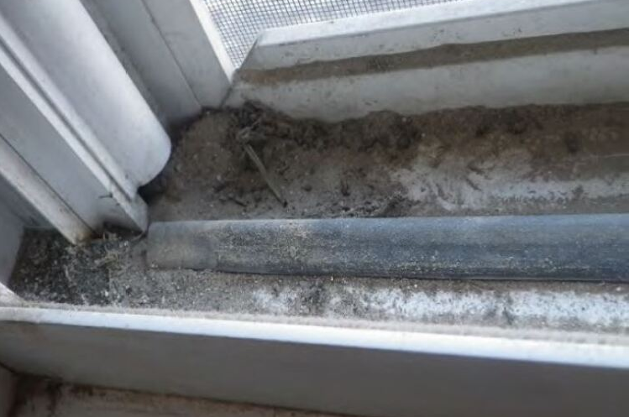
Abatement Notification
OMB Control No. 2070-0195
OCSPP-OPPT
www.uswateralliance.org

Slide 2
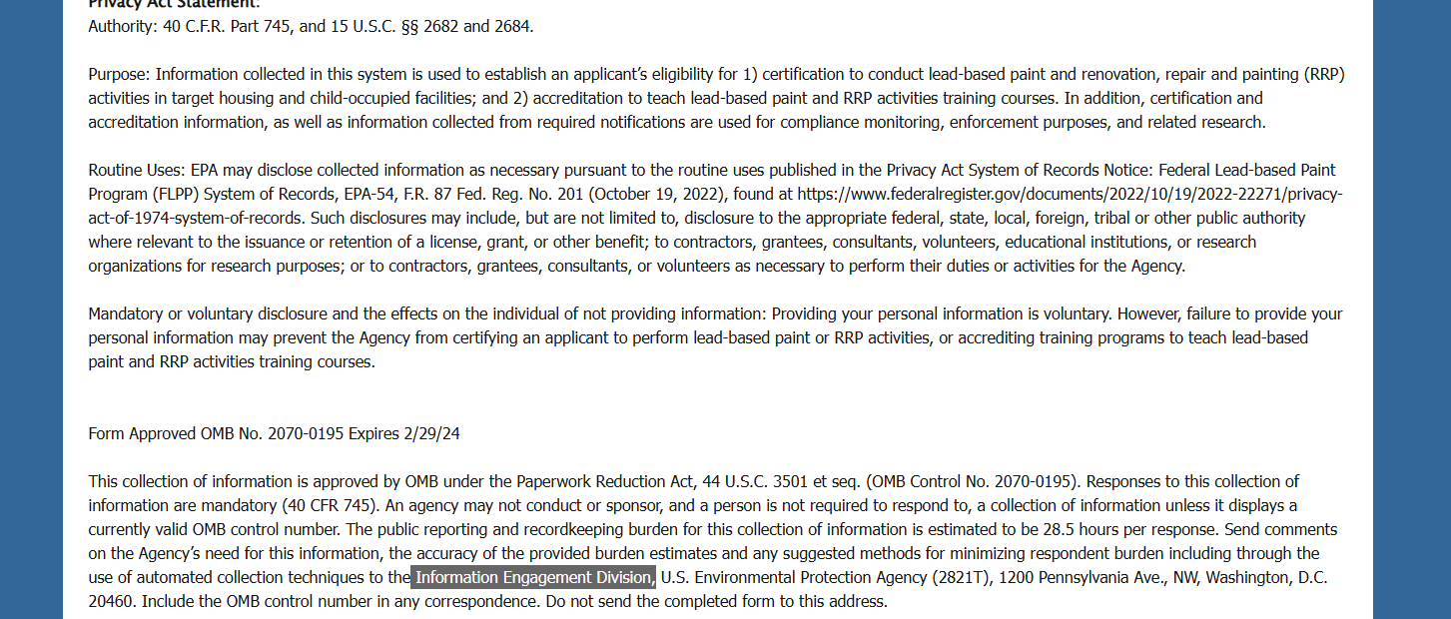
OMB Control No. 2070-0195
Expiration Date: 2/28/2025
EPA Form 9600-051
OCSPP-OPPT
1
www.uswateralliance.org

Slide 3
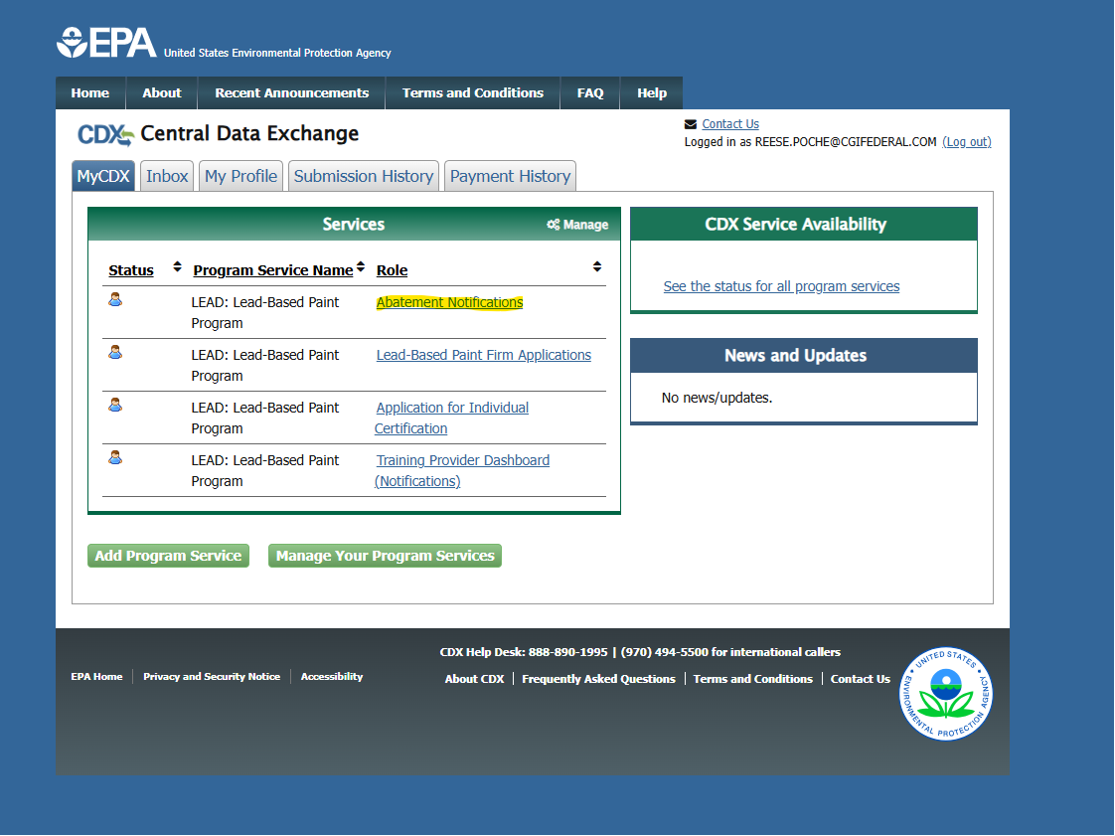
OMB Control No. 2070-0195 Expiration Date: 2/28/2025
EPA Form 9600-051
OCSPP-OPPT
1
www.uswateralliance.org

Slide 4
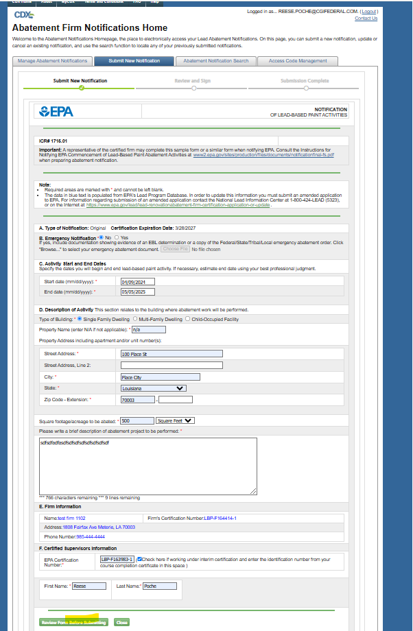
OMB Control No. 2070-0195 Expiration Date: 2/28/2025
EPA Form 9600-051
OCSPP-OPPT
1
www.uswateralliance.org

Slide 5
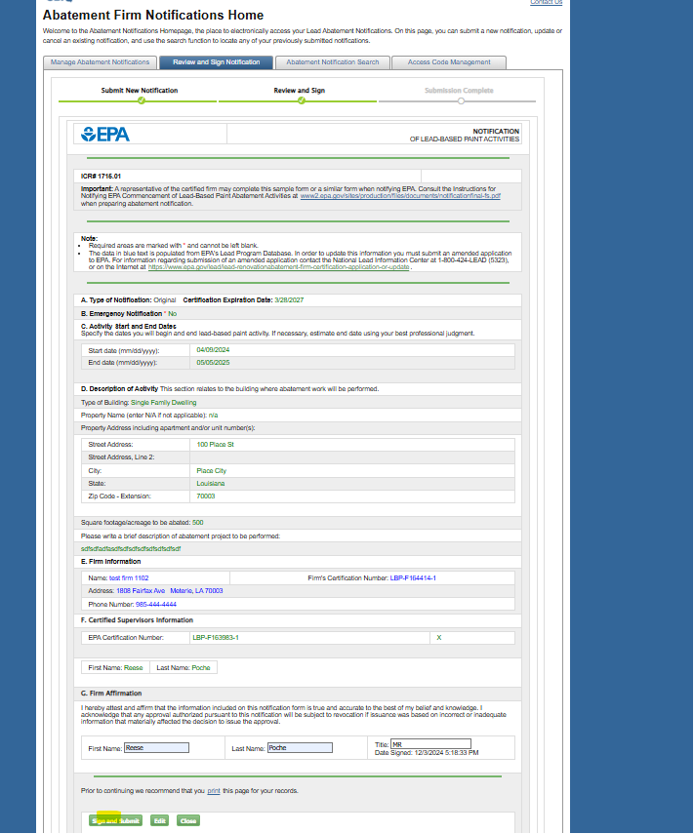
OMB Control No. 2070-0195 Expiration Date: 2/28/2025
EPA Form 9600-051
OCSPP-OPPT
1
www.uswateralliance.org

