Slide 1
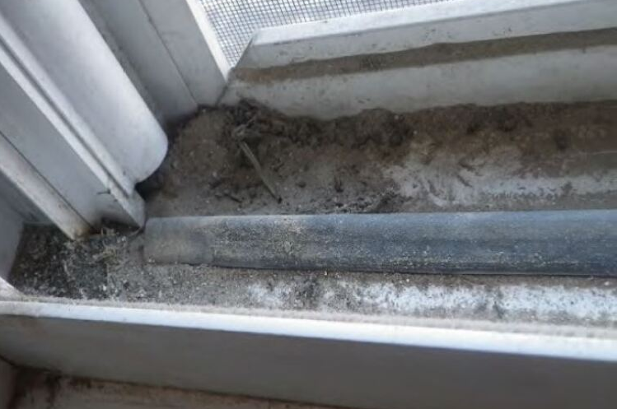
Post Training Notifications
OMB Control No. 2070-0195
OCSPP-OPPT
www.uswateralliance.org

Slide 2
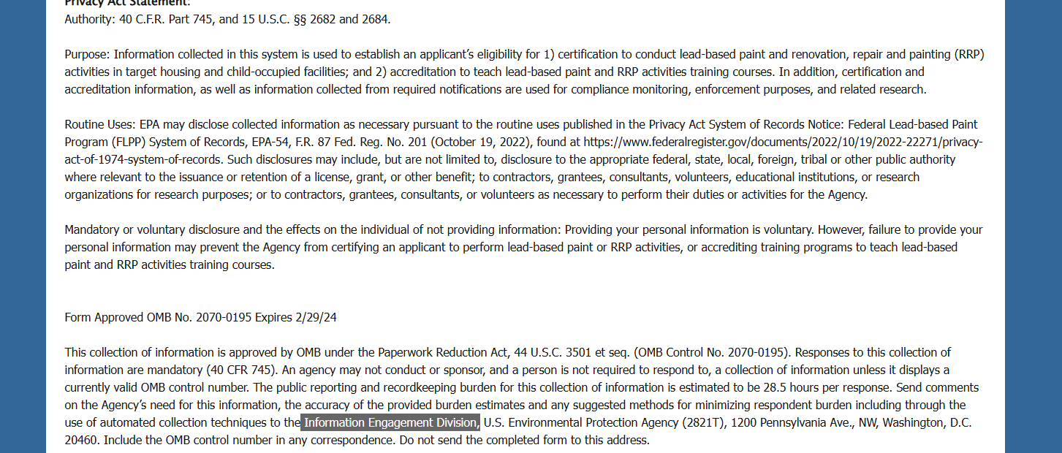
OMB Control No. 2070-0195
Expiration Date: 2/28/2025
EPA Form 9600-052
OCSPP-OPPT
1
www.uswateralliance.org

Slide 3
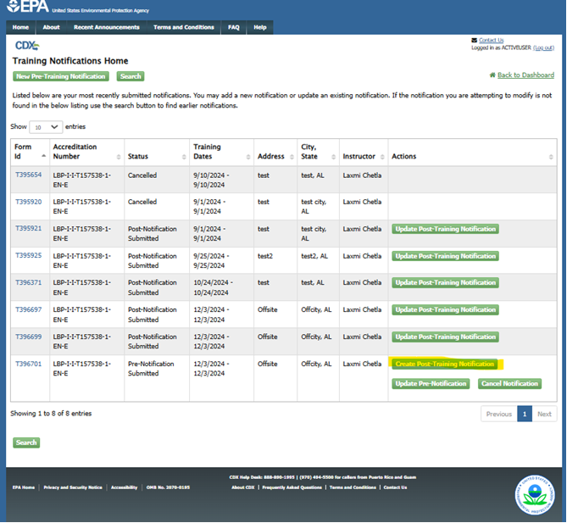
OMB Control No. 2070-0195 Expiration Date: 2/28/2025
EPA Form 9600-052
OCSPP-OPPT
1
www.uswateralliance.org

Slide 4
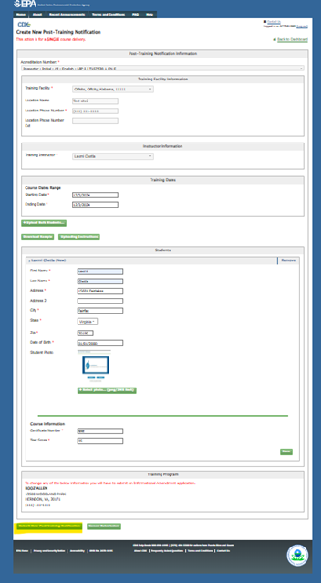
OMB Control No. 2070-0195 Expiration Date: 2/28/2025
EPA Form No. 9600-052
OCSPP-OPPT
1
www.uswateralliance.org

Slide 5
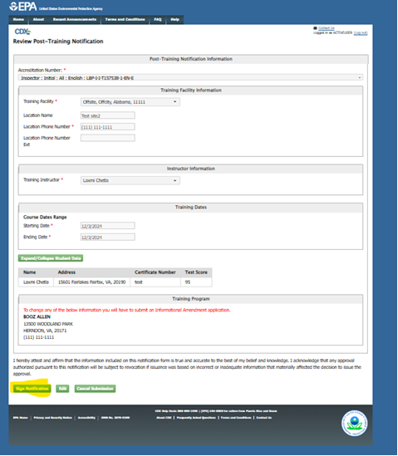
OMB Control No. 2070-0195 2070-
Expiration Date: 2/28/2025
EPA Form No. 9600-052
OCSPP-OPPT
1
www.uswateralliance.org

Slide 6
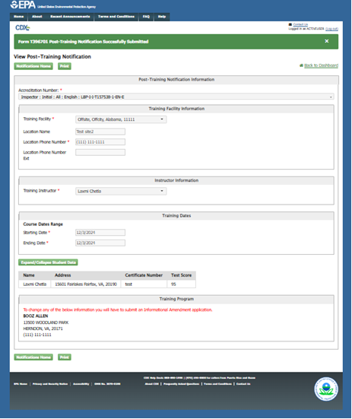
OMB Control No. 2070-0195 Expiration Date: 2/28/2025
EPA Form No. 9600-052
OCSPP-OPPT
1
www.uswateralliance.org

