Slide 1


ESTA Mobile App
I-Solutions Division
Passenger Systems Program Directorate (PSPD)
Office of Information Technology (OIT)
US Customs Border Protection (US CBP)

Slide 2
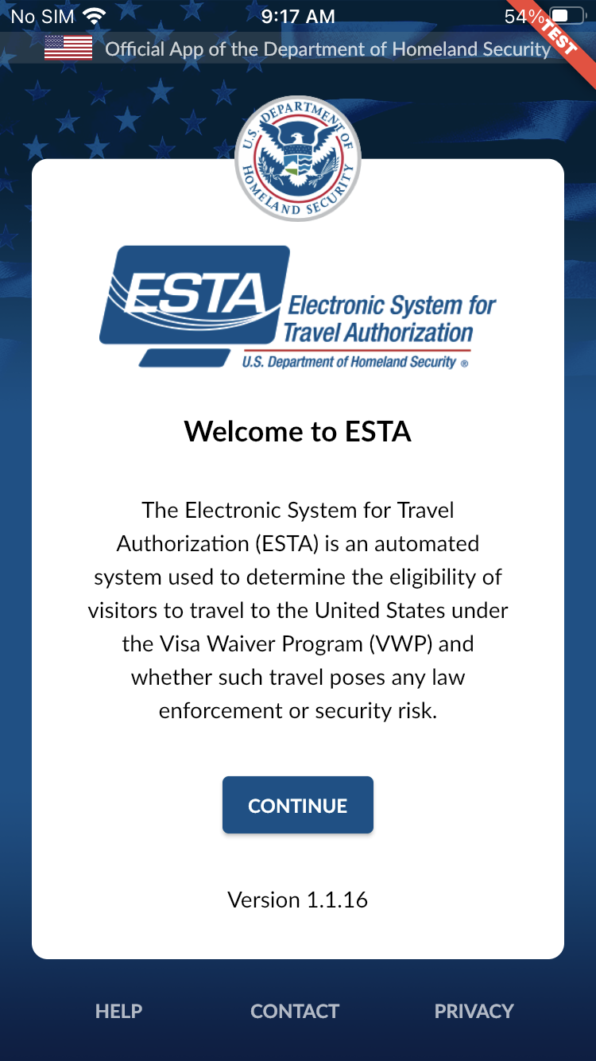
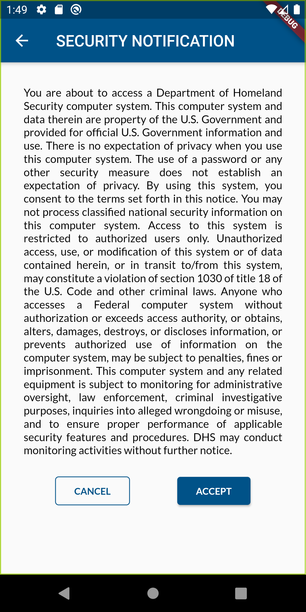
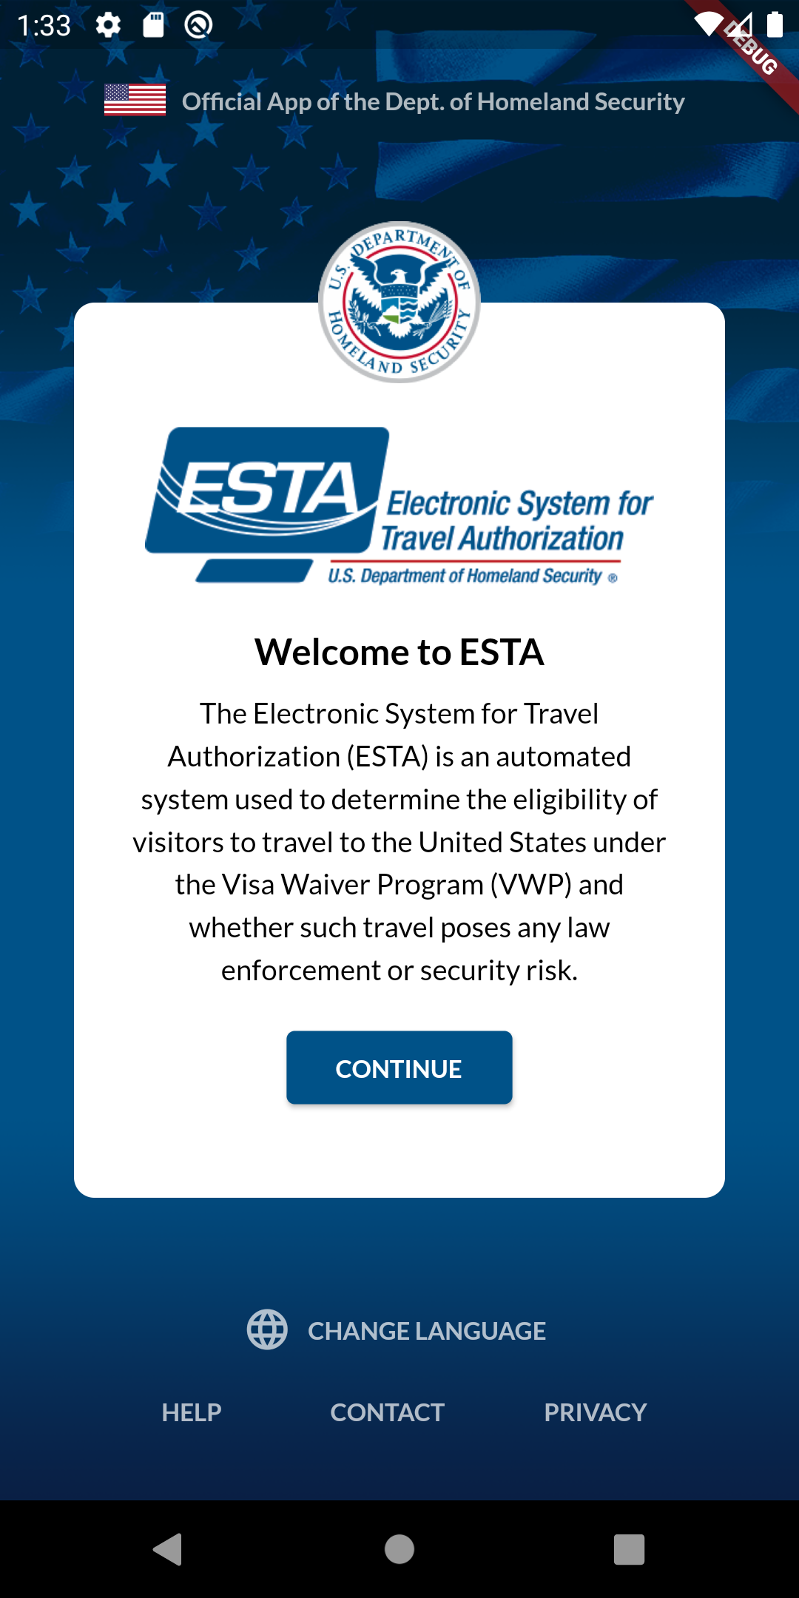
ESTA Mobile App – Welcome Page
2
1
CBP | OIT

Slide 3
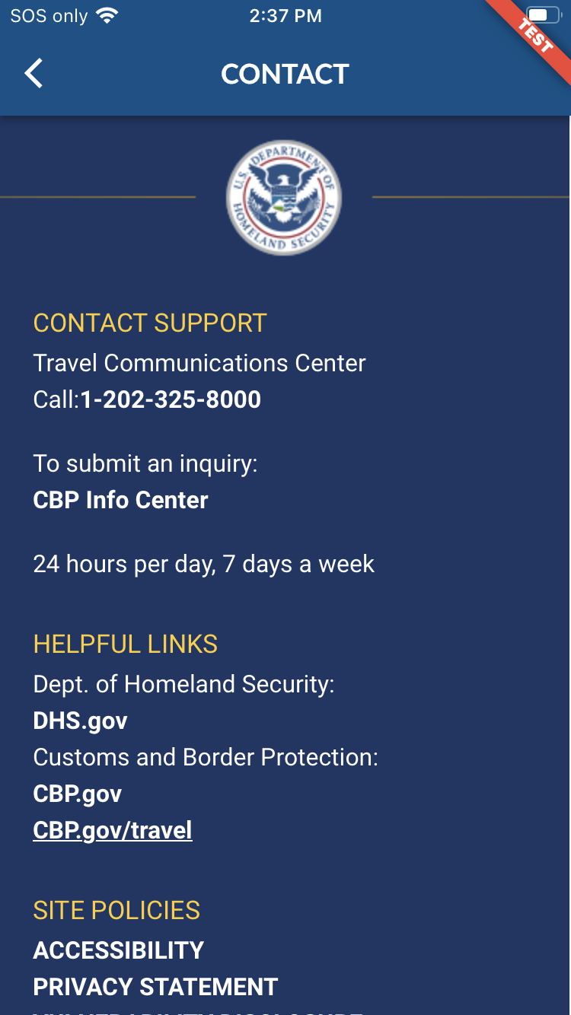
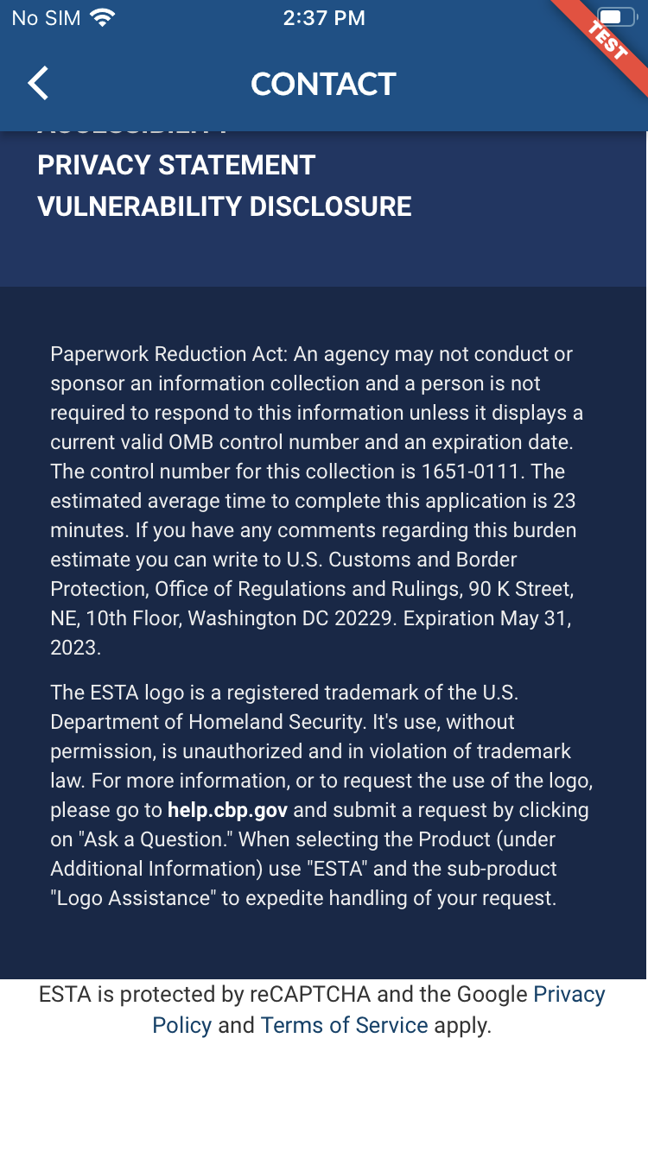
ESTA Mobile App – Contact Page
CBP | OIT

Slide 4
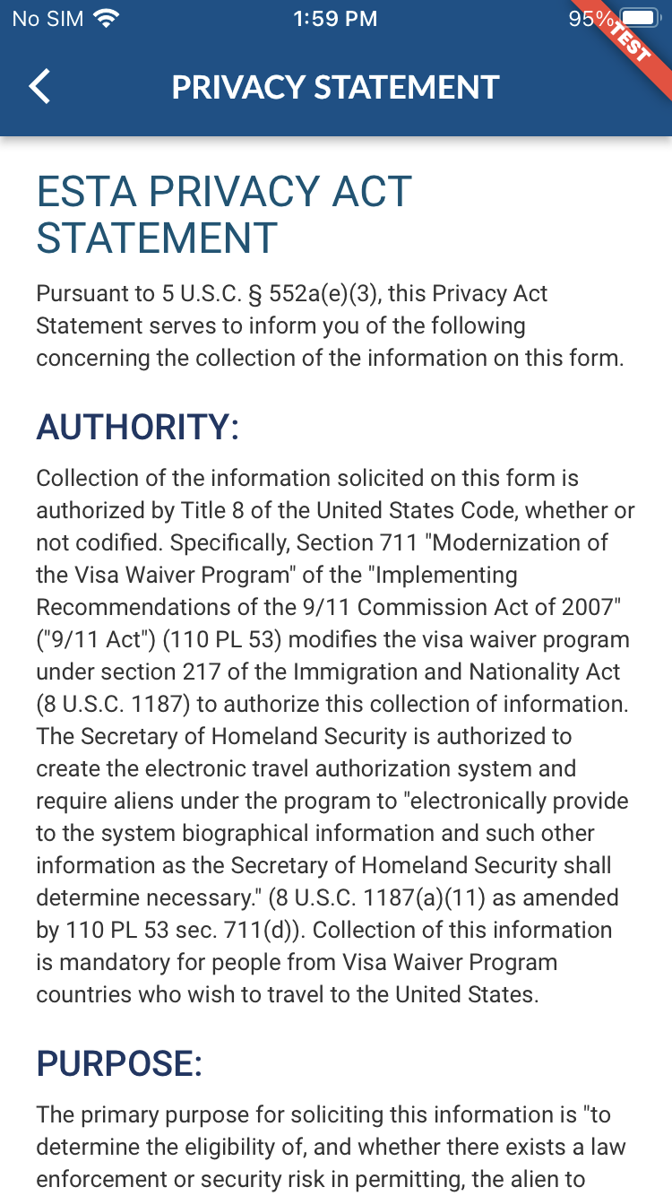
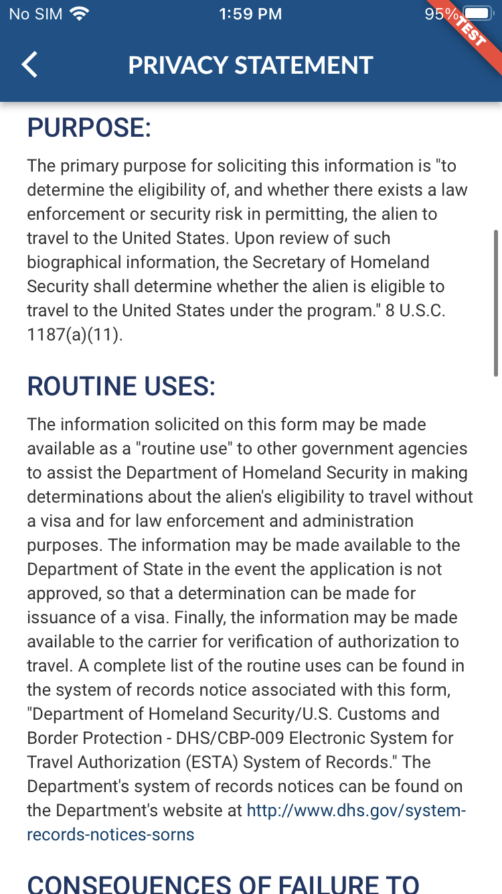
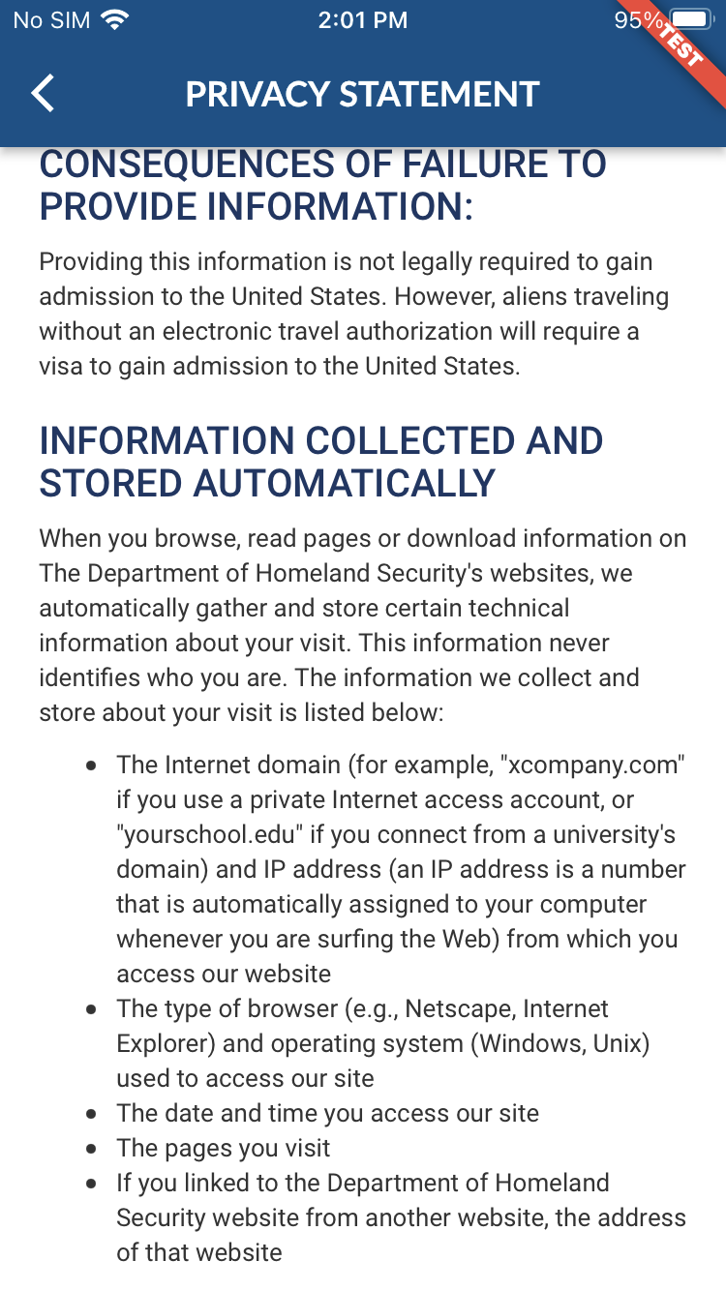
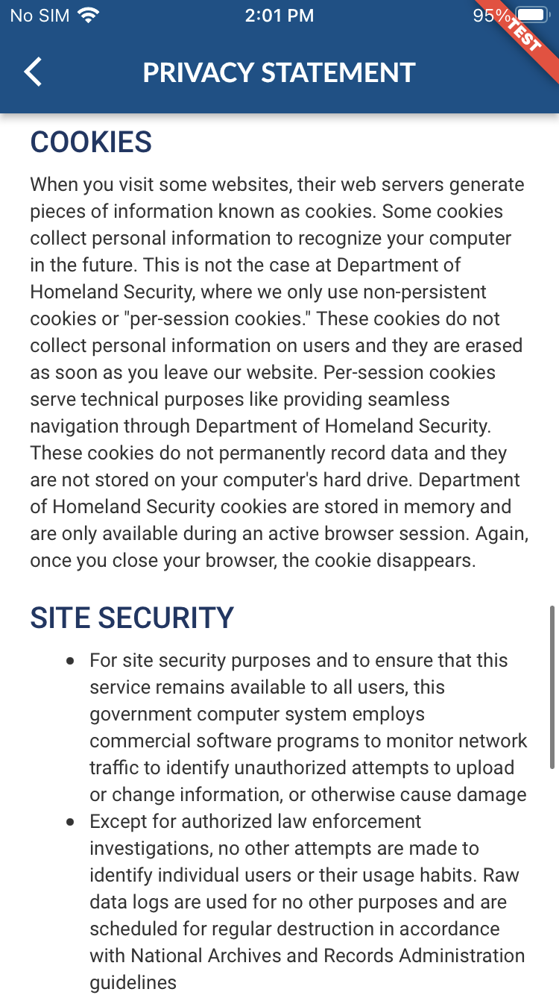
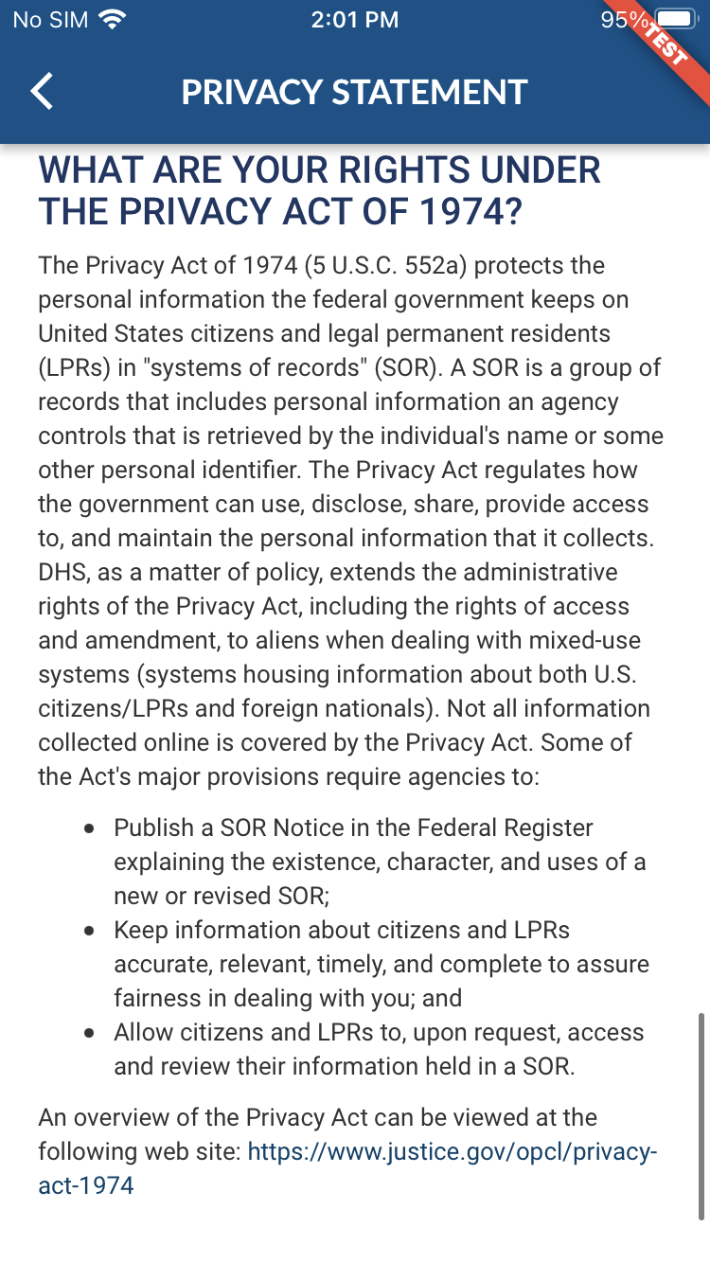
ESTA Mobile App – Privacy Act Statement Page
CBP | OIT

Slide 5
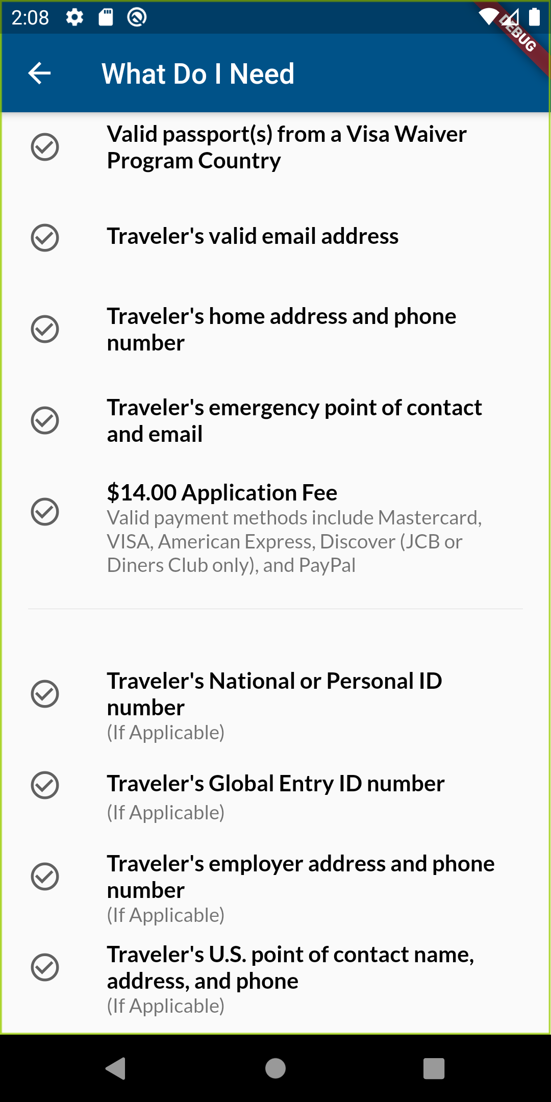
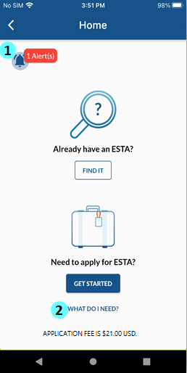
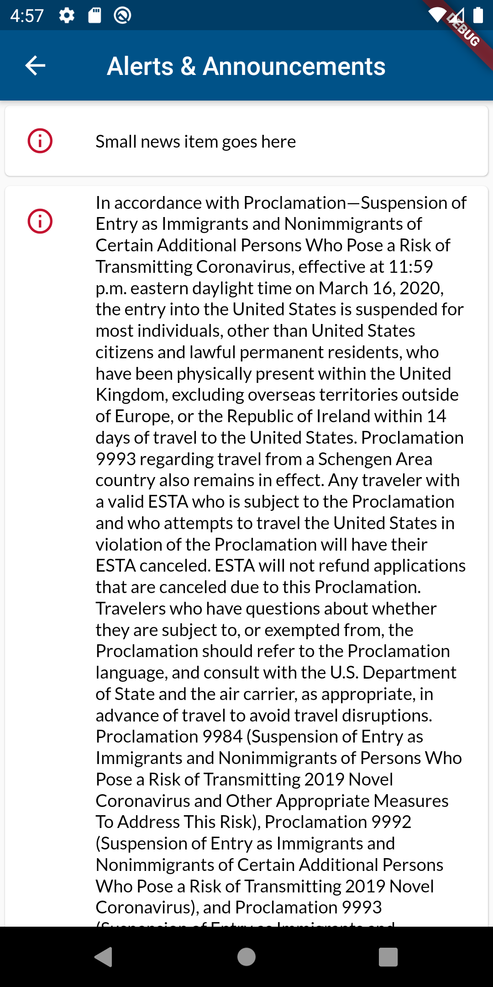
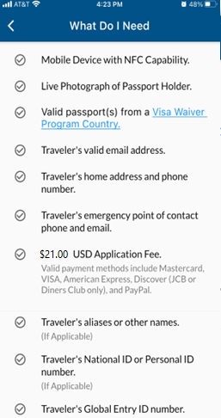
ESTA Mobile App – Home Page
1
2
CBP | OIT

Slide 6
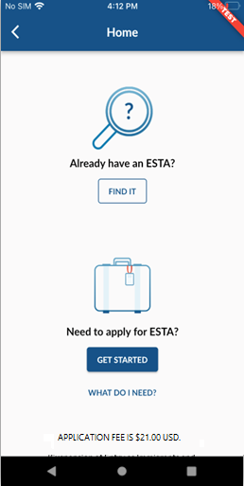
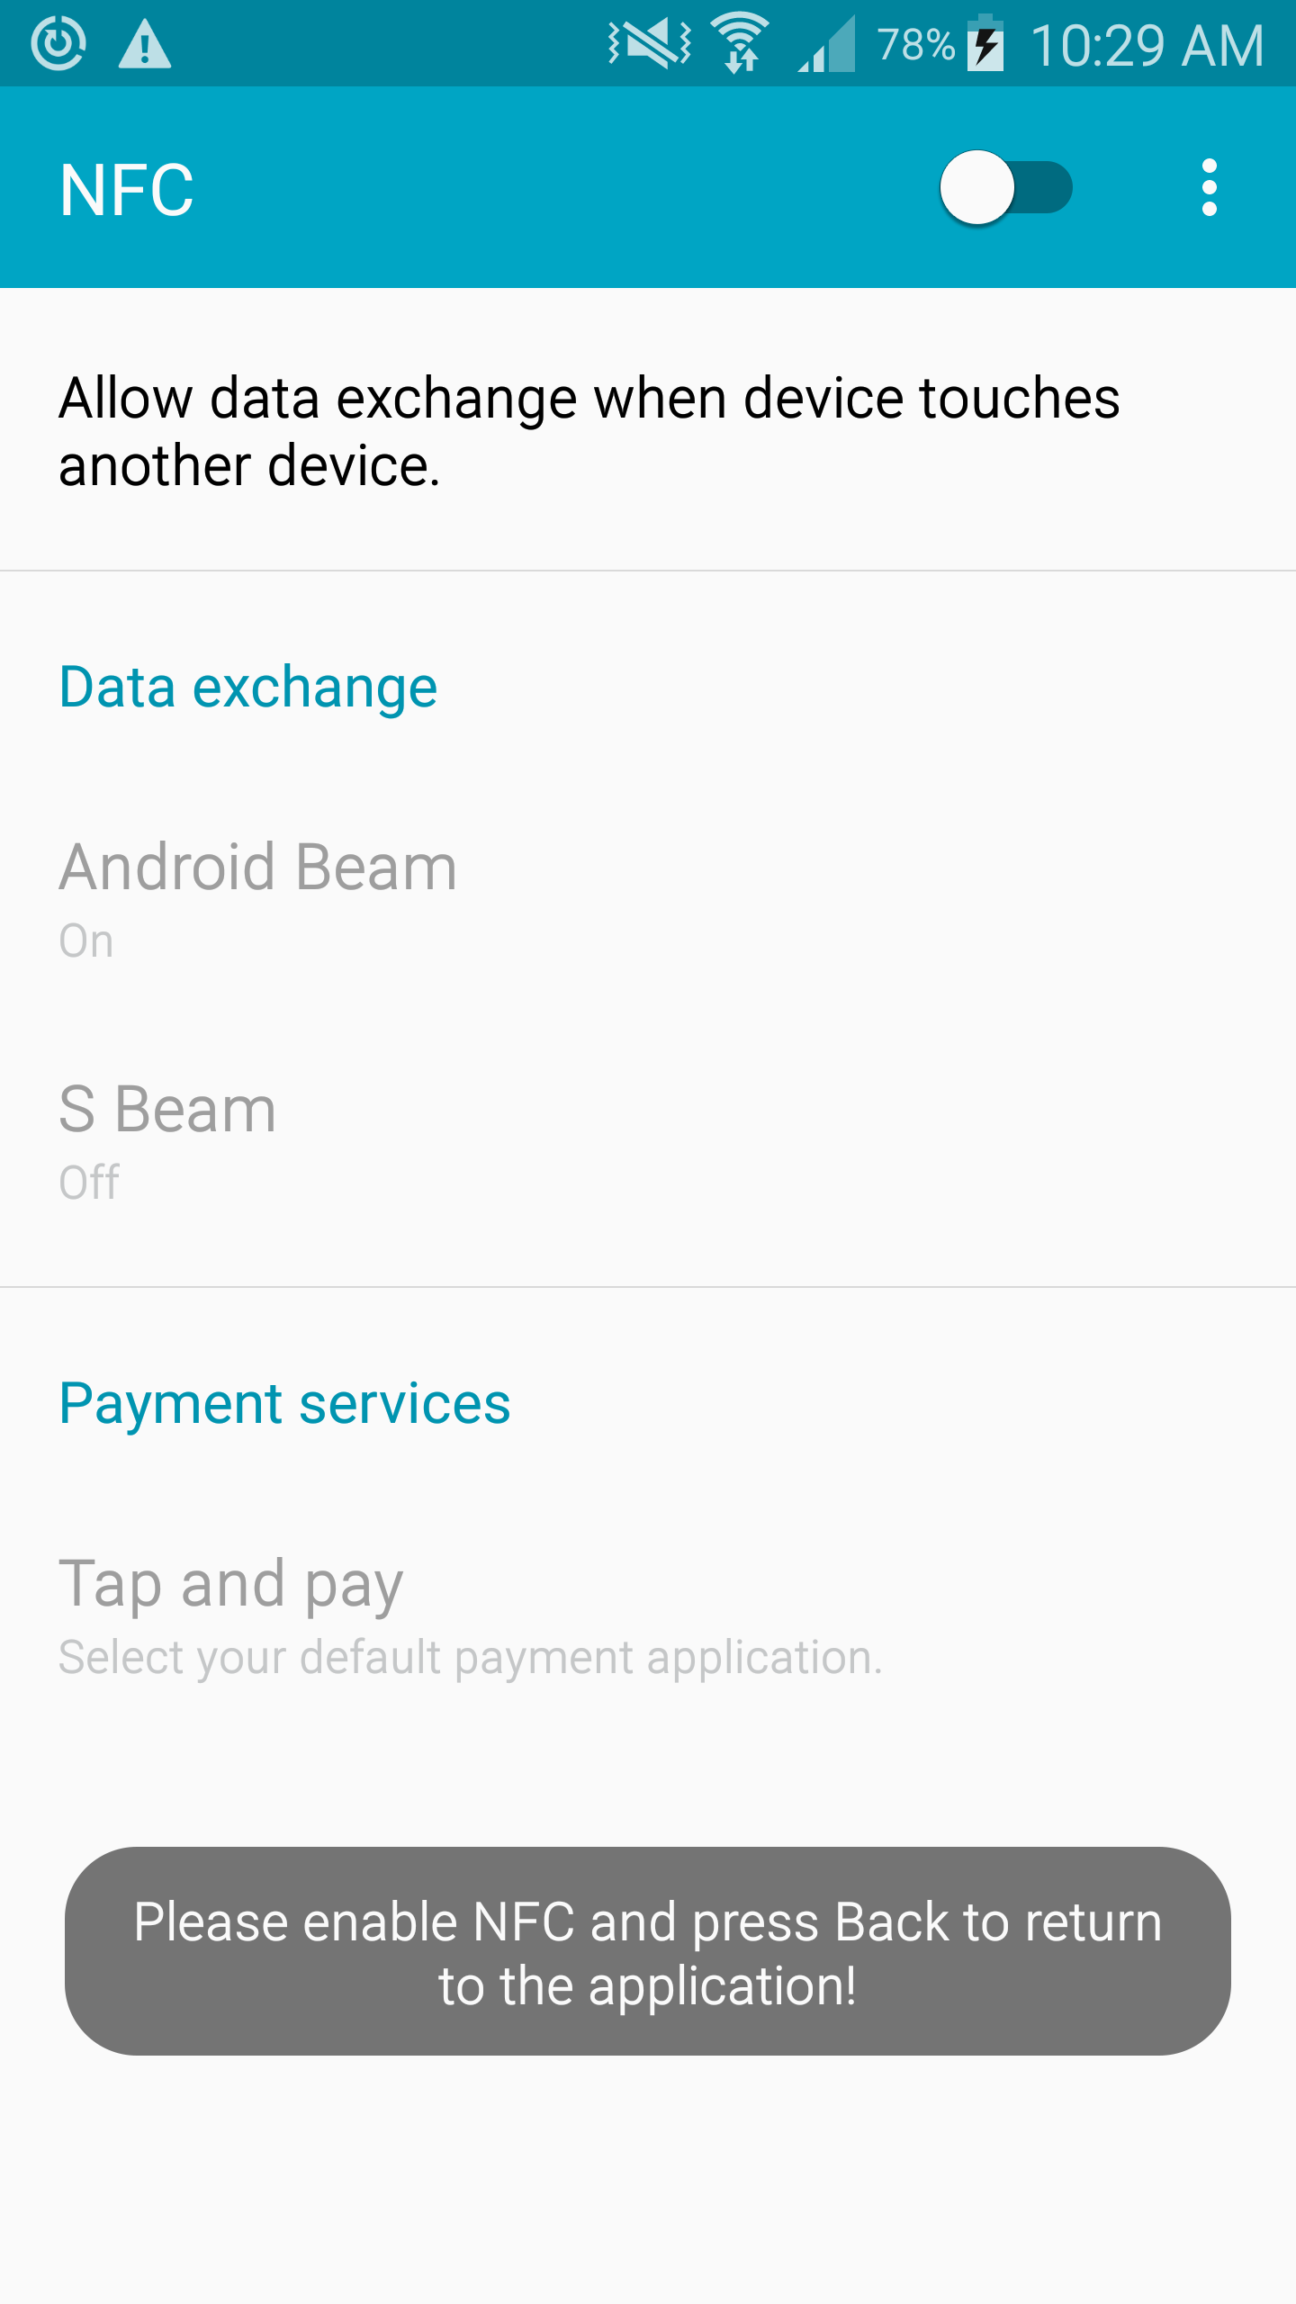
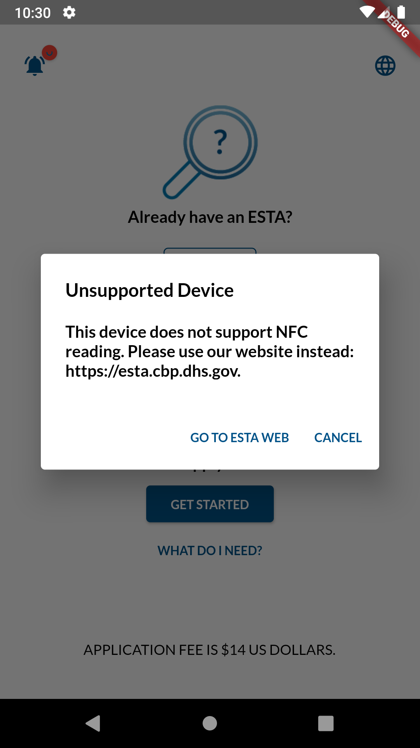
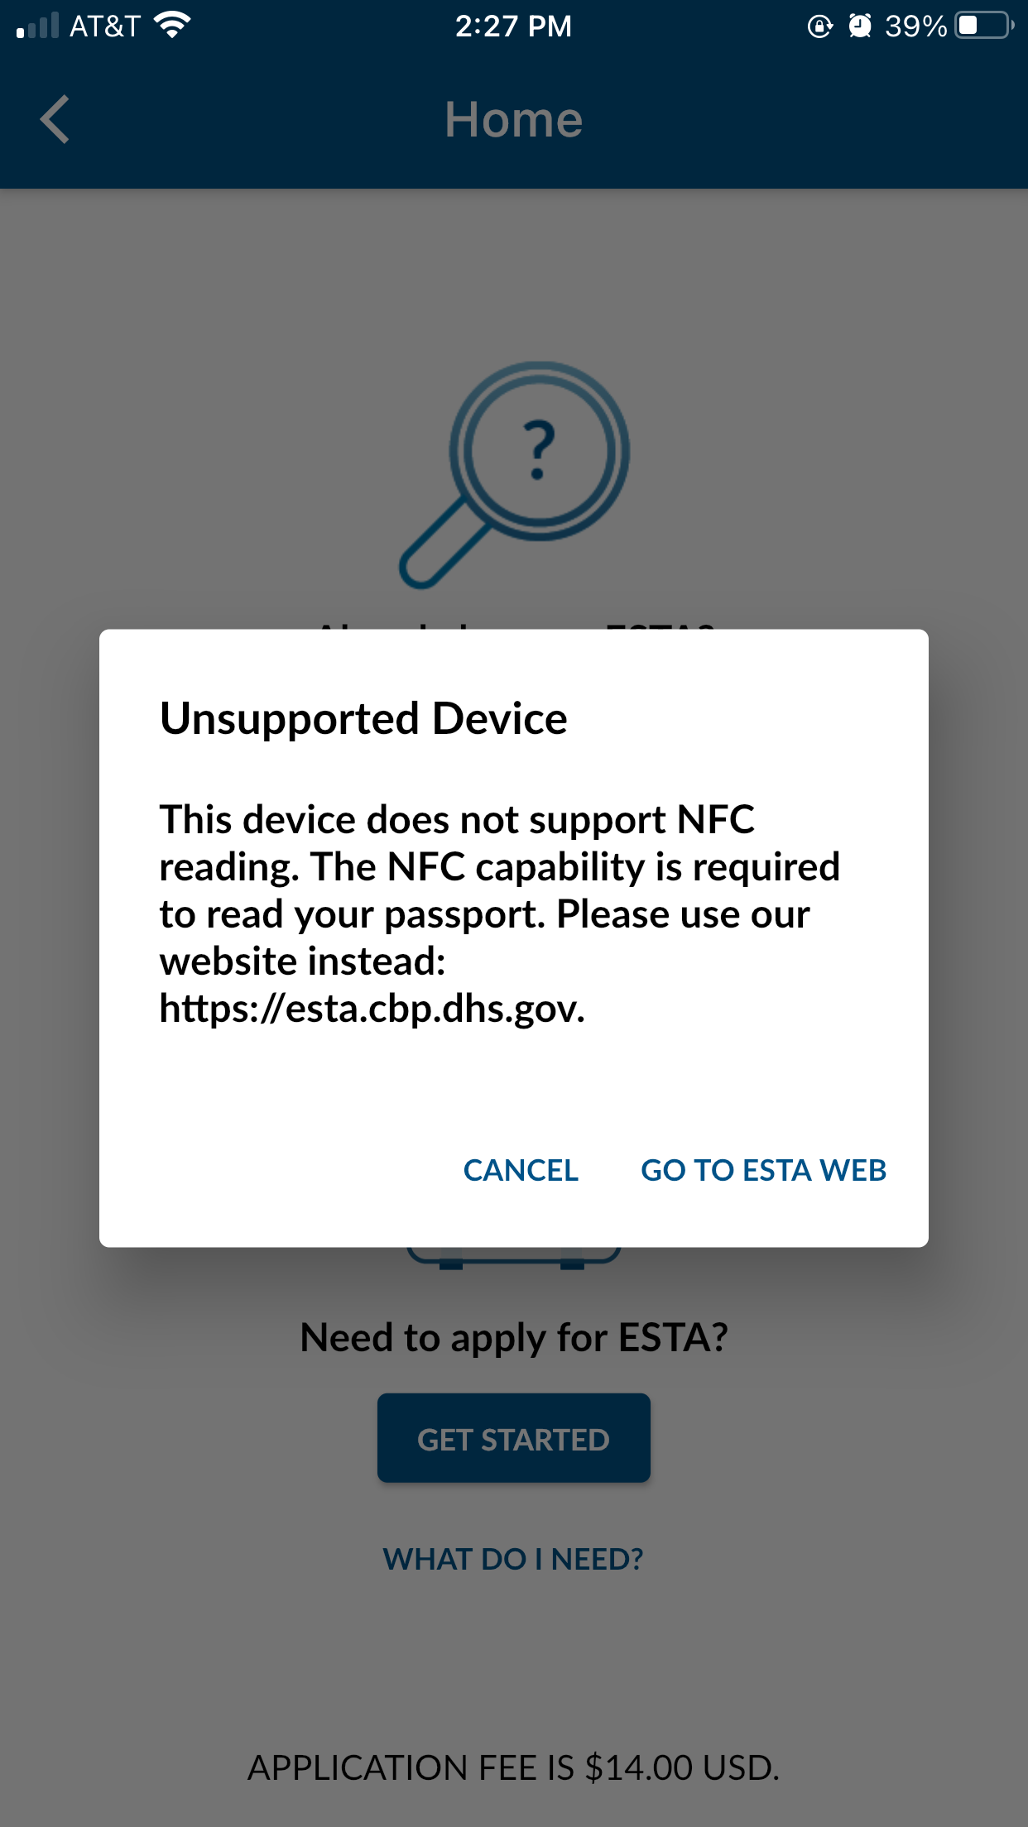
Home Page → GET STARTED (When NFC is turned off/Not Supported)
Near Field Communication (NFC), allows users to scan the passport eChip to extract passenger data located either in the front/ back of the passport.
A Mobile Device with a Near Field Communication (NFC) capability is required to scan the Passport E-Chip when applying for a new application using the ESTA Mobile App.
The ESTA Mobile App checks if the mobile device has the NFC capability and allows the user to turn on the NFC setting or display a message ‘Unsupported Device’ if the mobile device does not have the NFC capability.
CBP | OIT

Slide 7
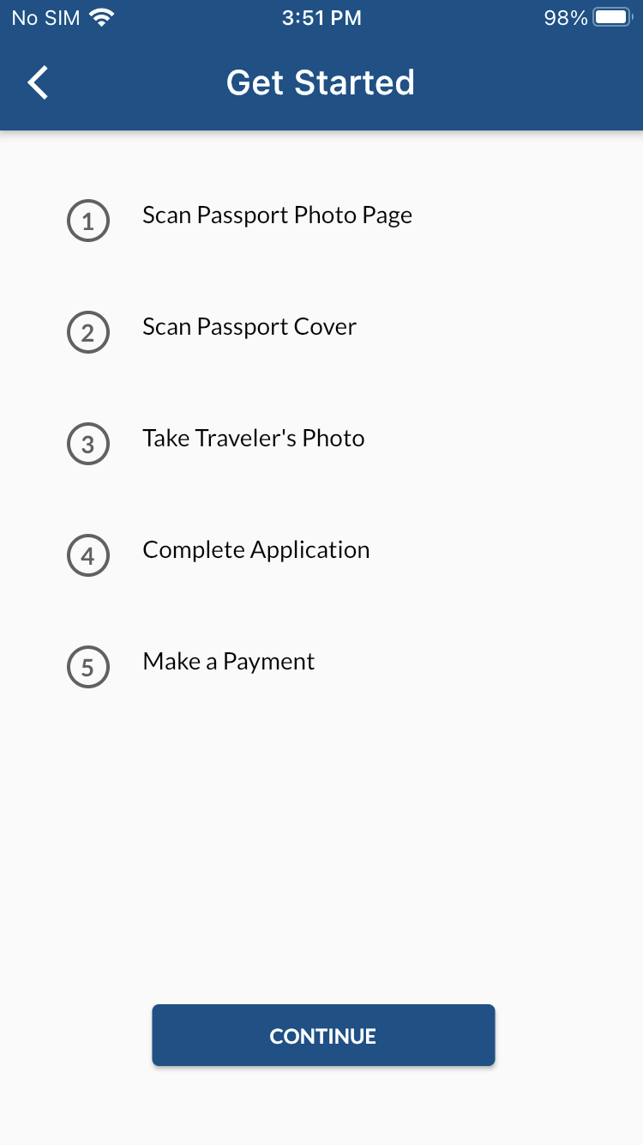
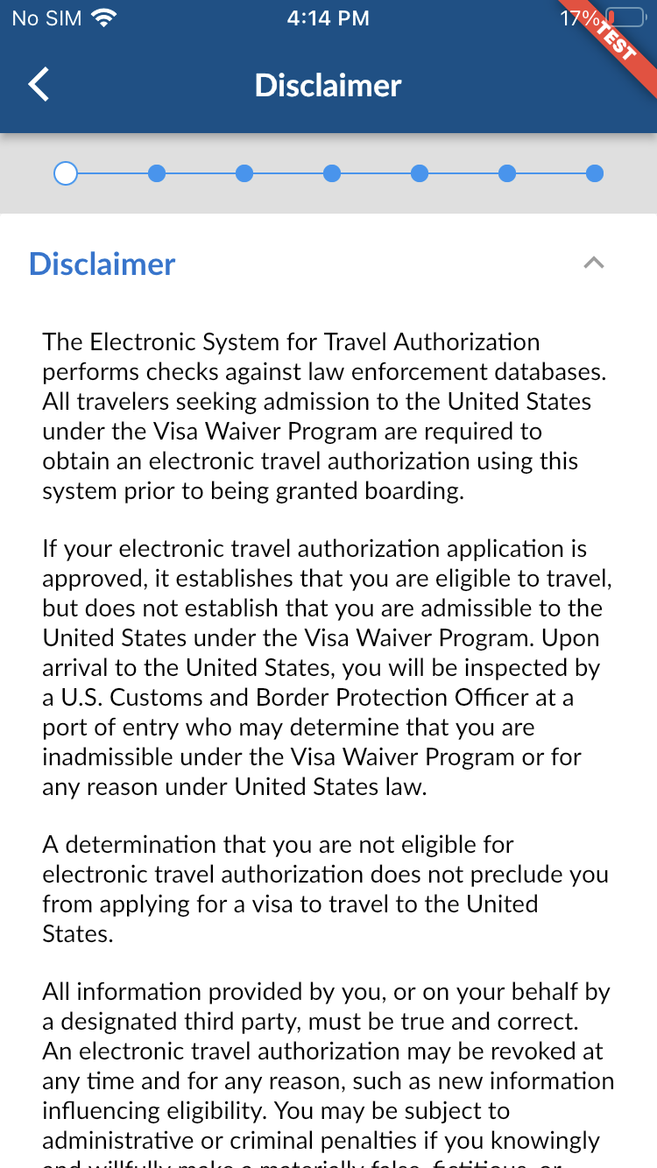
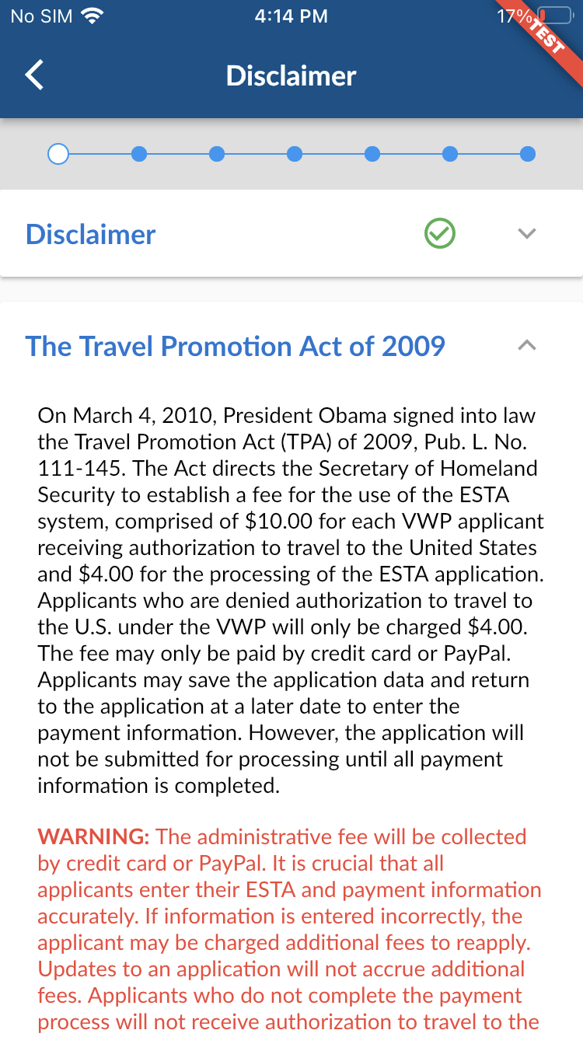
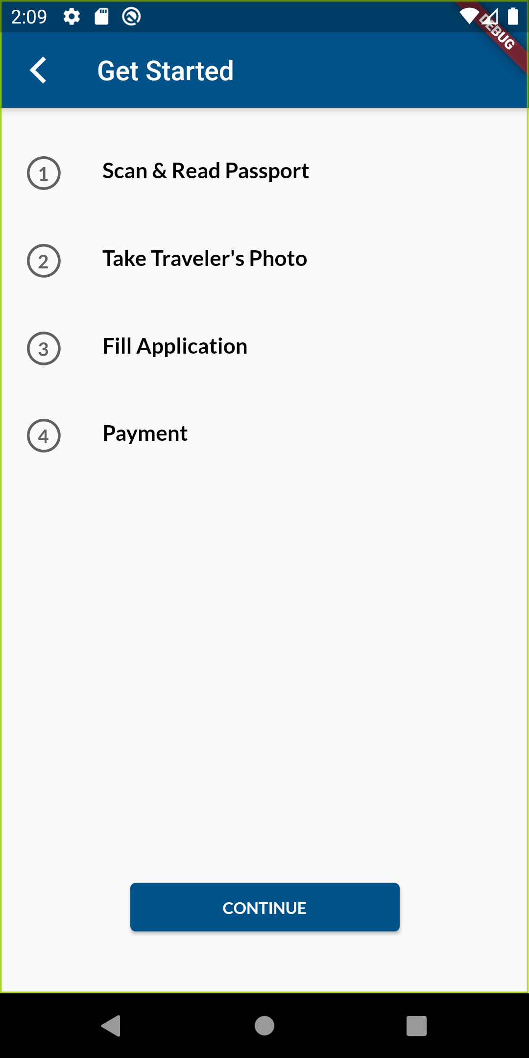
Home Page → GET STARTED
The “GET STARTED” option enables the user to fill out a new application.
CBP | OIT

Slide 8
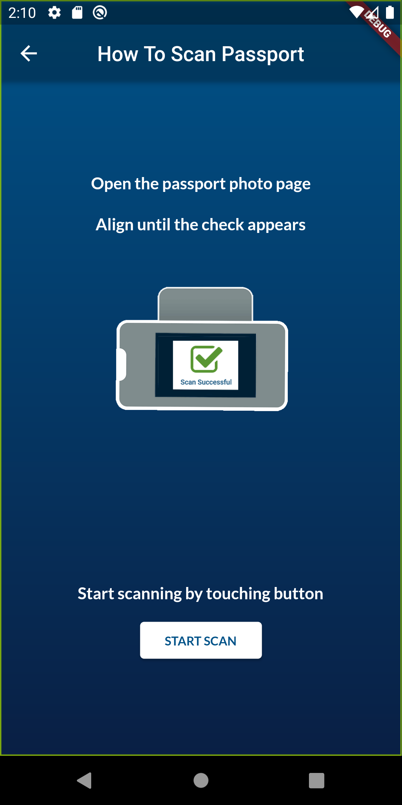
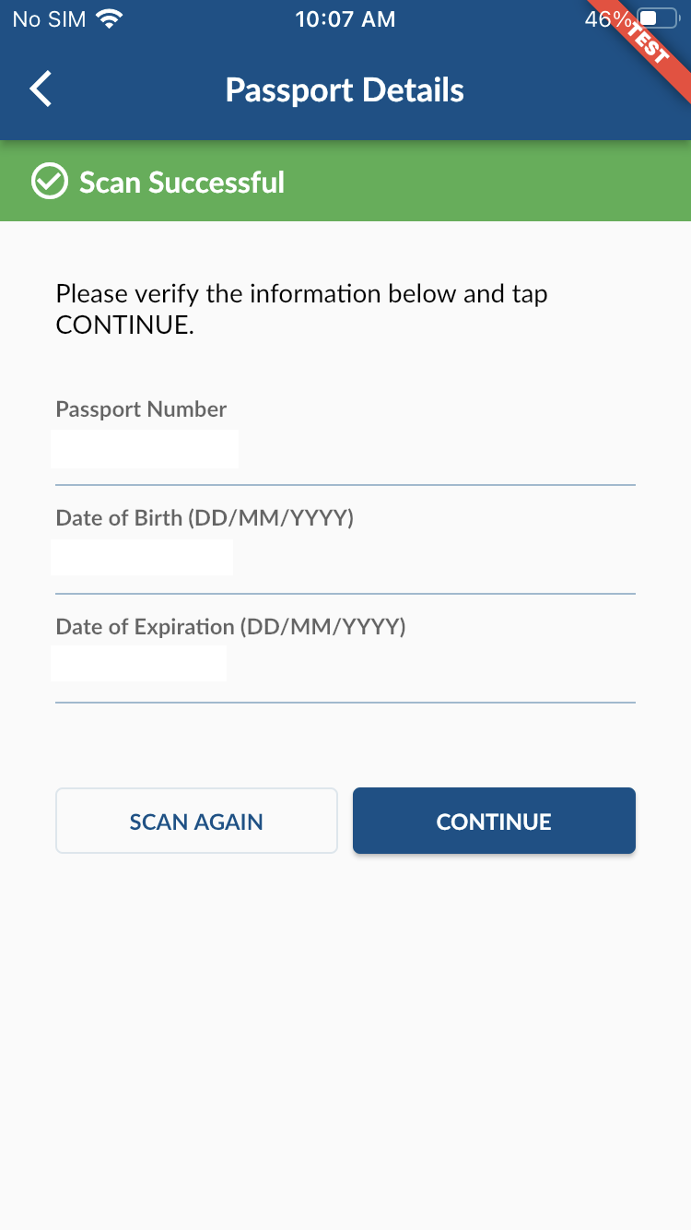
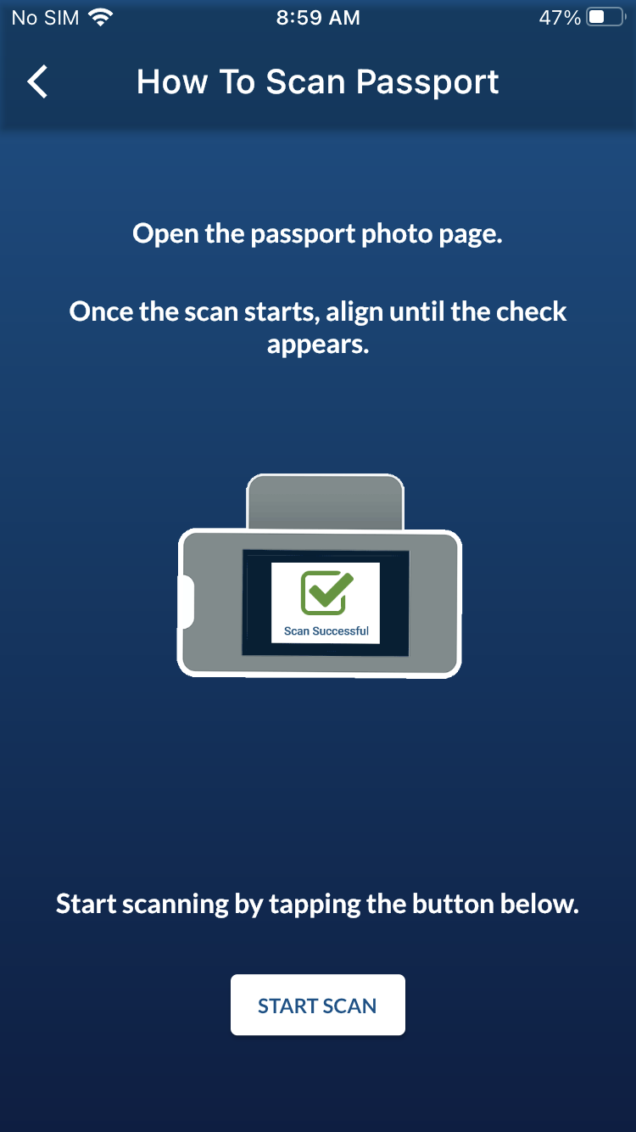
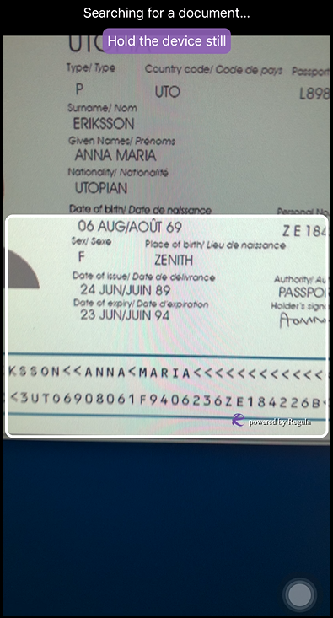
Passport Scan (MRZ)
Machine Readable Zone(MRZ), allows users to scan the identification page of the passport to read “Passport Details” -> Auto populate “Passport Details” page. This information is also needed to open the eChip.
CBP | OIT

Slide 9
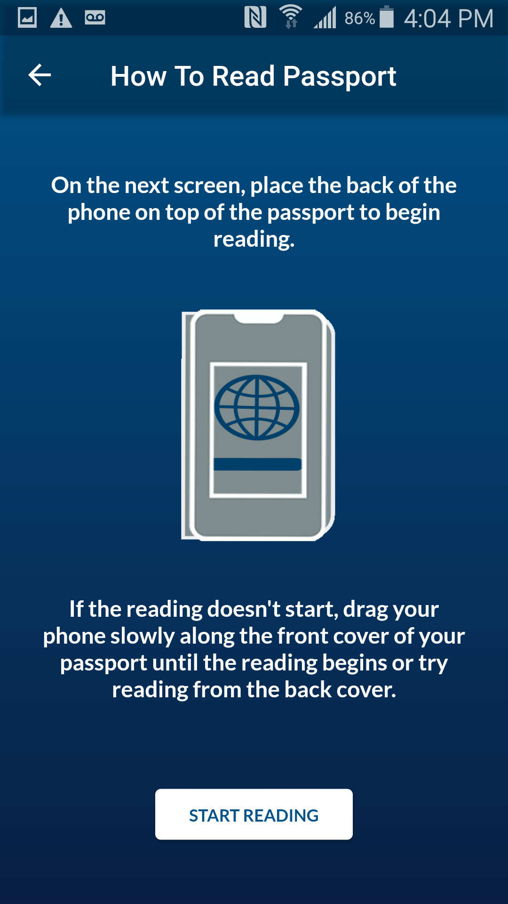
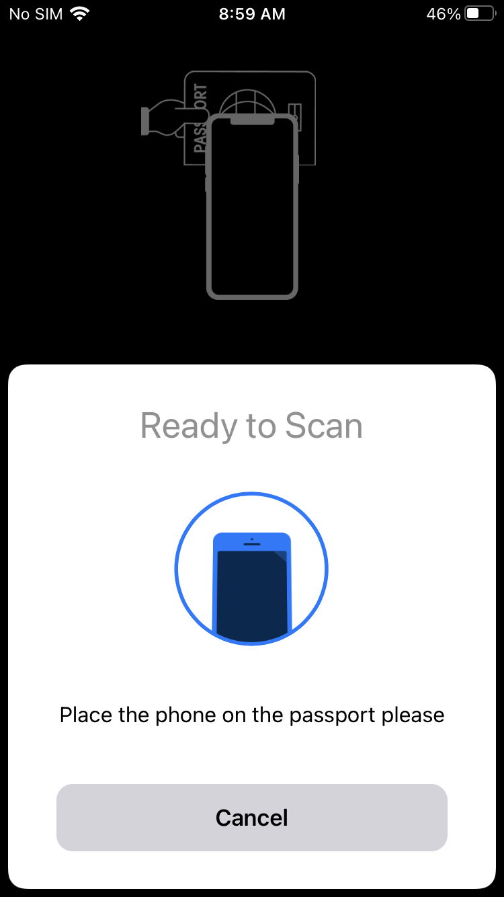
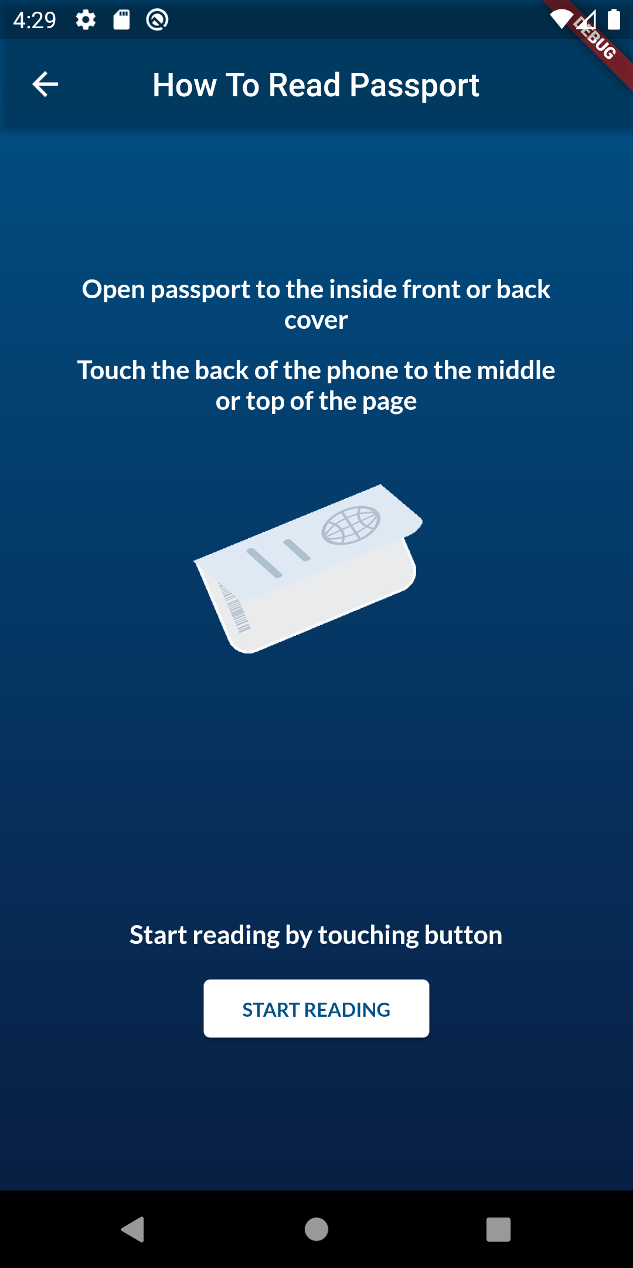
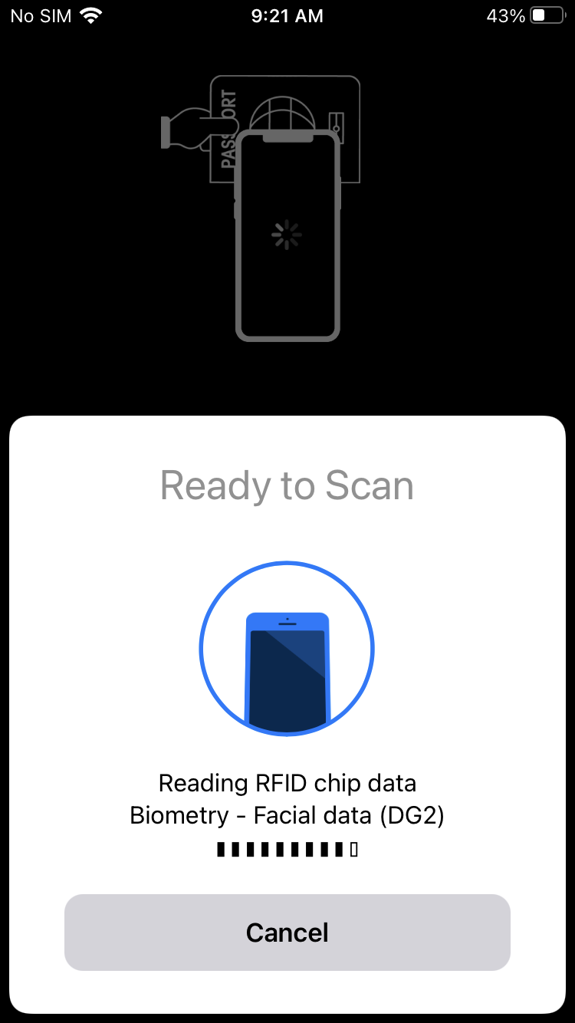
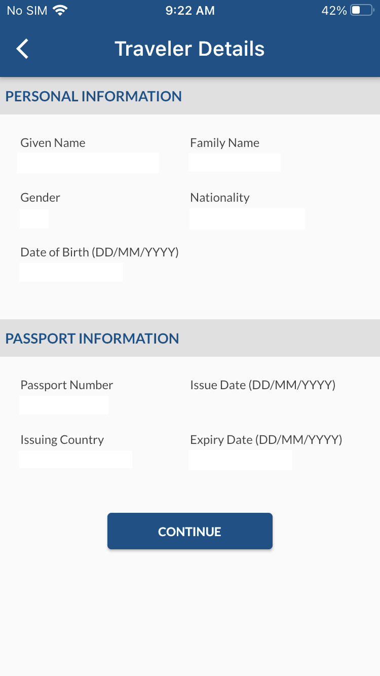
E-Passport Chip Read (NFC Scan)
E-Chip, contains data to enable the NFC Scan.
CBP | OIT

Slide 10
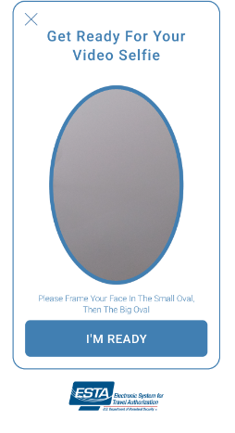
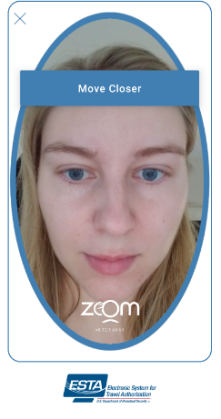
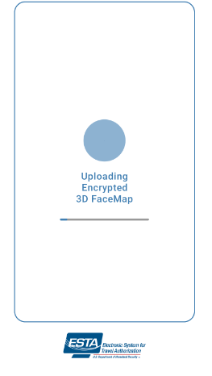
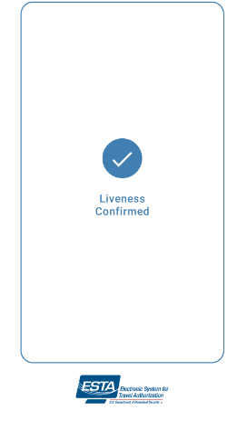

Live Photo Capture & Liveness Test (FaceTec)
CBP | OIT

Slide 11

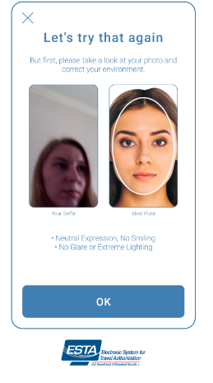


Live Photo Capture & Liveness Test (FaceTec)
Liveness Photo Capture & Test, is an AI computer system’s ability to determine that it is interfacing with a physically present human being and not an inanimate spoof artifact.
*Only displayed when photos do not match
In the background, ESTA Mobile App performs a Photo Matching process to determine if the passport photo retrieved from the Passport via NFC Scan matches the person who took the Live Photo, after the Liveness is confirmed.
The ‘Third Party Acknowledgement’ screen is only displayed if the Photo Matching service determines the Passport Photo and the Live Photo do not match.
Photo Mismatch
I certify submitting the application on behalf of the applicant
RETAKE PHOTO
CONTINUE
CANCEL
CBP | OIT

Slide 12
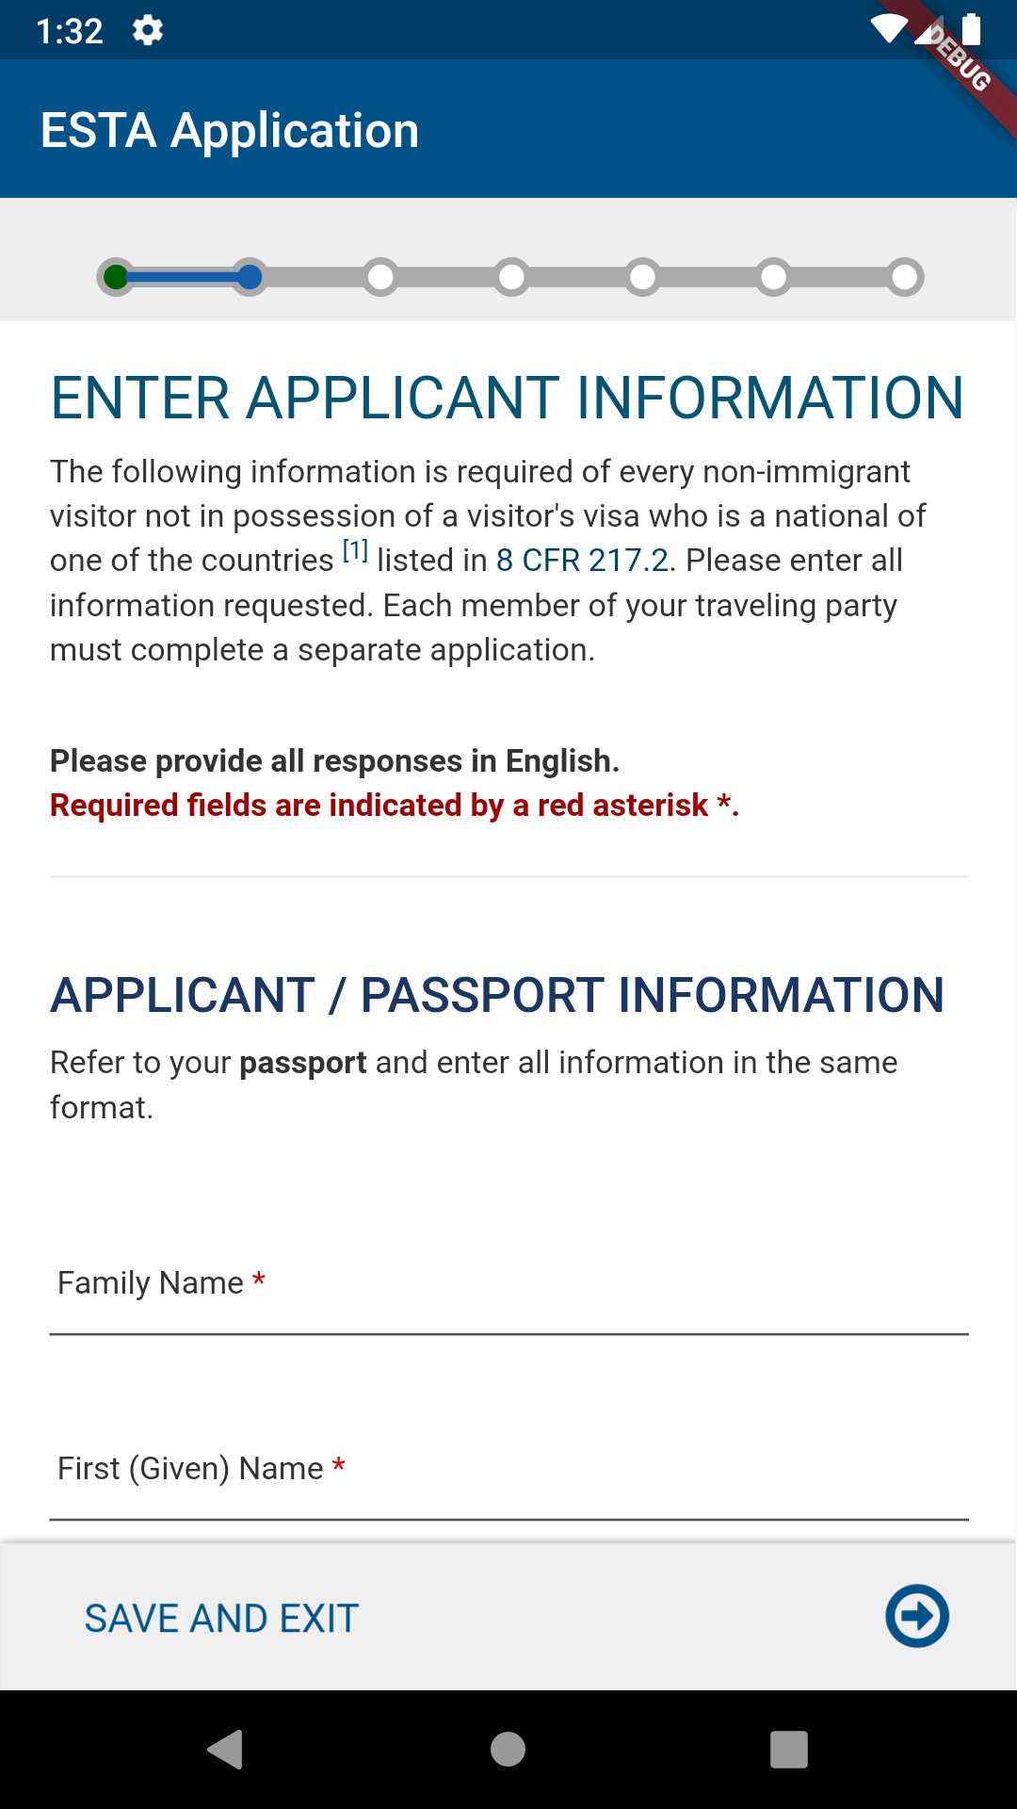
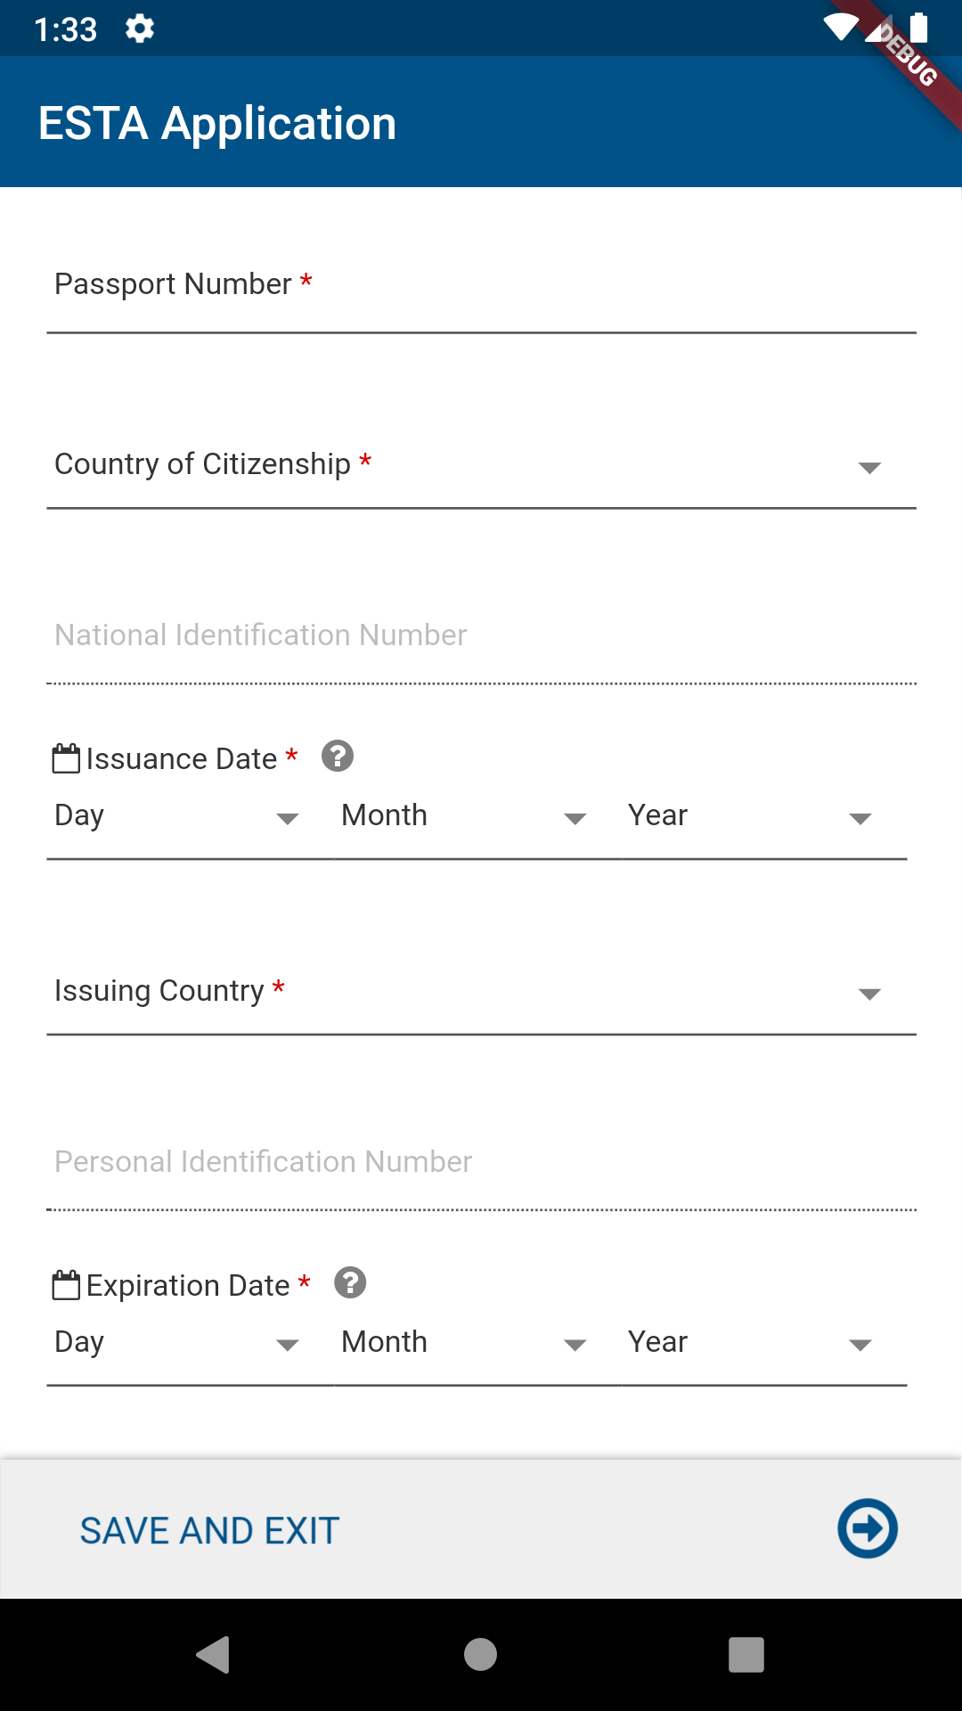
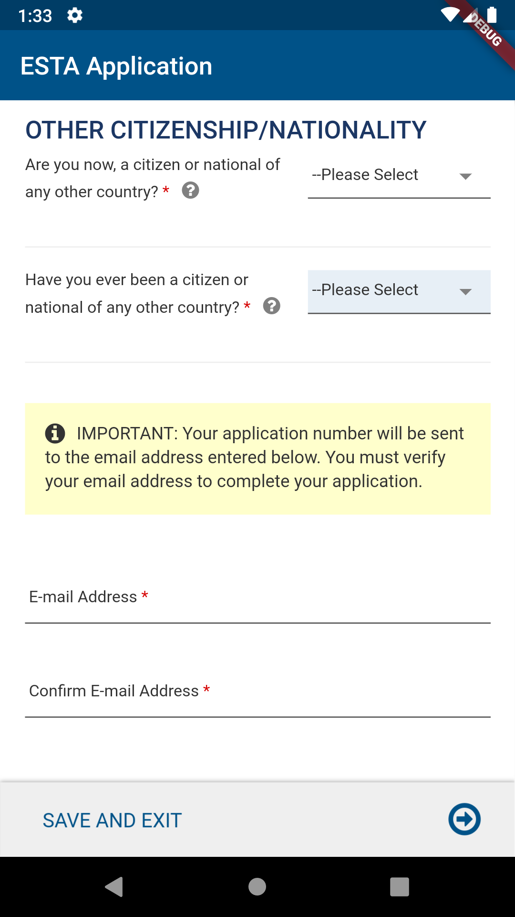
Enter Applicant Information page
Enter Applicant Information, After acknowledging the disclaimers, successful MRZ Scan, NFC Scan and Liveness Test, the applicant will be asked to enter the applicant information (or the information on the applicant’s behalf). The next few slides are the same as the ESTA web view.
CBP | OIT

Slide 13
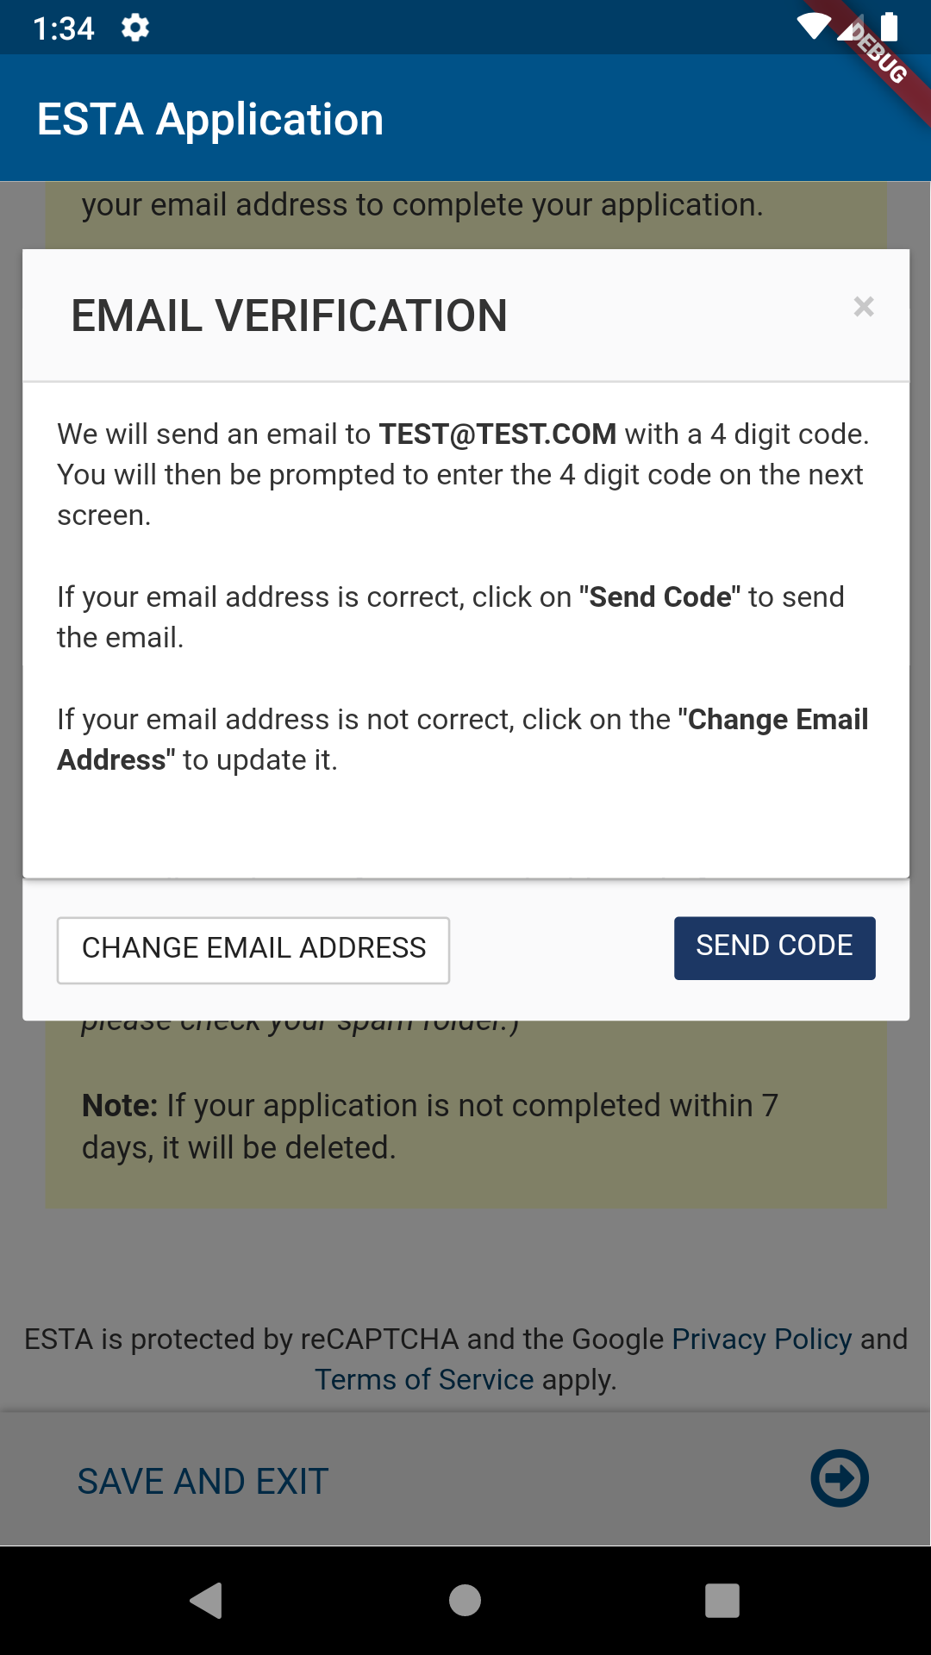
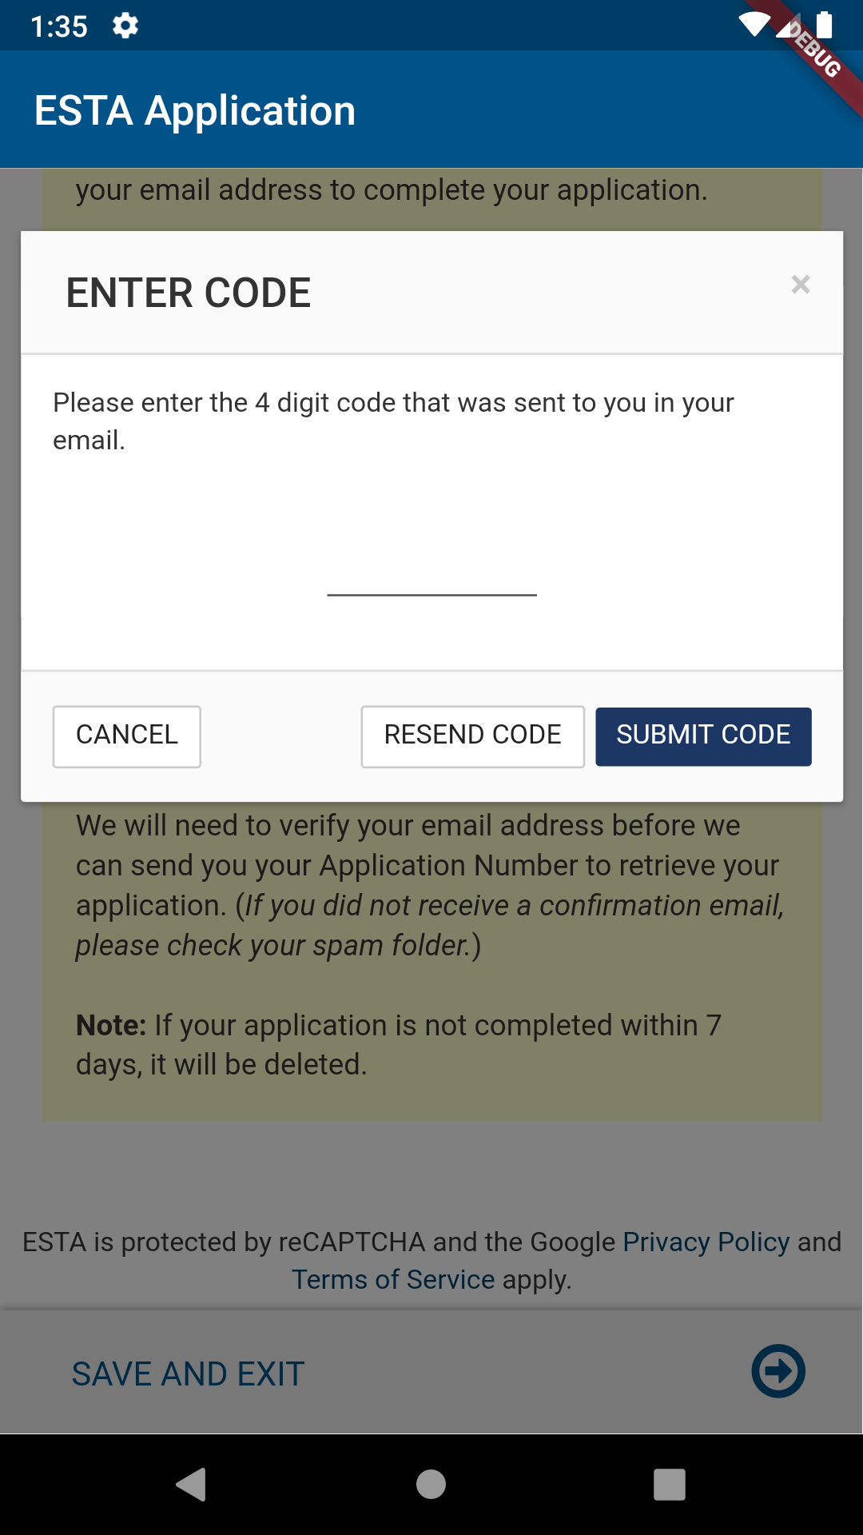
Email Verification
The “Email Verification” option prevents the user from proceeding to the application without verifying their email.
CBP | OIT

Slide 14
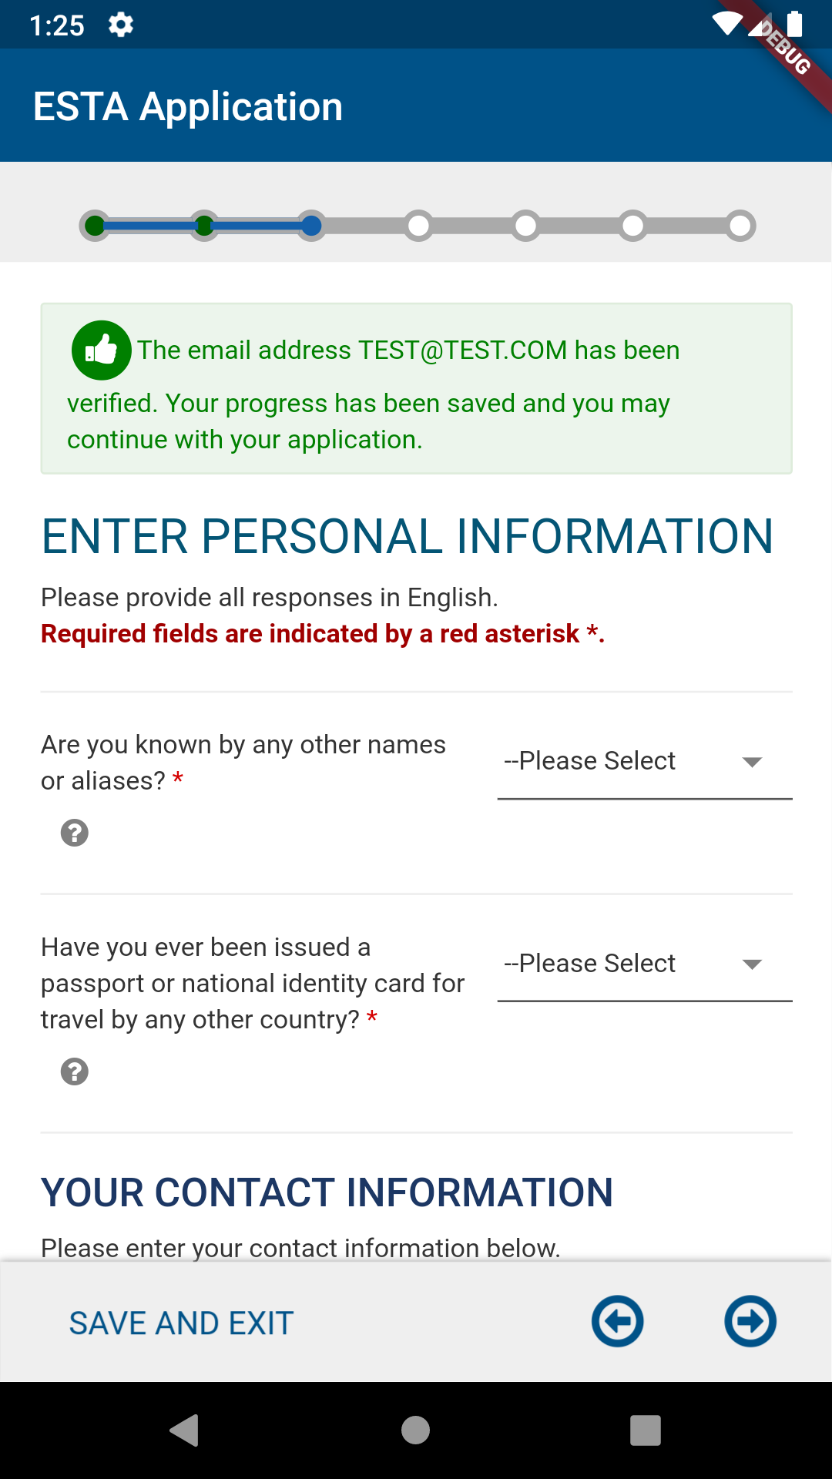
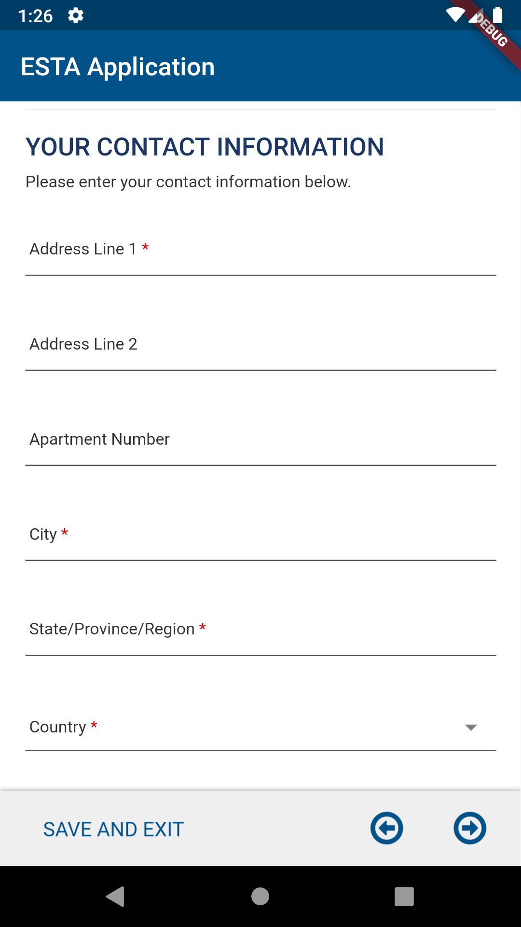
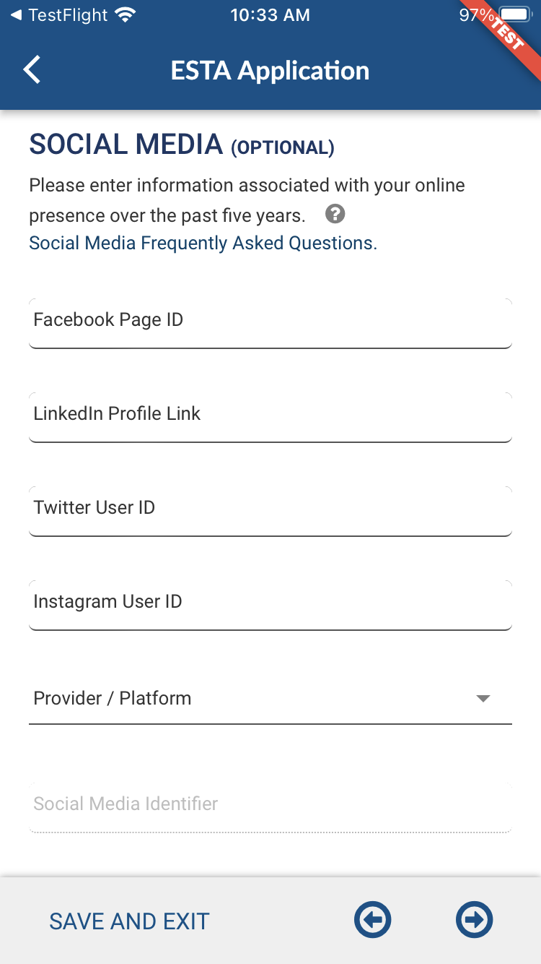
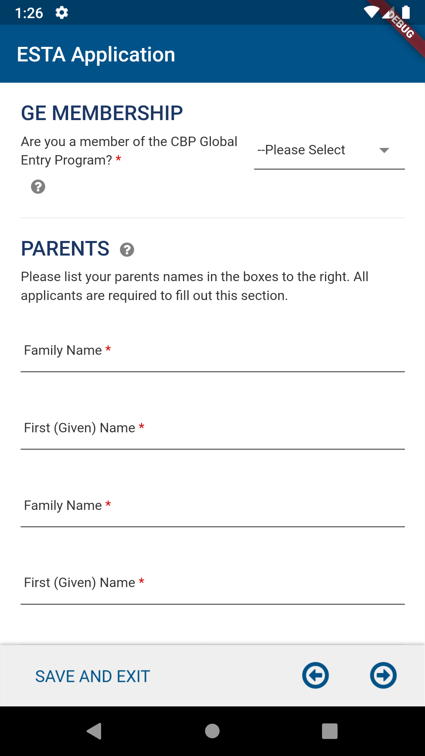
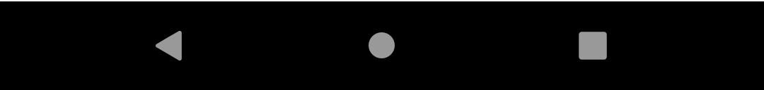
Enter Personal Information page
Enter Personal Information, After acknowledging the disclaimers the applicant will be asked to enter their personal information (or the information on applicant’s behalf).
CBP | OIT

Slide 15
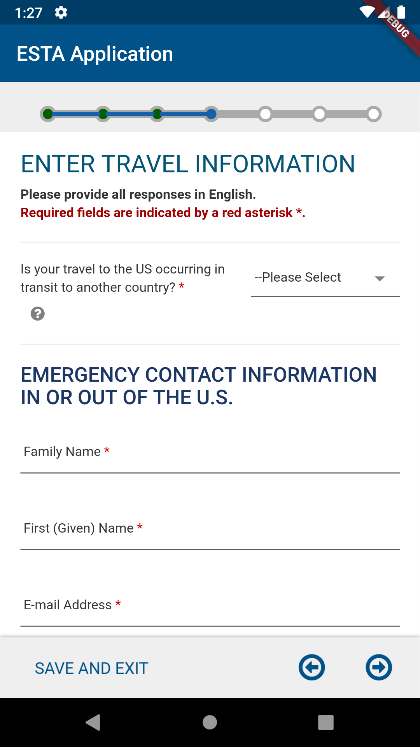
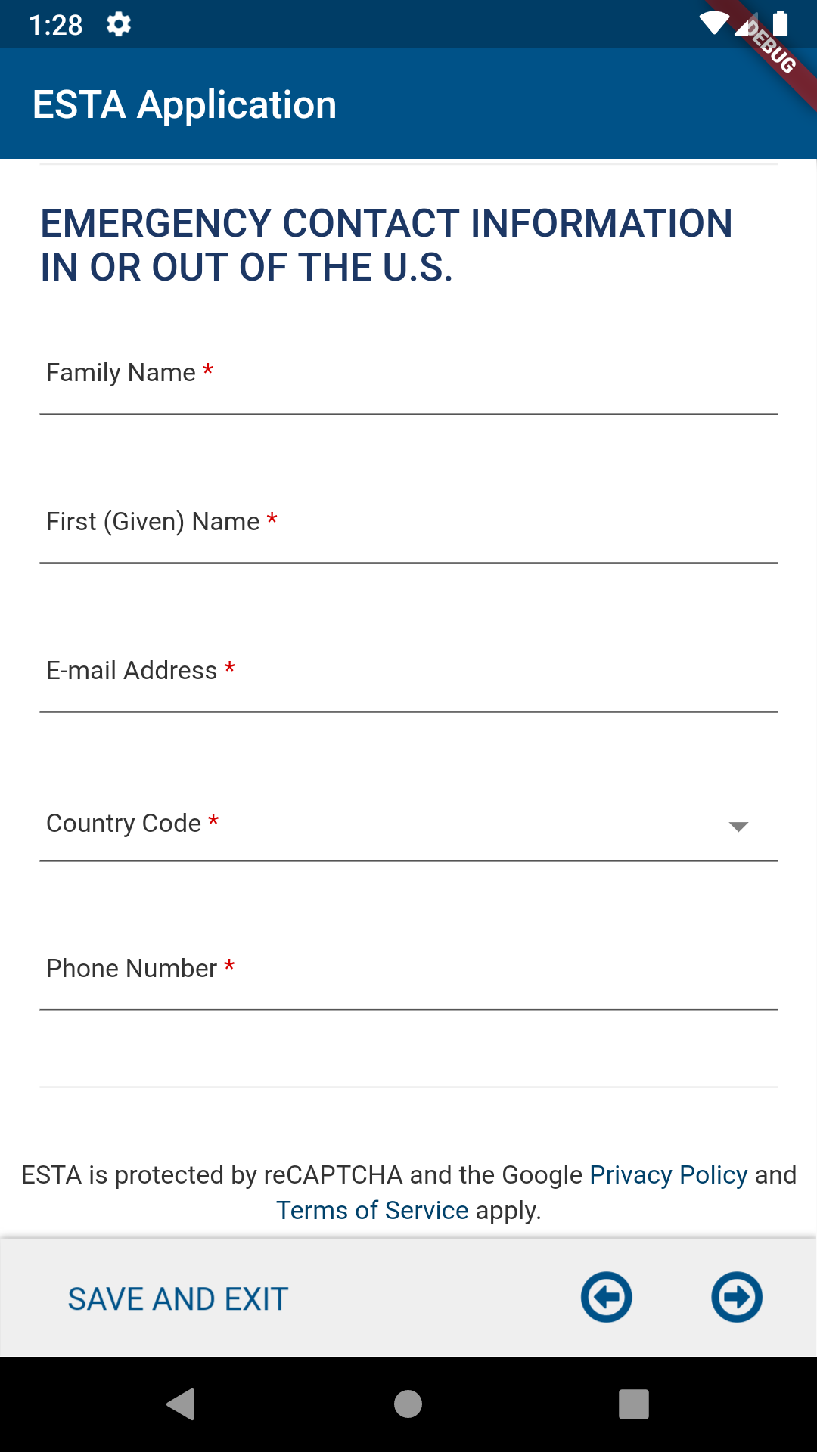
Enter Travel Information page
Enter Travel Information, After acknowledging the disclaimers the applicant will be asked to enter their travel information (or the information on applicant’s behalf).
CBP | OIT

Slide 16
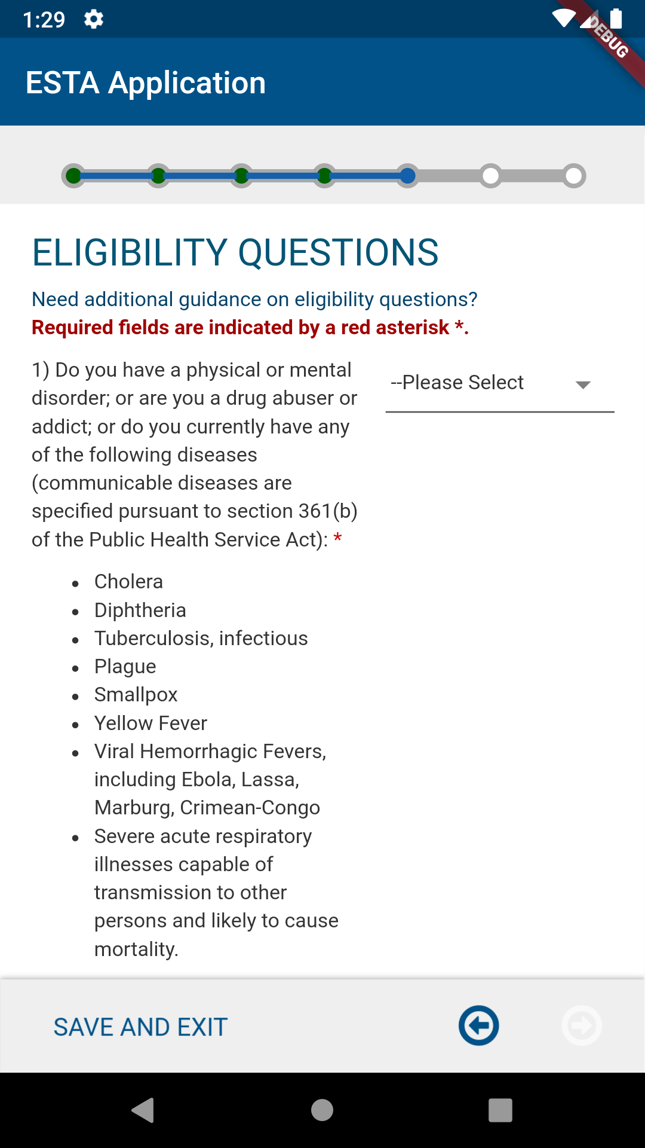
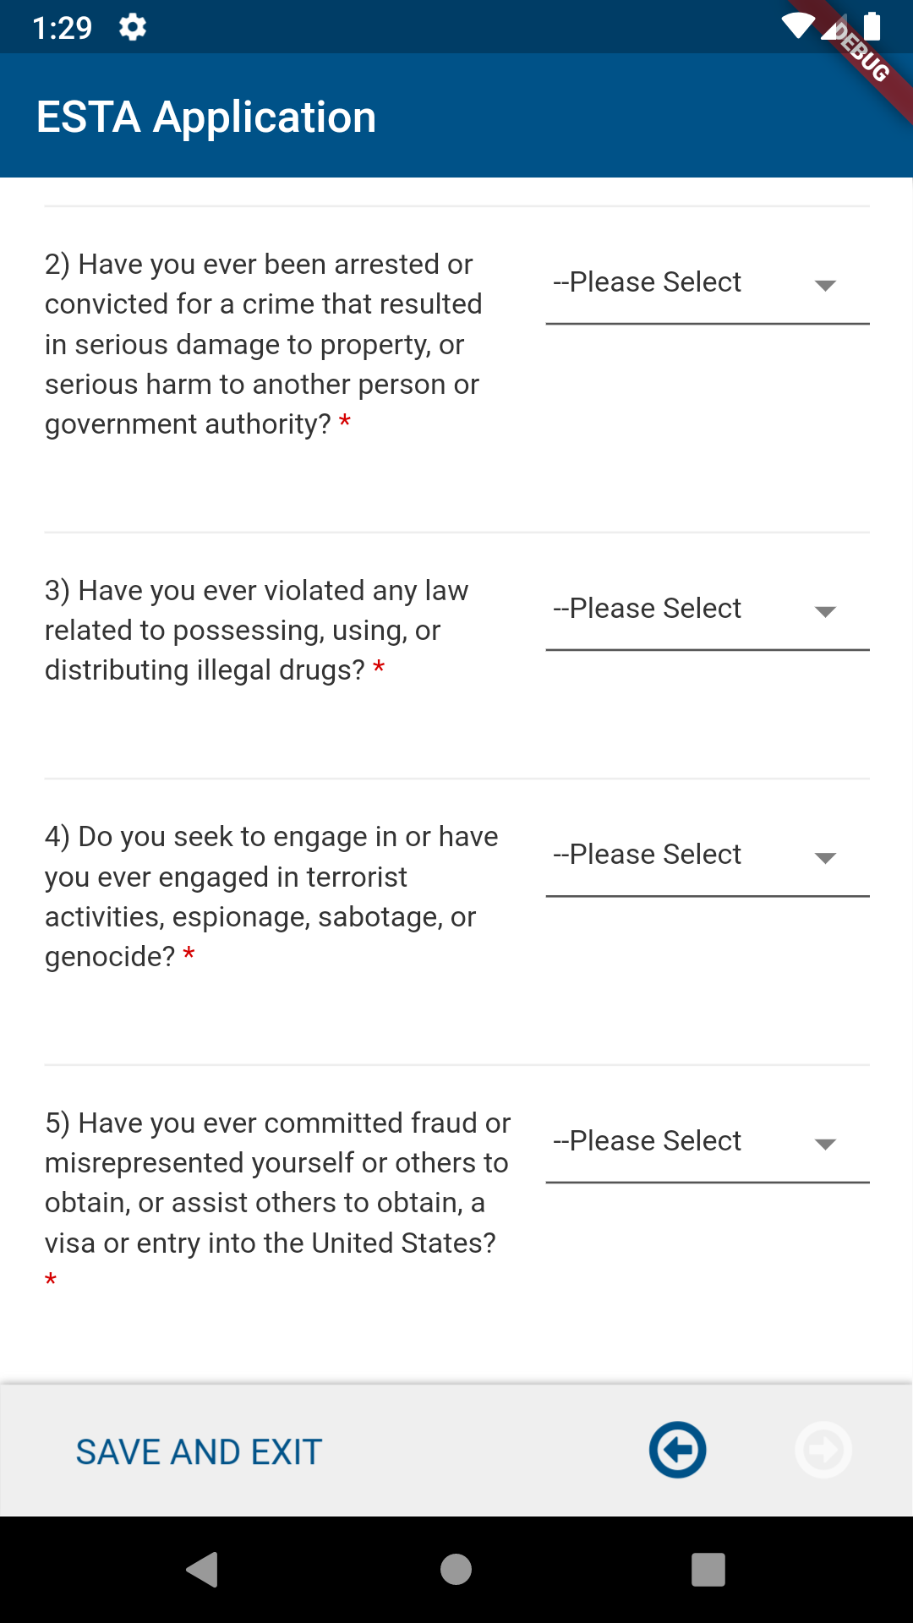


Eligibility Questions page
The Eligibility Questions determine vetting status of the applicant. Note: If a user selects “Yes” to this question 9, ESTA will prompt to select a primary reason for the trip. Certain options will prompt to fill out additional questionnaire.
CBP | OIT

Slide 17



Review Your Application page
On Review Your Application, the applicant will be given the option to review and edit their application before they submit it. To complete this part of the application the applicant must select the “Confirm & Continue” icon on each section.
CBP | OIT

Slide 18


Pay Now and Complete Application page
On Pay Now and Complete Application, applicants can submit a payment by checking the Disclaimer and clicking the “Pay Now” button. After the user clicks the “Pay Now” button, the application will redirect to the Pay.gov website where the user will be given the option to pay via PayPal, credit or debit card.
CBP | OIT

Slide 19






Pay.gov pages
On Pay.gov, the user will be given the option to pay via PayPal, credit or debit card. Once the payment is complete, Pay.gov will redirect back to the ESTA app.
CBP | OIT

Slide 20







Home Page → FIND IT
The “FIND IT” option enables the user to retrieve an existing application.
CBP | OIT

Slide 21




Home Page → FIND IT → Search Results by Different Statuses
Payment Required
Pending
Denied
CBP | OIT

Slide 22


ESTA Mobile App Icon
IOS
Android
CBP | OIT

