Slide 1
Departing Traveler > Submit Intent to Depart
ICE Capability for Self-Deportation
Complete Workflows
This presentation outlines functionalities in the Departing Traveler > Submit Intent to Depart workflows.

Slide 2
Table of Contents
Departing Traveler>Submit Intent to Depart
User Flow 1 – User successfully submits their exit.
User Flow 2 – User submits their exit and run into a system error.
User Flow 3 – User is not within 3-mile radius of the United States.
User Flow 4 – User submits their exit and run into a facial matching error. ( This flow highlights different types of facial matching errors.)

Slide 3
Departing Traveler > Submit Intent to Depart User Flow 1
User successfully submits their exit.

Slide 4
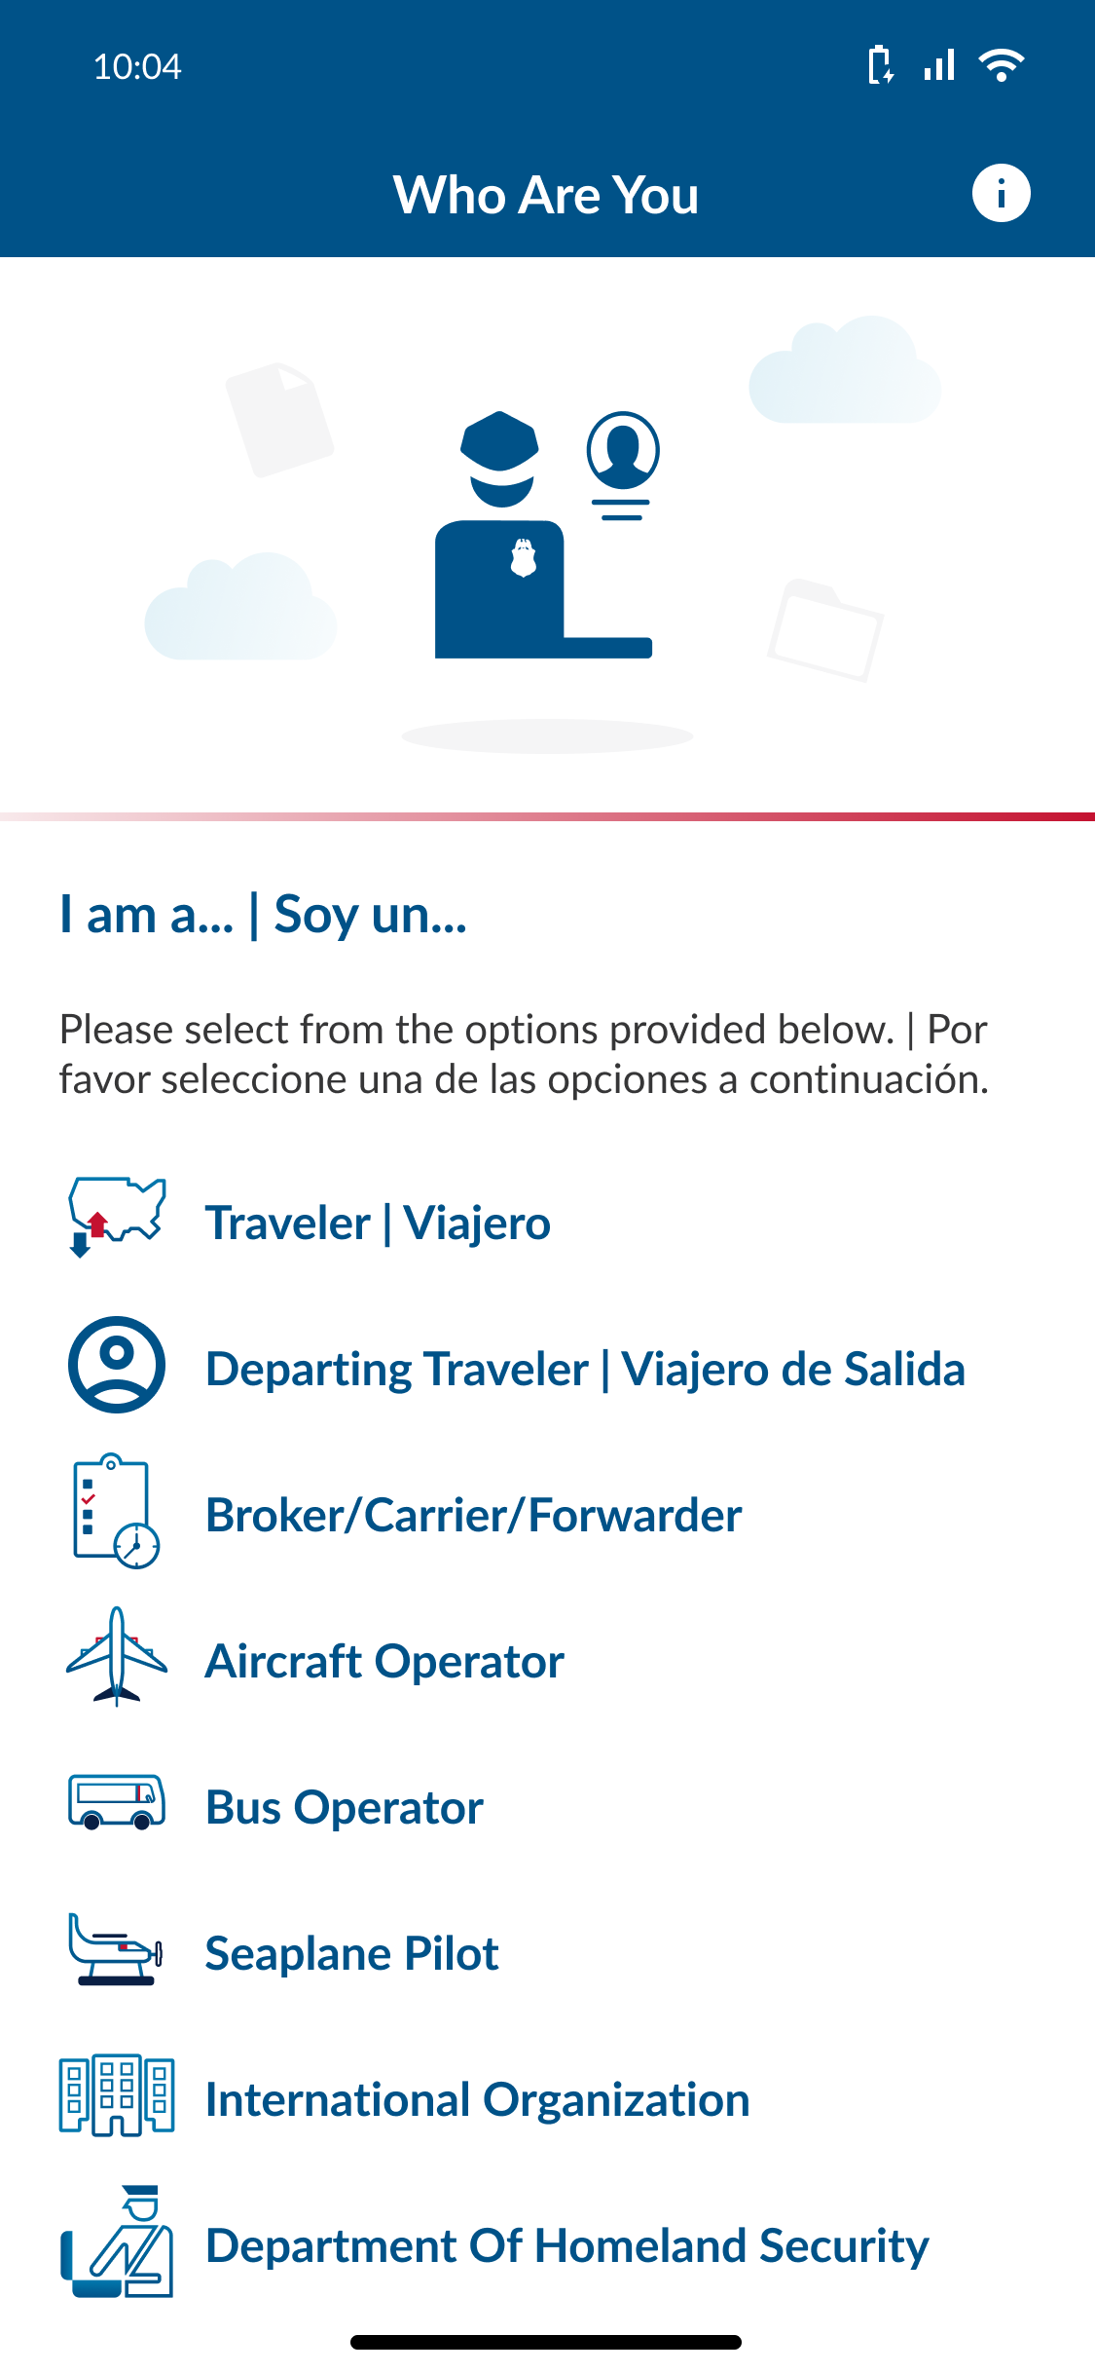
DT > SITD : User Flow 1
ACTION: User selects Departing Traveler.

Slide 5
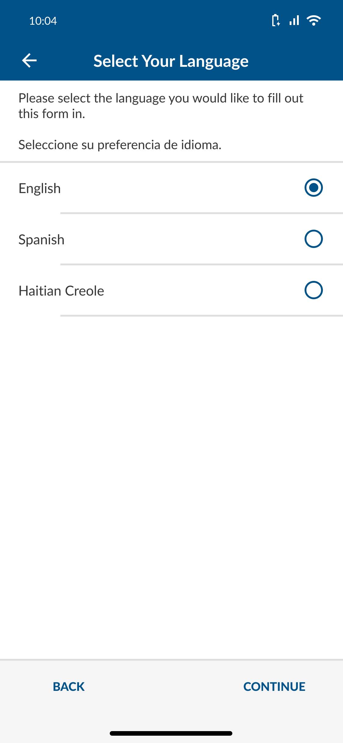
DT >SITD : User Flow 1
ACTION: User selects language and clicks Continue.

Slide 6
DT > SITD : User Flow 1
ACTION: User selects Accept.

Slide 7
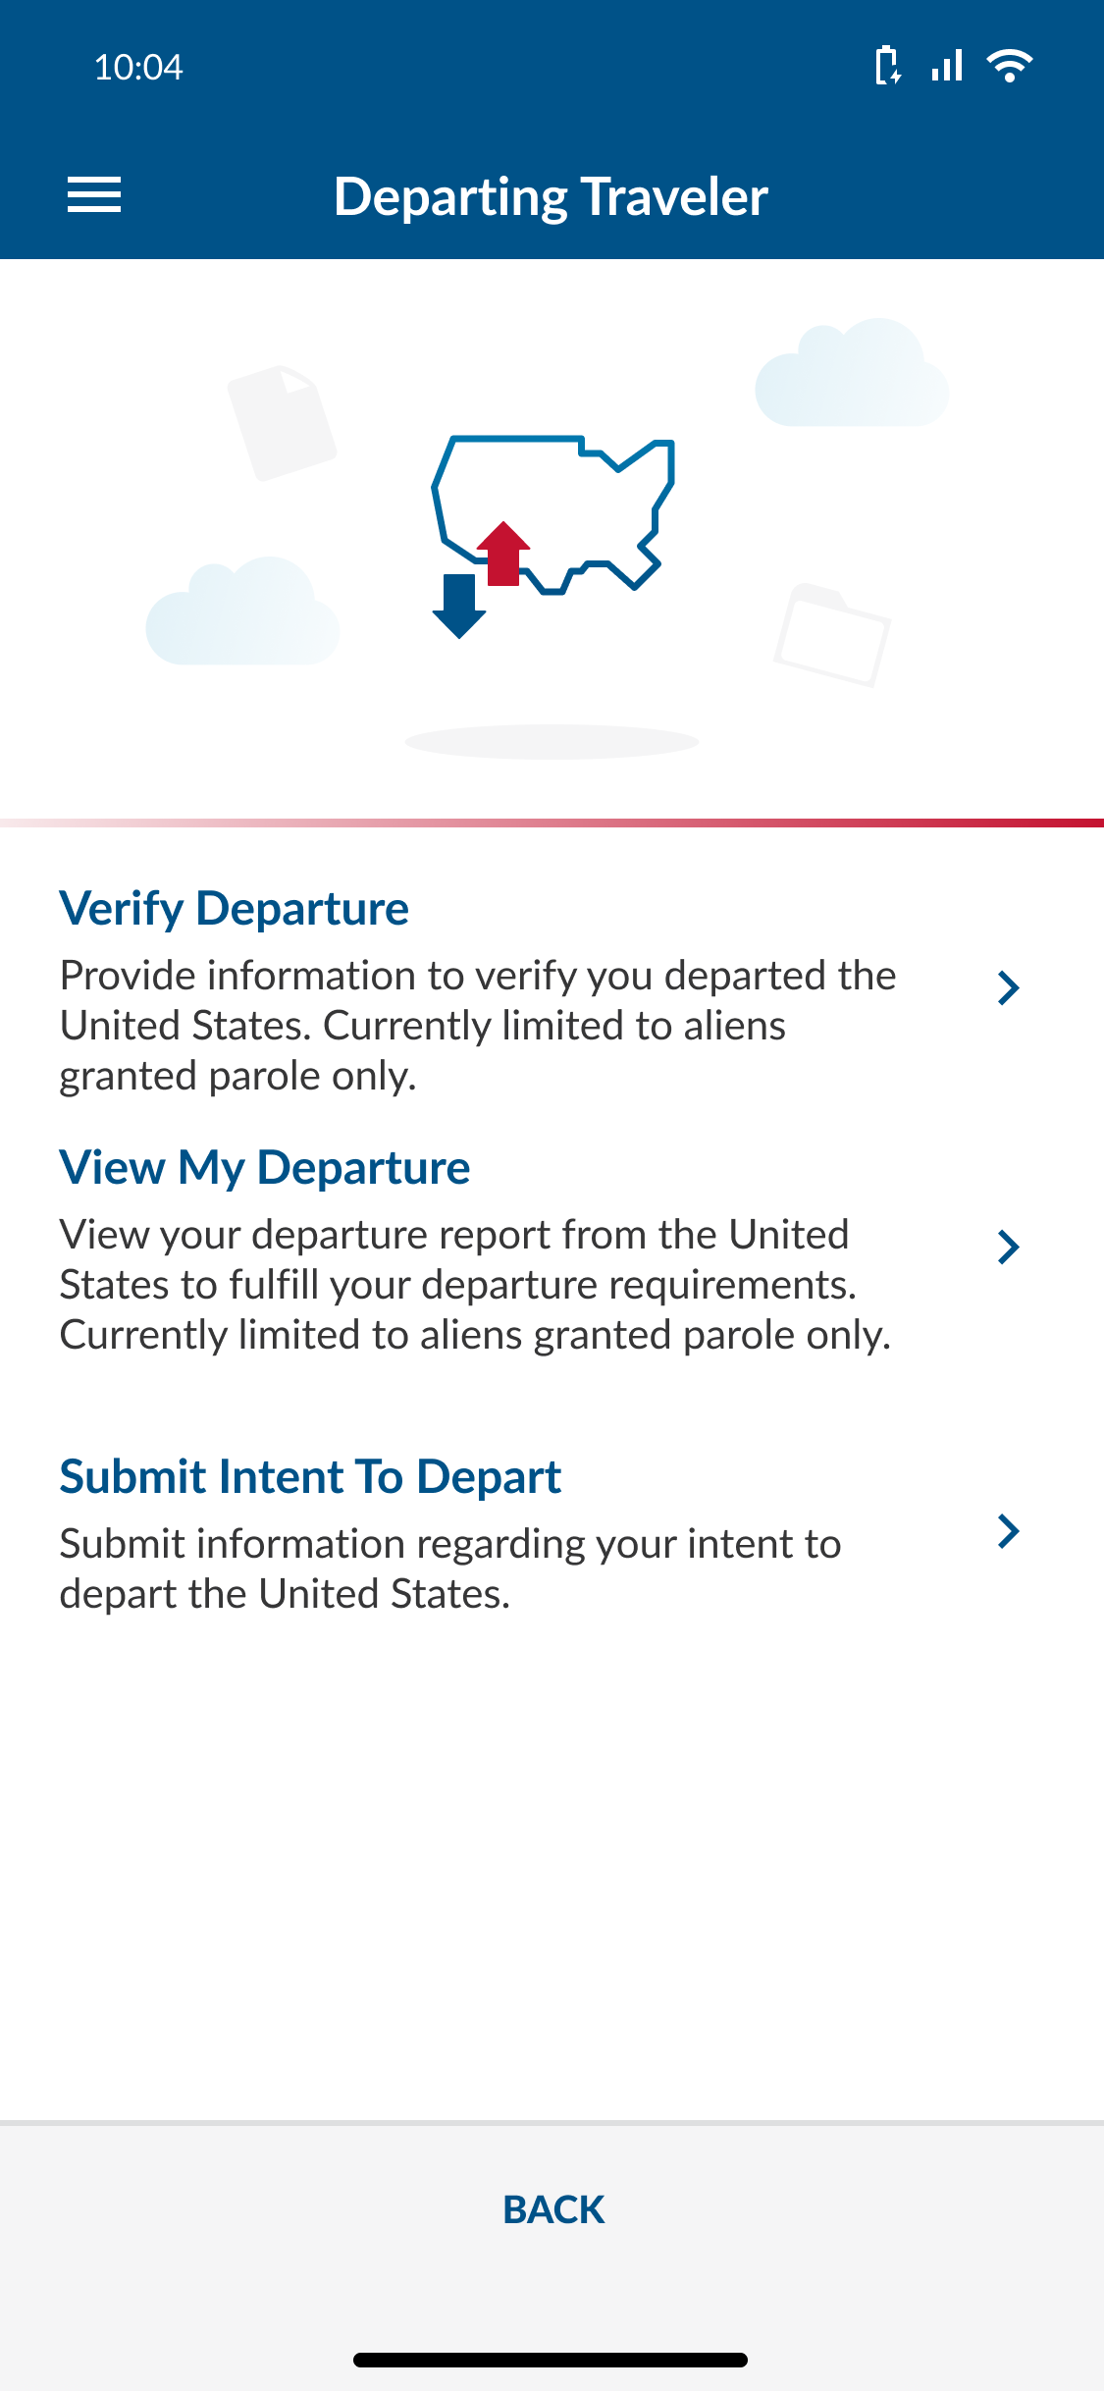
DT > SITD : User Flow 1
ACTION: User Selects Submit Intent to Depart

Slide 8
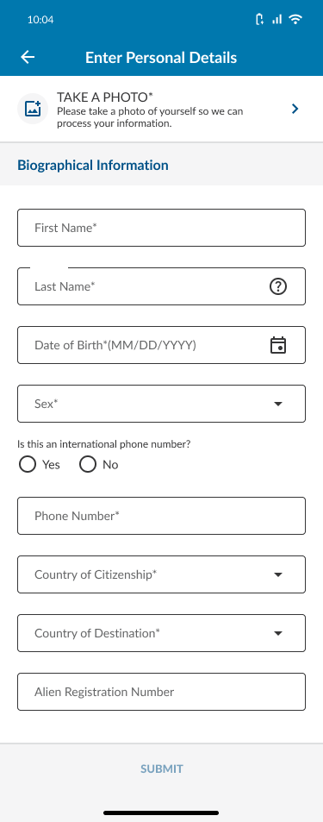
DT > SITD : User Flow 1
ACTION: User fills out personal information/take picture and clicks submit.

Slide 9
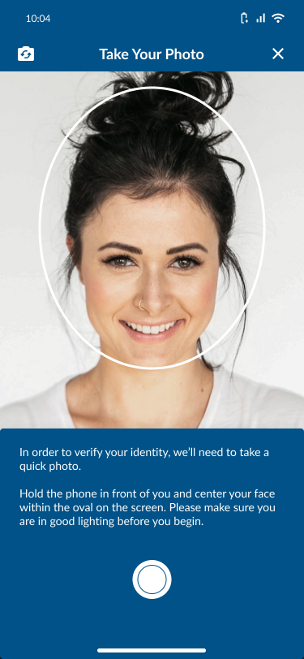
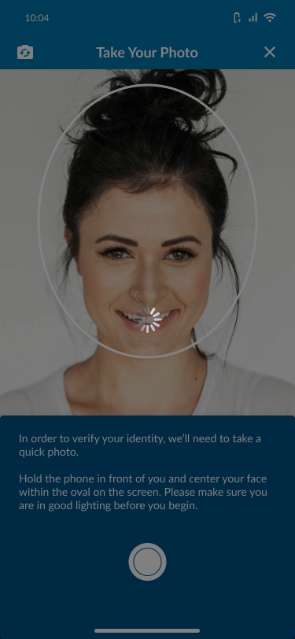
DT > SITD : User Flow 1
ACTION: User submits selfie capture.

Slide 10
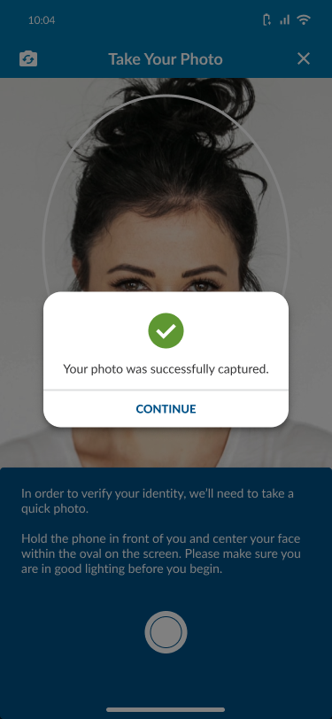
DT > SITD : User Flow 1
ACTION: User selects CONTINUE.

Slide 11
DT > SITD : User Flow 1
ACTION: User Submit information and once their information has been successfully processed, they will receive a successful message and click OK.

Slide 12
Departing Traveler > Submit Intent to Depart User Flow 2
User submit their exit and run into a system error.

Slide 13
DT > SITD : User Flow 2
ACTION: User repeat steps #5 to # 12 before receiving this error message and clicks OK.

Slide 14
Departing Traveler > Submit Intent to Depart User Flow 3
User is not within 3 miles radius of the United States.

Slide 15
DT > SITD : User Flow 3
ACTION: User repeat steps #5 to # 11 before receiving this error message and clicks OK.

Slide 16
Departing Traveler > Submit Intent to Depart User Flow 4
User submit their exit and run into a facial matching error.
Types of Facial Matching Errors:
Photo captured has poor quality.
Photo capture is accepted but resulted with no match.
Photo capture is accepted, and a match was found but it does not match the biographic information provided by the user.

Slide 17
DT > SITD – Photo captured has poor quality. : User Flow 4
ACTION: User repeat steps #5 to # 12 before receiving this error message and clicks OK.

Slide 18
DT > SITD Photo capture is accepted but resulted with no match. : User Flow 4
ACTION: User repeat steps #5 to # 12 before receiving this error message and clicks OK.

Slide 19
DT > SITD -Photo capture is accepted, and a match was found but it does not match the biographic information provided by the user. : User Flow 4
ACTION: User repeat steps #5 to # 12 before receiving this error message and clicks OK.

