Slide 1
Cares Act 2
Payroll Support Application Portal
System Screenshots
January 8, 2020

Slide 2
Overview
Navigating to PSP2 Application
Initial Application Workflow
Applicant Info section of Form

Slide 3
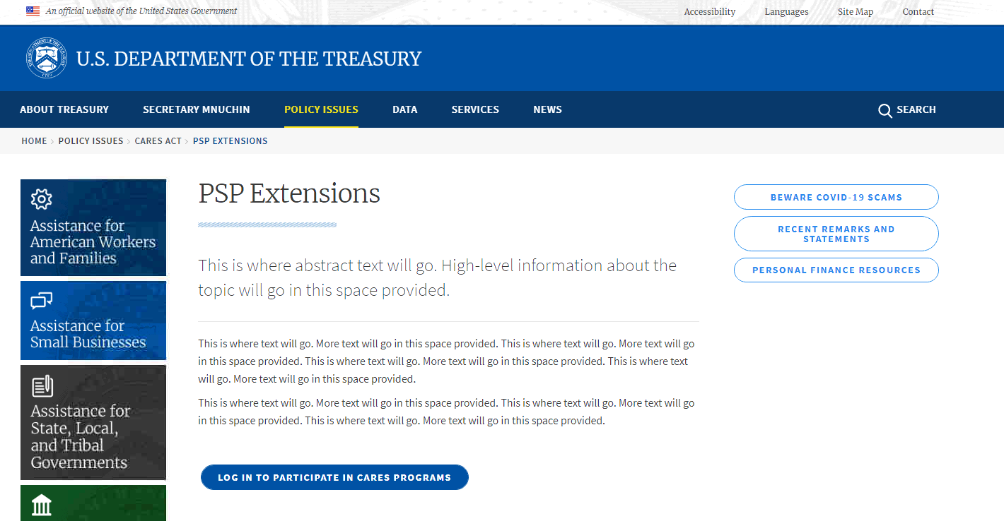
Step 1: Treasury Website
Treasury website with link to PSP2 Application/Cares Hub

Slide 4
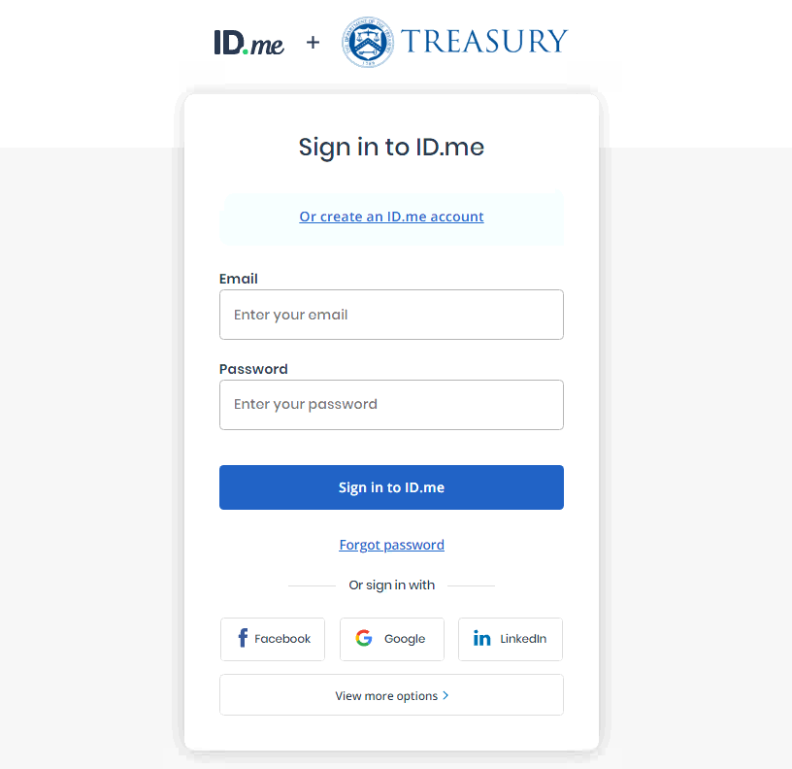
Step 2: Application Login
Login page for new or returning Cares Hub users.

Slide 5

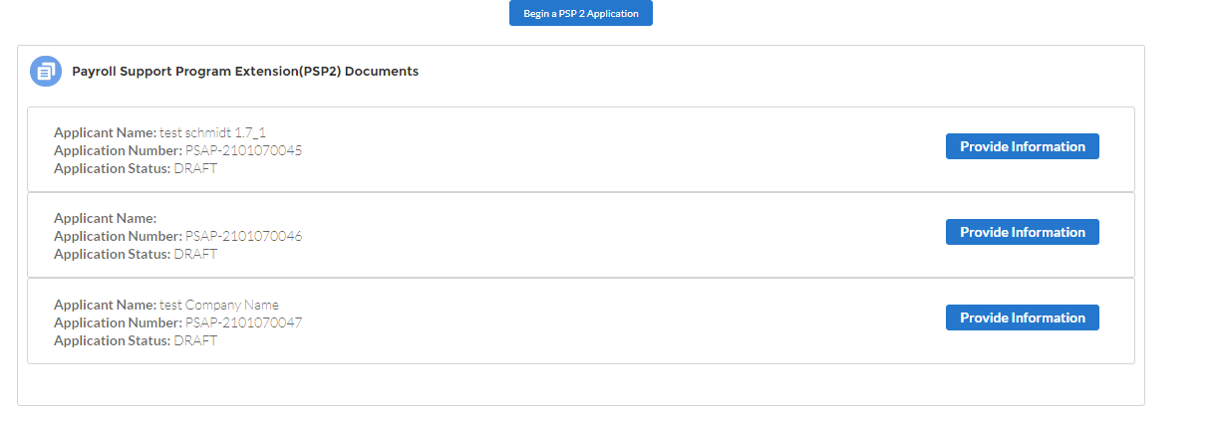
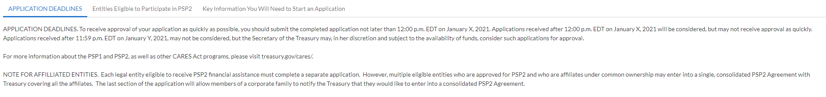
Step 3: Application Homepage (PSP2)

Slide 6
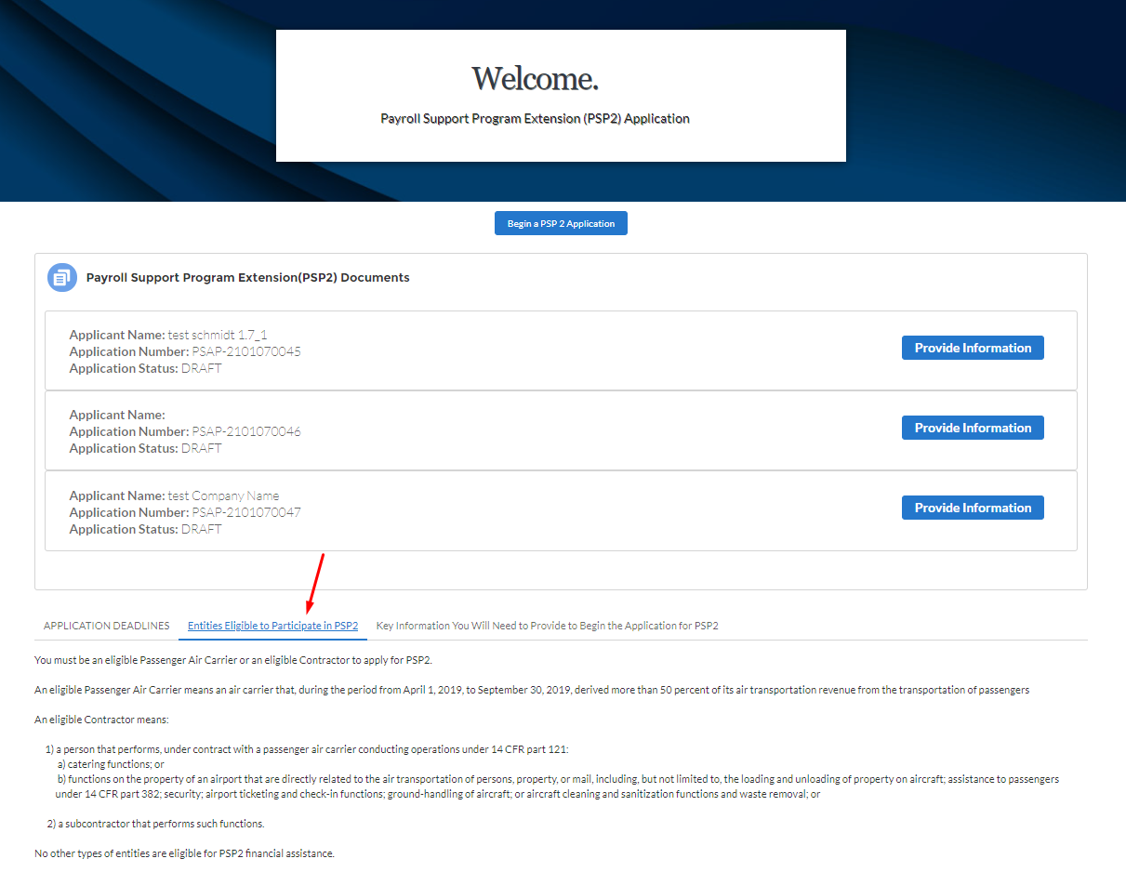
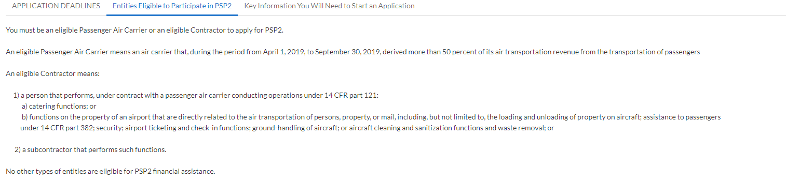
Step 3: Application Homepage (PSP2)

Slide 7
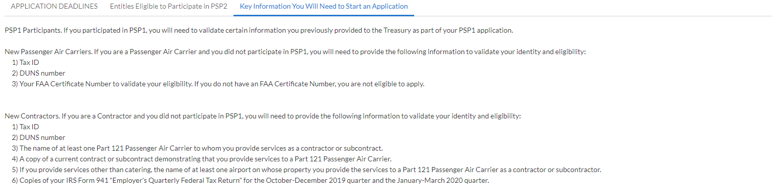
Step 3: Application Homepage (PSP2)

Slide 8
Step 4: Starting Application
Once the user clicks the “Begin a PSP 2 Application” button on the homepage, the system will create an application record and direct them to the form.

Slide 9
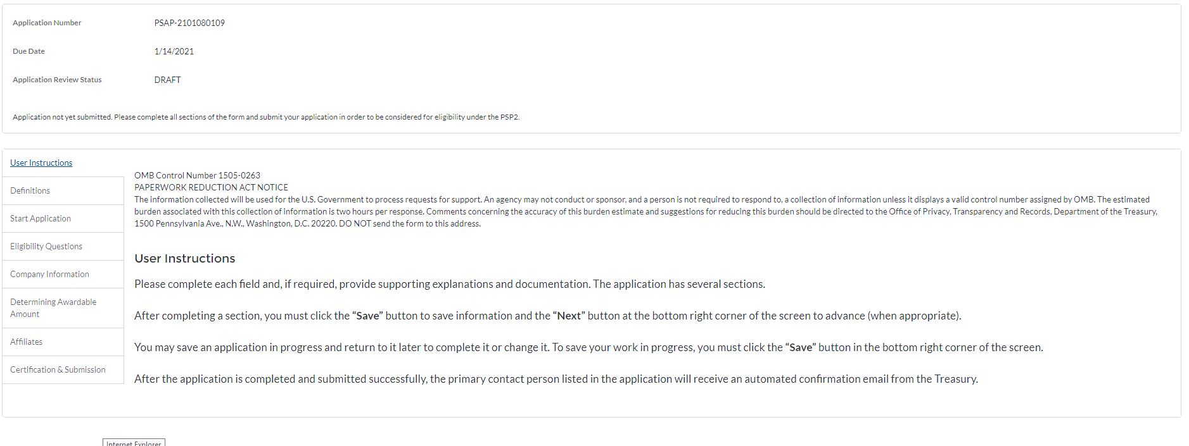
Step 4a: User Instructions

Slide 10
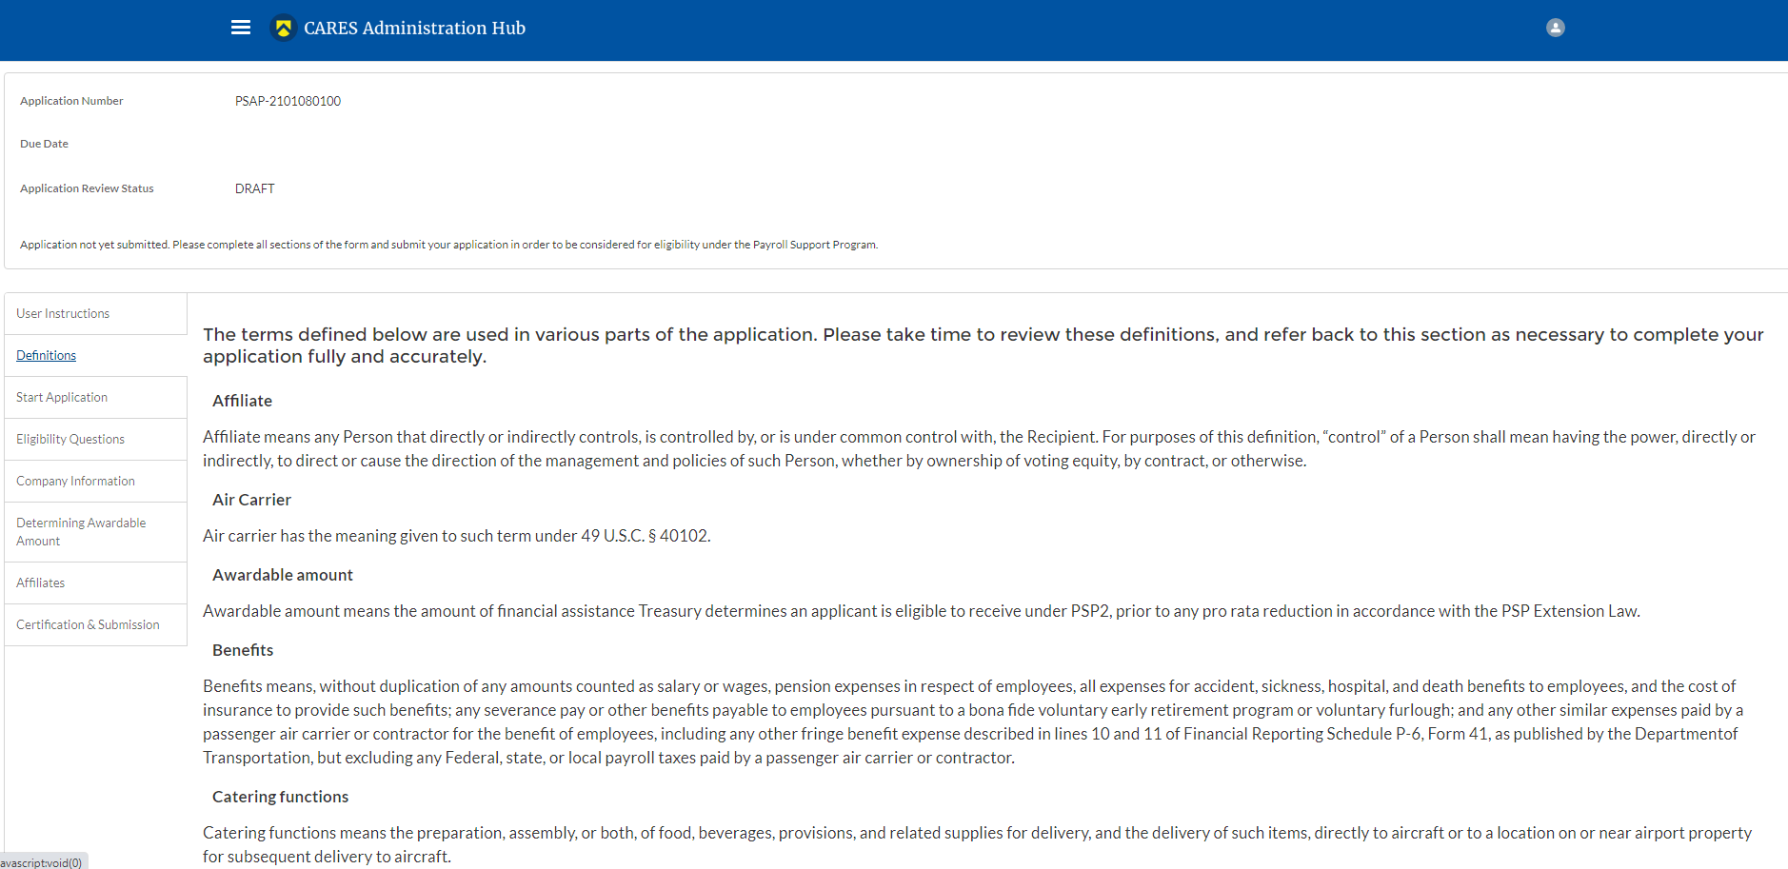
Step 4b: Definitions (1/3)

Slide 11
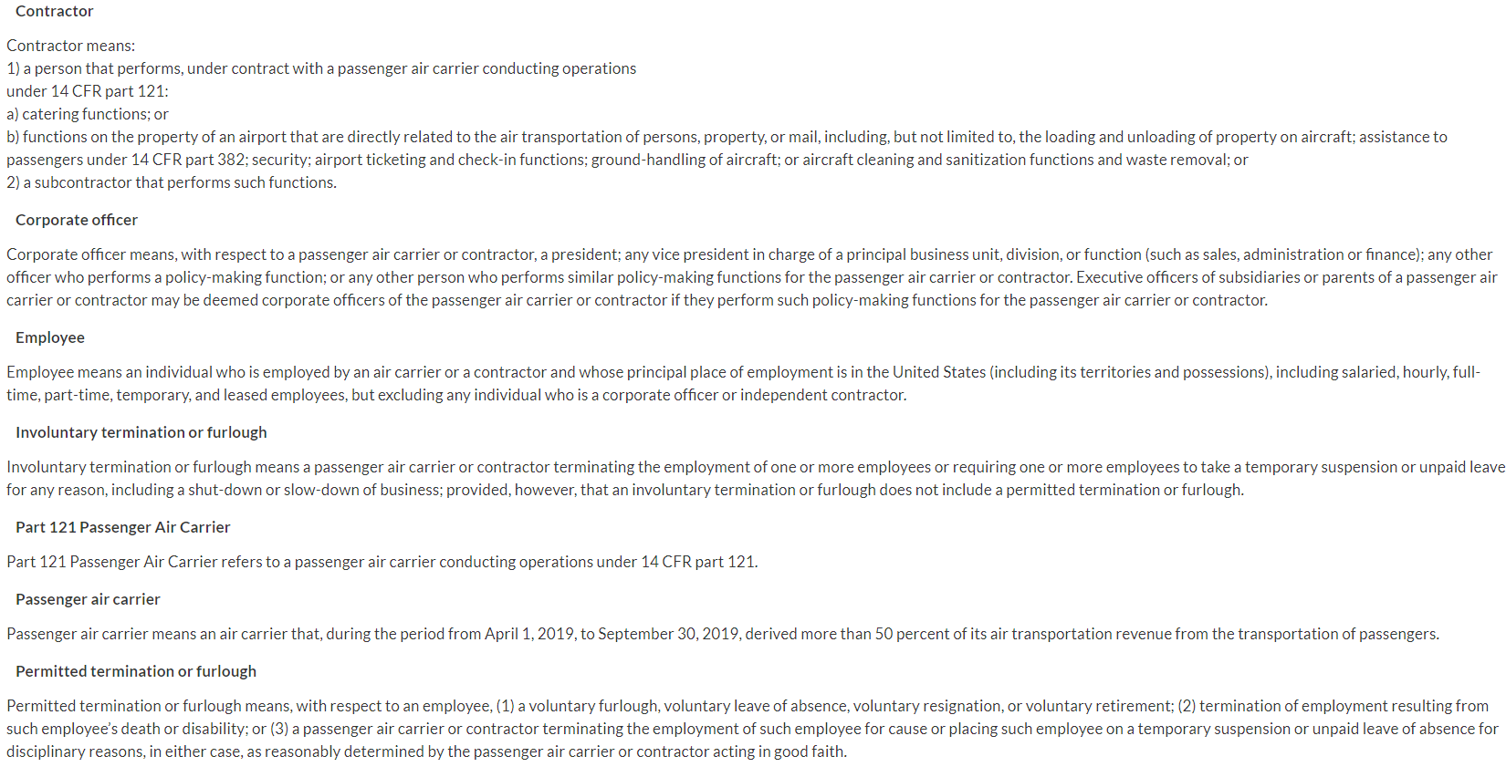
Step 4b: Definitions (2/3)

Slide 12
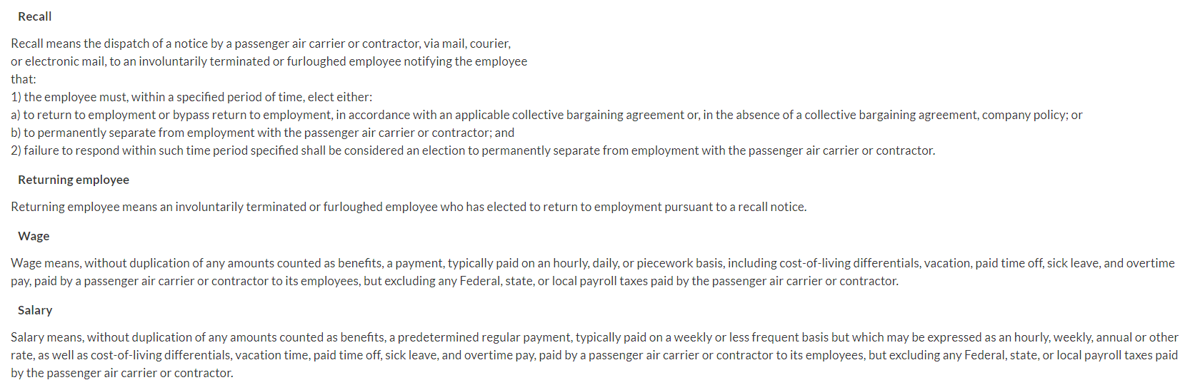
Step 4b: Definitions (3/3)

Slide 13
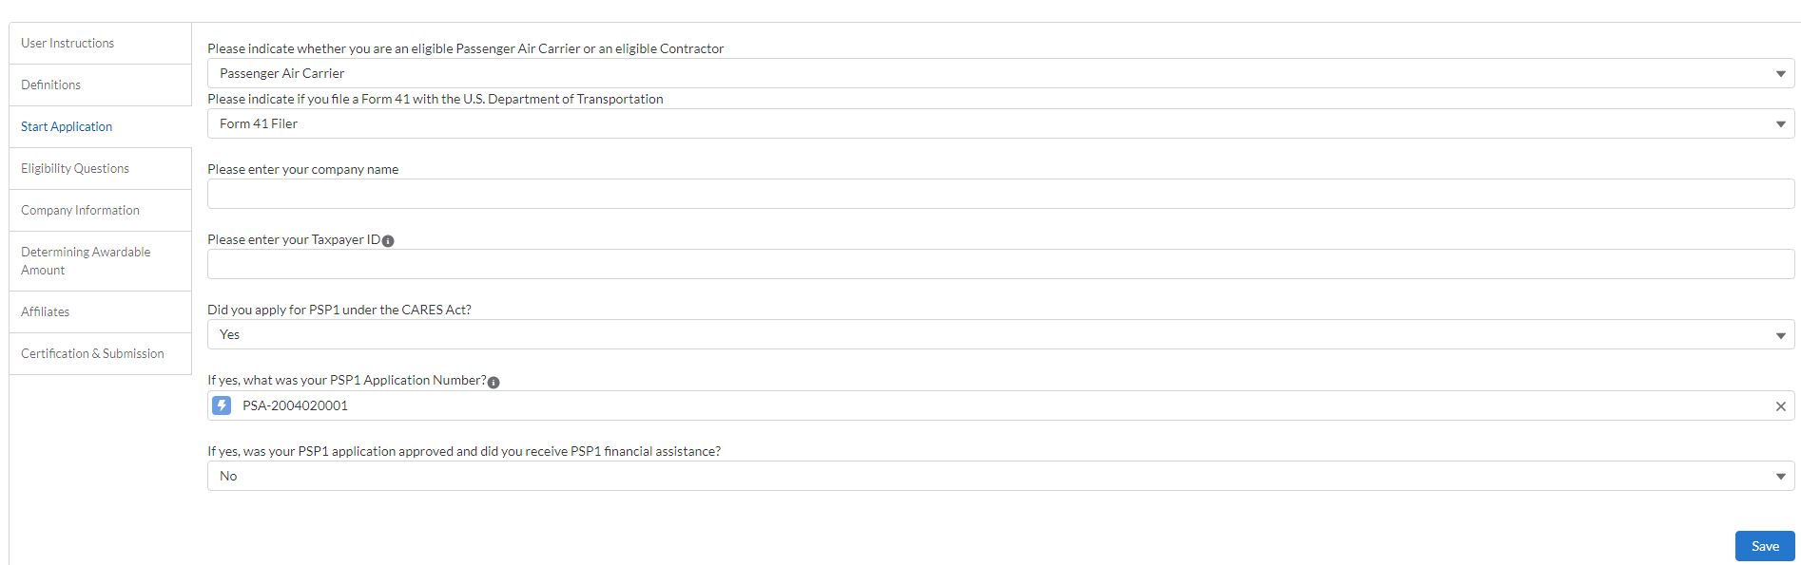
Step 4c: Start Application
Passenger Air Carrier AND PSP1 applicant

Slide 14
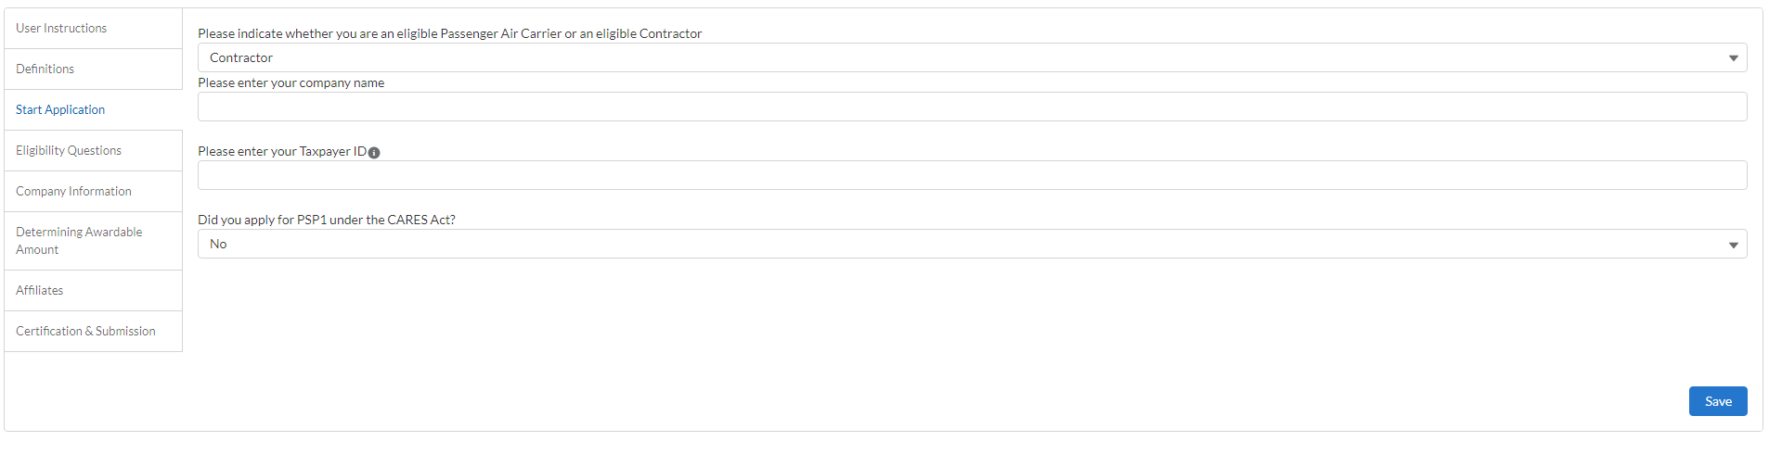
Step 4c: Start Application
Contractor AND NOT a PSP1 applicant

Slide 15
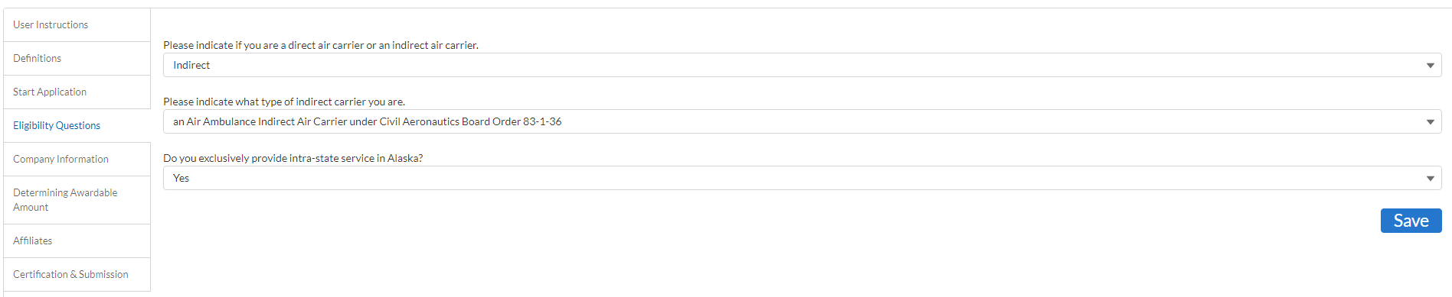
Step 4d: Eligibility Questions
Eligibility Questions section if applicant is a Passenger Carrier and Indirect

Slide 16
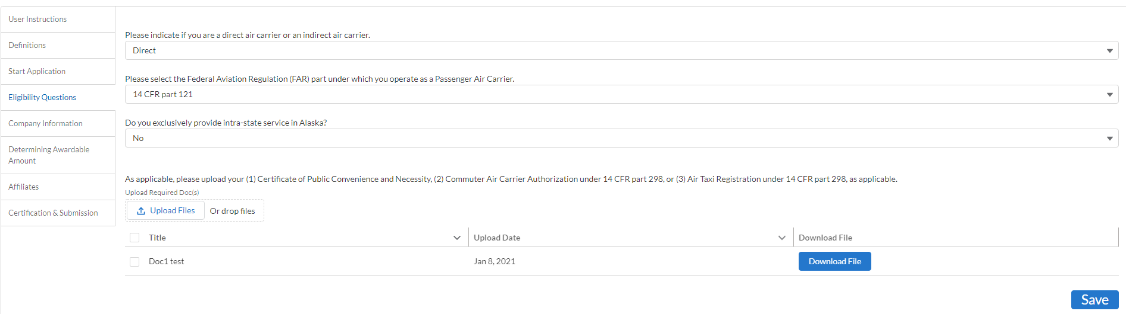
Step 4d: Eligibility Questions cont.
Eligibility Questions section if applicant is a Passenger Carrier AND Direct.

Slide 17
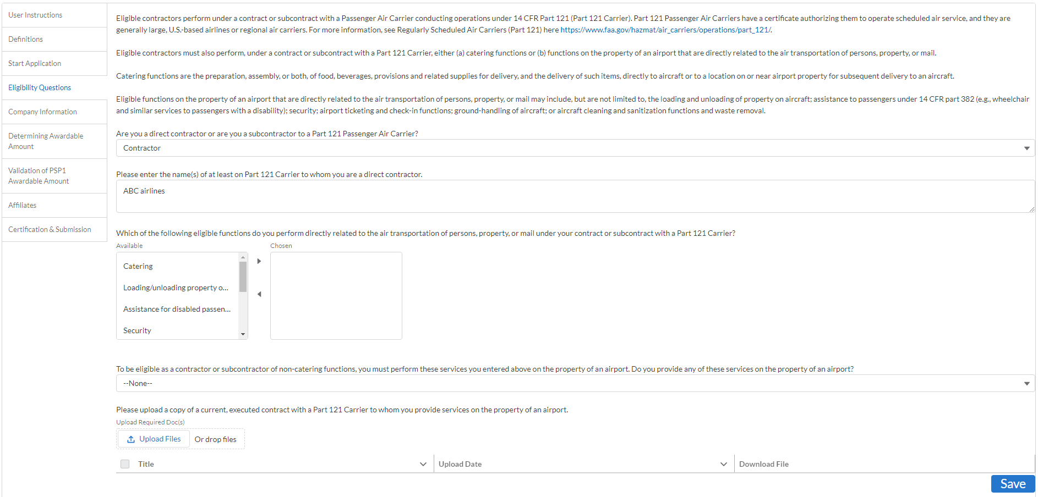
Step 4d: Eligibility Questions cont.
Eligibility Questions if applicant is a contractor AND Contractor

Slide 18
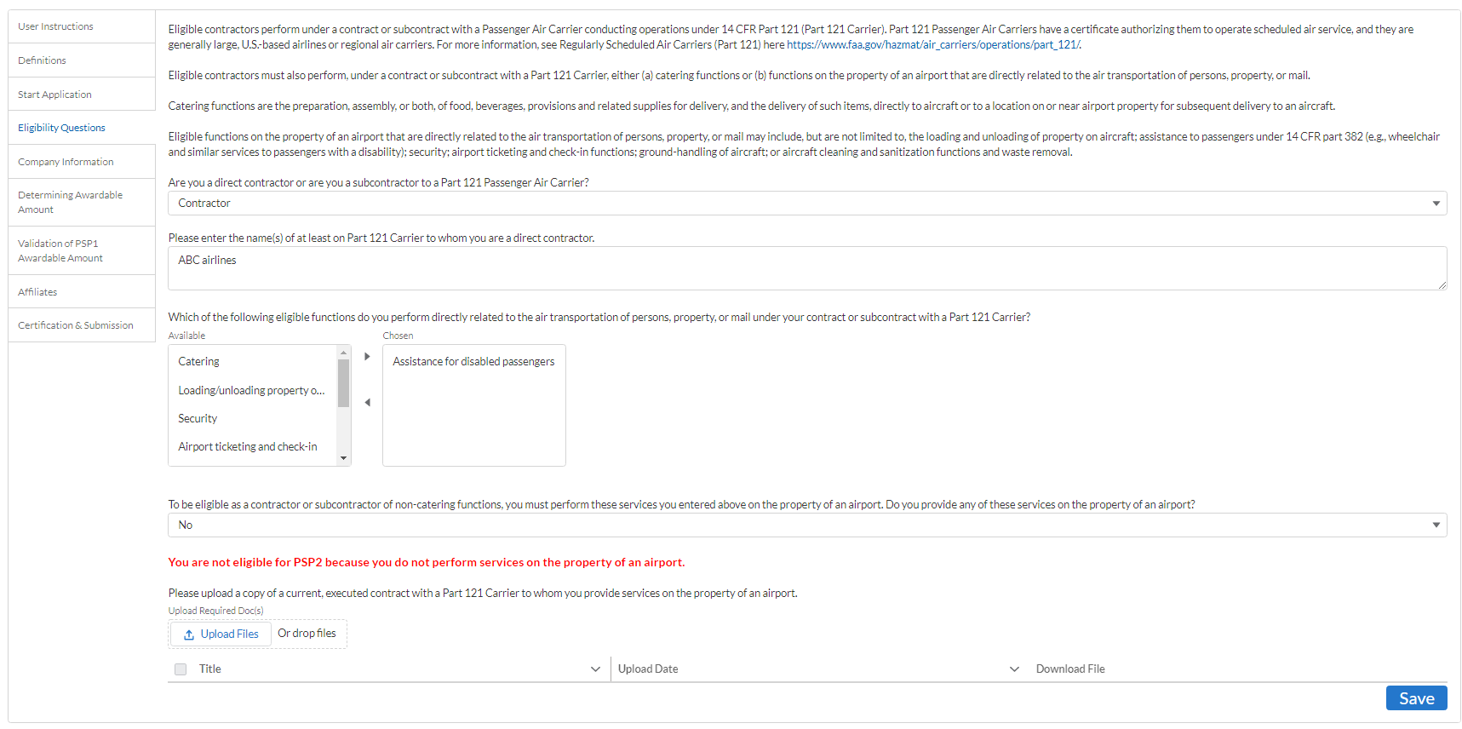
Step 4d: Eligibility Quesitons cont.
Eligibility Questions section if applicant is a contractor AND Contractor

Slide 19
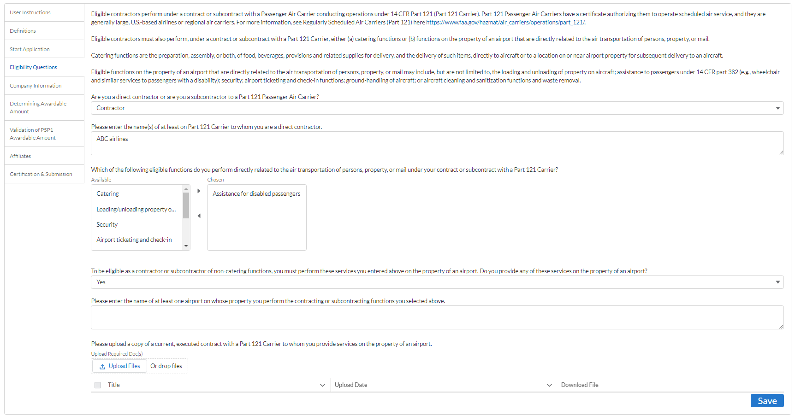
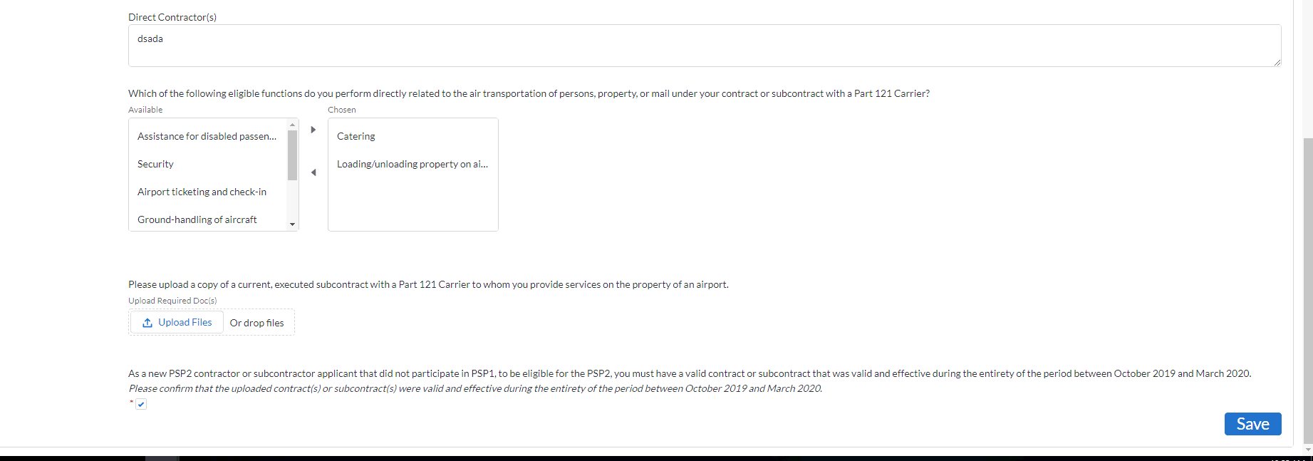
Step 4d: Eligibility Questions cont.
Eligibility Questions section if applicant is a contractor AND Contractor
Shows if Contractor was PSP1, for both contractor and sub-contractor
Notes:
Shows if Contractor was PSP1, for both contractor and sub-contractor

Slide 20
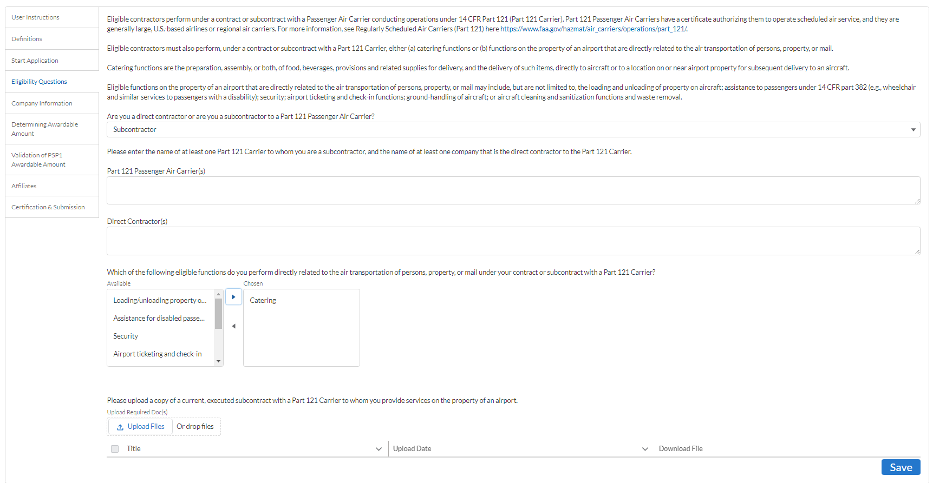
Step 4d: Eligibility Questions cont.
Eligibility Questions section if applicant is a contractor AND Subcontractor
Shows if Contractor was PSP1, for both contractor and sub-contractor

Slide 21
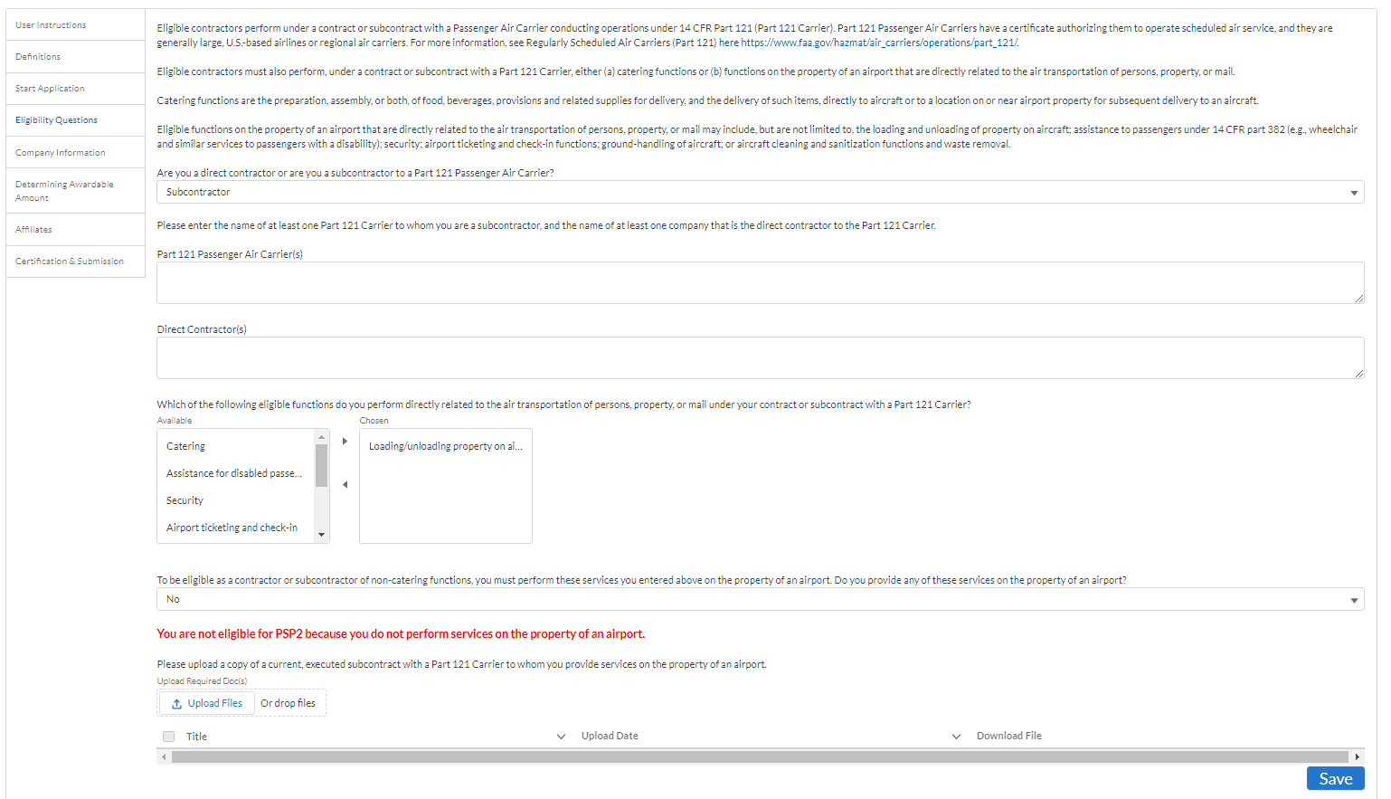
Step 4d: Eligibility Questions cont.
Additional Info section if applicant is a contractor AND Subcontractor

Slide 22

Step 4d: Eligibility Questions cont.
Eligibility Questions section if applicant is a contractor AND Subcontractor

Slide 23
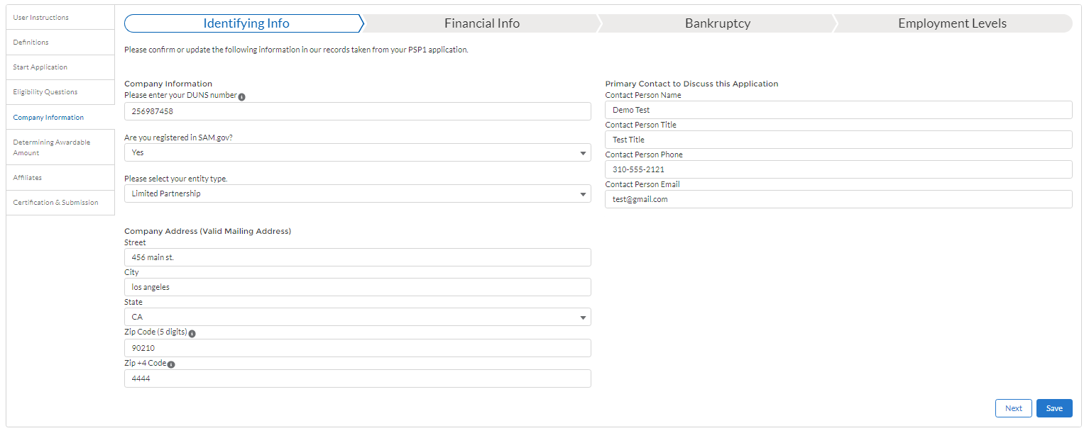
Step 4e: Company Information
Previous PSP1 Applicant

Slide 24
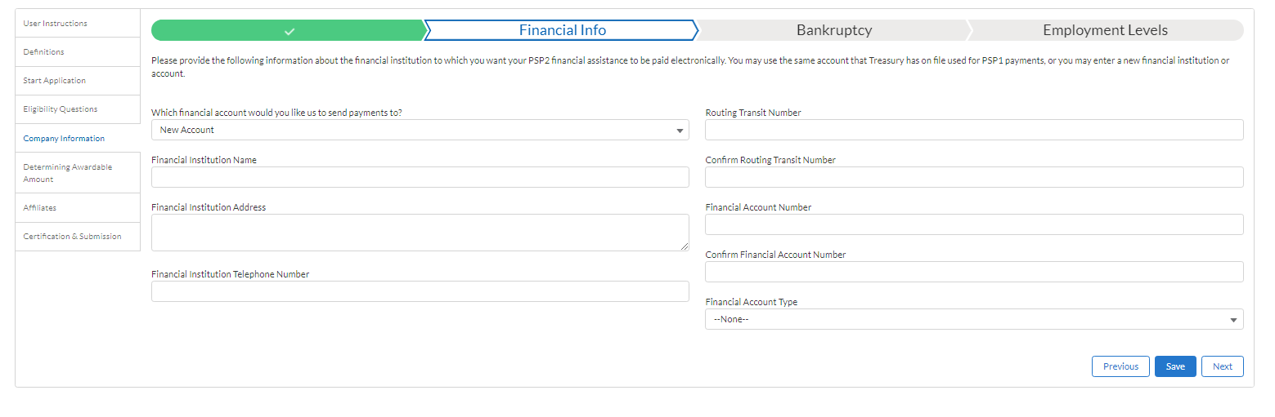
Step 4e: Company Information
Previous PSP1 Applicant

Slide 25
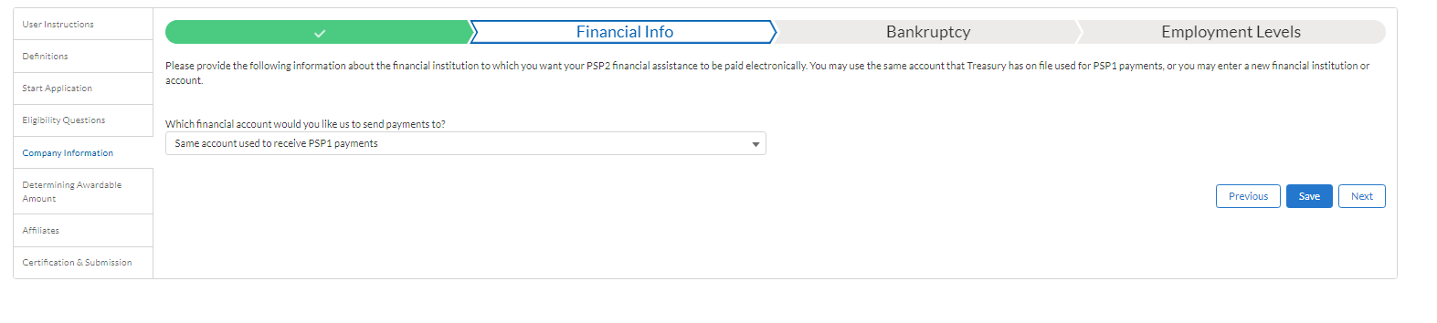
Step 4e: Company Information
Previous PSP1 Applicant

Slide 26
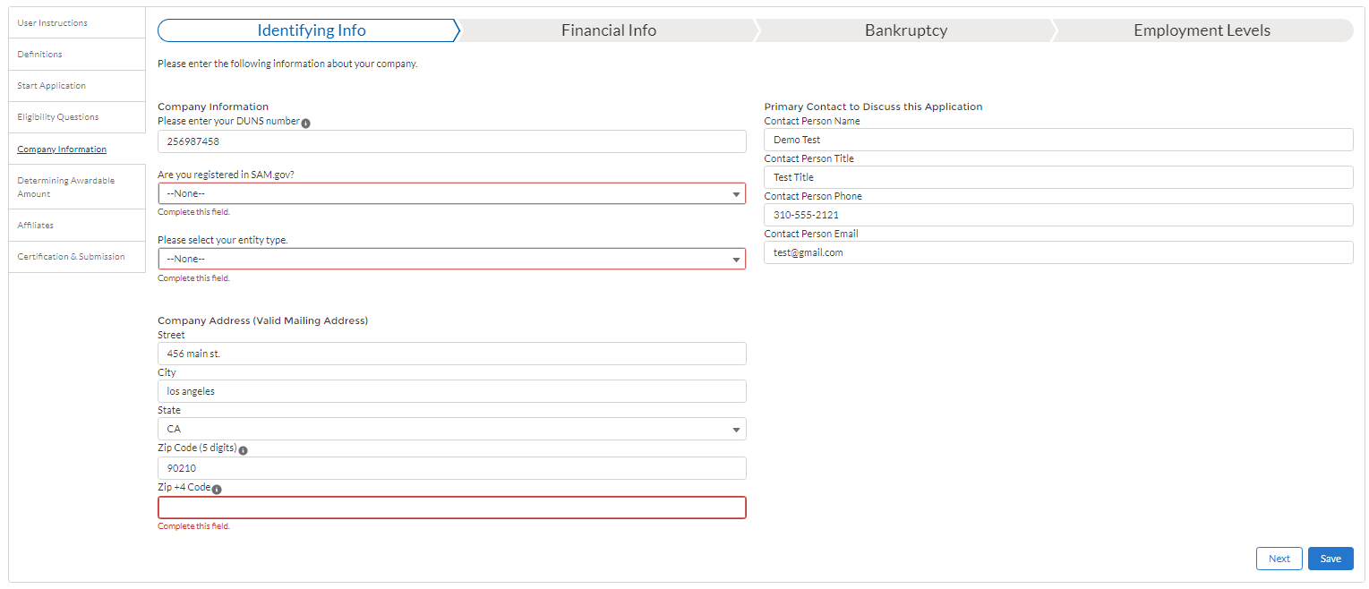
Step 4e: Company Information cont.
NO PSP1 Application, new applicant

Slide 27
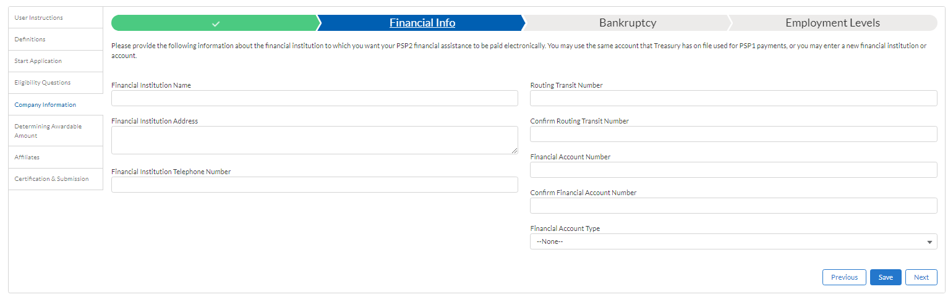
Step 4e: Company Information cont.
NO PSP1 Application, new applicant

Slide 28
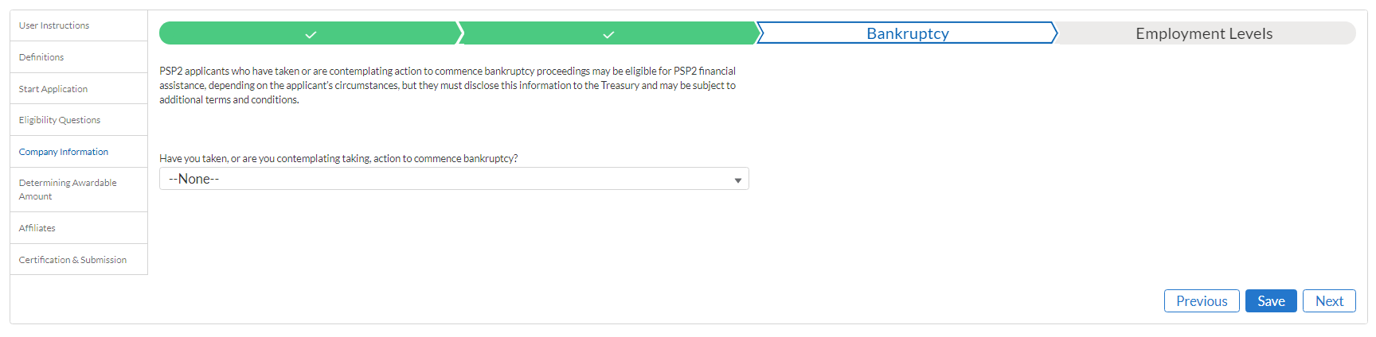
Step 4e: Company Information cont.
Both PSP1 and NOT PSP1 Applicants

Slide 29
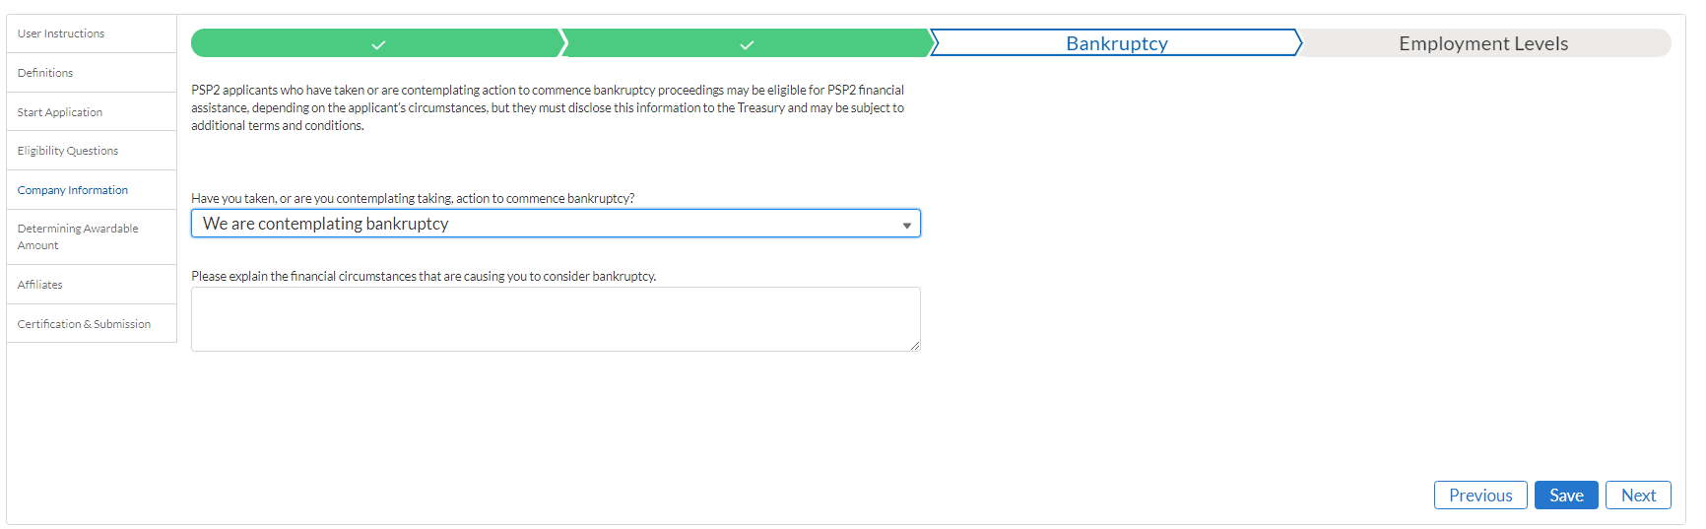
Step 4e: Company Information cont.
Both PSP1 and NOT PSP1 Applicants

Slide 30
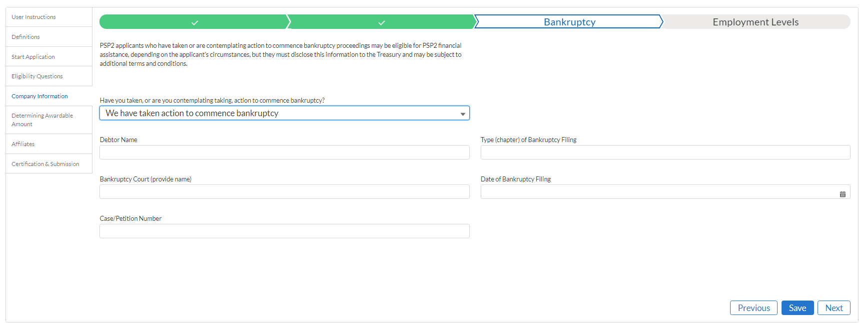
Step 4e: Company Information cont.
Both PSP1 and NOT PSP1 Applicants
Multiple fields shown

Slide 31
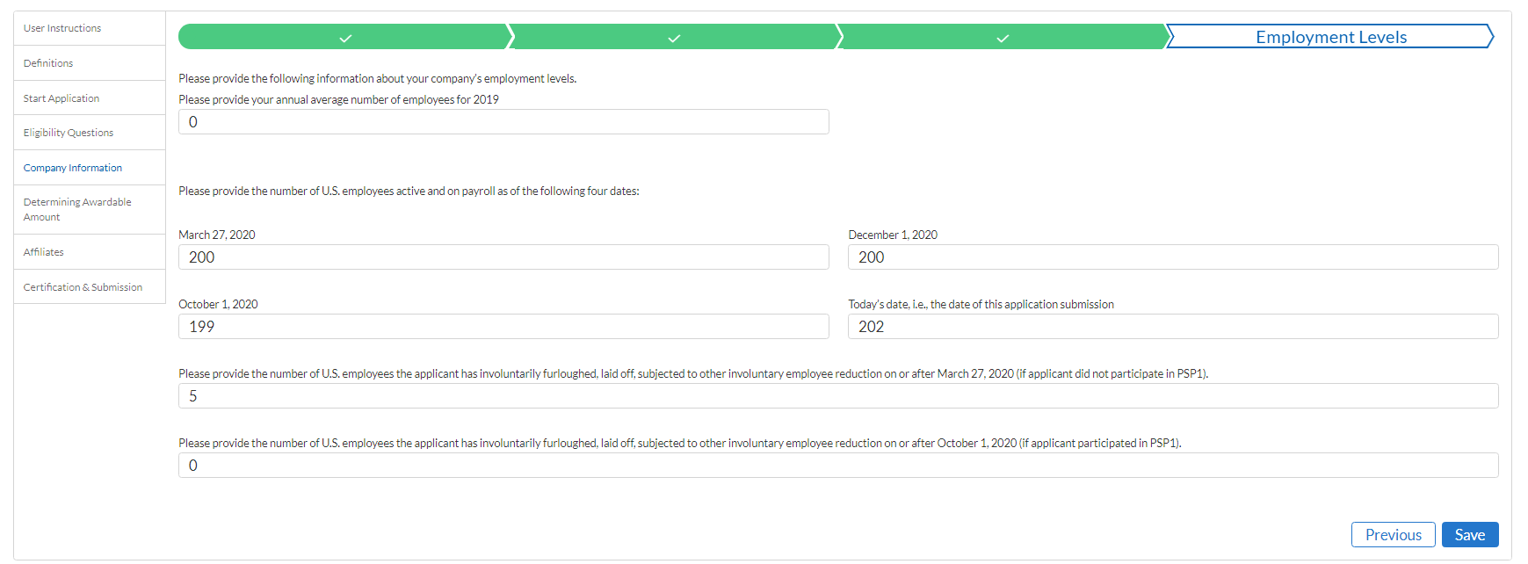
Step 4e: Company Information cont.
Both PSP1 and NOT PSP1 Applicants

Slide 32
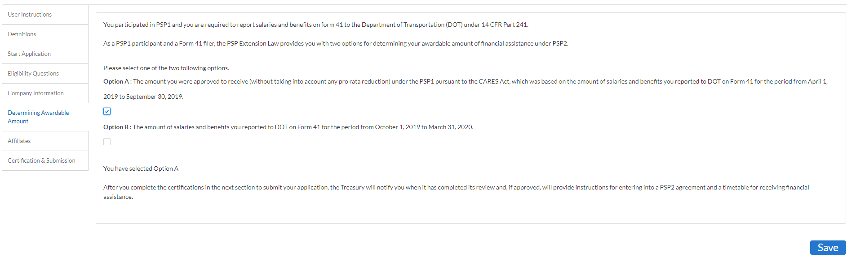
Step 4f: Determining Awardable Amount
1) Workflow: PSP1 participant, Passenger Air Carrier, Form 41 Filer
Option A

Slide 33
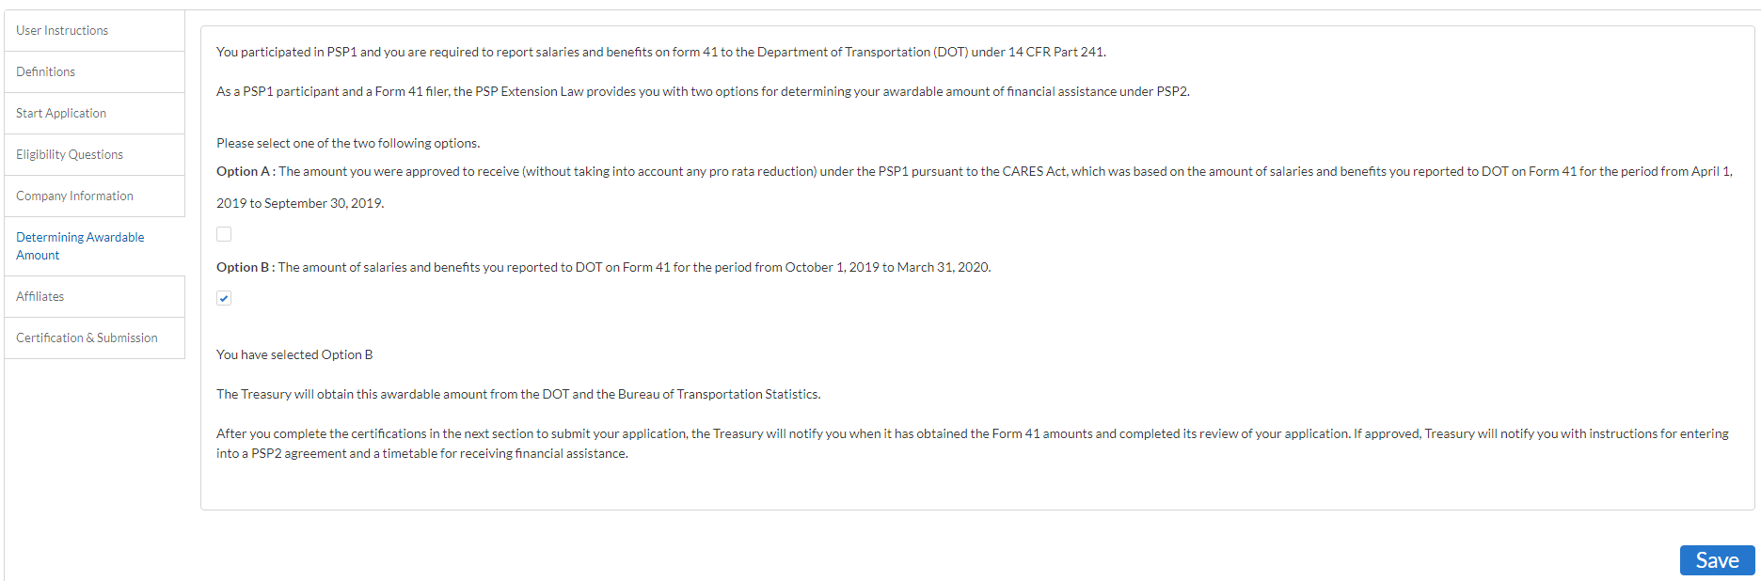
Step 4f: Determining Awardable Amount
1) Workflow: PSP1 participant, Passenger Air Carrier, Form 41 Filer
Option B

Slide 34
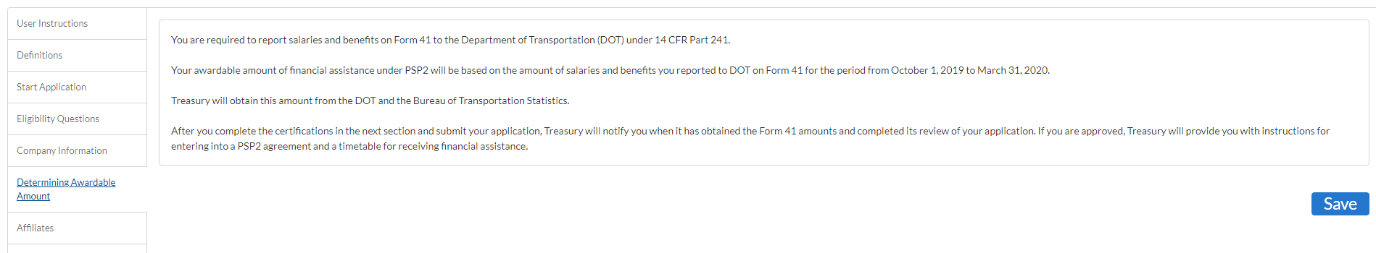
Step 4f: Determining Awardable Amount
2) Workflow: NOT a PSP1 participant, Passenger Air Carrier, Form 41 Filer

Slide 35
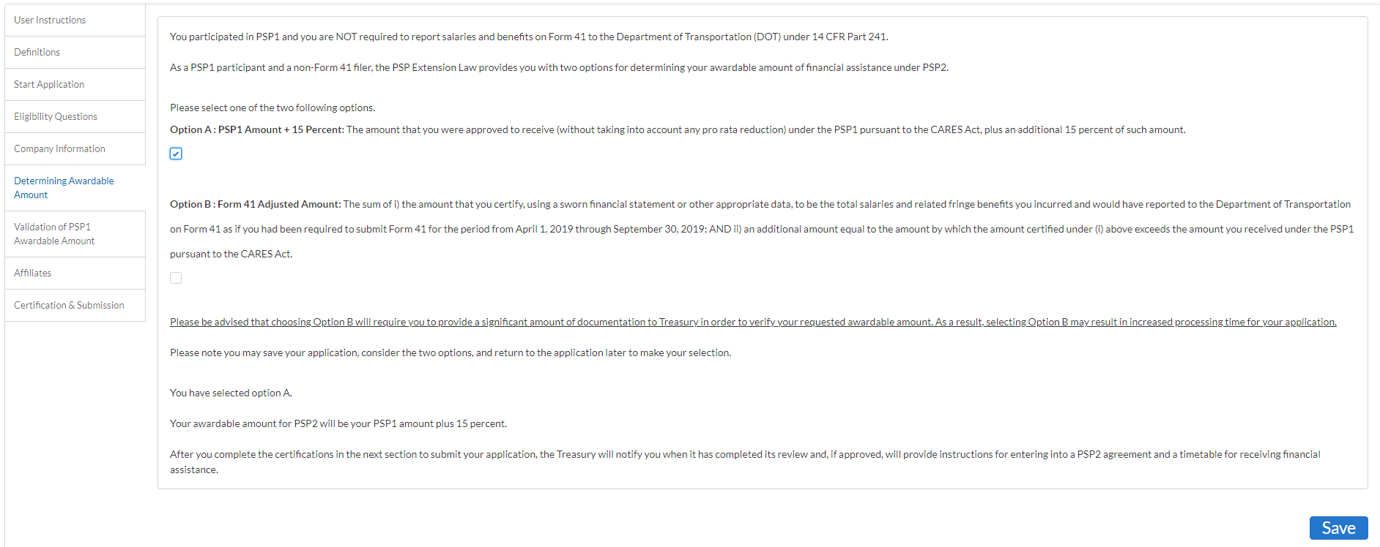
Step 4f: Determining Awardable Amount
3) Workflow: PSP1 participant, Passenger Air Carrier, Not a Form 41 Filer
Option A

Slide 36
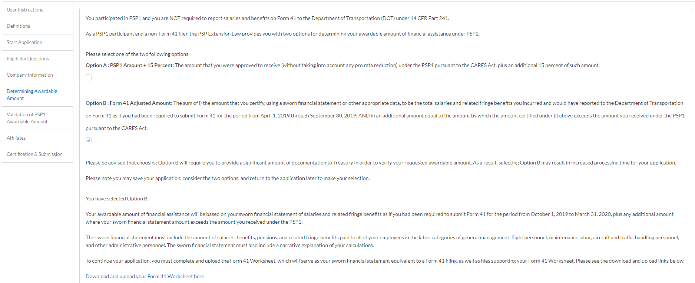
Step 4f: Determining Awardable Amount
3) Workflow: PSP1 participant, Passenger Air Carrier, Not a Form 41 Filer
Option B

Slide 37
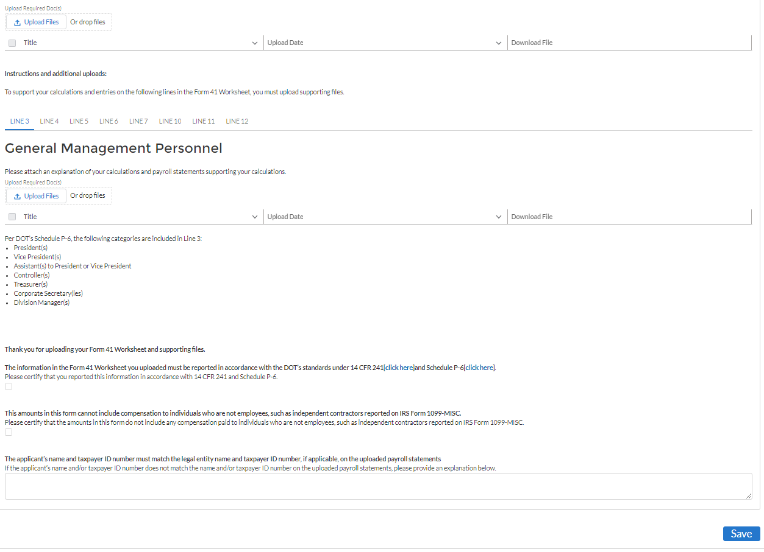
Step 4f: Determining Awardable Amount
3) Workflow: PSP1 participant, Passenger Air Carrier, Not a Form 41 Filer
Option B cont.

Slide 38
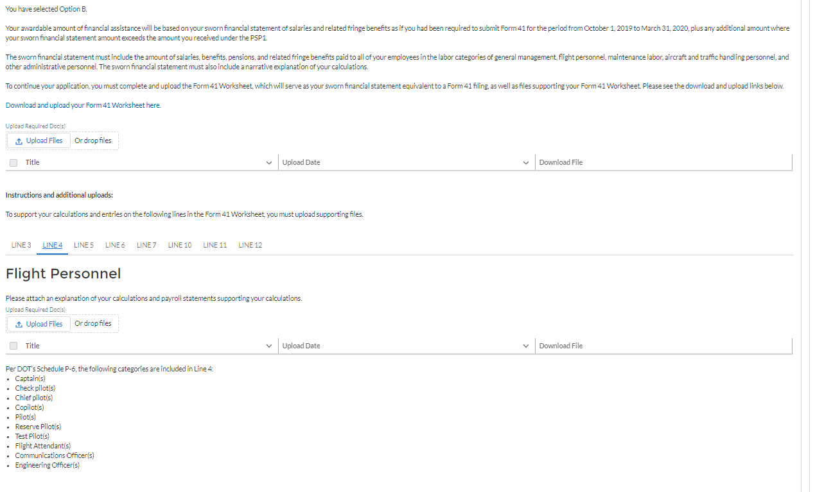
Step 4f: Determining Awardable Amount
3) Workflow: PSP1 participant, Passenger Air Carrier, Not a Form 41 Filer
Option B cont.

Slide 39
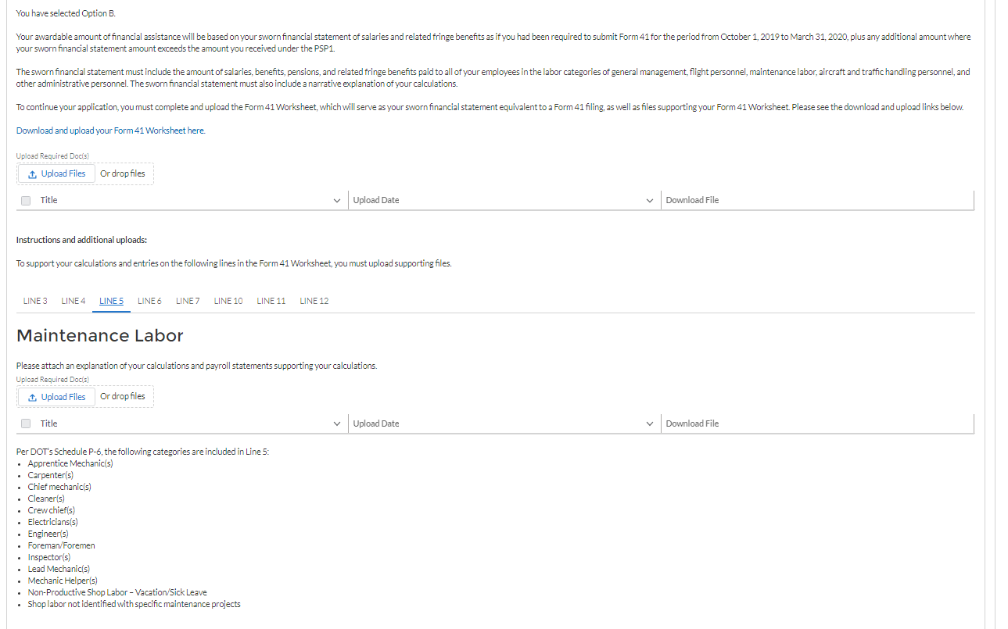
Step 4f: Determining Awardable Amount
3) Workflow: PSP1 participant, Passenger Air Carrier, Not a Form 41 Filer
Option B cont.

Slide 40
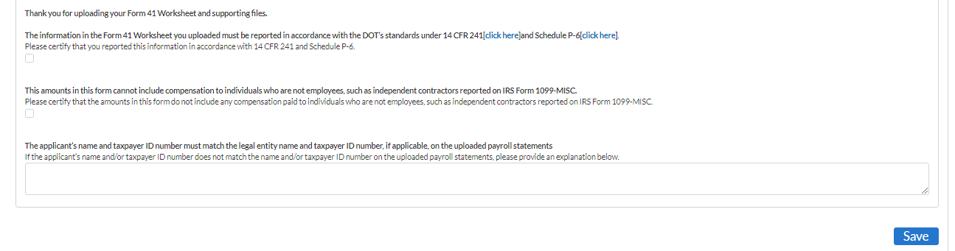
Step 4f: Determining Awardable Amount
3) Workflow: PSP1 participant, Passenger Air Carrier, Not a Form 41 Filer
Option B cont.

Slide 41
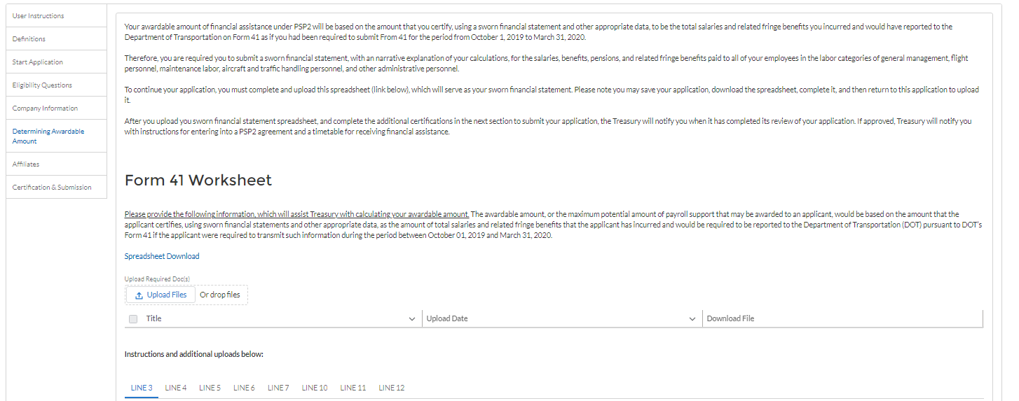
Step 4f: Determining Awardable Amount
4) Workflow: Not a PSP1 participant, Passenger Air Carrier, Not a Form 41 Filer

Slide 42
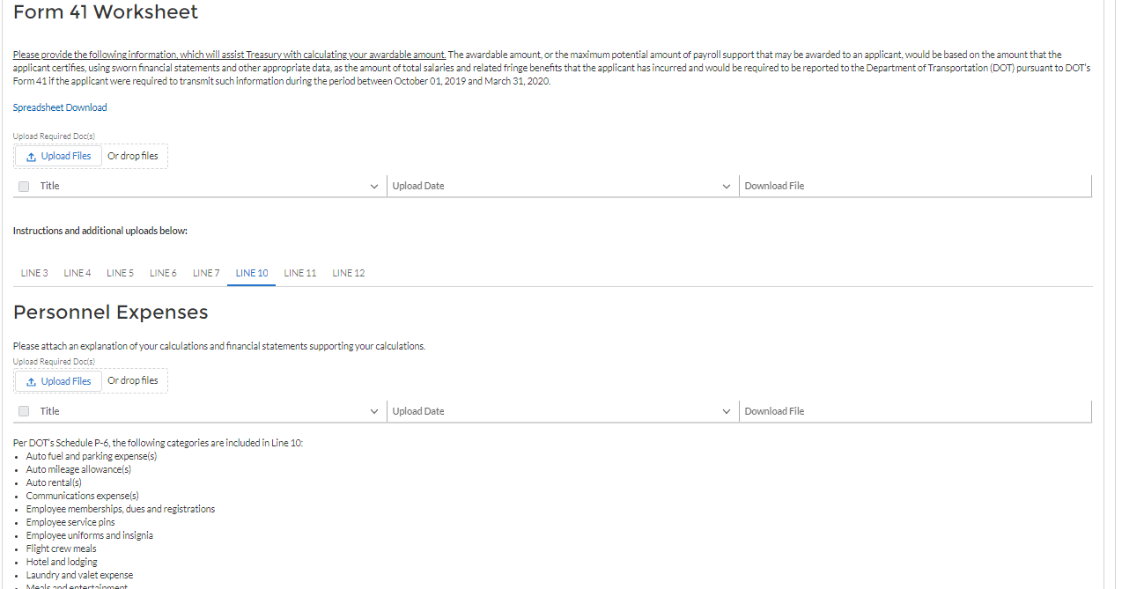
Step 4f: Determining Awardable Amount
4) Workflow: Not a PSP1 participant, Passenger Air Carrier, Not a Form 41 Filer cont.

Slide 43
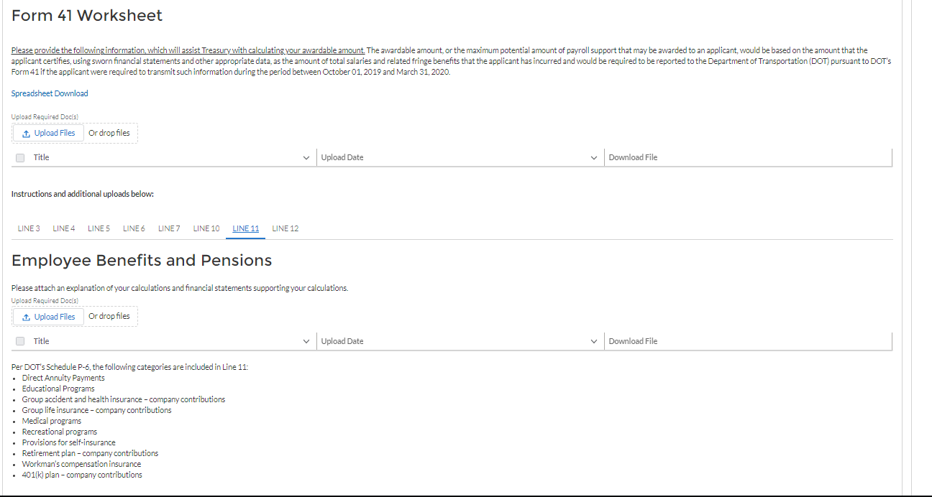
Step 4f: Determining Awardable Amount
4) Workflow: Not a PSP1 participant, Passenger Air Carrier, Not a Form 41 Filer cont.

Slide 44
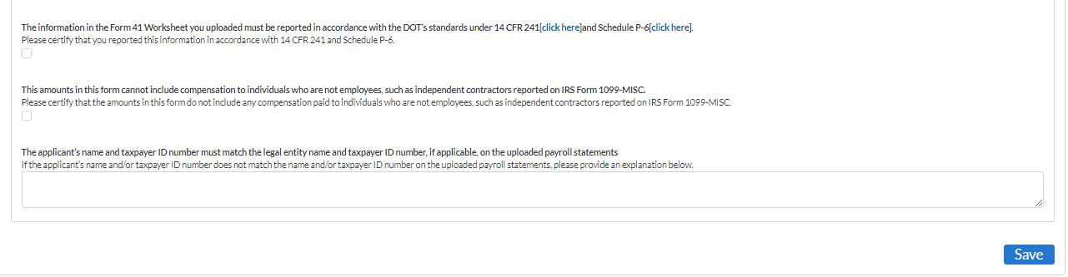
Step 4f: Determining Awardable Amount
4) Workflow: Not a PSP1 participant, Passenger Air Carrier, Not a Form 41 Filer cont.

Slide 45
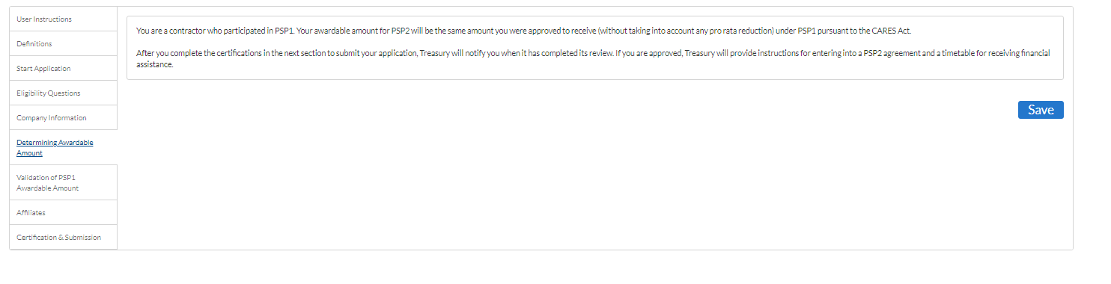
Step 4f: Determining Awardable Amount
5) Workflow: PSP1 participant, Contractor

Slide 46
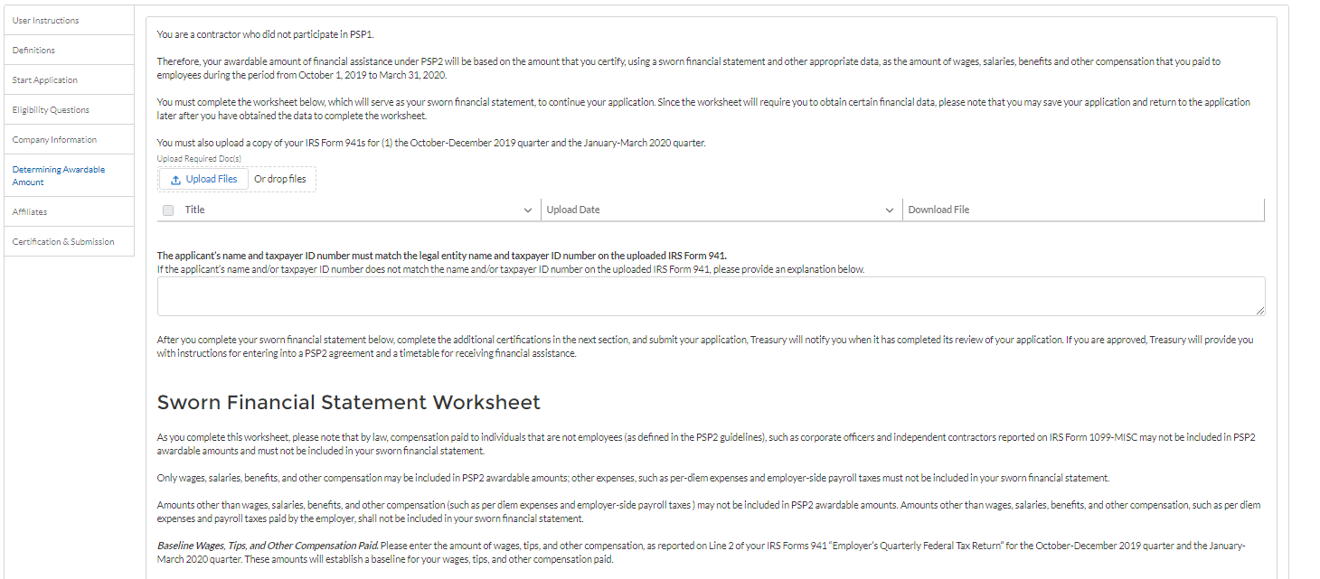
Step 4f: Determining Awardable Amount
6) Workflow: Not a PSP1 participant, Contractor

Slide 47
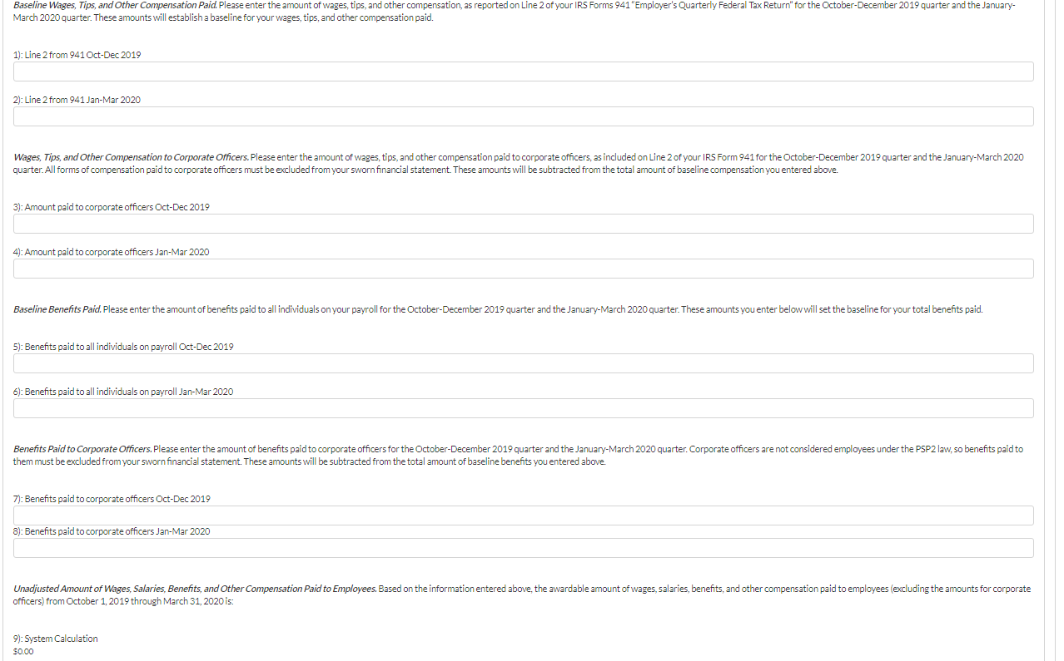
Step 4f: Determining Awardable Amount
6) Workflow: Not a PSP1 participant, Contractor cont.

Slide 48
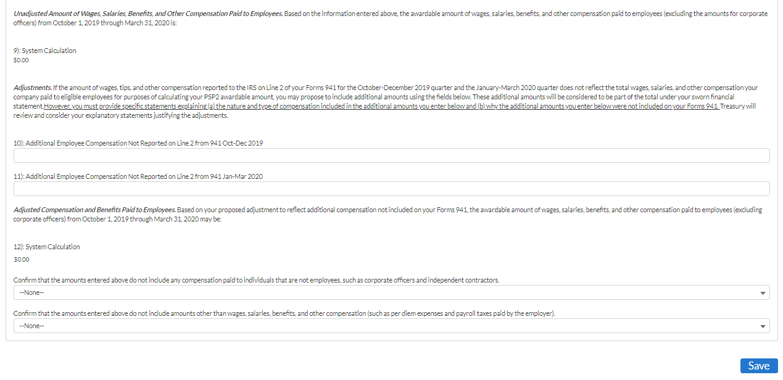
Step 4f: Determining Awardable Amount
6) Workflow: Not a PSP1 participant, Contractor cont.

Slide 49
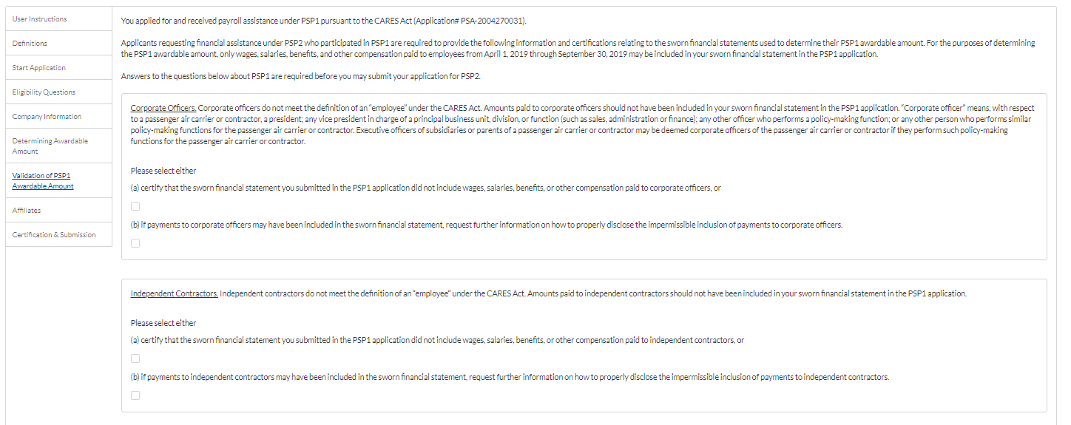
Step 4g: Validate PSP1
Validate PSP1 section visible if applicant is a Passenger Air Carrier, non-Form 41 AND PSP1 participant OR
Validate PSP1 section visible if applicant is a Contractor AND PSP1 participant

Slide 50
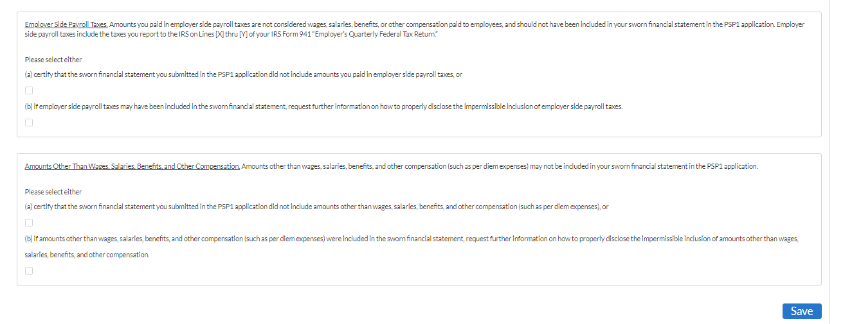
Step 4g: Validate PSP1 cont.
Validate PSP1 section visible if applicant is a Passenger Air Carrier, non-Form 41 AND PSP1 participant OR
Validate PSP1 section visible if applicant is a Contractor AND PSP1 participant

Slide 51
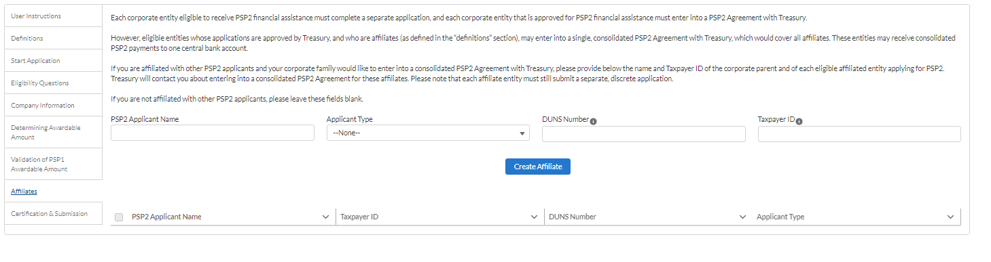
Step 4h: Affiliates

Slide 52

Step 4h: Affiliates

Slide 53

Step 4i: Certification

Slide 54

Step 4i: Certification cont.

