Slide 1
Cares Act 2
Re-Certification for Passenger Air Carriers who applied to PSP2
System Screenshots
January 29, 2020

Slide 2
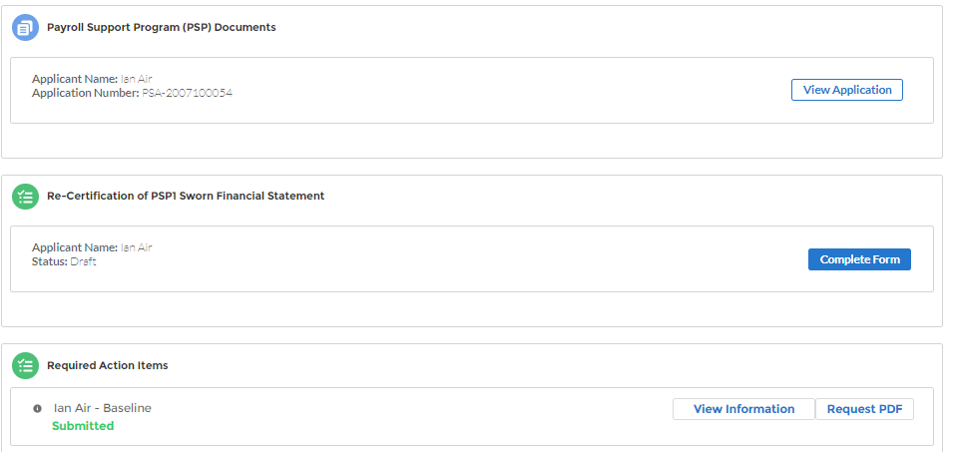
Step 1: Application Homepage (PSP1)

Slide 3
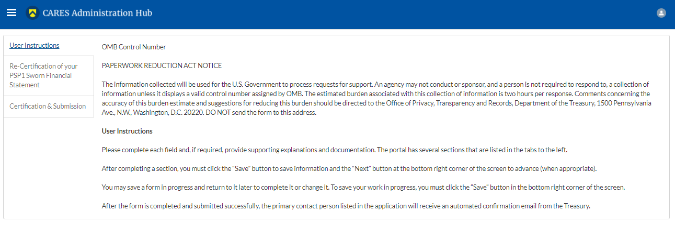
Step 2a: User Instructions

Slide 4
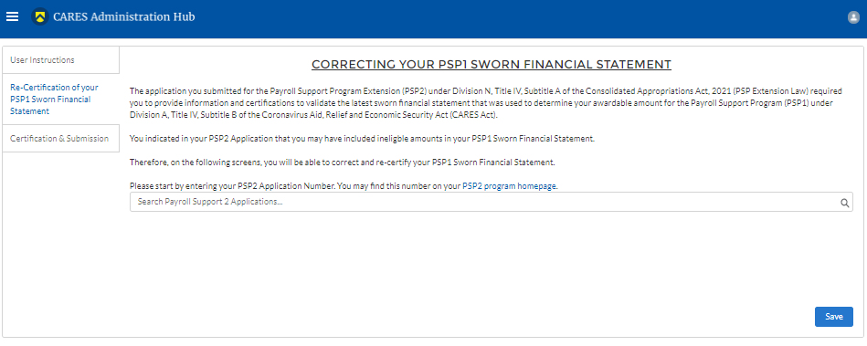
Step 2b: Re-Certification of your PSP1 Sworn Financial Statement

Slide 5
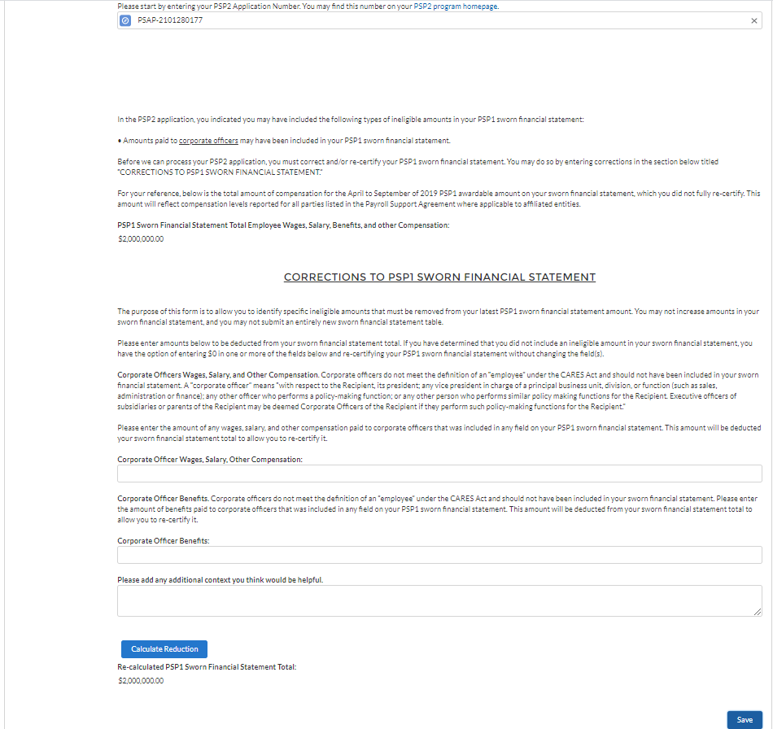
Step 2b: Re-Certification of your PSP1 Sworn Financial Statement
If Validate PSP1 section is (b) for Corporate Officers

Slide 6
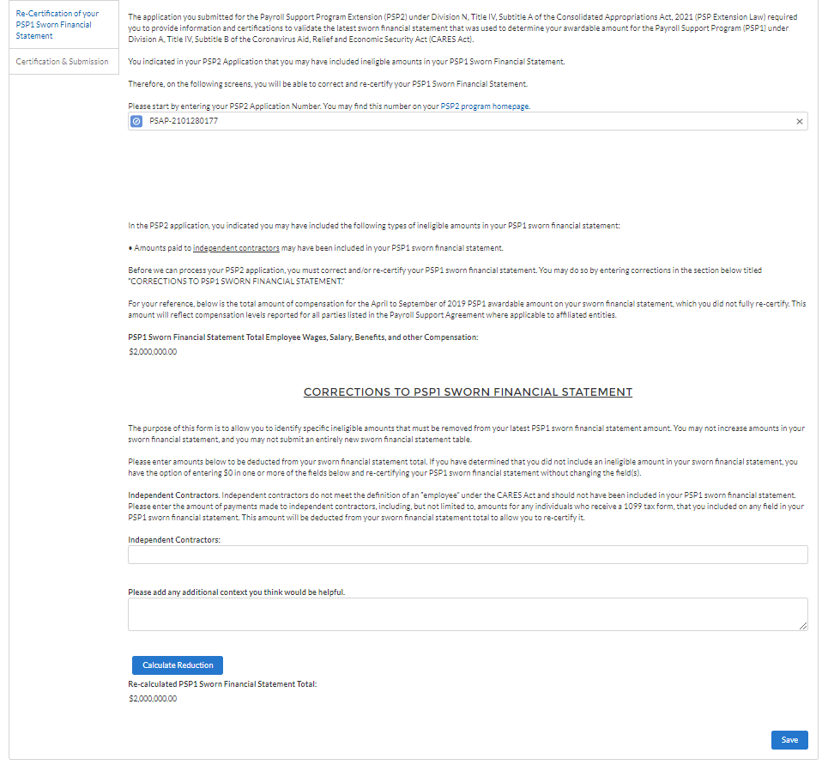
Step 2b: Re-Certification of your PSP1 Sworn Financial Statement
If Validate PSP1 section is (b) for Independent Contractors

Slide 7
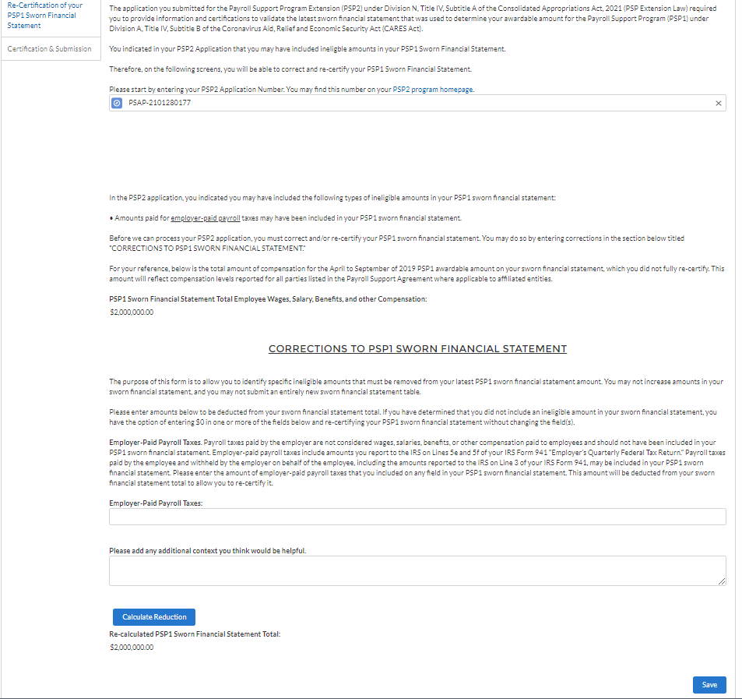
Step 2b: Re-Certification of your PSP1 Sworn Financial Statement
If Validate PSP1 section is (b) for Employer Side Payroll Taxes

Slide 8
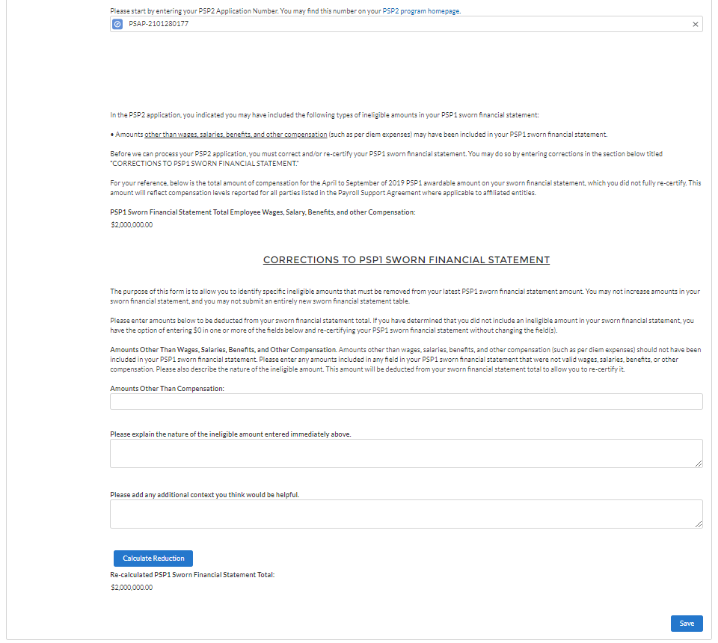
Step 2b: Re-Certification of your PSP1 Sworn Financial Statement
If Validate PSP1 section is (b) for Amounts Other than Wages

Slide 9
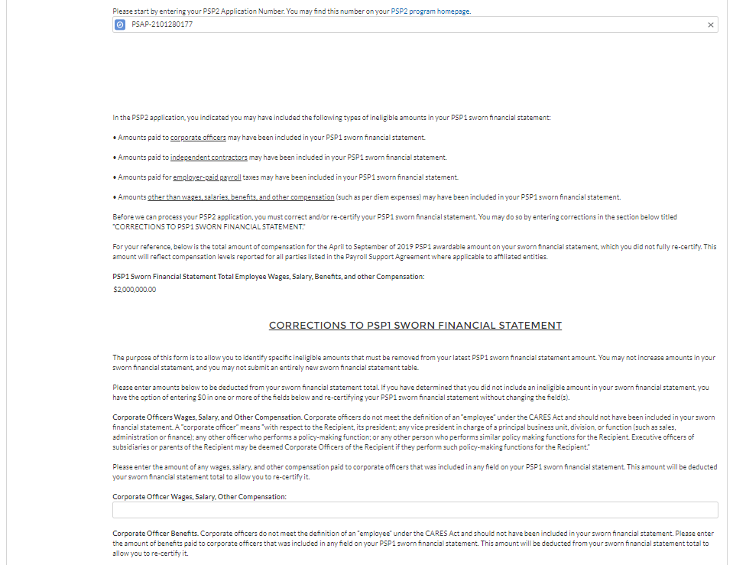
Step 2b: Re-Certification of your PSP1 Sworn Financial Statement
If Validate PSP1 section is (b) for all sections

Slide 10
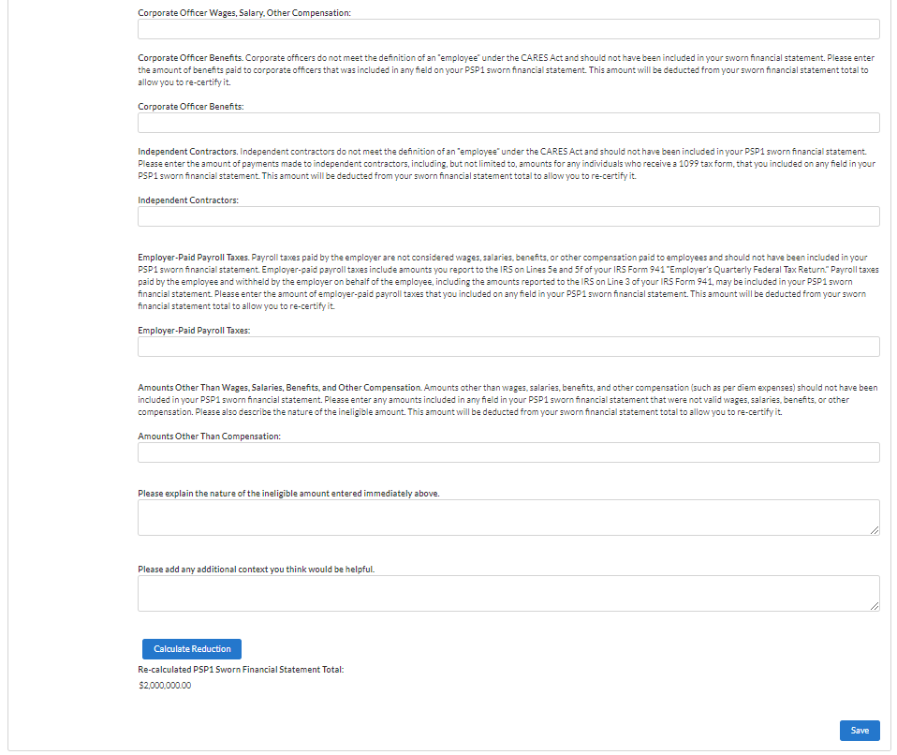
Step 2b: Re-Certification of your PSP1 Sworn Financial Statement
If Validate PSP1 section is (b) for all sections cont.

Slide 11
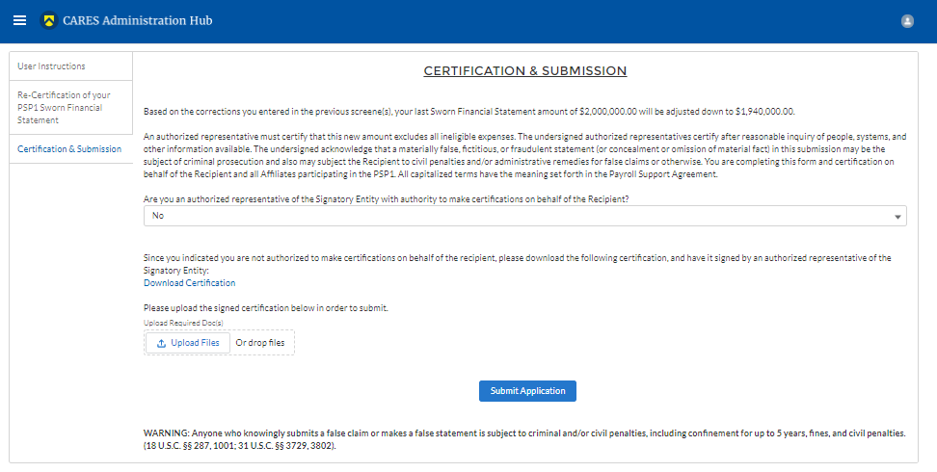
Step 2c: Certification & Submission
If ‘No’ for authorized representative

Slide 12
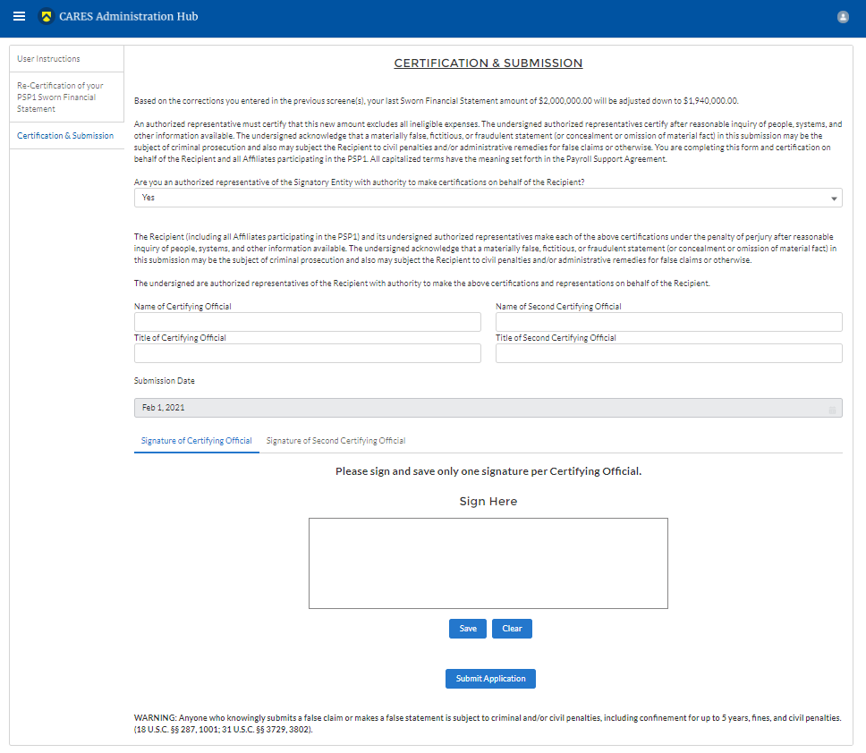
Step 2c: Certification & Submission
If ‘Yes’ for authorized representative

Slide 13
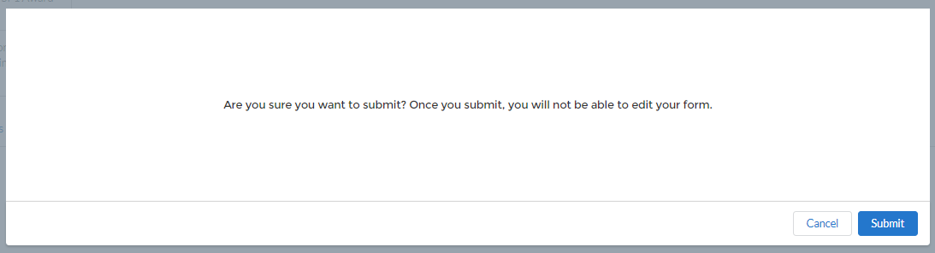
Step 3: Submit Confirmation

Slide 14
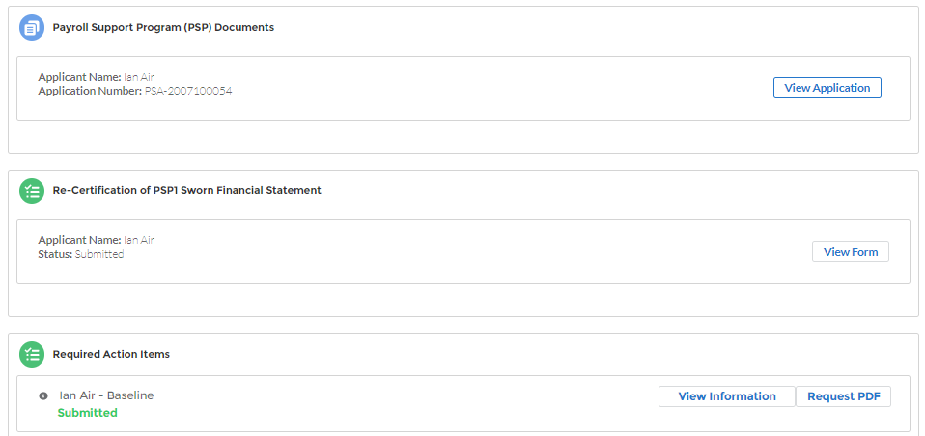
Step 3: Submitted Form

Slide 15
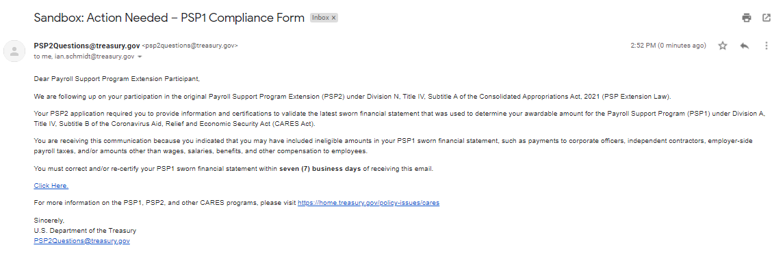
Emails
Notification for Applicant to complete

Slide 16
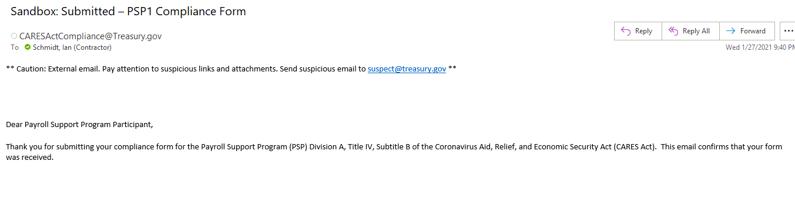
Emails
Successfully submitted

