Slide 1
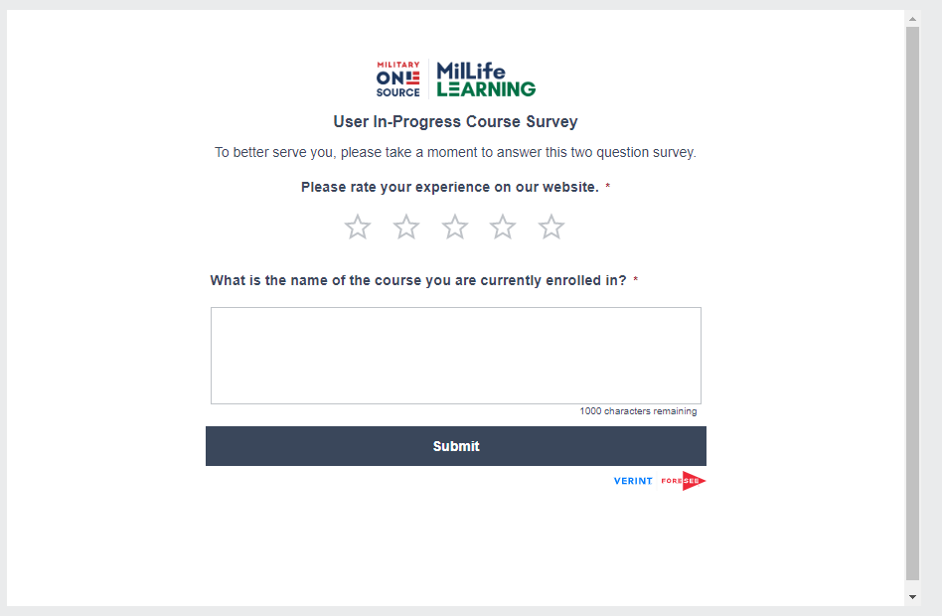
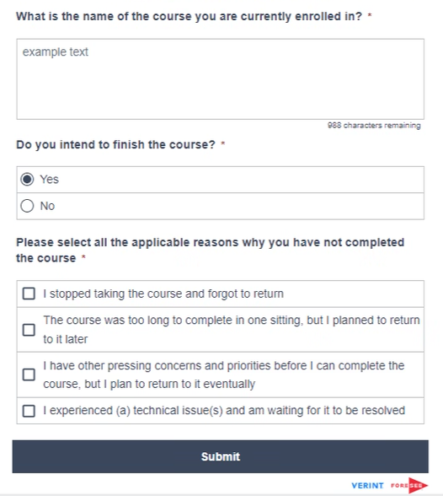
User In-Progress Course Survey

Slide 2
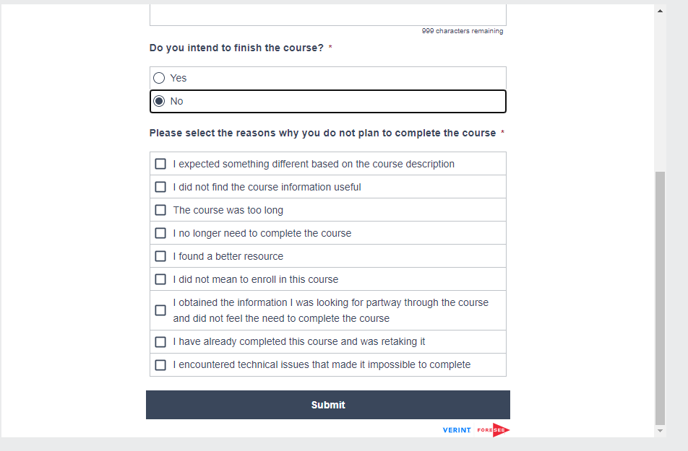
User In-Progress Course Survey

Slide 3
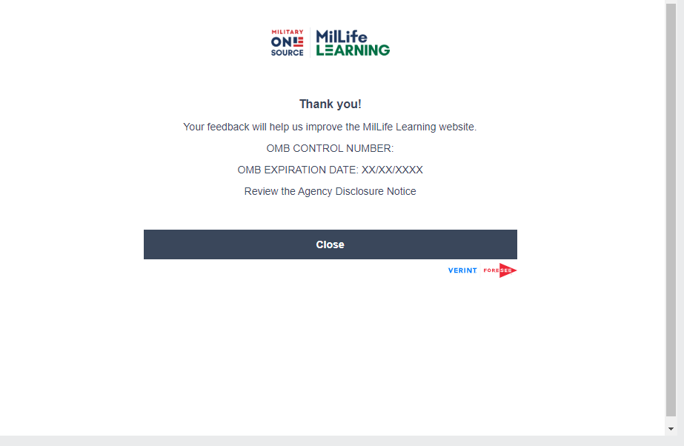
User In-Progress Course Survey
0704-0553
05/31/2025

Slide 4
Agency Disclosure Notice

