Slide 1
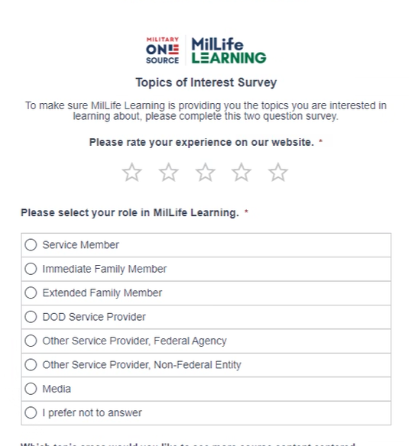
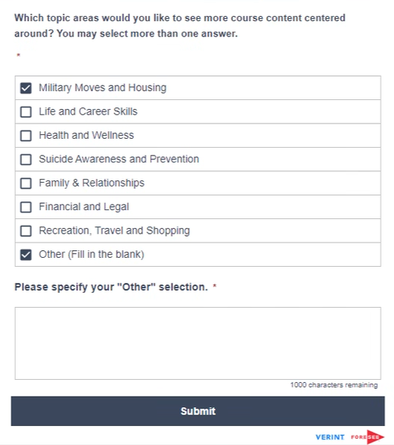
Topic of Interest Survey

Slide 2
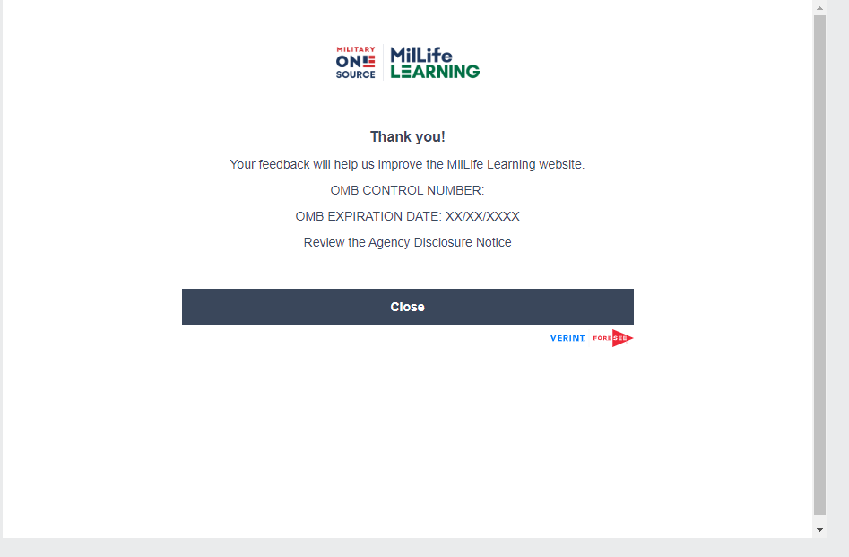
Topic of Interest Survey
0704-0553
05/31/2025

Slide 3
Agency Disclosure Notice

